Slide 1

Dense Nuclear Matter: QMC and Neutron Stars
Jesper Leong, University of Adelaide
Supervisor: Professor Anthony Thomas

Slide 2
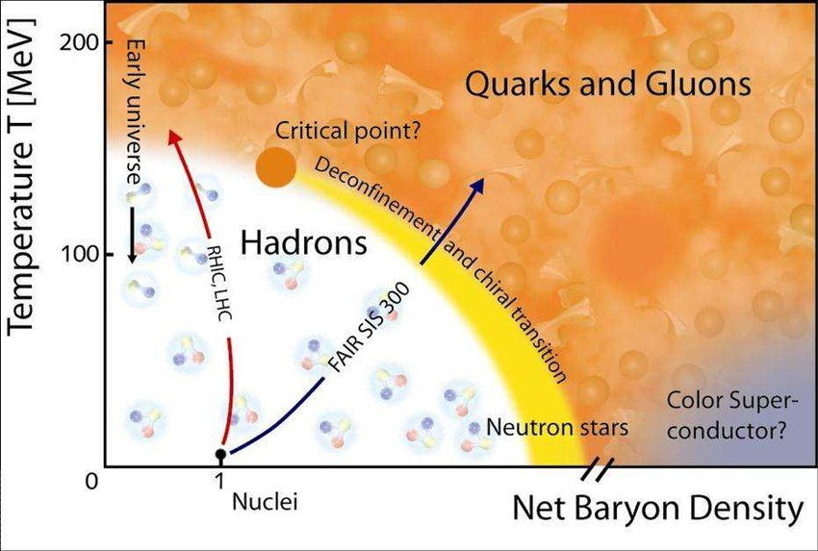
Why Neutron Stars?
There are many different phenomenological nuclear theories
Liquid Drop Model, shell models, potential models , QMC, …
Neutron Stars are crucial at constraining the Equation of State
Are NS made of nucleons, hyperons or deconfined quark matter?
EoS: relationship between energy and pressure and is unique to the underlying theory.
Neutron Stars constrain the EoS

Slide 3
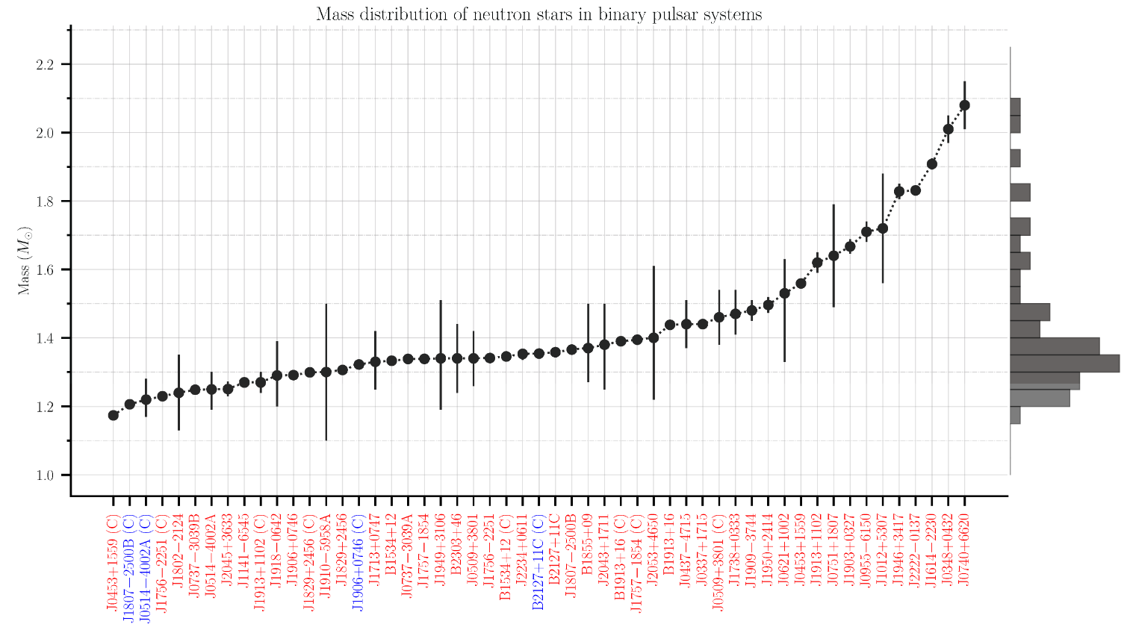
https://www3.mpifr-bonn.mpg.de/staff/pfreire/NS_masses.html

Slide 4
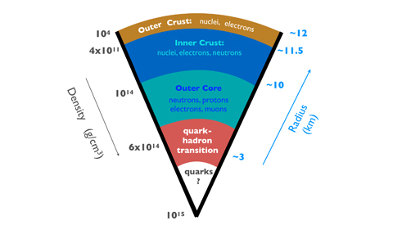
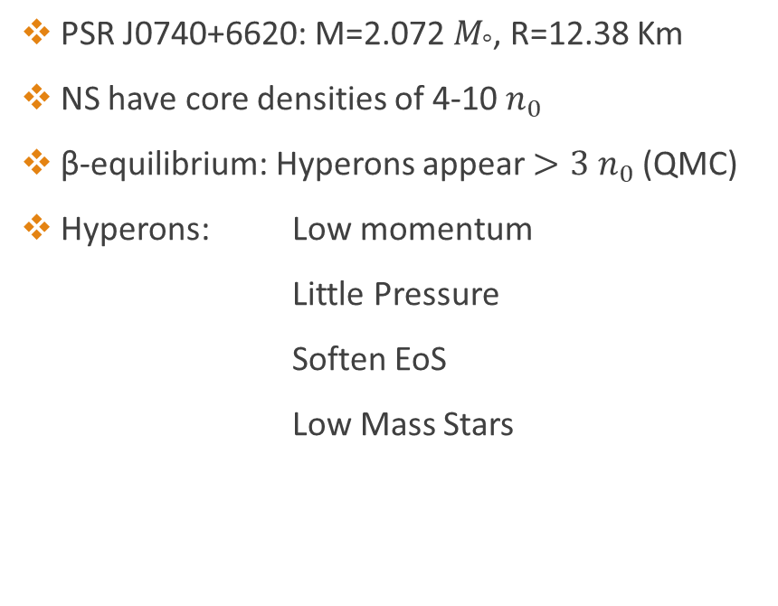
Heavy NS and the Hyperon Crisis
PSR J0740+6620: M=2.072 $M_{°}$, R=12.38 Km
NS have core densities of 4-10 $n_{0}$
β-equilibrium: Hyperons appear $>3{ n}_{0}$ (QMC)
Hyperons: Low momentum
Little Pressure
Soften EoS
Low Mass Stars
Credit: Ohio University

Slide 5
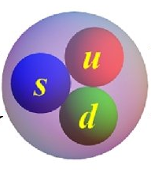
Quark-Meson-Coupling
QMC is a hadronic theory of the strong interaction.
Meson couple directly to the quarks inside of the proton and neutron.
Lorentz Scalar (σ) is attractive, and the Lorentz Vector (ω) is repulsive→ Saturation.
Dynamics change the internal structure.
Many-body forces arise from the scalar polarizability d.
Even with hyperons, only 5 parameters needed.
Applicable in neutron star research
P. A. M. Guichon, J. R. Stone, and A. W. Thomas, Quark-Meson-Coupling model for finite nuclei, nuclear matter, and beyond,Prog. Part. Nucl. Phys. 100, 262 (2018)

Slide 6
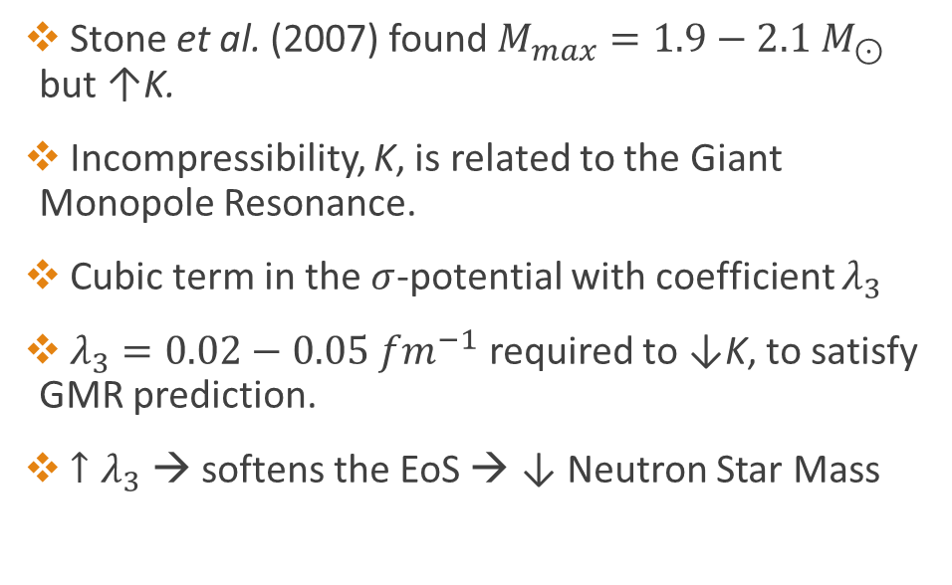
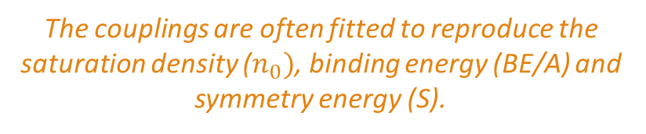
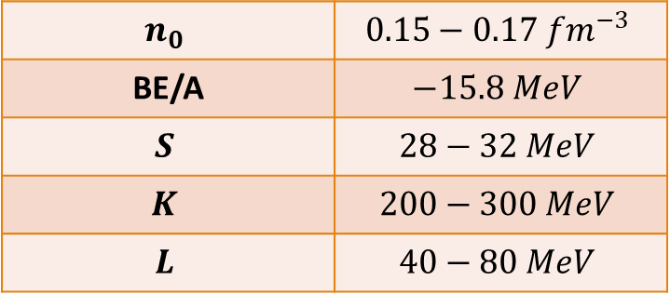
Review: QMC and Neutron Stars
$$n_{0}$$ | $$0.15−0.17 {fm}^{−3}$$
BE/A | $$−15.8 MeV$$
$$S$$ | $$28−32 MeV$$
$$K$$ | $$200−300 MeV$$
$$L$$ | $$40−80 MeV$$
Stone et al. (2007) found $M_{max}=1.9−2.1 M_{⊙}$
but ↑K.
Incompressibility, K, is related to the Giant Monopole Resonance.
Cubic term in the $σ$-potential with coefficient $λ_{3}$
$λ_{3}=0.02−0.05 {fm}^{−1}$ required to ↓K, to satisfy GMR prediction.
${↑λ}_{3}$ → softens the EoS → ↓ Neutron Star Mass
The couplings are often fitted to reproduce the saturation density ($n_{0})$, binding energy (BE/A) and symmetry energy (S).

Slide 7
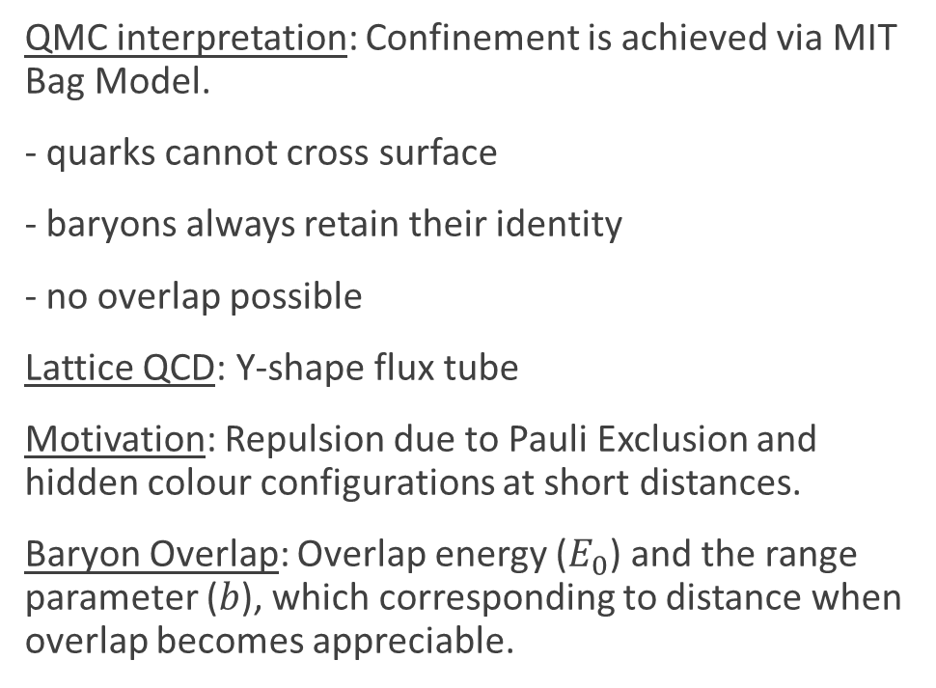
Baryon Overlap
QMC interpretation: Confinement is achieved via MIT Bag Model.
- quarks cannot cross surface
- baryons always retain their identity
- no overlap possible
Lattice QCD: Y-shape flux tube
Motivation: Repulsion due to Pauli Exclusion and hidden colour configurations at short distances.
Baryon Overlap: Overlap energy ($E_{0}$) and the range parameter ($b$), which corresponding to distance when overlap becomes appreciable.

Slide 8
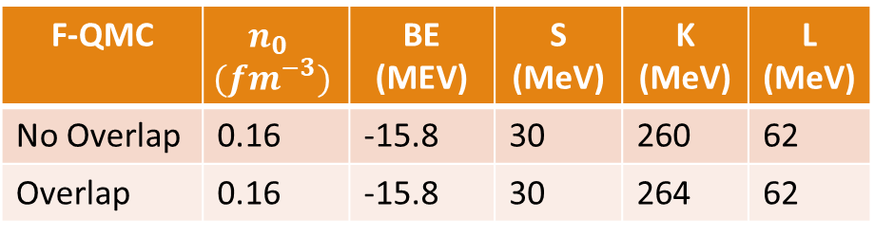
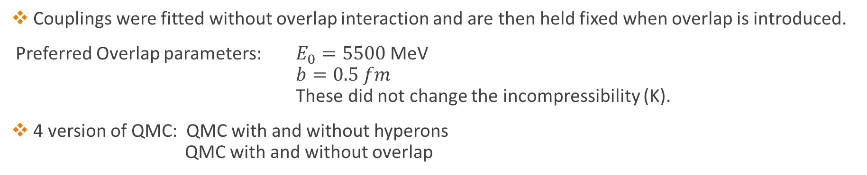
Parameters and Infinite Symmetric Nuclear Matter Properties at Saturation
The hypothesis is that the overlap interaction is only detectable at high densities
Therefore should not change the nuclear properties at ordinary densities (see table)
F-QMC | $$n_{0} \\ ({fm}^{−3})$$ | BE (MEV) | S (MeV) | K (MeV) | L (MeV)
No Overlap | 0.16 | -15.8 | 30 | 260 | 62
Overlap | 0.16 | -15.8 | 30 | 264 | 62
Couplings were fitted without overlap interaction and are then held fixed when overlap is introduced.
Preferred Overlap parameters: $E_{0}=5500$MeV
$b=0.5 fm$
These did not change the incompressibility (K).
4 version of QMC: QMC with and without hyperons
QMC with and without overlap

Slide 9
QMC Equation of State
Hyperons only appear in stars which have a core density greater than 3 times saturation density (above).
Hyperons (solid lines) soften the EoS
Overlap is repulsive and stiffer (blue) the EoS

Slide 10
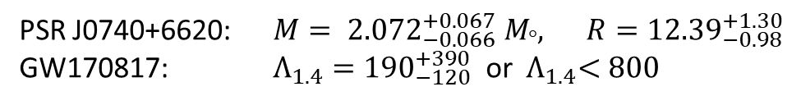
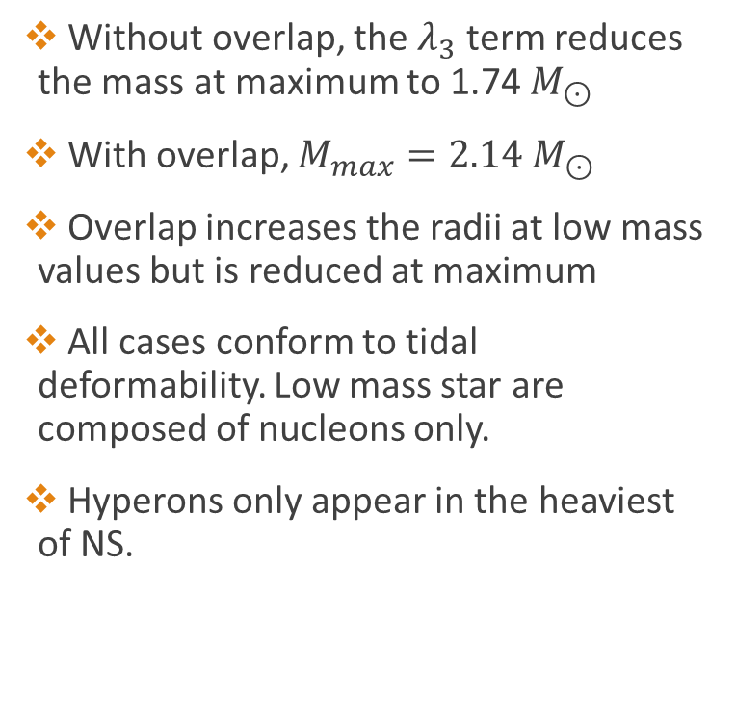
Bulk Properties of NS
Without overlap, the $λ_{3}$ term reduces the mass at maximum to 1.74 $M_{⊙}$
With overlap, $M_{max}=2.14 M_{⊙}$
Overlap increases the radii at low mass values but is reduced at maximum
All cases conform to tidal deformability. Low mass star are composed of nucleons only.
Hyperons only appear in the heaviest of NS.
PSR J0740+6620: $M= {2.072}_{−0.066}^{+0.067} M_{°}, R={12.39}_{−0.98}^{+1.30}$
GW170817: $Λ_{1.4}={190}_{−120}^{+390}$ or ${ Λ}_{1.4}<800$

Slide 11
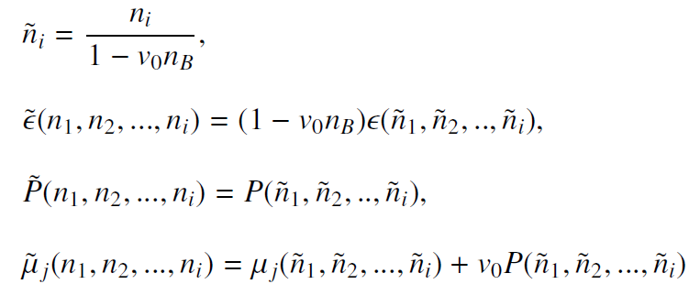
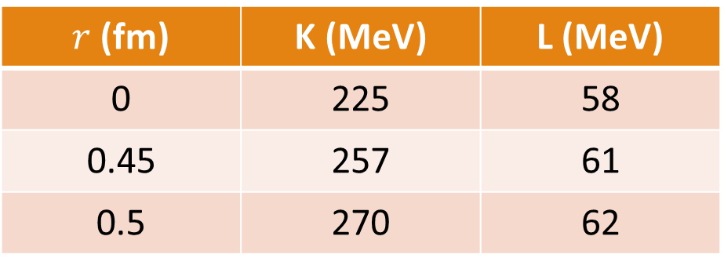
Excluded Volume Effect (EVE)
All baryons adopt a finite size, $v_{0}=\frac{4}{3}πr^{3}$, regardless of flavour. No baryon is permitted to enter the space occupied by other baryons.
$r$ (fm) | K (MeV) | L (MeV)
0 | 225 | 58
0.45 | 257 | 61
0.5 | 270 | 62
Rischke, Gorenstein, Soecker, Greiner, Excluded volume effect for the nuclear matter equation of state, Phys. C 51 (1991)

Slide 12

$β$-equilibrium
Hyperons: $Λ Ξ^{−} Ξ^{0}$
EVE lowers the threshold of hyperon appearance

Slide 13

Causality
EVE is known to violate Special Relativity
Causality requires $c_{s}^{2}<1$
Markers indicate central density at maximum

Slide 14
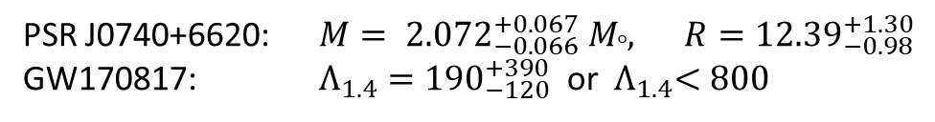

MR curve and Tidal Deformation
Hardcore radius, r, increases the maximum mass and the radii at all mass values.
- $r=0.45 fm→2.06 M_{⊙}$
- $r=0.5 fm →2.22 M_{⊙}$
Tidal deformation but for $r = 0.5 fm$ only if $Λ_{1.4}<800$
PSR J0740+6620: $M= {2.072}_{−0.066}^{+0.067} M_{°}, R={12.39}_{−0.98}^{+1.30}$
GW170817: $Λ_{1.4}={190}_{−120}^{+390}$ or ${ Λ}_{1.4}<800$

Slide 15
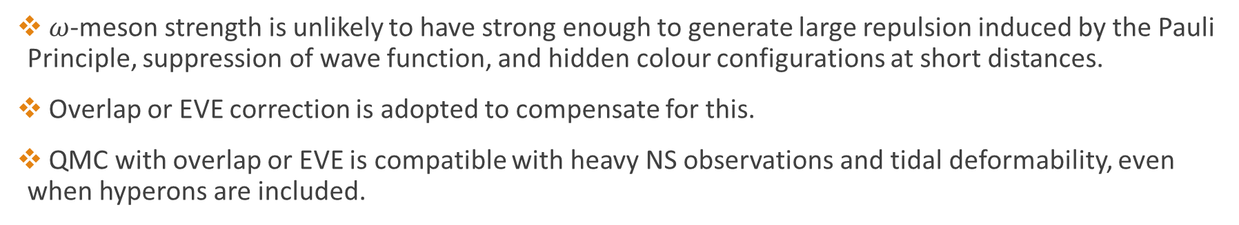
Summary
$ω$-meson strength is unlikely to have strong enough to generate large repulsion induced by the Pauli Principle, suppression of wave function, and hidden colour configurations at short distances.
Overlap or EVE correction is adopted to compensate for this.
QMC with overlap or EVE is compatible with heavy NS observations and tidal deformability, even when hyperons are included.
Open Questions
What is the star’s composition?
Still large amounts of experimental uncertainty
The role of the strange quark in coupling?

Slide 16
References
J. Leong, T. F. Motta, A. W. Thomas, P. A. M. Guichon, Dense nuclear matter with phenomenological short distance repulsion, Phys. Rev. C., 108 (2022).
arXiv: 2208.09331
J. Leong, A. W. Thomas, P. A. M Guichon, Excluded Volume Effects on Cold Neutron Star Phenomenology (2023). arXiv: 2308.08987

