Slide 1
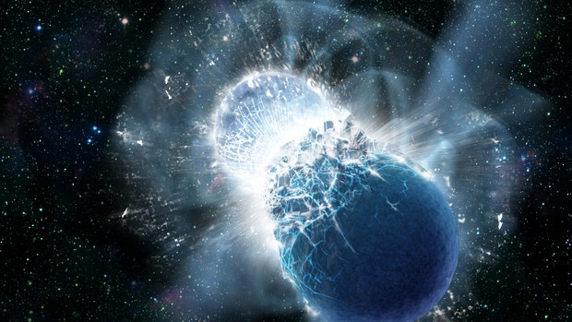
Thermal behavior as indicator for hyperons in binary neutron star merger remnants
arXiv:2307.03710; Sebastian Blacker, Hristijan Kochankovski, Andreas Bauswein, Angels Ramos, Laura Tolos
ROCKSTAR workshop,
Trento, Italy
9-13 October 2023

Slide 2
Outline
Motivation
Characteristic signatures of hyperons on the cold equation of state
Characteristic signatures of hyperons on the hot equation of state
Brief introduction to binary neutron star mergers
Hyperonic influence on the mergers observables
Summary and outlooks

Slide 3
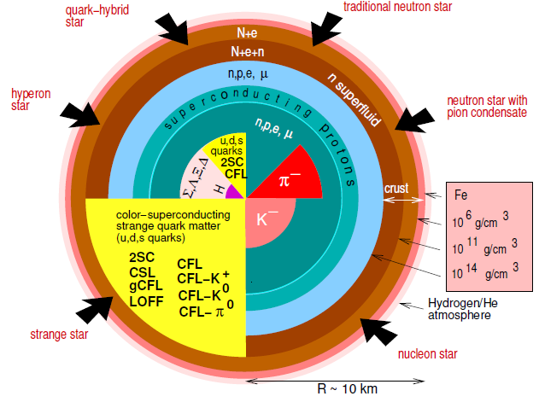
Motivation (I)
Constraints
Nuclear physics
models
Properties of
NS
F. Weber, Prog.Part.Nucl.Phys.54:193-288,2005
Predictions

Slide 4
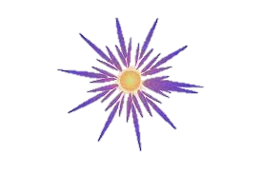
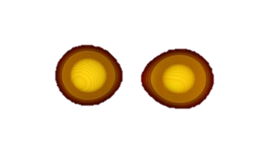
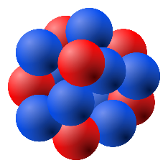
Motivation (II)
100
Nuclear experiments
Supernovae
NS mergers
Wide range of values to account for conditions in PNS and NS mergers:
$$T=\left(0−100\right) MeV$$
$$ρ_{B}=\left(0.5 −10\right)ρ_{0}$$
$$Y_{Q}=\left(0−0.6\right)$$
10
Temperature $T$ (MeV)
Nuclei
Cooling
Proto neutron stars (PNS)
1
Neutron Stars (NS)
0.5
Charge fractions $Y_{Q}$
0

Slide 5
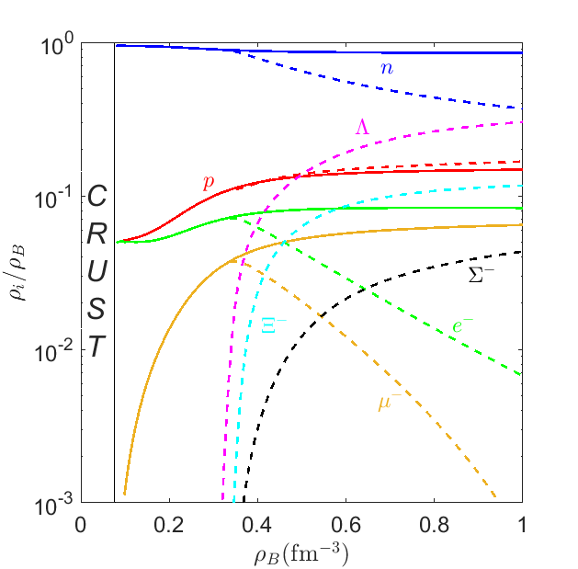
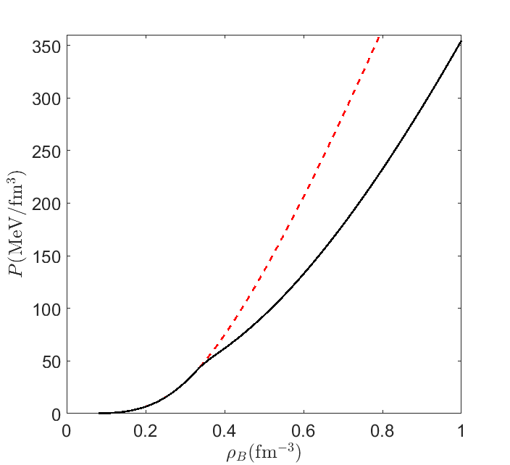
Characteristic signatures of hyperons on the cold equation of state (I)
Kochankovski et al, 2022, MNRAS
FSU2H
FSU2H*
FSU2H*
Hyperons artificially switched off
DELEPTONIZATION OF MATTER
SOFTENING OF THE EOS

Slide 6
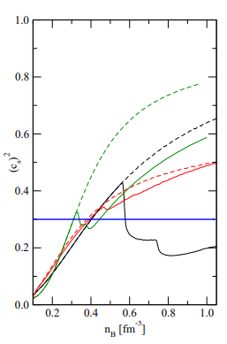
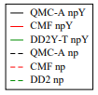
Characteristic signatures of hyperons on the cold equation of state (II)
DROP IN THE SPEED OF SOUND
FSU2H*
Hyperons artificially switched off
Stone et al, MNRAS, 2020

Slide 7
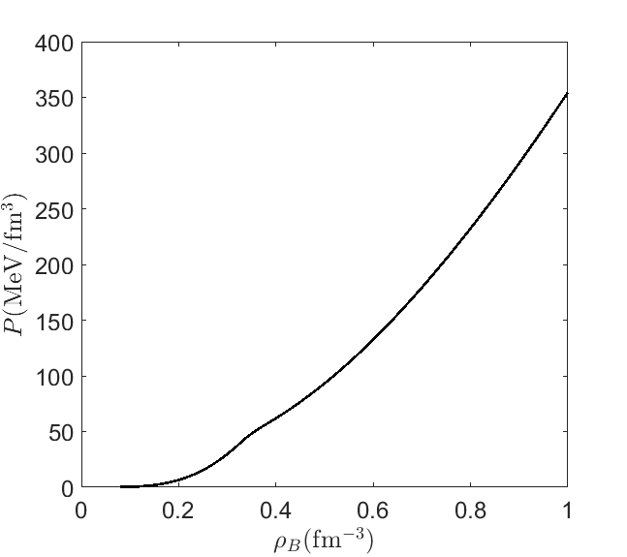
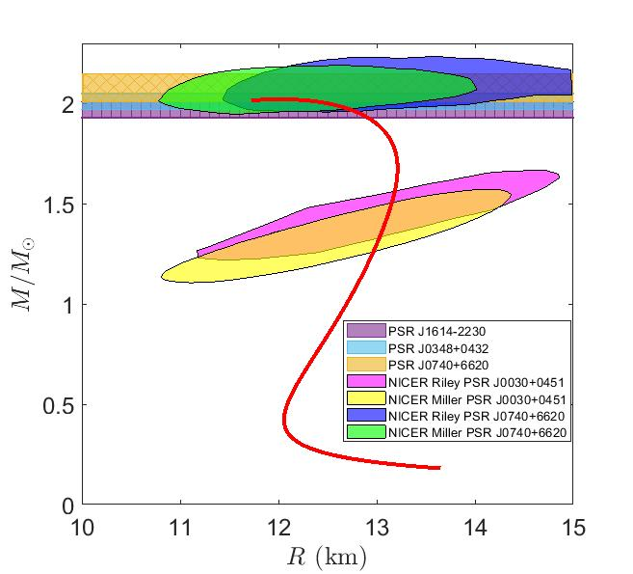
Characteristic signatures of hyperons on the cold equation of state (III)
$$\frac{dP}{dr}=−\frac{Gρm}{r^{2 }}\left(1+\frac{P}{ρ_{B}c^{2}}\right)\left(1+4πP\frac{r^{3}}{{mc}^{2}}\right){\left(1−\frac{2Gm}{c^{2}r}\right)}^{−1}$$
$\frac{dm}{dr}=4πr^{2}ρ$

Slide 8
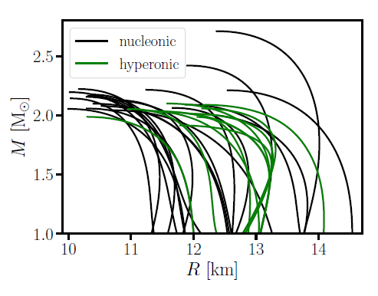
Characteristic signatures of hyperons on the cold equation of state (III)
IT IS DIFFICULT TO INFER THE COMPOSITION OF THE MATTER BASED ONLY FROM THE COLD STAR OBSERVABLES

Slide 9
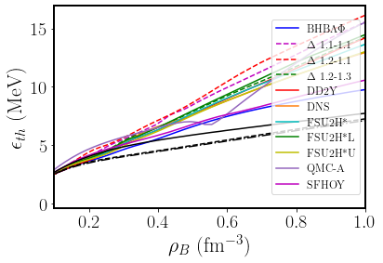
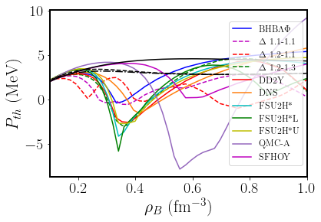
Characteristic signatures of hyperons on the hot equation of state (I)
Thermal correction to a quantity $X$
$$X_{th}\left(ρ_{B},Y_{Q},T\right)=X\left(ρ_{B},Y_{Q},T\right)−X\left(ρ_{B},Y_{Q},0\right)$$
Colored lines – hyperonic models
black lines – reference nucleonic models
MATTER AT FIXED CHARGE FRACTION $Y_{Q}=0.1$ AND TEMPERATURE $T=25$ MeV
*For each model it is assumed that weak equilibrium between the hadrons is fulfilled

Slide 10
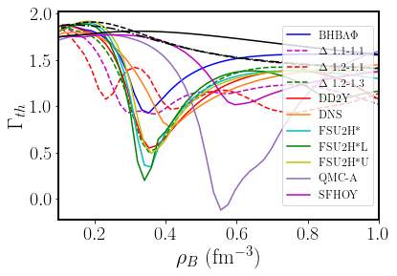
Characteristic signatures of hyperons on the hot equation of state (II)
Thermal index
$$Γ_{th}=1.75$$
$$Γ_{th}(ρ_{B},Y_{Q},T)=1+\frac{P_{th}}{ε_{th}}$$
Usual approximation:
$$Γ_{th}=const=1.75$$

Slide 11
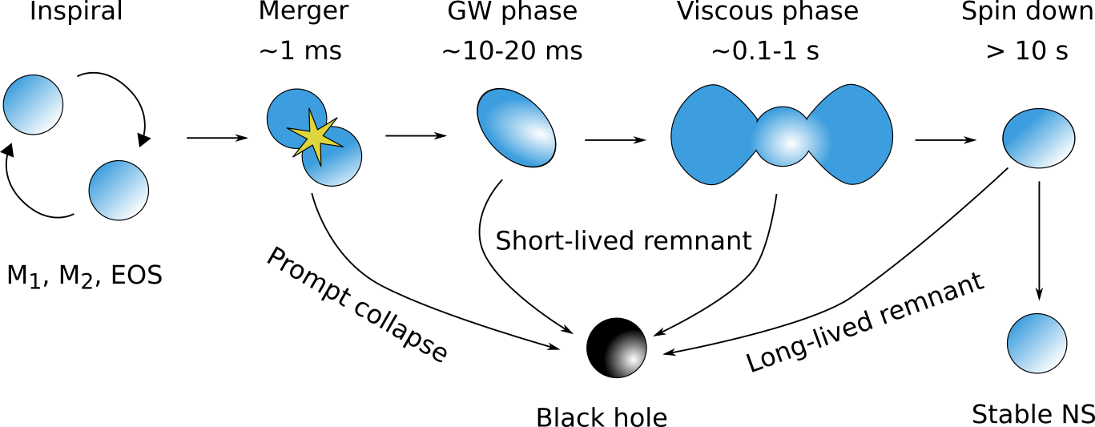
Brief introduction to binary neutron star mergers (I)
$$T>0$$
out of$β^{−}$ equilibrated
$$ρ_{B}↑$$
$$T=0$$
$β^{−}$ equilibrated
Radice et al. ARNPS, 2020

Slide 12
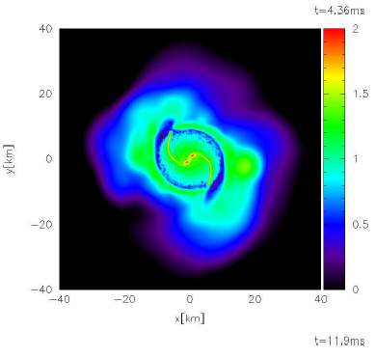
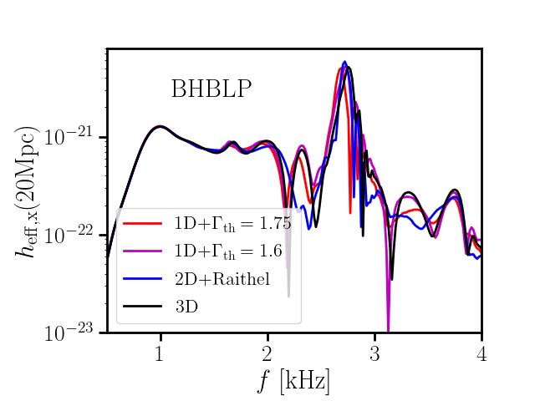
Brief introduction to binary neutron star mergers (II)
$\log{T}$
$$BHBΛφ$$
Bauswein et al. 2010, PRD

Slide 13
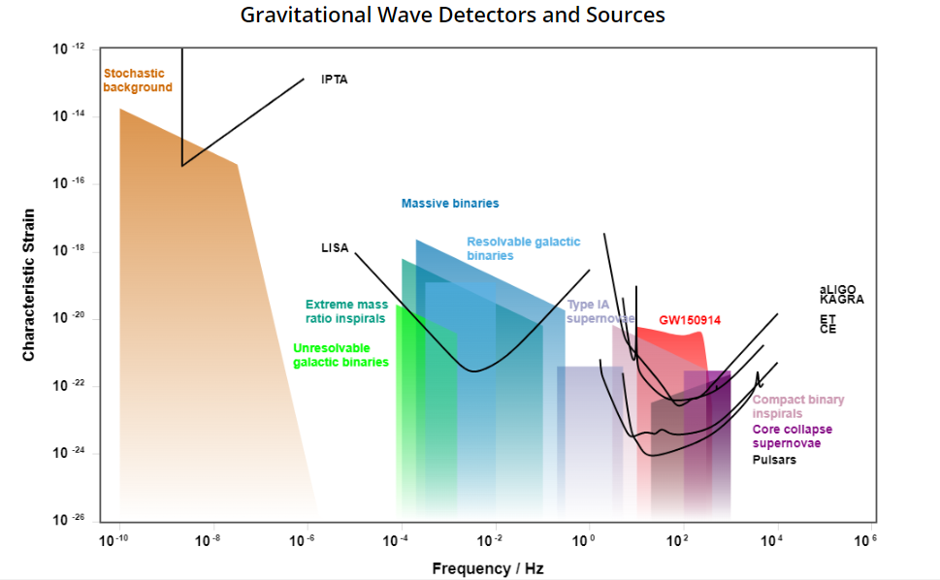
Brief introduction to binary neutron star mergers (III)
Dominant frequency

Slide 14
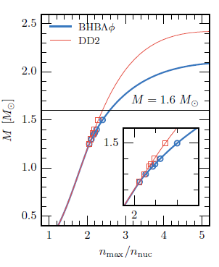
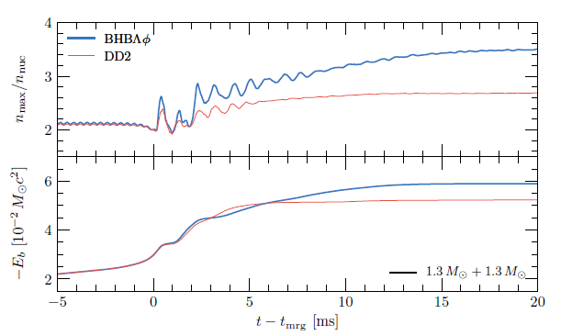
Hyperonic influence on the mergers observables (I)
Radice et al. ApJL 842 L10 (2017)
With $Λ$hyperon
With $Λ$hyperon
$$\sim 30\%$$
Hyperons switched off
Hyperons switched off
With $Λ$hyperon
Hyperons switched off

Slide 15
Hyperonic influence on the mergers observables (II)
Big set of three dimensional (3D) EoSs
$$\sim 30\%$$
We simulate the merger of two neutron stars with $1.4 M_{⊙}$ mass
HYPERONIC EOSs
NUCLEONIC EOSs
Discriminating the impact of the different thermal threatement – associating to the different compostion!
3D EoS
2D + $(Γ_{th}=1.75)$
$$Δf=f_{peak}\left(3D\right)−f_{peak}(2D+(Γ_{th}=1.75))$$

Slide 16
Hyperonic influence on the mergers observables (III)
MAIN CONCLUSIONS
Systematic shift toward higher frequencies of the hyperonic equations of states.
2. Nucleonic models are scattered around the reference values.
3. If the hyperons are present in the matter only in very small quantities, the corresponding EoSs behave like nucleonic ones

Slide 17
Hyperonic influence on the mergers observables (IV)
$$f_{peak}=f_{peak}(Λ_{1.75})$$
Second order polynomial fit of the nucleonic models
Maximum deviation of the nucleonic models

Slide 18
Hyperonic influence on the mergers observables (V)

Slide 19
Summary and outlooks
The appearance of the hyperons has a strong impact on both cold and finite-temperature EoSs.
All hyperonic EoSs show drop of the thermal pressure, and subsequently, of the thermal index at densities at which hyperons start to have significant contribution in the matter.
The different thermal behavior of the hyperonic EoSs leaves characteristic signature on the dominant post merger gravitational wave frequency. The signature is in a form of a systematic shift toward positive values that can reach values of $\sim 150$ Hz.
This effect can be mimicked by other exotic species, like quark matter.
More simulations need to be done to confirm that the effect is present for binaries with different mass ratios.

Slide 20
THANK YOU FOR YOUR ATTENTION

Slide 21
BACK UP SLIDES

Slide 22
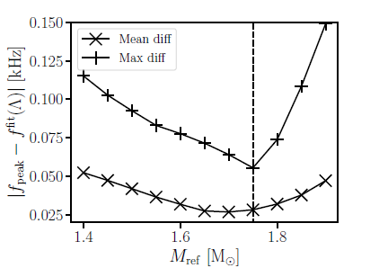
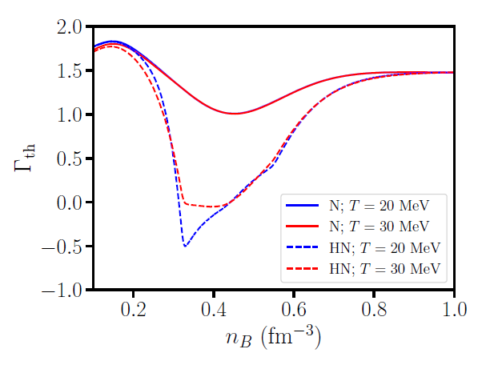

Slide 23
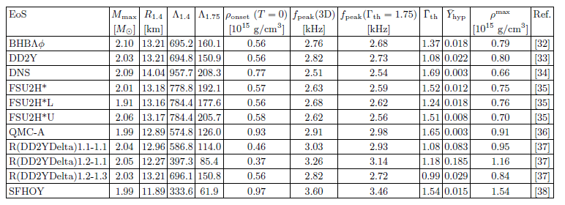

Slide 24
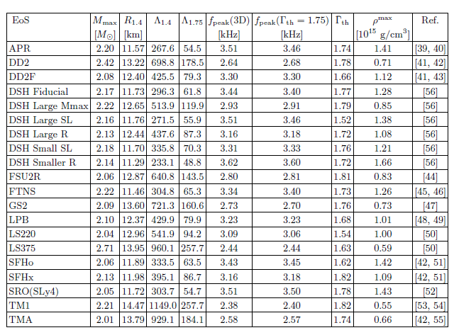

Slide 25
