Slide 1
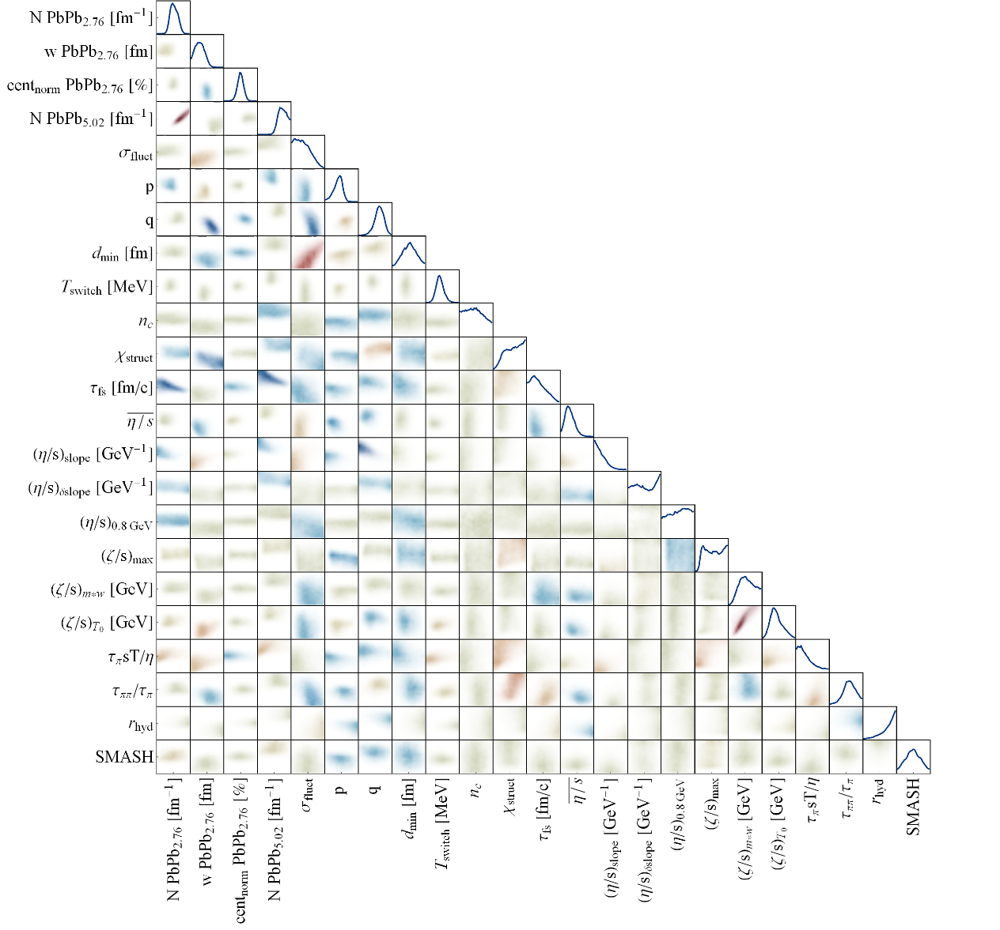
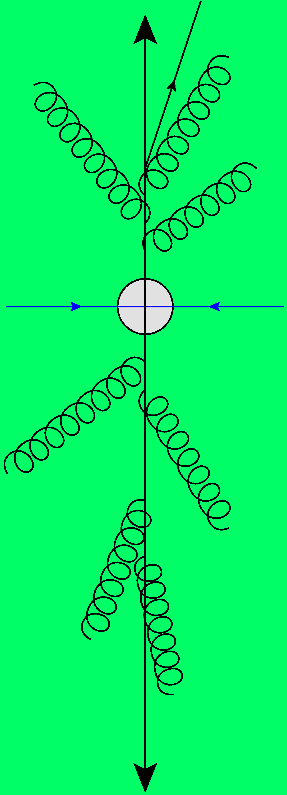
Macroscopic QGP Properties
Towards precision physics with global analyses
2112.13771, 2206.13522 (PRL) and 2305.00015 with Govert Nijs and Giuliano Giacalone
Wilke van der Schee
CMS Week, ECT* Trento
29 May 2023

Slide 2
Outline
Wilke van der Schee, CERN/Utrecht
Three parts:
Neutron skin, also as an illustration of Bayesian analyses
Ultracentral collisions: specific and interesting physics
The shape of nuclei and preparing for oxygen collisions

Slide 3
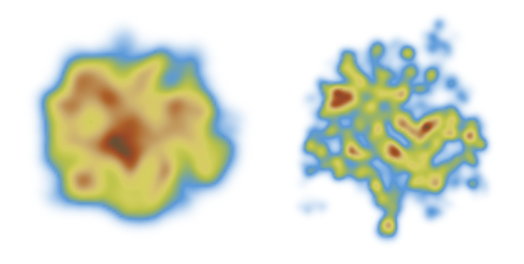
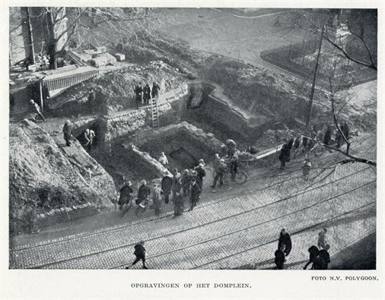
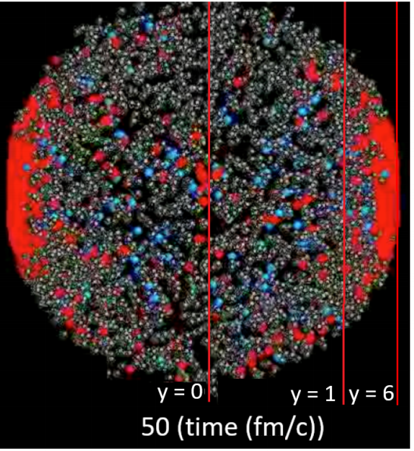
Standard model of heavy ion collisions
Wilke van der Schee, CERN/Utrecht
(# parameters)
Trajectum
New public heavy ion code
Originally Utrecht (now MIT/CERN)
Fast
Precise (all cuts equal to experiment)
Scalable
Initial stage (13)
Viscous hydrodynamics (10)
Subnucleonic structure? (8)
Non-thermal flow? (2) with hydrodynamised initial stage
Fluctuations? (1)
Shape (2)
Shear viscosity (4)
Bulk viscosity (3)
Second order transports: 2
EOS: 1
Cascade of hadrons (1)
Roman excavations in Utrecht in 1929
Jonah Bernhard, Scott Moreland and Steffen Bass, Bayesian estimation of the specific shear and bulk viscosity of quark–gluon plasma (2019)
Govert Nijs, WS, Umut Gursoy and Raimond Snellings, A Bayesian analysis of Heavy Ion Collisions with Trajectum (2020)

Slide 4
Trajectum
Quite straightforward to use (see param file, right)
Includes analyse routine
Parallelised: can analyse unlimited number of events
http://sites.google.com/view/govertnijs/trajectum
http://wilkevanderschee.nl/trajectum

Slide 5
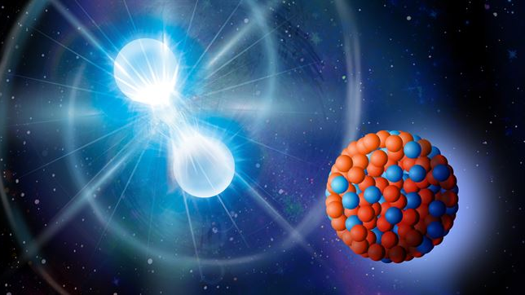
Neutron skin
With a short intro on Bayesian analysis

Slide 6
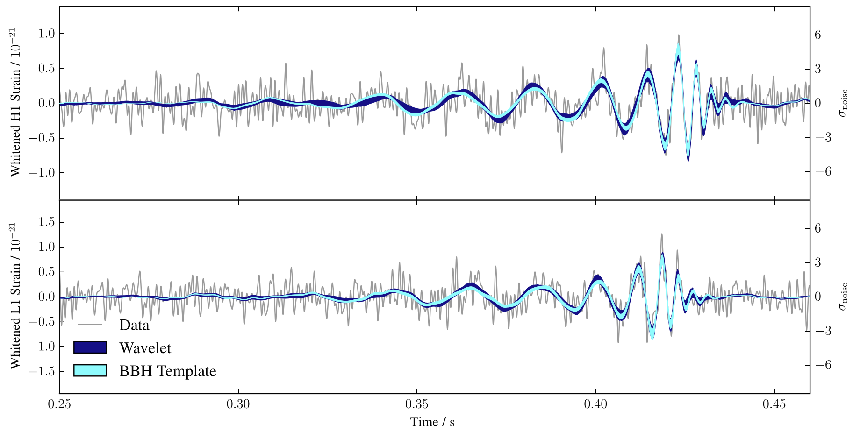
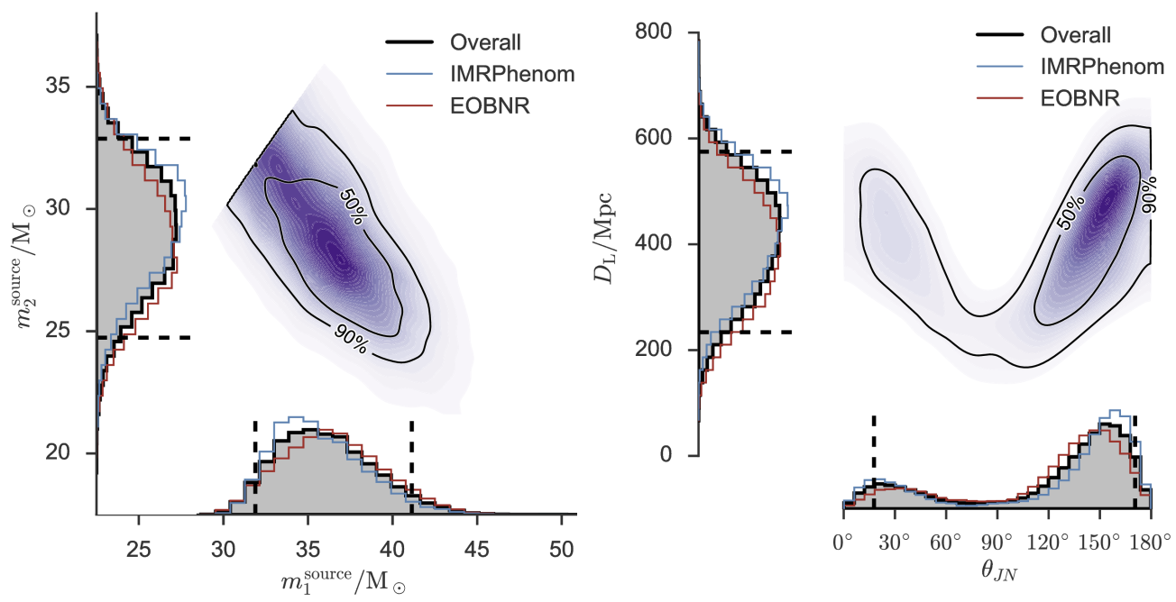
Performing a global analysis
Wilke van der Schee, CERN/Utrecht
Bayes theorem:
Same technique: gravitational waves
Model depends on parameters non-linearly
Run model on 1200 `design’ points
Use an emulator for any point in parameter space (GP)
Markov Chain Monte Carlo
653 data points
Obtain posterior probability density of parameters
Compare posterior with data
Can include high statistics run
LIGO, Properties of the Binary Black Hole Merger GW150914 (2016)
Notes:
Parameters influence observables in complex and non-linear way
Global analysis needed
Run on design points + emulate
MCMC with Bayes theorem and over 500 datapoints
Verify that high probability parameter set works well with other observables
Similar to gravitational waves with for instance waveform determines correlation between distance and inclination

Slide 7
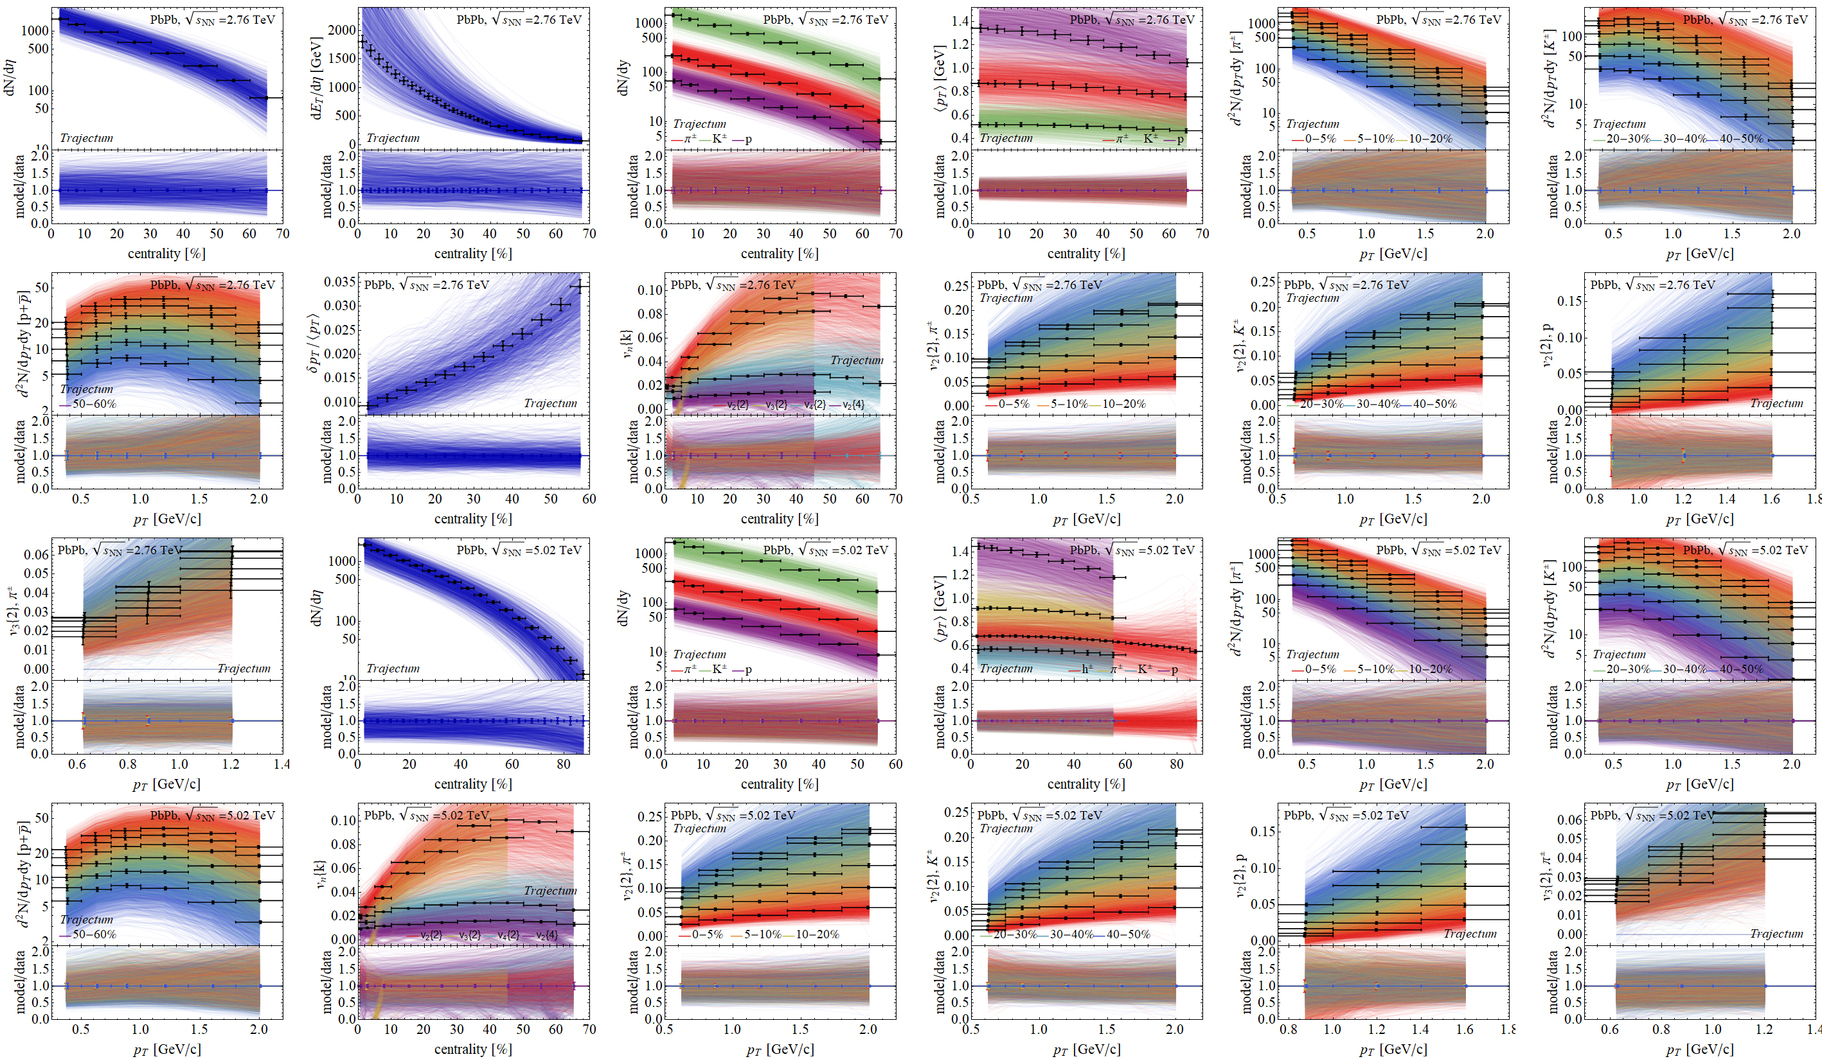
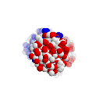
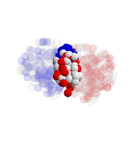
Experimental observables: a wealth of data
Prior

Slide 8
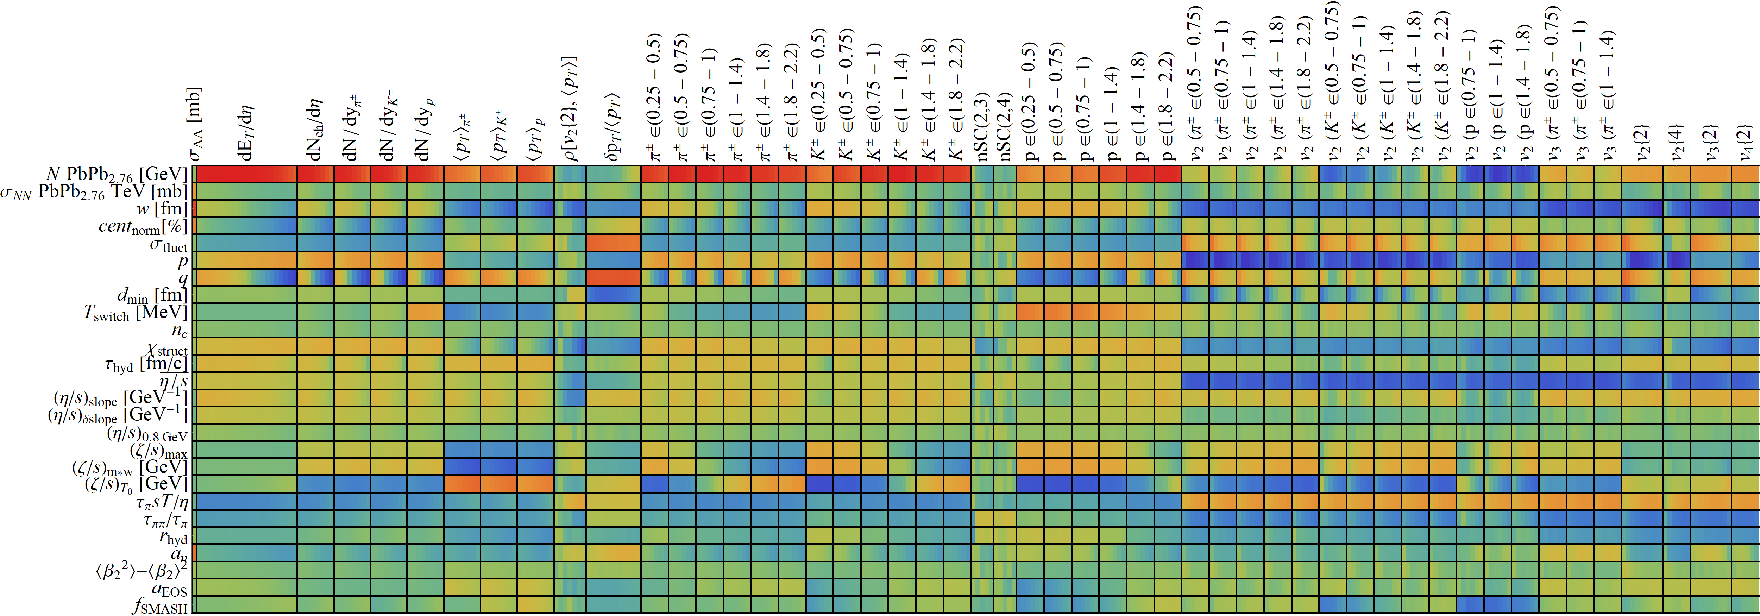
Design parameter-observable correlations:
Wilke van der Schee, CERN/Utrecht

Slide 9
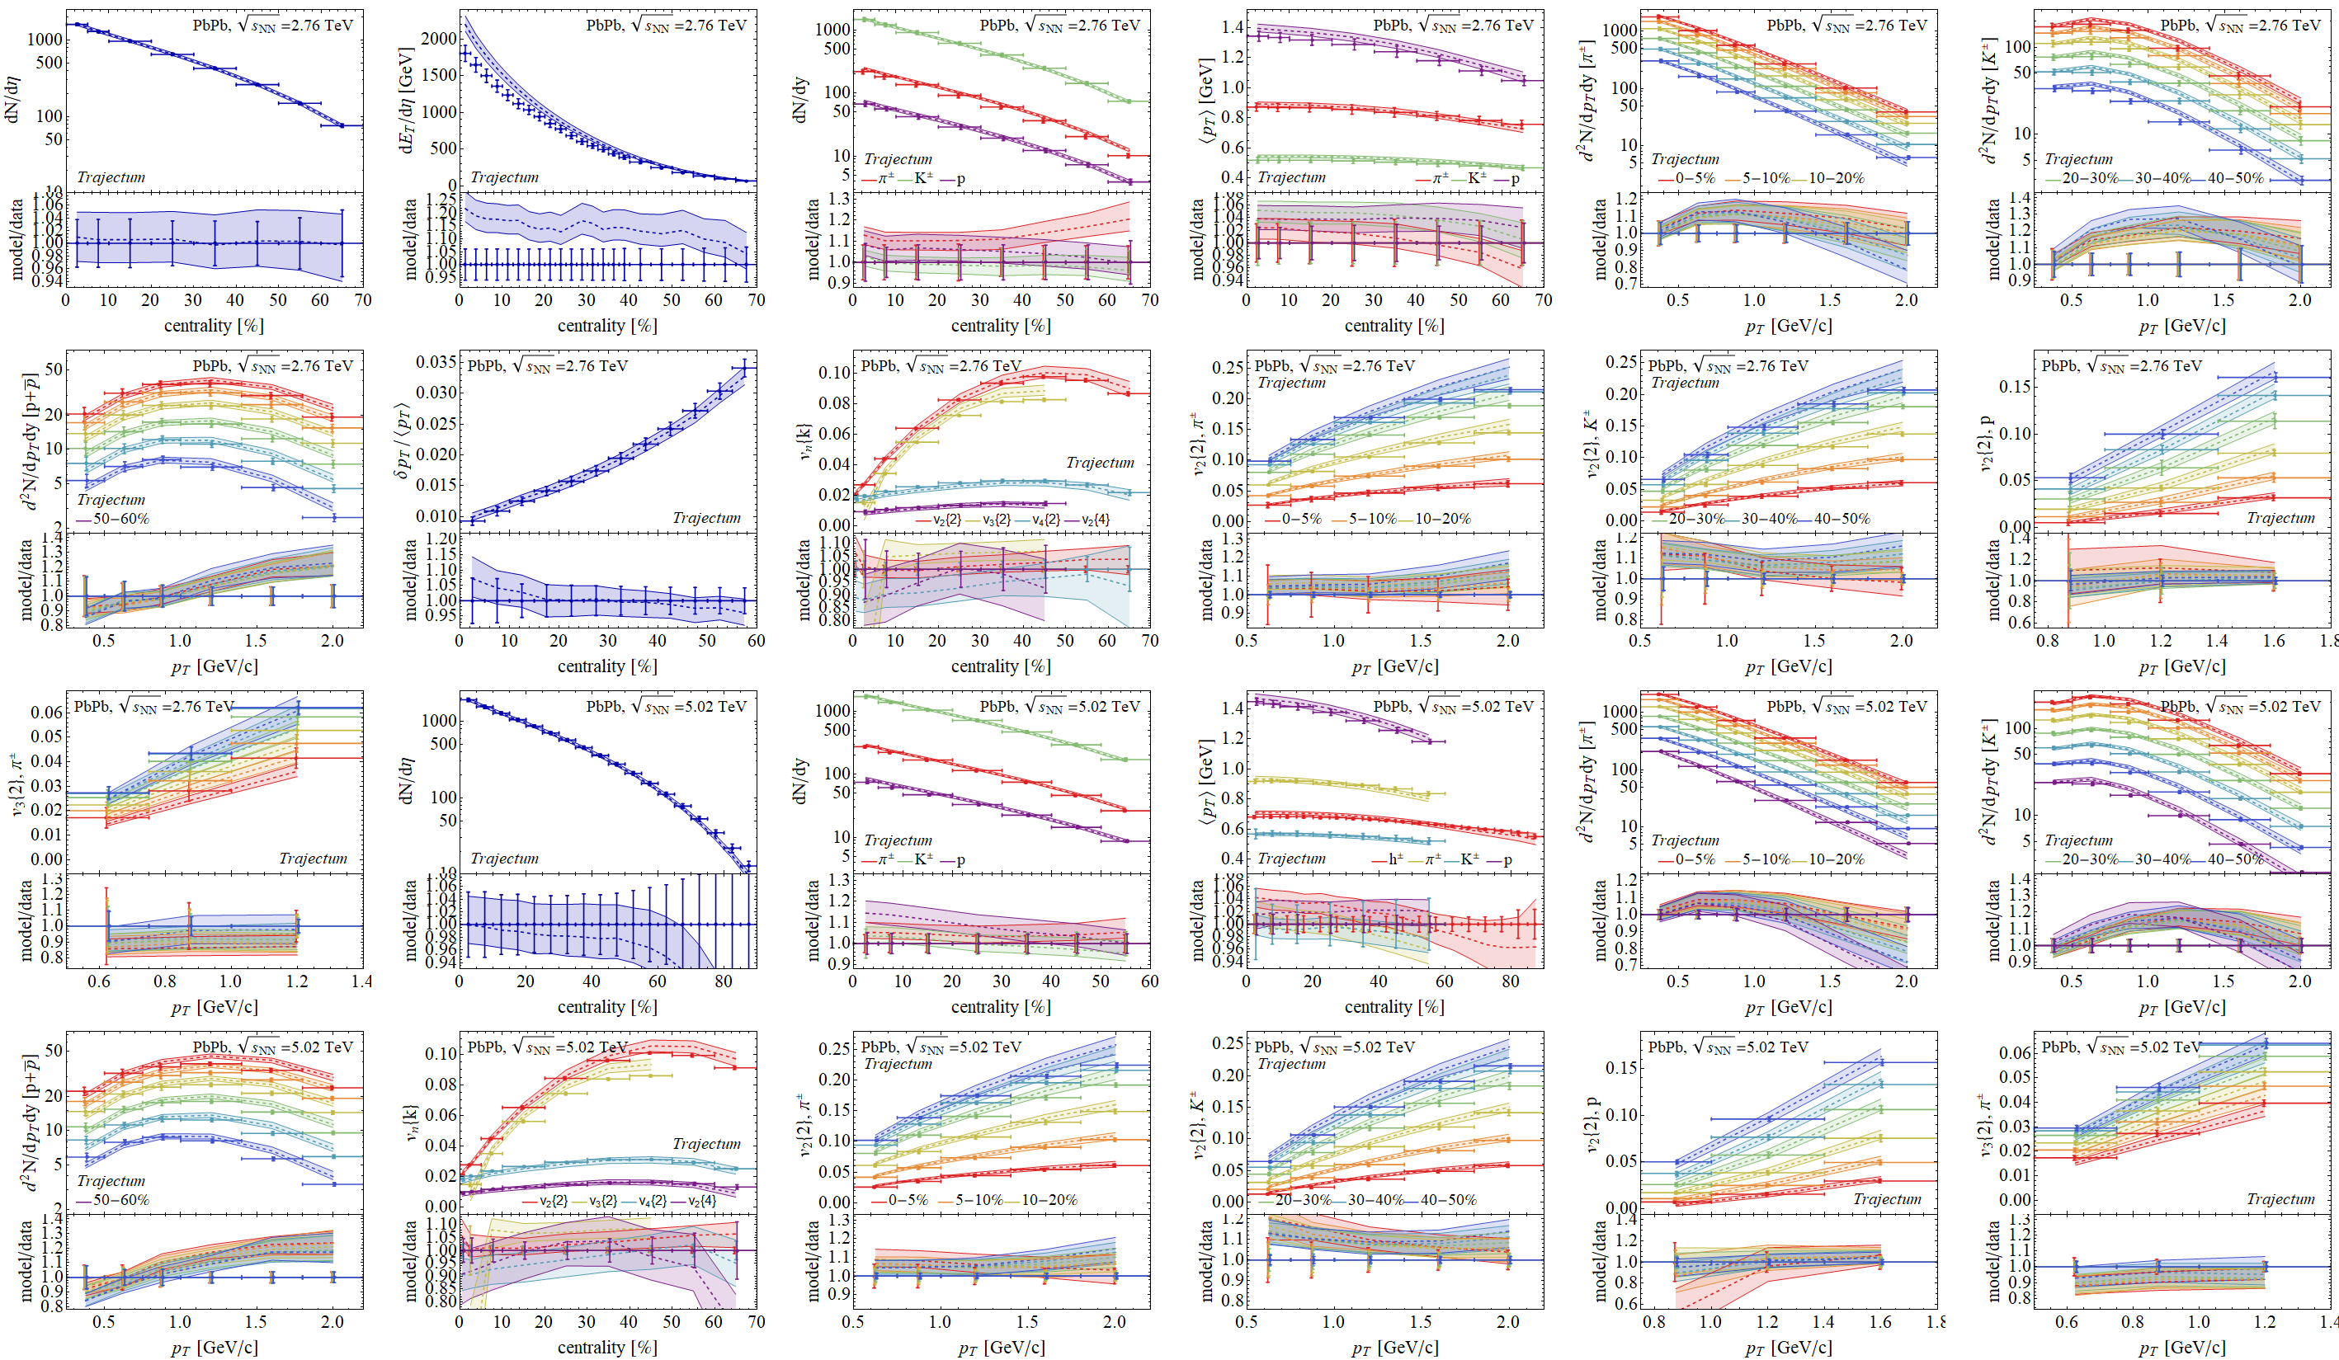
Experimental observables: a wealth of data
Posterior

Slide 10
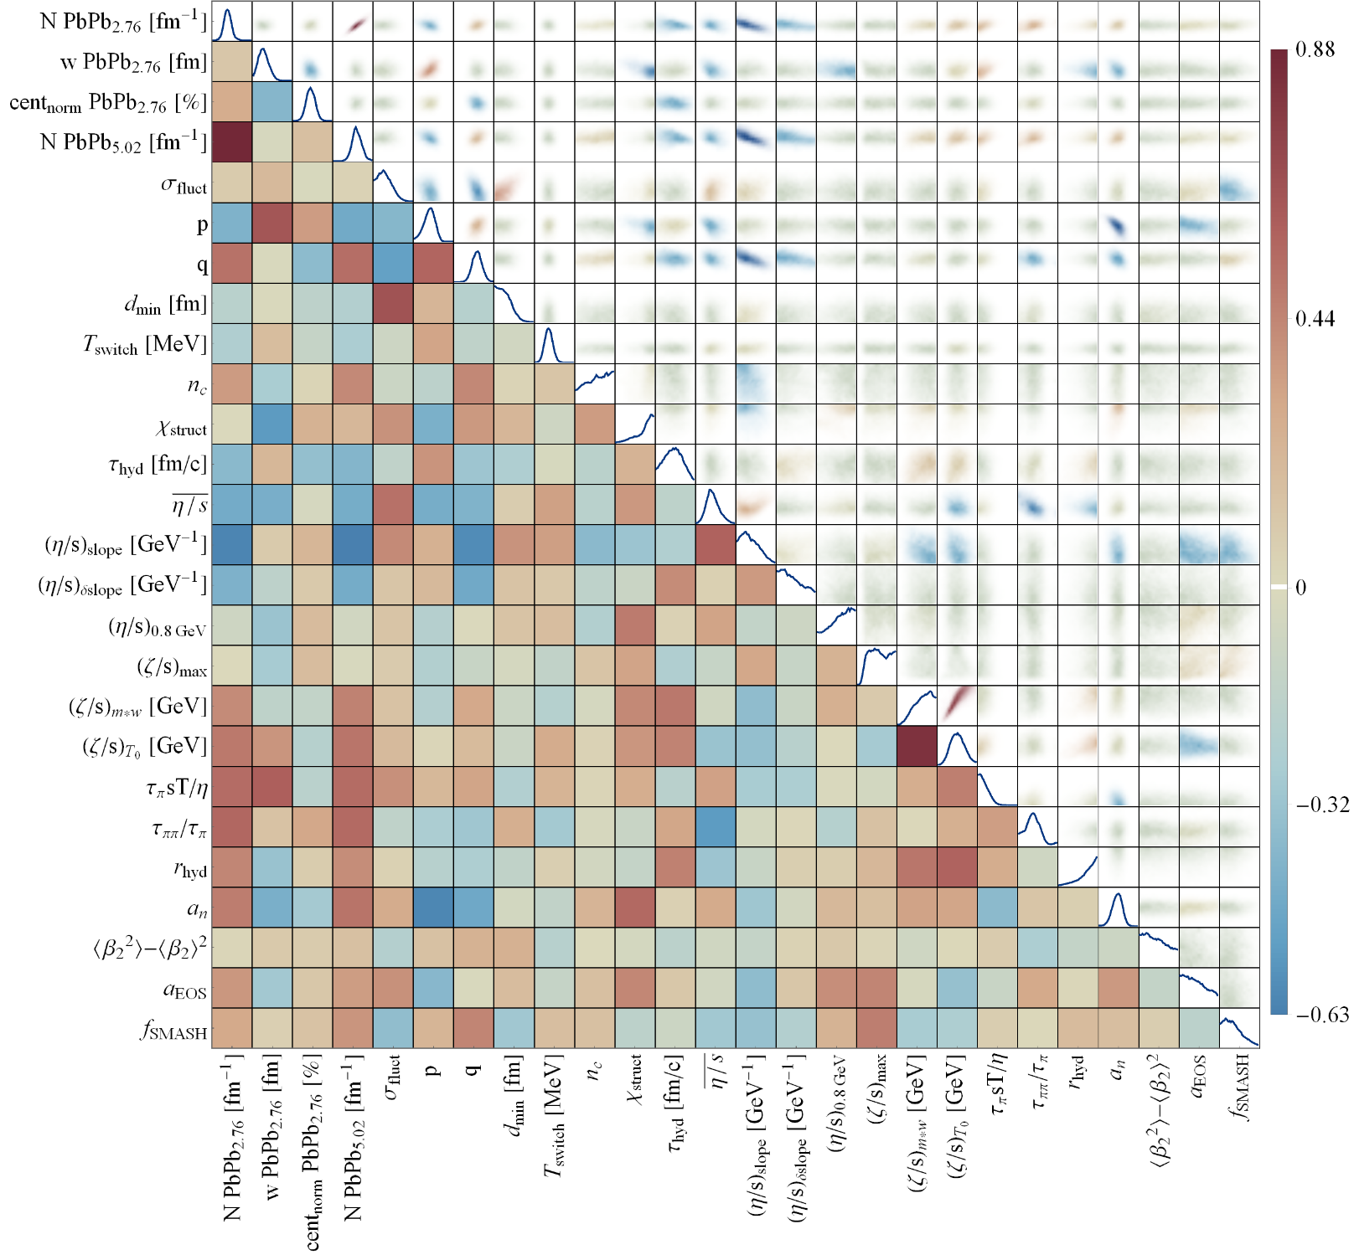
Full posterior distributions
Wilke van der Schee, CERN/Utrecht
Some parameters better constrained than others
Correlations add important information, e.g. width constrained much more accurately if q parameter is known

Slide 11
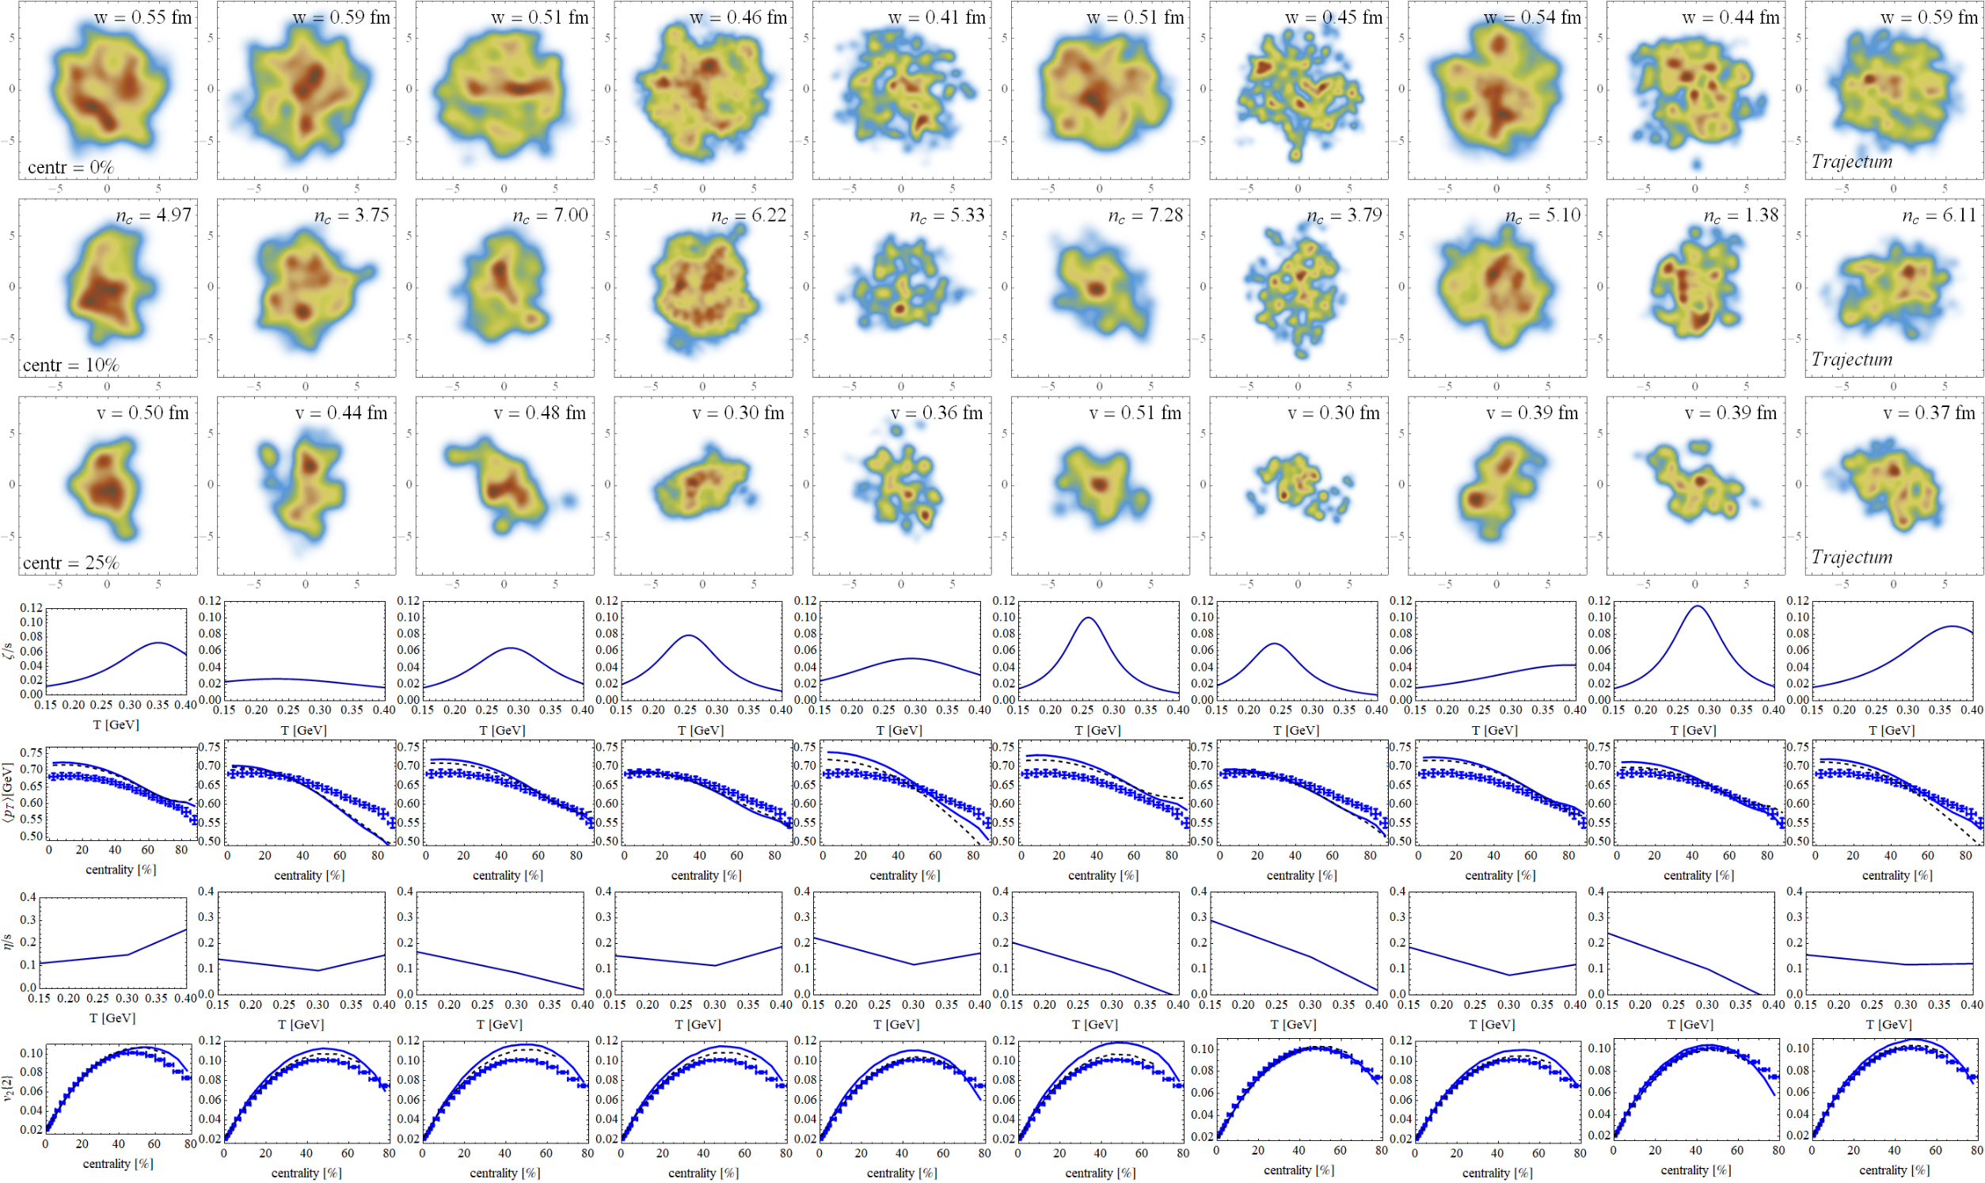
Energy + viscosities + experiment
Ten different probable parameter settings →
Centrality →

Slide 12
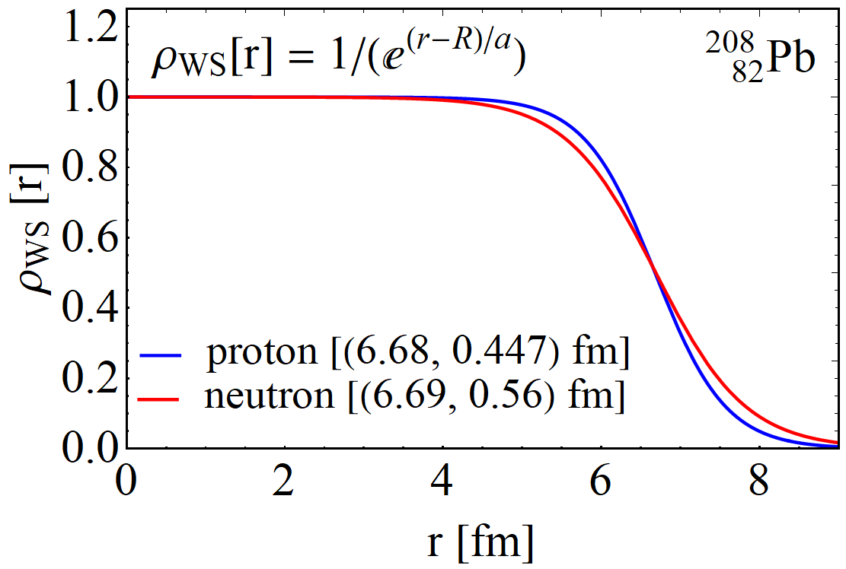
The neutron skin
Nucleus charge profile can be measured very accurately
Much more uncertainty in the profile of the neutrons
Relevant to understand cold QCD: EOS for neutron stars
Can we make progress using heavy ion collisions?
Isospin symmetry makes distinction neutron/proton difficult
Leverage accurate proton knowledge and obtain profile of nucleus?
How to obtain the profile of a nucleus?
Wood-Saxon + MC-Glauber + (model like Trento) → dynamics
Currently state-of-the-art …
Profile influences many observables
Interplay with bulk viscosity, Trento model etc
Likely need a full global analysis
Constantin Loizides, Jason Kamin and David d'Enterria, Improved Monte Carlo Glauber predictions at present and future nuclear colliders (2017)

Slide 13
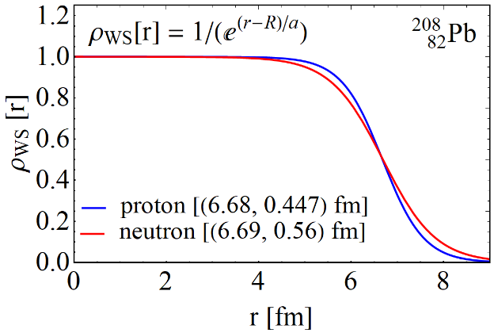
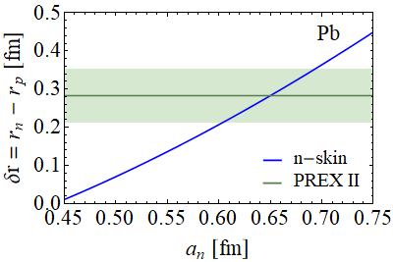
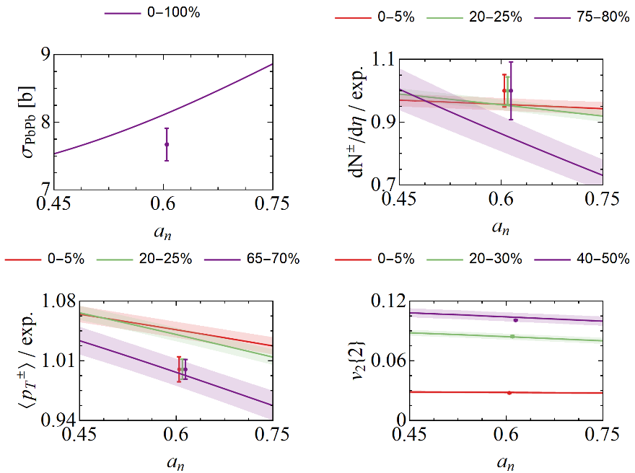
The neutron skin - emulator
Plan is to vary a for neutrons and see if HIC can constrain it
a determines the neutron radius (approx. linear for RMS radius)
First step: what does the emulator say?
Using a precise global analysis (26 parameters, 3000 design points)
Main change: cross section
Measures ‘size’ of nucleus
Both multiplicity and mean pT change
Mainly for peripheral (‘skin effect’)
Small changes for other observables

Slide 14
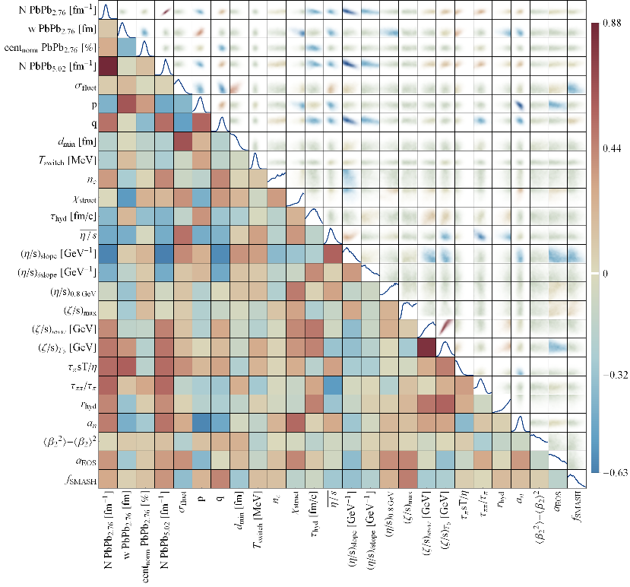
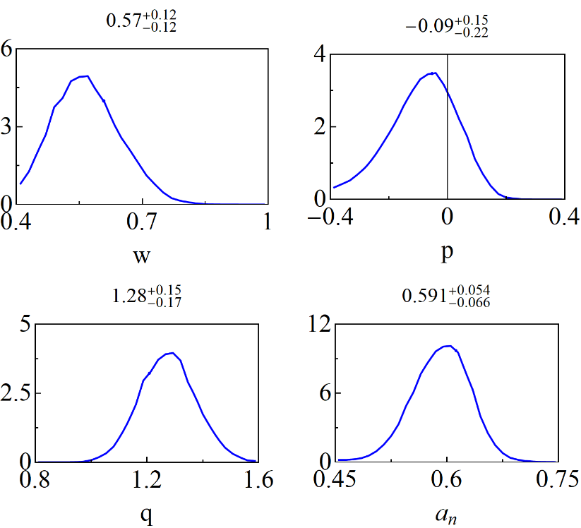
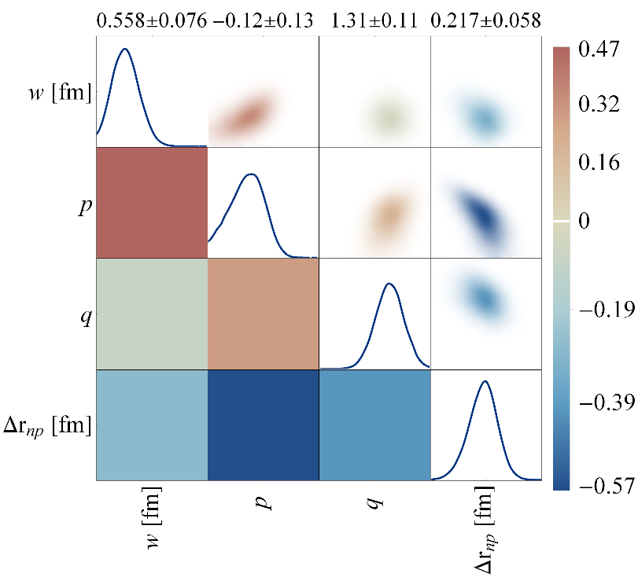
The neutron skin - posterior
Three parameters are most sensitive to the neutron skin:
The nucleon width and the Trento parameters p and q
Small correlation with width (cross section is highly sensitive to w)
Very strong anticorrelation with p; centrality dependence is crucial

Slide 15
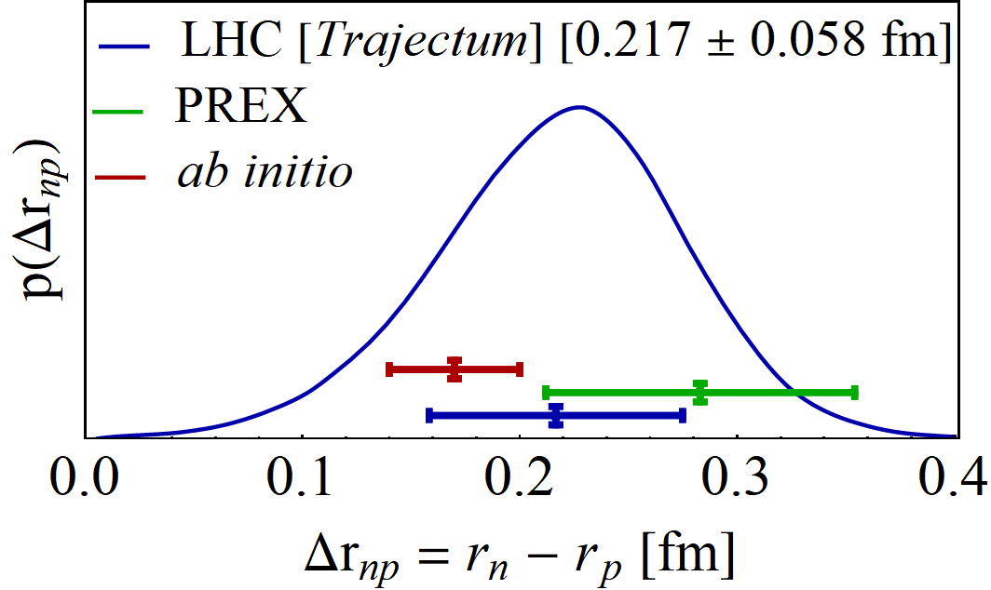
The neutron skin – final result
Transform to neutron radius minus proton radius
Final result consistent but smaller than PREX II
Uncertainty is about 20% smaller than PREX II
Cross section is crucially important, but also centrality dependence
Important to vary Trento parameters in particular
Not competitive with weighted averages (from 14 different methods), but adds unique experimental determination of neutron skin
PREX II, Accurate Determination of the Neutron Skin Thickness of ²⁰⁸Pb through Parity-Violation in Electron Scattering (2022)
James M. Lattimer, Constraints on Nuclear Symmetry Energy Parameters (2023)

Slide 16
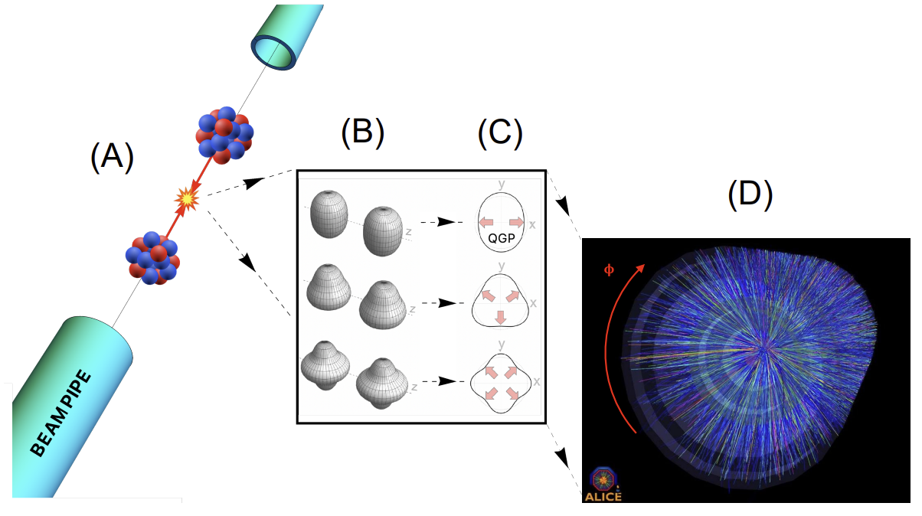
The shape of nuclei
Benjamin Bally, James Daniel Brandenburg, Giuliano Giacalone, Ulrich Heinz, Shengli Huang, Jiangoyng Jia, Dean Lee, Yen-Jie Lee, Wei Li, Constantin Loizides, Matthew Luzum, Govert Nijs, Jacquelyn Noronha-Hostler, Mateusz Ploskon, WS, Bjoern Schenke, Chun Shen, Vittorio Somà, Anthony Timmins, Zhangbu Xu and You Zhou
Imaging the initial condition of heavy-ion collisions and nuclear structure across the nuclide chart (2022)

Slide 17
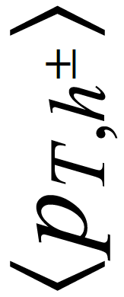
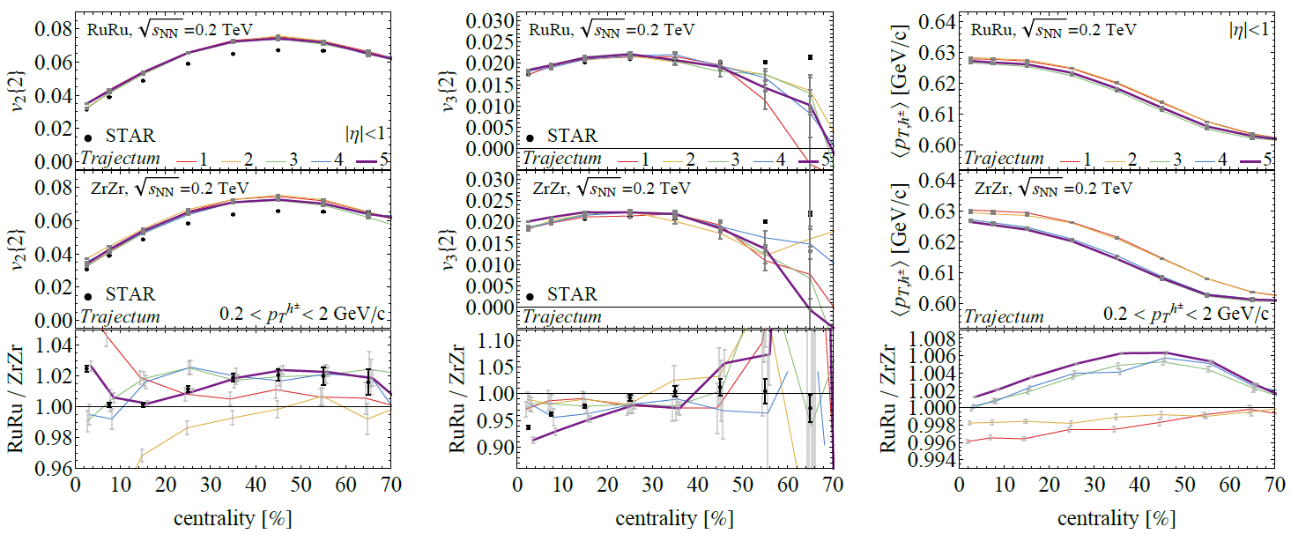
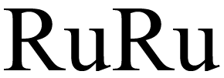
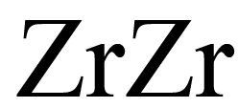
Isobar collisions at STAR – Flow and mean p_{T}
Wilke van der Schee, CERN/Utrecht
Ratio
Original motivation was to study Chiral Magnetic Effect (CME, not found…)
Turns out that the background is significant, can be studied with hydro only
Note that Trajectum is not fitted to RHIC energies, no absolute agreement
Requires many events, percent level accuracy
STAR, Search for the Chiral Magnetic Effect with Isobar Collisions at √s_{NN} = 200 GeV by the STAR Collaboration at RHIC (sept 2021)
Govert Nijs and WS, Inferring nuclear structure from heavy isobar collisions using Trajectum (2021)

Slide 18
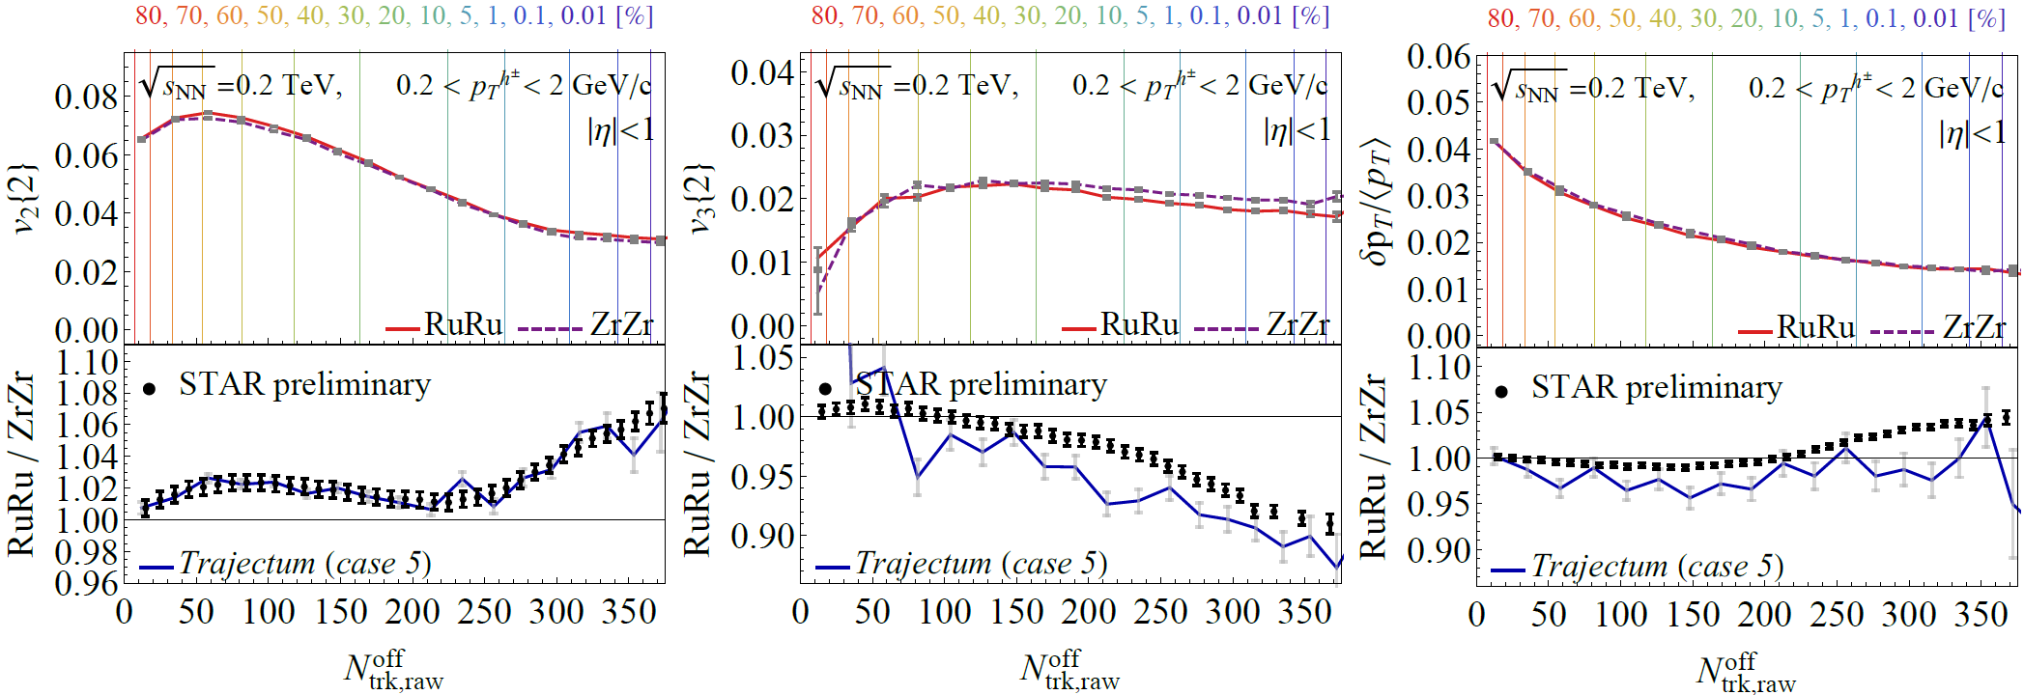
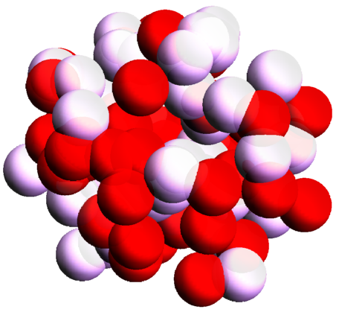
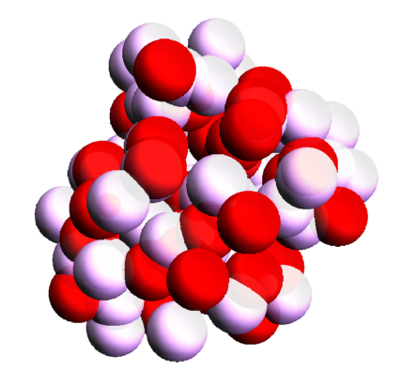
Extremely ultracentral collisions
Wilke van der Schee, CERN
Going to 0.01% centrality (we sample from 250M Trento events)
Excellent match v2, v3 and pt fluct somewhat overpostdicted
Extremely ultracentral is ideal regime to probe nuclear structure (also: better hydro!)
> β₂
> β₃
Averaged
Fluctuating (realistic)
ATHIC2021 talk Chunjian Zhang, https://drupal.star.bnl.gov/STAR/files/ATHIC_Nov_STAR_SBU_ChunjianZhang.pdf

Slide 19
Extremely ultracentral collisions at the LHC
Wilke van der Schee, CERN
Unique physics
Collisions at almost zero/constant impact parameter
Constant volume, no impact parameter fluctuations, but temperature fluctuations
Impact parameter
Size
Temperature at hydro start
Fernando G. Gardim, Giuliano Giacalone and Jean-Yves Ollitrault, The mean transverse momentum of ultracentral heavy-ion collisions: A new probe of hydrodynamics (2019)

Slide 20
Extremely ultracentral collisions at the LHC
Wilke van der Schee, CERN
Significant reduction in uncertainty when taking ratio with 0-5% centrality class
Stronger for temperature (depends on uncertain hydro starting time)
Somewhat curious impact parameter uncertainty that is not reduced
Impact parameter
Size
Temperature at hydro start
Fernando G. Gardim, Giuliano Giacalone and Jean-Yves Ollitrault, The mean transverse momentum of ultracentral heavy-ion collisions: A new probe of hydrodynamics (2019)

Slide 21
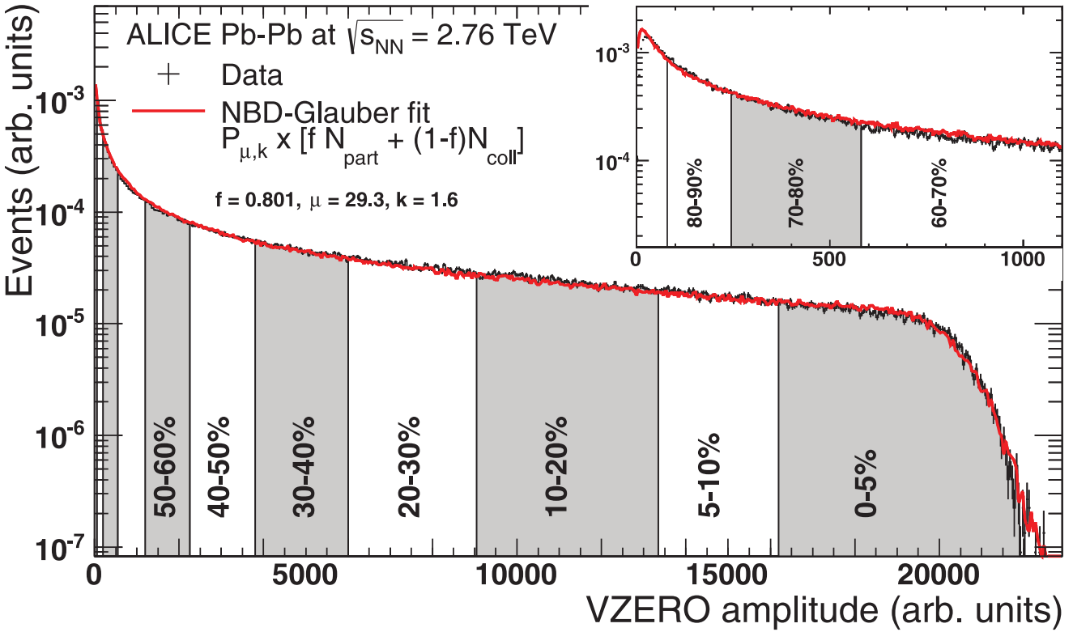
Extremely ultracentral collisions at the LHC
Wilke van der Schee, CERN
Characteristic rise in mean transverse momentum
Collective effect: thermalization, relation with temperature and entropy
Somewhat curious dip around 2%, not understood
Multiplicity (knee)
Transverse momentum
Transverse momentum vs N_{ch}
Govert Nijs and WS, Predictions and postdictions for relativistic lead and oxygen collisions with Trajectum
Fernando G. Gardim, Giuliano Giacalone and Jean-Yves Ollitrault, The mean transverse momentum of ultracentral heavy-ion collisions: A new probe of hydrodynamics (2019)

Slide 22
Extremely ultracentral collisions at the LHC
Wilke van der Schee, CERN
Characteristic decrease in pT fluctuations
Below ~1% centrality the impact parameter doesn’t vary anymore
Subtle but physically important `bend’
Multiplicity (knee)
pT fluctuations
pT fluctuations vs N_{ch}
Rupam Samanta, Somadutta Bhatta, Jiangyong Jia, Matthew Luzum and Jean-Yves Ollitrault, Thermalization at the femtoscale seen in high-energy Pb+Pb collision (2023)

Slide 23
Bonus slide
Wilke van der Schee, CERN/Utrecht
Several systems with MAP settings (systematic analysis with ratios for some to appear)

Slide 24
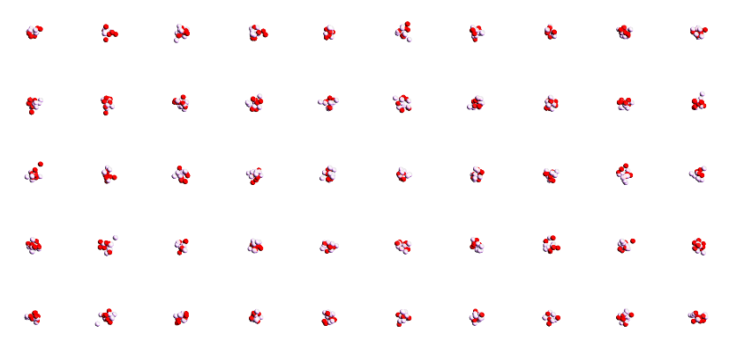
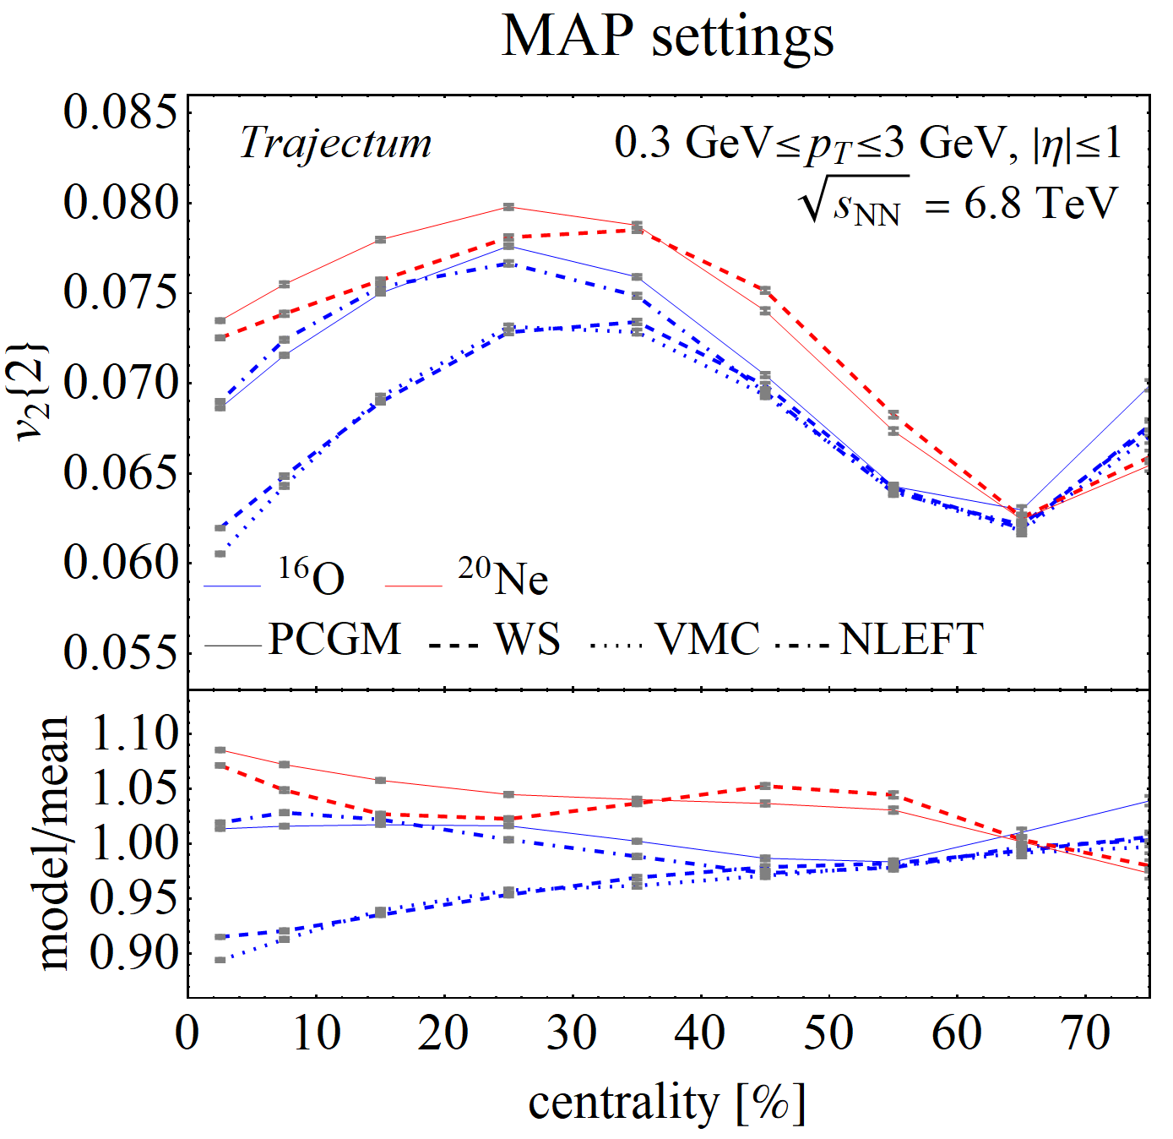
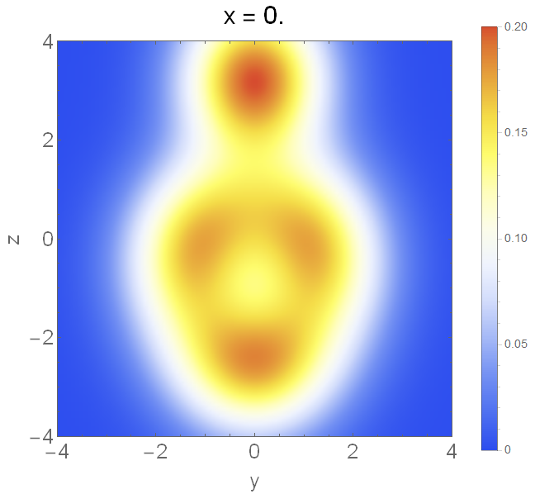
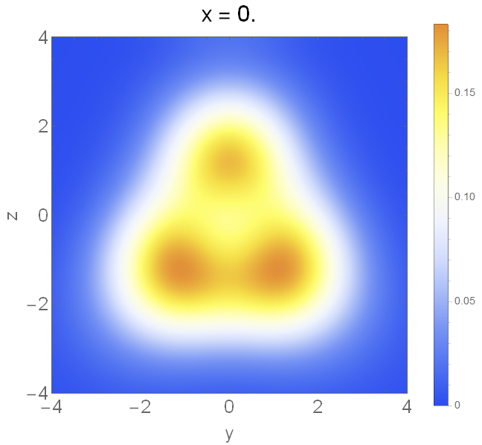
¹⁶Oxygen and ²⁰Neon nuclear structure
Do we understand and/or need to understand the shape of O and Ne?
Naively it seems so: large uncertainty
Interesting by itself: combination of 4 or 5 alpha particles
Work in progress: state-of-the-art Projected Generator Coordinate Method (PGCM) results:
²⁰Neon ¹⁶Oxygen
Work in process with B. Bally et al
Mikael Frosini, Thomas Duguet, Jean-Paul Ebran, Benjamin Bally, Tobias Mongelli, Tomás R. Rodríguez, Robert Roth, Vittorio Somà
Multi-reference many-body perturbation theory for nuclei II -- Ab initio study of neon isotopes via PGCM and IM-NCSM calculations (2021)

Slide 25
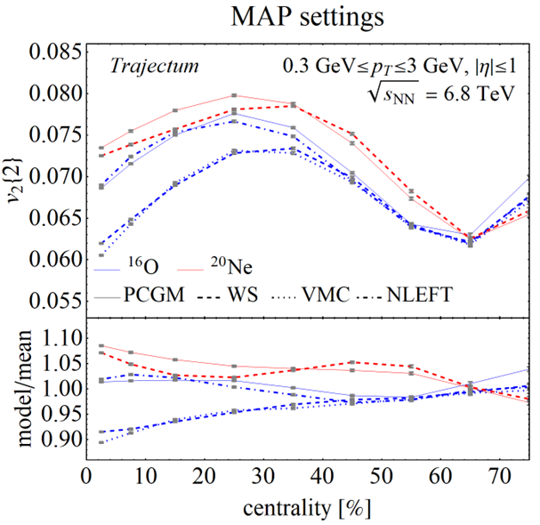
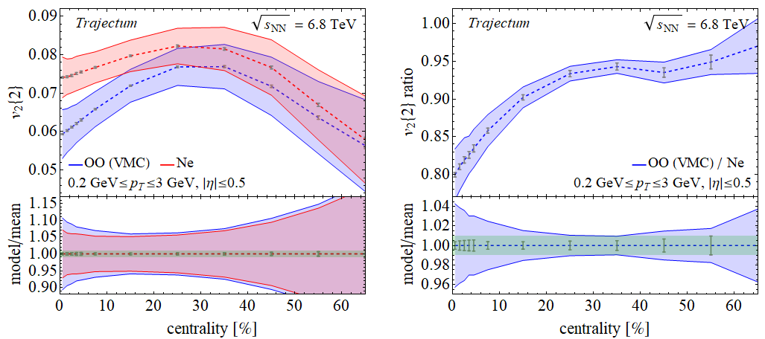
Systematic uncertainty could be a problem
What about the systematics?
Barely significant difference between Oxygen and Neon elliptic flow within systematics
The ratio, however, is accurate at percent level (!). Sweet spot at ~25% centrality
But does it help us? Is the ratio what we need for nuclear structure?
Mikael Frosini, Thomas Duguet, Jean-Paul Ebran, Benjamin Bally, Tobias Mongelli, Tomás R. Rodríguez, Robert Roth, Vittorio Somà
Multi-reference many-body perturbation theory for nuclei II -- Ab initio study of neon isotopes via PGCM and IM-NCSM calculations (2021)

Slide 26
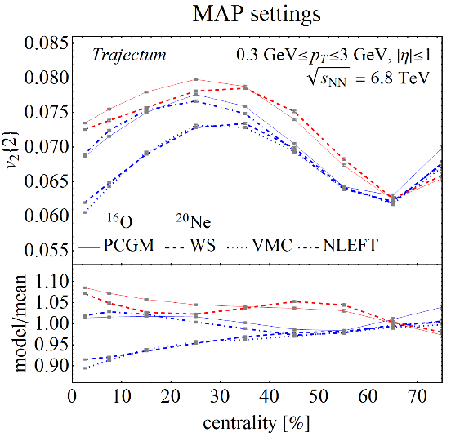
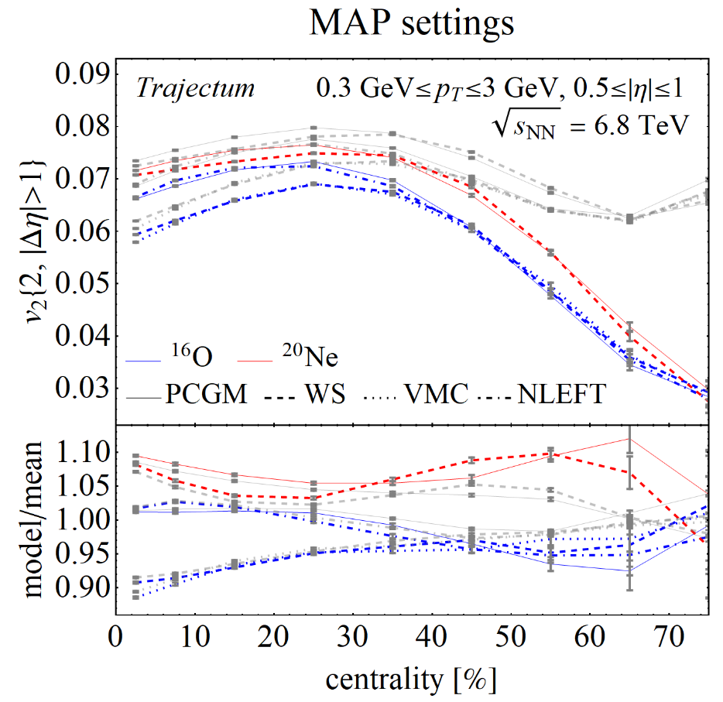
Systematic uncertainty potentially a problem
v₂{2} (much) smaller when applying a Δη cut
More of a theoretical worry than an experimental one (at least for CMS and ATLAS)
Also straightforward (but expensive…) to solve theoretically
Ratios quite robust, at least for central collisions
See also talk at Hard Probes 2023

Slide 27
Resonance decays are potentially a problem
v₂{2} (much) smaller when applying a Δη cut
More of a theoretical worry than an experimental one (at least for CMS and ATLAS)
Also straightforward (but expensive…) to solve theoretically
Ratios quite robust, at least for central collisions
Also subtleties how to impose d_{min} …
See also talk at Hard Probes 2023

Slide 28
Discussion
Exciting progress using global analyses
Heavy ion collisions towards percent level precision
Still interesting measurement potential: extremely ultracentral
Nuclear structure becoming relevant and interesting
Oxygen collisions to be performed at the LHC summer 2024!

Slide 29
Back-up

Slide 30
Nuclear structure and heavy ion collisions
Wilke van der Schee, CERN/Utrecht
Isobar collisions raise several questions:
Are HIC sensitive to nuclear structure? Yes, but at percent level accuracy
Are HIC understood at percent level? Historically likely not…
A more systematic approach
Vary several approaches to nuclear structure
Vary parameter settings within current posterior distribution
Do we need an (isobar) ratio to make progress?
Oxygen (and Neon?) at CERN
Independently interesting: the smallest droplet of QGP, cosmic rays (p-O collisions)
Oxygen (Neon) specifically interesting: can we see 4 (5) clusters of alpha-particles?
Neon – Lead beam gas collisions foreseen at LHCb fixed target mode
Jasmine Brewer, Aleksas Mazeliauskas and WS: http://cern.ch/ooatlhc or https://arxiv.org/abs/2103.01939
J.-P. Ebran, E. Khan, T. Niksic and D. Vretenar, Density Functional Theory studies of cluster states in nuclei (2014)

Slide 31
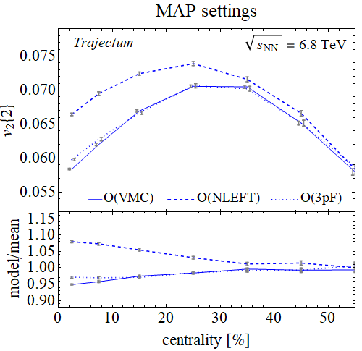
Oxygen nuclear structure
Comparing two state-of-the-art microscopics with old profile (MAP run with 100M events per run)
3pF: 3 parameter Wood-Saxon Fermi fit from 1976 with d_{min}
VMC: Variational Monte Carlo to sample wave function with advanced nucleon interaction
NLEFT: Nuclear Lattice Effective Field Theory, ground state with `pin holes‘ (no repulsive interaction implemented)
Elliptic flow does not distinguish VMC/3pF
Other observables can (e.g. mean transverse momentum)
Significant differences for central collisions
Giuliano Giacalone, Dean Lee, Govert Nijs and WS, to appear
D. Lonardoni, A. Lovato, Steven C. Pieper and R.B. Wiringa, Variational calculation of the ground state of closed-shell nuclei up to A=40 (2017)

Slide 32
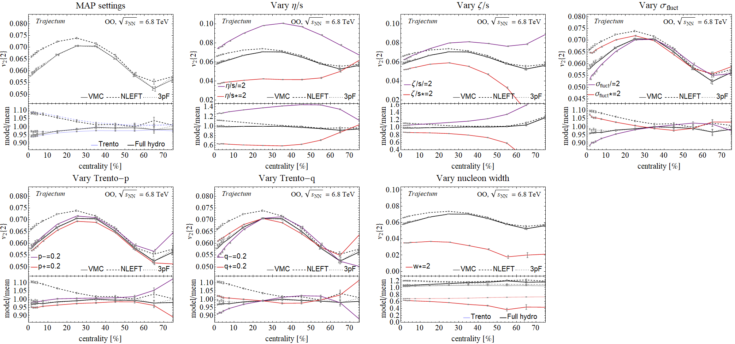
Oxygen nuclear structure
Are results robust when varying parameter?
Not really… nuclear structure similar to fluctuations

Slide 33
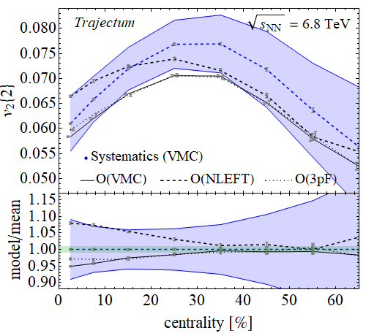
Oxygen nuclear structure
Can we do this more systematically?
Parameters such as viscosities are highly correlated
Take random sample of `probable’ parameter settings
Compute one standard deviation systematic uncertainty
Systematic uncertainty comparable to differences due to nuclear structure

Slide 34
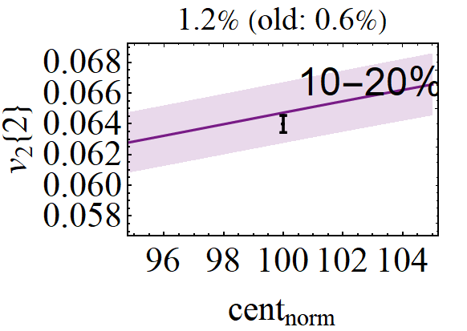
The PbPb cross section and the centrality normalisation
Cross section follows from
Luminosity (van der Meer scan, dominates uncertainty)
The number of collisions
First measured in April 2022 (!)
ALICE can accurately measure collisions in 0-90% region
90-100% is estimated from NBD Glauber fit
Trajectum defines 100% by having at least one nucleon-nucleon interaction
Now also a parameter, perhaps as a check, or to address experimental uncertainty
We take a Gaussian prior of width 1%
Centrality normalisation trivially correlates all observables by shifting classes
Probably best to marginalise over in MCMC Bayesian analysis
Means ALICE should quote this uncertainty separately
Important even for some central observables (v₂{2})
ALICE , Centrality determination of Pb-Pb collisions at √s_{NN} = 2.76 TeV (2013)
ALICE luminosity determination for Pb-−Pb collisions at √s_{NN} = 5.02 TeV (2022)

Slide 35
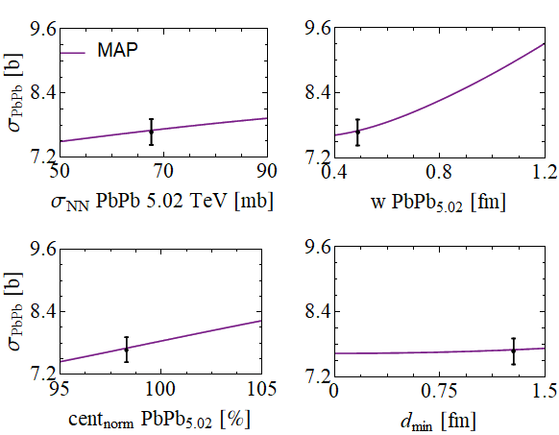
The nucleon width and the total PbPb hadronic cross section What is easier to measure the width than by simply measuring the size?
Wilke van der Schee, CERN/Utrecht
Fix nucleon-nucleon cross section:
e.g. collision probability tuned to σ_{NN} for Gaussian profile ρ
Theoretically, cross section only depends on
Nucleon-nucleon cross section
Nucleon Gaussian width (dominant)
Centrality normalisation
Minimum inter-nucleon spacing
Makes the cross section a robust observable
Basically implying every model needs to get this right
Basically implying the nucleon width should be small
See also David d’Enterria and Constantin Loizides, Progress in the Glauber Model at Collider Energies (2020)

Slide 36
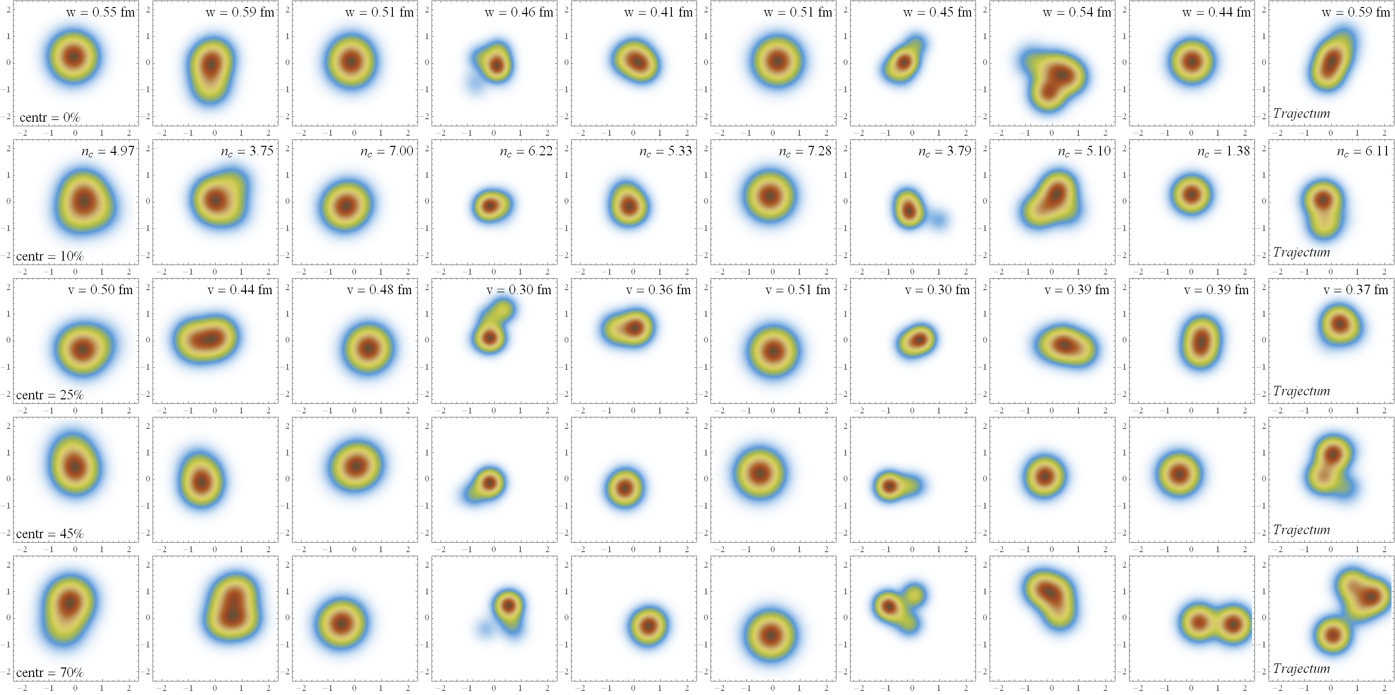
Thickness function nucleon
Ten different probable parameter settings →
Configurations →

Slide 37
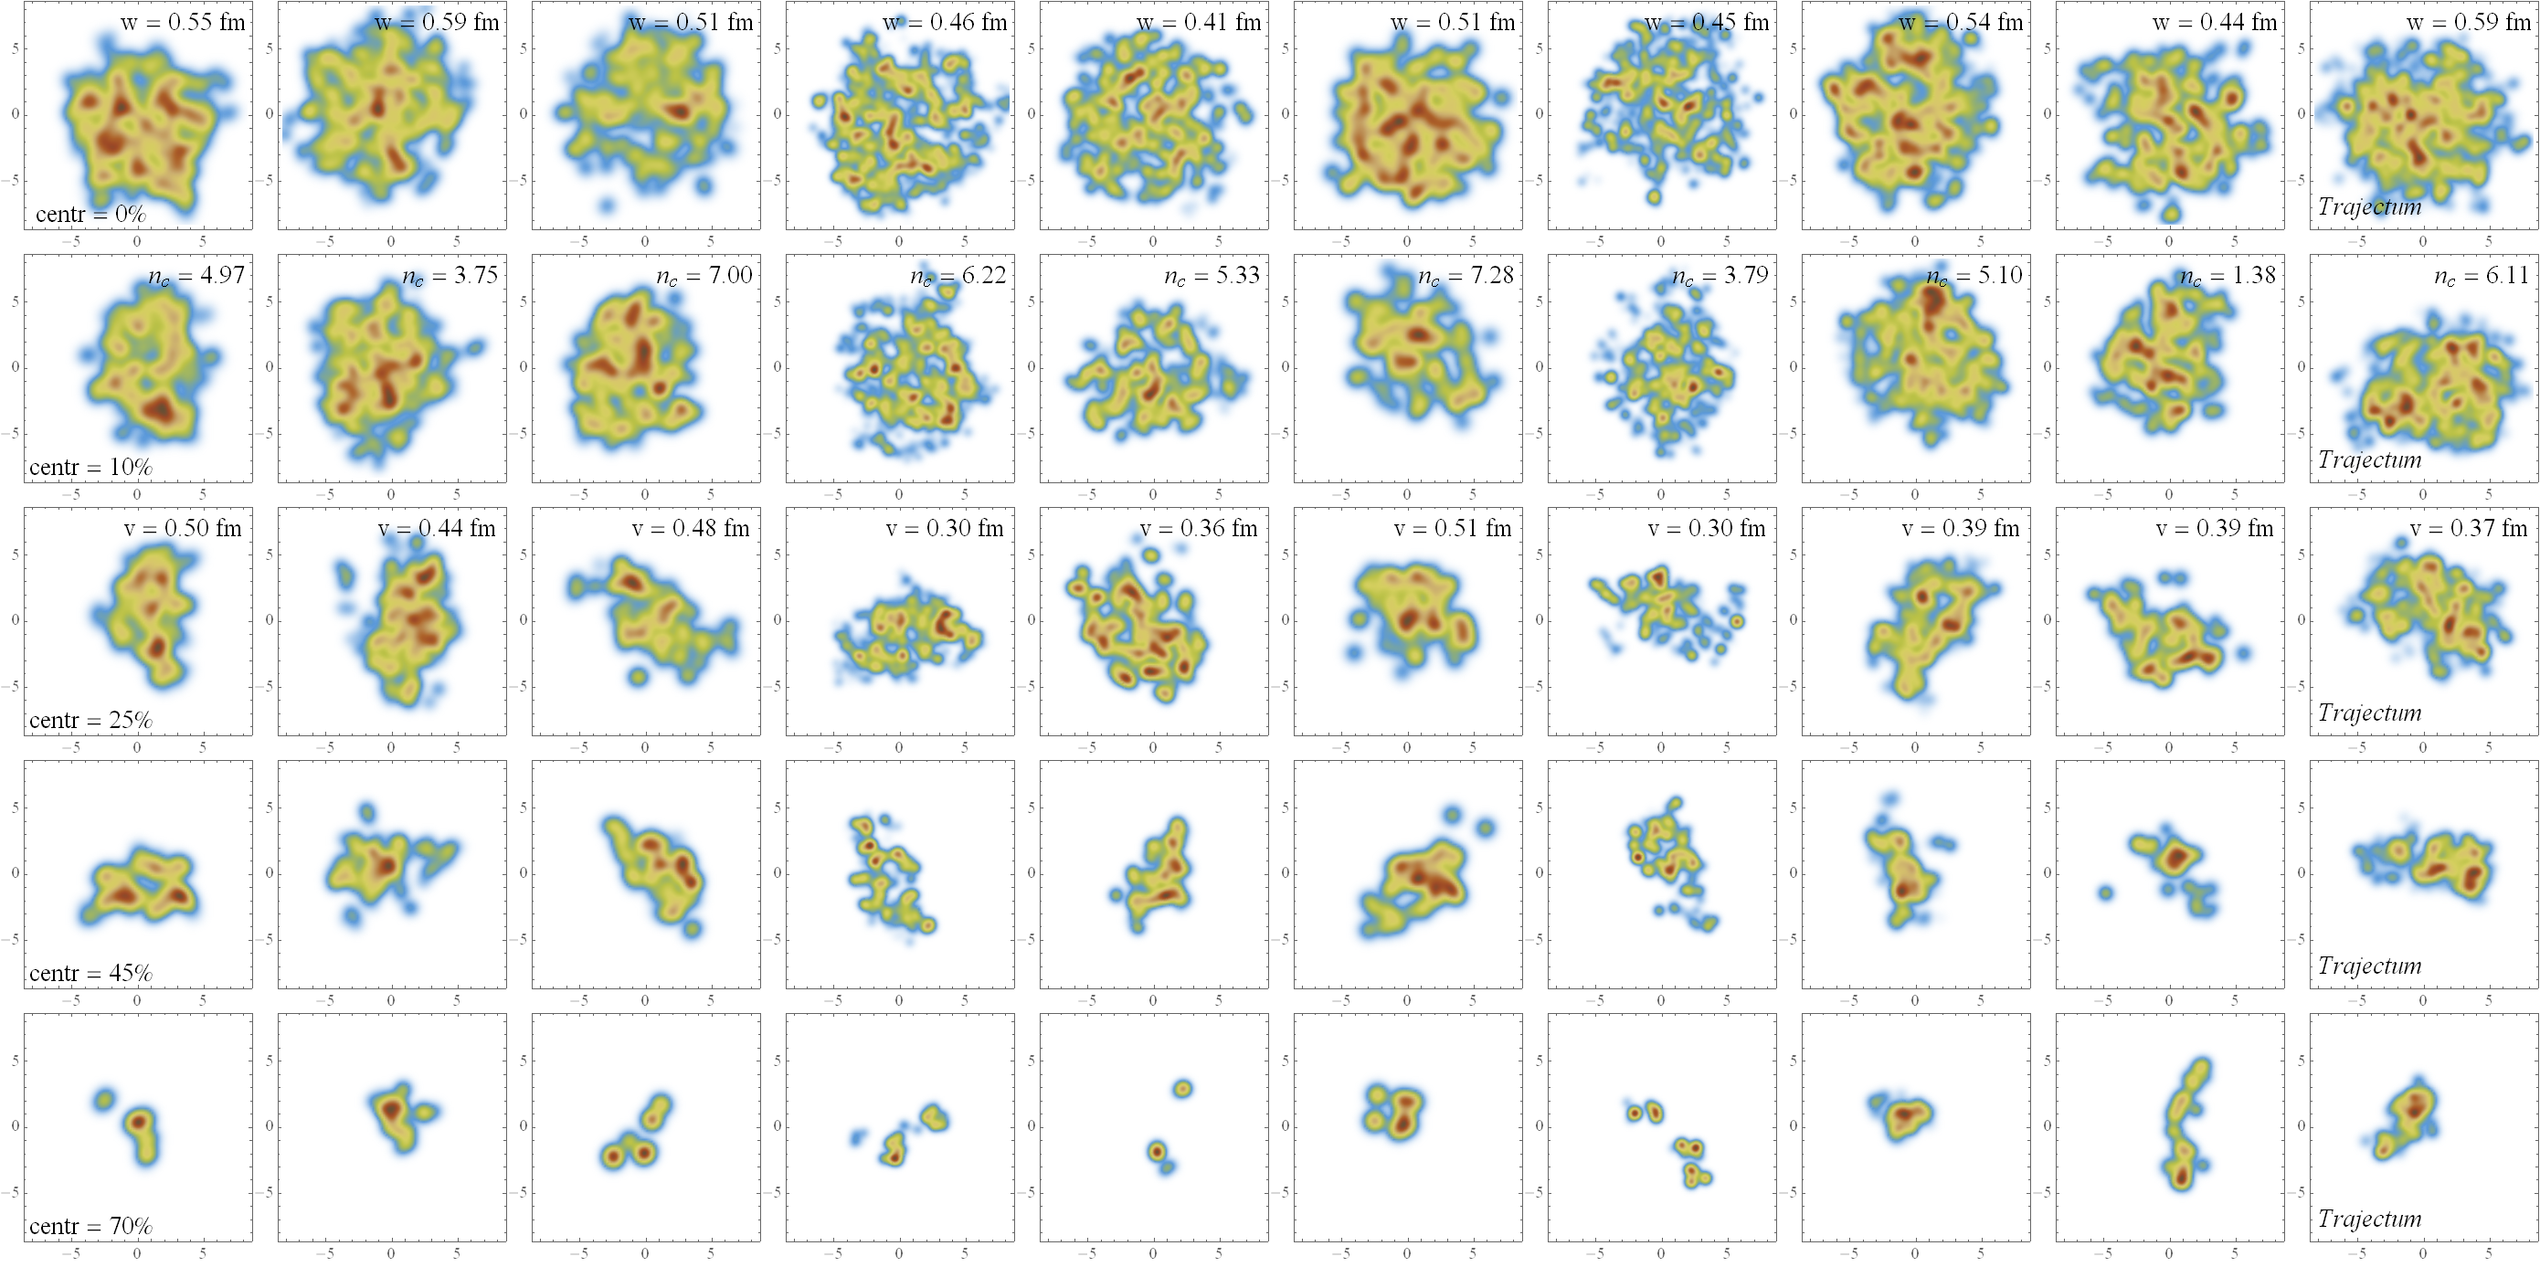
Thickness function Pb
Ten different probable parameter settings →
Centrality →

Slide 38
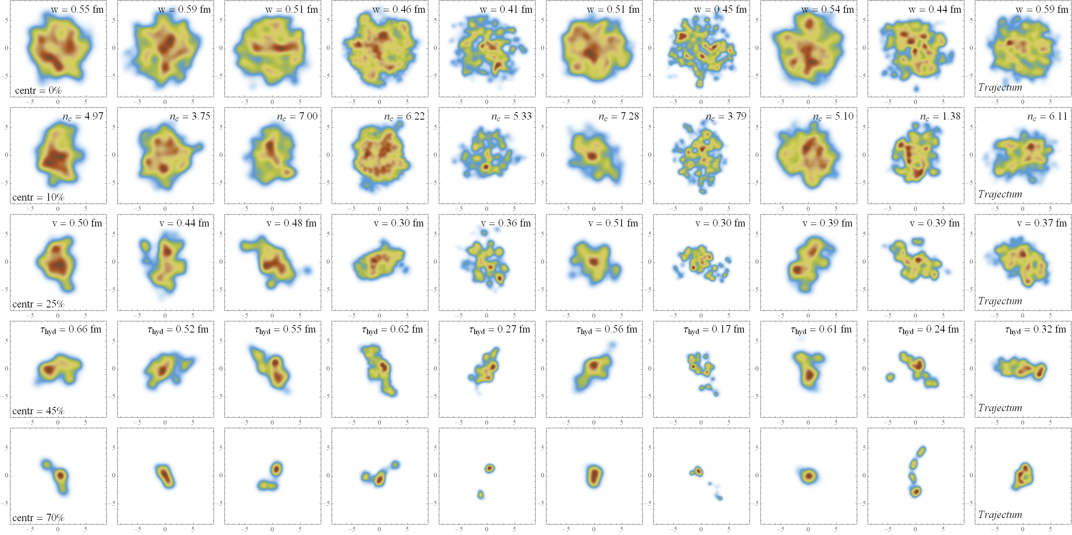
Energy density function Pb
Ten different probable parameter settings →
Centrality →

Slide 39
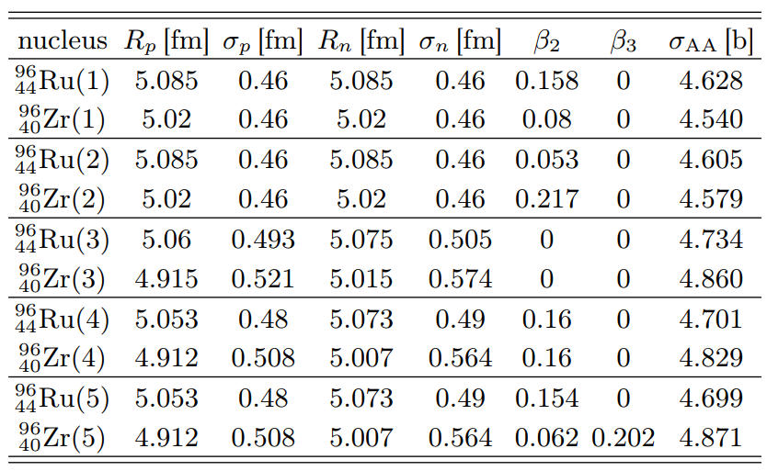
Isobar collisions at STAR
Wilke van der Schee, CERN
Five different cases simulated:
e-A scattering experiments(STAR case 1)
Theory (finite-range liquid drop model, STAR 2)
DFT with neutron skin (spherical) [1]
DFT with neutron skin (deformed, β₂ = 0.16) [1]
As 4, but with β₂ from electric transition probability and β₃ from comparing AMPT with STAR [2]
[1] Hao-jie Xua, Hanlin Lib, Xiaobao Wanga, Caiwan Shena and Fuqiang Wang, Determine the neutron skin type by relativistic isobaric collisions (2021)
[2] Chunjian Zhang and Jiangyong Jia, Evidence of quadrupole and octupole deformations in 96Zr+96Zr and 96Ru+96Ru collisions at ultra-relativistic energies (2021)

Slide 40
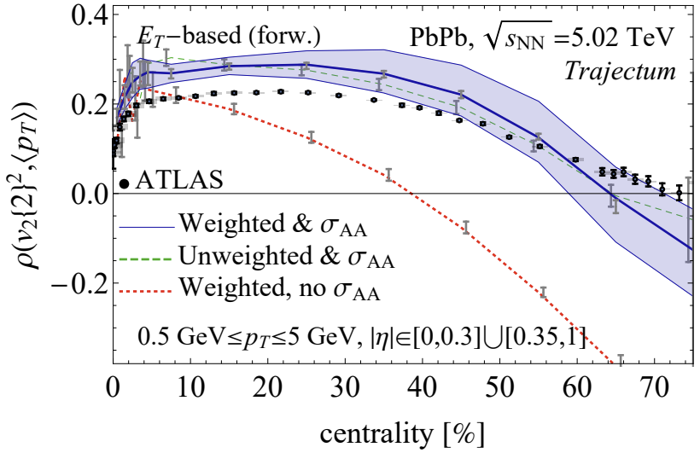
Bonus: mean p_{T} and v₂ or v₃ correlations
Wilke van der Schee, CERN/Utrecht
A Bayesian MAP check: unfitted data:
Triple differential observables:
Correlation p_{T} and v_{n}
Anticipated by (simpler) Trento analysis:
Giuliano Giacalone, Bjorn Schenke and Chun Shen, Constraining the nucleon size with relativistic nuclear collisions (2021)
ALICE, Characterizing the initial conditions of heavy-ion collisions at the LHC with mean transverse momentum and anisotropic flow correlations (2021)

Slide 41
Isobar collisions at STAR Varying the magnetic field
Wilke van der Schee, CERN
Idea: similar nuclei (same # of baryons), different charge
Ruthenium generates a 10% larger magnetic field
Ideal set-up to suppress background and detect Chiral Magnetic Effect (CME)
Very precise blinded analysis by STAR:
CME-like
Averaged
No CME
Fluctuating (realistic)
Unfortunately (?), no CME detected
STAR, Search for the Chiral Magnetic Effect with Isobar Collisions at √s_{NN} = 200 GeV by the STAR Collaboration at RHIC (sept 2021)

Slide 42
Isobar collisions at STAR - Multiplicity
For each case we run 0.5M collisions except for case 5 (5M), 14M in total.
Wilke van der Schee, CERN
Theory: only change centrality bounds
Precision and non-conventional definition of centrality
Subtlety in STAR data: “centrality label” is different for Ru and Zr
Especially important for multiplicity (~7% effect)
Hardly significant for other observables (<0.5% for v₂)
STAR, Search for the Chiral Magnetic Effect with Isobar Collisions at √s_{NN} = 200 GeV by the STAR Collaboration at RHIC (sept 2021)

Slide 43
Isobar collisions at STAR - Multiplicity
Wilke van der Schee, CERN
Better to directly look at (raw) data
Experimental subtlety: crucial to correct for detector efficiency
Trajectum subtlety: norm not fitted to RHIC energy: multiply mult by 1.21
Experiment misses (many) very peripheral collisions: multiply P(N) by 1.31 to correct for this (not for ratio)
Ratio experiment: normalise both and divide Subtle: experiment unreliable for N_{trk} < 50 Ratio theory: integrate Ru+Zr experiment and Ru+Zr theory for N_{trk} > 50 and require ratio to match Exp-theory comparison only depends on N_{trk} > 50
Only case 3, 4 and 5 match well over entire range (neutron-skin)
STAR, Search for the Chiral Magnetic Effect with Isobar Collisions at √s_{NN} = 200 GeV by the STAR Collaboration at RHIC (sept 2021)

Slide 44
Initial state predictors
Wilke van der Schee, CERN
With large sample we can verify the relation
All else being equal this works, e.g. within Zr as in right plots
If also size changes etc (Zr vs Ru), it can affect κ and the initial geometry cannot be used
Unfortunate: hydro is expensive…

Slide 45
Full posterior distributions
Wilke van der Schee, CERN/Utrecht

Slide 46
Exciting: oxygen-oxygen special run in 2024!
Predictions for oxygen at RHIC (run already performed) and LHC
Perhaps surprisingly narrow predictions, only fitted on PbPb data
Jasmine Brewer, Aleksas Mazeliauskas and WS: http://cern.ch/ooatlhc or https://arxiv.org/abs/2103.01939
Govert Nijs and WS, Predictions and postdictions for relativistic lead and oxygen collisions with Trajectum (2021)

Slide 47
Correlation between v₂ and mean p_{T} Vary some model parameters (for VMC only)
Conjectured to be a good observable. But must be careful with width and viscosities.

