Slide 1

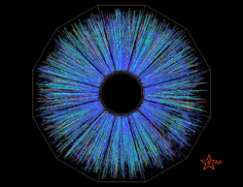



Experimental search for the chiral magnetic effect
Strongly interacting matter in extreme magnetic fields
Fuqiang Wang
Purdue University

Slide 2
OUTLINE
Chiral magnetic effect (CME) and the Δγ observable
Flow and nonflow backgrounds
  Isobar collisions – vary signal
  Event shape engineering – vary background
  Au+Au collisions – vary both signal and background
Summary

Slide 3
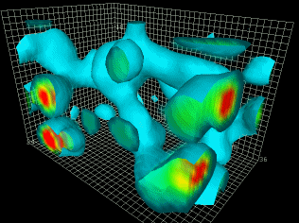
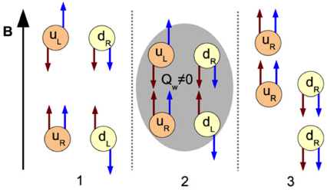
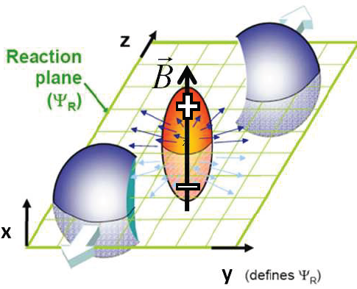
CHIRAL MAGNETIC EFFECT (CME)
The strong interaction
to solve the U(1)_{A} problem (1976)
‘t Hooft vacuum
E: C-odd, P-odd, T-even
B: C-odd, P-even, T-odd
quarks
quark-gluon
interactions
quarks
gluons
Explicitly breaks CP
Early universe ultraviolet θ ≈ 1 ?? >> current infrared θ ≈ 0
vacua
-
Kharzeev, et al. NPA 803 (2008) 227
y
B ~ 10¹⁵ T
Kharzeev,Pisarski,Tytgat,PRL81(1998)512
x
QCD vacuum fluctuation, chiral anomaly, topological gluon field
Chiral Magnetic Effect (CME)
Discovery of CME: Chiral symmetry restoration, Local P/CP violation (matter-antimatter asymmetry)

Slide 4
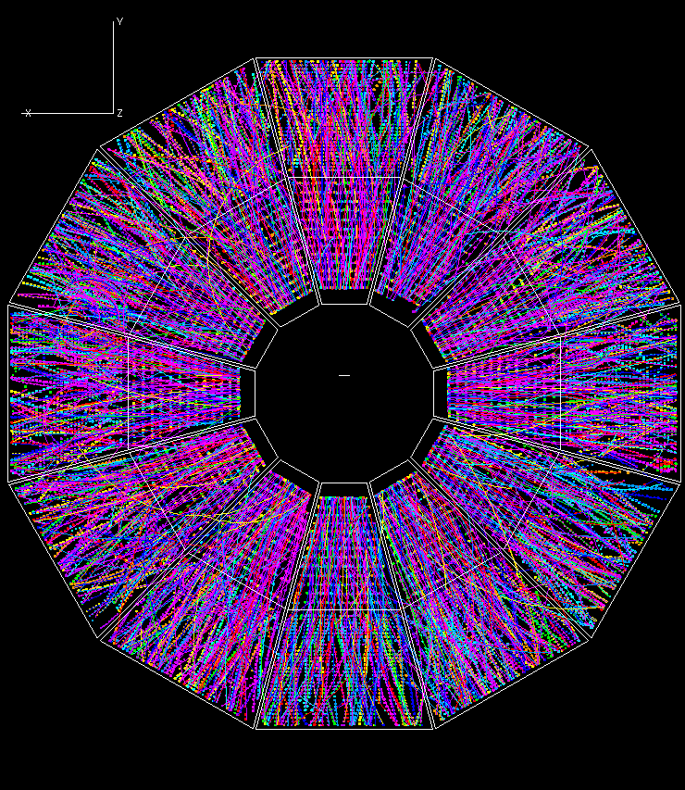
Δγ CORRELATOR AND EARLY RESULTS
Voloshin, PRC 2004
STAR, PRL 2009, PRC 2010
Look for charge separation
π⁺
π⁺
Δγ
RP
π⁻
π⁻
Significant signal
Δγ ∼ 5 × 10⁻⁴
A few % signal!

Slide 5
SIGNIFICANT FLOW-INDUCED BACKRGOUND
FW 2009
Bzdak, Koch, Liao 2010
Pratt, Schlichting 2010
Y
π⁺
π⁻
π⁺
ρ
π⁺
ρ
π⁻
X
ψ_{RP}
Flow-induced charge-dependent background: nonflow coupled with flow
ρ
π⁺
π⁻
π⁻

Slide 6
THE NONFLOW BACKGROUND
Feng et al., PRC 105 (2022) 024913
The flow-induced background is very-well understood
Nonflow issues are the next/final hurdle
2p
nonflow
CME
flow
3p
nonflow
flow-induced bkgd

Slide 7
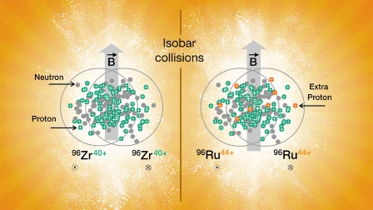
ISOBAR COLLISIONS
Voloshin, PRL 105 (2010) 172301
STAR, PRC 105 (2022) 014901
Haojie Xu et al. PRL 121 (2018) 022301
Hanlin Li et al. PRC 98 (2018) 054907
Same A -> Same background
Different Z -> different signal
Only considering flow-induced background…
Δγ/v₂
If N_{cluster} ∝ N
Then f_{CME} = 6.8 ± 2.6%
Kharzeev, Liao & Shi,
PRC 106 (2022) L051903
0.4% precision is achieved!
But isobar ratios are below unity.
Primary reason is mult. difference due to nuclear structure subtlety

Slide 8
NONFLOW ESTIMATES IN ISOBAR
STAR, PRC 105 (2022) 014901
Feng et al., PRC 105 (2022) 024913
FENG Yicheng (STAR): QM’2022
STAR, 2308.16846
Δγ/v₂
Total uncertainty:
0.4%⊕0.3%⊕0.5% = 0.7%
Assuming 15% B² diff:
δf_{CME} = 0.7%/15% = 5%
CME Upper Limit:
f_{CME} < 10% at 95% CL
FENG Yicheng (STAR): QM’2022
STAR, 2308.16846

Slide 9
Vary background by
Event Shape Engineering

Slide 10
EVENT-SHAPE-ENGINEERING METHOD
Schukraft, Timmins, Voloshin, PLB 719 (2013) 394
ALICE, PLB 777 (2018) 151
CMS, PRC 97 (2018) 044912
ALICE
ALICE:
Model study of v₂-dependent reconstruction of B direction within a given centrality because
different q₂ classes have different EP resolutions.

Slide 11
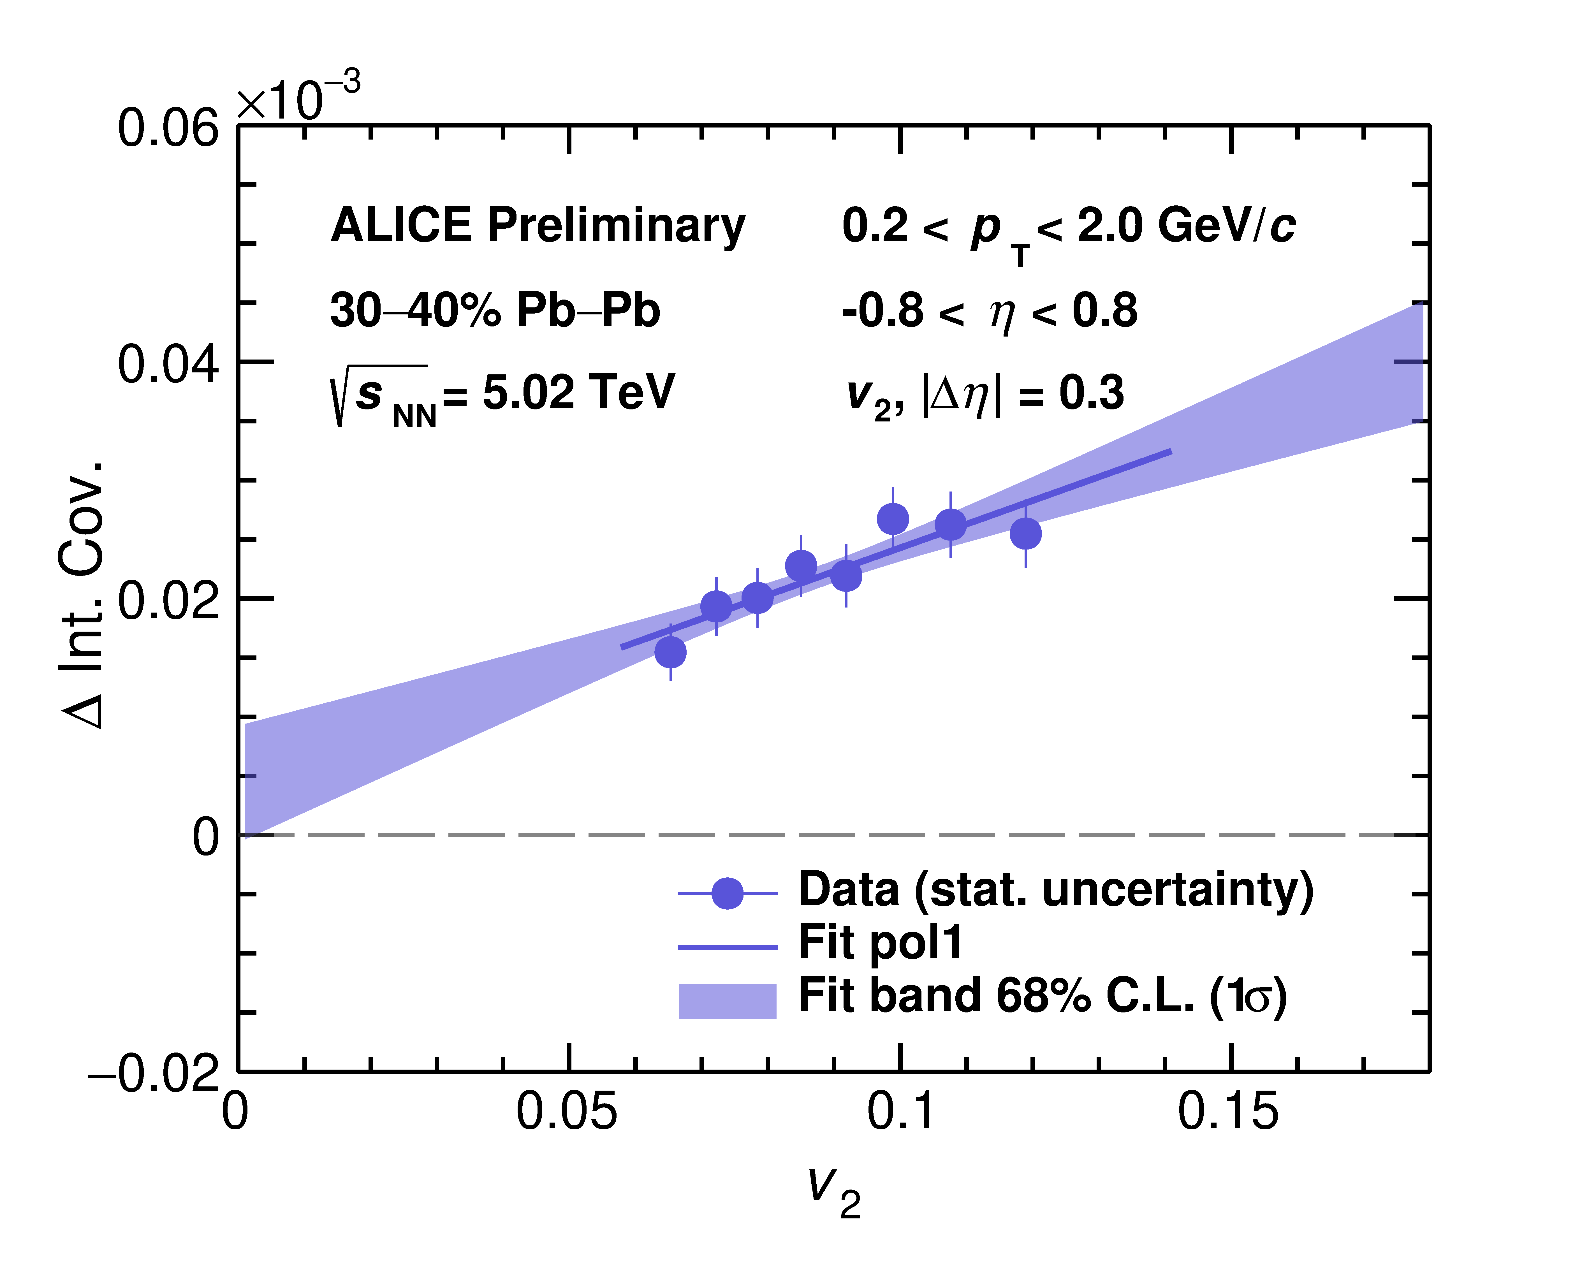
CMW & CME: COMMON BKG SOURCE
Wu, Shou, et al., PRC 107, L031902 (2023)
Wu (ALICE), SQM 2002, EPJ Web Conf. 276, 01001 (2023)
LCC background
Qiye Shou, Chirality Workshop 2023

Slide 12
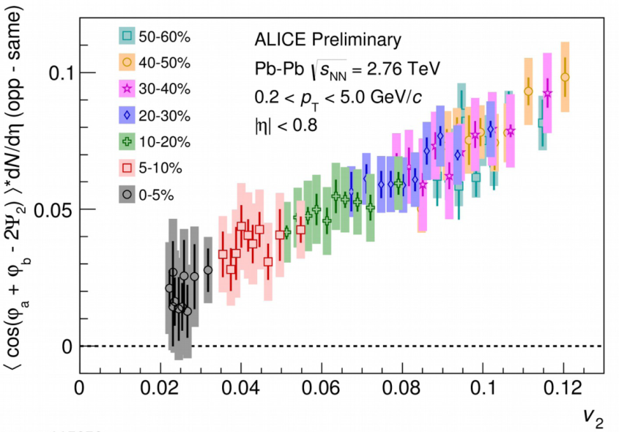
HANDLE NONFLOW IN ESE
Schukraft, Timmins, Voloshin, PLB 719 (2013) 394
ALICE, PLB 777 (2018) 151
CMS, PRC 97 (2018) 044912
Feng et al., PRC 105 (2022) 024913
Contaminated
by 3p nonflow
Flow background is taken care of
3p nonflow removal
will bring down
Δγ magnitude
ALICE
Remove v2 nonflow by (Δη,Δφ) analysis?
Use v₂{4} instead of v₂{2} to minimize nonflow? (implicit assumption: fluct. ~ v₂)
v2 contaminated by nonflow
Once nonflow taken care of, ESE is a promising way to extract CME signal

Slide 13
Vary both signal and background:
Spectator/Participant Plane Method

Slide 14
200 GEV AU+AU COLLISIONS
H.-j. Xu, et al., CPC 42 (2018) 084103, arXiv:1710.07265
S.A. Voloshin, PRC 98 (2018) 054911, arXiv:1805.05300
STAR, PRL 128 (2022) 092301
BKG
CME
ψ_{SP}
Peripheral 50-80%: consistent-with-zero signal
Mid-central 20-50%: indication of finite CME, ∼2σ significance

Slide 15
NONFLOW IN AU+AU
Feng et al., PRC 105 (2022) 024913
Au+Au
v₂ nonflow → makes TPC Δγ smaller → positive f_{CME}
3p nonflow → makes TPC Δγ larger → negative f_{CME}

Slide 16
NONFLOW SUBTRACTED SIGNAL
STAR, PRL 128 (2022) 092301
Feng et al., PRC 105 (2022) 024913
AMPT 2p estimates
(14.7 ± 5.0)%
(6.3 ± 5.6)%
(4.1 ± 4.8)%
(−5.0 ± 2.6)%
Net nonflow effect could be negative!
HIJING 3p estimates
There may indeed be hint of ∼10% CME in Au+Au data!

Slide 17
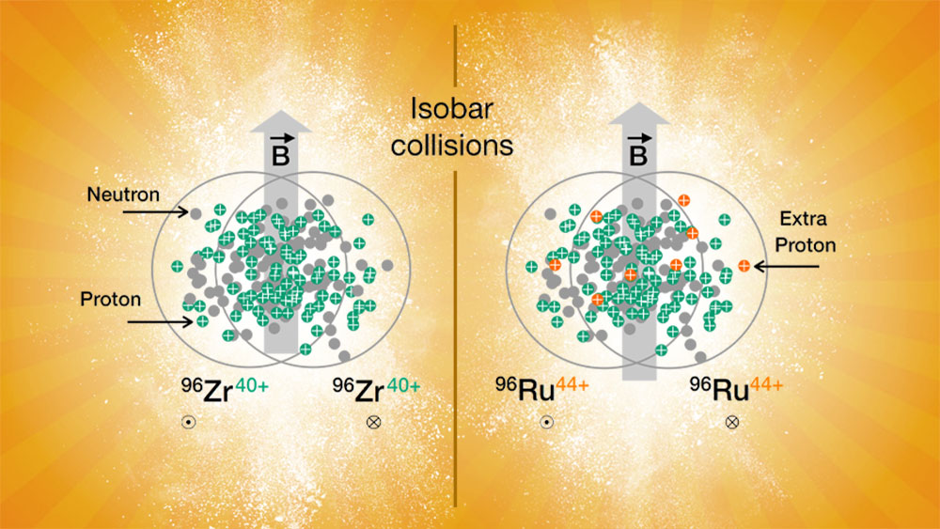
AU+AU AND ISOBAR ARE CONSISTENT
Shi et al., Ann. Phys. 394 (2018) 50–72
Feng et al., PLB 820 (2021) 136549
Background ∝ 1/N → isobar/AuAu ∼ 2
Mag. field B ∼ A/A^{2/3} ∼ A^{1/3}, Δγ_{CME} ∼ B² ∼ A^{2/3} → Signal: AuAu/isobar ∼ 1.5
Could be x3 reduction in f_{CME}
https://www.bnl.gov/newsroom/news.php?a=119062
Δγ ∝ B², differ by 15% between isobars
If CME signal in isobar ∼ Au+Au ∼ 10%,
Then isobar difference ∼ 15%*10% = 1.5%.
With 0.4% uncertainty, ∼4σ effect
If AuAu f_{CME}=10%, then isobar 3% (1σ effect)
Ru/Zr = 1 + 15%*3% = 1.005 (±0.004)

Slide 18
“LOOSE” CONCLUSION FROM AU+AU DATA
CME SIGNAL
10% ± 5%
x10 more data, iTPC larger acceptance, EPD larger η gap
Expect 1-1.5% total uncertainty

Slide 19
Any additional issues?

Slide 20
GLOBAL SPIN ALIGNMENT EFFECT?
Z.-T. Liang, X.-N. Wang, PRL 94, 102301 (2005)
STAR, Nature 548, 62 (2017)
Diyu Shen et al., PLB 839 (2023) 137777
Conceivable that ρ mesons can also have significant spin alignment.
A couple of % back-to-back preference along L can have a large contribution to Δγ.
Potential background to CME?
Probably not.
Because spin alignment is caused by orbit-spin interaction, and is therefore relative to the participant orbital angular momentum, so behaves just like participant flow background.
However, v₂ measurement is affected by ρ spin alignment, and can be significant.

Slide 21
SUMMARY
CME has been one of the most active and challenging fields of research
Theoretically well understood; Experimentally many innovative approaches
Flow-induced background is well understood and under control
Nonflow is the next (and hopefully final) issue
All indications suggest a finite ∼10% CME signal (2σ significance)
At least x10 more data to come, larger acceptance, new event-plane detector

