Slide 1
A quantitative criterion to predict the explodability of core-collapse supernovae: the role of the Si/O interface
Luca Boccioli
Collaborators: Grant J. Mathews, Alessandro Chieffi, Marco Limongi, Lorenzo Roberti
MICRA 2023
September 11th 2023

Slide 3
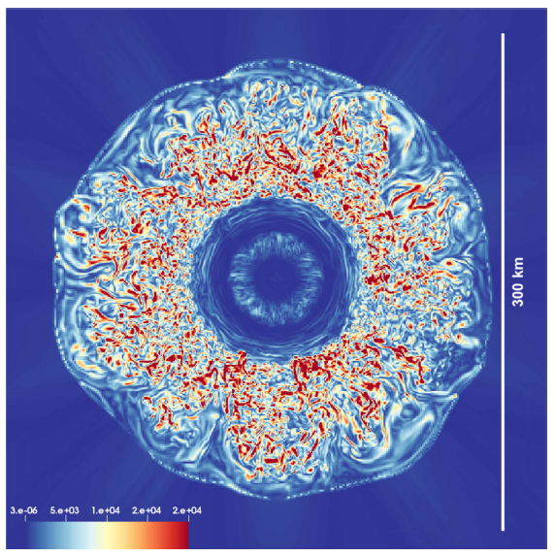
Neutrino-Driven Convection
Snapshot at 200 ms post bounce
shock
ν
PNS
Radice et al. (2018)

Slide 4
Neutrino-Driven Convection
Snapshot at 200 ms post bounce
shock
ν
PNS
Radice et al. (2018)

Slide 5
Neutrino-Driven Convection
3D simulations:
They simulate convection self-consistently
They are computationally very expensive
Snapshot at 200 ms post bounce
shock
Spherically symmetric simulations (1D):
They cannot simulate convection
They are computationally very cheap
ν
We need to find a compromise:
Parametric model for convection in 1D:
PNS
STIR
Couch et al (2020)
Boccioli et al (2021), ApJ, 912, 29
But also: Murphy et al. (2013), Mabanta & Murphy (2018), etc...
Radice et al. (2018)

Slide 6
What makes one star explode and another collapse?
1) Predictive Approach:
Conditions before the collapse that predict whether the star is going to explode or not
2) Dynamical Approach:
Conditions during the collapse that trace when the explosion is about to happen
O’Connor & Ott (2011)
Ertl et al. (2016)
Wang et al. (2022)
Boccioli et al. (2023)
Burrows & Goshy (1993)
Pejcha & Thompson (2012)
Müller et al. (2016)
Gogilashvili & Murphy (2022)

Slide 7
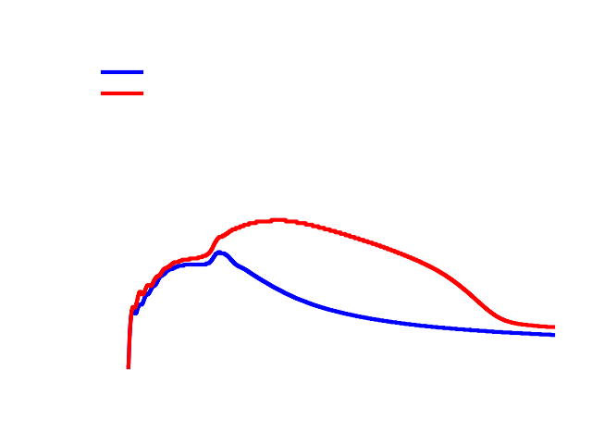
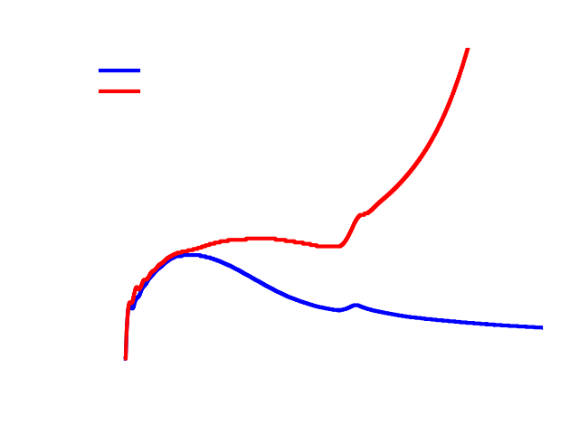
Predictive approach: the starting point
Short answer: the accretion of the Si/O interface...
…but it’s not clear how to quantify it

Slide 8
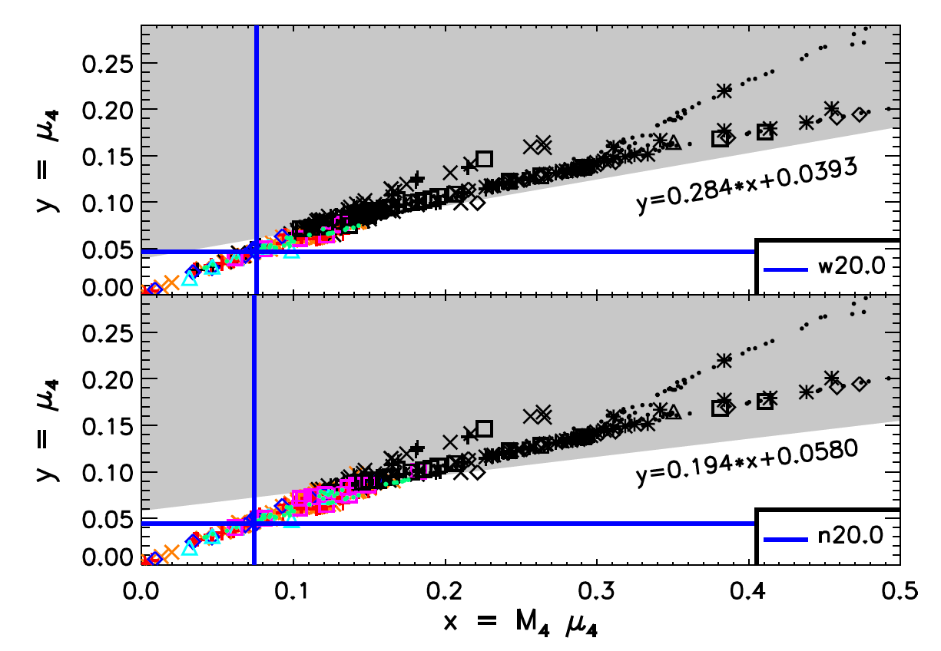
Ertl et al. (2016)
The Si/O interface is located at s = 4.
Can properties of this layer predict the outcome of the explosion?
PHOTB: Explosion triggered by manually increasing neutrino luminosity
Black = Failed SN
Colors = Successful SN
Figure from Ertl (2016)

Slide 9
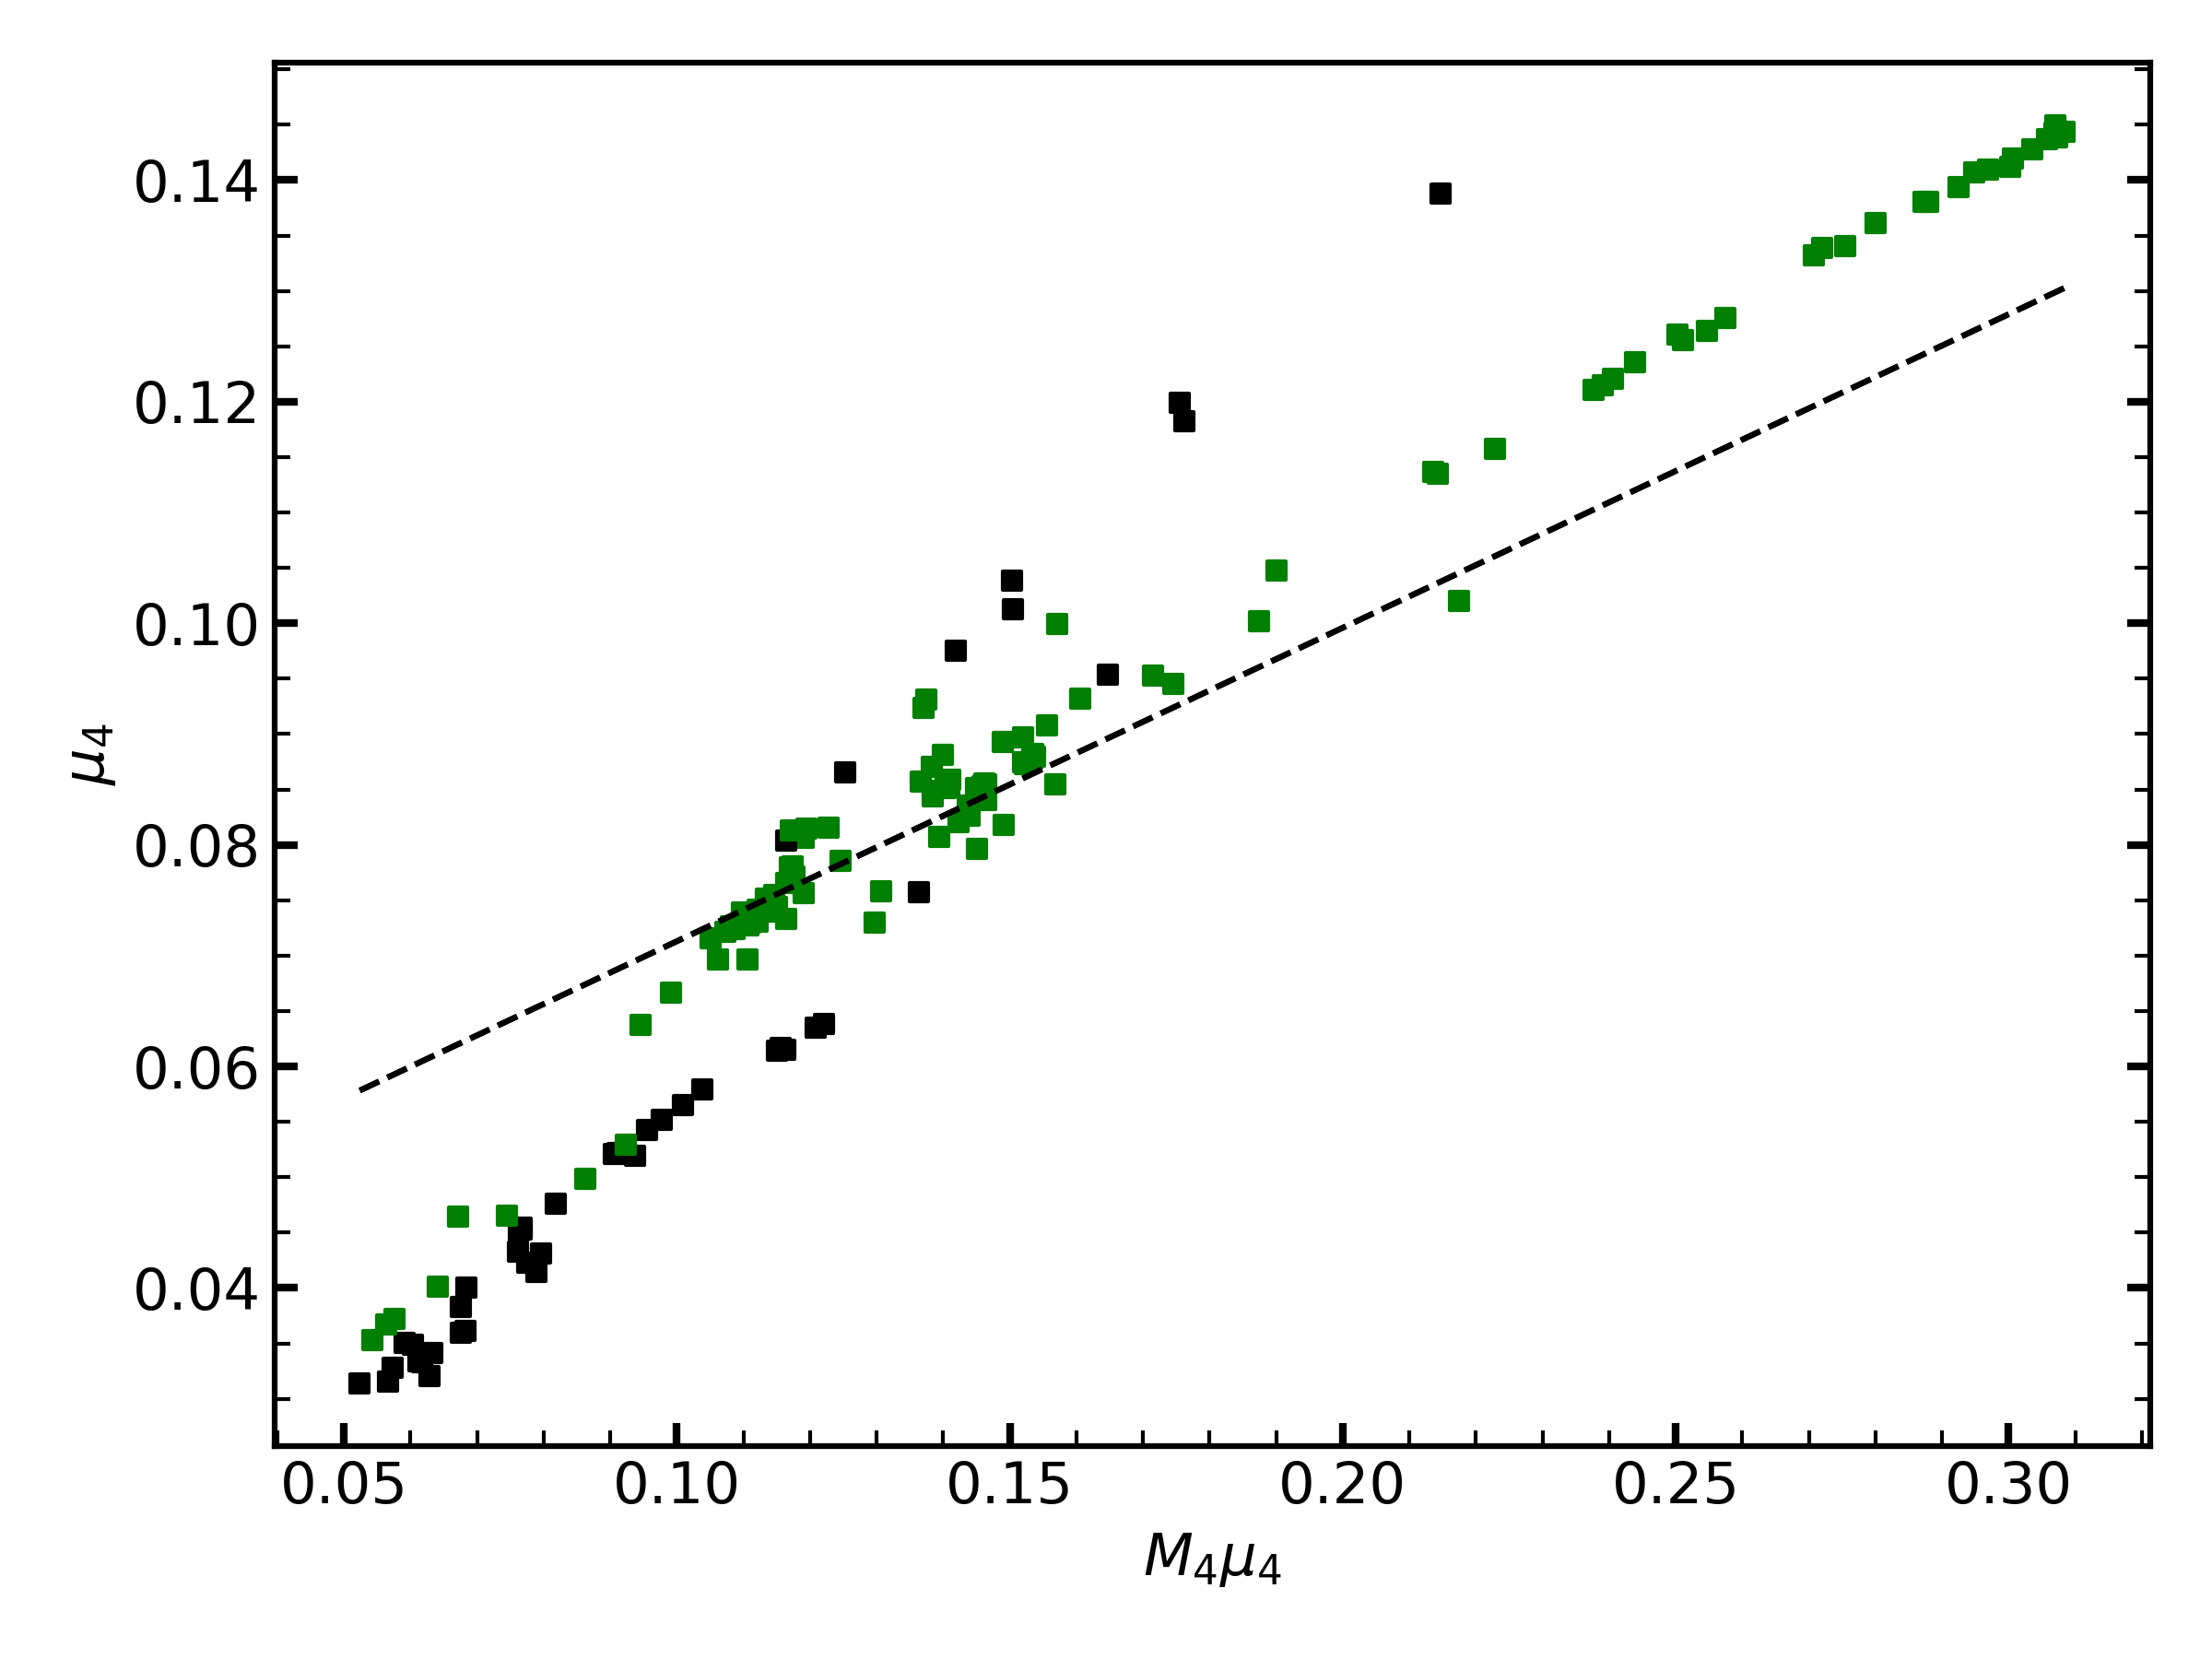
Ertl vs. STIR
STIR and PHOTB predict different explodabilities.
= explosion
= failed SN
Ertl’s criterion does not work for STIR
PHOTB - from Sukhbold et al. (2016)
STIR – from Boccioli et al. (2023)

Slide 10
Our setup
Example of a 21 M⨀ without convection
1) We run a standard 1D supernova simulation of each star, without the inclusion of ν-driven convection
R_{accr}
2) We define $δ$R_{surge} caused by the accretion of the Si/O interface
$δ$R_{surge}

Slide 11
Our setup
Example of a 21 M⨀ before collapse
3) We locate the Si-Si/O interface in the progenitor. We do it by looking for a discontinuity in entropy.
ρ*
4) We identify the layer at which the discontinuity start, and calculate how pronounced the discontinuity is.
δρ*

Slide 12
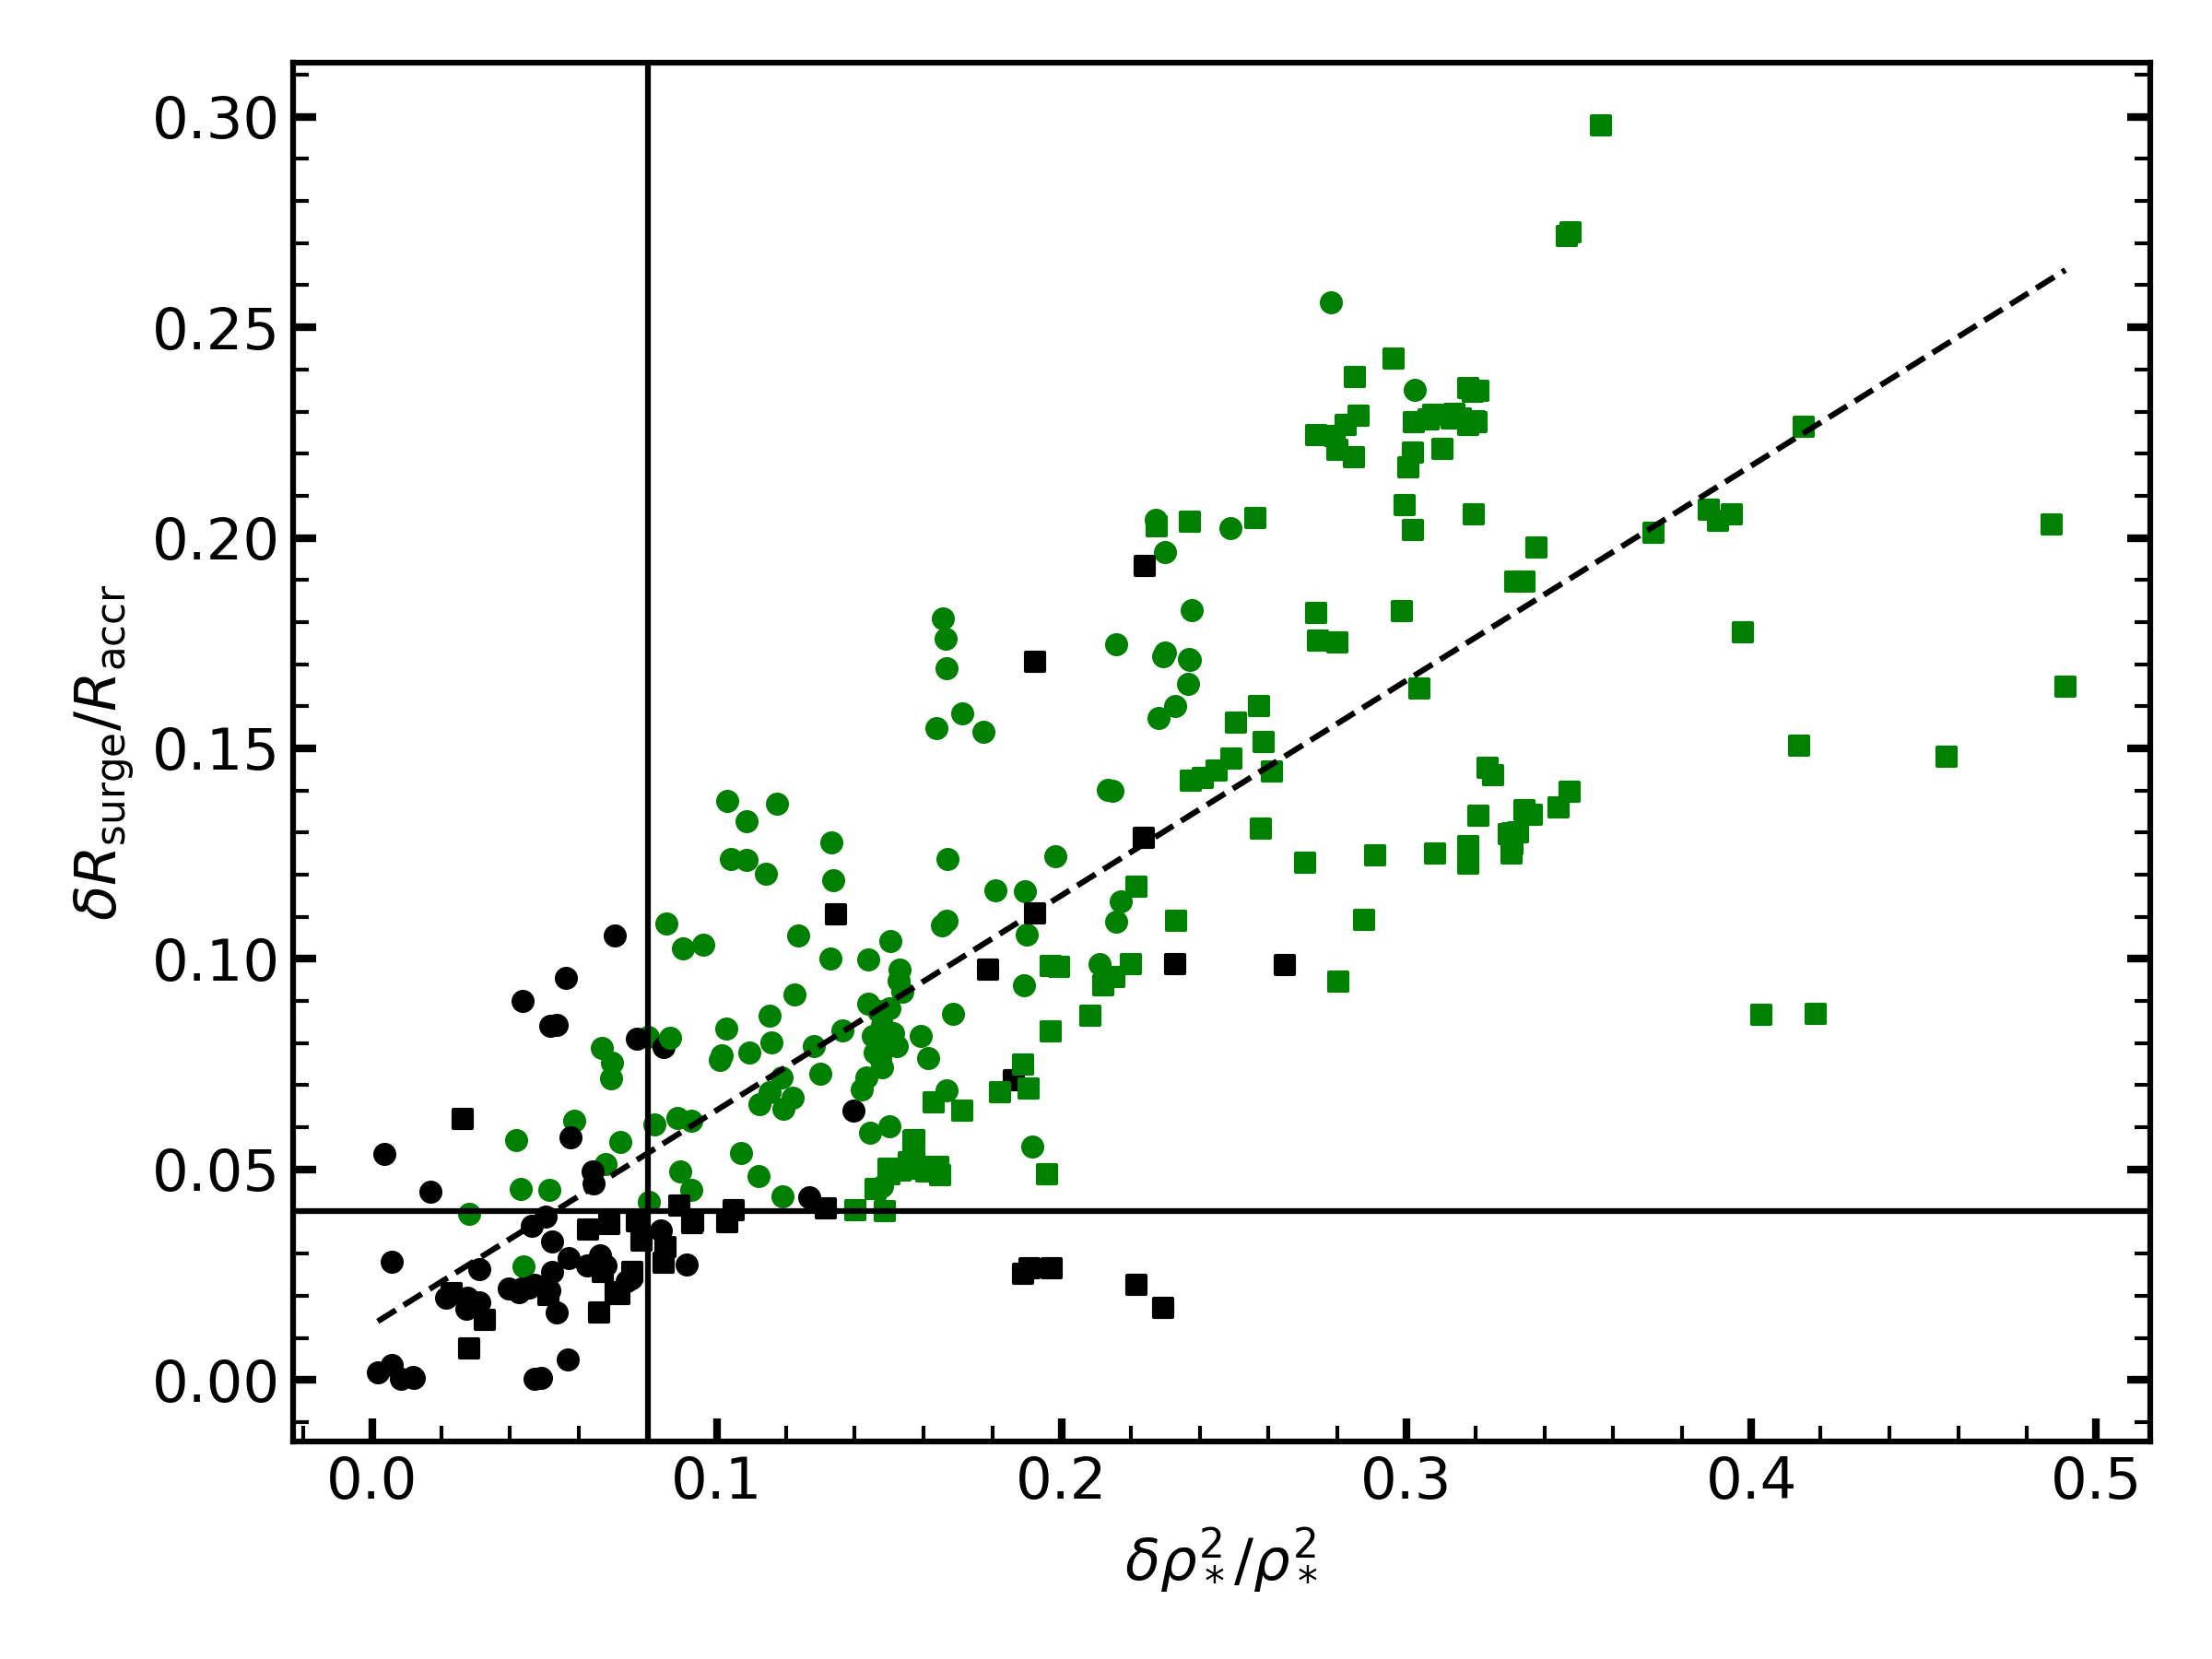
Results: our criterion
= explosion
= failed SN
= KEPLER
= FRANEC
We are ready to formulate a criterion:
Boccioli et al. (2023)
If ${δ\text{ρ}}_{∗}^{2}$ / ${\text{ρ}}_{∗}^{2}$ > 0.08 explosion
If ${δP}_{ram}$/ $P_{ram}$> 0.28 explosion
Wang et al. (2022)
Only ~ 5-8 % of progenitor stars are mislabeled

Slide 13
Results: our criterion
= explosion
= failed SN
= KEPLER
= FRANEC
We are ready to formulate a criterion:
Boccioli et al. (2023)
If ${δ\text{ρ}}_{∗}^{2}$ / ${\text{ρ}}_{∗}^{2}$ > 0.08 explosion
If ${δ\text{ρ}}_{∗}^{2}$ / ${\text{ρ}}_{∗}^{2}$ > 0.078 explosion
Wang et al. (2022)
Only ~ 5-8 % of progenitor stars are mislabeled

Slide 14
Conclusions
Neutrino-driven convection is a key ingredient for supernova explosions
One can predict the explodability of the star based on the density profile before collapse
You only need 3 numbers to predict whether a pre-supernova progenitor will explode

Slide 15
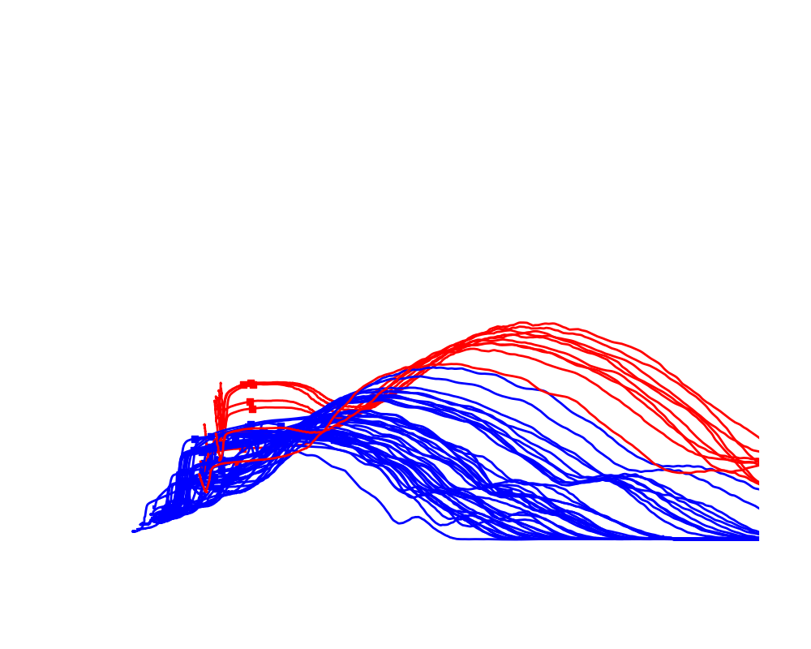
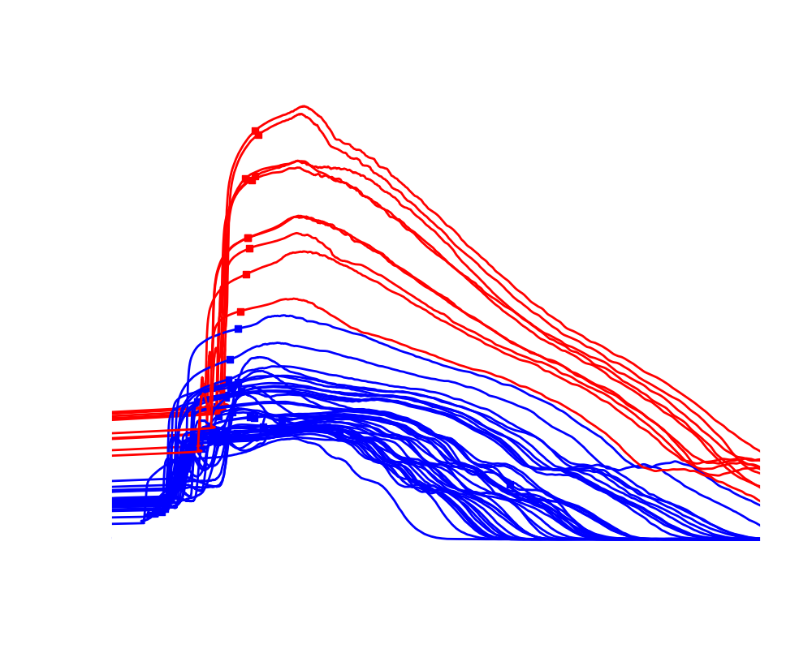
Results: the effect of ν-driven convection
= ξ_{2.5} ≥ 0.3 = 22 M☉ $≲$ M $≲$ 25 M☉

Slide 16
Explodability depends on many variables…
= explosion
= failed SN
Ertl 2016
KEPLER & PHOTB
1D+STIR
KEPLER & GR1D
…the model used to trigger the explosion…
1D+STIR
FRANEC & GR1D
…the code used to evolve the star…
1D+STIR
FRANEC & GR1D
new ¹²C fusion rate^{(*)}
…the reaction rates for key processes…
(*) = Tumino et al. (2018)

Slide 17
Part 3: Effect of the EOS on the explosion
Boccioli et al. (2022) ApJ, 926, 147

Slide 18
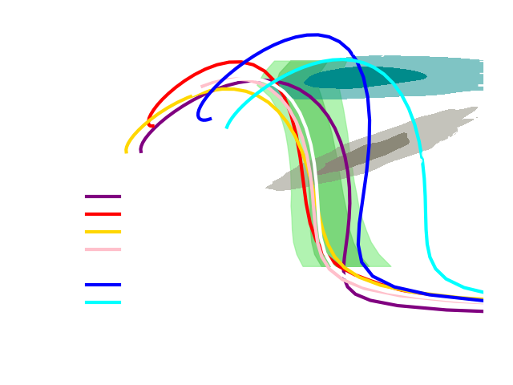
3) Details of the EOS used
Skyrme-type: compressible liquid-drop model
- LS220
- APR
- KDE0v1
- SLy4
RMF-type: relativistic mean field model
- SFHo
- DD2
- HShen

Slide 19
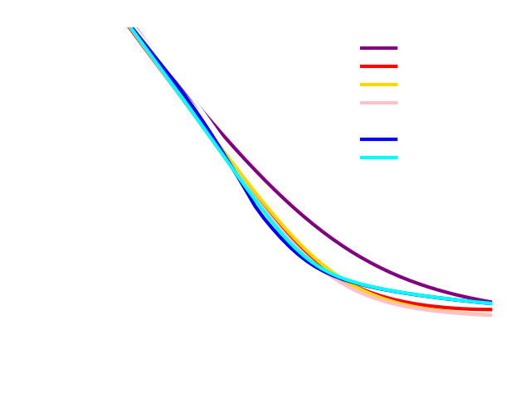
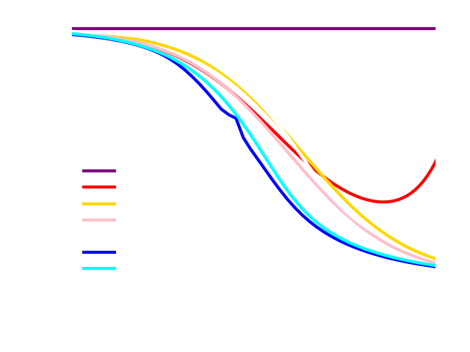
3) Details of the EOS used

Slide 20
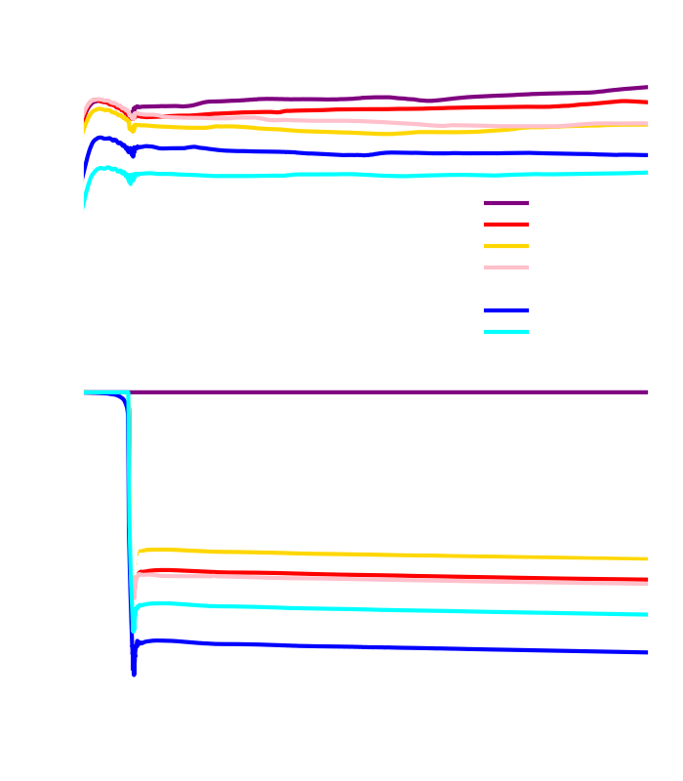
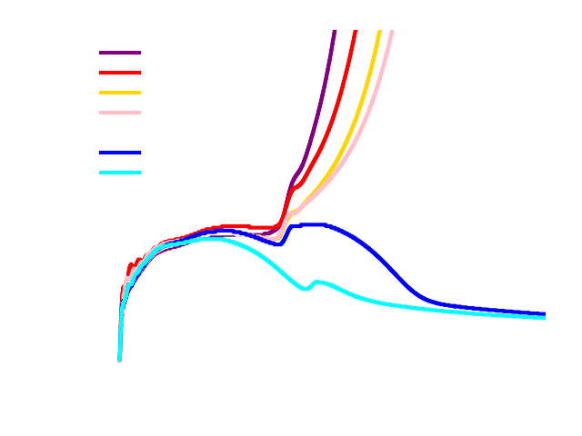
3) Results: the role of entropy and $m_{n}^{∗}$
Schneider (2019) and Yasin (2020) see a correlation between$m_{n}^{∗}$ and explosion for Skyrme EOSs.
We see a correlation between central entropy (but NOT $m_{n}^{∗}$ ) and explosion for different EOSs.

Slide 21
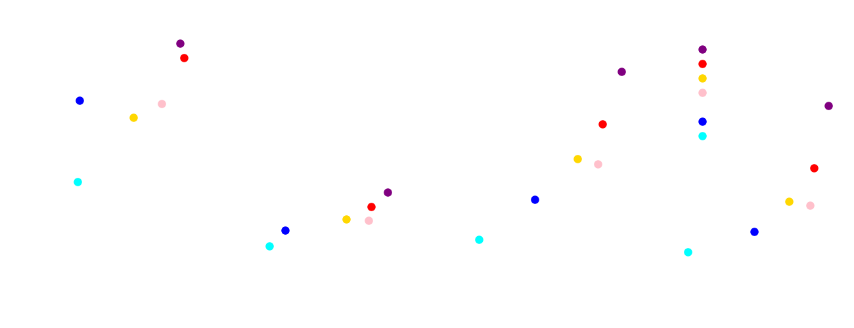
3) Results: the role of entropy and $m_{n}^{∗}$

Slide 22
2) Dynamical Approach: an example
Burrows & Goshy (1993)
Larger ν-Luminosities provide more heating behind the shock
Smaller accretion rates result in smaller ram pressure
Accretion rates that are too small will produce small ν-Luminosities

Slide 23
2) Dynamical Approach: the Force Explosion Condition
Force equation to determine the Explosion
Neutrino Optical depth in the gain region
Neutrino Opacity in the gain region
Neutrino Luminosity
${\tilde{L}}_{ν}τ_{g}−0.06 \tilde{κ}>$ 0.38
Neutrino heating in the gain region
${\tilde{\dot{Q}}}_{ν}−0.06 \tilde{κ}>$ 0.38

Slide 24
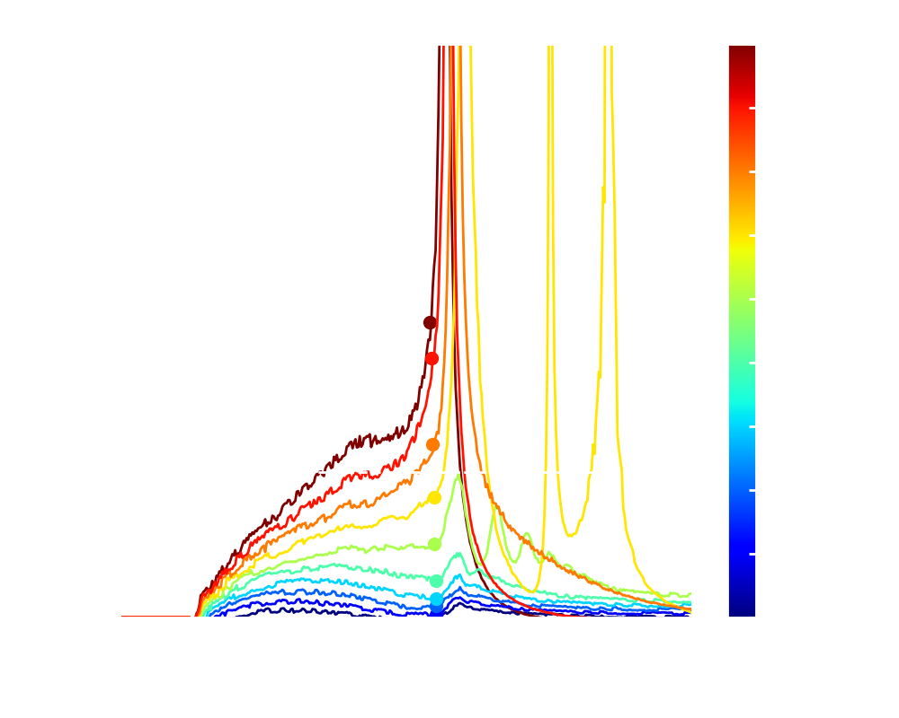
2) Dynamical Approach: the Force Explosion Condition
${\tilde{L}}_{ν}τ_{g}−0.06 \tilde{κ}>$ 0.38
${\tilde{\dot{Q}}}_{ν}−0.06 \tilde{κ}>$ 0.38
Adapted from Gogilashvili et al. (2023)

Slide 25
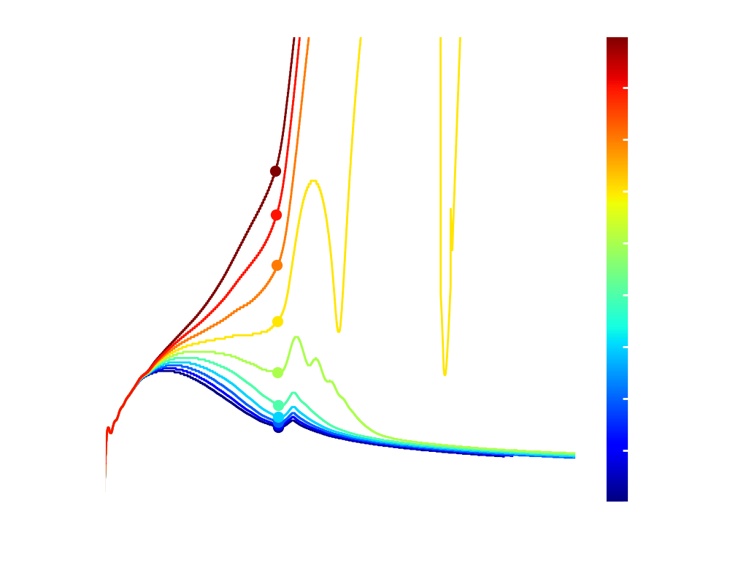
2) Dynamical Approach: the Force Explosion Condition

Slide 26
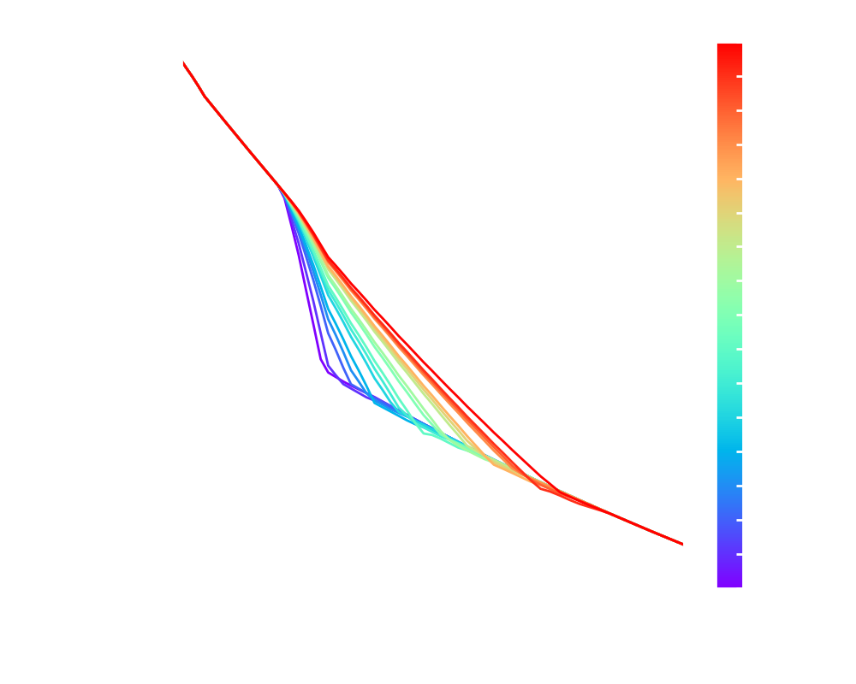
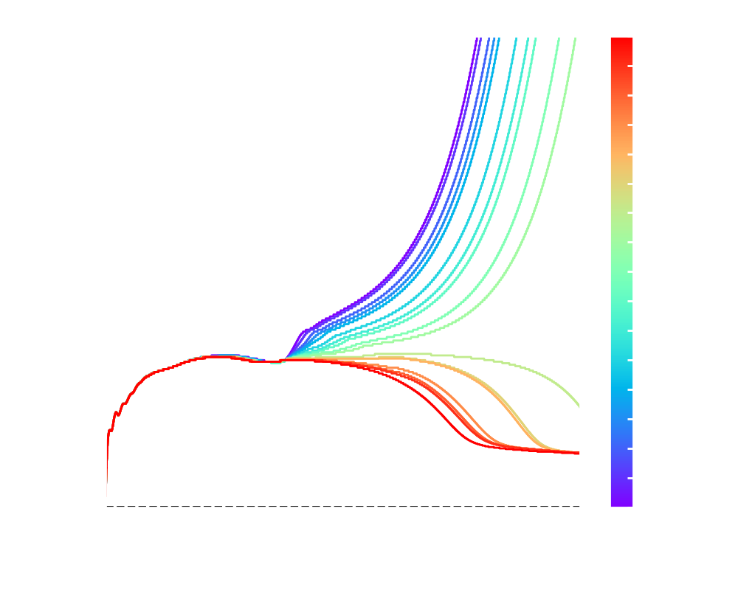
2) Dynamical Approach: connection with the Si/O interface
Preliminary
Preliminary

Slide 27
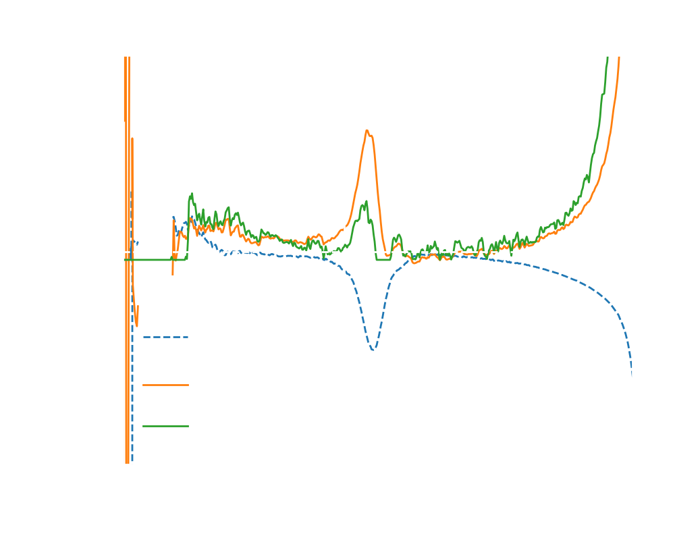
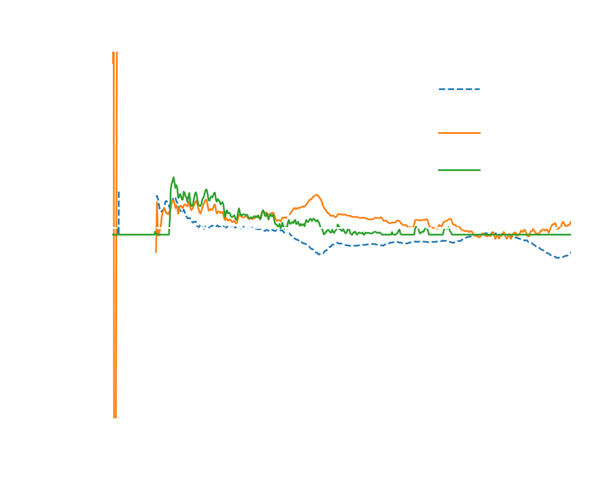
2) Dynamical Approach: connection with the Si/O interface
Preliminary
Preliminary

