Slide 1






Microphysics In Computational Relativistic Astrophysics, ECT* Trento, 11-15.9.2023
Stellar weak interaction processes at finite temperature
in the relativistic energy density functional theory
N. Paar
Department of Physics
Faculty of Science
University of Zagreb, Croatia

Slide 2
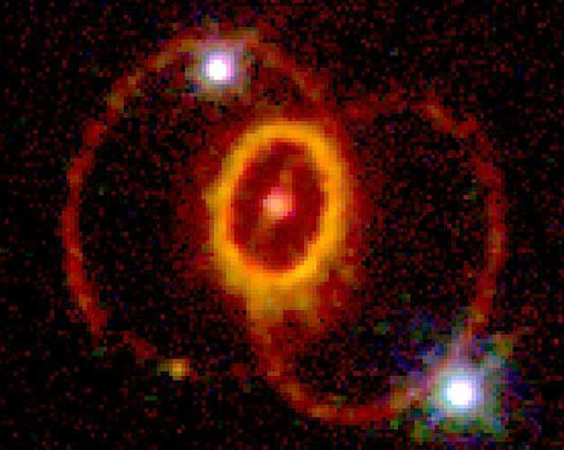
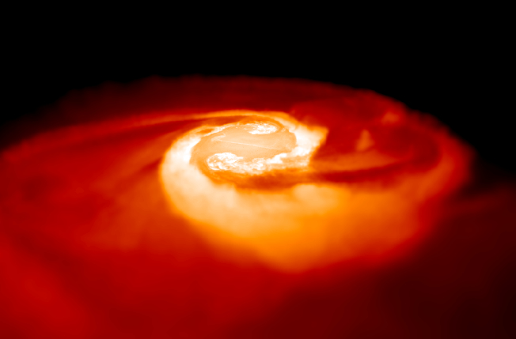
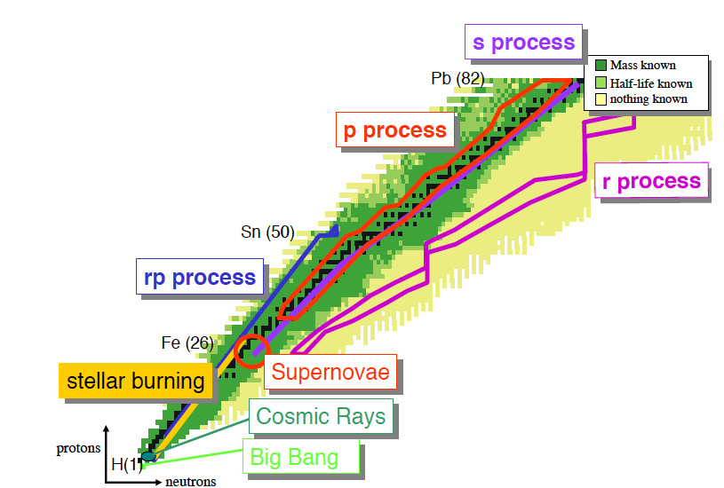
INTRODUCTION
Nuclear physics properties and processes are important for understanding the evolution of stars and nucleosynthesis (e.g., supernovae, neutron star mergers,…)
Astrophysically relevant nuclear processes, e.g.,
  electron capture
  beta decay
  beta-delayed neutron emission
  neutrino-nucleus reactions
  neutron capture
  photodissociation
  fission
  …
Many nuclear properties involved are beyond reach for the experiment. Consistent microscopic theory is required.
Nuclei in stellar environments are hot. Their properties and processes at finite temperature
are different than at zero temperature
From: SPES project
Weak interaction
processes
(UNEDF)
How binding energy, nuclear structure, nuclear processes change with temperature?
(UNEDF)

Slide 3
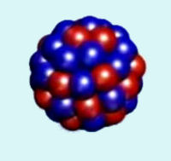
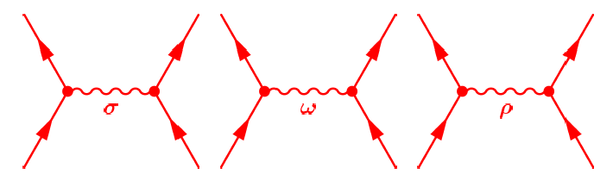
THEORY FRAMEWORK
RELATIVISTIC NUCLEAR ENERGY DENSITY FUNCTIONAL (EDF)
Include density dependent vertex functions. The model parameters are constrained directly by many-body observables (masses, charge radii, pseudo-data, excitations, …)
Nuclear (ground state) properties - relativistic self-consistent mean-field framework for atomic nuclei - Relativistic Hartree Bogoliubov (RHB) model T. Niksic et al., Comp. Phys. Comm. 185, 1808 (2014).
Nuclear excitations - In the small amplitude limit, self-consistent relativistic quasiparticle random phase approximation (RQRPA)
Finite temperature effects are included in the finite-temperature RHB+RQRPA models
E. Yuksel, N.P., G. Colo, E. Khan, and Y. F. Niu, PRC 101, 044305 (2020).
A. Ravlić, E. Yuksel, T. Nikšić, N.P., Nature Communications 14, 4834 (2023),
i) Nucleons are Dirac particles coupled ii) Four-fermion contact interaction
by the exchange mesons and the photon field T (Point-coupling model)
σ
ω
ρ
→ static and dynamic properties of atomic nuclei across the nuclide map

Slide 4
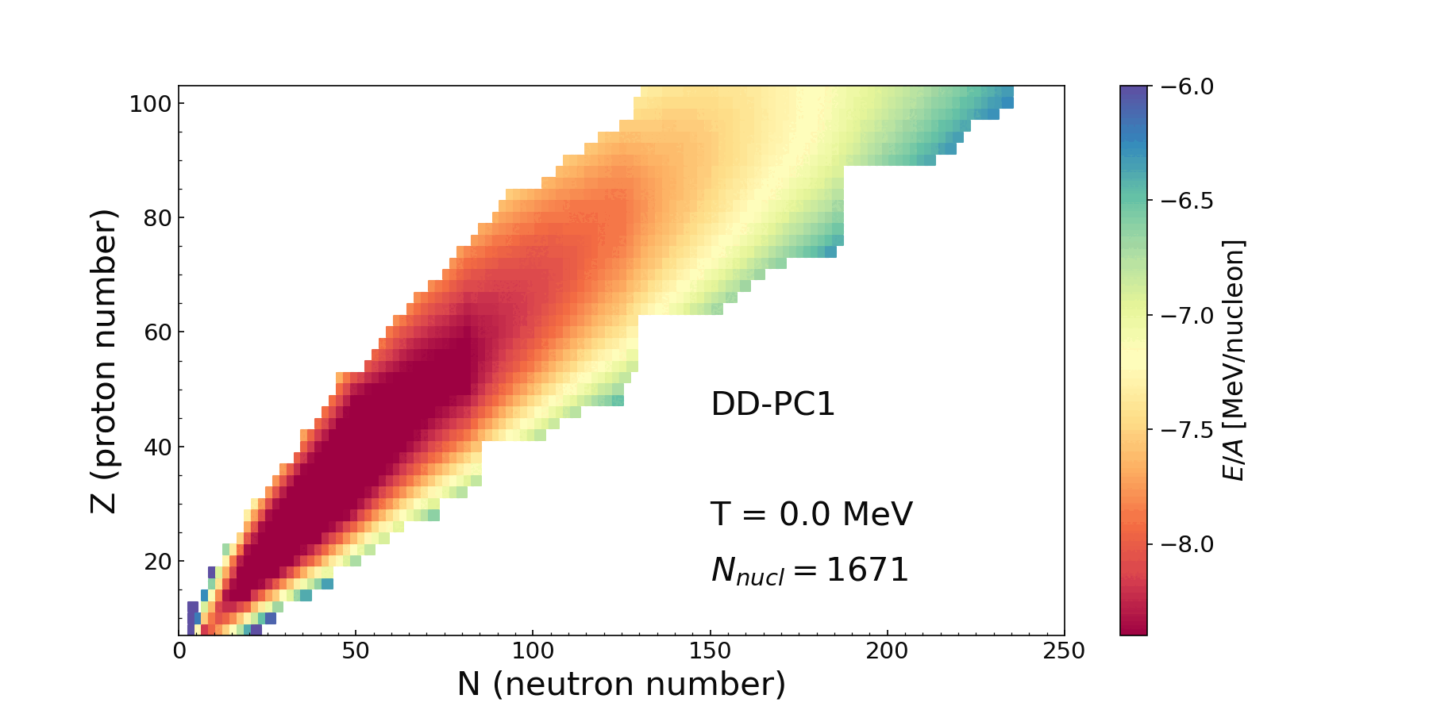
GLOBAL NUCLEAR PROPERTIES AT FINITE TEMPERATURE
How the nuclear properties evolve with increasing temperature across the nuclide chart?
Relativistic Hartree-Bogoliubov (RHB) model with finite temperature
Including the nuclear deformation, pairing correlation effects, and treatment of nucleon states in the continuum.
NUCLIDE CHART AT FINITE TEMPERATURE
The evolution of
nuclear binding
energies for
temperatures
T = 0 - 2 MeV
(0 - 2.3*10¹⁰ K)
A. Ravlić, E. Yuksel, T. Nikšić, N.P., Nature Communications 14, 4834 (2023),

Slide 5
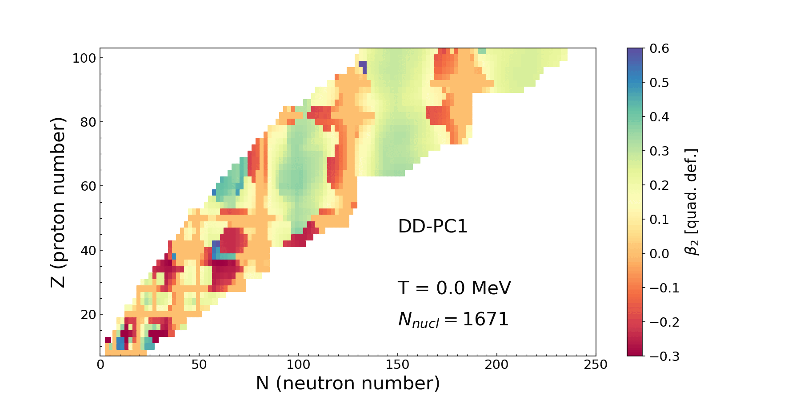
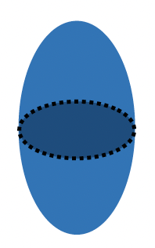


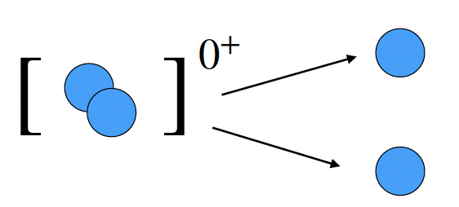
GLOBAL NUCLEAR PROPERTIES AT FINITE TEMPERATURE
The temperature evolution of the isoscalar quadrupole deformation β2 for T = 0 - 2 MeV,
calculated with the DD-PC1 functional
With temperature increase, shape-phase transitions occur from deformed nuclei toward spherical shapes.
At critical temperature a phase transition occurs from the superfluid to a normal state

Slide 6
EXPANDING THE LIMITS OF NUCLEAR EXISTENCE WITH TEMPERATURE
How the nuclear drip lines evolve with temperature?
Two-neutron separation energy
Two-proton separation energy
Increase of the number of bound nuclei in the nuclide map due to thermal quenching of the shell effects
The drip-lines are changing dynamically with the temperature increase
A. Ravlić, E. Yuksel, T. Nikšić, N.P., Nature Communications 14, 4834 (2023),

Slide 7
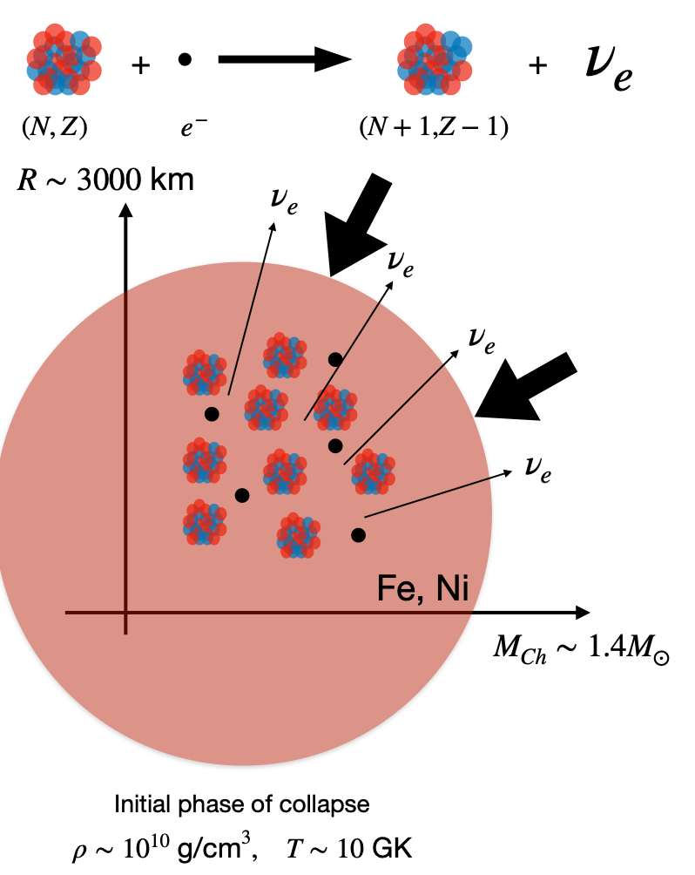
STELLAR ELECTRON CAPTURE
The core of a massive star at the end of hydrostatic burning is stabilized by electron degeneracy pressure
Electron capture (on protons and nuclei) reduces the number of electrons available for pressure support, initiates the gravitational collapse of the core of a massive star, triggering a supernova explosion
Weak interaction process, occurs at finite temperature and at various densities depending on the stage of the stellar evolution
Finite-temperature proton-neutron relativistic QRPA (FT-PNRQRPA) is used for the description of relevant nuclear charge-exchange transitions
Electron capture cross sections
  A. Ravlić, E. Yuksel, Y. F. Niu, G. Colo, E. Khan, N. P., PRC 102, 065804 (2020).

Slide 8
STELLAR ELECTRON CAPTURE CROSS SECTIONS AND RATES
Electron capture rates are obtained by folding
the cross section with Fermi-Dirac distribution for electrons
Electron capture is nuclear weak interaction process
Weak interaction Hamiltonian:
Fermi golden rule to obtain the cross section:
Transition matrix elements are calculated
using finite temperature relativistic proton-neutron QRPA (FT-PNRQRPA)
  A. Ravlić, E. Yuksel, Y. F. Niu, G. Colo, E. Khan, N. P,
  PRC 102, 065804 (2020).

Slide 9
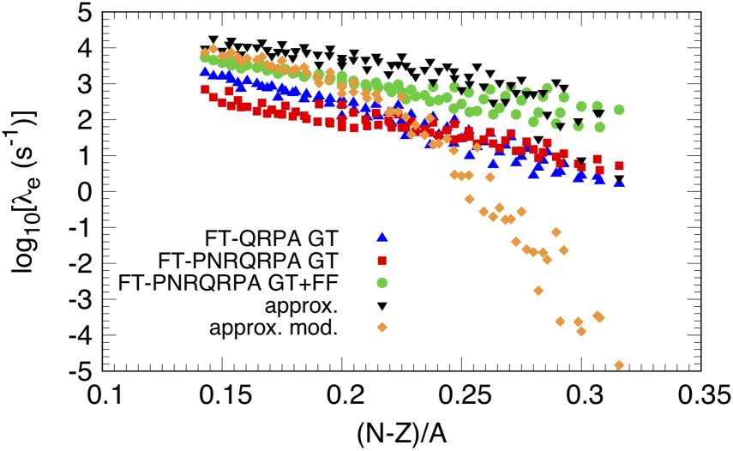
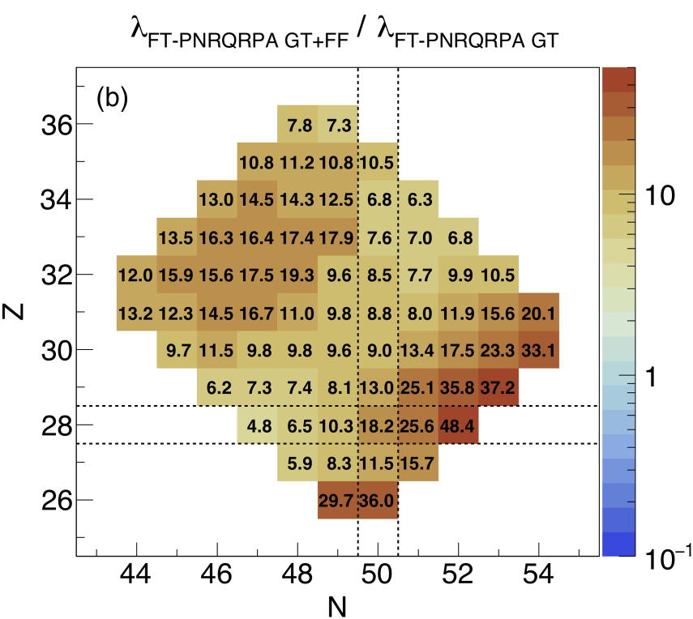
ELECTRON CAPTURE RATES AROUND N=50 SHELL CLOSURE
Diamond region around N=50 shell closure relevant for core collapse supernova
Complete calculation includes Gamow-Teller and forbidden transitions
Comparison of the electron capture rates calculated using relativistic and nonrelativistic energy density functionals
→ Only our FT-PNRQRPA calculation is complete (GT+forbidden transitions)
S. Giraud, E. M. Ney, A. Ravlić, R. G. T. Zegers, J. Engel, N. P. et al., PRC 105, 055801 (2022)

Slide 10
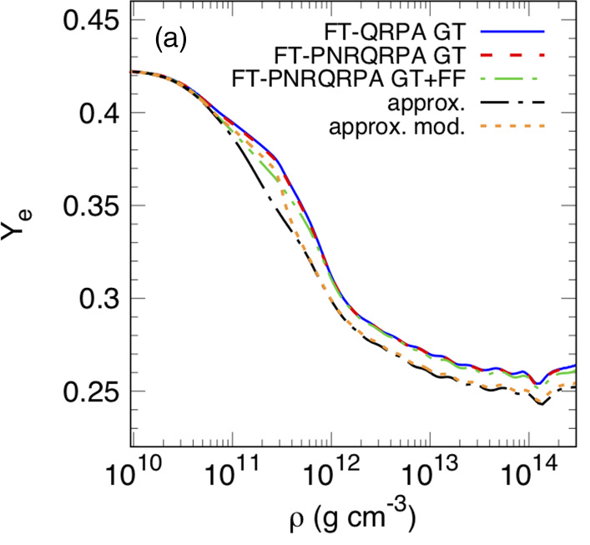
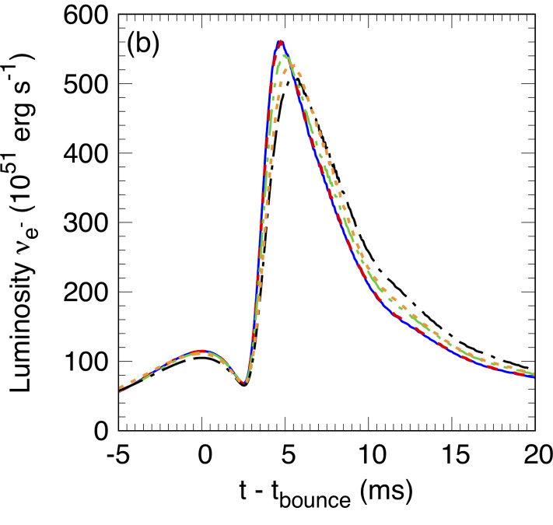
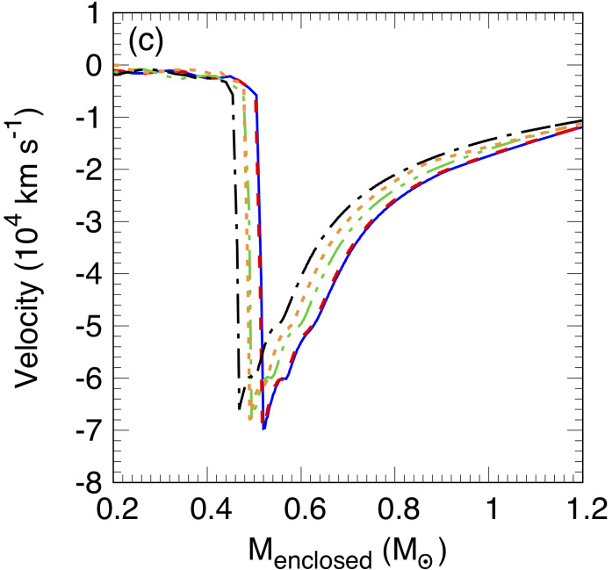
CORE-COLLAPSE SUPERNOVA SIMULATION RESULTS
Initial test case for the new electron capture rates in N=50 diamond region
core collapse supernova simulation with spherically symmetric code GR1D
E. O’Connor, Astrophys. J. Suppl. Ser. 219, 24 (2015).
C. Sullivan, E. O’Connor, R. G. T. Zegers, T. Grubb, and S. M. Austin, Astrophys. J. 816, 44 (2015).
s15WW95 progenitor S. E. Woosley and T. A. Weaver, Astrophys. J. Suppl. 101, 181 (1995).
SFHo equation of state A.W. Steiner, M. Hempel, and T. Fischer, Astrophys. J. 774, 17 (2013).
The electron-fraction Y_{e}
as a function of central
baryon density ρ
The electron neutrino luminosity
at a radius of 500 km as a
function of time after bounce,
The central velocity as a function of the enclosed mass.
S. Giraud, E. M. Ney, A. Ravlić, R. G. T. Zegers, J. Engel, N. P. et al., PRC 105, 055801 (2022)

Slide 11
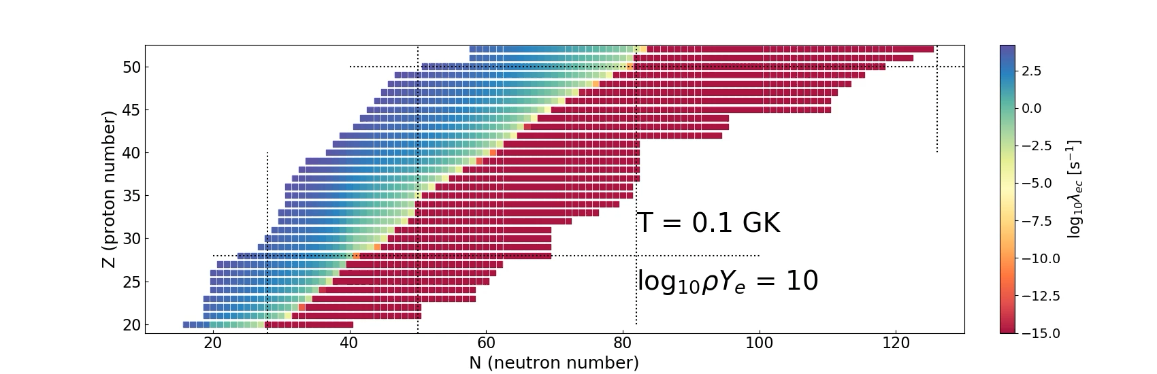
SYSTEMATIC CALCULATIONS OF STELLAR ELECTRON CAPTURE RATES
Completing the large-scale calculations of electron capture rates (EC) in the relativistic energy density functional approach using the FT-PNRQRPA
Covering astrophysically relevant range of temperature and densities
For example, for ⍴Ye=10¹⁰ g/cm³ :
Future applications of these EC rates in state-of-the-art core collapse supernova simulations are called for

Slide 12
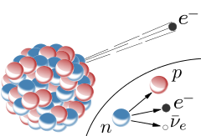
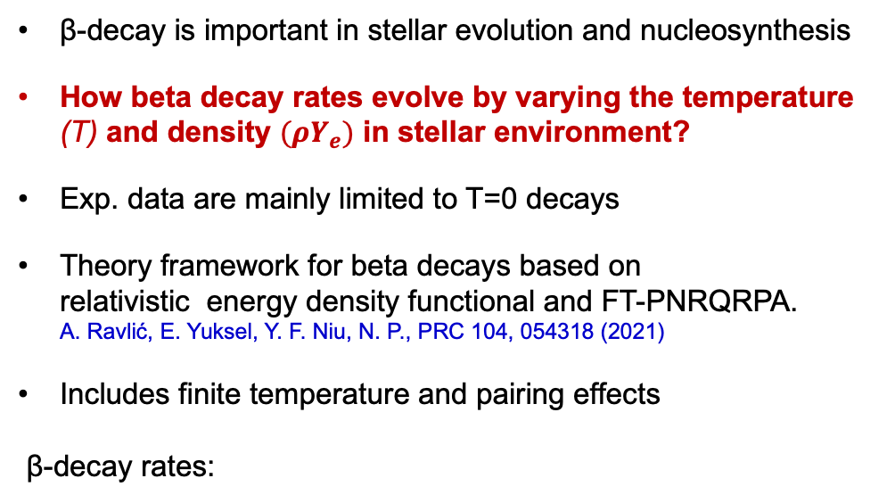

STELLAR BETA-DECAY RATES AT FINITE TEMPERATURE
β-decay is important in stellar evolution and nucleosynthesis
How beta decay rates evolve by varying the temperature (T) and density $(ρY_{e})$ in stellar environment?
Exp. data are mainly limited to T=0 decays
Theory framework for beta decays based on relativistic energy density functional and FT-PNRQRPA. A. Ravlić, E. Yuksel, Y. F. Niu, N. P., PRC 104, 054318 (2021)
Includes finite temperature and pairing effects
β-decay rates:
Fermi-Dirac distribution
for outgoing electrons
electron
energy and
momentum
Fermi
function
Shape factor
(=B(GT) for allowed
transitions)
$$T_{1/2}=\frac{ln⁡(2)}{λ}$$
Half-life
Benchmarking the model with the
experimental data at zero temperature.

Slide 13
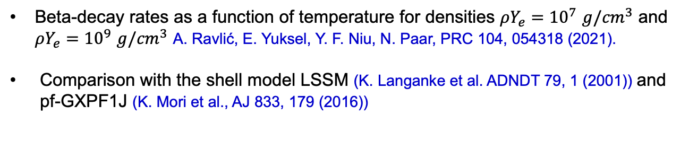
EVOLUTION OF BETA-DECAY RATES IN STELLAR ENVIRONMENT
Beta-decay rates as a function of temperature for densities $ρY_{e}={10}^{7}$ $g/{cm}^{3}$ and $ρY_{e}={10}^{9}$ $g/{cm}^{3}$ A. Ravlić, E. Yuksel, Y. F. Niu, N. Paar, PRC 104, 054318 (2021).
Comparison with the shell model LSSM (K. Langanke et al. ADNDT 79, 1 (2001)) and pf-GXPF1J (K. Mori et al., AJ 833, 179 (2016))

Slide 14
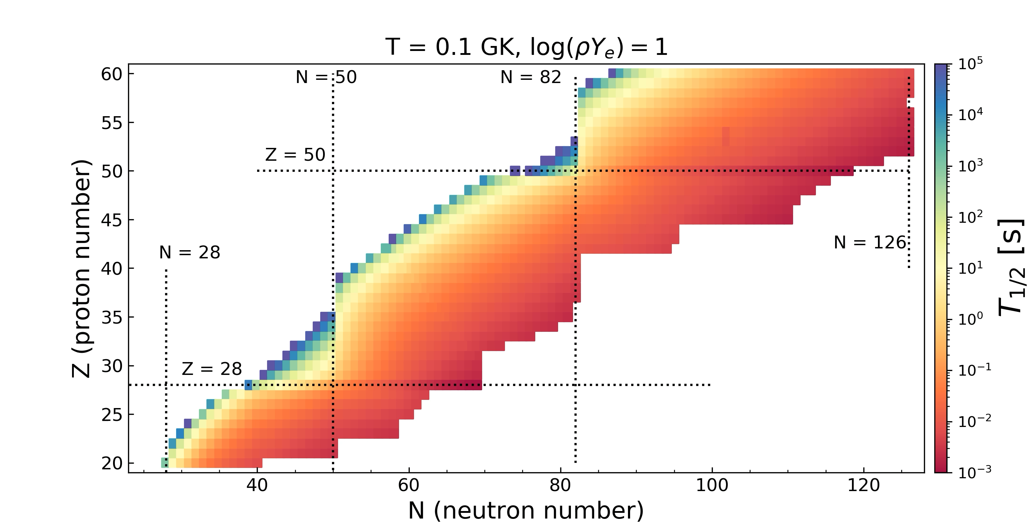
EVOLUTION OF BETA-DECAY HALF LIVES WITH TEMPERATURE INCREASE
Largest impact of temperature effect on nuclei with long half-lives at T=0
With temperature increase more nuclei start to decay (initially with long T_{1/2})
For most of nuclei half-lives decrease with increase of temperature

Slide 15
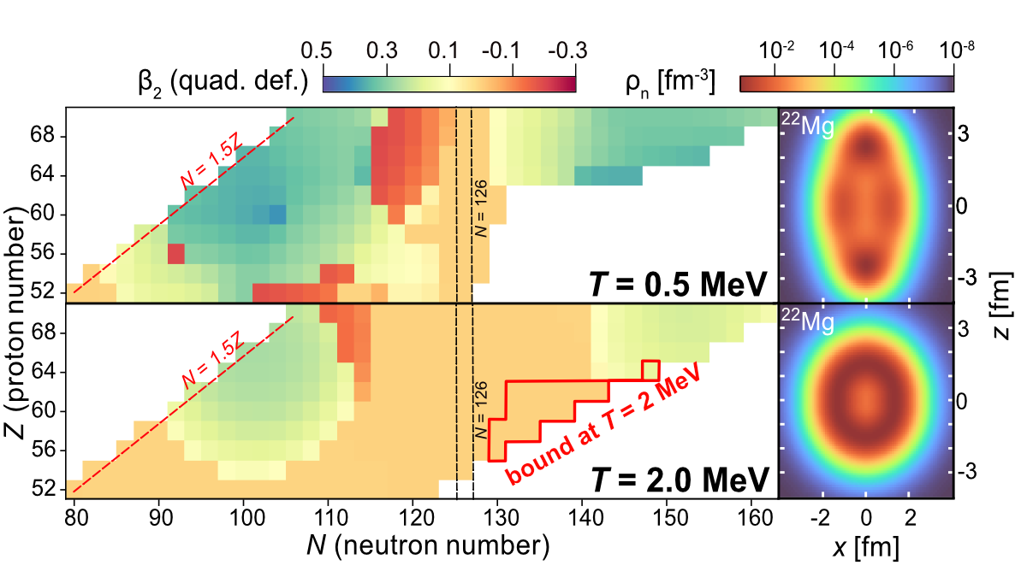
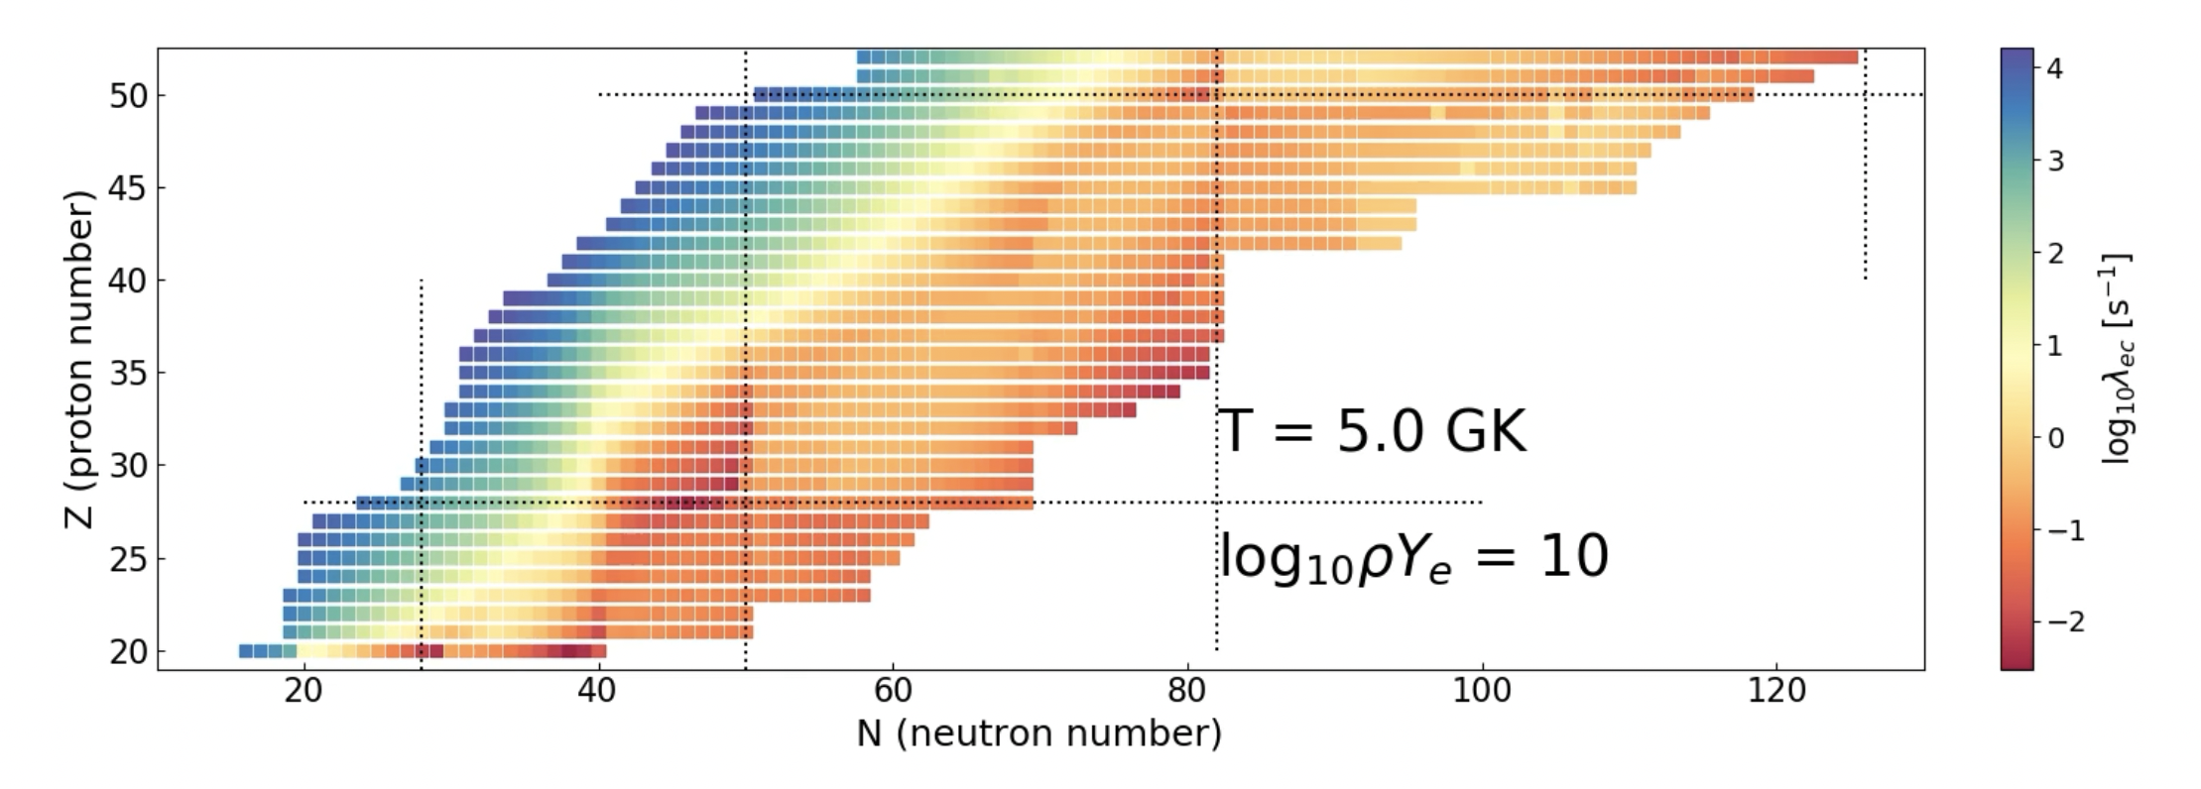
CONCLUDING REMARKS
We have established a new microscopic relativistic framework for the description of nuclear properties and weak interaction processes at finite temperature (FT-RHB, FT-PNRQRPA)
With temperature increase nuclei exhibit significant changes in their structure and excitation properties and weak processes – the interplay of temperature, pairing, deformation effects
The electron capture and beta decay rates along nuclide map at stellar temperatures and densities, including nuclear binding energies at finite temperature will be published as tables (end of 2023.)
Possible applications in astrophysical simulations and nucleosynthesis calculations
THANKS TO COLLABORATORS
A. Ravlić (MSU, Zagreb), T. Nikšić, A. Kaur, S. Kucuksucu (Zagreb)
E. Yuksel (Surrey), Y. F. Niu (Lanzhou), G. Colo (Milano), E. Khan (Orsay),
R. G. T. Zegers and S. Giraud (MSU/NSCL/FRIB)

Slide 16



This work was supported by the QuantiXLie Centre of Excellence, a project co-financed by the Croatian Government and European Union through the European Regional Development Fund - the Competitiveness and Cohesion Operational Program (Grant KK.01.1.1.01.0004).
For more information please visit:
http://bela.phy.hr/quantixlie/hr/
https://strukturnifondovi.hr/
The sole responsibility for the content of this presentation lies with the Faculty of Science, University of Zagreb. It does not necessarily reflect the opinion of the European Union.

Slide 17
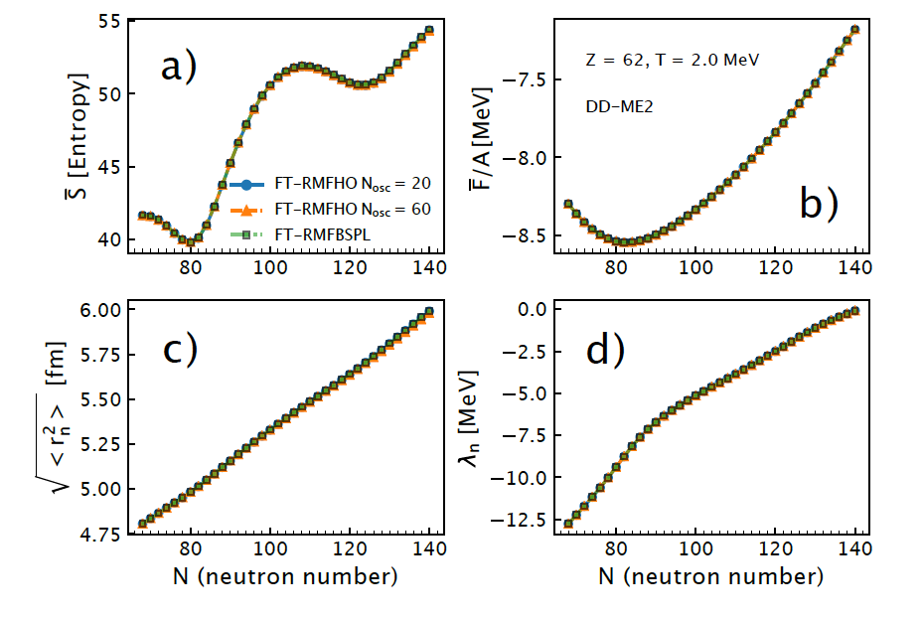
Test of the FT-RMFHO model in comparison to FT-RMFBSPL model

Slide 18
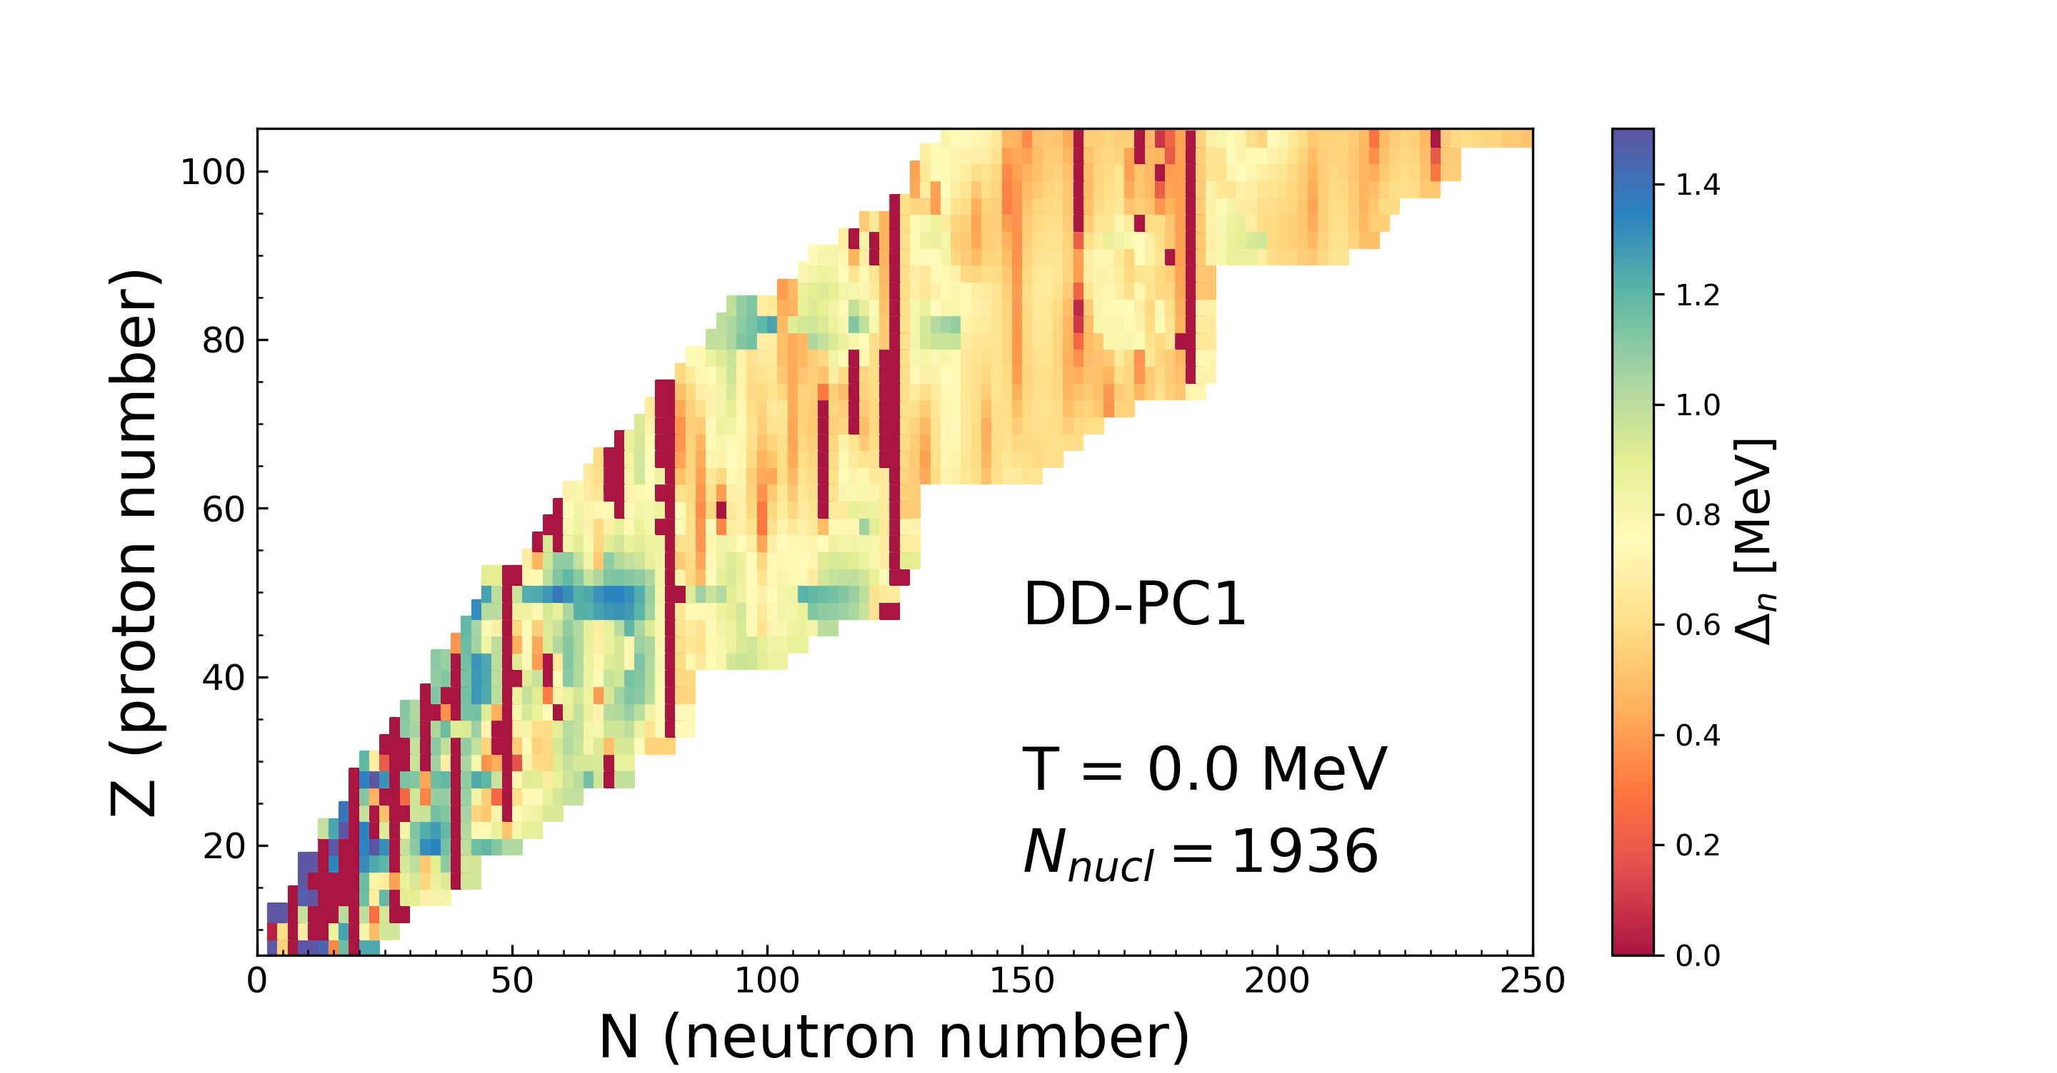
GLOBAL NUCLEAR PROPERTIES AT FINITE TEMPERATURE
The temperature evolution of nuclear pairing properties
→ neutron pairing gaps in the temperature range T = 0 – 1 MeV
At lower temperatures, interplay of the pairing and temperature effects.
At critical temperature a phase transition occurs from the superfluid to a normal state.

Slide 19
Impact of continuum subtraction on the position of the two-neutron drip-line

Slide 20
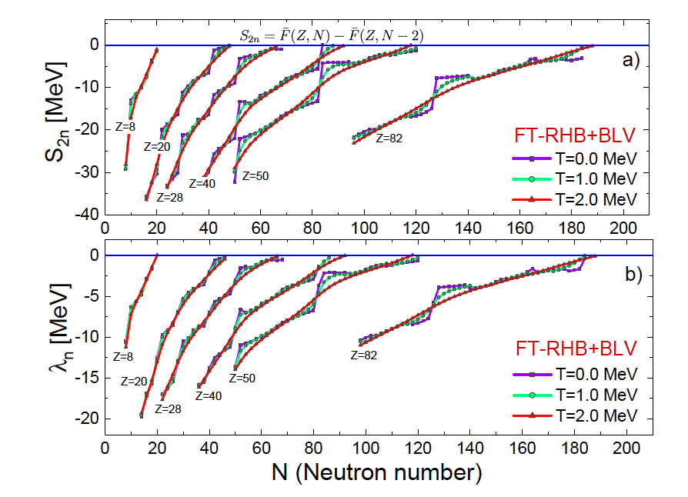
Isotopic dependence of two-neutron separation energy S_{2n} (a) and
neutron chemical potential λ_{n} (b)

Slide 21
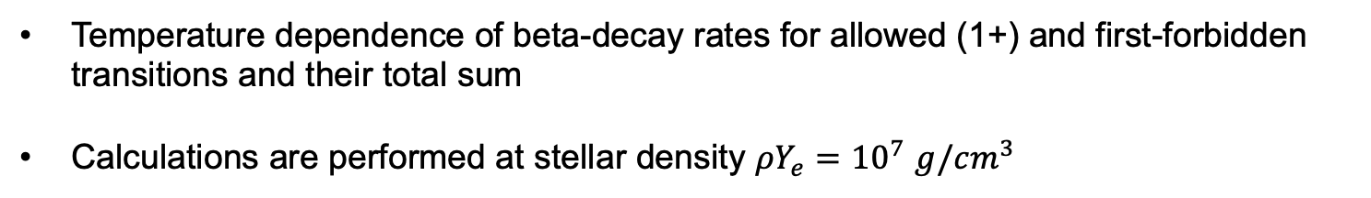
EVOLUTION OF BETA-DECAY RATES IN STELLAR ENVIRONMENT
Temperature dependence of beta-decay rates for allowed (1+) and first-forbidden transitions and their total sum
Calculations are performed at stellar density $ρY_{e}={10}^{7}$ $g/{cm}^{3}$
A. Ravlić, E. Yuksel, Y. F. Niu, N. Paar, PRC 104, 054318 (2021)

Slide 22
EVOLUTION OF BETA-DECAY HALF LIVES IN STELLAR ENVIRONMENT

Slide 23
Percentage change of the beta-decay half-lives at finite temperature $T_{9}\left(K\right)=5$ and 10 with respect to zero temperature for density $ρY_{e}={10}^{7}$ $g/{cm}^{3}$ and ${10}^{9}$ $g/{cm}^{3}$

