Slide 1
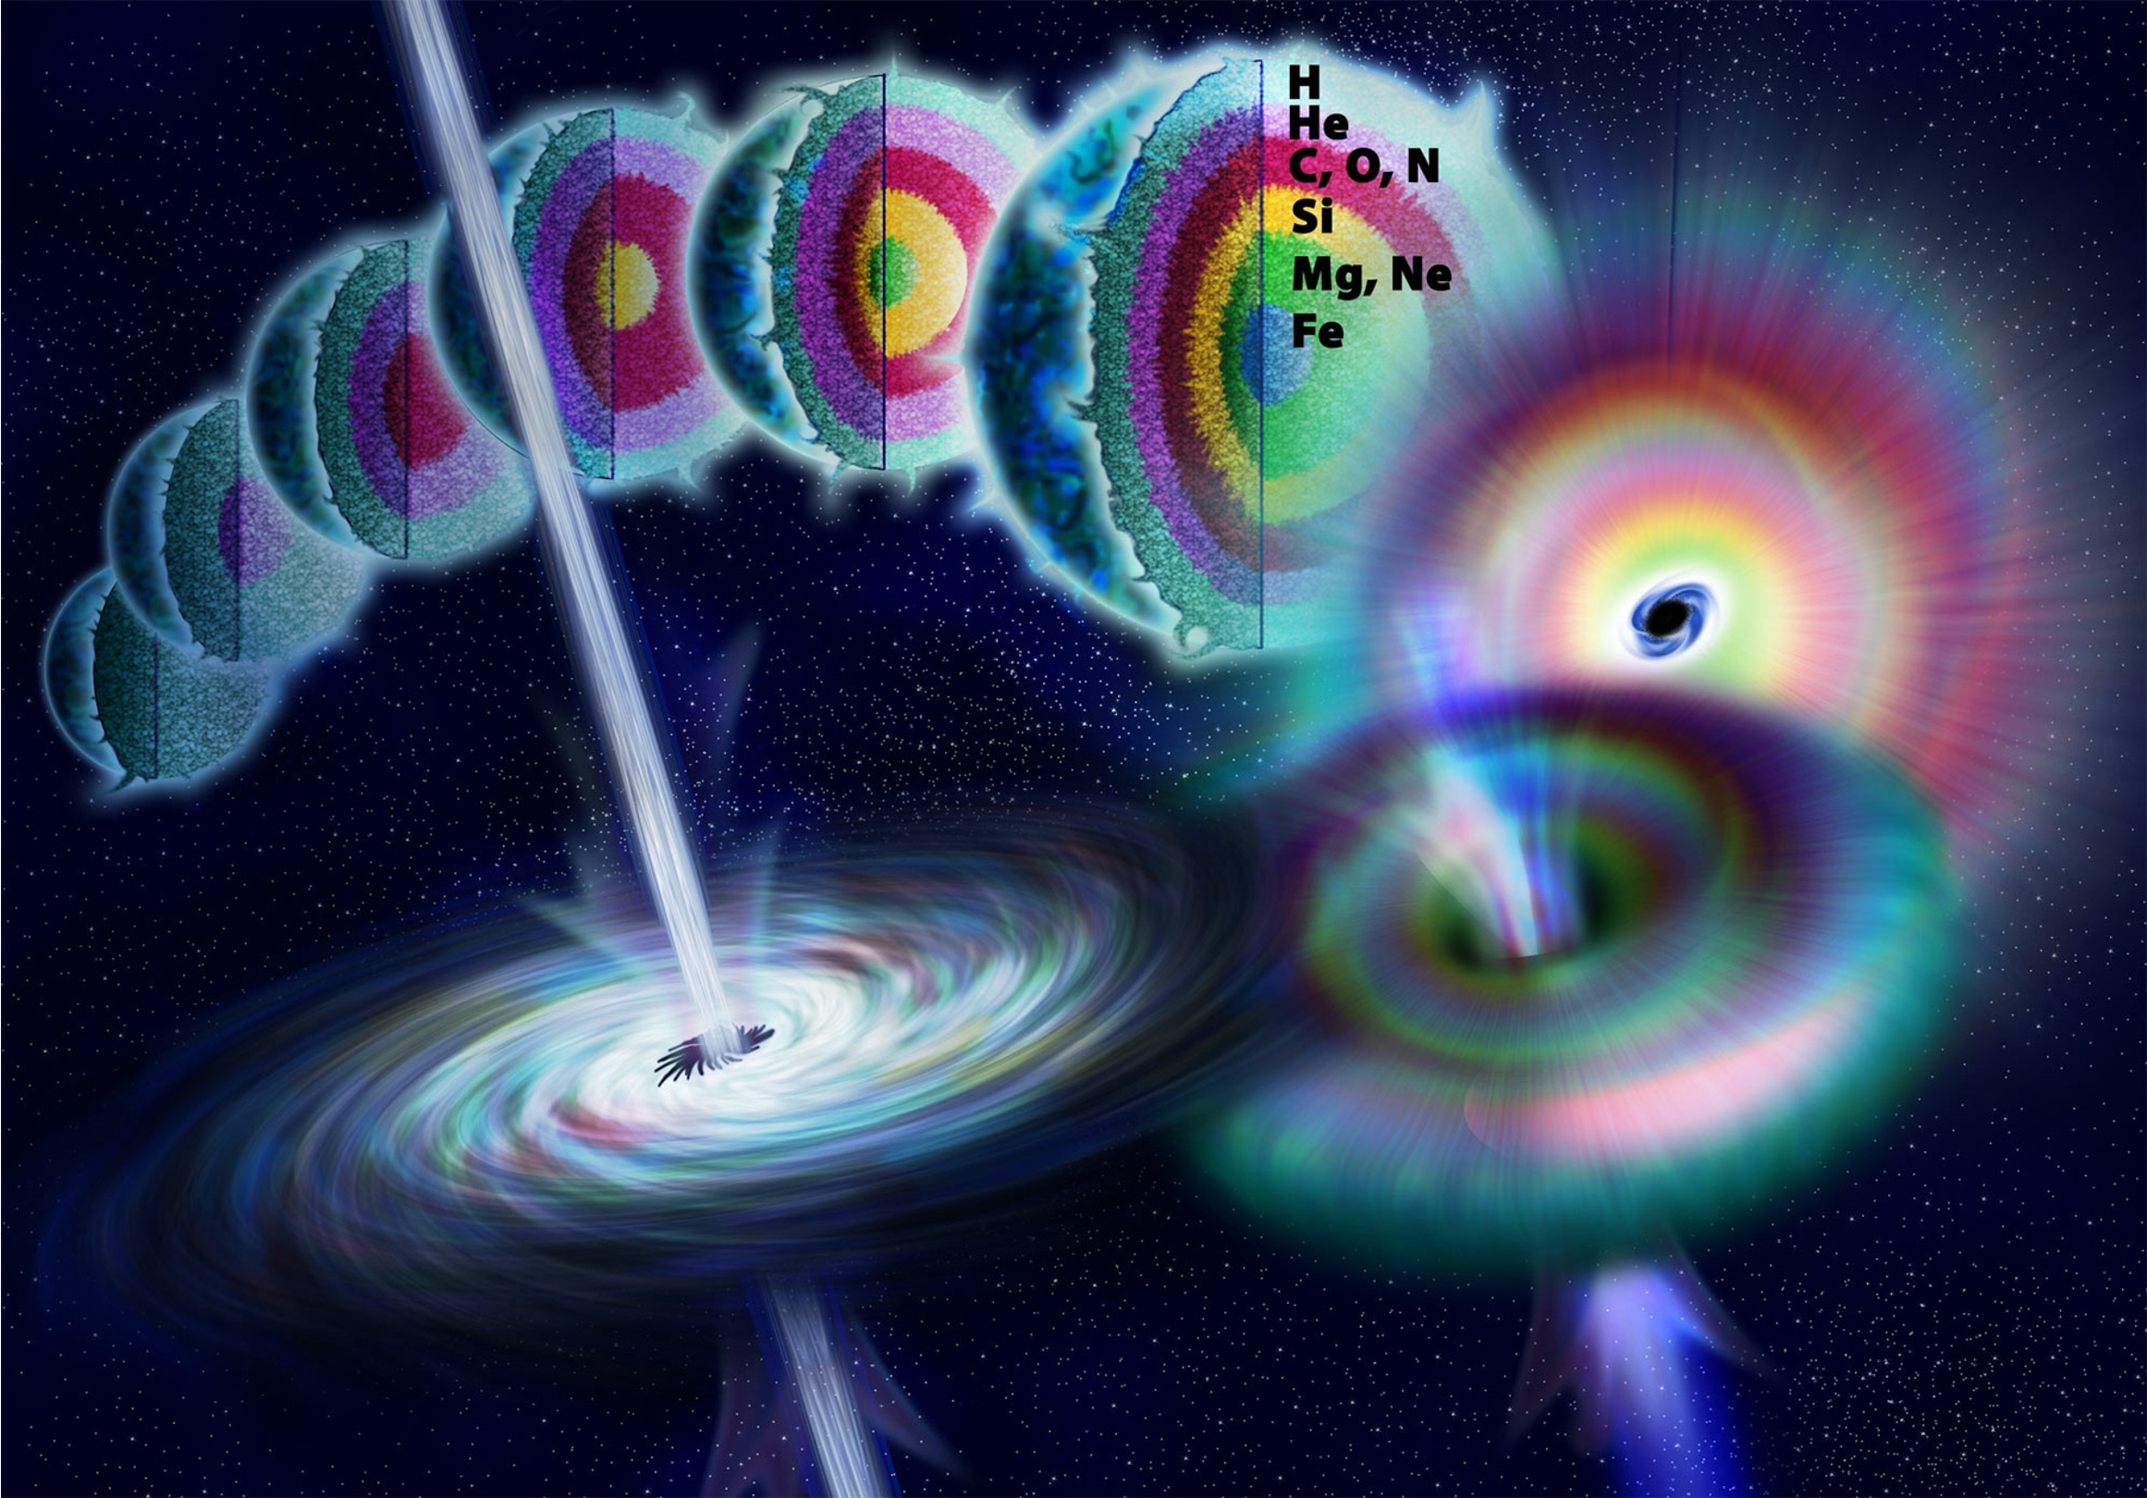
the stellar progenitors of long-duration gamma ray bursts
MICRA 2023
ECT*, Trento, IT
september 10, 2023
goni halevi
goni@northwestern.edu
CIERA postdoctoral fellow

Slide 2
(G. Halevi)
a brief overview of the collapsar model for lGRBs
(stripped) stellar envelope
gravitational collapse
iron core
a stripped massive star ends its life

Slide 3
(G. Halevi)
Ω
its core collapses to form a BH
its rotating envelope accretes onto the newly born BH
fallback accretion
BH

Slide 4
(G. Halevi)
BH
potentially forming an MRI-driven accretion disk

Slide 5
(G. Halevi)
which may launch an outflow enriched with the products of r-process nucleosynthesis
BH

Slide 6
(G. Halevi)
& power a relativistic jet through the BZ mechanism
BH

Slide 7
to be observed as an lGRB…

Slide 8
this jet has to tunnel through the star

Slide 9
end-to-end simulations of collapsars are challenging
scale separation: must resolve ~6 orders of magnitude in combined spatial+temporal ranges
need relativity and MHD to self-consistently launch a jet
intrinsically 3D problem (rotation, instabilities)
to predict nucleosynthetic properties, also need tabulated EoS, neutrino transport, and tracer particles
poorly constrained initial conditions for stellar progenitors

Slide 10
how does the initial stellar density profile affect lGRB properties?

Slide 11
Gottlieb et al. (2021)
jet power required? [erg/s]
(naïve) light curve evolution?
$$α≲0.5$$
$$≲{10}^{49}$$
$$0.5≲α≲1.5$$
$${10}^{49}−{10}^{52}$$
steepness of density profile ($α$)
$$α≳2$$
$$≳{10}^{52}$$
which jet properties are inconsistent with observations?
which physical conditions are consistent with observations?

Slide 12
10
20
30
40
explosion according to both tests
explosion according to Müller test
explosion according to Ertl test
implosion (collapsar progenitors?)
0.8
0.6
$$ξ_{M}=\frac{M/{M_{⊙}}}{R(M)/(1000km)}$$
compactness parameter $ξ_{2.5}$
0.4
0.2
initial mass [$M_{⊙}$]
choose realistic updated stellar evolution models for potential long GRB progenitors
Notes:
\xi_M = M/Msun / (R(Mbary=M)/1000 km)

Slide 13
Aguilera-Dena et al. (2021)
10
20
30
40
explosion according to both tests
explosion according to Müller test
explosion according to Ertl test
implosion (collapsar progenitors?)
40$M_{⊙}$
0.8
45$M_{⊙}$
18$M_{⊙}$
21$M_{⊙}$
0.6
compactness parameter $ξ_{2.5}$
35$M_{⊙}$
25$M_{⊙}$
0.4
0.2
13$M_{⊙}$
initial mass [$M_{⊙}$]
choose realistic updated stellar evolution models for potential long GRB progenitors
Notes:
\xi_M = M/Msun / (R(Mbary=M)/1000 km)

Slide 14
evolve each model with GR1D: relativistic hydro in 1.5D with M1 neutrino transport and a tabulated EoS

Slide 15
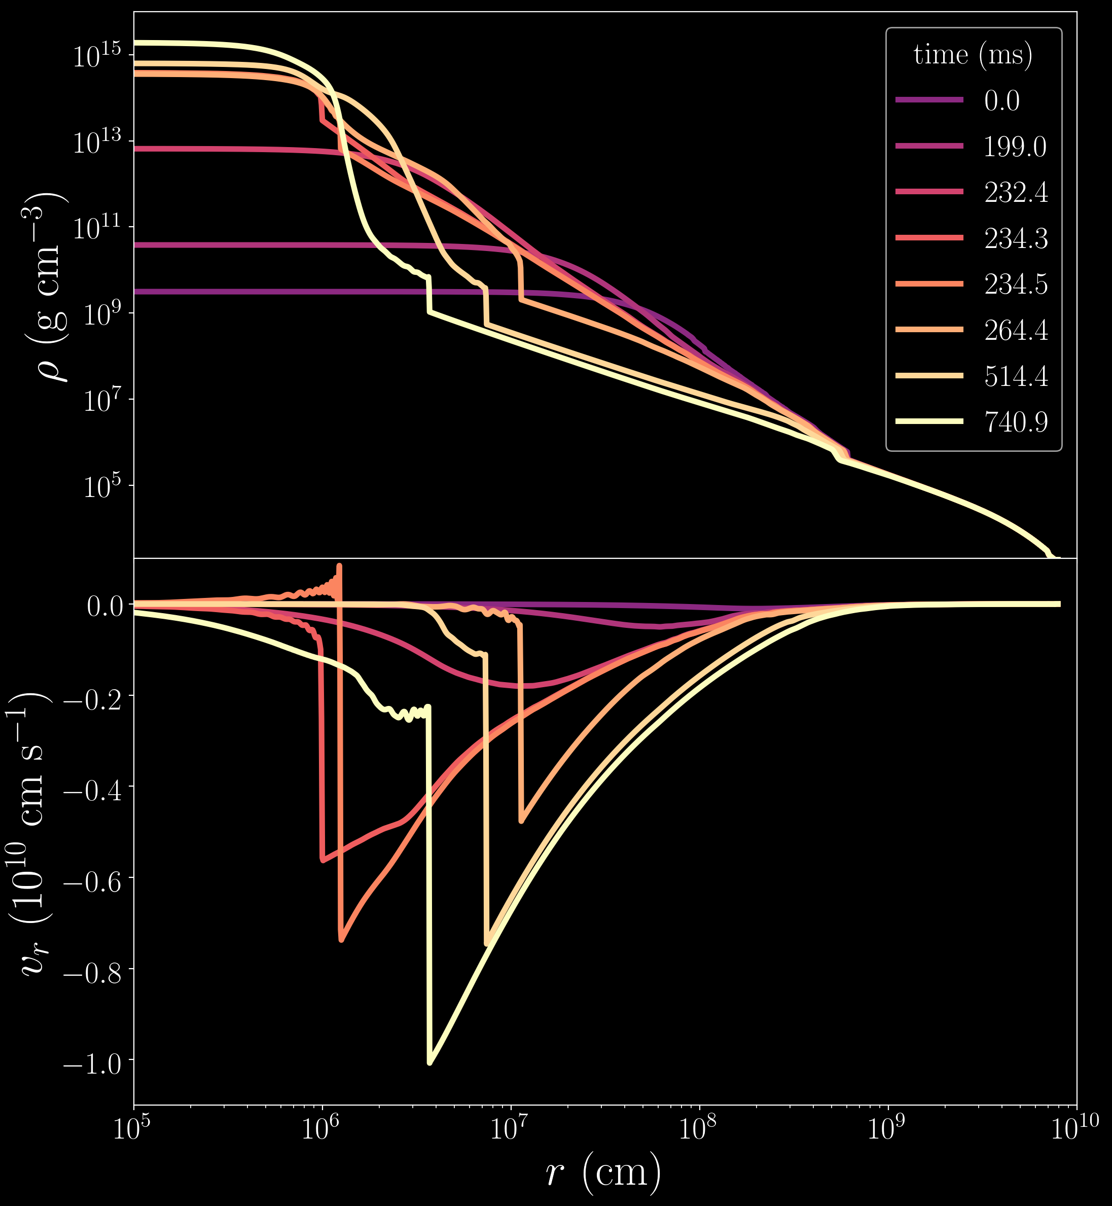
Halevi et. al. (2022)

Slide 16
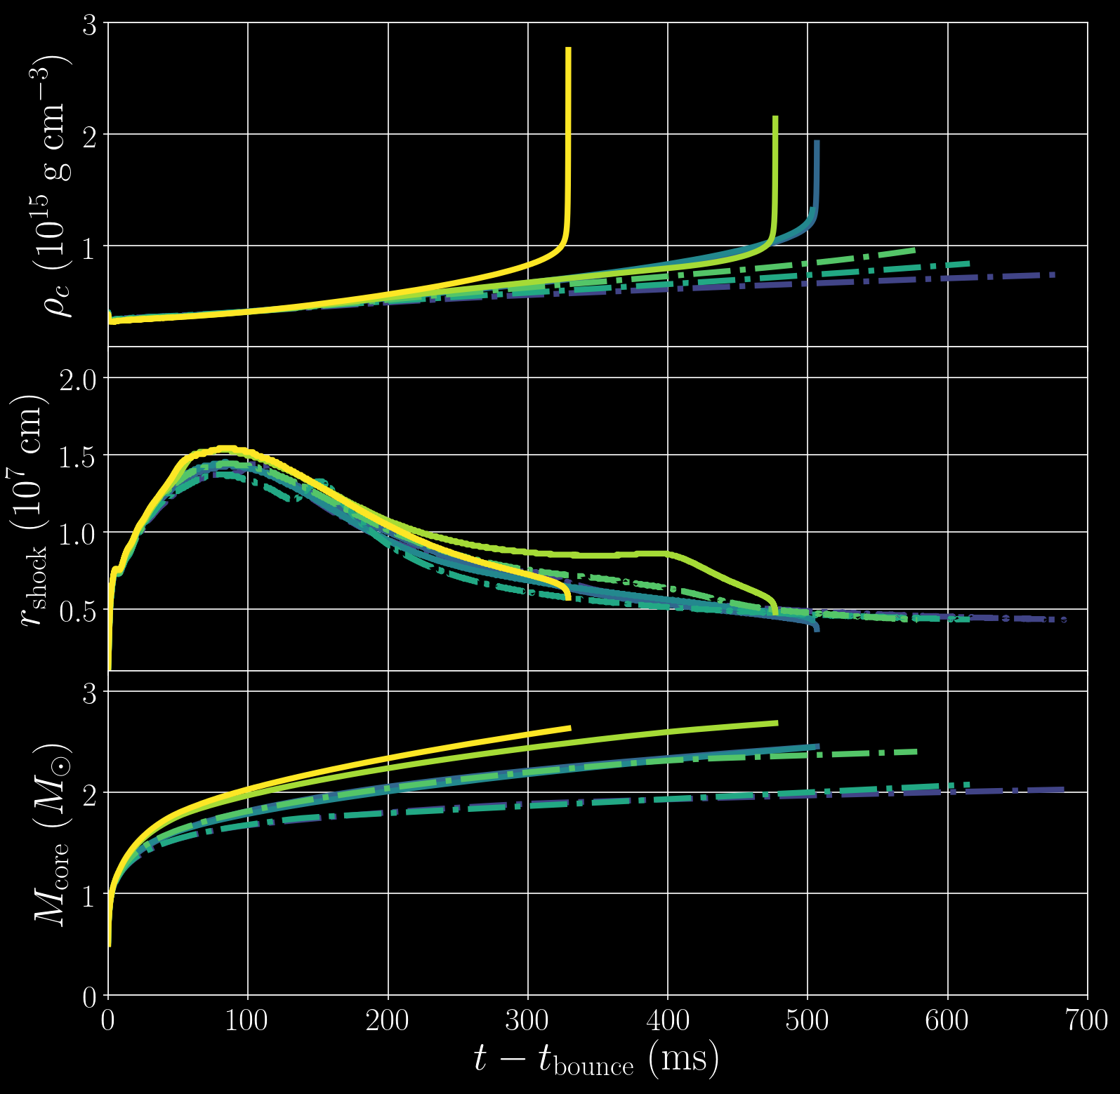
central density
(${10}^{15}g{cm}^{−3}$)
time after core bounce (ms)
shock radius
mass within shock radius

Slide 17
central density
(${10}^{15}g{cm}^{−3}$)
200
shock radius
(km)
150
100
50
time after core bounce (ms)
mass within shock radius

Slide 18
central density
(${10}^{15}g{cm}^{−3}$)
200
shock radius
(km)
150
100
50
mass within shock radius
($M_{⊙}$)
time after core bounce (ms)
Halevi et. al. (2022)

Slide 19
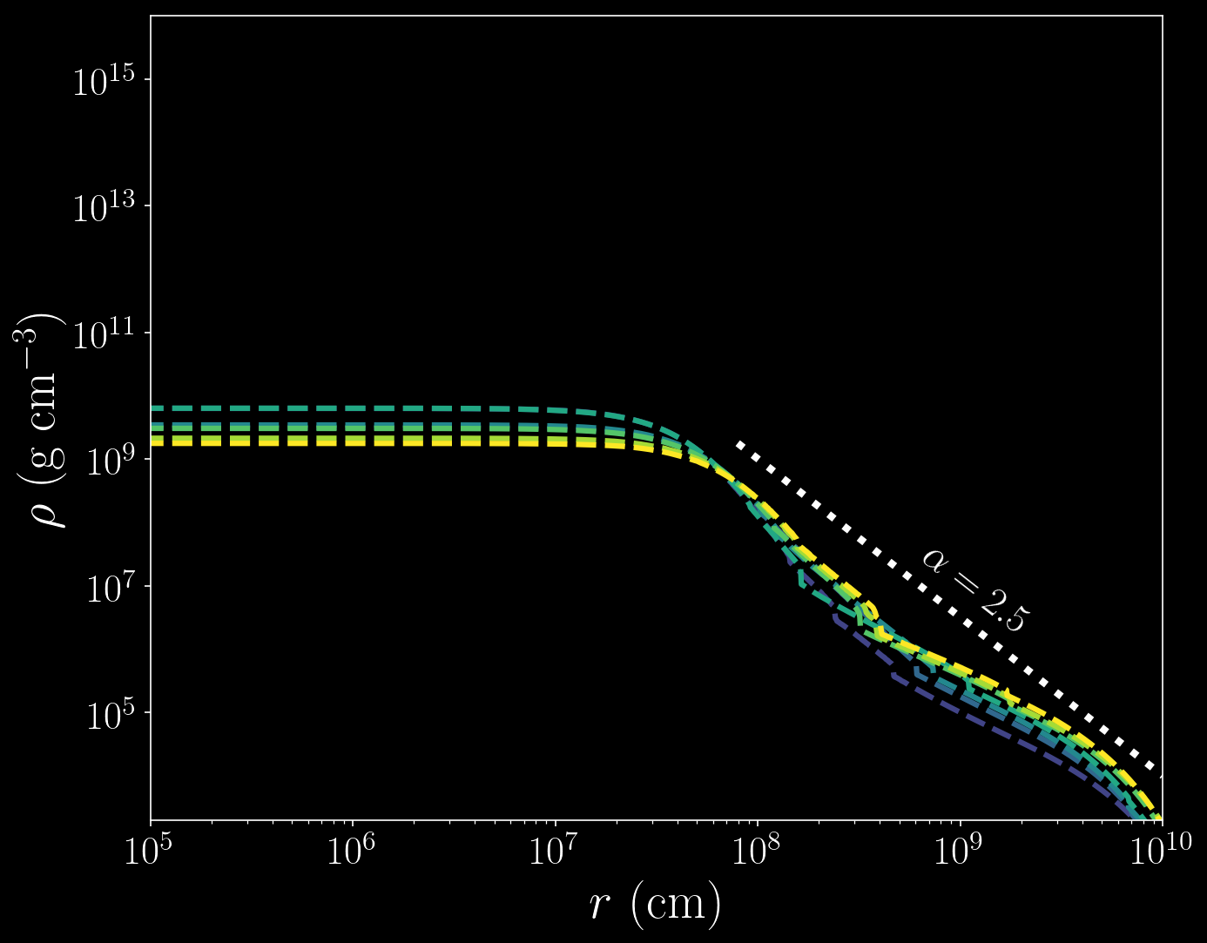
initial (pre-collapse) density profiles
Halevi et. al. (2022)

Slide 20
final (post-collapse) density profiles are significantly shallower
Halevi et. al. (2022)

Slide 21
this slope is ~1.5— what you’d expect from simple free-fall
Halevi et. al. (2022)

Slide 22
Ω
initialize 3D GRMHD simulation, in H-AMR, of a rotating stellar envelope with a central BH
use my core-collapsed stellar model to
motivate initial
conditions
BH

Slide 23
(Halevi+ 2023 in prep.)
radius [cm]

Slide 24
magnetization σ
(Halevi+ 2023 in prep.)
8.2 ms
16 ms
25 ms
33 ms
cm
density

Slide 25
(Halevi+ 2023 in prep.)
negl_W
density evolution

Slide 26
end-to-end simulations of collapsars are within reach
scale separation is tractable with GPUs and AMR
we can self-consistently launch jets in 3D GRMHD
an M1 neutrino transport scheme has recently been developed– we can soon perform detailed nucleosynthesis calculations
we can better constrain initial conditions for stellar progenitors
magnetic field configurations? rotation profiles?

Slide 27
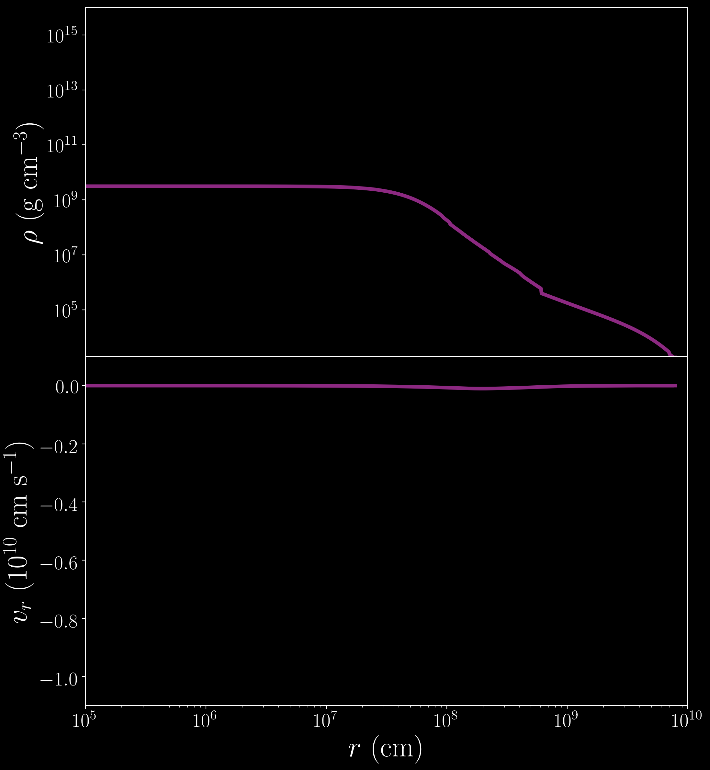
$$0ms$$
$$M_{ZAMS}=18M_{⊙}$$

Slide 28
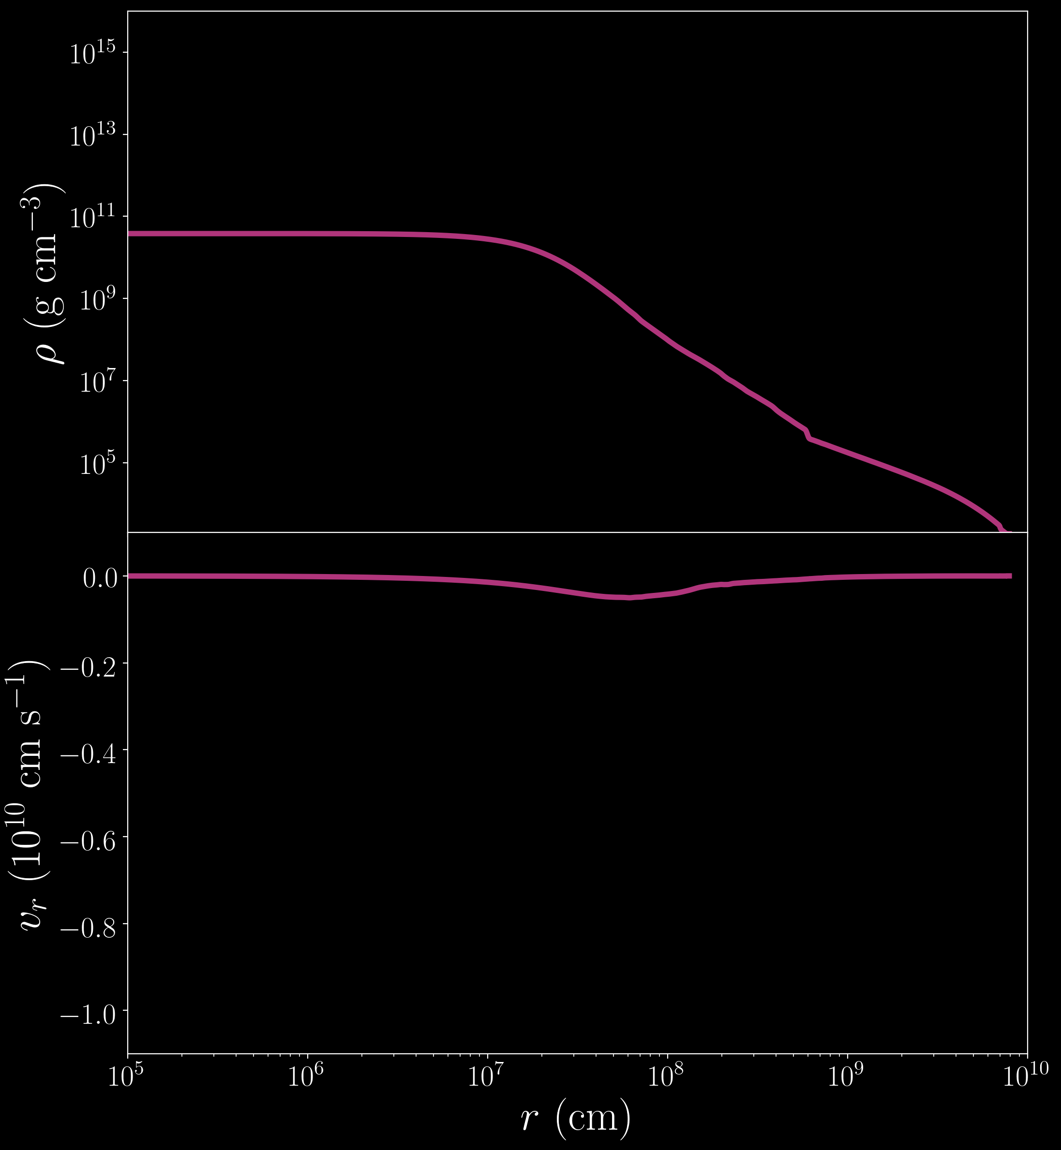
$$199ms$$

Slide 29
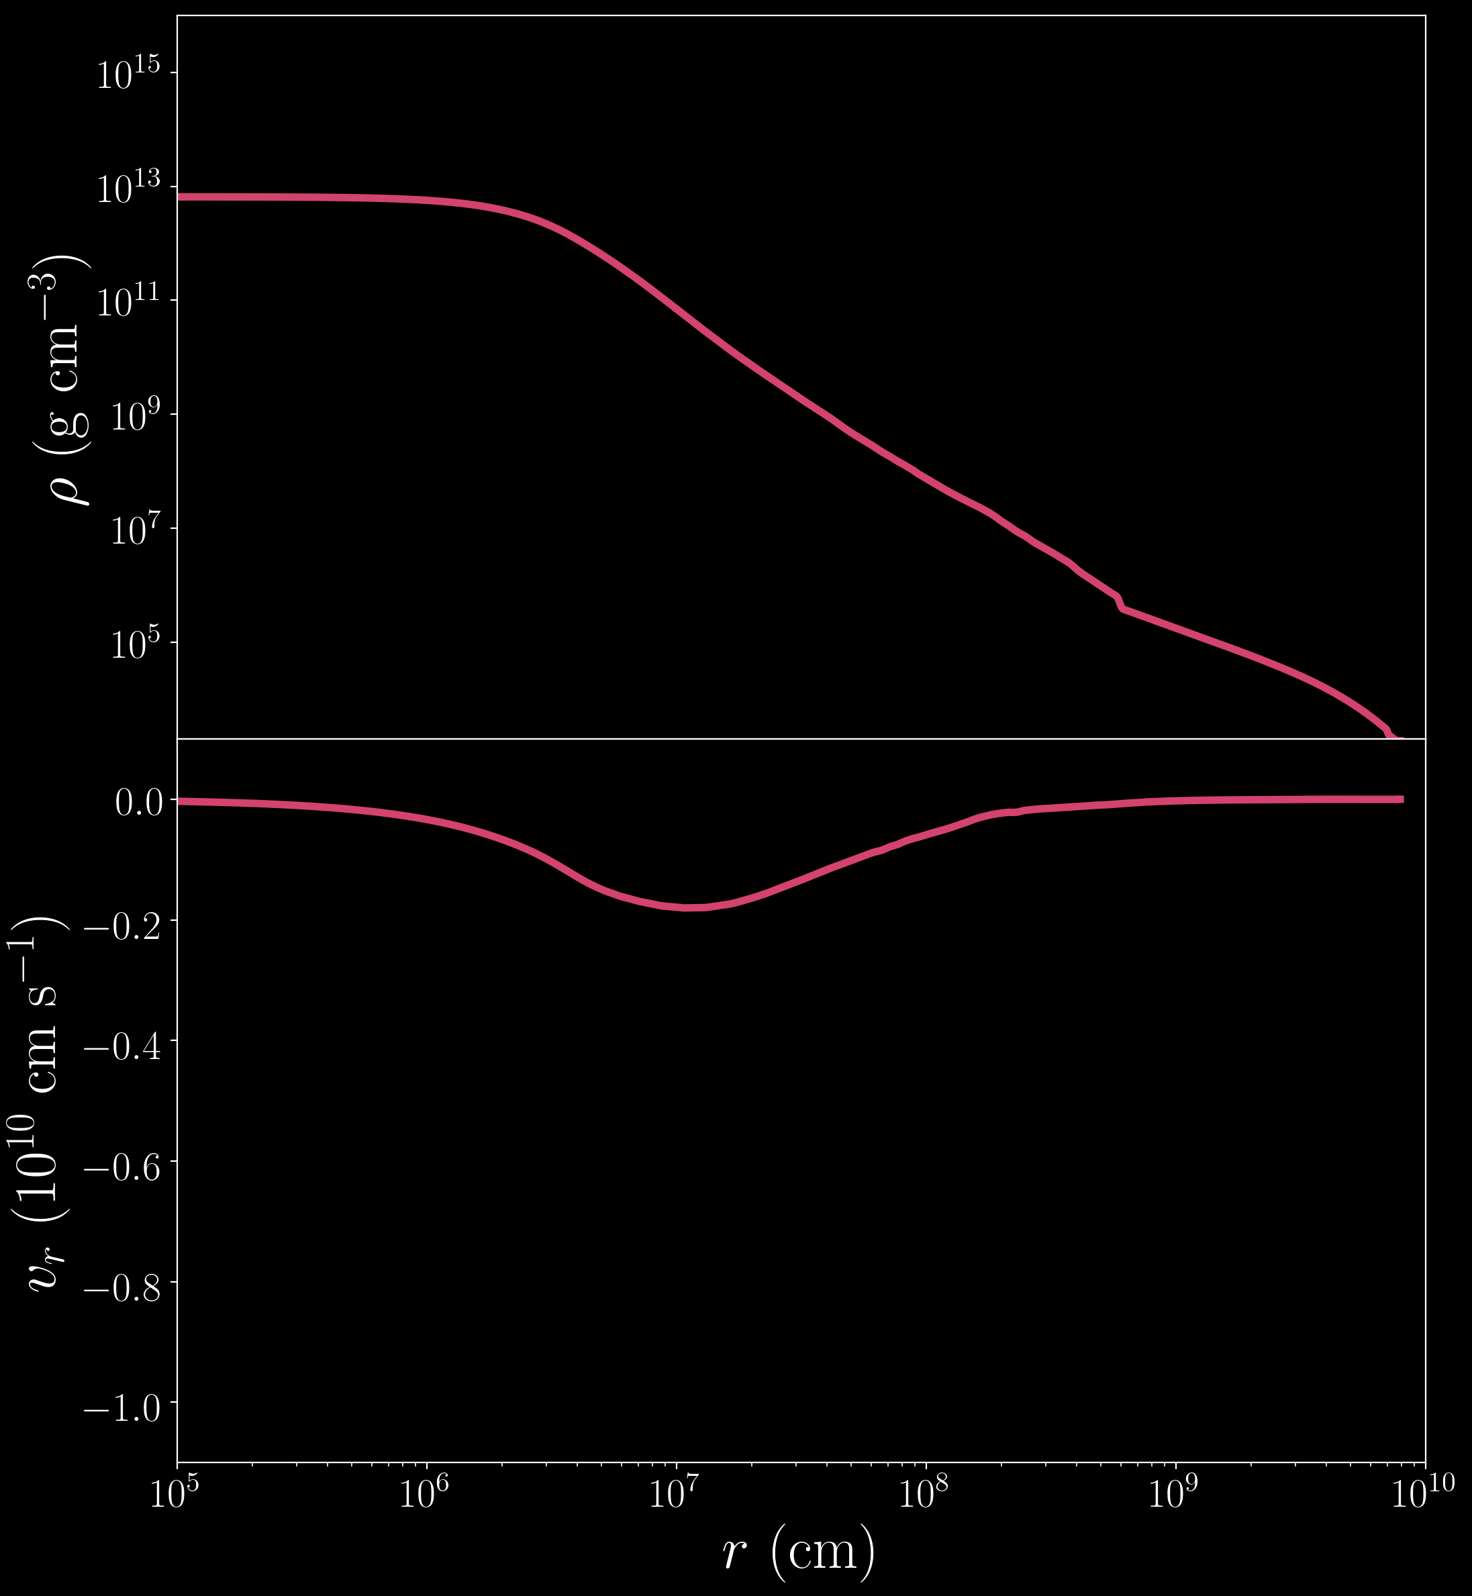
$$232.4ms$$

Slide 30
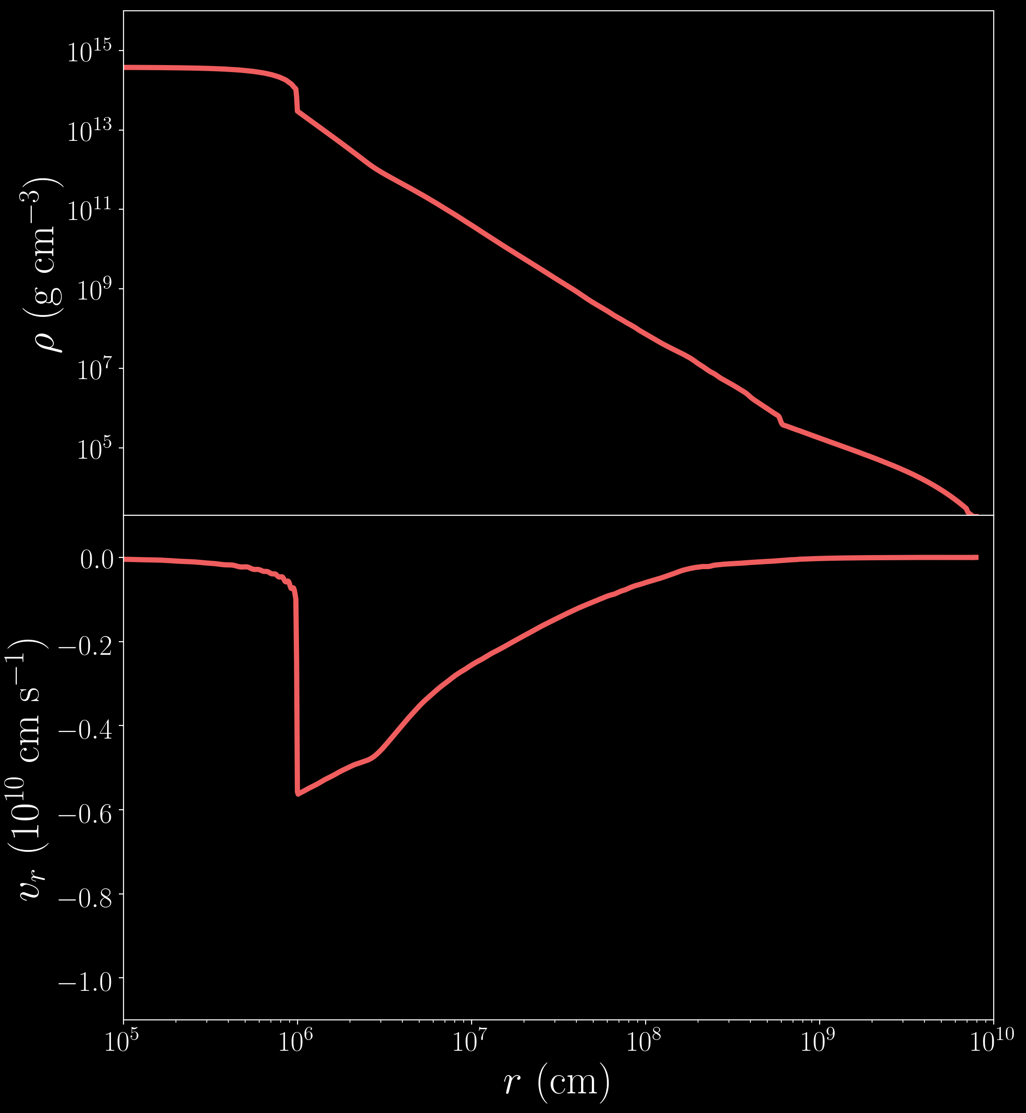
$$234.3ms$$

Slide 31
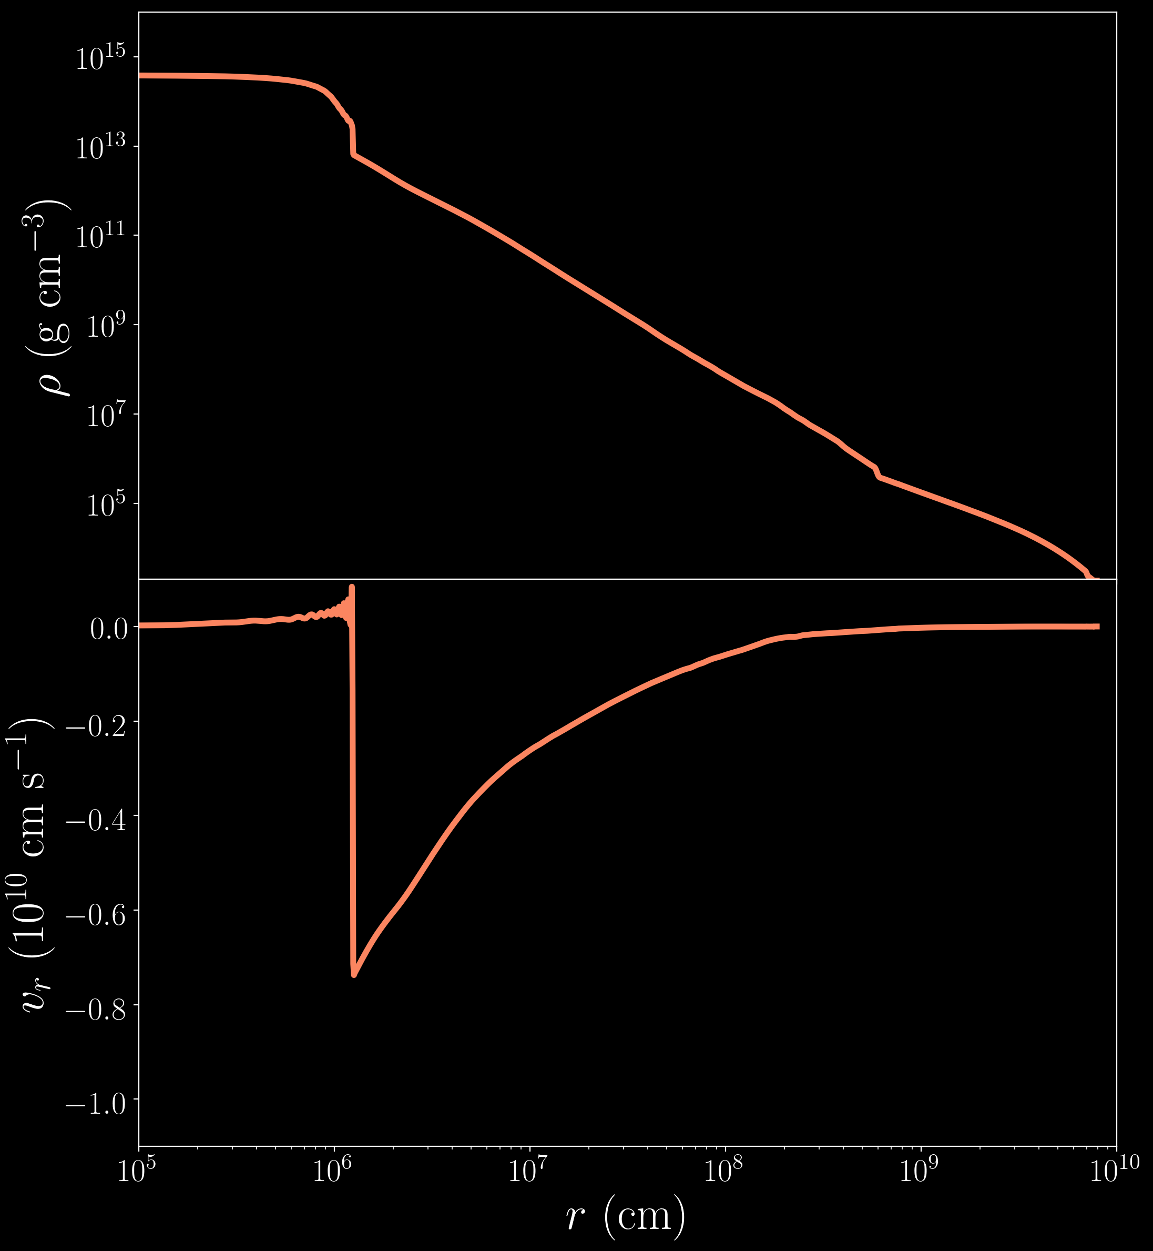
$$234.5ms$$
core bounce!

Slide 32
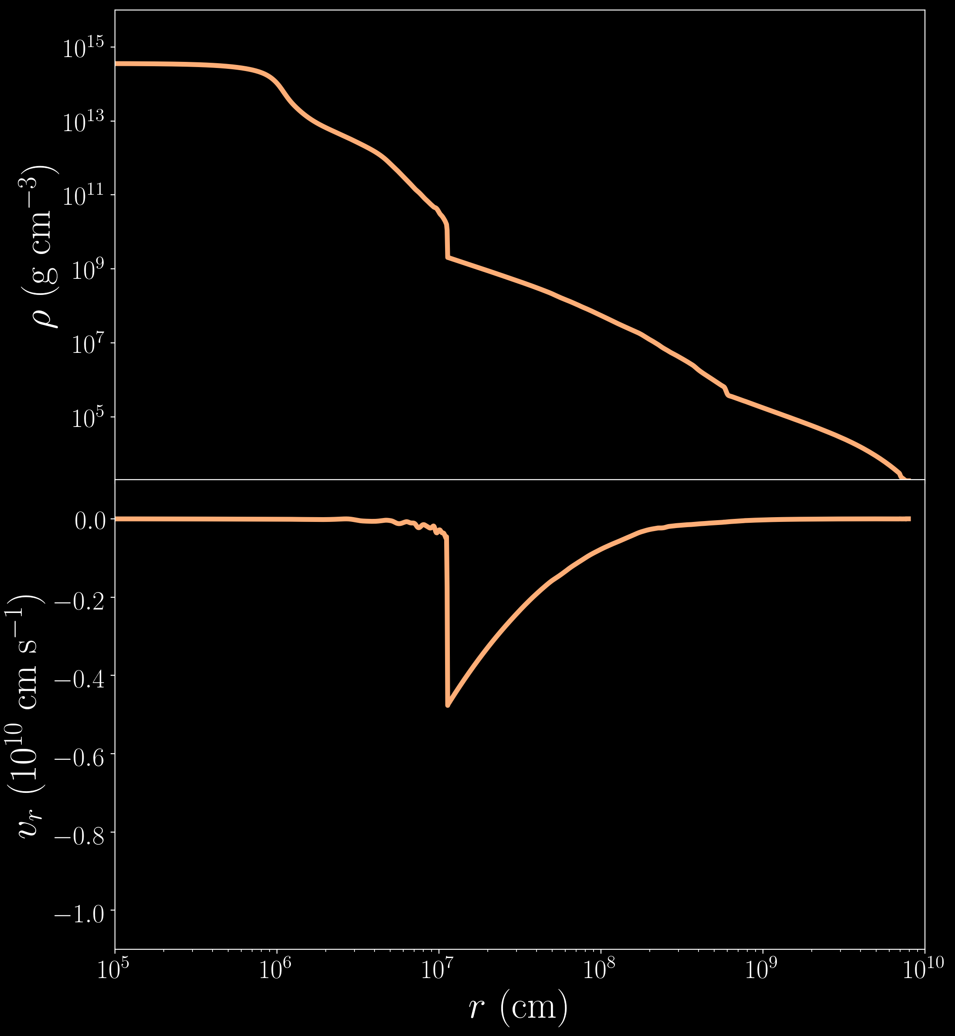
$$264.4ms$$

Slide 33
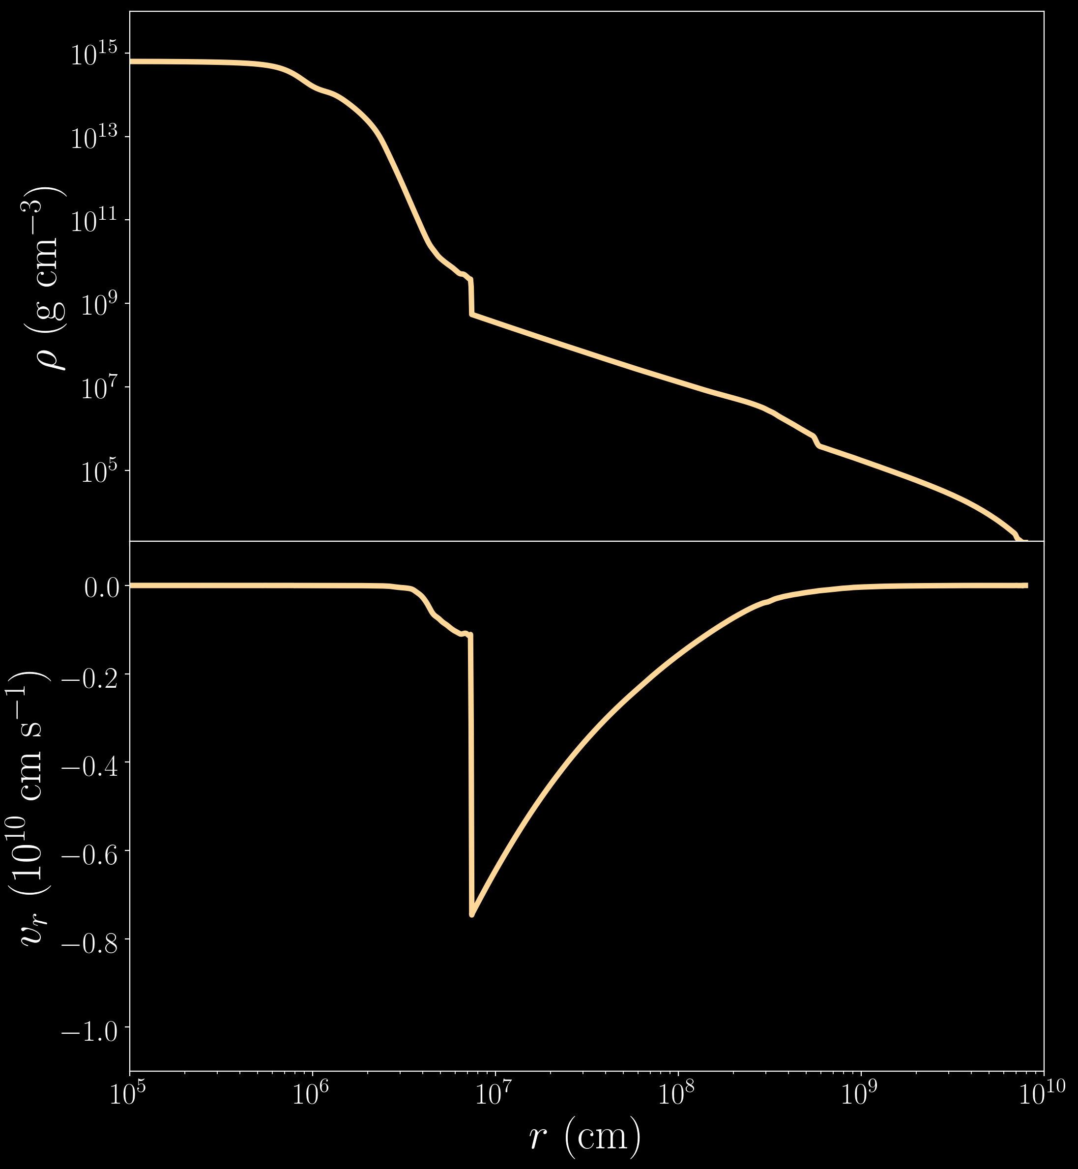
$$514.4ms$$

Slide 34
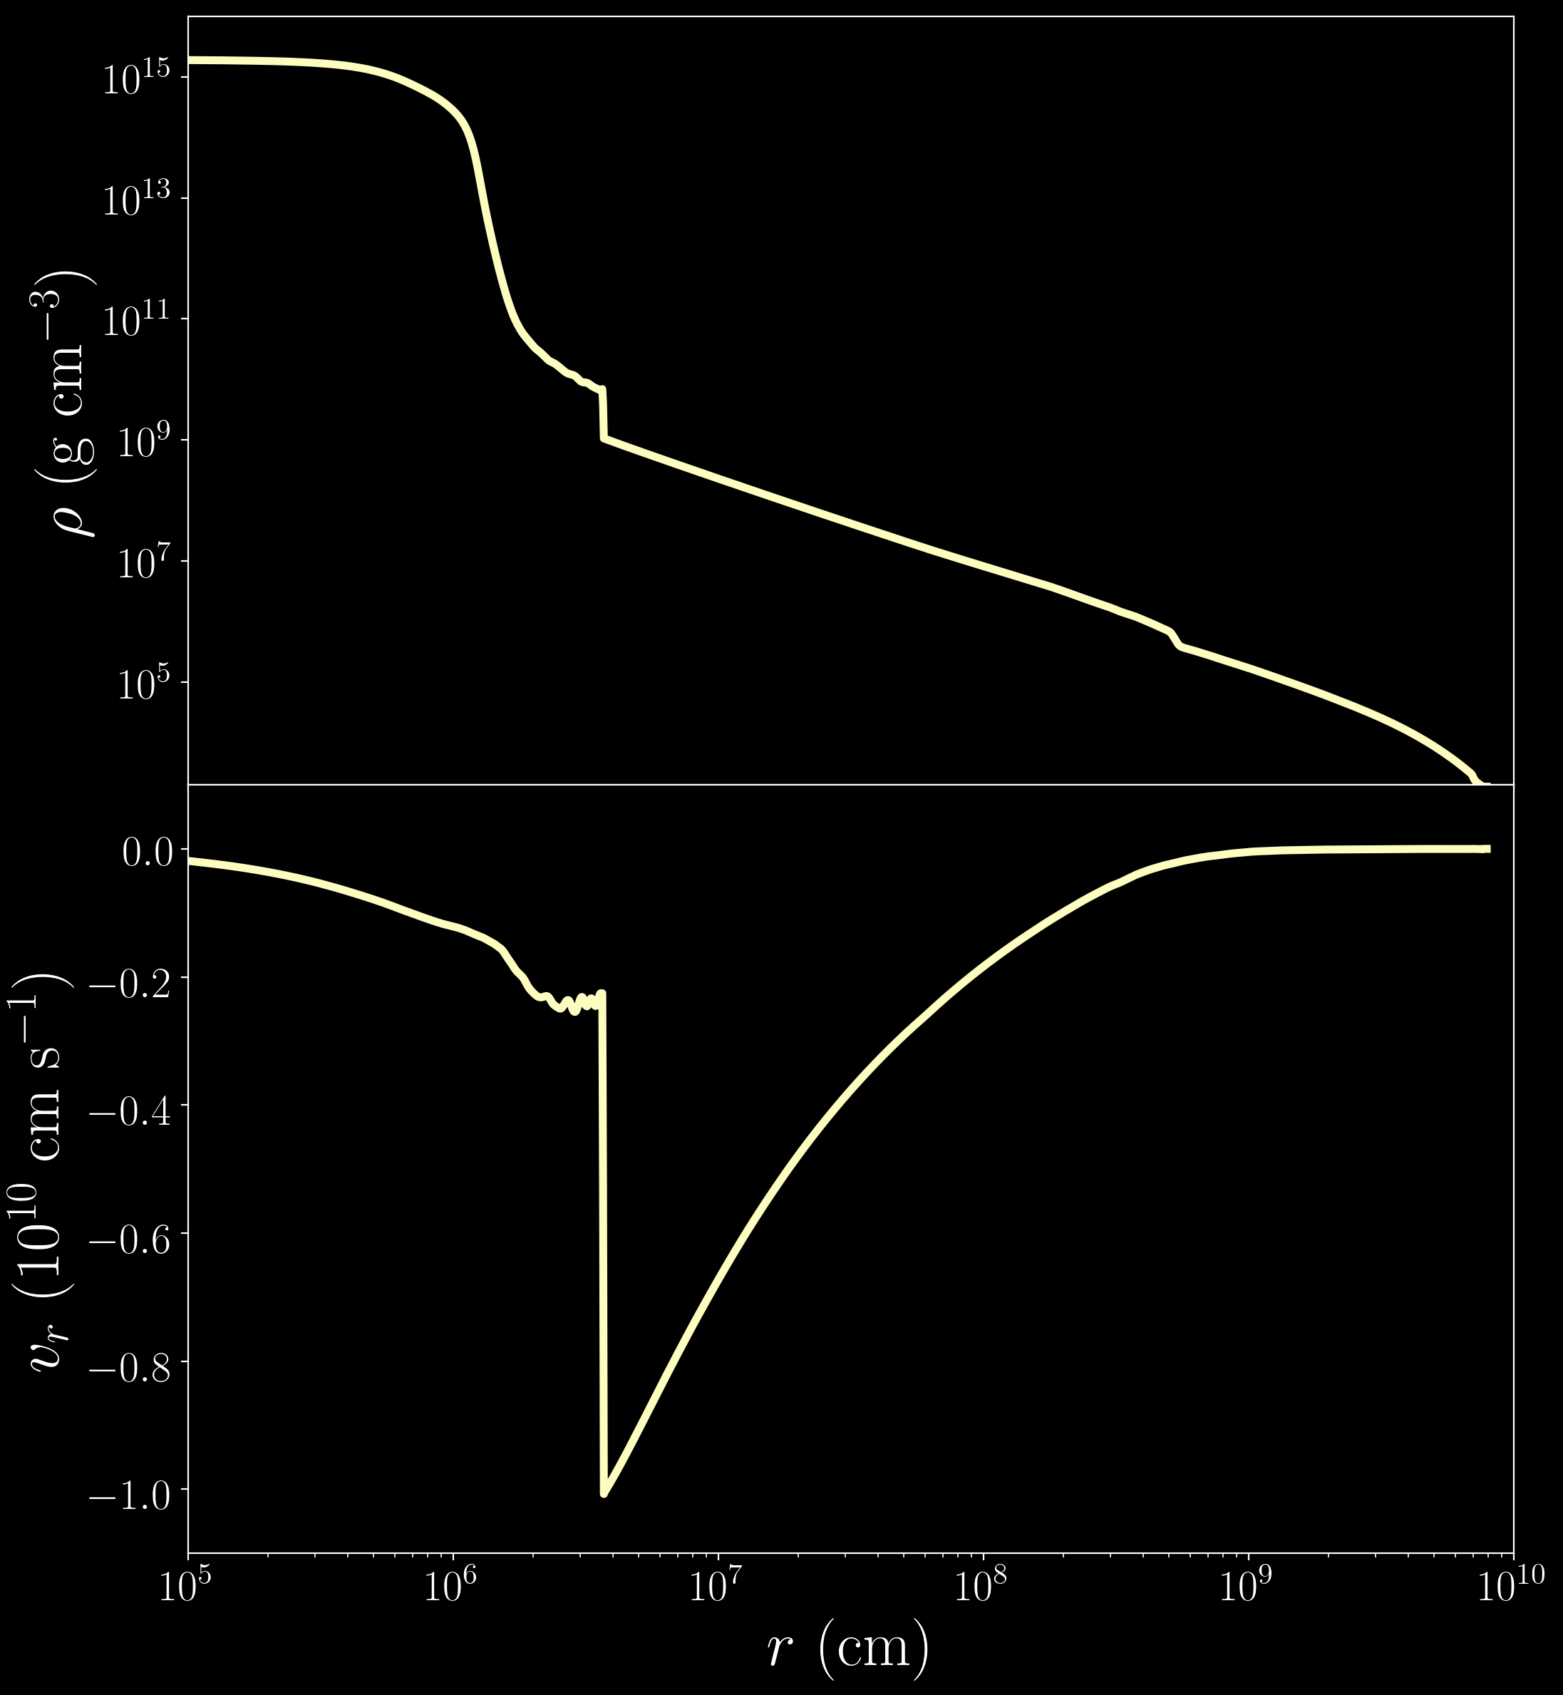
$$740.9ms$$
collapse of
proto-neutron star

