Slide 1




Explosive failed supernovae
MICRA 2023, Trento
Oliver Eggenberger Andersen
Notes:
OKC logo, snic logo, Naiss, swedish research council

Slide 2
Explosive failed supernovae
Successful shock revival but continued accretion induce BH formation shortly after which decreases the explosion energy, yet asymtotes to a positive value.

Slide 3
A relatively novel BH formation channel:
Literature: Chan et al. (2018); Burrows et al. (2023)
Open questions:
How viable and common are EFSNe?
How massive are the BHs left behind?
Impact on the BH population?

Slide 4
A relatively novel BH formation channel:
Literature: Chan et al. (2018); Burrows et al. (2023)
Open questions:
How viable and common are EFSNe?
How massive are the BHs left behind?
What explosion energies do they yield?
Is there any equation of state dependence?
What is the composition of the ejecta?
Multimessenger signals?
Impact on the BH population?

Slide 5
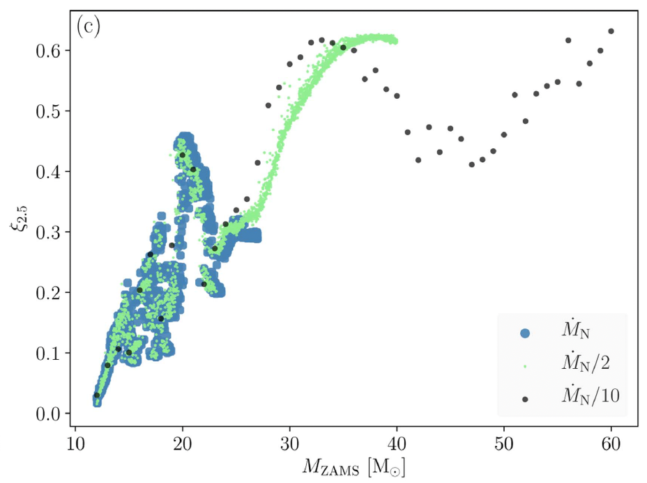
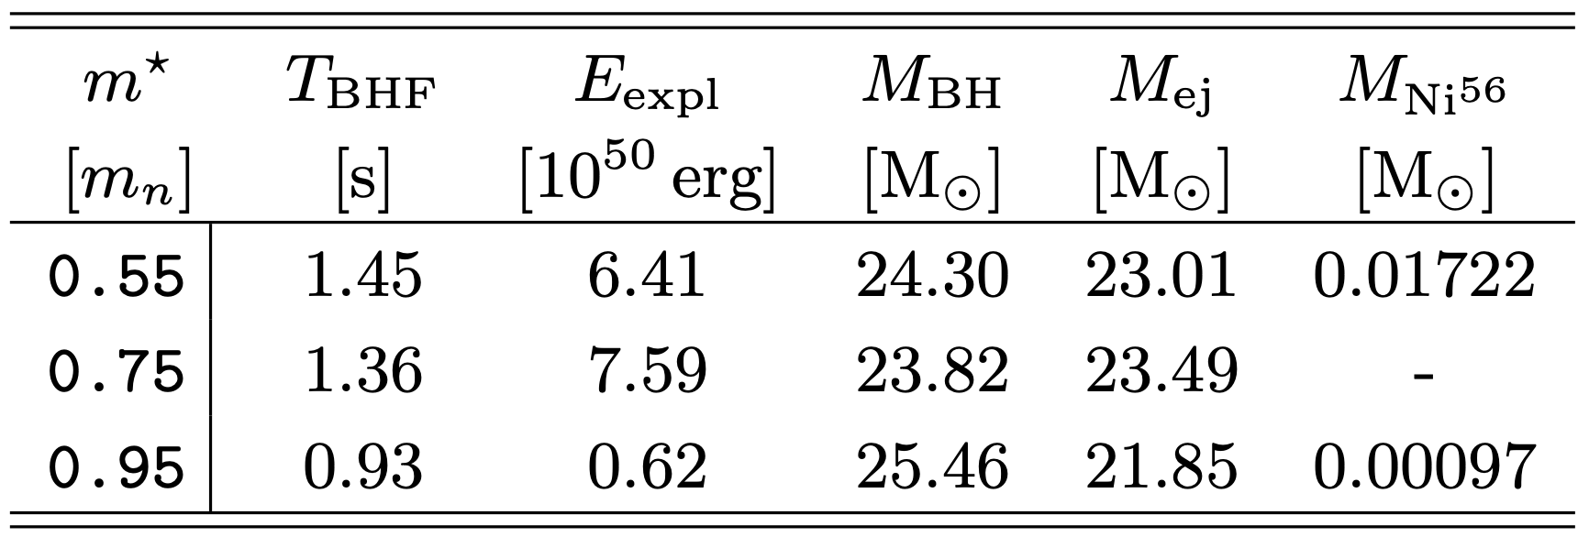
``Explosive Failed Supernovae, equation of state dependence and ejecta composition’’
Eggenberger Andersen. O, O’Connor. E, Andresen. H. in prep
60 ZAMS progenitor, compactess ca 0.64 (Sukhbbold, Woosley, & Heger 2018)
FLASH, 2D. Two moment energy dependent neutrino transport scheme with 3 species. Effective potential to approximate GR. At BHF we mask the central region, shut off the neutrino transport, and accumulate the accreting matter to a point mass. Advect the elements.
Skyrme-type EOS from da Silva Schneider et al. (2019). We vary the effective mass parameter.
Figure from Sukhbold et al. (2018)
Picture shock radius
Still have ample accretion
BH formation at different times
duration of the energy engine
Explosion energies
Notes:
High neutrino luminosities and energies and optical depths -> a lot of heating that facilitates explosion

Slide 6
``Explosive Failed Supernovae, equation of state dependence and ejecta composition’’
Eggenberger Andersen. O, O’Connor. E, Andresen. H. in prep
60 ZAMS progenitor, compactess ca 0.64 (Sukhbbold, Woosley, & Heger 2018)
FLASH, 2D. Two moment energy dependent neutrino transport scheme with 3 species. Effective potential to approximate GR. At BHF we mask the central region, shut off the neutrino transport, and accumulate the accreting matter to a point mass. Advect the elements.
Skyrme-type EOS from da Silva Schneider et al. (2019). We vary the effective mass parameter.
Figure from Sukhbold et al. (2018)
Picture shock radius
Still have ample accretion
BH formation at different times
duration of the energy engine
Explosion energies
Notes:
We probe the EOS dependence by using Sk type EOSs from da Silva.. And vary the effective mass parameter. This parameter mainly enters into the thermal part of the EOS. We set its value 0.55, 0.75, and 0.95, specified as a fraction of the vacuum mass of a nucleon and at nuclear saturation density. We know from previous work that with an increased effective mass, the EOS becomes more soft via a decrease in thermal pressure. This has a myriad of consequences, one of them that the PNS is formed more compactly, releasing more gravitational binding energy, increasing the explodability of the model. For this progenitor however, we see successful shock revivals in all of our models, demonstrated here by a plot of the shock radius as a function of time. Another consequence is that with a more stiff EOS, the duration between shock revival and BHF is longer. Here we have the time

Slide 7
``Explosive Failed Supernovae, equation of state dependence and ejecta composition’’
Eggenberger Andersen. O, O’Connor. E, Andresen. H. in prep
Notes:
Whats next:

Slide 8
``Explosive Failed Supernovae, equation of state dependence and ejecta composition’’
Eggenberger Andersen. O, O’Connor. E, Andresen. H. in prep
Notes:
Whats next:

Slide 9
``Explosive Failed Supernovae, equation of state dependence and ejecta composition’’
Eggenberger Andersen. O, O’Connor. E, Andresen. H. in prep
Notes:
Diagnostic explosion energy, Sean Couch

Slide 10
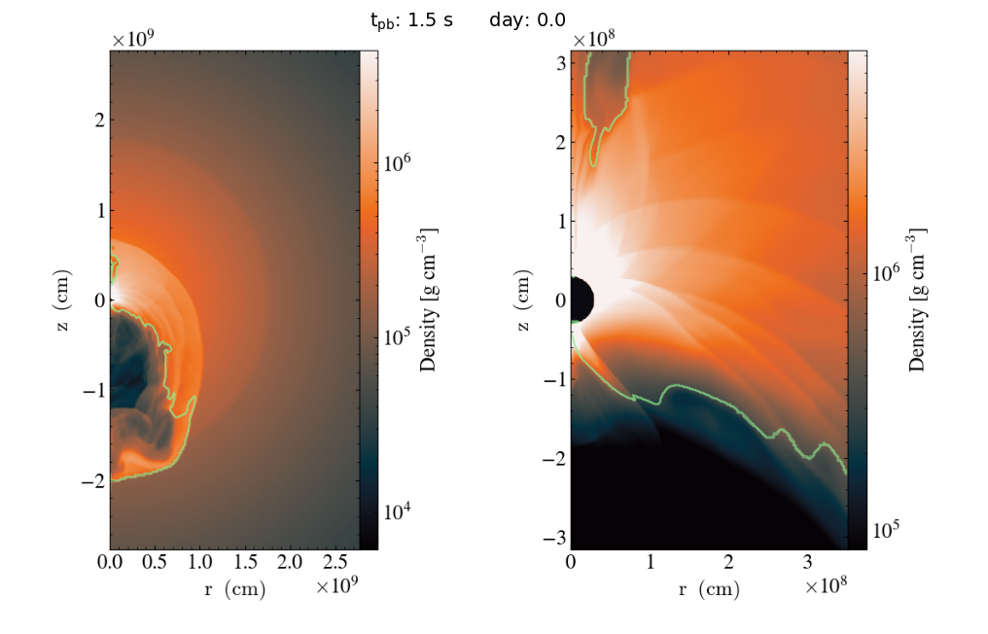
Notes:
Not accreting unbound material

Slide 13
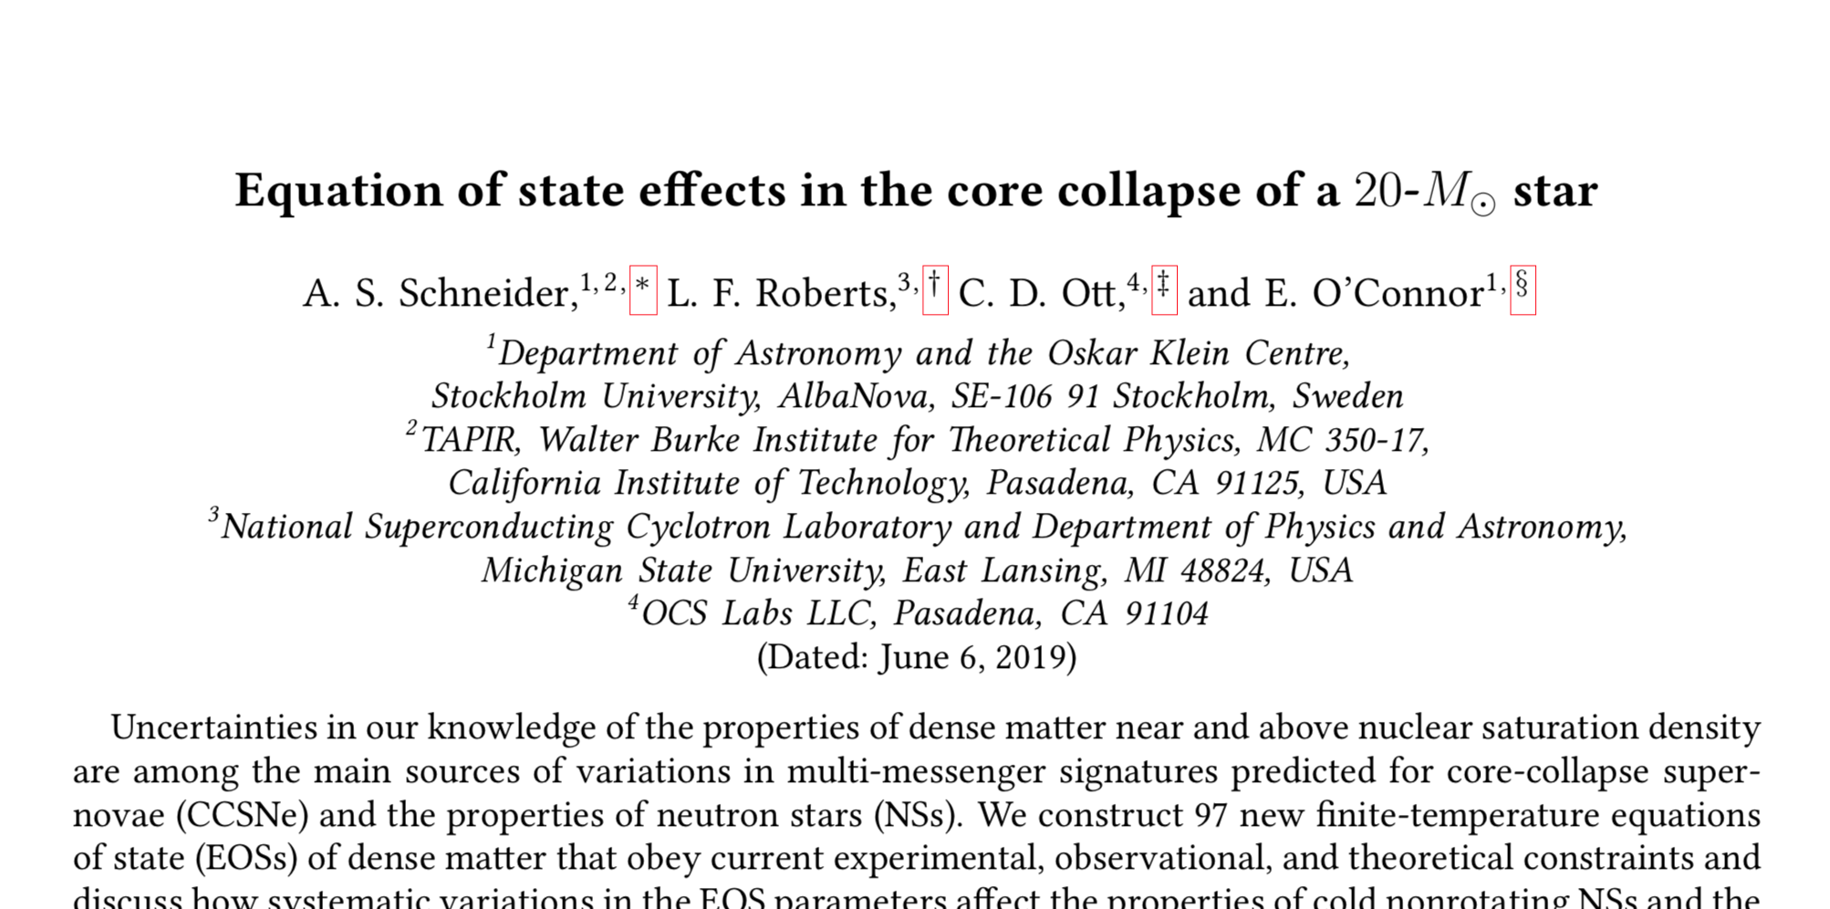
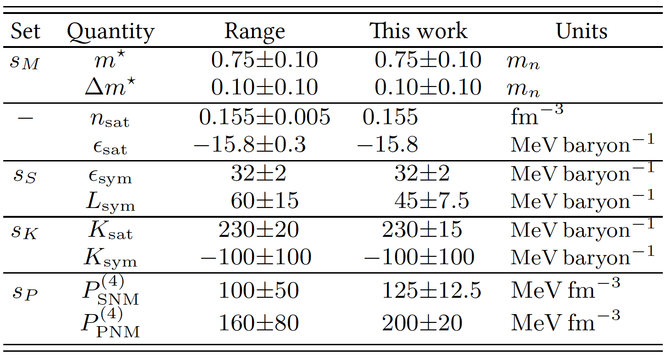
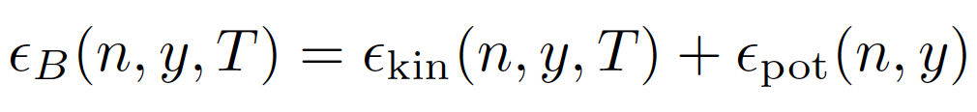
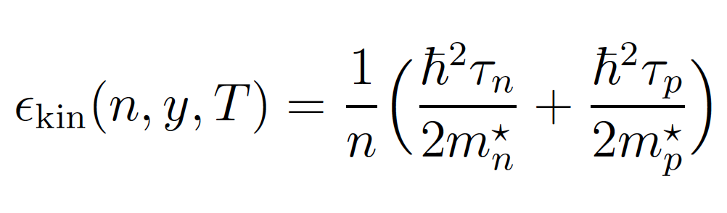
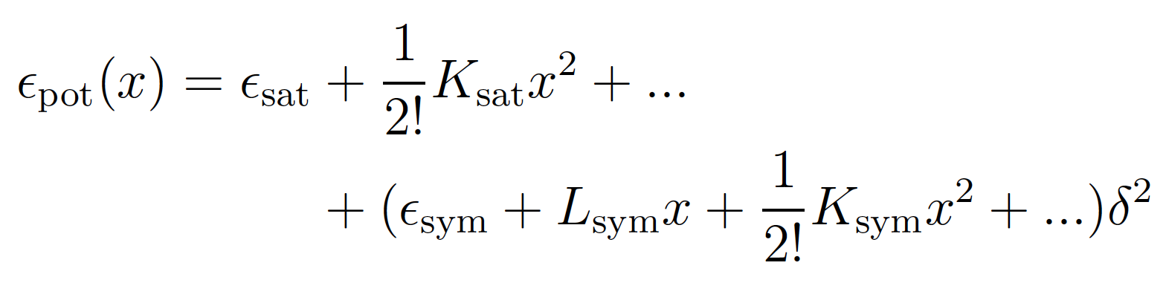
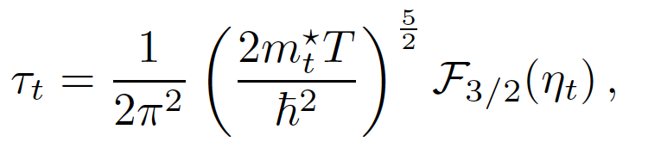
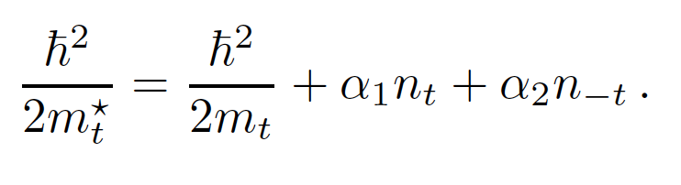
Notes:
They find that variations in certain EOS parameters affect the post-bounce dynamics, in particular properties related to the neutrino heating mechanism.

