Slide 1
Thermal Effects in Binary Neutron Star Mergers
Jacob Fields
J. Fields, A. Prakash, M. Breschi, D. Radice, S. Bernuzzi, A. d. S. Schneider, ApJL 952, L36 (2023),
arXiv:2302.11359 [astro-ph.HE].

Slide 2
Status of the nuclear equation of state
Some major sources of constraints:
Heavy-ion collisions
X-ray and radio observations of pulsars
GW observations of BNS inspirals and EM counterparts
Fewer constraints for hot matter at NS densities!
Capano et al, Nat. Astr. 4, 625-632 (2020).

Slide 3
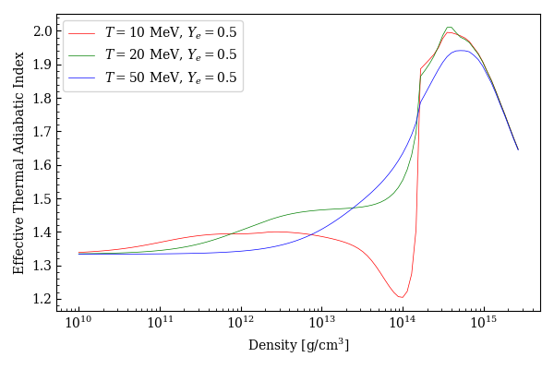
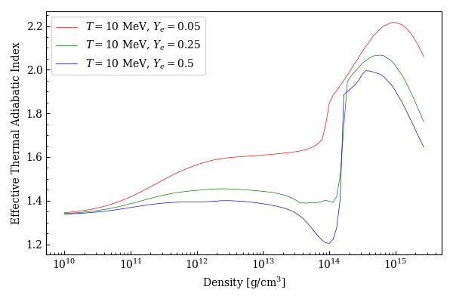
Prior work in thermal effects
Modifying only thermal component usually requires hybrid EOS
Effective thermal $Γ$ strongly dependent on temperature and composition
Neutrinos (if included) incorporated via leakage
Cannot account for trapped neutrinos in optically-thick regions

Slide 4
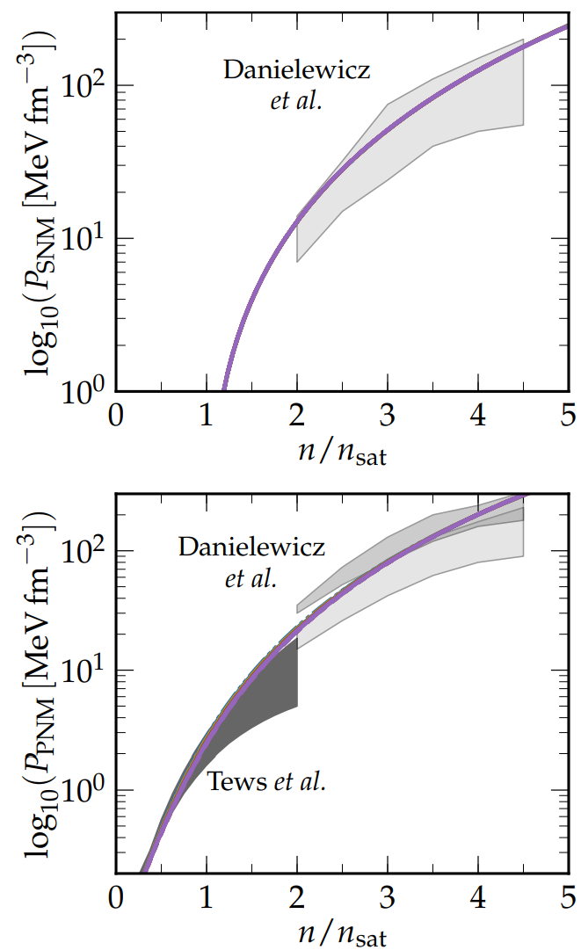
A parameterized EOS
EOS w/ Skyrme-interaction of form
$$e_{B}\left(n,y,T\right)=e_{kin}\left(n,y,T\right)+e_{pot}\left(n,y\right)$$
$e_{kin}(n,y,T)$ depends on effective nucleon masses $m_{n}^{∗}$ and $m_{p}^{∗}$
Can be parameterized by defining
$$m^{∗}≡m_{n}^{∗}\left(n=n_{sat},y=1/2\right)$$
$m^{∗}$ effectively controls the specific heat capacity ➔ only affects thermal behavior
Schneider et al, PRC 100, 055802 (2019).

Slide 5
Simulations
Equal mass binaries with $m^{∗}/m_{n}∈\{0.55,0.75,0.95\}$
THC_M1
No magnetic fields
M1 neutrino transport
GRLES subgrid model

Slide 6
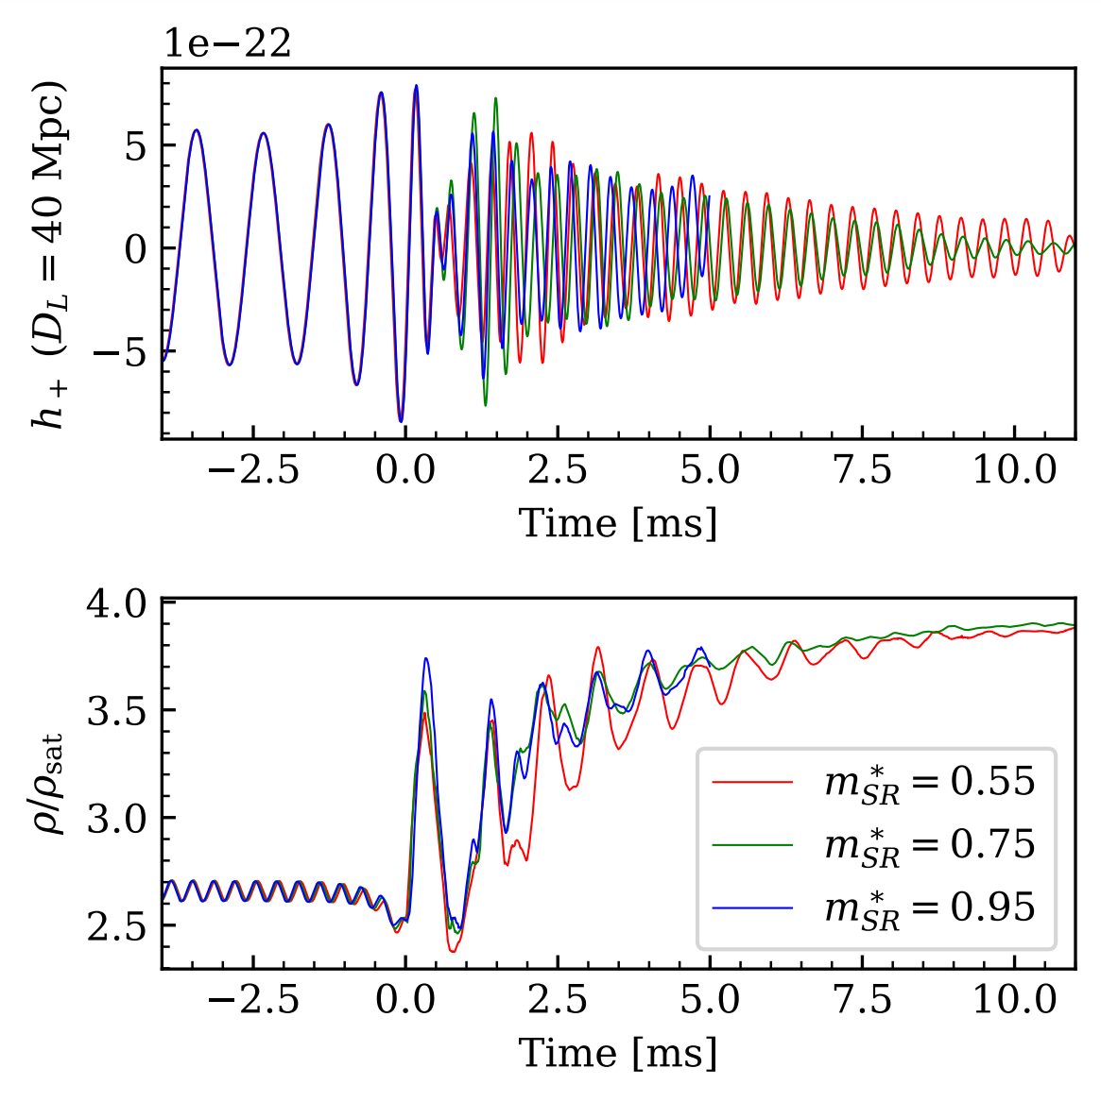
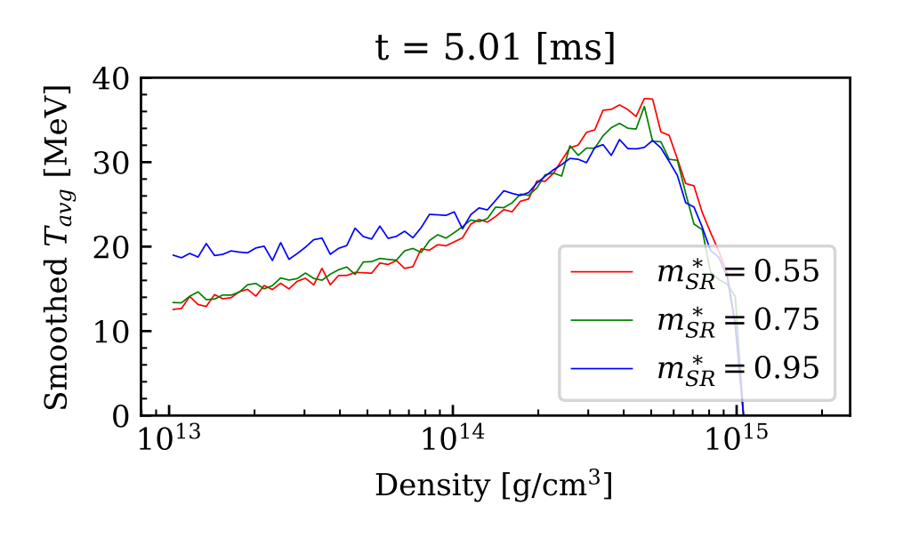
Results

Slide 7
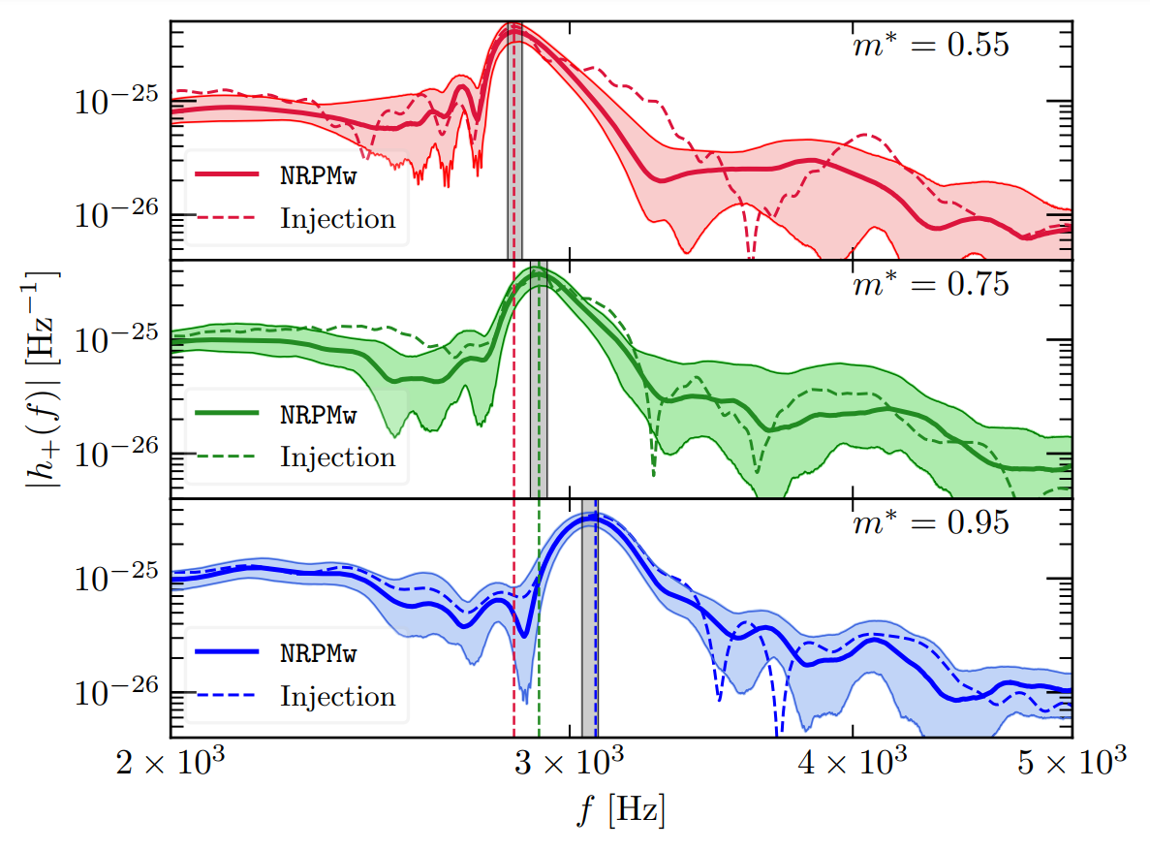
Observational signatures
Peak frequency positively correlated with $m^{∗}$
Differences discernible at SNR 15 or less in next-gen detectors

Slide 8
What next?
Tests with other EOS models, mass ranges, mass ratios, etc.
Need higher resolutions and longer simulations
Need better algorithms
Need faster code
GR-Athena++ (see Will Cook’s talk this afternoon)
AthenaK

Slide 9
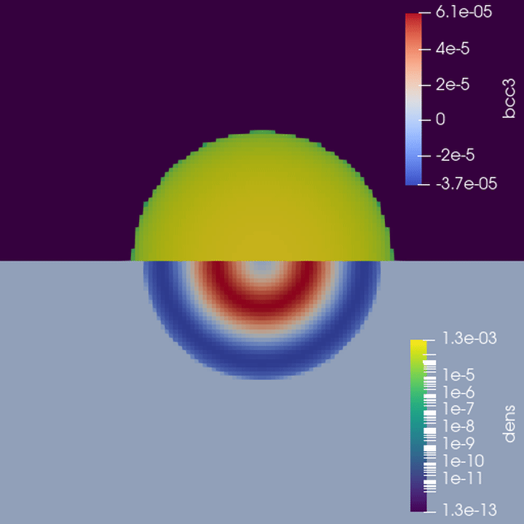
AthenaK
Rewrite of Athena++ with Kokkos framework to run on GPUs
TOV test (MHD, no Z4c):
$3.0×{10}^{6}$ zone-cycles/sec (personal laptop, RK3)
$1.8×{10}^{7}$ zone-cycles/sec (NERSC Perlmutter, RK3, bottle-necked, 1 GPU)
Athena++ for reference:
$6×{10}^{6}$ zc/sec (NERSC Perlmutter, RK3, 128 CPU cores, appropriate load)

Slide 10
Summary
Simulated BNS mergers with parameterized finite-temperature EOS and M1 neutrino transport
Higher $m^{∗}$ results in denser, colder cores
Effective mass $m^{∗}$ shows correlation with peak post-merger frequency
Differences would be observable in future GW detectors at SNR 15
Future NR codes promise to make more in-depth studies possible

Slide 11
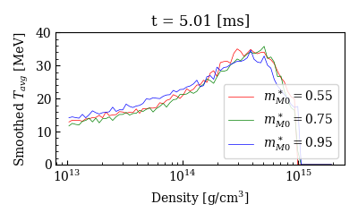
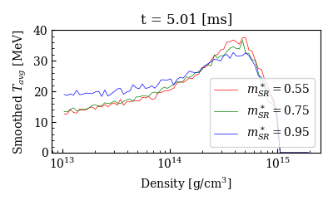
M1 vs. M0

Slide 12
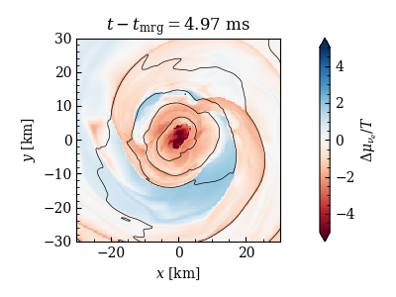
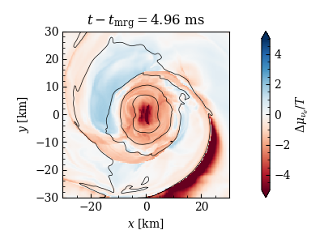
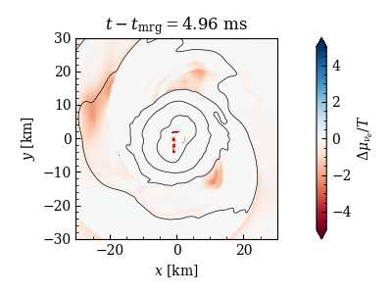
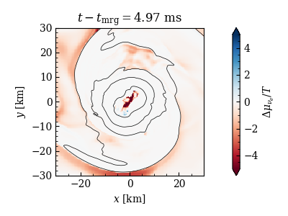
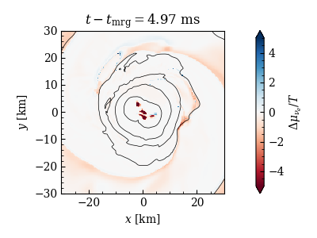
M1 vs. M0 (cont.)
M0
M1

