Slide 1
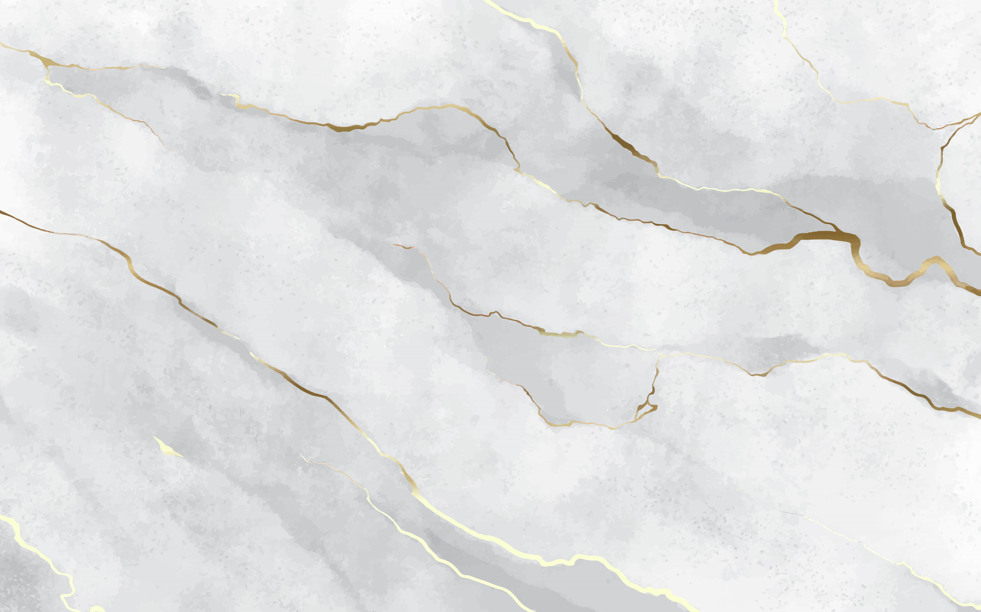
Improving Qubit Readout with Autoencoders
Quantum Science and Technology in Trento
Piero Luchi 8 September 2023
ECT* workshop:
Many Body Quantum Physics and Machine Learning

Slide 2
Outline
Dispersive qubit readout for superconducting qubits
Standard readout models
Improving qubit readout with autoencoders

Slide 3
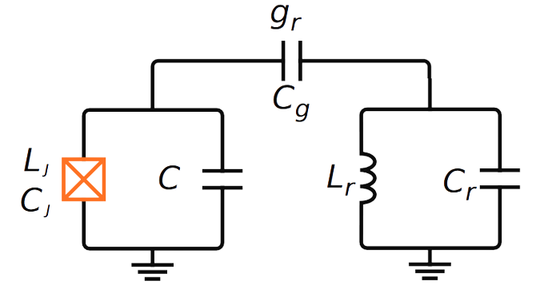
Qubit – Cavity system
Qubit - readout cavity system described by Jaynes-Cumming model:

Slide 4
Dispersive Regime
Dispersive Readout approach
Write the equation in the dispersive regime
Dispersive approximation

Slide 5
Dispersive Qubit Readout
Dispersive shift of the resonator frequency based on the state of the qubit
Measurement: Indirectly measuring the qubit state by measuring the resonator frequency shift.

Slide 6
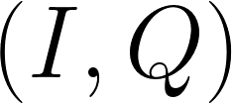
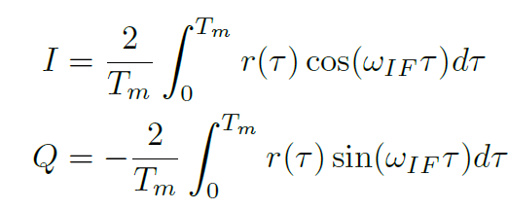
Dispersive Qubit Readout
Input signal
signal $r\left(t\right)$
Signal manipulation
Full Demodulation
Q
Output signal
I

Slide 7
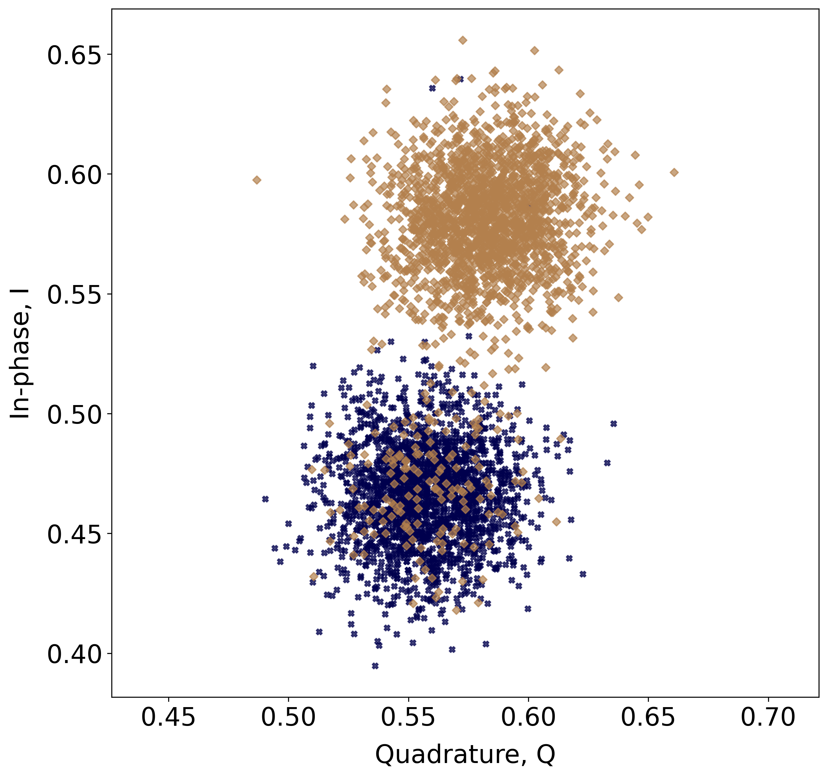
Results of Readout
According to the qubit state, the point will fall in different part of the I-Q plane.
Labelled data: Prepared in state 0 (or 1) and immediately measured.

Slide 8
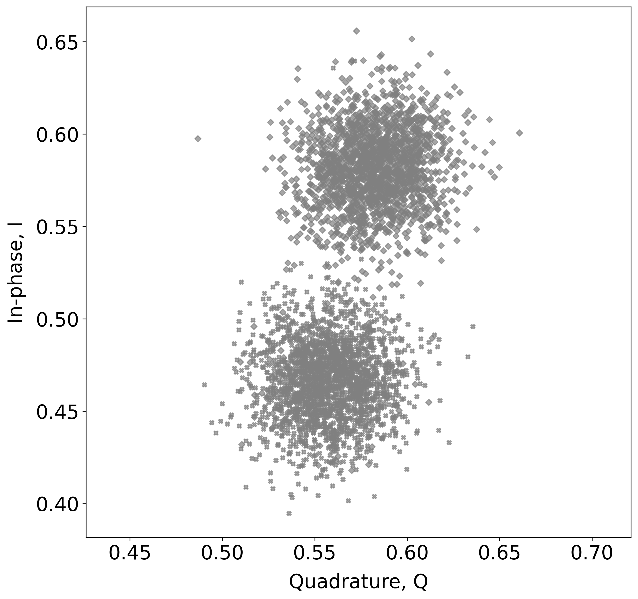
Qubit Readout: Classification
How to assign the correct label to each point?
Unlabelled data
Labelled data
?

Slide 9
Qubit Readout: Classification
How to assign the correct label to each point?
Dataset:
Prepare many times each state and measure it immediately
Methods :
Gaussian Mixture models
Neural Networks
Neural Network with Autoencoder-type Pre-training

Slide 10
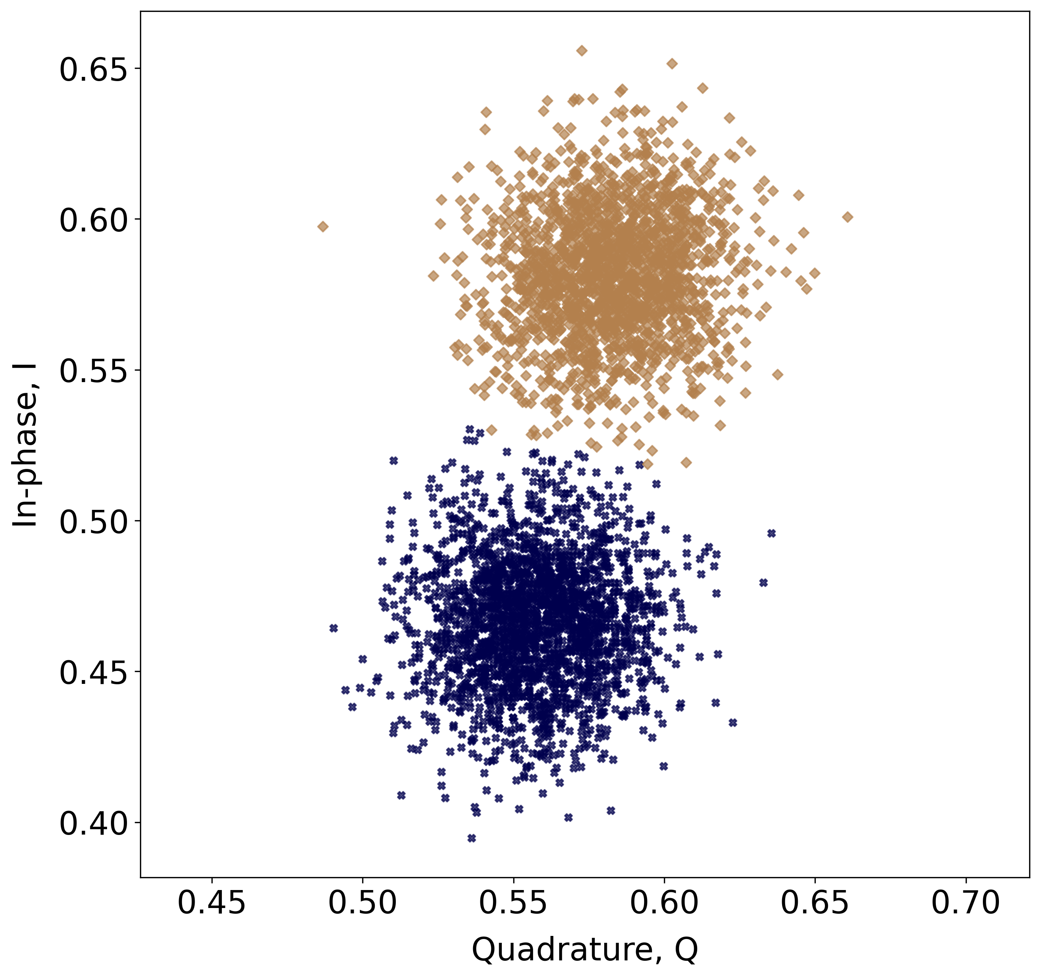
Readout Classification: 1. Gaussian Mixture Model (GMM)
GMM labelled data
Real data
Optimize parameters of a superposition of Gaussians
Problems:
Incorrect classification of many points
Not good for long or short measurements
Sharp edge

Slide 11
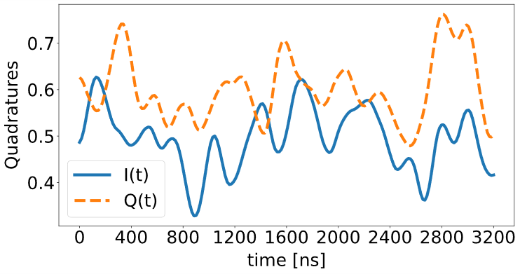
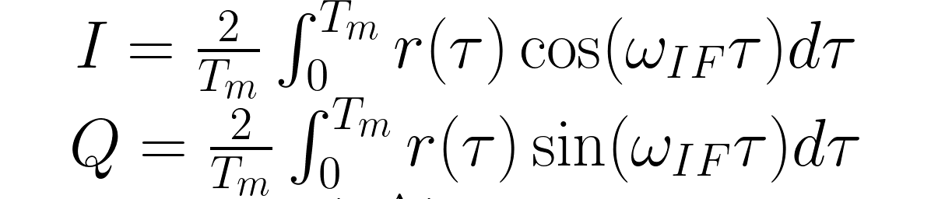
Qubit Readout: Demodulation
Input signal
Sliced Demodulation
Time average
Turn to a finer-grained signal
signal $r\left(t\right)$
Signal manipulation
Full Demodulation
Q
Output signal
I

Slide 12
Readout Classification: 2. Feed-Forward Neural Network (FFNN)
Try to use all information available
Lienhard, Benjamin, et al. "Deep-Neural-Network Discrimination of Multiplexed Superconducting-Qubit States." Physical Review Applied 17.1 (2022): 014024.

Slide 13
Readout Classification: Feed-Forward Neural Network (FFNN)
FFNN labelled data
Labelled (real) data
Problems:
Lower performance for long measurements
gradual transition
13

Slide 14
Readout Classification: 3. Autoencoder-type Pre-training Neural Network (PreTraNN)
An autoencoder an artificial neural network that learn a compressed representation of input data by encoding it into a lower-dimensional space and then decoding it back into its original form.
It minimizes the reconstruction error.
Feature extraction, dimensionality reduction
Pre-training of feed-forward neural network
Unsupervised approach
encoder
decoder
Input
Input
Encoded/synthetic representation
14

Slide 15
Readout Classification: 3. Autoencoder-type Pre-training Neural Network (PreTraNN)
We train the autoencoder on readout data
We obtain a low dimensional representation h of readout signals
are noisy, difficult to discriminate.
h should retain only the important features of the readout signals
Inner dimension should be optimized.
Encoded representation

Slide 16
Qubit Readout: 3. Autoencoder-type Pre-training Neural Network
Train the new neural network on the encoded representation h of the readout signals, rather than on the readout signal itself.
This should improve the classification accuracy.
Neural network
LP et al. Phys. Rev. Applied 20, 014045 (2023)
16

Slide 17
Qubit Readout: 3. Autoencoder-type Pre-training Neural Network
Putting it all together...
Encoder
Neural network
LP et al. Phys. Rev. Applied 20, 014045 (2023)
17

Slide 18
Qubit Readout: Summary
Gaussian Mixture
Neural Networks
PreTraNN

Slide 19
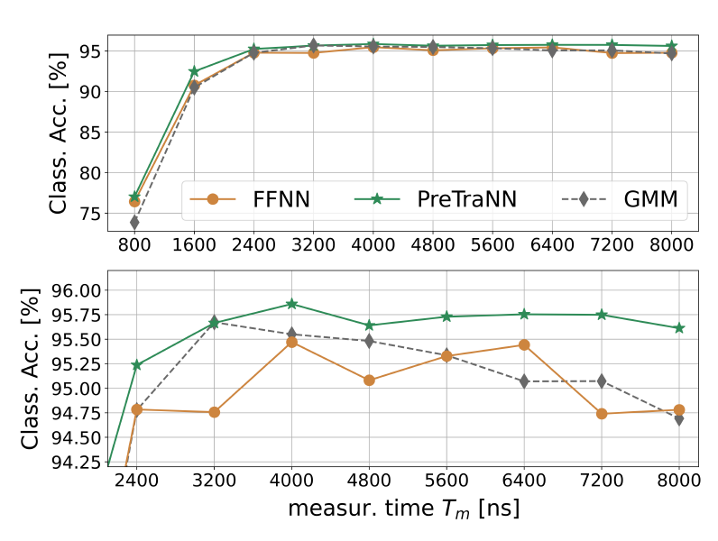
Classification accuracy: Measurement duration
Wide range of measurement times.
Autoencoder method (PreTraNN) has a better classification accuracy.

Slide 20
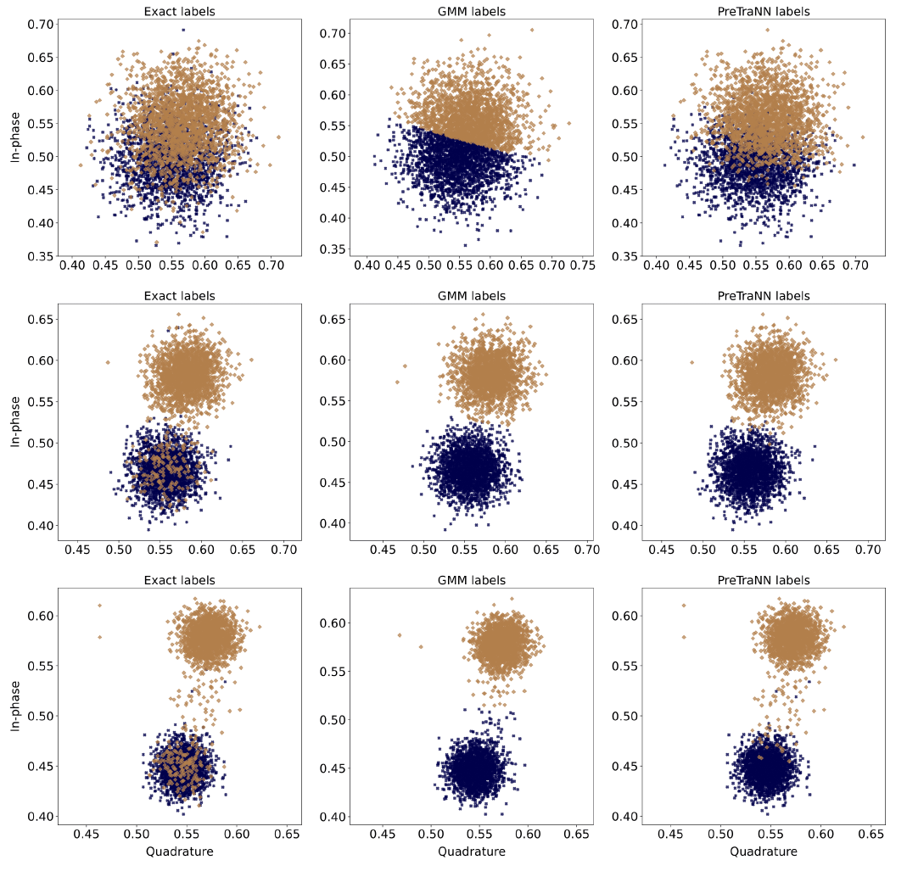
Classification accuracy: Distributions
GMM
PreTraNN
exact
74,4
Neural network-based methods produce more realistic distributions.
Readout 8000 ns
20

Slide 21
Conclusions
Dispersive readout in superconducting qubits
Common techniques to classify readout data
Autoecoder-based model to improve the classification accuracy

