Slide 1
Flow-based Generative model for nuclear many-body calculations with quantified uncertainties
Pengsheng Wen¹, Jeremy W. Holt¹, Jack Brady¹, Maggie Li²
[1] Texas A&M University
[2] Cornell University

Slide 2
Outlines
Motivation
Flow model
Importance sampling
Nuclear potential modeling
Summary

Slide 3
Motivation
High Dimensional Integral + nuclear potential modeling

Slide 4
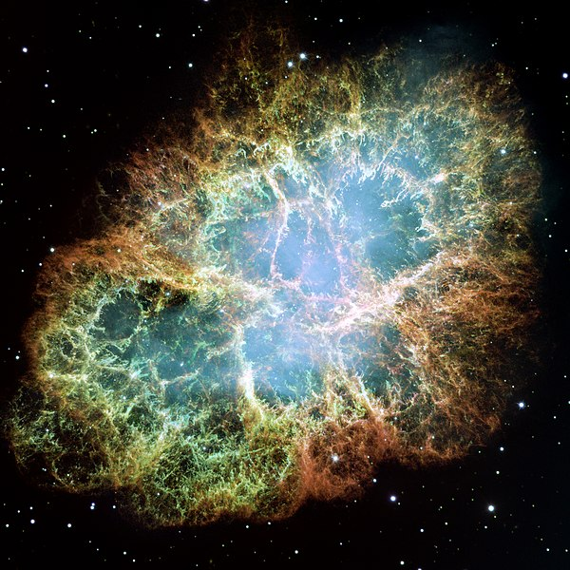
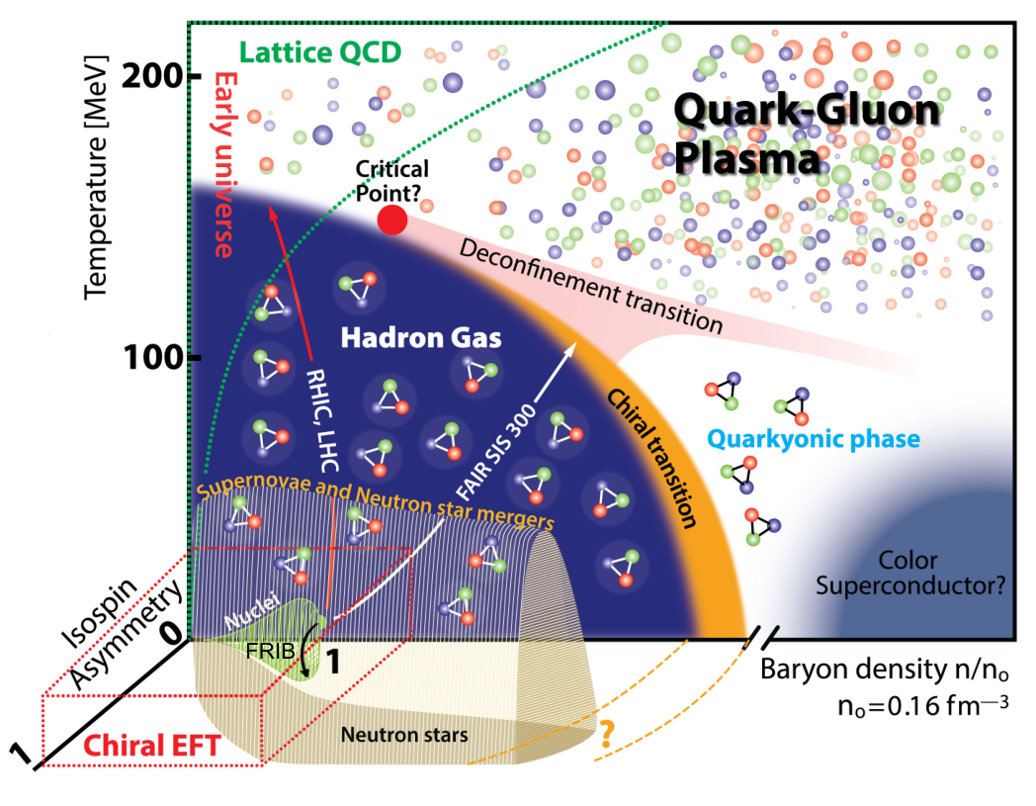
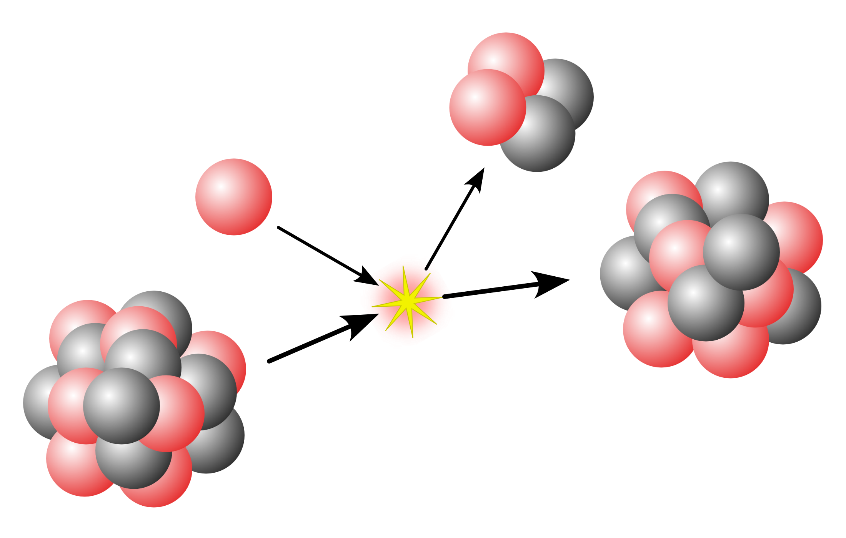
Motivation
Supernova
Nuclear interaction
EFT
Nuclear matter EOS
Many body perturbation theory
Neutron star

Slide 5
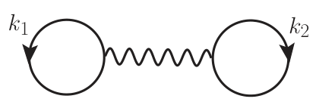
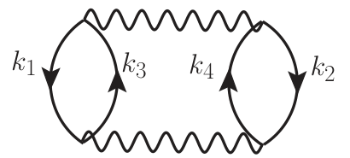
Motivation 1: Monte Carlo importance sampling for MBPT
Nuclear matter EOS: Mean-Field theory [1]
Nuclear matter EOS: Many body perturbation theory [2]
Order-by-order calculation
…
[1] H. Shen, H. Toki, K. Oyamatsu, K. Sumiyoshi, Nucl. Phys. A 637 (1998), 435-450
[2] Wellenhofer, Corbinian and Holt, Jeremy W. and Kaiser, Norbert and Weise, Wolfram, Phys. Rev. C 89 (2014) 6, 064009

Slide 6
Motivation 1: Monte Carlo importance sampling for MBPT
Nuclear matter EOS: Many body perturbation theory
…
High-order calculation: high-dimensional integrals

Slide 7
Motivation 1: Monte Carlo importance sampling for MBPT
Astrophysics simulation: tabulation of EOS under different $(n,T)$
 | $$n_{1}$$ | $$n_{2}$$ | …
$$T_{1}$$ | $$Ω_{11}$$ | $$Ω_{12}$$ | …
$$T_{2}$$ | $$Ω_{21}$$ | $$Ω_{22}$$ | …
… | … | … | …
Calculate high-dimensional integral repeatedly
$→$ computationally expensive
Training Wave function $→$ MCMC every iterations

Slide 8
Motivation 1: Monte Carlo importance sampling for MBPT
Supernova
Nuclear interaction
EFT
Nuclear matter EOS
Many body perturbation theory
Neutron star
A tool for high-precision integrations.
The precision can be transferred to other similar integrals conventionally.

Slide 9
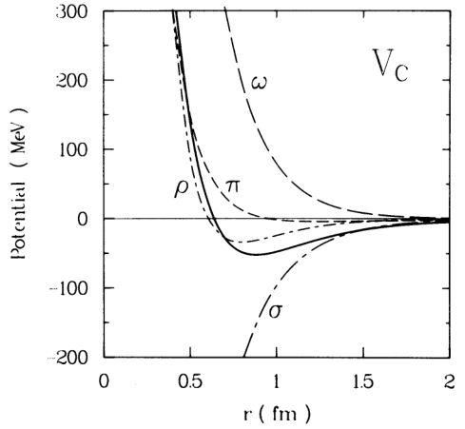
Motivation 2: Generative modeling of nuclear forces
Many nuclear interaction models
Yukawa potential
Paris, Argonne AV18, CD-Bonn, Nijmegen…

Slide 10
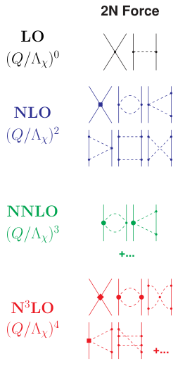
Motivation 2: Generative modeling of nuclear forces
Chiral Effective Theory
Degree of freedom: $π, p, n$
Build an interaction according to
Momentum expansion according to ${\left(\frac{Q}{Λ}\right)}^{ν}$
Chiral symmetry
Includes contact interactions and pion exchange interactions
Low Energy constants (LECs)

Slide 11
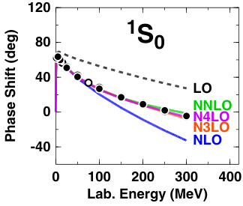
Motivation 2: Generative modeling of nuclear forces
Chiral Effective Theory (ChEFT)
Order $ν$
Cutoff $Λ$
Fit experimental data
n$ν$lo$Λ$
n2lo450 n2lo500 n2lo550
n3lo450 n3lo500 n3lo550
n4lo450 n4lo500 n4lo550

Slide 12
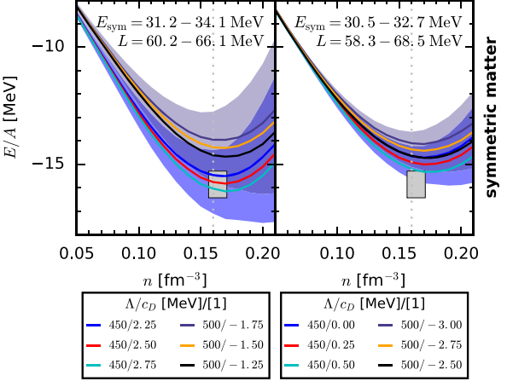
Motivation 2: Generative modeling of nuclear forces
Chiral Effective Theory (ChEFT)
Different $nνloΛ$ $→$ Uncertainties in theoretical calculation
1. Energy per particle [4]
[4] C. Drischler, K. Hebeler, and A. Schwenk, Phys. Rev. Lett. 122 (2019) 4, 042501

Slide 13
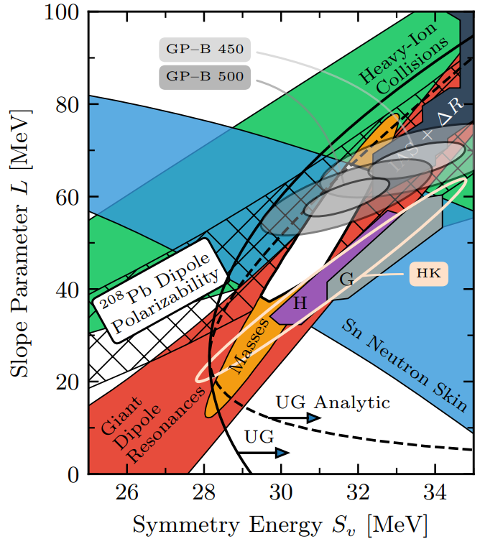
Motivation 2: Generative modeling of nuclear forces
Chiral Effective Theory (ChEFT)
Different $nνloΛ$ $→$ Uncertainties in theoretical calculation
Energy per particle
Slope Parameter – Symmetry Energy relation [5]
[5] C. Drischler, J.W. Holt, C. Wellenhofer, Ann. Rev. Nucl. Part. Sci. 71 (2021), 403-432

Slide 14
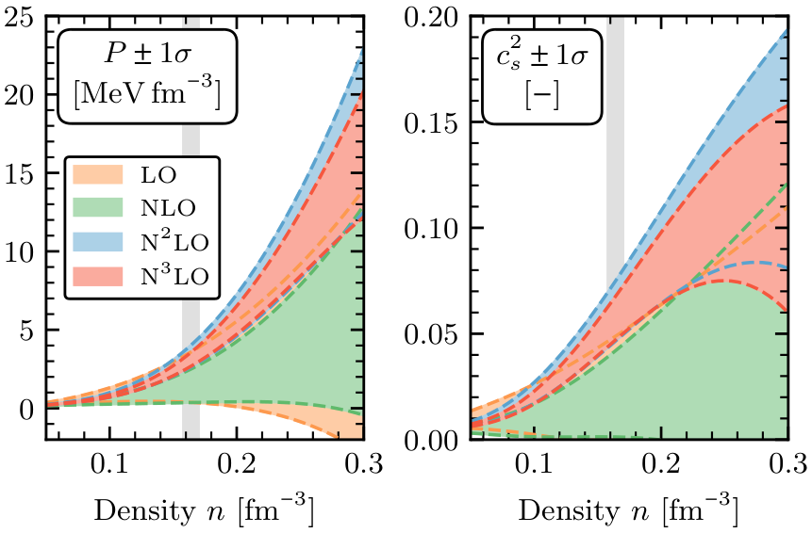
Motivation 2: Generative modeling of nuclear forces
Chiral Effective Theory (ChEFT)
Different $nνloΛ$ $→$ Uncertainties in theoretical calculation
Energy per particle
Slope Parameter – Symmetry Energy relation
Pressure and speed of sound [6]
[6] C. Drischler, J.W. Holt, C. Wellenhofer, Ann. Rev. Nucl. Part. Sci. 71 (2021), 403-432

Slide 15
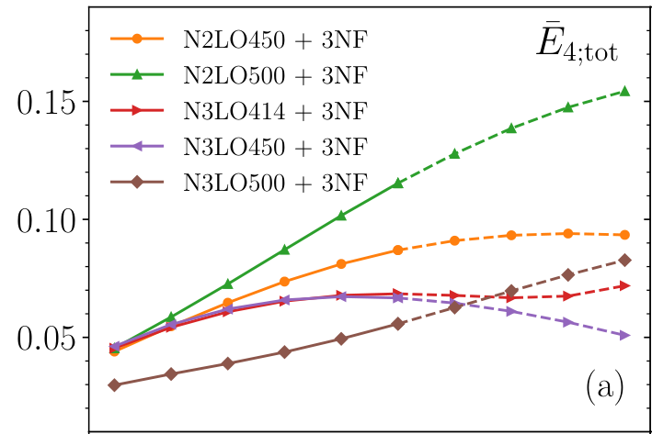
Motivation 2: Generative modeling of nuclear forces
Chiral Effective Theory (ChEFT)
Different $nνloΛ$ $→$ Uncertainties in theoretical calculation
Energy per particle
Slope Parameter – Symmetry Energy relation
Pressure and speed of sound
Proton fraction in $β$-equilibrium nuclear matter [7]
…
[7] Pengsheng Wen, Jeremy W. Holt, Phys. Rev. C 103 (2021) 6, 064002

Slide 16
Motivation 2: Generative modeling of nuclear forces
Chiral Effective Theory (ChEFT)
Different $nνloΛ$ $→$ Uncertainties in theoretical calculation
Energy per particle
Slope Parameter – Symmetry Energy relation
Pressure and speed of sound
Proton fraction in $β$-equilibrium nuclear matter
…
But generating a chiral potential is computationally expensive [8]
[8] B. D. Carlsson, A. Ekström, C. Forssén, D. Fahlin Strömberg, G. R. Jansen, O. Lilja, M. Lindby, B. A. Mattsson, K. A. Wendt, Phys. Rev. X 6 (2016) 1, 011019

Slide 17
Motivation 2: Generative modeling of nuclear forces
Supernova
Nuclear interaction
EFT
Nuclear matter EOS
Many body perturbation theory
Neutron star
A convenient method to build the distribution of chiral potentials and generate chiral potentials makes uncertainty estimation effectively.
A tool for high-precision integrations.
The precision can be transferred to other similar integrals conventionally.

Slide 18
Flow-Based model
Build transformation functions to transfer probability density distribution

Slide 19
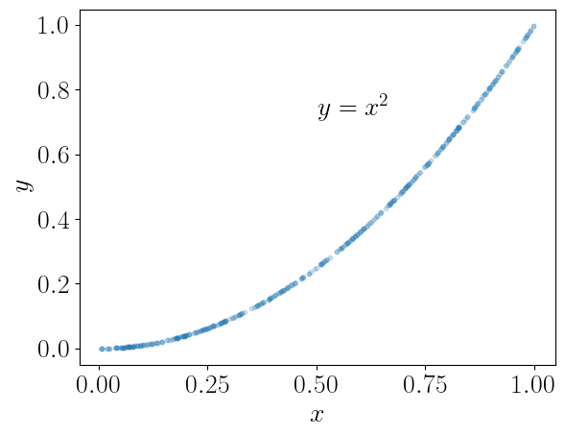
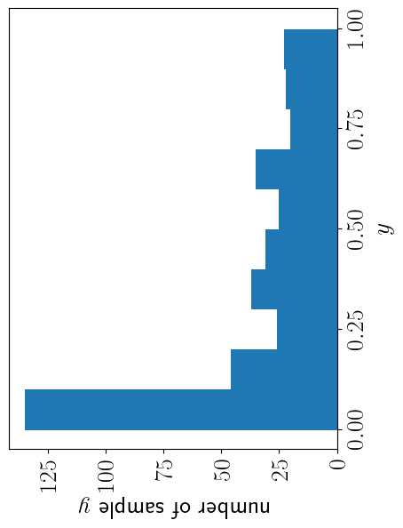
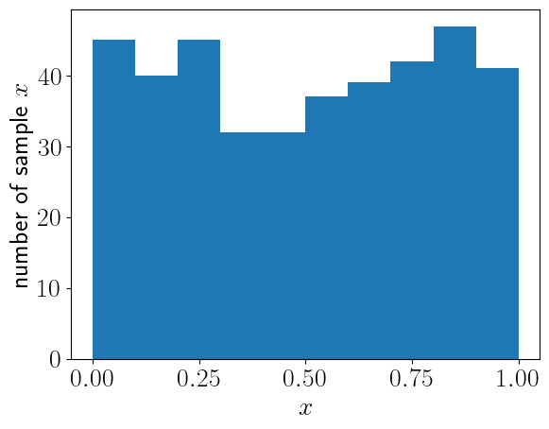
Flow-based models: Transform distributions
Transformation Function:
$\vec{y}=g_{θ}(\vec{x})$ $→$ $p\left(\vec{x}\right)→p^{′}\left(\vec{y}\right)=p\left(\vec{x}\right)\left|\frac{∂\vec{y}}{∂\vec{x}}\right|$
Transfer a simple distribution to a complicated distribution
Trainable transformation: Neural Networks $→$ $θ$ $→$ $g_{θ}$
In our work: Rational Quadratic Spline as transformation function

Slide 20
Importance Sampling
Monte Carlo Method For High Dimensional Integration

Slide 21
Importance Sampling: Monte Carlo Method
Monte Carlo Integration
Arbitrary PDF
Sampling According to probability density function (PDF) $p(\vec{x})$

Slide 22
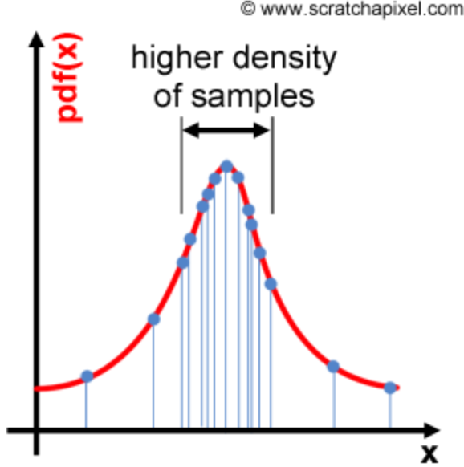
Importance Sampling: Variance
Variance of Monte Carlo Integration
$Var=E_{p}\left[{\left(\frac{ψ\left(\vec{X}\right)}{p\left(\vec{X}\right)}\right)}^{2}\right]−E_{p}{\left[\left(\frac{ψ\left(\vec{X}\right)}{p\left(\vec{X}\right)}\right)\right]}^{2}$
Importance Sampling
$p\left(\vec{x}\right)≈|ψ\left(\vec{x}\right)|/\tilde{I}$, $\tilde{I}$: normalizing constant
$Var=E_{p}\left[{\left(\frac{ψ\left(\vec{X}\right)}{p\left(\vec{X}\right)}\right)}^{2}\right]−E_{p}{\left[\left(\frac{ψ\left(\vec{X}\right)}{p\left(\vec{X}\right)}\right)\right]}^{2}≈{\tilde{I}}^{2}−{\tilde{I}}^{2}=0$
Focus on important parts
How to sample points according to $\left|ψ\left(\vec{x}\right)\right|/\tilde{I}$?

Slide 23
Normalizing Flow: Workflow
$$\vec{x}=(x_{1},x_{2},x_{3},x_{4},x_{5})$$
Initial uniform PDF $p_{0}=\frac{1}{V}$
NN1($d_{2},d_{5}$)$→r_{θ}^{\left(1\right)}$
1st transformation
$$\left(r_{θ_{1}}^{\left(1\right)}\left(x_{1}\right), x_{2}, r_{θ_{3}}^{\left(1\right)}\left(x_{3}\right),r_{θ_{4}}^{\left(1\right)}\left(x_{4}\right),x_{5}\right)$$
NN2($d_{1},d_{3},d_{5}$)$→r_{θ}^{\left(2\right)}$
2nd transformation
$$\left(r_{θ_{1}}^{\left(1\right)}\left(x_{1}\right),r_{θ_{2}}^{\left(2\right)}(x_{2}),r_{θ_{3}}^{\left(1\right)}\left(x_{3}\right),r_{θ_{4}}^{\left(1\right)}\left(x_{4}\right),r_{θ_{5}}^{\left(2\right)}(x_{5})\right)$$
$L$-th transformation
$${\vec{x}}^{\left(L\right)}$$
Final complicated PDF $p_{K}$

Slide 24
Normalizing Flow: Loss Function and Training
1. Loss Function: Measure the difference between $p(\vec{x})$ and $\left|ψ\left(\vec{x}\right)\right|/I$
The transformation is determined by parameters $θ$
$θ$ are generated by NN
$→$ Loss Function is determined by NN
$→$ Apply Adam descent optimization algorithm to optimize NN
$→$ Training NN so that it can build suitable transformation function
$→$ $p\left(\vec{x}\right)≈|ψ\left(\vec{x}\right)|/\tilde{I}$

Slide 25
Normalizing Flow: Transferability
Training a normalizing flow at a given physical condition
Using the trained normalizing flow at different physical conditions
$p\left(\vec{x},n_{0},T_{0}\right)≈|ψ\left(\vec{x},n_{0},T_{0}\right)|/\tilde{I}\left(n_{0},T_{0}\right)→$ $Ω^{(2)}\left(n_{0},T_{0}\right)$
$p\left(\vec{x},n_{0},T_{0}\right)≈|ψ\left(\vec{x},n_{1},T_{1}\right)|/\tilde{I}\left(n_{1},T_{1}\right)→$ $Ω^{(2)}\left(n_{1},T_{1}\right)$
$p\left(\vec{x},n_{0},T_{0}\right)≈|ψ\left(\vec{x},n_{2},T_{2}\right)|/\tilde{I}\left(n_{2},T_{2}\right)→$ $Ω^{(2)}\left(n_{2},T_{2}\right)$
$p\left(\vec{x},n_{0},T_{0}\right)≈|ψ\left(\vec{x},n_{3},T_{3}\right)|/\tilde{I}\left(n_{3},T_{3}\right)→$ $Ω^{(2)}\left(n_{3},T_{3}\right)$
……

Slide 26
Numerical Result
Application Of Normalizing Flow

Slide 27
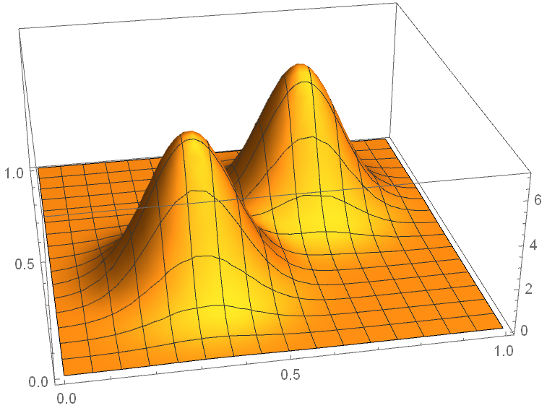
Numerical Result: 2D Camel Function
Iteration: 50-2000

Slide 28
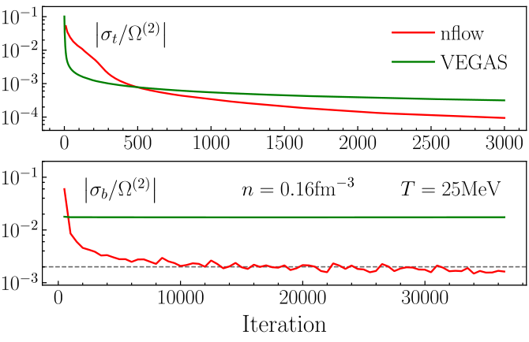
Numerical Result: Grand Canonical Potential at 2nd order
Estimate $Ω^{\left(2\right)}$ and training nflow
physical condition: $\left(ρ,T\right)=\left(0.16 fm^{−1},25 MeV\right)$
nuclear potential: scalar-meson interaction
5k samples at each iteration
VEGAS convergences very quickly
nflow reaches an order of magnitude of improvement [9]
Total uncertainty: total samples
Batch uncertainty: 5k samples
[9] J. Brady, P. Wen and J. W. Holt, Phys. Rev. Lett. 127, 062701 (2021)

Slide 29
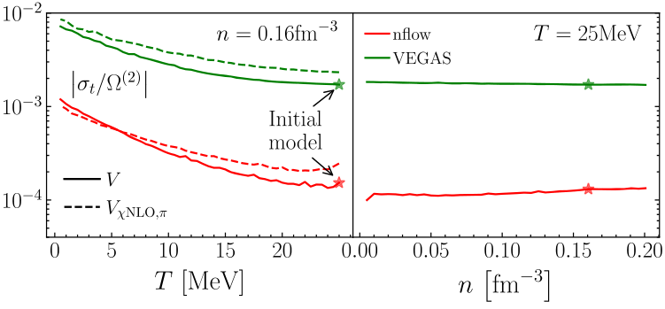
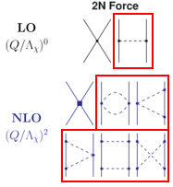
Numerical Result: Grand Canonical Potential at 2nd order
Estimate $Ω^{\left(2\right)}$ using trained nflow
Varying temperature $T$
Varying nuclear density $n$
Changing unclear interaction:
Scale-meson interaction $→$ $χ$EFT
100 iterations at each physical condition

Slide 30
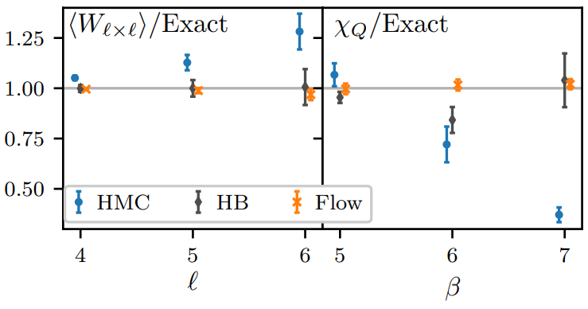
Numerical Result: normalizing flow for Lattice QCD calculation
Distribution of gauge variables
Sample $U$ from initial uniform distribution
$→$ $U′=nflow(U)$ nflow: gauge-equivariant coupling layers [8]
$U(1)$ gauge theory
$U(1)$ gauge theory
MCMC
MCMC
Exploring the distribution of topological charge $Q$
$l×l$ Wilson loop
Topological
susceptibility
[10] Gurtej Kanwar et al, Phys. Rev. Lett. 125, 121601 (2020)

Slide 31
Nuclear potential modeling
Use flow-based model for maximizing likelihood

Slide 32
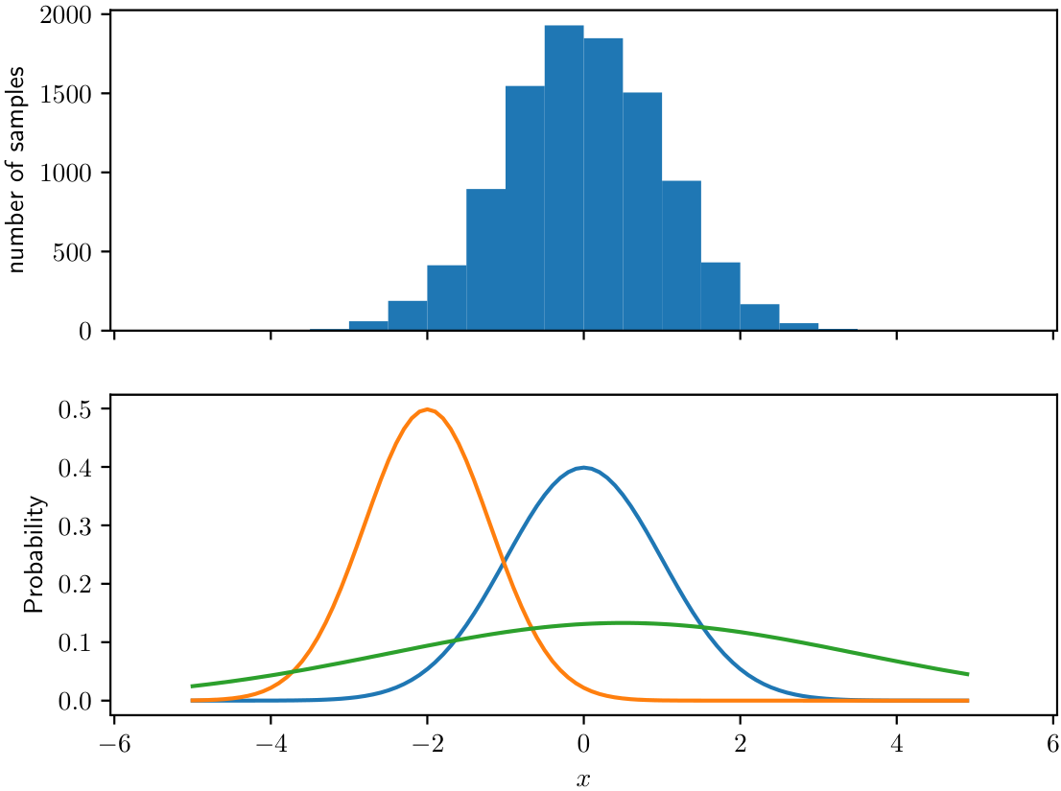
Maximize likelihood
Maximize likelihood: capture the properties of a given set of samples
Example: $x∼$ $𝒩\left(μ=0,σ=0.1\right)$
$$ℒ_{1}=\prod_{i}{𝒩\left(X_{i};μ=0,σ=0.1\right)}$$
$$ℒ_{2}=\prod_{i}{𝒩\left(X_{i};μ=−2,σ=0.8\right)}$$
$$ℒ_{3}=\prod_{i}{𝒩\left(X_{i};μ=0.5,σ=3\right)}$$
$$→\max{(ℒ_{1},ℒ_{2},ℒ_{3})}=ℒ_{2}$$
A proper probability distribution model 𝒩(𝜇, 𝜎) $→$ the maximum likelihood $ℒ$

Slide 33
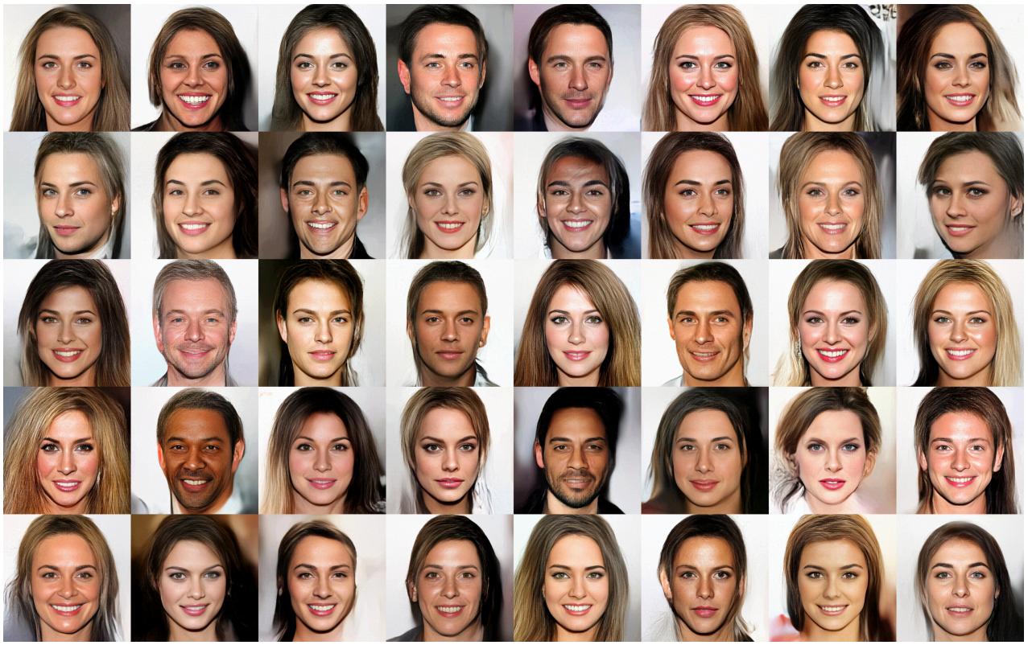
Generative flow (Glow) models
Glow: generate realistic faces
Nuclear Potential

Slide 34
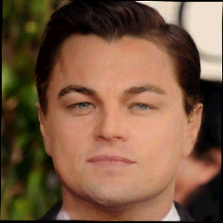
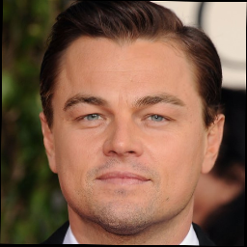
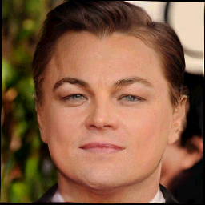
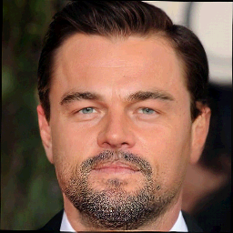
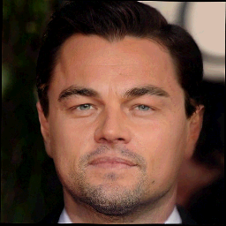
Generative flow (Glow) models
Glow: Manipulate attributes of a face
Nuclear Potential
Age
Original face
Glow
Beard
Blonde Hair

Slide 35
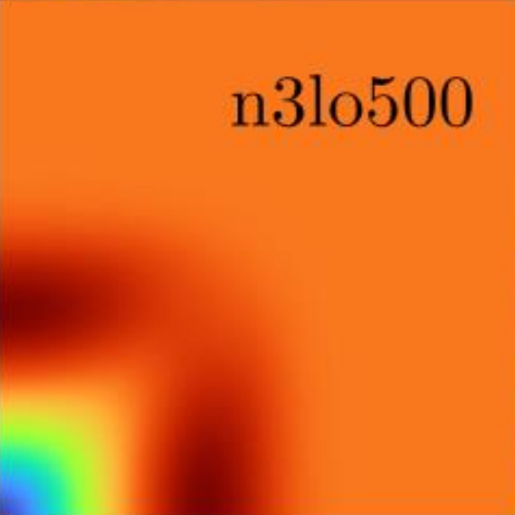
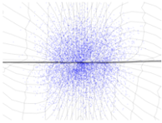
Glow: Workflow
(chiral order, cutoff)
$$Labels(\vec{x})$$
$$\vec{x}=(x_{1}, x_{2},..,x_{2k−1},x_{2k})$$
Data space:
chiral potentials
(tensors)
Flow Transformation
$$\vec{x}=f_{θ}\left(\vec{x}\right)$$
$$L×$$
$$μ, σ=NN(Labels)$$
$$𝓛\left(\vec{x}\right)=\prod_{i}{𝒩\left({\vec{x}}_{i};μ_{i} σ_{i}\right)}×q({\vec{x}}_{i};f_{θ})$$
Latent space:
Gaussian

Slide 36
Glow: Loss Function and Training
Trainable parameters:
1. Transformation functions
2. NNs for building base distributions
Likelihood is determined by
1. transformation functions
2. base distributions
Maximize likelihood = optimize trainable parameters
Define $Loss = − likelihood$
Adam $→$ $Loss$ $→$ $Likelihood$

Slide 37
Glow: Build distributions and sampling
The trained NNs can build proper gaussian distribution
${\vec{μ}}_{infer},{\vec{σ}}_{infer}=NN(Labels)$
Sample points from the built gaussian distribution
${\vec{y}}_{infer}∼𝒩({\vec{μ}}_{infer},{\vec{σ}}_{infer})$
Transform back to the realistic space
${\vec{X}}_{infer}=f_{θ}^{−1}\left({\vec{Y}}_{infer}\right)$

Slide 38
Glow: Generate target potentials
Given best-fitted Chiral potentials at different $Λ$s.
Using forward Glow to get potentials in latent space.
Interpolate in latent space for target $Λ$.
Using backward Glow to get potentials in realistic space.
Sample 1
Sample 2
Interpolation
Target

Slide 39
Glow: Similarity Renormalization Group
Similarity Renormalization Group (SRG)
From high energy to low energy $V_{init}→V_{λ}$
Observables $⟨\hat{O}⟩$ should be invariant
For a matrix element $V_{λ}(k,k′)$ far from the diagonal, it is suppressed by:
$V_{λ}≈V_{init}e^{−\frac{{\left(k^{2}−{k^{′}}^{2}\right)}^{2}}{λ^{4}}}$
SRG dataset: {sample: $V_{λ}\left(p,p^{′}\right)$; label: $λ$}

Slide 40
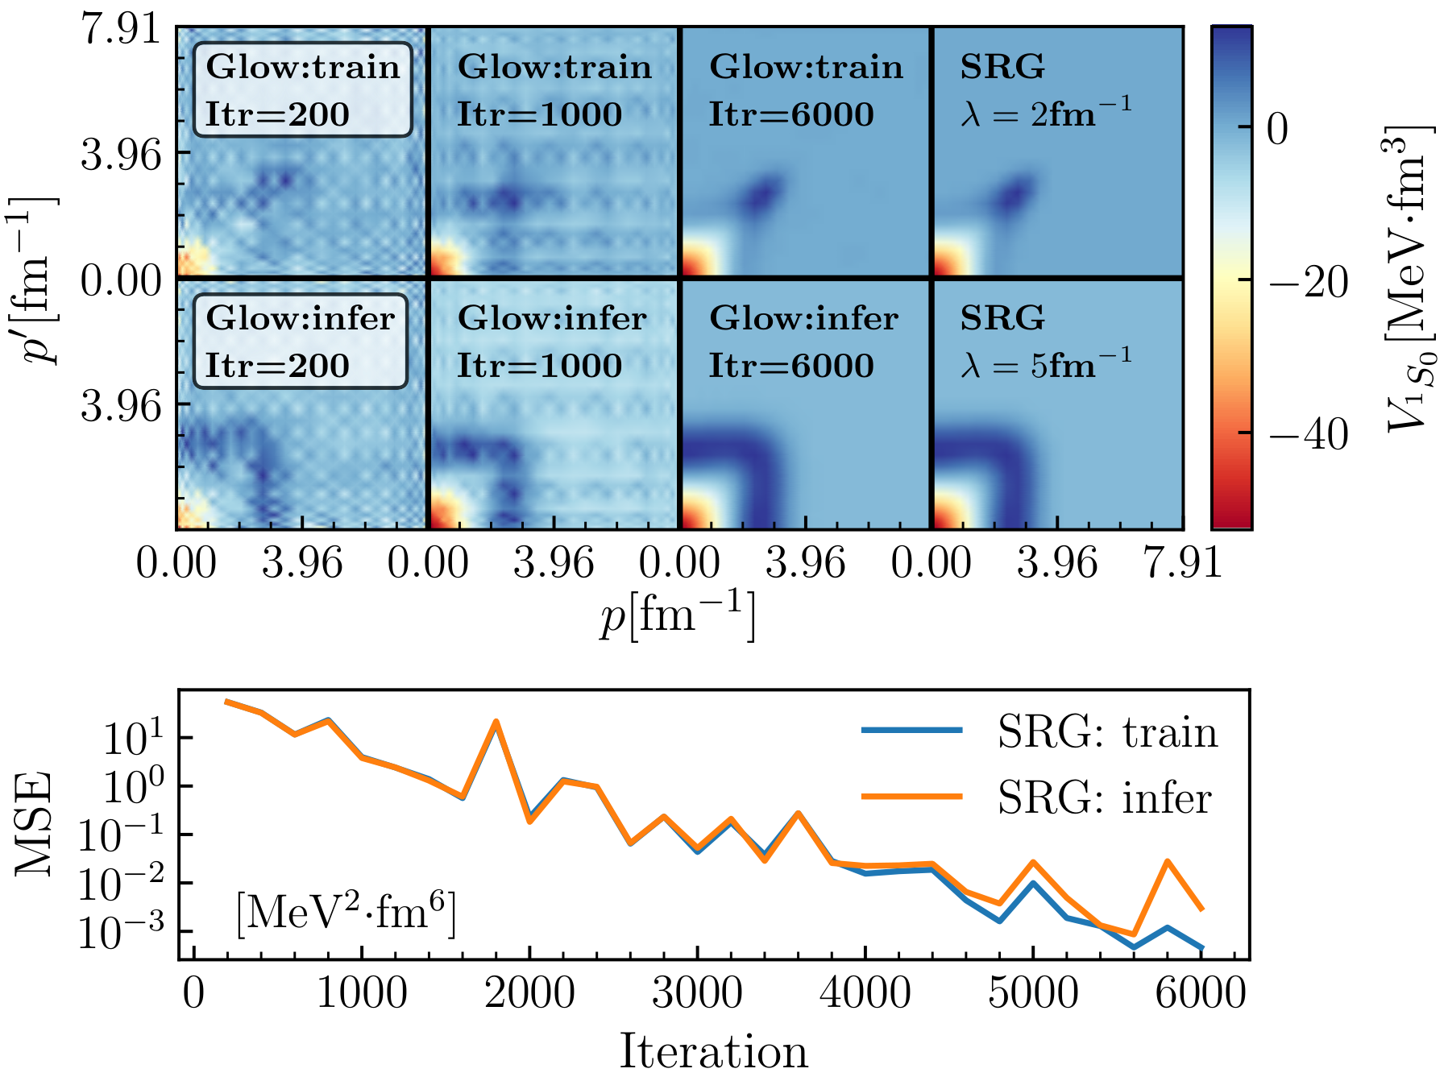
Glow: Similarity Renormalization Group
Training and inference for similarity renormalization group potentials

Slide 41
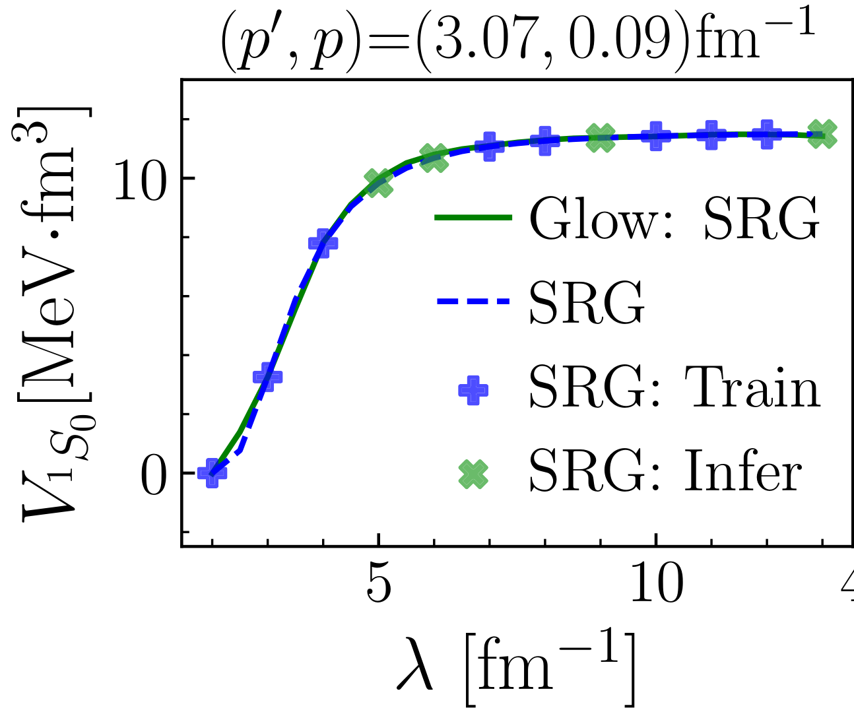
Glow: Similarity Renormalization Group
Rebuild the SRG potentials precisely.
Predict SRG potentials at arbitrary $λ$ values precisely.
Learn the suppression property of the high-momentum off-diagonal matrix elements:
$$V_{λ}≈V_{init}e^{−\frac{{\left(p^{2}−{p^{′}}^{2}\right)}^{2}}{λ^{4}}}$$

Slide 42
Glow: Chiral Potentials
Chiral Potentials $nνloΛ$
n2lo450 n2lo500 n2lo550
n3lo450 n3lo500 n3lo550
n4lo450 n4lo500 n4lo550
Chiral Potentials Dataset:
{sample: $nνloΛ$; label: $\left(ν,Λ\right)$}

Slide 43
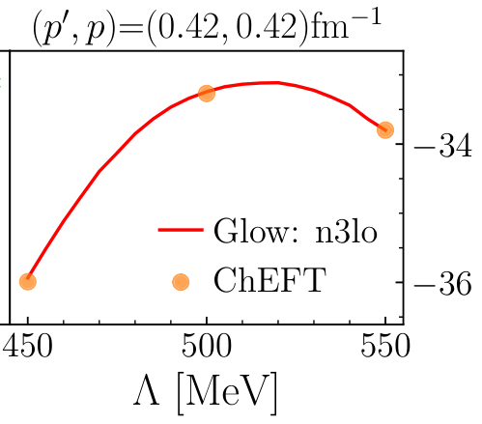
Glow: Chiral Potentials
Rebuild original chiral potentials precisely
Predict reasonable chiral potentials at arbitrary cutoffs

Slide 44
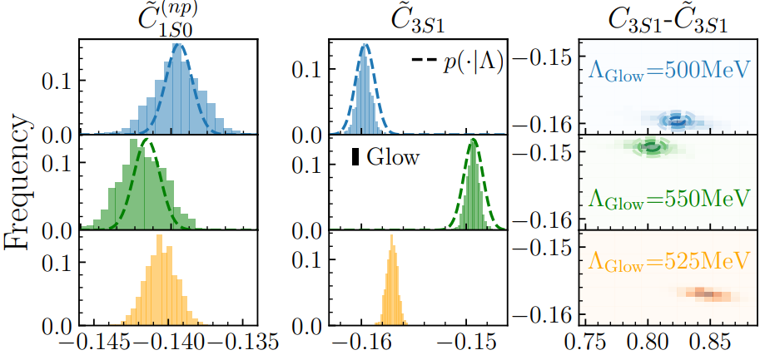
Glow + ViT: Chiral Potentials
Vision Transformer Model (ViT):
extract LECs and $Λ$ from potentials
Glow:
rebuild $p\left(V_{χ} | Λ\right)$ precisely
predict reasonable $p(V_{χ}|Λ )$ at arbitrary $Λ$

Slide 45
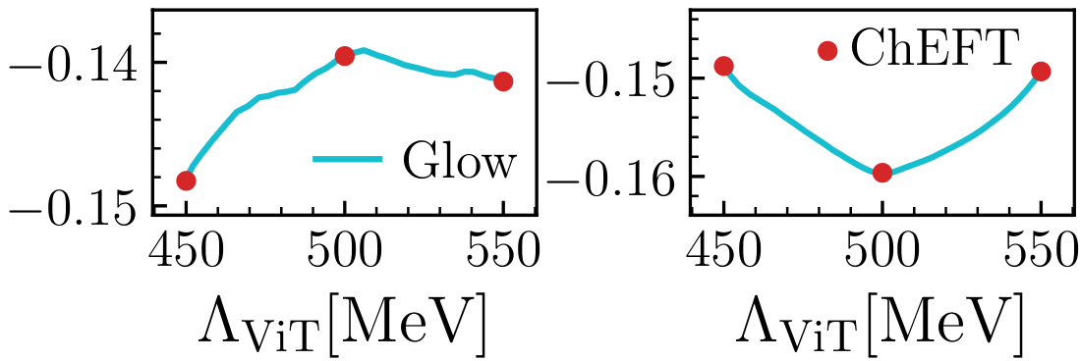
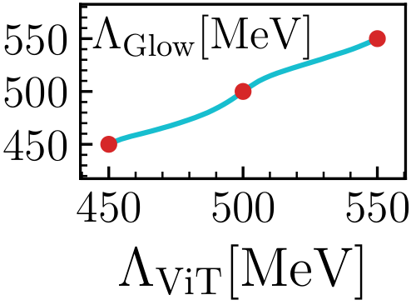
Glow + ViT: Chiral Potentials
Glow:
Rebuild $V_{χ}$ precisely
Predict reasonable $V_{χ}$
Glow:
Understand the evolution of $V_{χ}$ with Λ

Slide 46
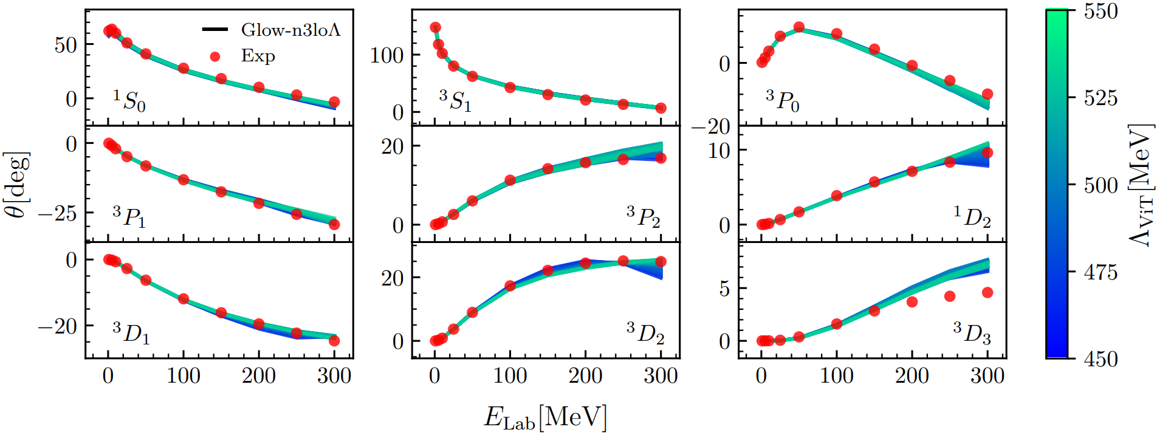
Glow + ViT: Chiral Potentials
Good phase shift result $→$ The Glow-generated potentials are physically reasonable
Reveal the uncertainty from $Λ$

Slide 47
Summary

Slide 48
Summary
Normalizing flow is good at high dimensional integration
A trained normalizing flow can be used to calculate similar integrals precisely
Glow model can learn the properties of nuclear potentials
Glow model can be used for nuclear potential modeling
The Low Energy Constants at arbitrary cutoffs can be revealed by the combination of Glow and ViT models.

Slide 49
Thank you!

