Slide 1
Unbiasing time-dependent Variational Monte Carlo by projected quantum evolution
[Sinibaldi, Giuliani, Carleo, Vicentini, arXiv:2305.14294 (2023)]
Alessandro Sinibaldi
September 2023 - ECT workshop Trento

Slide 2
Overview
Numerical challenges in variational Monte Carlo methods
Bias problem
Signal to noise ratio analysis

Slide 3
Overview
Numerical challenges in variational Monte Carlo methods
Bias problem
Signal to noise ratio analysis
Projected time-dependent Variational Monte Carlo
Infidelity optimization
Control variates
Importance sampling

Slide 4
Overview
Numerical challenges in variational Monte Carlo methods
Bias problem
Signal to noise ratio analysis
Projected time-dependent Variational Monte Carlo
Infidelity optimization
Control variates
Importance sampling
non-Clifford unitary dynamics with random measurements in 2D

Slide 5
Numerical challenges in VMC/tVMC

Slide 6
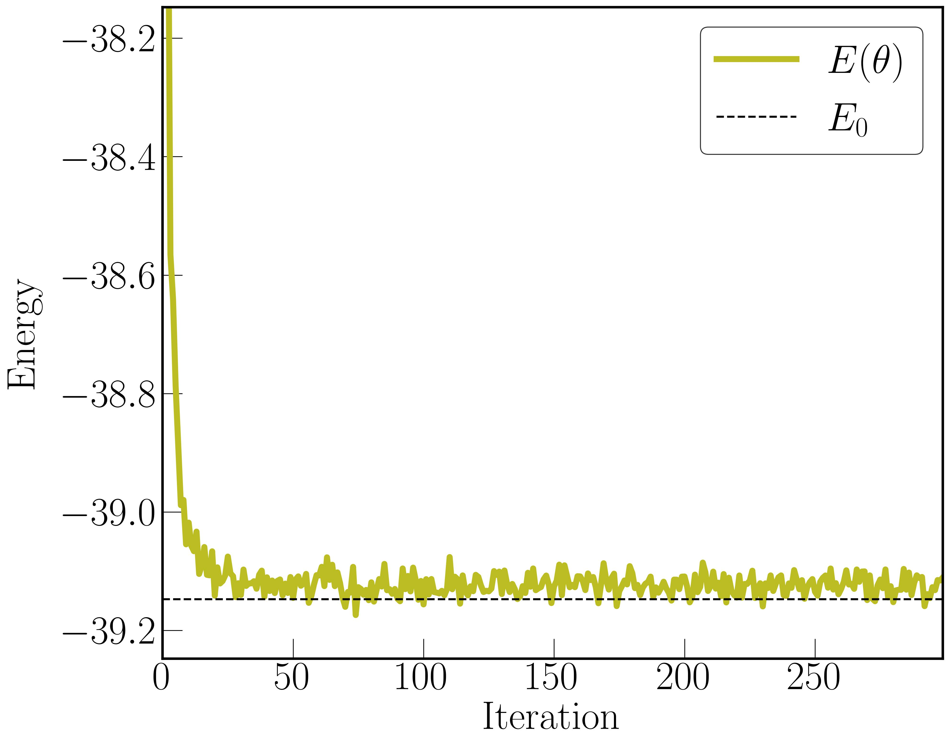
VMC for ground state
We need the energy gradient :
[McMillan, Phys. Rev., 138:A442–A45 (1965)]

Slide 7
time-dependent Variational Monte Carlo
VMC for dynamics: tVMC
Minimize the Fubini-Study distance :
[Carleo, Becca et al., Scientific Reports 2, 243 (2012)]

Slide 8
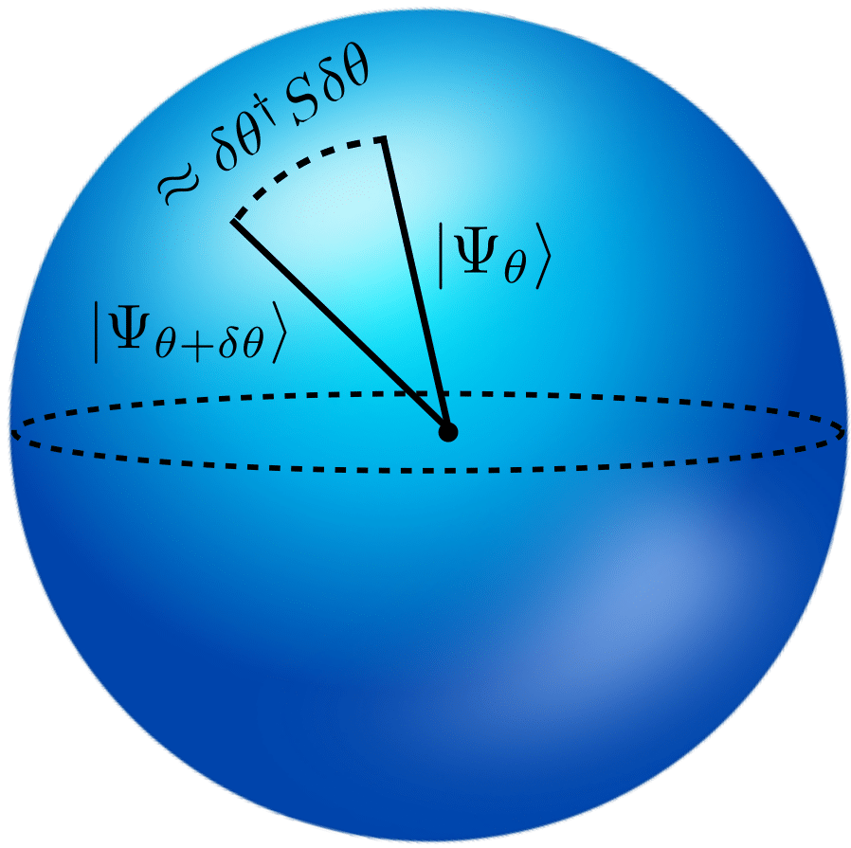
time-dependent Variational Monte Carlo
VMC for dynamics: tVMC
Minimize the Fubini-Study distance :
QGT
[Carleo, Becca et al., Scientific Reports 2, 243 (2012)]

Slide 9
Biases in and

Slide 10
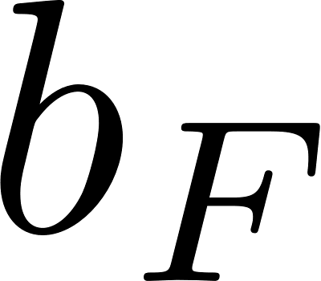
Biases in and
bias

Slide 11
Biases in and
bias

Slide 12
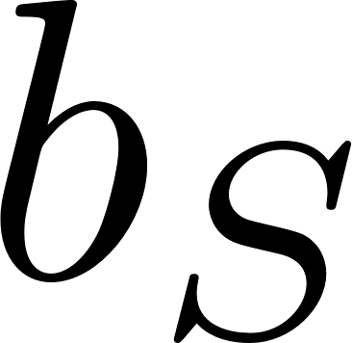
Biases in and
bias
bias

Slide 13
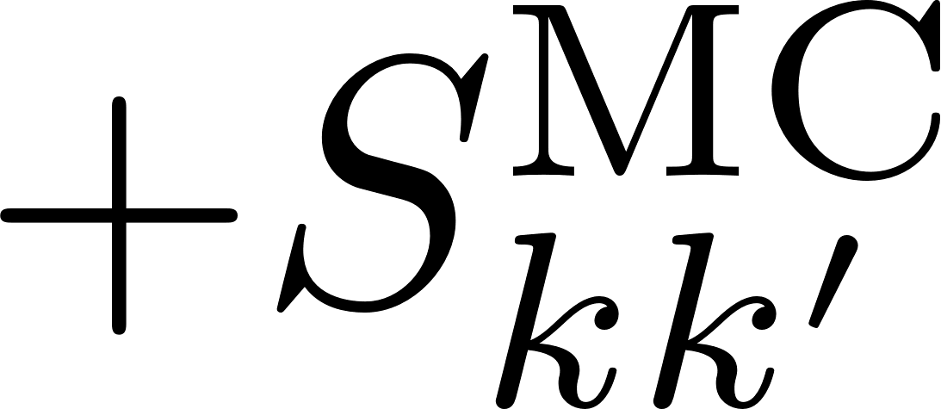
Biases in and
bias
bias

Slide 14
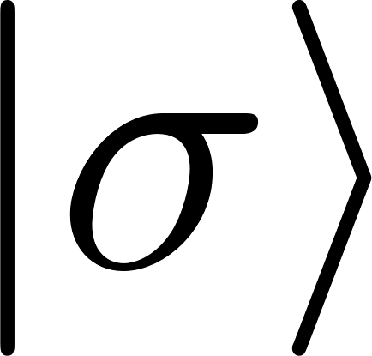
Biases in and
bias
Cases when :
bias
basis states
anti-symmetric wave functions
states in digital quantum circuits
states subject to projective measurements
ground state of frustrated systems
METTS states
thermofield double states

Slide 15
Examples of bias
1 spin
2 spins

Slide 16
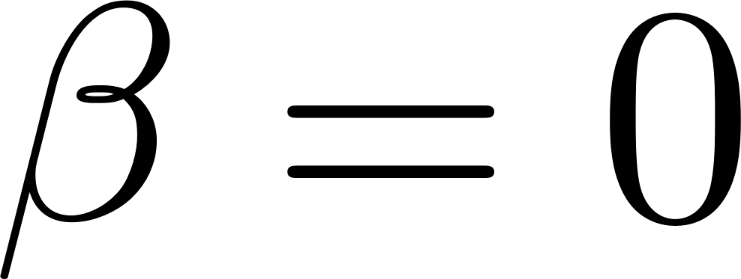
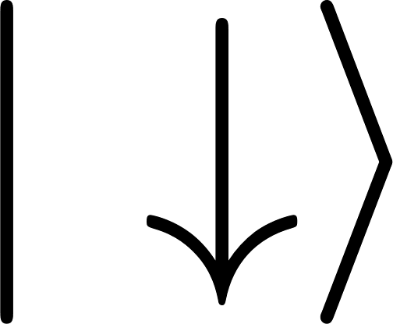
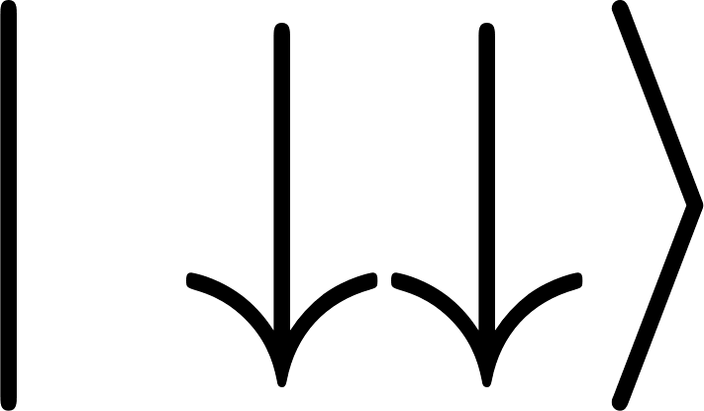
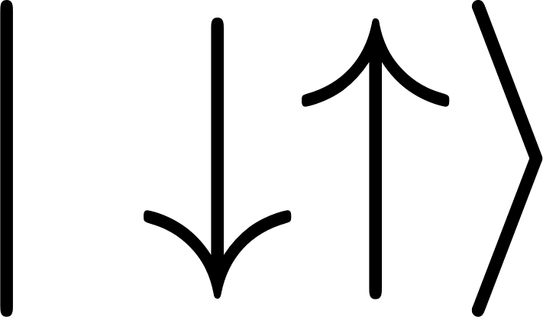
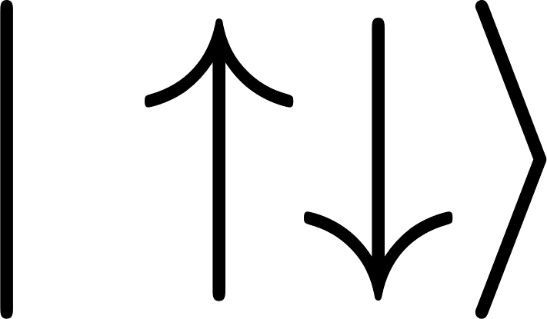
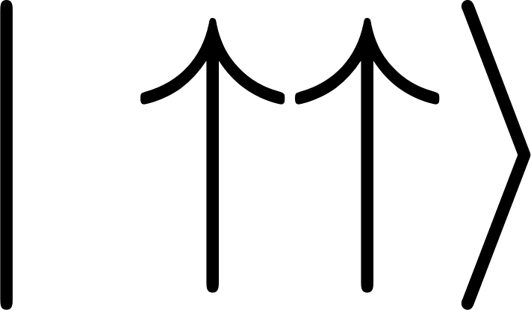
Examples of bias
1 spin
2 spins

Slide 17
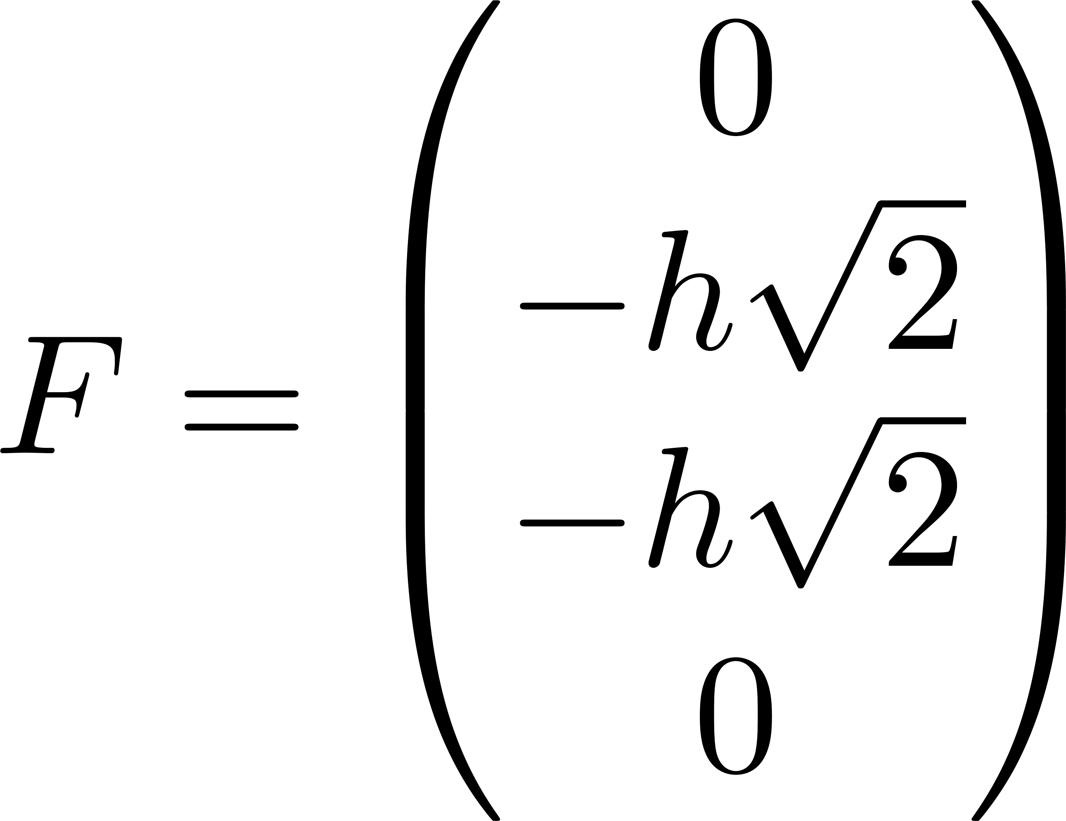
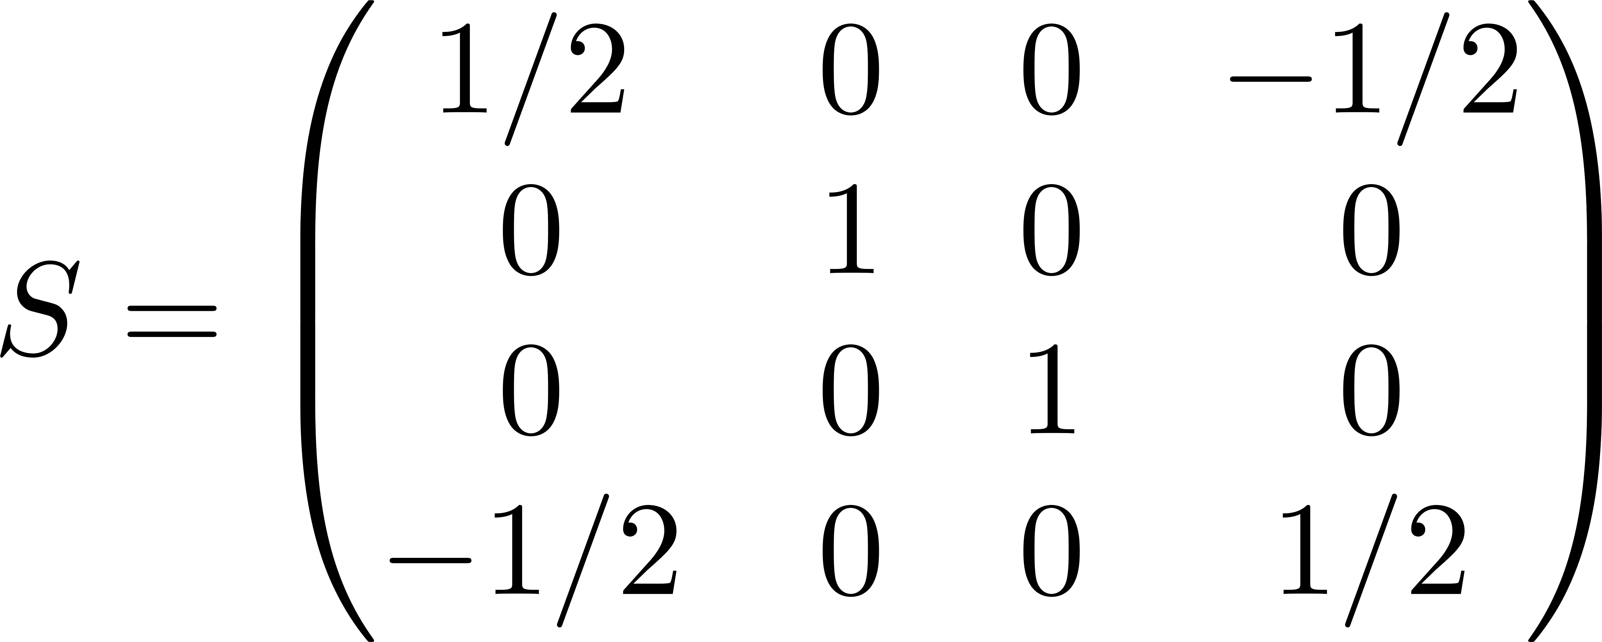
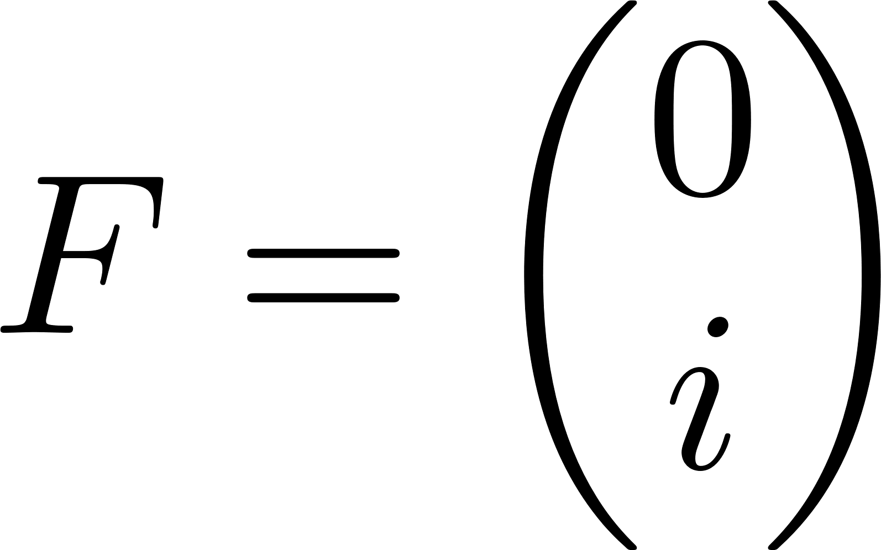
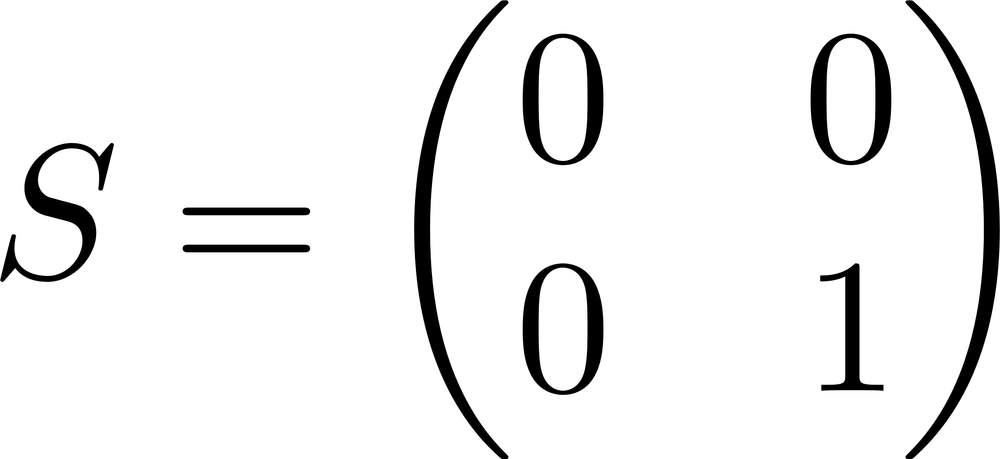
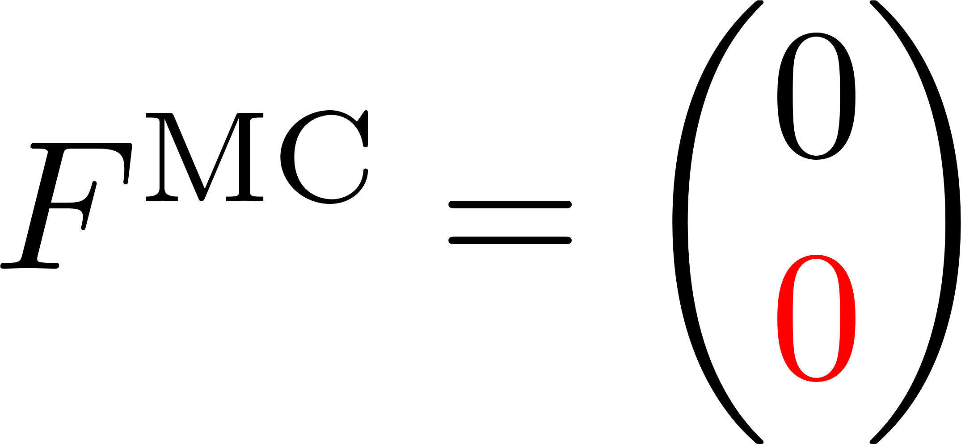
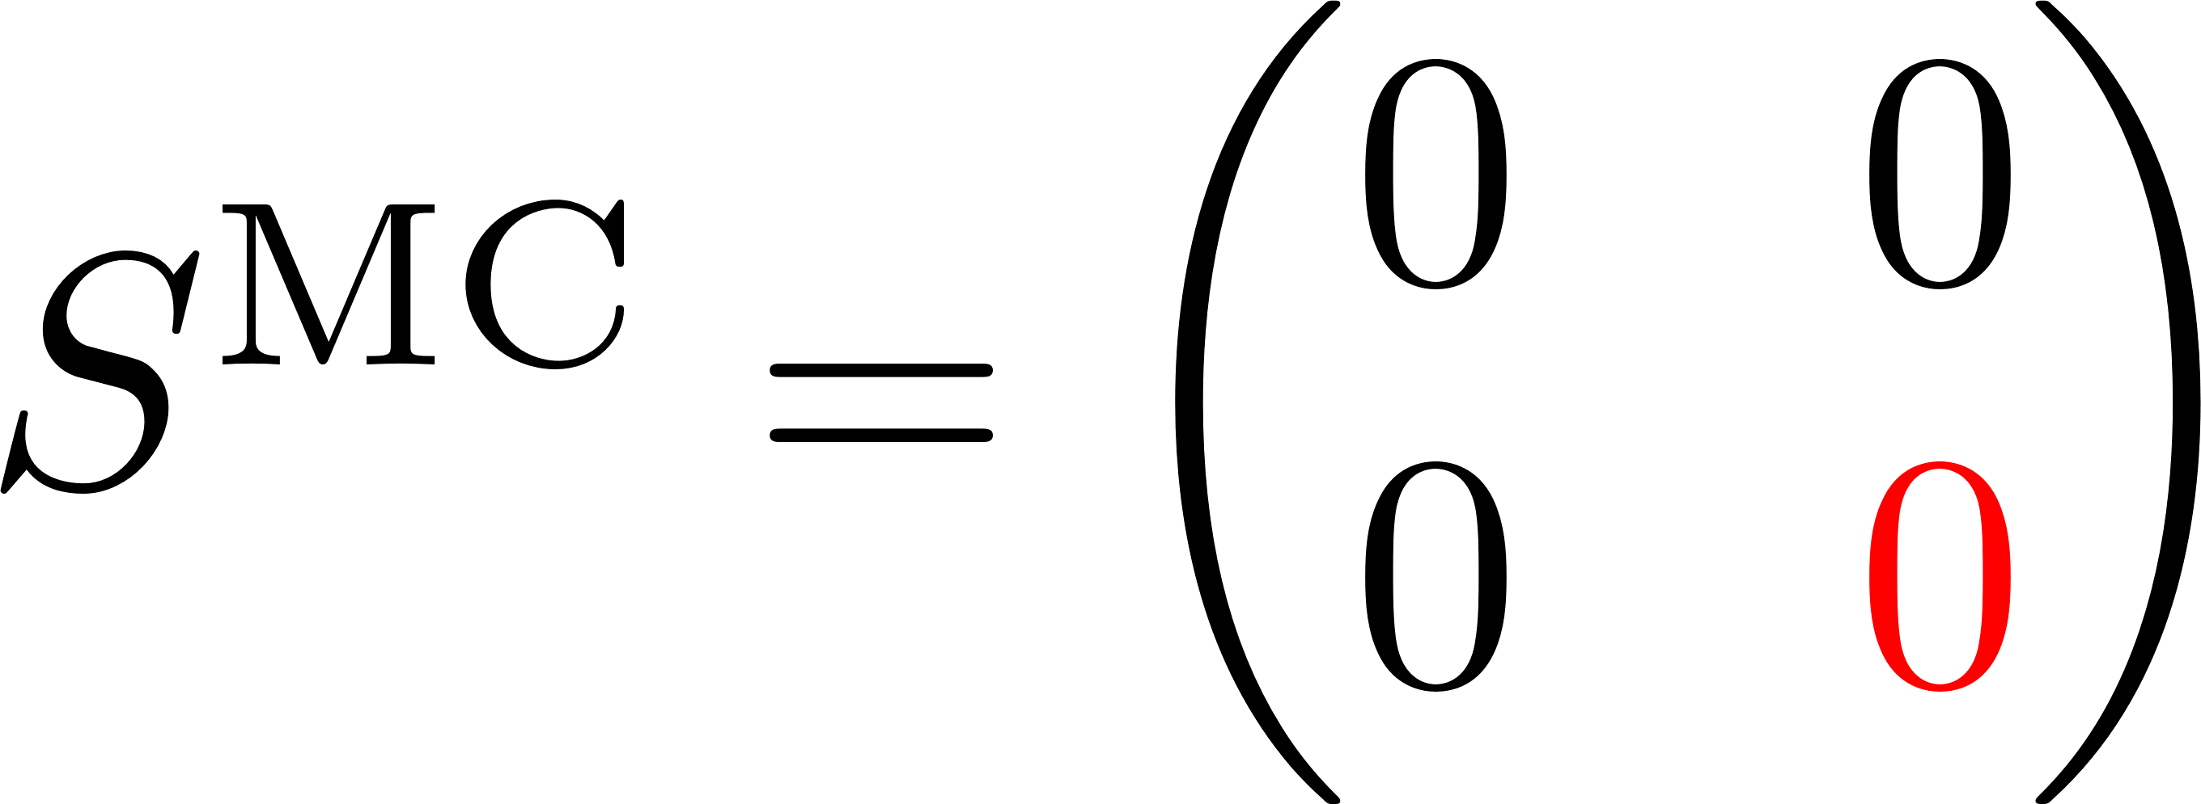
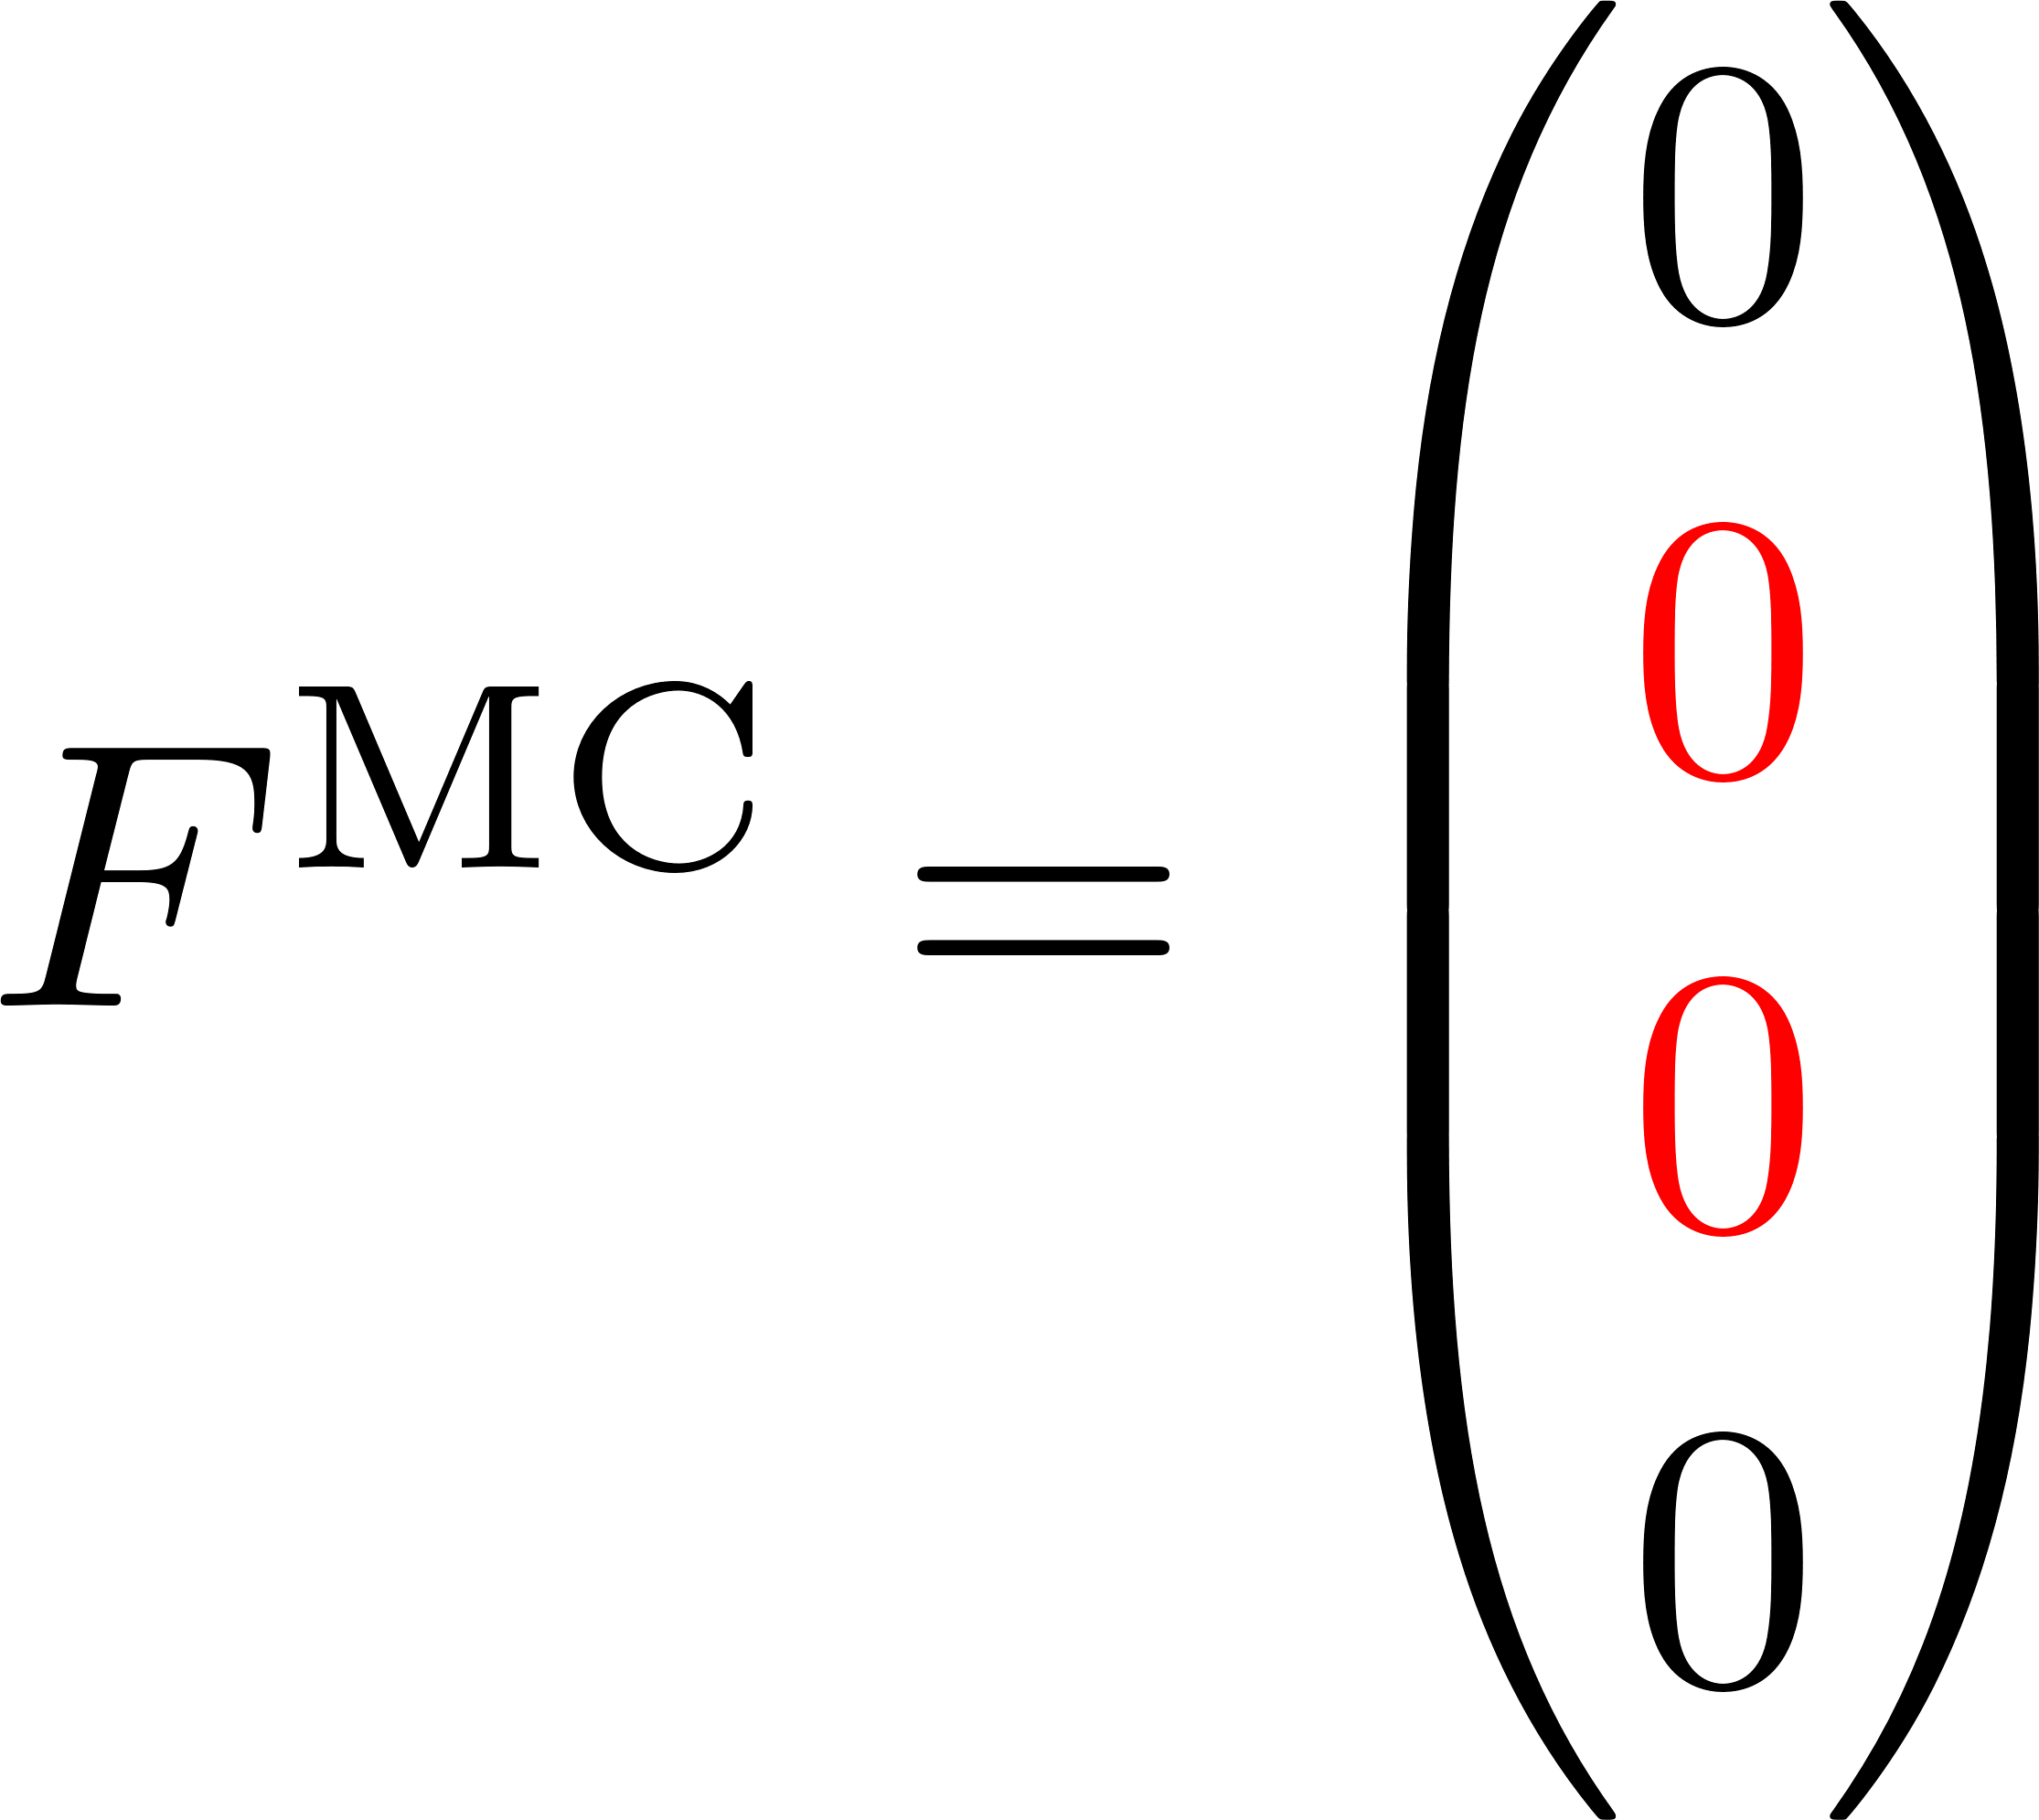
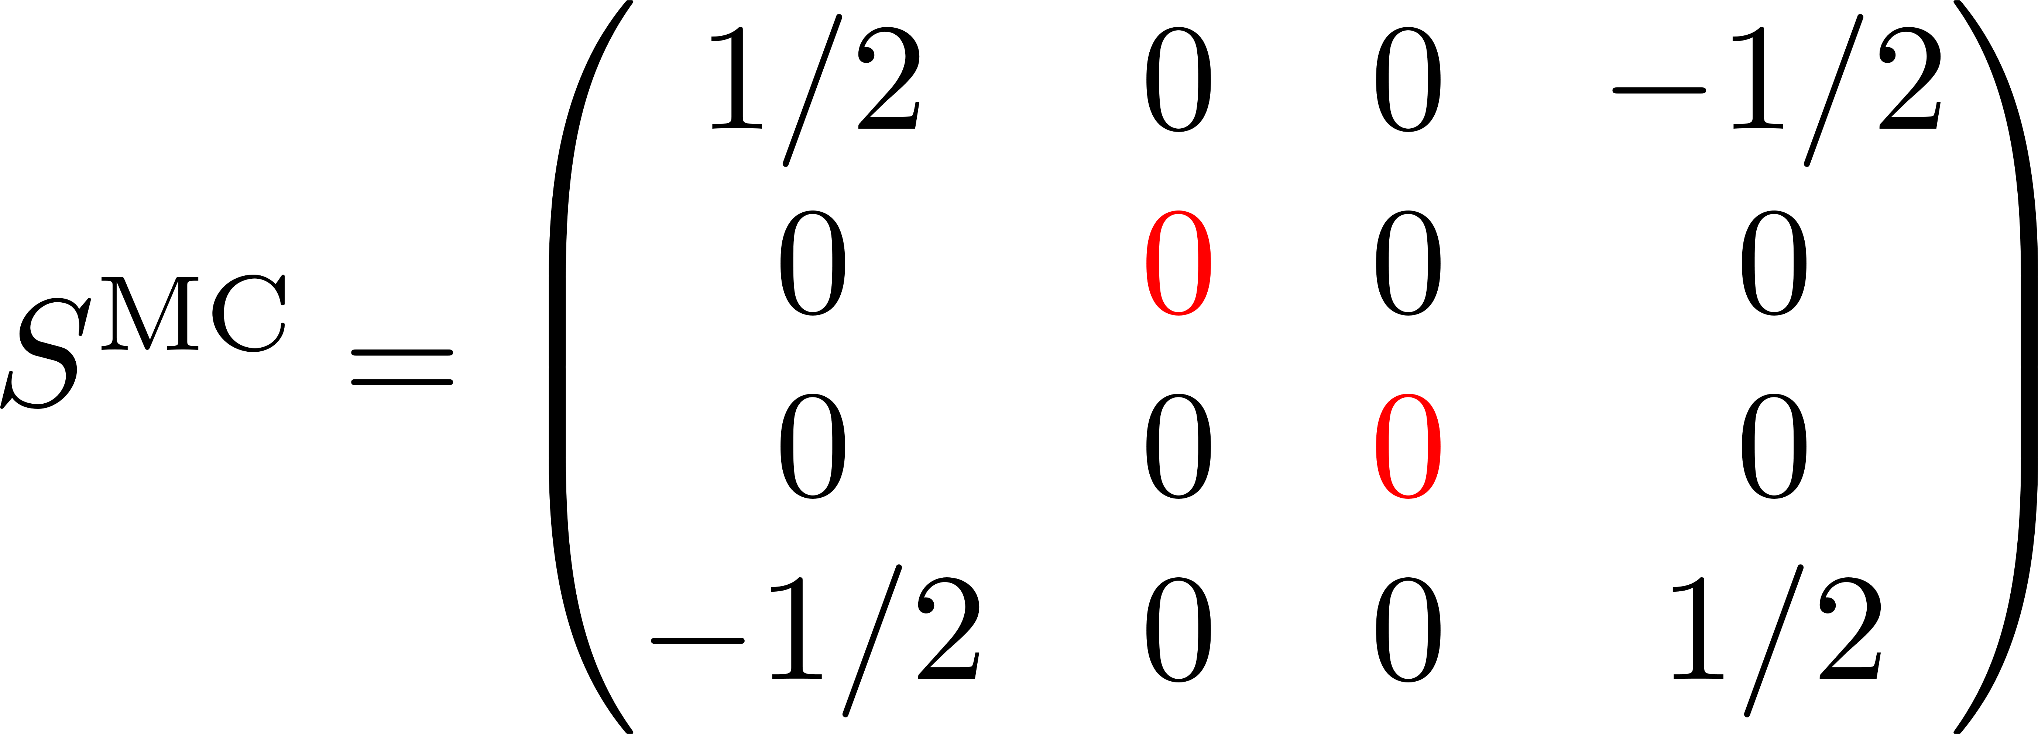
Examples of bias
1 spin
2 spins

Slide 18
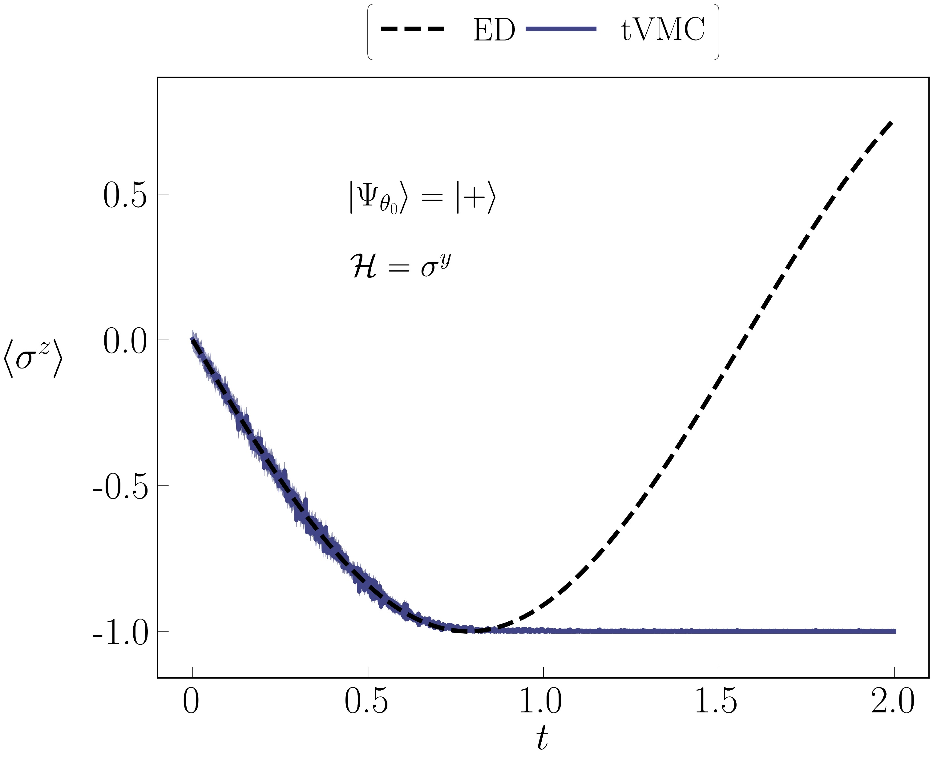
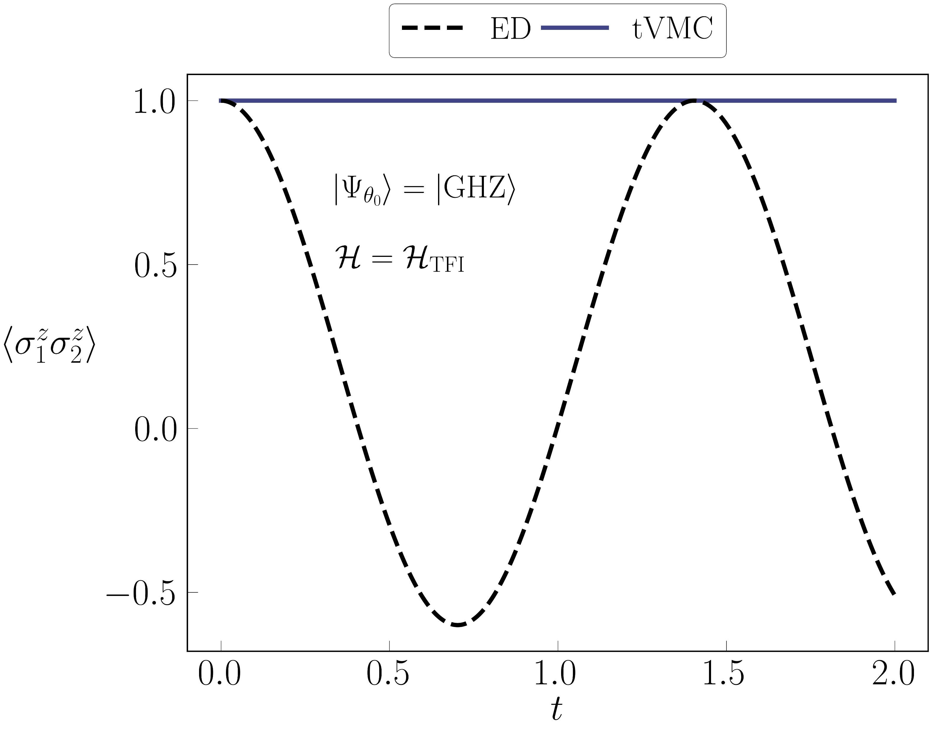
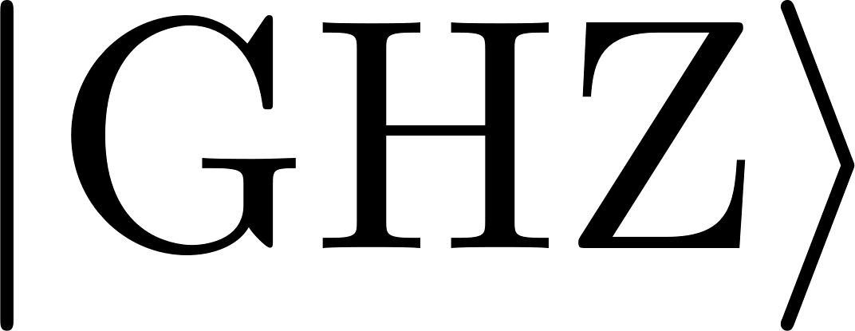
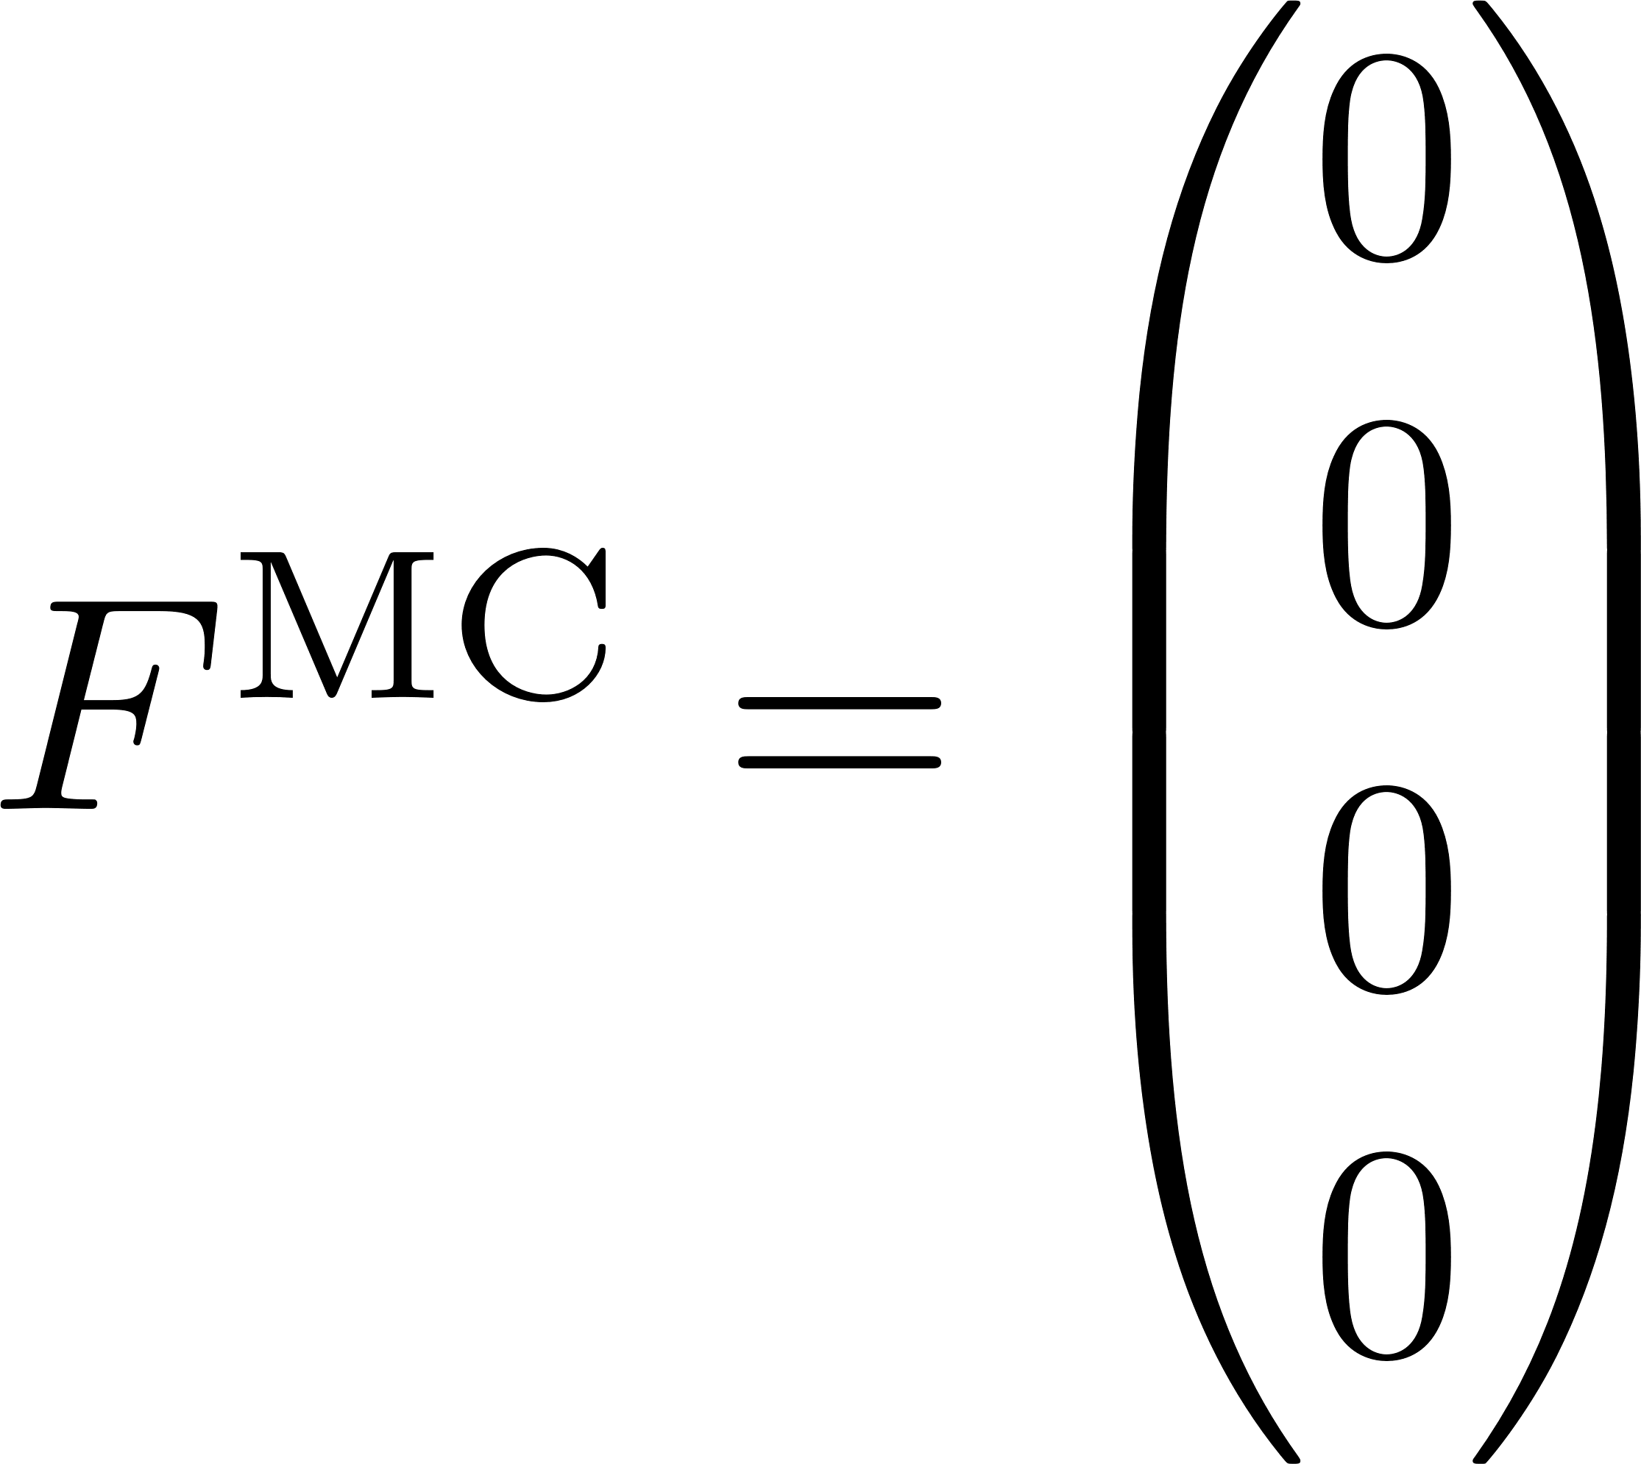
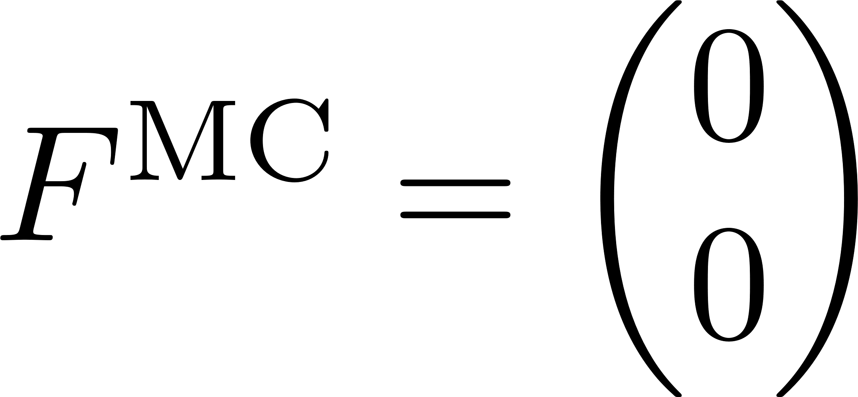
Examples of bias
1 spin
2 spins

Slide 19
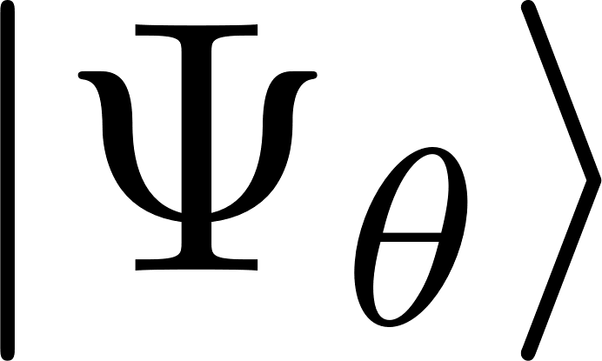
SNR in and
usually does not encode nodes, but approximate zeros

Slide 20
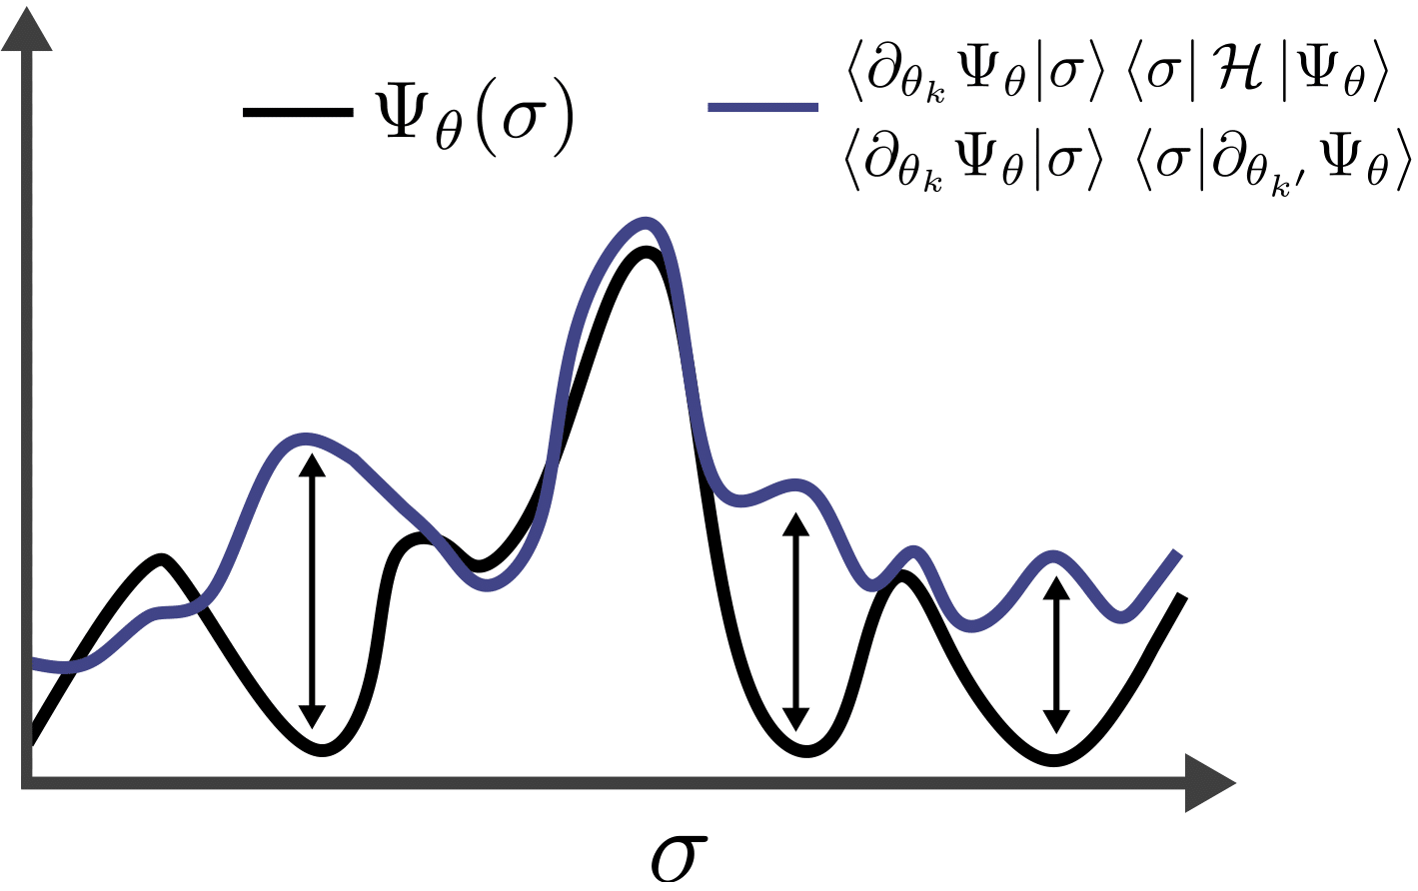
SNR in and
usually does not encode nodes, but approximate zeros
BUT IF

Slide 21
SNR in and
usually does not encode nodes, but approximate zeros
BUT IF
This is indicated by vanishing signal to noise ratios:

Slide 22
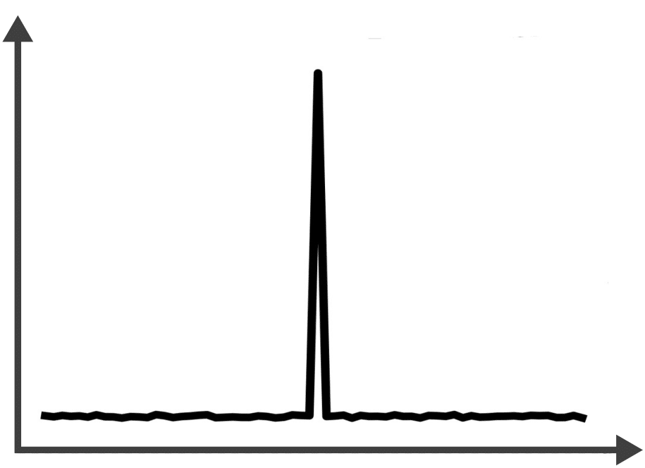
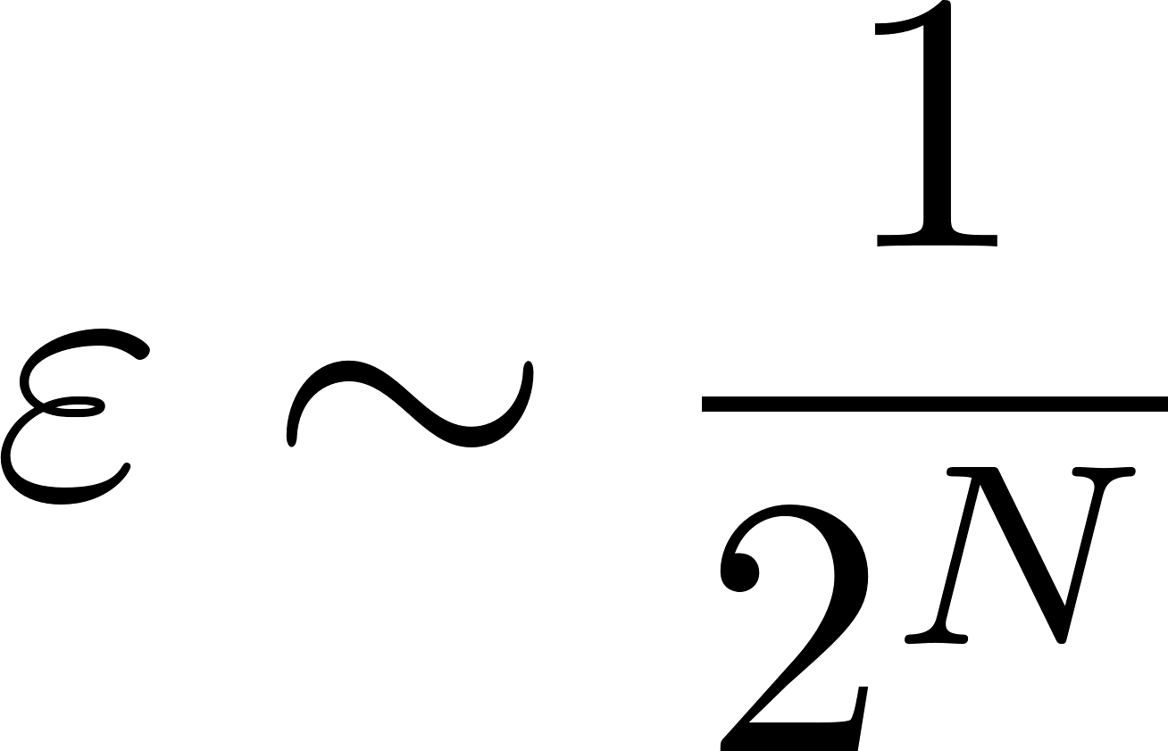
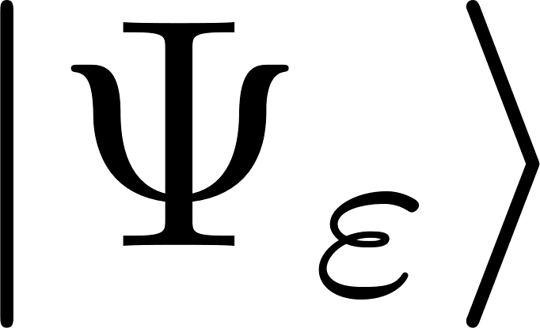
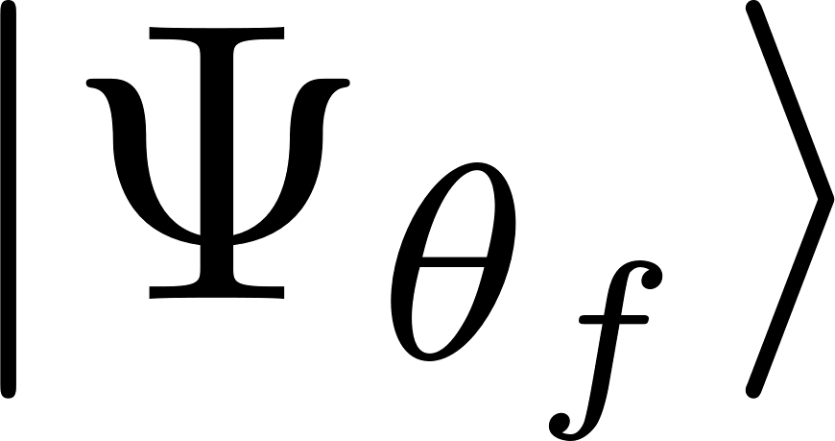
Numerical simulation for SNR
Infidelity between ED and tVMC

Slide 23
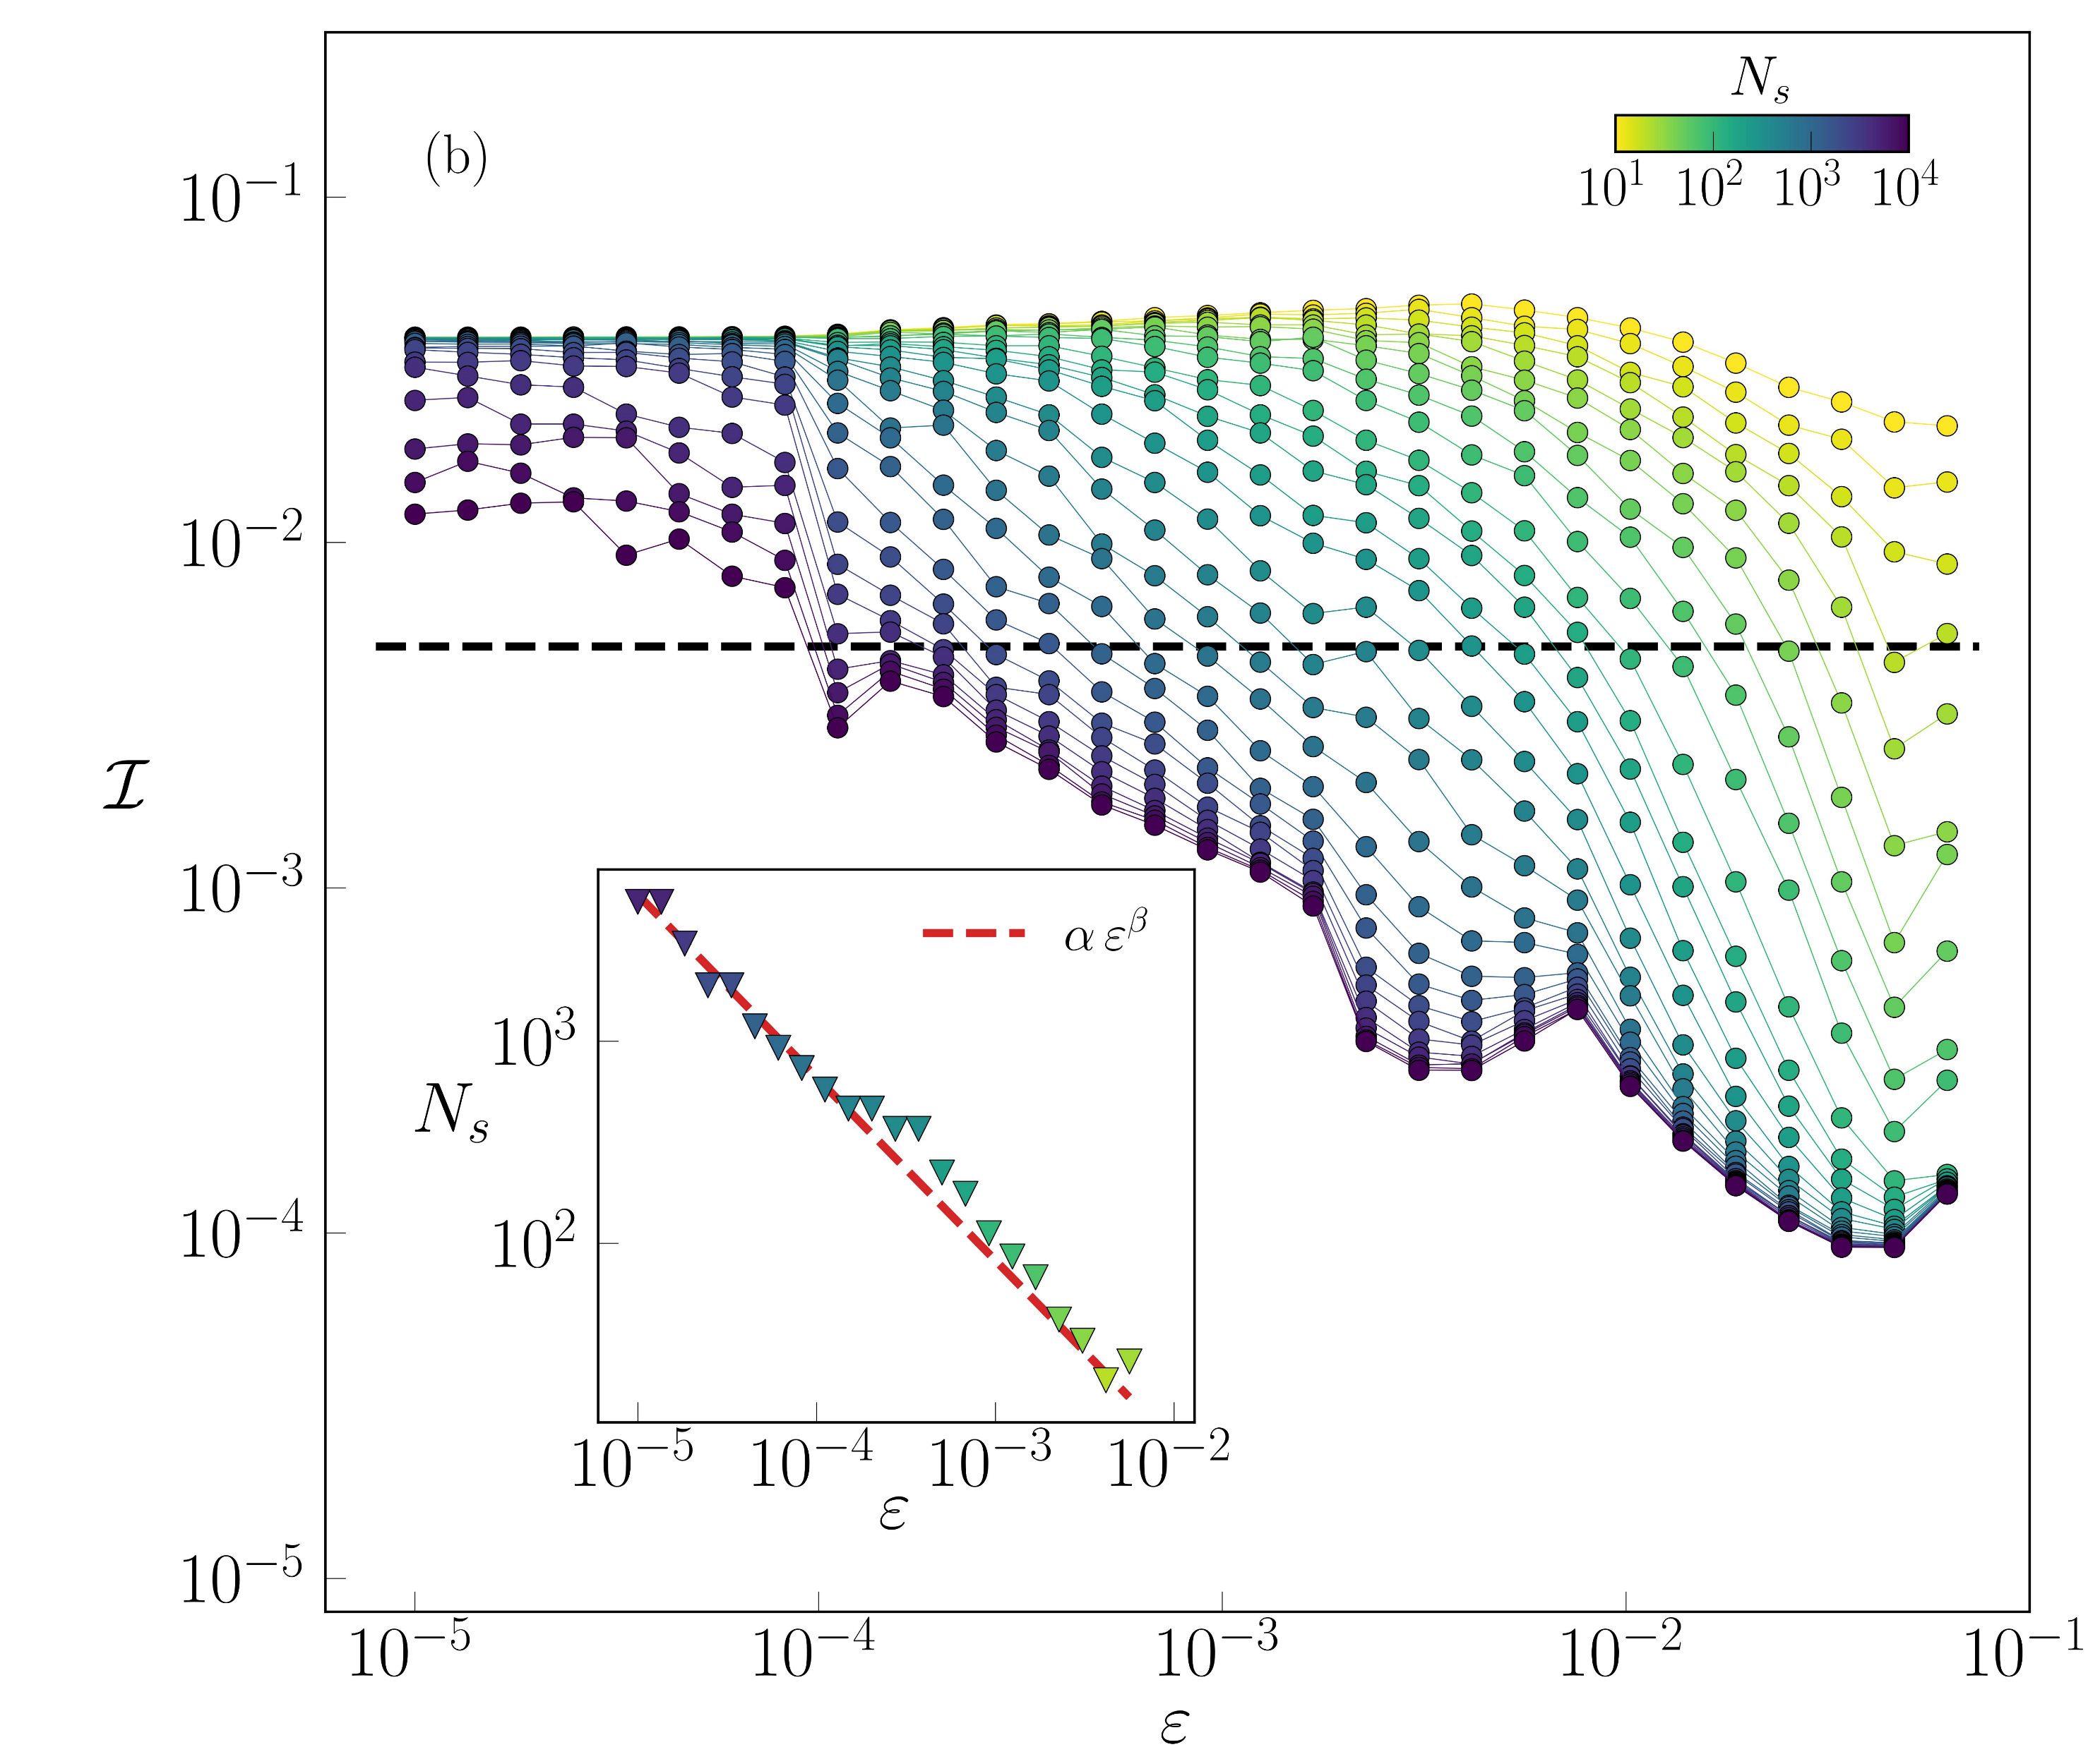
Numerical simulation for SNR
Infidelity between ED and tVMC
23

Slide 24
Numerical simulation for SNR
Infidelity between ED and tVMC

Slide 25
p-tVMC

Slide 26
projected-tVMC
Iteratively solving the optimization problem

Slide 27
projected-tVMC
Iteratively solving the optimization problem
[Jònsson, Bauer, and Carleo, arXiv:1808.05232 (2018)]
[Gutiérrez, and Mendl, Quantum 6, 627 (2022)]
[Barison, Vicentini, and Carleo, Quantum 5, 512 (2021)]
[Donatella, Denis, et al., arXiv:2209.03241 (2022)]
[Medvidović, and Carleo, npj Quantum Inf 7, 101 (2021)]
[Sinibaldi, et al., arXiv:2305.14294 (2023)]

Slide 28
Infidelity optimization
Stochastic optimization of :

Slide 29
Infidelity optimization
Stochastic optimization of :
zero variance principle
vanishing SNR as

Slide 30
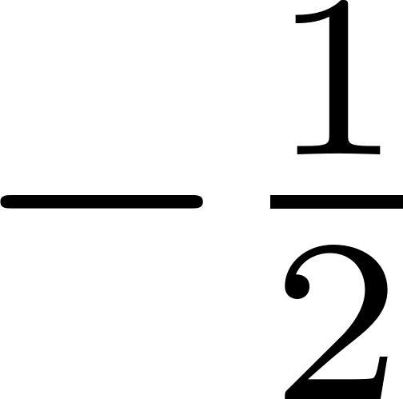
Control variates
Since :
can be chosen to minimize the variance as: :
makes the SNR of to be constant

Slide 31
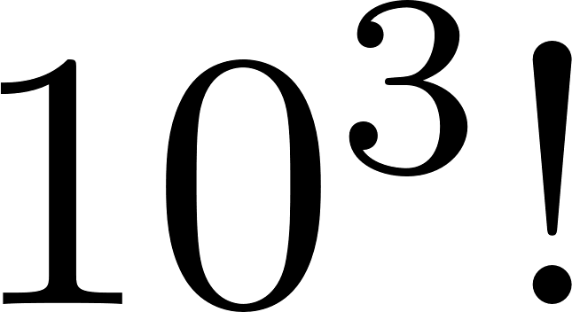
Control variates
zero variance principle
constant SNR as

Slide 32
Unitary dynamics with random measurements

Slide 33
Unitary dynamics with measurements

Slide 34
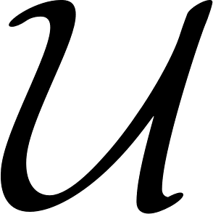
Unitary dynamics with measurements
Two processes:
unitary evolution
stochastic
quantum trajectory
random measurements
with rate

Slide 35
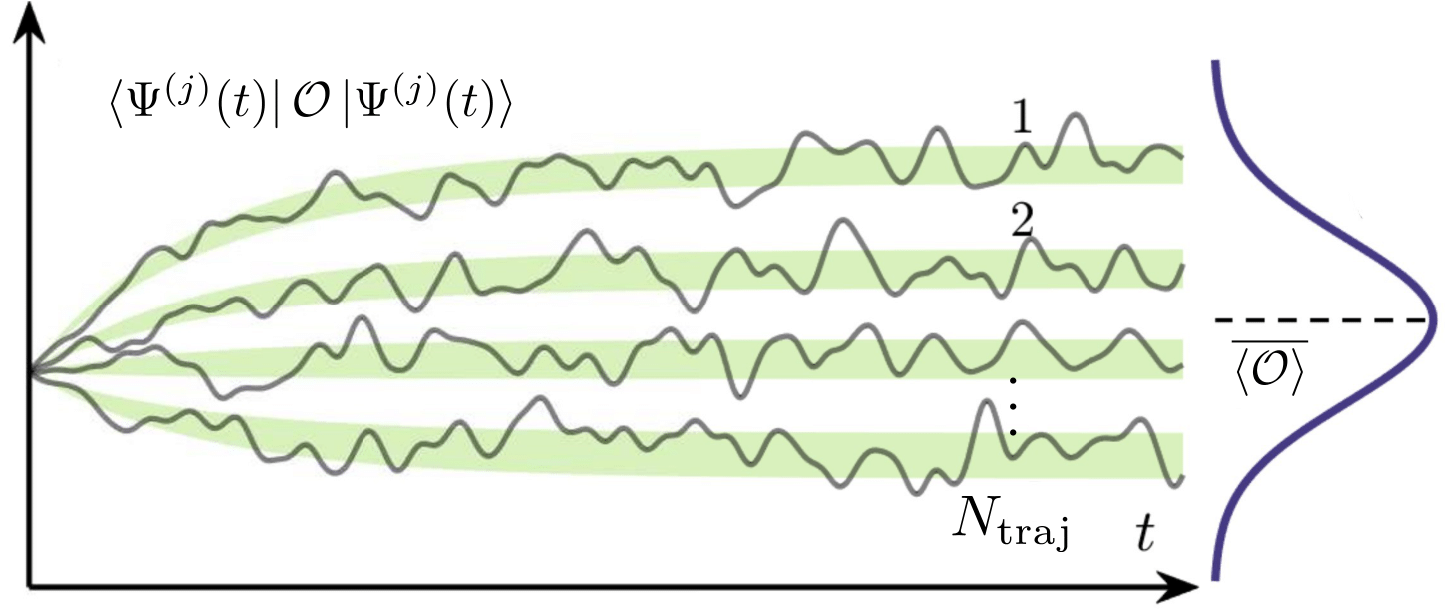
Unitary dynamics with measurements
Two processes:
unitary evolution
stochastic
quantum trajectory
random measurements
with rate
© F. Vicentini

Slide 36
Entanglement phase transition
Entanglement entropy of the steady-state

Slide 37
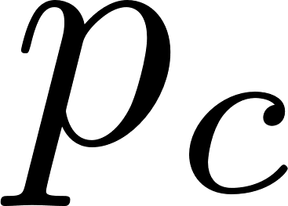
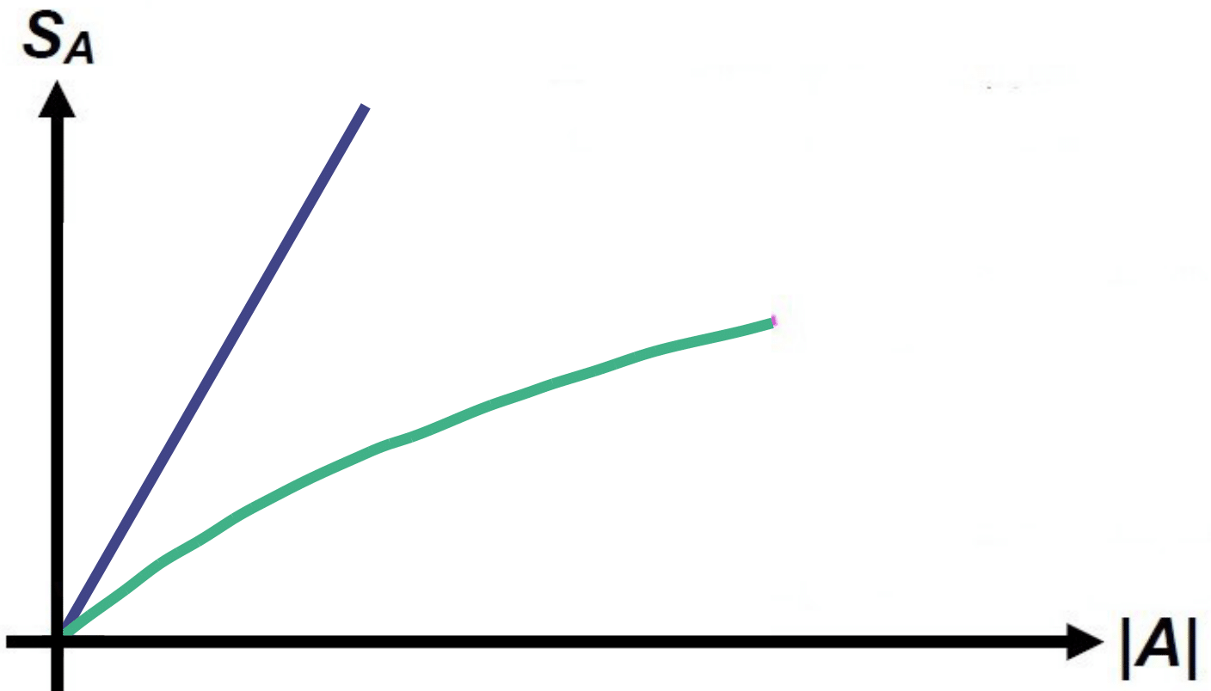
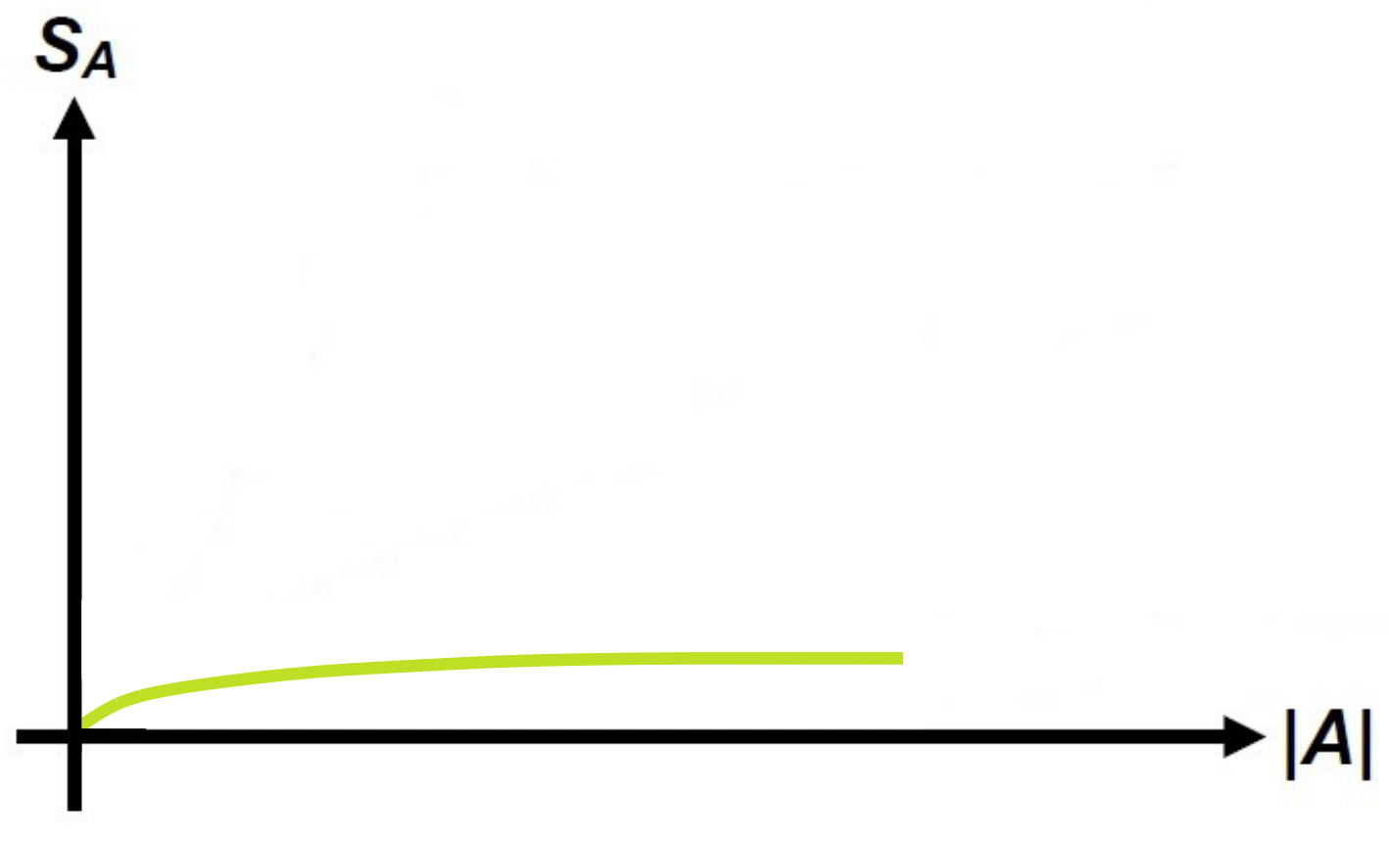
Entanglement phase transition
Entanglement entropy of the steady-state
volume-law / log-law
area-law
hard for
SOTA (TNs)

Slide 38
Entanglement phase transition
Entanglement entropy of the steady-state
volume-law / log-law
area-law
hard for
SOTA (TNs)
So far: random Clifford circuits, systems mappable to free fermions, non-integrable models in 1D (ED or TNs)
Open question: interacting non-integrable models in 2D or non-Clifford circuits (NO stabilizers)

Slide 39
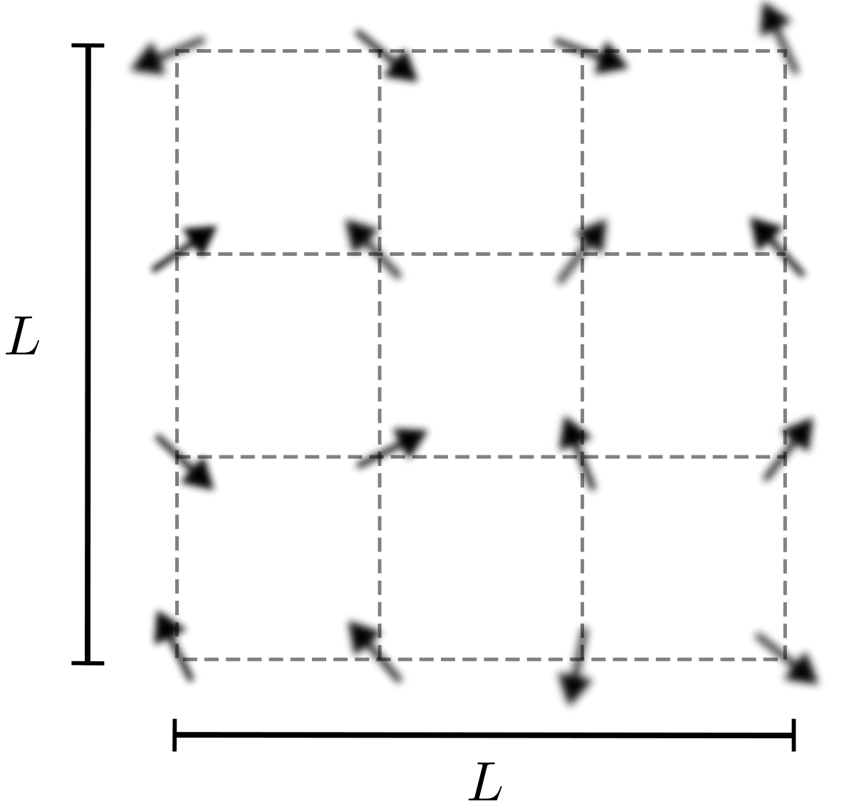
Our model
2D spin 1/2 lattice

Slide 40
Our model
2D spin 1/2 lattice
Unitary propagator generated by 2D TFIM Hamiltonian

Slide 41
Our model
2D spin 1/2 lattice
Unitary propagator generated by 2D TFIM Hamiltonian

Slide 42
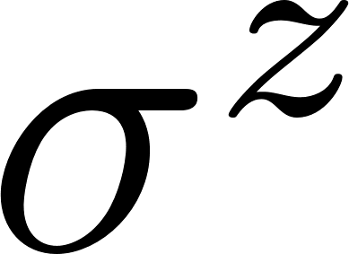
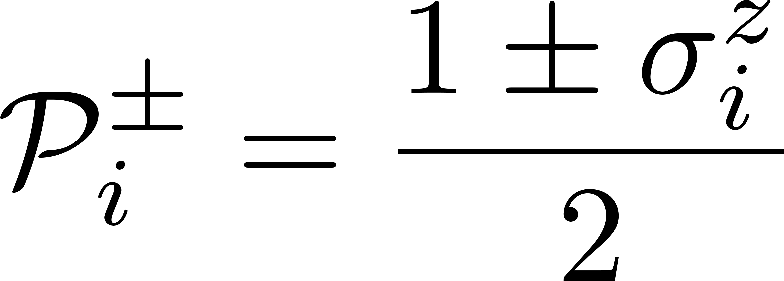
Our model
2D spin 1/2 lattice
Unitary propagator generated by 2D TFIM Hamiltonian
Projective measurements in the basis

Slide 43
Entanglement scaling
We measured entanglement through the Rényi-2 entropy that can be sampled as
[Hastings, et al., Phys. Rev. Lett. 104, 157201 (2010)]

Slide 44
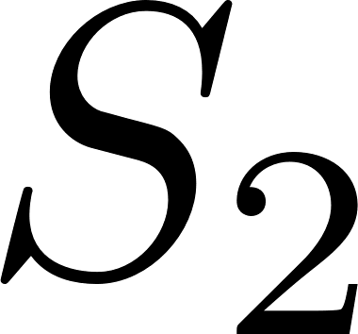
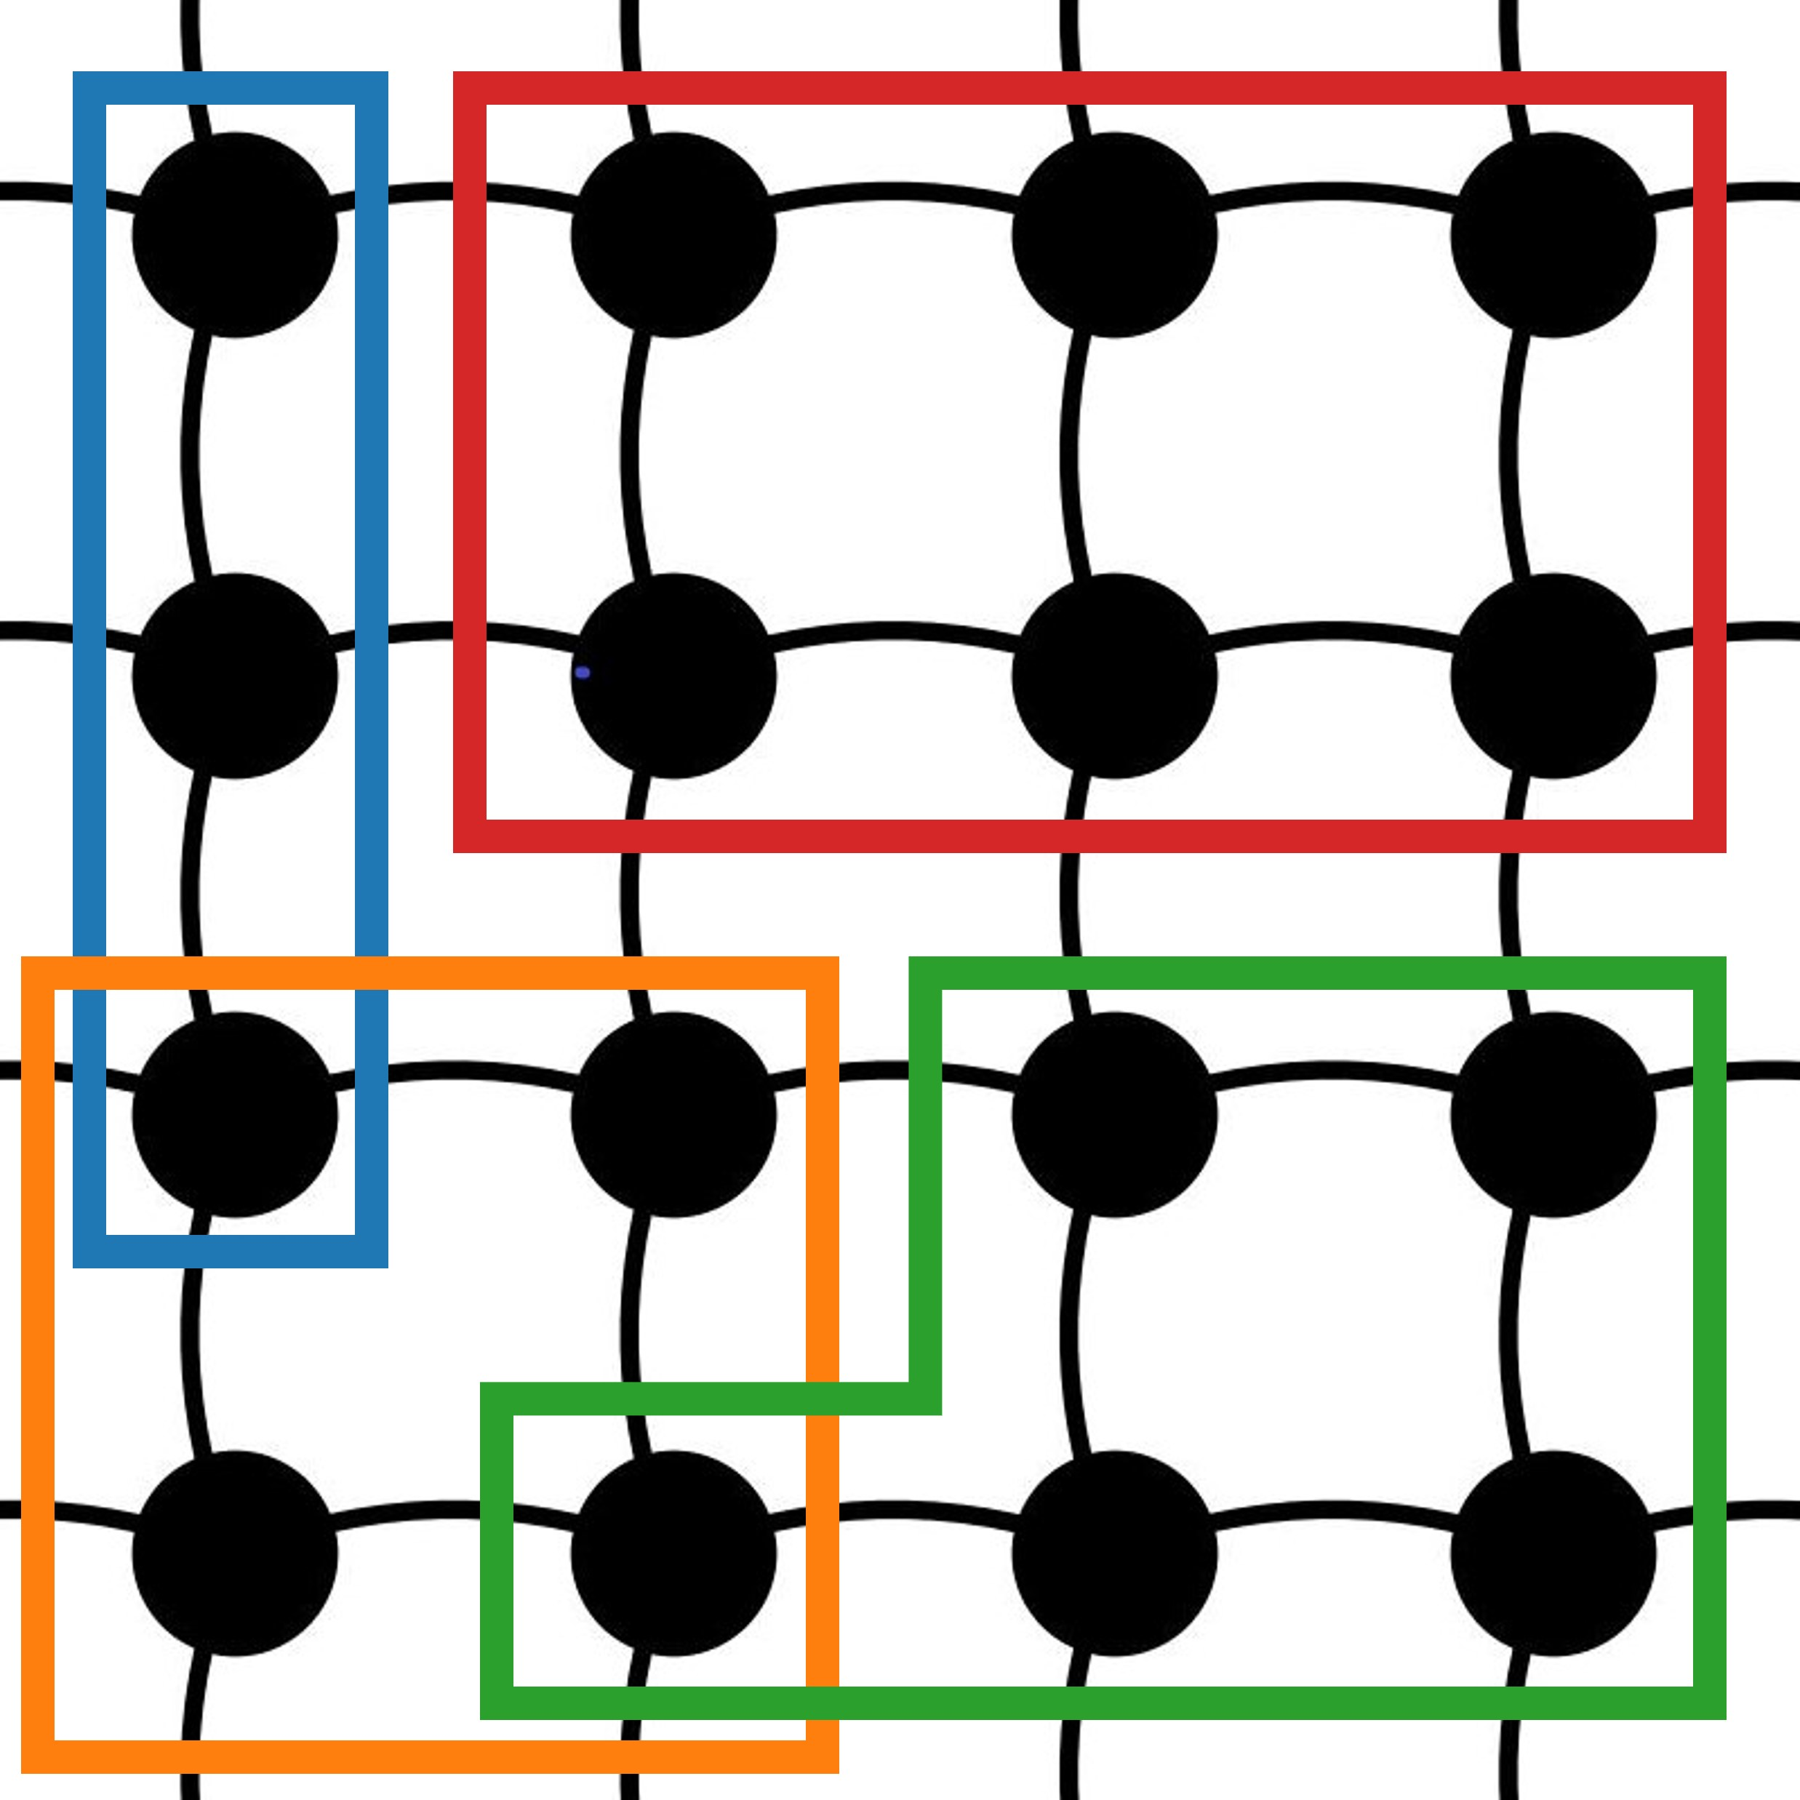
Entanglement scaling
We measured entanglement through the Rényi-2 entropy that can be sampled as
Scaling of with subsystem size
volume-law
log-law
area-law

Slide 45
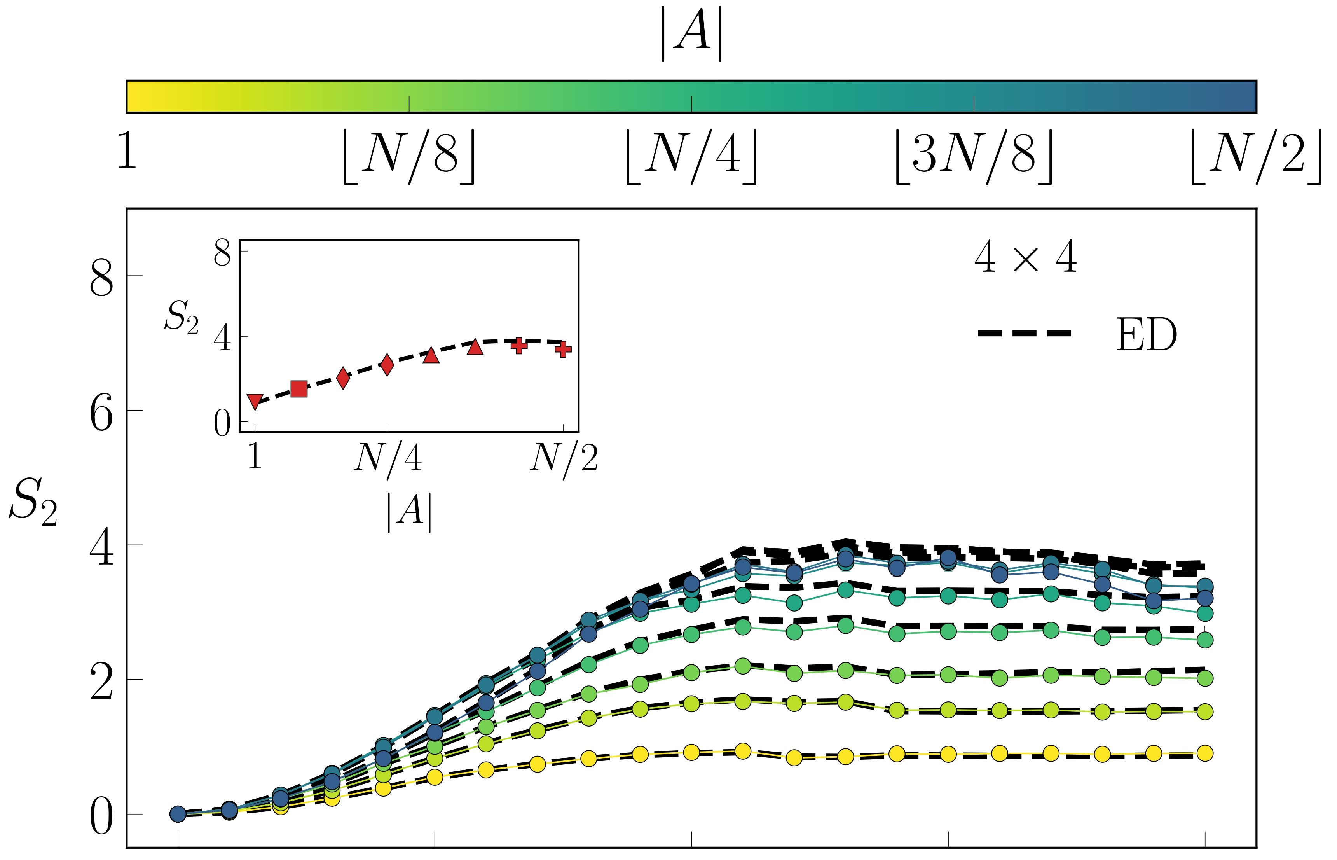
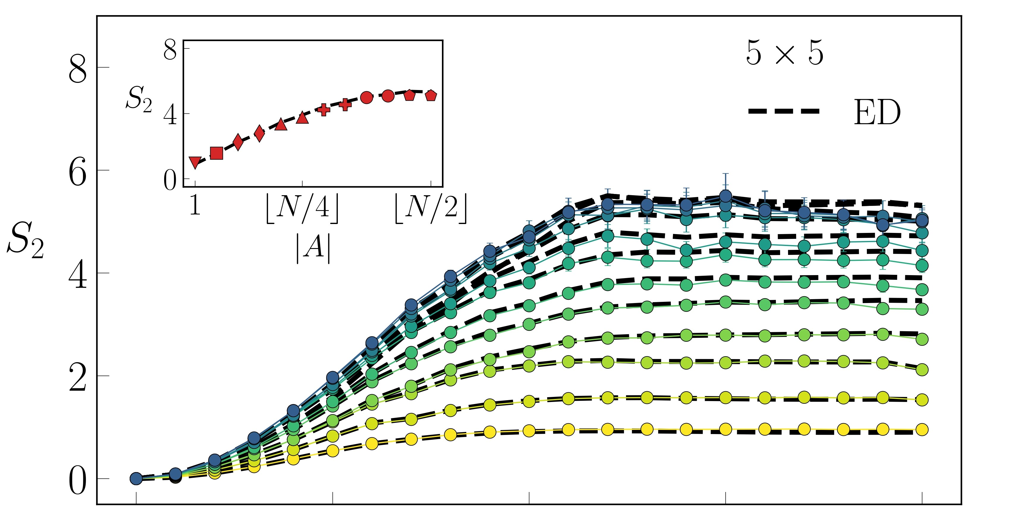
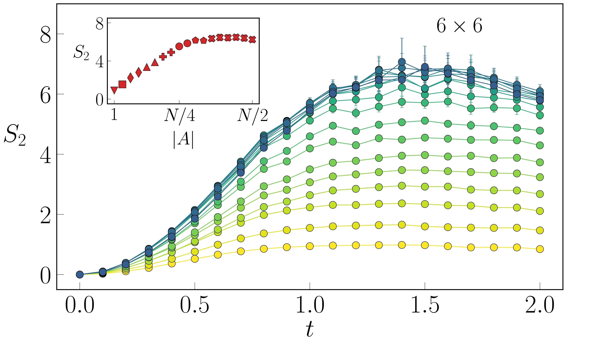
lattices

Slide 46
lattices
high agreement
with ED

Slide 47
lattices
*
*
high agreement
with ED
*
different for subsystem with same area (same marker)
*
high-entanglement phase

Slide 48
Conclusions
Bias or exponential cost in variational Monte Carlo methods
Projected-tVMC as alternative to tVMC: improvements and variations
Unitary dynamics with random measurements in a non-integrable 2D strongly interacting system

Slide 49
Conclusions
Bias or exponential cost in variational Monte Carlo methods
Projected-tVMC as alternative to tVMC: improvements and variations
Unitary dynamics with random measurements in a non-integrable 2D strongly interacting system

Slide 50
Conclusions
Bias or exponential cost in variational Monte Carlo methods
Projected-tVMC as alternative to tVMC: improvements and variations
Unitary dynamics with random measurements in a non-integrable 2D strongly interacting system

Slide 51
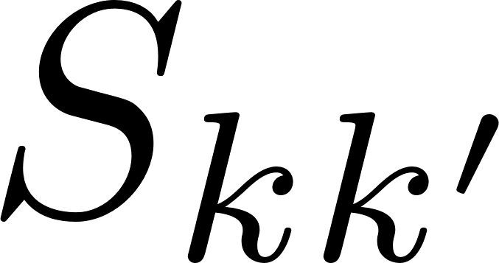
Outlook
Alternative estimator for
p-tVMC for Lindblad master equation / trajectory unravellings and digital quantum circuits
Full entanglement phase transition (critical exponents, central charges of CFTs, …)

Slide 52
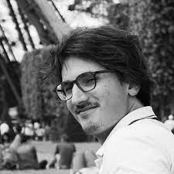
Collaborators
Clemens Giuliani (EPFL)
Giuseppe Carleo (EPFL)
Filippo Vicentini (École Polytechnique)

Slide 53
Thank you for the attention!

Slide 54
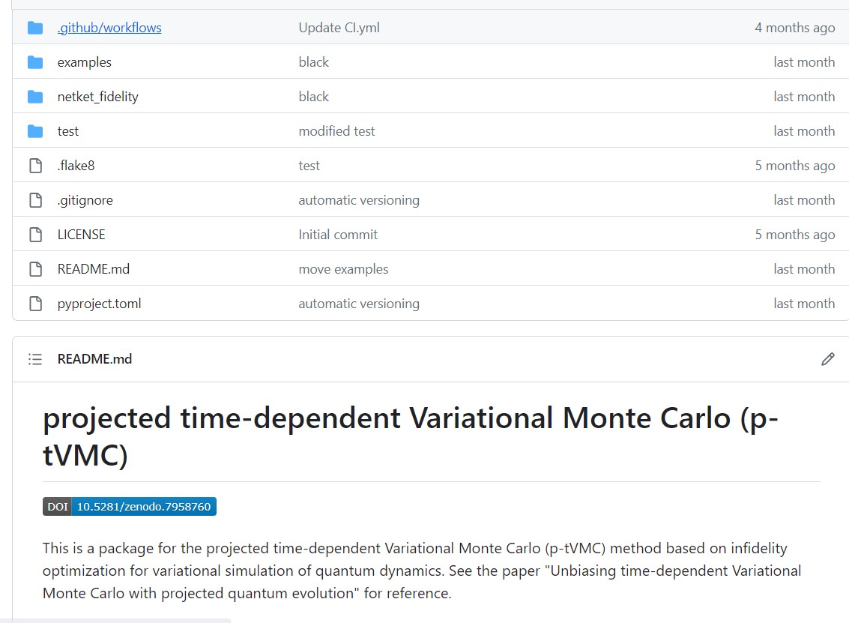
N
netket_fidelity package for p-tVMC in Netket
[Vicentini et al., SciPost Phys.
Codebases:10.21468 (2022)]
[Sinibaldi, and Vicentini, 10.5281/zenodo.7958760 (2023)]

Slide 56
Outlook
Quantitative indicator for numerical issues
Unbiased estimator for
p-tVMC for Lindblad master equation / trajectory unravellings and digital quantum circuits
Full entanglement phase transition

Slide 57
Example for SNR
Adiabatic evolution of spins

Slide 58
Example for SNR
Adiabatic evolution of spins

Slide 59
Example for SNR
Adiabatic evolution of spins
Increased
to reduce SNR

Slide 60
Importance sampling
Needed when the state has many zeros:

Slide 61
Importance sampling
Needed when the state has many zeros:

Slide 62
Importance sampling
Needed when the state has many zeros:
outliers not sampled

Slide 63
Unbiased estimator for

Slide 64
Unbiased estimator for
VS
BUT larger variance and higher computational cost

Slide 65
Unbiased estimator for
VS
BUT larger variance and higher computational cost
[Barison, Vicentini, and Carleo,
in preparation (2023)]

Slide 66
Control variates

Slide 67
Biases in and

Slide 68
Biases in and

Slide 69
Biases in and

Slide 70
Biases in and
bias

Slide 71
Biases in and

Slide 72
Biases in and

Slide 73
Biases in and

Slide 74
Biases in and
bias

Slide 75
p-tVMC vs tVMC
p-tVMC succeeds when tVMC fails, since we don’t need and

Slide 76
Variational Monte Carlo
Two ingredients:

Slide 77
Variational Monte Carlo
Two ingredients:
Variational ansatz
© F. Vicentini

Slide 78
Variational Monte Carlo
Two ingredients:
Variational ansatz
Stochastic sampling
© F. Vicentini

Slide 79
Analytical calculation for SNR
SNR of peaked states

Slide 80
Analytical calculation for SNR
SNR of peaked states

Slide 81
Analytical calculation for SNR
SNR of peaked states

Slide 82
tVMC is not always the best option
Monte Carlo estimations in VMC/tVMC
Projected-tVMC
Dynamics with measurements in 2D
+

Slide 83
Variational Monte Carlo
Ground state
Dynamics
QGT
[McMillan, Phys. Rev., 138:A442–A45 (1965)]
[Carleo, Becca et al., Scientific Reports 2, 243 (2012)]
Notes:
Say what Ok is and put the reference for tVMC

