Slide 1
Transfer Learning for Many-Body Systems
Amir Azzam
Arnau Rios
Javier Rozalén
James Keeble
Tuesday 5th of September

Slide 2
Presentation Structure
Problem Description
Fundamentals
Neural Network Quantum states
Sampling
Implemented Techniques
Early Stopping
Transfer Learning
Scheduled Re-weighted Metropolis-Hastings
Results
Summary and Future Work

Slide 3
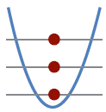
Problem Description
We study the ground-state properties of fermionic system that is:
fully-polarized
Trapped
one-dimensional
interacting through a Gaussian potential

Slide 4
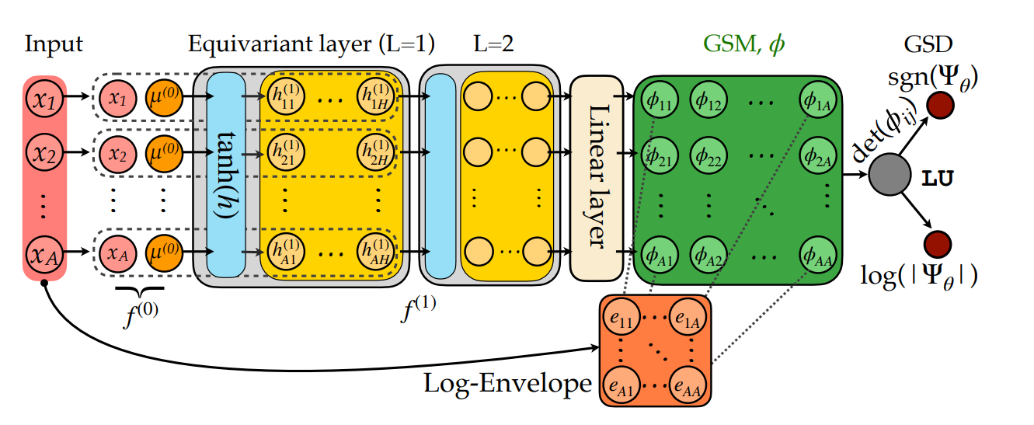
Neural Network Quantum States
Permutation equivariance
We study A = 4 particles, H = 64 hidden nodes
Linear dependence on A, and Quadratic on H in parameters
- J. Keeble et al. arXiv:2304.04725, 2023
- J. W. Keeble, PhD thesis, University of Surrey, 2022.

Slide 5
Sampling
We use Metropolis-Hastings sampling
4096 Walkers in real space
Each Walker allowed to progress for 10 steps (sweeps)
C. P. Robert and G. Casella, pp. 167–197. Springer New York, 2010

Slide 6
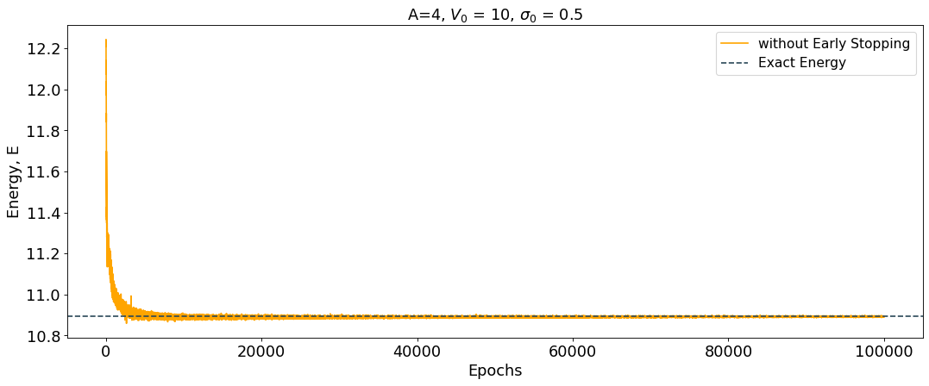
Early Stopping

Slide 7
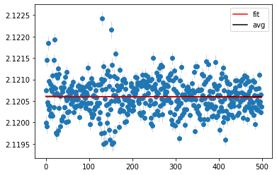
Early Stopping

Slide 8
Early Stopping
 | Without Early Stopping | With Early Stopping
Energy (10.8916) | 10.892 ± 5 × 10⁻³ | 10.89 ± 2×10⁻²
Epochs | 100000 | 23022

Slide 9
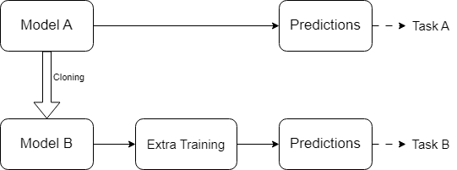
Transfer Learning
Repurpose a model to perform a new task
Copy the weights of model A that was trained to perform Task A and use them as the starting point to train model B for Task B.
F. Zhuang, Z. Qi, et al, IEEE, vol. 109, no. 1, pp. 43–76, 2020.

Slide 10
Transfer Learning
Interaction Transfer
Particle Transfer
A = 2
{V₀, σ₀}
{V₀’, σ₀’}
A = 4

Slide 11
Transfer Learning (Interaction Transfer)
 | Without Interaction Transfer | With Interaction Transfer
Energy (10.8916) | 10.89 ± 2×10⁻² | 10.892 ± 4 × 10⁻³
Epochs | 23022 | 8007

Slide 12
Transfer Learning (Particle Transfer)
We freeze the training on the equivariant layers.
Remember: Linear dependence on A, and Quadratic on H in parameters
Equivariant layers account for 8448 parameters out of the total 8712 parameters of the network for A=4 and H= 64

Slide 13
Transfer Learning (Particle Transfer)
 | Without Particle Transfer | With Particle Transfer
Energy (10.8916) | 10.89 ± 2×10⁻² | 10.9 ± 6 × 10⁻¹
Epochs | 23022 | 100,000
Trainable Parameters | 8712 | 264

Slide 14
Transfer Learning (Particle Transfer)

Slide 15
Scheduled Re-Weighted Metropolis-Hastings

Slide 16
Scheduled Re-Weighted Metropolis-Hastings
 | Without Re-Weighted MH | With Re-Weighted MH
Energy (10.8916) | 10.89 ± 2×10⁻² | 10.89 ± 1×10⁻²
Epochs | 23022 | 15014
Average Sampling time | 44ms | 0.7ms

Slide 17
Scheduled Re-Weighted Metropolis-Hastings

Slide 18
Results
 | Without Re-Weighting | With Re-Weighting (8k walkers, 60 sweeps) | With Re-Weighting (4k walkers, 10 sweeps)
Energy (10.8916) | 10.892 ± 4 × 10⁻³ | 10.8938 ± 7×10⁻⁴ | 10.892 ± 3×10⁻³
Epochs | 8007 | 19018 | 92091
H. Zhang, et al. “Understanding and eliminating spurious modes in variational monte carlo using collective variables,” Physical Review Research, vol. 5, no. 2, p. 023101, 2023

Slide 19
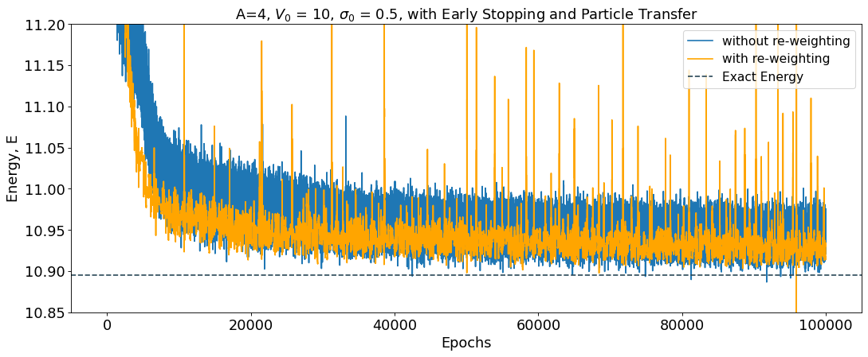
Results
 | Without Re-Weighting | With Re-Weighting
Energy (10.8916) | 10.9 ± 6 × 10⁻¹ | 10.928 ± 7 × 10⁻³
Epochs | 100000 | 100000

Slide 20
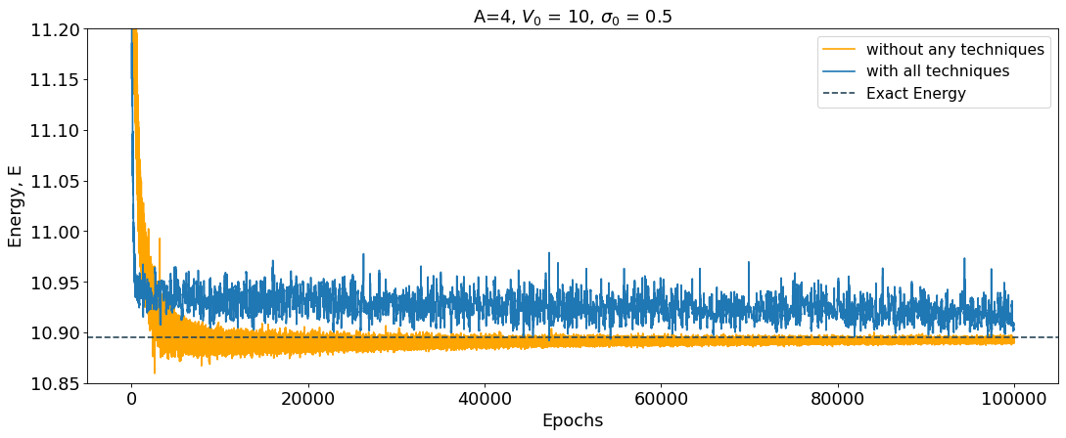
Results
 | Without any techniques | With All techniques
Energy (10.8916) | 10.893 ± 5 × 10⁻³ | 10.917 ± 7×10⁻³
Epochs | 100000 | 100000

Slide 21
Summary and Future Work
 | Original Network | With Improvements
Interaction Transfer | 100K epochs to converge | 8K epochs to converge (92% faster)
Particle Transfer | 8712 trainable parameters | 264 trainable parameters (97% less parameters)
Scheduled Re-Weighted Metropolis-Hastings | 44ms sampling average time | 0.7ms sampling average time (98% faster)
Future work:
Further explore the spikes and find more efficient ways to eliminate them.
Explore different interactions and different systems.
Explore the effects of the starting interaction in the Interaction Transfer on the training.

Slide 22
Thanks for Listening
I would like to acknowledge the computer resources at Artemisa, funded by the European Union ERDF and Comunitat Valenciana as well as the technical support provided by the Instituto de Física Corpuscular, IFIC (CSIC-UV).

Slide 23
Network Training and the Loss function
Network trained with Adam Optimizer and a maximum of 10⁵ epochs.
,

Slide 24
Artificial Neural Networks
Ex: ${(f\left(x\right)−y)}^{2}$
Ex:

Slide 25
Random-Walk Metropolis-Hastings
Starting with $X^{(0)}≔(X_{1}^{(0)},…,X_{p}^{(0)})$ iterating for $t=1,2,…$
Draw $X^{(0)}\sim q\left(· | X^{\left(t−1\right)}\right)$ where $q$ is a proposed distribution.
Compute
$$α\left(X | X^{\left(t−1\right)}\right)=min⁡\left\{1, \frac{f\left(X\right)}{f\left(X^{\left(t−1\right)}\right)}\right\}$$
Where $f$ is the target distribution.
With probability $α\left(X | X^{\left(t−1\right)}\right)$ set $X^{(t)}=X$, otherwise set $X^{(t)}=X^{(t−1)}$

Slide 28
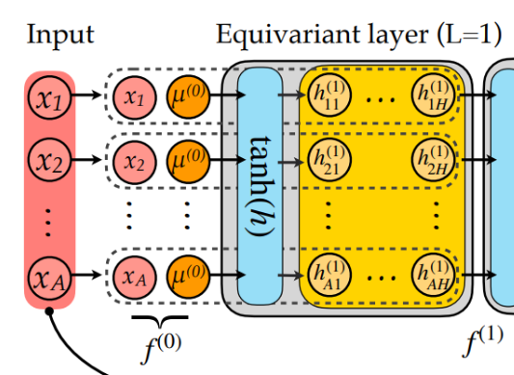
Network architecture

Slide 29
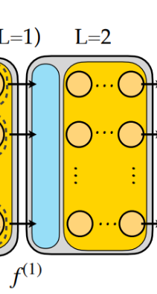
Network architecture
(column wise average of $h_{i}^{(1)} )$

Slide 30
Network architecture
- Shared Weights:

Slide 31
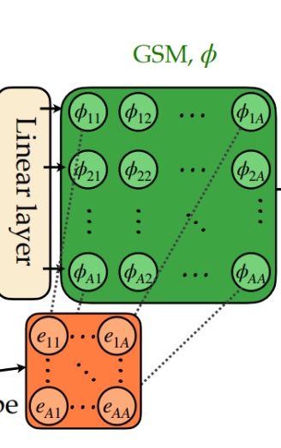
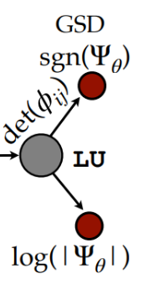
Network architecture
- Shared Weights:

Slide 32
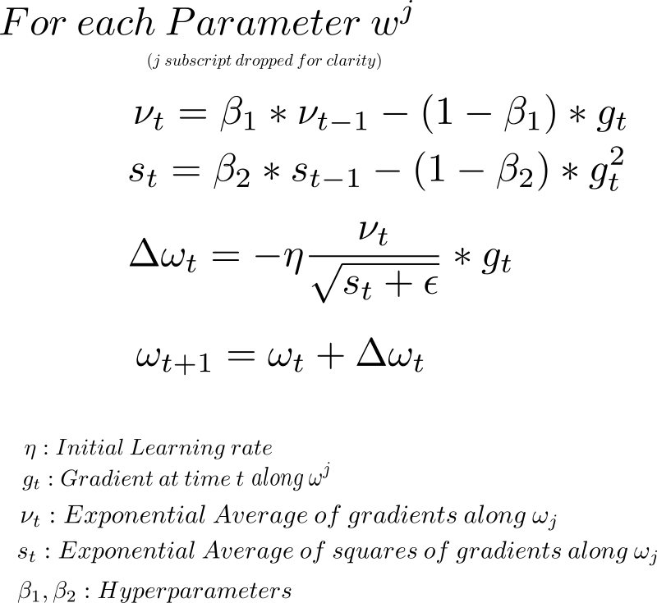
Adam Optimizer

