Slide 1
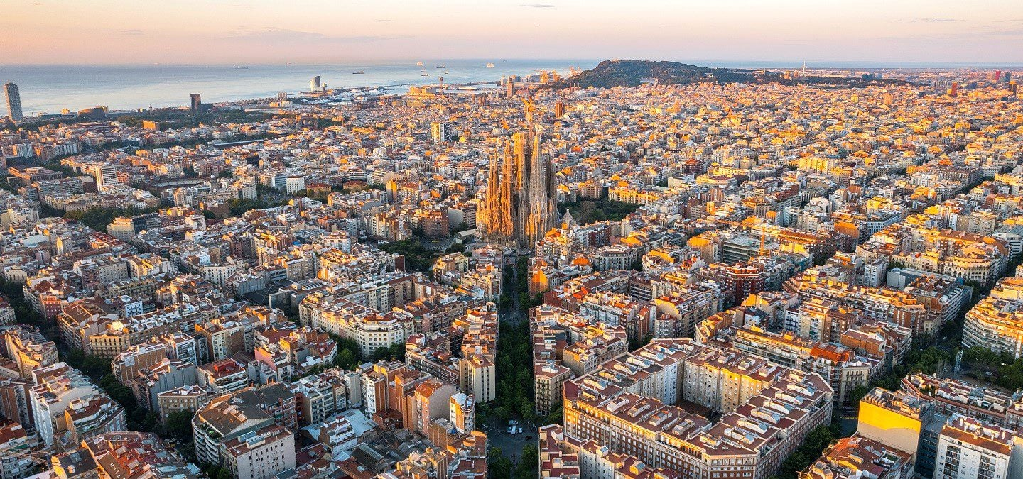
Anti-symmetrized Neural Quantum States
Javier Rozalén Sarmiento
Advisor: Arnau Rios Huguet

Slide 2
Problem set-up
Goal: Solve for the non-relativistic ground-state wave function of an atomic nucleus, $ψ$
Set-up: Rayleigh-Ritz variational principle
$$\frac{\left.<ψ| \hat{H}|ψ\right.>}{\left.<ψ|ψ\right.>}{≥E}_{GS}$$
$$\hat{H}=\hat{T}+\hat{V}$$
$$|ψ> =∫|p>ψ\left(p_{1},p_{2},…,p_{N}\right)d^{3N}p$$
$W^{\left(1\right)},B^{\left(1\right)}$
$$p_{1}$$
$W^{\left(2\right)},B^{\left(2\right)}$
Ansatz: Neural Network, $ψ_{NQS}\left(p_{1},p_{2},…,p_{N}, ;θ\right)$
$$p_{2}$$
$$ψ_{NQS}(p;θ)$$
$$⋮$$
$$p_{N}$$
$θ={\left\{W^{\left(i\right)},B^{\left(i\right)}\right\}}_{i=1}^{L}$

Slide 3
Core idea
Neural Quantum States (NQSs)
$W^{\left(1\right)},B^{\left(1\right)}$
$$p_{1}$$
$W^{\left(2\right)},B^{\left(2\right)}$
Neural Quantum State: $ψ_{NQS}\left(p_{1},p_{2},…,p_{N}, ;θ\right)$
$$p_{2}$$
$$ψ_{NQS}(p;θ)$$
$$⋮$$
$$p_{N}$$
$θ={\left\{W^{\left(i\right)},B^{\left(i\right)}\right\}}_{i=1}^{L}$
Variational parameters: $θ={\left\{W^{\left(i\right)},B^{\left(i\right)}\right\}}_{i=1}^{L}$, $L=\#$ of layers
“Training”
“Learning”
+ numerical minimisation algorithm or Optimizer
Minimise the loss function: $Loss=E=\frac{\left.<ψ_{NQS}| \hat{H}|ψ_{NQS}\right.>}{\left.<ψ_{NQS}|ψ_{NQS}\right.>}$

Slide 4
Advantages
Universal approximation: a neural network can approximate any continuous function [1], [2]
Space complexity: polynomial scaling of the weights… possibly!
Software with GPU integration: PyTorch, Jax, Tensorflow… also libraries like NetKet [2].
Constants matter! (parallelization)
“Artificial Intelligence” sounds great when asking funding ☺
[1] G. Cybenko, Approximation by superpositions of a sigmoidal function, 1989
[2] K. Hornik M. Stinchcombe, H. White, Multilayer feedforward networks are universal approximators, 1989

Slide 5
Disadvantages
“Black box” issue: it is difficult to extract physical information from the analytical form of the neural net.
Optimization: as the Hamiltonian becomes more complex, the task of searching the parameter space for a good set of parameters becomes more difficult.
Neural net architecture: what is the best architecture for a given problem?
Providing physical information: symmetries of $\hat{H}$, boundary conditions, etc.
my current work

Slide 6
Symmetries in Quantum Mechanics
$\left[\hat{H}, \hat{O}\right]=0⇒\{|ψ⟩$ solution kets} are eigenstates of $\hat{O}$
Example: 1D HO
$H=\frac{1}{2}∇^{2}+\frac{1}{2}mw^{2}x^{2}⟶\left[\hat{H}, \hat{P}\right]=0$, where $\hat{P}$ is the parity operator
$ψ\left(x\right)=±ψ\left(−x\right)$, solutions are either parity-even or parity-odd
Example: Hydrogen atom
$$\hat{H}=−\frac{ℏ^{2}}{2μ}\left\{\frac{1}{r^{2}}\frac{∂}{∂r}\left(r^{2}\frac{∂}{∂r}\right)+\frac{1}{r^{2}}\left[\frac{1}{ sinθ}\frac{∂}{∂θ}\left( sinθ\frac{∂}{∂θ}\right)+\frac{1}{\sin^{2}θ}\frac{∂^{2}}{∂φ^{2}}\right]\right\}−\frac{Ze^{2}}{r}⟶\left[\hat{H}, \hat{L^{2}}\right]=\left[\hat{H}, \hat{L_{z}}\right]=0$$
$$ψ_{nlm}\left(r,θ,φ\right)=\sum_{n=1}^{∞}{\sum_{l=0}^{n−1}{\sum_{m=−l}^{+l}{{c_{nlm}P}_{nl}\left(r\right)Y_{lm}(θ,φ)}}}$$

Slide 7
Symmetries in neural networks
1D HO: naive approach (but good!)
Fermionic particle exchange: common approach
$$H=\frac{1}{2}∇^{2}+\frac{1}{2}mw^{2}x^{2}⟶ψ\left(x\right)=±ψ\left(−x\right)$$
Spin-statistics theorem (or just assume it ☺)
$$ψ_{NQS}\left(x\right)≔ψ_{NN}\left(x\right)+ψ_{NN}(−x)$$
$ψ_{NQS}\left(x_{1},x_{2},…,x_{N}\right)=φ_{EQUIV}∘det φ_{GSM}(x_{1},x_{2},…,x_{N}$)
$W^{\left(1\right)},B^{\left(1\right)}$
$W^{\left(2\right)},B^{\left(2\right)}$
$$x$$
$$ψ_{NN}(x)$$
[3]
Is this the best way?
What about other symmetries (continuous groups)?
[3] J Keeble, A Rios et al, Machine learning one-dimensional spinless trapped fermionic systems with neural-network quantum states, arXiv:2304.0475

Slide 8
Group theory
Def. (group): a group G is a set of elements with a binary operation · with respect to which it is closed.
Ex. 1: Symmetries of a triangle$.$ $D_{2n} ,n=3 →\{e, r_{120}, r_{240},m_{1},m_{2},m_{3}\}$ ($r→$rotation, $m →$mirror)
 | $$e$$ | $$r_{120}$$ | $$r_{240}$$ | $$m_{1}$$ | $$m_{2}$$ | $$m_{3}$$
$$e$$ | $$e$$ | $$r_{120}$$ | $$r_{240}$$ | $$m_{1}$$ | $$m_{2}$$ | $$m_{3}$$
$$r_{120}$$ | $$r_{120}$$ | $$r_{240}$$ | $$e$$ | $$m_{2}$$ | $$m_{3}$$ | $$m_{1}$$
$$r_{240}$$ | $$r_{240}$$ | $$e$$ | $$r_{120}$$ | $$m_{3}$$ | $$m_{1}$$ | $$m_{2}$$
$$m_{1}$$ | $$m_{1}$$ | $$m_{3}$$ | $$m_{2}$$ | $$e$$ | $$r_{240}$$ | $$r_{120}$$
$$m_{2}$$ | $$m_{2}$$ | $$m_{1}$$ | $$m_{3}$$ | $$r_{120}$$ | $$e$$ | $$r_{240}$$
$$m_{3}$$ | $$m_{3}$$ | $$m_{2}$$ | $$m_{1}$$ | $$r_{120}$$ | $$r_{240}$$ | $$e$$
$$S_{1}$$
$$1$$
$$S_{2}$$
$$3$$
$$S_{3}$$
$$2$$
Cayley table

Slide 9
Group theory
Def. (linear representation, informal): a linear representation of a group $G$ is a map $ρ:G⟶GL(ℂ)$ such that matrix
multiplication is associated with the group product: $D rep:g_{1}g_{2}=g_{3}→D\left(g_{1}\right)D\left(g_{2}\right)=D(g_{3})$
Example (rotation in 2D). $G=SO\left(2\right)=\{R\left(θ\right), θ∈\left[0, 2π\right)\}$. This is a cyclic group (only one generator).
Trivial representation
$R\left(θ\right)⟶D\left(θ\right)=\left(1\right), ∀θ∈[0, 2π)$ $D\left(θ\right)D\left(φ\right)=\left(1\right)\left(1\right)=\left(1·1\right)=\left(1\right)=D(θ+φ)$
Defining representation over $ℝ^{2}$
$$R\left(θ\right)⟶D\left(θ\right)=\left(\begin{matrix}\cos{θ} & −sin{θ} \\ \sin{θ} & \cos{θ}\end{matrix}\right),∀θ∈\left[0, 2π\right) D\left(θ\right)D\left(φ\right)=D(θ+φ) (2−dimensional representation)$$
Defining Representation over $ℂ$
$R\left(θ\right)⟶D\left(θ\right)=\left(\begin{matrix}e^{−iθ} & 0 \\ 0 & e^{+iθ}\end{matrix}\right),∀θ∈\left[0, 2π\right), in the basis spanned by e_{±}=\frac{1}{\sqrt{2}}\left(∓e_{1}−ie_{2}\right)$, $D\left(θ\right)D\left(φ\right)=D(θ+φ)$

Slide 10
Group theory
Def. (Irreducible representation, informal): a representation is irreducible if the matrix can be block-diagonalized.
Example (rotation in 2D). $The change of basis e_{±}=\frac{1}{\sqrt{2}}\left(∓e_{1}−ie_{2}\right) \left(block−\right)diagonalizes the rep. over ℝ^{2}$
Defining representation over $ℝ^{2}$
$R\left(θ\right)⟶D\left(θ\right)=\left(\begin{matrix}\cos{θ} & −sin{θ} \\ \sin{θ} & \cos{θ}\end{matrix}\right)⟶\left(\begin{matrix}e^{−iθ} & 0 \\ 0 & e^{+iθ}\end{matrix}\right)=D_{1}\left(θ\right)⊕D_{2}\left(θ\right)⇒D_{i}\left(θ\right)$ are irreps
Example (rotation in 3D).
Euler parametrization over $S^{2}$ (sphere). Defining representation
$$R\left(α,β, γ\right)⟶D\left(α,β,γ\right)=R_{3}\left(α\right)R_{2}\left(β\right)R_{3}\left(γ\right), where R_{3}\left(ψ\right)=\left(\begin{matrix}\cos{ψ} & −\sin{ψ} \\ \begin{aligned}\sin{ψ} \\ 0\end{aligned} & \begin{aligned}\cos{ψ} \\ 0\end{aligned}\end{matrix} \begin{matrix}0 \\ 0 \\ 1\end{matrix}\right),R_{2}\left(ψ\right)=\left(\begin{matrix}\cos{ψ} & 0 \\ \begin{aligned}0 \\ −\sin{ψ}\end{aligned} & \begin{aligned}1 \\ 0\end{aligned}\end{matrix} \begin{matrix}\sin{ψ} \\ 0 \\ \cos{ψ}\end{matrix}\right)$$
Euler parametrization over $S^{2}$ (sphere). Irreducible representations
$$R\left(α,β, γ\right)⟶{\left(j−th irrep\right) D}^{j}{\left(α,β,γ\right)}_{ m}^{m^{′}}=e^{−iαm^{′}} d^{j}{\left(β\right)}_{ m}^{m^{′}}e^{−iγm}, where d^{j}{\left(β\right)}_{ m}^{m^{′}}=⟨jm^{′}\left|e^{−iβJ_{2}}\right|jm⟩$$
Wigner D-matrices

Slide 11
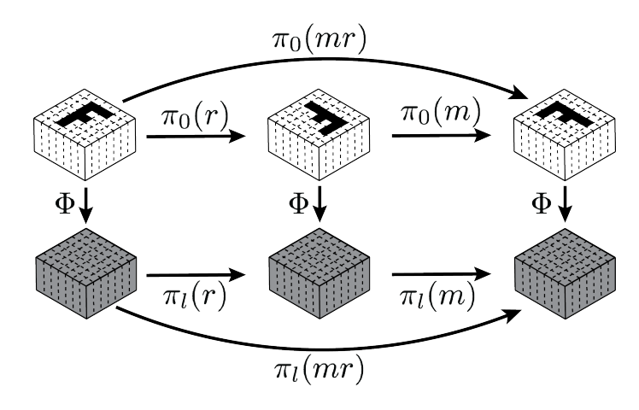
G-CNNs are the only way
In general, we want our NN $Φ$output to be equivariant under a certain group $G$ of transformations:
$$Φ\left(T_{g}x\right)=T_{g}^{′}Φ\left(x\right)$$
$T_{g}$ is the action/representation of $g∈G$ on $X∋x$. $Φ$ is an equivariant map (also intertwiner).
Group convolution $⇒$ Group equivariance (2016) [4]
$$\left(f⋆χ\right)\left(g\right)=\sum_{u∈G }{f\left(u^{−1}g\right)χ(u)}$$
(regular representation)
Steerable CNNs (2016) [5]
$ρ\left(h\right)Ψ=Ψπ\left(h\right), Ψ$ filter
$$μ= \frac{\dim\left(π\right)dim⁡(ρ)}{\dim{Hom_{H}(π,ρ)}}$$
(any representation)
$$\dim{Hom_{H}(π,ρ)}=\sum_{i}{m_{i}m_{i}^{′}}$$
[4] T S Cohen and M Welling, Group Convolutional Neural Networks, arXiv:1602.07576
[5] T S Cohen and M Welling, Steerable CNNs, arXiv:1612.08498

Slide 12
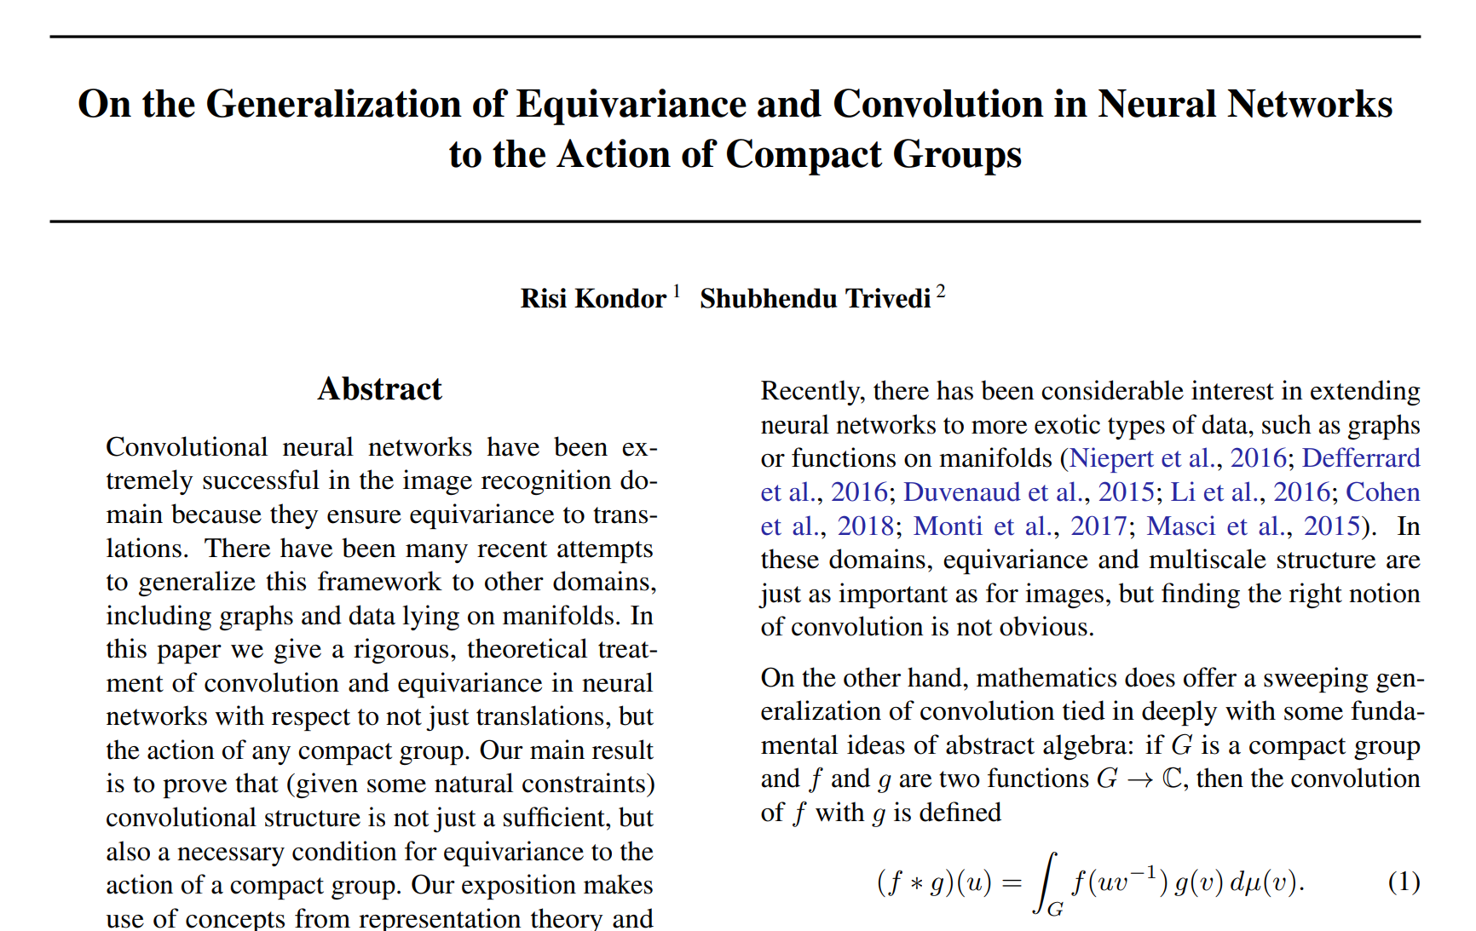
G-CNNs are the only way
Group equivariance $⇒$ Group convolution (2018) [6]
Question (I): can we re-think all our previous to write
our NQSs?
(MPNNs are proved to be a special case of G-CNNs)
Question (II): is there an advantage to designing
our NQS within this framework?
[6] R Kondor and S Trivedi, On the Generalization of Equivariance and Convolution in Neural Networks to the Action of Compact Groups, arXiv:1802.03690

Slide 13
Toy example (I)
$ℤ/2ℤ$,$C_{2}=\{e, a\}$ (parity)
$$ψ_{NQS}\left(x\right)≔ψ_{NN}\left(x\right)+ψ_{NN}(−x)$$
What are the irreps of $ℤ/2ℤ$? In position space, the trivial and defining/sign representations are:
$D^{t}\left(e\right)=\left(1\right), { D}^{t}\left(a\right)=\left(1\right)$ Trivial representation
$D^{s}\left(e\right)=\left(1\right), { D}^{s}\left(a\right)=\left(−1\right)$ Sign representation
We can project onto the invariant subspaces and we will find they are spanned by: $f_{+}\left(x\right)≔f\left(x\right)+f(−x)$,
$f_{−}\left(x\right)≔f\left(x\right)−f(−x)$
$ψ_{NQS}\left(x\right)≔ψ_{NN}\left(x\right)+ψ_{NN}(−x)$ is for wave functions transforming with the trivial rep.
$ψ_{NQS}\left(x\right)≔ψ_{NN}\left(x\right)−ψ_{NN}(−x)$ is for wave functions transforming with the sign rep.

Slide 14
Toy example (II)
$S_{N}$ (symmetric/permutation group)
(for fermionic particle exchange symmetry)
We can take the permutation/regular representation of $S_{N}.$
$N=3$
$D\left(σ_{1}\right)=\left(\begin{matrix}1 & 0 \\ \begin{aligned}0 \\ 0\end{aligned} & \begin{aligned}1 \\ 0\end{aligned}\end{matrix} \begin{matrix}0 \\ 0 \\ 1\end{matrix}\right),D\left(σ_{2}\right)=\left(\begin{matrix}1 & 0 \\ \begin{aligned}0 \\ 0\end{aligned} & \begin{aligned}0 \\ 1\end{aligned}\end{matrix} \begin{matrix}0 \\ 1 \\ 0\end{matrix}\right),$ $D\left(σ_{3}\right)=\left(\begin{matrix}0 & 1 \\ \begin{aligned}1 \\ 0\end{aligned} & \begin{aligned}0 \\ 0\end{aligned}\end{matrix} \begin{matrix}0 \\ 0 \\ 1\end{matrix}\right),$
$$D\left(σ_{4}\right)=\left(\begin{matrix}0 & 1 \\ \begin{aligned}0 \\ 1\end{aligned} & \begin{aligned}0 \\ 0\end{aligned}\end{matrix} \begin{matrix}0 \\ 1 \\ 0\end{matrix}\right),D\left(σ_{5}\right)=\left(\begin{matrix}0 & 0 \\ \begin{aligned}1 \\ 0\end{aligned} & \begin{aligned}0 \\ 1\end{aligned}\end{matrix} \begin{matrix}1 \\ 0 \\ 0\end{matrix}\right), D\left(σ_{6}\right)=\left(\begin{matrix}0 & 0 \\ \begin{aligned}0 \\ 1\end{aligned} & \begin{aligned}1 \\ 0\end{aligned}\end{matrix} \begin{matrix}1 \\ 0 \\ 0\end{matrix}\right)$$
Using this representation/action, our G-CNN input layer looks like:
$$\left(f⋆χ\right)\left(\vec{x}\right)=\sum_{σ∈S_{N}}{χ(σ)D\left(σ^{−1}\right)}\vec{x}=\sum_{i=1}^{N!}{χ_{i}D(σ_{i}^{−1})\vec{x}}$$
Pro: # parameters “fixed” by N → for few particles, we need less parameters than other architectures.
Con: the scaling is factorial!

Slide 15
Next steps and open questions…
· Some people have already shown G-CNN advantage for quantum systems [7]
· Why is the Slater determinant “so good”? Can we explain it from the irreps of $S_{N}?$ Can we find something even better?
· Since the different excited states have different symmetries (they transform according to different irreps of the same group), can we predict the spectrum all at once by having different output neurons transform differently?
· In nuclear physics, the usual DOF are hadrons → spin-½ particles → spinors. We could leverage the language of G-CNNs to encode the spinor transformation under different symmetries!
$$φ^{′m}\left(x\right)=D^{j}{\left(R\right)}_{ n}^{m}φ^{n}(R^{−1}x)$$
THANK YOU
[7] C Roth and A MacDonald, Group Convolutional Neural Networks Improve Quantum State Accuracy, arXiv:2104.05085

