Slide 1
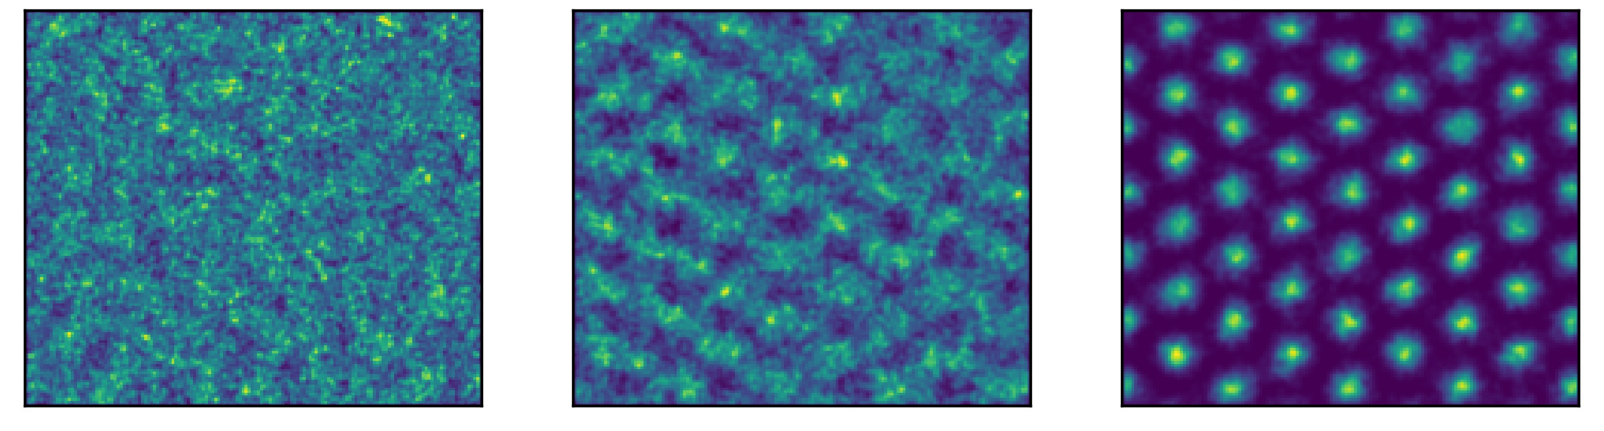
Liquid-solid phase transition in two-dimensional helium-4 with neural network quantum states
David Linteau
Institute of Physics, EPFL, Lausanne, Switzerland
Giuseppe Carleo, Gabriel Pescia, Jannes Nys and Markus Holzmann
Notes:
-Mention clearly in intro we are doing VMC, so we are looking for the ground state of the system

Slide 2
Motivations
Interesting physics: different phases of matter
Notes:
-Example of a strongly correlated system → cannot simply use analytical methods, need numerical tools
-Sometimes ansatz are not translation invariant, sometimes crystal are pinned
-Feynman and Cohen introduced this idea of backflow to improve on the excitation spectrum of liquid helium 4, and this concept is now extensively used for fermionic systems to define auxiliary coordinates – For instance PauliNet and Ferminet

Slide 3
Motivations
Interesting physics: different phases of matter
Proposed VMC trial wavefunctions often adapted for a specific phase or not flexible enough
Notes:
-Example of a strongly correlated system → cannot simply use analytical methods, need numerical tools
-Sometimes ansatz are not translation invariant, sometimes crystal are pinned
-Feynman and Cohen introduced this idea of backflow to improve on the excitation spectrum of liquid helium 4, and this concept is now extensively used for fermionic systems to define auxiliary coordinates – For instance PauliNet and Ferminet

Slide 4
Motivations
Interesting physics: different phases of matter
Proposed VMC trial wavefunctions often adapted for a specific phase or not flexible enough
Limited work with (neural) backflow transformations for bosonic systems
Notes:
-Example of a strongly correlated system → cannot simply use analytical methods, need numerical tools
-Sometimes ansatz are not translation invariant, sometimes crystal are pinned
-Feynman and Cohen introduced this idea of backflow to improve on the excitation spectrum of liquid helium 4, and this concept is now extensively used for fermionic systems to define auxiliary coordinates – For instance PauliNet and Ferminet

Slide 5
The Hamiltonian
Notes:
Describe potential:
-Specify that it is a short-range potential
-microscopic interatomic potential for helium-4 (so he4 are considered as elementary particles here)
-it includes a repulsive hard core roughly of radius 2.6 Ang, an attractive power law tail, and a minimum of depth 11 K at a radius of roughly 3 Ang

Slide 6
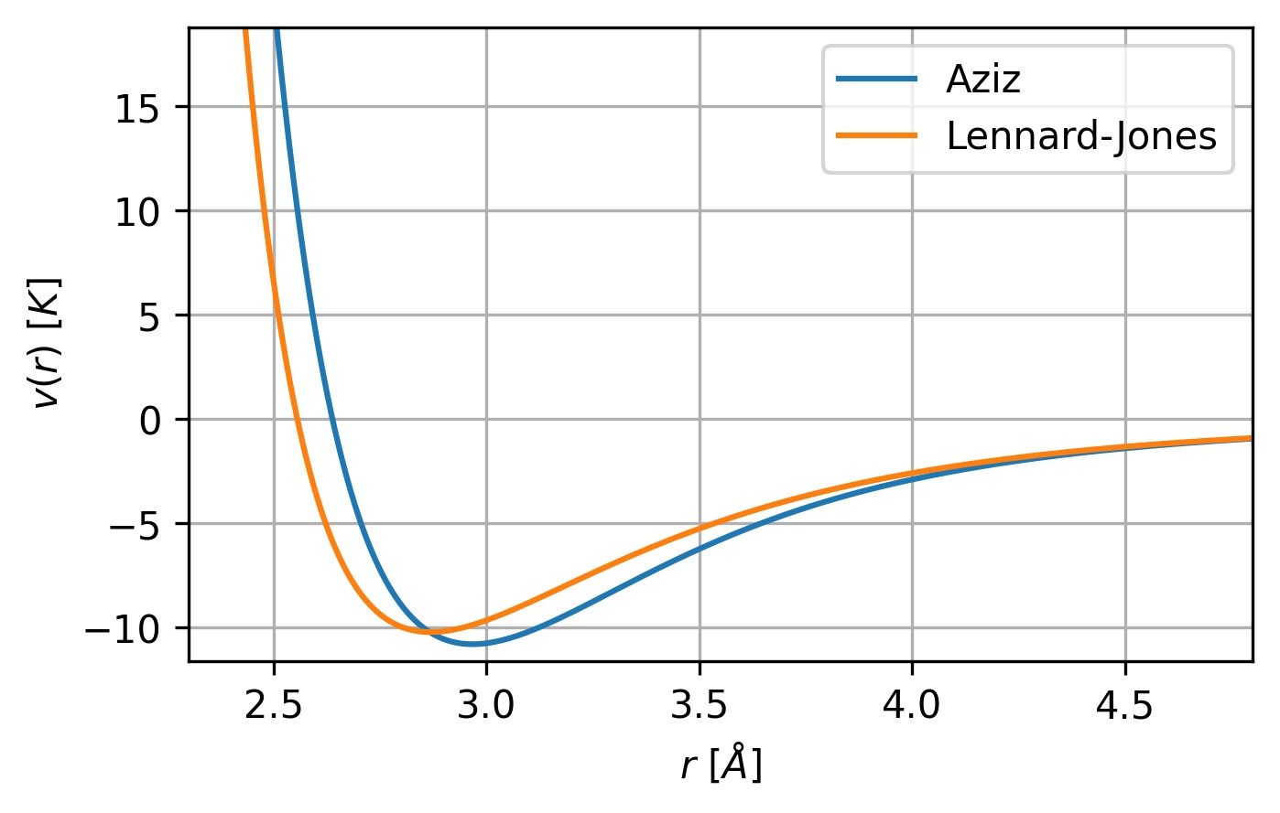
The Hamiltonian
Notes:
Describe potential:
-Specify that it is a short-range potential
-microscopic interatomic potential for helium-4 (so he4 are considered as elementary particles here)
-it includes a repulsive hard core roughly of radius 2.6 Ang, an attractive power law tail, and a minimum of depth 11 K at a radius of roughly 3 Ang

Slide 7
The Hamiltonian
[R. A. Aziz et al., J. Chem. Phys. 70, 4330 (1979)]
Notes:
Describe potential:
-Specify that it is a short-range potential
-microscopic interatomic potential for helium-4 (so he4 are considered as elementary particles here)
-it includes a repulsive hard core roughly of radius 2.6 Ang, an attractive power law tail, and a minimum of depth 11 K at a radius of roughly 3 Ang

Slide 8
Physical Setup
$N$ ⁴He atoms in $d=2$ spatial dimensions
Restricted to a rectangular box - allowing
the formation of a triangular lattice

Slide 9
Physical Setup
$N$ ⁴He atoms in $d=2$ spatial dimensions
Restricted to a rectangular box - allowing
the formation of a triangular lattice
⁴He atoms act like spinless bosons

Slide 10
Physical Setup
$N$ ⁴He atoms in $d=2$ spatial dimensions
Restricted to a rectangular box - allowing
the formation of a triangular lattice
⁴He atoms act like spinless bosons
At zero temperature ($T=0$ K)

Slide 11
Physical Setup
$N$ ⁴He atoms in $d=2$ spatial dimensions
Restricted to a rectangular box - allowing
the formation of a triangular lattice
⁴He atoms act like spinless bosons
At zero temperature ($T=0$ K)
Interested in the bulk properties → PBCs

Slide 12
Physical Setup
$N$ ⁴He atoms in $d=2$ spatial dimensions
Restricted to a rectangular box - allowing
the formation of a triangular lattice
⁴He atoms act like spinless bosons
At zero temperature ($T=0$ K)
Interested in the bulk properties → PBCs
To calculate distances:
nearest image convention

Slide 13
Variational Monte Carlo
One sample/configuration:
Energy:
Local energy:

Slide 14
Variational Monte Carlo
Sampling of via Metropolis-Hastings: Gaussian move acting on all particles
Acceptance probability:
Optimization:
Notes:
-The sampling of R is performed via the Metropolis-Hastings algorithm with a proposed move based on a Gaussian distribution acting on all particle positions.

Slide 15
Trial Wavefunction
Short-range part of the trial wavefunction should lead to a finite local energy:
Notes:
-Most of the physics here is happening at short-range distances
-The diverging behavior of the potential V(R) at short distances r should be compensated by the kinetic contribution so that the total energy remains finite
-What is shown: the local energy for two helium atoms should remain finite

Slide 16
Trial Wavefunction
Short-range part of the trial wavefunction should lead to a finite local energy:
Asymptotic solution of two-body SE:
[W. L. McMillan, Phys. Rev. 138 (1965)]
Notes:
-Most of the physics here is happening at short-range distances
-The diverging behavior of the potential V(R) at short distances r should be compensated by the kinetic contribution so that the total energy remains finite
-What is shown: the local energy for two helium atoms should remain finite

Slide 17
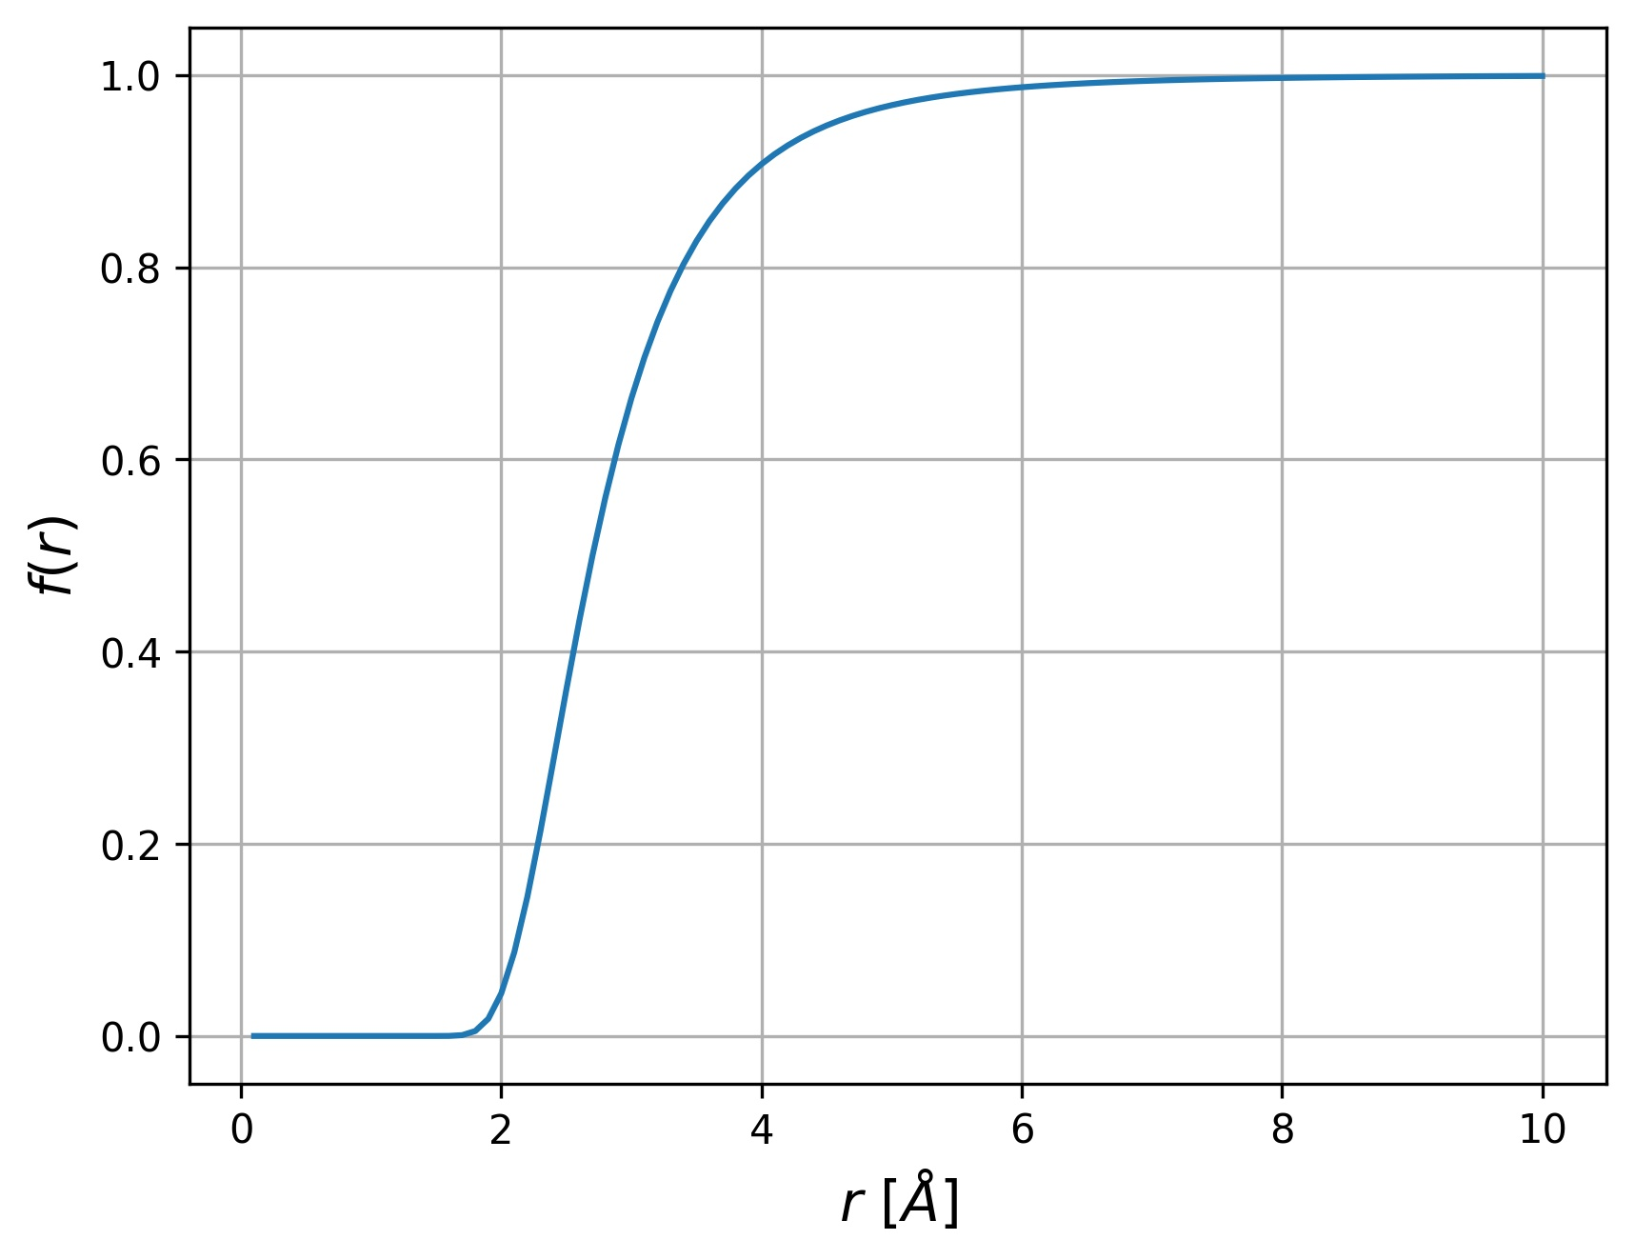
Trial Wavefunction
Short-range part of the trial wavefunction should lead to a finite local energy:
Asymptotic solution of two-body SE:
[W. L. McMillan, Phys. Rev. 138 (1965)]
Notes:
-Most of the physics here is happening at short-range distances
-The diverging behavior of the potential V(R) at short distances r should be compensated by the kinetic contribution so that the total energy remains finite
-What is shown: the local energy for two helium atoms should remain finite

Slide 18
Trial Wavefunction
Short-range part of the trial wavefunction should lead to a finite local energy:
Asymptotic solution of two-body SE:
McMillan variational ansatz:
[W. L. McMillan, Phys. Rev. 138 (1965)]
Notes:
-Most of the physics here is happening at short-range distances
-The diverging behavior of the potential V(R) at short distances r should be compensated by the kinetic contribution so that the total energy remains finite
-What is shown: the local energy for two helium atoms should remain finite

Slide 19
Trial Wavefunction
Given a reference state , the exact ground state is obtained in
the limit of large imaginary times *:
* Provided that the reference state is non-orthogonal to the exact ground state.
Notes:
-Imaginary-time evolution can be used to find the ground state of a Hamiltonian.
(-This can be showed by performing a spectral decomposition of the trial wavefunction with the eigenstates of the Hamiltonian and taking the limit of tau >> energy differences Delta E_k = E_k-E_0)

Slide 20
Trial Wavefunction
Given a reference state , the exact ground state is obtained in
the limit of large imaginary times *:
Adding a completeness relation:
* Provided that the reference state is non-orthogonal to the exact ground state.
Notes:
-Imaginary-time evolution can be used to find the ground state of a Hamiltonian.
(-This can be showed by performing a spectral decomposition of the trial wavefunction with the eigenstates of the Hamiltonian and taking the limit of tau >> energy differences Delta E_k = E_k-E_0)
-Adding a completeness relation TO MAKE FURTHER PROGRESS IN FINDING A FUNCTIONAL FORM

Slide 21
Trial Wavefunction
Full bosonic trial wavefunction:
Notes:
-Trial wavefunction characterized by some real parameters theta

Slide 22
Trial Wavefunction
Full bosonic trial wavefunction:
Notes:
-Trial wavefunction characterized by some real parameters theta

Slide 23
Trial Wavefunction
Full bosonic trial wavefunction:
Permutation invariant, translation invariant, periodic
Notes:
-Trial wavefunction characterized by some real parameters theta

Slide 24
Trial Wavefunction
Full bosonic trial wavefunction:
Permutation invariant, translation invariant, periodic
Rapidly decay when two atoms are close
Notes:
-Trial wavefunction characterized by some real parameters theta

Slide 25
Message Passing Neural Network
Notes:
-We will go step by step on how we process single-particle coordinates by focusing on r1 and r2

Slide 26
Message Passing Neural Network
Notes:
-We map each single-particle coordinate to the vertex of a graph
-To avoid making unnecessary assumptions about the adjacency of the vertices, we assume a complete graph
-The mpnn acts on top of this graph structure

Slide 27
Message Passing Neural Network
Notes:
-We map each single-particle coordinate to the vertex of a graph
-To avoid making unnecessary assumptions about the adjacency of the vertices, we assume a complete graph
-The mpnn acts on top of this graph structure

Slide 28
Message Passing Neural Network
Notes:
-Physical input are stored in the edges via I, which contain periodized coordinates and distances
-Hidden variables h and H are introduced
-Everything is stored in vertex and edge states y and Y
-The square brackets correspond to the concatenation operation
-The index l is the backflow transformation index

Slide 29
Message Passing Neural Network
Notes:
-Physical input are stored in the edges via I, which contain periodized coordinates and distances
-Hidden variables h and H are introduced
-Everything is stored in vertex and edge states y and Y
-The square brackets correspond to the concatenation operation
-The index l is the backflow transformation index

Slide 30
Message Passing Neural Network
Notes:
-Message spread across the graph;
-Message constructed with edge states using an attention mechanism

Slide 31
Message Passing Neural Network

Slide 32
Message Passing Neural Network

Slide 33
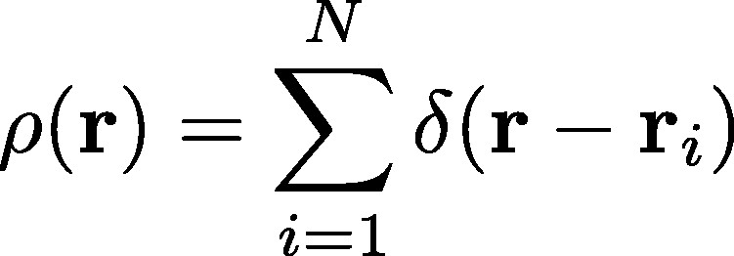
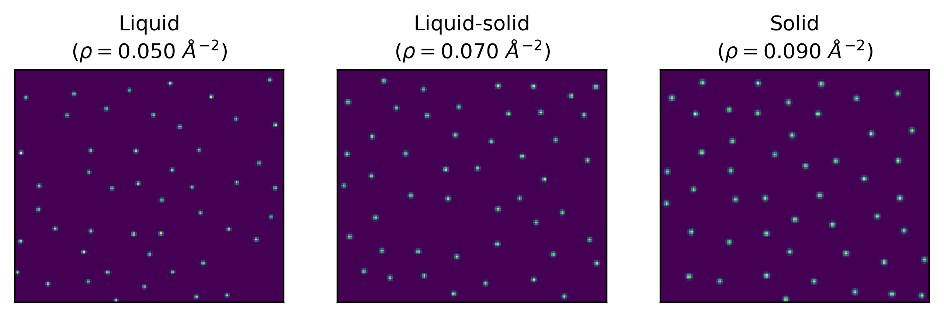
Liquid vs Solid: Density Operator
Number of sample(s): 1
$$N=48$$
Notes:
-Mention that we start the results section
-Give details of the plot: number of particles, geometry of the box
-One sample is equivalent to just plotting the 2D single-particle coordinates
-The delta function is approximated as a Gaussian

Slide 34
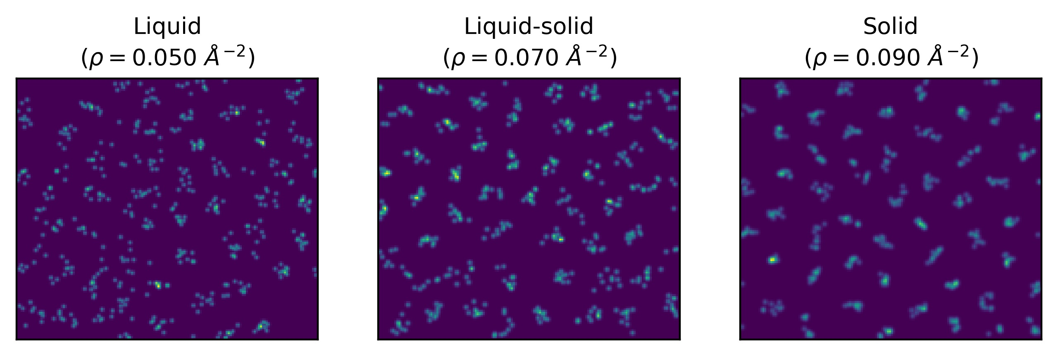
Liquid vs Solid: Density Operator
Number of sample(s): 10
Notes:
-Statistical average over a single chain

Slide 35
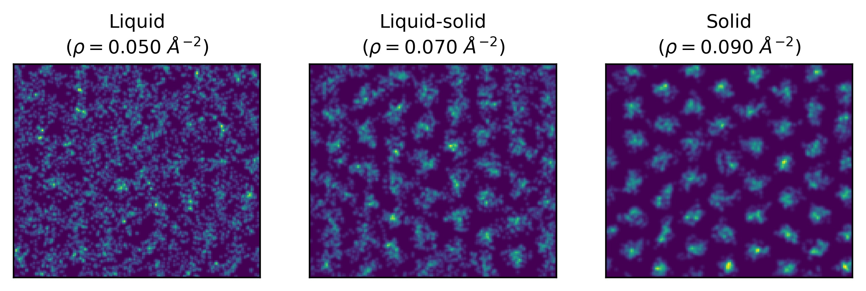
Liquid vs Solid: Density Operator
Number of sample(s): 100

Slide 36
Liquid vs Solid: Density Operator
Number of sample(s): 1000
Notes:
-Mention that the liquid is in fact superfluid since we are at T=0K

Slide 37
Liquid vs Solid: Structure Factor

Slide 38
Liquid vs Solid: Structure Factor

Slide 39
Liquid vs Solid: Structure Factor

Slide 40
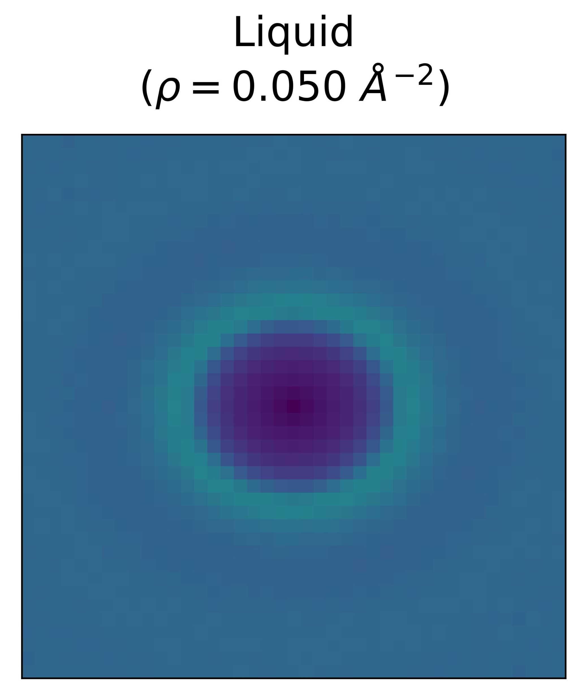
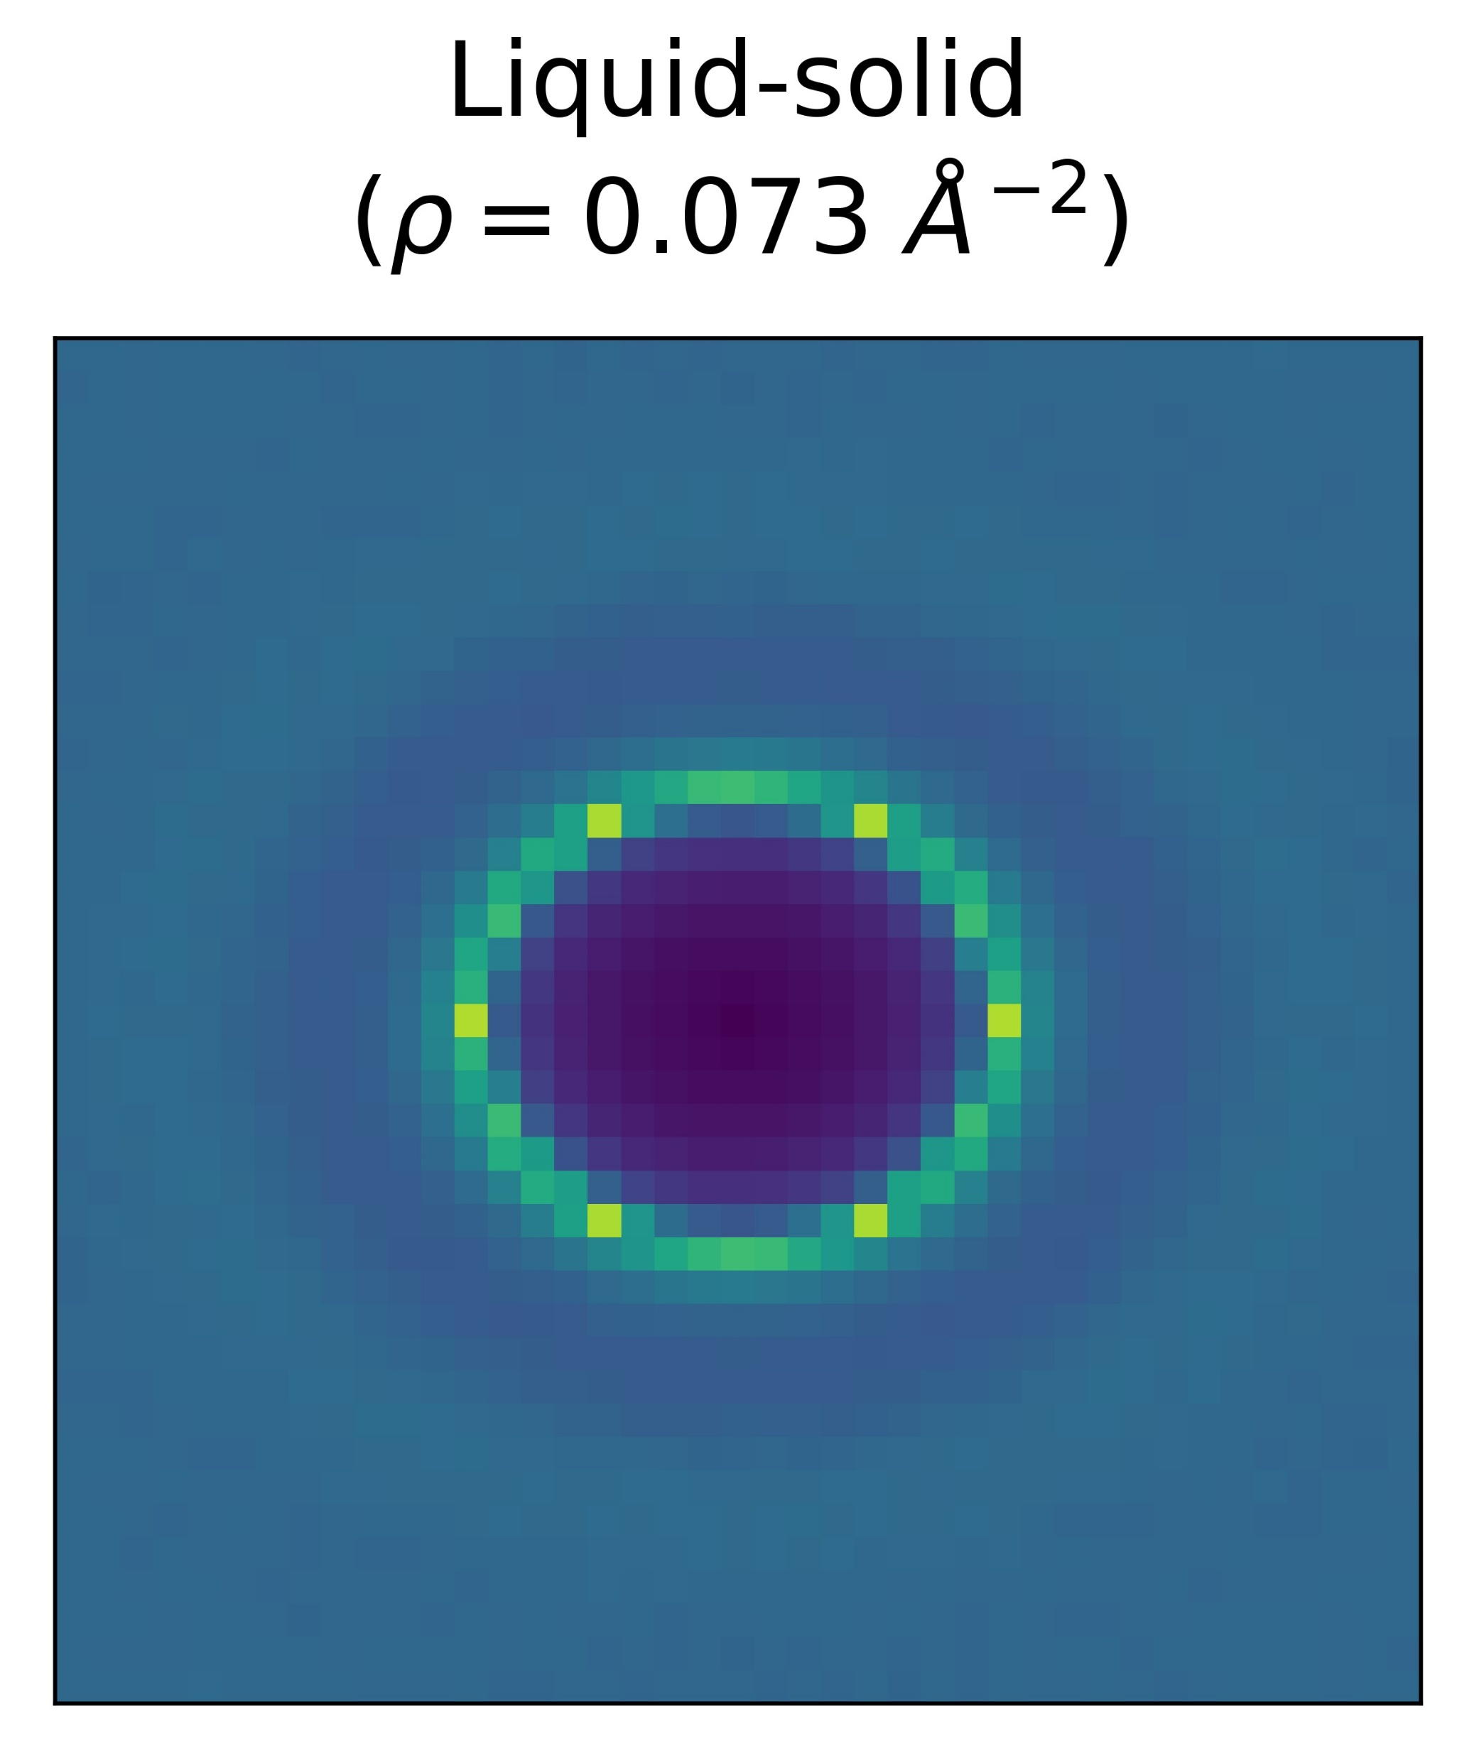
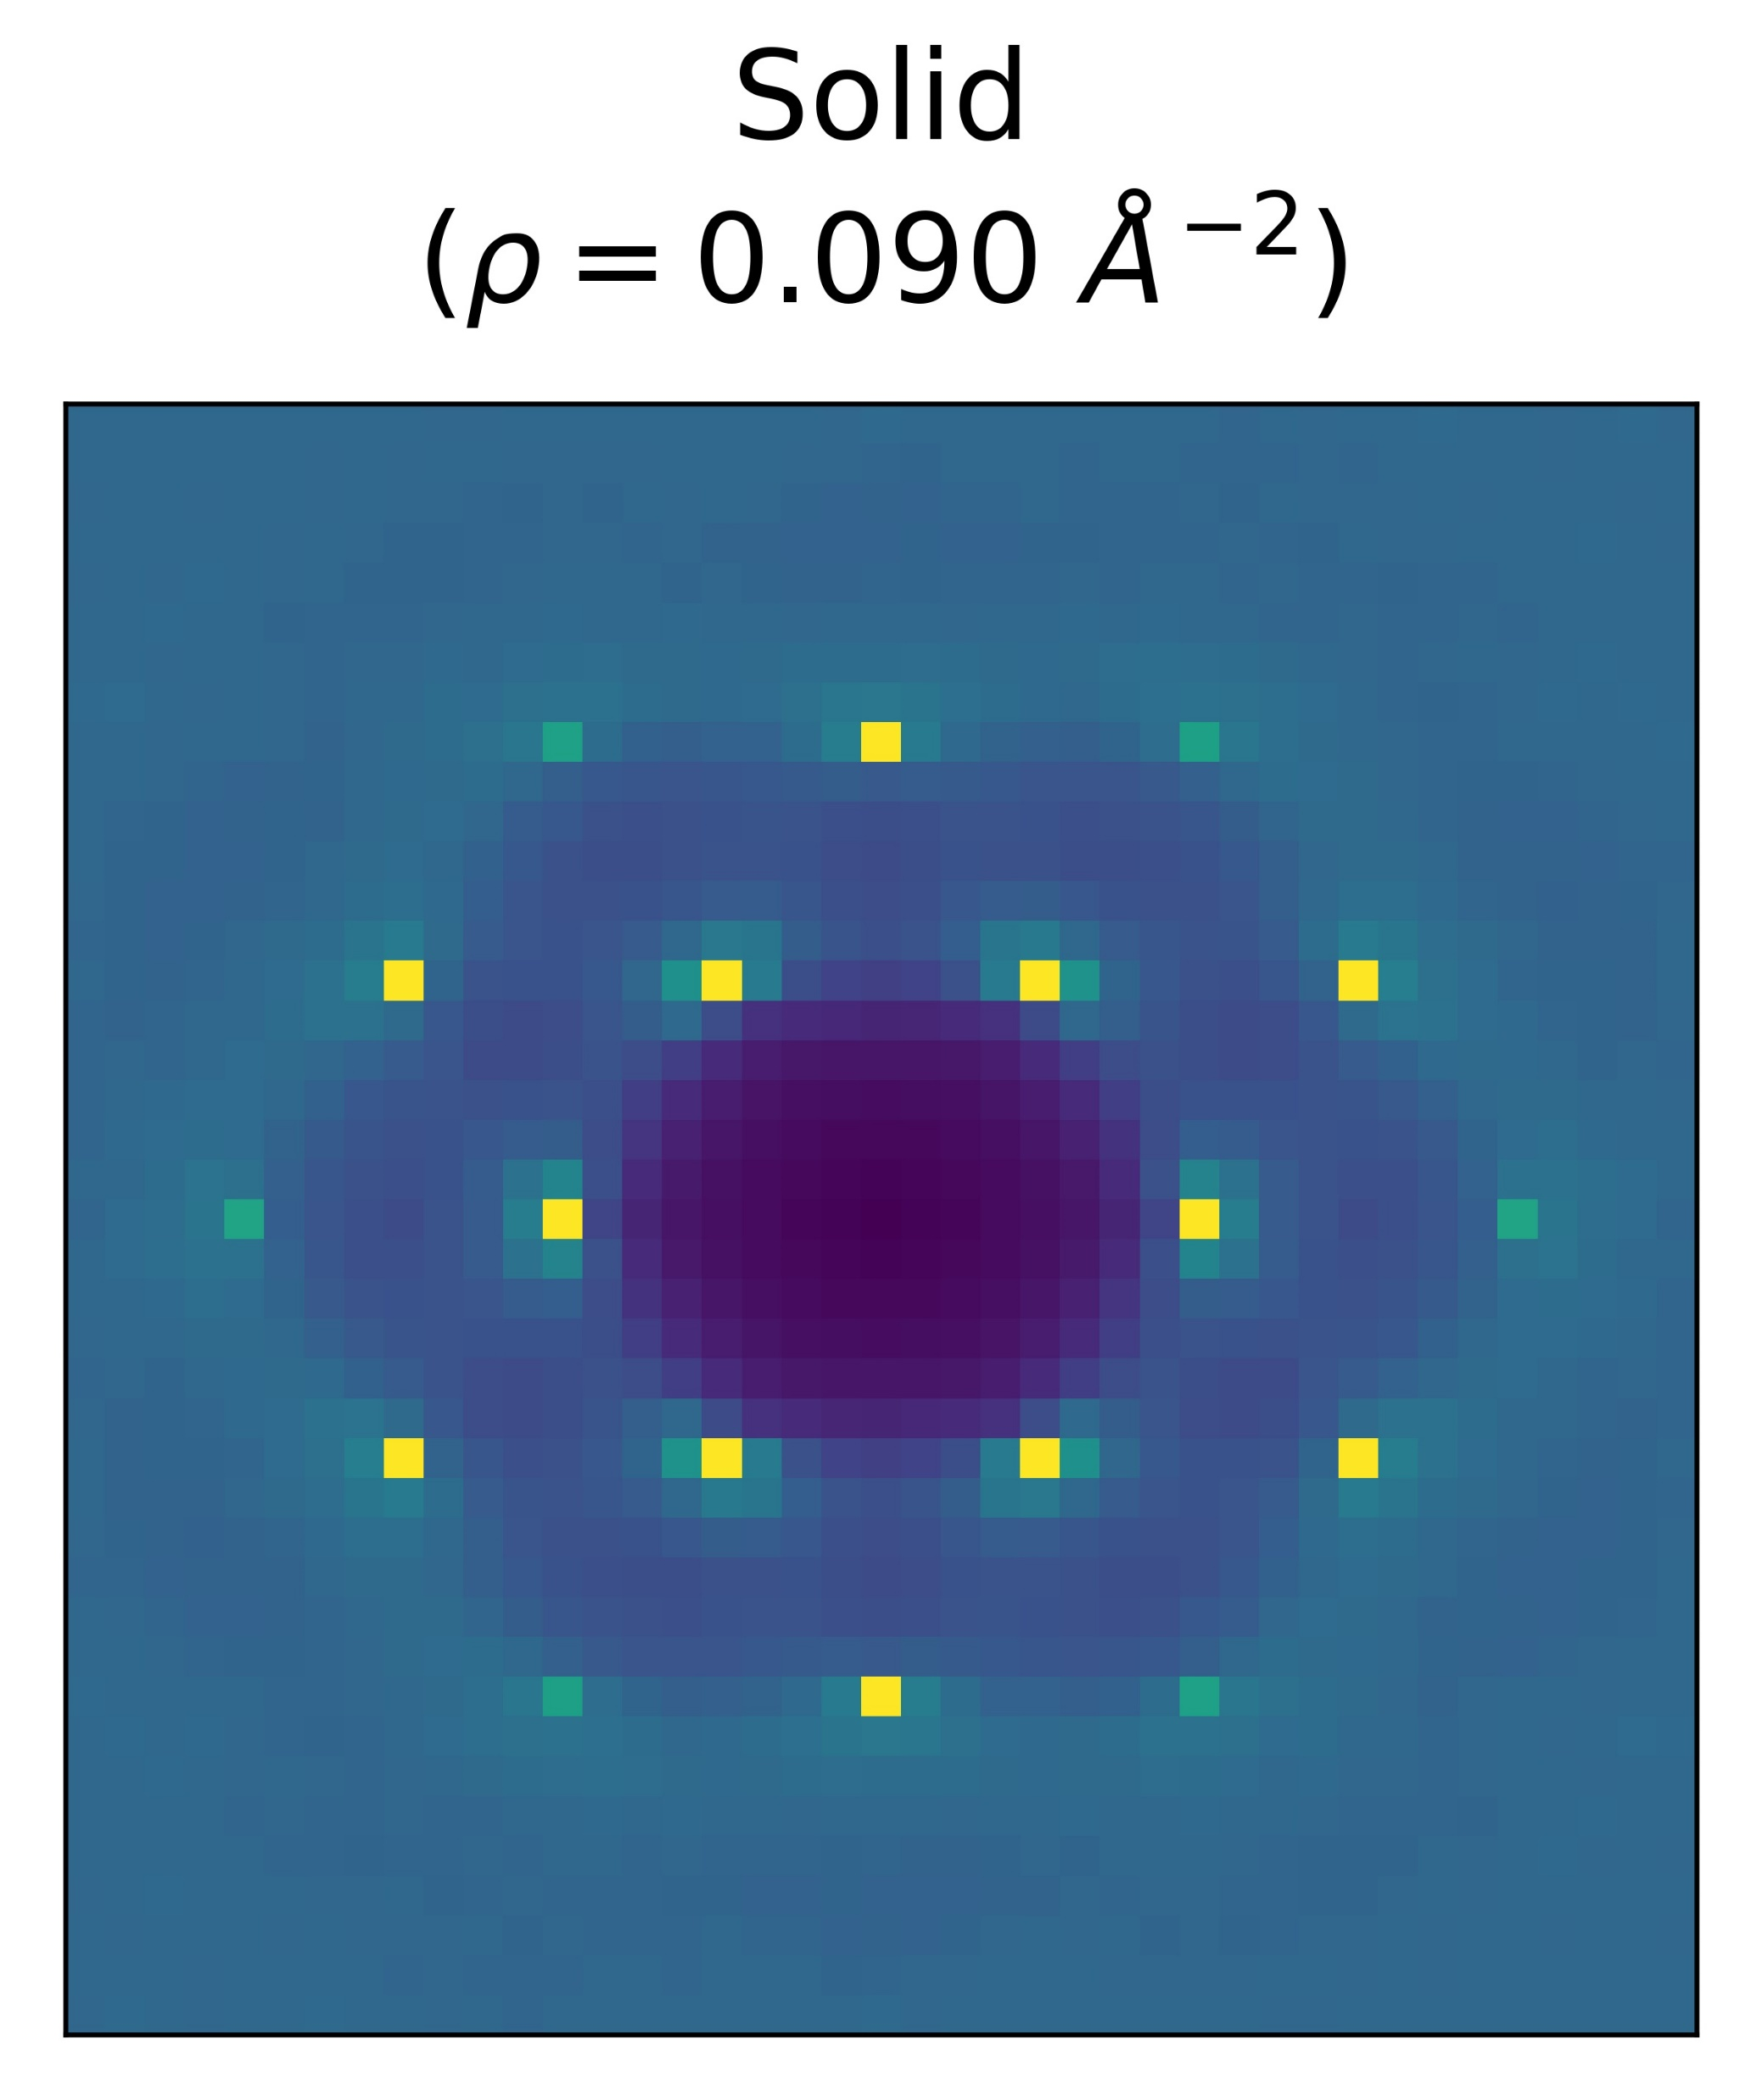
Liquid vs Solid: Structure Factor

Slide 41
Ground-State Energy Estimates
Comparison table:
Notes:
-In fact, in the solid phase, the VMC results are in many cases lower than the ones obtained through DMC
-The trial wave function for solids underlying the DMC calculations is based on a pinned crystal, and seems to have difficulties to project to the correct floating crystal of the ground state.
-whereas we do not initially impose any point to fix the triangular lattice

Slide 42
First-Order Phase Transition
Notes:
-In the previous slide, we put the energies in a table; Now we put the energies in a plot like this
-I’ve mentioned the presence of a phase transition, so we will now discuss the boundaries of this phase transition

Slide 43
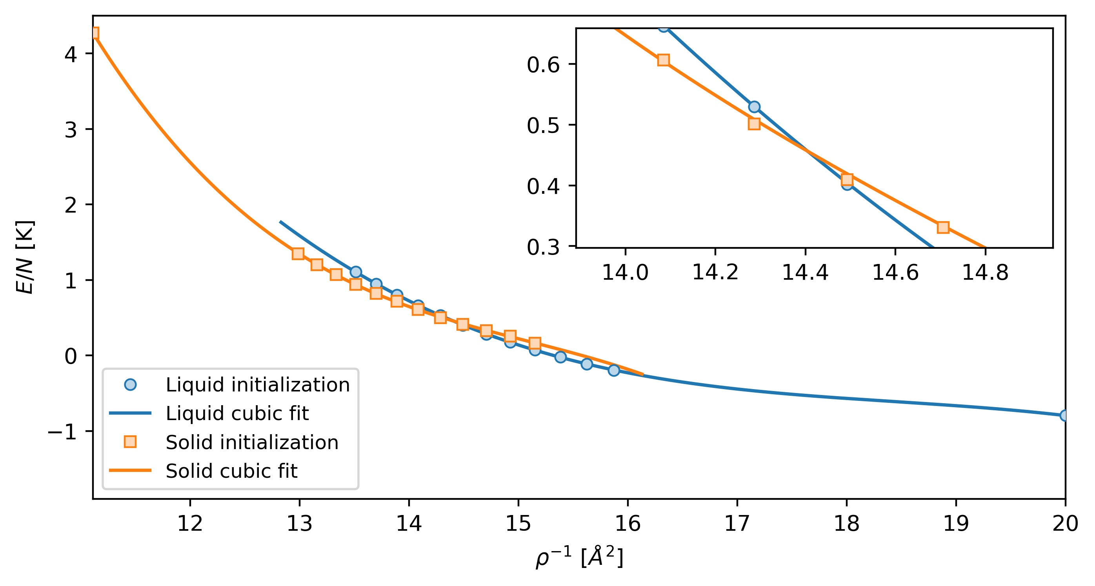
First-Order Phase Transition
Notes:
-In first-order phase transitions, the key characteristic is the presence of an energy barrier between the two phases involved.
-This barrier prevents the system from smoothly transitioning from one phase to another and leads to the coexistence of both phases during the transition.
-The boundaries of the phase transition are determined by the common tangent of the two branches of the energy (and not for instance at the crossing of the two branches).
-This is because the pressure remains constant along this line connecting the two branches, meaning that the system remains in equilibrium

Slide 44
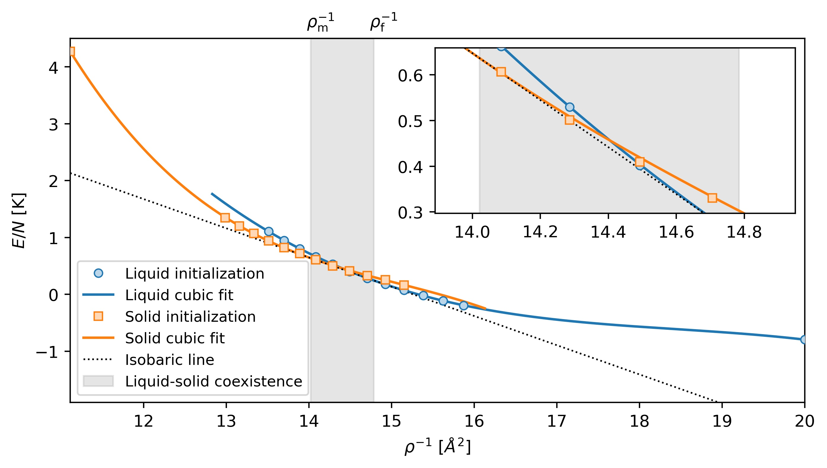
First-Order Phase Transition

Slide 45
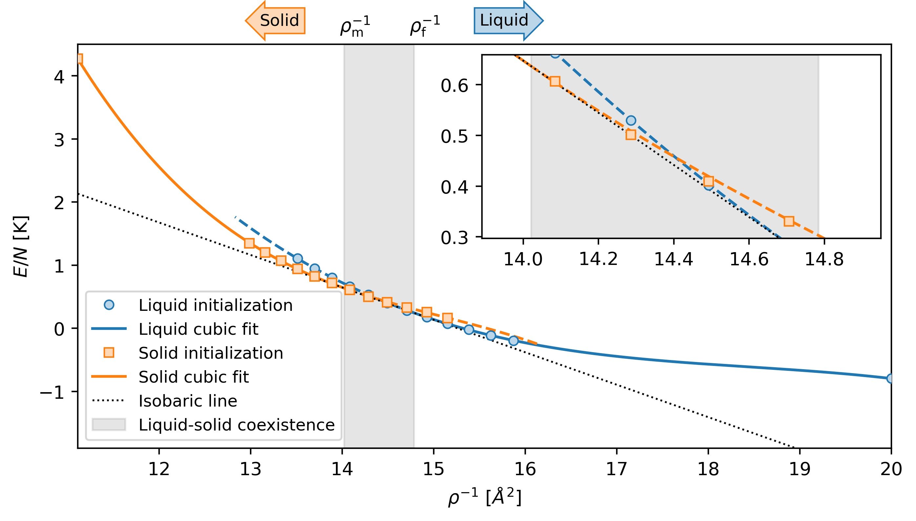
First-Order Phase Transition
Notes:
-Dashed lines correspond to unstable configurations, determined via the common tangent line

Slide 46
First-Order Phase Transition

Slide 47
First-Order Phase Transition
W. C. K. : [P. A. Whitlock, G. V. Chester, and M. H. Kalos, Phys. Rev. B 38 (1988)]
G. C. : [M. C. Gordillo and D. M. Ceperley, Phys. Rev. B 58 (1998)]

Slide 48
First-Order Phase Transition
W. C. K. : [P. A. Whitlock, G. V. Chester, and M. H. Kalos, Phys. Rev. B 38 (1988)]
G. C. : [M. C. Gordillo and D. M. Ceperley, Phys. Rev. B 58 (1998)]

Slide 49
First-Order Phase Transition
W. C. K. : [P. A. Whitlock, G. V. Chester, and M. H. Kalos, Phys. Rev. B 38 (1988)]
G. C. : [M. C. Gordillo and D. M. Ceperley, Phys. Rev. B 58 (1998)]

Slide 50
First-Order Phase Transition
W. C. K. : [P. A. Whitlock, G. V. Chester, and M. H. Kalos, Phys. Rev. B 38 (1988)]
G. C. : [M. C. Gordillo and D. M. Ceperley, Phys. Rev. B 58 (1998)]
Compare with G. C. PIMC results:
Notes:
W. C. K.: VMC McMillan form ansatz in the liquid phase (N=64), and in solid phase (N=80) they were pinning the crystal lattice points
G. C.: PIMC at finite temperature (N=30) (rho_f and rho_m obtained at T=0.25 K)

Slide 51
Condensate fraction
A superfluid sample is a Bose-Einstein condensate
⁴He atoms are spinless bosons → can occupy same state

Slide 52
Condensate fraction
A superfluid sample is a Bose-Einstein condensate
⁴He atoms are spinless bosons → can occupy same state
Due to strong interactions, only a fraction $n_{0}$ are in the condensate

Slide 53
Condensate fraction
A superfluid sample is a Bose-Einstein condensate
⁴He atoms are spinless bosons → can occupy same state
Due to strong interactions, only a fraction $n_{0}$ are in the condensate
Estimator:
Notes:
-A bit sloppy in writing the estimator; it’s really a statistical average over the Born distribution

Slide 54
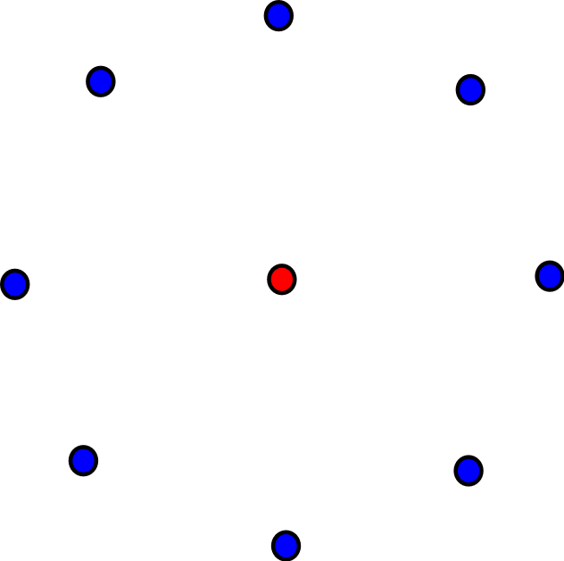
Condensate fraction
A superfluid sample is a Bose-Einstein condensate
⁴He atoms are spinless bosons → can occupy same state
Due to strong interactions, only a fraction $n_{0}$ are in the condensate
Estimator:

Slide 55
Condensate fraction
A superfluid sample is a Bose-Einstein condensate
⁴He atoms are spinless bosons → can occupy same state
Due to strong interactions, only a fraction $n_{0}$ are in the condensate
Estimator:

Slide 56
Condensate fraction
A superfluid sample is a Bose-Einstein condensate
⁴He atoms are spinless bosons → can occupy same state
Due to strong interactions, only a fraction $n_{0}$ are in the condensate
Estimator:

Slide 57
Condensate fraction
A superfluid sample is a Bose-Einstein condensate
⁴He atoms are spinless bosons → can occupy same state
Due to strong interactions, only a fraction $n_{0}$ are in the condensate
Estimator:

Slide 58
Condensate fraction
3D ⁴He atoms in a square box at equilibrium density (saturated vapour pressure $ρ\sim 0.0218$Å)
Comparison table:
Notes:
-Detour in 3D
-The condensate fraction n0 can be inferred from the dynamic structure factor S(q, ω), probed experimentally by deep inelastic neutron scattering off the superfluid [REF: S. Moroni and M. Boninsegni]
-PMC (projector monte carlo): using a novel projection method, similar in spirit to DMC, but without the bias from the initial trial wave function, that affects estimates for off-diagonal operators in DMC. This (Quantum Monte Carlo) technique combines sampling ideas from PIMC, as well as from Reptation Quantum Monte Carlo (RQMC)
-This work: 0.0218
-Moroni: 0.02186
-Boninsegni: 0.02184
-Rota: 0.02186

Slide 59
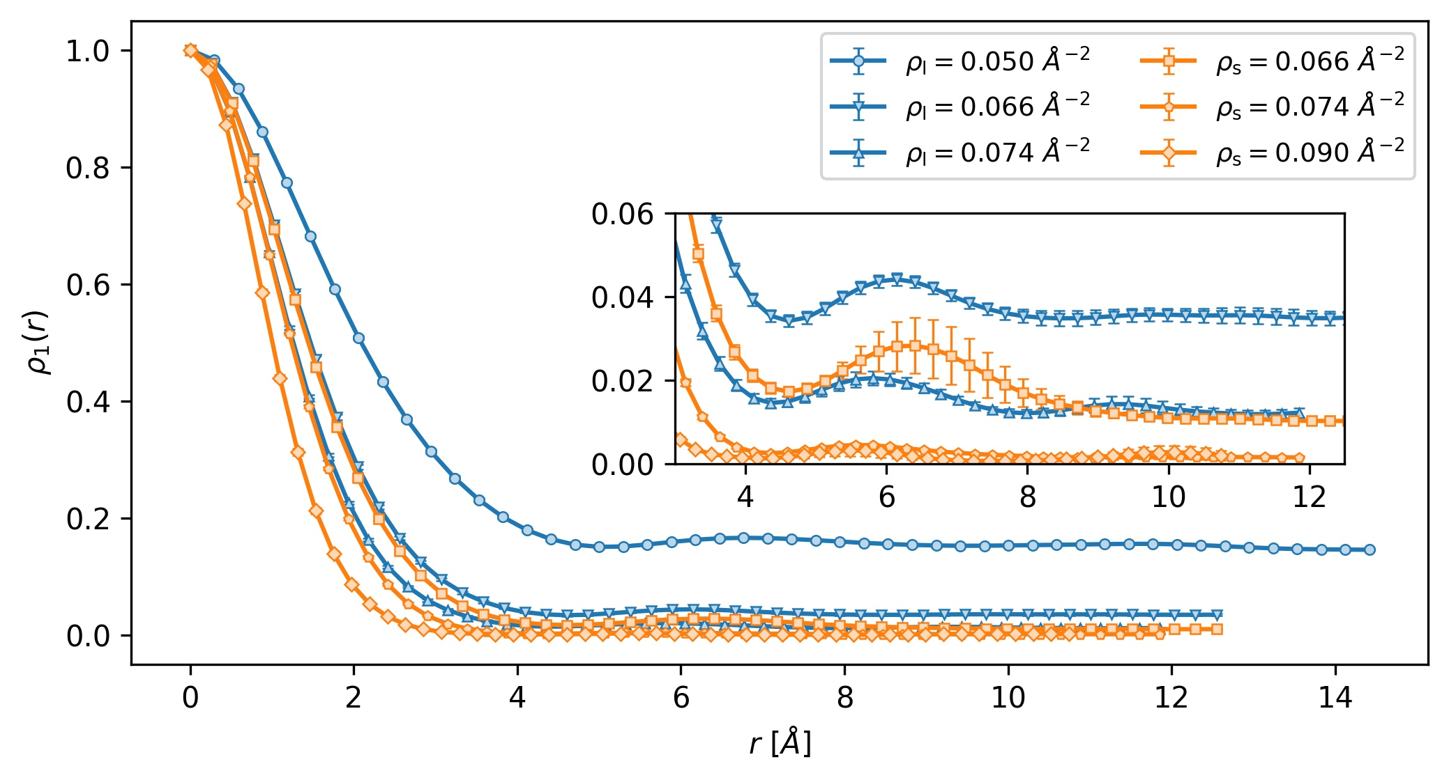
Condensate fraction

Slide 60
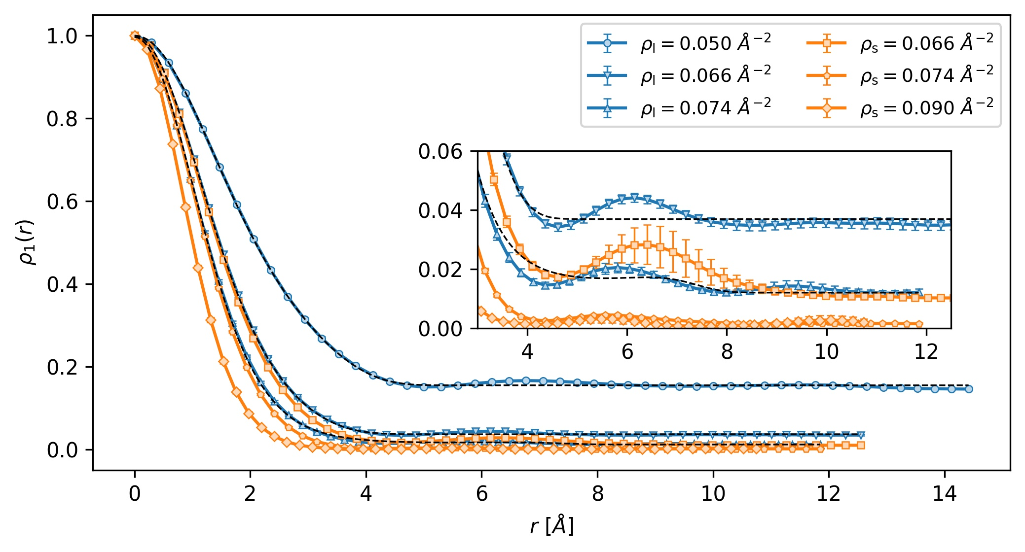
Condensate fraction
Fit:
[Glyde, Azuah and Stirling, Phys. Rev. B 62 (2000)]
Notes:
-Since it’s difficult to take the limit as r->Infinity of a numerical dataset, we instead use a fit that was used to analyze experimental data

Slide 61
Rényi-2 entropy
Consider two partitions A and B of the system

Slide 62
Rényi-2 entropy
Consider two partitions A and B of the system
Reduced density matrix of subsystem A:

Slide 63
Rényi-2 entropy
Consider two partitions A and B of the system
Reduced density matrix of subsystem A:
Measure the bipartite entanglement with the Rényi-2 entropy:

Slide 64
Rényi-2 entropy
Consider two partitions A and B of the system
Reduced density matrix of subsystem A:
Measure the bipartite entanglement with the Rényi-2 entropy:
Two samples are necessary to evaluate the estimator. Let’s call them and

Slide 65
Rényi-2 entropy
Consider two partitions A and B of the system
Reduced density matrix of subsystem A:
Measure the bipartite entanglement with the Rényi-2 entropy:
Two samples are necessary to evaluate the estimator. Let’s call them and
Here is the estimator:

Slide 66
Rényi-2 entropy

Slide 67
Rényi-2 entropy
Consider a spherical spatial bipartition

Slide 68
Rényi-2 entropy
Consider a spherical spatial bipartition

Slide 69
Rényi-2 entropy
Consider a spherical spatial bipartition

Slide 70
Rényi-2 entropy
Consider a spherical spatial bipartition
* Non-zero contributions to the estimator only if the number of particles in partition A is the same as in B

Slide 71
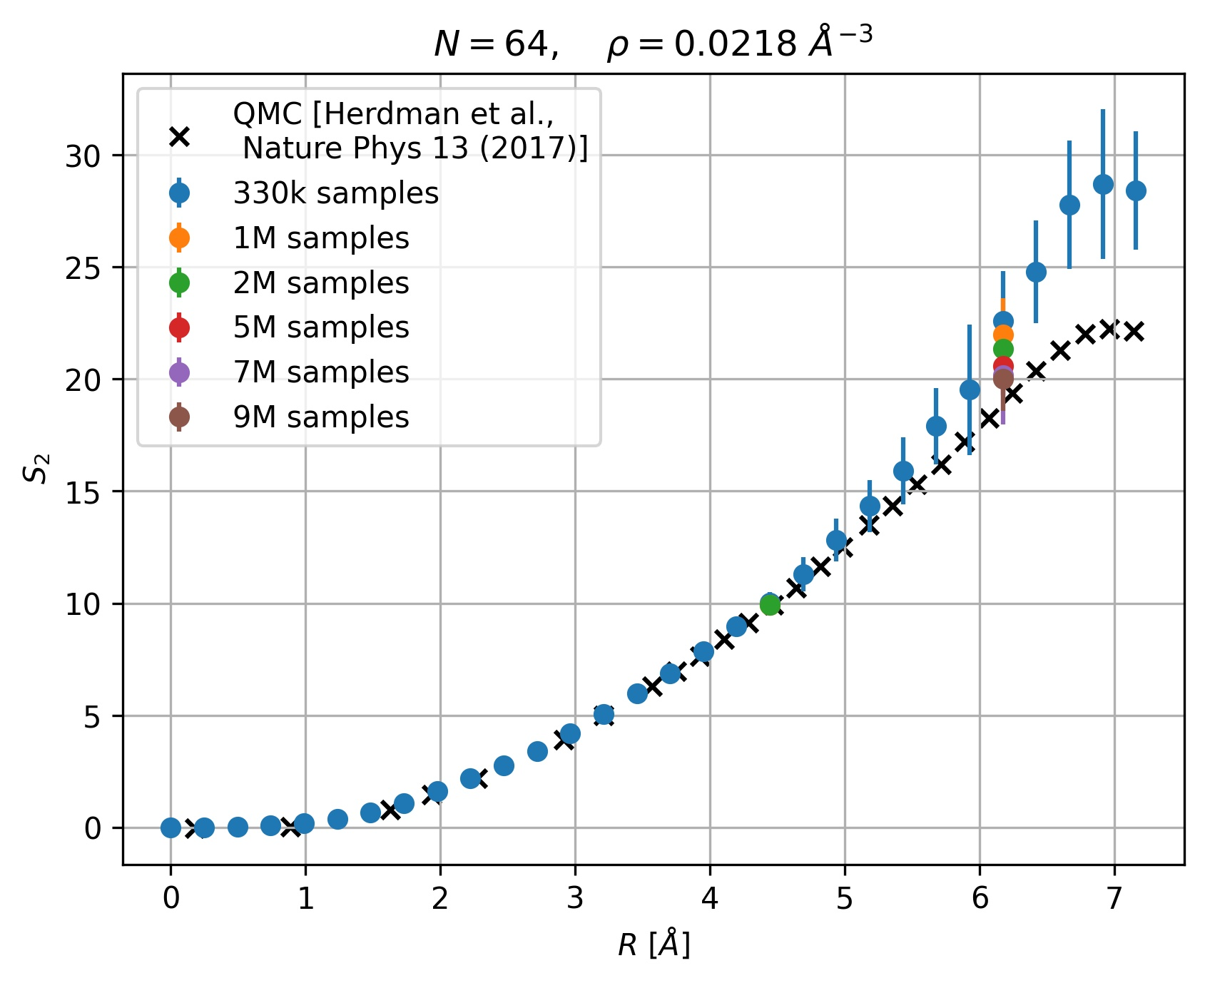
Rényi-2 entropy (in progress)
Able to reproduce 3D
results from:
[Herdman, Roy, Melko and Del Maestro, Entanglement area law in superfluid 4He. Nature Phys 13, 556–558 (2017).]
Radius of the spherical subregion

Slide 72
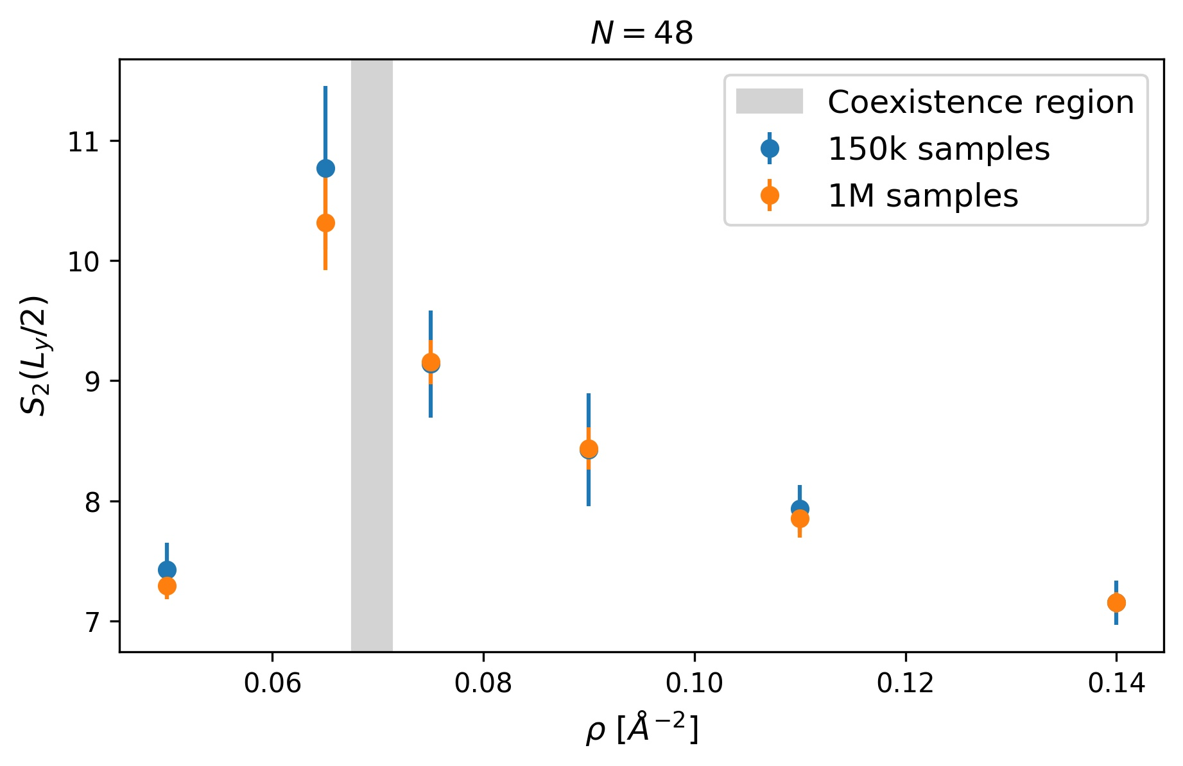
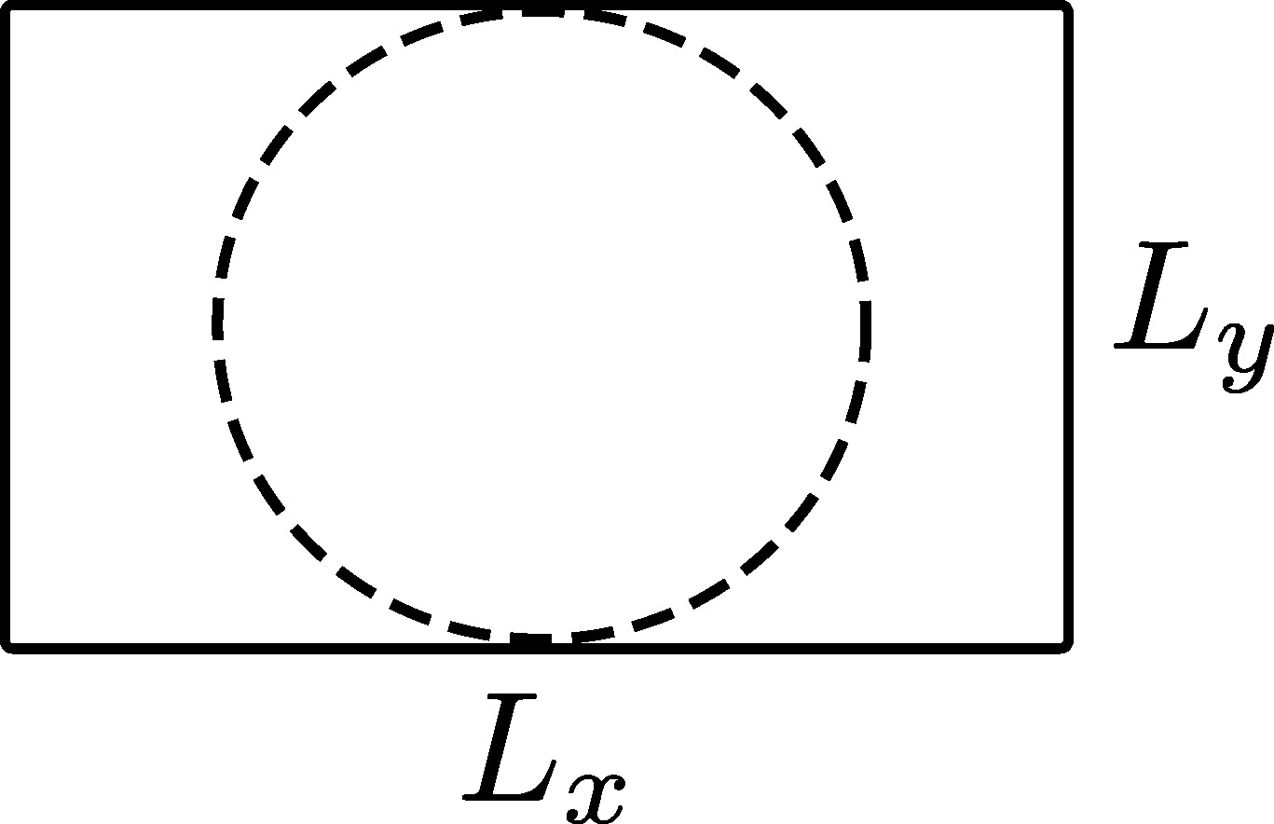
Rényi-2 entropy (in progress)
Can be used as a probe to detect the phase transition. For $N=48:$
Simulation box
geometry
Notes:
-The spike occurs because particles are in a transitional state near the coexistence region, as they can be partially ordered (in the solid phase) and partially disordered (in the liquid phase)

Slide 73
Conclusion
Presented a powerful trial wavefunction (WF) to study the ⁴He ground state in 2D and 3D;

Slide 74
Conclusion
Presented a powerful trial wavefunction (WF) to study the ⁴He ground state in 2D and 3D;
Obtained results that agree with the literature;

Slide 75
Conclusion
Presented a powerful trial wavefunction (WF) to study the ⁴He ground state in 2D and 3D;
Obtained results that agree with the literature;
The WF’s structure, based on MPNN, is general and can be applied to other problems;

Slide 76
Conclusion
Presented a powerful trial wavefunction (WF) to study the ⁴He ground state in 2D and 3D;
Obtained results that agree with the literature;
The WF’s structure, based on MPNN, is general and can be applied to other problems;
Outlook: compute other relevant quantities (e.g. Rényi-2 entropy), consider different systems (e.g. ³He) with the same WF structure.

Slide 77
Conclusion
Presented a powerful trial wavefunction (WF) to study the ⁴He ground state in 2D and 3D;
Obtained results that agree with the literature;
The WF’s structure, based on MPNN, is general and can be applied to other problems;
Outlook: compute other relevant quantities (e.g. Rényi-2 entropy), consider different systems (e.g. ³He) with the same WF structure.
Start writing a manuscript

Slide 78
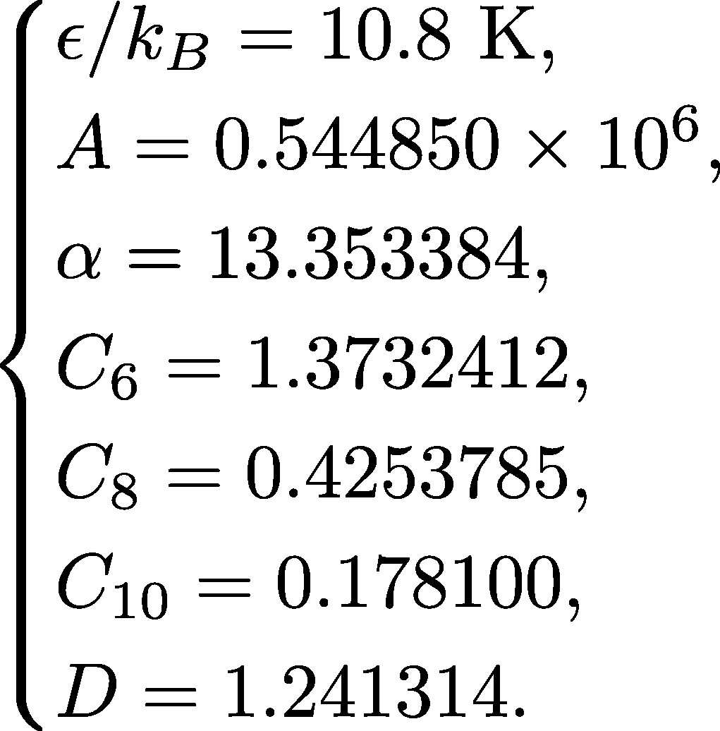
Appendix I: Potential
Notes:
-we are interested in the thermodynamic limit but only have access to finite size systems
-constant contributions: to balance the truncation and the shift of the potential

