Slide 1
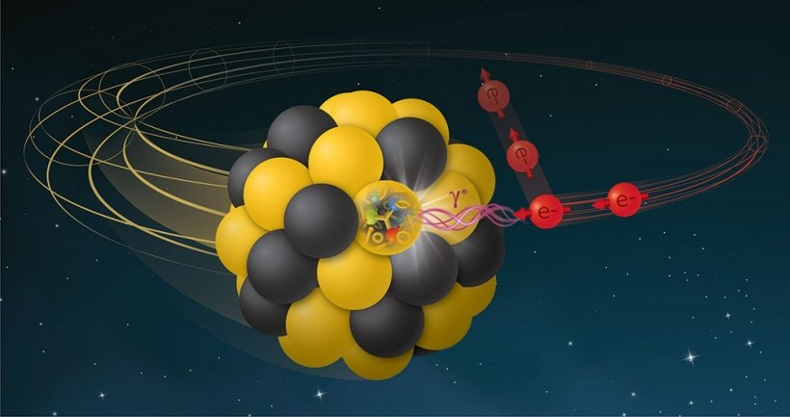
Moment parameterization of GPDs and global analysis
Yuxun Guo
University of Maryland, College Park
Lawrence Berkeley National Laboratory
ECT*-APCTP Joint Workshop:
Exploring resonance structure with transition GPDs
Aug. 21-25th, 2023

Slide 2
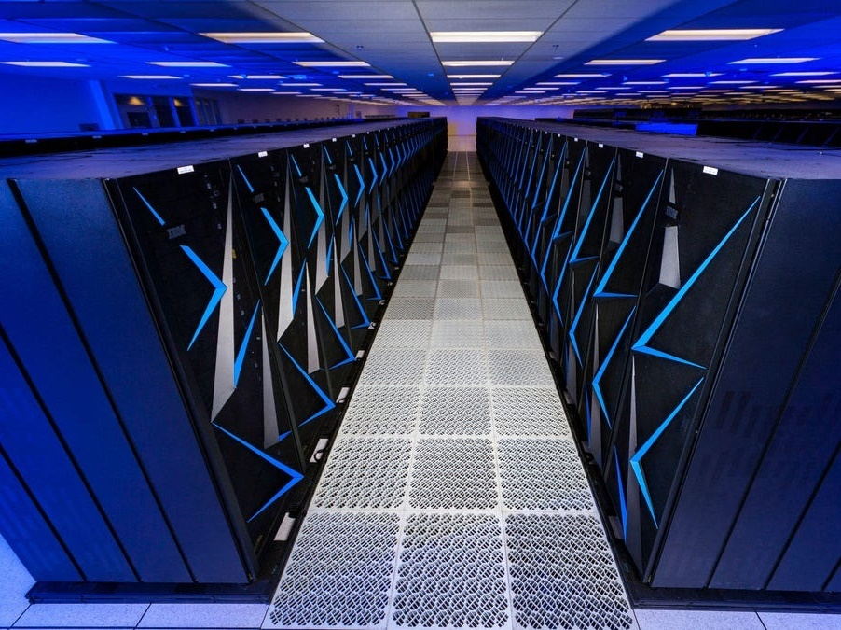
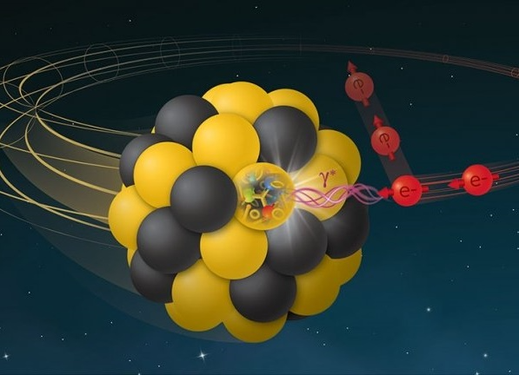
Outline
Intro – GPD and nucleon 3D structure
Global analysis program of GPD
GPD at non-zero skewness and DA terms
Summary and outlook

Slide 3
Nucleon spin and 3D structure
The nucleon structure can be accessed by higher-energy knock-out processes by virtue of the asymptotic freedom.
To access the full nucleon AM structure, we also need to localize the particle in coordinate space for the orbital AM.
Generalized Parton Distributions (GPDs)
D. Muller et. al. Fortsch.Phys. 42 101 (1994)
X. Ji Phys. Rev. Lett. 78, 610 (1997)

Slide 4
Properties of GPDs
GPDs are 3D distributions unifying parton distributions and form factors
: parton momentum fraction
: skewness parameter – longitudinal momentum transfer
: total momentum transfer squared
GPDs reduce to form factors when integrated over x
X. Ji, J. Phys. G 24 1181-1205 (1998)
Charge FFs
Gravitational FFs
GFFs contain mechanical properties of nucleon, which can be accessed with GPDs!

Slide 5
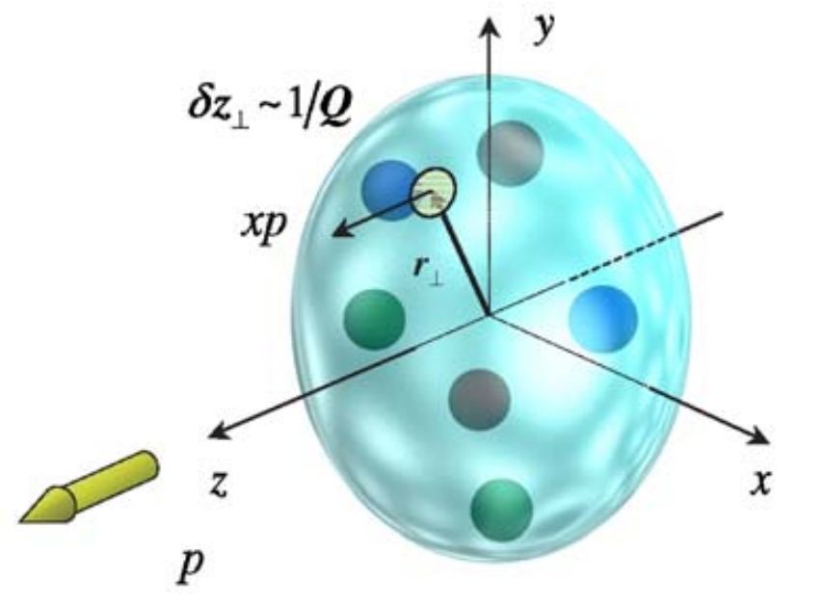
Properties of GPDs
GPDs are 3D distributions unifying parton distributions and form factors
: parton momentum fraction
: skewness parameter – longitudinal momentum transfer
: total momentum transfer squared
3D quark/gluon dist.
GPDs also provide an intuitive 3D image of nucleon:
M. Burkardt, Int. J. Mod. Phys. A 18 173-208 (2003)
which contains information of nucleon spin structure, e. g. transverse spin
Y. Guo et. al. Nucl. Phys. B 969 115440 (2021)

Slide 6
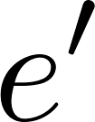
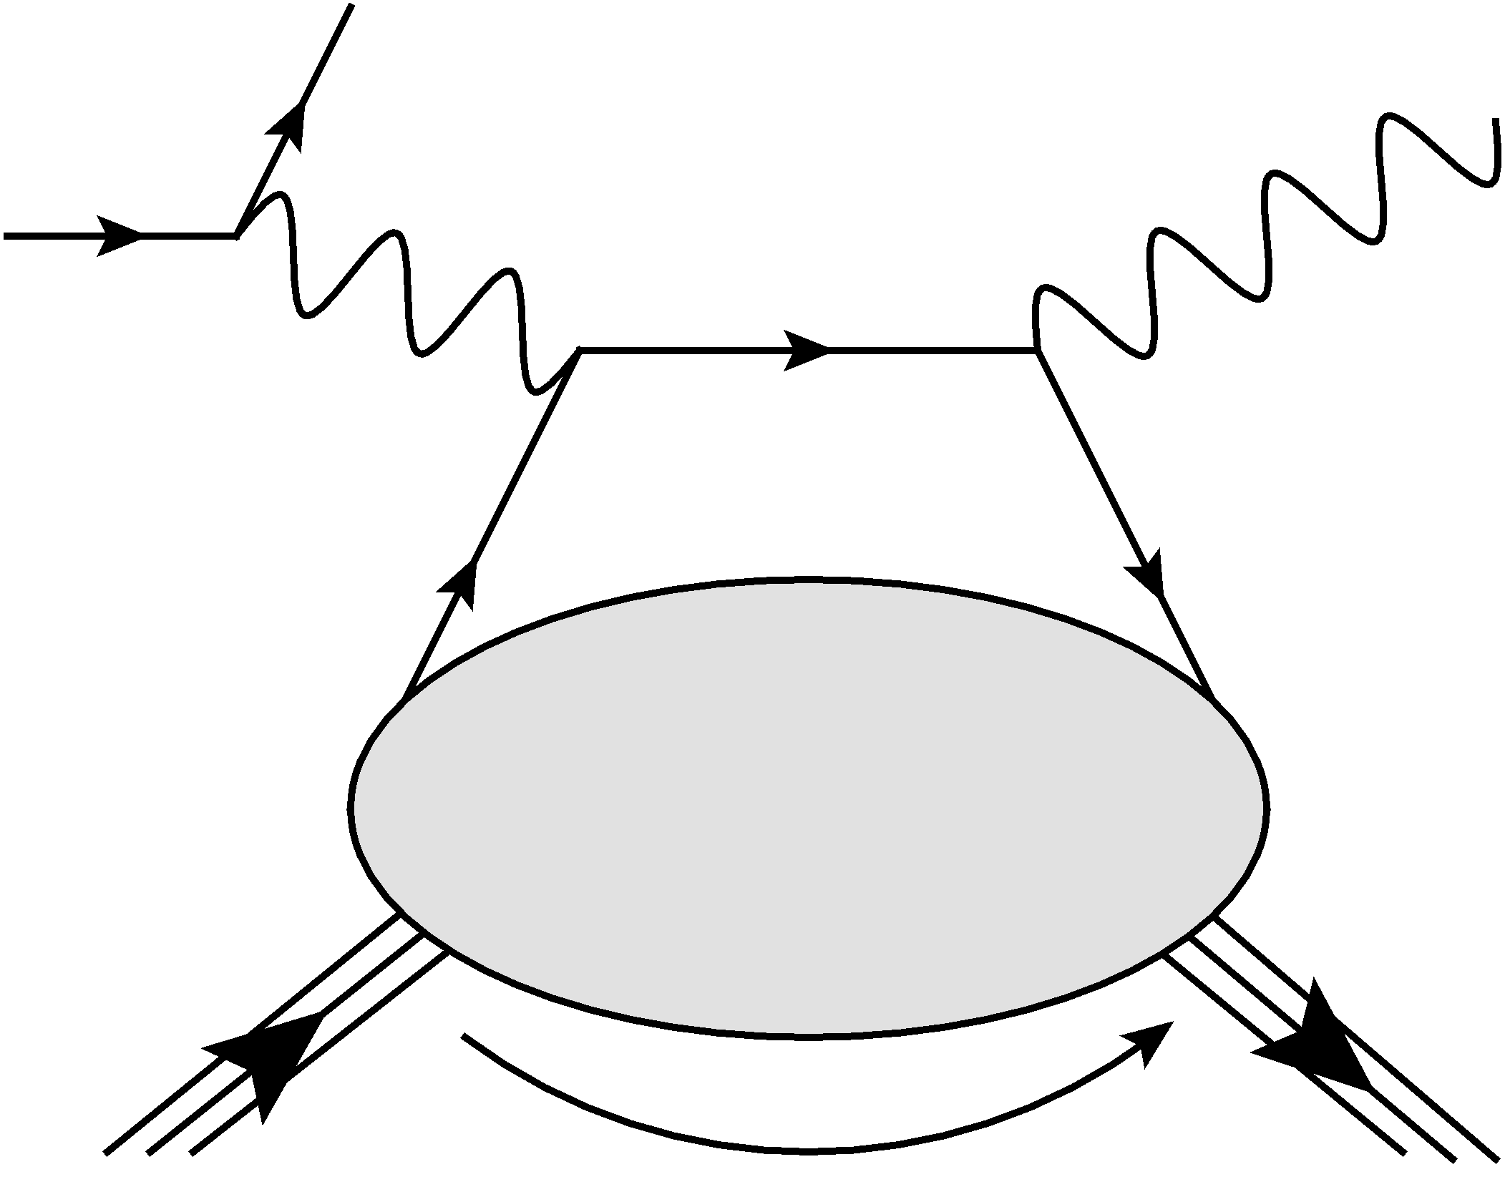
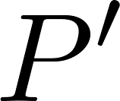
Challenge in measurement
Parton must go back to the nucleon to avoid breaking it!
Deeply virtual Compton scattering
X. Ji, Phys. Rev. D 55, 7114 (1997)
GPD
General features of exclusive processes

Slide 7
Strategy for GPD global analysis
Parameterization of GPDs
Compute GPD observables
Inputs (Constraints) on GPDs
Compare and iterate

Slide 8
Parameterization of GPD
The conformal moment parameterization of GPD is helpful
D. Mueller and A. Schafer Nucl. Phys. B 739 1-59 (2006)
K. Kumericki et al. Nucl. Phys. B 794 244-323 (2008)
Advantages:
Polynomiality condition:
- In moment space, you get this almost for free.
X. Ji, J. Phys. G 24 1181-1205 (1998)
Conformal moments are (LO) multiplicatively renormalizable
- Solve evolution equation in x space is much slower.
I. Balitsky and V. Braun
Nucl. Phys. B 311 541-584 (1989)
GPDs through Universal Moment Parameterization (GUMP)
Collaborators: Xiangdong Ji, Kyle Shiells, Gabriel Santiago, Jinghong Yang
Y. Guo et. al. JHEP 09 215 (2022)
Y. Guo et. al. JHEP 05 150 (2023)

Slide 9
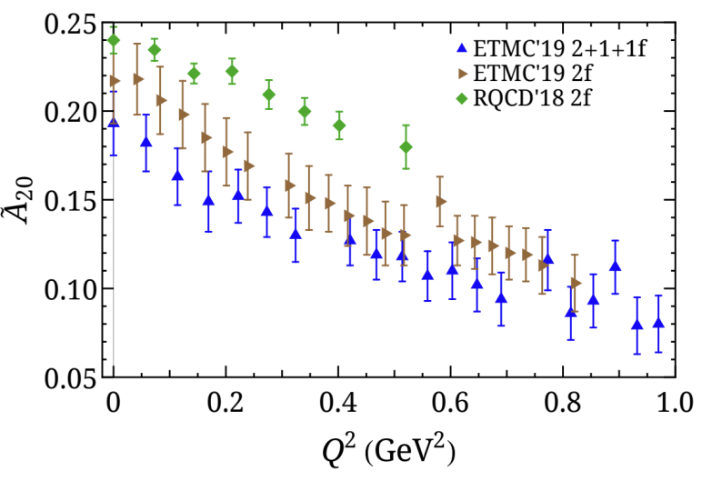
Inputs for the global analysis
Experiments
Lattice
PDFs from global analysis
Polarized and unpolarized PDFs from JAM
Charge form factors from global analysis
YAHL global analysis of EM form factors
Flavor separation combing proton and neutron data
DVCS cross-section measurements
Combined data from CLAS and Hall A (UU and LU)
H1 experiments at HERA
Different setups used in lattice simulations induce systematical uncertainties and deviations.
JAM, Phys. Rev. D 106 3, L031502 (2022)
Z. Ye et. Al., Phys. Lett. B 777 8-15 (2018)
CLAS, Phys. Rev. Lett. 123 3, 032502 (2019)
JLab Hall A, PoS Hadron2017 170 (2018)
M. Constantinou et. al. Prog. Part. Nucl. Phys. 121 103908 (2021)
Lattice form factors and GPDs from a single group.
H1, Phys. Lett. B 681 391-399 (2009)
C. Alexandrou et. al. Phys. Rev. Lett. 125 26, 262001 (2020)
C. Alexandrou et. al. PoS LATTICE2021 250 (2022)

Slide 10
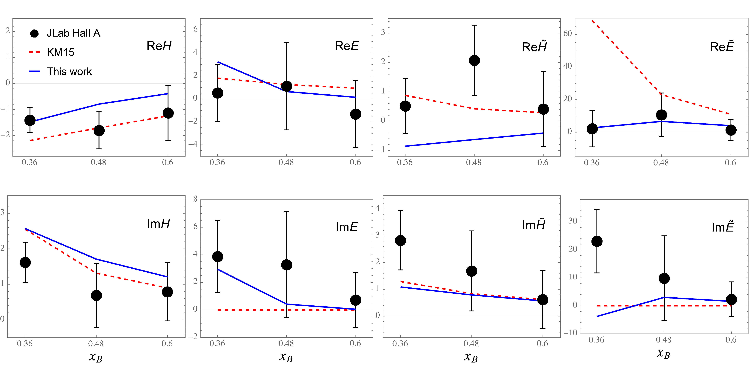
Extracted CFFs
Extracted CFFs compared to both local (JLab Hall A) and global (KM15) extractions.
JLab Hall A, Phys. Rev. Lett. 128 25, 252002 (2022), K. Kumericki and D. Muller EPJ Web Conf. 112 01012 (2016)
Y. Guo et. al. JHEP 05 150 (2023)
Is everything alright?

Slide 11
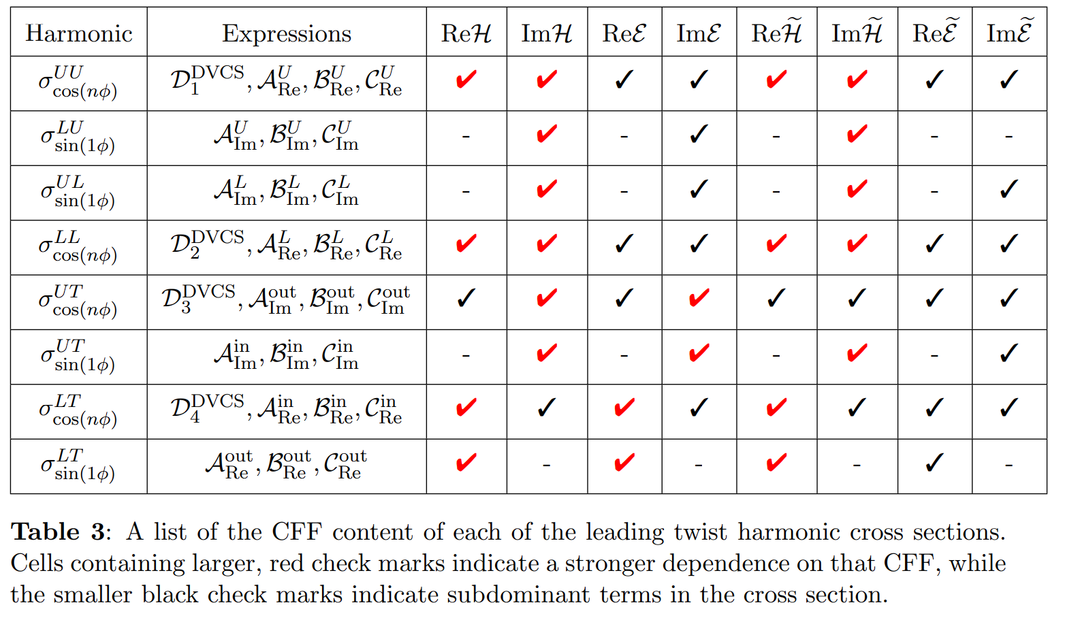
Degeneracy in CFFs
K. Shiells et. al. JHEP 08 048 (2022)
Results obtained still depends on ansatzes/empirical constraints.

Slide 12
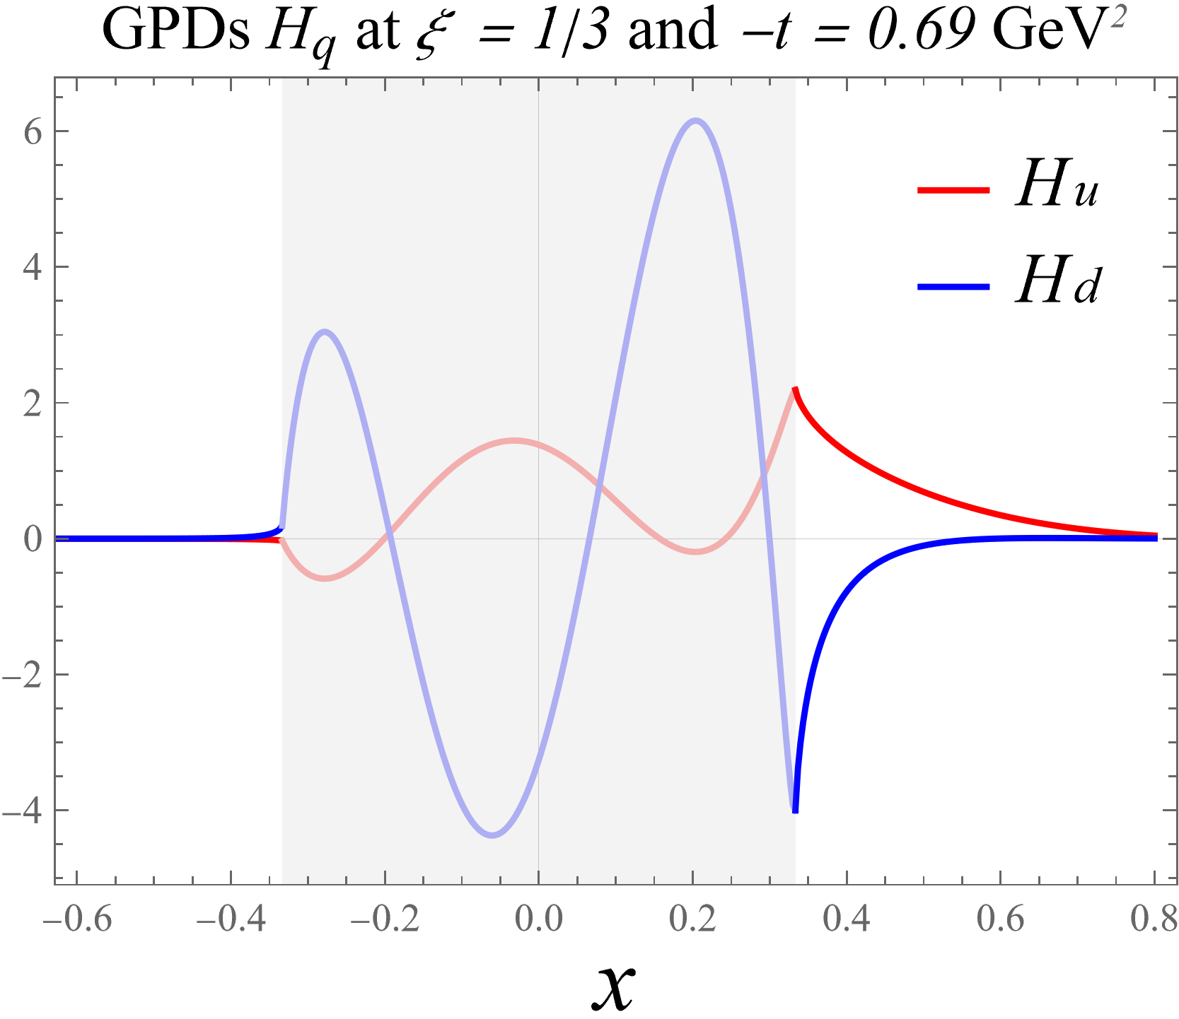
Extracted GPDs
The extracted GPDs encounter similar degeneracy - the inverse problem.
The left-hand side does not constrain the x-dependence at all.
There are many undetermined degrees of freedom.
Y. Guo et. al. JHEP 05 150 (2023)

Slide 13
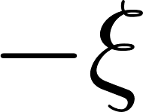
Partonic interpretations of GPDs
GPDs involve different partonic interpretations
A. Belitsky et al., Phys. Rept. 418 1-387 (2005)
Certain degrees of freedom exist solely in the DA-like region

Slide 14
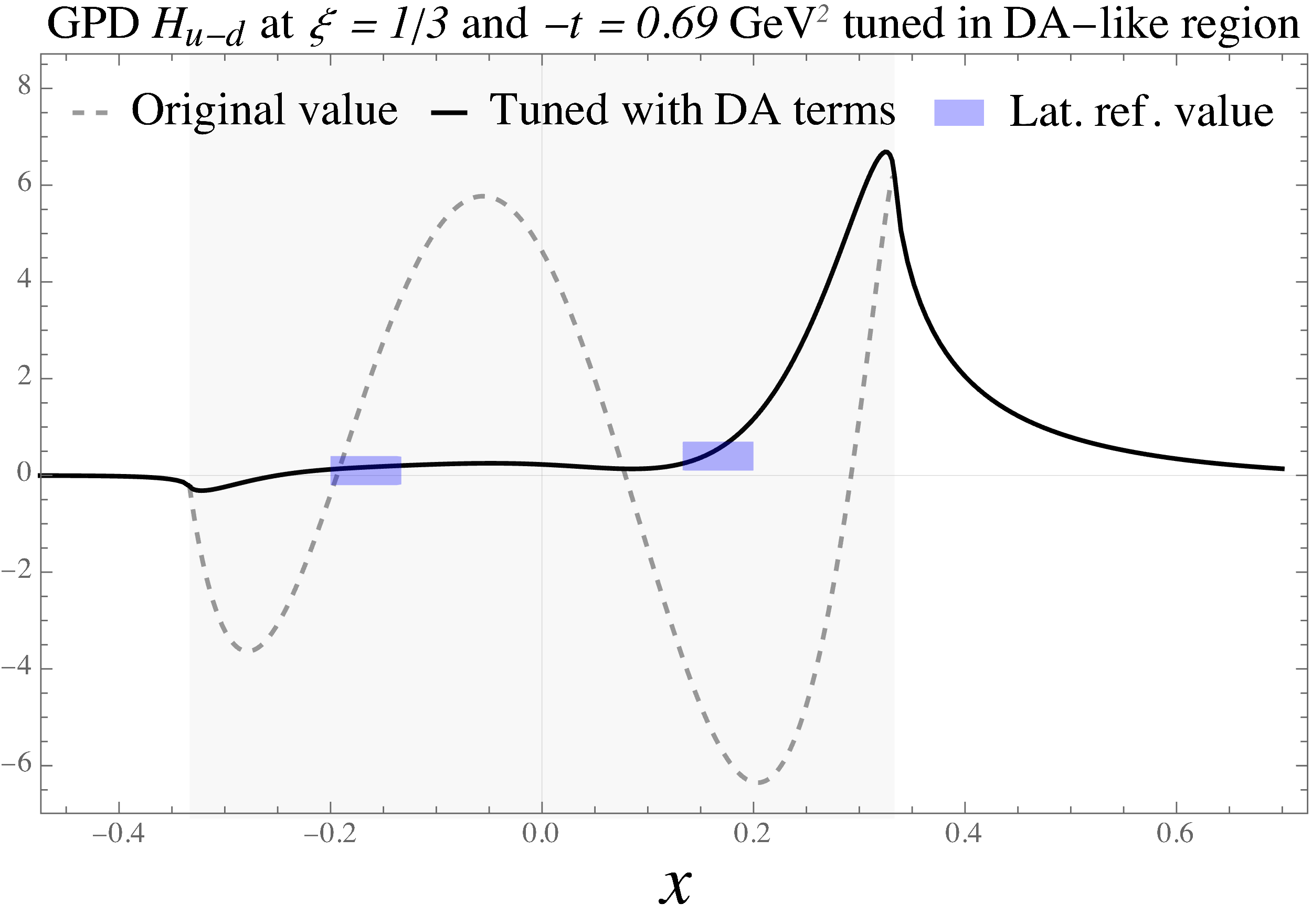
GPD in DA-like region
The DA terms become non-trivial as xi increases
Y. Guo et. al. JHEP 05 150 (2023)
Extra inputs crucial to determine the shape of GPDs in the middle regions.

Slide 15
Physical implications
The DA terms also provide a different perspective on GPD study
Gravitational FFs
As the skewness gets large, the DA region dominates
DA terms can be investigated for physical purposes.

Slide 16
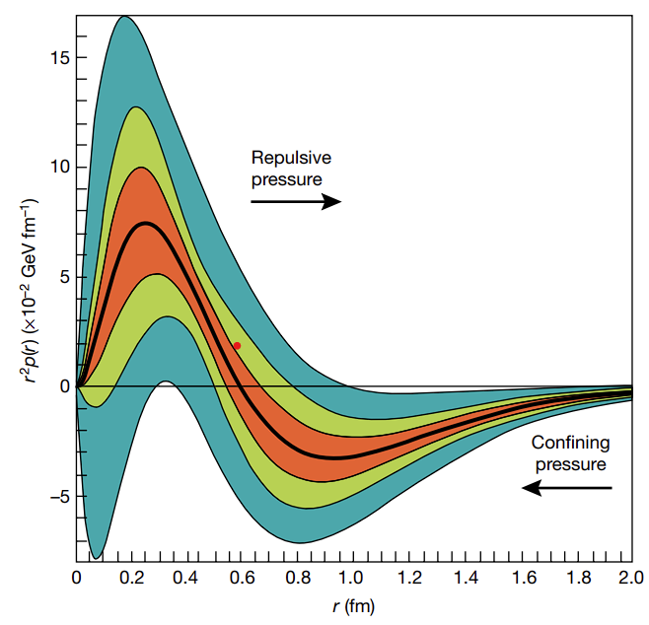
E.g.: Extraction of D term with DVCS
The D term in GPD is one type of term that exist in the DA region only
V. D. Burkert et. al., Nature 557 7705, 396-399 (2018)
Related to the GFF:
Can be extracted with, e.g., dispersion relation:

Slide 17
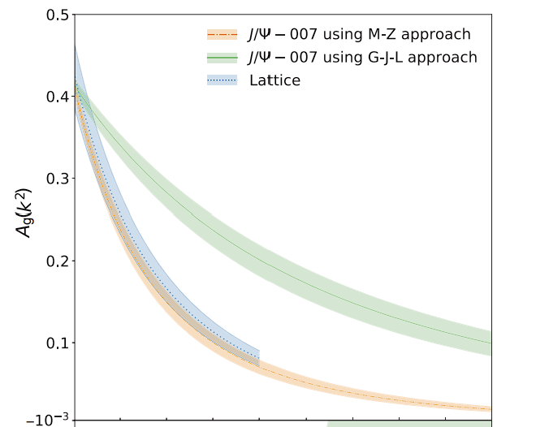
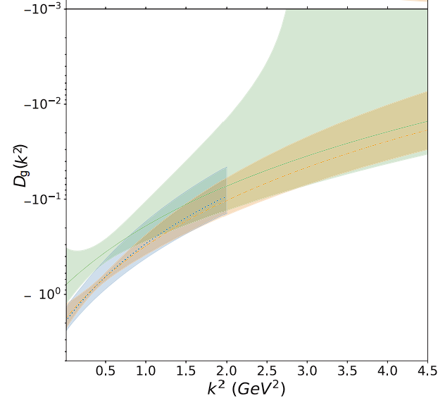
E.g. large xi behavior of the CFFs
We further argue that in the large xi region, the real parts of CFFs are dominated by DA terms:
Y. Guo et. al. Phys. Rev. D 103, 096010 (2021)
Y. Guo et. al. Phys. Rev. D 108, 034003 (2023)
Y. Guo, X Ji, and F. Yuan. in progress
Study of DA terms and essentially GFFs with large xi measurements, e.g., threshold heavy meson productions.
B. Duran et. al., Nature 615, 813-816 (2023)

Slide 18
Some final comments
The DA terms become non-trivial as xi increases
Y. Guo et. al. JHEP 05 150 (2023)
Besides just for fitting purpose, they contain rich physics.

Slide 19
Summary and outlook
Summary
GPDs reveals the nucleon 3D structures including mass and spin.
Global analysis program with PDFs, DVCS and lattice simulations.
Interesting developments utilizing the skewness effects and DA terms
Outlook
Improved global analysis (next to leading effects, gluon GPDs)
More polarization config. and more processes e.g. DVMP
Other perspective – large xi

Slide 20
Thank you!

