Slide 1
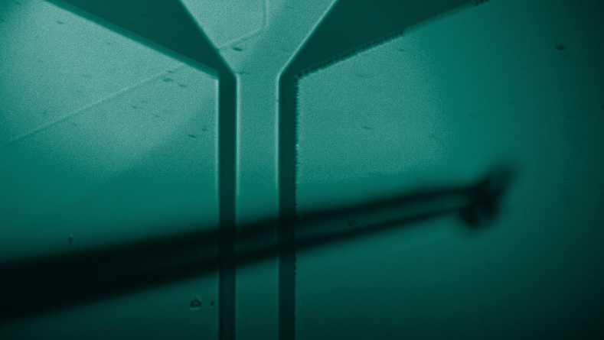
Towards on-chip levitated magnetomechanics with a single spin
DaLi Schaefer
Harvard University
Lukin Group

Slide 2
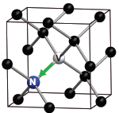
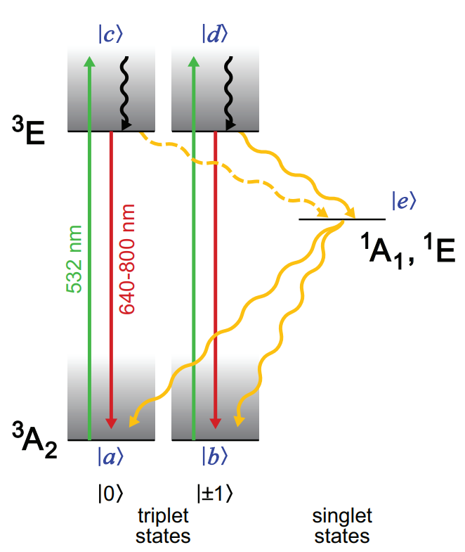
Combining Mechanics with Solid-State Spins
NV centers in diamond
Long coherence time (> 1 ms) even in ambient conditions No trapping needed Optical readout and initialization How do we generate scalable long-range entanglement?
Diamond
Pham, Linh My. Magnetic field sensing with nitrogen-vacancy color centers in diamond. Harvard University, 2013.
Notes:
Dipolar coupling:
Short range (10s of nm)
Not tunable
Cannot choose spins

Slide 3
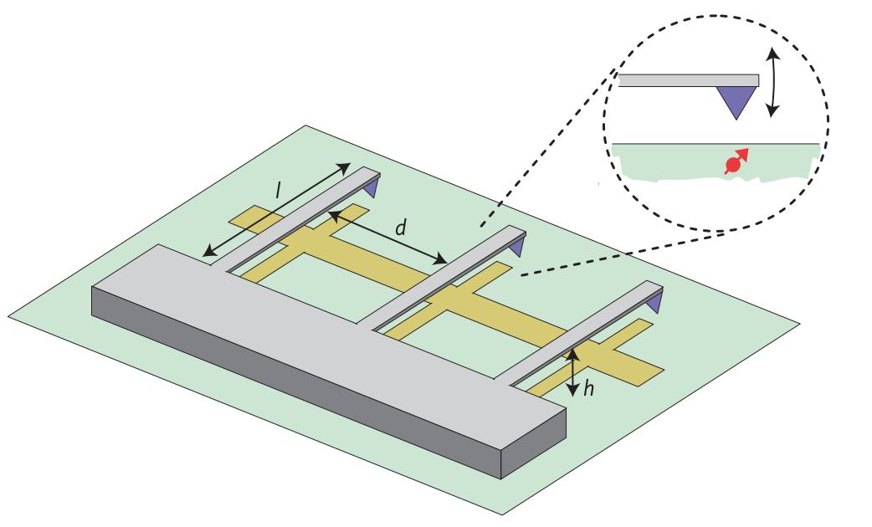
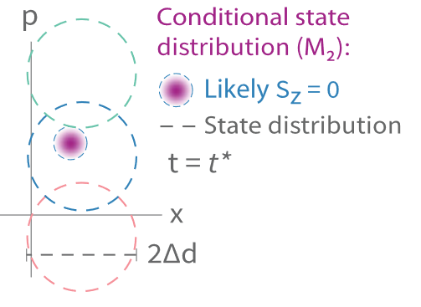
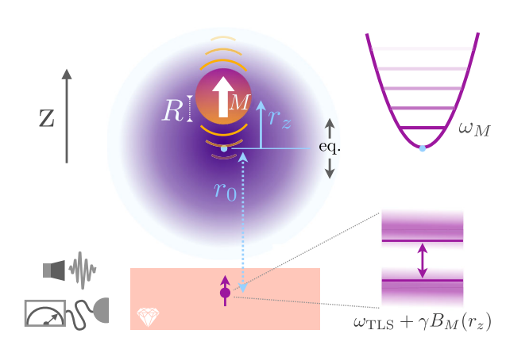
Combining Mechanics with Solid-State Spins
Arrays of mechanical resonators mediating interactions between spins [1]
Mechanically mediated entanglement of spins with relaxed cooperativity requirements [2]
Ground-state cooling by measurement with single spin [3]
P. Rabl. et. al, Nat. Phys. 6 (2010)
E. Rosenfeld et. al, Phys. Rev. Lett. 126, 250505 (2021)
K. Streltsov, et. al.. Phys. Rev. Lett. 126, 193602 (2021)

Slide 4
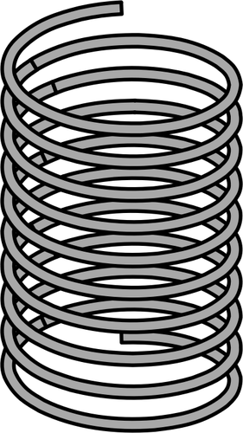
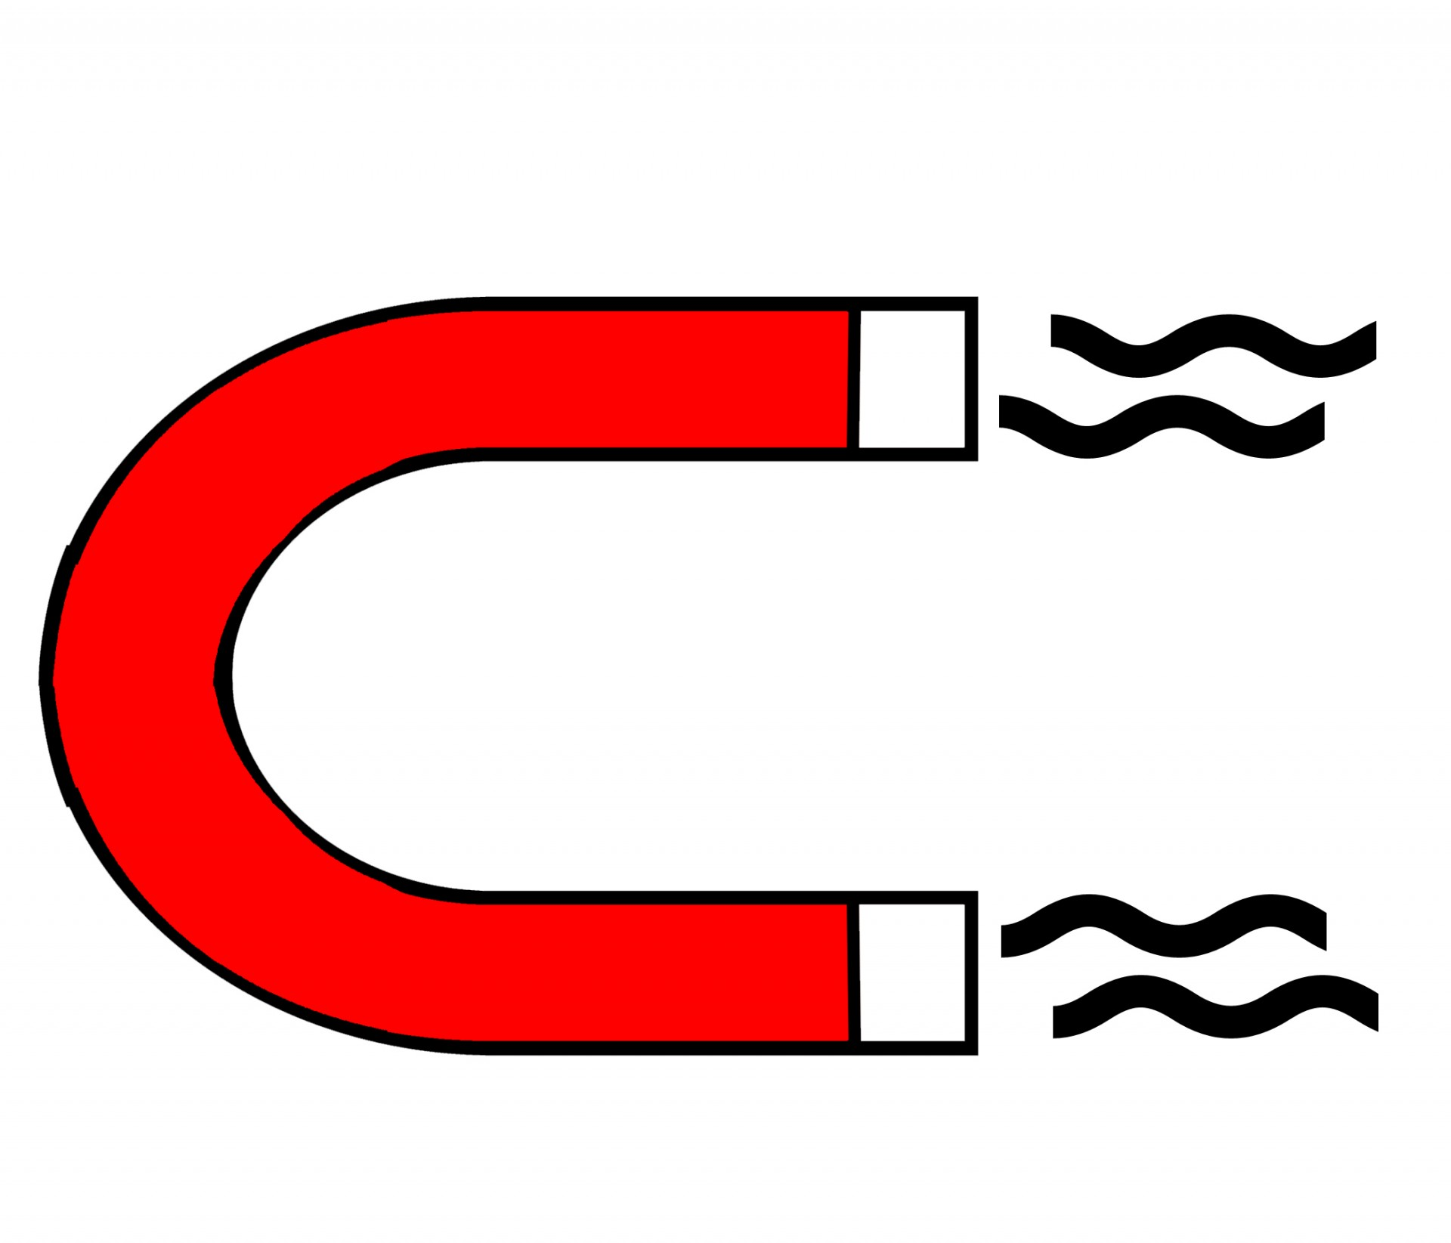
Spin-Mechanical Hamiltonian
Spin
Resonator
Interaction
NV gyromagnetic ratio
Mechanical zero-pt motion
Magnetic field gradient
Notes:
WHAT

Slide 5
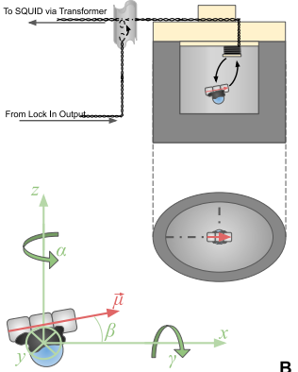
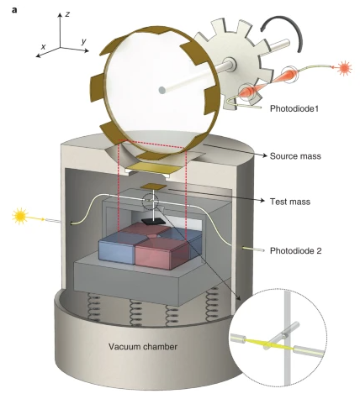
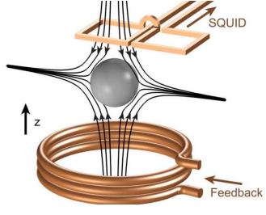
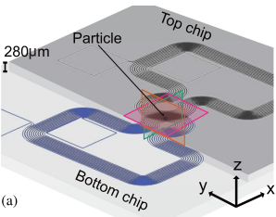
Levitated magnets have several advantages
Levitated magnets
No clamping ⇒ high Q possible High gradient to mass ratio Engineerable traps Potential to scale up
J. Hofer et. al. arXiv:2211.06289 (2022)
T. M. Fuchs. et. al, arXiv:2303.03545 (2023)
P. Yin et. al, Nat. Phys. vol. 18, p. 1181–1185 (2022)
M. G. Latorre et. al, IEEE Applied Superconductivity 32, 4 (2022)
Notes:
NEMS: nanoelectrical mechanical systems

Slide 6
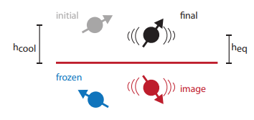
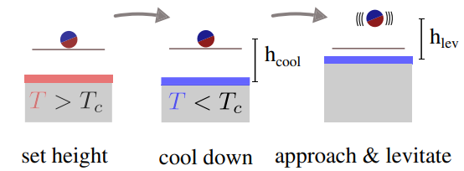
Levitate micromagnets using type-II superconductors (SC)
Trap frequencies partially controlled by initial height before cooldown
Trap for magnetic dipole well-modeled by frozen image dipole method
Traps center-of-mass and dipole orientation
A. A. Kordyuk. Journal of Applied Physics 83, 610 (1998)

Slide 7
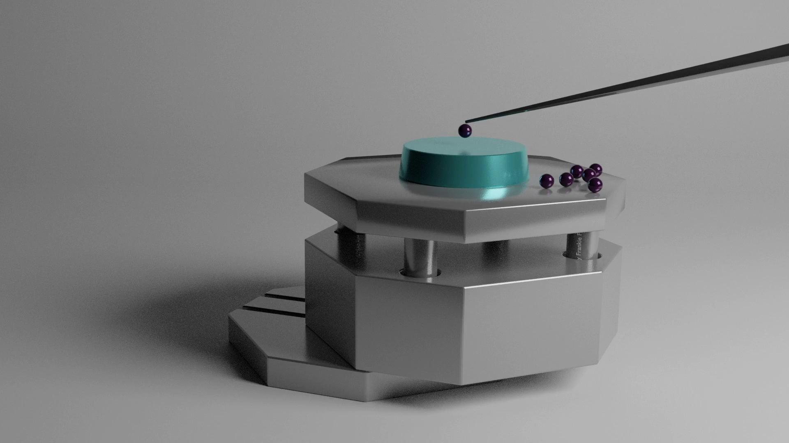
Levitation by in-situ micromanipulation
Pick up magnets at T > T_{c}
Position above superconductor
Cool to T < T_{c}
Move tip until magnet is released
Notes:
Tip mounted on spring for low-pass filter
Can attempt as many times as there are magnets

Slide 8
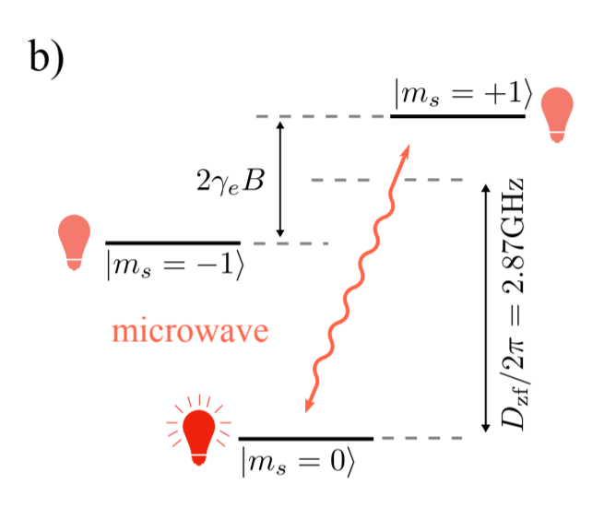
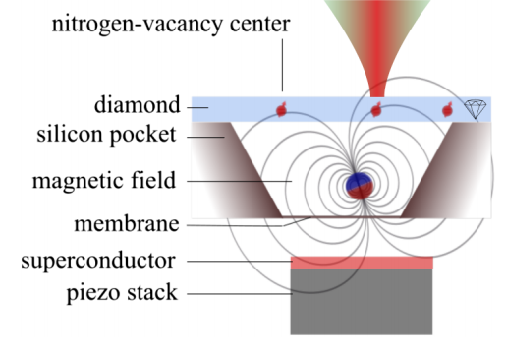
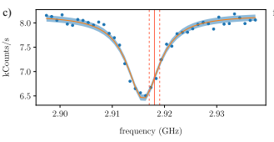
Previous coupling NVs to center-of-mass modes
NV transition adiabatically follows field from levitated magnet
ODMR
Notes:
confocal

Slide 9
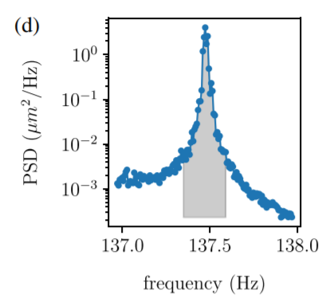
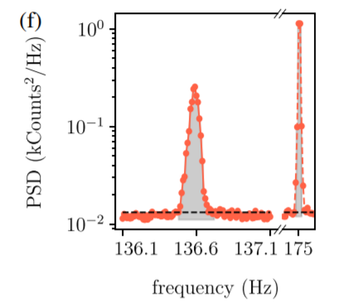
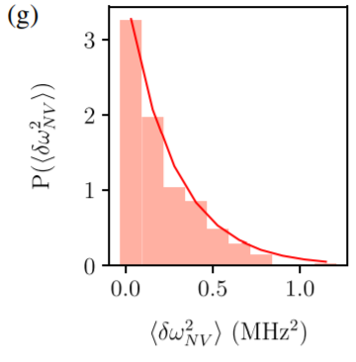
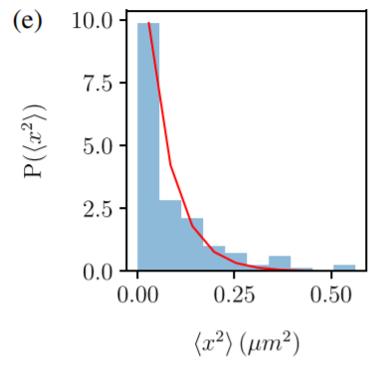
Previous coupling NVs to center-of-mass modes
NV
Camera
Measurement of mode
= 48(2) mHz
Energy distribution

Slide 10
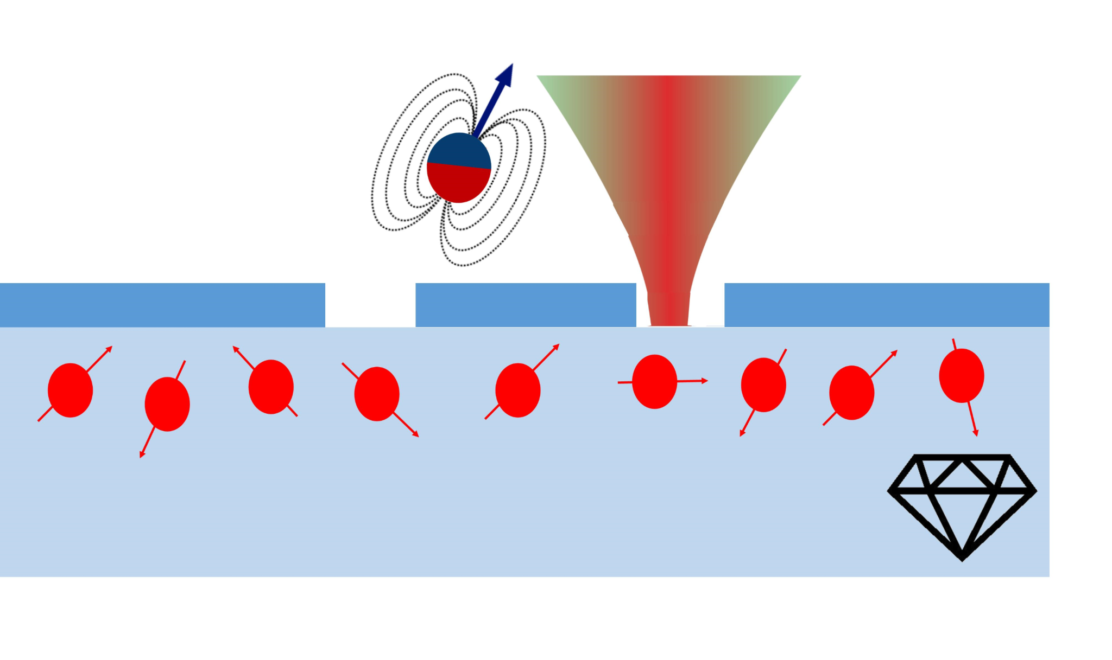
On-chip spin-mechanics device
Pattern gaps in NbTiN to levitate close to
Image NVs in gaps to avoid illuminating SC
Use SC to drive NV microwave transitions
Spins, MW control, levitated magnet all in one!

Slide 11
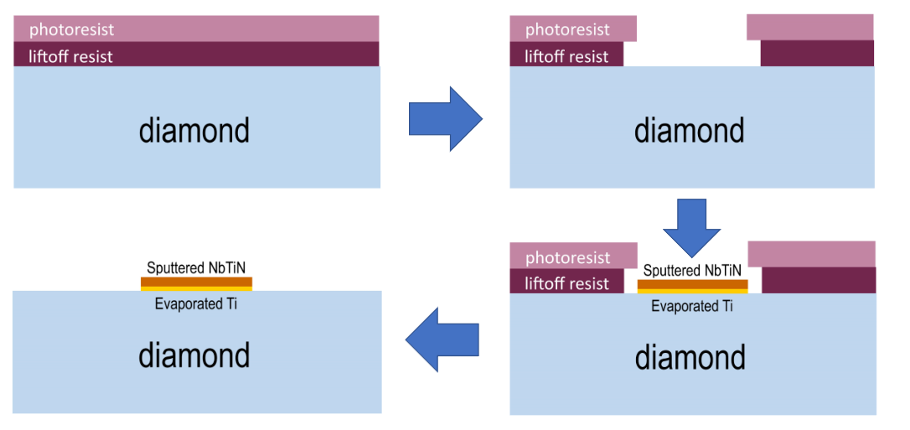
Liftoff process to preserve NV stability

Slide 12
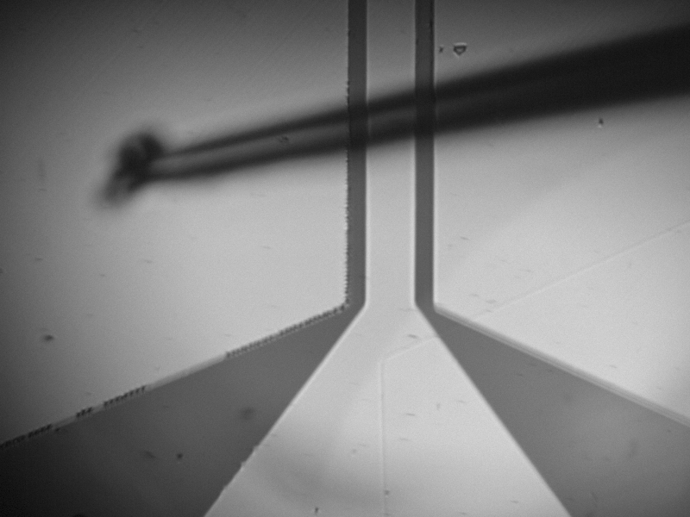
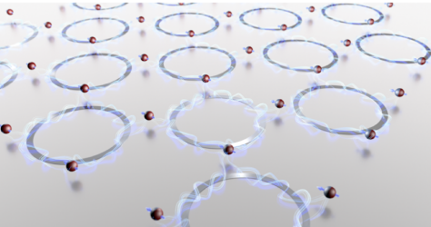
Device offers other key advantages
SC patterning recipe is modular
Enhanced stability of NV-magnet distance
Less heating from MW
C. C. Rusconi et al., Phys. Rev. A 100, 022343 (2019)
Notes:
Mention what works?

Slide 13
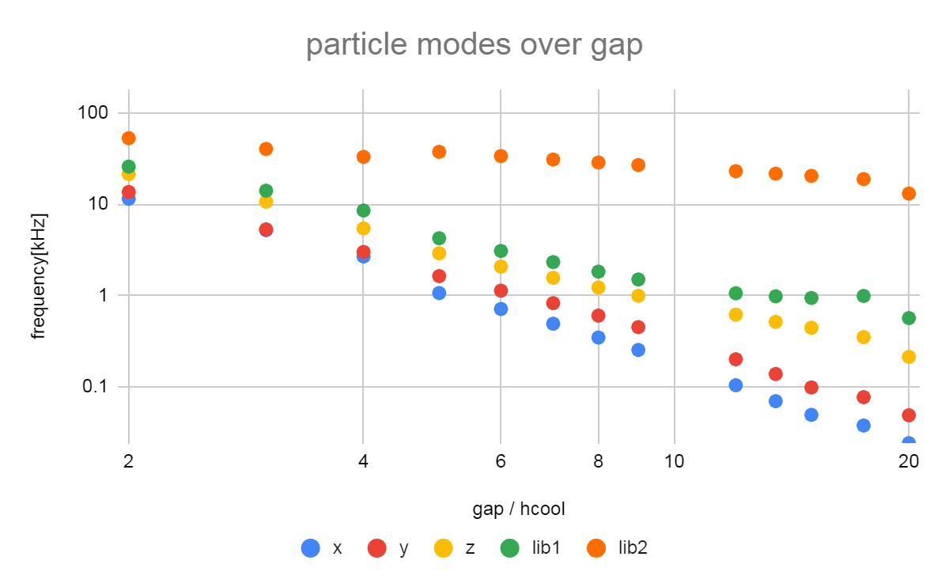
Simulating modes for arbitrary geometries
magnet
h_{cool}
superconductor
g
Use COMSOL to simulate field from superconductor in response to magnet
Assumes incident magnetic field at surface is unchanged upon cooldown
A. A. Kordyuk. Journal of Applied Physics 83, 610 (1998)

Slide 14
Current progress with new devices
Able to levitate and run pulsed microwaves experiments at same time
Able to coherently manipulate NVs with fast Rabi frequencies
Superconductor does not break when imaging NVs

Slide 15
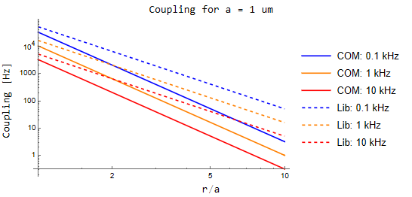
Couple stronger to librational modes
Librational modes have higher (and tunable) frequencies ~kHz - MHz
Coupling tends to be better than translational modes at longer distances
Notes:
Can reach higher coupling for same distances
Talk about sensing this
Diagram for librational modes

Slide 16
Couple stronger to librational modes
Librational modes have higher (and tunable) frequencies ~kHz - MHz
Coupling tends to be better than translational modes at longer distances
Can characterize all modes with laser reflection on photon detector
Notes:
Can reach higher coupling for same distances
Talk about sensing this
Diagram for librational modes

Slide 17
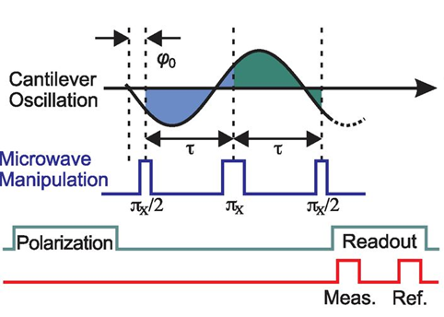
Couple stronger to librational modes
Librational modes have higher (and tunable) frequencies ~kHz - MHz
Coupling tends to be better than translational modes at longer distances
Can characterize all modes with laser reflection on photon detector
Measure using spin echo with NV
S. Kolkowitz et. al. Science 335 (6076), 1603-1606 (2012)
Notes:
Can reach higher coupling for same distances
Talk about sensing this
Diagram for librational modes

Slide 18
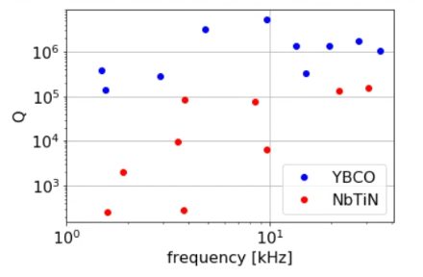
Q factor likely limited by superconductor properties
Q~1e6 at >10 kHz
YBCO tends to have higher Q across translational and librational modes
Translational
Librational

Slide 19
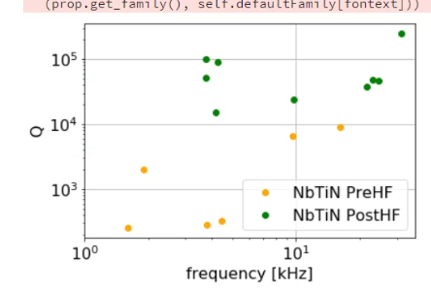
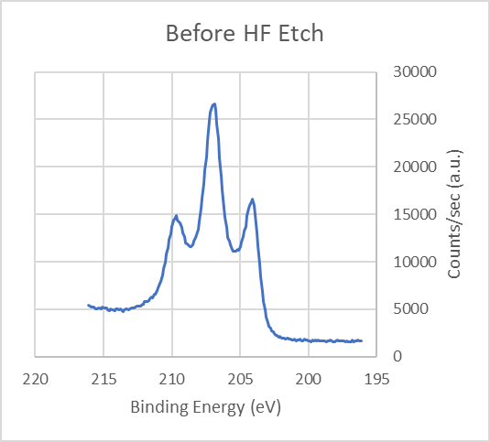
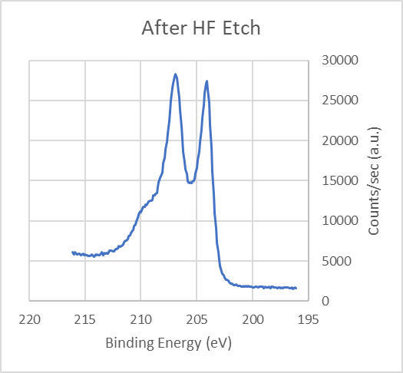
Q factor likely limited by superconductor properties
Translational
Librational
NbTiN is known to grow oxides that can be normal conductors or lower-T_{c} superconductors
Dipping in hydrofluoric acid appears to improve Q
Further prevent using capping layer
XPS

Slide 20
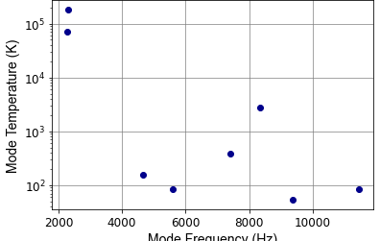
Vibration isolation efforts
XY modes effective temperatures
Hang sample stage by BeCu springs
Copper braids to cold finger
Found that pulse tube vibrations still present

Slide 21
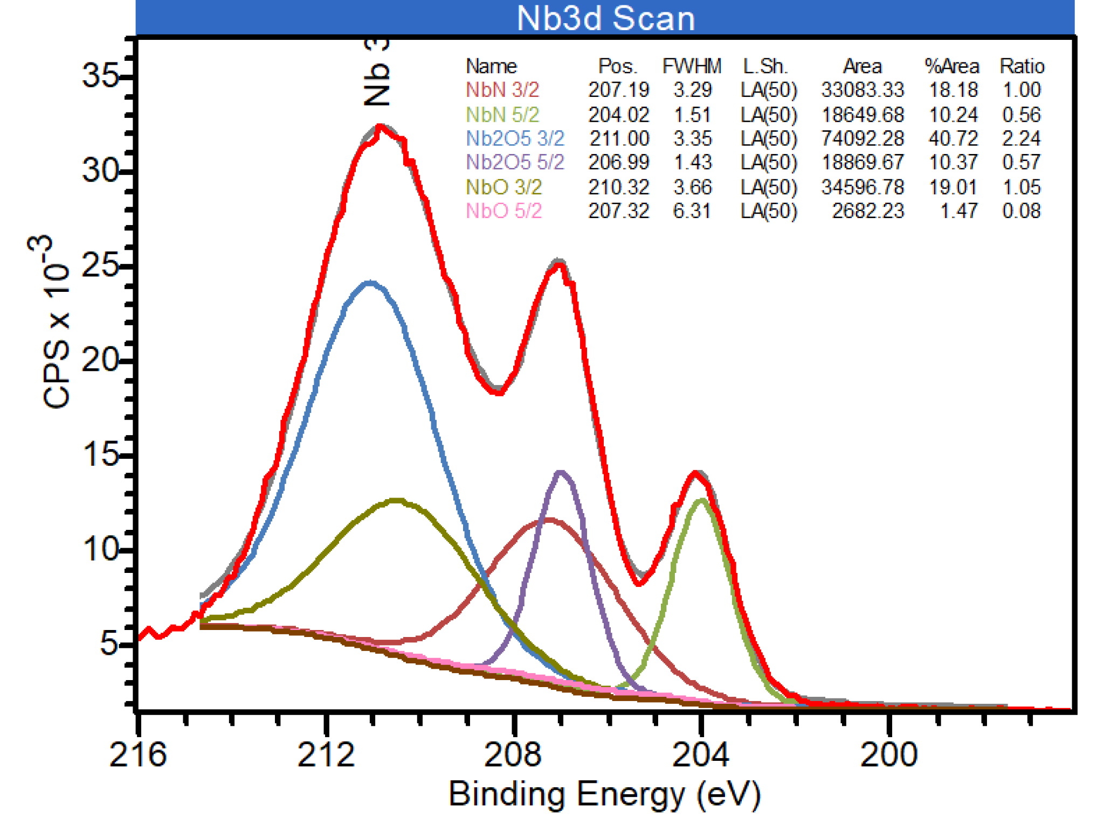
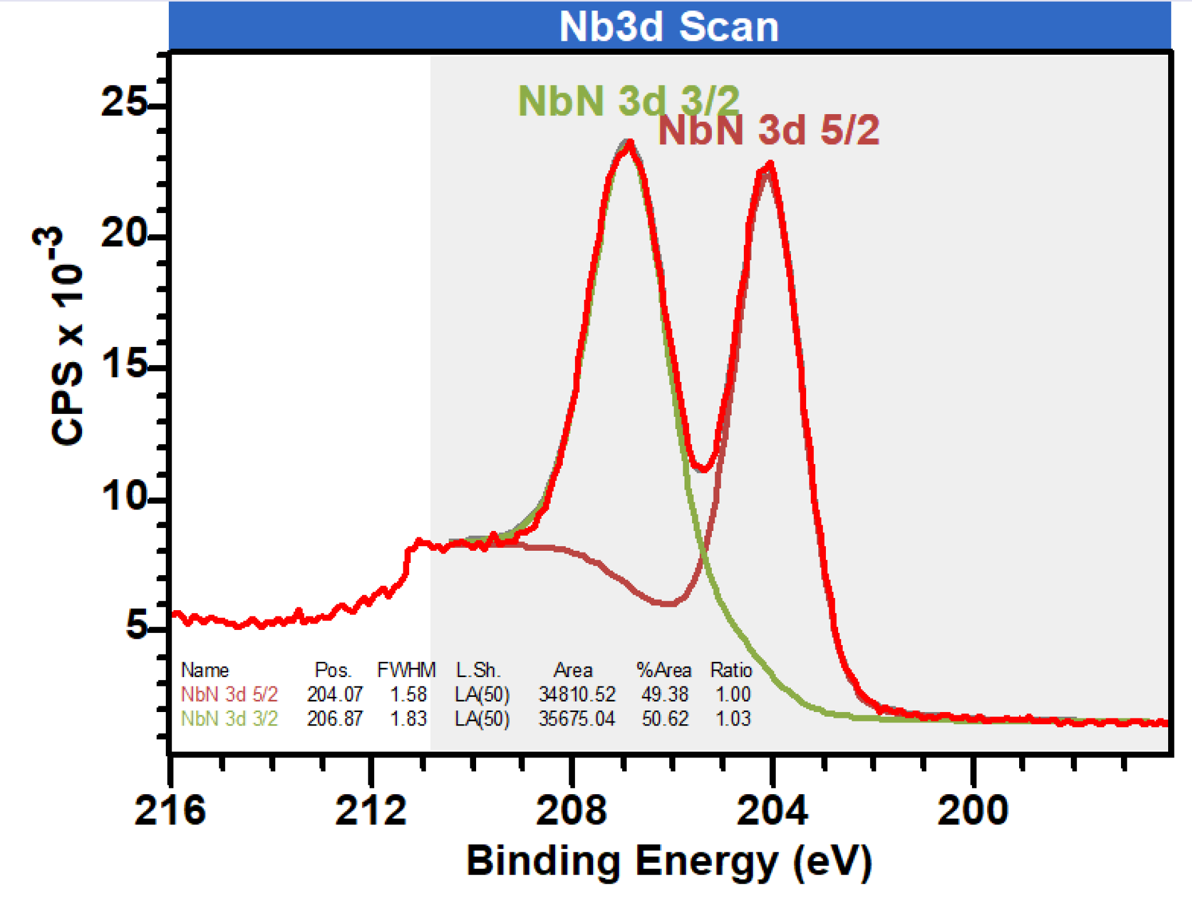
Detailed XPS data

Slide 22
Near term: Inducing motion with single NV center
(g/κ)² > n_{th}
NV pulse train
Force on magnet
𝜋
t
...
𝜋/𝜔_{r}
Resonator motion
Notes:
T2~T1 -> NV entanglement, Emma’s scheme
Rabl paper
Backaction easier, T1 limited

Slide 23
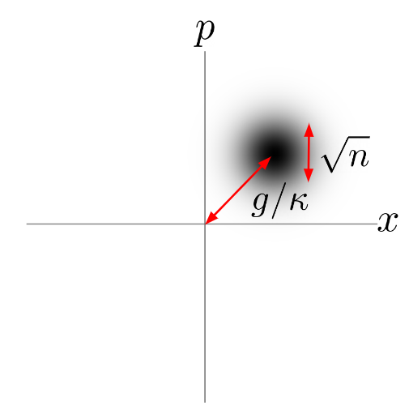
Prospects for Inducing motion with single NV center
(g/κ)² > n_{th}
 |  | Current | Near-term | Improvement
g/(2π) | Spin-mech. coupling | 48 mHz | 200 Hz | Reduce NV-magnet distance from 100 um to 1 um Reduce particle size from 15 um to 1 um
κ/(2π) | Mechanical linewidth | 0.01 Hz | 0.01 Hz | Seen on YBCO, but need to have on NbTiN
n_{th} | Phonon occupation of mech. mode | ~10⁸ | 2 x 10⁷ | Severe vibration issues. Need to implement vibration isolation

Slide 24
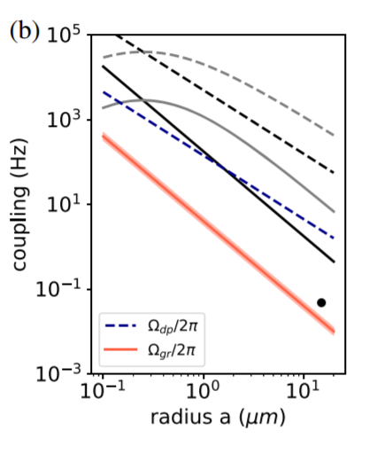
Outlook for quantum coupling regime
Optimistic parameters
g ~ 1 kHz
Q ~ 10⁸
T ~ 4 K
T₂ ~ 10 ms
C > 1
Notes:
Assumed h/a=3
Colored: d/a=5.5
Black: d/a=1
Curved: d/a=250 nm

Slide 25
Summary
Levitation over type-II superconductor offers rich spectrum of modes with engineerable frequencies
Librational modes leads to higher frequencies and coupling
Clear path towards backaction from single spin
Notes:
Summary instead

Slide 26
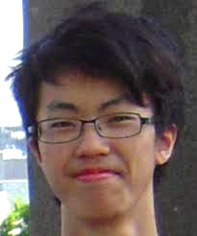
Scanning NV probe coupled to SiN nanobeam
Programmable Quantum Processors based on Spin Qubits with Mechanically-Mediated Interactions and Transport
F. Fung, et. al. arXiv:2307.12193 (2023)
Magnetically functionalized mechanical resonator
1.4 MHz resonance
Q = 8.3 x 10⁵
Frankie Fung

Slide 27
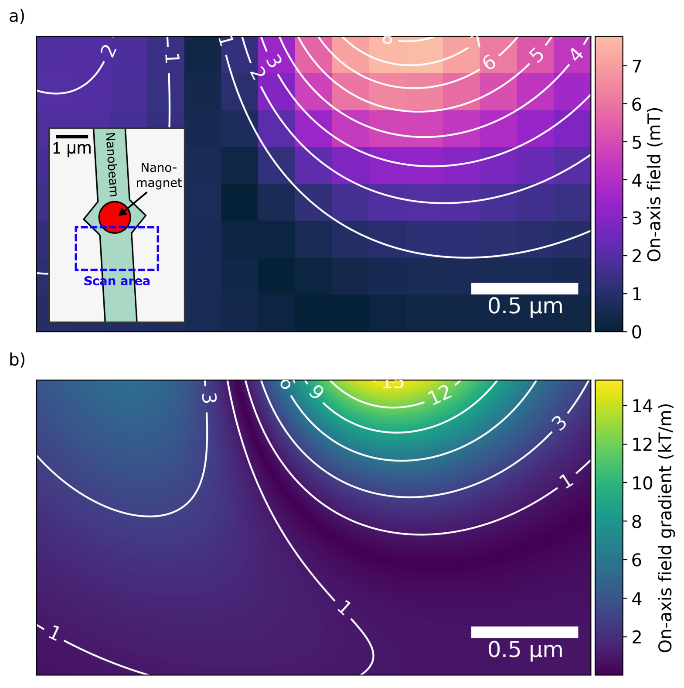
Measuring coupling using Hahn echo
Scan NV probe to maximize gradient: ~1.5 x 10⁴ T / m
Measured coupling: 7.7 Hz

Slide 28
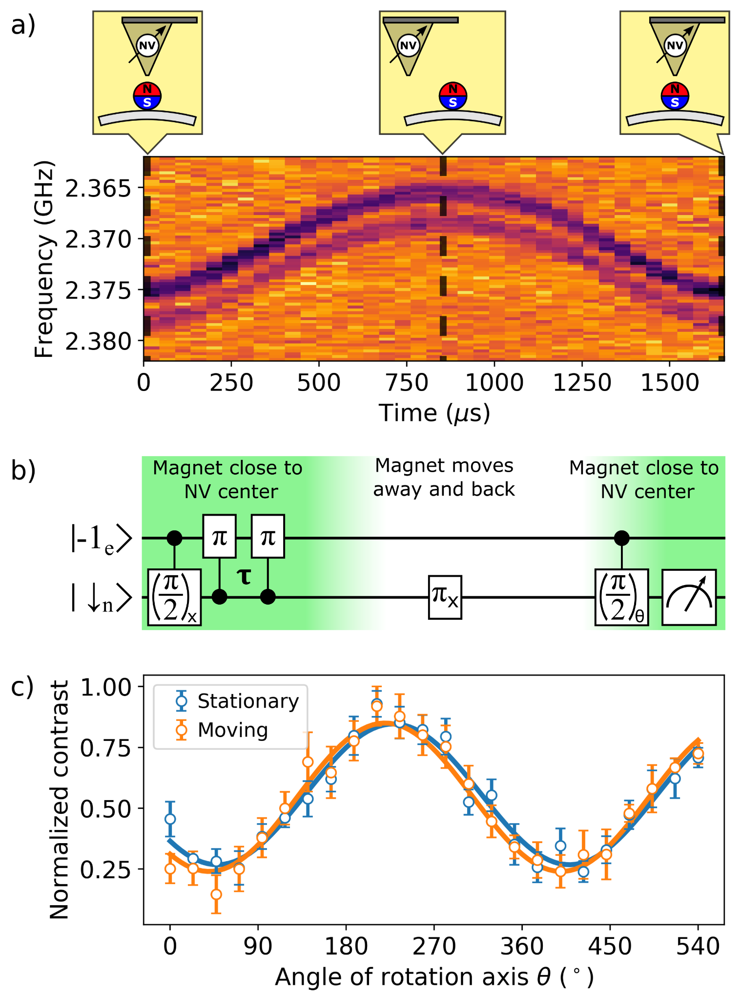
Preservation of coherent information while moving
Move magnet 1.7 um away and back in 1.7 ms
Coherence preserved

Slide 29
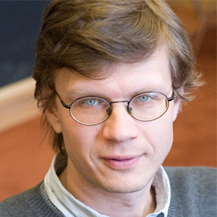
Contributors
DaLi Schaefer
Trisha Madhavan
Mikhail Lukin
Laboratory for Integrated Science and Engineering (LISE)
Nadine Meister
Frankie Fung

