Slide 1
QCD Dynamics of Nuclear Core
Misak Sargsian
Florida International University, Miami
Short Distance Nuclear Structure and PDFs, ECT*, Trento July 17-21th, 2023

Slide 2
Probing NN Repulsive Core
- strength of the core;
- isospin dependence of repulsive core
- non-nucleonic components, hidden color, gluons
- dependence of the nature of the core to the nature of the process

Slide 3
Probing NN Repulsive Core
- NN force is attractive: But Nuclei are Stable
“If the two-body forces are everywhere attractive and if many-body forces are neglected then the nucleon pairs are sufficiently close to take advantage of attractive interactions and a collapsed state of nuclear matter results “
G. Breit and E.P. Wigner, Phys. Rev. 53, 998 (1938).
Many body forces keeping nucleus stable
Jastrow 1951 assumed the existence of the infinite hard core to explain the angular distribution of pp cross section at 340 MeV (r₀=0.6fm)
Non-monotonic NN central potential with the repulsive core was introduced:
Brueckner & Watson 1953 to obtain nuclear density saturation.

Slide 4
Modern NN Potentials
60’s

Slide 5
NN potential
Vc, MeV
r, Fm

Slide 7
Field Theory of Nucleons & Mesons 1947-

Slide 8
Pomeranchuk, Landau - 1950's
Infinite interaction occurs at transferred momenta approx 500 MeV/c or
at internucleon distances 1~Fm.
It seems we have a problem about which the Nature is not aware of Y.Pomeranchuk
All formal quantum field theories with Yukawa type interactions contain
the problem of the ``Zero Charge'’
Pomeranchuk, Sudakov, Ter-Martirosyan, Phys. Rev. 1956

Slide 10
Lattice Calculations

Slide 11
QCD
Pauli Blocking
Contradicts Neutron Star Observations:
will predict masses not more than 0.1 - 0.6 Solar mass

Slide 12
Vc, MeV
QCD
Intrinsic strangeness/charm
Hidden Color
r
~80% hidden color
Brodsky,Ji, Lepage, PRL 83

Slide 13
Quasi-Elastic Scattering
Vc, MeV
pn
pn
Hidden Color
r

Slide 14
Probing the Deuteron at Short Distances
The NN core can be due to the orthogonality of

Slide 15
Vc, MeV
pn
pn
Hidden Color
r

Slide 16
Conceptually: How to probe nuclei
at such a short nucleon separations
- probe bound nucleons at large internal momenta >300MeV/c
- considering quasielastic
E. Piasetzky, MS, L. Frankfurt, M. Strikman, J.Watson, PRL , 2006
MS,arXiv:1210.3280 (2012), Phys. Rev. C 2014
- several novel observations:
JLab produced 2 Science and 1 Nature papers
Limitations
- to probe larger internal momenta larger Q² is needed

Slide 17
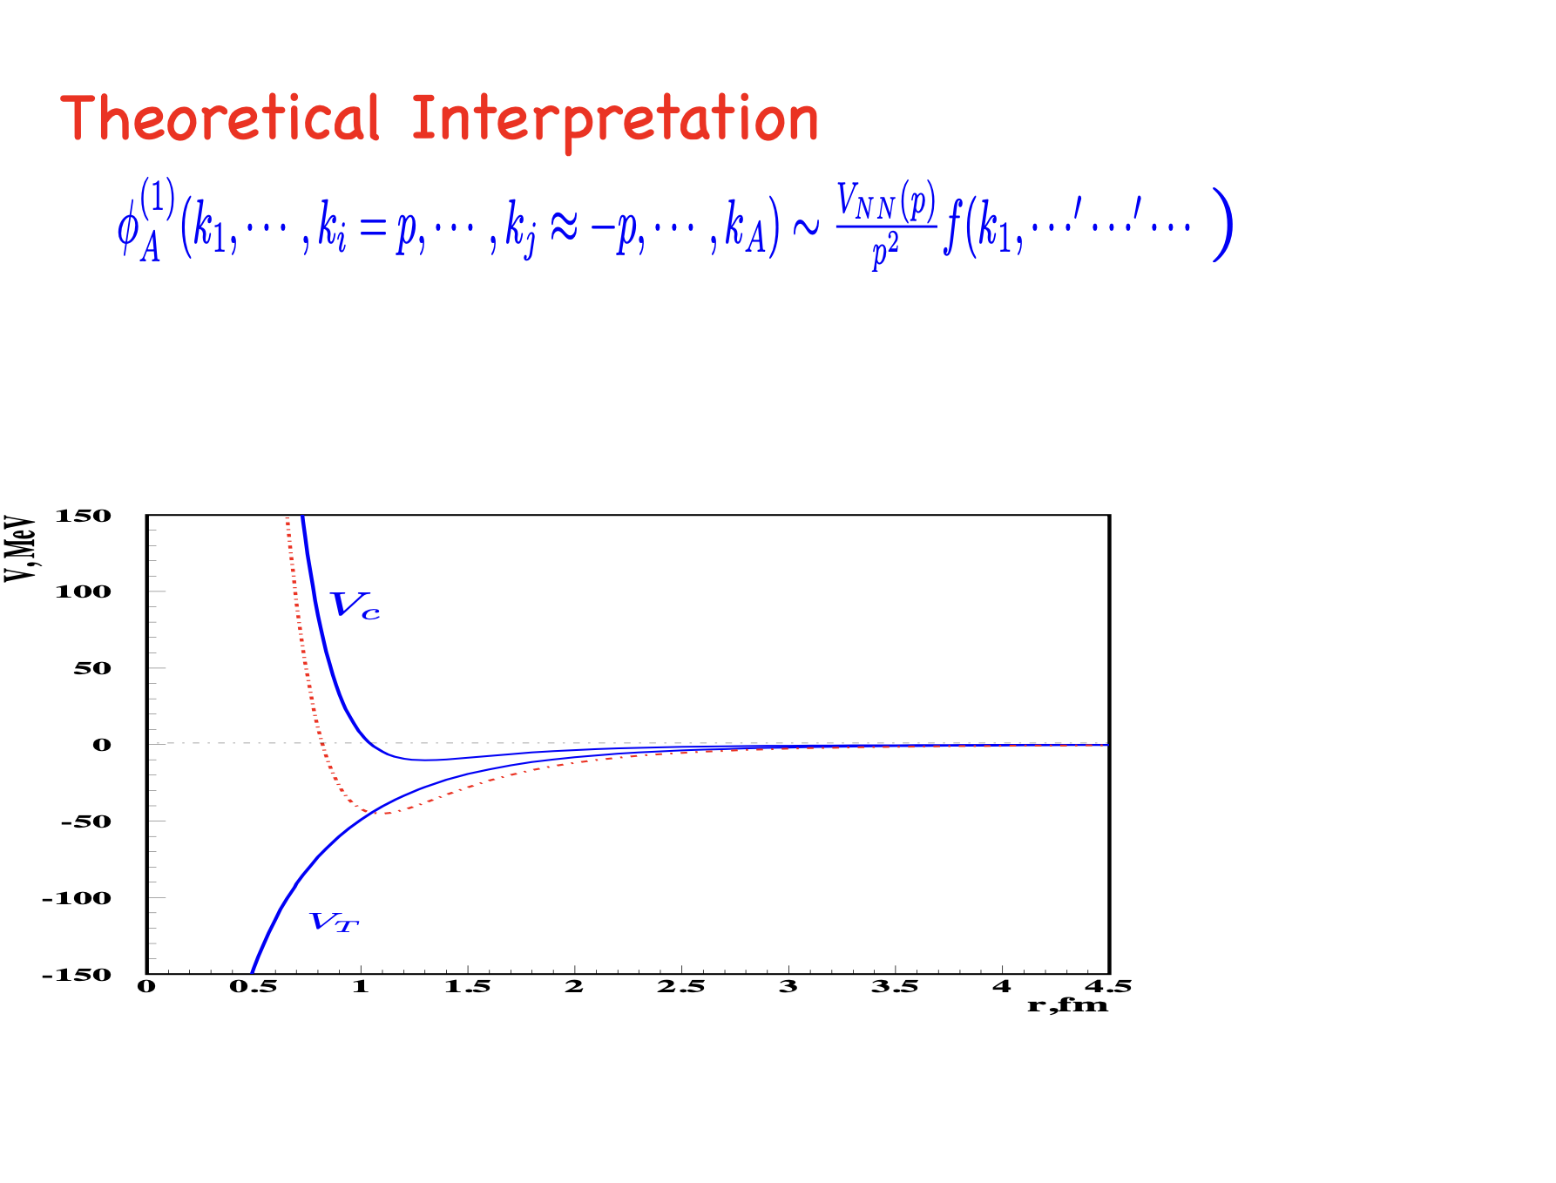

Slide 18
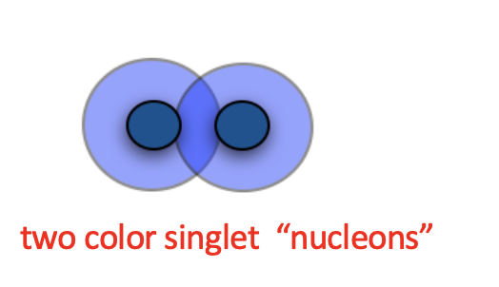
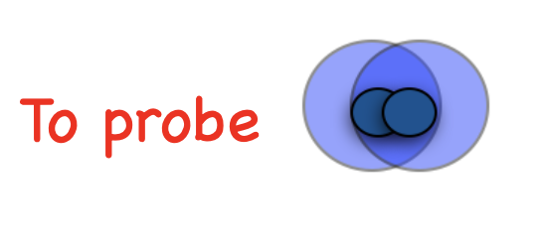
To Summarize….
- are being currently investigated in quasielastic
channel
- needs significantly larger Q2 or missing momenta
- Alternative approach is to explore nuclear Deep Inelastic Scattering at x>1

Slide 19
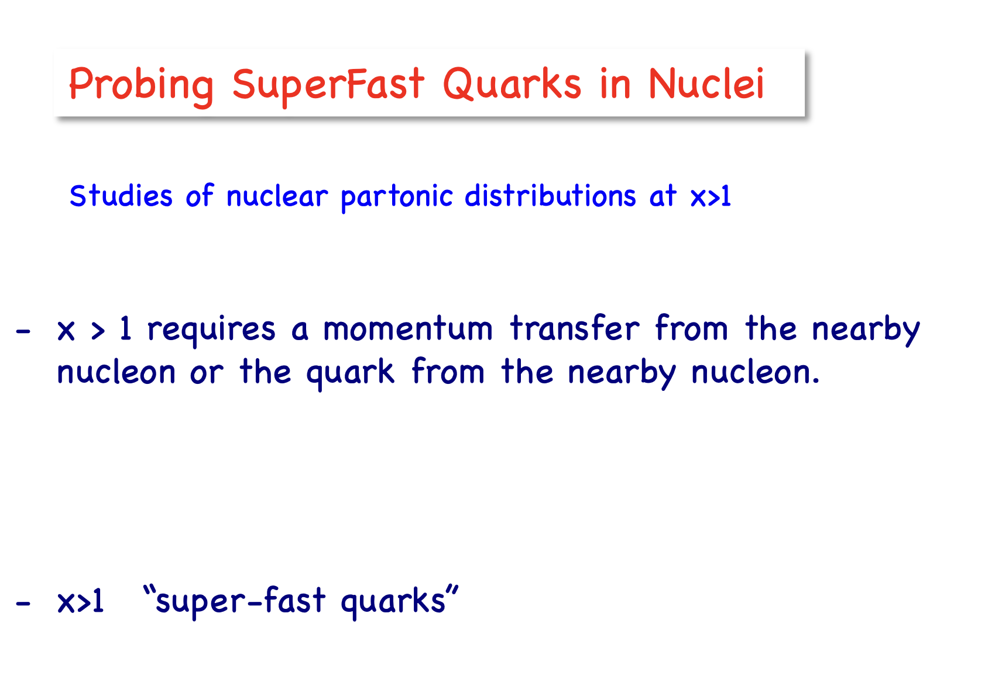

Slide 20
SuperFast quarks – short distance probes in nuclei
Two factors driving nucleons close together
Kinematic
Dynamical:
QCD evolution

Slide 23
Q², GeV²

Slide 24
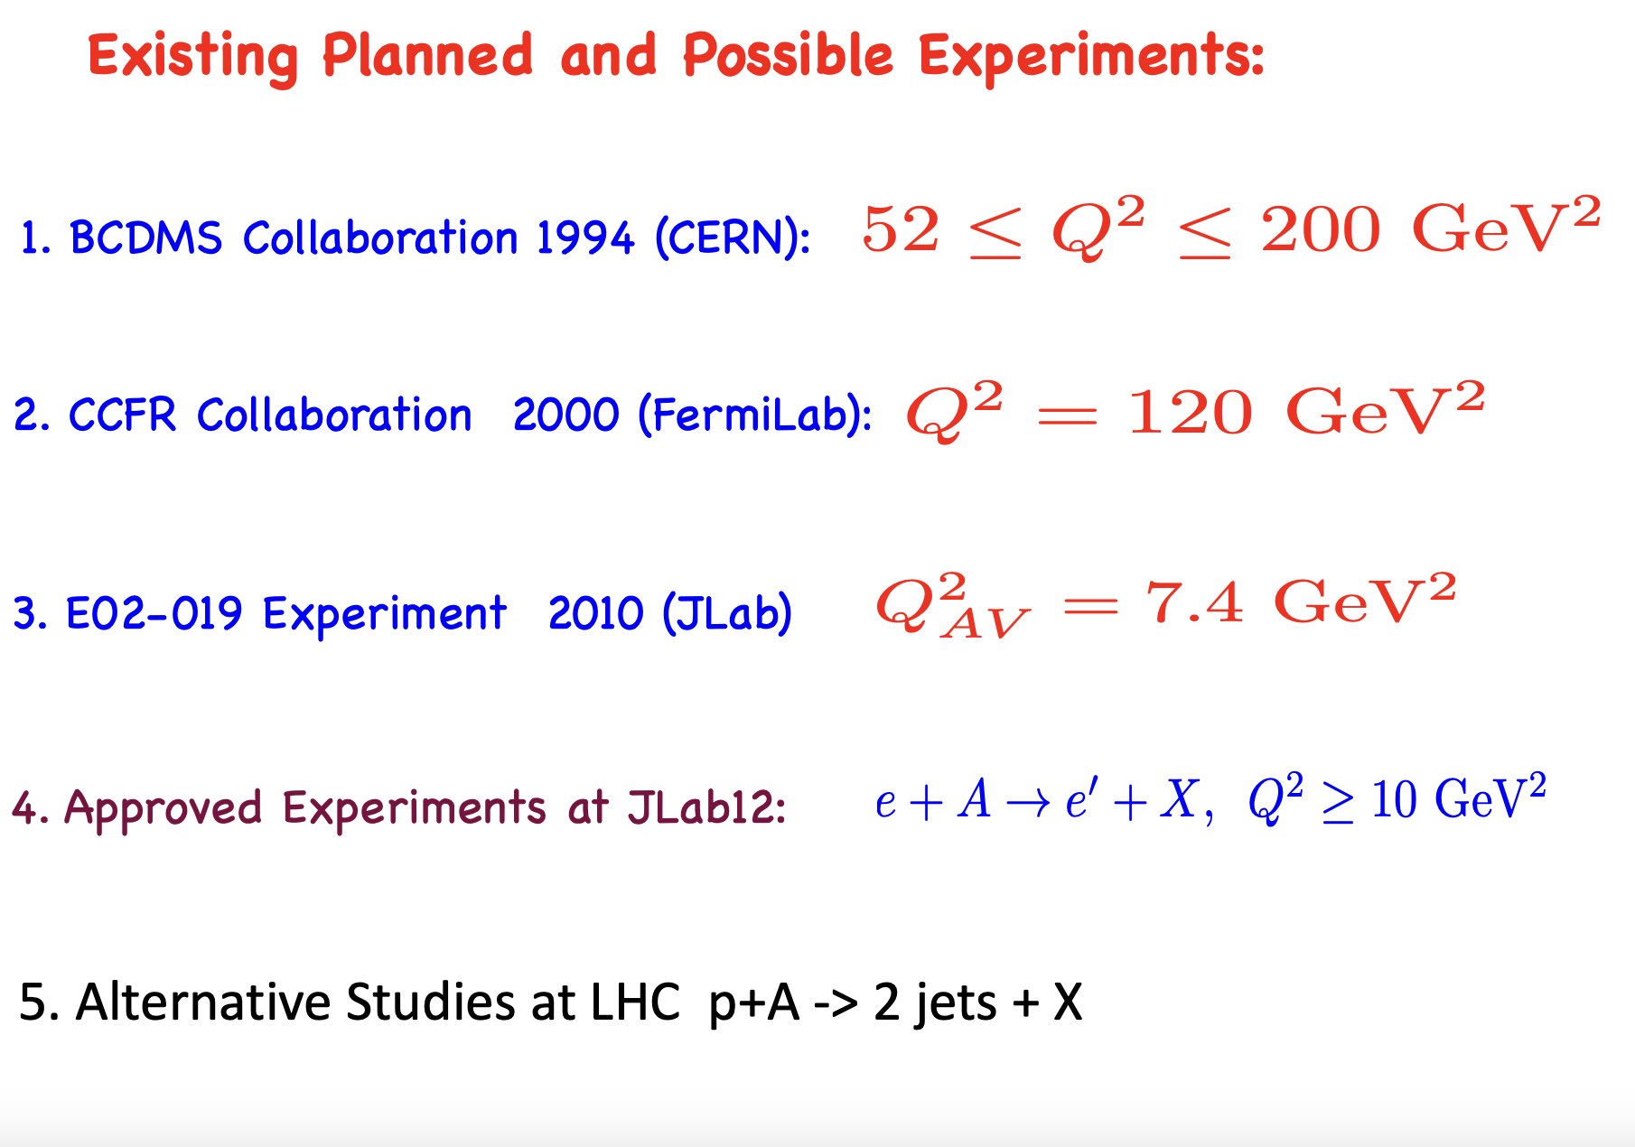

Slide 25
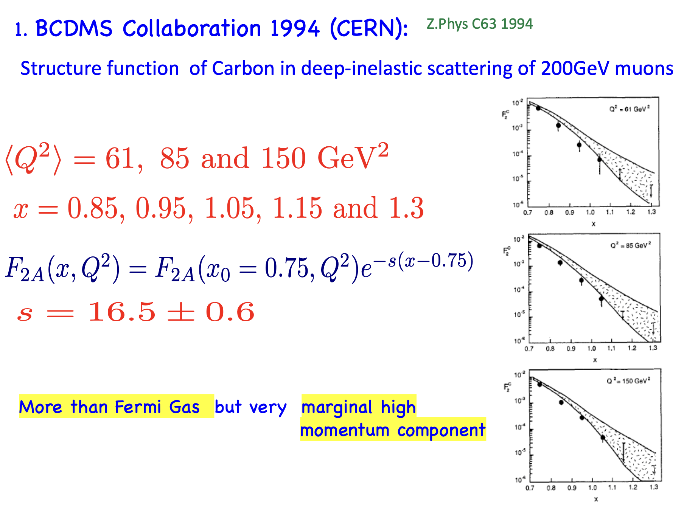

Slide 26
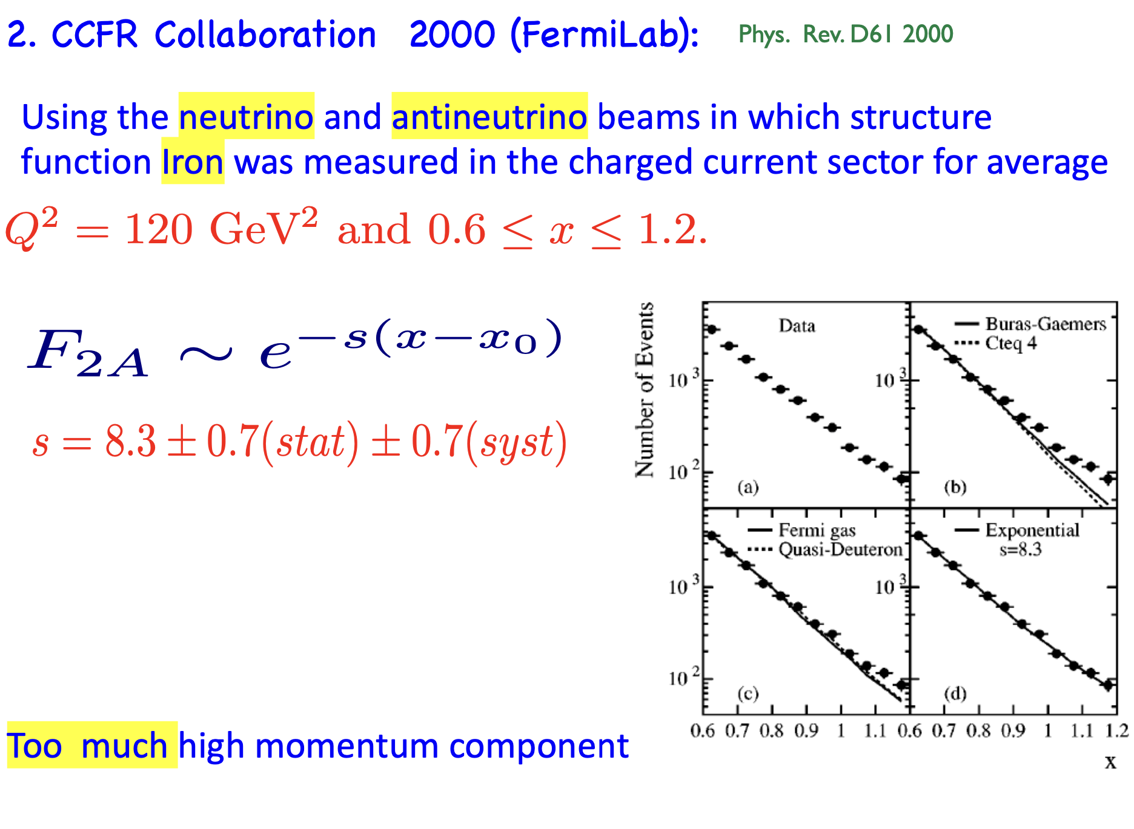

Slide 27
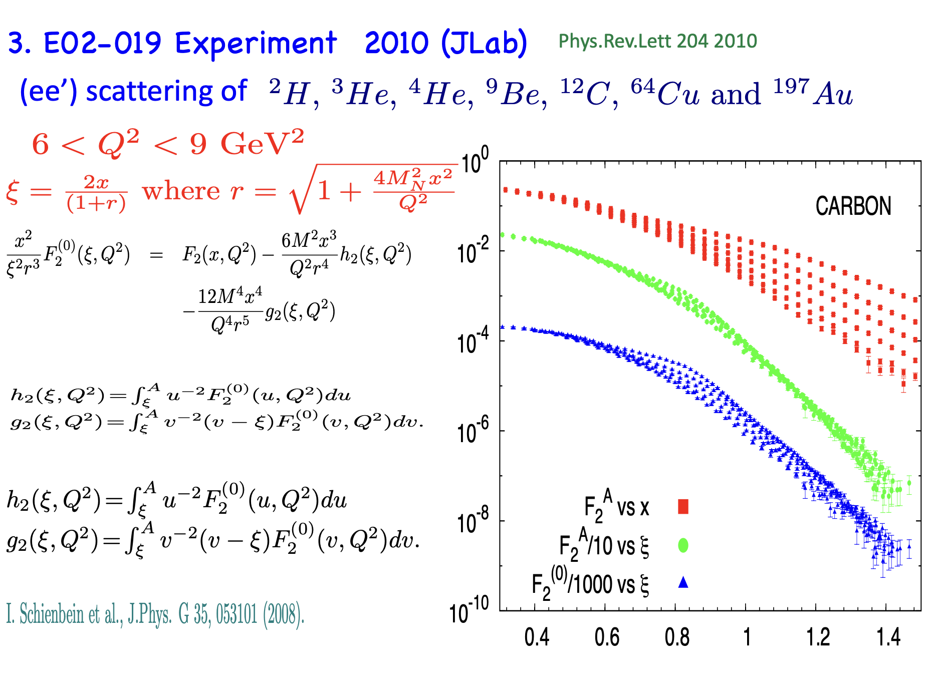
Fomin, Arrington, et al. Phys.Rev.Lett 204 2010

Slide 28
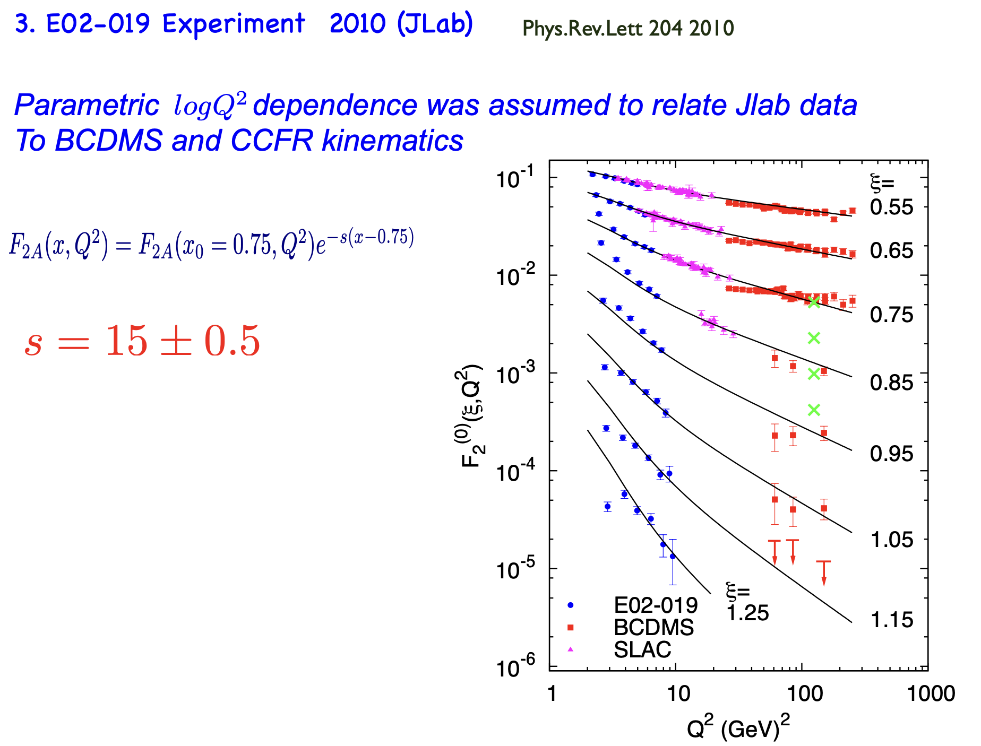

Slide 29
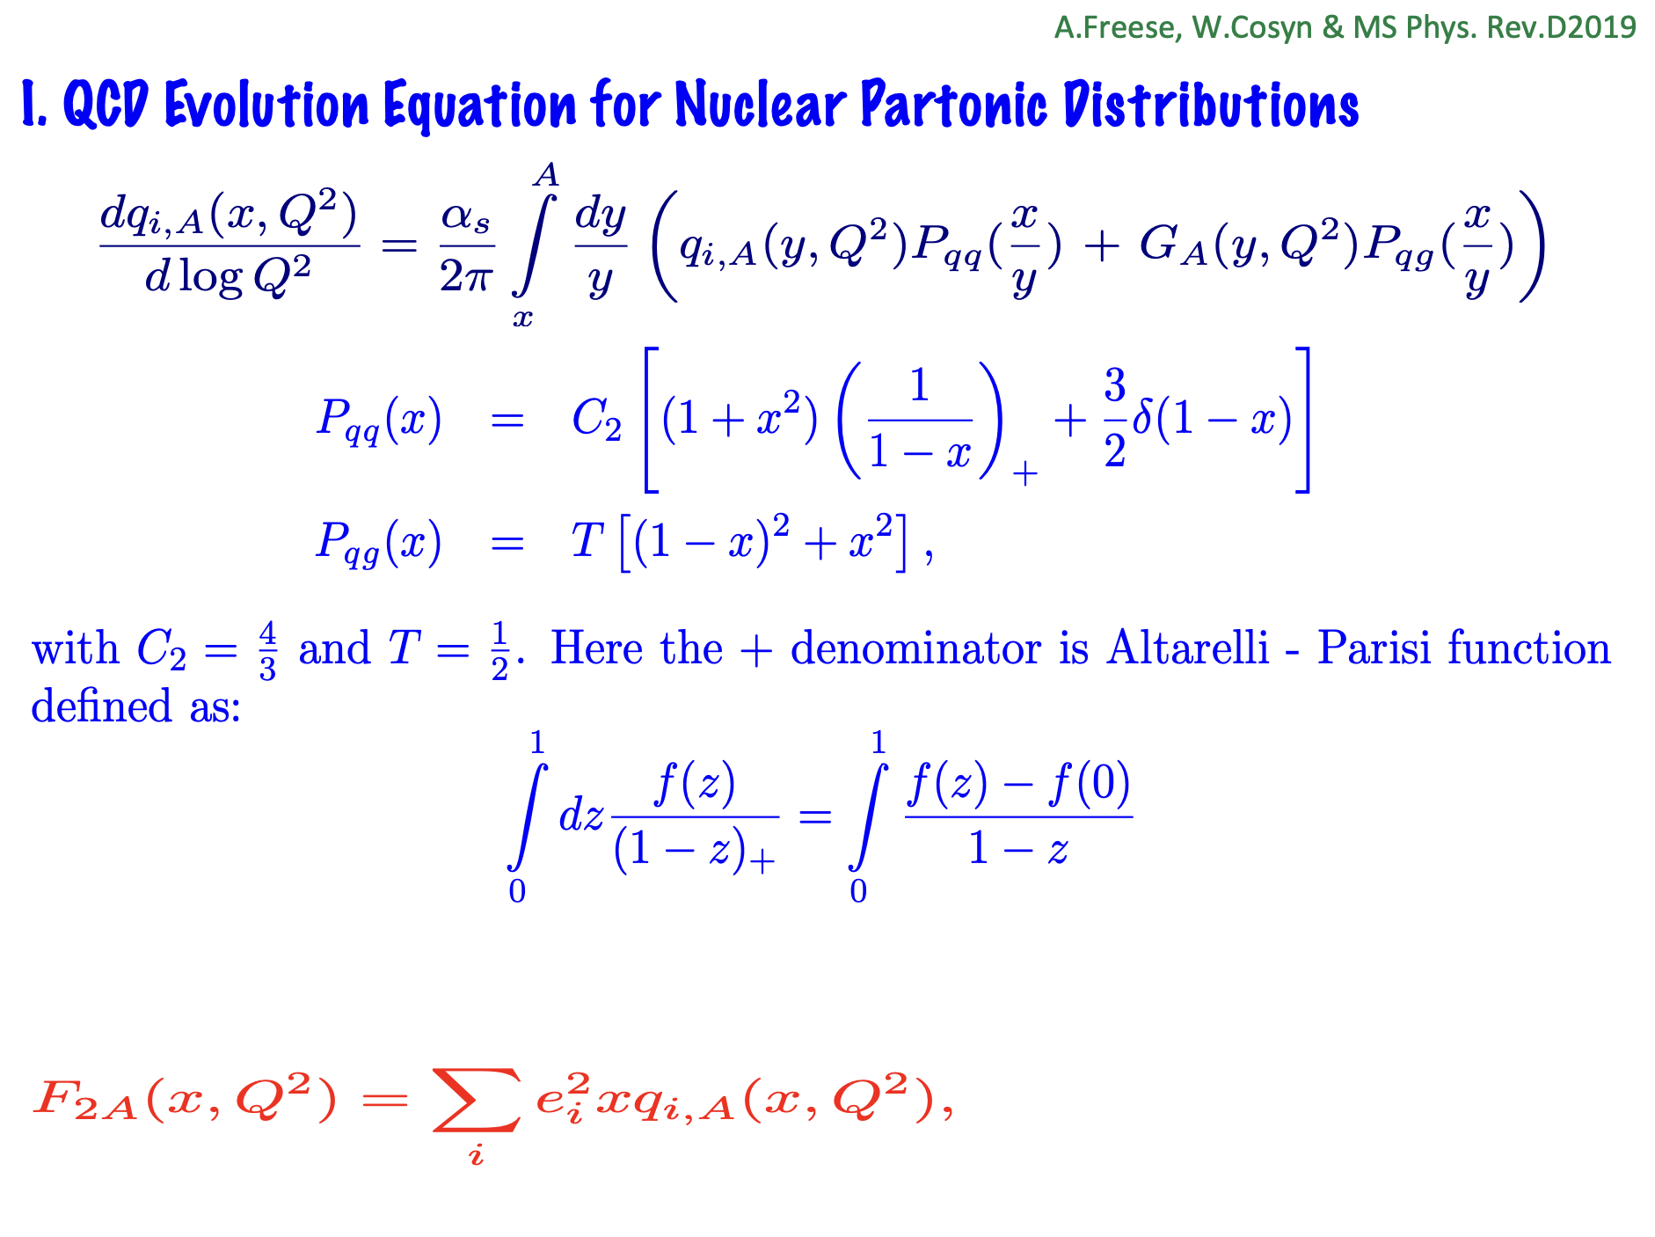

Slide 30
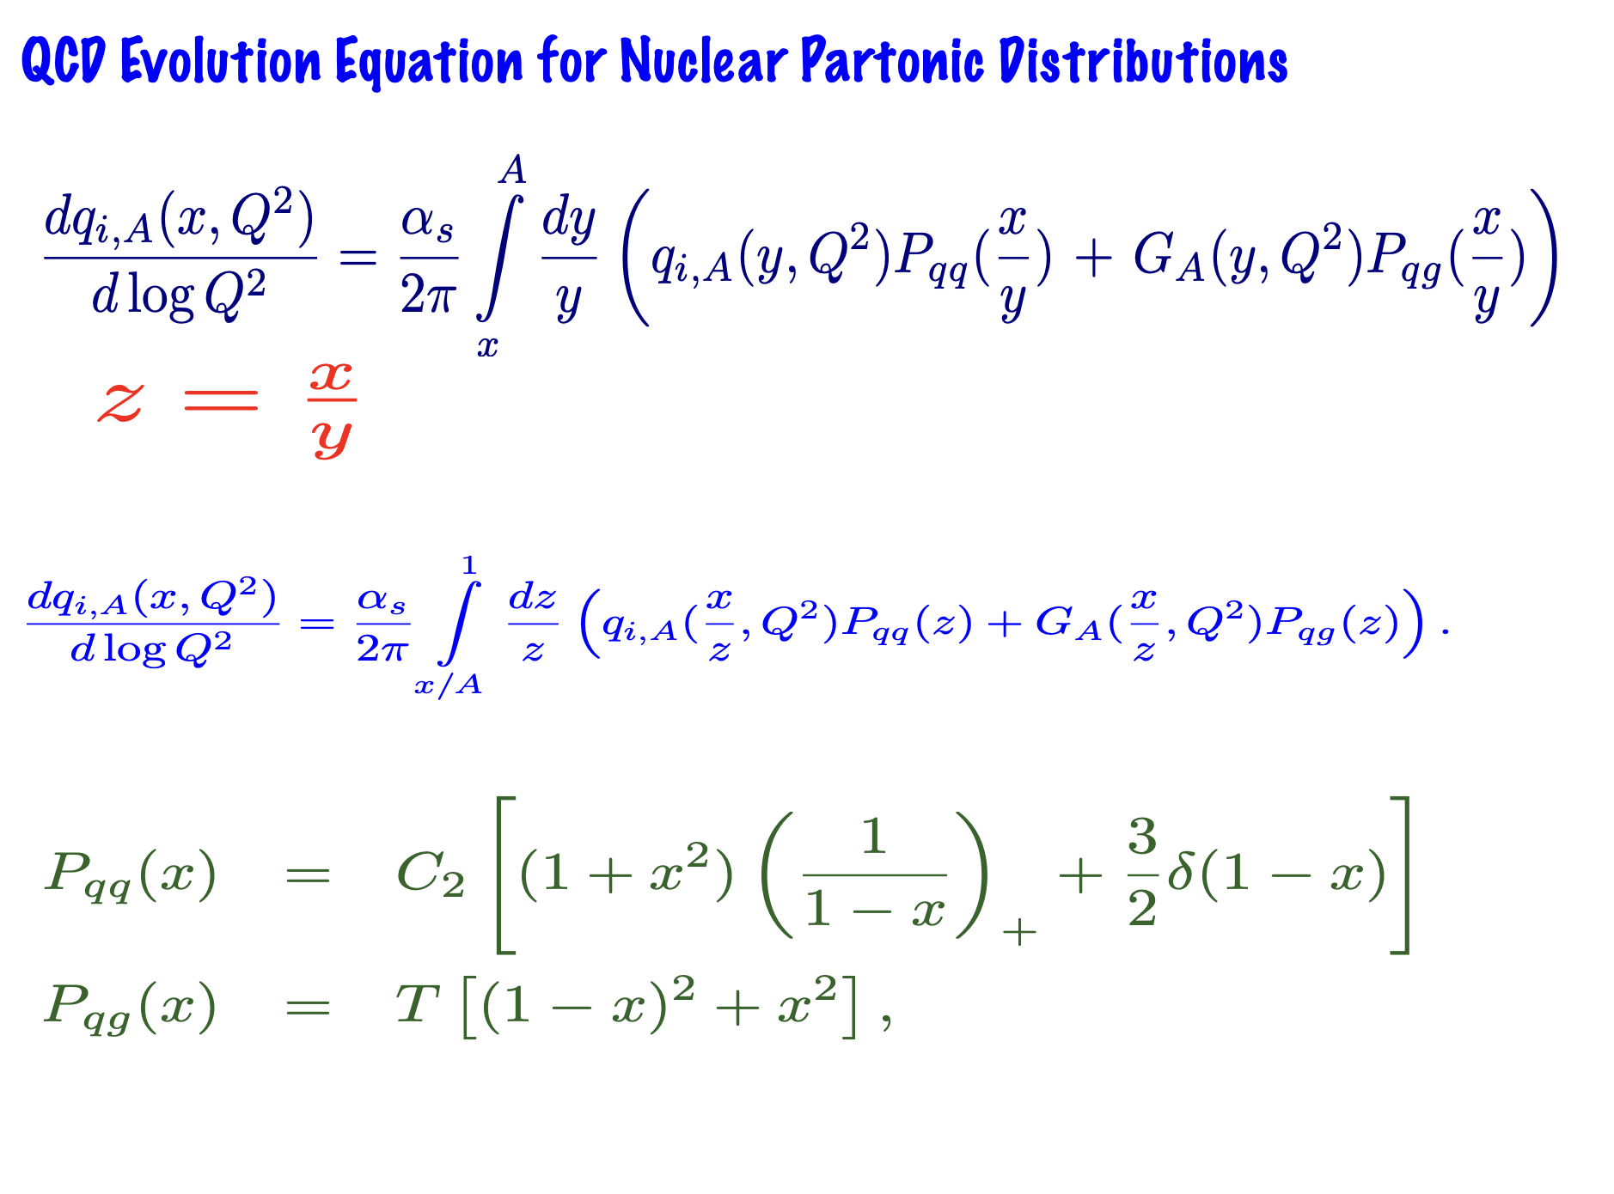

Slide 31
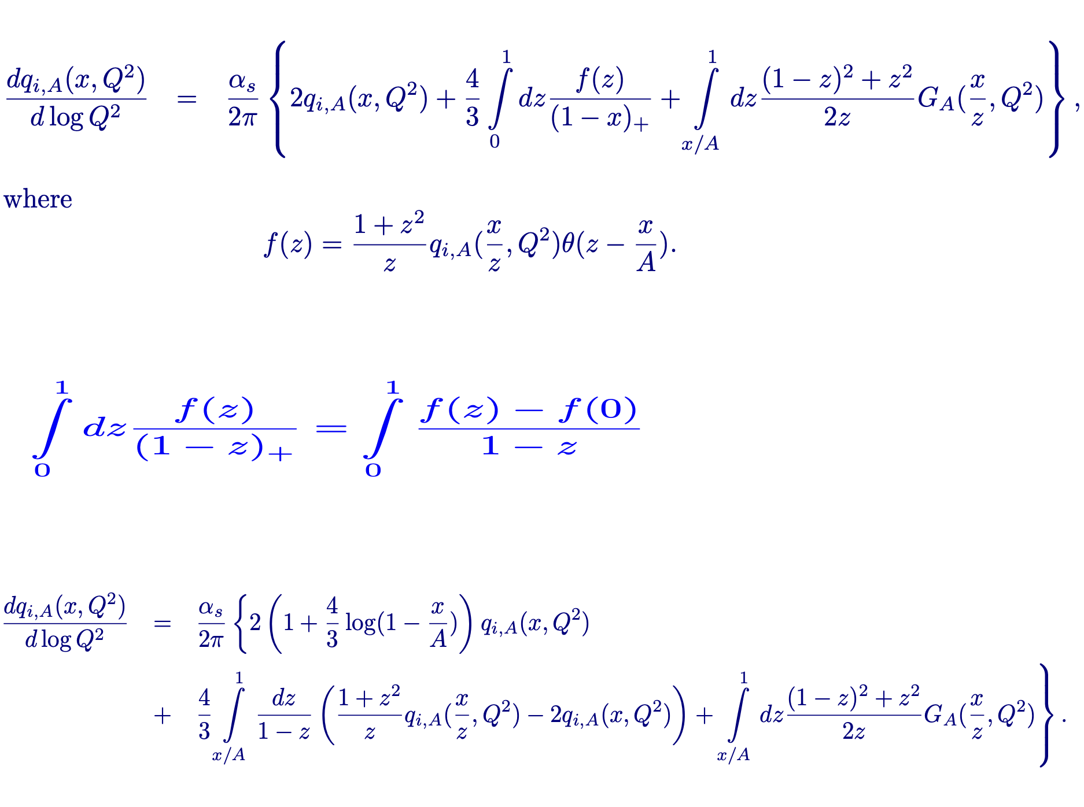

Slide 32
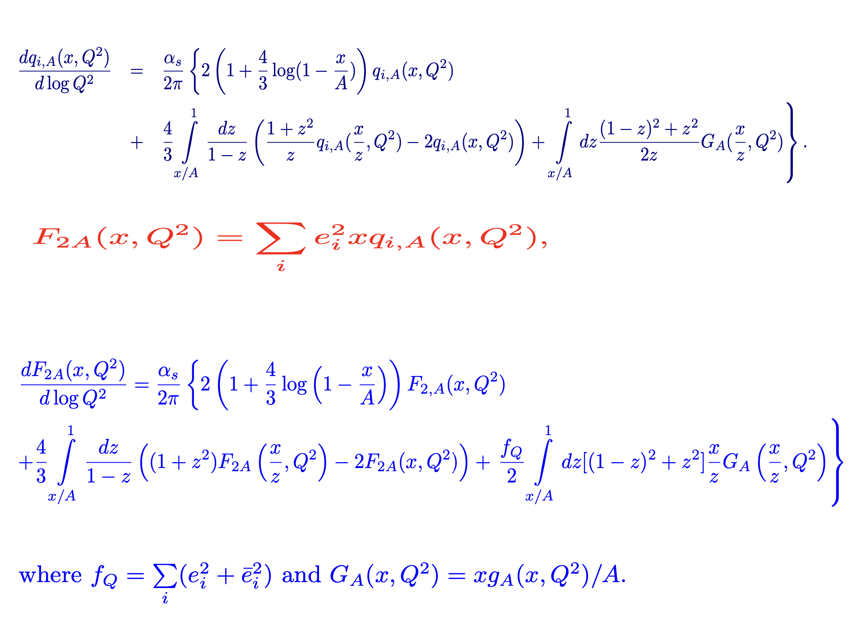

Slide 33
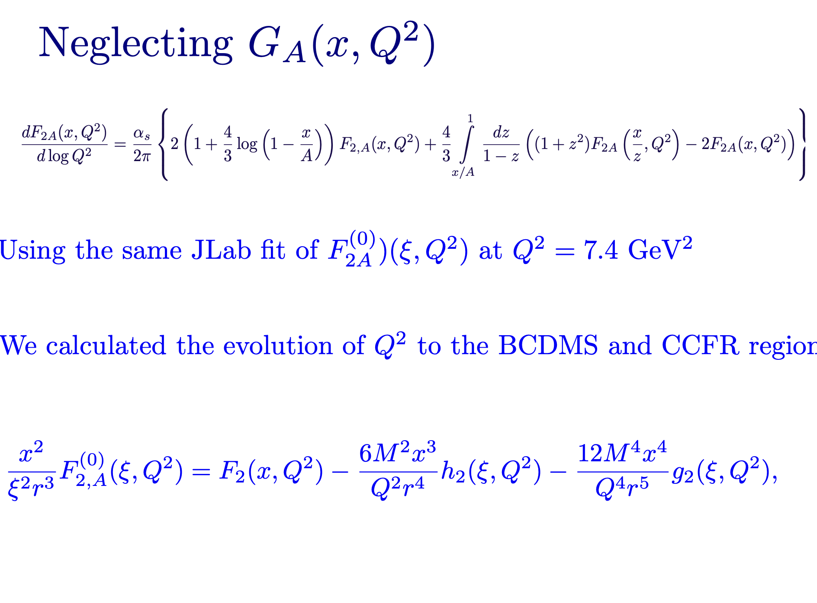

Slide 35
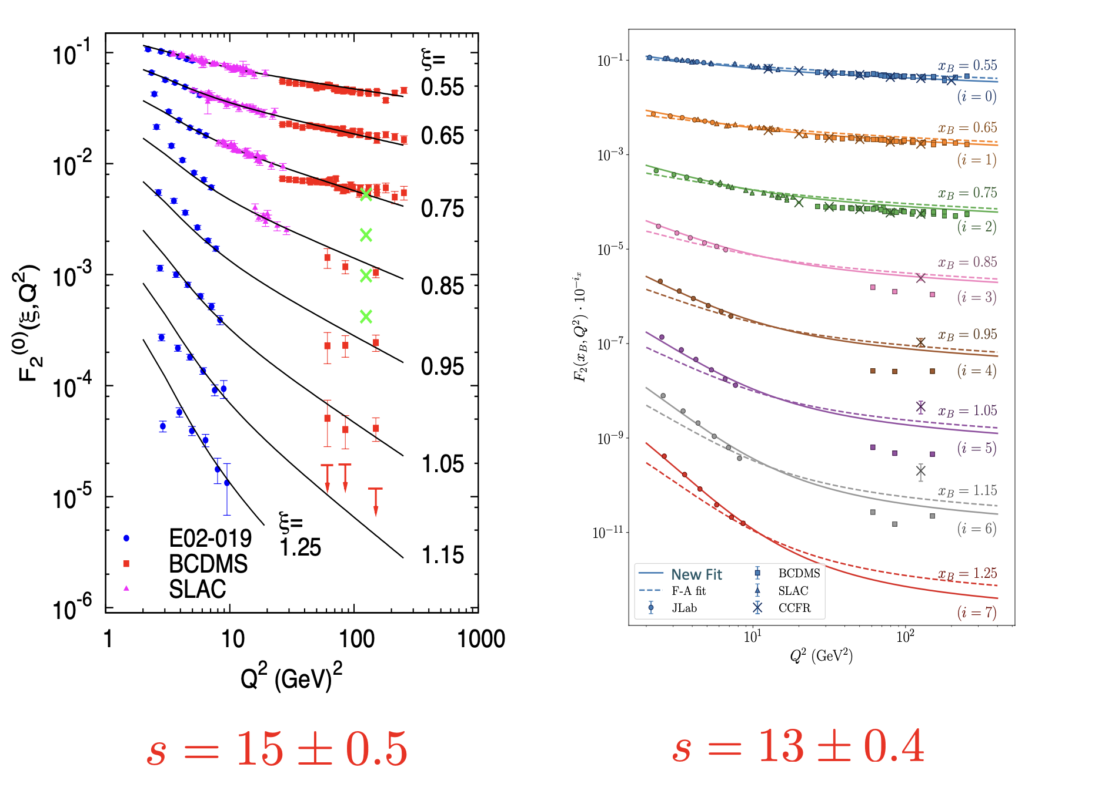

Slide 36
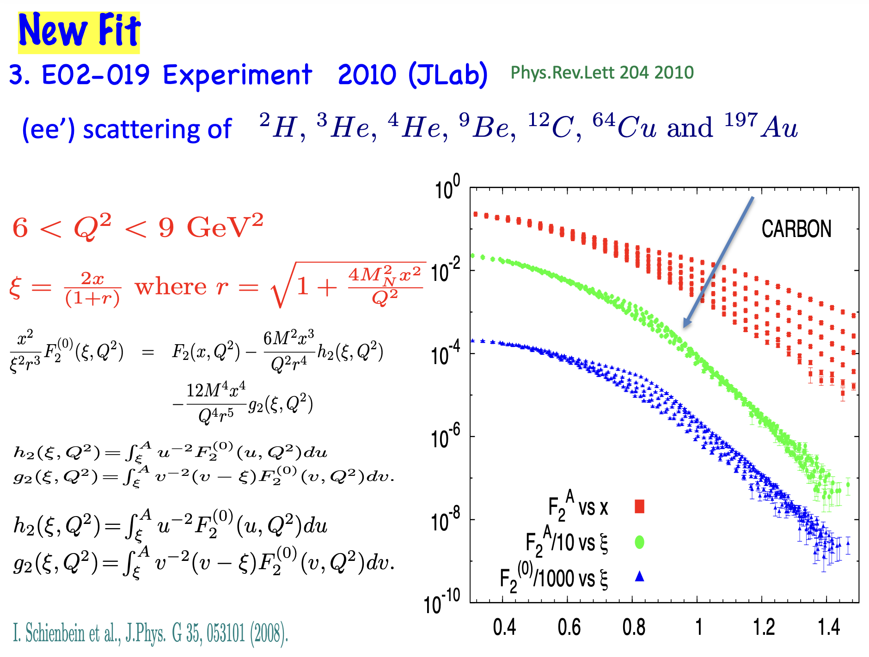

Slide 37
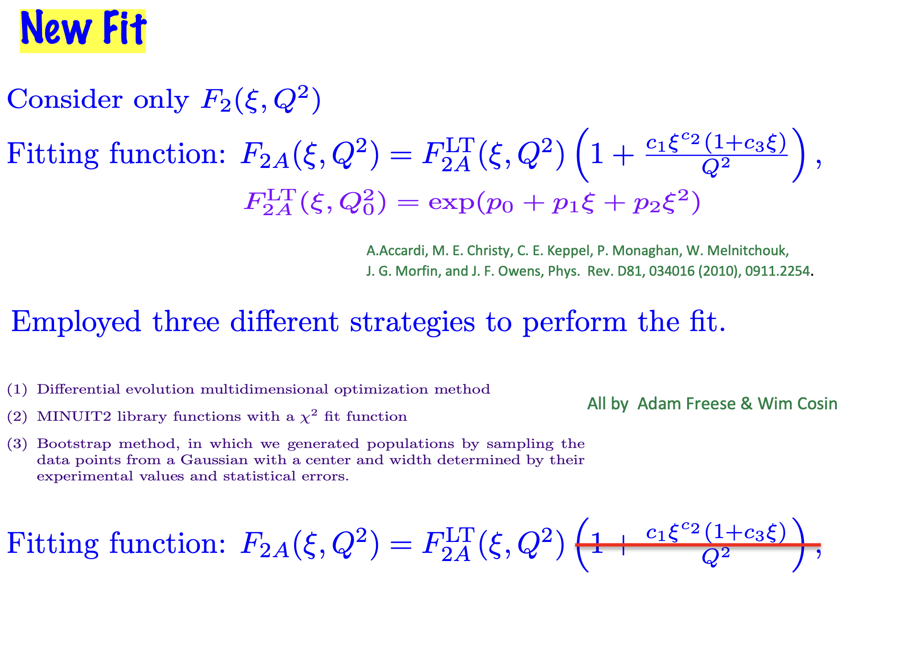

Slide 38
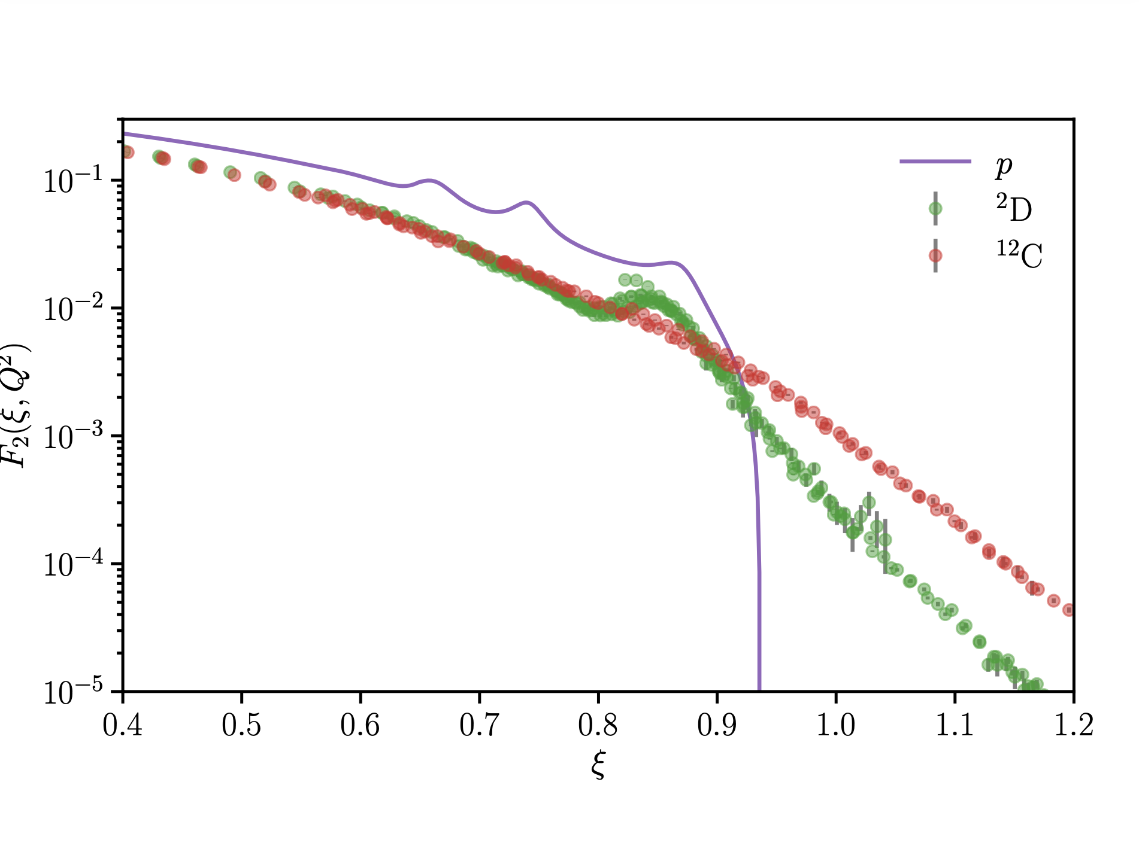

Slide 39
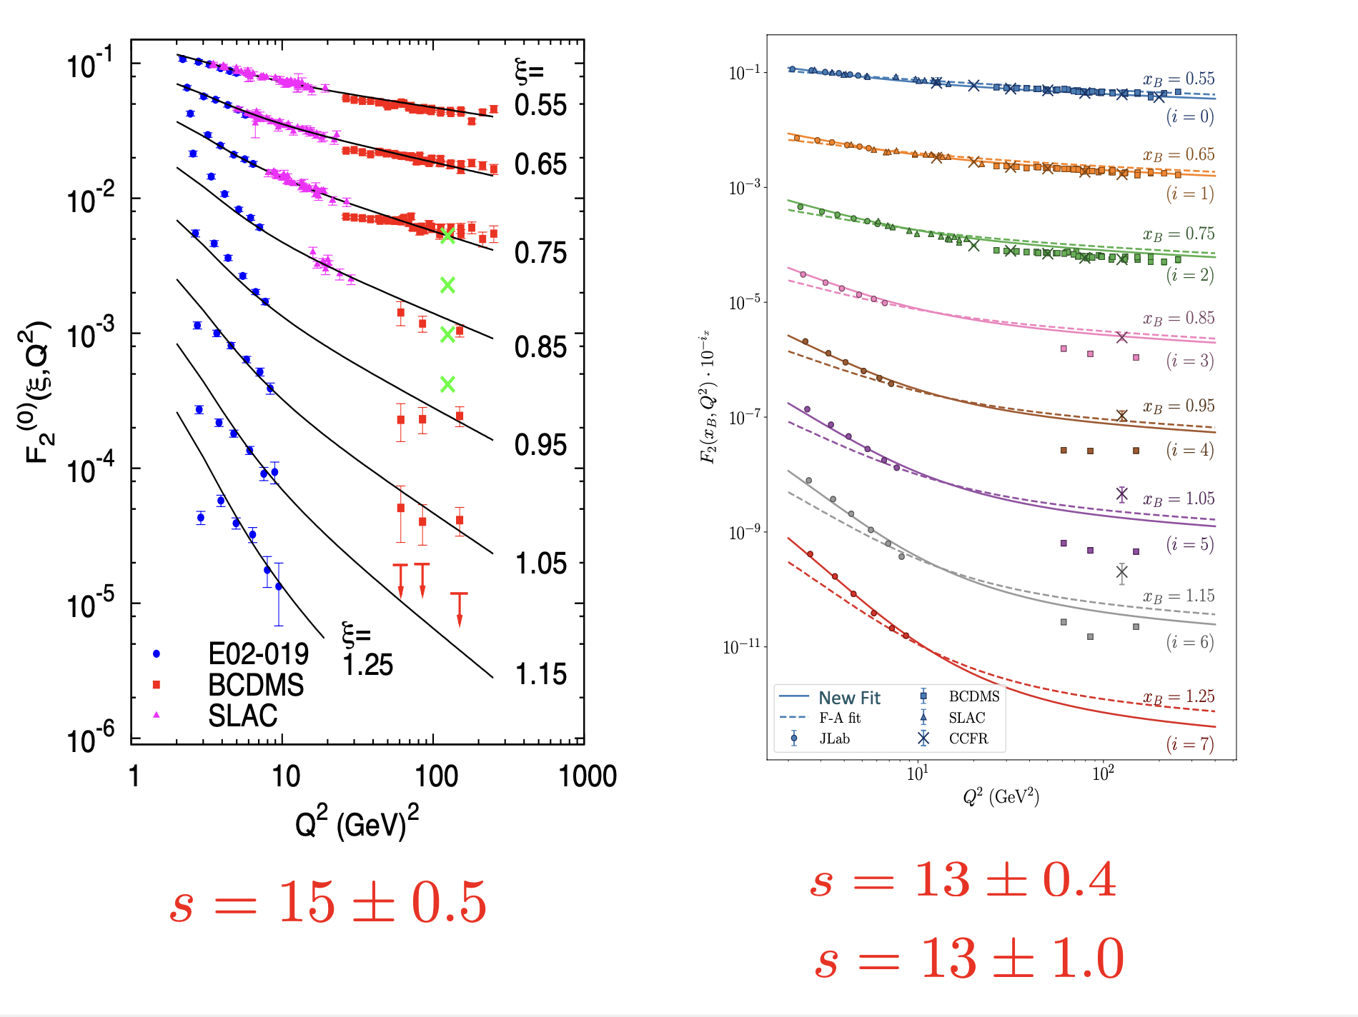

Slide 40
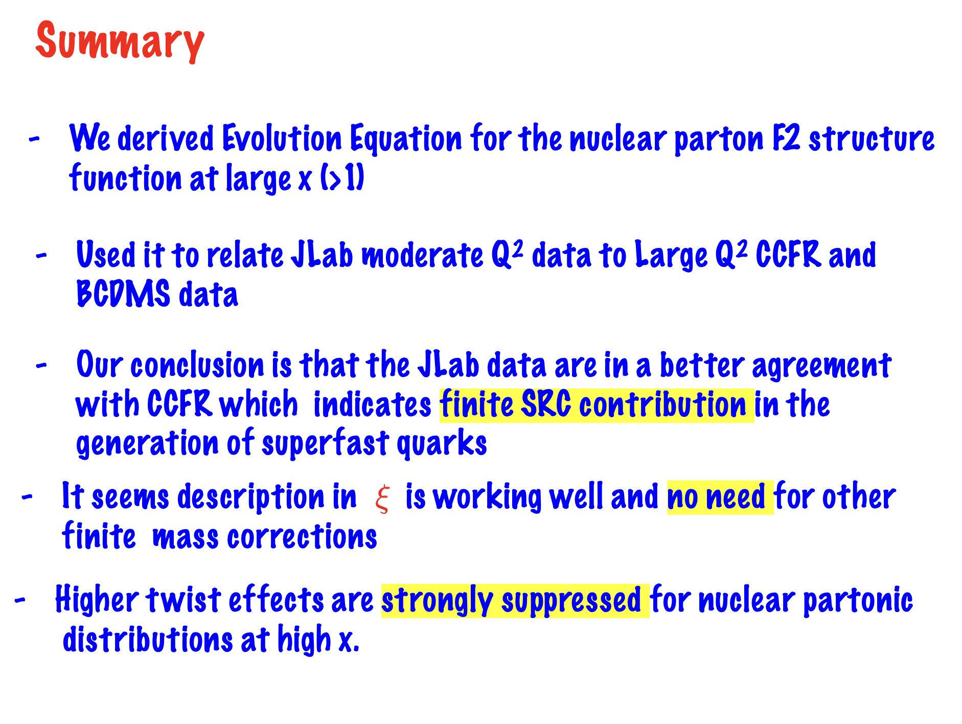

Slide 41
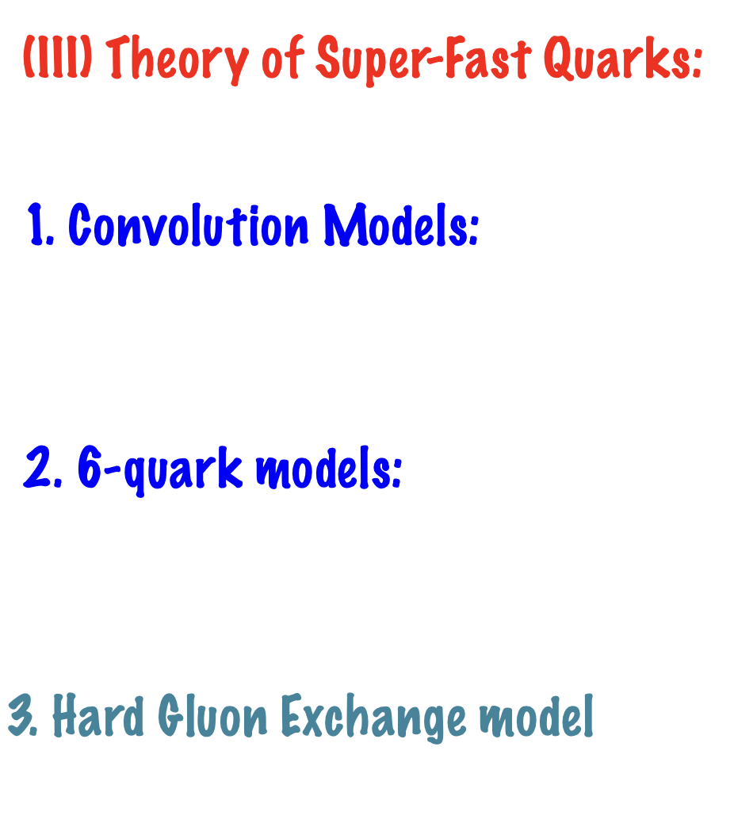

Slide 42
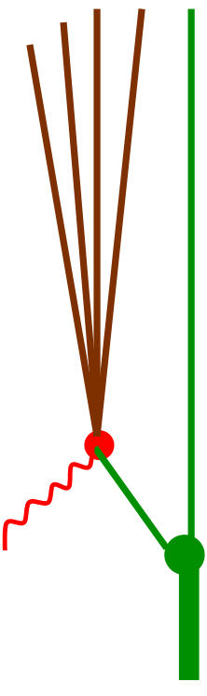

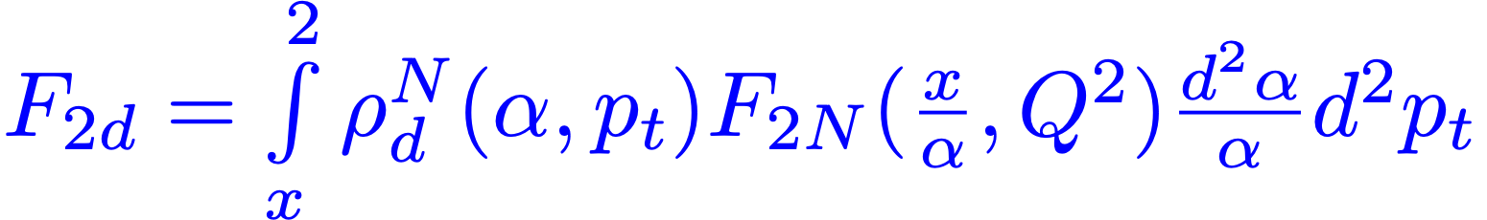
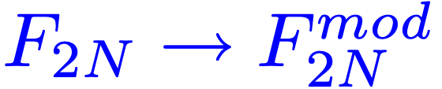
1. Convolution Model
X
d
N

Slide 43
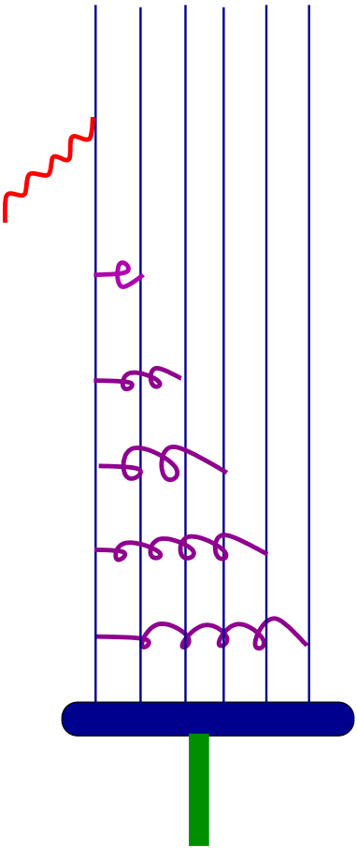
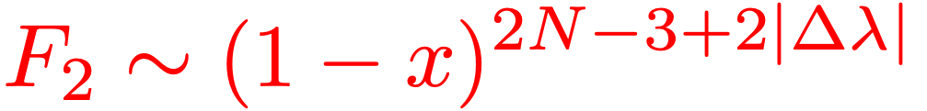
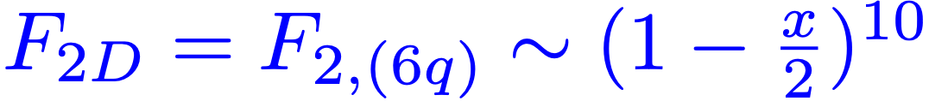
2. Quark-Cluster - 6q - Model
+
+
+
+
-
T
T
T
d
T
Gunion, Nason, Blankenbecler, PRD 1984
T
Carlson, Lassila, Sukhatme, PLB 1988,1991

Slide 44
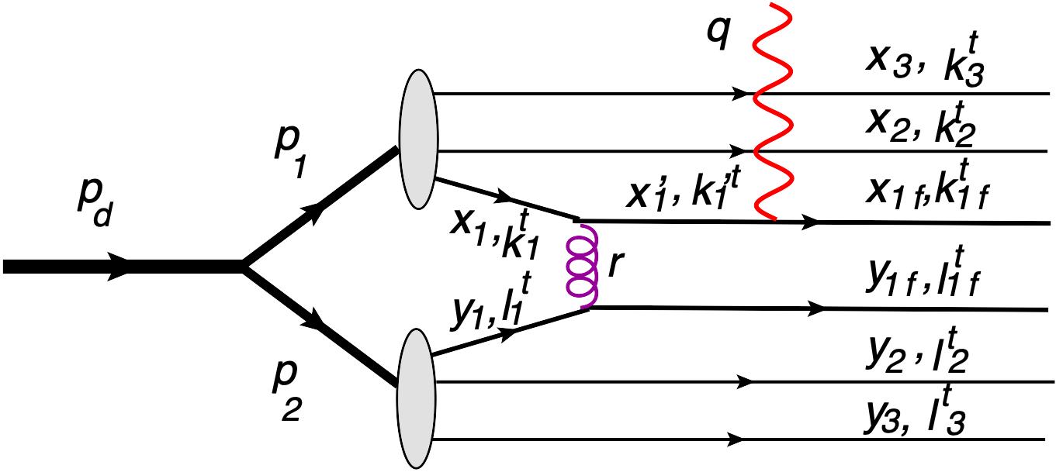
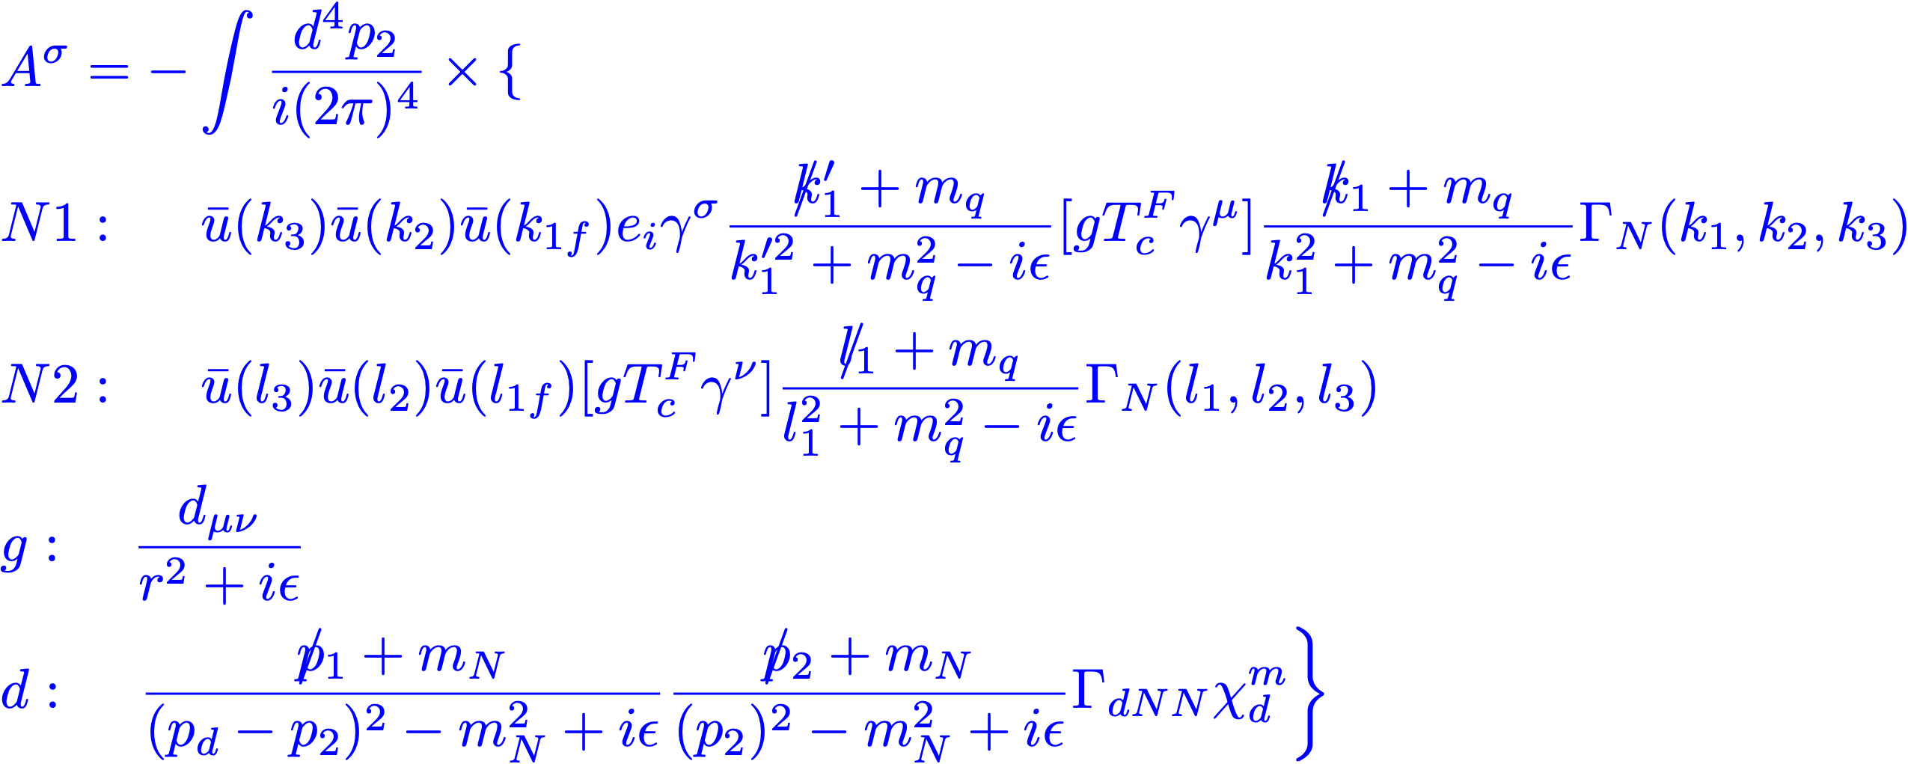
3. Hard Gluon Exchange Model

Slide 45
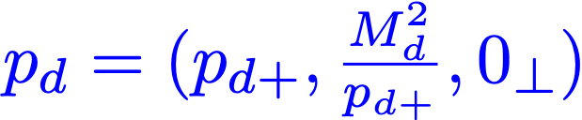
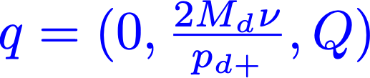
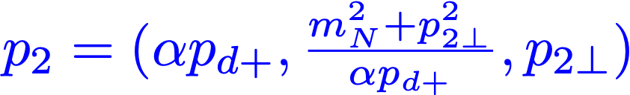
Reference Frame
Defining light-cone four-momenta:
Pseudo-CM Reference Frame:

Slide 46
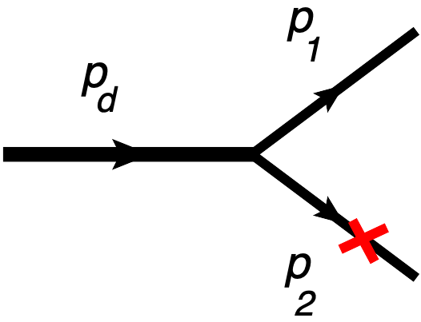
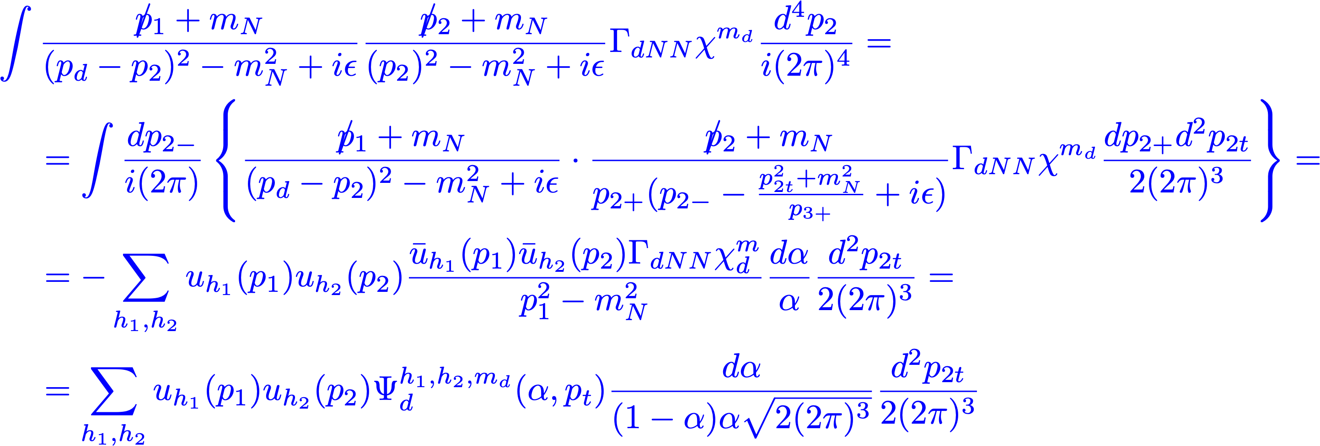
Deuteron Wave Function

Slide 47
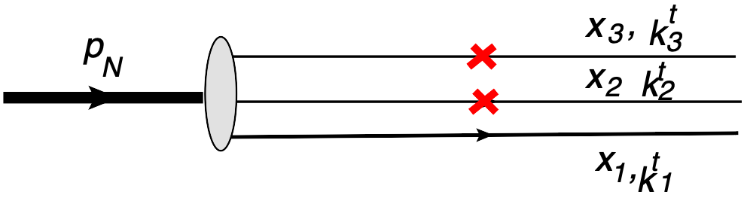
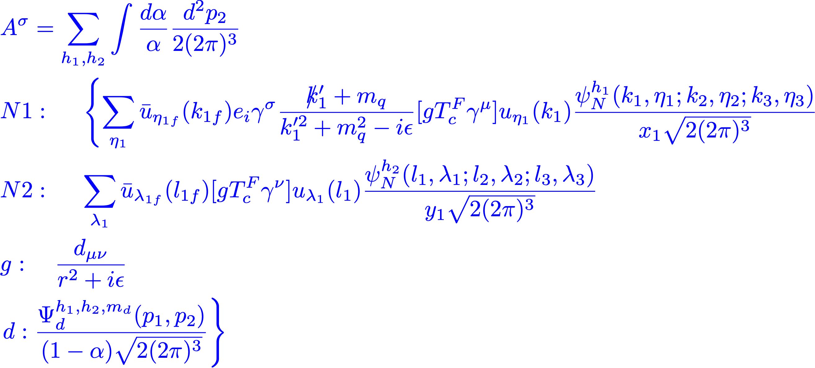
Nucleon Wave Function

Slide 48
Amplitude of Hard Subprocess

Slide 49
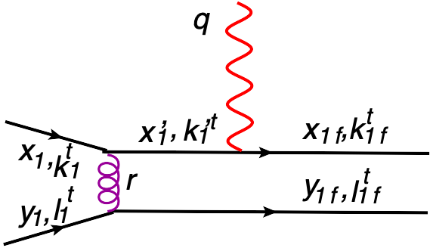
Amplitude of Hard Subprocess

Slide 50
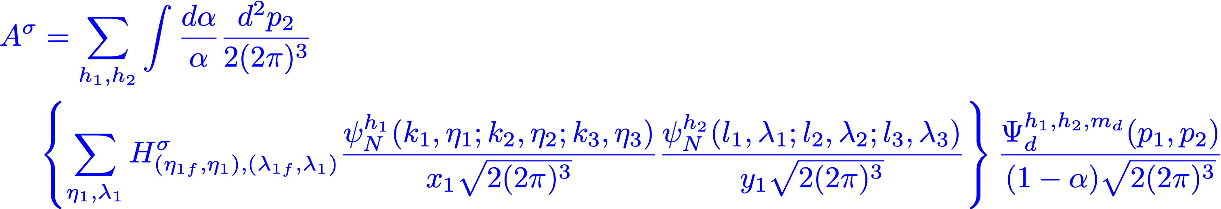
Amplitude of Hard Subprocess

Slide 51
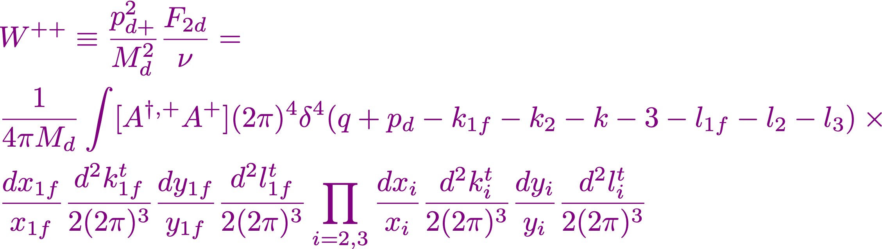
Deuteron Structure Function

Slide 52

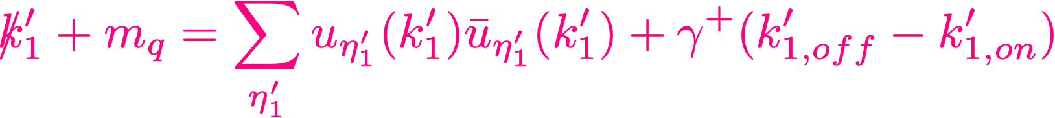
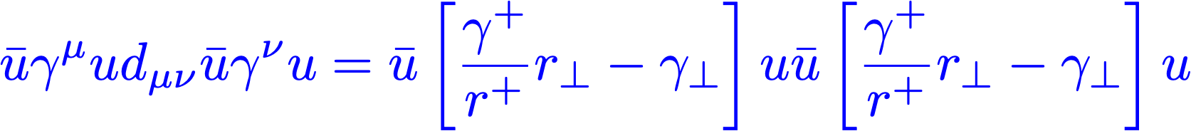


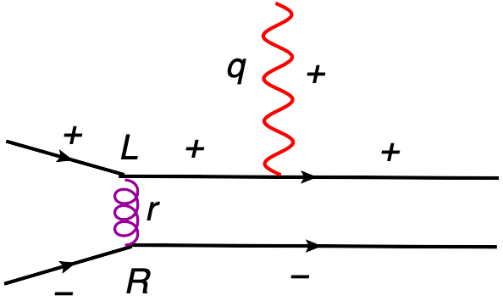

Amplitude of Hard Subprocess
-Need to calculate:
-Use:
-Fixing Light Cone Gauge for Gluon:
-Using:
and
-where:

Slide 53
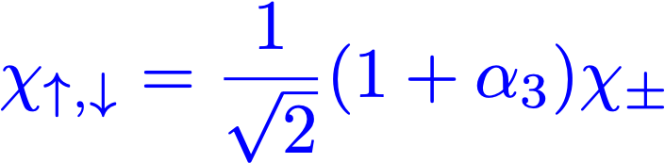
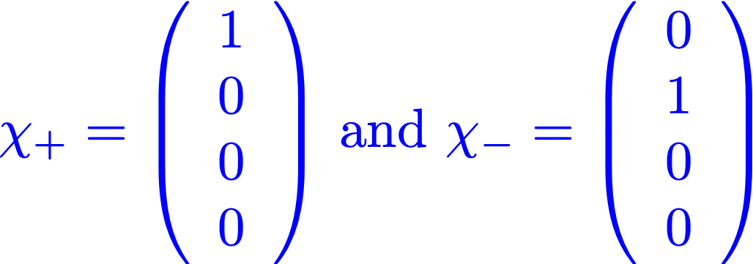
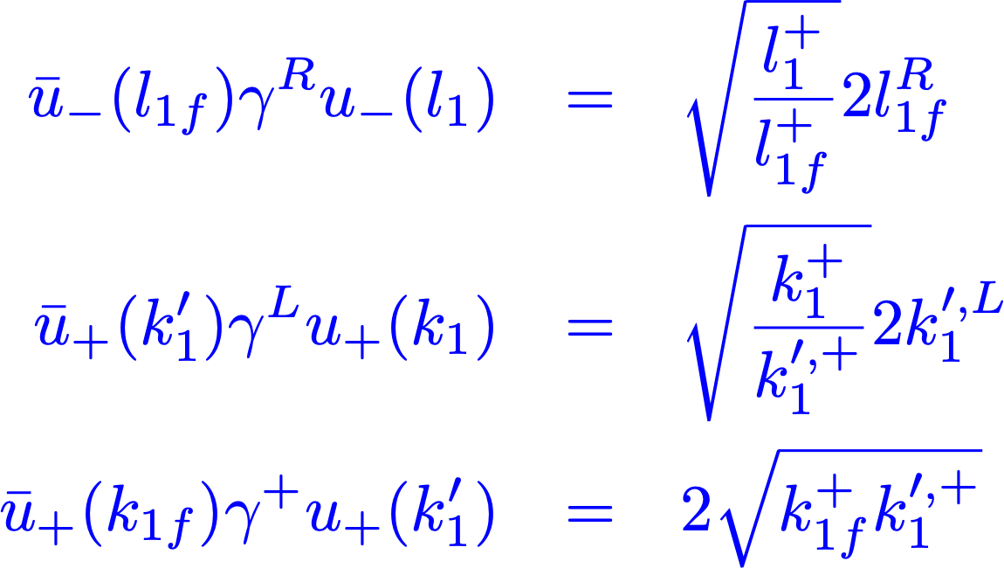
Amplitude of Hard Subprocess
-using light cone spinors:
Brodsky, Lepage PRD 1980
where:
and:
- calculating:

Slide 54
Amplitude of Hard Subprocess

Slide 55
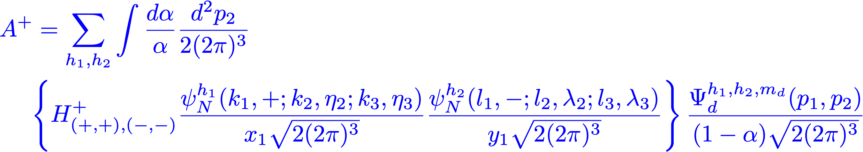
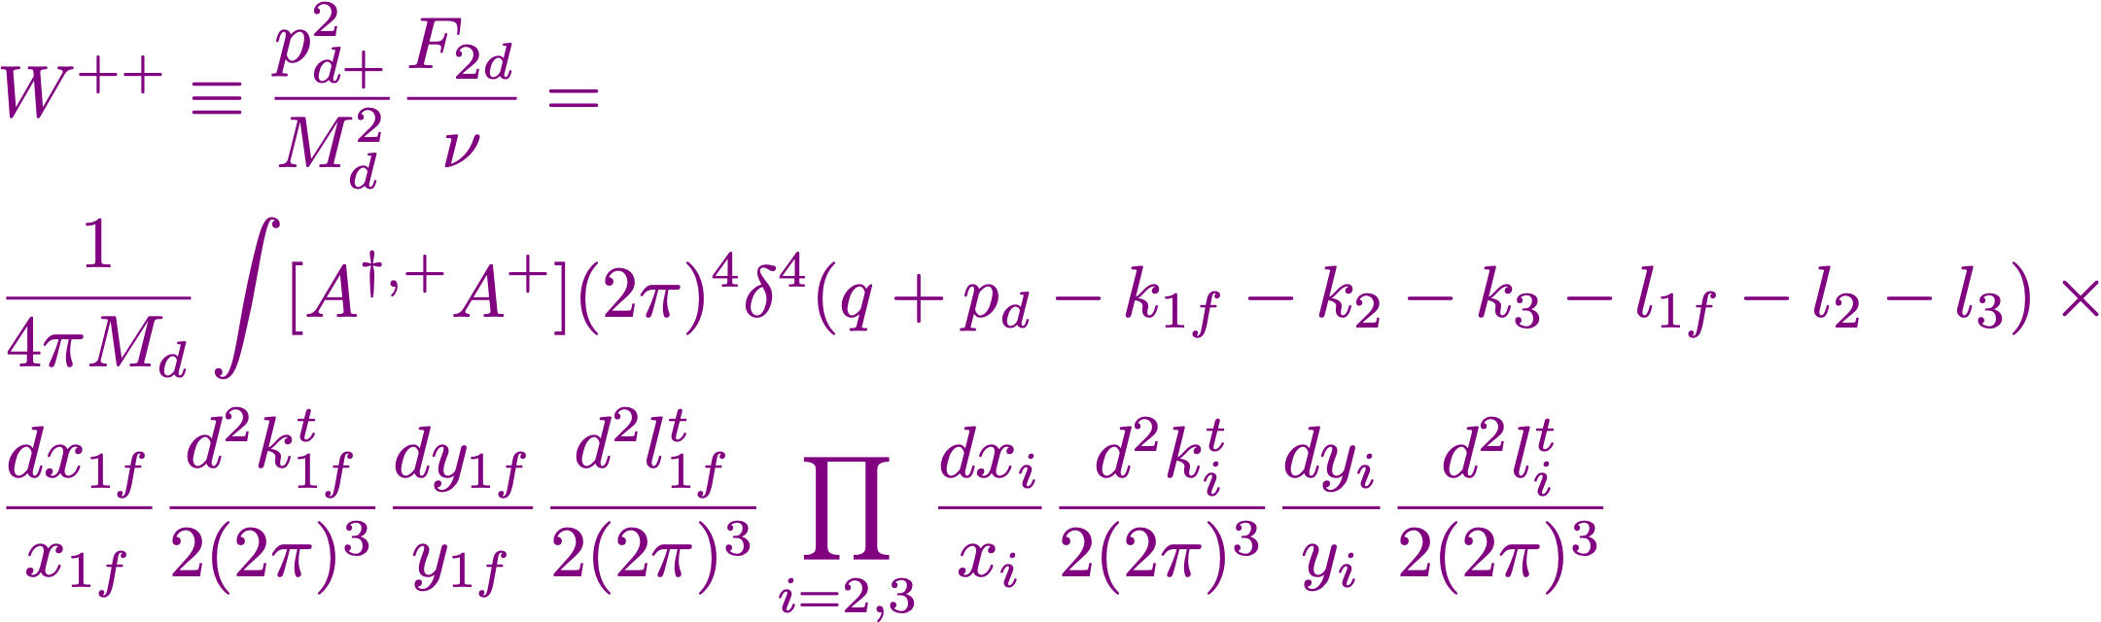
Deuteron Structure Function

Slide 56
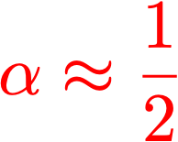
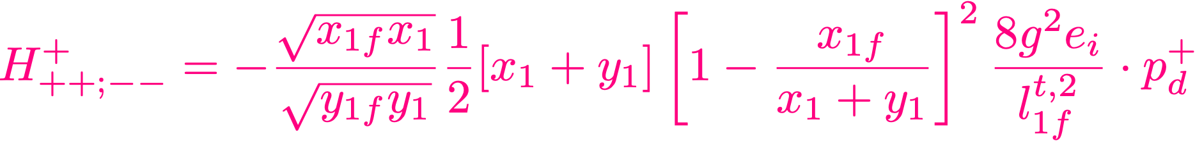
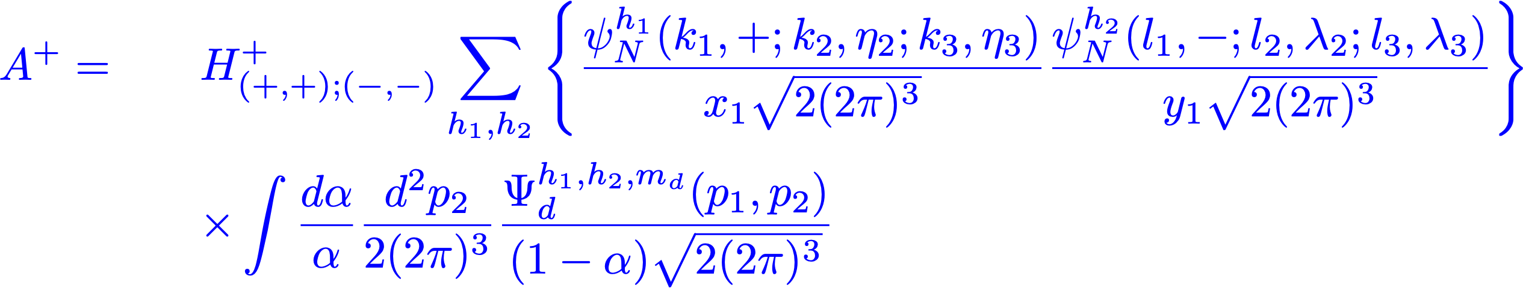
Deuteron Structure Function
- approximation:

Slide 57

Deuteron Structure Function
- definition of PDF:
- Parametrically:

Slide 58
Deuteron Structure Function
Why Double Partonic Distributions?

Slide 59


Slide 60


6q
hgex
Convolution

Slide 61

6q cluster
2N SRCs+F2-Mod
hgex model

Slide 62

- softening of x distribution
- hard gluon exchange model predicts less
soft than 6q and less hard than NN
- possible double Q2 evolution equation ?
- observation of hgex like scenario will indicate
on existence of mixed quark- hadron phase in
baryon-quark-gluon transition
d
T
T
d

