Slide 1

Observing Flavor Dependence of the EMC Effect through Parity Violation
erhtjhtyhy
Paul E Reimer
20 July 2023
ECT*, Trento, Italy
This work was partially supported under grant DE-AC02-06CH11357 from the US Department of Energy, Office of Nuclear Physics

Slide 2
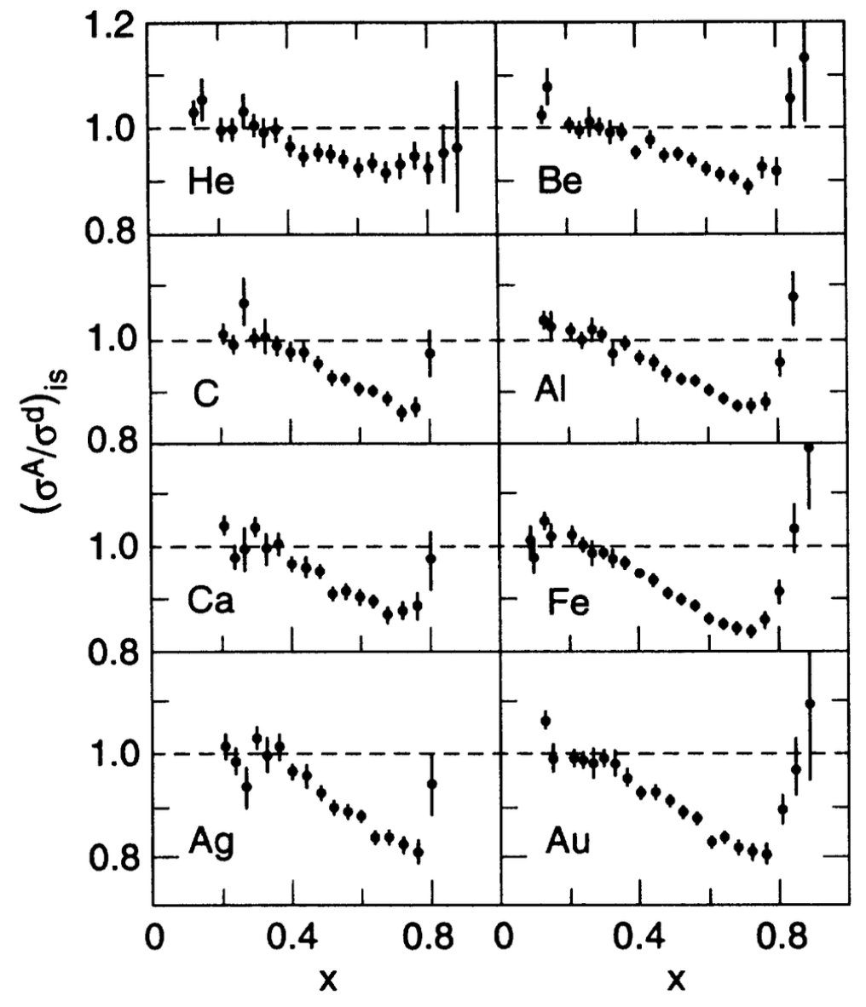

Probing the EMC Effect
Backup Slides
What we know: (See T. Hague’s talk)
Parton distributions in nuclei are different
$$R^{A}\left(x, Q^{2}\right)= \frac{F_{2}^{A}\left(x,Q^{2}\right)}{ZF_{2}^{p}\left(x,Q^{2}\right)+NF_{2}^{n}\left(x,Q^{2}\right)}≠1$$
Local density and SRC appear to be important
Appears to follow a universal curve
Gomez, et al., PRD 49 4348 (1994)

Slide 3
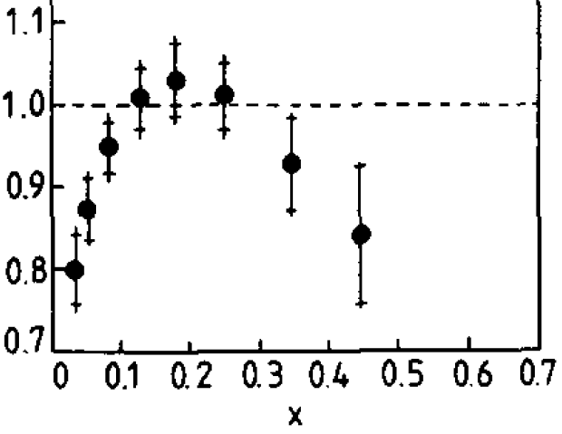
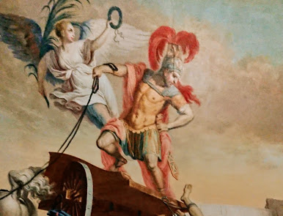
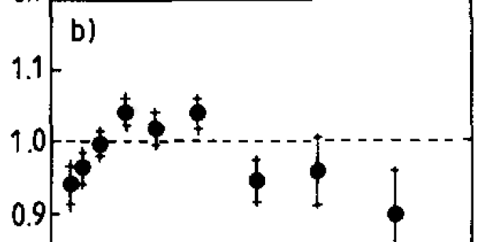
EMC Effect is
NeoClassic
F₂ Sn/D
F₂ C/D

Slide 4
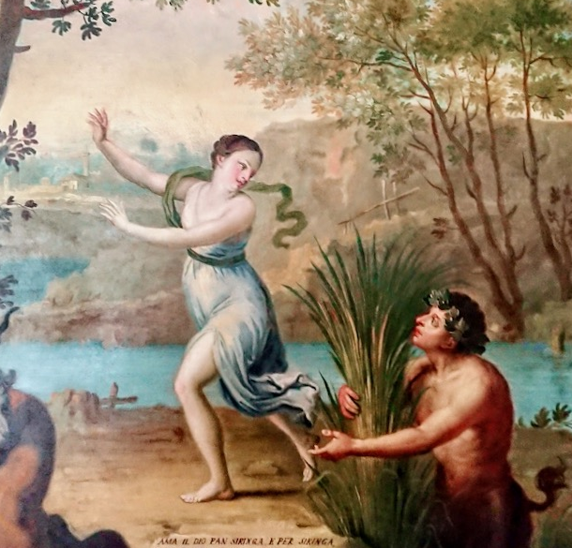
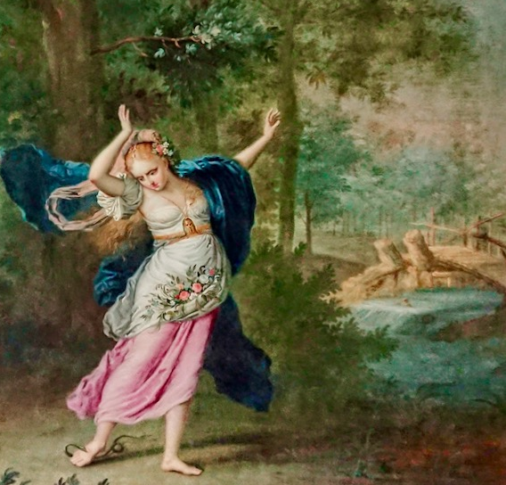
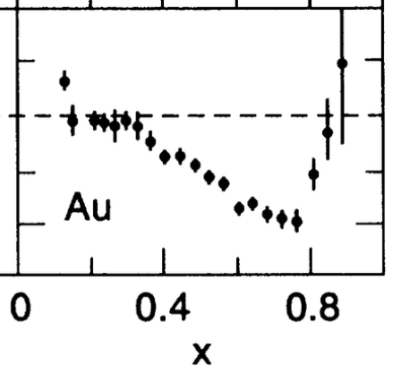
EMC Shape Predicted in Art at ECT*

Slide 5
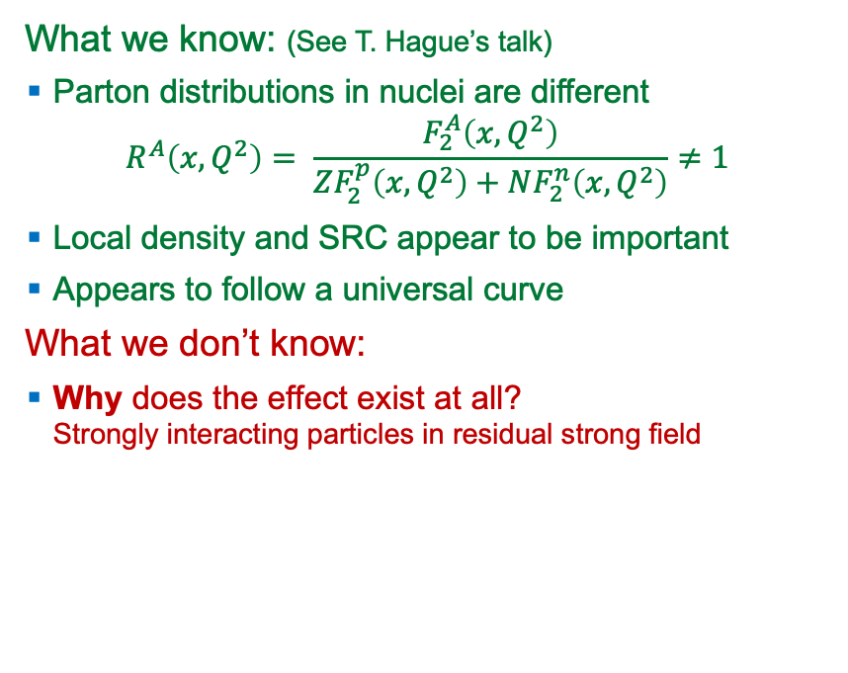
Probing the EMC Effect
What we know: (See T. Hague’s talk)
Parton distributions in nuclei are different
$$R^{A}\left(x, Q^{2}\right)= \frac{F_{2}^{A}\left(x,Q^{2}\right)}{ZF_{2}^{p}\left(x,Q^{2}\right)+NF_{2}^{n}\left(x,Q^{2}\right)}≠1$$
Local density and SRC appear to be important
Appears to follow a universal curve
What we don’t know:
Why does the effect exist at all?
  Strongly interacting particles in residual strong field
Gomez, et al., PRD 49 4348 (1994)

Slide 6
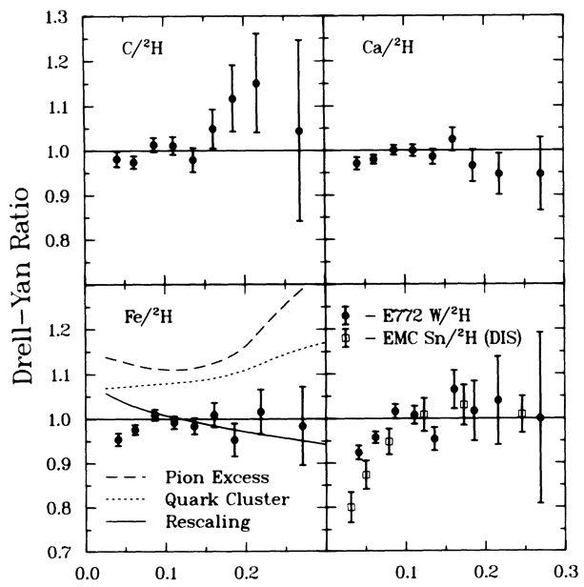
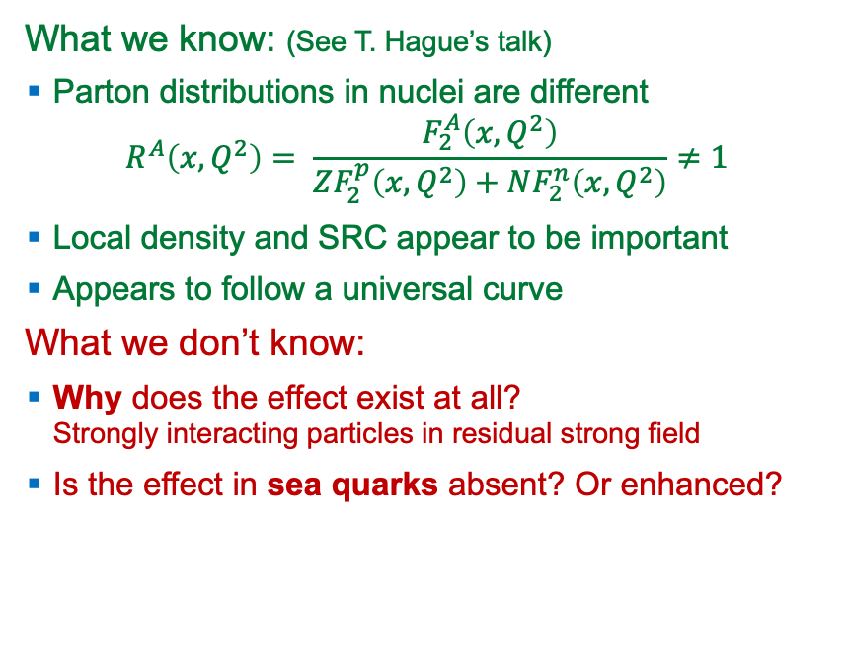
Probing the EMC Effect
What we know: (See T. Hague’s talk)
Parton distributions in nuclei are different
$$R^{A}\left(x, Q^{2}\right)= \frac{F_{2}^{A}\left(x,Q^{2}\right)}{ZF_{2}^{p}\left(x,Q^{2}\right)+NF_{2}^{n}\left(x,Q^{2}\right)}≠1$$
Local density and SRC appear to be important
Appears to follow a universal curve
What we don’t know:
Why does the effect exist at all?
  Strongly interacting particles in residual strong field
Is the effect in sea quarks absent? Or enhanced?
Alde et al. (Fermilab E772)
Phys. Rev. Lett. 64 2479 (1990)

Slide 7
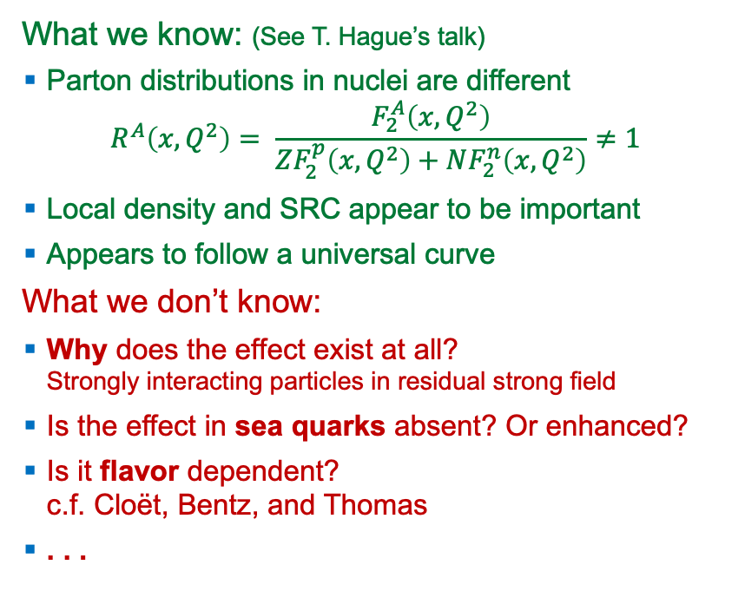
Probing the EMC Effect
What we know: (See T. Hague’s talk)
Parton distributions in nuclei are different
$$R^{A}\left(x, Q^{2}\right)= \frac{F_{2}^{A}\left(x,Q^{2}\right)}{ZF_{2}^{p}\left(x,Q^{2}\right)+NF_{2}^{n}\left(x,Q^{2}\right)}≠1$$
Local density and SRC appear to be important
Appears to follow a universal curve
What we don’t know:
Why does the effect exist at all?
  Strongly interacting particles in residual strong field
Is the effect in sea quarks absent? Or enhanced?
Is it flavor dependent?
  c.f. Cloët, Bentz, and Thomas
. . .
Gomez, et al., PRD 49 4348 (1994)

Slide 8
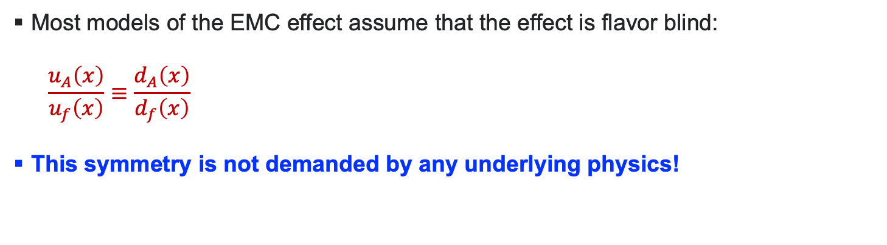
Flavor Dependent EMC
Most models of the EMC effect assume that the effect is flavor blind:
  $$\frac{u_{A}\left(x\right)}{u_{f}\left(x\right)}≡\frac{d_{A}\left(x\right)}{d_{f}\left(x\right)}$$
This symmetry is not demanded by any underlying physics!

Slide 9
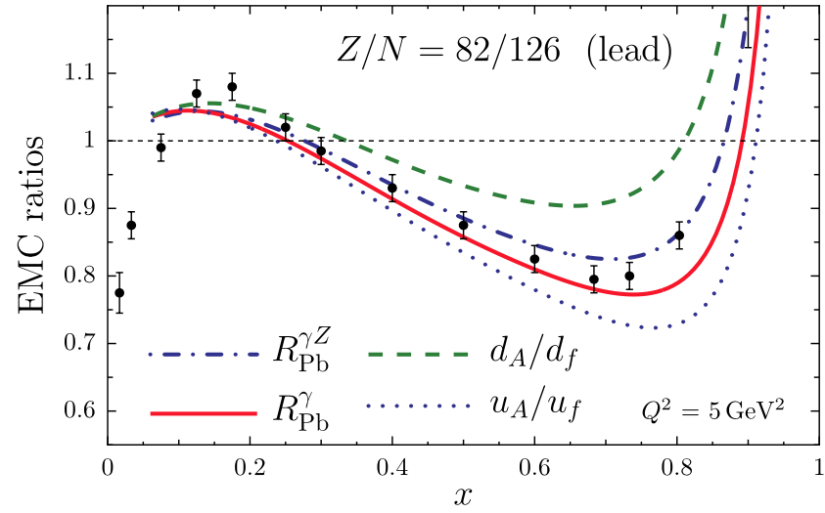
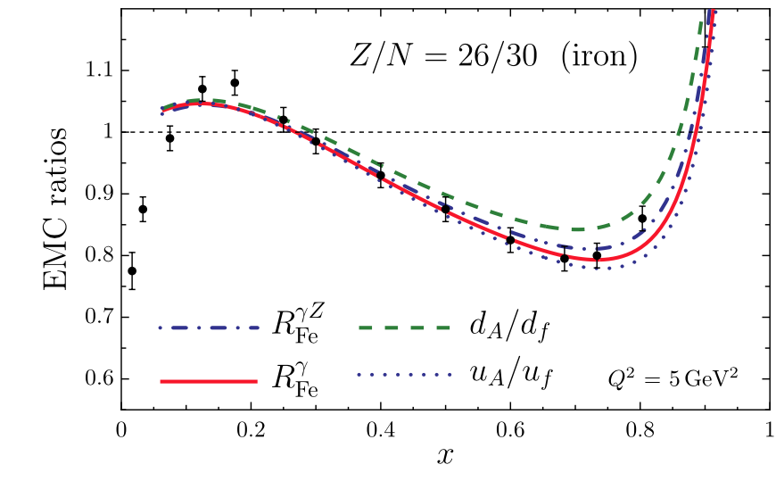
Flavor Dependent EMC—Cloët, Bentz, and Thomas
General idea
For N ≠ Z there is a small isovector-vector mean field, 𝜌⁰
Additional vector
  attraction for u-quarks
  repulsion for d-quarks
Cloët et al., PRL 109, 182301 (2012)
Cloët et al., PRL 102, 252301 (2009)

Slide 10
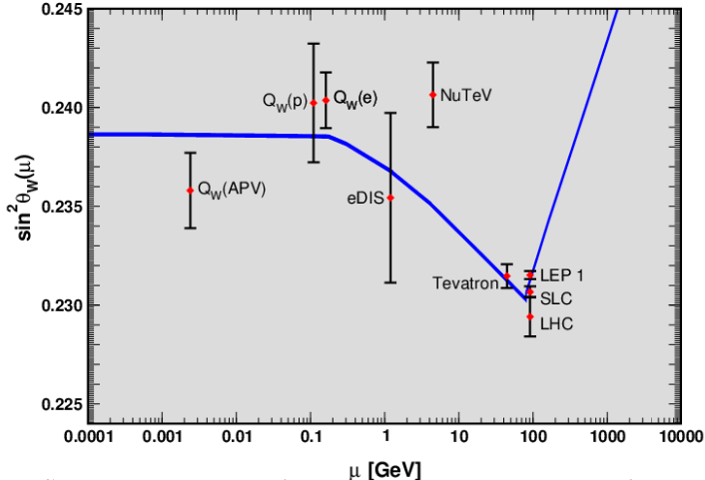
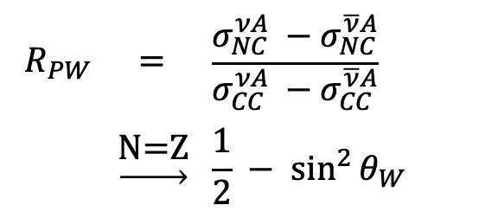
NuTeV
Standard Model test
Pachos-Wolfenstein (PW) relationship
Extremely difficult experiment
Fe target (needed high density since 𝜈’s don’t interact).
This flavor dependent EMC (if it exists) can explain about 1.5𝜎 of the observed approx. 3𝜎 discrepancy
$$R_{PW}$$ | $$=$$ | $$\frac{σ_{NC}^{νA} −σ_{NC}^{\overline{ν}A}}{σ_{CC}^{νA} −σ_{CC}^{\overline{ν}A}}$$
 | $$\underset{→}{\text{N}\text{=}\text{Z}}$$ | $$\frac{1}{2} − \sin^{2}{θ_{W}}$$
2014 Particle Data Group
Cloët et al., PRL 109, 182301 (2012)
Cloët et al., PRL 102, 252301 (2009)

Slide 11
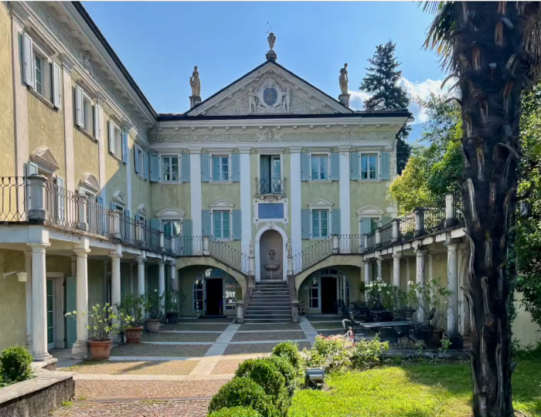
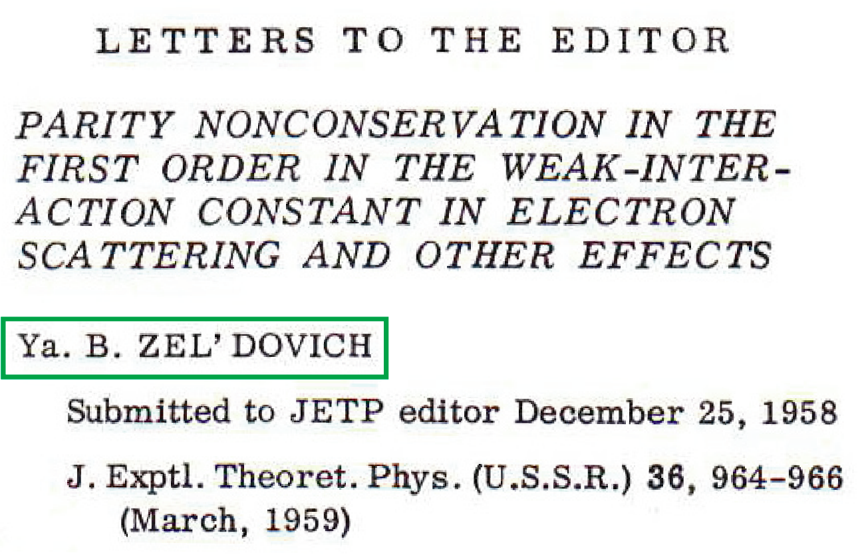
Parity NonConservation and Electron Scattering
ν
e
e
e
Proposes that electron scattering should have measurable parity violating asymmetry
Proposes interaction like that responsible for β decay to occur in electron scattering
Argues cross sections for scattering left- and right-handed electrons could differ
G_{F}
G_{F}
n
p
p
p

Slide 12
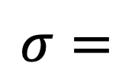

Zel’dovich
2
e
e
e
e
$$σ=$$
+
$$γ$$
Z

Slide 13
Zel’dovich
2
e
e
e
e
$$σ=$$
+
$$γ$$
Z
Tiny
Large,
but equal

Slide 14
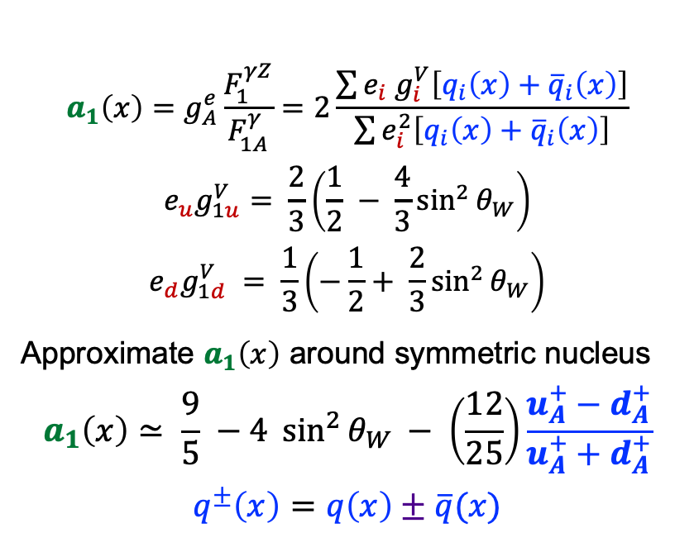
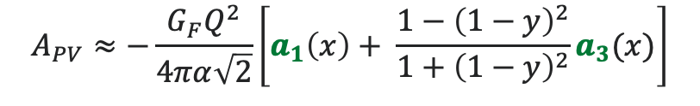
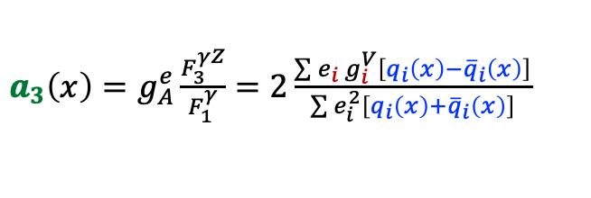
PVEMC
$$A_{PV}≈−\frac{G_{F}Q^{2}}{4πα\sqrt{2}}\left[a_{1}\left(x\right)+ \frac{1−{\left(1−y\right)}^{2}}{1+{\left(1−y\right)}^{2}}a_{3}(x)\right]$$
$$a_{1}\left(x\right)=g_{A}^{e}\frac{F_{1}^{γZ}}{F_{1A}^{γ}}=2\frac{\sum{e_{i}{ g}_{i}^{V}\left[q_{i}\left(x\right)+{\overline{q}}_{i}\left(x\right)\right]}}{\sum{e_{i}^{2}\left[q_{i}\left(x\right)+{\overline{q}}_{i}\left(x\right)\right]}}$$
$${e_{u}g}_{1u}^{V}= \frac{2}{3}\left(\frac{1}{2} − \frac{4}{3}\sin^{2}{θ_{W}}\right)$$
$$e_{d}g_{1d}^{V} = \frac{1}{3}\left(−\frac{1}{2}+ \frac{2}{3}\sin^{2}{θ_{W}}\right)$$
Approximate $a_{1}\left(x\right)$ around symmetric nucleus
$$a_{1}\left(x\right)≃ \frac{9}{5} −4 \sin^{2}{θ_{W}} − \left(\frac{12}{25}\right)\frac{u_{A}^{+}−d_{A}^{+}}{u_{A}^{+}+d_{A}^{+}}$$
$$q^{±}\left(x\right)=q\left(x\right)±\overline{q}(x)$$
$a_{3}\left(x\right)=g_{A}^{e}\frac{F_{3}^{γZ}}{F_{1}^{γ}}=2\frac{\sum{e_{i}{ g}_{i}^{V}\left[q_{i}\left(x\right)−{\overline{q}}_{i}\left(x\right)\right]}}{\sum{e_{i}^{2}\left[q_{i}\left(x\right)+{\overline{q}}_{i}\left(x\right)\right]}}$
Measures flavor differences!
Cloët et al., PRL 109, 182301 (2012)
Cloët et al., PRL 102, 252301 (2009)

Slide 15
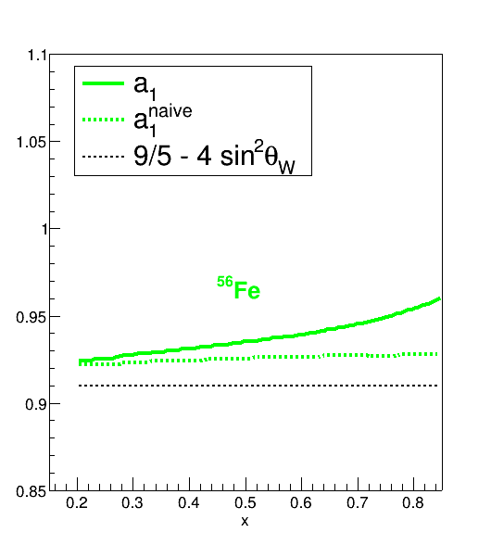
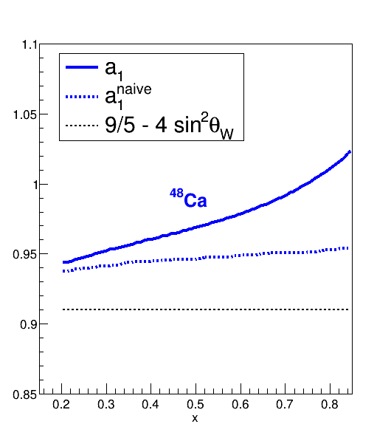
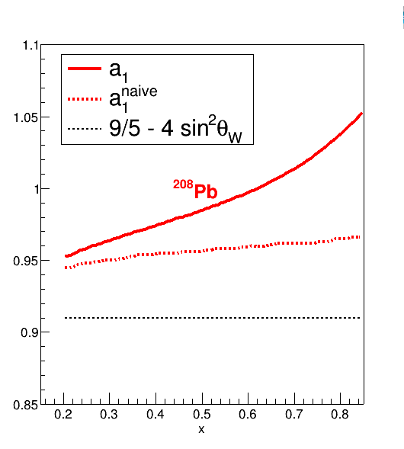
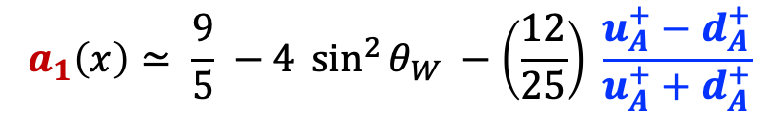
$a_{1}\left(x\right)$ for Nuclei
Cloët et al., PRL 109, 182301 (2012)
Cloët et al., PRL 102, 252301 (2009)
$$a_{1}\left(x\right)≃ \frac{9}{5} −4 \sin^{2}{θ_{W}} −\left(\frac{12}{25}\right) \frac{u_{A}^{+}−d_{A}^{+}}{u_{A}^{+}+d_{A}^{+}}$$

Slide 16
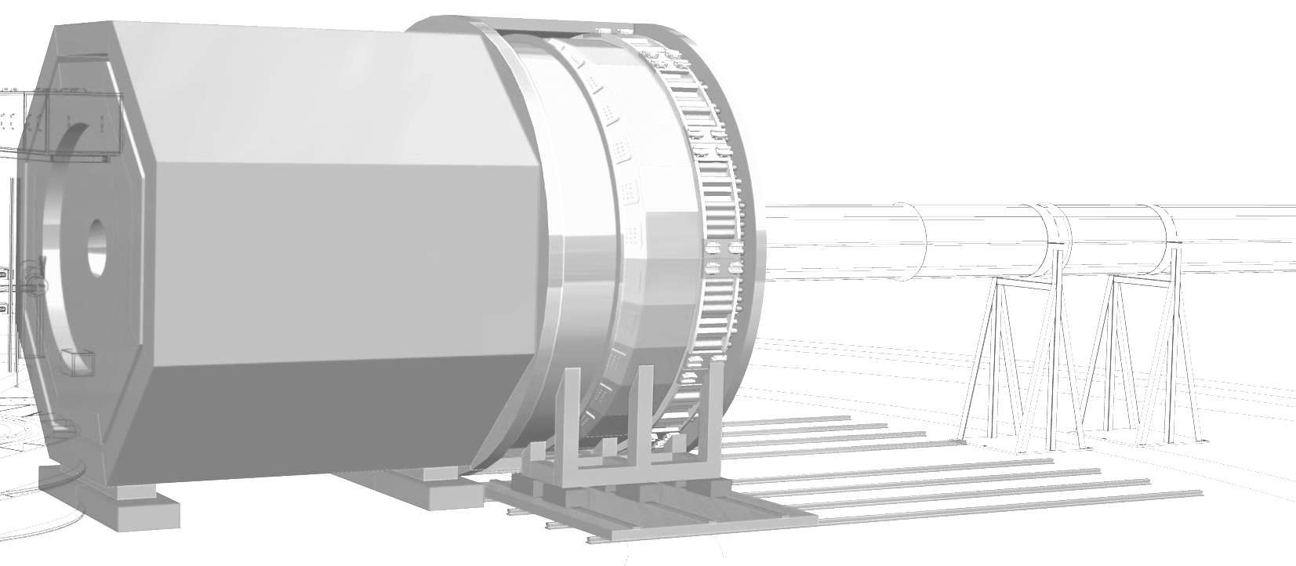
SoLID – The Next-Gen Spectrometer at JLab
Solid
  Solenoidal Large Intensity Device
Rich physics program including
  SIDIS
  J/𝜓 production
  Parity Violation
For an overview, see
White Paper arXiv:2209.13357

Slide 17
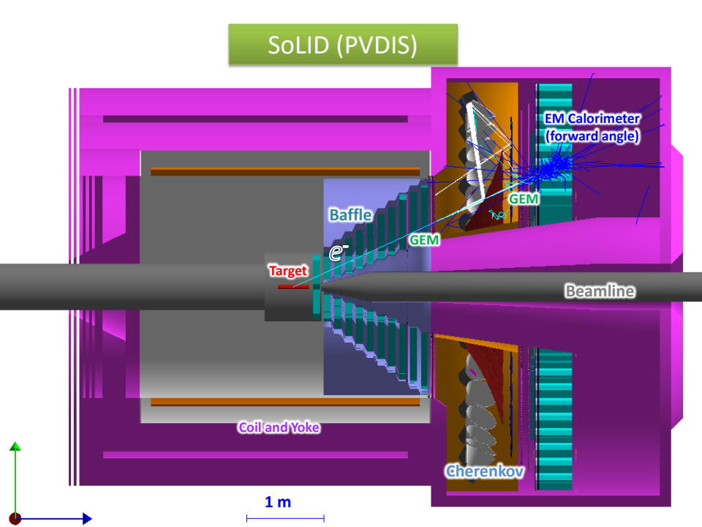
SoLID Apparatus for PVDIS
What do you need for to measure parity violation in DIS?
DIS experiment: W² > 4 GeV² Isolate DIS events. Only electron is detected.
PV experiment: High Luminosity, E ~ 11 GeV, stable systematics
What do you need to address the physics?
Wide x-range: 0.25-0.75
Large azimuthal acceptance.
Better than 1% statistical errors for small bins
2 GeV < E’< 6 GeV: Low background
Around 2% Momentum resolution

Slide 18
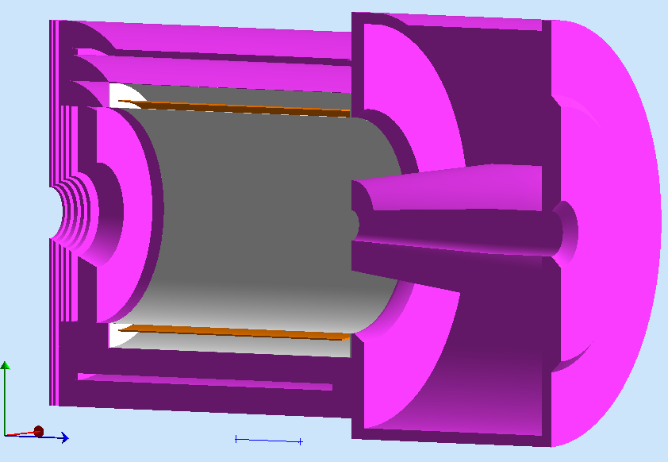
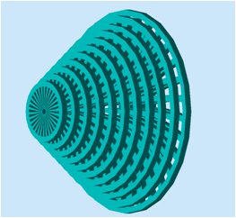
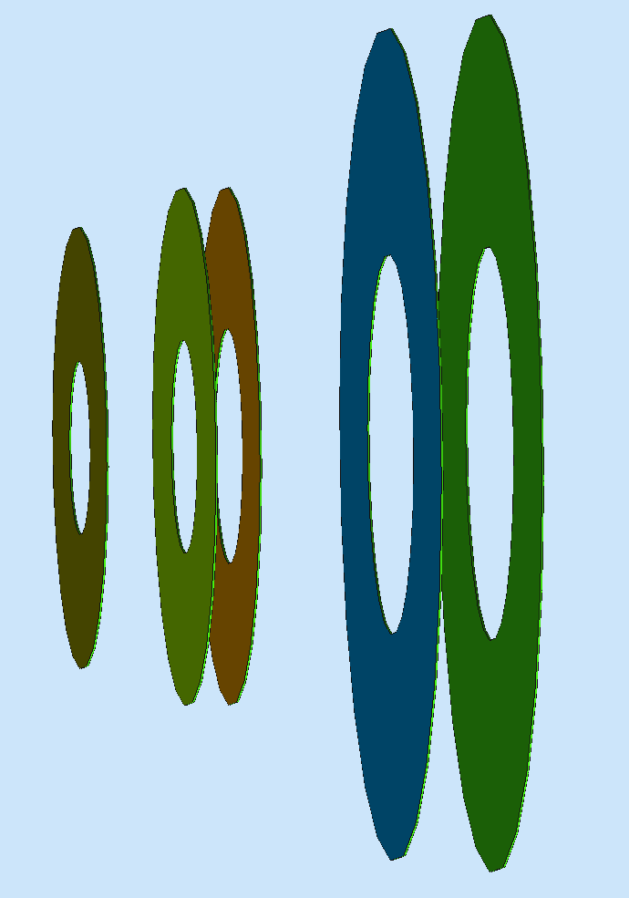
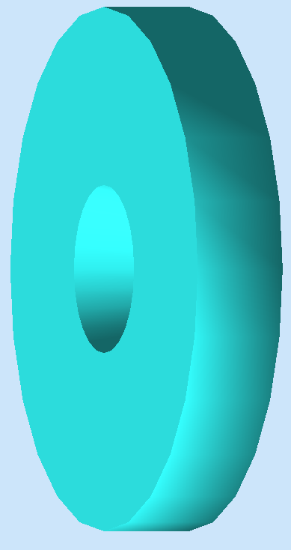
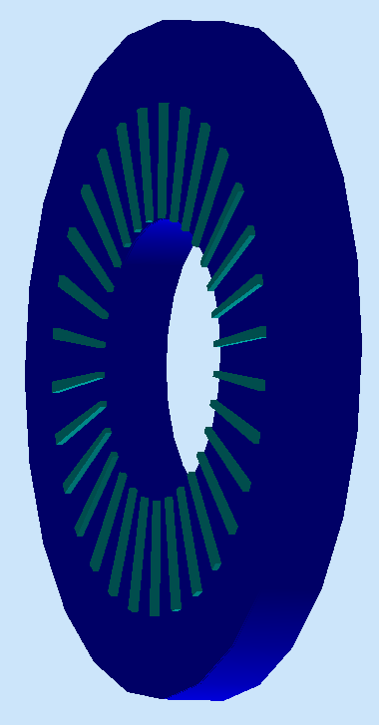
SoLID Apparatus
Baffles to reject wrong momentum background
Light Gas Cerekkov: identify electrons for trigger; reject pions.
Shashlyk electromagnetic calorimeter (Ecal) : coincident trigger and further particle identification.
With tracking, tight E/p cuts reduce pion backgrounds.
Baffle 5xGEMs EC
LGC

Slide 19
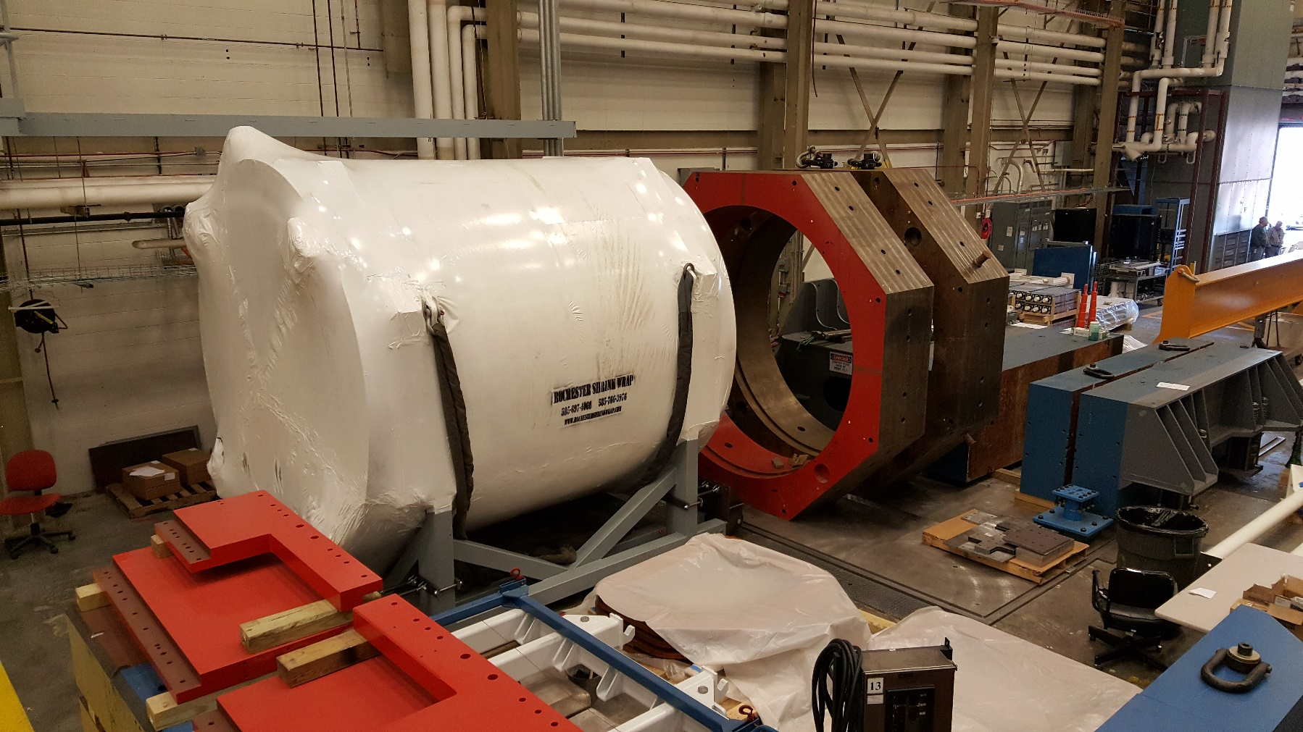
Latest – CLEO-II Magnet Cold Test at JLab

Slide 20
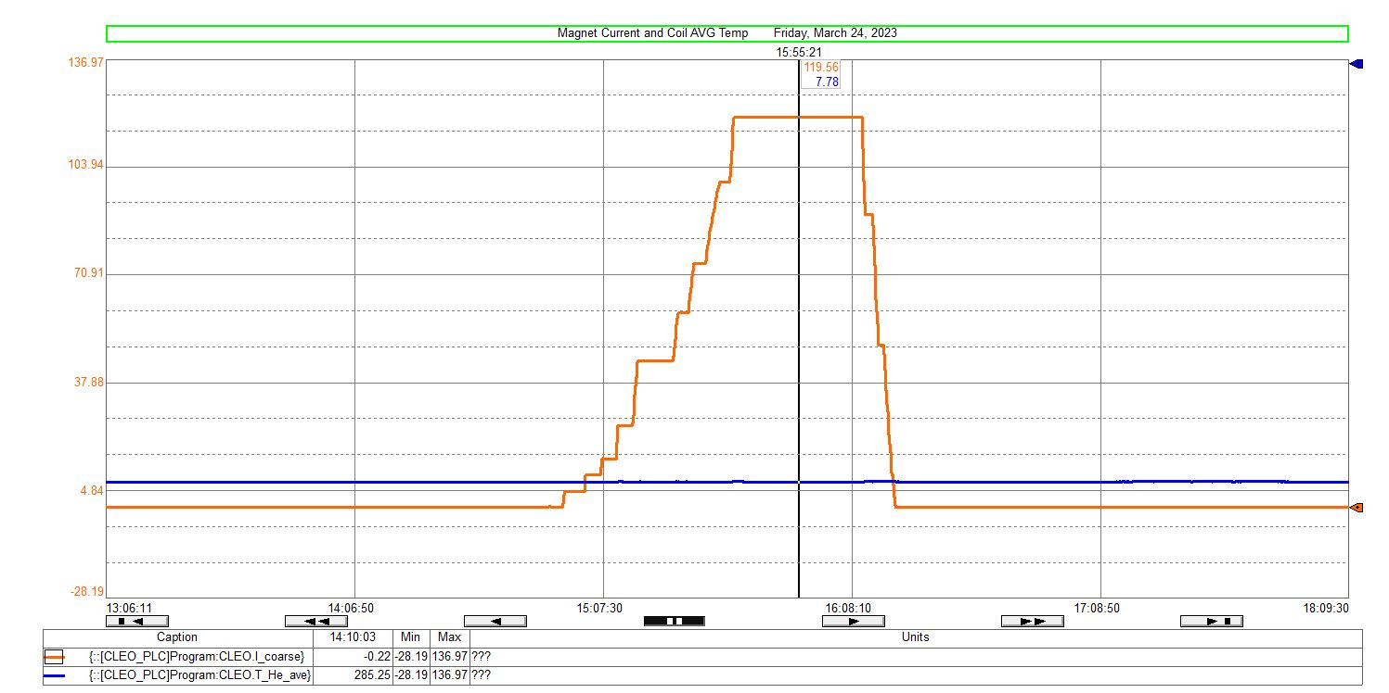
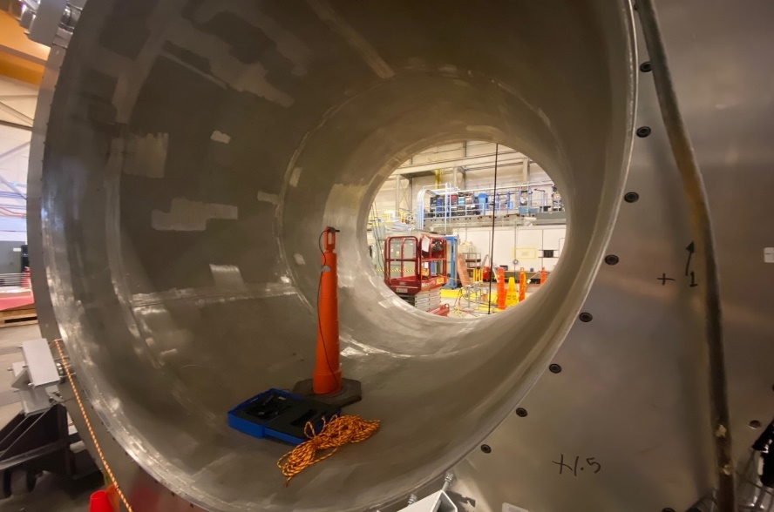
Latest – CLEO-II Magnet Cold Test at JLab
A low current test on March 24th.
3-axis Hall probe data matched TOSCA model well.
Coil average temperature remained constant during test.
Success!!
content from W. Seay and X. Zheng

Slide 21
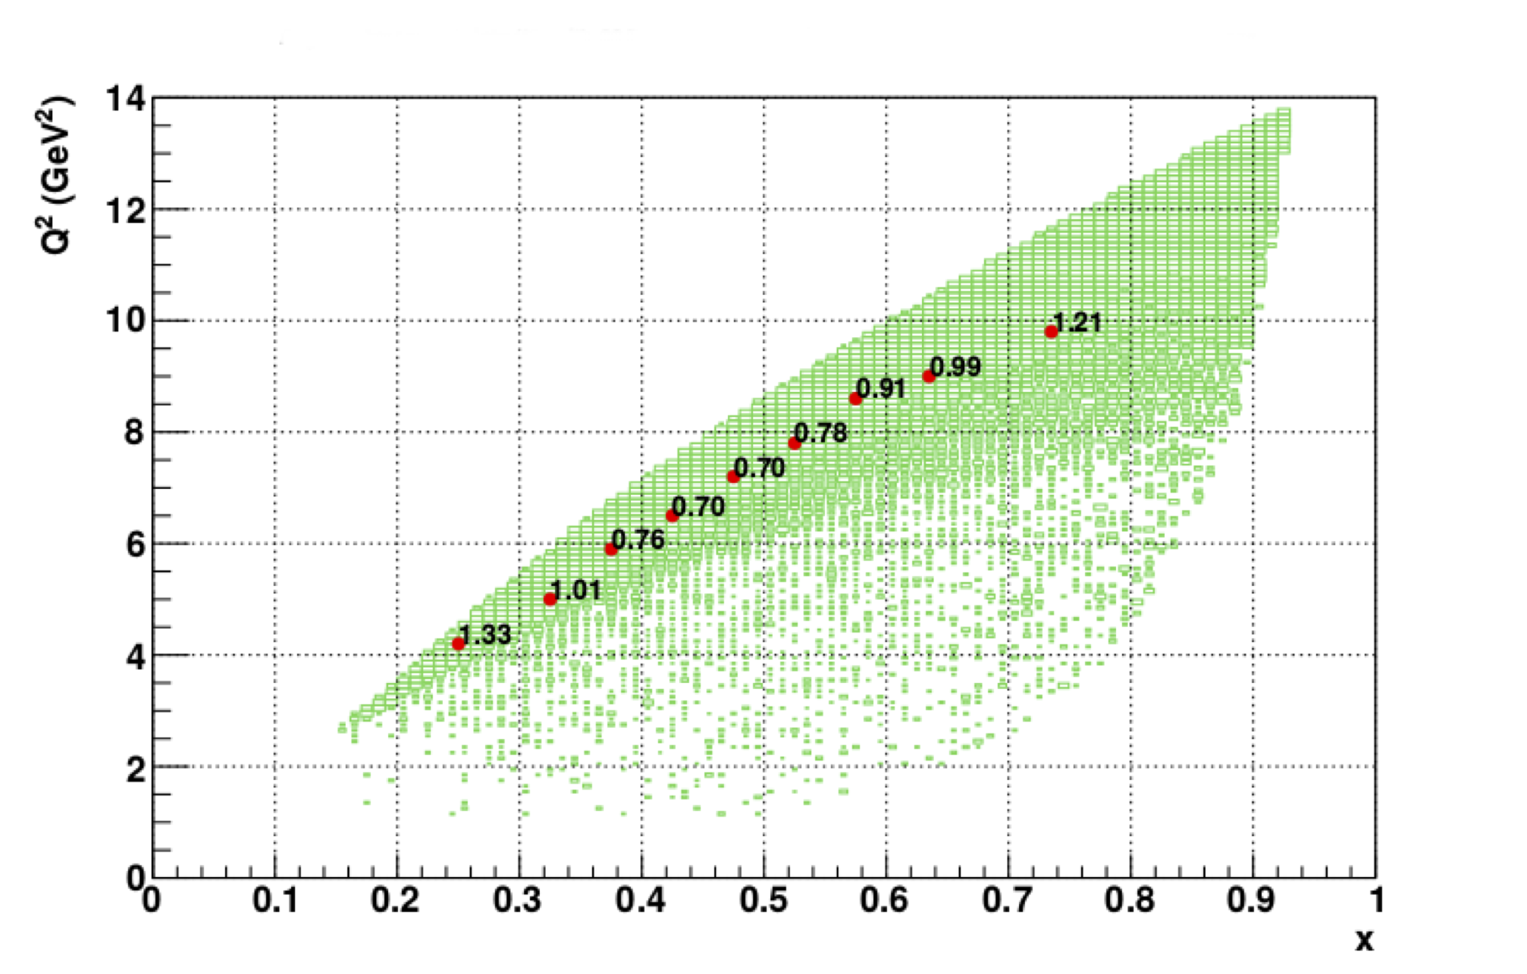
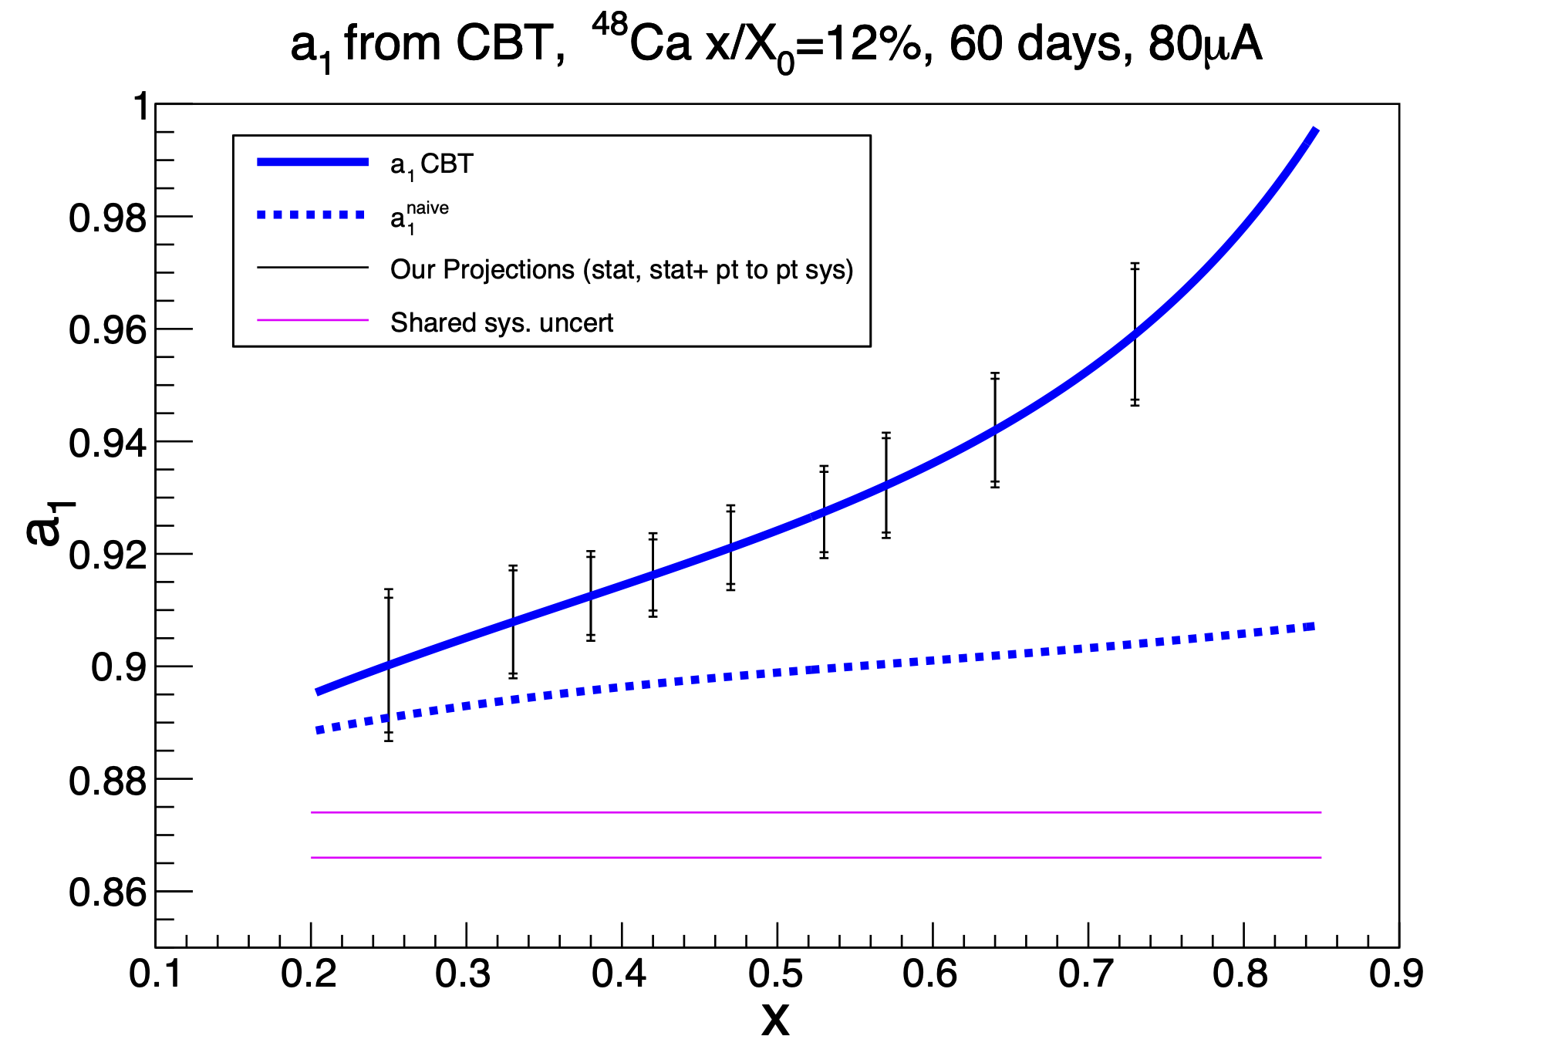
Expected Results

Slide 22
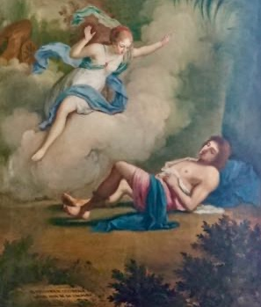
Expected Results

Slide 23

Probing the EMC Effect
What we know:
Parton distributions in nuclei appear different than those in nucleons
$$R_{A}\left(x, Q^{2}\right)= \frac{F_{2A}\left(x,Q^{2}\right)}{ZF_{2p}\left(x,Q^{2}\right)+NF_{2n}\left(x,Q^{2}\right)}≠1$$
What we don’t know:
Why does the effect exist at all?
Is the sea quark effect absent?
  c.f. Alde et al., (Fermilab E772) Phys. Rev. Lett. 64 2479 (1990),
  SeaQuest D-Y data
  Alvioli, Strikman, Phys.Lett.B 841 (2023) 137935
Alde et al (Fermilab E772)
Phys. Rev. Lett. 64 2479 (1990)

Slide 24
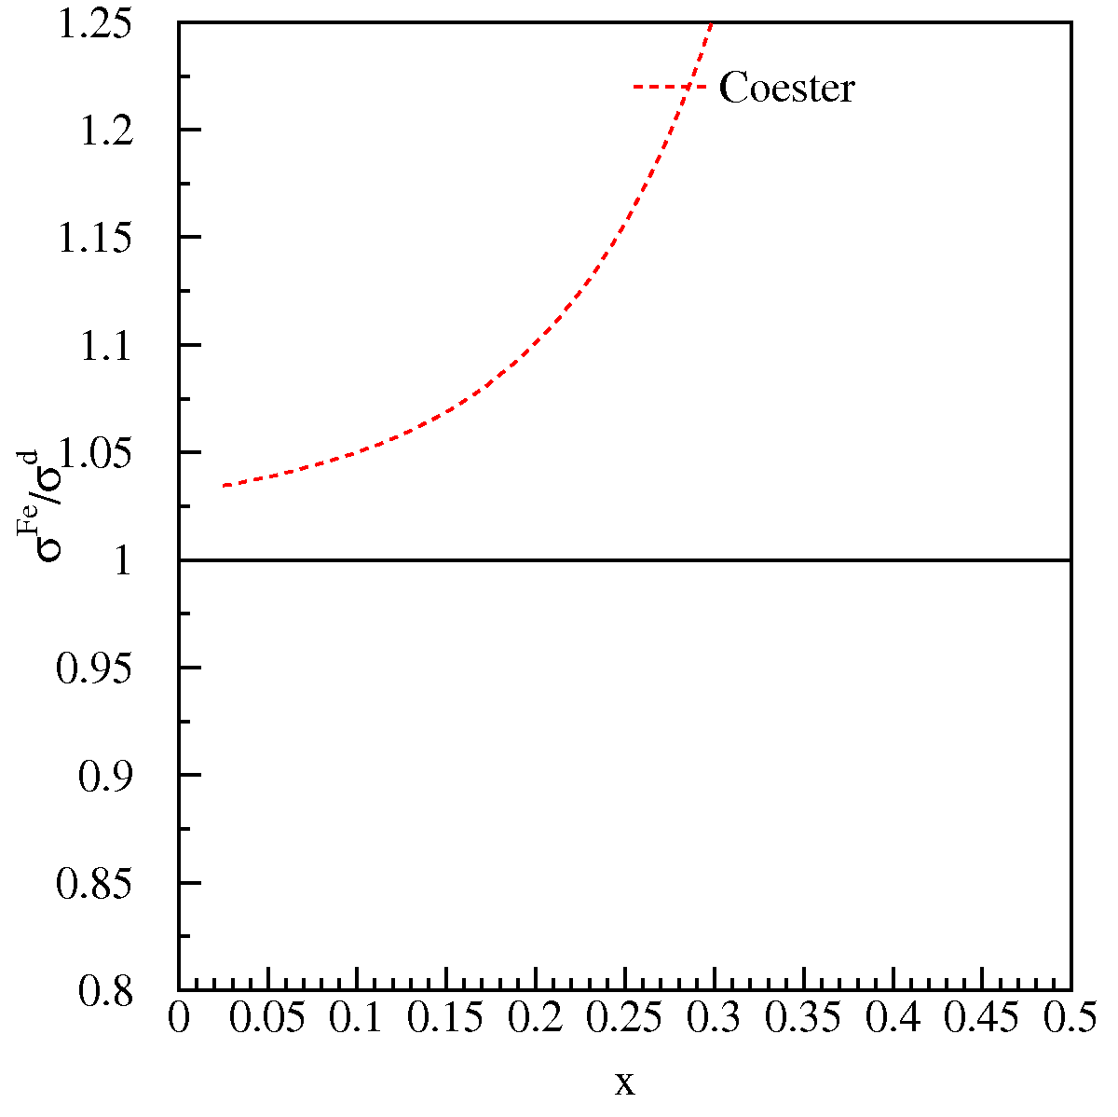
EMC Effect With Anti Quarks?
Expectations of large antiquark effects

Slide 25
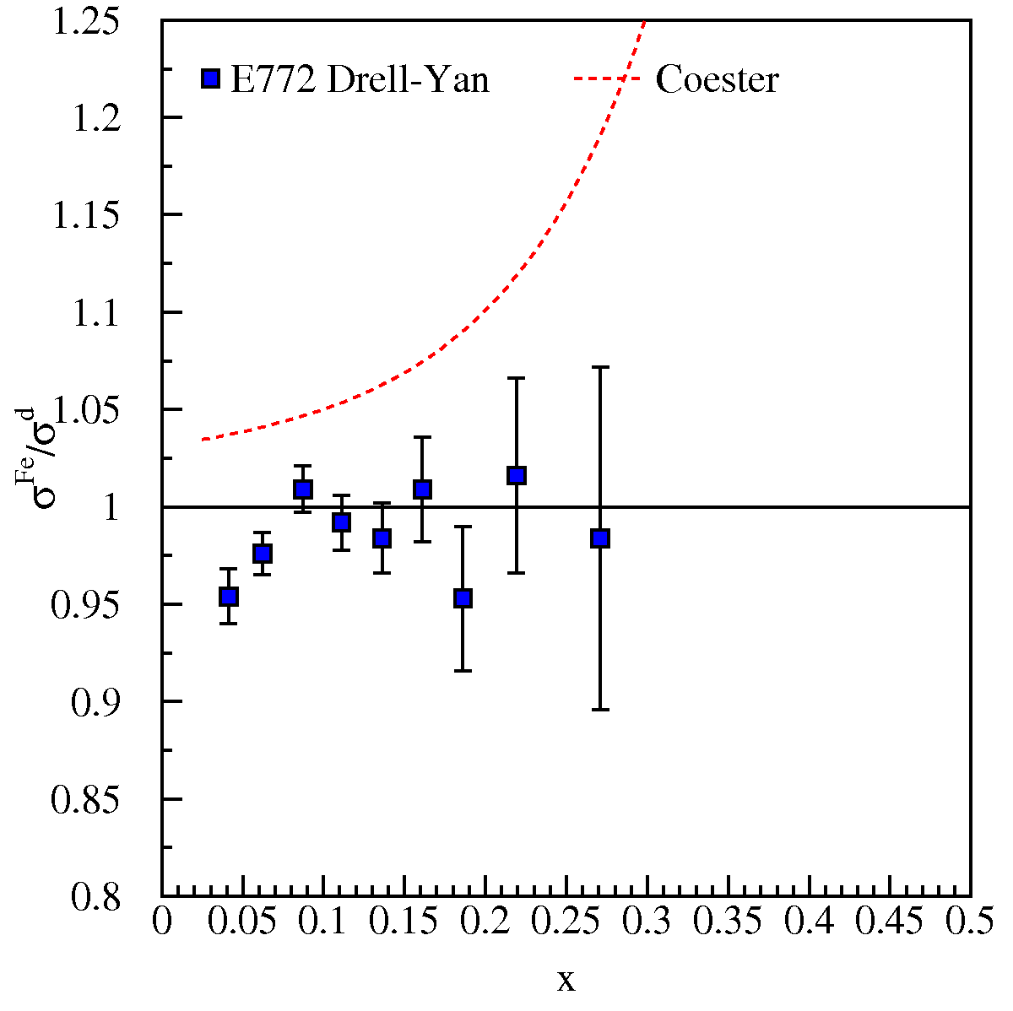
EMC Effect With Anti Quarks?
Expectations of large antiquark effects
No effects were seen in Drell-Yan
Alde et al. (Fermilab E772) Phys. Rev. Lett. 64 2479 (1990)

Slide 26
EMC Effect With Anti Quarks?
Expectations of large antiquark effects
No effects were seen in Drell-Yan
Contemporary models predict more modest effects at large x_{Bj}

Slide 27
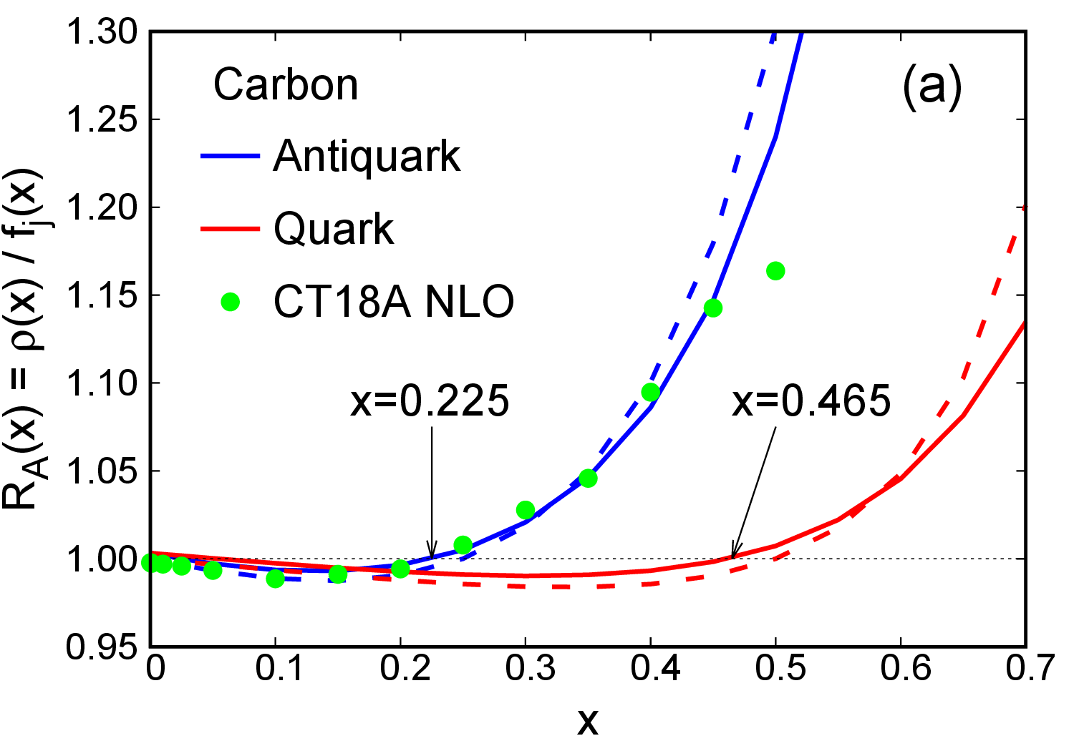
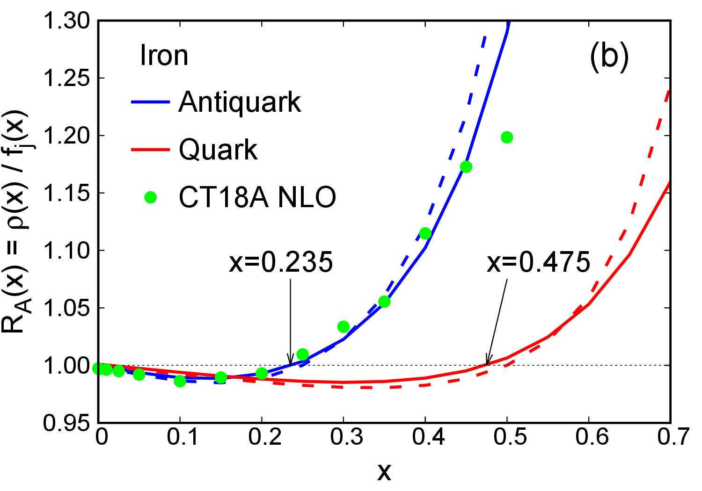
Effects of Fermi Motion
(See M. Strikman—Tuesday)
Phys.Lett.B 841 (2023) 137935

Slide 28
Effects of Fermi Motion
(See M. Strikman—Tuesday)
Phys.Lett.B 841 (2023) 137935

Slide 29
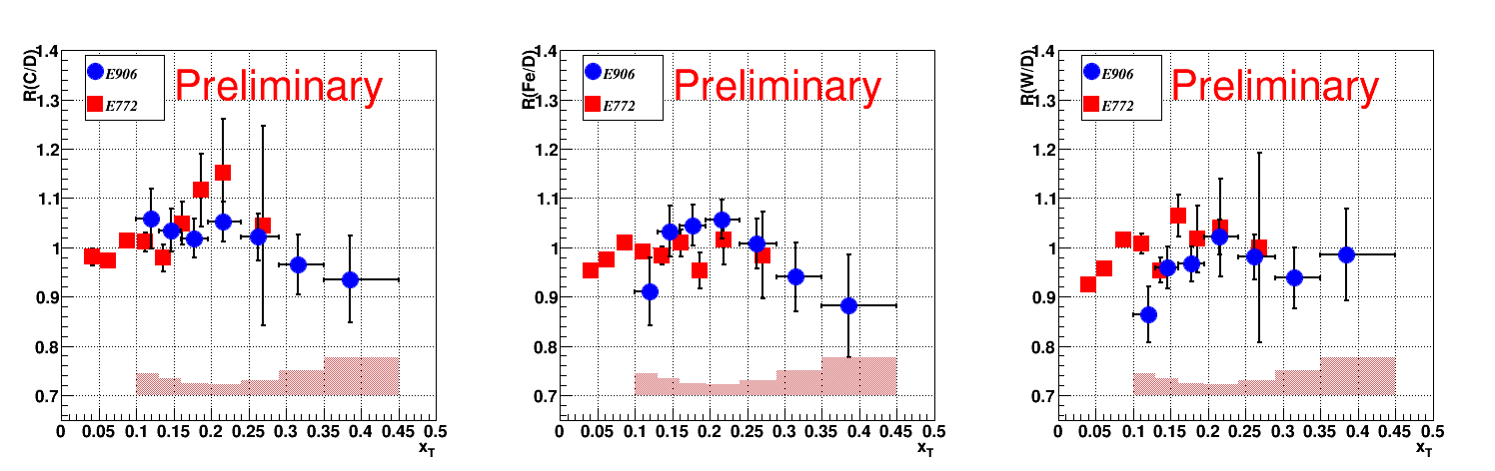
SeaQuest EMC Nuclear Dependence
*E772 systematics not shown
Data are subject to revision—Preliminary!
No enhancement seen as in the case of a pion excess model
In agreement with E772 results in the overlap region

Slide 30
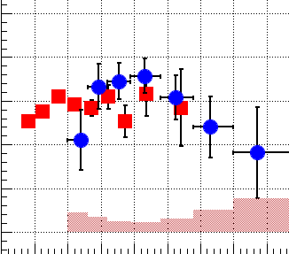
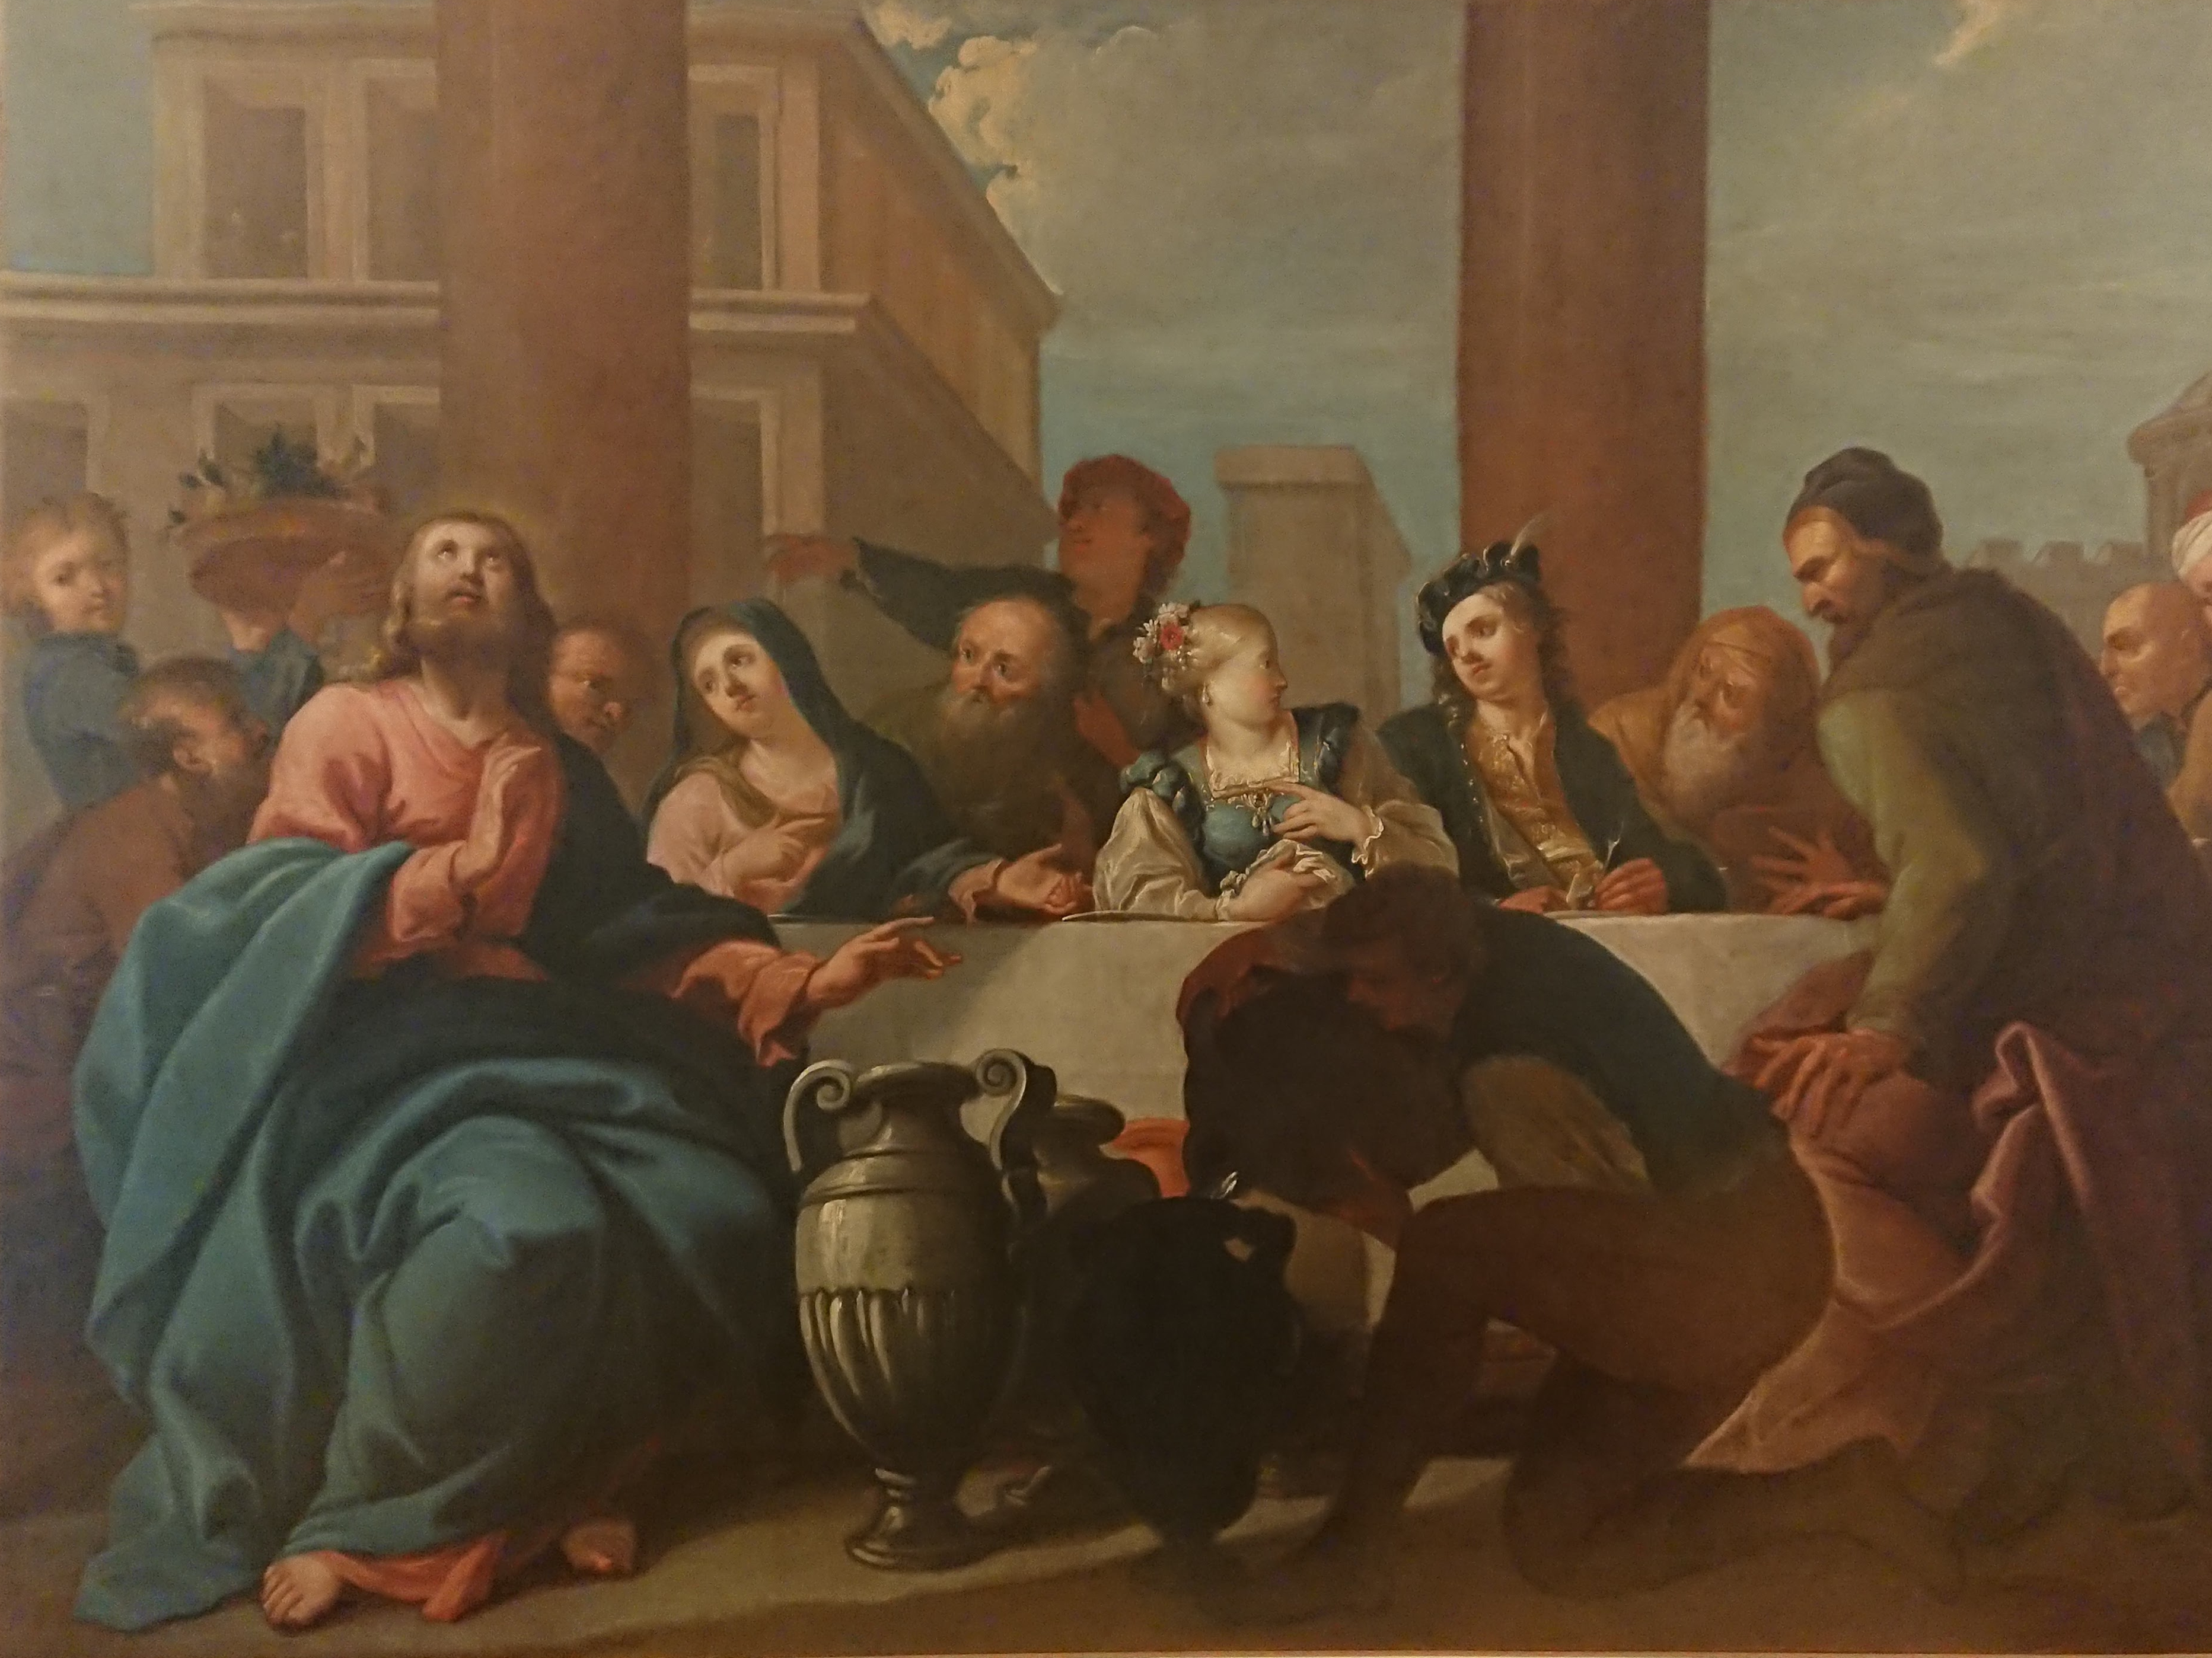

Slide 31
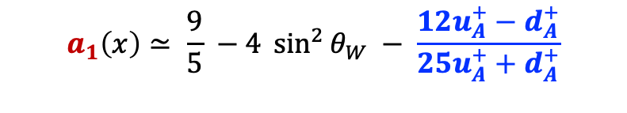
Recap
Parity violation in DIS enables electroweak and QCD exploration
$$a_{1}\left(x\right)≃ \frac{9}{5} −4 \sin^{2}{θ_{W}} − \frac{12u_{A}^{+}−d_{A}^{+}}{25u_{A}^{+}+d_{A}^{+}}$$
Baffle 5xGEMs EC
LGC

Slide 32
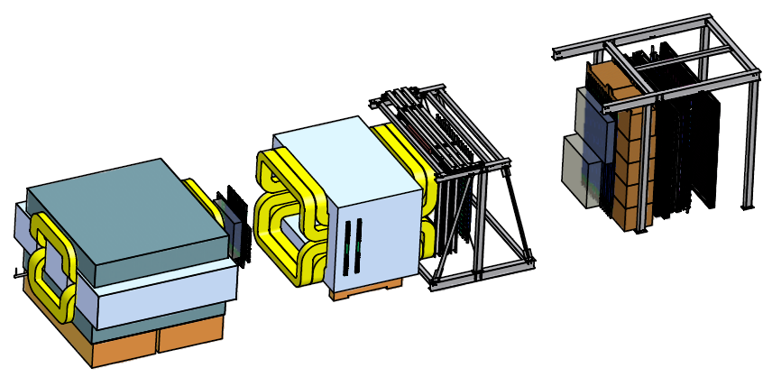
Recap
Drell-Yan looking for Sea Quark nuclear effects
Can different nuclear effects be resolved:
  quark energy loss
  EMC
  Fermi motion

Slide 33

$$A_{PV}^{eDIS}=\frac{σ^{e}−σ^{l}}{σ^{e}+σ^{l}}$$
= $2\frac{sy}{M_{Z}^{2}}\frac{g_{A}^{e}\sum{Q_{A}^{q}g_{V}^{q}\left[q\left(x\right)+ \overline{q}(x)\right]}\left[1+{\left(1−y\right)}^{2}\right]+g_{V}^{e}\sum{Q_{A}^{q}g_{A}^{q}\left[q\left(x\right)− \overline{q}(x)\right]}\left[1−{\left(1−y\right)}^{2}\right]}{Q_{A}^{e}\sum{{\left(2Q_{A}^{q}\right)}^{2}\left[q\left(x\right)+ \overline{q}(x)\right]\left[1+{\left(1−y\right)}^{2}\right]}}$
$≈ \frac{3}{20πα(Q)}\frac{Q^2}{ν}\left[\left(2g_{AV}^{eu}− g_{AV}^{ed}\right)+\left(2g_{VA}^{eu}− g_{VA}^{ed}\right)\left(\frac{1−{\left(1−y\right)}^{2}}{1+{\left(1−y\right)}^{2}}\right)\right]$

Slide 34
Why use Parity Violation?
⁴⁸Ca/⁴⁰Ca ratio (E12-10-008)
³H/³He (MARARHON)
  more sensitive to neutron structure function than flavor dependence
π⁺/π⁻ from ³H/³He (12-21-004 Hall B)
  Conditional approval
  PAC “The physics programme is very rich, but the extraction of the underlying physics observables is very challenging”
No Flav. Dep.
Cloët
Common Syst.

Slide 35

Possible Lepto-Phobic Z’; Example at lower energy
Motivation for introducing new particle:
C2
Baryon number is a global symmetry in the SM (bad).
Theories of local baryon number symmetry are attractive.
They predict a lepto-phobic boson.
They also predict a dark matter candidate.
$$A\sim \frac{(gB)2}{\left(MZ^{′}\right)2}$$
Perez, Phys. Rept. 597, (2015) 1-30
Modifies mainly C₂’s
in PVES
Perez, et al.,
JHEP 07 (2020) 087
Limits depend on branching ratios.
Plot shows that the LHC is interested in Leptophobics

