Slide 1
DNP @ UNH: Vector and Tensor Polarization Extraction from Line-Shape Analysis
Michael McClellan
Department of Physics, University of New Hampshire, Durham, NH 03824

Slide 2
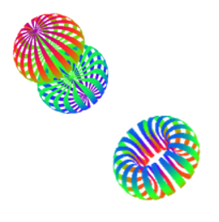
Background
Solid Polarized Target Group at UNH
developing dynamically polarized target
measure spin-structure & tensor spin observables
A_{ZZ}, T₂₀ and b₁
E. Long et al., C-12-15-005 PAC 44 (2016)

Slide 3
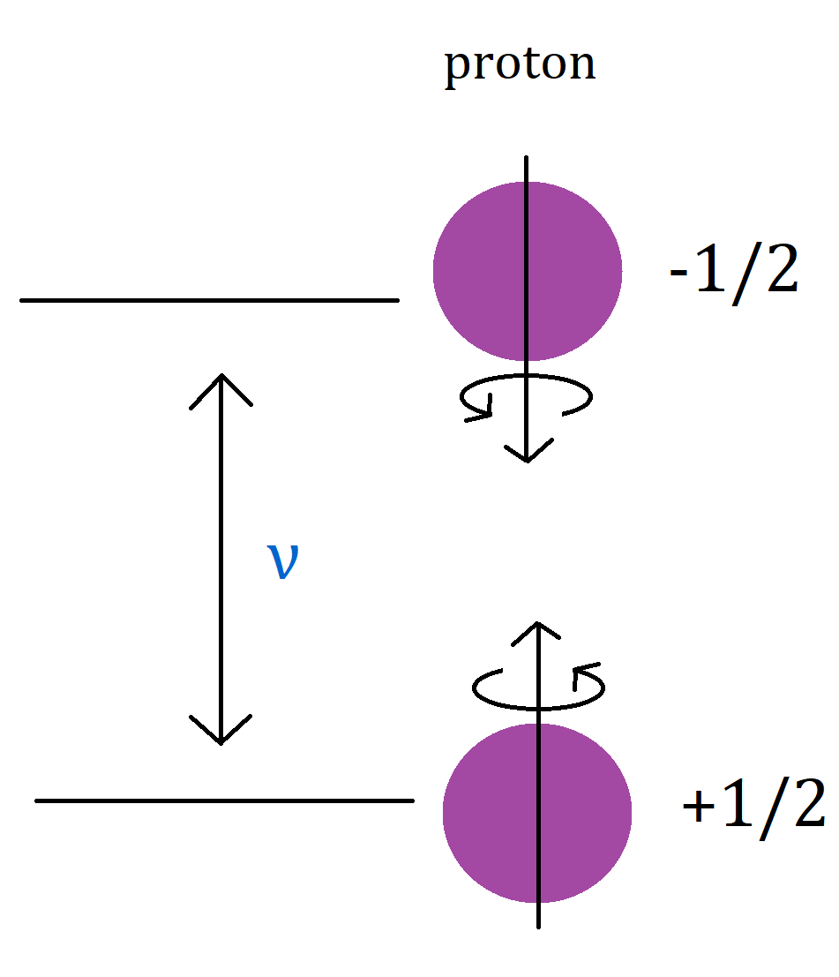
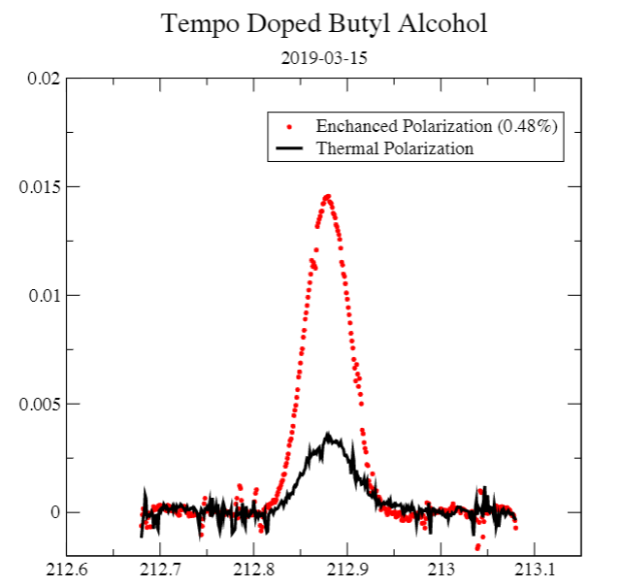
Proton Signals
Spin polarized protons: low T, high B → energy gap between spin states → uneven distribution
Thermal equilibrium (TE) signal – can be enhanced
Detectable through nuclear magnetic resonance (NMR)
Area under curve → % vector polarization (P_{Z})
One of our first signals!

Slide 4
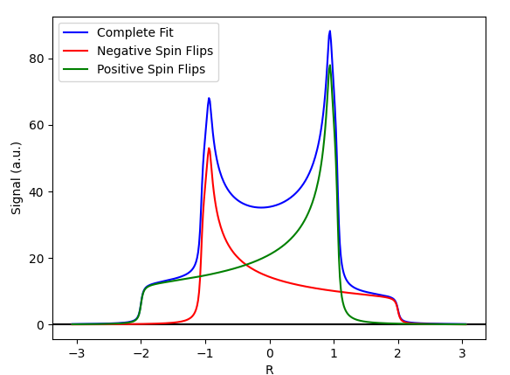
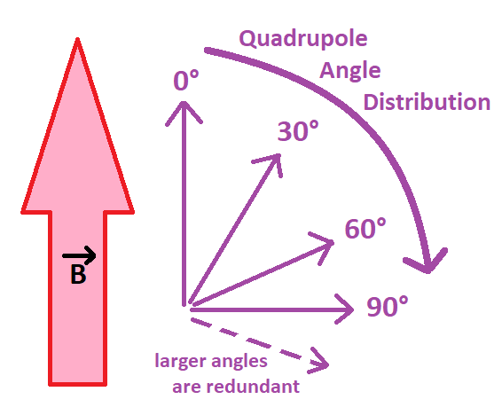
Deuteron Signals
Deuteron signal (with quadrupole splitting) more complex:
One curve for -1 → 0, another for 0 → +1 – sum gives P_{Z}, difference gives P_{ZZ}
Curves span quadrupole angle distrubtion, 0-90° (up to 180° doubles back)
Ideally, NMR signal would be compared to TE signal and scaled
TE integral is physical quantity dictated by B, T
At 5T & 1K: P_{Z} for deuteron ~ 0.08% - on level of noise for our lab

Slide 5
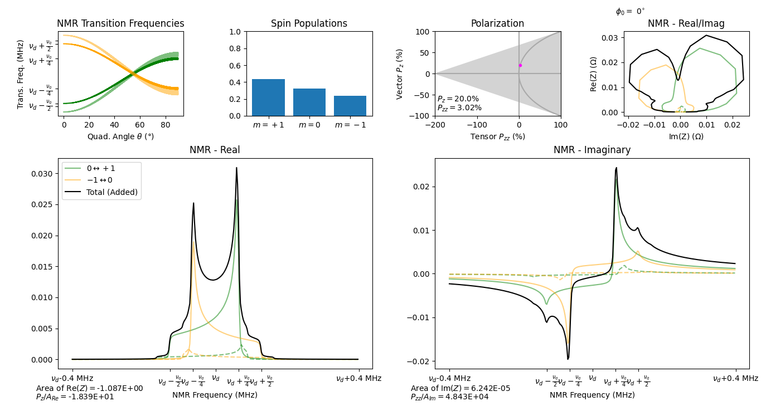
Simulating Spin Flips
Macro that directly simulates spin flips for a given polarization
Can use to explore new avenues for increasing P_{ZZ}
Plots from code by Elena Long, drawing on: M. H. Cohen et al., Solid State Physics 5, 321 (1957)

Slide 6
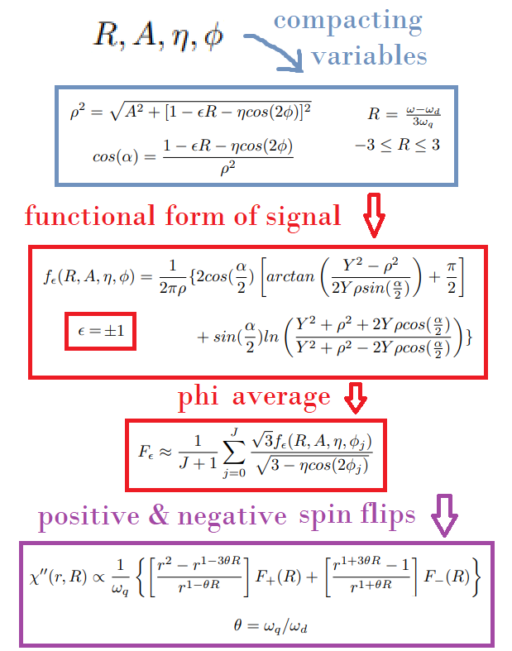
NMR Analysis
Without reliable TE, curve fit NMR lineshape to known formula from Dulya, et al.
At high P_{Z}, physical parameters can be extracted – B, T not required!
With parameters, curve fit for r across timespan for data taking
Naively, ratio of peak heights of signal
Instead of area method, r is used for ratio method to find both P_{Z} and P_{ZZ}
In materials with different bonds to deuterium (e.g. butanol – C and O bonds), set of curves for each bond type
C. Dulya et al., Nuclear Instruments and Methods in Physics Research A 398 (1997)

Slide 7
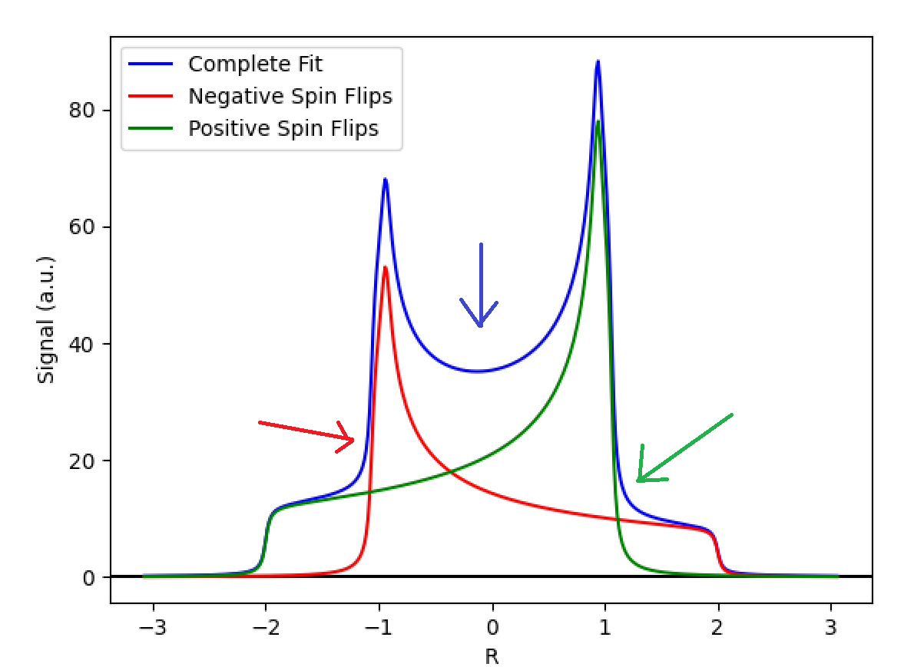
NMR Analysis
χ’’
F₊₁
F₋₁
C. Dulya et al., Nuclear Instruments and Methods in Physics Research A 398 (1997)

Slide 8
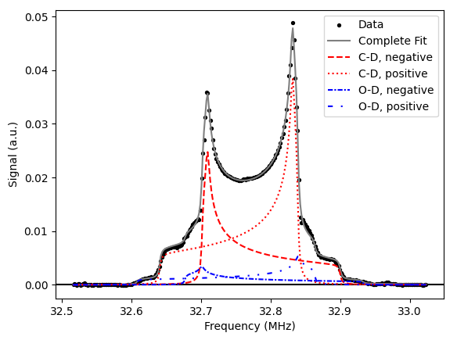
Data Analysis
Passing deuteron signal data through curve fitting routine based on Dulya yields good fit
Component spin-flip curves can be reconstructed from curve fitting parameters
Can perform both area and ratio methods!
Passing simulated data through routine extracts P_{Z} that agrees with input!
PRELIMINARY
P_{Z} = 28.2%
P_{ZZ} = 6.1%

Slide 9
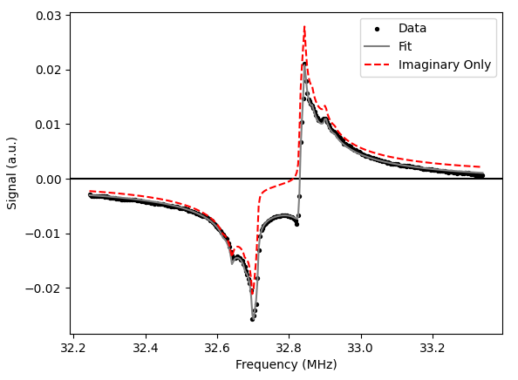
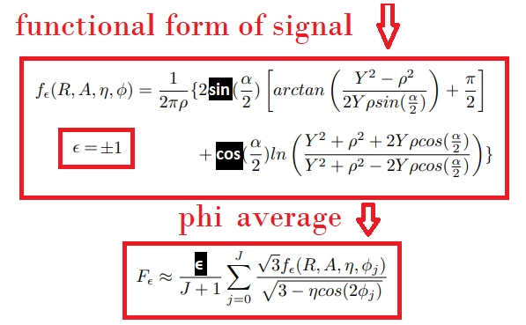
Real & Imaginary Analysis
Issue with Dulya – “false asymmetry” – seems artificial – why not just fit both real and imaginary parts of signal?
Two different parts to signal – absorptive and dispersive – rotate between through phase angle
Real = χ’’ cosθ - χ’ sinθ
Imag. = χ’’ sinθ + χ’ cosθ
Changes for dispersive:
PRELIMINARY

Slide 10
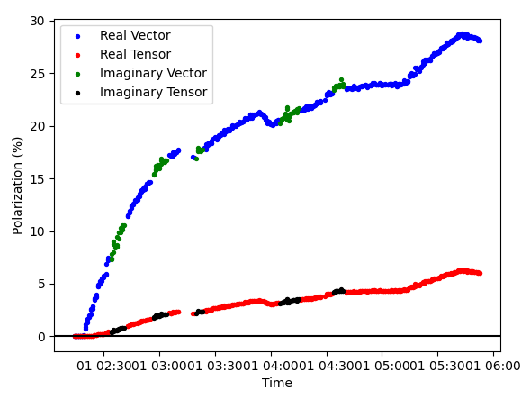
Real & Imaginary Analysis
Preliminary agreement between P_{Z} and P_{ZZ} taken from real and imaginary signals!
VERY PRELIMINARY

Slide 11
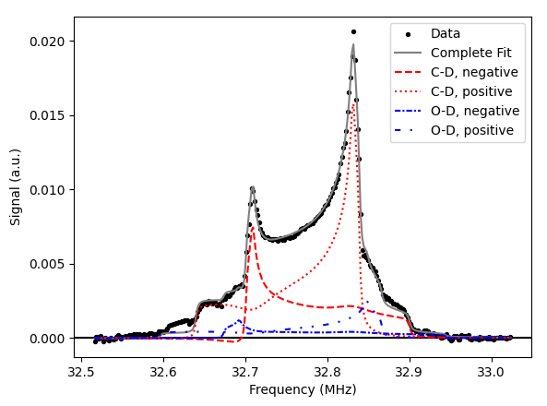
Increasing P_{ZZ}
Increasing P_{Z} via mm-wave enhancement naturally gives P_{ZZ}
Signal skews as it gets bigger
To increase further, can use hole-burning: separate solenoid fires at specific frequency to drive spin flips – increase area difference
Lose some P_{Z} but for A_{ZZ}, P_{ZZ} is more important
Other options:
Rotating target cup
Solid crystal of ND₃
PRELIMINARY

Slide 12
Future Goals
Reach P_{ZZ} of ~30% in deuterated ammonia
Continue with hole-burning
Use EPR to focus mm-wave frequencies
Add hole-burning to curve-fitting method – in progress!
Continue simulations:
Can component spin-flip signals be separated in frequency?
Reduce signal width by manipulating quadrupole angles in material

Slide 13
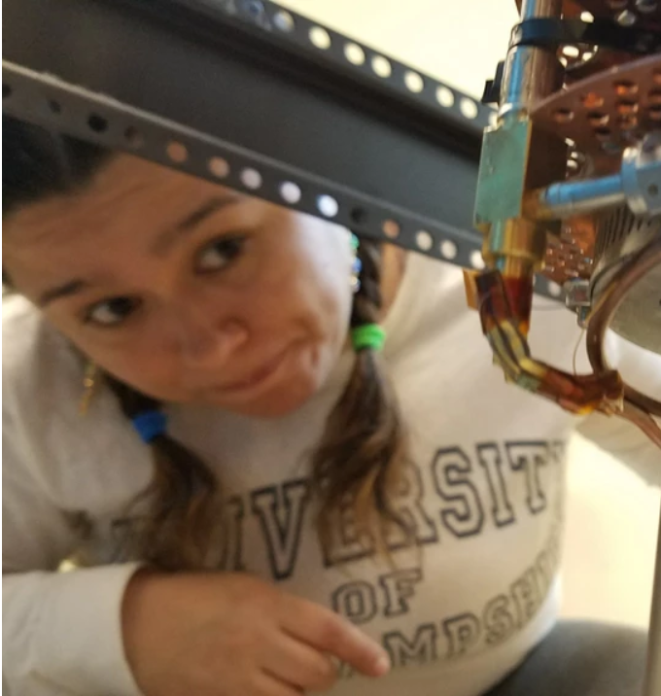
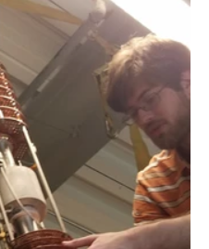
Acknowledgments
UNH DNP PIs:
Elena Long
Nathaly Santiesteban
Karl Slifer
UNH DNP collaborators:
Anchit Arora
David Ruth
Zoe Wolters
Allison Zec
This work is supported by the Dept. of Energy Grant DE-FG02-88ER40410.

Slide 14
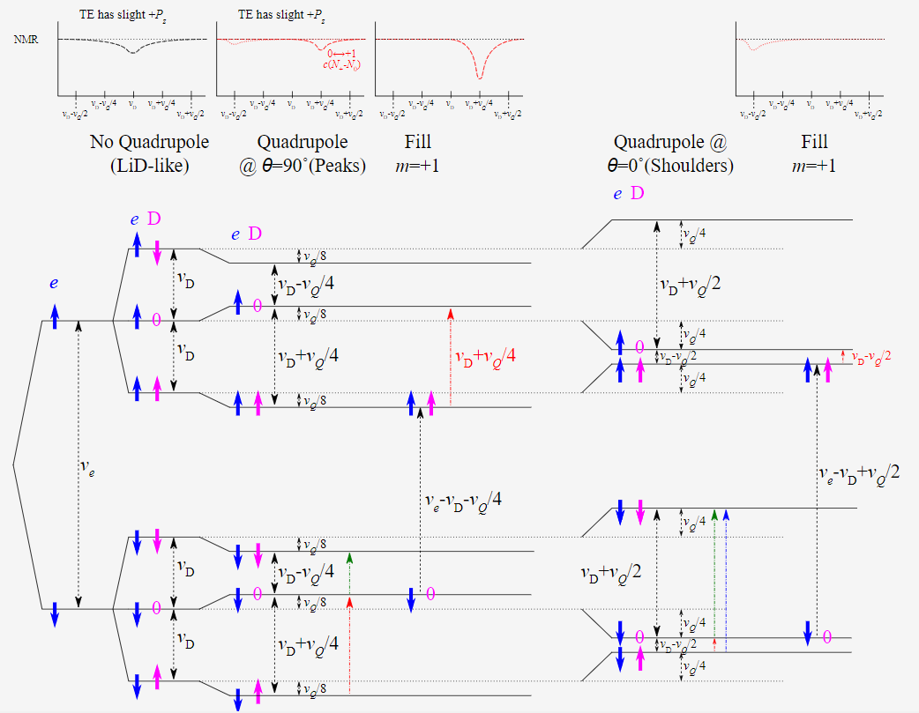
Deuteron-Electron Energy Levels

