Slide 1
along with an overview of the status of this DOE project
Technical Challenges of Spin at the EIC
Douglas W. Higinbotham
12 July 2023

Slide 2
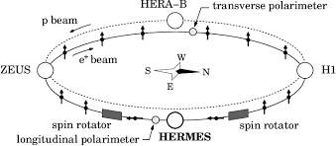
HERA
HERA (German: Hadron-Elektron-Ringanlage, English: Hadron-Electron Ring Accelerator) was a particle accelerator at DESY in Hamburg.
318 GeV center of mass energies: 27.5 GeV e, 920 GeV p
Electron-proton collider ran from 1992 – 2007
Electron polarization by Sokolov – Ternov effect.
Amazing machine and publications are still coming out from the data.
Luminosity and some design choices limited the physics reach which now naturally lead to next generation machine: the EIC.

Slide 3
October 2019 Review of Two Competing EIC Designs
For e-N collisions:
  Polarized beams: e, p, d/³He (effective neutron)
  e beam 5-10(20) GeV
  Luminosity ~ 10³³⁻³⁴ cm⁻²sec⁻¹
  100-1000 times HERA
  20-100 (140) GeV variable center of mass energy
For e-A collisions:
  Wide range in nuclei
  Luminosity per nucleon same as e-p
  Variable center of mass energy
JLEIC

Slide 4
Key Science Questions For The EIC To Answer
How do the nucleonic properties such as mass and spin emerge from partons and their underlying interactions?
How are partons inside the nucleon distributed in both momentum and position space?
How do color-charged quarks and gluons, and jets, interact with a nuclear medium? How do the confined hadronic states emerge from these quarks and gluons? How do the quark-gluon interactions create nuclear binding?
How does a dense nuclear environment affect the quarks and gluons, their correlations, and their interactions? What happens to the gluon density in nuclei? Does it saturate at high energy, giving rise to a gluonic matter with universal properties in all nuclei and even nucleons?
https://www.nap.edu/login.php?record_id=25171&page=https%3A%2F%2Fwww.nap.edu%2Fdownload%2F25171 and download as guest for a free copy of the National Academy of Science pdf

Slide 5
Critical Decision Process
PED: Project Engineering & Design

Slide 6
Site Selection & Intellectual Ownership of the Physics
CD0 was approved 19 Dec. 2019 with an announcement from the DOE department of energy on 9 Jan. 2020 https://www.energy.gov/articles/us-department-energy-selects-brookhaven-national-laboratory-host-major-new-nuclear-physics
While JLab scientists were understandably disappointed, Tim Hallman came here after site selection and encouraged them to continue to develop our intellectual ownership of the physics.
This idea really resonated with many of us and a very positive partnership and commitment to the EIC has taken root.
This commitment to the EIC was formalized with the BNL-JLAB Partnering Agreement, signed May 7, 2020.
Informally, this flourishing BNL-JLab partnership can be seen online almost day of the week at the numerous EIC meetings, workshops, and discussions.

Slide 7
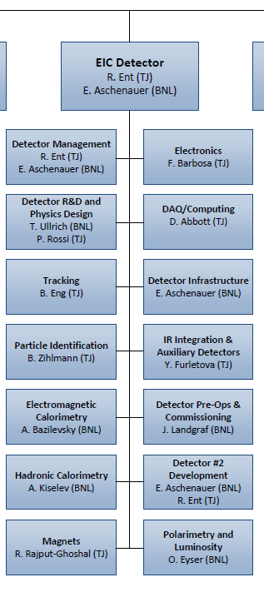
EIC Detector Project – joint JLab and BNL responsibility
Co-associate directors for Experimental Program: Rolf Ent (JLab) and Elke Aschenauer (BNL)
  6.10 Detectors
  6.10.01 Detector Management
  6.10.13 Detector #2 Development
We also heavily utilize Walt Akers (Jlab) who is a Systems Engineer
R&D scope has both a BNL and JLab person
  6.10.02 Detector R&D Thomas Ullrich (BNL), Patrizia Rossi (JLab)
Some scope has a BNL person
  6.10.05 EM Calorimetry Alexander Bazilevsky (BNL)
  6.10.06 Hadronic Calorimetry Alexander Kiselev (BNL)
  6.10.10 Detector Infrastructure Rahul Sharma (BNL)
  6.10.12 Detector Pre-Ops Elke Aschenauer – acting (BNL)
  6.10.14 Polarimetry & Luminosity Oleg Eyser (BNL)
  (L4 electron polarimetry is David Gaskell (JLab))
Some scope has a JLab person
  6.10.03 Tracking Brian Eng (JLab)
  6.10.04 Particle Identification Beni Zihlmann (JLab)
  6.10.07 Magnets Renuka Rajput-Ghoshal (JLab)
  6.10.08 Electronics Fernando Barbosa (JLab)
  6.10.09 DAQ/Computing David Abbott (JLab)
  6.10.11 IR Integration, Aux. Detectors Yulia Furletova (JLab)

Slide 8
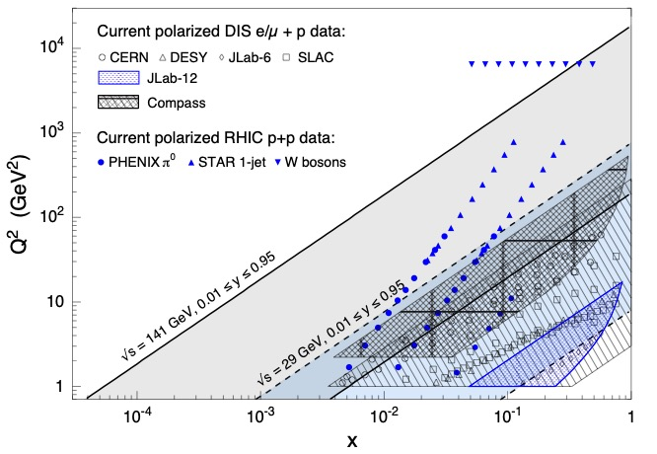
Kinematic Coverage Of The Electron Ion Collider
Q² is the Lorentz invariant four-momentum transfer and x = Q²/(2m(E-E’))
NOTE: Jefferson Lab is also very high luminosity >10³⁸ cm⁻²s⁻¹ while the proposed
EIC would be ~10³³ to 10³⁴ cm⁻²s⁻¹ so kinematic coverage alone isn’t the whole story!

Slide 9
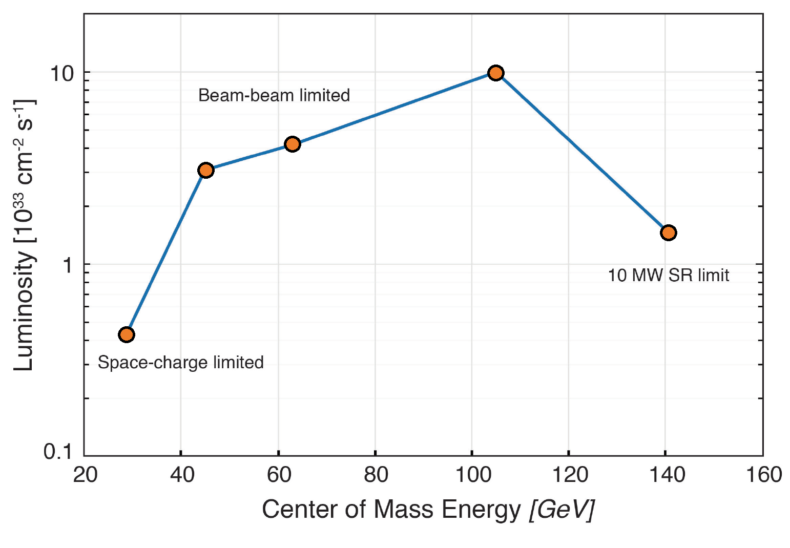
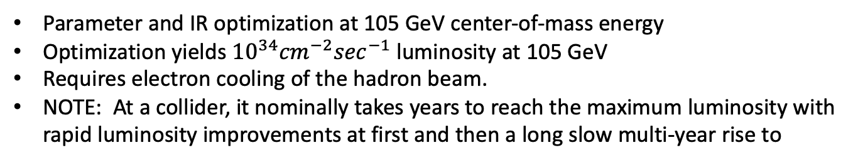
Luminosity vs Center of Mass Energy at the EIC
Parameter and IR optimization at 105 GeV center-of-mass energy
Optimization yields ${10}^{34}{cm}^{−2}\sec^{−1}$luminosity at 105 GeV
Requires electron cooling of the hadron beam.
NOTE: At a collider, it nominally takes years to reach the maximum luminosity with rapid luminosity improvements at first and then a long slow multi-year rise to

Slide 10
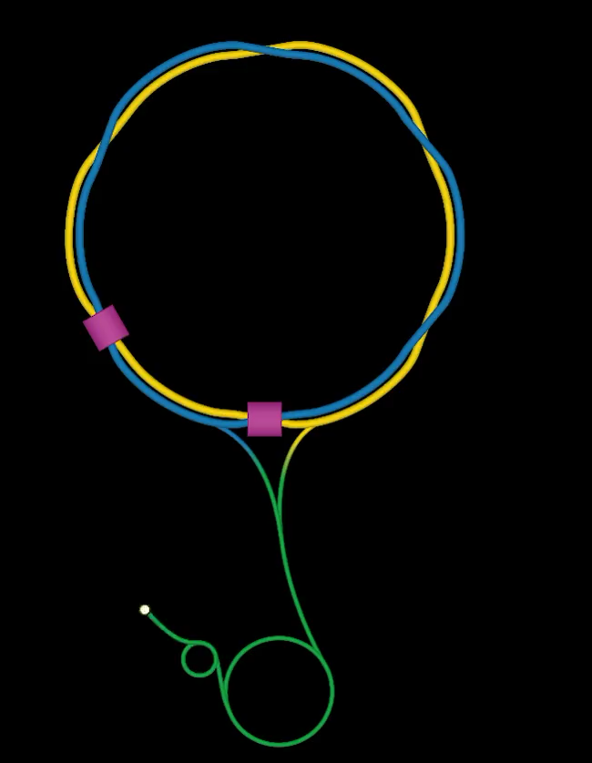
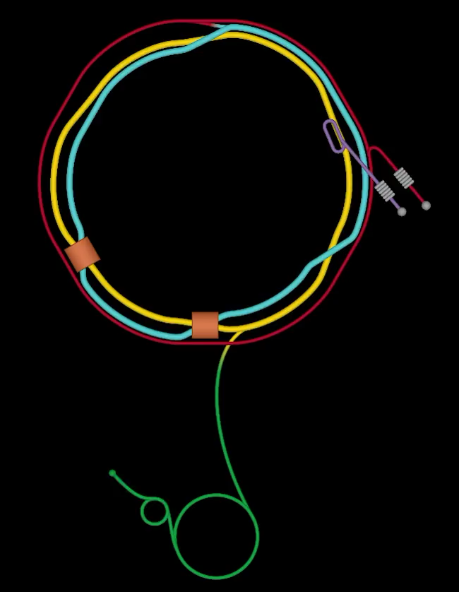
From RHIC to Electron Ion Collider

Slide 11
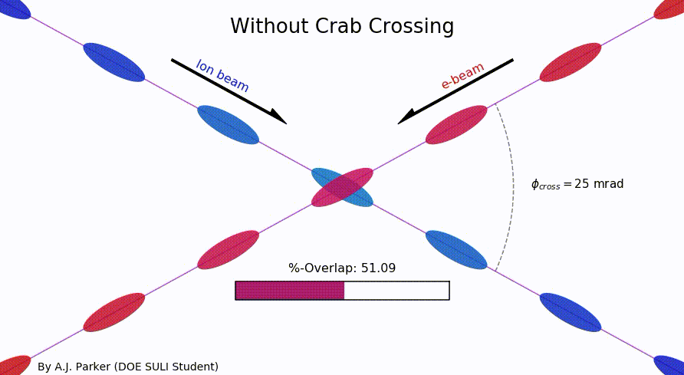
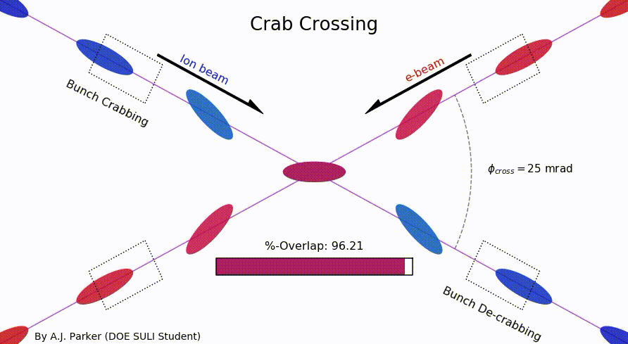
Visualization of The Colliding Beams
DOE SULI summer student Asia Parker (Duquesne University)
Showing how crab crossing increases the overlap of the beams
https://github.com/sherwberry/SULI2020_CrabCrossingAnimation

Slide 12
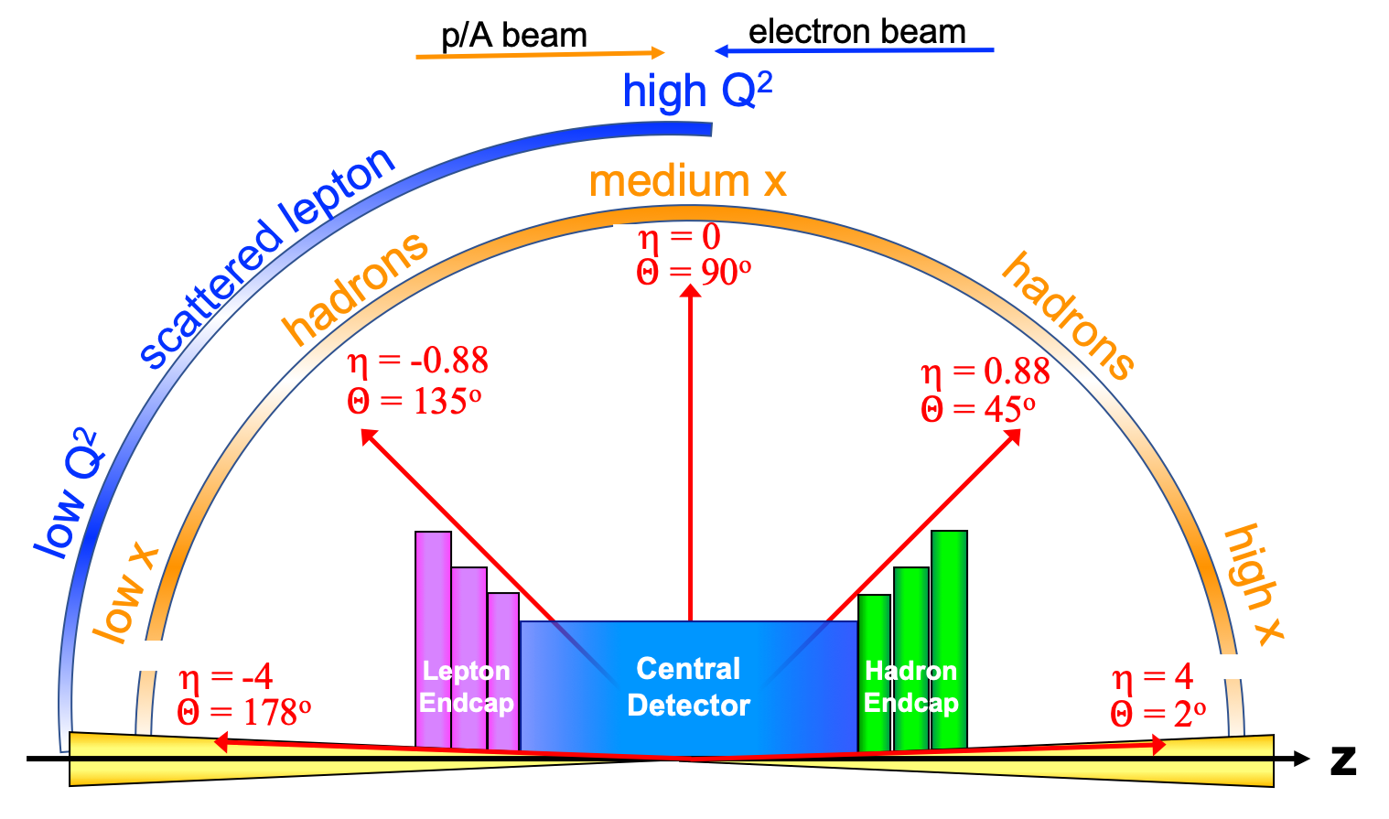
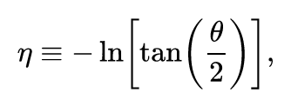
Detector polar angle / pseudo-rapidity coverage

Slide 13
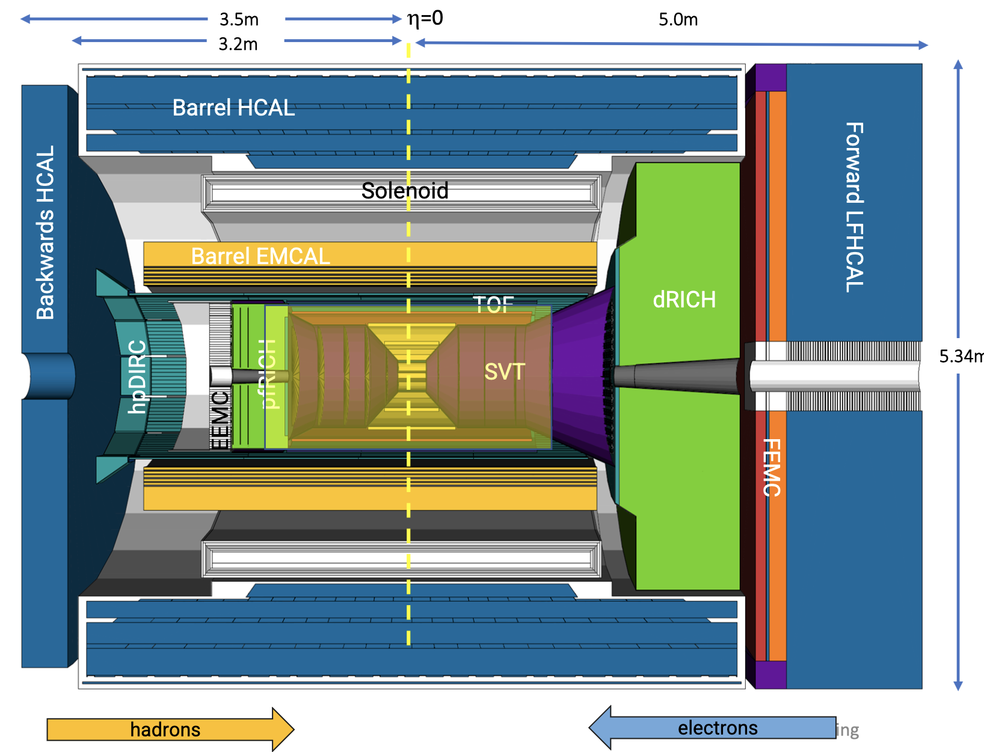
Current Layout (July 2023) of ePIC Detector System

Slide 14
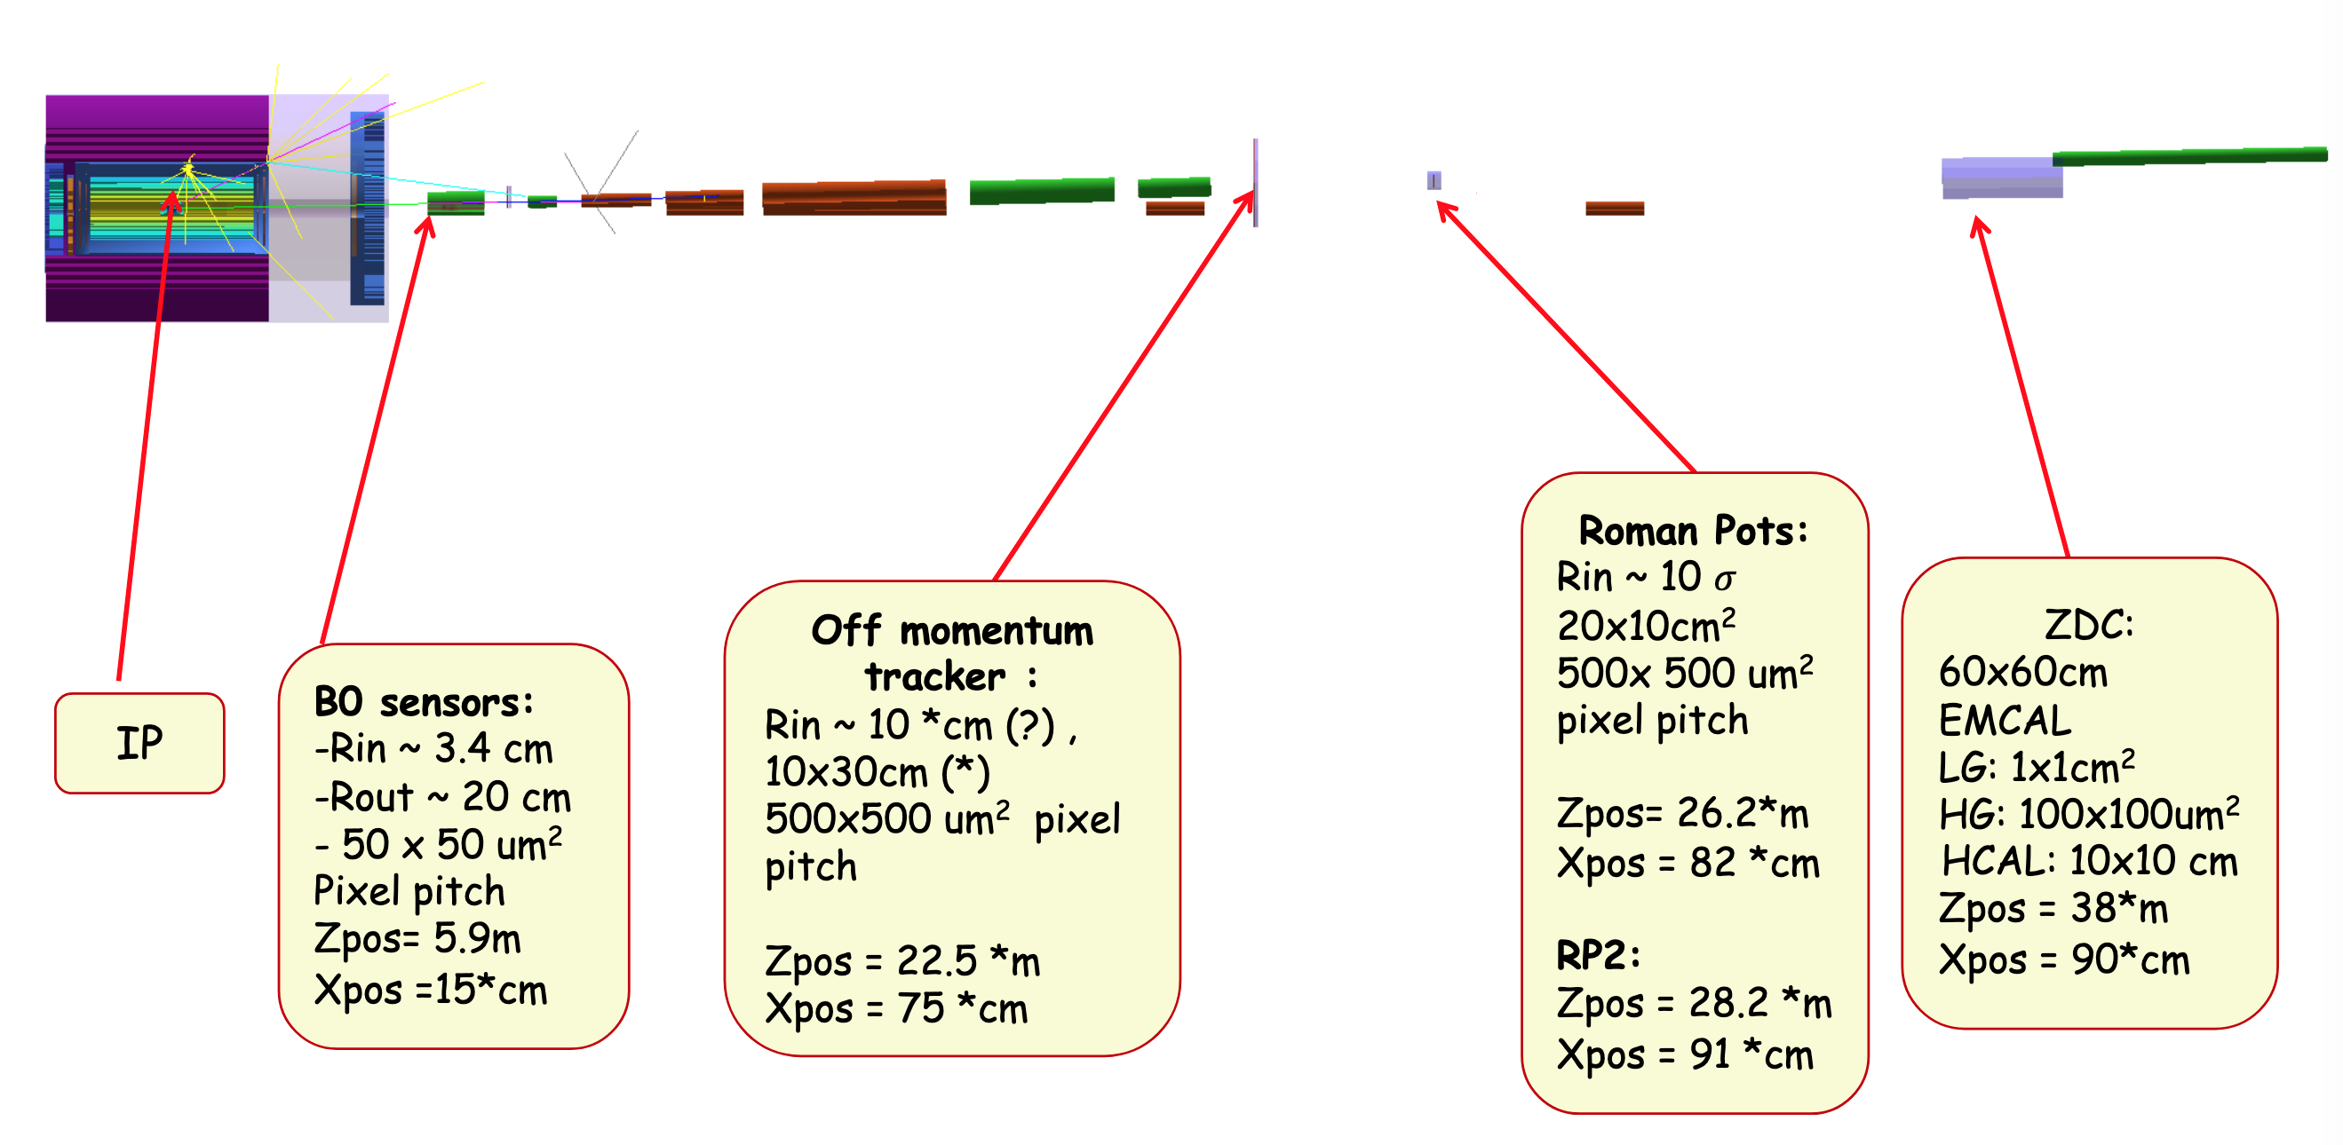
Far Forward Detection Systems ( my favorite part of the EIC)
Detectors located tens of meters from the main EIC detector and are small in size.

Slide 15

EIC Yellow Report
Posted to the arXiv on 8 March 2021:
https://arxiv.org/abs/2103.05419
902 pages, 415 authors, and 151 institutions
LaTeX Source Code On The arXiv
Now also published in a refereed journal:
Nucl.Phys.A 1026 (2022) 122447
As of 12 July 2023 has 574 citations.
The document is broken into three volumes:
Executive Summary
Physics
Detectors

Slide 16
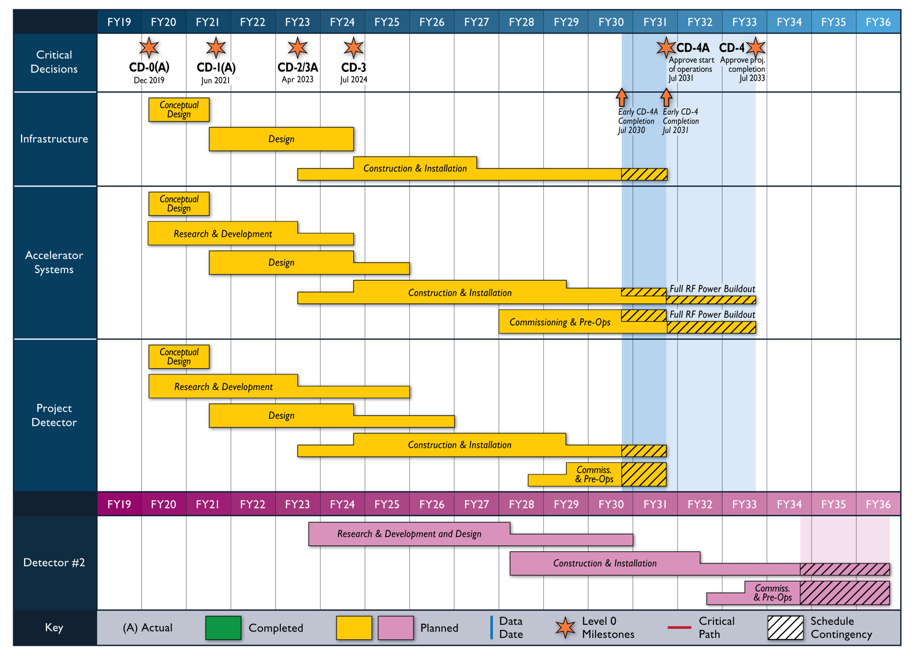
Reference Schedule (Oct. 2021)
Notional Schedule
2nd IR and
Schedule
Generic Detector R&D

Slide 17
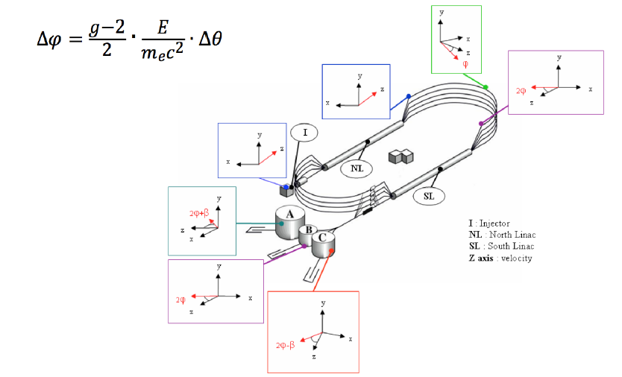
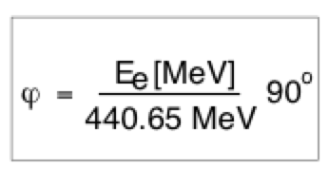
Spin Precession in CEBAF
Like a trick shot, by carefully picking the beam energy, highly polarized electrons can
be sent to multiple experimental halls at once.
I = Injector
NL = North Linac
SL = South Linac
A, B, C exp. halls
https://doi.org/10.1063/1.3215753
17

Slide 18
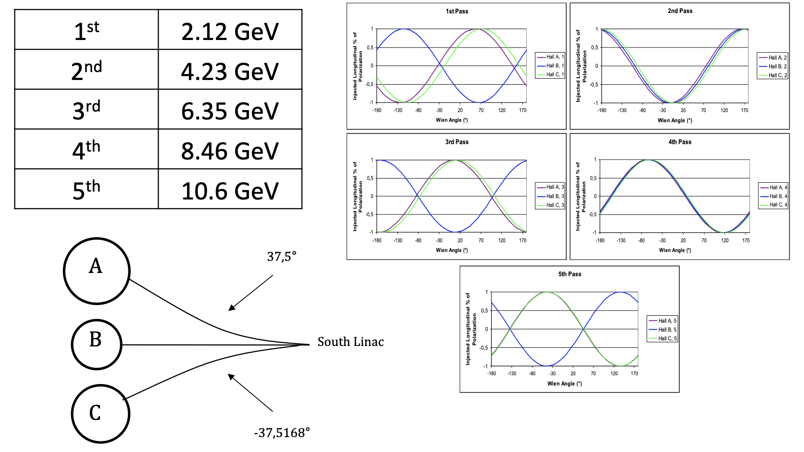
Magic CEBAF Energies
Last JLab run was very close to this with 1.047 GeV/linac + 0.1 GeV injector energy.

Slide 19
Electron Polarization @ NIKHEF with a Full and Partial Snake
The NIKHEF storage ring with a full Siberian Snake could provide stored, longitudinally polarized electrons at any energy.
When the NIKHEF Snake broke, we were able to continue doing physics by going to 440.65 MeV along with a partial snake.
https://doi.org/10.1103/PhysRevLett.84.3855
The hard core version of a spin precession experiment is the Muon g-2 measurement at Fermilab.
NIKHEF/JLab/EIC use our knowledge of anomalous magnetic moments, while Fermilab is pushing the limits of the standard model with ~0.1 ppm measurements.
19

Slide 20
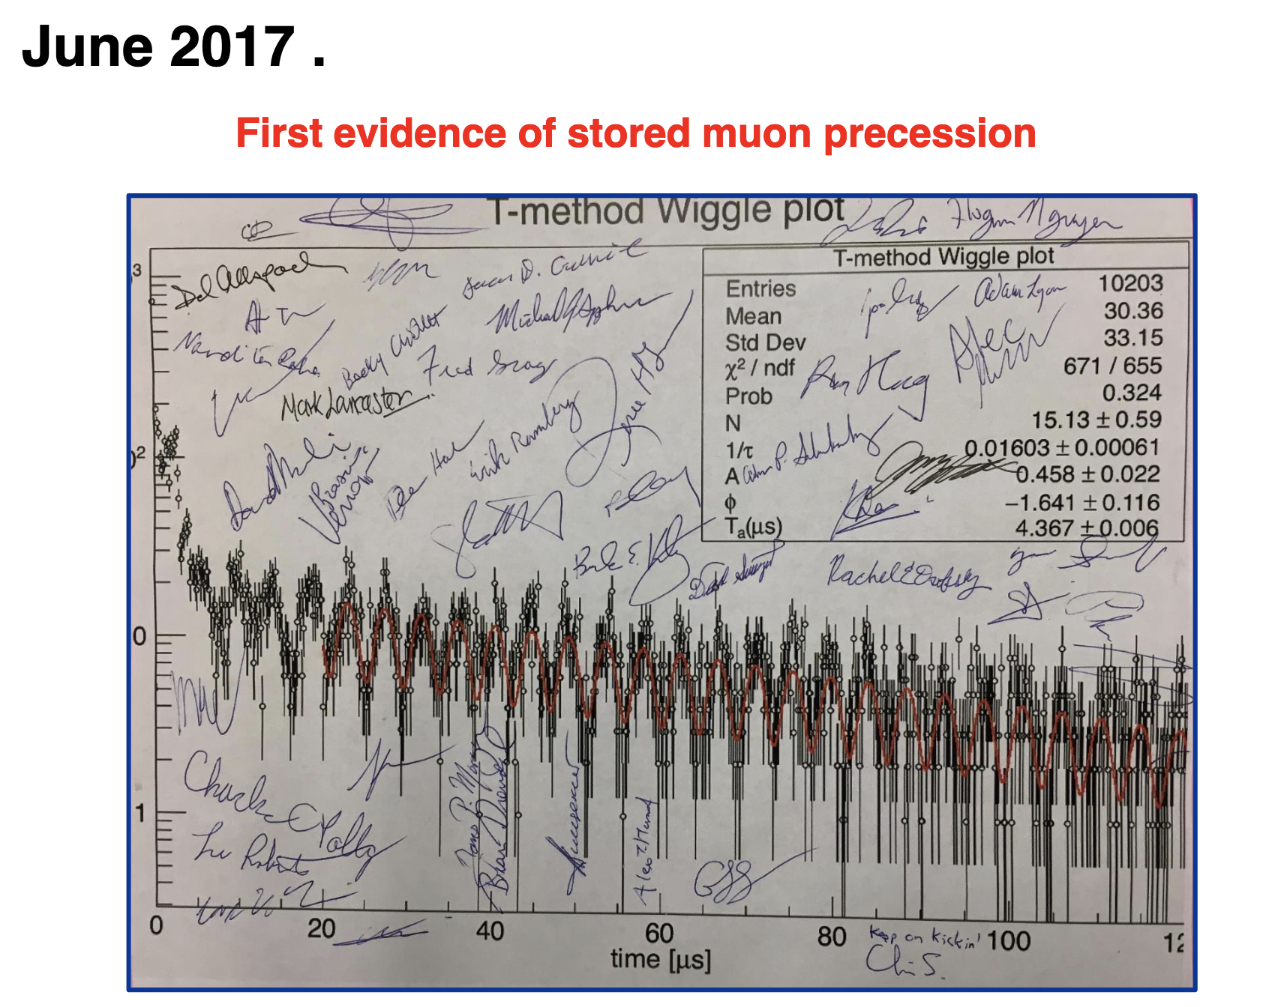
First Results from the Fermilab Muon g-2 Experiment

Slide 21
Six Hadron Ring Snakes Planned for the EIC
Being designed for polarized protons and polarized 3He.
-45º
Ideally multiple snake arrangement is perfectly symmetric with 60 degree bending angle between Snakes.
Due to the injection region constraint, the snake at IP6 can not be put into the desired place. The proposed snake locations are as following with counting starting at IP12: snake1 = 𝜙, snake2=𝜋/3 − 𝜙, snake3 = 2𝜋/3−𝜙, snake4 =𝜋+𝜙, snake5 = 4𝜋/3−𝜙, snake6= 5𝜋/3− 𝜙, where 𝜙 = 0.0435rad.
( slide adapted from the Haixin Huang’s yesterday )

Slide 22
Deuteron Polarization at the EIC
Magnetic moment of the proton is 2.79 nuclear magnetons, neutron moment is -1.91, 3He is -2.13 (i.e. we already no pol. 3He not equal to pol. n) ) BUT the deuteron moment is 0.857 nuclear magnetons making it significantly harder to manipulate with Siberian snakes.
Assuming the deuterons can be accelerated from an atomic beam source without loosing polarization (this is a non-trivial challenge of depolarizing resonances), the idea of magic energies can be used to allow longitudinal deuteron polarization at an interaction region in the EIC without (hopefully) having to further upgrade the Siberian snakes.
Assuming an EIC deuteron energy range of 20.5 to 137.5 GeV/nucleon, there are a total of 17 energies where the deuteron polarization can in principle be made longitudinal at least at one interaction point: 26.2, 32.8, 39.4, 45.9, 52.5, 59.0, 65.6, 72.1, 78.7, 85.3, 91.8, 98.4, 104.9, 111.5, 118.1, 124.6, and 131.2 GeV/nucleon.
Of these energies, there are 5 where the deuteron polarization can be made longitudinal at both interaction points: 39.4, 59.0, 78.7, 98.4, and 118.1 GeV/nucleon.
Two of those are very close to the yellow report energies of 41 and 110 GeV.

Slide 23

Summary
EIC project is underway with major construction efforts likely to start in a couple years and colliding beams in the early 2030’s.
The base program includes polarized H and 3He, but polarized deuterons are not part of the base project and hard to provide at arbitrary energies.
Making use of the idea of magic energies and partial snakes, it should be possible to have polarized deuterons without a costly upgrade.
Polarized deuterons are a natural EIC upgrade and with strong scientific support, polarized deuterons could be possible in the 2040’s.
That may seem far away, but that is really the first opportunity for an upgrade after the base EIC program is achieved.
EIC

