Slide 1
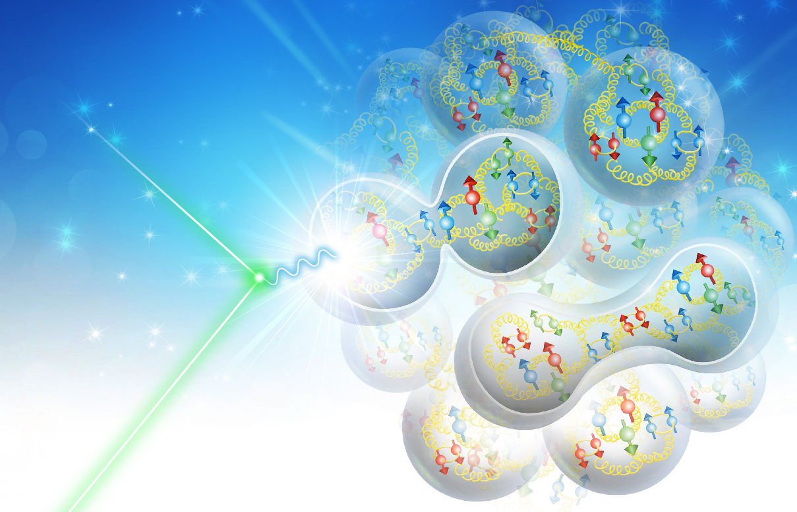
Polarized Deuteron Magic Energies at the EIC
V. Morozov, J. Guo, Y. Zhang
JLab
JLab EIC Meeting, June 19, 2020

Slide 2
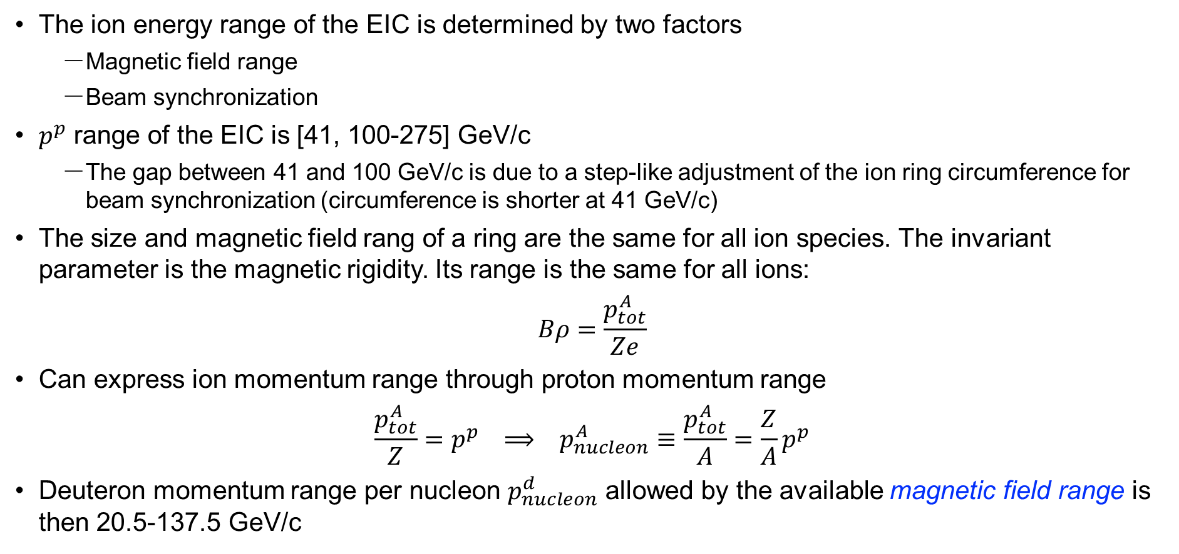
EIC Ion Energy Range
The ion energy range of the EIC is determined by two factors
  Magnetic field range
  Beam synchronization
$p^{p}$ range of the EIC is [41, 100-275] GeV/c
  The gap between 41 and 100 GeV/c is due to a step-like adjustment of the ion ring circumference for beam synchronization (circumference is shorter at 41 GeV/c)
The size and magnetic field rang of a ring are the same for all ion species. The invariant parameter is the magnetic rigidity. Its range is the same for all ions:
$$Bρ=\frac{p_{tot}^{A}}{Ze}$$
Can express ion momentum range through proton momentum range
$$\frac{p_{tot}^{A}}{Z}=p^{p} ⟹ p_{nucleon}^{A}≡\frac{p_{tot}^{A}}{A}=\frac{Z}{A}p^{p}$$
Deuteron momentum range per nucleon $p_{nucleon}^{d}$ allowed by the available magnetic field range is then 20.5-137.5 GeV/c

Slide 3
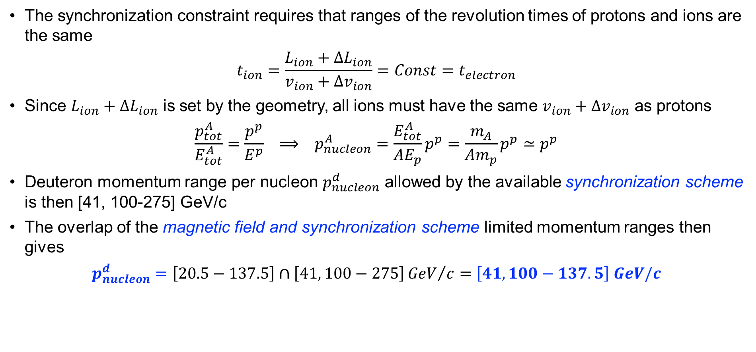
EIC Ion Energy Range Continued
The synchronization constraint requires that ranges of the revolution times of protons and ions are the same
$$t_{ion}=\frac{L_{ion}+ΔL_{ion}}{v_{ion}+Δv_{ion}}=Const=t_{electron}$$
Since $L_{ion}+ΔL_{ion}$ is set by the geometry, all ions must have the same $v_{ion}+Δv_{ion}$ as protons
$$\frac{p_{tot}^{A}}{E_{tot}^{A}}=\frac{p^{p}}{E^{p}} ⟹ p_{nucleon}^{A}=\frac{E_{tot}^{A}}{AE_{p}}p^{p}=\frac{m_{A}}{Am_{p}}p^{p}≃p^{p}$$
Deuteron momentum range per nucleon $p_{nucleon}^{d}$ allowed by the available synchronization scheme is then [41, 100-275] GeV/c
The overlap of the magnetic field and synchronization scheme limited momentum ranges then gives
$$p_{nucleon}^{d}=\left[20.5−137.5\right]∩\left[41, 100−275\right]{GeV}/c=\left[41, 100−137.5\right] GeV/c$$

Slide 4
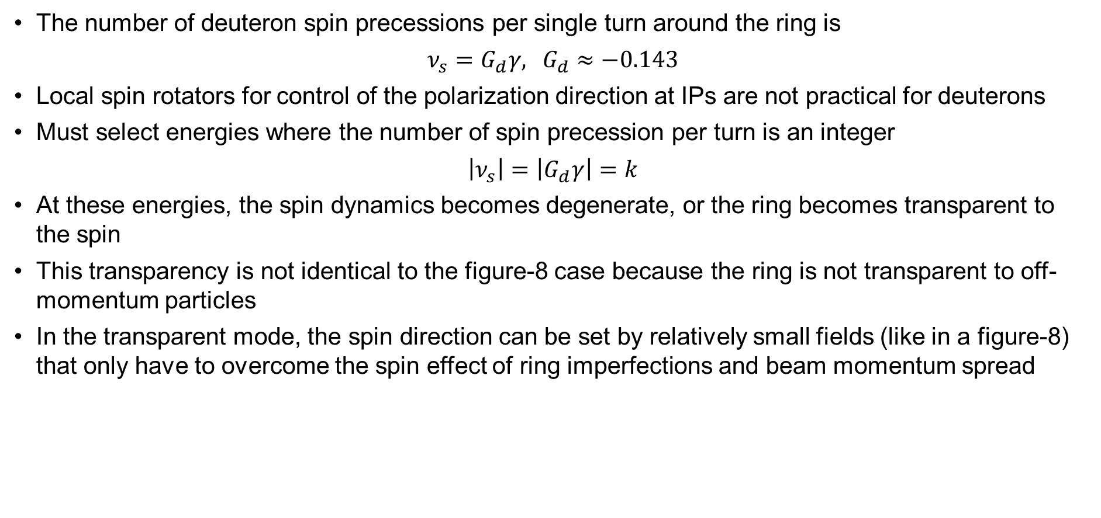
Deuteron Magic Energies
The number of deuteron spin precessions per single turn around the ring is
$$ν_{s}=G_{d}γ\text{, }G_{d}≈−0.143$$
Local spin rotators for control of the polarization direction at IPs are not practical for deuterons
Must select energies where the number of spin precession per turn is an integer
$$\left|ν_{s}\right|=\left|G_{d}γ\right|=k$$
At these energies, the spin dynamics becomes degenerate, or the ring becomes transparent to the spin
This transparency is not identical to the figure-8 case because the ring is not transparent to off-momentum particles
In the transparent mode, the spin direction can be set by relatively small fields (like in a figure-8) that only have to overcome the spin effect of ring imperfections and beam momentum spread

Slide 5
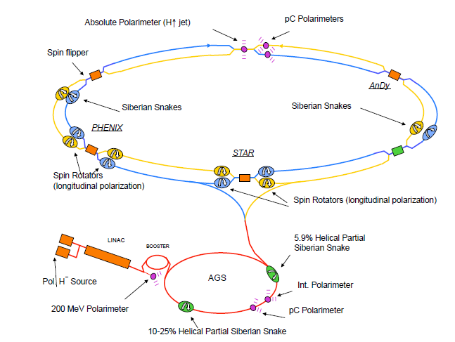
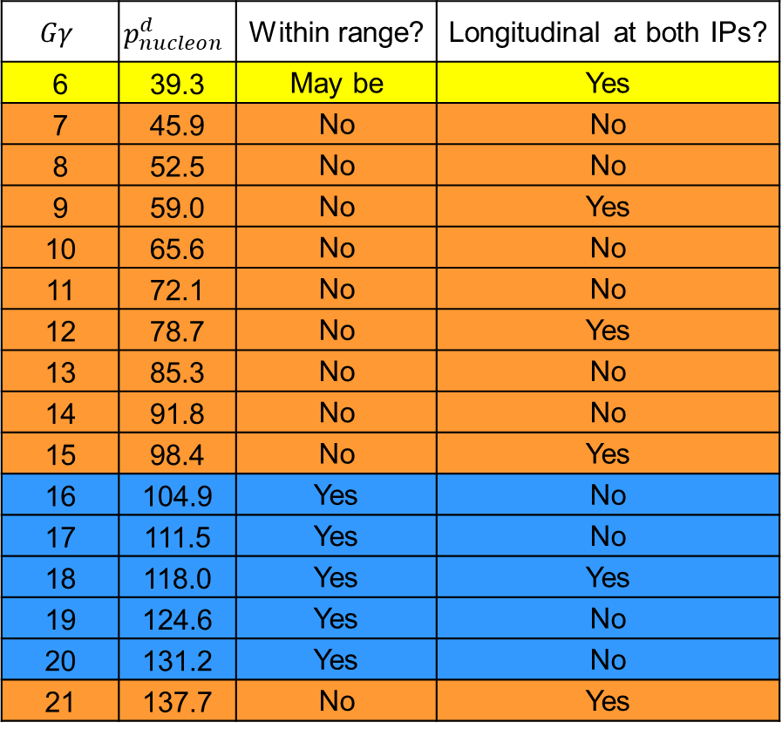

Deuteron Magic Energies Continues
Which magic momenta fall into the EIC deuteron
momentum range?
The two IPs are separated by 1/6th of the ring.
If spin is longitudinal at one IP, it will be longitudinal
at the second IP if the spin precession between the
two IPs in an integer number of $π$
$$\frac{2πGγ}{6}=kπ ⇒ Gγ=3k$$
$$Gγ$$ | $$p_{nucleon}^{d}$$ | Within range? | Longitudinal at both IPs?
6 | 39.3 | May be | Yes
7 | 45.9 | No | No
8 | 52.5 | No | No
9 | 59.0 | No | Yes
10 | 65.6 | No | No
11 | 72.1 | No | No
12 | 78.7 | No | Yes
13 | 85.3 | No | No
14 | 91.8 | No | No
15 | 98.4 | No | Yes
16 | 104.9 | Yes | No
17 | 111.5 | Yes | No
18 | 118.0 | Yes | Yes
19 | 124.6 | Yes | No
20 | 131.2 | Yes | No
21 | 137.7 | No | Yes

Slide 6
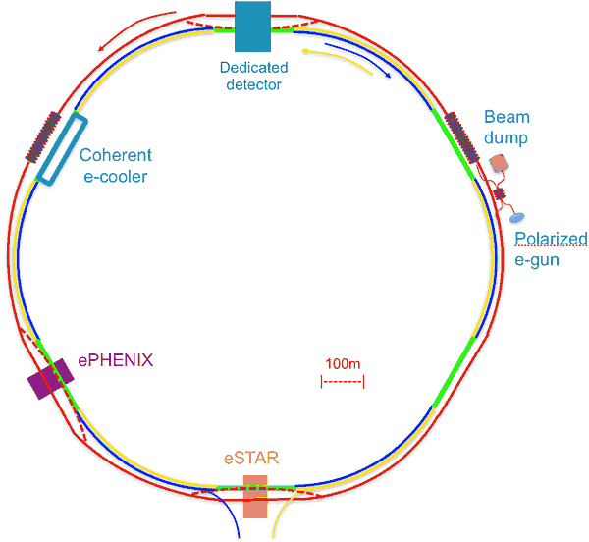
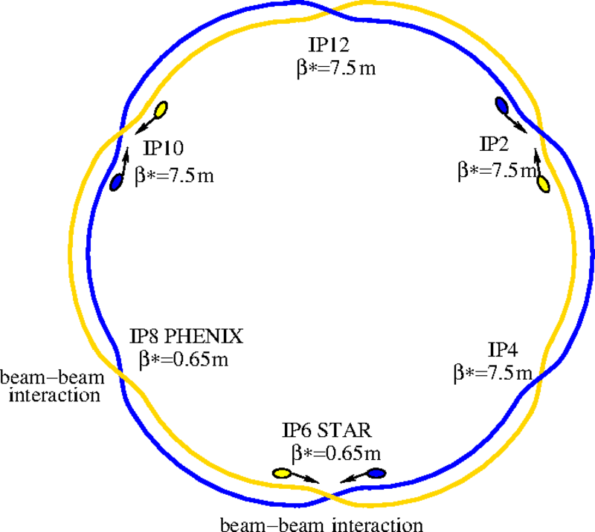
Lowering Proton Energy: Beam Synchronization
There are several issues that need to be mitigated
Beam synchronization: protons move slower than electrons, and energy dependent
Total energy | GeV | 275 | 133 | 100 | 40.3 | 39.4 | 29.2 | 24.05
Relativistic gamma |  | 293.09 | 141.75 | 106.58 | 42.99 | 41.99 | 32.12 | 25.63
Relativistic beta |  | 0.99999 | 0.99998 | 0.99996 | 0.99973 | 0.99972 | 0.99948 | 0.99924
Ion ring circumference | m | 3833.92 | 3833.85 | 3833.77 | 3832.90 | 3832.85 | 3831.96 | 3831.02
Change of circum. | cm | 7.3 | 0 | -7.3 | -94.2 | -99.2 | -188.4 | 282.6
Shifting center of orbit (<+/-8 cm) |  | x |  | x |  | x
Extra inner arc sextants (x92.4 cm) |  |  |  |  | 1 | 1 | 2 | 3
Design orbit
Path length difference between inner & outer sextants is 94.2 cm
Design orbit: by carefully choosing circumferences of two collider rings, electron and 133 GeV proton are synchronized
For protons between 100 GeV and 275 GeV, the ion ring circumference must be increased or shortened by up to ±7.3 cm, this can be accomplished by up to ±14 mm radial shift of its orbit
An inner sextant is 94.2 cm shorter than the outer sextant, if proton takes an additional one or three inner sextants, it can achieve beam synchronization at 40.3 GeV, 29.2 GeV and 24.05 GeV proton energy respectively.
The energies closes to these synchronized energies can also be synchronized through shifting the center of orbit.

Slide 7
Backup

Slide 8
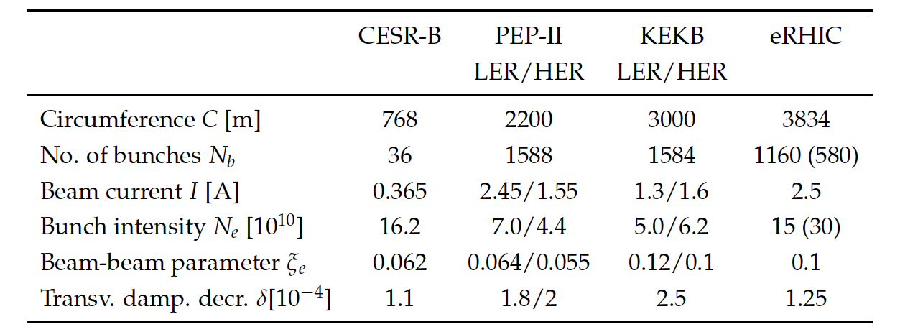
Lowering Electron Energy: Maintaining Strong SR Damping
eRHIC pCDR: 5 ~ 18 GeV, however several machine design presentations also discussed possibility going as low as 2.8 GeV
The main issue is how to ensure sufficient SR damping required to suppress beam-beam in order to stabilize the beam
Radiation energy loss per turn: ΔE = C_{γ} E⁴ / ρ
Damping decrement: α = (ΔE/T)/2E = C_{γ}E³/2Tρ ~ E³/ρ
Further lowering the electron energy, it could be challenging to maintain strong damping
Using 10 GeV as a reference design point, required damping enhancement: 10³/5³=8 10³/4³=15.6 10³/3³=36.9 10³/2.8³=55.6
EIC superbend arc dipole
reversing polarity of the middle section ➔ damping at 5 GeV same as at 10 GeV
Present (pCDR) design supports 5 GeV
A new design superbend arc magnet is under development, aiming to support electron energy as low as 2.8 GeV

