Slide 1
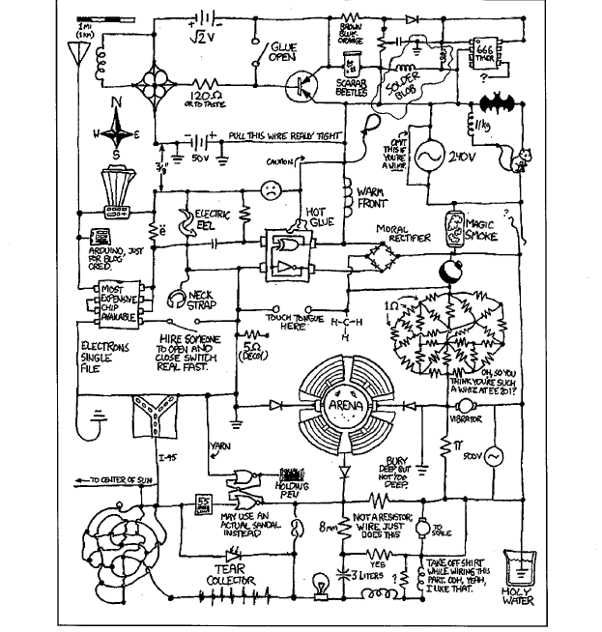
Charge Monitoring for the Tensor Polarized Target Program
D. Mack (TJNAF)
ECT* Tensor Spin Observables
Trento, Italy
July 12, 2023

Slide 2
What is my error budget for charge monitoring?

Slide 3
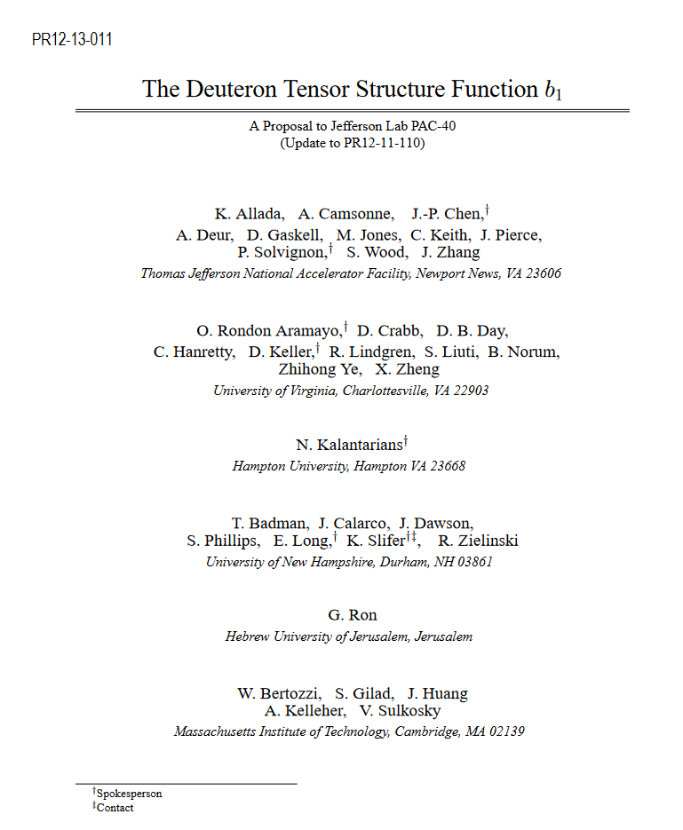
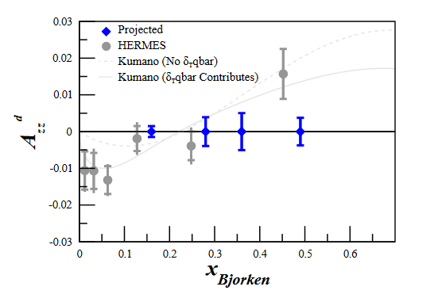
Expected Size of the A_{zz} Asymmetry and Its Error
The model of Kumano predicts the largest value of A_{zz} .
This model is consistent with the Hermes data.
A significantly non-zero observation of A_{zz} is in principle feasible.
X_bj | Projected dAzz_stat (from Table 2 of the proposal*)
0.16 | 1.5e-3
0.28 | 3.9e-3
0.36 | 5e-3
0.49 | 3.7e-3

Slide 4
Expected Size of the A_{zz} Asymmetry and Its Error
The model of Kumano predicts the largest value of A_{zz} .
This model is consistent with the Hermes data.
A significantly non-zero observation of A_{zz} is in principle feasible.
X_bj | Projected dAzz_stat (from Table 2 of the proposal)
0.16 | 1.5e-3
0.28 | 3.9e-3
0.36 | 5e-3
0.49 | 3.7e-3
If we blow these errors by a factor of 2, it will be hard to distinguish the Kumano model from the null hypothesis.

Slide 5
Expected Size of the Error on the Measured Asymmetry
I converted the projected dAzz_stat to dA_measured to see how large these statistical errors are before inflation by the corrections for target polarization and dilution.
X_bj | Projected dAzz_stat (from Table 2 of the proposal) | dA_measured = f*Ptgt*dAzz_stat = 0.285*0.2*dAzz_stat
0.16 | 1.5e-3 | 8.6e-5
0.28 | 3.9e-3 | 2.2e-4
0.36 | 5e-3 | 2.9e-4
0.49 | 3.7e-3 | 2.1e-4

Slide 6
Expected Size of the Error on the Measured Asymmetry
I converted the projected dAzz_stat to dA_measured to see how large these statistical errors are before inflation by the corrections for target polarization and dilution.
X_bj | Projected dAzz_stat (from Table 2 of the proposal) | dA_measured = f*Ptgt*dAzz_stat = 0.285*0.2*dAzz_stat | BeamDays
0.16 | 1.5e-3 | 8.6e-5 | 6
0.28 | 3.9e-3 | 2.2e-4 | 9
0.36 | 5e-3 | 2.9e-4 | 15
0.49 | 3.7e-3 | 2.1e-4 | 30
The lowest x_b point is most challenging:
In only ~12 calendar days, all other random errors arguably need to average down to no larger than 2/3 of this, or ~5.7e-5.

Slide 7
Slow Cycles (Once per Beam Day)
Keeping all other random error below 5.7e-5 in 6 days is the wrong way to think about it.
Each pair of (polarized, unpolarized) is a mini-experiment.
If we’re cycling once per Beam Day, then we “only” need to keep all other random errors below 1.4e-4 in each mini-experiment.
X_bj | Projected dAzz_stat (from Table 2 of the proposal*) | Projected dA_measured = f*Ptgt*dAzz_stat = 0.285*0.2*dAzz_stat | dA_measured Per Beam Day =column 3 x sqrt(Beam Days)
0.16 | 1.5e-3 | 8.6e-5 | 2.1e-4
0.28 | 3.9e-3 | 2.2e-4 | 6.6e-4
0.36 | 5e-3 | 2.9e-4 | 1.1-3
0.49 | 3.7e-3 | 2.1e-4 | 1.2e-3

Slide 8
Not-So-Slow Cycles (Once per Beam Hour)
If we’re cycling once per Beam Hour, then we “only” need to keep all other random errors below 6.7e-4 in each mini-experiment.
X_bj | Projected dAzz_stat (from Table 2 of the proposal*) | Projected dA_measured = f*Ptgt*dAzz_stat = 0.285*0.2*dAzz_stat | dA_measured Per Beam Day =column 3 x sqrt(Beam Hours)
0.16 | 1.5e-3 | 8.6e-5 | 1.0e-3
0.28 | 3.9e-3 | 2.2e-4 | 3.2e-3
0.36 | 5e-3 | 2.9e-4 | 5.4e-3
0.49 | 3.7e-3 | 2.1e-4 | 5.6e-3

Slide 9
There Are Many Potential Random Errors at the O(1)E-4 Level
So Charge Monitoring Cannot Consume the Entire Budget!
Most of the random errors in the Yield calculation are:
Target stuff: | Bead settling or slumping changing the fill factor
 | Target field variations changing the acceptance
 | Target temperature differences between polarized and unpolarized
Detector stuff: | Errors in corrections for drifts in the deadtime
 | Errors in corrections for drifts in the tracking efficiency
 | Unmitigated drifts in the Gas Cerenkov thresholds
 | Unmitigated drifts in the Pb Glass thresholds
Accelerator stuff: | Unmitigated drifts in beam energy
 | Unmitigated drifts in beam position on target
Charge: | Charge normalization
Perhaps half of these were mentioned in the proposal.
Let’s say charge monitoring takes half the error budget for additional random errors. (This allows for 4 errors of similar magnitude, added in quadrature, to saturate the total random error budget.) Then:
if we do daily pairs, I have to do 7e-5 or better, every day.
if we do hourly pairs, I have to do 3.4e-4 or better, every hour.

Slide 10
The answer to the question:
What is my error budget for charge monitoring?
Hand-wavingly, we need to do O(1)e-4 in the charge monitoring for each pair.
(ditto for other non-statistical random errors)
This specification is driven by the lowest x_bj point.
Faster target cycling than 1 beam day will make my job easier. But 1 clock hour cycles would hurt the statistical error bar.
Perhaps 2-4 cycles per shift will be a reasonable compromise?

Slide 11
Overview of BCMs and Their Stability

Slide 12
Beam Cavity Monitors (BCMs)
Jlab BCMs are resonant pillbox cavities operating in TM₀₁₀ mode at 1.497 GHz. (the 3rd harmonic of the 499 MHz bunch frequency)
They are completely passive: when beam passes through them, it excites a mode with just the right phase of longitudinal electric field
to extract power from the beam.
These BCMs act like O(100) kOhm resistors, so linear processing of the RF to a voltage will be linearly proportional to the beam current.
An RF engineer would spec this as 1 muA → -40 dBm (or 0.1 microWatts). Even at 100 muA the extracted power is only I²*R = 1 mWatt, so
there is no significant nonlinearity from heating.
beam
x
1497 MHz out
1497 MHz out

Slide 13
Beam Cavity Monitors (BCMs)
Jlab BCMs are resonant pillbox cavities operating in TM₀₁₀ mode at 1.497 GHz. (the 3rd harmonic of the 499MHz bunch frequency)
They are completely passive: when beam passes through them, it excites a self-reinforcing mode with just the right phase of longitudinal
electric field to extract power from the beam.
BCMs act like O(100) kOhm resistors, so linear processing of the RF to a voltage will be linearly proportional to the beam current.
An RF engineer would spec this as 1 muA → -40 dBm (or 0.1 microWatts). Even at 100 muA the power is only I²*R = 1 mWatt, so
there is no significant nonlinearity from heating.
beam
x
For polarized ND3 target operation,
a beam current of 100 nA is -60dBm
(or 1 nanoWatt).
This is not as hard as radio-astronomy,
but the BCM signal level is getting small-ish and more amplification is needed.
1497 MHz out
1497 MHz out

Slide 14
Making Temperature-stable BCMs
The TM₀₁₀ mode is in principle independent of the cavity length, but does depend on the radius.
For charge measurements with excellent long term stability, one has to ensure that thermal expansion and contraction cycles don’t
change the radius and cause the cavity to wander on and off resonance. The problem is worse for higher Q cavities, since their resonance
peak is narrower (Δf = f₀/Q). The problem is also worse if the cavity is tuned slightly off the 1.497 GHz of the beam.
The cavities were therefore made of stainless steel (SS) which has a low thermal coefficient of expansion.
The loaded Q was a fairly modest ~1500.
(Even a good conductor struggles at 1.5 GHz due to the shallow skin depth, and Stainless Steel is not a good conductor.)
The cavities are tuned within +-20KHz. (roughly 1 part in 10⁵ of the 1.497 GHz beam frequency)
The cavities are temperature controlled to +-0.2F, going thru a full cycle every 5 minutes.

Slide 15
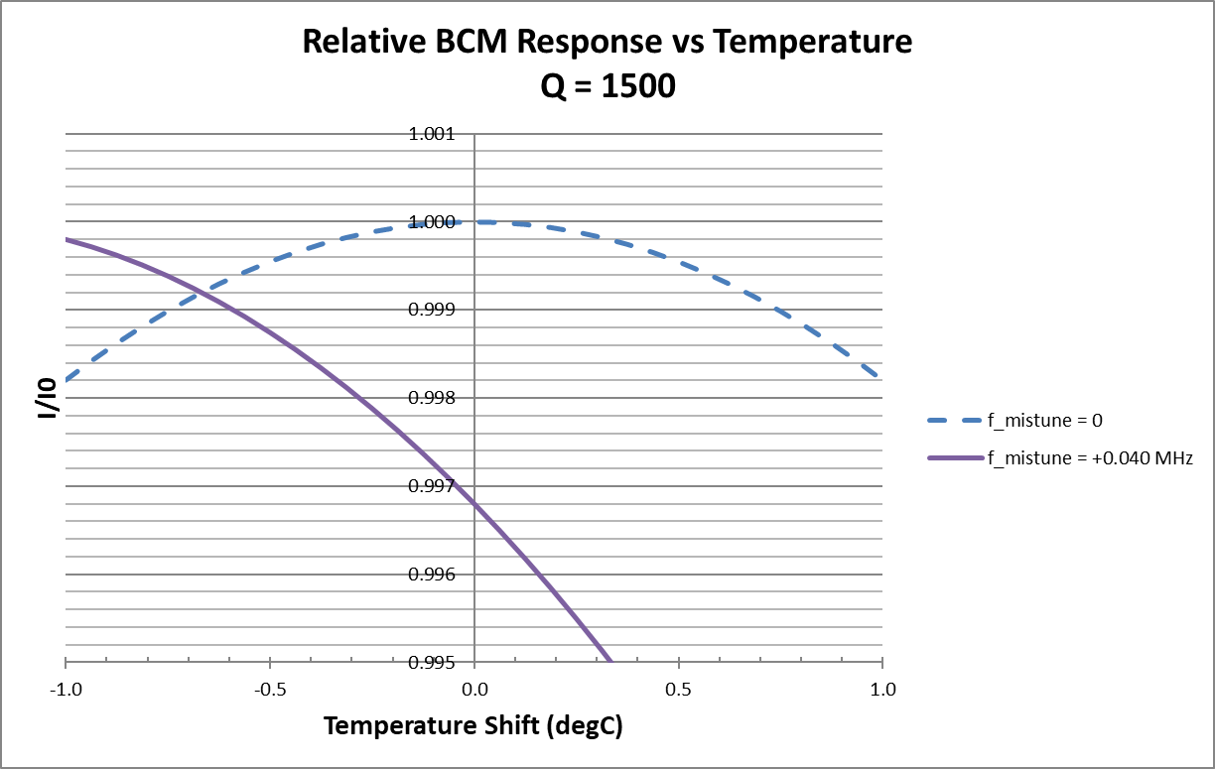
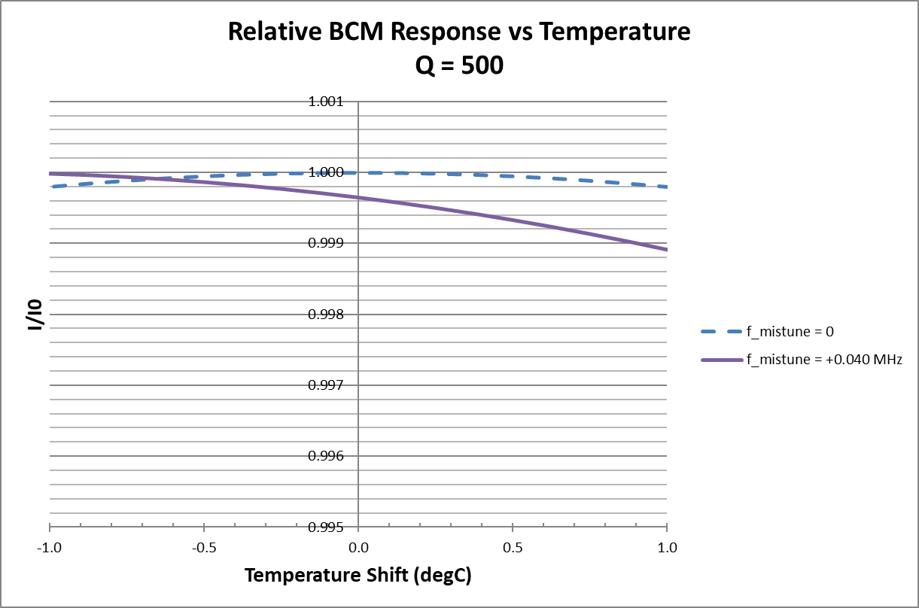
Model Stability for Q = 500 vs 1500
The resulting cavities were still too temperature sensitive for precision cross-section work! So decades ago, I asked them to be de-Q’d to ~500.
(The accelerator Machine Protection System soon followed suit. This is how most BCMs at Jlab are operated.)

Slide 16
Two Thermally Separate BCM Enclosures on the Hall C Beamline
BCM4a,b
Package 2
Digital Receiver
BCM1,2
Package 1
Analog Receiver
All the 1.497 GHz RF cables run upstairs to the counting house.
Package 1 uses better quality RF cable.

Slide 17
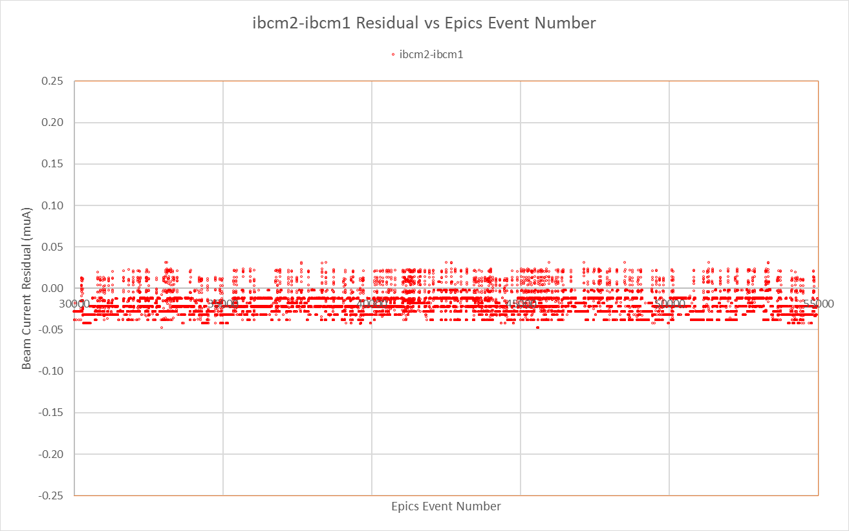
BCM Differences During 17 Hours at 58 muA
2 seconds per EPICS sample
Package 1
(better RF cable)
BCM1 - BCM2
(less than +-2E-4 relative)
limited by V-to-F
counting noise

Slide 18
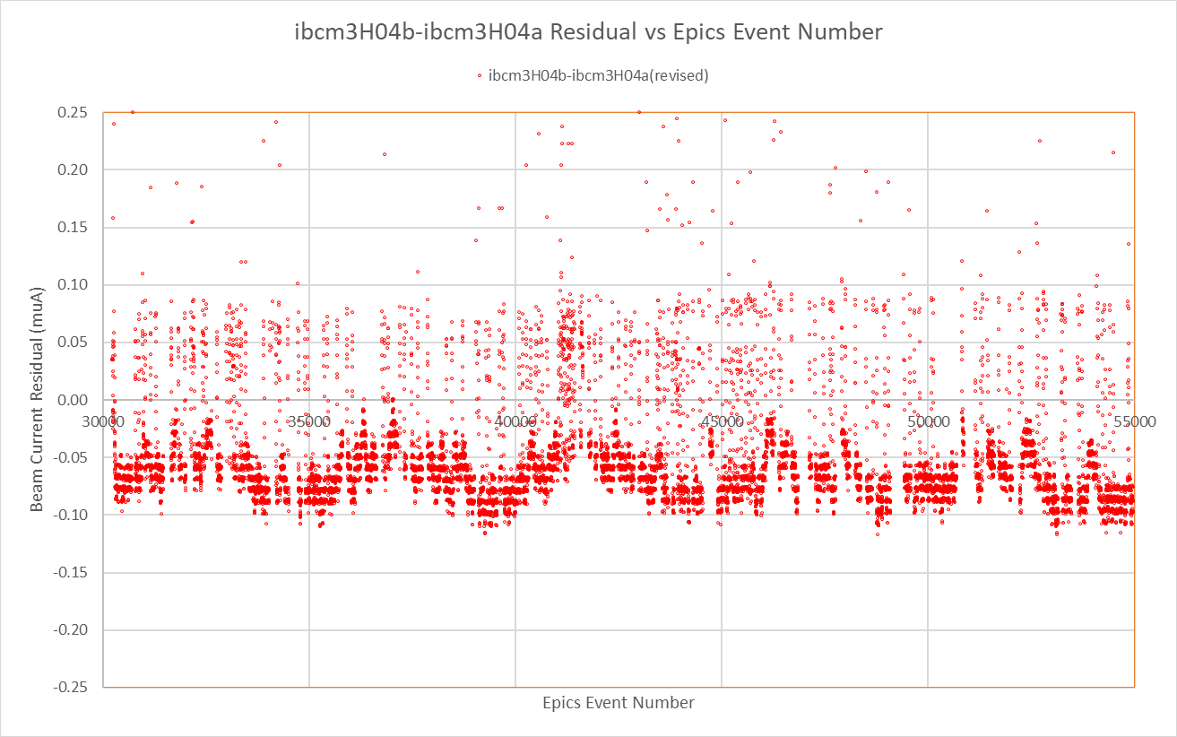
BCM Differences During 17 Hours at 58 muA
2 seconds per EPICS sample
Package 1
(better RF cable)
BCM1 - BCM2
(less than +-2E-4 relative)
limited by V-to-F
counting noise
Package 2
BCM4B – BCM4A
(+-4E-4 relative)
2.8 hour period
This is almost certainly due to temperature variations, but where is not clear.

Slide 19
BCM Differences During 17 Hours at 58 muA
2 seconds per EPICS sample
Package 1
(better RF cable)
BCM1 - BCM2
(less than +-2E-4 relative)
limited by V-to-F
counting noise
The consistency of BCMs
in a given group is promising,
as it should be (same thermal enclosure, similar cable run, similar electronics).
But in hindsight, there’s huge rejection of common-mode errors in this exercise.
So the next plot, which takes differences between BCMs in different enclosures with different electronics, is a more fair comparison.
Package 2
BCM4B – BCM4A
(+-4E-4 relative)
2.8 hour period
This is almost certainly due to temperature variations, but where is not clear.

Slide 20
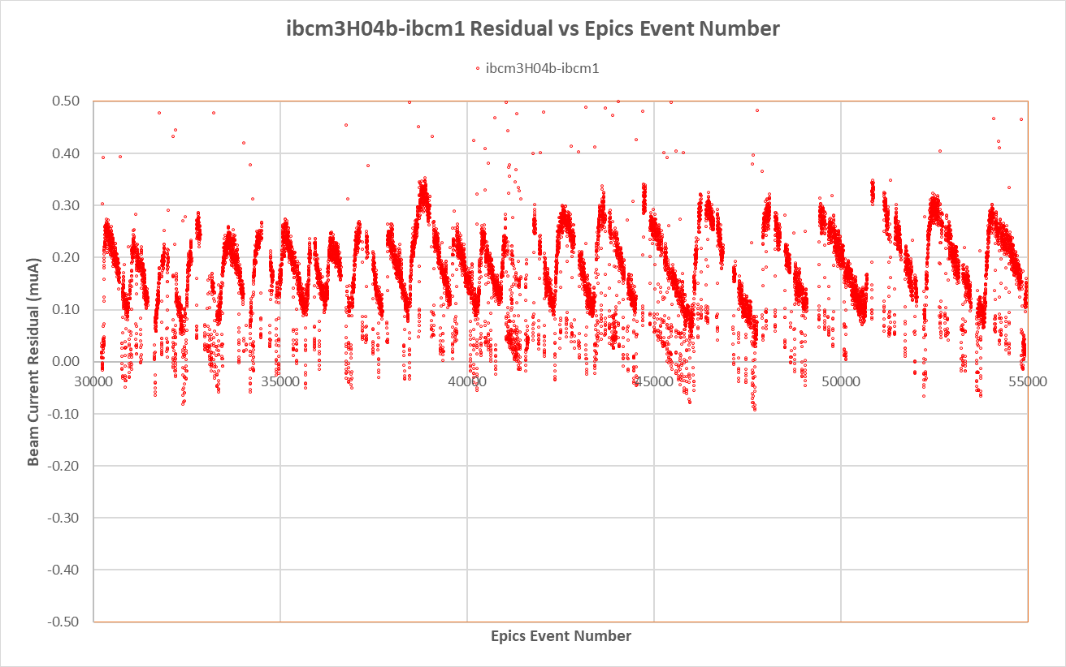
BCM Differences During 17 Hours at 58 muA
2 seconds per EPICS sample
Package 1 rel. Package 2
BCM4B - BCMa
(+-0.2% relative)
25 minute period
This is 5x larger, and with a completely different period, than that seen on the previous slides.

Slide 21
BCM Differences During 17 Hours at 58 muA
2 seconds per EPICS sample
Package 1 rel. Package 2
BCM4B - BCMa
(+-0.2% relative)
25 minute period
This is 5x larger, and with a completely different period, than that seen on the previous slides.
These variations are far too large to be explained by the +-0.2F cavity temperature variations seen in the earlier model.
I don’t understand the detailed source of this variation, but it’s the right time scale to be explained by HVAC induced temperature variation in the RF cables and/or receiver electronics.
One can dream that it will average away with target cycles of 1-4 hours, but beam trips make this not so easy to model. And you can see the period was getting longer.

Slide 22
What’s the BCM Situation for Polarized Target Running?
We will have less information.
Package 2 Removed and replaced by the Slow Raster
Package 1’

Slide 23
What’s the BCM Situation for Polarized Target Running?
We will have less information.
Package 2 Removed and replaced by the Slow Raster
Package 1’
RF cables are already the highest quality except for ~10m jumpers.
Lowest risk, lowest effort concept for Package 1’:
upgrade those ~10m jumpers (moots any rad-damage questions)
upgrade the thermal enclosure
split the RF 50:50 upstairs to feed 2 analog and 2 digital channels

Slide 24
What’s the BCM Situation for Polarized Target Running?
We will have less information.
Package 2 Removed and replaced by the Slow Raster
Package 1’
RF cables are already the highest quality except for ~10m jumpers.
Lowest risk, lowest effort concept for Package 1’:
upgrade those ~10m jumpers (moots any rad-damage questions)
upgrade the thermal enclosure
split the RF 50:50 upstairs to feed 2 analog and 2 digital channels
I can do some tempco calculations and temperature checks. But if I don’t find a smoking gun to explain the +-0.2% variation, the only choice in the data analysis the students will have is between analog and digital receivers. So fingers crossed on the temperature stability of the cavities, cables, and tuners of Package 1’.

Slide 25
Section Summary on BCMs and Their Stability
Measurement of the beam current with non-intercepting BCMs to achieve pair-level random errors at the +-O(0.1)% level is not a given.
And lest we forget, our goal is O(0.01)%!
BCM cavity stability is probably a solved problem (low tempco Stainless Streel, low Q, regulated temperature, accurate tuning).
But we still have to run 1.497 GHz through an inherently lossy and temperature-dependent cable to a location where the receiver electronics won’t get rad-damaged. And the receivers will have their own tempcos.
It’s probably not impossible to achieve O(0.01)%, but we should hedge our bets.

Slide 26

I’d Like to sell you on the idea of a Timeshare Faraday Cup

Slide 27
Basic Idea of a Faraday Cup (FC)
Simple in principle: one captures the vast majority of the beam charge, and measures the current.
FC
Tgt
Ammeter

Slide 28
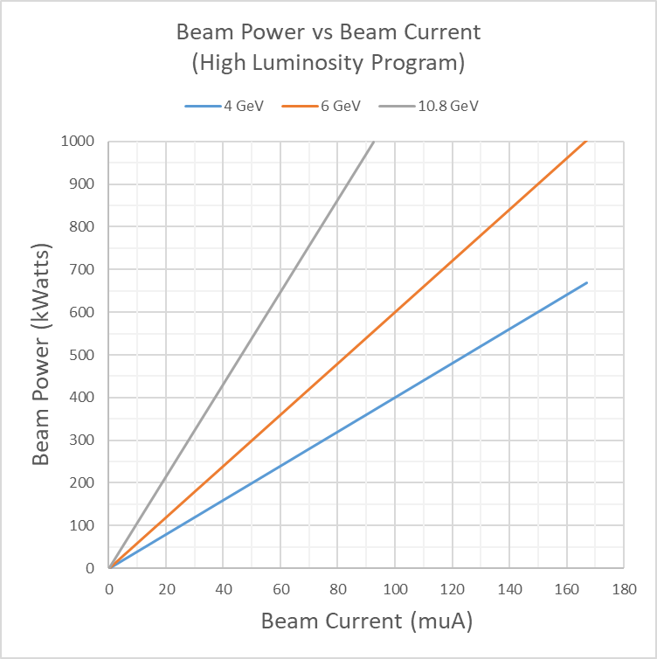
Beam Power Levels
The FC also has to absorb most of the beam energy. But electrons shower, leading to maximum energy deposition at ~ 5-6 X₀.
For the Hall A/C high luminosity program reaching ~1 Mwatt, this arguably made a FC impractical.

Slide 29
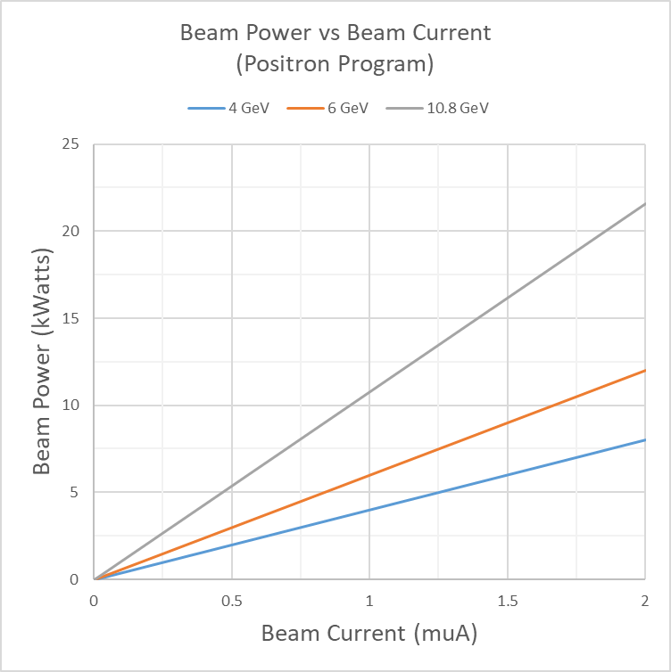
Beam Power Levels
The FC also has to absorb most of the beam energy. But electrons shower, leading to maximum energy deposition at ~ 5-6 X₀.
For the Hall A/C high luminosity program reaching ~1 MWatt, this arguably made a FC impractical.
For the anticipated positron program reaching ~22 kWatts, a FC looks challenging but likely feasible. (Solving the calibration problem!)

Slide 30
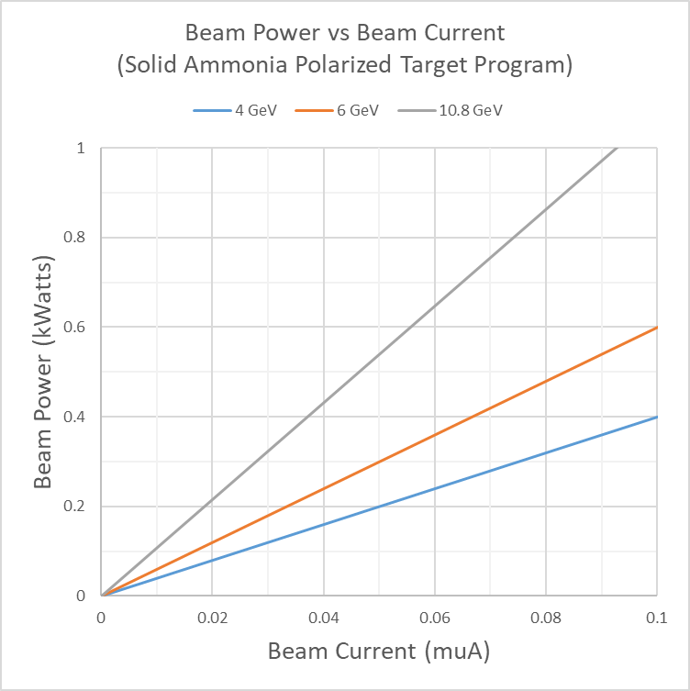
Beam Power Levels
The FC also has to absorb most of the beam energy. But electrons shower, leading to maximum energy deposition at ~ 5-6 X₀.
For the Hall A/C high luminosity program reaching ~1 Mwatt, this arguably made a FC impractical.
For the anticipated positron program reaching ~22 kWatts, a FC looks challenging but likely feasible. (Solving the calibration problem!)
For the solid ammonia polarized target program at less than ~1kWatt, a FC looks relatively easy.

Slide 31
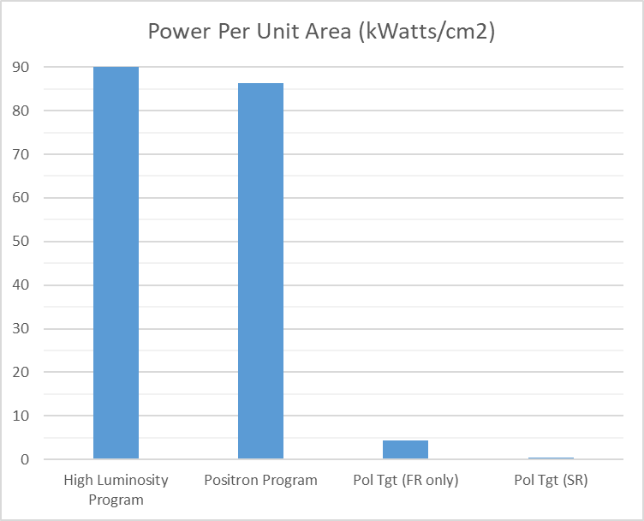
Beam Power Per Unit Area
In terms of maximum beam power per unit area at the face of the FC, with the Slow Raster enabled,
the Pol Tgt Program value is at most 0.3 kWatts/cm2. It seems there’s no way to melt anything.
With the slow raster enabled, we are here.

Slide 32
Classical Errors in FCs
We stand on the shoulders of giants who have already recognized and solved most systematic effects in FC’s for GeV-scale electron beams.
Problem | Mitigations | Comment
Charged Backscatter | Re-entrant geometry (to recapture backscatter); Graphite facing (low secondary emission coefficient); Transverse B field (traps low energy electrons) | Only a problem for b1 if it’s time dependent. So design to keep backscatter small, and keep the FC guts under high vacuum.
Electron Shower Penetration | Need enough radiation lengths in radial and longitudinal directions. | Not a source of random error for b1.
Leakage paths to ground | Excellent vacuum to suppress neutralization by ions; Insulating stand-offs; Disconnect any ion gauges during operation | Only a problem for b1 if vacuum goes bad.
Target out-scattering | Entrance hole needs to be large enough that the measured current is insensitive to small changes in beam position. | Given the large size of the beam at the FC due to the Slow Raster and thick target, this needs careful analysis.
Asymmetric charge losses | Secondary e- emission off the rear face due to muons; Probably more mu- than mu+ (cuz more neutrons?); Proton escape matters while neutron losses do not; | Not a source of random error for b1.
The possibly unique feature here is the low current of 100 nA at 100% duty factor. (1e-4 would be 10 pA, which is a very small current.)
Measuring the current of old, pulsed beams was sometimes 4 orders of magnitude less sensitive to small, time-varying current offsets!
The good news is one gets to integrate for thousands of seconds in b1. But life gets harder below the 1 nA level.

Slide 33
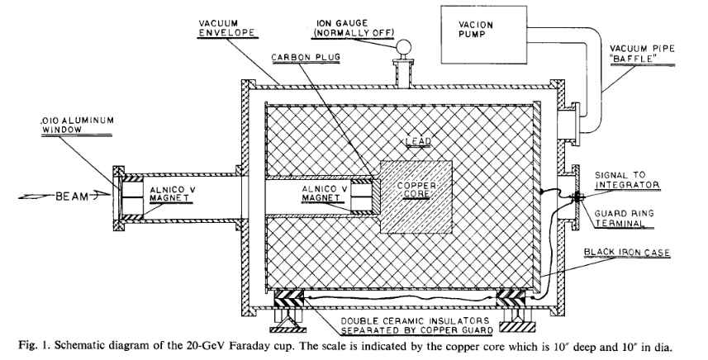
SLAC “High” Power Faraday Cup (1 kWatt CW)
You can see the many features already mentioned: large but re-entrant aperture, high vacuum jacket, insulating stand-offs,
oodles of radiation lengths, etc.
With no cooling water, and apparently sketchy FEA, they were unclear on the melting threshold so kept average power < 1 kWatt.
For 20 GeV, they wanted
72 X₀ long
and
46 X₀ radially.
(0.01% shower
penetration loss, which seems overkill)
*D. Young, “A High Precision Faraday Cup and Quantameter for SLAC”, SLAC-PUB-264 (January 1967); and NIM 52 (1967) 1-14.

Slide 34
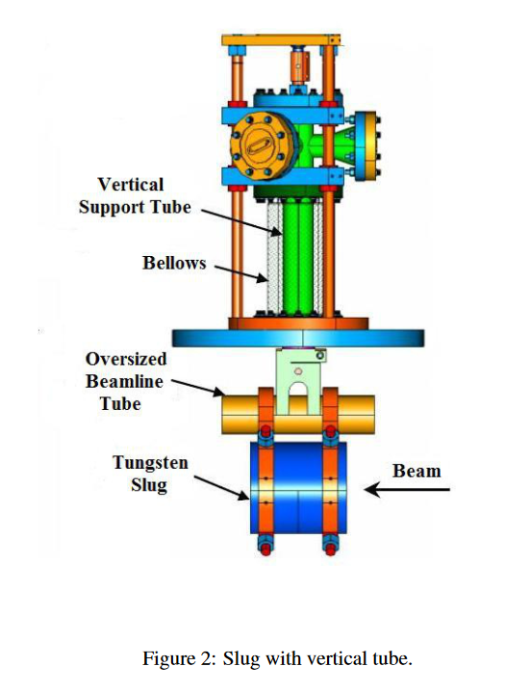
Tungsten-Copper Calorimter
95% W, 5% Cu
16cm long (45.7 X₀)
8cm radius (22.9 X₀)
Very thin wrt SLAC FC.
But given the large proposed relative error on A_zz, charge losses of 1% would be no problem as long as any drifts are small during a target cycle.
Hole is the wrong size (0.5cm radius,
and 2.5cm deep).
Since it is mildly activated, drilling to the right size and aspect ratio could be a pain.
Left-over from an old Hall A project.
M.M. Ali et al, “Precision Absolute Current Measurement of Low Power Electron Beam”, Proceedings of BIW2012, Newport News, VA, USA.

Slide 35
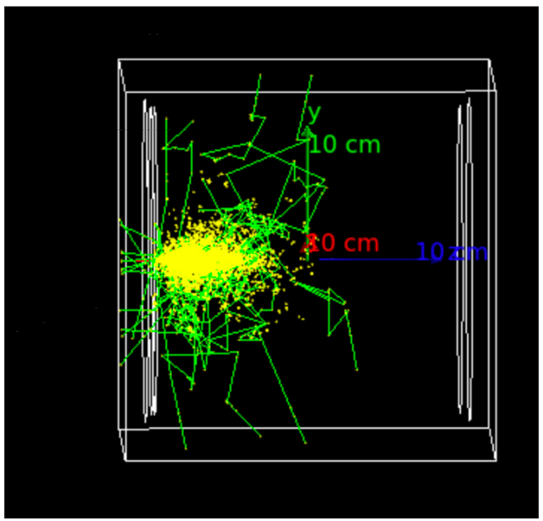
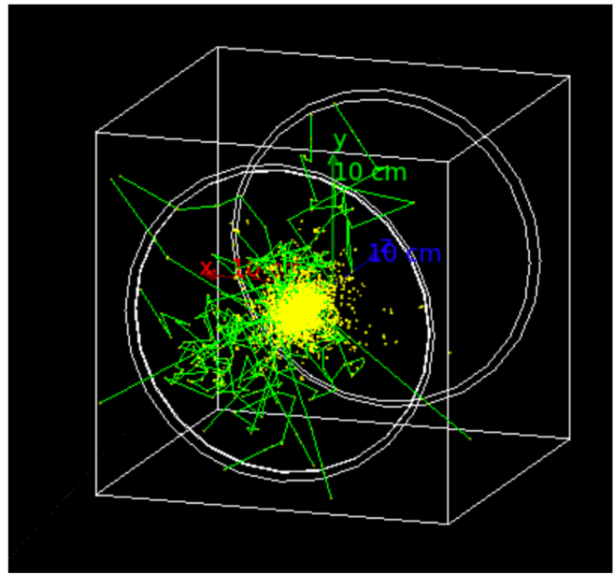
Related G4 Simulations by Nathaly Santiesteban
Qualitatively Noteworthy:
Longitudinally, the shower peaks at shallow depth, so not much energy escapes out the back. (Cannot use W-Cu at high power though lol!)
There’s some escape from the front, which mostly appears to be gammas.
Radially, some escape is easily observed, again mostly appearing to be gammas.
Gamma rays of O(1) MeV have surprising penetrating power, so Compton scattering losses can matter for absolute charge monitoring.

Slide 36
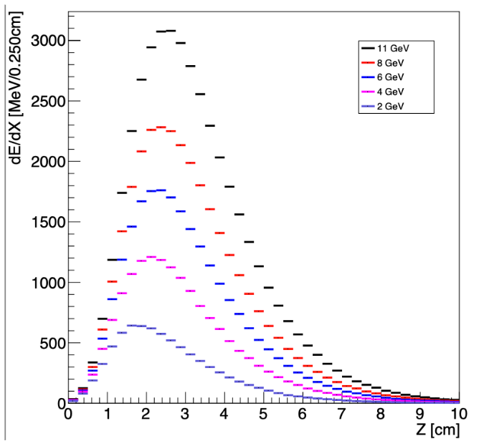
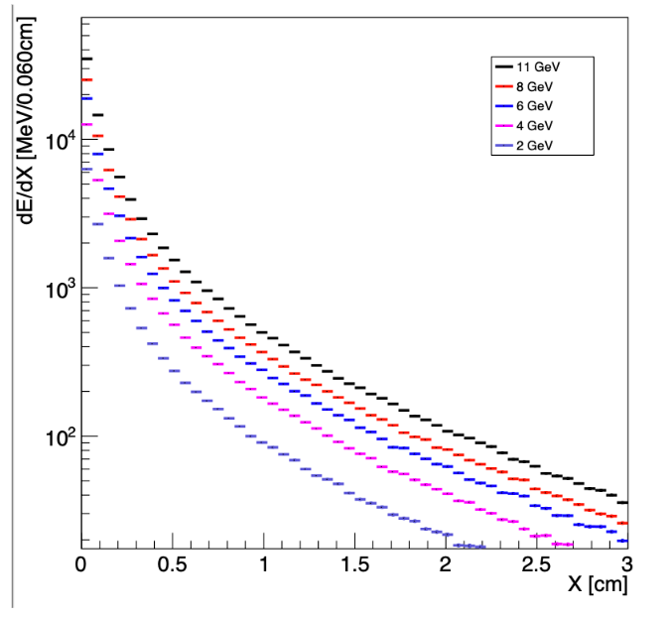
Related G4 Simulations by Nathaly Santiesteban
Semi-quantitatively now:
Longitudinally on linear scale, there’s not much escape out the back at 10cm (~30 X0).
Radially on log scale, you can see the narrow (90%) core of energy inside the exponential-ish Moliere radius, but there’s a small , long tail beyond that.
Needs more study, but for relative charge monitoring, the W-Cu plug with a larger hole may be large enough.

Slide 37
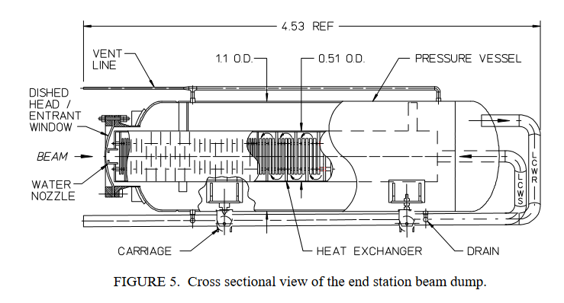
Why Not Just Hook an Ammeter up to the Existing Beam Dump?
Many of the reasons we just mentioned:
No backscatter reduction
Many leakage paths to ground, including the low-conductivity cooling water and ionized air.
Highly activated area after 30 years.
(Dimensions are in meters.)
High power electron beam dumps at CEBAF | IEEE Conference Publication | IEEE Xplore

Slide 38
Section summary on FC
Beam power is less than 1 kWatt. Despite high vacuum and no cooling water, FC can likely passively shed heat thru black body radiation to outer vessel (and BeO supporting insulators?).
Beam power per unit area is crazy low. Probably no issues there, even in Tungsten.
High vacuum (1E-5 Torr) is an important specification.
Can the W-Cu calorimeter be modified to be useful? It is certainly compact. Existing hole is way too small. Might not be practical to modify though since it has been in the beam and is mildly activated.
Monitoring leakage currents at the 10 pA level sounds hard. This is probably at the level of the dark current out of the injector, so we’ll need to insert a beam block in the injector. (The 5 MeV FC will do just fine.)

Slide 39
Charge Monitoring Talk Summary
BCMs:
I need to do some tempco estimates and thermal stability tests, then decide what tweaks to make in the BCM system.
This is the devil I know, so the necessary-but-not-necessarily-sufficient improvement path is clear. But we’re ultimately limited by 1.497 GHz losses in RF cables with significant tempco’s. Given the likely target cycling period of a few hours (?), it would be irrationally optimistic to think this random error can get down to the O(0.01)% level.
FC:
I originally thought of the b1 measurement as a stepping stone to a FC for the positron program. We will learn a lot from our first FC in Hall C, but I can see now that the two will be QUITE different:
b1 is low-powered at < 1 kWatt, so presumably a FC wouldn’t need water-cooling.
The trick will be keep any time-dependent background currents below the O(10) pA level.
I am perhaps being irrationally optimistic, but it sounds fun!
The positron program at < 22 kWatts will likely need water cooling for its FC.
The trick will be to design a closed cycle system with negligible (< 2nA) time varying leakage current leakage to ground.
This will be a more difficult design and R&D project.
(Comments on the order of magnitude of parity-violating asymmetry corrections to any single target cycle are in the backups.
In her draft Jeopardy slides, Elena says we’ll be reversing the vector part of the target polarization, so these small contributions will cancel within a pair of target cycles.)

Slide 40
extras

Slide 41
PV Asymmetry Corrections?
Since the measured asymmetries are so small, and the target has vector polarization, do we have to make corrections
for PV asymmetries? (I’m assuming the worst case where the target vector polarization never gets flipped.)
It seems that PV corrections are small-ish and could probably be ignored:
X_bj | Q2 | Projected dAzz_stat (from Table 2 of the proposal*) | dA_measured = f*Ptgt*dAzz_stat = 0.285*0.2*dAzz_stat | measured PV Asymmetry WAG ~100ppm*Q2*f*Pvector =1e-4*Q2*0.285*0.5 =1.43e-5*Q2 | measured PV Asymmetry WAG after correcting for the correct f and the wrong polarization =1e-4*Q2*(0.5/0.2) =2.5e-4*Q2
 |  |  |  | Compare to column 4 O(10)% | Compare to column 3 O(20)%
0.16 | 1.17 | 1.5e-3 | 8.6e-5 | 1.7e-5 | 2.9e-4
0.28 | 1.76 | 3.9e-3 | 2.2e-4 | 2.5e-5 | 4.4e-4
0.36 | 2.12 | 5e-3 | 2.9e-4 | 3.0e-5 | 5.3e-4
0.49 | 3.25 | 3.7e-3 | 2.1e-4 | 4.6e-5 | 8.1e-4
The size of the PV correction is O(10)% of the statistical error bar on the measured asymmetry.
But because the vector asymmetry is larger than the tensor asymmetry, I think this gets enhanced to O(20)% of the Azz error.
(This estimate could be off a factor of 2 in either direction!)

Slide 42
Title
What is my error budget for charge monitoring?
Expected size of the Azz asymmetry and its error
With doubled error bars
Expected size of the error on the measured asymmetry
Only have 6 days
Slow cycles
Not-so-slow cycles
Random error budget
Section summary
Overview of BCMs
BCM infrastructure
BCM infrastructure 2
Making temperature-stable BCMs
Model stability for Q = 500 vs 1500
Two thermally separate BCM enclosures
Bcm difference package 1
Bcm difference package 2
Bcm difference package 1 – package 2
Mods for polarized target running
Section summary
Overview of FCs
The basic idea of a FC
Beam power levels 1, 2, 3
Power per unit area
Classical errors
SLAC “high” power FCC
JLab Tungsten calorimeter
JLab high power beam dump
Section summary
Overall summary
PV asymmetry corrections?

Slide 43
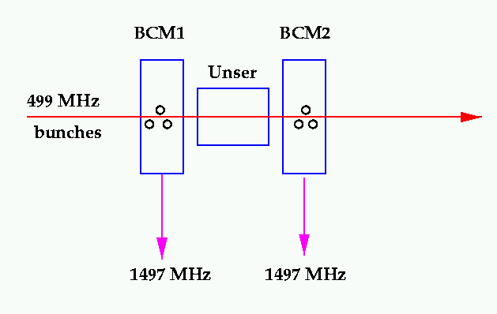
Big Picture
Two key types of non-intercepting transducers:
1. Resonant cavity monitors (pill-box, TM_{010,} Q value ~ 1500??) –
very high S/N,
but unfeasible to dead-reckon an accurate calibration with RF at 1497 MHz
2. Unser monitor (Parametric Current Transformer) –
extremely stable gain,
but low S/N, and offset has poor long term stability
Fast Raster
Target
The cavities and Unser are sensitive to temperature change, so are located inside an insulating box regulated at 110F.
With beam threading both cavities and Unser, an absolute calibration can be transferred from the Unser to the cavities.
The Unser signal is then generally ignored until the next calibration, but is available for backup.

Slide 44
Unser
Determines absolute current for calibration of cavities
The Unser gain is stable and accurate to 0.1% out of the box (4 mV/muA).
We check the gain of the Unser+V/F+gated electronics chain by passing an accurate current thru a wire.
The current reference is a
Fast Raster
Target
Wire
Current

Slide 45
Current Monitors
The RF cavities monitors have high S/N and can be very linear, but have to be calibrated.
The Unser monitor has a stable gain which can be verified with wire current calibrations, but it is noisy and the offset tends to drift. It is only used for calibration.
Same beam current threads all three devices.
Fast Raster
Target
Wire
Current

Slide 46
beam
x
1497 MHz out
1497 MHz out

