Slide 1
High-Field Instrumentation for
EPR and DNP Spectroscopy
Thorsten Maly
Bridge12 Technologies, Inc.
ECT* Tensor Spin Observables, Trento, Italy, 07/10 – 07/14/2023

Slide 2
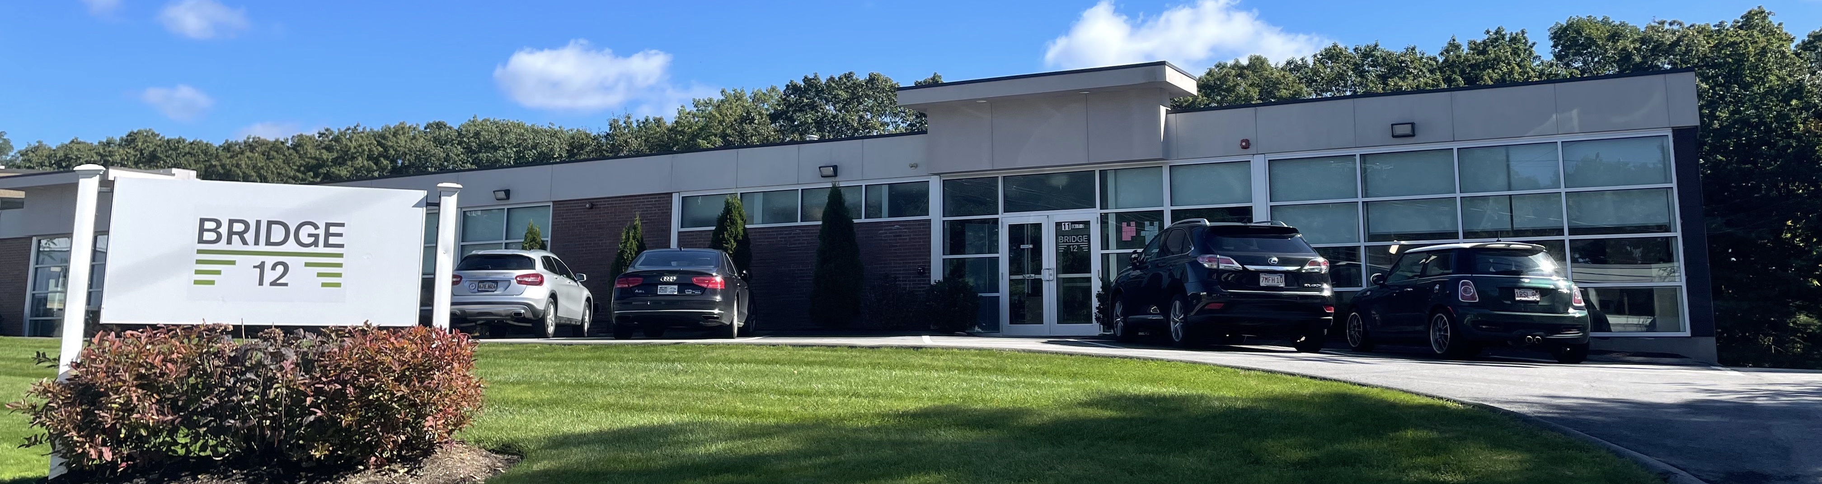
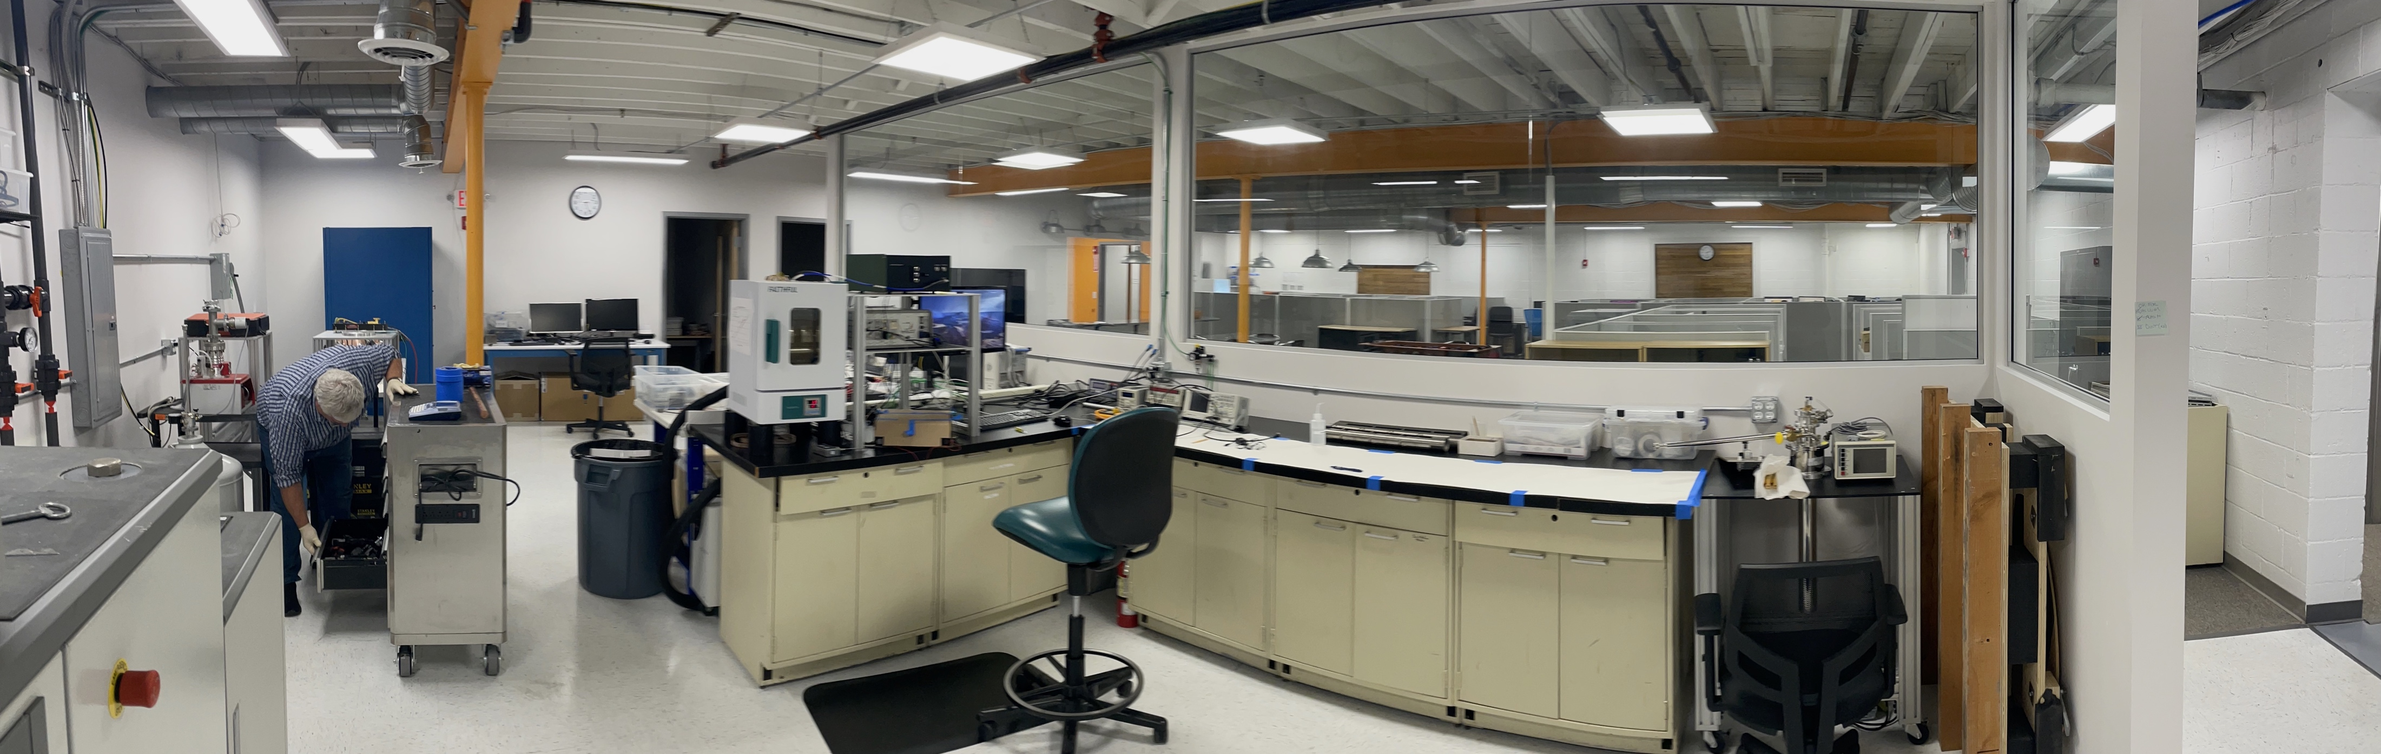
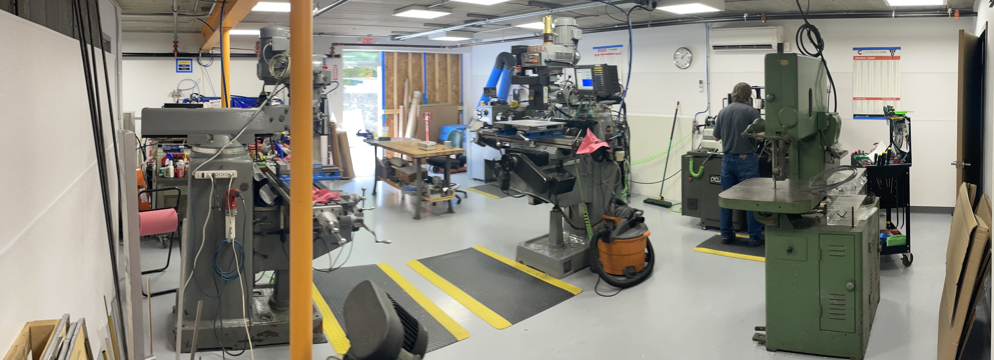
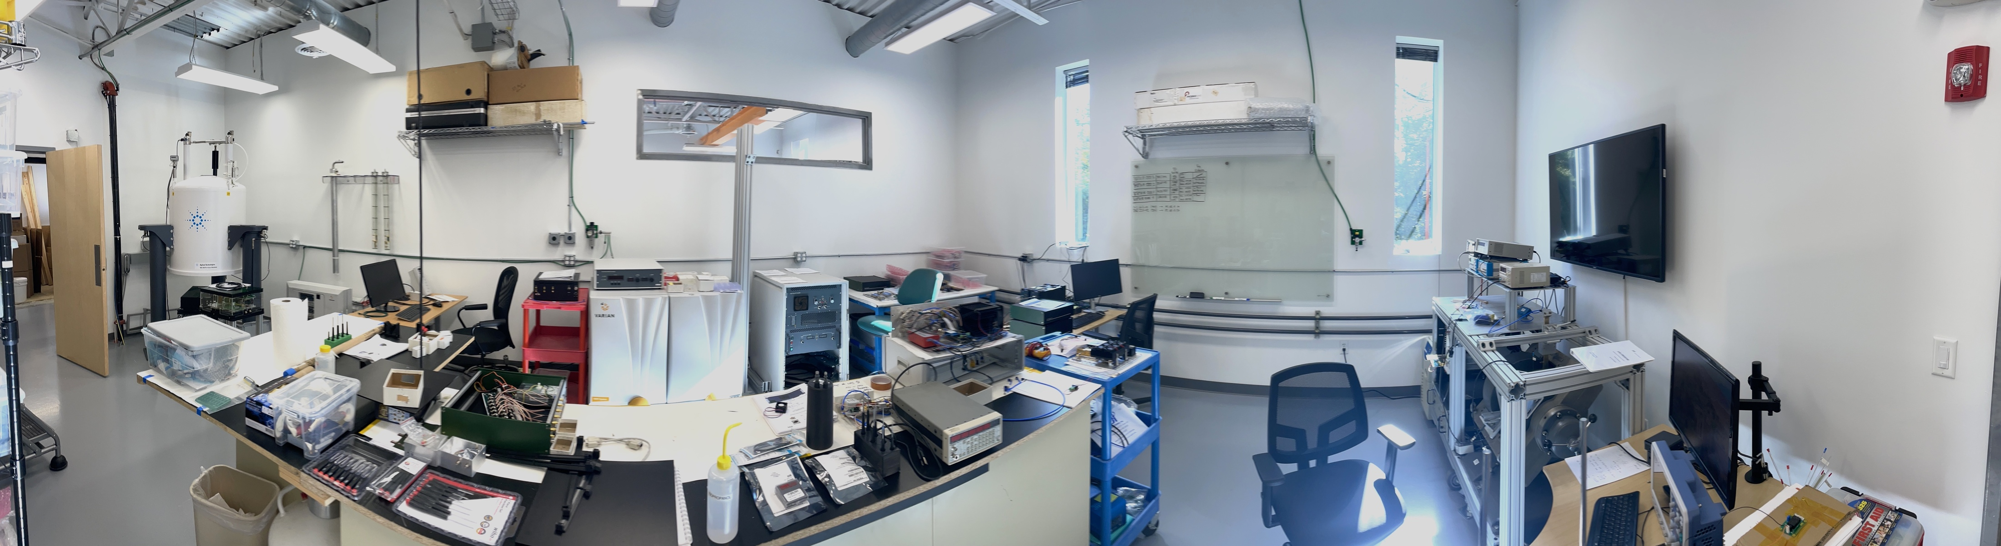
Bridge12 – Modular, agile high/low-frequency microwave instruments and systems for academic research
Two large labs for EPR/NMR/DNP
In-house workshop

Slide 3
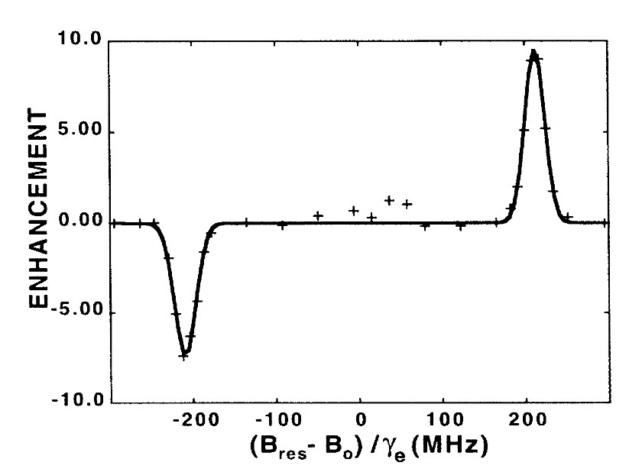
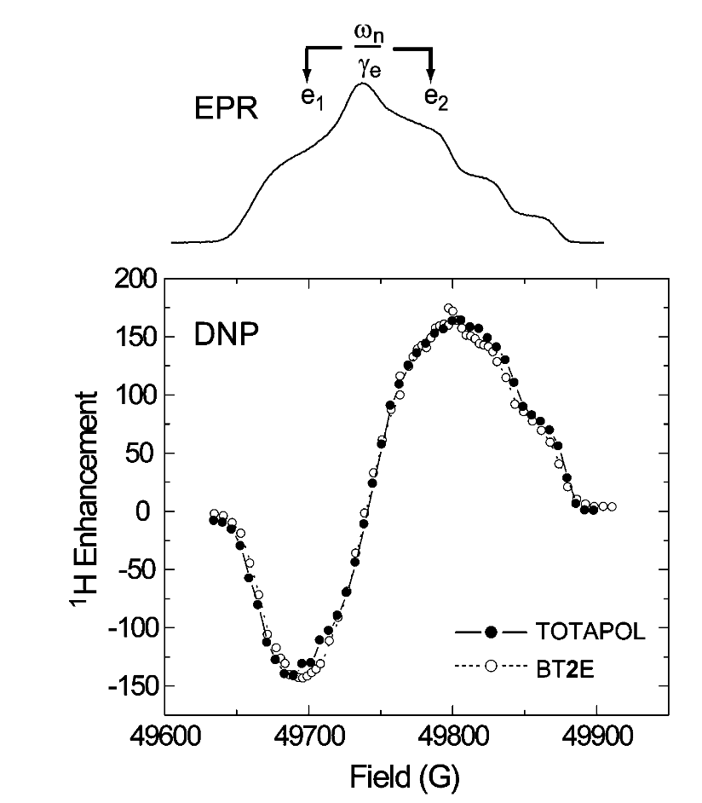
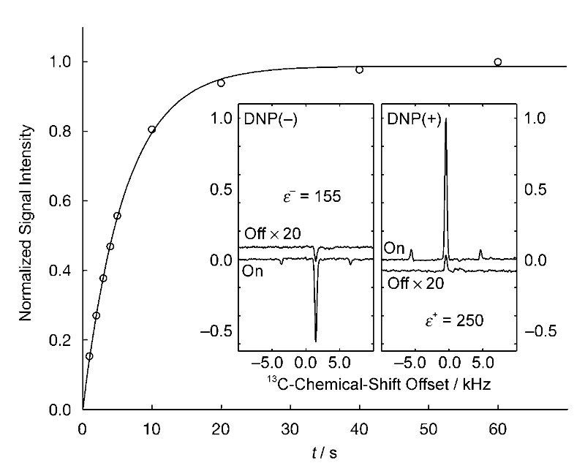
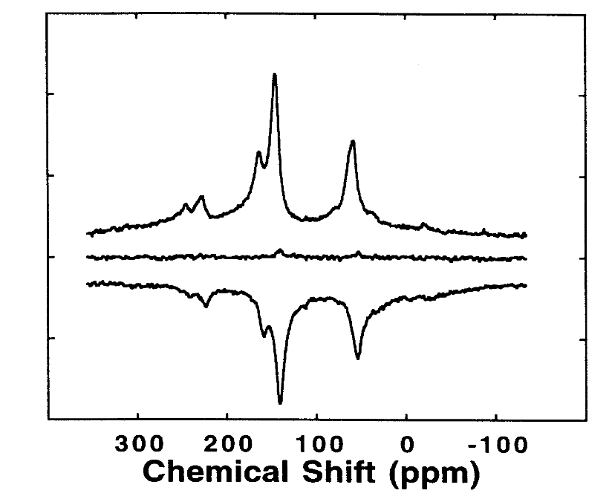
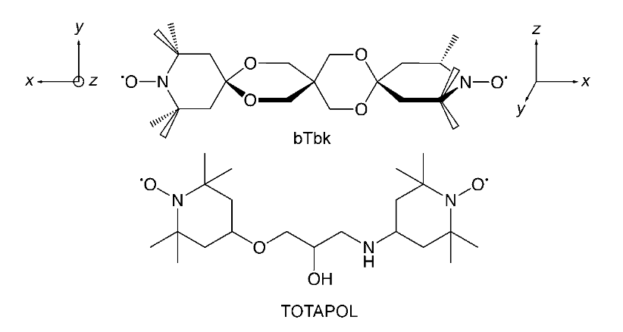
Progress of DNP-NMR Spectroscopy in the Bio Community
ε ~ 10
ε > 180
ε > 250
bTbK, 2009
TOTAPO, 2006
BDPA/PS, 1993

Slide 4
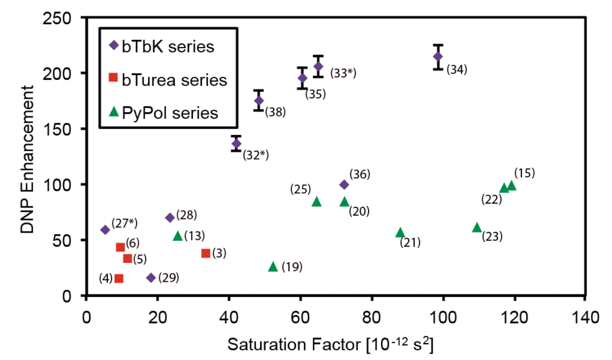
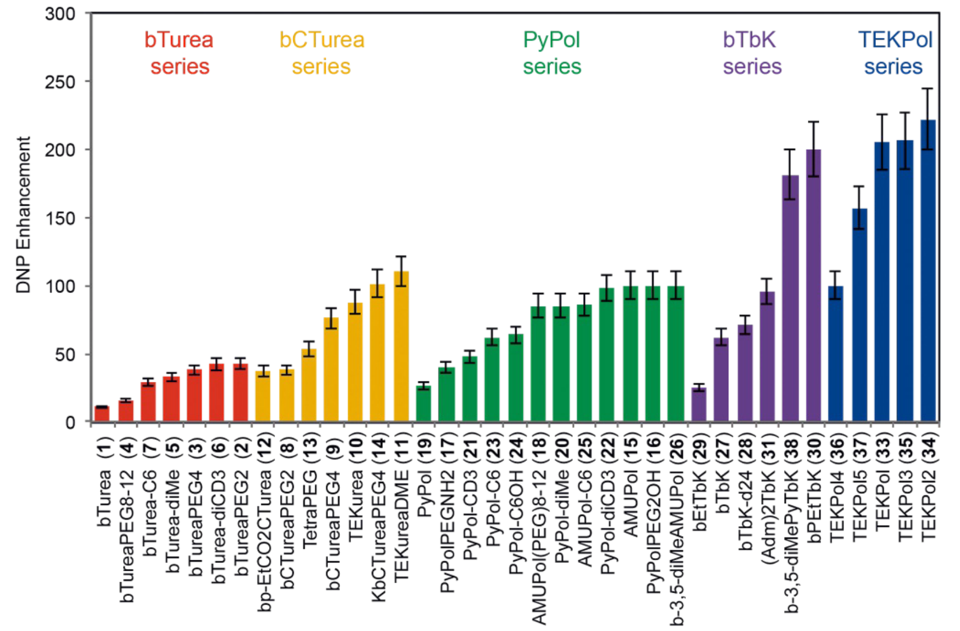
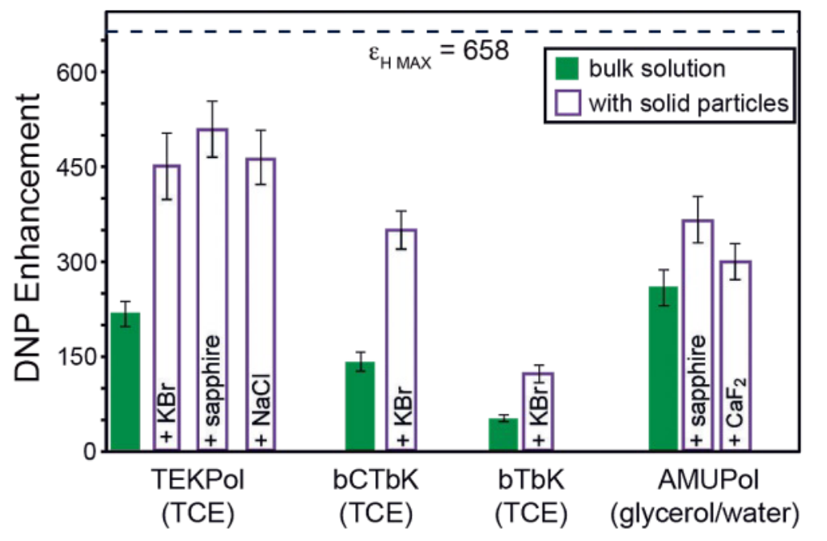
Optimizing Polarizing Agents for ¹H DNP-NMR Spectroscopy
9.4 T, 400 MHz ¹H-NMR
Kubicki et al. Chimia , 2017
Notes:
1H polarization close to 50 % at 90 K

Slide 5
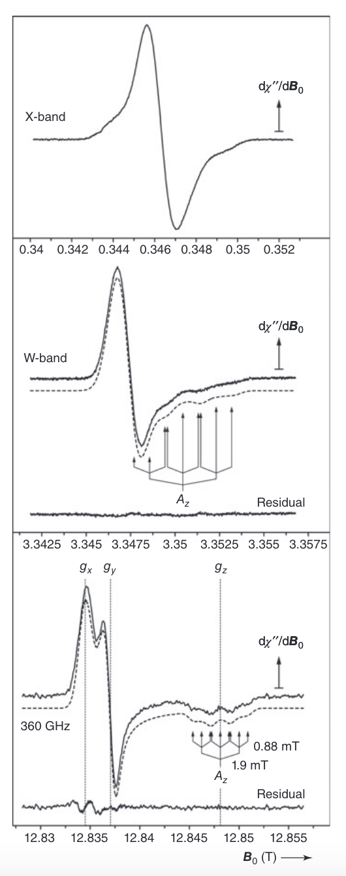
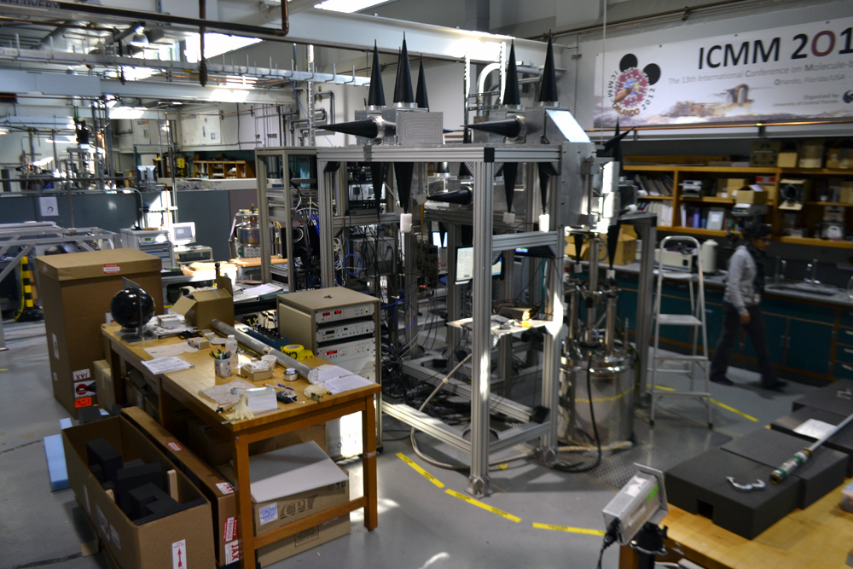
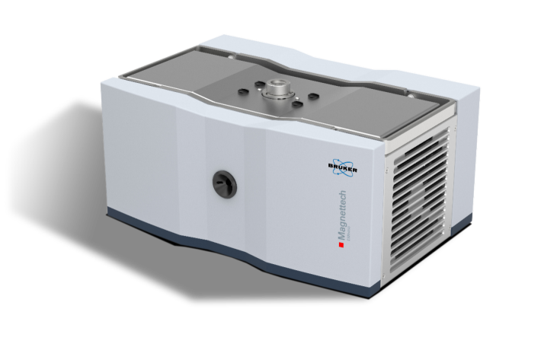
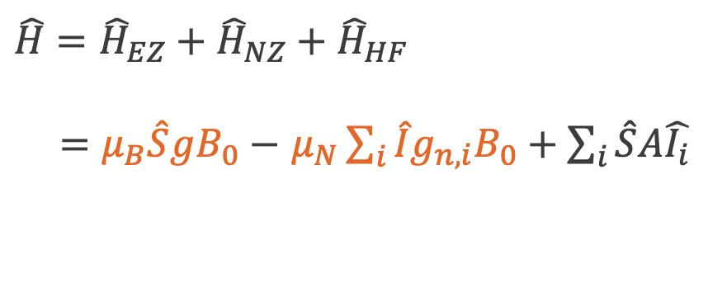
High-Field EPR Spectroscopy
$$\hat{H}={\hat{H}}_{EZ}+{\hat{H}}_{NZ}+{\hat{H}}_{HF}$$
$=μ_{B}\hat{S}gB_{0}−$ $μ_{N}\sum_{i}{\hat{I}g_{n,i}B_{0}}+\sum_{i}{\hat{S}A\hat{I_{i}}}$
Pros
  g-Tensor resolution
  Increased sensitivity
Cons
  Demanding instrumentation
  Often not turn-key operation
FAD Cofactor Anion in Glucose Oxidase
Weber et al., J. Phys. Chem. B, 2008
MagLab
Notes:
Example is an organic radical in a protein
Increased resolution good to understand electronic structure, study vicinity and dynamics (libration)
Predominantly home-built instrumentation

Slide 6
State-of-the-Art – High-Field DNP/NMR Spectroscopy
DNP-NMR (MAS) Spectroscopy
  Temperature regime: 90 K and up
  Uses magic angle spinning (MAS), some static experiments
  Turn-key method/instrumentation
    Stable sources (gyrotron)
    Optimized microwave coupling to sample
  Most commonly used at 9.4 T (400 MHz ¹H)
  Try-and-error approach to optimizing polarizing agents. Need more EPR data (T_{1e}, T_{2e}, T_{1n}, J, …) at different magnetic field strengths
  Already good understanding of mechanisms, but more work required especially for DNP-NMR experiments under MAS conditions

Slide 7
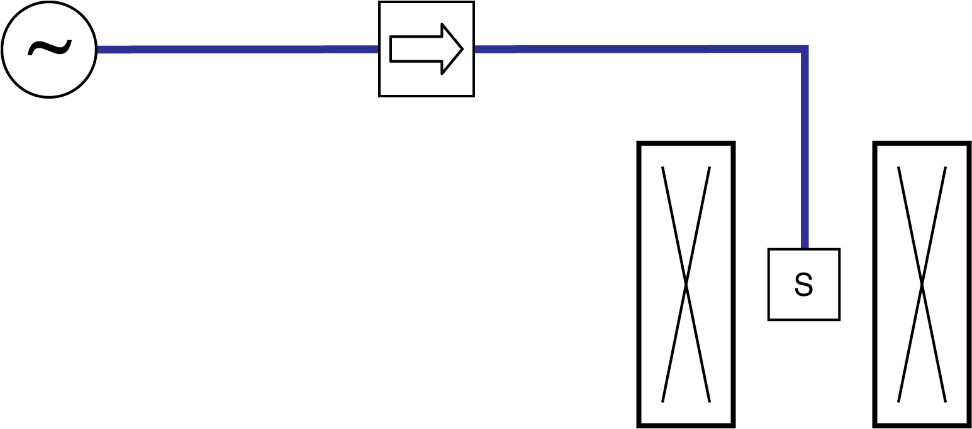
Irradiation Only with Isolator
Isolator
Basic setup
Source protection using isolator
  Important when using solid-state sources

Slide 8
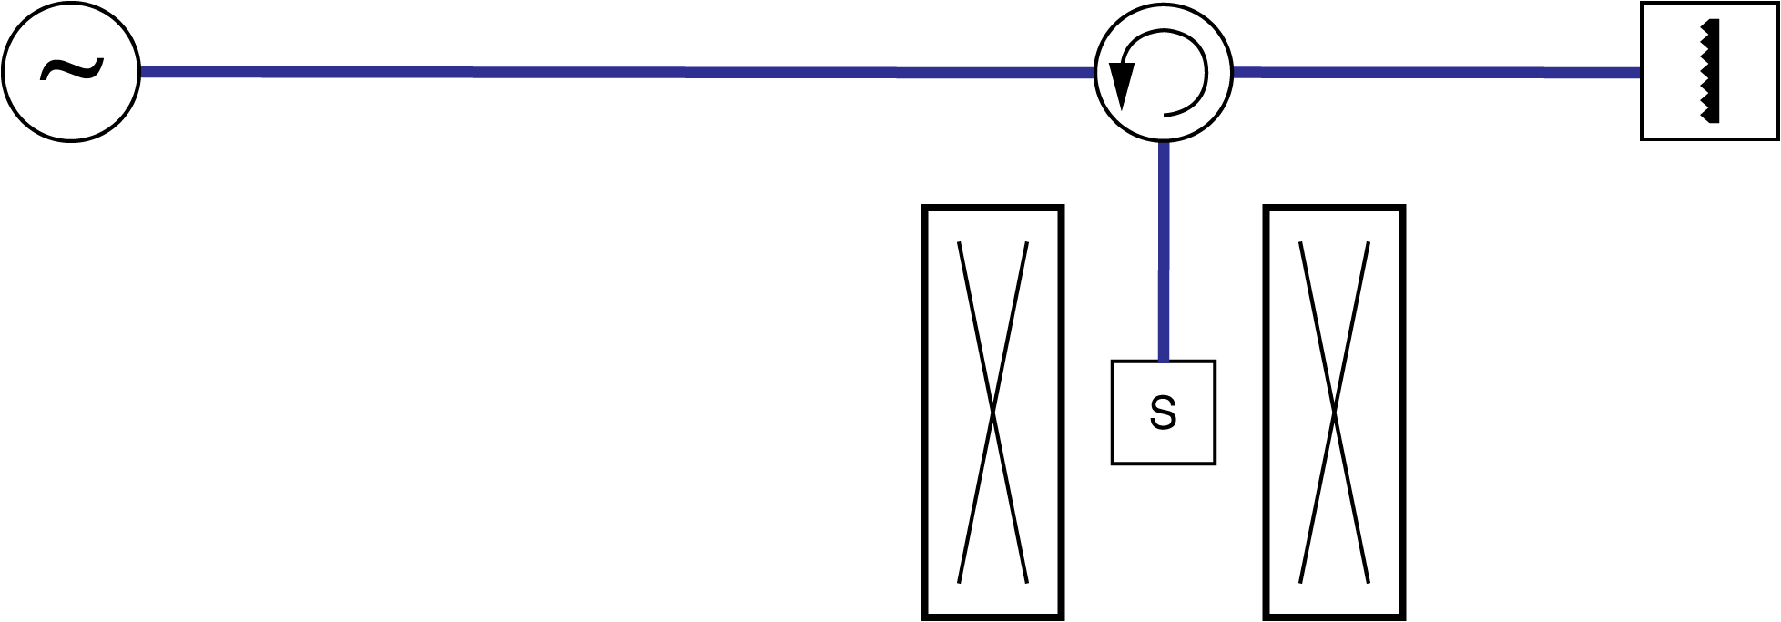
Irradiation Only with Circulator
Circulator
Absorber
Circulator
3 or 4 port device
Directs microwave power
  Port 1 → Port 2
  Port 2 → Port 3
  Port 3 → Port 1
Basic setup
Source protection using circulator
Reflected power is directed to load
Minimize standing waves

Slide 9
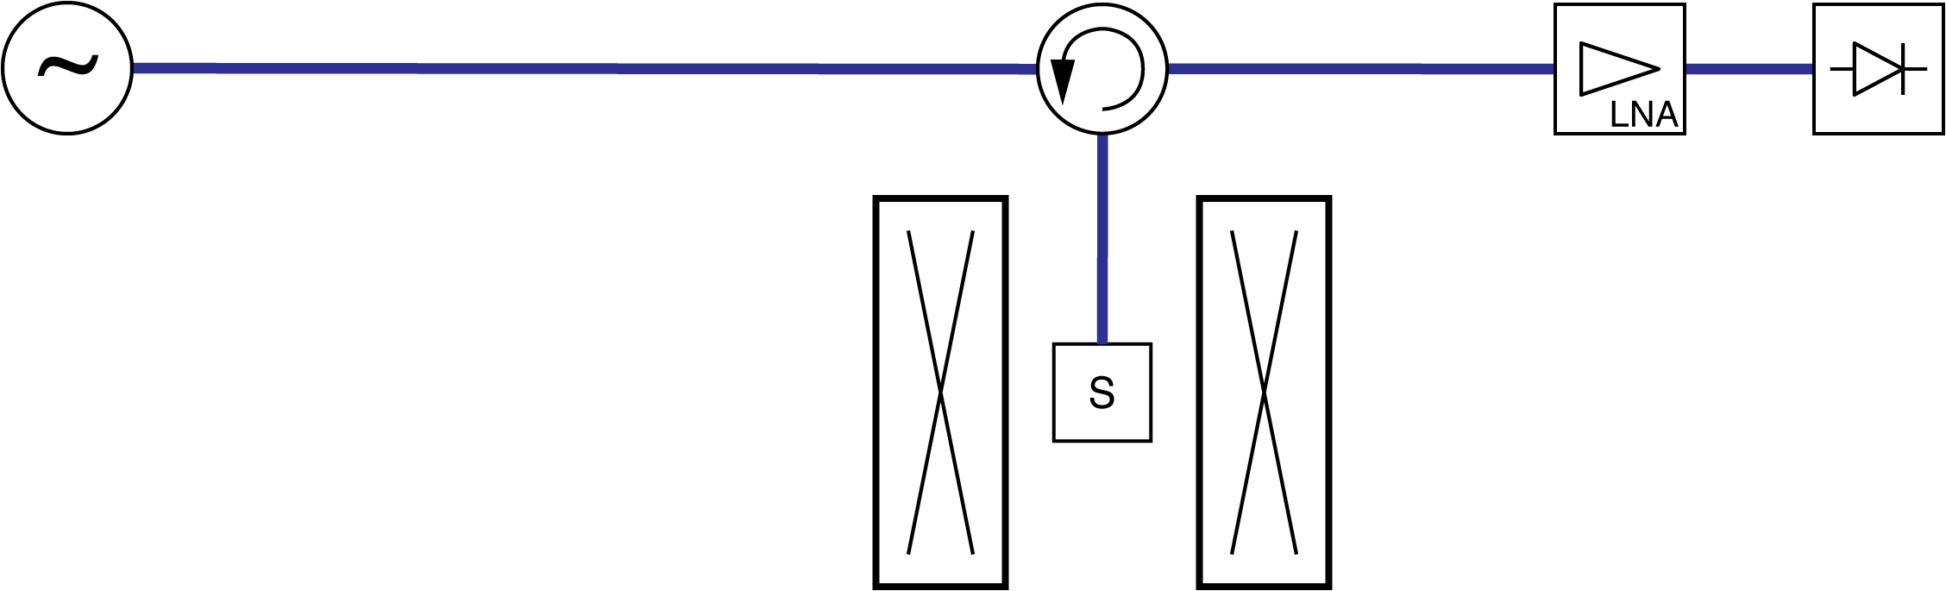
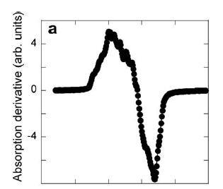
Reflection Bridge
Direct Detection
LNA
Detector
TEMPO @ 263 GHz
Basic setup for EPR detection
Source protection through circulator
Reflected power is directed to detector (need resonator)
No phase information (superposition of absorption and dispersion signal)
Thurber et al. “Low-Temperature Dynamic Nuclear Polarization at 9.4T with a 30mW Microwave Source.” Journal of Magnetic Resonance 2010
Notes:
Could be a very simple EPR spectrometer, but you need a very well tuned microwave cavity (resonator)

Slide 10
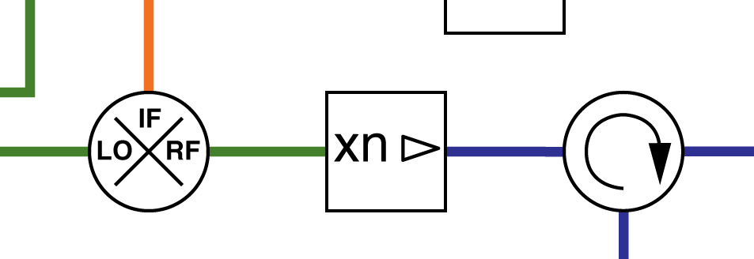

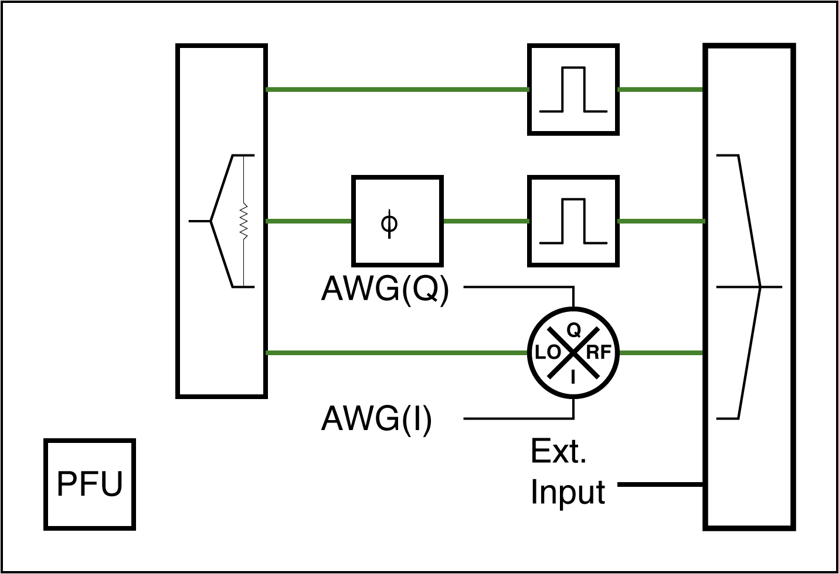
Superheterodyne Detection
Phase Sensitive and Highest Overall Sensitivity
IF
Offset
50 MHz
LO
Add Pulse Forming Unit
AMC
Create/shape pulses at
LO frequency (e.g. x-band)
Most sophisticated setup for EPR detection
Maximum sensitivity (amplification at IF)
Create/Shape pulses at LO frequency

Slide 11
Components
Transmission Lines
Excitation
  Microwave Sources
  Pulse Shaping
Detection
  cw or time domain
Discreet Components
  Circulators
  Isolators
  Power Splitters/Combiners

Slide 12
Transmission Lines

Slide 13
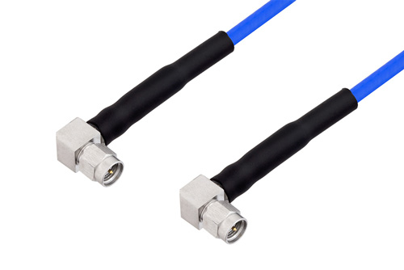
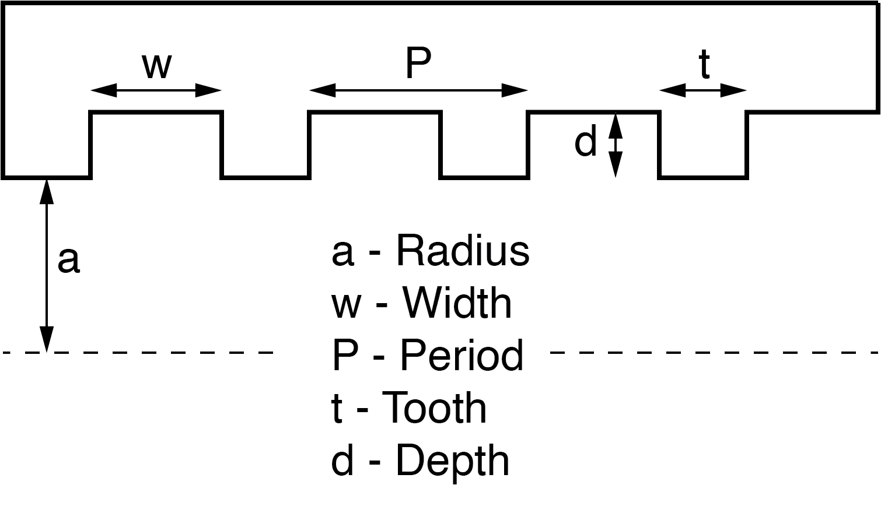
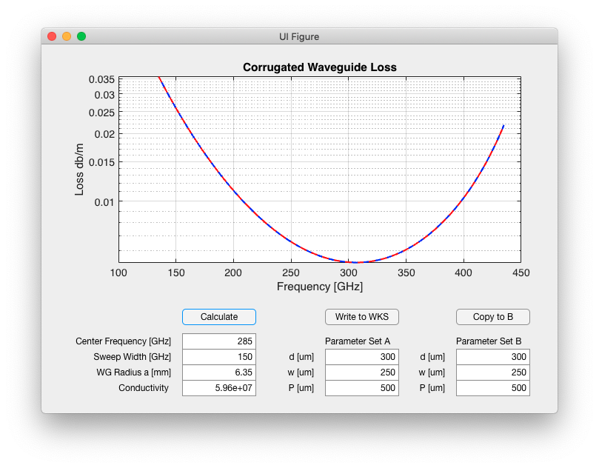
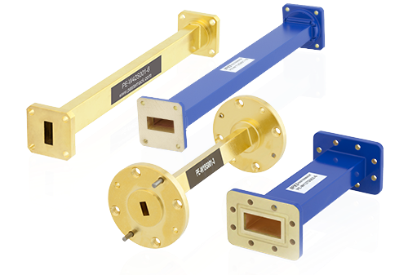
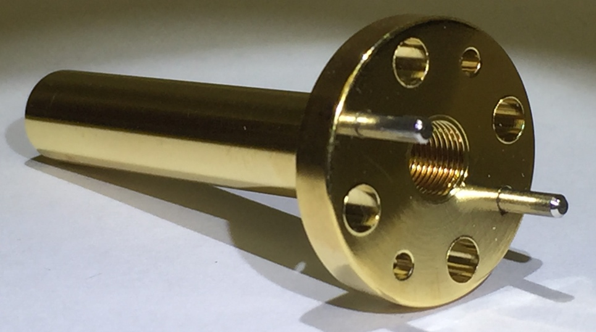
Transmission Lines
Corrugated Waveguides
Coaxial
Cable
RF to 18-28 GHz depending on connector (N-type, SMA, 2.92 …)
Waveguide
< 28 GHz: low losses
> 95 GHz: high losses
(22.7 dB/m for WR-4.3)
Corrugated
Waveguide
Excellent performance
Expensive
Extreme low losses at high frequencies.
Can be direct machined or electroformed

Slide 14
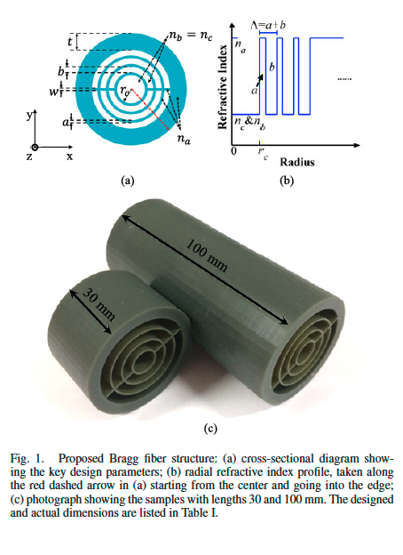
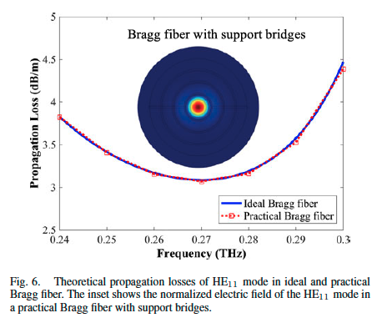
3D Printed Hollow Fibers
Something to keep an eye on …
~3dB/m
Hong et al., “Low-Loss Asymptotically Single-Mode THz Bragg Fiber Fabricated by Digital Light Processing Rapid Prototyping.” IEEE Transactions on Terahertz Science and Technology 8, no. 1 (January 2018): 90–99

Slide 15
Microwave Sources

Slide 16
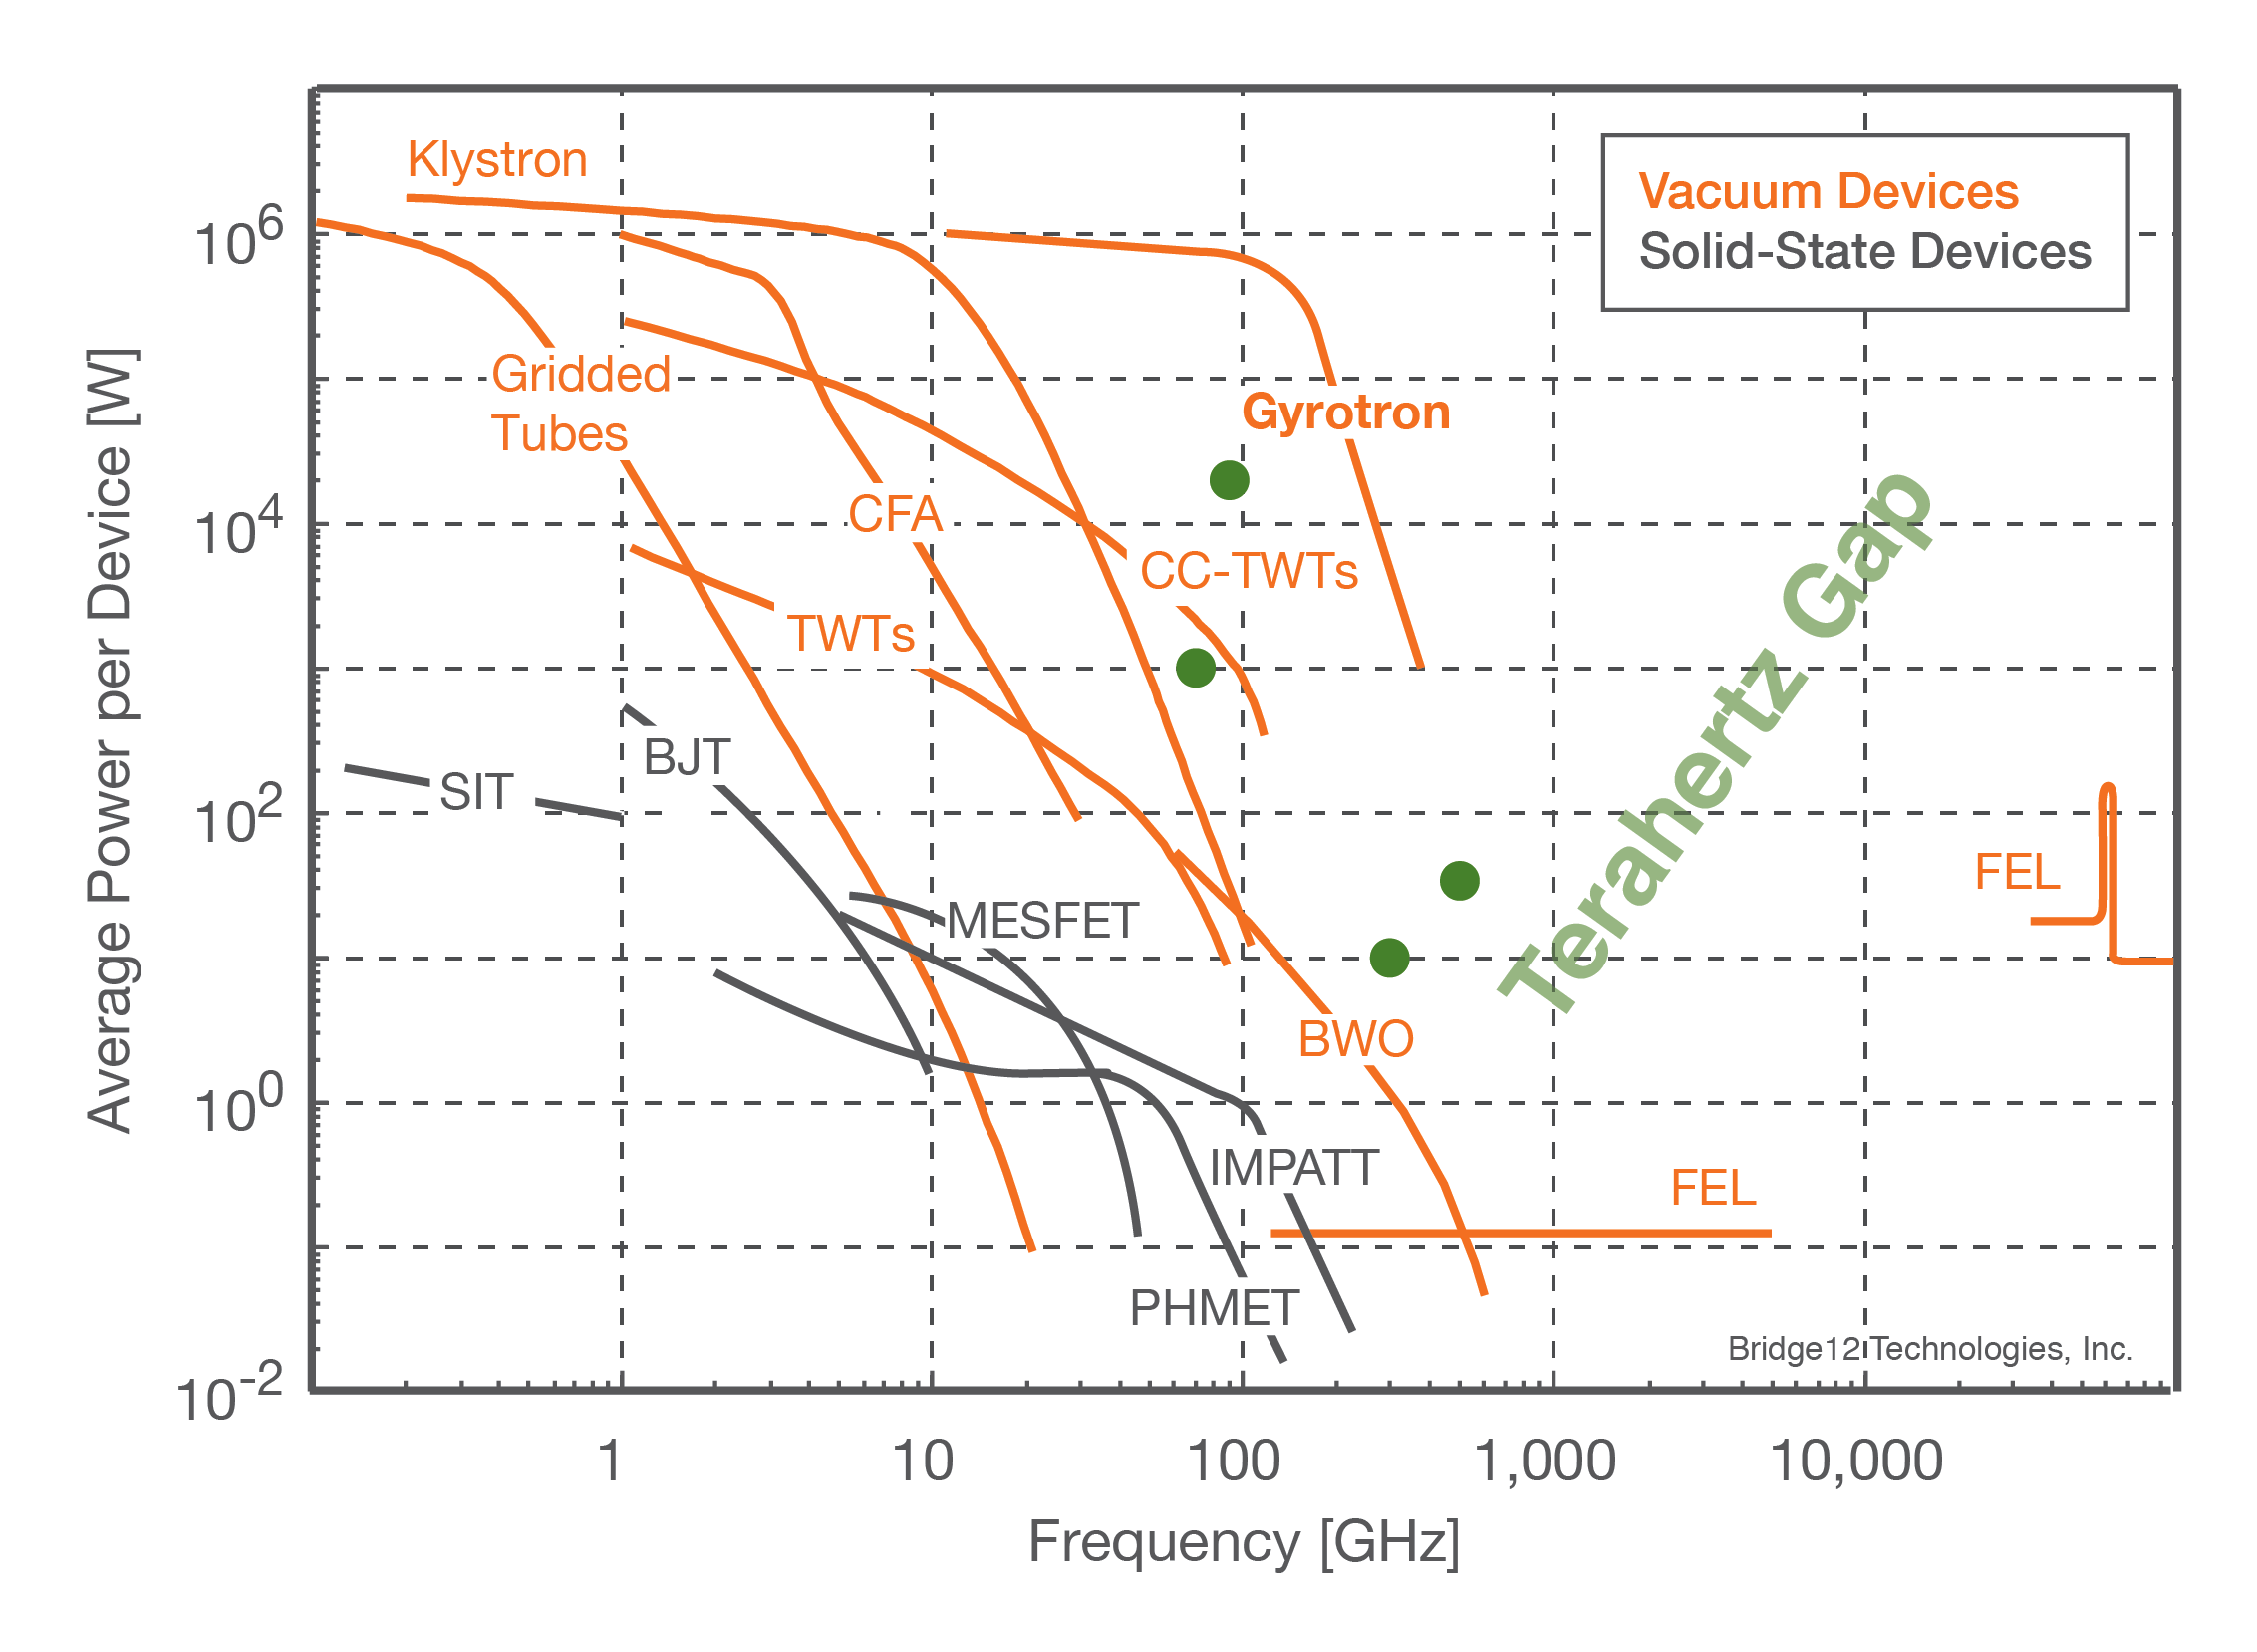
Microwave Sources - Tube Map
Vacuum Electronic Devices (VED)
  Gyrotron
  Klystron (EIO, EIK ..)
  Traveling Wave Tube (TWT)
  Backward Wave Oscillator (BWO)
Gyrotron is the only demonstrated high-power source at frequencies > 263 GHz
Watch Monica Blank’s talk: “Millimeter Sources for NMR/DNP” on YouTube

Slide 17
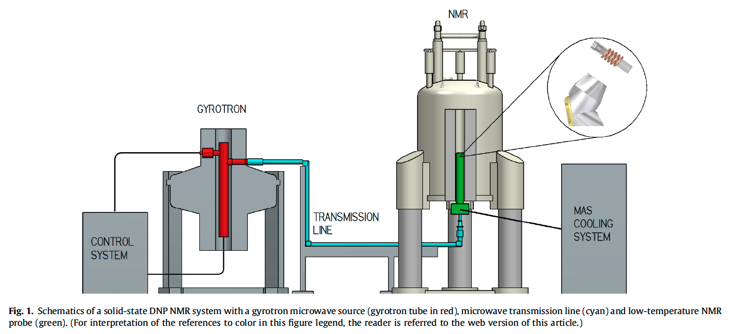
Gyrotron-Based DNP-NMR Spectroscopy
Rosay, M., M. Blank, and F. Engelke. “Instrumentation for Solid-State Dynamic Nuclear Polarization with Magic Angle Spinning NMR.” J Magn Reson 264 (March 2016): 88–98

Slide 18
Solid-State Microwave Sources
Amplification Multiplication Chains (AMCs)
(ww.vadiodes.com)
Principle of Operation
  Start at X-Band (8 – 12 GHz)
  Use series of amplification and multiplication steps (AMC)
  Key player: Virginia Diodes
Benefits
  Truly frequency agile
  Cost-effective
  Small footprint
  Turn-key
  No additional requirements (cooling water, 3-phase power, air …)
Limitations
  Low power
  (but … steadily increasing)
  up to 800 mW @ 140 GHz
  > 250 mW @ 263 GHz
  > 100 mW @ 380 GHz
Notes:
Power depends on the bandwidth

Slide 19
Source Comparison
After Monica Blank’s talk on the MIT zoominar
 | Solid-State | VED (EIO/EIA) | Gyrotron
Size/Weight | Compact | Compact | Large
Facility Requirements | Minimal | Cooling water, HV | Cooling water, air HV
Output power (for DNP) | < 250 mW | 1 – 10 W | > 50 W
Cost | $ | $$ | $$$
Cost/Watt | $$$ | $$ | $

Slide 20
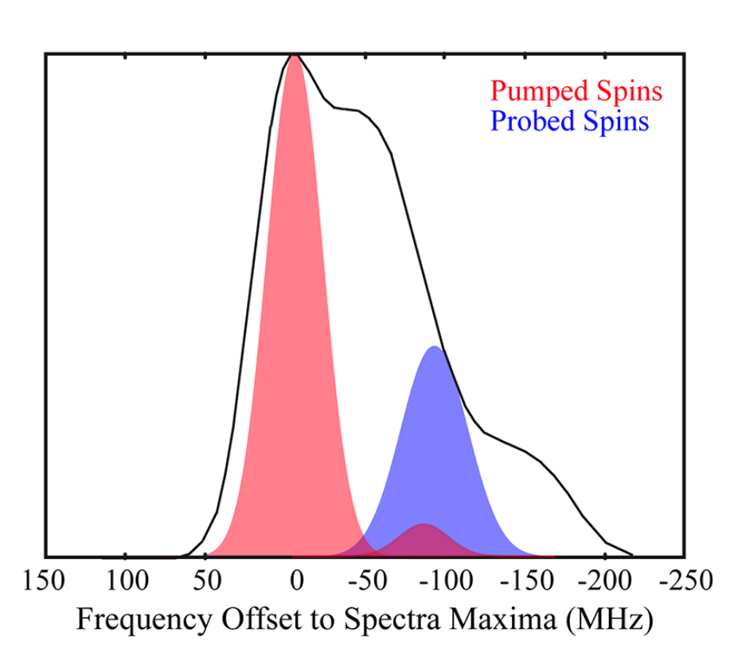
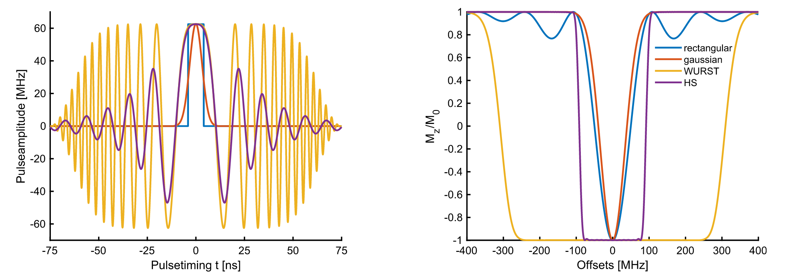
Pulse Shaping
Pulse Shaping
  Tailor the pulse excitation profile for optimum performance
PELDOR/DEER
Spectroscopy
  Minimize area of overlap to
    Minimize detection artifacts
    Acquire more accurate/reliable distance distributions
Endeward et al., JMR, 2023

Slide 21
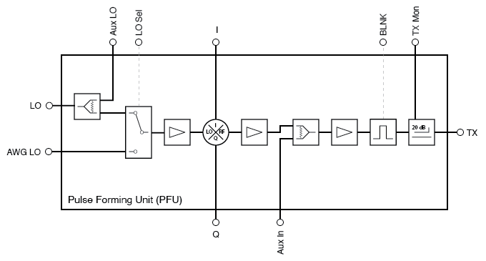
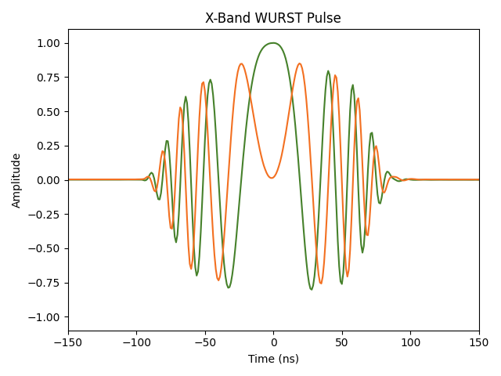
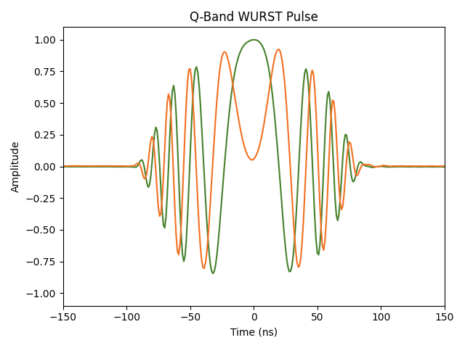
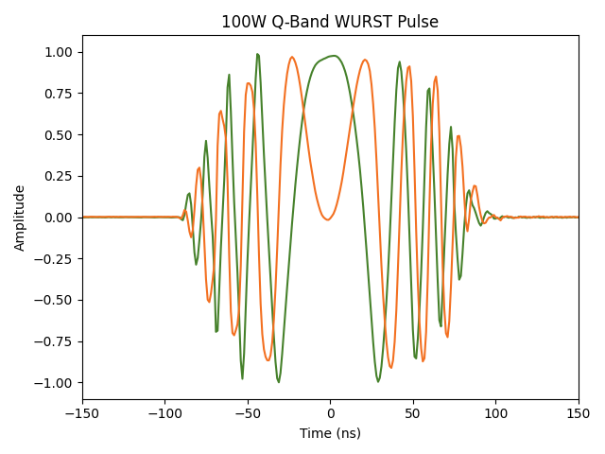
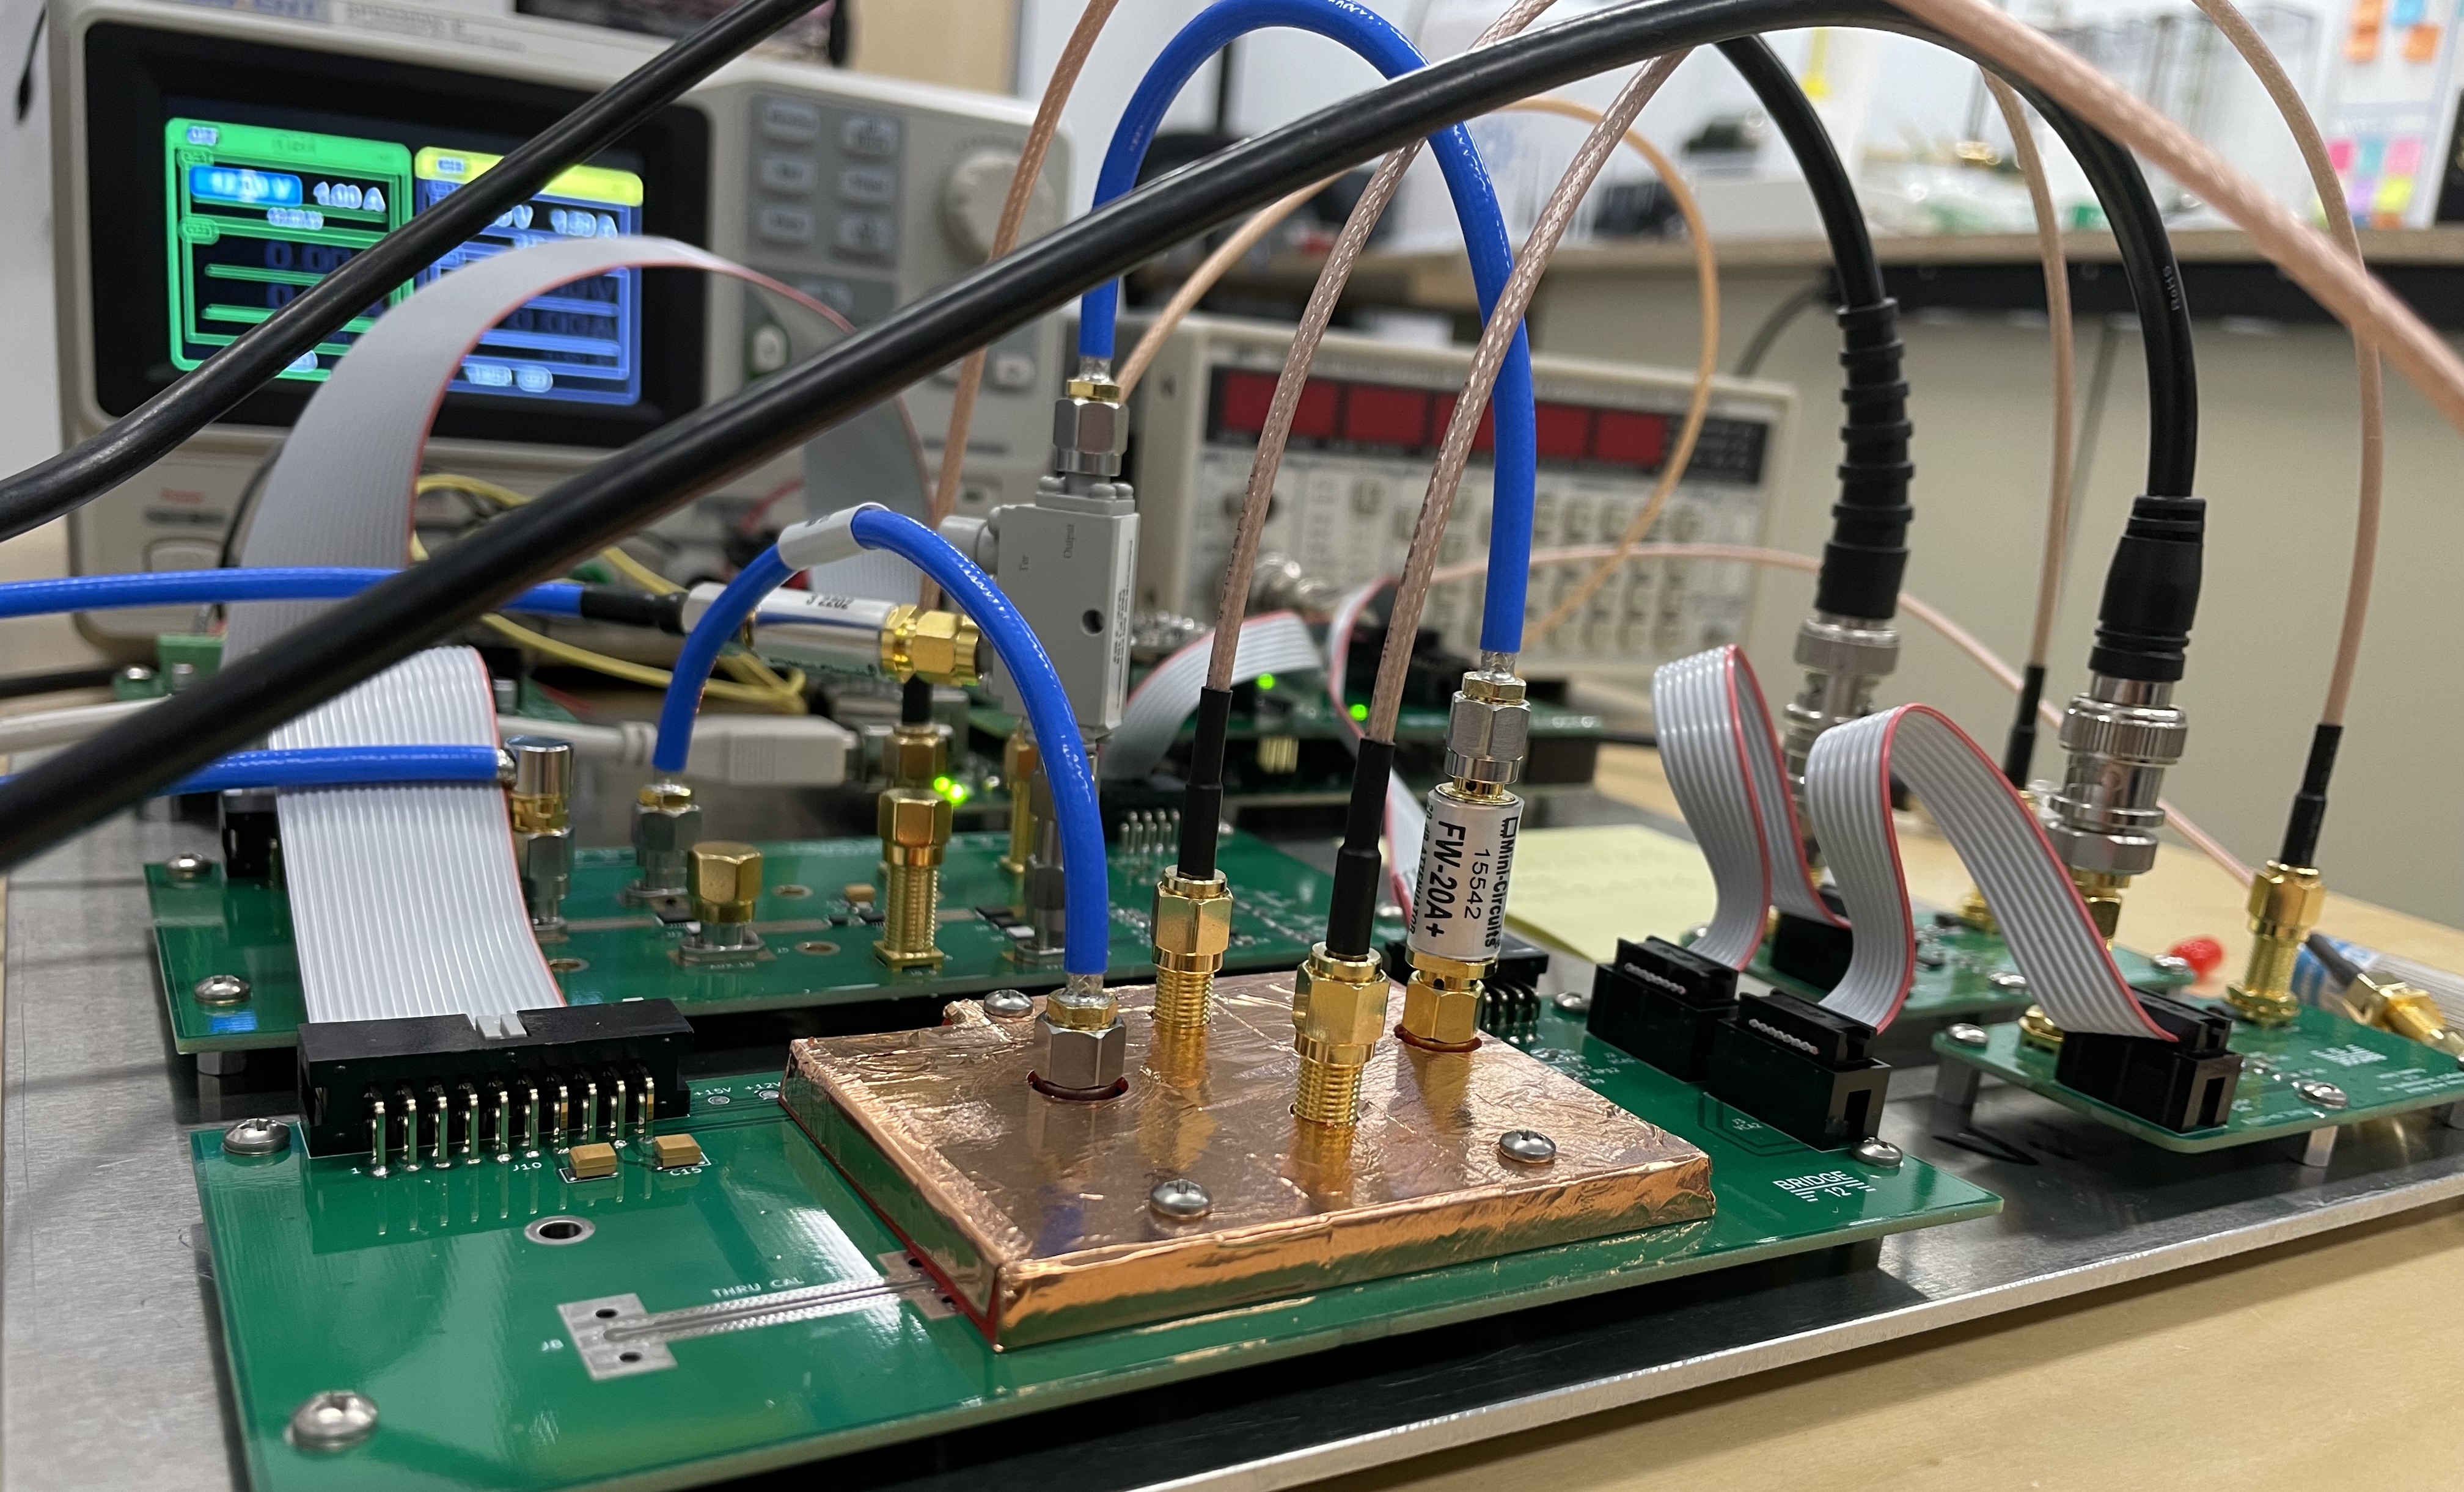
Pulse Shaping
PRELIMINARY RESULTS
PFU
RCVR

Slide 22
Discreet Microwave Components

Slide 23
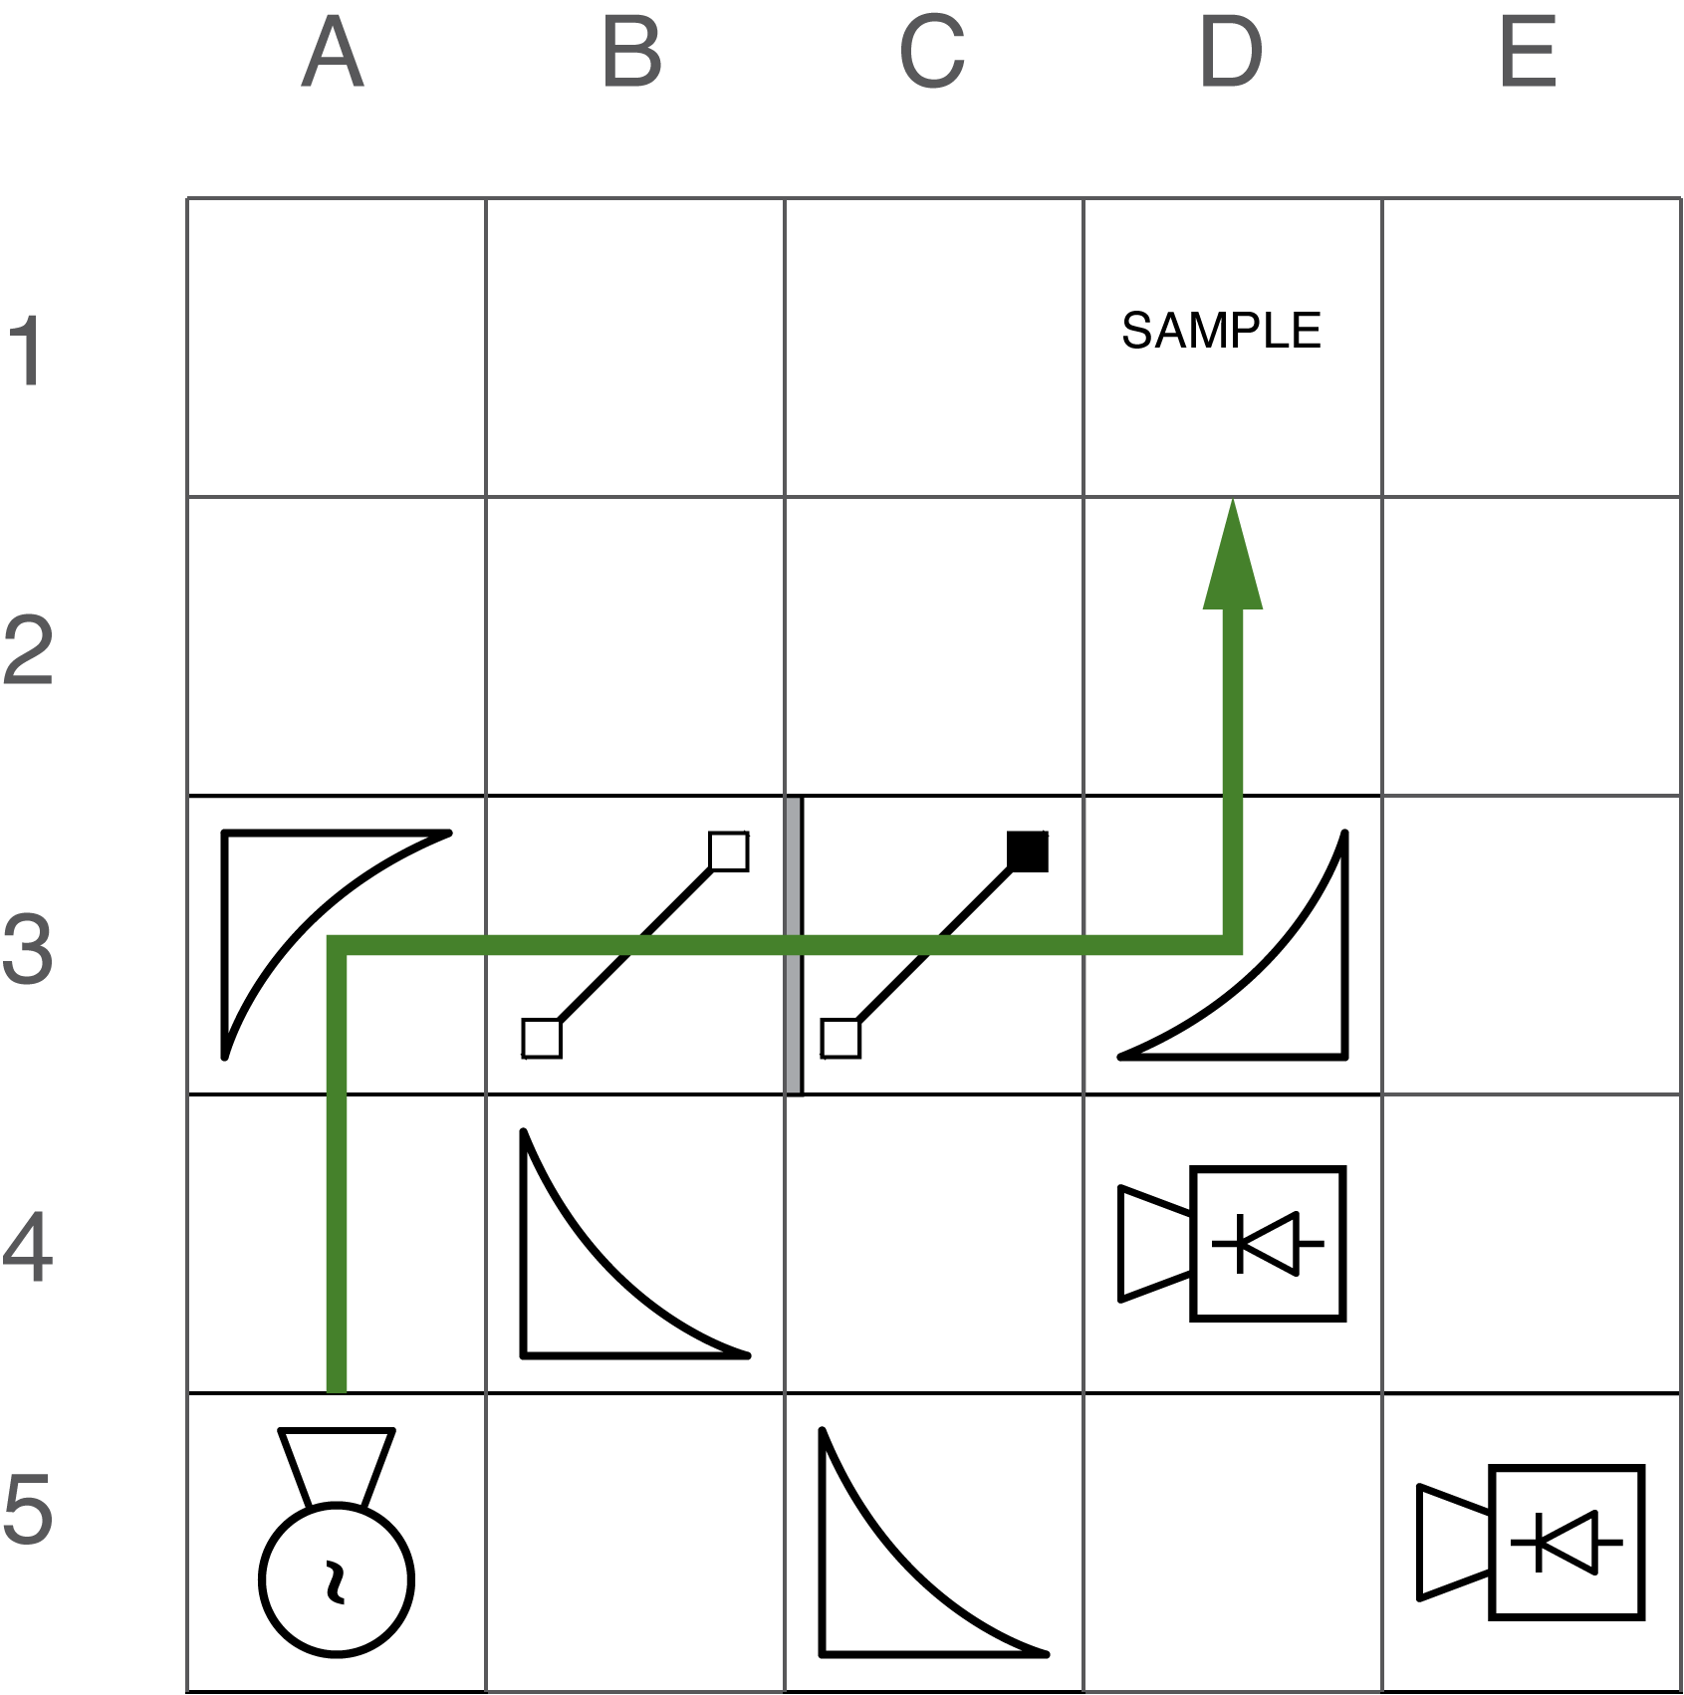
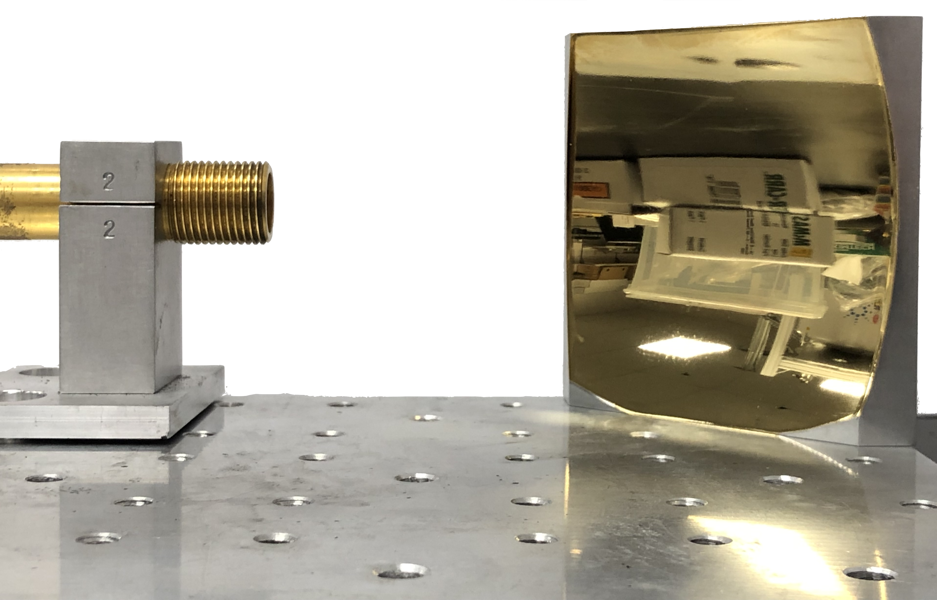
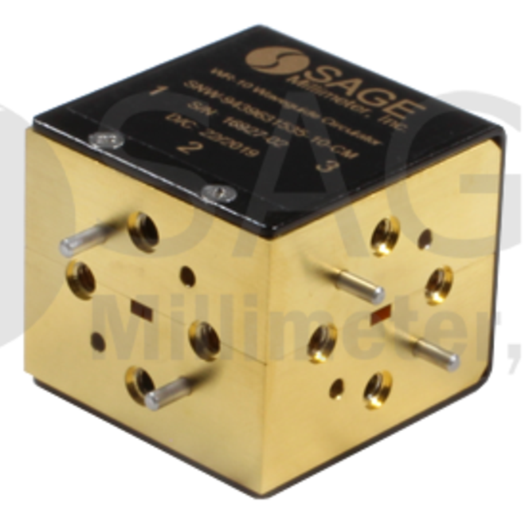
High-Frequency Circulator
Use low-low Quasi-Optics for Beam Manipulation
Low Frequencies (< 100 GHz)
Waveguide (or coaxial) transmission
Low insertion losses
Many discrete components
  Circulators
  Attenuators
  Phase shifters
94 – 96 GHz
1.5 dB loss

Slide 24
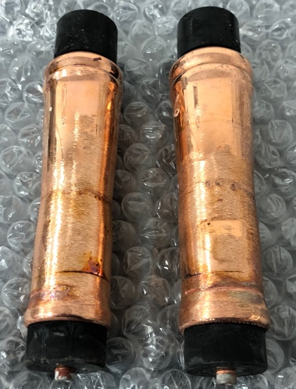
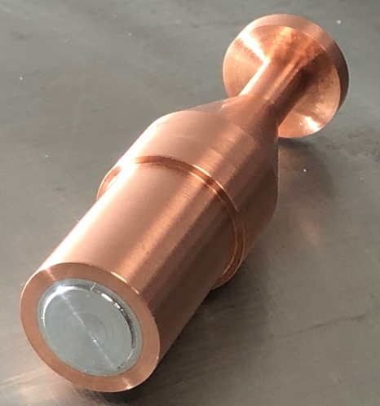
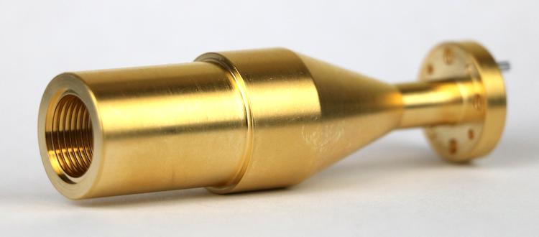
What are Quasi-Optics (QO)?
Free-space Gaussian Beam (TEM00)
Manipulate beam using combination of mirrors, grids, and λ/4-plates (or equivalent)
Extremely low losses
Every discreet microwave component
has a QO equivalent
Each QO component has a quadratic footprint, arranged on a grid
Distance between focusing elements is constant
Polarization controlling elements are placed in between pair of mirrors
  Gaussian Telescope
95 GHz launcher, 97.8 % HE₁₁ –TEM₀₀ coupling
Notes:
Magnification: Unity
Frequency Independent

Slide 25
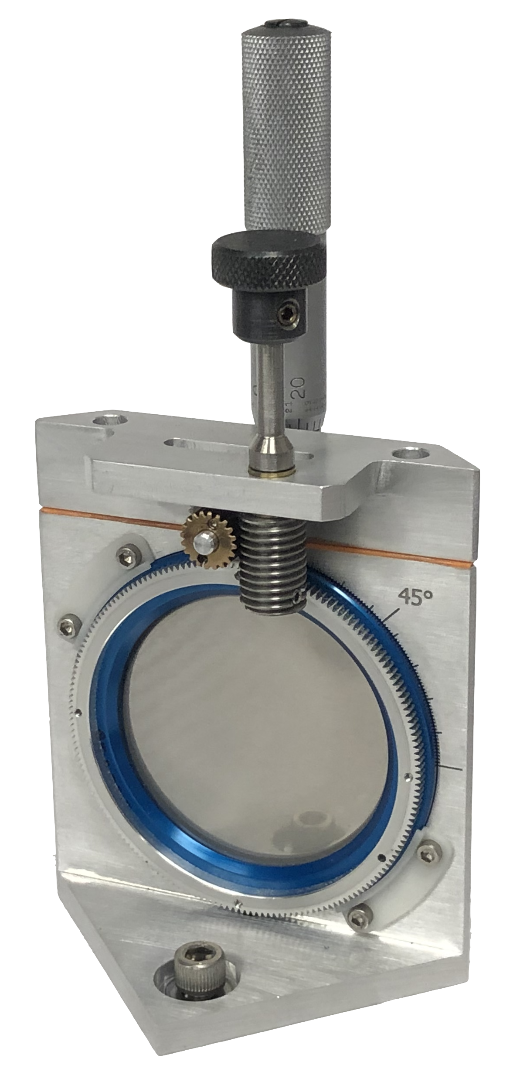
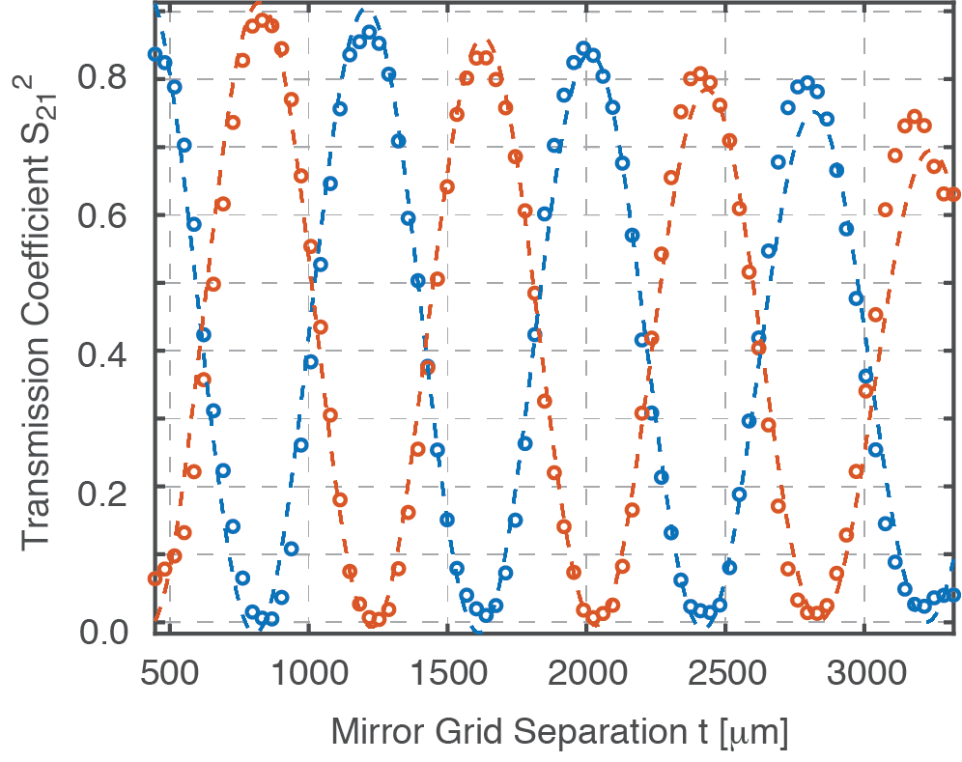
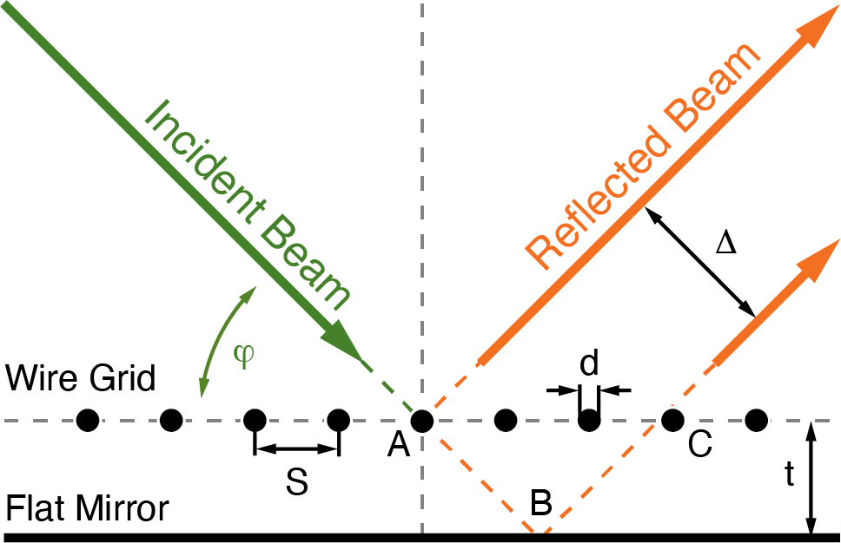
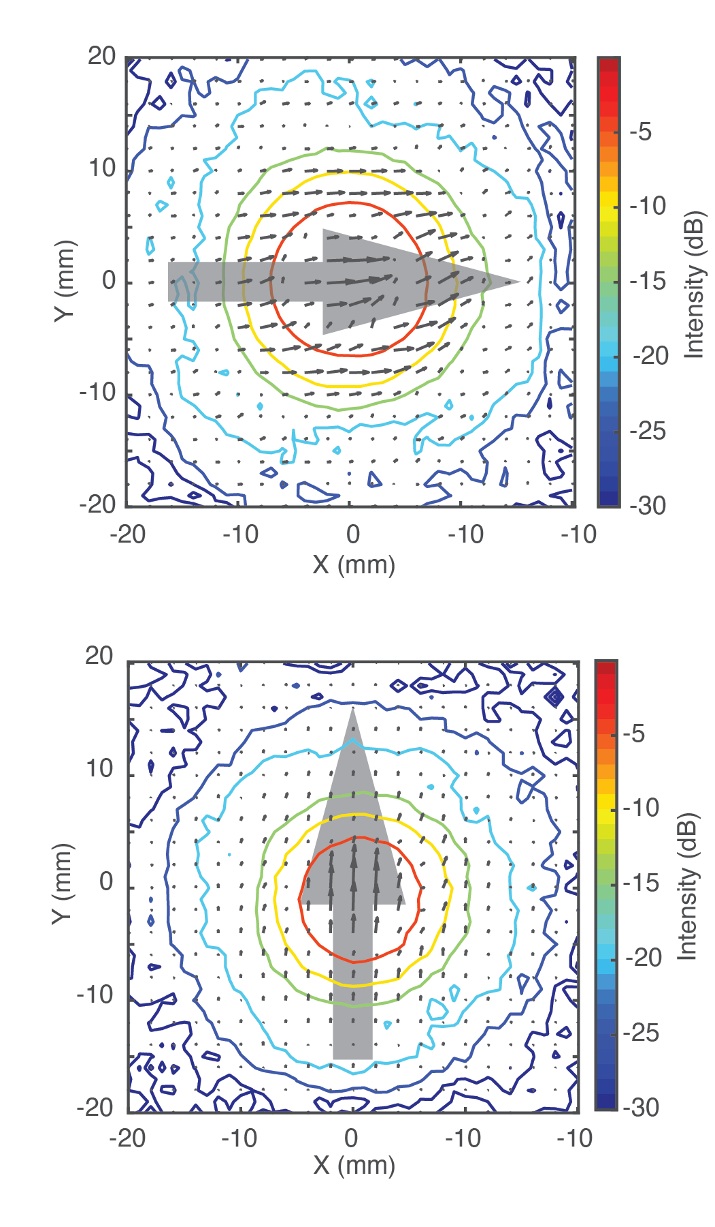
Polarization Transforming Reflector (PTR)
Introduce phase difference to change polarization
Convert linear to circular polarization
or any in between
Low insertion loss, high isolation
Compact design
Insertion Loss: 0.80 dB
Isolation: 30.9 dB

Slide 26
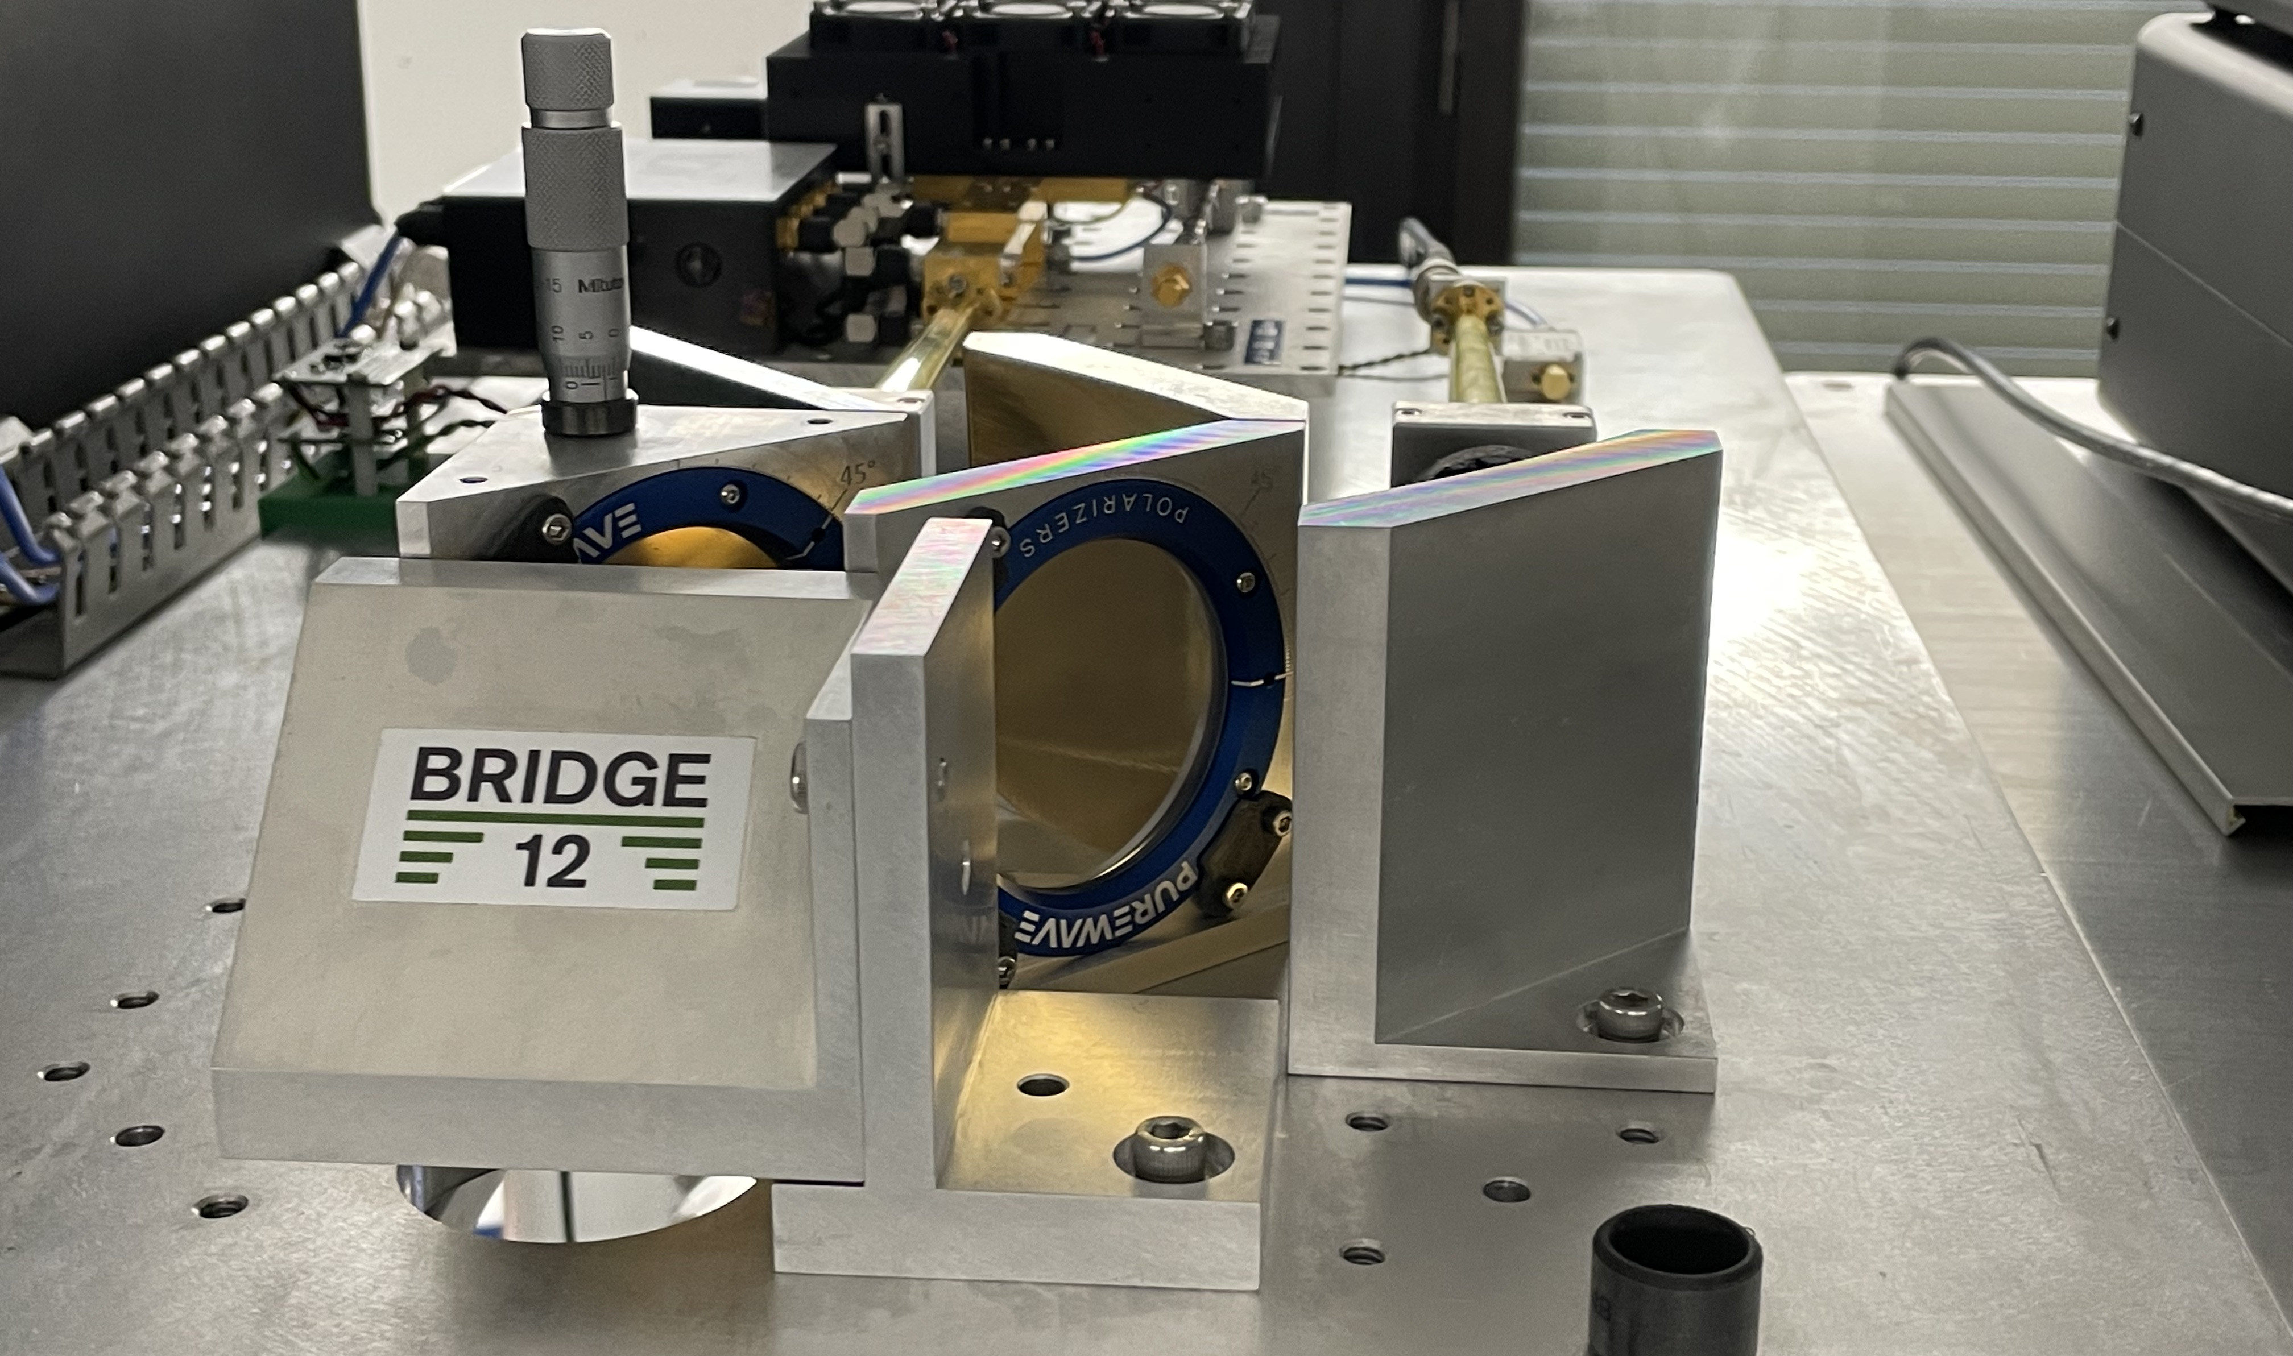
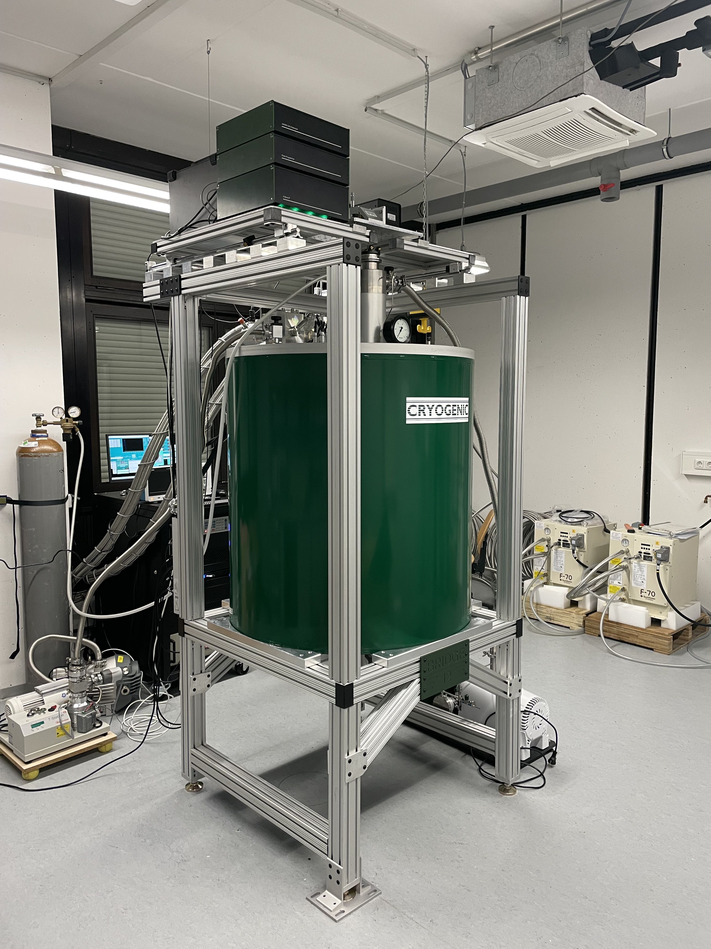


140/350 GHz Dual-Frequency EPR Spectrometer
140/350 GHz EPR Spectroscopy
  Max. magnetic field: 14.5 T
  Temperature regime: 1.95 to 300 K
  Liquid cryogen free operation
  Microwave power
    140 GHz: > 500 mW
    350 GHz: > 100 mW
  Operation modes:
    CW
      lock-in detection
    Time-domain
      Discreet and AWG generated pulses
  Completely automated operation
PTR-based QO Duplexer

Slide 27


140/350 GHz Dual-Frequency EPR Spectrometer
CW
Pulsed
PRELIMINARY RESULTS

Slide 28
DNP Literature Blog: blog.bridge12.com
Twitter: @thmaly
Email: tmaly@bridge12.com
THANK YOU

Slide 29








Building an EPR Community Through OS Hard- and Software
First fully open-source X-Band Loop Gap Resonator
pip install dnplab
import dnplab as dnp
data = dnp.load("topspin/1")
Hardware < 50 $
Easily assembled
Teach EPR spectroscopy
Teach instrumentation
data = dnp.apodize(data,lw=100)
data = dnp.fourier_transform(data)
data = dnp.autophase(data)
Single PCB
Resonator
dnp.fancy_plot(data)
dnp.show()
Python-based
Object-oriented
Open-source
Modulation
Coils
DNPLab is created by Bridge12, the Han Lab (UCSB) and the Franck Lab (Syracuse).
OpenPCBLGR
Find it on GitHub

Slide 30

Q-Band (35 GHz) EPR Spectrometer
Q-Band EPR Spectrometer
  Max. magnetic field: 3.5 T
  Temperature regime: 1.95 to 300 K
  Liquid cryogen free operation
  Microwave power
    34 GHz: > 100 W
  Time Domain Operation
    Fully AWG controlled
  Completely automated operation

Slide 31



QO Duplexer using a PTR
140 GHz
Excitation
PTR changes beam polarization from linear to circular (e.g. RH)
Detection
Reflected beam has opposite polarization (e.g LH)
PTR changes polarization back to linear
(but orthogonal to incident beam)
263 GHz

Slide 32


Compact Quasi-Optical Bridges for Beam Manipulation
Application: Gyrotron-based DNP-NMR Spectroscopy
Polarizing Transforming Mirror and Universal Polarizers
QO bridge for gyrotron-based DNP-NMR spectrometers
Continuous, remote-controlled attenuator
Universal polarizer
Shutter to create ms pulses
Chen et al., Rev. Sci. Inst, 2022 https://doi.org/10.1063/5.0036292

Slide 33

Cube Layout of Quasi-Optics Systems
Each QO component has a quadratic footprint
All components are arranged on grid
Mirror, grid holders are designed as half cube elements
Distance between focusing elements is constant
Polarization controlling elements are placed in between pair of mirrors
  Gaussian Telescope
Gaussian Telescope
Magnification: Unity
Frequency Independent
Lesurf, J. C. G. Millimetre-Wave Optics, Devices, and Systems. Bristol, England ; New York: A. Hilger, 1990.

Slide 34




What is a Gaussian Beam?
Gaussian beam mode: TEM₀₀
Efficient coupling of the TEM₀₀ mode to the HE₁₁ mode
Description is extensively used in optical spectroscopy
Fully characterized by its beam waist radius (ω) and radius of curvature (R)
At the origin ω = ω₀ and R = $∞$ (flat beam front)
$$ω= ω_{0} {\left(1+ {\left(\frac{γ z}{π ω_{0}^{2}}\right)}^{2}\right)}^{0.5}$$
Beam waist radius
expands while propagating
Expansion depends
on frequency
Each transition HE₁₁ to TEM₀₀ introduces ~2 % loss
$$R=z+ \frac{1}{z}+ \frac{1}{2}{\left(\frac{π{ ω}_{0}^{2}}{λ}\right)}^{2}$$
Goldsmith, Paul F. Quasioptical Systems: Gaussian Beam Quasioptical Propagation and Applications. IEEE Press/ Champman & Hall Publishers, 1998.

Slide 35




Components of a Quasi-Optical System
Launchers
  Input/Output Port
Mirrors
  Focusing Mirrors
  Flat Mirrors
(Lenses)
Wire Grids
  Polarization Control
Wave Plates
  Quarter Wave Plates
  Faraday Rotator
Beam Splitters
Absorbers

Slide 36


Slide 37


QO Duplexer – Faraday Rotator
For Superheterodyne Detection
Excitation
Source (A5) protected by grid (B3) from reflected power
Faraday rotator located in C3, rotates polarization by 45º
Mirror (D3) can be used to direct beam out of plane
Sample (D1) is illuminated with a linearly polarized beam
Reflection Mode Detection
Power reflected by sample (D1) passes grid (C3)
Faraday rotator rotates polarization again by 45º
Beam is reflected by grid B1
Beam focused (C4) and directed to detector (D4)
Change in intensity corresponds to EPR resonance
Induction Mode Detection
Power reflected by sample (D1) passes grid (C3)
Beam has elliptical polarization
Some power proportional to absorption is reflected by grid C3, re-focused (C5) and detected E5

Slide 38









Off-Axis Mirrors
Flat Mirror
Focusing Mirror
Rooftop Mirror
$$M= \left[\begin{matrix}−1 & 0 \\ 0 & 1\end{matrix}\right]$$
$$M= \left[\begin{matrix}−1 & 0 \\ 0 & 1\end{matrix}\right]$$
$$M= \left[\begin{matrix}1 & 0 \\ 0 & 1\end{matrix}\right]$$
Jones Matrix
$$ABCD= \left[\begin{matrix}1 & d \\ 0 & 1\end{matrix}\right]$$
$$ABCD= \left[\begin{matrix}1 & 0 \\ {−2}/R & 1\end{matrix}\right]$$
$$ABCD= \left[\begin{matrix}1 & d \\ 0 & 1\end{matrix}\right]$$
Ray Propagation
Change propagation direction by 90º
(Re)-focus
expanding beam
Reverse beam
propagation direction

Slide 39


Image Distortion in Mirror Pairs
Trans configuration yields more symmetric beam
Cis configuration has lower cross-polarization content

Slide 40
DNP is a Proven Method to Enhance NMR Signal Intensities
Direct Polarization
Polarize sample directly
Solids: Straightforward approach
Solution: “Easy” at low fields, “Difficult” at high fields
Dissolution
Polarize solid at low field
Melt sample with hot solvent
Transfer sample
Record solution-state NMR
Pump/Shuttle
Polarize solution at low fields
Shuttle sample to high field
Record solution-state NMR
Shuttle sample back, repeat cycle
Temperature-Jump
Polarize solid at high fields
Melt sample with laser flash
Record solution-state NMR
Freeze sample, repeat cycle
Notes:
DNP enhances NMR signal intensities. The method is successfully employed in solid-state NMR spectroscopy
We heard about all of these different methods.

Slide 41
High-Field EPR/DNP Spectroscopy – Why Bother?
High-Field EPR Spectroscopy
  Paramagnetic bio-macromolecules
  (electron transfer proteins)
  Material science
  (catalysis, battery materials)
High-Field DNP-NMR Spectroscopy
  Sensitivity enhancement of NMR experiments
  Surface characterization
  Domain size characterization

