Slide 1
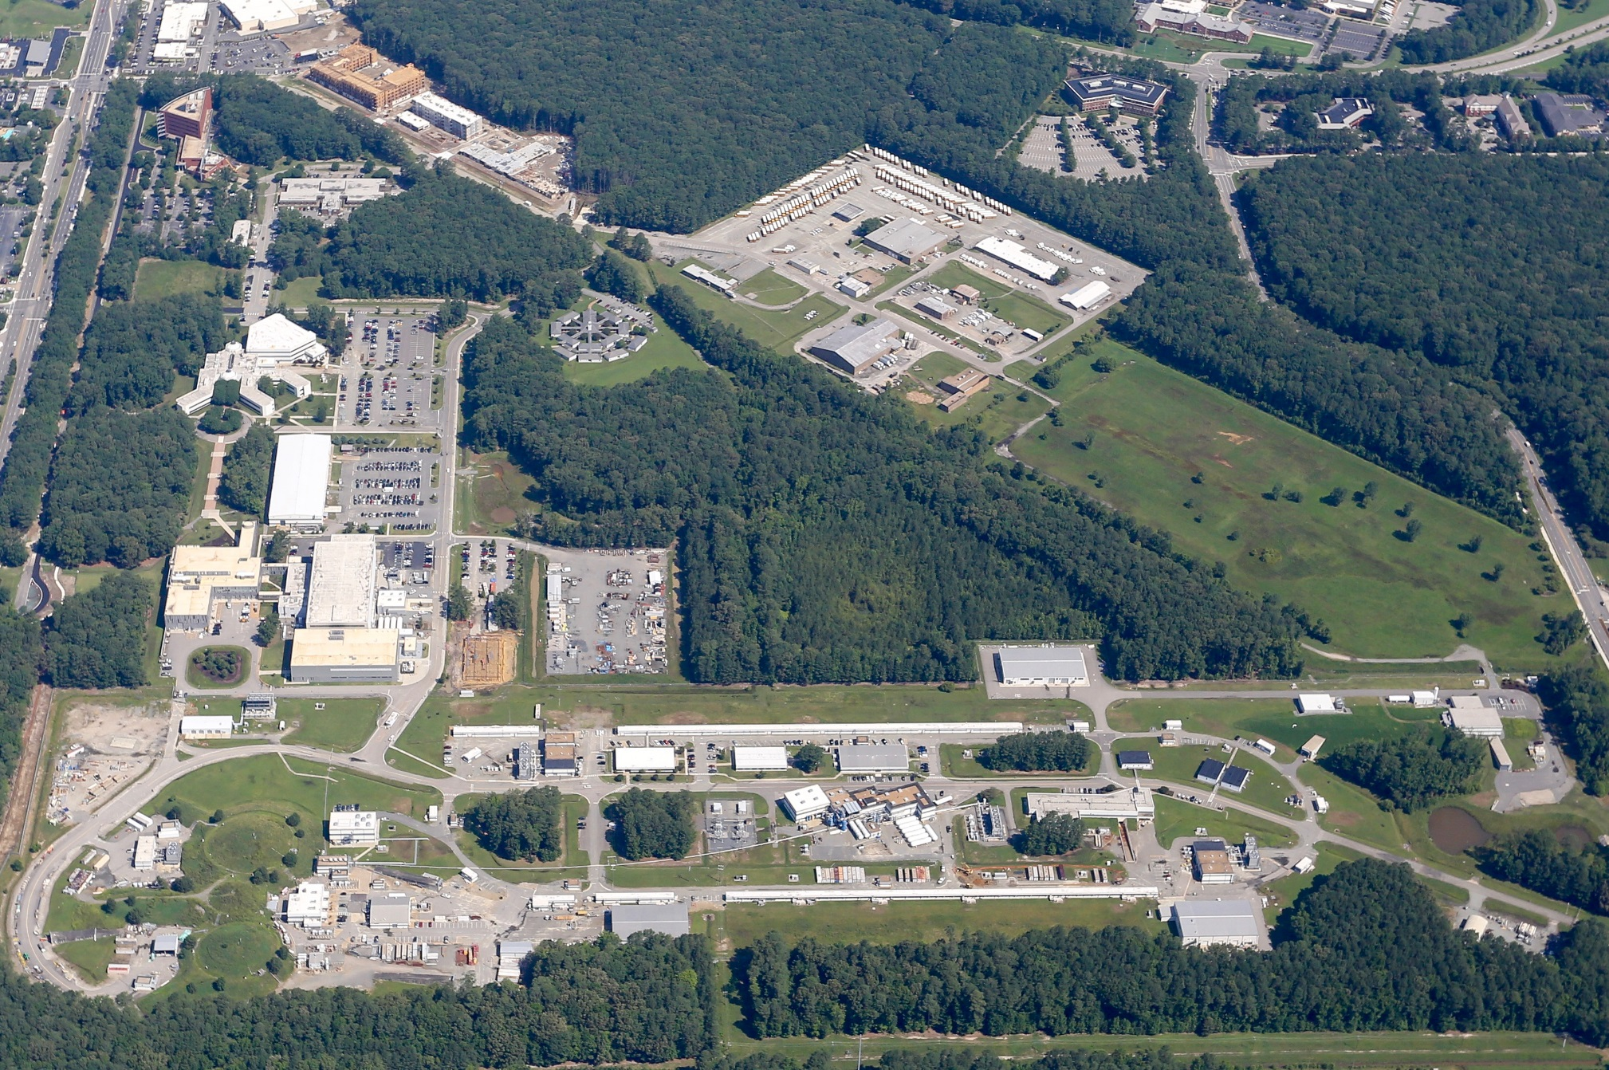
JLab Future Plans and Upcoming Schedule
by
Douglas Higinbotham

Slide 2
Jefferson Lab investigates quarks at medium to large x
QCD manifests fascinating complexity (e.g. emergent phenomena)
  Large research facilities like CEBAF/EIC are required to understand the implications of QCD in experiments
  CEBAF has a long program ahead that is complementary to the envisioned EIC program (Thursday talks)
CEBAF will remain the prime facility for fixed target electron scattering at the luminosity frontier
  A groundbreaking experimental program has already been developed stretching into the 2030s
  Moller is fully funded, case for SOLID is being refined for the LRP, and many new ideas coming at PAC51
There is a path toward e+ @ 12 GeV and e- @ 22 GeV
This group has the opportunity to provide input and help in further developing the scientific case for the upcoming and future tensor polarized deuteron experiments at JLab (medium & large x) and at the EIC (low & medium x)

Slide 3
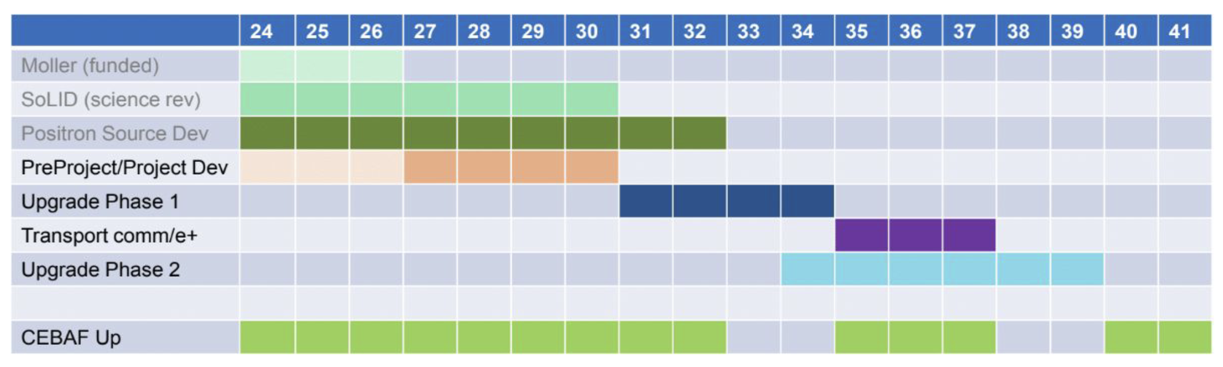
EXTREMELY ROUGH Timeline CEBAF’s Future
( though 2040 maybe seem very far away, this is actually a very aggressive schedule )
Phase 1 includes building a positron source and the tunnel & beamline connecting the source to main machine.
Phase 2 includes the new permanent magnets to allow 22 GeV within current CEBAF footprint.
NOTE: Plan was formulated so that these projects are ramping up as the EIC project cost is ramping down.

Slide 4
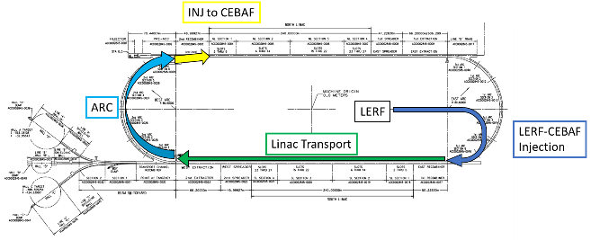
A CEBAF Energy upgrade is technically feasible
Capitalizing on recent science insights and US-led accelerator science and technology innovations, develop a staged program at the luminosity frontier
Injection energy Upgrade for 650 MeV Electron (e-) in LERF
Replace arcs on each side with new Fixed Field Alternating-gradient (FFA) magnets arcs to upgrade to 22 GeV
It will be possible to send the beam to Hall D though likely half pass lower energy then A,B,C instead of the half pass higher energy as 12GeV Jefferson Lab.

Slide 5
Permanent Magnet Design – Open Mid-plane Geometry
10 cm
10 cm
10 cm
10 cm
Focusing Magnet
Defocusing Magnet

Slide 6
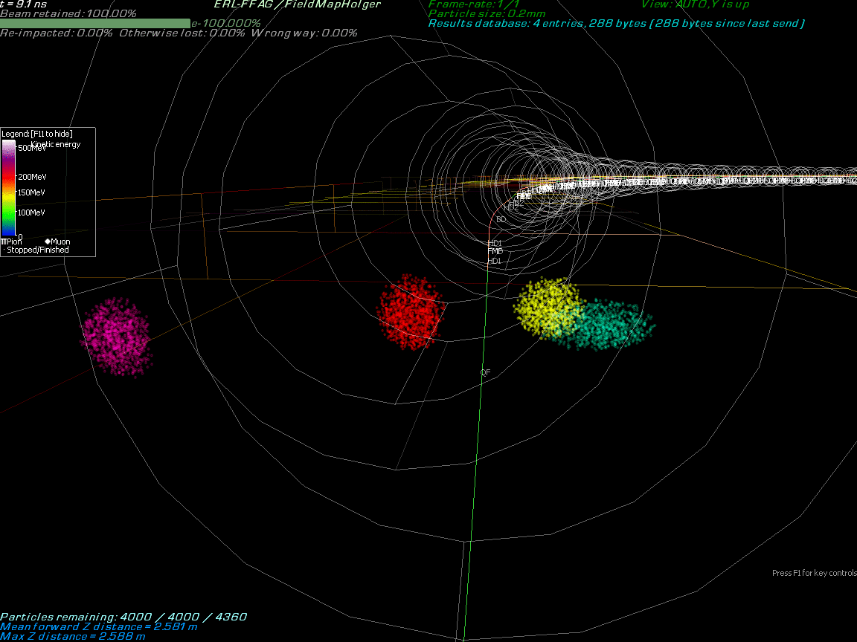
Multi-Bunch Dynamics in Fixed Field Alternating-gradient (FFA) Arc

Slide 7
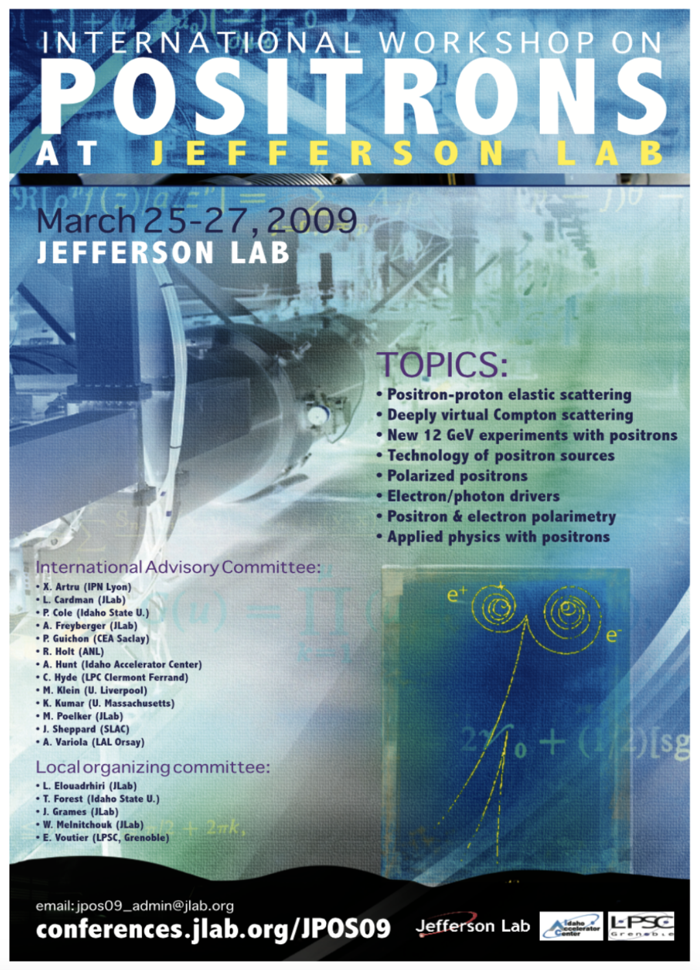

Polarized Electrons for Polarized Positrons (PEPPo)
https://doi.org/10.1103/PhysRevLett.116.214801
Photo of the PEPPo setup in the injector area of CEABF.

Slide 8
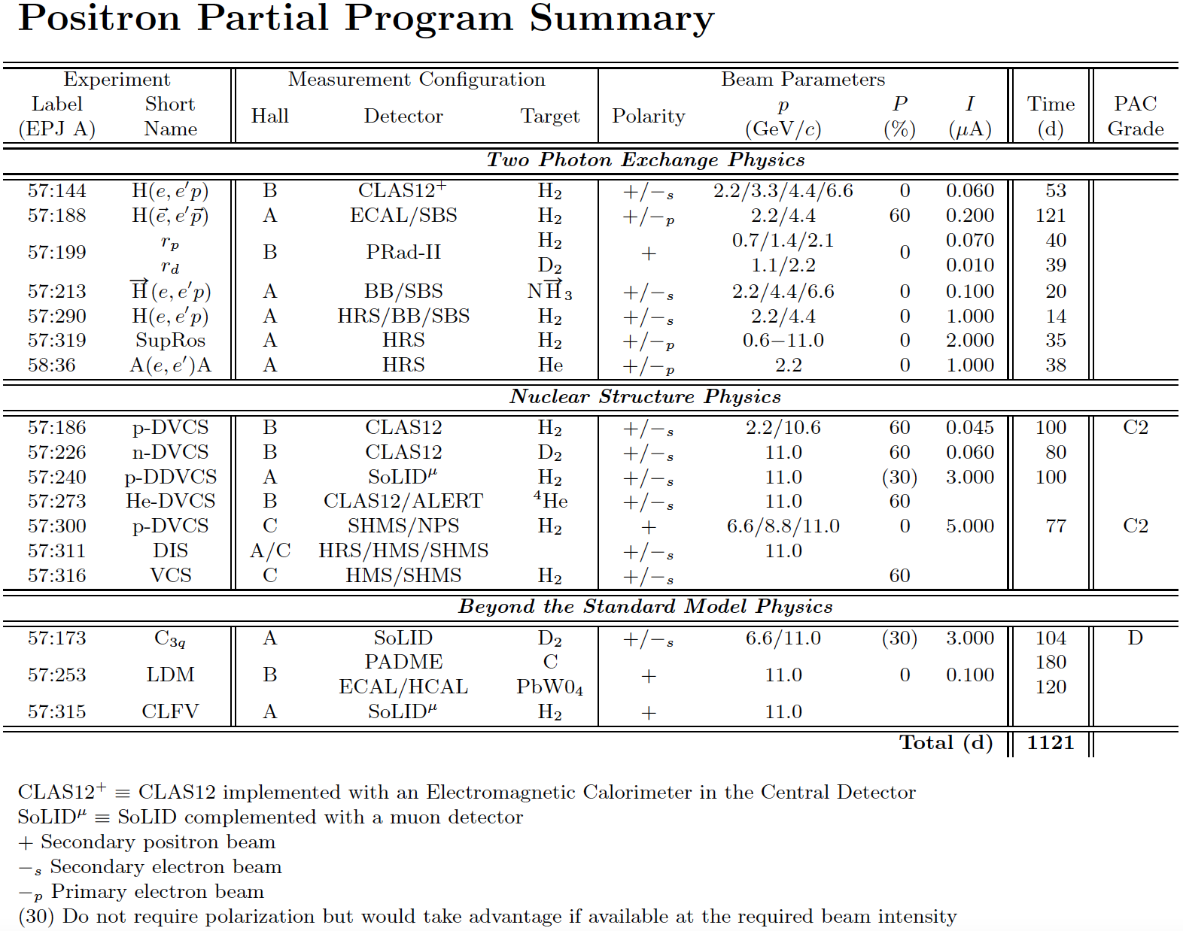
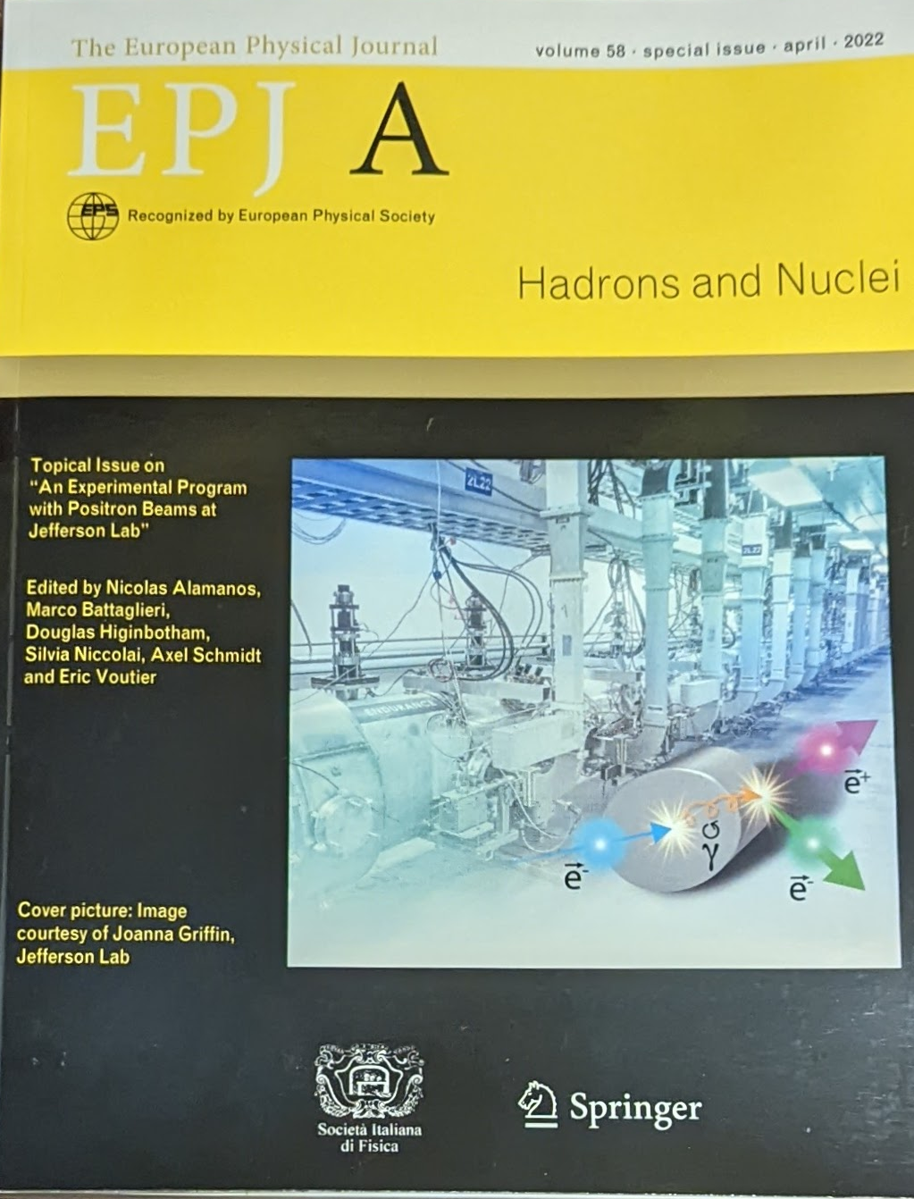
Positron Program White Paper Published 2022
https://doi.org/10.1140/epja/s10050-022-00699-6

Slide 9
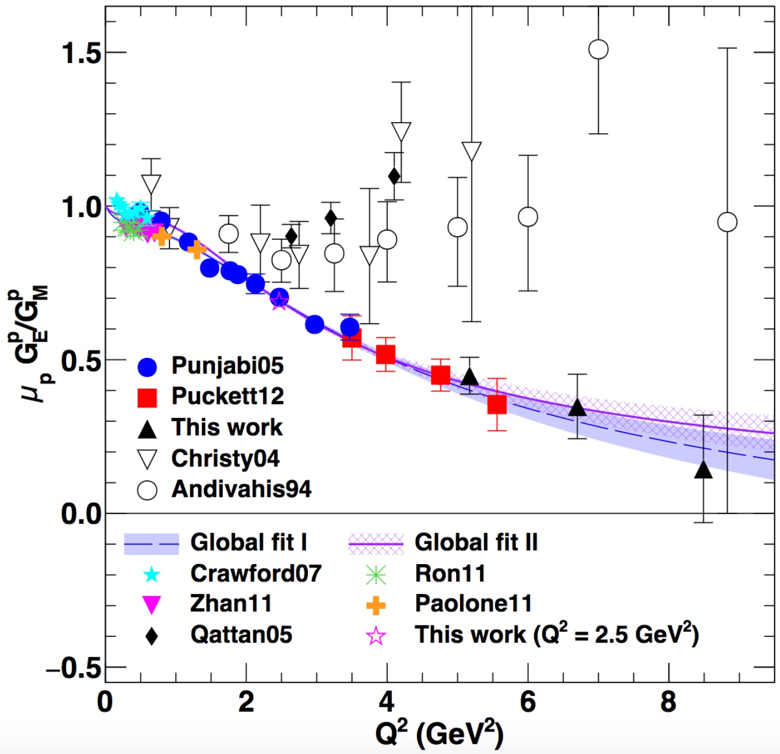
One Detailed Example: Understanding Two Photo Exchange
P.A.M. Guichon, M. Vanderhaeghen, PRL 91 (2003) 142303 P.G. Blunden, W. Melnitchouk, J.A. Tjon, PRL 91 (2003) 142304
Measurements of polarization transfer observables in electron elastic scattering off protons question the validity of the 1γ exchange approximation of the electromagnetic interaction.
A.J.R. Puckett et al. PRC 96 (2017) 055203
Two-photon exchange (TPE) is likely the cause of the form factor discrepancy at high Q².
Q² (GeV²)
e⁺ @ JLab has a the unique opportunity to bring a definitive answer about TPE.

Slide 10
12 GeV CEBAF vs. Ce⁺BAF
Machine Parameter | Electrons | Positrons
Hall Multiplicity | 4 | 1 or more
Max. Energy (ABC/D) | 11/12 GeV | 11/12 GeV
Beam Repetition | 249.5/499 MHz | 249.5/499/1497 MHz
Duty Factor | 100% cw | 100% cw
Unpolarized Intensity | 170 μA** | > 1 μA
Polarized Intensity | 170 μA** | > 50 nA
Beam Polarization | > 85% | > 60%
** Total beam power at Jefferson Lab is limited to 1.1 MW with a max. of 0.9 MW to individual high power dumps.

Slide 11
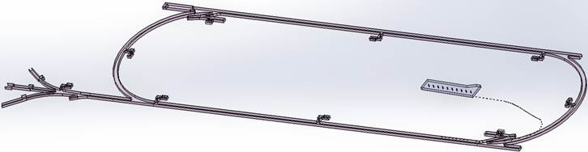

Low Energy Recirculator Facility (LEFRF) As The New Injector Facility for CEBAF
123 MeV e+
(650 MeV e-)
Inject e⁺ into North Linac to usual 12 GeV (w/ magnets reversed)
Build e⁺ injector at the LERF
Build new LERF to CEBAF tunnel
123 MeV e+
(650 MeV e-)
Build new transport line along South Linac and West Arc

Slide 12
Many Positron Proposals and Letters of Intent In Submitted to JLab PAC51
Jefferson Lab has an annual Program Advisory Committee to review experimental proposals. https://www.jlab.org/physics/PAC
Positron Proposals
  p-DVCS @ NPS in Hall C (point of contact Carlos Munoz Camacho [CNRS/IN2P3] )
  p-DVCS @ CLAS12 / Hall B (point of contact Eric Voutier [CNRS/IN2P3] )
  TPE @ CLAS12 / Hall D (point of contact Axel Schmidt [GWU] )
  Super Rosenbluth TPE in Hall C (point of contact John Arrington [LBNL] )
  A’ search in Hall B (Bogdan Wojtsekhowski [JLab] )
  Coulomb corrections in DIS in Hall C (point of contact Dave Gaskell [JLab] )
Seven Letters of Intent Including
  Axial Form Factors (point of contact Dipangkar Dutta [MSU] )
  p-VCS (point of contact Nikos Sparveris [Temple] )
Ideas presented at March 2023 Positron Workshop: https://indico.jlab.org/event/680/

Slide 13
Nuclear Physics Experiment Scheduling Committee https://www.jlab.org/physics/experiments/NPEScommittee
Deputy Director for Research | David Dean | deandj@jlab.org
Physics Division AD | Thia Keppel | keppel@jlab.org
Physics Division Deputy AD | Patrizia Rossi | rossi@jlab.org
Operations Interface (chair) | Douglas Higinbotham | doug@jlab.org
Halls A & C Leader | Mark Jones | jones@jlab.org
Hall B Leader | Patrick Achenbach | patricka@jlab.org
Hall D Leader | Eugene Chudakov | gen@jlab.org
Accelerator Division Deputy AD | Mike Spata | spata@jlab.org
Director of Accelerator Operations | Eduard Pozdeyev | pozdeyev@jlab.org
Center for Injector Studies Leader | Joe Grames | grames@jlab.org
Input is taken from MANY other groups!
Many thanks to Randy Michaud who served on the committee as interim accelerator operations director during the last planning cycle.

Slide 14
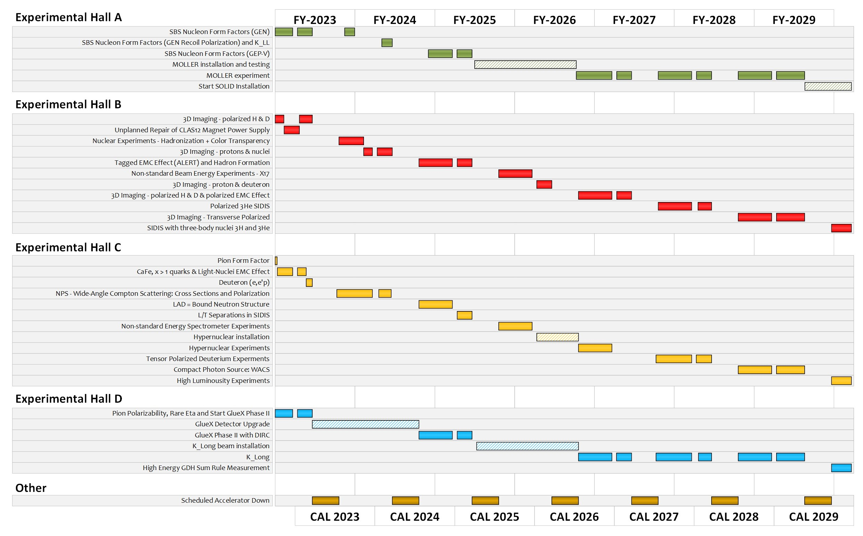
Extended Experimental Schedule
205 completed experiments to-date (28 full; 28 partial in 12 GeV era)
51 experiments remaining
~7 years at ~30 weeks/year
…not including SoLID
…not including new proposals

Slide 15
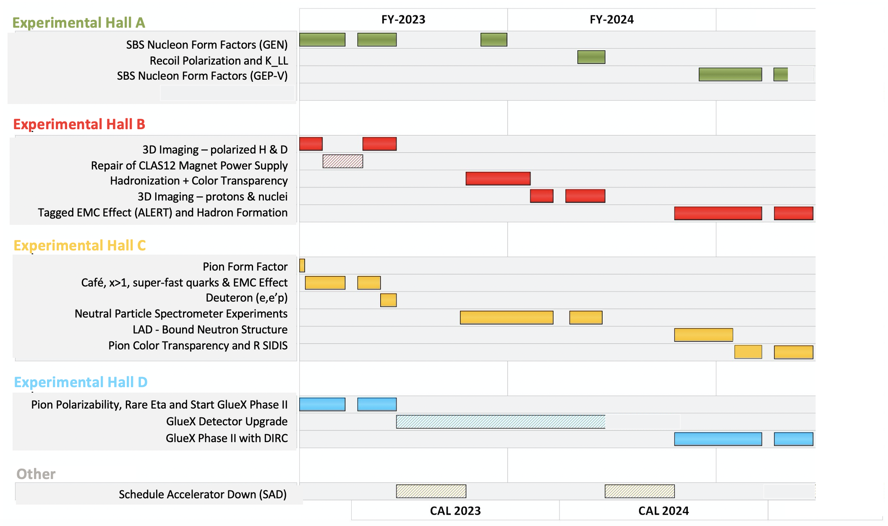

Slide 16
Useful Links
Scheduling Memo
  https://www.jlab.org/physics/experiments/schedule
  Note the text on priority halls completely changed to be a simpler first among equals
  Feedback on the posted schedule is welcome
Approved Experiment Lists
  https://www.jlab.org/physics/experiments

Slide 17
Summary
Ideals are being developed to use strong permanent magnets to allowed 22 GeV electrons in the current CEABAF tunnels.
Positron source will be developed in the JLab LERF/FEL building and connected to CEBAF. This source will be future upgraded to provide the source for 22 GeV beams.
Moller experiment will, in many ways, drive the JLab schedule in the near term, BUT will also provide opportunities for low current experiments in Hall C: e.g. the Tensor polarized target experiments!!

