Slide 1




Andrea Vinante
CNR - Istituto di Fotonica e Nanotecnologie - Trento
“Progress in testing collapse models using mechanical and thermal effects
COLMO – ECT* 2023

Slide 2
Outline
  Testing collapse models (CSL) with mechanical systems
  - established bounds with optimized cantilevers
  - levitated micromagnets: potential improvements
  Testing collapse models (CSL + DP) with thermal experiments
  - spontaneous heating & classical gravity
  - a new experiment at microkelvin temperature

Slide 3
Continuous Spontaneous Localization (CSL)
Schrödinger equation + Stochastic term (collapse field)
[ GRW model: Ghirardi, Rimini, Weber, PRD 34, 470 (1986)
CSL model: Ghirardi, Pearle, Rimini, PRD 42, 1978 (1990) ]
Stochastic modification replacing the
reduction postulate of standard quantum mechanics!
Collapse term couple to the system mass
1) negligible at microscale (atoms,molecules, …) ⇒ quantum
2) dominant beyond some mass scale ⇒ classical
Measurement-based “collapse” and Born rule follow from dynamics
( “Measurement = macroscopic” )

Slide 4
Continuous Spontaneous Localization (CSL)
Schrödinger equation + Stochastic term (collapse field)
2 phenomenological constants (free parameters)
Correlation Length r_{C}
conventional “literature value” r_{C} =10⁻⁷ m
Collapse rate λ
(= collapse rate for a single nucleon)
    λ ∼ 10⁻¹⁶ s⁻¹ @ r_{C} =10⁻⁷ m following Ghirardi, Rimini, Weber (GRW), 1986
    λ ∼ 10^{-8±2} s⁻¹ @ r_{C} =10⁻⁷ m following Adler, 2007
( N = number density of nucleons, “smeared” over r_{C} )

Slide 5
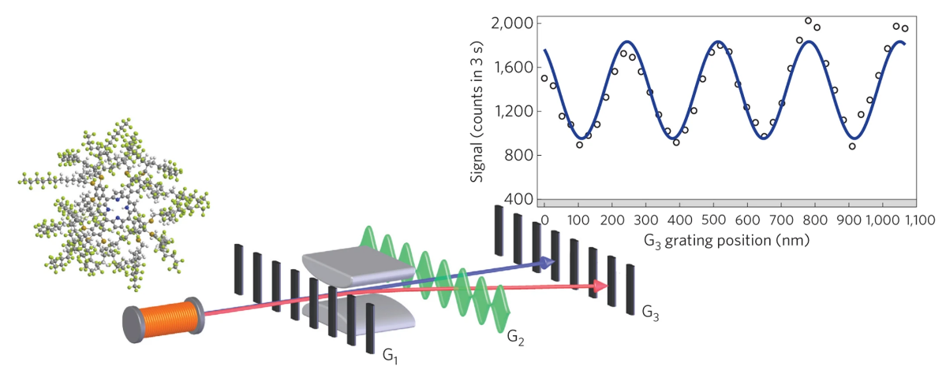
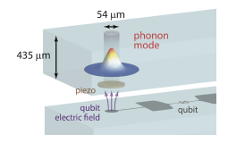
Collapse models can be tested (= falsified)
(unlike “interpretations” of quantum mechanics)
QUANTUM INTERFERENCE: collapse of massive quantum superpositions
Experimentally
very demanding !
Molecular Interferometry
(M. Arndt et al, Vienna)
Nature Phys. 10, 271 (2014)
Acoustic bulk resonator + SC qubit
(M. Fadel et al, ETH )
Phys. Rev. Lett. 130, 133604 (2023)
2) INDIRECT (noninterferometric): violation of energy conservation
X-ray spontaneous emission from free electrons
Spontaneous diffusion / heating / force noise in mechanical resonators
Spontaneous heating of solid matter

Slide 6
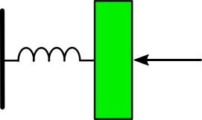
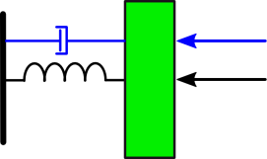
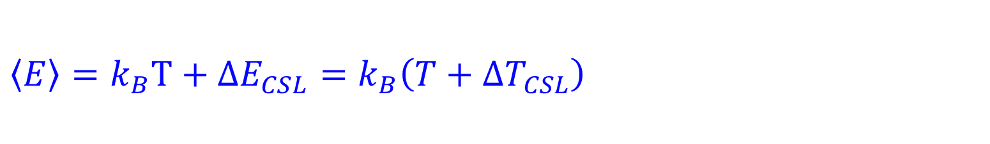

Random Collapses Momentum kicks Stochastic driving force
τ=Q/ω₀
F_{therm}
M
k=Mω₀²
F_{CSL}
$$\left\langle E\right\rangle =k_{B}T+ΔE_{CSL}=k_{B}\left(T+{ΔT}_{CSL}\right)$$
S. Nimmrichter et al, PRL 113 020045 (2014)
L. Diosi, PRL 114, 050403 (2015)
A. Vinante et al, PRL 116, 090402 (2016)

Slide 7

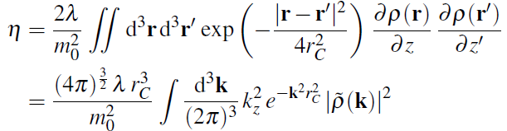


CSL-heating of a mechanical resonator
MAXIMIZATION of Signal to Noise (actually Noise to Noise):
High $τ=\frac{Q}{ω_{0}}$
Low frequency are better! (unlike optomechanics)
Low T
High $\frac{η}{m}$ $×$ Geometrical factors
S. Nimmrichter et al, PRL 113 020045 (2014)
L. Diosi, PRL 114, 050403 (2015)
A. Vinante et al, PRL 116, 090402 (2016)

Slide 8
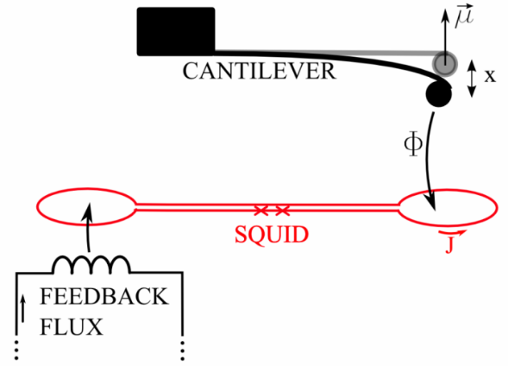
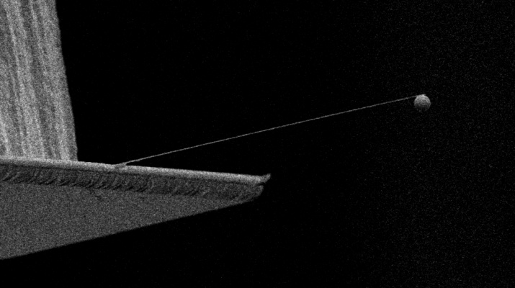

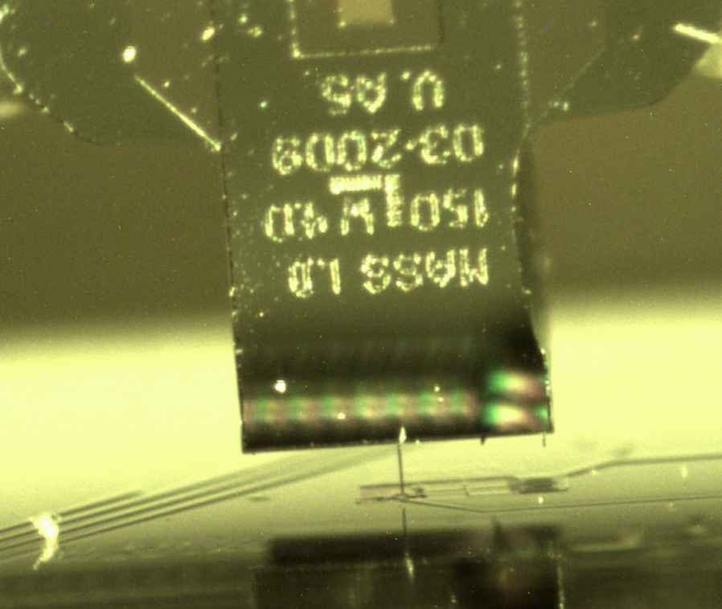
Cantilever-magnet-SQUID
Very soft AFM cantilevers
Initial work at Leiden University
A. Vinante et al, Appl Phys Lett 101, 123101 (2012)

Slide 9
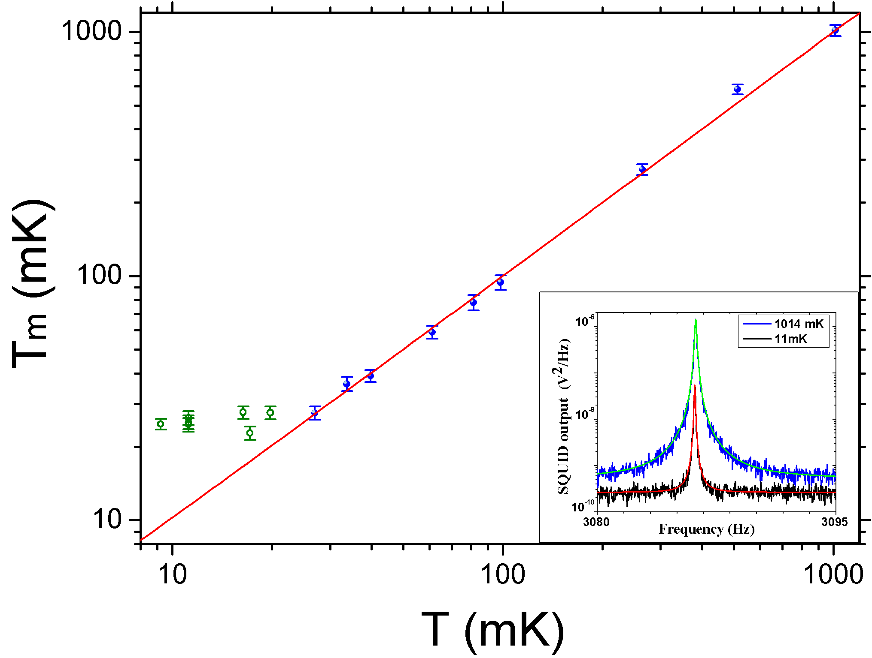
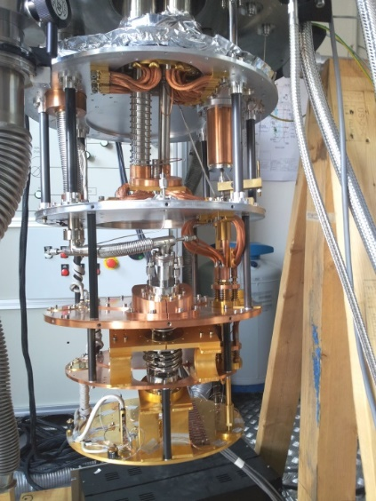

Mean Energy $\frac{\left\langle E\right\rangle }{k_{B}}$ vs Temperature
Force noise S_{ff}=5x10⁻¹⁹ N/√Hz @ T_{m}∼25 mK

Slide 10
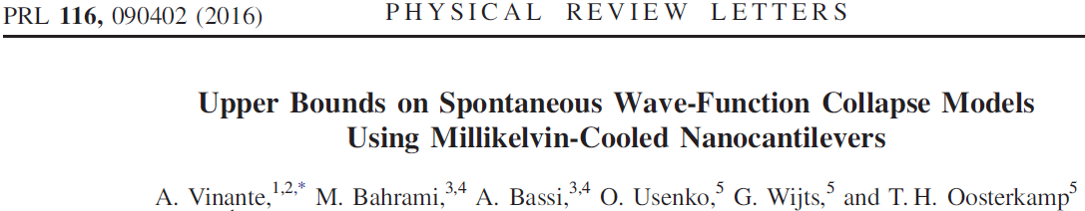
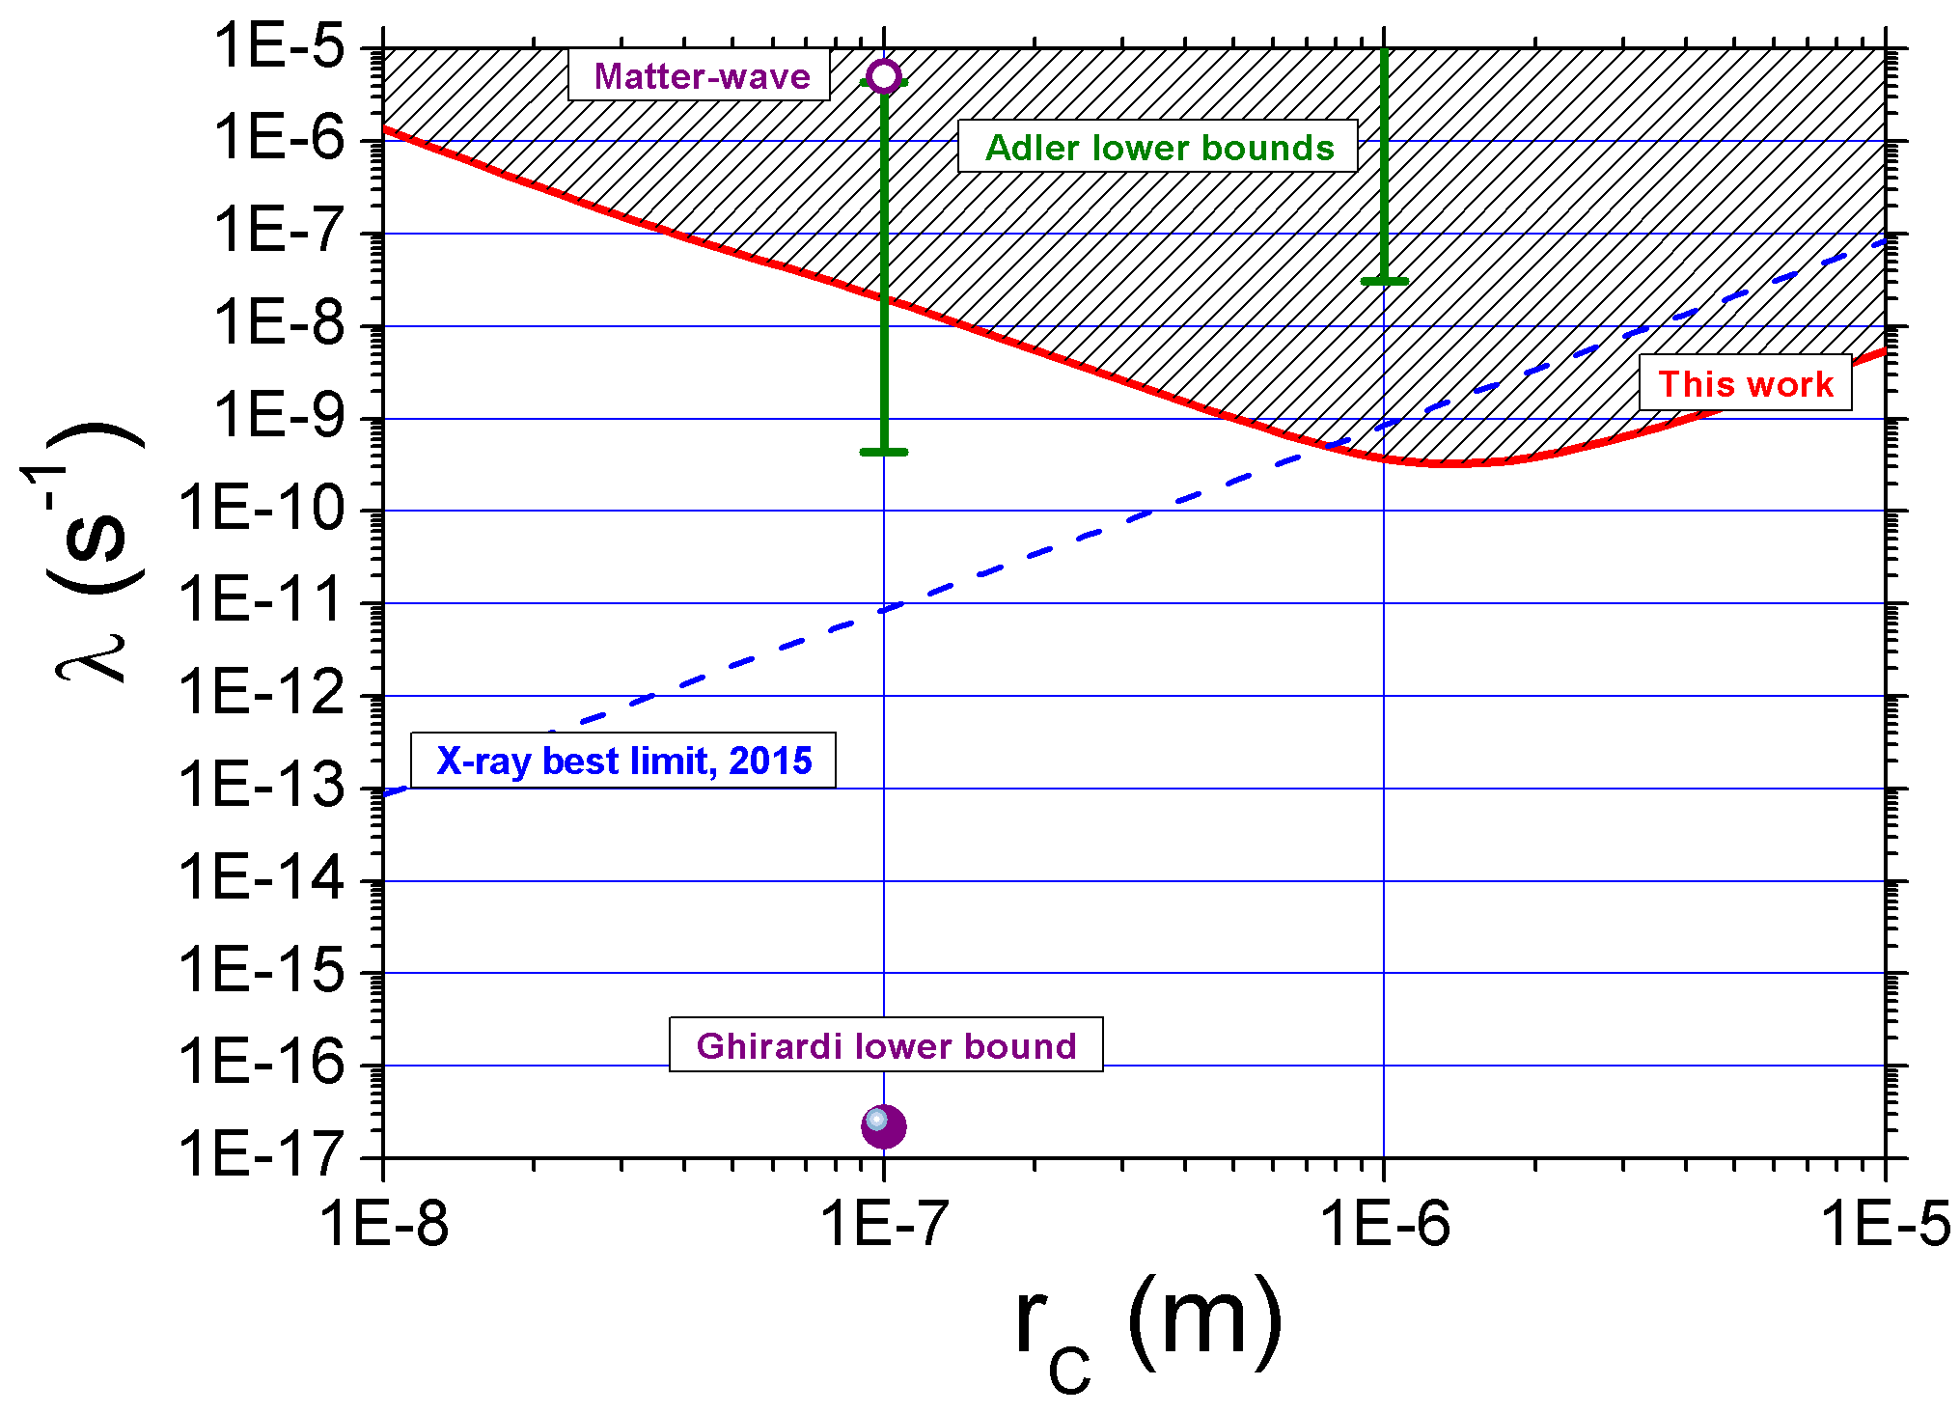

Slide 11
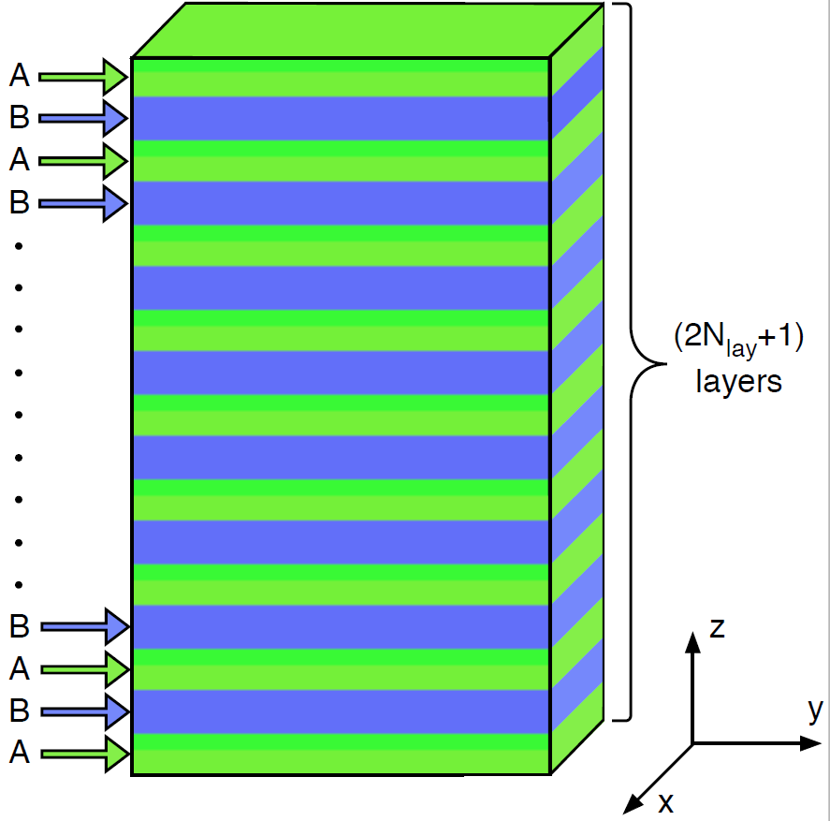
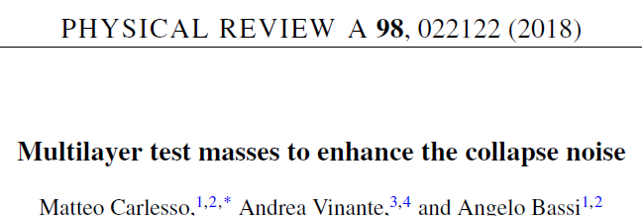
Most recent experiment in Trento
1) AFM cantilever with very high Q at mK (close to 3 x10⁶)
2) Attach another heavier mass to the cantilever
Multilayer with two different materials (heavy/light) maximizes CSL noise in the relevant portion of parameter space

Slide 12
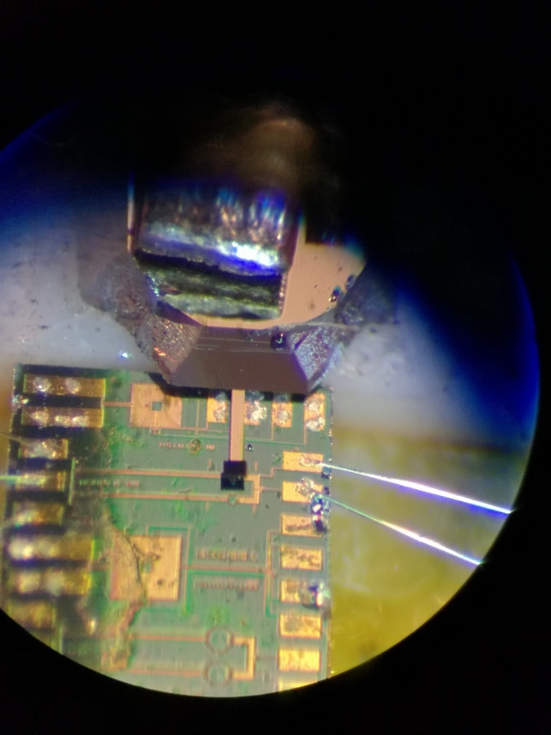
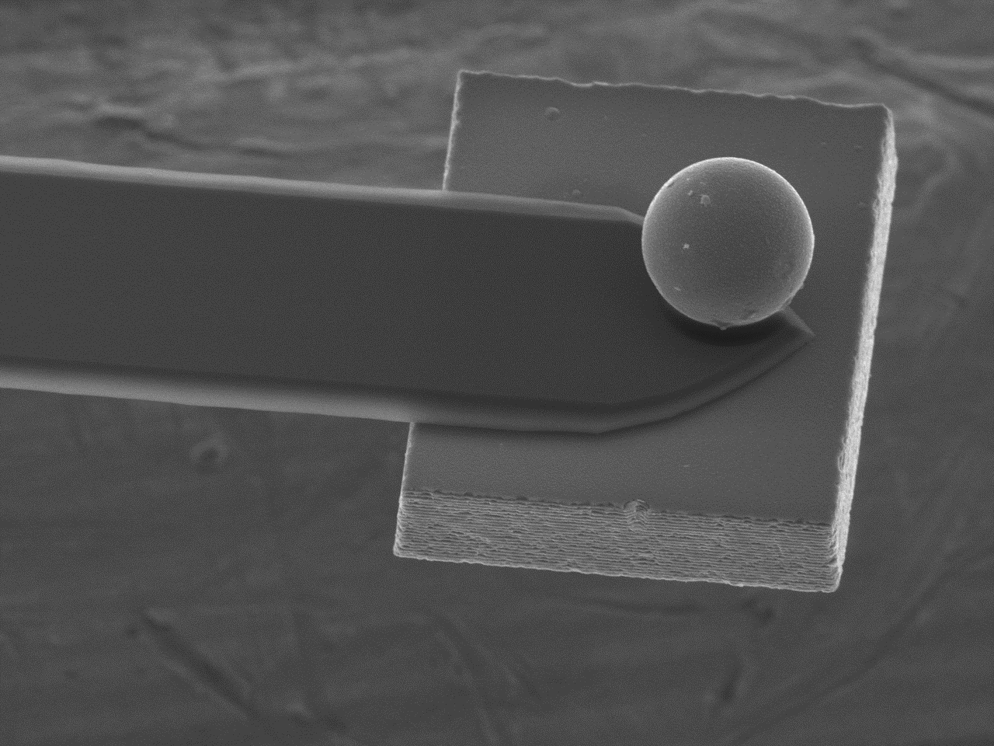
SiO₂/WO₃ multilayer fabricated by A. Chiasera & S. Varas, IFN Trento

Slide 13

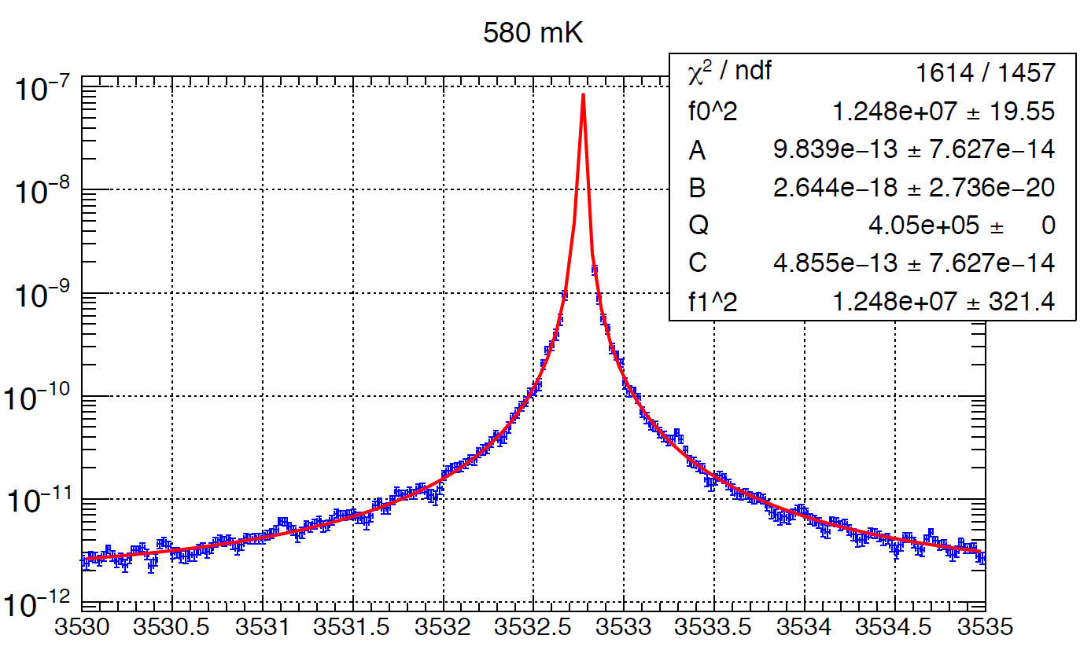
Noise at millikelvin (Pulse tube dilution – PT OFF)
Measurement scheme

Slide 14
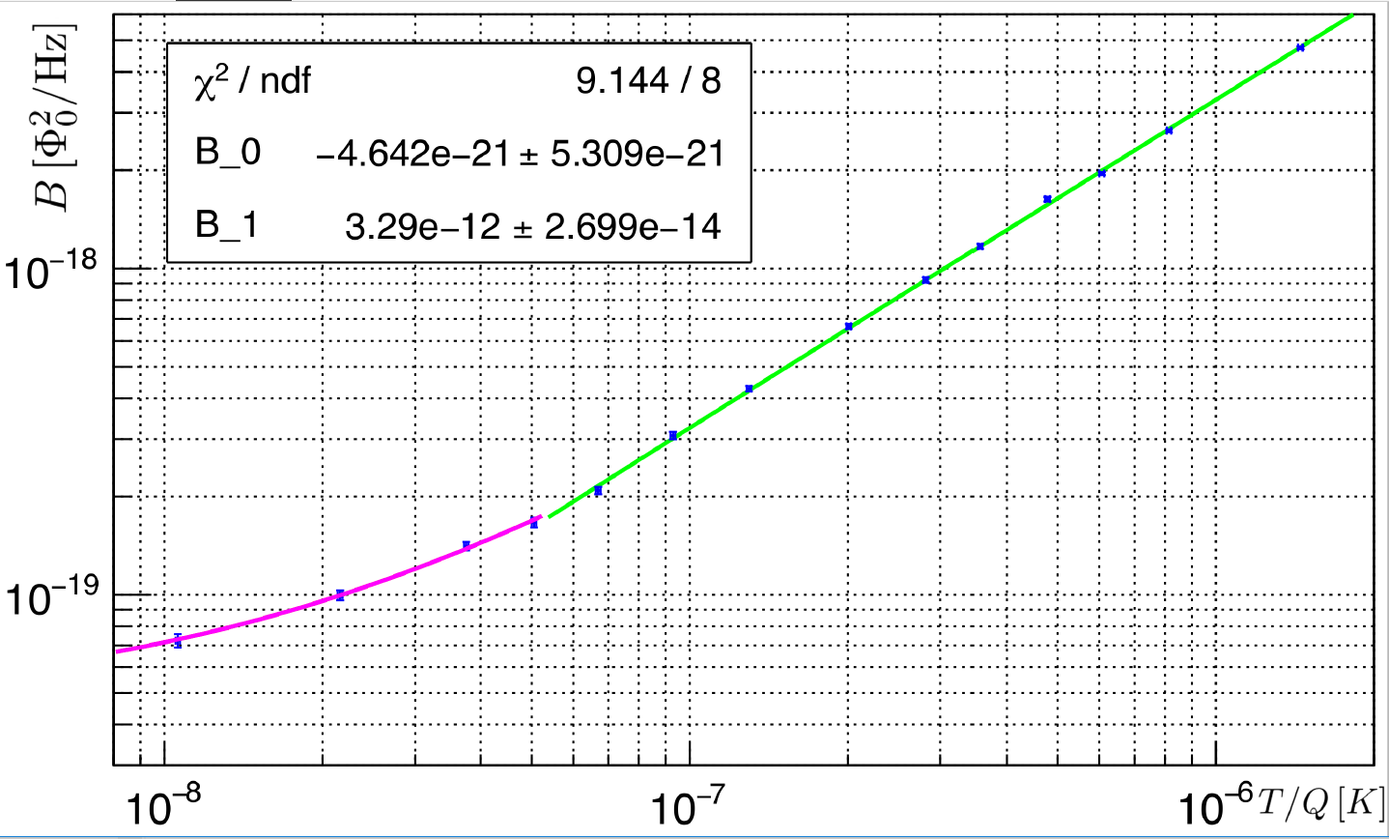
Noise vs Temperature
at 95% CL

Slide 15
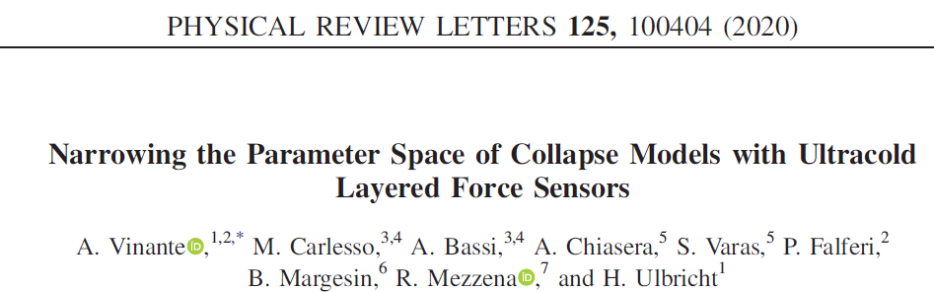
MATTER WAVE
This
exp
Adler parameter range falsified
X ray
LISA PTF
GRW

Slide 16
Exploring new approaches:
Magnetic Levitation of micromagnets

Slide 17
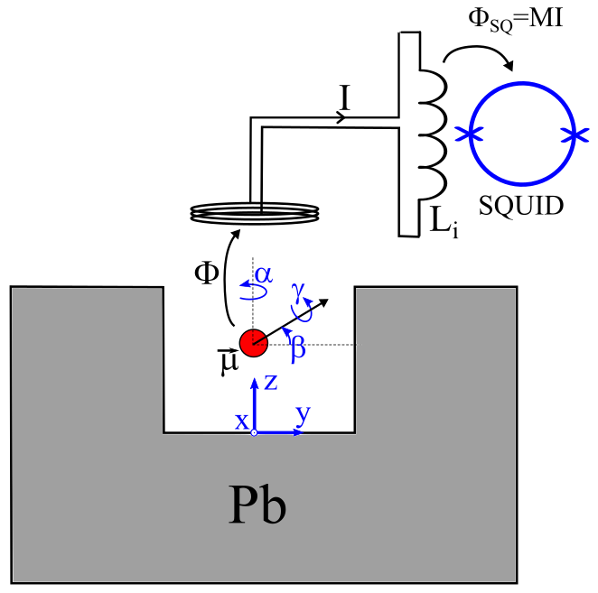
Levitated micromagnets: motivations
Very clean mechanical modes (rigid body translations and rotations)
remove mechanical losses should allow for much better isolation from external world (= ultralow damping / ultrahigh Q factor)
Passive levitation (no heating)
compatible with cryogenics
(UNLIKE OPTICAL LEVITATION ie TWEEZER, where trapped particles are very hot)

Slide 18
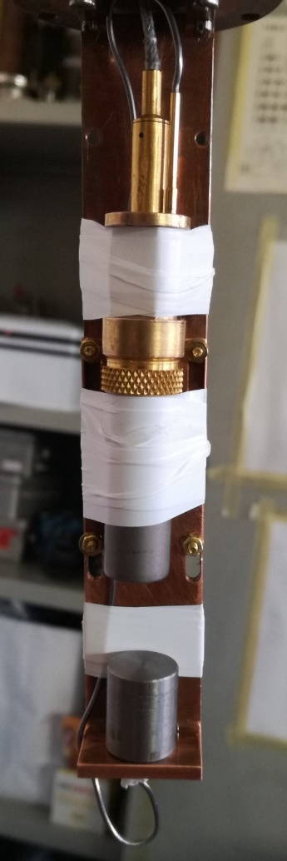
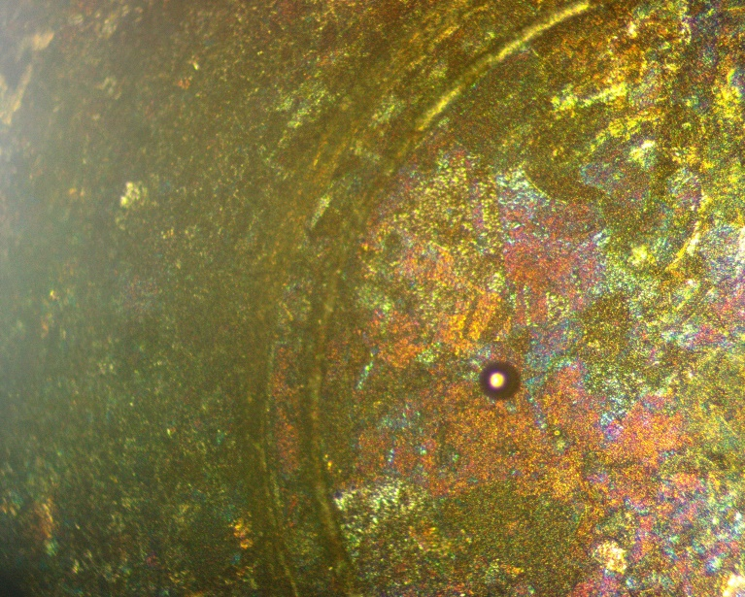
Proof-of-principle experiment
Pb trap: Type I superconductor at 4.2K
SQUID
Trap
NdFeB microsphere
Radius = 27 μm
Trap Radius = 2 mm
1) One individual microsphere can be picked up, magnetized and placed in the trap at room T
2) Spontaneous levitation upon cooldown to 4.2 K (Meissner Effect)
DIPPED
in a liquid He
Transport Dewar

Slide 19
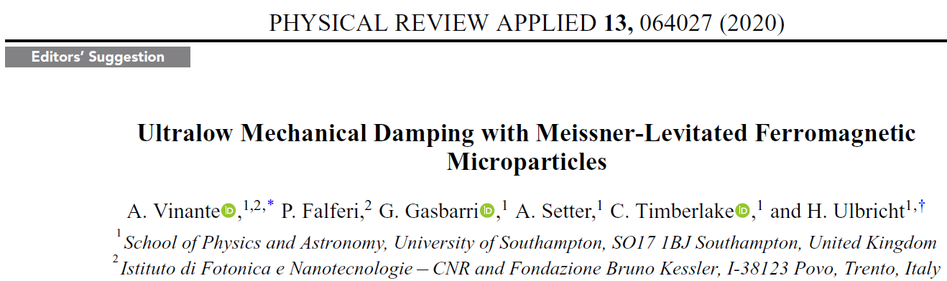
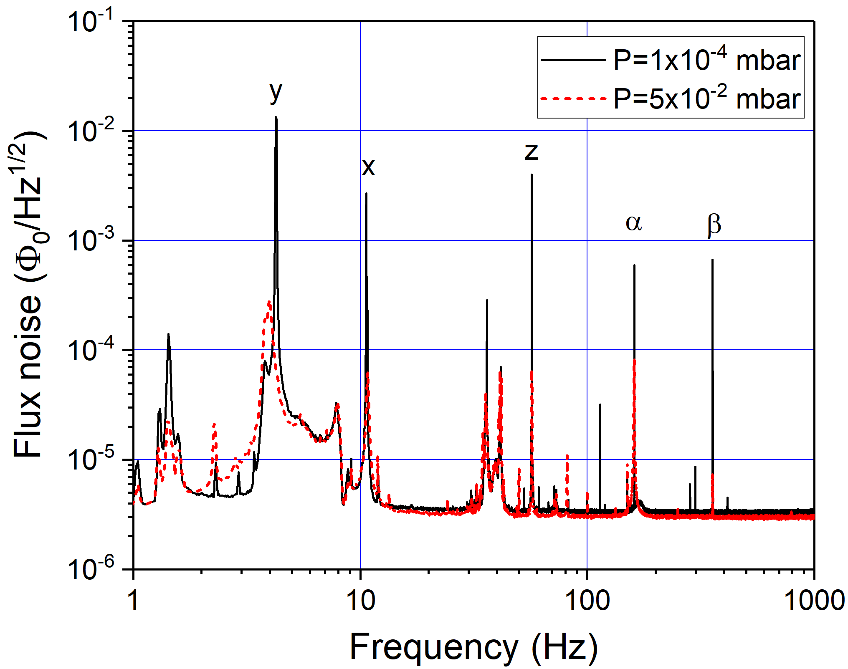
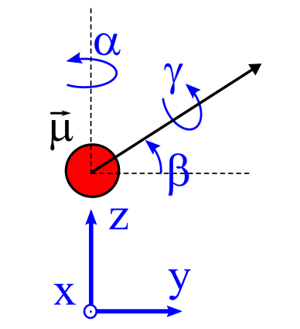
Spectrum & mechanical modes

Slide 20
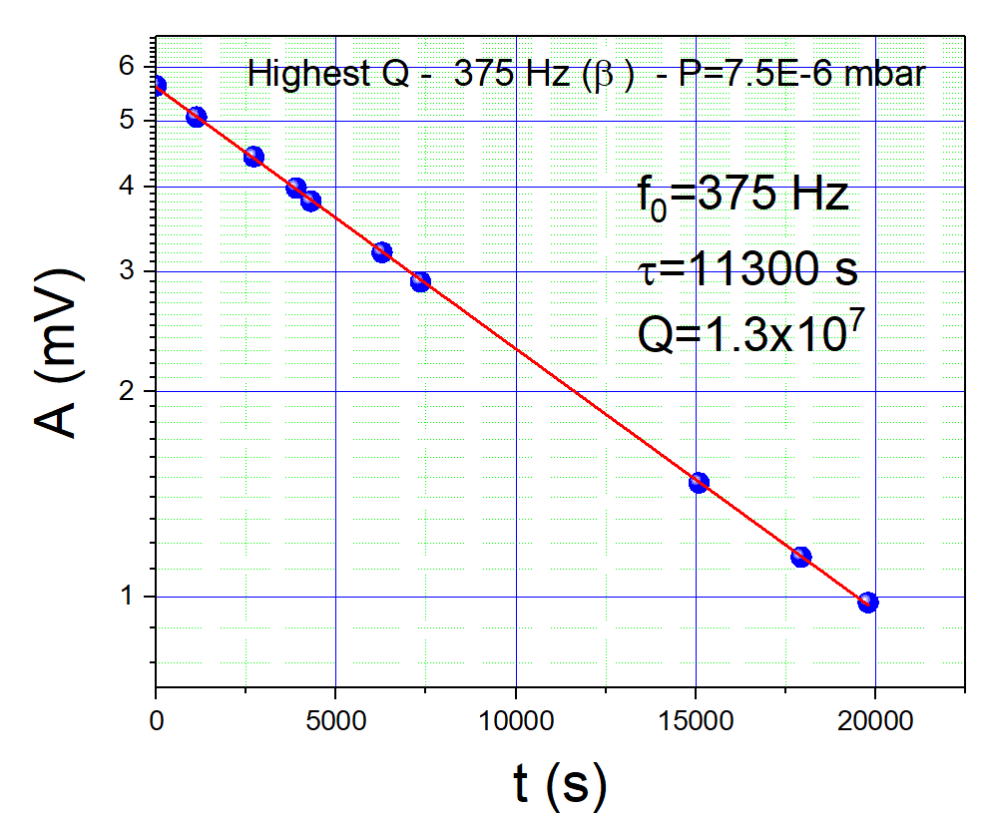
Mechanical damping - Q factor
RINGDOWN MEASUREMENT
(lock-in amplifier)
Tricky for low freq modes
(too long time - seismic noise – nonlinearities)
τ > 3 hours !

Slide 21
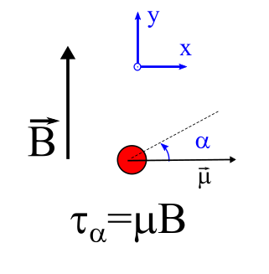
Torque Magnetometry
Magnetic Field
Torque
How sensitive can this be as a magnetometer ?

Slide 22
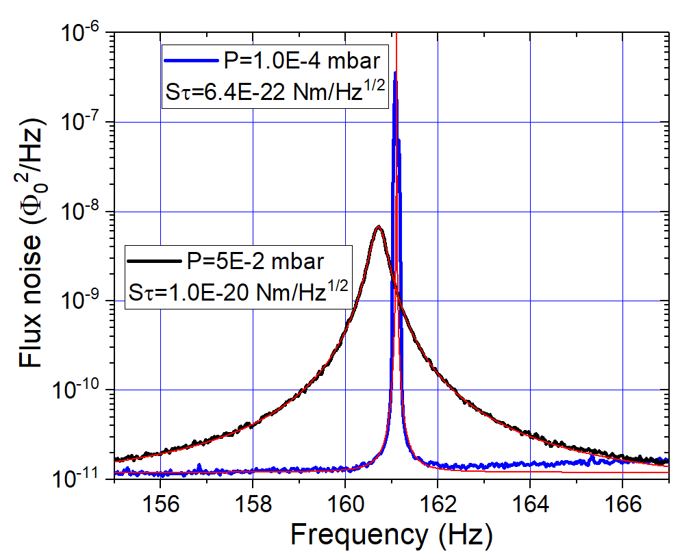
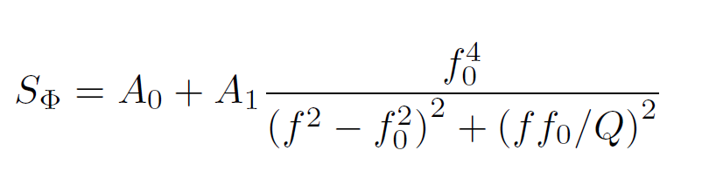
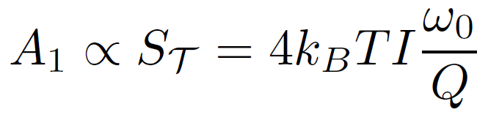
Noise: α mode (horizontal torsional)
Fitting Function
Torque noise

Slide 23
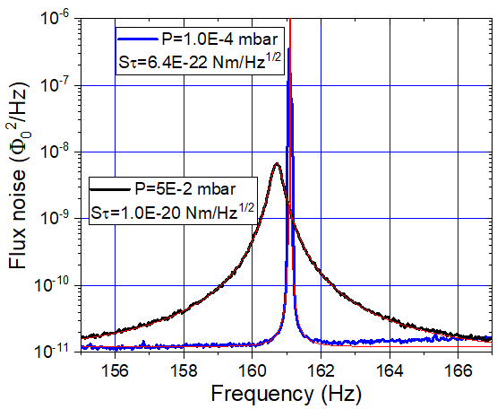
ac torque Magnetometry

Slide 24
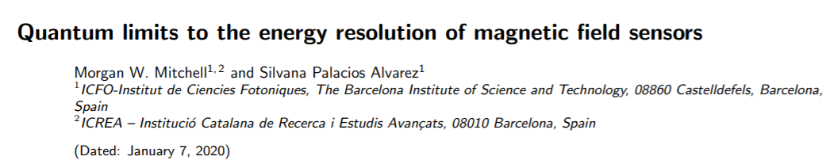
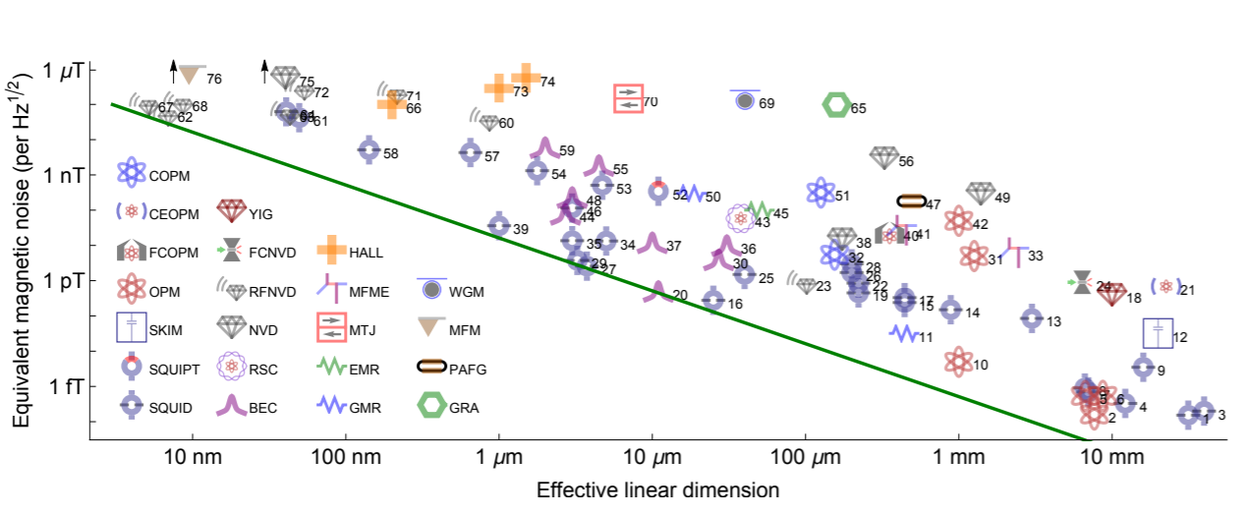
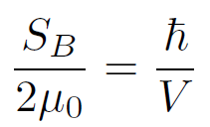
Review Modern Physics 92, 021001 (2020)
Field Resolution improves with sensing (=“averaging”) volume !

Slide 25
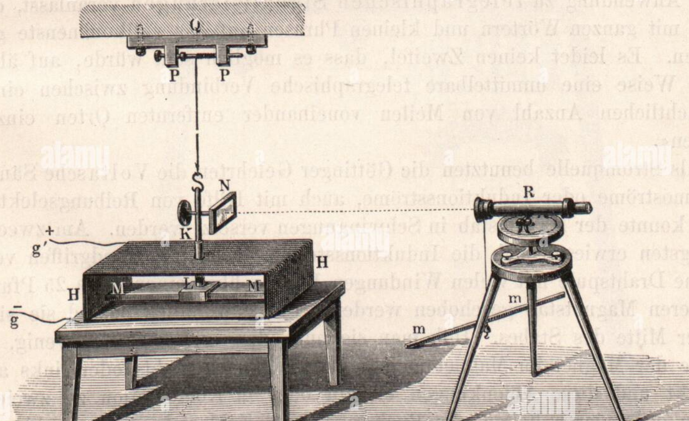
Credits
C.F. Gauss, Intensitas vis magnetica et terrestris ad mensuram absolutam revocata,
Göttingen,1833
Essentially a classical device
In the quantum era, still the most sensitive magnetometer ?

Slide 26
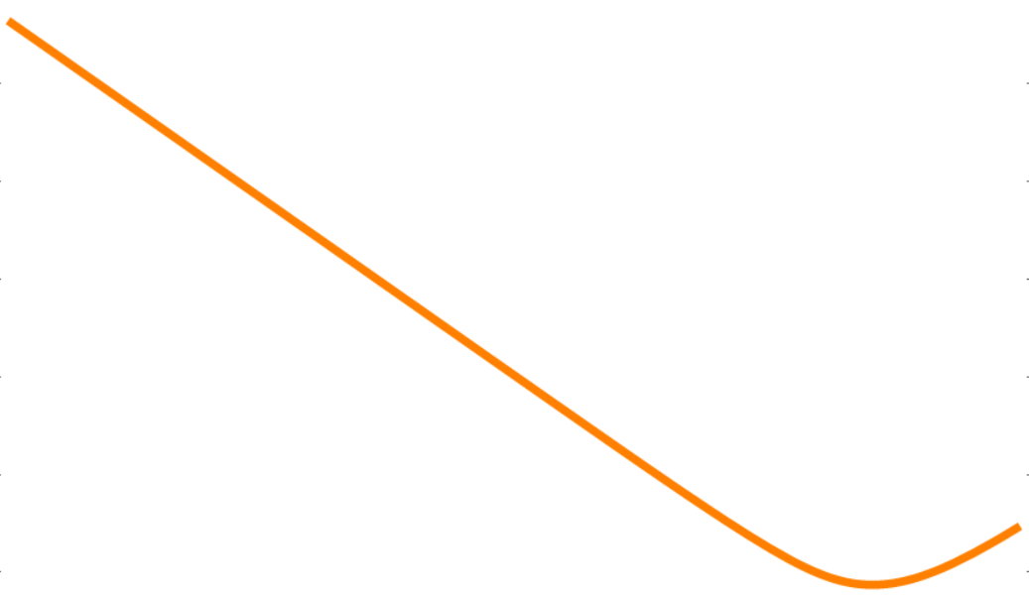
Prospects for testing CSL
with a levitated magnet
Predicted bound for:
2-sphere dumbbell,
R=20 μm
Librational mode
Thermal noise
T=0.1 K
τ=10⁶ s
CANTILEVER
LEVITATED
MAGNET
LISA PTF

Slide 27
From mechanical to thermal tests

Slide 28
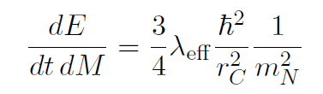
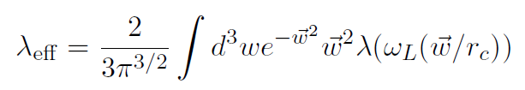
Heating of a solid body by CSL
Collapse field will generate spontaneous heating of:
individual mechanical modes mechanical experiments
all phononic modes of a solid body thermal experiments
(From integration over all acoustic phononic modes)
NOTE:
Relevant frequency is that of phonons with wavelength r_{c}
(10¹¹ Hz in solid matter)
S. Adler and A. Vinante “Bulk Heating Effects as Tests for Collapse Models”, PRA 97, 052119 (2018)
M. Bahrami: “Testing collapse models by a thermometer”, PRA 97 052118 (2018)

Slide 29
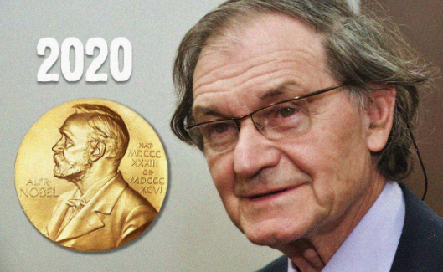
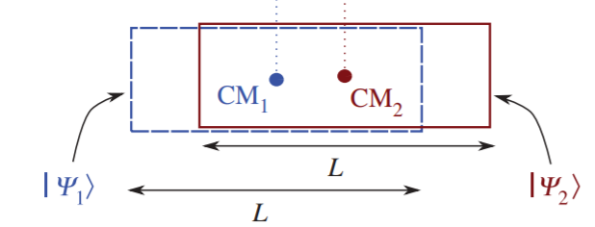
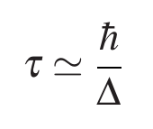
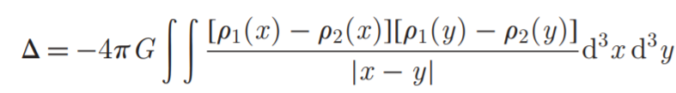
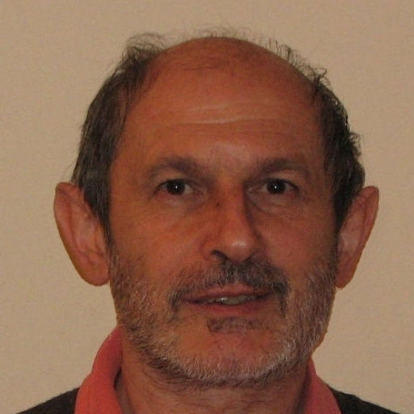
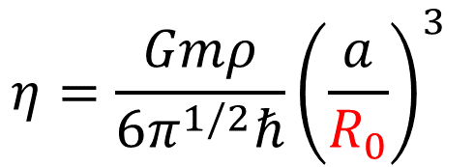
The Diosi-Penrose (DP) model
L. Diosi, Phys. Rev. 40, 1165 (1989)
Gravity-induced collapse according to Penrose
Diosi model (DP) is similar to CSL, and captures the same expression for collapse rate predicted by Penrose!
Force noise on a mechanical system
$$η=\frac{Gmρ}{6π^{1/2}ℏ}{\left(\frac{a}{R_{0}}\right)}^{3}$$
No dependence on shape!
No optimal size
a: interatomic distance
Only one free parameter: R₀ !

Slide 30
Parameter-free DP model
Penrose and others suggest that the DP model can be made parameter-free by linking R₀ to some characteristic length parameter of the system
Take R₀ = spread of wavefunction of nuclei in the crystal field. This tells how mass is effectively distributed.
For low T systems, R₀ is determined by zero point fluctuations.
( for instance R₀ ≈ 4.3 pm in copper at low T )
Model incompatible with x-ray spontaneous radiation
S. Donadi et al, Nature Physics 17, 74 (2021)
Can we confirm exclusion searching for heating in matter?

Slide 31

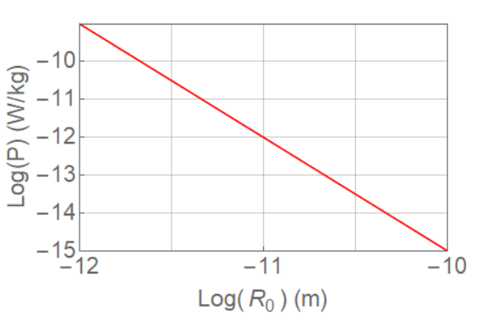
Heating of a solid body by DP model
(From integration over all acoustic phononic modes)
Power per unit mass independent of:
- shape
- density
Best lower bound with mechanical systems:
R₀ > 84 fm
(LISA PATHFINDER SPACE MISSION)
Thermal tests more sensitive
than mechanical ones!

Slide 32

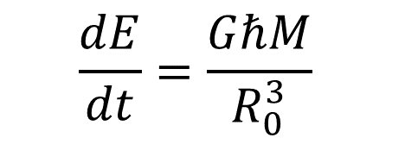
Classical Channel Gravity
New Journ Phys. 17, 006015 (2015)
Assumption: Gravity is a purely classical communication channel
(= no entanglement through gravity!)
Same spontaneous heating of matter of DP model! (apart of a numerical constant)
$$\frac{dE}{dt}=\frac{GℏM}{R_{0}^{3}}$$
New physical interpretation: predicted deviations from Newton’s law at R₀

Slide 33


Spontaneous heating of matter experimental bounds
1) Astrophysical bounds
Equilibrium temperature of planets of outer solar system (Neptune)
$P≲20$ pW/kg
S. Adler et al, Phys. Rev. D 99, 103001
2) Laboratory bounds: experiments at ultralow temperature
$P≲10÷100$ pW/kg
For instance: Gloos et al, Journ. Low Temp. Phys. 73, 101 (1988)
(or F. Pobell, Matter and Methods of Low Temperature Physics)

Slide 34
Bounds on CSL from heating
CANTILEVER
HEATING OF SOLID MATTER
LISA PTF
GRW

Slide 35
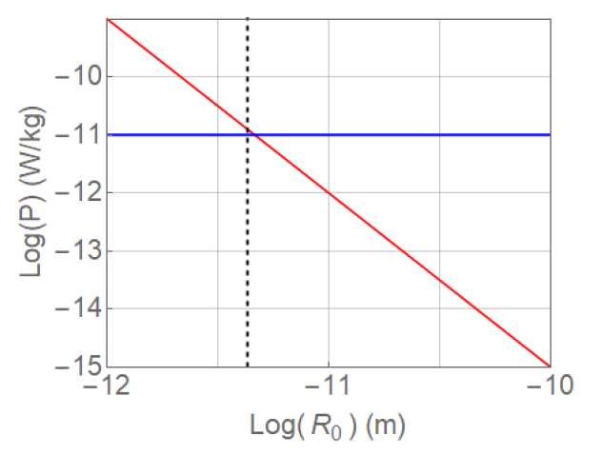
Bounds on DP from heating
A. Vinante, H. Ulbricht,
AVS Quantum Sci. 3, 045602 (2021)
10 pW/Kg
DP model power
R₀ = 4.3 pm = spread of nuclear wavefunction in the copper crystal at ultralow T
Effective Length parameter in the Parameter-Free DP model

Slide 36
PROBLEM
Current lab estimations of unexplained residual heat leaks are quite inaccurate
Indirect extrapolation from old measurements
Require interpretation
Design a dedicated experimental setup (at millikelvin or below):
Flexible tuning of relevant parameters (heat capacity, thermal resistance)
Accurate temperature and heat capacity measurements
Manageable size (easily transferrable to underground facilities in future)

Slide 37


Experimental Setup
(Design by Ján Nyéki – Royal Holloway London)
User project within
European Microkelvin Platform
EU infrastructure for ultralow temperature
Transnational Access of External Users to
EMP facilities:
( nuclear demagnetization cryostats with T<1 mK )
Collaboration with Hendrik Ulbricht, Southampton

Slide 38
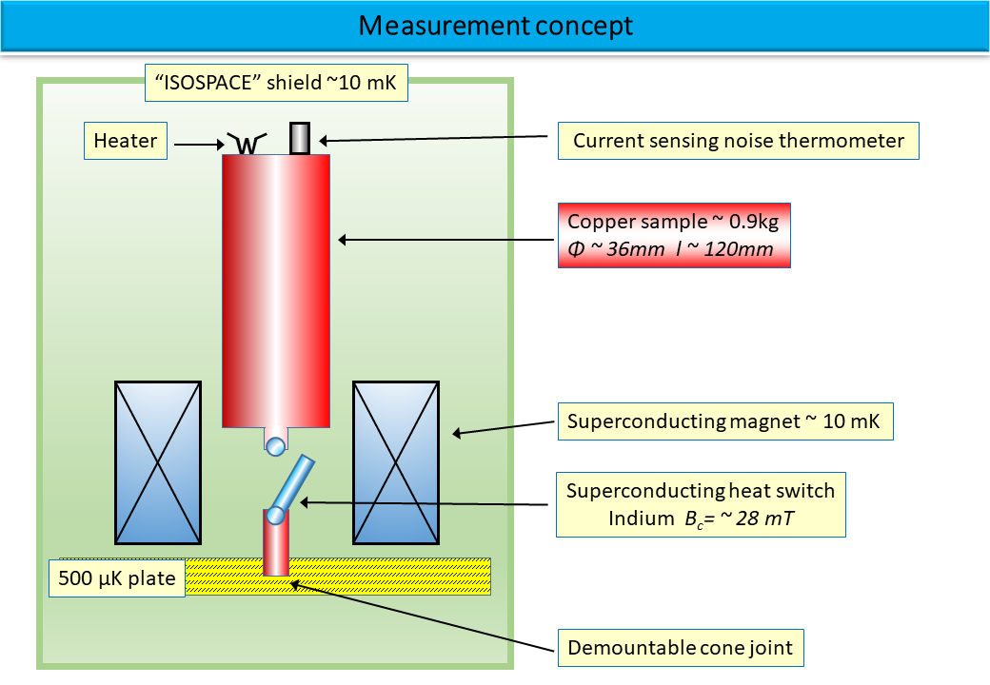

Slide 39
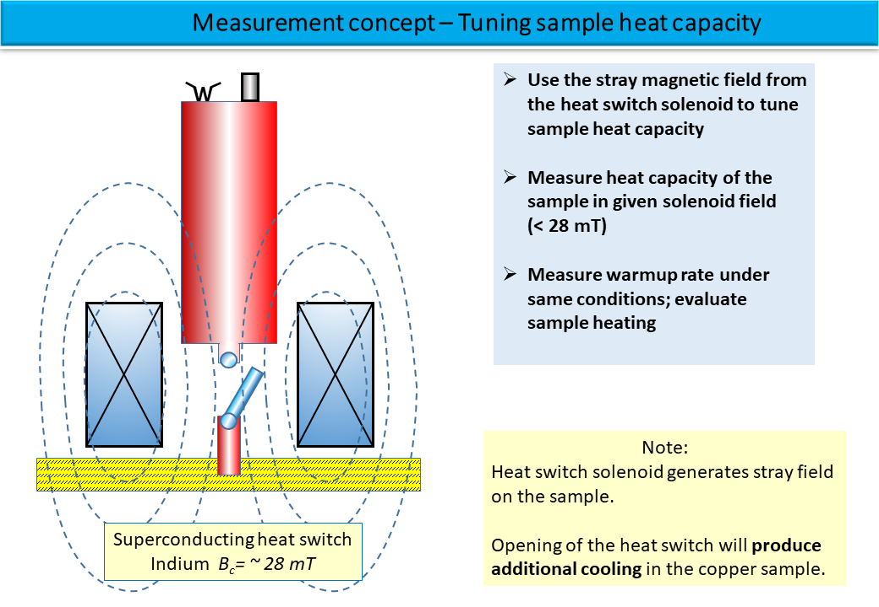

Slide 40


Slide 41


Slide 42


Slide 43


Slide 44
Conclusions
Spontaneous wave function collapse models can be tested by mechanical and thermal experiments (besides interferometry)
Spontaneous force noise in mechanical systems: best results with cantilevers. Levitated systems on the way
New experimental setup to measure spontaneous heating designed and realized
First measurements soon
Short term goal: hit the cosmic ray limit

Slide 45

The Cryo & Quantum team in Trento: CNR-IFN + FBK + UniTN
We have openings for postdoc and PhD positions in Trento
Levitated magnetomechanics
Microwave optomechanics
Microwave devices fabrication (FBK microfab)

