Slide 1
Using Talbot Nanoparticle Matter-Wave Interferometry to Test Collapse Models
Jakub Wardak
5th July 2023 – COLMO Workshop ECT* Trento

Slide 2
Outline
Motivations
- Testing Objective Collapse Models - CSL
2) Current state of the Art
Current mass record
Previous proposals
3) Our Proposal
Creating a coherent source
Optical grating
Detection
Expected interference patterns
Distinguishing between quantum and classical results
Accounting for decoherence effects
4) Exciting Future Prospects

Slide 3
Collapse Models:
Continuous Spontaneous Localization - CSL
Two parameters:
P. Pearle, Phys. Rev. A 39, 2277 (1989). G.C. Ghirardi, P. Pearle and A. Rimini, Phys. Rev. A 42, 78 (1990)

Slide 4
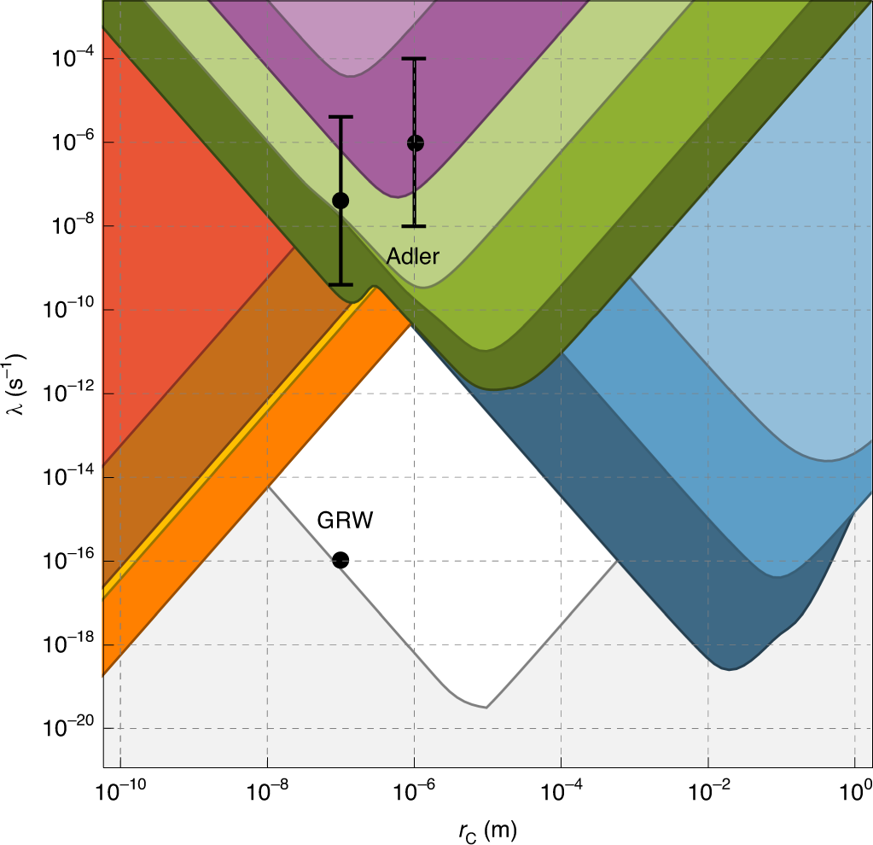
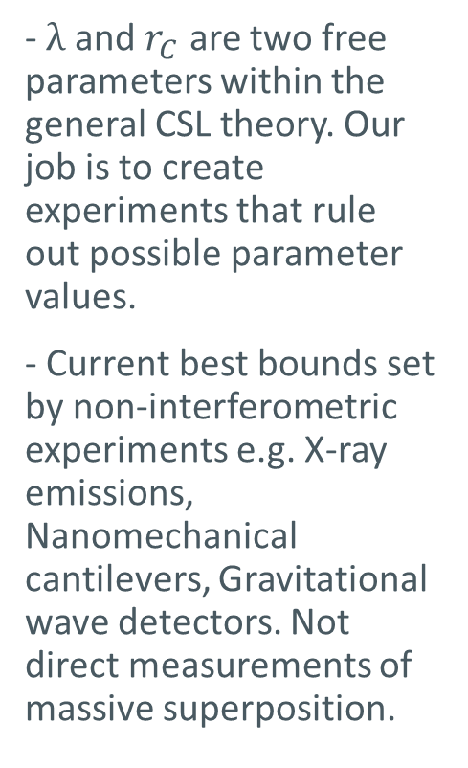
CSL Parameter Space
- $λ$ and $r_{C}$ are two free parameters within the general CSL theory. Our job is to create experiments that rule out possible parameter values.
- Current best bounds set by non-interferometric experiments e.g. X-ray emissions, Nanomechanical cantilevers, Gravitational wave detectors. Not direct measurements of massive superposition.
Carlesso et al. Nature Physics 18, 243-250 (2022)

Slide 5
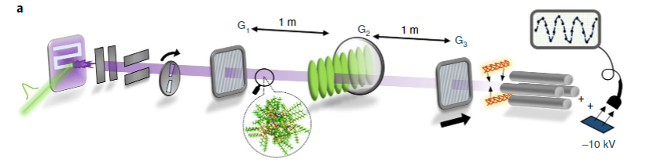
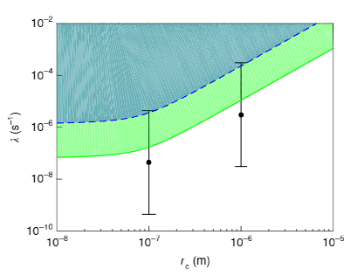
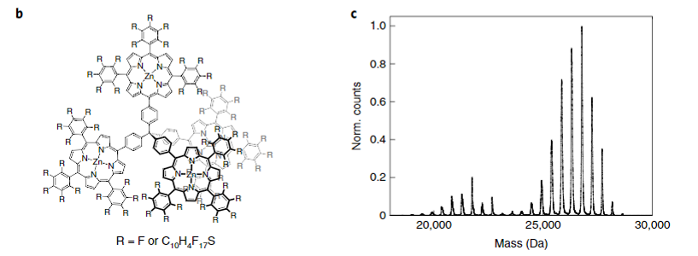
Current Record – 2019 Vienna: Arndt Group – 25000amu
Fein, Y.Y., Geyer, P., Zwick, P. et al. Nat. Phys. 15, 1242–1245 (2019).

Slide 6
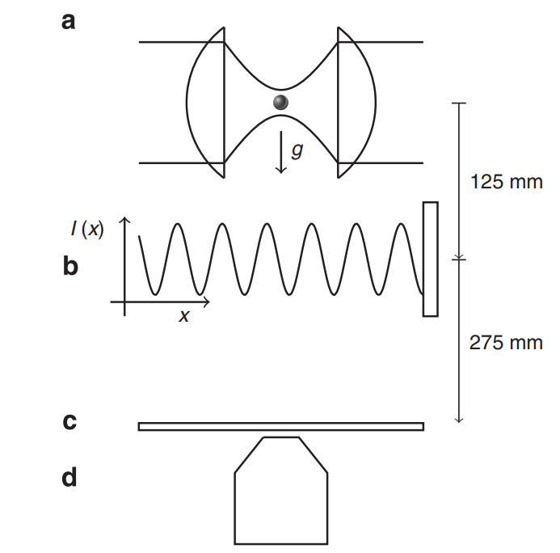
An Initial Idea
-Trap and cool a nanoparticle to create a coherent matter-wave source
-Release and pass through an optical grating to begin interference
-Detect on glass slide via optical microscopy
-Reload and repeat
Bateman, J. et al. Nat. Commun. 5:4788 (2014).

Slide 7
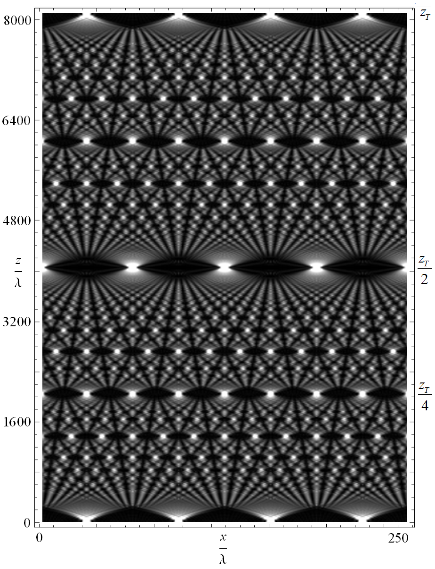
Talbot Lau Effect
-We are making use of the near-field Talbot-Lau interference effect.
-This allows us to limit the necessary size of the interferometer whilst still seeing distinct wave effects
Ben Goodman, 2008, The Optical Talbot Carpet [Online] San Francisco: Wikimedia Foundation. Available from: https://commons.wikimedia.org/wiki/File:Optical_Talbot_Carpet.png

Slide 8
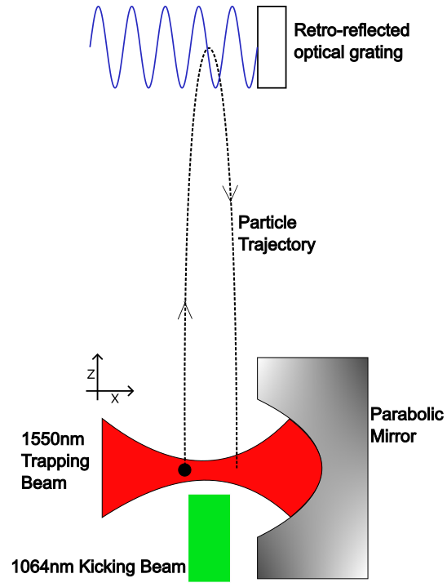
Our Proposal – NAnoparticle TAlbot Lau Interferometer (NATALI)
Optically trap an SiO2 nanosphere
Kick it upwards by turning off the trap and firing an appropriately high energy laser pulse at the sphere from below
At the peak of its trajectory, fire a 213nm laser pulse – this is our optical grating
Re-capture and detect back in the trap
Repeat

Slide 9
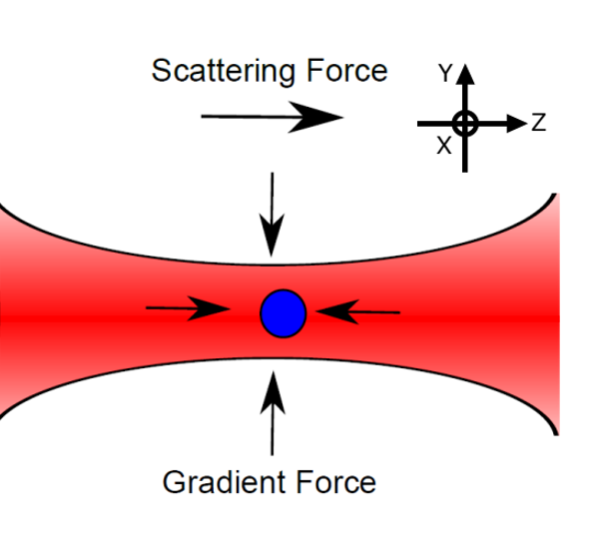
Step 1 – Matter-wave source preparation - Trapping
Optical trapping is achieved using the well known techniques of optical tweezers
We use a high NA parabolic mirror along with a 1550nm CW laser beam to create a Gaussian beam profile
The particle can be thought of as point dipole charges in an E field
This generates two forces, the gradient force pushing the particle to the region of highest intensity and the scattering force due to the net flux of photons from one direction
Vovrosh, J., Rashid, M., Hempston, D., Bateman, J., Paternostro, M., & Ulbricht, H. (2017). JOSA B, 34(7), 1421-1428.

Slide 10
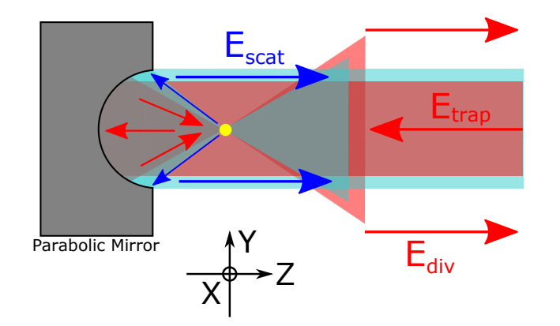
Detection
Light scattered by the particle is collimated by parabola
Optical path length of scattered light to reach detector varies with particle motion
This means the phase difference between the E fields of the light that hits the particle and the light that misses it changes with particle motion
Vovrosh, J., Rashid, M., Hempston, D., Bateman, J., Paternostro, M., & Ulbricht, H. (2017). JOSA B, 34(7), 1421-1428.

Slide 11
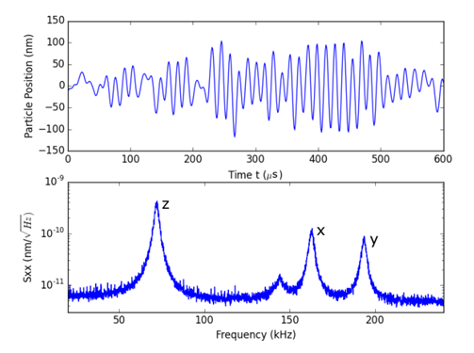
Example PSDs
-When the scattered and diverging fields interfere we get an amplitude modulation at the frequency of the particle oscillation
-We take the power spectral density which allows us to extract various relevant parameters, e.g. radius, mass.
50nm radius particle at 1mbar pressure
Vovrosh, J., Rashid, M., Hempston, D., Bateman, J., Paternostro, M., & Ulbricht, H. (2017). JOSA B, 34(7), 1421-1428.

Slide 12
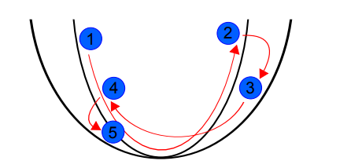
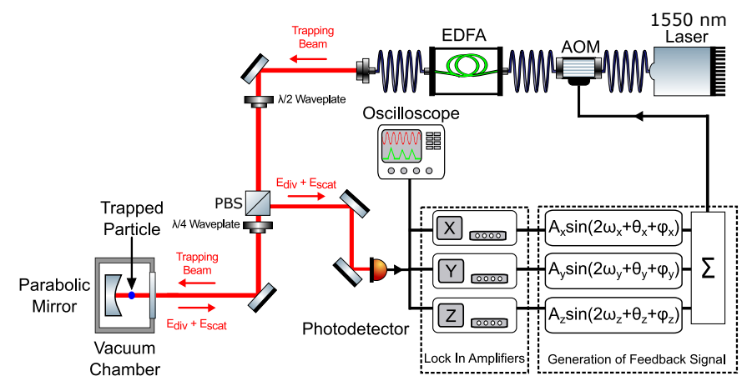
Parametric Feedback Cooling
-For distinct fringes to be seen we require the particle to be as stationary as possible in the trap
-This is accomplished by modulating the trapping potential
-Initial temperature can be artificially decreased through phase tracking and selection of low velocity states
Hempston, D., J. Vovrosh, M. Toroš, M. Rashid, and H. Ulbricht, Appl. Phys. Lett. 111, 133111 (2017)

Slide 13
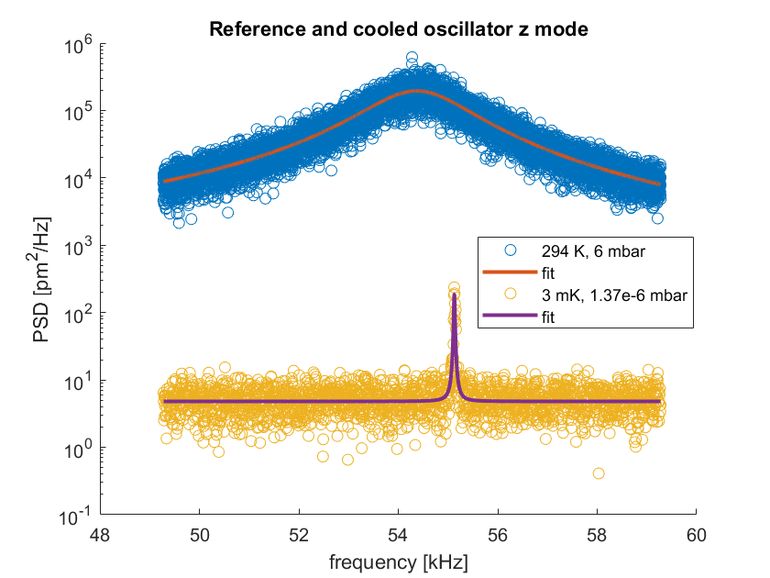
Example Cooling Data
SiO2 Particle with 140nm radius trapped and cooled down to 3mK in the vertical direction of motion

Slide 14



Step 2 – Optical Grating
The optical grating provides a phase bump to the nanoparticle wavefunction
The ‘phase modulation parameter’:
$E_{L}$=
Energy of grating pulse
$a_{L}$=
Spot size of grating pulse

Slide 15
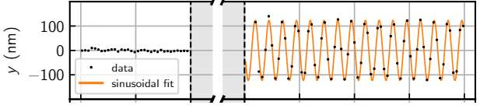
Step 3 - Detection
-When the particle returns to the trap we once again measure its motion as described before
-We can use the measured signal to infer where in the trap the particle landed
Erik Hebestreit, Martin Frimmer, René Reimann, and Lukas Novotny
Phys. Rev. Lett. 121, 063602 – 2018

Slide 16
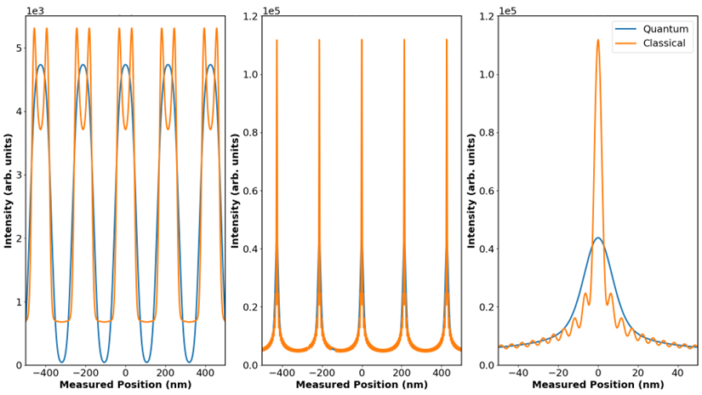
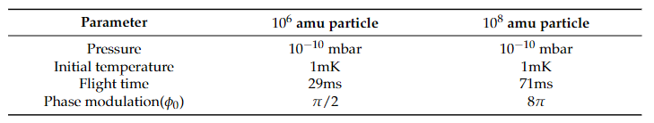



Expected Patterns
${10}^{6}$amu
${10}^{8}$amu
${10}^{8}$amu

Slide 17
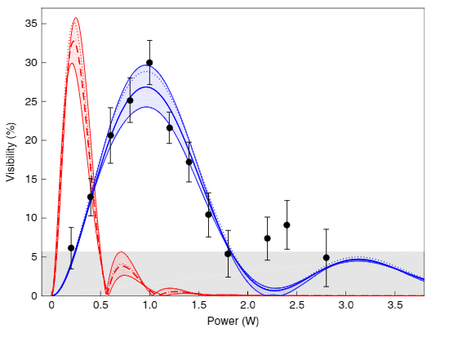
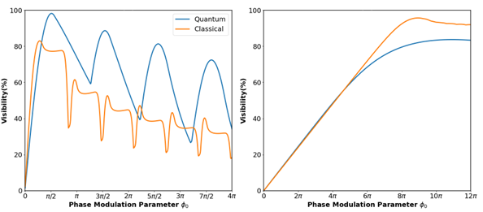



Showing quantum behaviour
${10}^{5}$amu past data
${10}^{6}$amu
${10}^{8}$amu
-Varying the energy of the grating pulse and hence the phase imparted on the particle is the typical method for distinguishing quantum and classical behaviour
-We expect to be able to reliably detect 5% changes in visibility
Fein, Y.Y., Geyer, P., Zwick, P. et al. Nat. Phys. 15, 1242–1245 (2019).

Slide 18
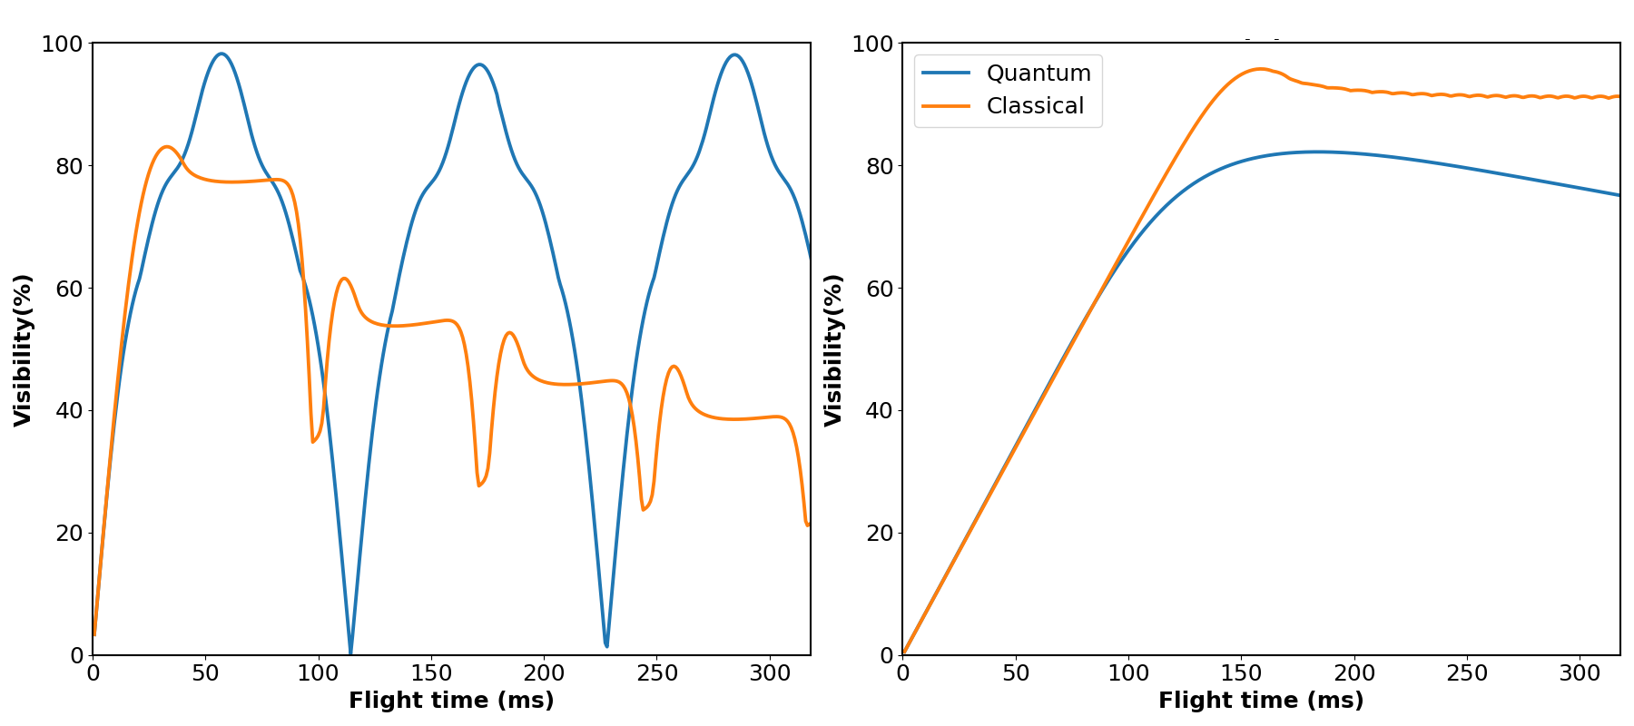
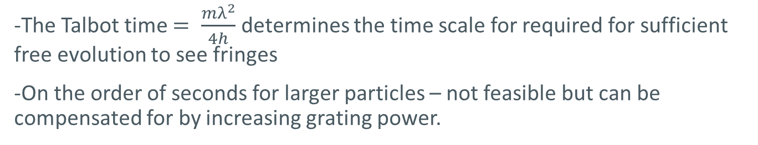


Sub-Talbot Time Measurements
${10}^{6}$amu
${10}^{8}$amu
-The Talbot time $= \frac{mλ^{2}}{4h}$ determines the time scale for required for sufficient free evolution to see fringes
-On the order of seconds for larger particles – not feasible but can be compensated for by increasing grating power.

Slide 19
Main Sources of Decoherence
1)Incoherent source - different starting positions and velocities at launch
2)Internal temperature – emission of black body photons
-1550nm laser for trapping – SiO2 has low absorption at this wavelength so minimal heating by trap
3)Absorption – absorption of photons whilst interacting with grating
-Nanosecond pulse to minimise interaction time and minimise absorption
4)Gas collisions – colliding with gas particles whilst in flight
-Run experiment at UHV
5)Charge – if particle is charged it will interact with any trapped charges in vacuum chamber walls
-Discharge particle before beginning

Slide 20
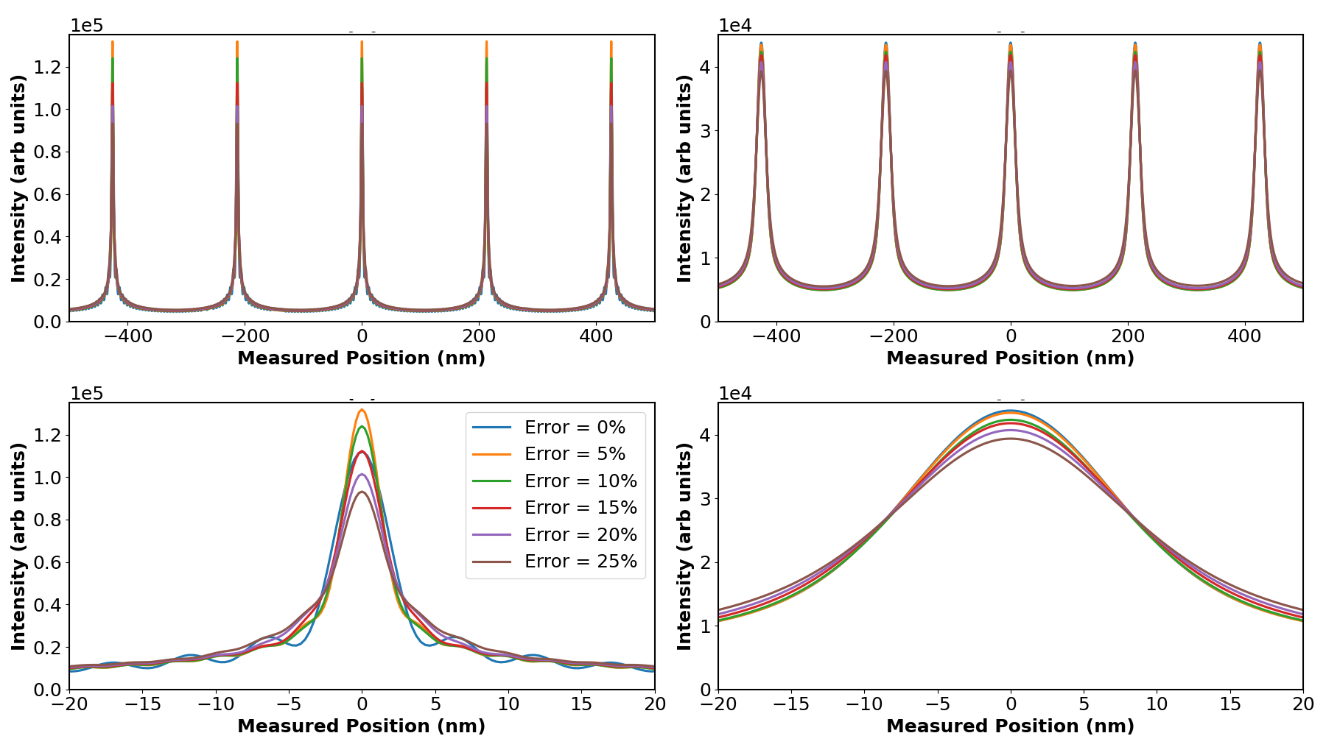


Kick Specific Decoherence
${10}^{8}$amu - Classical
${10}^{8}$amu - Quantum
-Errors in the power of the initial kick will lead to an error in the initial velocity and therefore the flight time of the particle.
-Simulations show we are allowed a high degree of leniency especially for larger particles

Slide 21
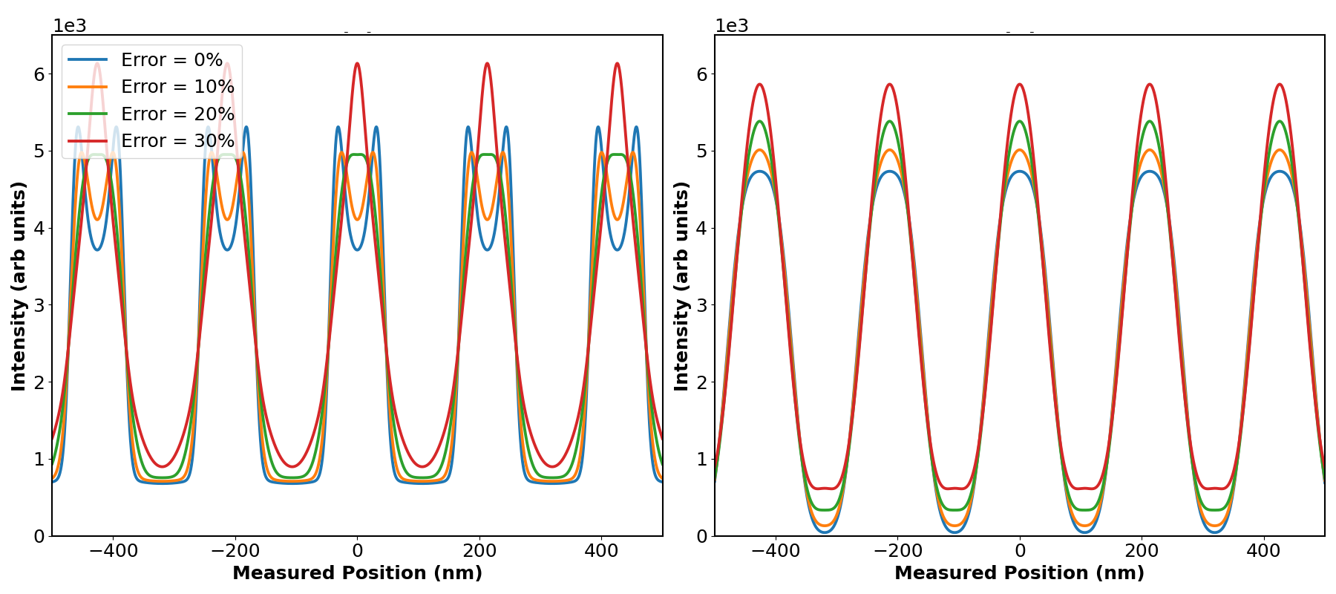


Kick Specific Decoherence
${10}^{6}$amu - Classical
${10}^{6}$amu - Quantum
-Lower mass particles are more affected by errors in initial velocity due to their parameters being well tuned to a maximum visibility position.
-Moving off this maximum causes more immediate visibility drops

Slide 22
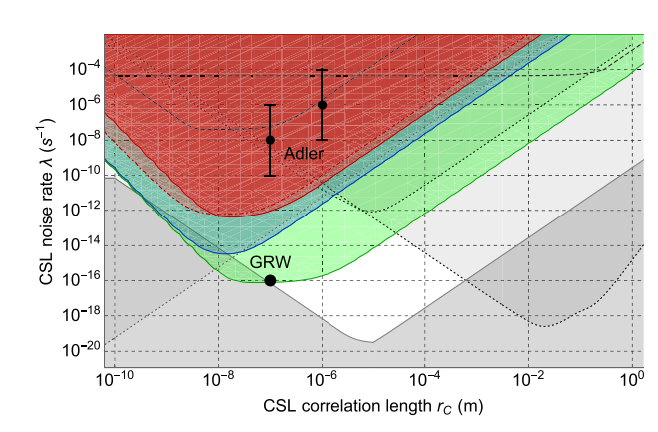
CSL Exclusion Progress
-Red – 10^6 amu particles
-Blue – 10^7 amu particles
-Green – 10^7 amu particles at cryogenic temperatures
Giulio Gasbarri, Alessio Belenchia, Mauro Paternostro, and Hendrik Ulbricht
Phys. Rev. A 103, 022214 – Published 17 February 2021

Slide 23
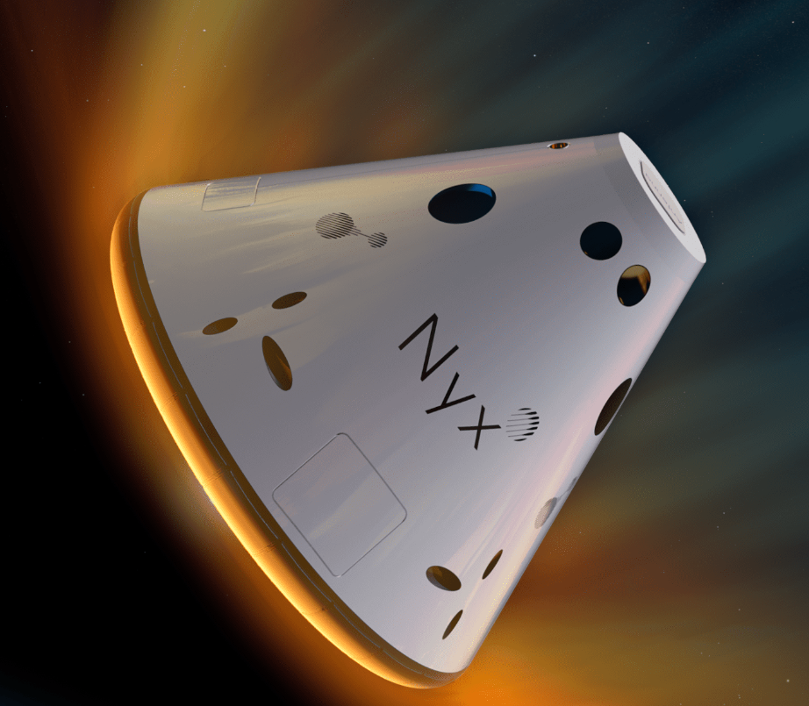
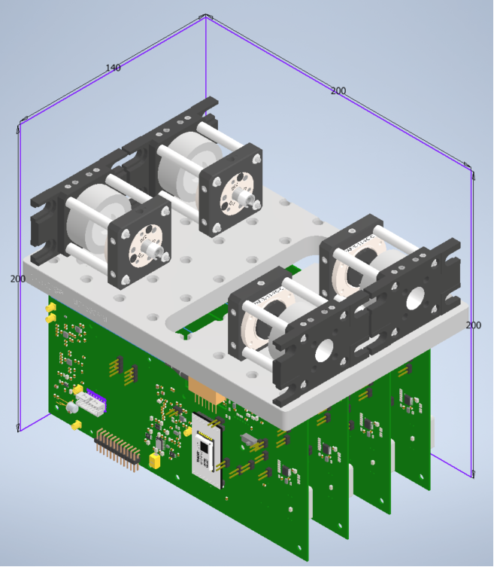
Alternative ideas and future work
We have recently won a place on the Nyx mission, being shot up on a SpaceX Falcon 9 rocket, which will allow us to perform a 30 minute experiment in microgravity.
Throw and catch system is a trick used to counteract gravity acting on the particle.
Microgravity allows for free evolution periods on the order of seconds or even tens of seconds, not possible on Earth.
Can allow for evolution times on the order of the Talbot time even for large particles.
An Einstein Elevator could allow for similar advantages on Earth

Slide 24

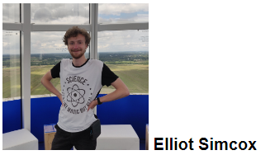
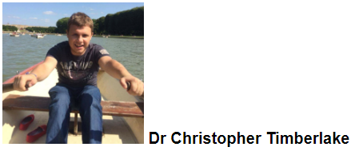
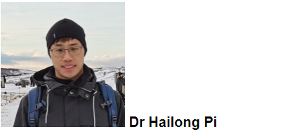
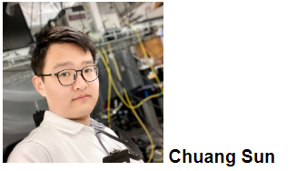
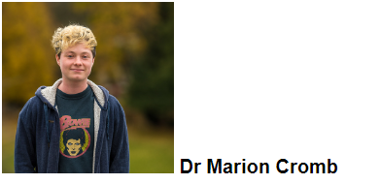

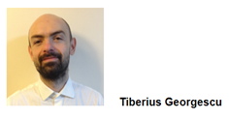
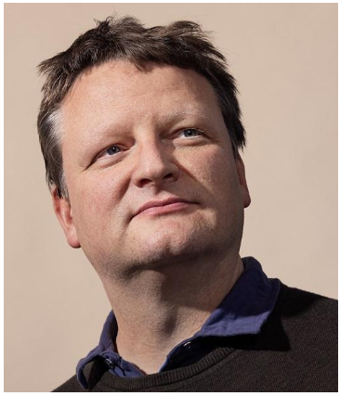

Acknowledgements
Special thanks to:
Hendrik Ulbricht
Tiberius Georgescu
Sarah Waddington
Also thanks to:
Giulio Gasbarri
Alessio Belenchia

