Slide 1

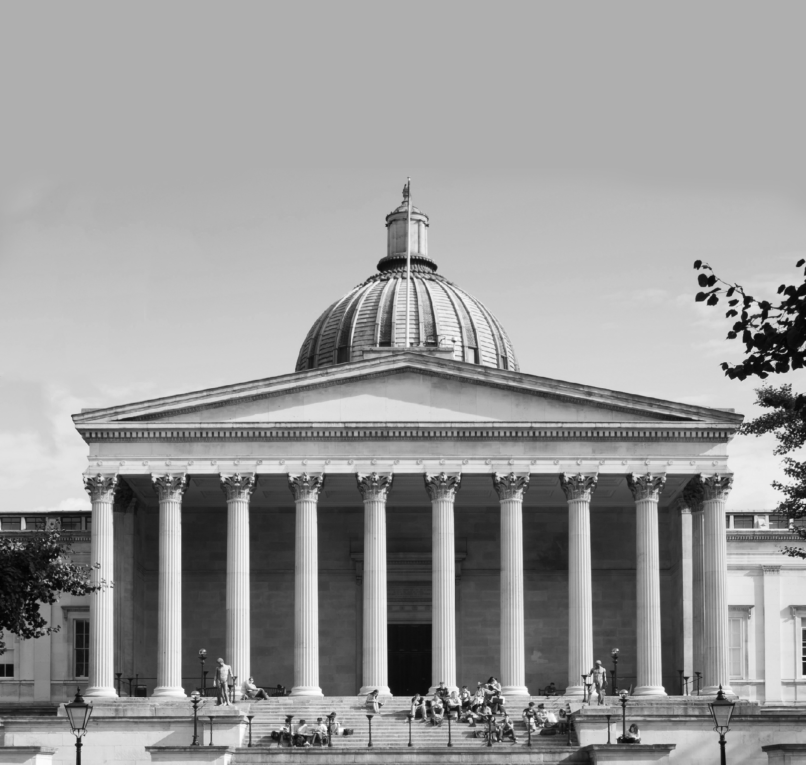

Department of Physics and Astronomy
Fundamental physics with levitated optomechanics at UCL
^{A. Pontin}
COLMO, Trento July 2023

Slide 2

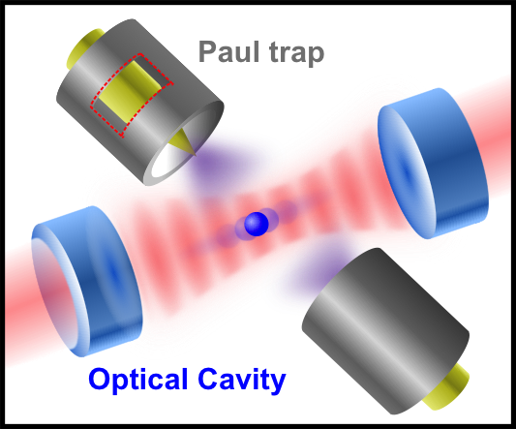
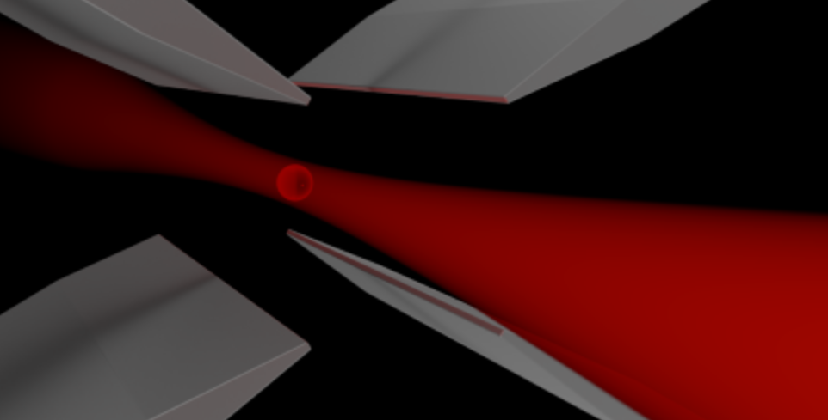
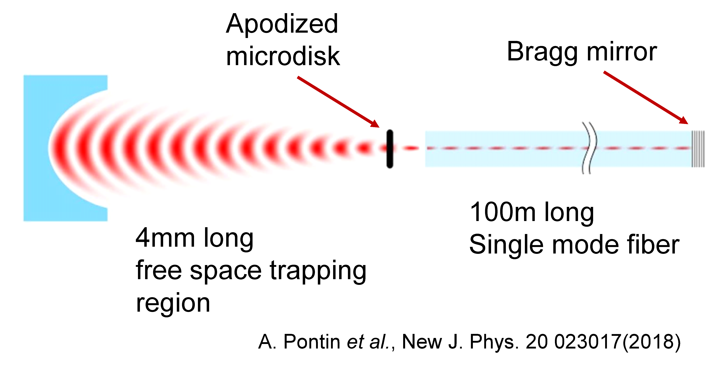
Testing fundamental physics with levitated optomechanics
Exploring macroscopic quantum systems
Cooling and manipulation of nanoparticles in optical and electric traps
Quantum and classical noise in low frequency narrow linewidth oscillators
Wave function collapse noise
Laser refrigeration – cooling internal degrees of freedom
Controlling motional heating
Force detection
Fibre cavity optomechanics
  (High frequency GW detector)
Plus some applications
Whispering gallery mode accelerometers and gyroscope
Notes:
I would like to start giving a brief overview of the experimental activities in our group. We mainly focus on testing fundamental physics with levitated oscillators.
This is pursued with different platforms. We use and optical levitation both in tweezers and Fabry-Perot cavities, but we also use electrodynamic traps for charged nanoparticles.
These systems offer great sensitivities for both force and acceleration detection, depending on the parameter regime, with a number of potential applications.
Ultimately, we are interested in exploring quantum mechanics with these mesoscopic oscillators.

Slide 3
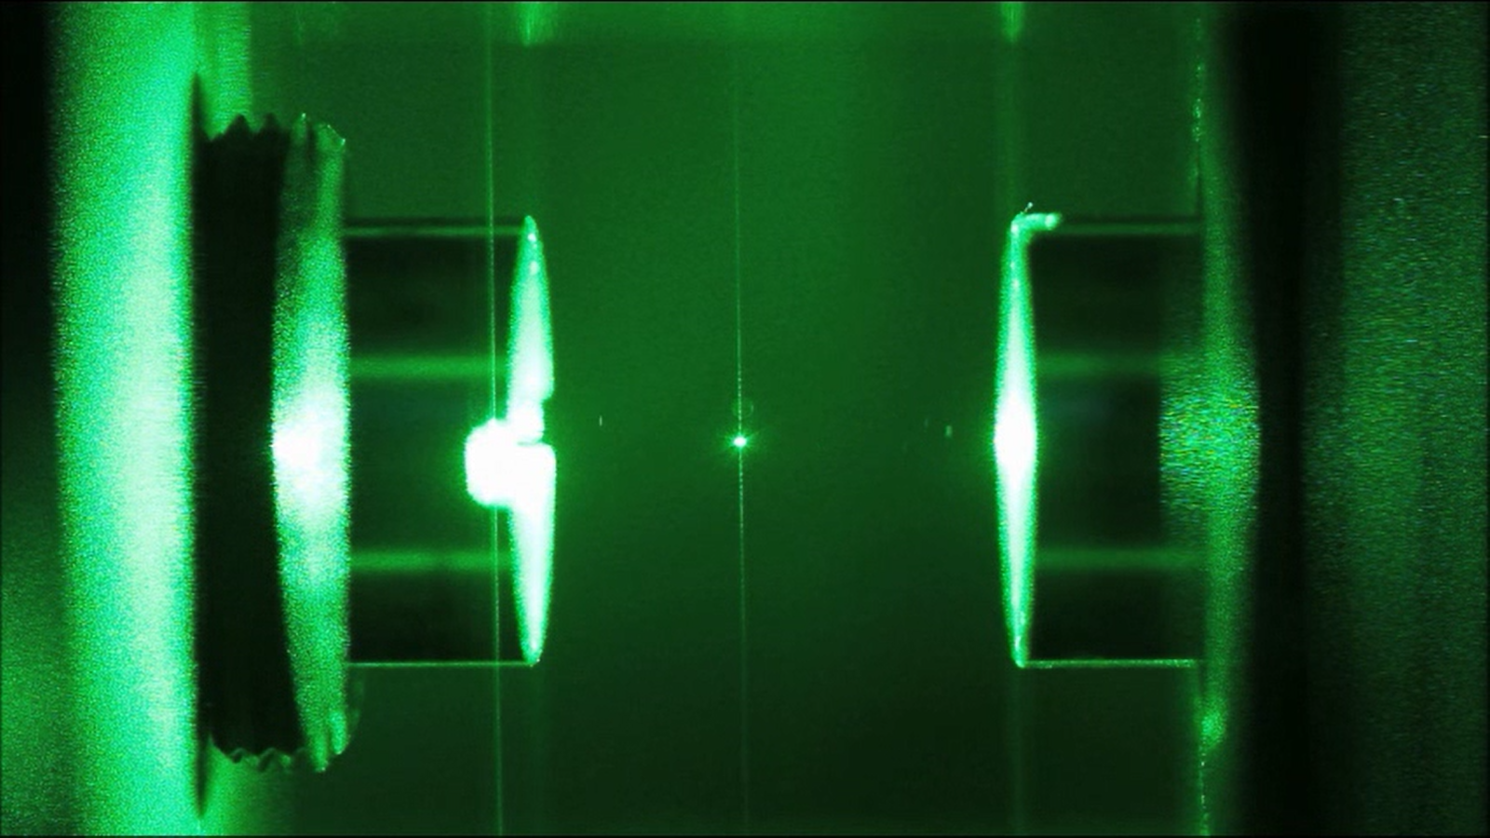
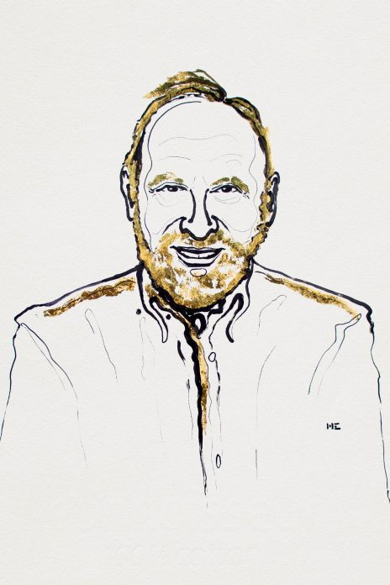
Macroscopic QM with levitation
The Nobel Prize in Physics 2018
Arthur Ashkin
Field insulates the particle from environment
Tunable spring constant
High mechanical Q~10¹²
Cooling achieved by feedback and cavity cooling

Slide 4
Outline
Topic 1:
TEQ – Testing the large-scale limit of Quantum Mechanics
  Testing CSL with a levitated nanoparticle
  Overview and results
Topic 2:
Towards the quantum regime
  Sympathetic cooling of co-trapped particle
  Coherent scattering
  Rotational dynamics of non-spherical particles

Slide 5
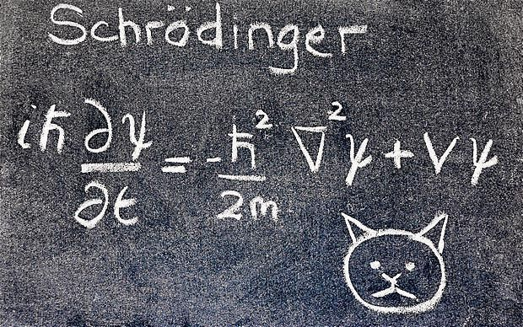
Testing the macroscopic limits of quantum mechanics
Microscopic systems can be in a quantum superposition; macroscopic systems no… at least so far.
How is quantumness lost when moving from the micro- to the macro-world?

Slide 6

Goal of TEQ project
…test CSL in a parameter range which is two orders of magnitude beyond any other test performed so far – using levitated nanoparticles
TEQ
Lower bound: Collapse effective at the macroscopic level
Graphene disk: N = 10¹¹ amu, d = 10⁻⁵ m, T = 10⁻² s
Levitation - higher Q and lower frequency, few degrees of freedom

Slide 7
Continuous spontaneous localisation
CSL model
2 phenomenological constants (free parameters)
Correlation radius r_{C}
− conventional “literature value” r_{C} =10⁻⁷ m
Collapse rate λ
    Lower bounds (to guarantee collapse at “macroscopic” or “mesoscopic” scale)
    λ ∼ 10⁻¹⁶ s⁻¹ @ r_{C} =10⁻⁷ m following Ghirardi, Rimini, Weber (GRW)
    λ ∼ 10⁻⁸ s⁻¹ @ r_{C} =10⁻⁷ m following Adler

Slide 8
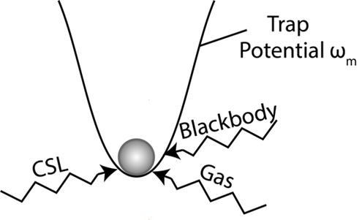
‘Cool and Release’ Protocol
Collapse as excess noise – heating
Levitate a particle in vacuum

Slide 9
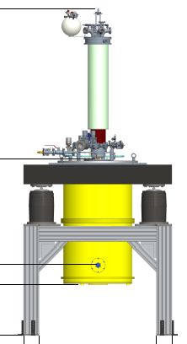
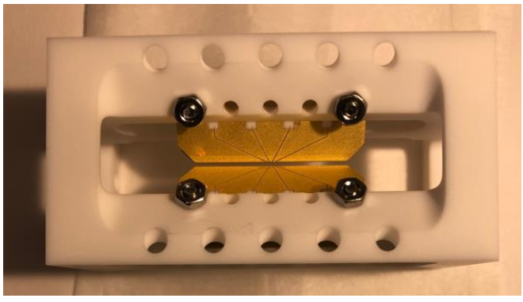
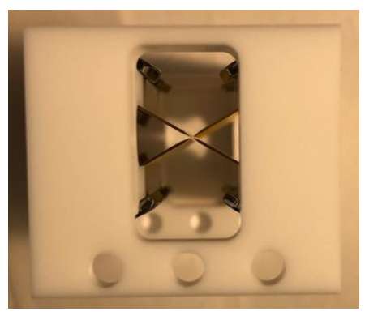
TEQ experiment
Nanoparticle
ion Paul-trap with optical
detection inside a 300 mK
cryostat to test CSL.
Measurement of reheating rates
Final experiments at UoS
Blade trap (Aarhus Univ., M. Drewsen)

Slide 10
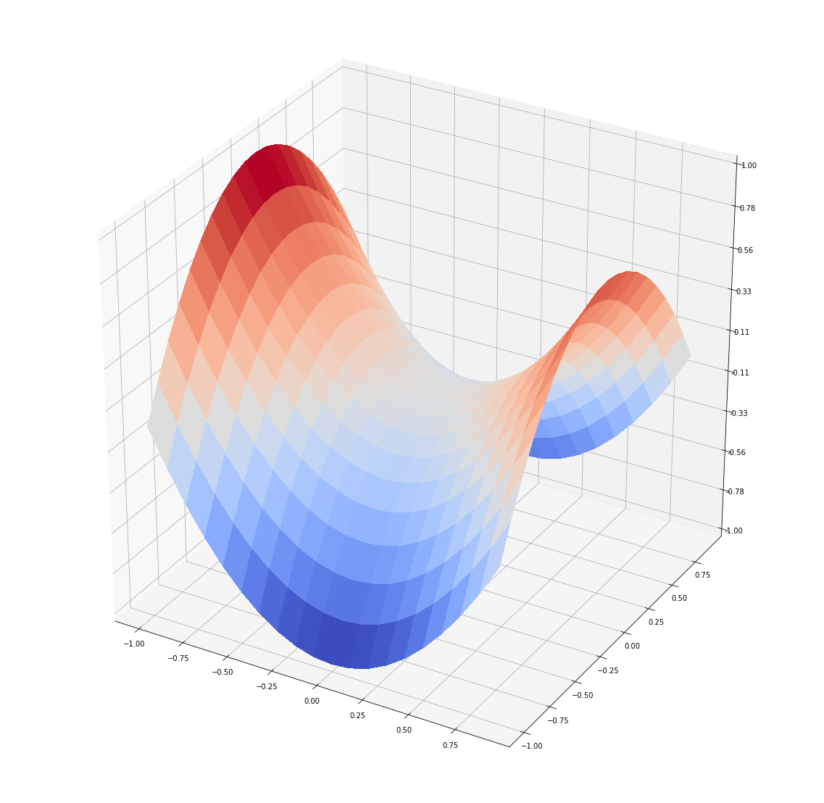
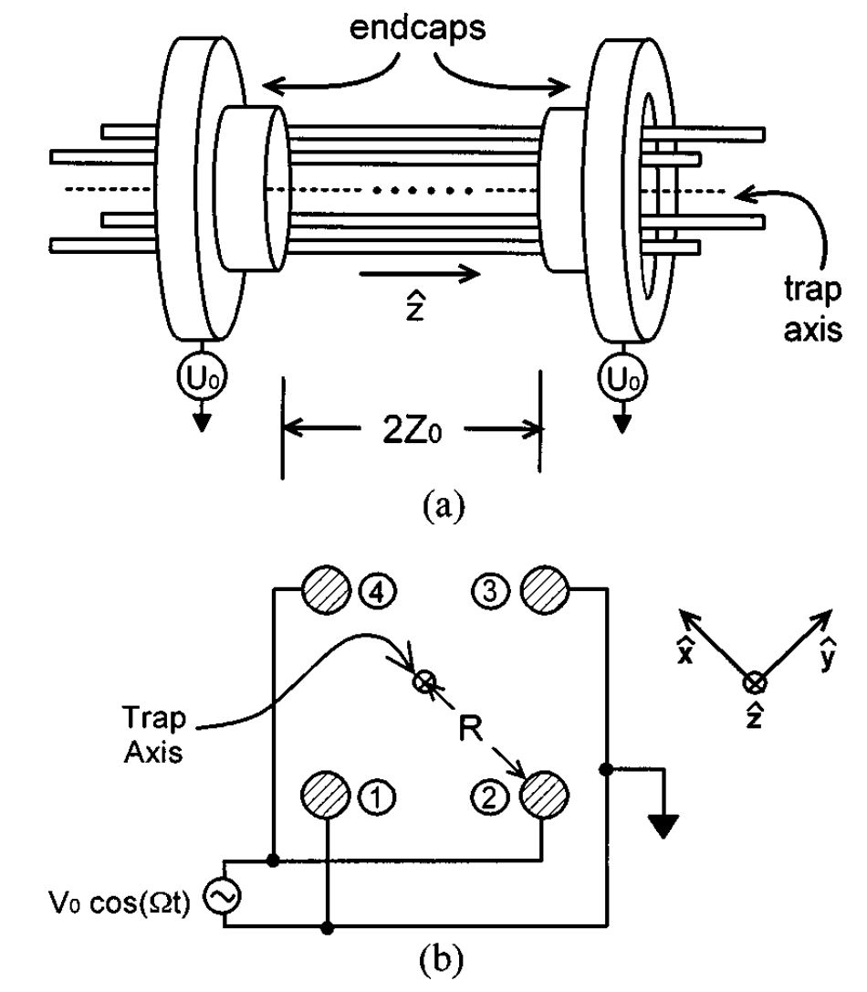
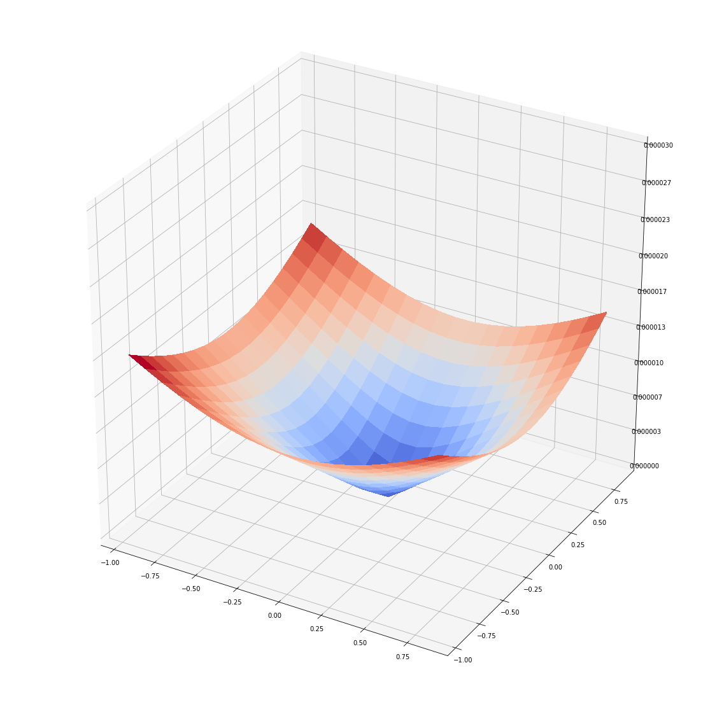


Paul trap
V$\left(x, y, z\right)= V_{0}(α′x^{2}+ β′y^{2}+ γ′z^{2})$
Strong suppression of photon recoil
$$α′+ β′+ γ′=0$$
$$\frac{q}{4m{ω_{d}}^{2}}{|∇V\left(x, y, z\right)|}^{2}$$
Typical trap frequencies
0.1 – 1 kHz
From: J.Appl.Phys 83, 5025(1998)

Slide 11
What problems
Absorption
Detection
Additional heating rates
(force noise)

Slide 12
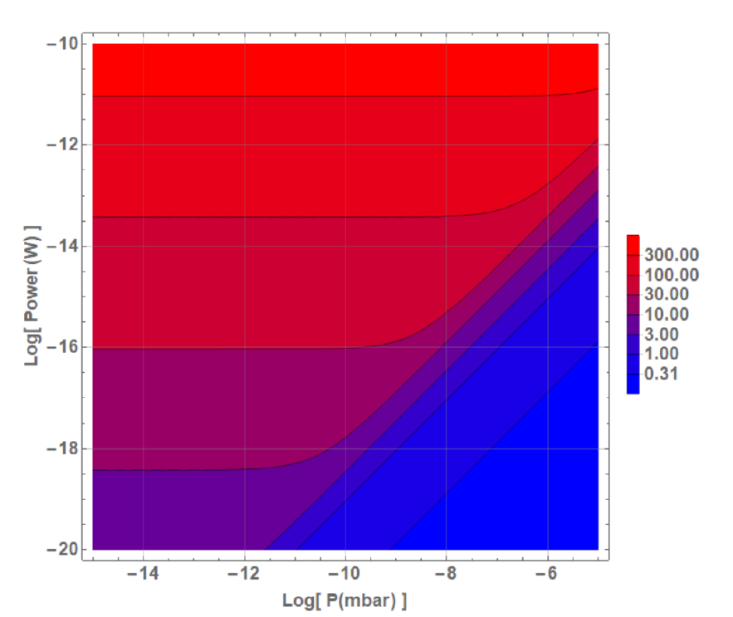
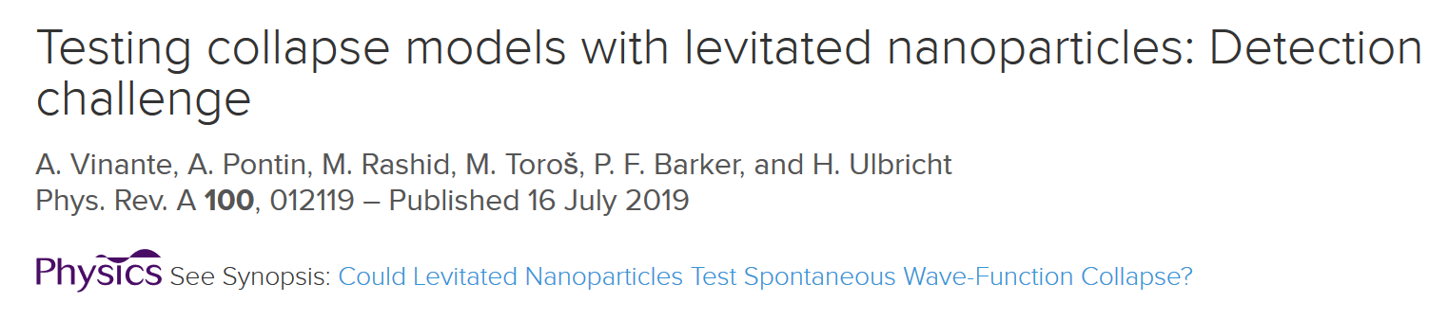
Absorption
Internal temperature: determines gas collision effective temperature
Optical trapping is not an option
Noise in Paul trap + electronics
needs to be very low
Low pressure
High power
Cooling dominated by
blackbody emission
NEED TO WORK IN THIS
REGIME!
High pressure
Low power
Cooling dominated by
Gas collisions

Slide 13
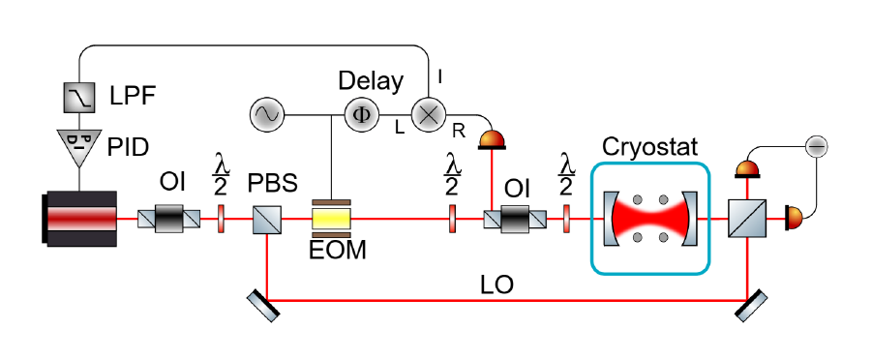
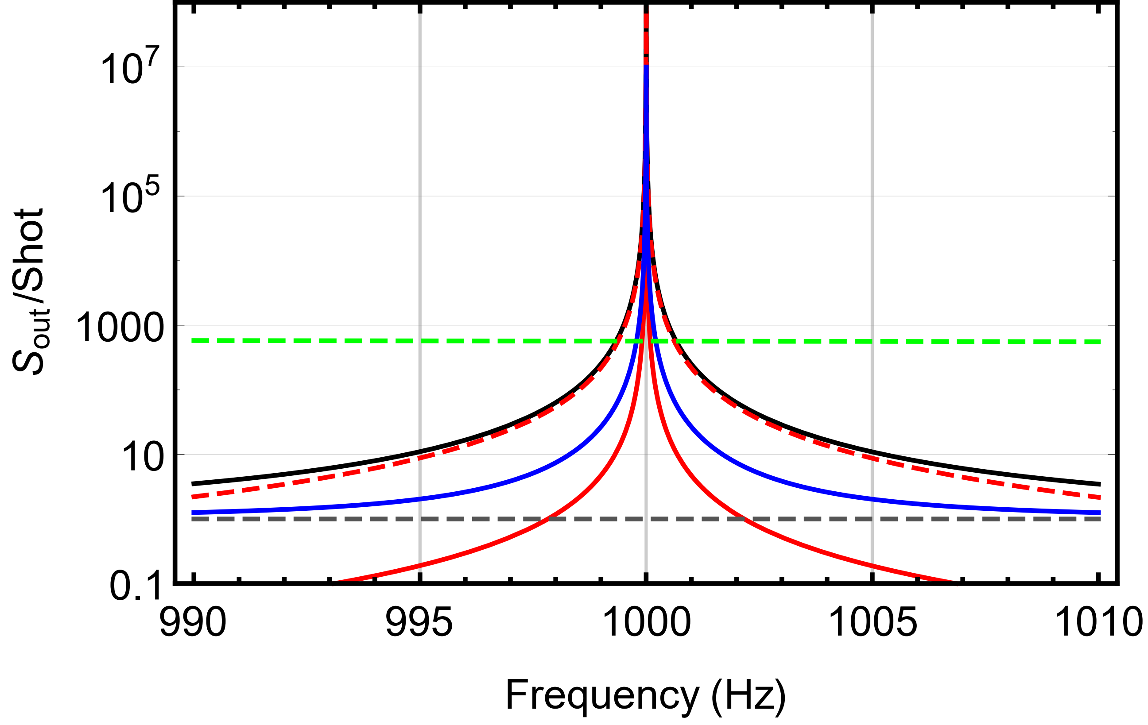
Detection at ultralow absorbed power
Low-finesse (~1000) OPTICAL CAVITY
NOISE BUDGET @ P=10⁻¹³ mbar, 10⁻⁶ W cavity input power
total noise
back action noise
Thermal noise
Photon recoil noise
Issues:
Locking at low power
Requires very accurate alignment
Requires feedback to stabilise particle position
Laser Frequency noise
(commercial)
SHOT NOISE
GOOD EFFECTIVE BANDWIDTH ≈ Hz
(Photon recoil dominated)
SIMILAR FOR OPTICAL TWEEZER APPROACH
(limited by NEP of detector …)

Slide 14
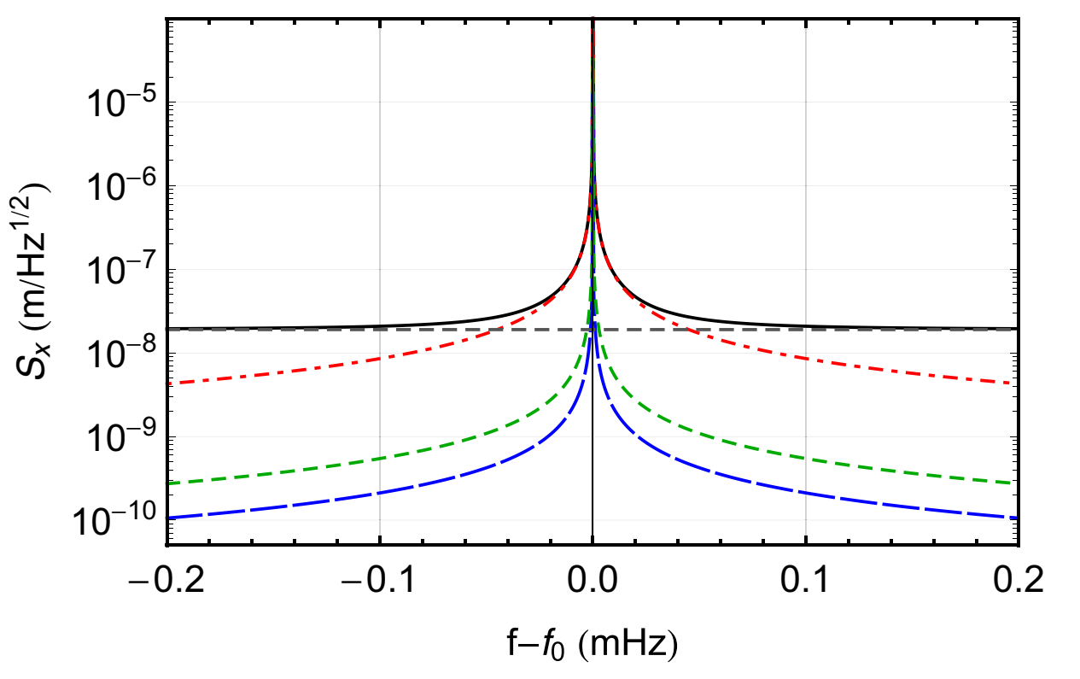
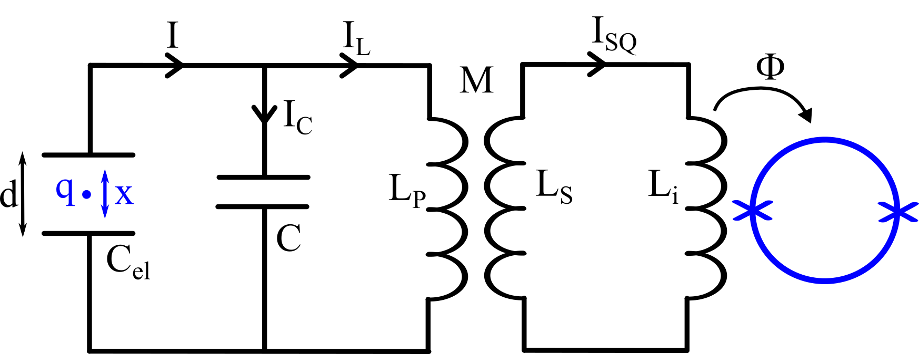
Detection at ultralow absorbed power
2) Electrical readout + SQUID
total noise
electrical noise
thermal gas coll. noise
SQUID backaction noise
SQUID imprecision
PAUL TRAP ELECTRODES
Issues:
Needs a huge superconducting transformer
Paul trap bias drive could saturate SQUID
Advantages:
No alignment issues
No power dissipated in particle
Lower thermal noise achievable
VERY NARROW BANDWIDTH ≈ mHz
(low coupling, thermal noise dominated)
LOWER FORCE NOISE BUT
NEEDS VERY HIGH FREQUENCY STABILITY!

Slide 15
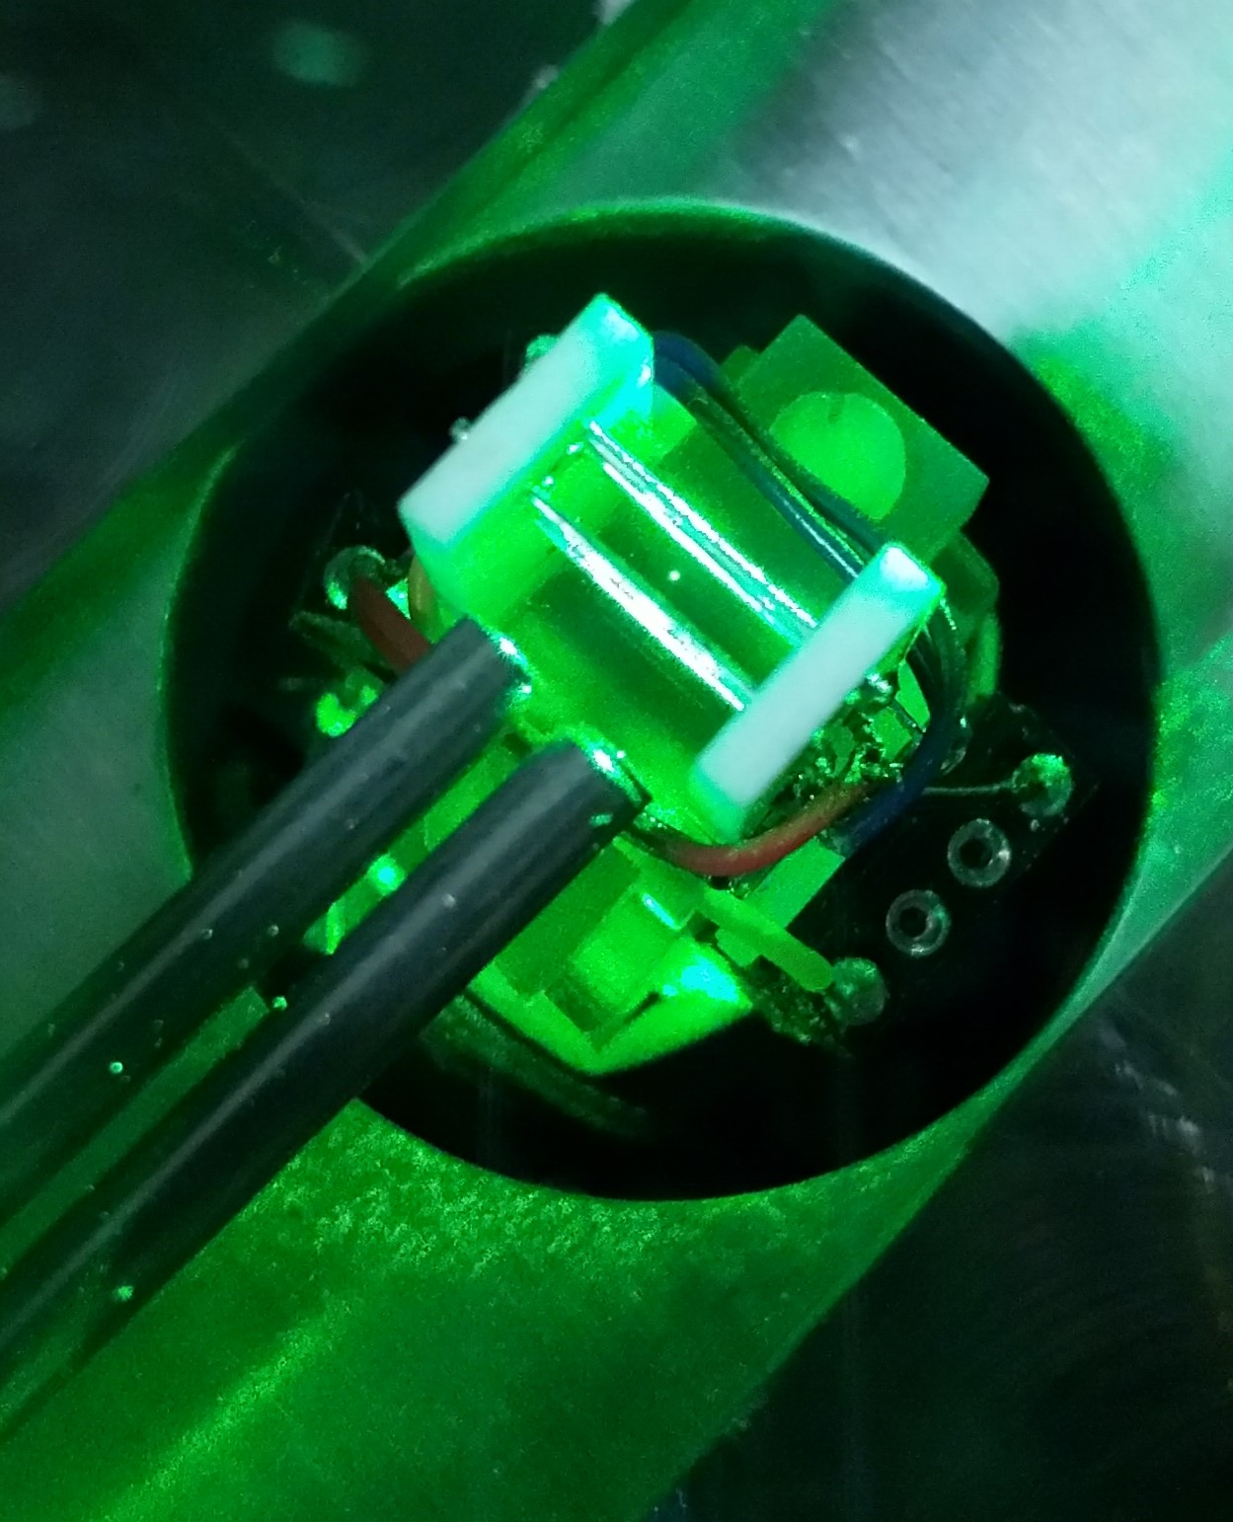
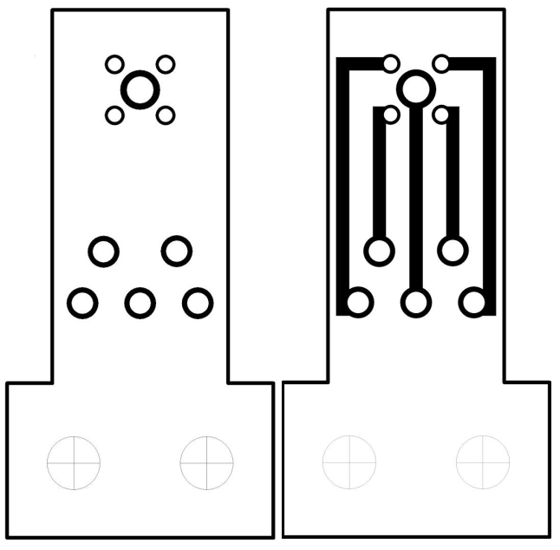
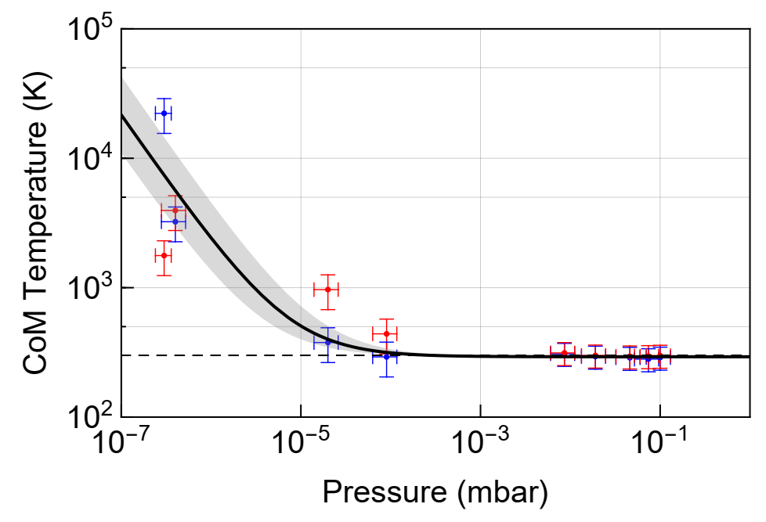

Electric field noise
Initial testing on UCL trap
End cap
Voltage noise induced CoM heating
10 mm
Excess force noise
~ 1 10⁻³⁸ N²/Hz
Rods
Guide
AC distance: r_{o} = 1.1 mm
DC distance: d_{o} = 3.5 mm
CSL noise @ λ=10⁻¹⁰ Hz
~10⁻⁴⁴ N²/Hz

Slide 16
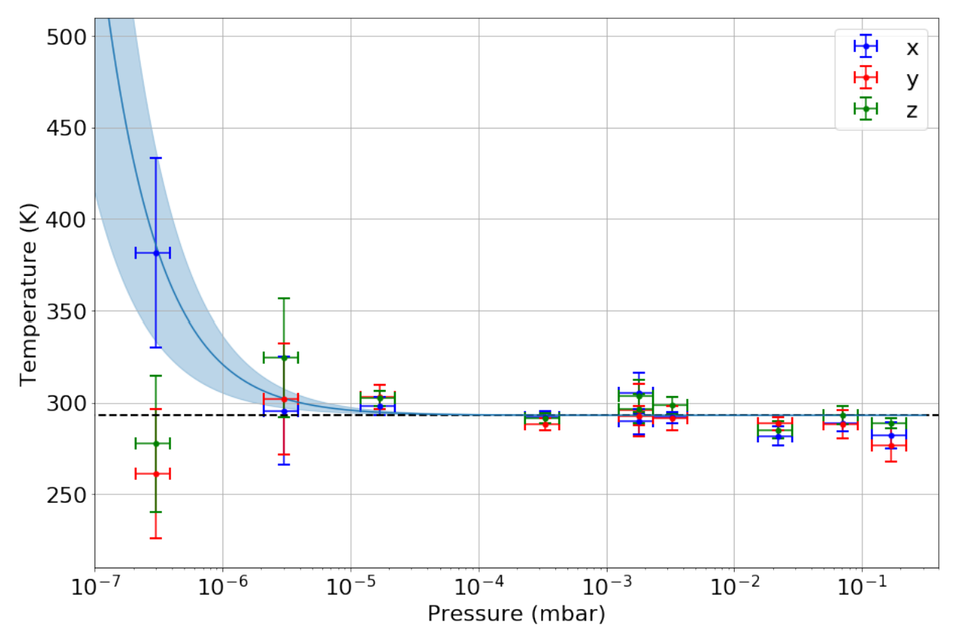
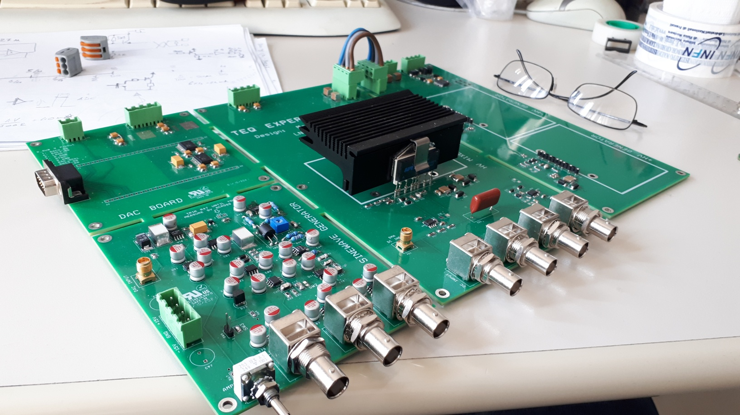
New driving electronics
Developed by LNF, M. Bazzi
Voltage noise heating now absent
DC source
AC drive
AC amplifier
4 orders of magnitude improvement in desired BW
2-4 orders of magnitude improvement in desired BW
No heating consistent with voltage noise observed

Slide 17

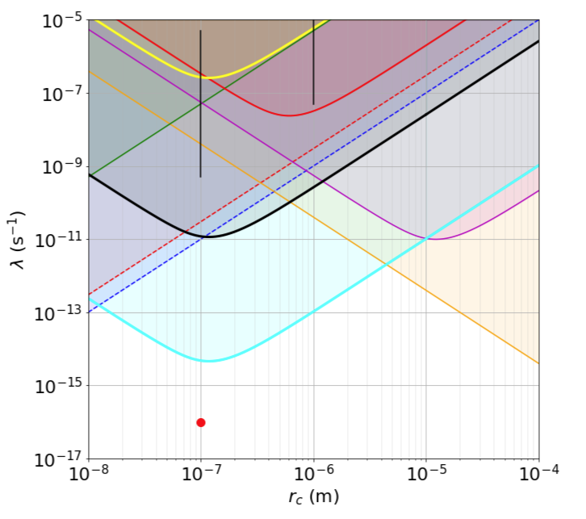
What does it mean for CLS bounds
Red dot - GRW predictions, Vertical Black bars – Adler predictions
Green line - cold atoms
Purple line - cantilever experiments
Orange line - LISA pathfinder
Red dashed line - bulk heating
Blue dashed line - x-ray
Solid red line - previous best measurements with a levitated spheres
Yellow line - bounds from initial experiment
Black line - prediction for TEQ using a particle with a charge of 50e
Cyan - prediction for TEQ using a particle with a charge of 1e.

Slide 18
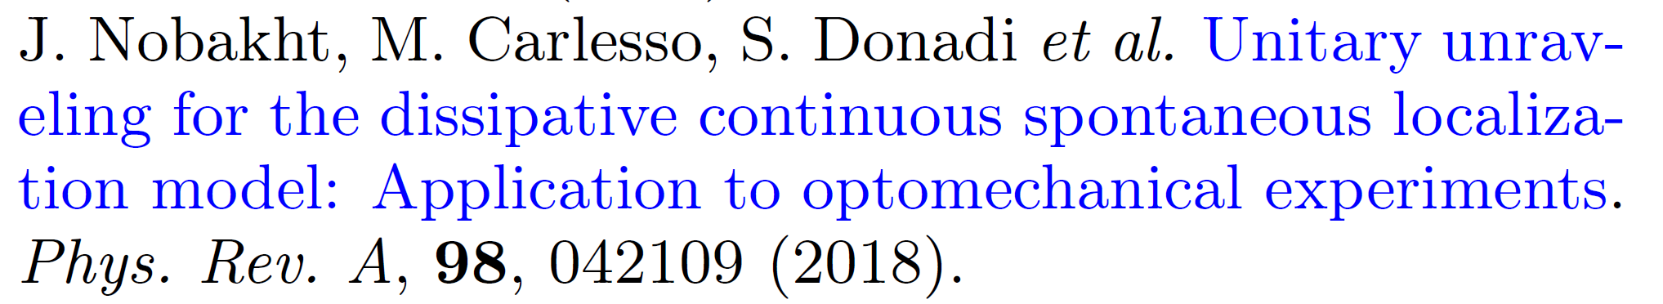
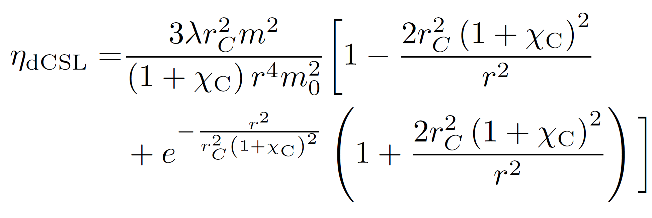
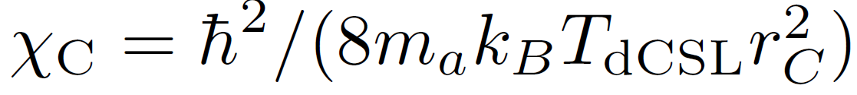
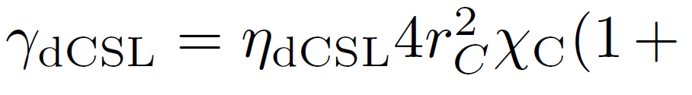
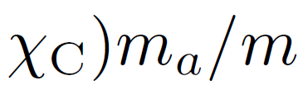

Dissipative CSL
Now Characterised by linewidth and temperature

Slide 19
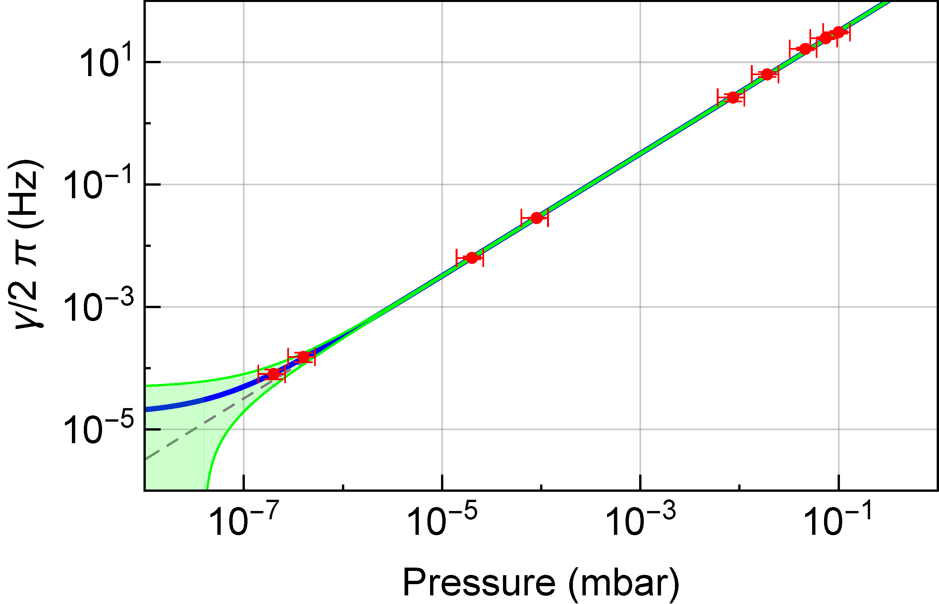
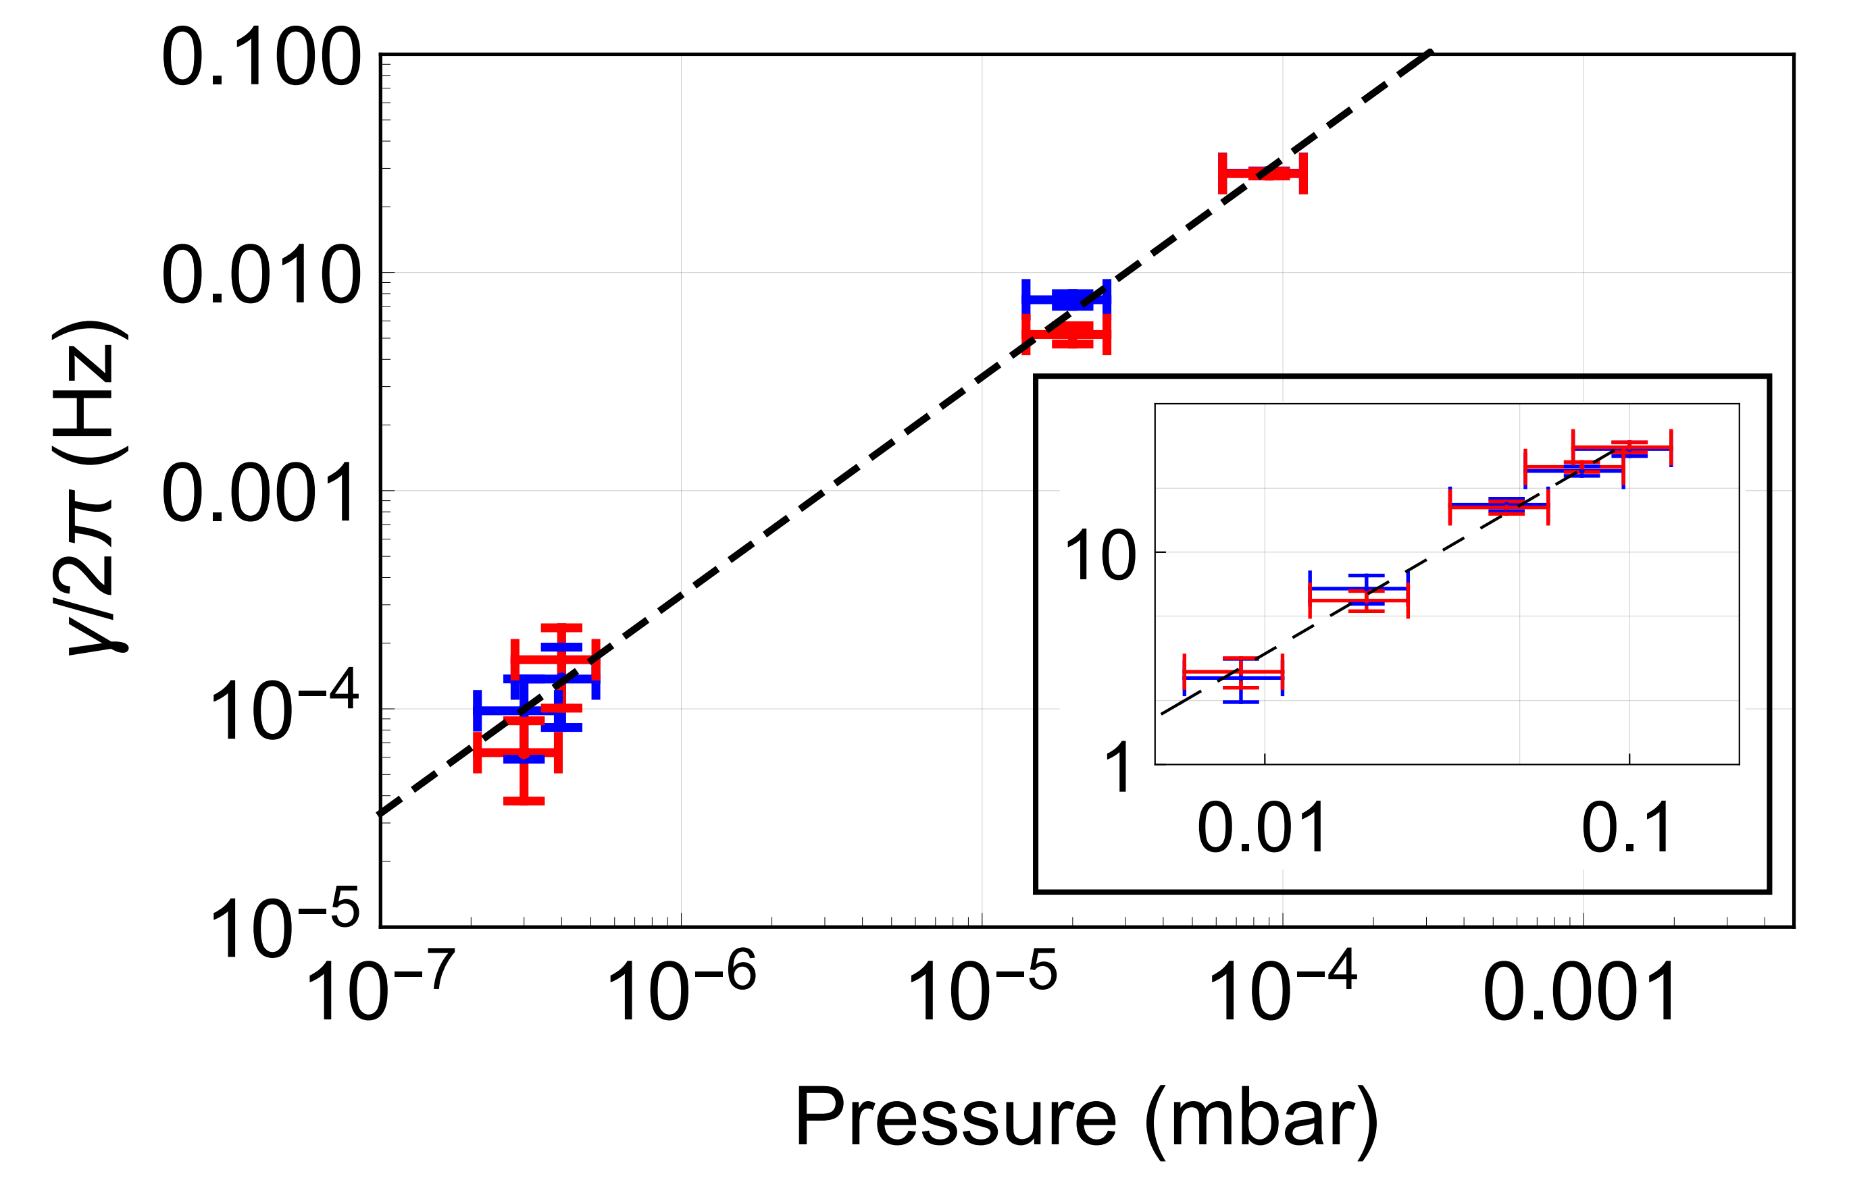
Maximum linewidth offset

Slide 20
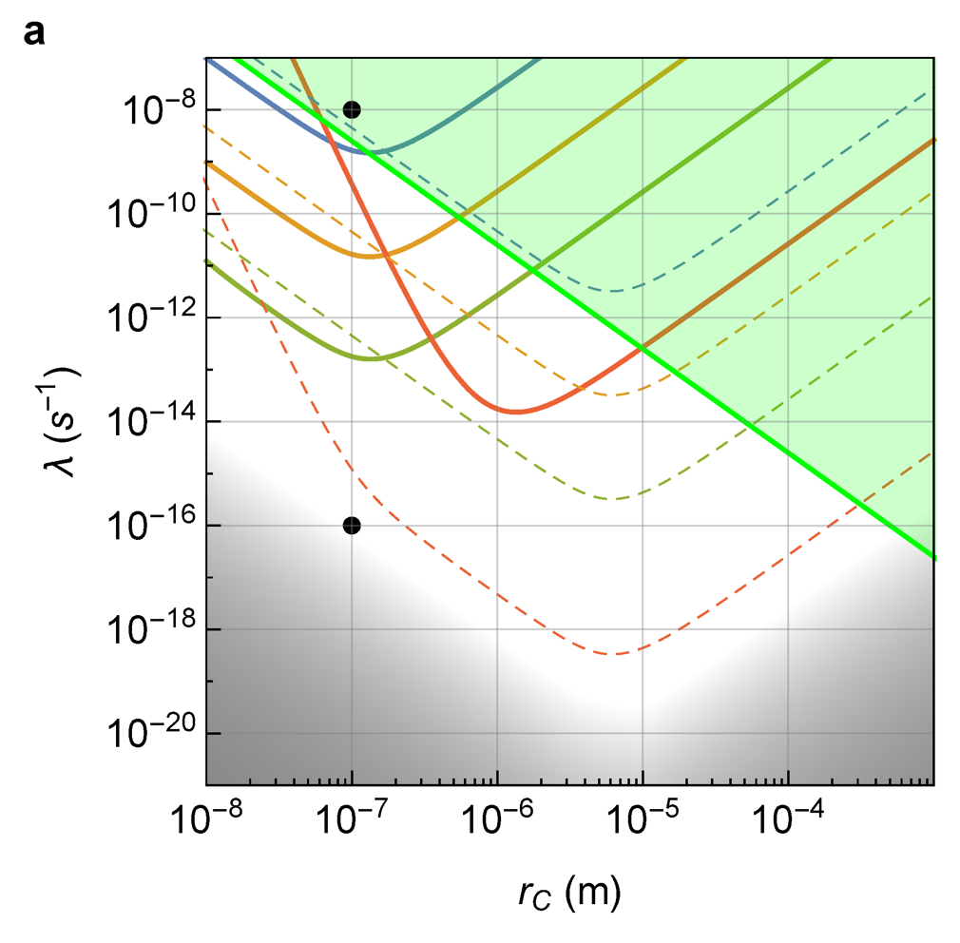
Limits on dCSL
Adler
1 K
10⁻² K
10⁻⁴ K
Solid lines - 231 nm radius
10⁻⁷ K
Dashed lines – 10 000 nm radius
GRW

Slide 21
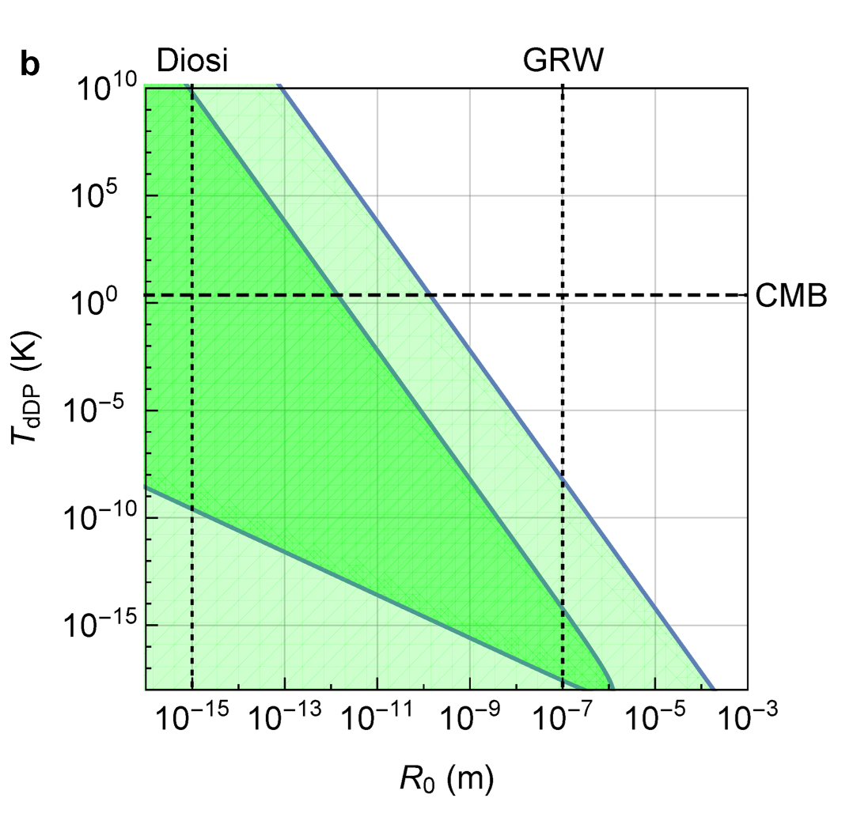
Dissipative Diósi-Penrose

Slide 22
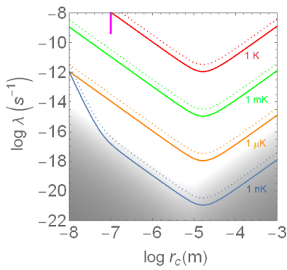
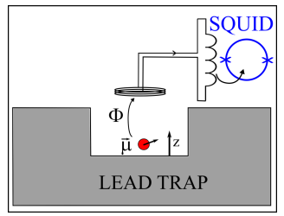
Improved limits on dCSL
Levitation of permanent magnet
27 µm radius
(density 4 times larger)
A. Vinante, et. Al., Phys Rev. Research 2, 043229 (2020)

Slide 23
Topic 1 summary
New trap and electronic developed
Tests confirm that electronic noise is not the dominant noise down to approximately 10⁻¹³ mbar and has reached TEQ requirements
Placed new bounds on dissipative variants of collapse models both at UCL and UoS
Trap now at UoS

Slide 24
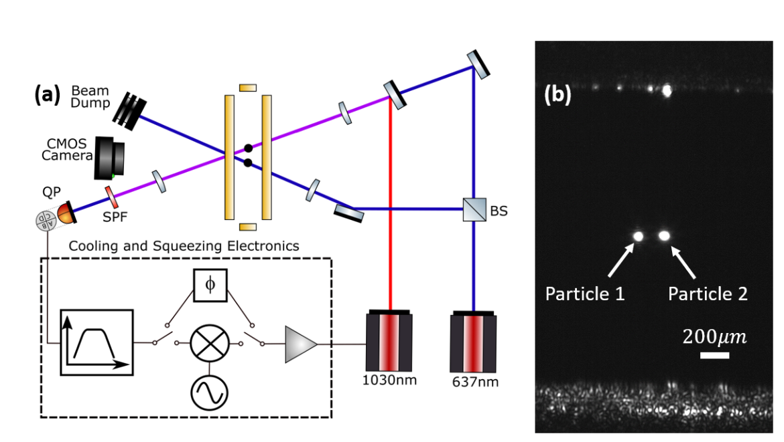
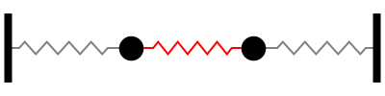
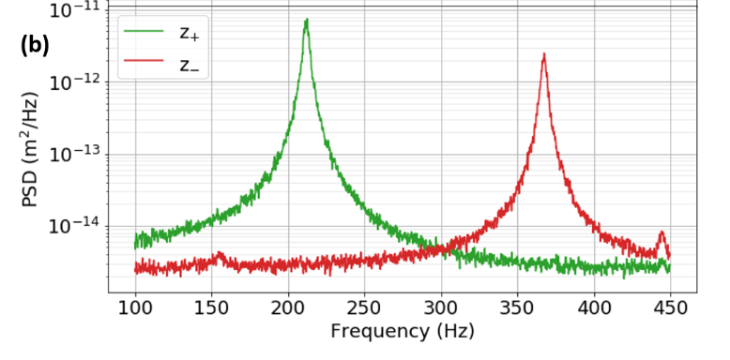
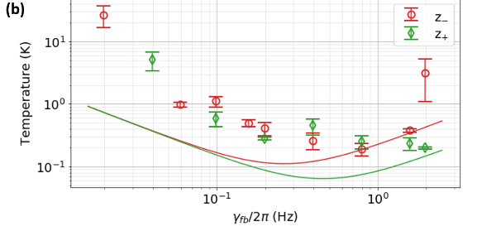
Sympathetic cooling
Strong Coulomb coupling allow sympathetic cooling of one particle by another

Slide 25
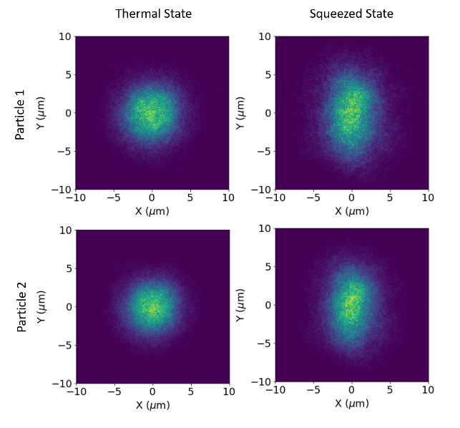
Sympathetic cooling
Strong Coulomb coupling allow sympathetic cooling of one particle by another
Classical sympathetic squeezing

Slide 26
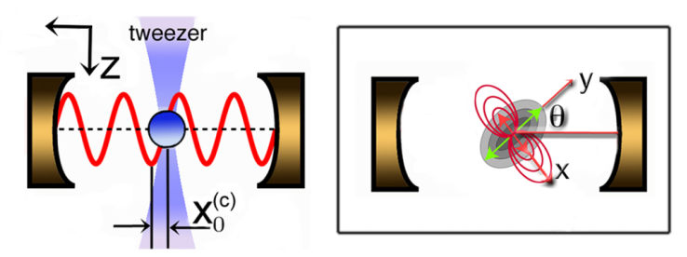
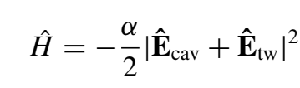
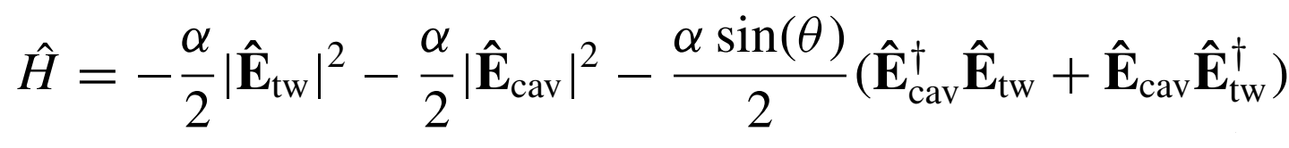
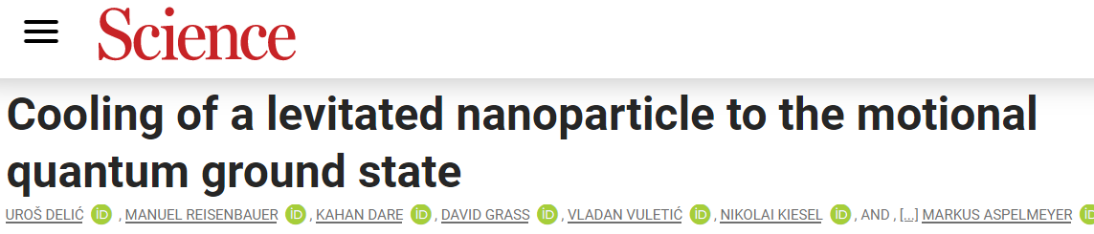
Coherent scattering
Optical tweezer linearly polarized along Y
Scattered light can populate the cavity field depending on angle ϴ
Y
Total Hamiltonian
From: Toroš and Monteiro PRReserch 2, 023228 (2020)
If the tweezer field is resonant with the cavity
Interference term

Slide 27
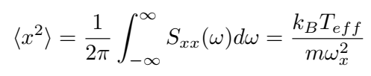
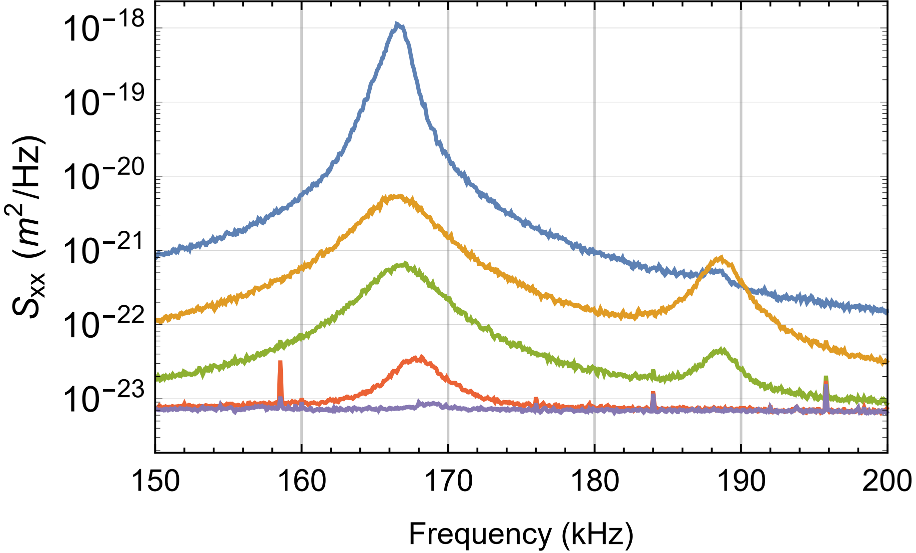
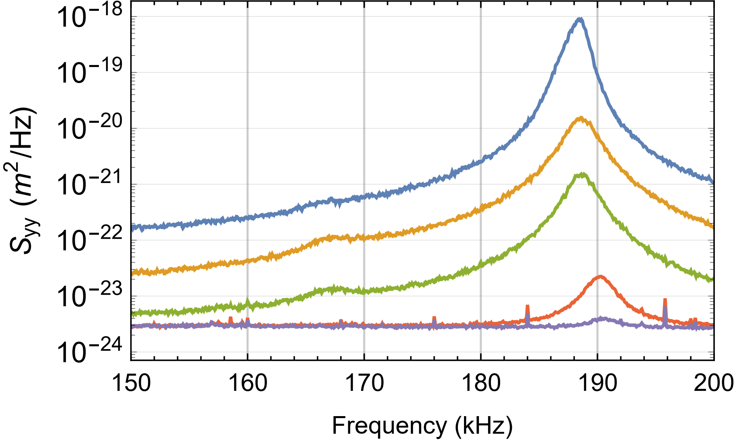
Effective Temperature
We estimate the temperature from the peak area
Silica nanoparticle
R = 60 nm
As the pressure is reduced
X mode
Y mode
Motion cooled by factor ~10⁷
Zero-point motion ~ 7 pm

Slide 28
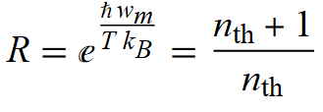

Ground state
Ratio of Stokes to anti-Stokes transition
Clear signature of quantum behavior
Y mode
X mode
At the ground state
n_{th} ~ 1

Slide 29


Measuring particle shape by scatteing
Particle trapped and aligned in an optical Tweezer

Slide 30





Measuring particle shape by scatteing
Particle trapped and aligned in an optical Tweezer
Dumbbell
YLF bi-piramidal
Droplet
Sphere

Slide 31


Coherent scattering for
non-spherical nanoparticle
Need to consider 2 cavity modes
Elliptical TW polarization
Body to Lab frame: Euler angles α β γ (z-y’-z’’)
E.g.: Prolate geometry
α rotation within TW polarization plane
β rotation outside TW polarization plane
γ rotation around the particle long axis
Steady state
→ θ
→ π/2
→ fixed only if no cyl. symm.
Couplings for α, β, γ follow z → cooling rate optimal at antinode
H. Rudolph et.al, PRA 103, 043514 (2021)

Slide 32



Effective temperature
Lowest temperatures
@ 1x10⁻⁶mbar
Mean occupation
X
Y
Z
α
β
Motion along z remains fairly hot
Likely non-thermal
But could be affected by rotational motion

Slide 33
Topic 2 summary
“classical” state transfer on multiparticle system
At the ground state – 1D
Demonstrated cooling of the rotational degrees of freedom

Slide 34












UCL optomechanics
Peter Barker Tania Monteiro Antonio Pontin
Jon Gosling Markus Rademacher Amy Hopper Hayden Fu Fiona Alder
Previous:
Tom Penny Marko Toros Nathanael Bullier Ying Li

Slide 35
Thanks!

Slide 36



Camera detection
Simple
Absolute calibration
Easy to extend to
3 DoF

Slide 37



Imaging base feedback cooling
Real-time processing of camera images

Slide 38




Experimental setup
Monolithic tweezer assembly
Silica nanoparticle
P_{TW} ~200-500 mW@ 1064nm
Lens NA~0.77 (single lens)
Cavity parameters
Lcav=12.23 ± 0.02 mm
κ/2π=198 ± 1 kHz
Finesse ~ 31000
Cavity mirrors
High NA lens
Collection lens
(imaging)

Slide 39



Tweezer only spectra
2.5 mbar – No cavity
Valid for elliptical polarization
Split det.
β
α
PBS det.
Seberson&Robicheaux PRA99,013821(2019)
Spectra exploited to calibrate each DoF assuming thermal equilibrium
γ → free diffusion → Redefine librational normal modes

Slide 40


Roto-translational cavity cooling
2.5 mbar – No cavity
4x10⁻² mbar
6.9z10⁻⁴ mbar
1.1x10⁻⁶ mbar
β
α

Slide 41

Motion of γ
γ → rotation around long axis of the particle
Low frequency feature
4x10⁻⁵mbar
Typical behavior for a α and βaffected by diffusion of γ
Low frequency feature and α and β highly correlated

Slide 42

Motion of γ
4x10⁻⁵mbar
Very different dynamics at the lowest pressure
Consistent with a confined γ
5x10⁻⁷mbar
This transition is very well reproduced in numerical simulation

Slide 43






Numerical simulations
α
β
g
Significantly shallower than center of mass
10⁻⁶ mbar
This transition is very well reproduced in numerical simulation

Slide 44

Comparison with analytical estimates

