Slide 1
Colmo: Quantum collapse models investigated with particle, nuclear, atomic and macro systems
Collapse dynamics are diffusive
Sandro Donadi
Centre for Quantum Materials and Technologies, School of Mathematics and Physics
03/07/2023

Slide 2
Collapse dynamics are diffusive
Sandro Donadi
WHAT I WILL PRESENT
Introduction to collapse models;
Radiation emission in collapse models;
Collapse dynamics are diffusive.
Main Take-Away
Any dynamics which
Is space-translational covariant;
Does not allow for faster than light signalling;
Collapses the wave function in space.
⇒ diffusion in momentum.
S. Donadi, L. Ferialdi, A. Bassi, Phys. Rev. Lett. 130, 230202 (2023).

Slide 3
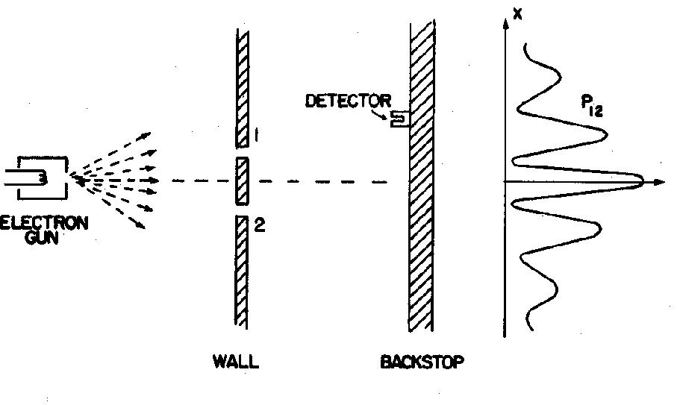
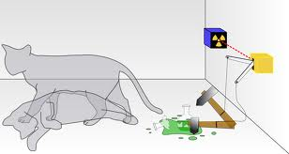
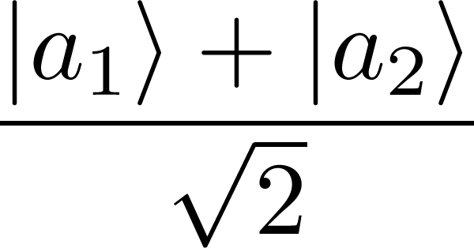
Collapse dynamics are diffusive
Sandro Donadi
PART 1
Introduction to CM
THE MEASUREMENT PROBLEM
The SchrÖdinger equation:
Linear
Deterministic
What exactly qualifies some physical systems to play the role of “measurer”?
Was the wave function of the world waiting to jump for thousands of millions of years until a single-celled living creature appeared? Or did it have to wait a little longer for some better qualified system...with a PhD?
J. S. Bell
OK
KO
The wave packet reduction postulate:
measurement
half of total cases
Non Linear
Stochastic
half of total cases
There are two different laws for the evolution of the state vectors but it is not clear when to use which one.

Slide 4
Collapse dynamics are diffusive
Sandro Donadi
PART 1
Introduction to CM
THE CSL MODEL
(CONTINUOUS SPONTANEOUS LOCALIZATIONS MODEL)
G.C. Ghirardi, P. Pearle and A. Rimini, Phys. Rev. A 42, 78 (1990).
SchrÖdinger
Stochasticity
Non linearity
First model valid also for identical particles;
Localization in space;
Amplification mechanism.
THE MASTER EQUATION

Slide 5
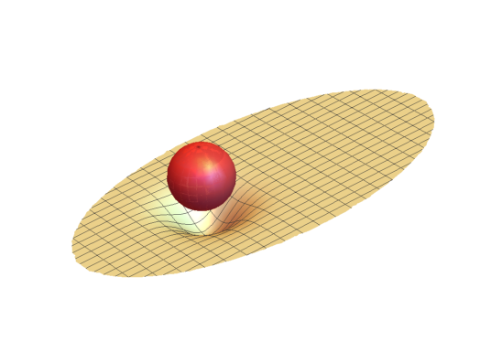
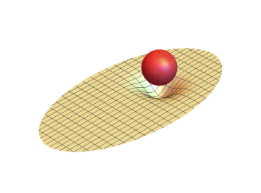
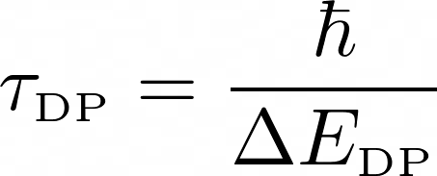
Collapse dynamics are diffusive
Sandro Donadi
PART 1
Introduction to CM
PENROSE PROPOSAL
R. Penrose, Gen. Relativ. Gravit. 28, 581–600 (1996).
R. Penrose, Found. Phys. 44, 557–575 (2014).
a
b
Proton: m ≃ 10⁻²⁷ Kg, R ≃ 10⁻¹⁵ m
𝜏_{DP}≃ 10⁶ years
Dust grain: m ≃ 10⁻¹² Kg, R ≃ 10⁻⁵ m
𝜏_{DP}≃ 10⁻⁸ s

Slide 6
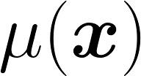
Collapse dynamics are diffusive
Sandro Donadi
PART 1
Introduction to CM
DIÓSI MODEL
L. Diósi, Phys. Rev. A 40, 1165–1174 (1989).
Schrödinger
Collapse
cannot be point-like → mass density with extension
R.Penrose, Gen. Relativ. Gravit. 28, 581 (1996).
G. Ghirardi, R. Grassi & A. Rimini, Phys. Rev. A 42, 1057 (1990).

Slide 7
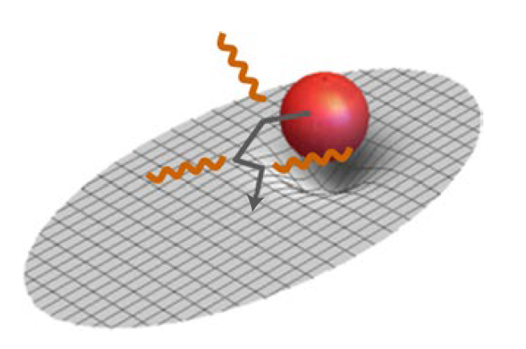
Collapse dynamics are diffusive
Sandro Donadi
PART 2
Radiation emission in CM
TEST OF THE MODEL
Interferometric tests, there are interesting proposals:
1) Optomechanical devices (W. Marshall, et al. Phys. Rev. Lett. 91, 130401 (2003)).
2) B.E.C. (R. Howl, R. Penrose, I. Fuentes, New J. Phys. 21, 043047 (2019)).
3) Experiments in space: no gravity ---> more time (MAQRO, CAL, etc..).
(A. Belenchia, et al. Nature 596, 32–34 (2021), G. Gasbarri et al. Commun. Phys. 4, 155 (2021))
…but they are still hard to perform.
Non interferometric tests does not require to create large superpositions!
When the system is charged, the master equation implies radiation emission, even when it is well localized!
For the Continuous Spontaneous Localisation (CSL) model this kind of test is quite effective.

Slide 8
Collapse dynamics are diffusive
Sandro Donadi
PART 2
Radiation emission in CM
THEORETICAL CALCULATIONS: AN OUTLINE
S. Donadi, K. Piscicchia, C. Curceanu, L. Diósi, M. Laubenstein, and A. Bassi, Nat. Phys. 17, 74 (2021).
Radiation emission rate:
Adjoint Master Equation:
Perturbative treatment of the collapse and the EM interaction, calculation ….. and more calculation….. and finally:
N = atomic number; Na = number of atoms;
R₀= mass density size.

Slide 9
Collapse dynamics are diffusive
Sandro Donadi
PART 2
Radiation emission in CM
AN EASIER APPROACH
L. Diósi and B. Lukács, Phys. Lett. A 181, 366–368 (1993); S. L. Adler. J. Phys. A 40, 2935–2957 (2007).
S. Donadi, K. Piscicchia, R. Del Grande, C. Curceanu, M. Laubenstein, and A. Bassi, Eur. Phys. J. C 81, 773 (2021).
Lead to the same master equation of the collapse equations —> same radiation emission

Slide 10
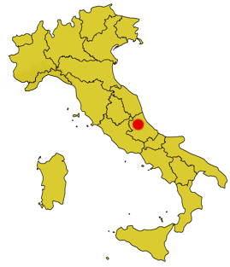
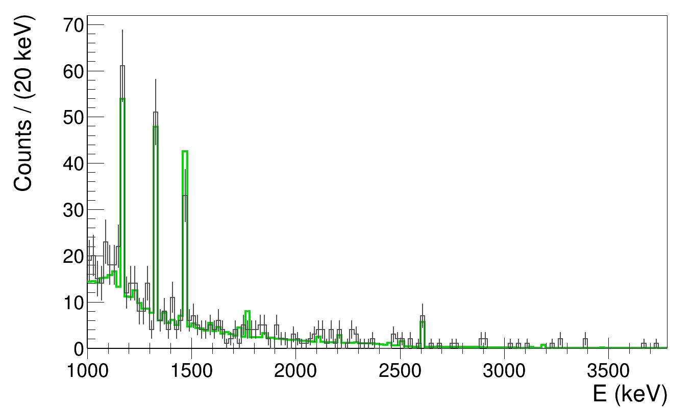
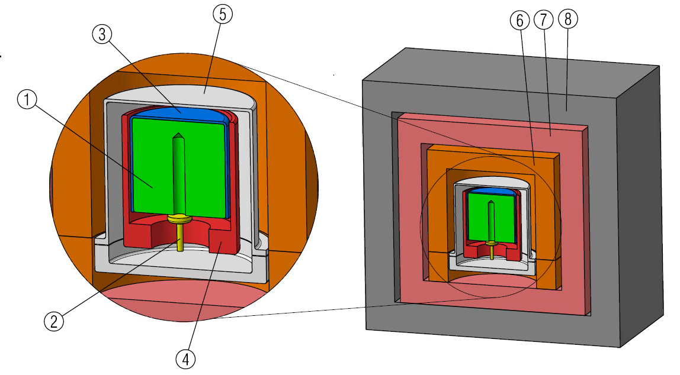
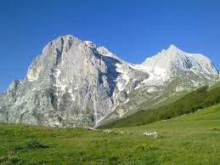
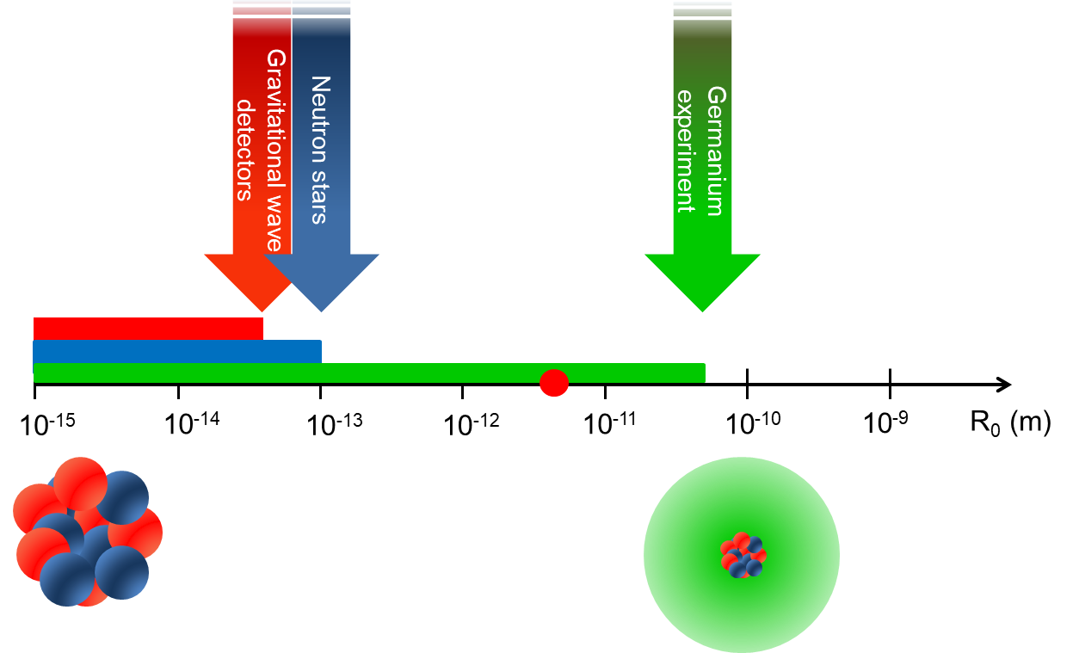
Collapse dynamics are diffusive
Sandro Donadi
PART 2
Radiation emission in CM
EXPERIMENTAL PART: SETUP AND MEASURED SPECTRUM
S. Donadi, K. Piscicchia, C. Curceanu, L. Diósi, M. Laubenstein, and A. Bassi, Nat. Phys. 17, 74 (2021).
1, germanium crystal; 2, electric contact; 3, plastic insulator; 4, copper cup; 5, copper end-cup; 6, copper block and plate; 7, inner
copper shield; 8, lead shield.
Data collected in 62 days:
Grey line: measured, tot= 576
Green line: simulated, tot= 506
(95% c.l.)
I. J. Arnquist, et al. (Majorana Collaboration), Phys. Rev. Lett. 129, 080401 (2022).

Slide 11
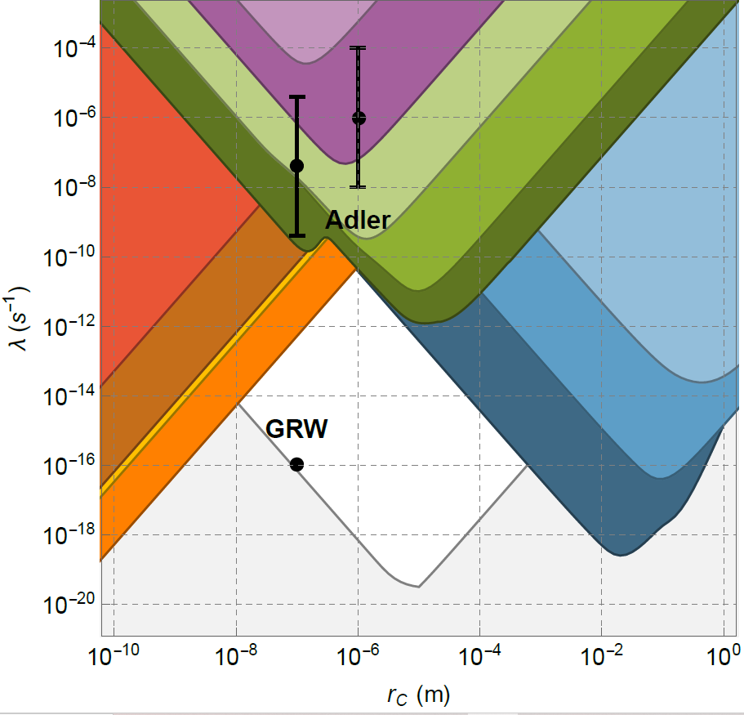
Collapse dynamics are diffusive
Sandro Donadi
PART 2
Radiation emission in CM
EXCLUSION PLOT, LAST UPDATE!
M. Carlesso, S. Donadi, L. Ferialdi, M. Paternostro, H. Ulbricht, A. Bassi. Nat. Phys. 18, 243 (2022).
Cantilever
Auriga
Cold gas
Cantilever
Neutron Star
LIGO
X-rays
LISA Pathfinder
Majorana
Theoretical

Slide 12
Collapse dynamics are diffusive
Sandro Donadi
PART 3
Collapse ⇒ diffusion
COLLAPSE DYNAMICS ARE DIFFUSIVE
Non-interferometric tests provide a powerful way to test collapse theories.
They are based on the diffusive motion induced by the noise responsible for collapse to systems.
TWO INTERESTING QUESTIONS
Is this a feature of collapse models or something more general?
Is it possible to have collapse without diffusion?
This is interesting from a phenomenological (non-interferometric tests) as well as from a more fundamental (diffusion is there or not?) point of view.

Slide 13
Collapse dynamics are diffusive
Sandro Donadi
PART 3
Collapse ⇒ diffusion
COLLAPSE IMPLIES DIFFUSION
Under the hypothesis:
The probability the state collapses is Poissonian in time;
Translational covariance and momentum independence;
Time of decay is that given by Penrose;

Slide 14
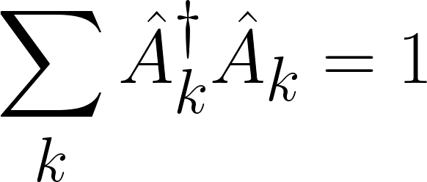
Collapse dynamics are diffusive
Sandro Donadi
PART 3
Collapse ⇒ diffusion
COLLAPSE DYNAMICS ARE DIFFUSIVE
S. Donadi, L. Ferialdi, A. Bassi, Phys. Rev. Lett. 130, 230202 (2023).
We require that collapse cannot be used to do signalling in EPR-like setups. This implies the map must be linear (N. Gisin, Helv. Phys. Acta 62.4, 363-371 (1989)).
We also require the map to be completely positive → Kraus form:
We require the map to be space-translational covariant:

Slide 15
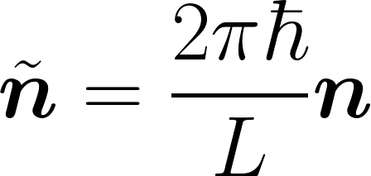
Collapse dynamics are diffusive
Sandro Donadi
PART 3
Collapse ⇒ diffusion
COLLAPSE DYNAMICS ARE DIFFUSIVE
We focus on maps that does not change the average momentum.
Then the diffusion along the j direction is quantified by:
which takes the form:
is a probability distribution for the variable for all .

Slide 16
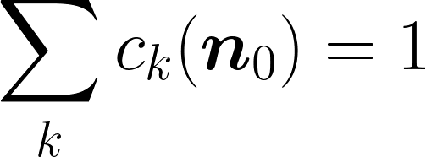
Collapse dynamics are diffusive
Sandro Donadi
PART 3
Collapse ⇒ diffusion
COLLAPSE DYNAMICS ARE DIFFUSIVE
Let us suppose that for all plane waves one has:
We can characterise the map:
This map cannot collapse in position.

Slide 17
Collapse dynamics are diffusive
Sandro Donadi
PART 3
Collapse ⇒ diffusion
COLLAPSE DYNAMICS ARE DIFFUSIVE
No diffusion ⇒ No collapse = Yes Collapse ⇒ Yes diffusion
Let us suppose that for a specific plane wave the map induces diffusion:
Keeping in mind that for a generic state:
all states which has the component diffuse.
A model which collapses in space must affect all plane waves.
Conclusion: Collapse in space comes together with diffusion in momentum.

Slide 18
Collapse dynamics are diffusive
Sandro Donadi
PART 3
Collapse ⇒ diffusion
CONCLUSIONS
Collapse models solve the measurement problem by modifying the Schrödinger equation, adding proper stochastic and nonlinear terms that induce collapse in space.
Several experiments set bounds on the CSL and DP model, narrowing the allowed parameter space. The strongest bounds are coming from non-interferometric experiments.
The diffusion in momentum, typical of the GRW, CSL and DP models, it is a general feature of collapse dynamics, as long as one requires no faster than light signalling and space translational covariance.
FINANCIAL SUPPORT
THANKS

