Slide 1



Collapse models
an overview from theory to experimental endeavour
ECT* COLMO workshop
Matteo Carlesso
(University of Trieste, INFN and Queen’s University Belfast)

Slide 2


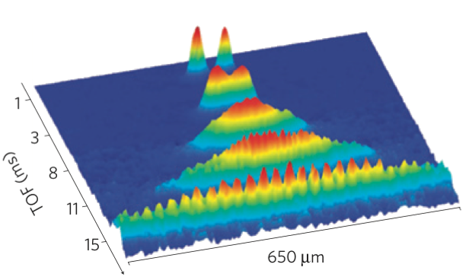

Collapse models, an overview from theory to experimental endeavour – Matteo Carlesso
Limits of the Quantum Superposition Principle
Quantum World
Classical World
Micro
Macro

Slide 3
Collapse models, an overview from theory to experimental endeavour – Matteo Carlesso
Standard Quantum Mechanics
Quantum World
Classical World
Micro
Macro
“The Copenhagen interpretation assumes a mysterious division between the microscopic world governed by quantum mechanics and a macroscopic world of apparatus and observers that obeys classical physics.”
S. Weinberg, Phys. Rev. A 85, 062116 (2012)

Slide 4
Collapse models, an overview from theory to experimental endeavour – Matteo Carlesso
Quantum Mechanics wonna be
Quantum World
Classical World
Micro
Macro
“What exactly qualifies some physical systems to play the role of 'measurer’?“
John Bell, Against ‘measurement’, Physics World, Phys. World 3 (8) 33 (1990)

Slide 5
Collapse models, an overview from theory to experimental endeavour – Matteo Carlesso
Quantum Mechanics + Decoherence
Quantum World
Classical World
Micro
Macro
Environment
The division system-environment is arbitrary, and similarly to the division quantum-classical in the Copenhagen interpretation.

Slide 6
Collapse models, an overview from theory to experimental endeavour – Matteo Carlesso
Possible solutions
Quantum World
Classical World
Micro
Macro
Environment
Bohmian Mechanics
Many Worlds
Collapse Models

Slide 7
Collapse models, an overview from theory to experimental endeavour – Matteo Carlesso
Collapse models – a modified quantum theory
Stochastic noise
Non-linear wavefunction dynamics
Negligible microscopic action
No effective collapse
Quantum systems
Strong macroscopic action
Rapid collapse
Systems behave classically
Amplification mechanism

Slide 8
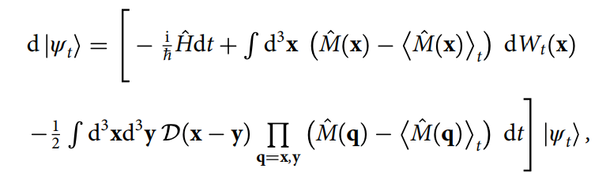
Collapse models, an overview from theory to experimental endeavour – Matteo Carlesso
General structure of the dynamical equation
Measured
operator
(mass density, position, …)
White noise
Q. Hamiltonian
Non-linear term
Noise’s spatial correlation
The structure is fixed by the requests of:
1) having a collapse in an eigenstate of M(x)
2) preserving the normalisation of the state
3) not leading to faster-than-light signalling
In particular,
i) linear and stochastic equations do not lead to a collapse
ii) non-linear and deterministic equations lead to FTL signalling

Slide 9
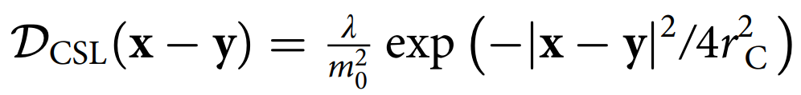


Collapse models, an overview from theory to experimental endeavour – Matteo Carlesso
General structure of the dynamical equation
Measured
operator
(mass density, position, …)
White noise
Q. Hamiltonian
Non-linear term
Noise’s spatial correlation
Two main models
Continuous Spontaneous Localization (CSL) model
Diósi-Penrose model
Fully phenomenological model
Gravity-related model
collapse rate
spatial cutoff
gravity regularization at small distances
correlation length

Slide 10
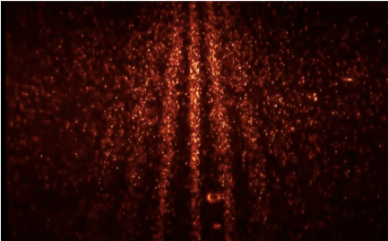
Collapse models, an overview from theory to experimental endeavour – Matteo Carlesso
Experiments
Destruction of quantum superposition
Interferometric Experiments
Extra jiggling due to collapse noise

Slide 11
Collapse models, an overview from theory to experimental endeavour – Matteo Carlesso
Parameters’ space
Adler’s proposed values
Adler, J. Phys. A 40, 2935 (2007)
GRW’s proposed values
Ghirardi et al., Phys. Rev. D 34, 470 (1986)
Theoretical lower bound
Toros et al., Phys. Lett. A 381, 3921 (2017)
Review Paper: Carlesso et al. Nature Physics 18, 243-250 (2022)

Slide 12
Collapse models, an overview from theory to experimental endeavour – Matteo Carlesso
Interferometric Tests
Atom fountain
Kovachy et al., Nature 528, 530 (2016)
Kapitza Dirac Talbot Lau
Eibenberger et al., Phys. Chem. Chem. Phys. 15, 14696 (2013)
Toros et al., J. Phys. A 51, 115302 (2018)
Diamonds
Lee et al., Science 334, 1253 (2011)
Belli et al., Phys. Rev. A 94, 012108 (2016)
Macromolecules
Fein et al., Nat. Phys 15, 1242 (2019)
Review Paper: Arndt & Hornberger, Nature Physics 10, 271-277 (2014)

Slide 13
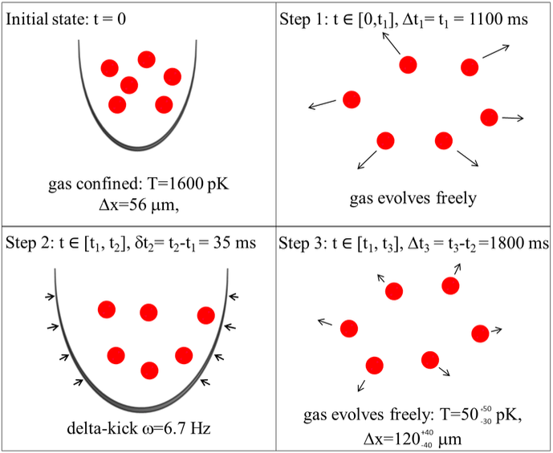
Collapse models, an overview from theory to experimental endeavour – Matteo Carlesso
Non-interferometric Tests
Cold Atoms
Kovachy et al., Phys. Rev. Lett. 114, 143004 (2015)
Bilardello et al., Physica A, 462:764-782 (2016)
Review Paper: Carlesso et al. Nature Physics 18, 243-250 (2022)

Slide 14
Collapse models, an overview from theory to experimental endeavour – Matteo Carlesso
Non-interferometric Tests
Nanomechanical cantilevers
Vinante et al., Phys. Rev. Lett. 116, 090402 (2016)
Vinante et al., Phys. Rev. Lett. 119, 110401 (2017)
Review Paper: Carlesso et al. Nature Physics 18, 243-250 (2022)

Slide 15
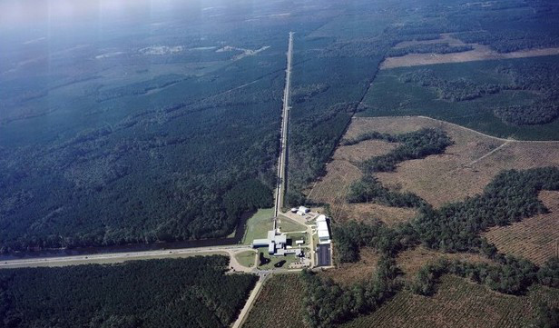
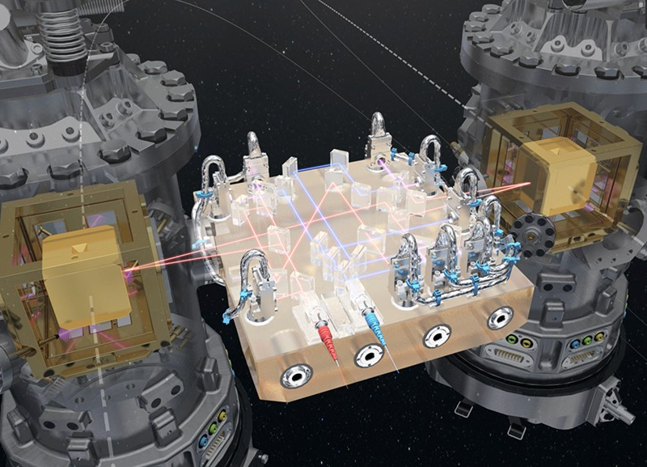
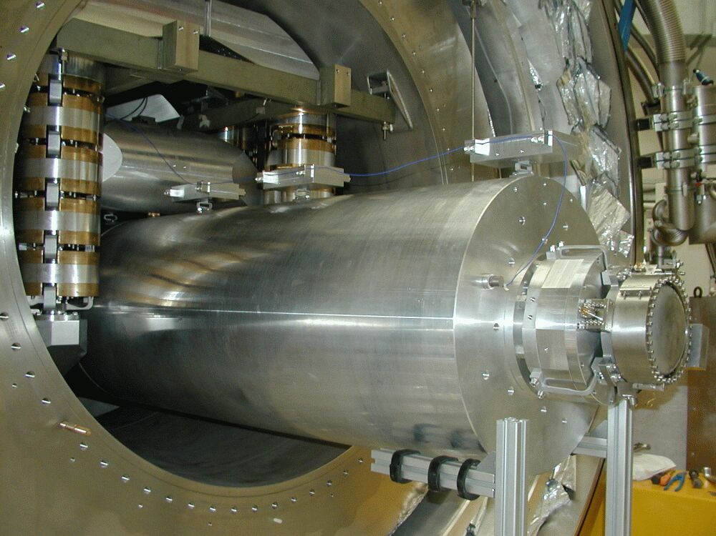
Collapse models, an overview from theory to experimental endeavour – Matteo Carlesso
Non-interferometric Tests
Gravitational wave detectors Auriga, LIGO, LISA Pathfinder
Carlesso et al, Phys. Rev. D 94, 124036 (2016)
Review Paper: Carlesso et al. Nature Physics 18, 243-250 (2022)

Slide 16
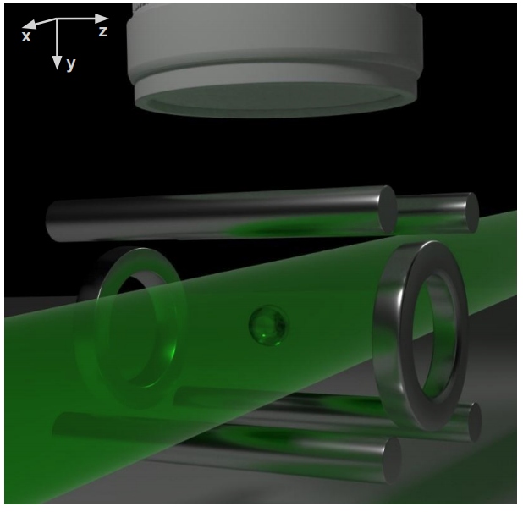
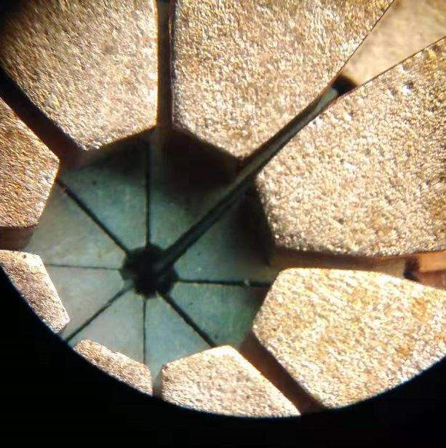
Collapse models, an overview from theory to experimental endeavour – Matteo Carlesso
Non-interferometric Tests
Levitated nano-oscillators
Pontin et al., Phys. Rev. Res. 2, 023349 (2020)
Zheng et al., Phys. Rev. Res. 2, 013057 (2020)
Review Paper: Carlesso et al. Nature Physics 18, 243-250 (2022)

Slide 17
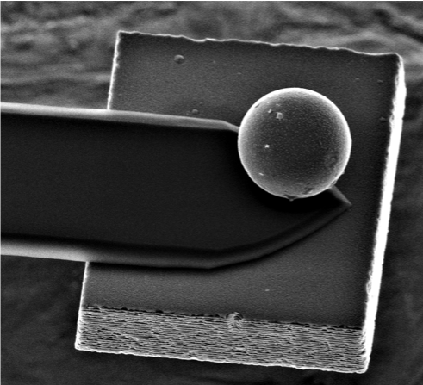
Collapse models, an overview from theory to experimental endeavour – Matteo Carlesso
Non-interferometric Tests
Nanomechanical cantilevers
Vinante et al., Phys. Rev. Lett. 125, 100404 (2020)
Review Paper: Carlesso et al. Nature Physics 18, 243-250 (2022)

Slide 18
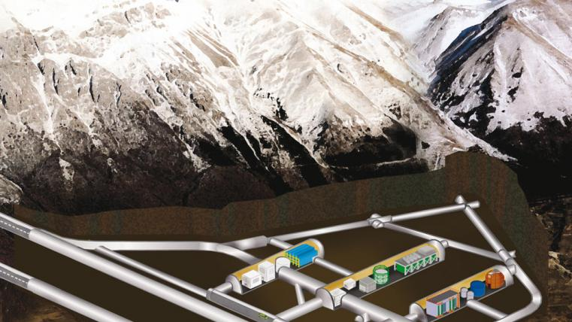
Collapse models, an overview from theory to experimental endeavour – Matteo Carlesso
Non-interferometric Tests
X-rays emission
Donadi et al, Eur. Phys. J. C 81, 1 (2021)
Review Paper: Carlesso et al. Nature Physics 18, 243-250 (2022)

Slide 19
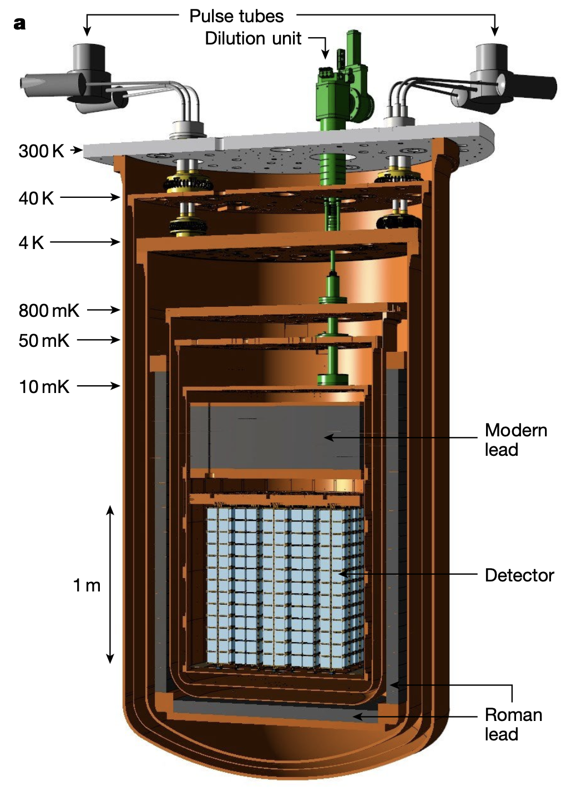
Collapse models, an overview from theory to experimental endeavour – Matteo Carlesso
Non-interferometric Tests
Phonon Spectrum
Adler et al., Phys. Rev. A 97, 052119 (2018).
Bahrami, Phys. Rev. A 97, 052118 (2018).
Review Paper: Carlesso et al. Nature Physics 18, 243-250 (2022)

Slide 20
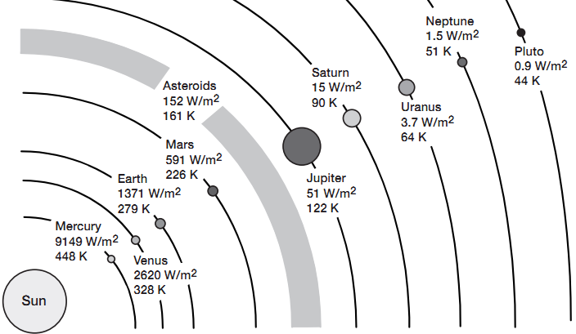
Collapse models, an overview from theory to experimental endeavour – Matteo Carlesso
Non-interferometric Tests
Neptune
S.L. Adler et al., Phys. Rev. D 99, 103001 (2019)
Review Paper: Carlesso et al. Nature Physics 18, 243-250 (2022)

Slide 21
Collapse models, an overview from theory to experimental endeavour – Matteo Carlesso
Non-interferometric Tests
Cold Atoms
Kovachy et al., Phys. Rev. Lett. 114, 143004 (2015)
Bilardello et al., Physica A, 462:764-782 (2016)
Levitated nano-oscillators
Pontin et al., Phys. Rev. Res. 2, 023349 (2020)
Zheng et al., Phys. Rev. Res. 2, 013057 (2020)
Neptune
S.L. Adler et al., Phys. Rev. D 99, 103001 (2019)
A Tilloy and T. M. Stace, Phys. Rev. Lett. 123, 080402 (2019)
Nanomechanical cantilevers
Vinante et al., Phys. Rev. Lett. 116, 090402 (2016)
Vinante et al., Phys. Rev. Lett. 119, 110401 (2017) Vinante et al., Phys. Rev. Lett. 125, 100404 (2020)
Phonon Spectrum
Adler et al., Phys. Rev. A 97, 052119 (2018).
Bahrami, Phys. Rev. A 97, 052118 (2018).
X-rays emission
Donadi et al, Eur. Phys. J. C 81, 1 (2021)
Gravitational wave detectors Auriga, LIGO, LISA Pathfinder
Carlesso et al, Phys. Rev. D 94, 124036 (2016)
Review Paper: Carlesso et al. Nature Physics 18, 243-250 (2022)

Slide 22
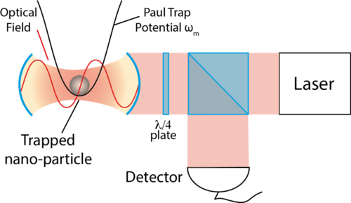
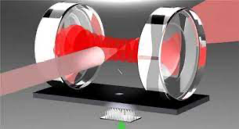

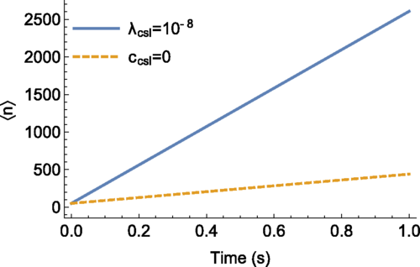
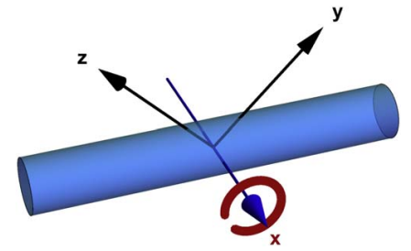
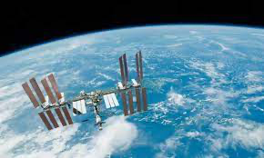
Collapse models, an overview from theory to experimental endeavour – Matteo Carlesso
Future challenges
Goldwater et at., Phys. Rev. A 94, 010104 (2016)
Carlesso et at., New J. Phys 20, 083022 (2018)
Belenchia et at., Nature 596, 32 (2021)
Belenchia et al., Phys. Rep. 951, 1 (2022)

Slide 23
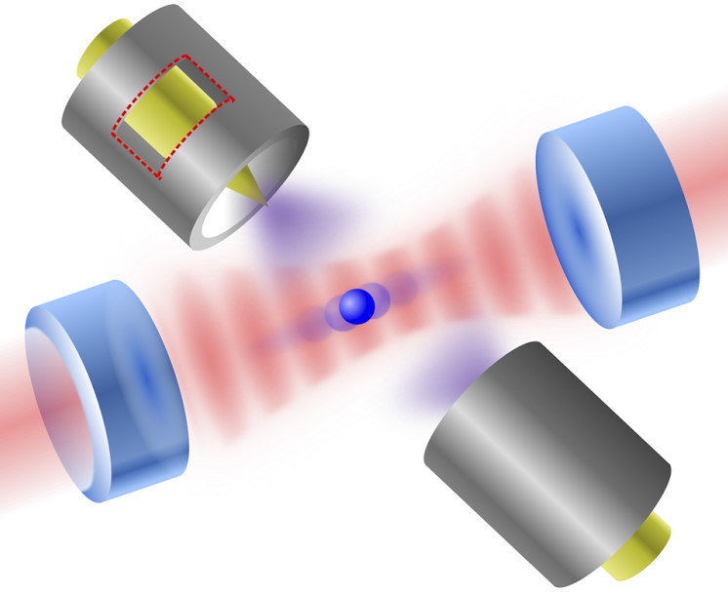

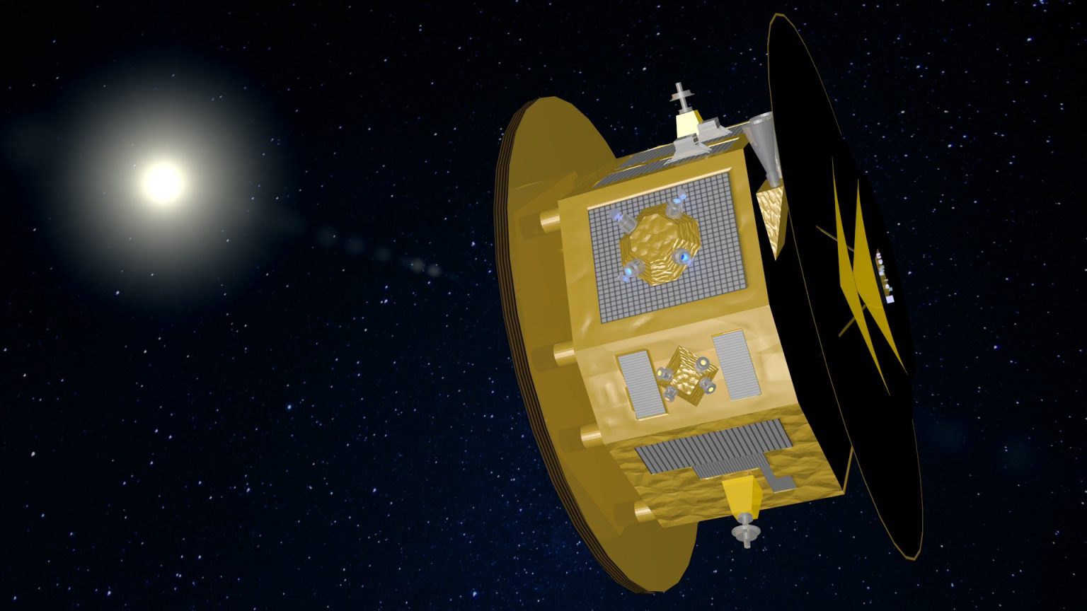


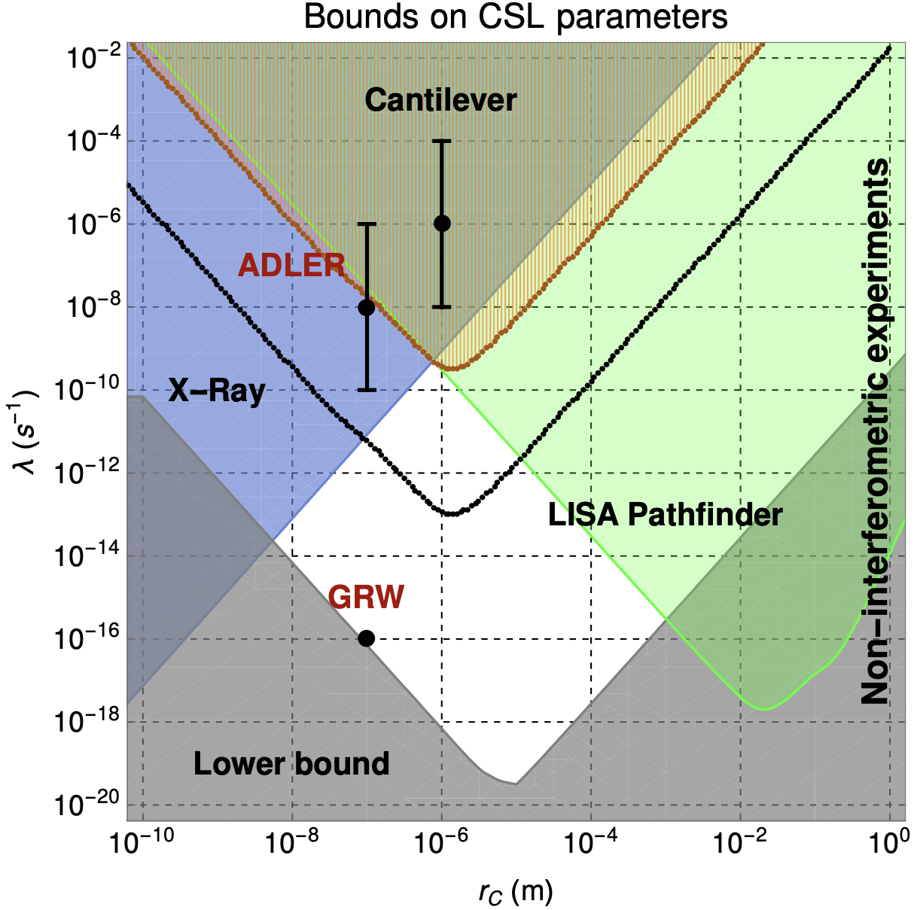
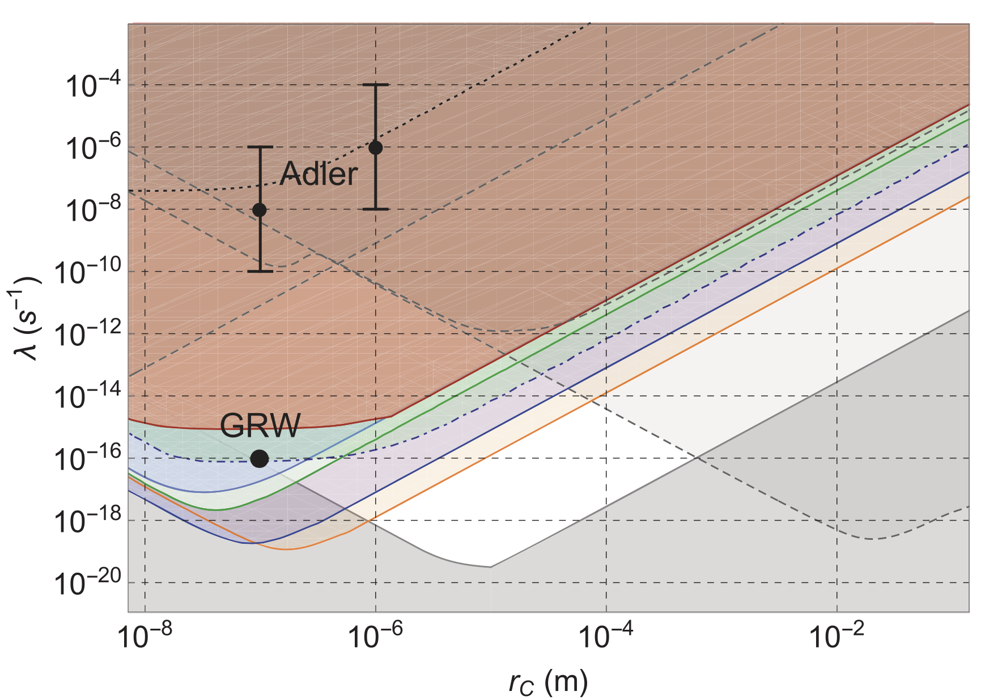
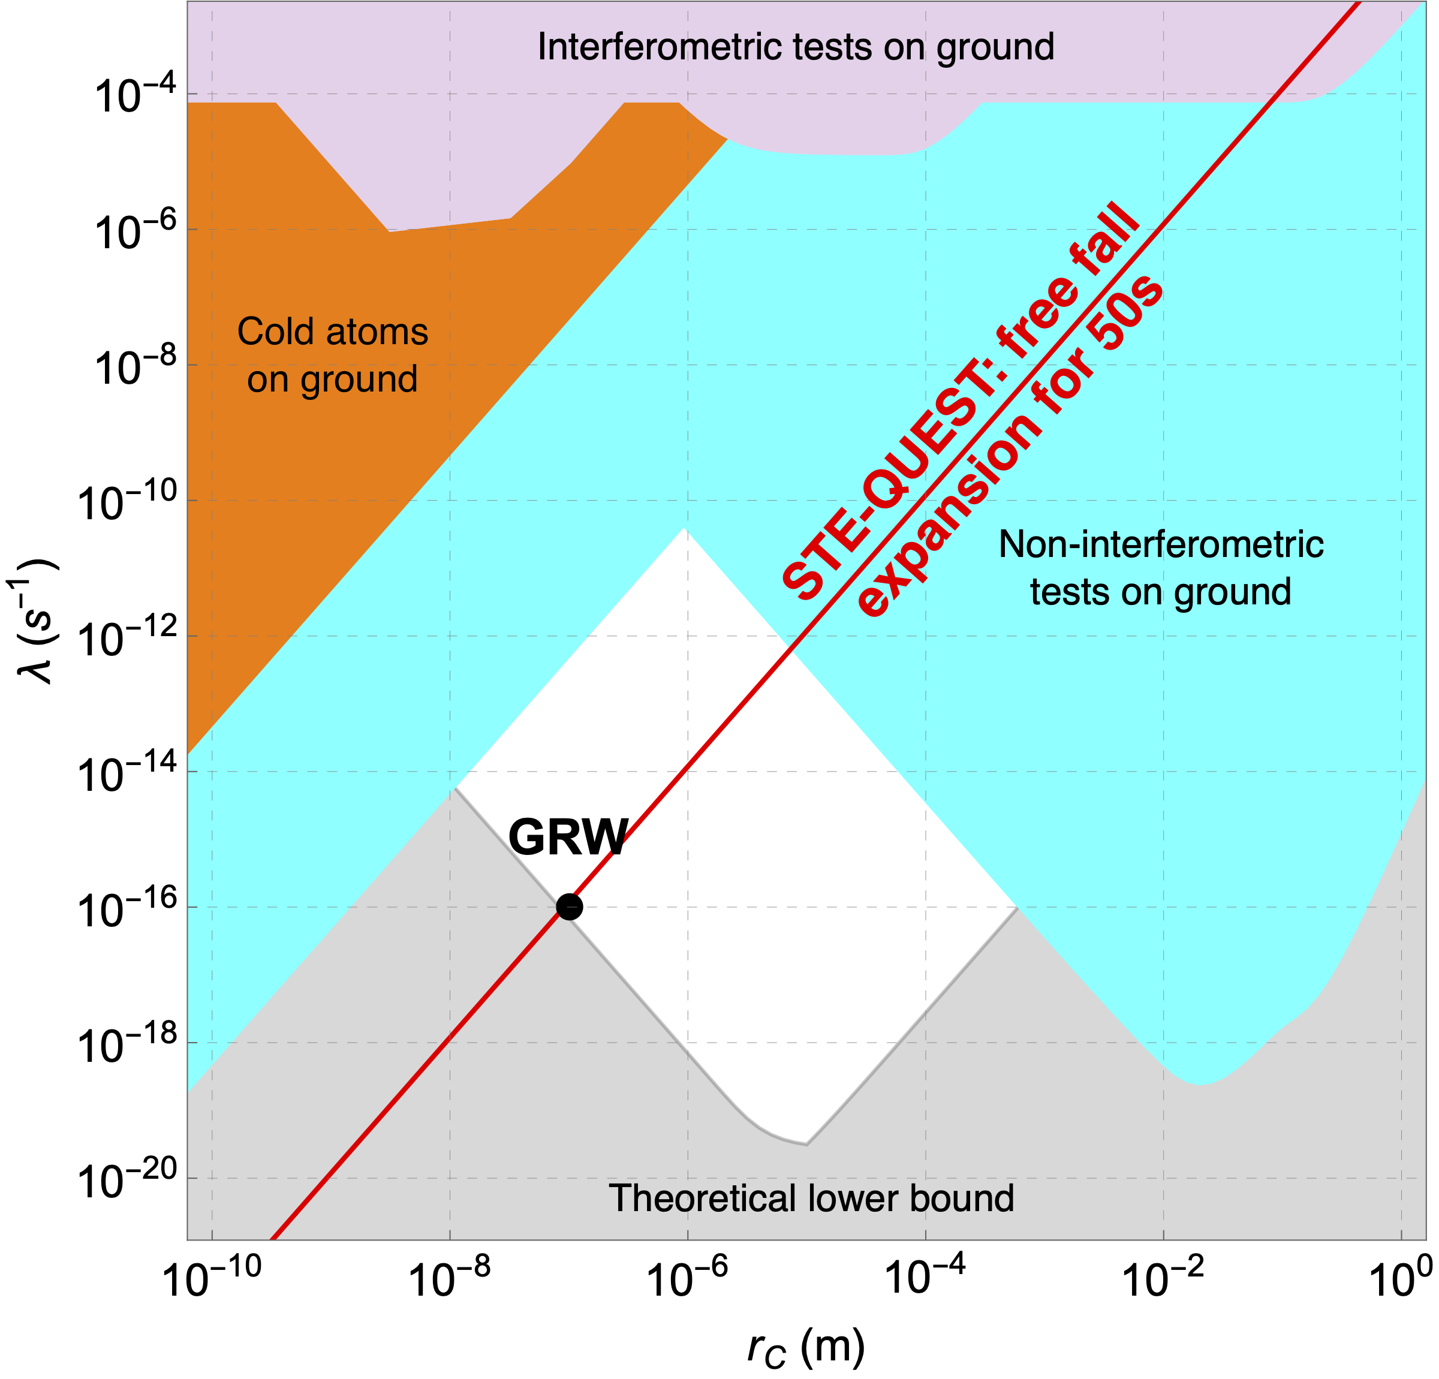
Collapse models, an overview from theory to experimental endeavour – Matteo Carlesso
Future experiments
TEQ experiment
Levitation in Paul trap @ 300mK, dedicated experiment testing collapse models
MAQRO mission
Matter-wave interference up to 10¹⁰ amu testing limits of QM
STE-QUEST mission
Atom interference testing the EEP, DM and limits of QM
Experiment under run, results out soon
Gasbarri et al., Comm. Physics 4, 155 (2021)
Carlesso et al., in preparation

Slide 24
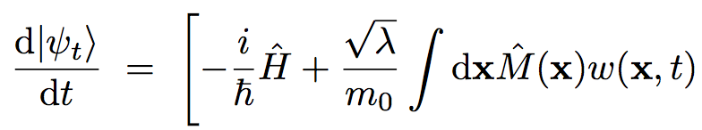
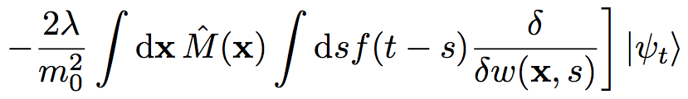
Collapse models, an overview from theory to experimental endeavour – Matteo Carlesso
Develop more the theory
Two weak points:
The noise spectrum is flat (white noise)
  Approximation of a realistic noise, which is instead characterized by a frequency cutoff
  Colored extension of the model
The noise leads to infinite energy for the system
  Approximation of a finite temperature noise
  Dissipative extension of the model
Non-trivial time correlation function

Slide 25
Collapse models, an overview from theory to experimental endeavour – Matteo Carlesso
Cold Atoms
Bilardello et al.,
Physica A 462, 764 (2016).
Adler
J. Phys. A 40, 2935 (2007),
J. Phys. A 40, 13501 (2007).
Nanomechanical Cantilever
Vinante et al.,
Phys. Rev. Lett. 119, 110401 (2017)
Phonons
Adler et al.,
Phys. Rev. A 97, 052119 (2018).
GRW
Ghirardi et al.,
Phys. Rev. D 34, 470 (1986).
X-rays emission
K. Piscicchia et al.,
Entropy 19 (2017).
Gravitational wave detectors
Carlesso et al.,
Phys. Rev. D 94, 124036 (2016).
Carlesso, Ferialdi, Bassi, Eur. Phys. J. D, 72, 159 (2018)

Slide 26
Collapse models, an overview from theory to experimental endeavour – Matteo Carlesso
Why a dissipative collapse models? CSL model predicts an infinite energy increment!
For a nucleon we have
in one year with GRW parameters
A new parameter is introduced to solve the problem: the CSL temperature

Slide 27
Collapse models, an overview from theory to experimental endeavour – Matteo Carlesso
A. Smirne and A. Bassi, Sci. Rep. 5, 12518 (2015).
CSL Temperature dependence

Slide 28
Collapse models, an overview from theory to experimental endeavour – Matteo Carlesso
Cold Atoms
Bilardello et al.,
Physica A 462, 764 (2016).
Adler
J. Phys. A 40, 2935 (2007),
J. Phys. A 40, 13501 (2007).
Nanomechanical Cantilever
Vinante et al.,
Phys. Rev. Lett. 119, 110401 (2017)
?
X-rays emission
K. Piscicchia et al.,
Entropy 19 (2017).
GRW
Ghirardi et al.,
Phys. Rev. D 34, 470 (1986).
Gravitational wave detectors
Carlesso et al.,
Phys. Rev. D 94, 124036 (2016).
Nobakht, Phys. Rev. A 98, 042109 (2018)

Slide 29
Collapse models, an overview from theory to experimental endeavour – Matteo Carlesso
Cold Atoms
Bilardello et al.,
Physica A 462, 764 (2016).
Adler
J. Phys. A 40, 2935 (2007),
J. Phys. A 40, 13501 (2007).
Nanomechanical Cantilever
Vinante et al.,
Phys. Rev. Lett. 119, 110401 (2017)
Adler
1 K
10⁻² K
10⁻⁴ K
X-rays emission
K. Piscicchia et al.,
Entropy 19 (2017).
10⁻⁷ K
GRW
Ghirardi et al.,
Phys. Rev. D 34, 470 (1986).
GRW
Gravitational wave detectors
Carlesso et al.,
Phys. Rev. D 94, 124036 (2016).
Pontin et al., Phys. Rev. Research 2, 023349 (2020)

Slide 30
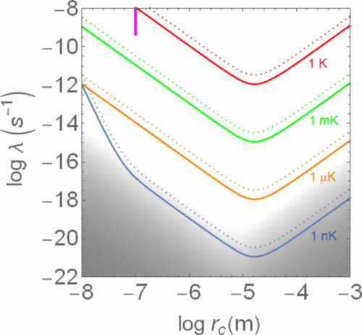
Collapse models, an overview from theory to experimental endeavour – Matteo Carlesso
Cold Atoms
Bilardello et al.,
Physica A 462, 764 (2016).
Adler
J. Phys. A 40, 2935 (2007),
J. Phys. A 40, 13501 (2007).
Nanomechanical Cantilever
Vinante et al.,
Phys. Rev. Lett. 119, 110401 (2017)
Adler
1 K
10⁻² K
10⁻⁴ K
X-rays emission
K. Piscicchia et al.,
Entropy 19 (2017).
10⁻⁷ K
GRW
Ghirardi et al.,
Phys. Rev. D 34, 470 (1986).
GRW
Gravitational wave detectors
Carlesso et al.,
Phys. Rev. D 94, 124036 (2016).
Vinante et al., Phys. Rev. Research 2, 043229 (2020)

Slide 31

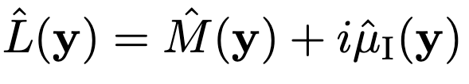


Collapse models, an overview from theory to experimental endeavour – Matteo Carlesso
Alternative dissipative generalisation
with
Di Bartolomeo et al.,
ArXiv 2301.07661;
accepted in Phys. Rev. A
mass density
current
Now the model has a more fundamental flavour
with
which gives a finite asymptotic energy

Slide 32



Collapse models, an overview from theory to experimental endeavour – Matteo Carlesso
Strong improvement of the bounds when moving to indirect (non-interferometric) tests
Different possible approaches have been considered
There are still other option that can be exploited
New ideas?
Review Paper: Carlesso et al. Nature Physics 18, 243-250 (2022)

Slide 33

Collapse models, an overview from theory to experimental endeavour – Matteo Carlesso
Strong improvement of the bounds when moving to indirect (non-interferometric) tests
Different possible approaches have been considered
There are still other option that can be exploited
New ideas?
We are organising a School in Foundations
“Fundamental Problems in Quantum Physics 2023”
in Trieste, from 13 to 15 September 2023.
Info and registration at www.qmts.it/?q=fpqp2023
Review Paper: Carlesso et al. Nature Physics 18, 243-250 (2022)

