Slide 1
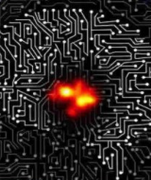
Deep Learning Inverse Problems in Extreme QCD Matter Studies
Kai Zhou (FIAS)
Machine learning for lattice field theory and beyond – ECT*

Slide 2
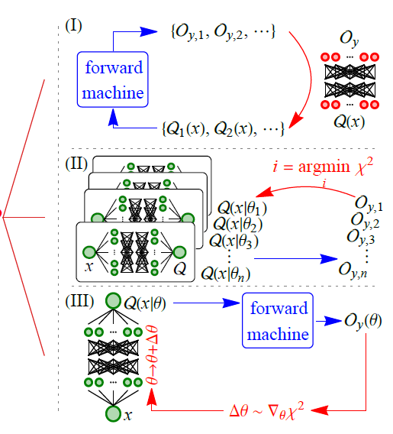
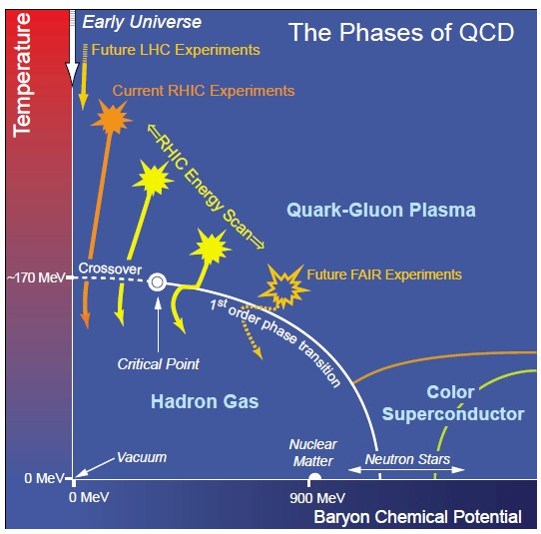
Overview : Inverse Problems Solving with ML
Direct inverse mapping capturing :
with Supervised Learning
Statistical approach to $χ^{2}$ fitting :
Bayesian Reconstruction for posterior or Heuristic (Generic) Algorithm to min.
Automatic Differentiation :
fuse physical prior into reconstruction via differentiable programming strategy
Accessible
Observation $O_{y}$
Explicit
mapping
Exist
but implicit
Quantity of Interest Q(x)
Hot/Dense matter study from Heavy Ion Collisions
Physics Inference from LQCD Data
Dense matter study from Neutron Star observational
1/15

Slide 3
1, QCD matter EoS identification from Heavy Ion Collisions with Deep Learning
Nature Communications 9 (2018), no.1, 210
JHEP 12 (2019) 122
Eur.Phys.J.C 80 (2020) 6, 516
Phys. Lett. B 811 (2020)
JHEP 21 (2021) 184
Phys. Rev. D 103 (2021) 11, 116023
arXiv:2211.11670

Slide 4
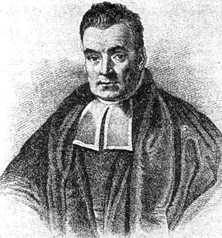
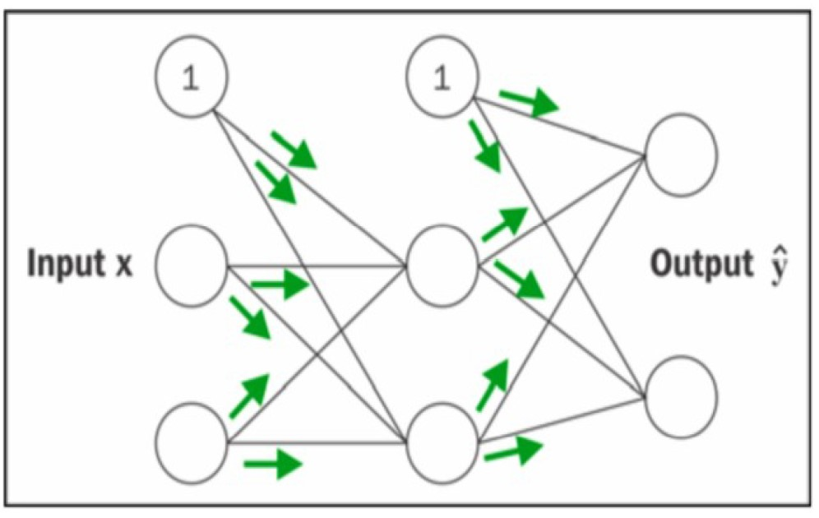
Challenge in HIC and Machine Learning
1
QGP
Fig: arXiv:1804.04649
Uncertainties in HIC modeling
Multiple parameters entangle with multiple observables
How to disentangle different factors
to reveal fundamental physics from
the dynamical environment?
Universal approximator
Differentiable programming
Gradient based optimization
2/15

Slide 5
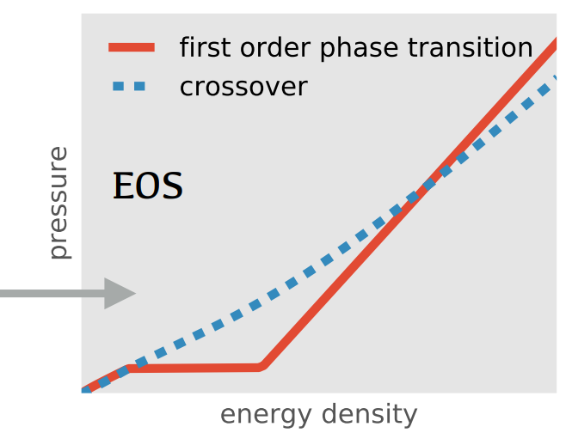
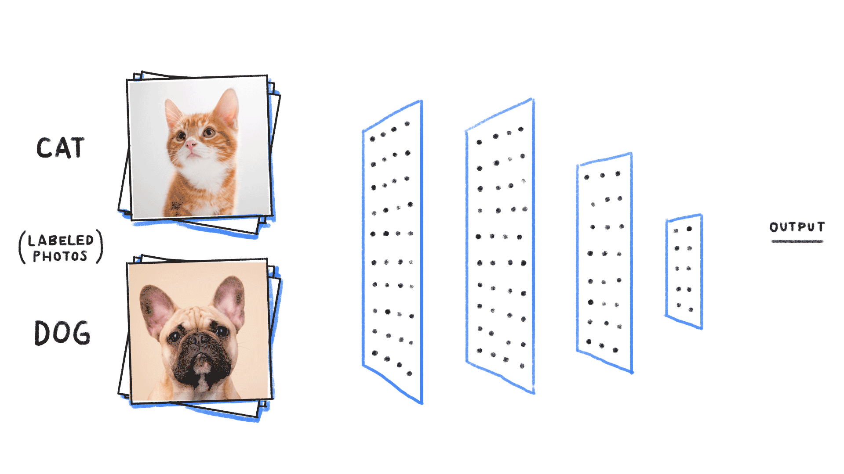
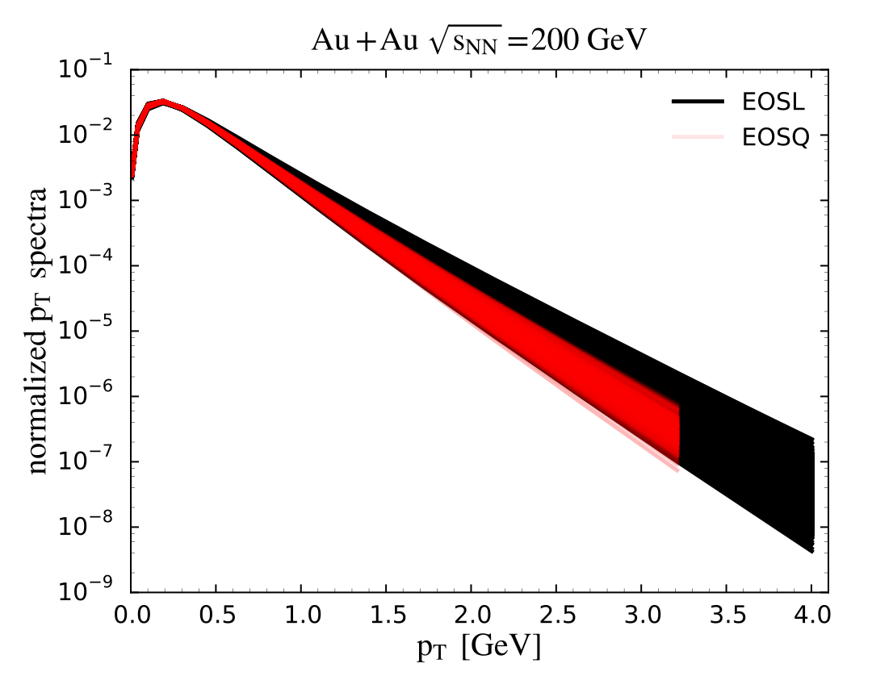
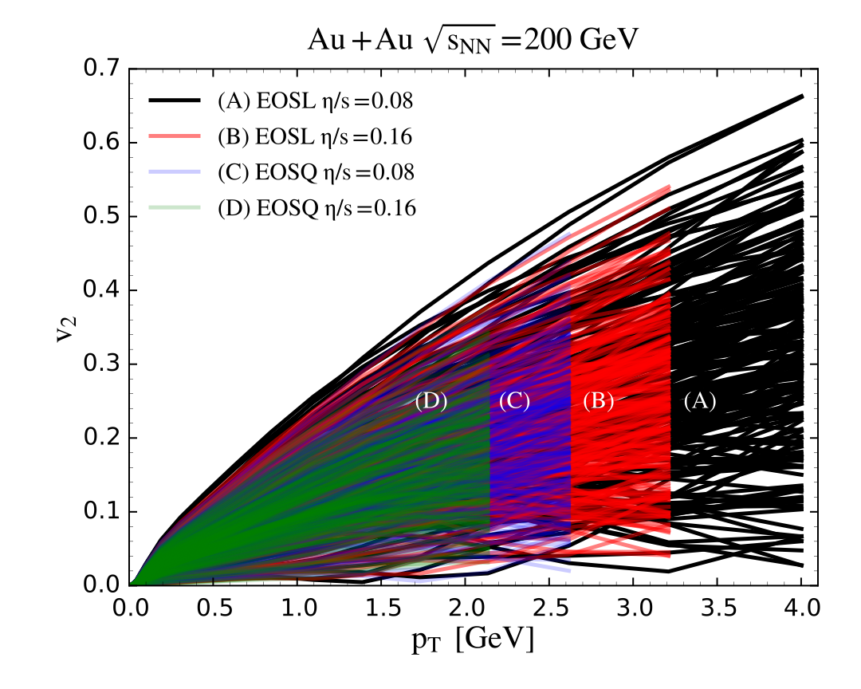
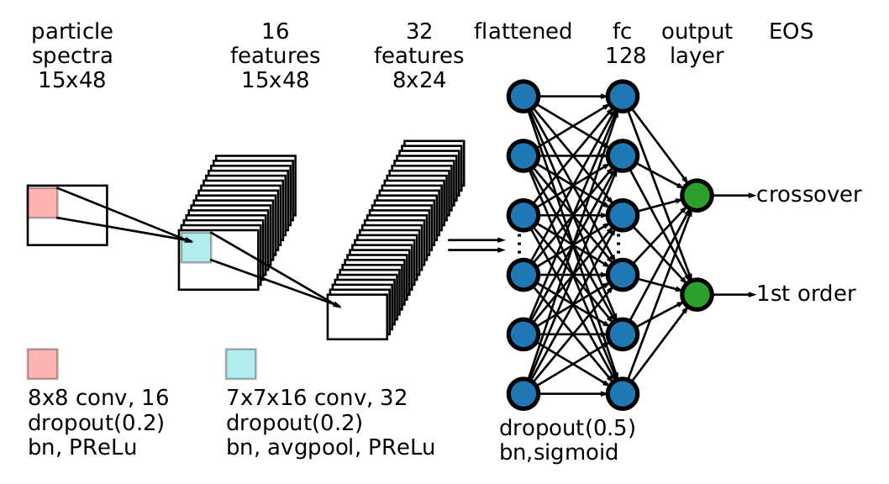
Direct inverse mapping? CNN make the road
2
Conventional obs. hard to distinguish
Strongly influence from initial fluctuations
and other uncertainties
95% event-by-event accuracy!
Robust to initial conditions, eta/s
Conclusion : Information of early dynamics can survive to the end of the hydrodynamics and encoded within the final state raw spectra, immune to evolution’s uncertainties, with deep CNN we can decode it back.
L.G.Pang, K. Zhou, N.Su et al., Nature Commu.9 (2018), no.1, 210
3/15

Slide 6
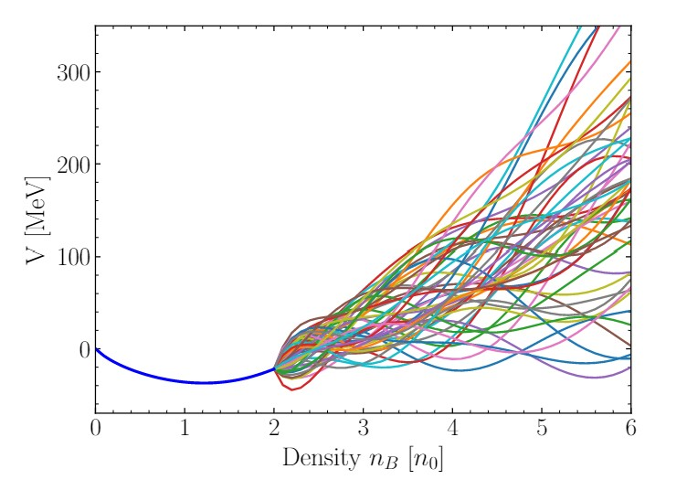
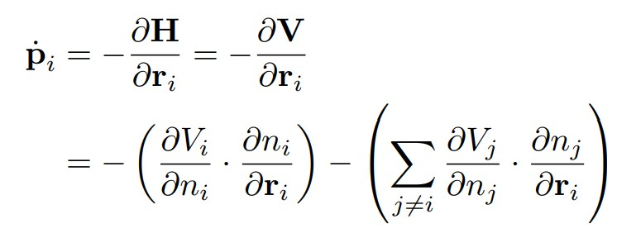
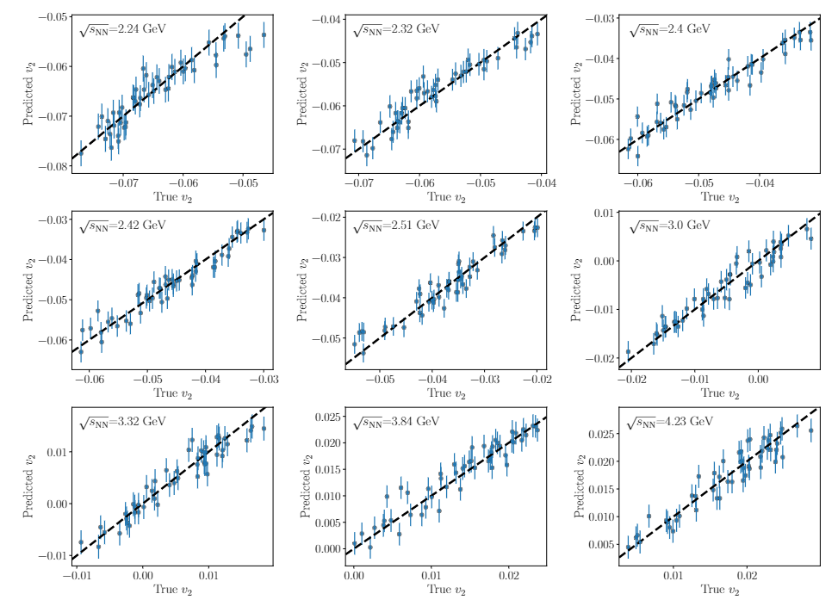
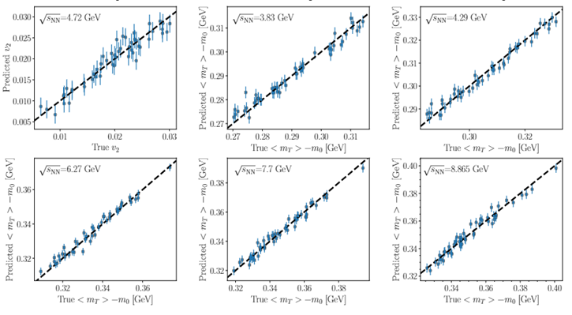
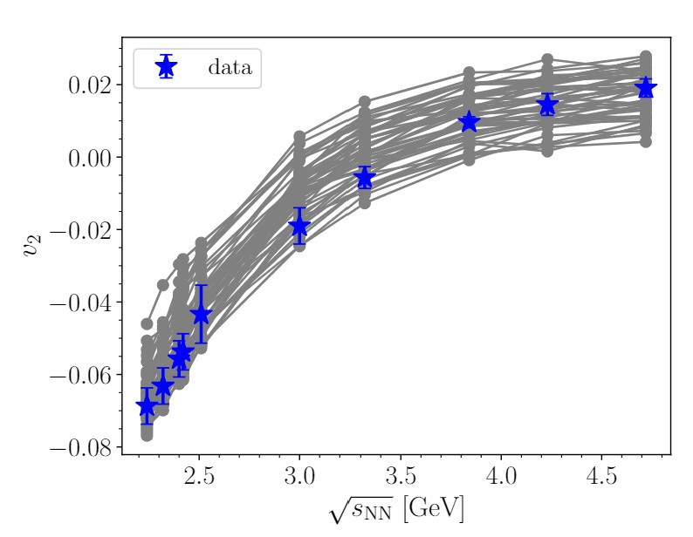
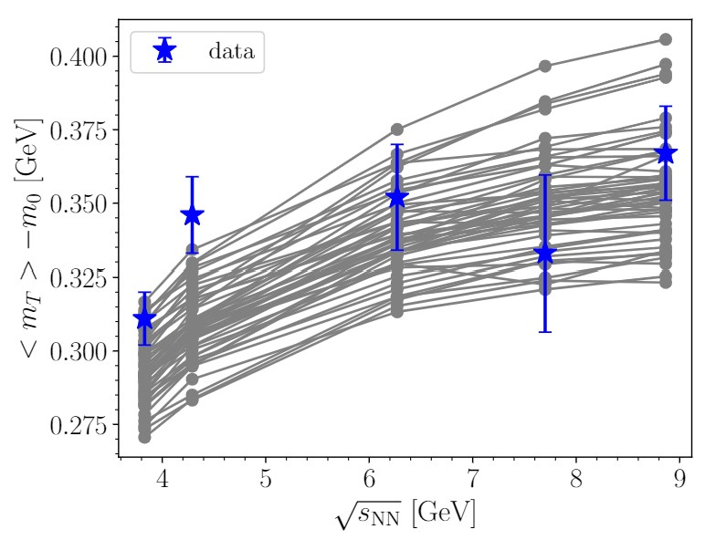
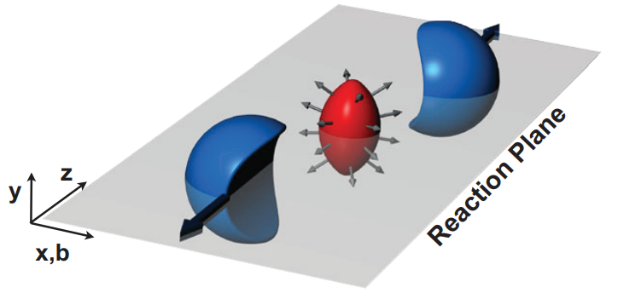
The EoS parameterization, the flow and transverse kinetic energy measurements
4
Hadronic cascade dominant
UrQMD model adapted to any
density dependent EoS →
via density dependent potential
Eur.Phys.J.C82(2022)5,417
Polynomial
CMF +
Evidence : proton’s v2 and transverse kinetic energy
Gaussian Process Emulator : ${Obs}_{i}\left(θ\right) \sim GP(μ(θ$), $κ(θ,θ^{′}))$
$\text{The} \text{trained} \text{emulator} \text{predict} \text{observables} \text{well}\text{: }R^{2} \sim 0.9$
M.OK, J. Steinheimer, H. Stoecker, K. Zhou, arXiv:2211.11670
4/15

Slide 7
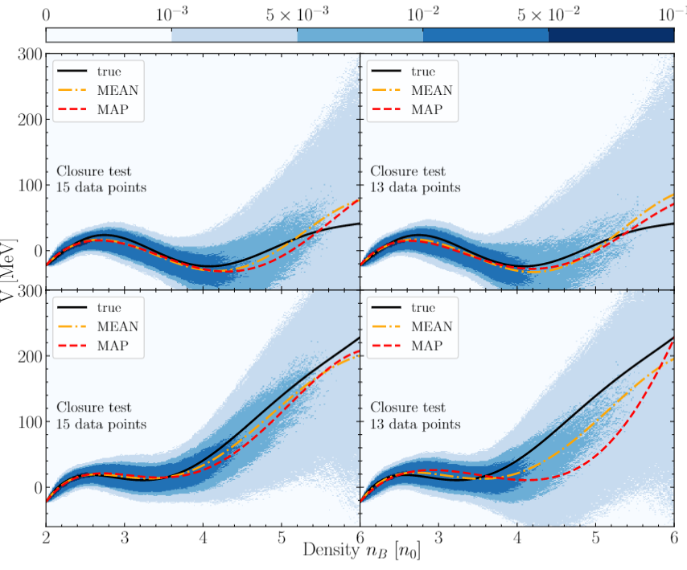
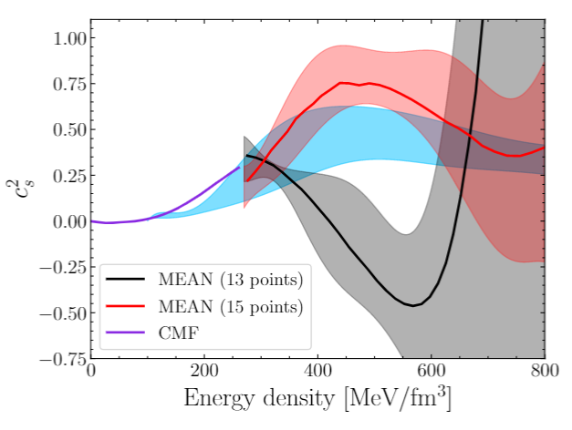
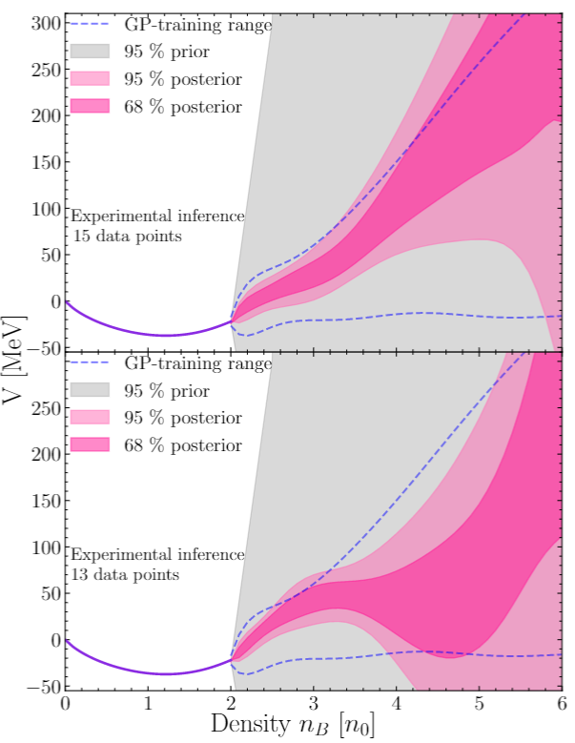
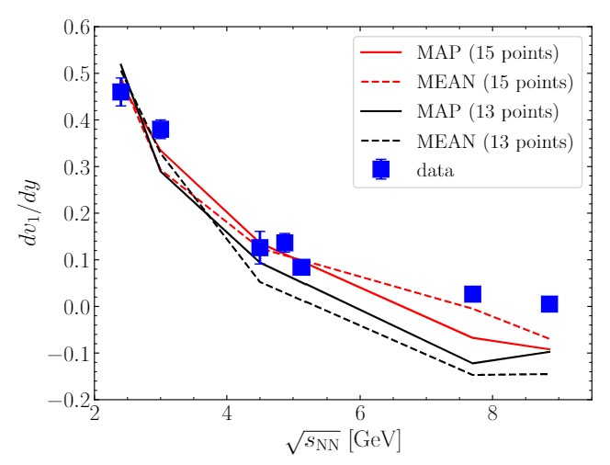
EoS reconstruction Closure tests, with Exp. Data, Predictability
5
Posterior ~ Likelihood * Prior
With real experimental data
68% posterior
Test the extracted EoS on different observables (not used in Bayesian analysis)
arXiv:2211.11670
5/15

Slide 8
2, From LQCD to physics analysis
Shuzhe Shi, Kai Zhou, Jiaxing Zhao, Swagato Mukherjee, Pengfei Zhuang
Phys. Rev. D 105 (2022) 1, 1
Fu-Peng Li, Hong-Liang Lue, Long-Gang Pang, Guang-You Qin,
arXiv:2211.07994

Slide 9
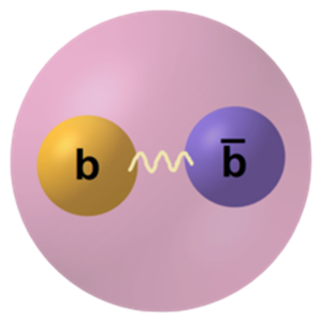
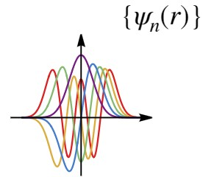
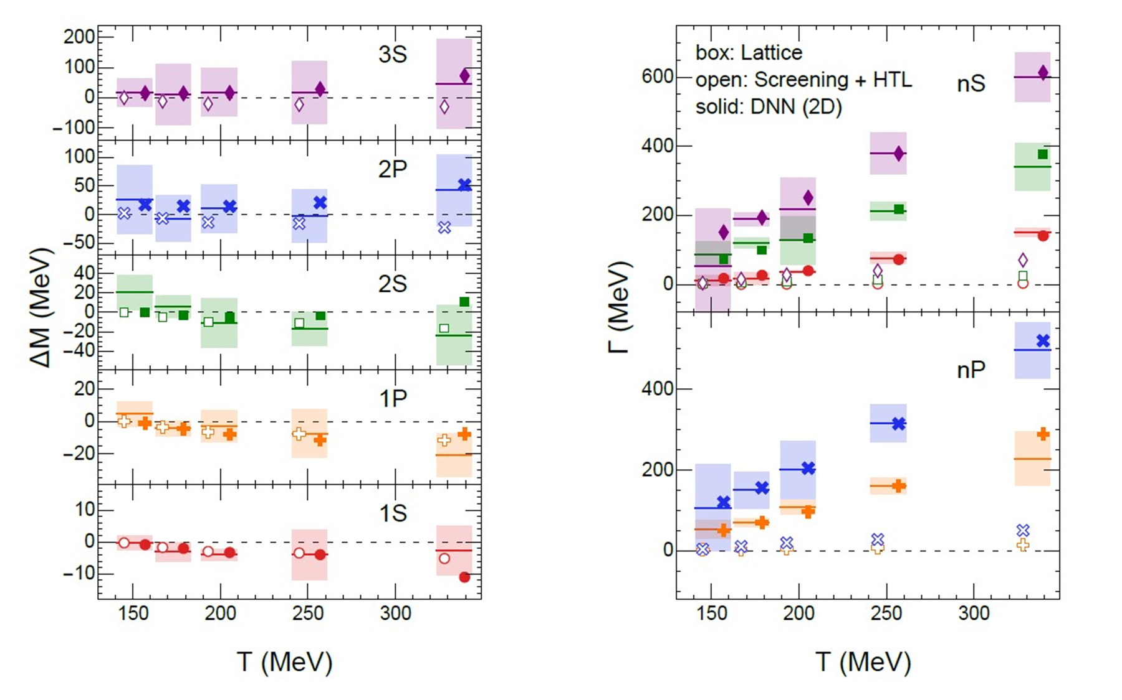
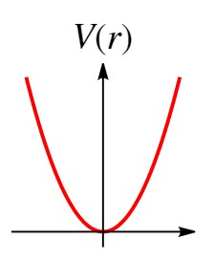
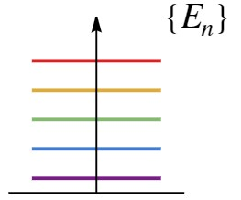
Introduction, Potential Model, Inverse Shroedinger Eq.
Large mass scale :
Large mass scale :
$$m_{Q}>>Λ_{QCD}, T,p$$
Hard Process production in early stage
‘Calibrated’ QCD Force – HQ interaction
Vacuum: NRQCD, Cornell-like
Medium: Color Screening, Thermal width
M. Strickland, et.at., PRC(2015) PRD(2018), PLB(2020)
$$V\left(r\right)=−\frac{α}{r}+σr+B$$
New lQCD results cannot be explained by
Perturbative HTL-inspired potentials !
Laine, et.al, JHEP(2007)
Inverse Power method
H.W.Crater, JCP(1994)
?
R. Larsen, et.al, PRD(2019),
PLB(2020), PRD(2020)
How to extract effective potential given limited spectroscopy ?
6/15

Slide 10
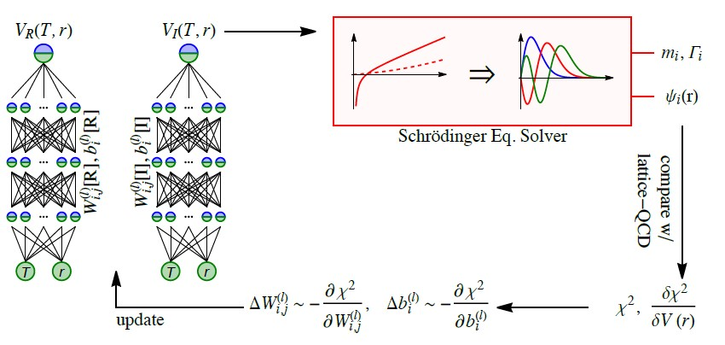
Flow chart for “DNN + Schrödinger Eq.”
Hellmann-Feynman theorem
Phys. Rev. (1939)
Phys. Rev. D 105 (2022) 1, 1
7/15

Slide 11
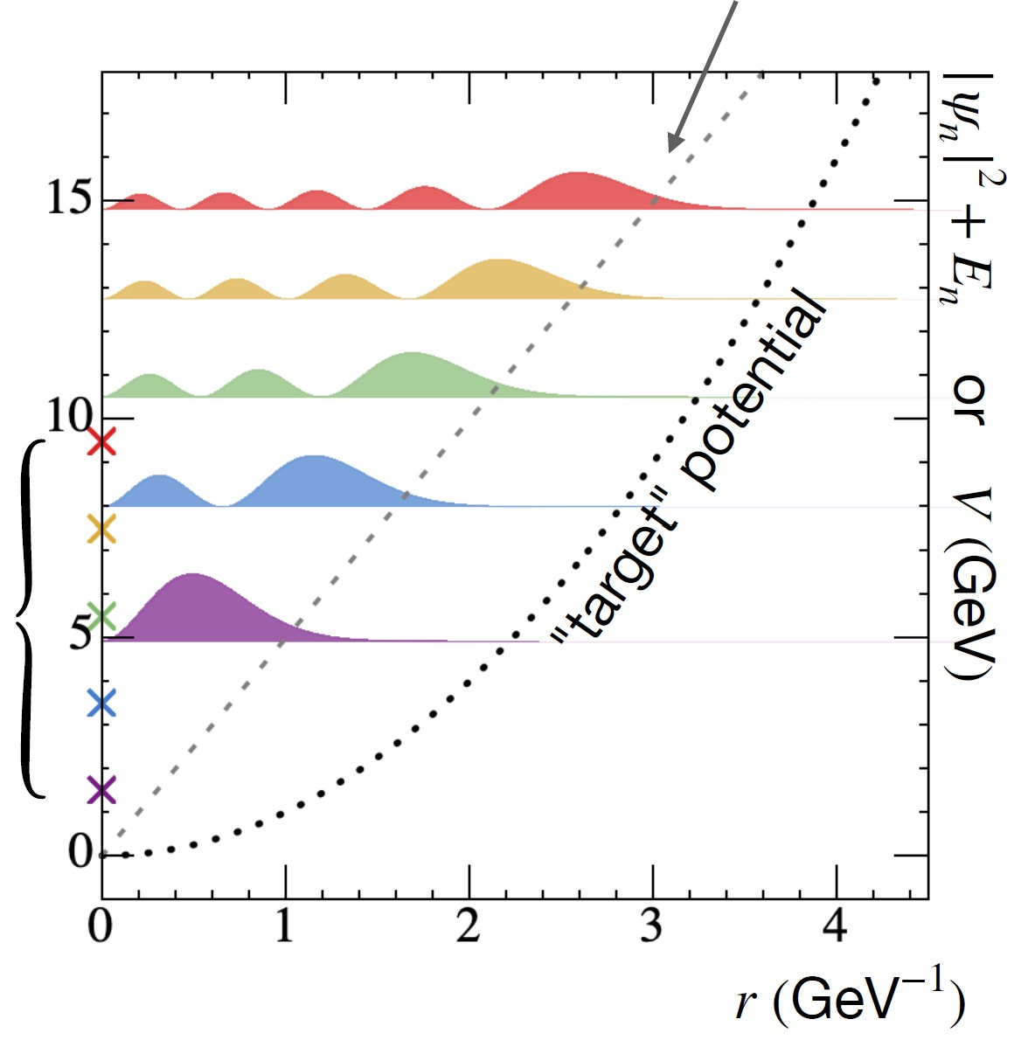
Proof of Concept
limited spectrum { En } to continuous interaction V(r) ?
initial potential
Learn V(r) from 5 eigenvalues :
{ En } = {3/2, 7/2, 11/2, 15/12, 19/2} GeV
8/15

Slide 12
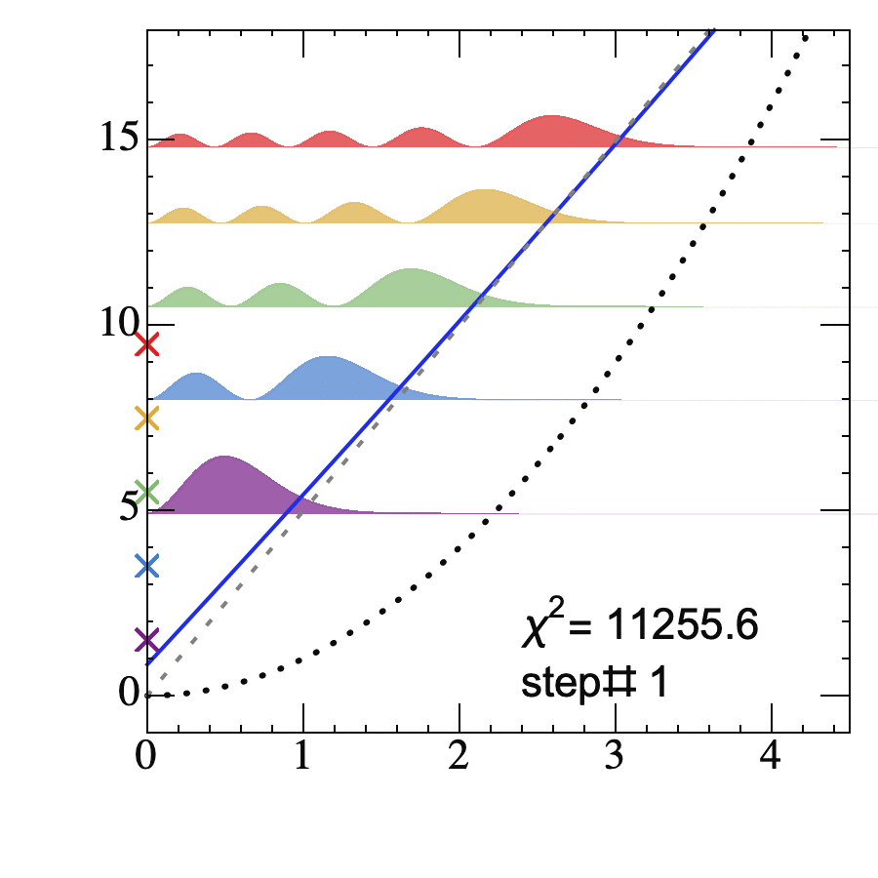
Proof of Concept
limited spectrum { En } to continuous interaction V(r) ?
initial potential
Learn V(r) from 5 eigenvalues :
{ En } = {3/2, 7/2, 11/2, 15/12, 19/2} GeV
8/15

Slide 13
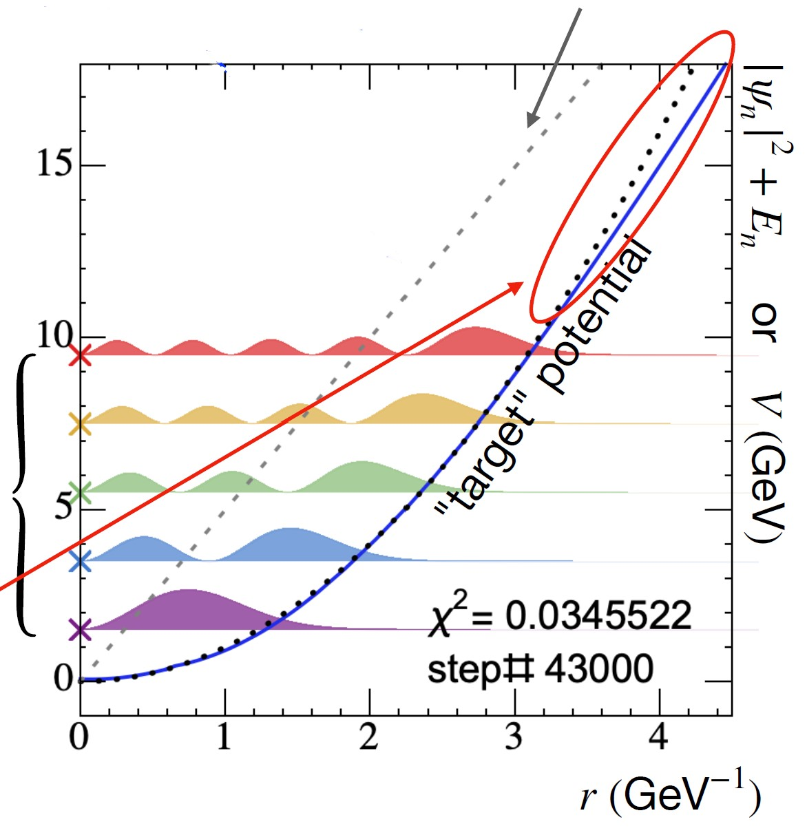
Proof of Concept
limited spectrum { En } to continuous interaction V(r) ?
initial potential
-- Yes! But to some range decided by the used states.
Learn V(r) from 5 eigenvalues :
{ En } = {3/2, 7/2, 11/2, 15/12, 19/2} GeV
target spectrum
Deviation @ given states’ wavefunction vanishes
8/15

Slide 14
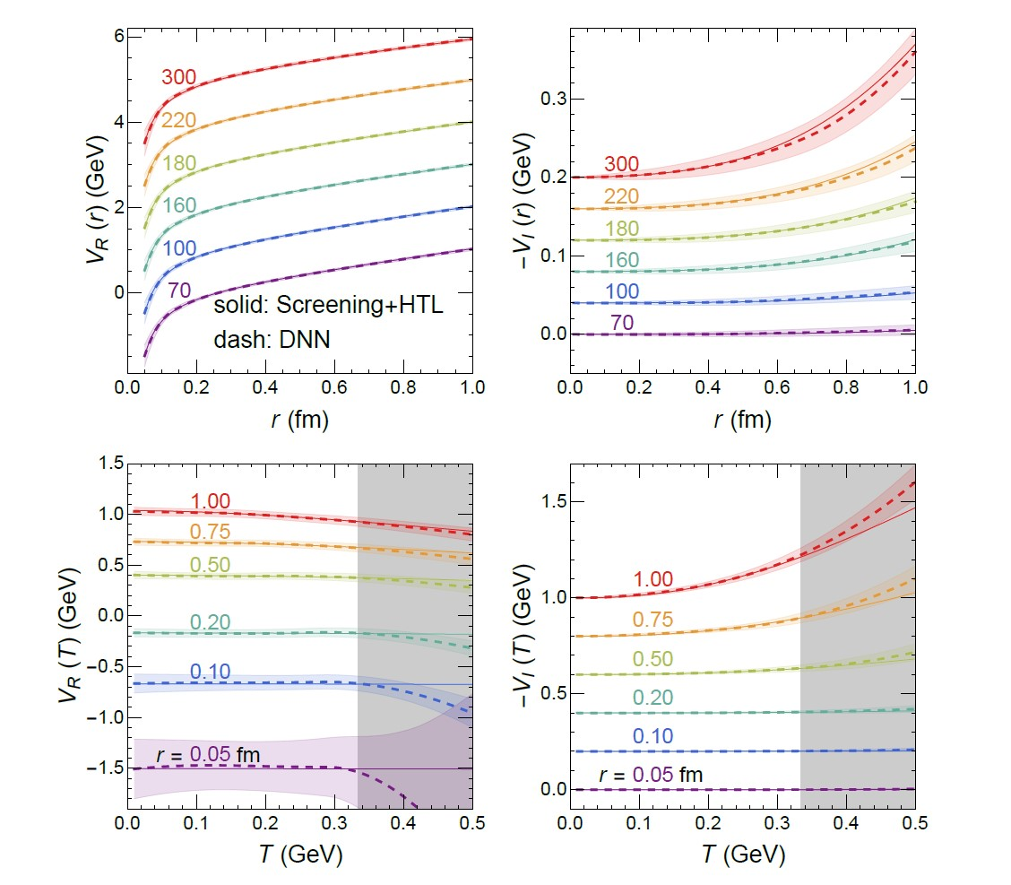
Closure Test – suppose HTL is true
Provide mass and width of
@
9/15

Slide 15
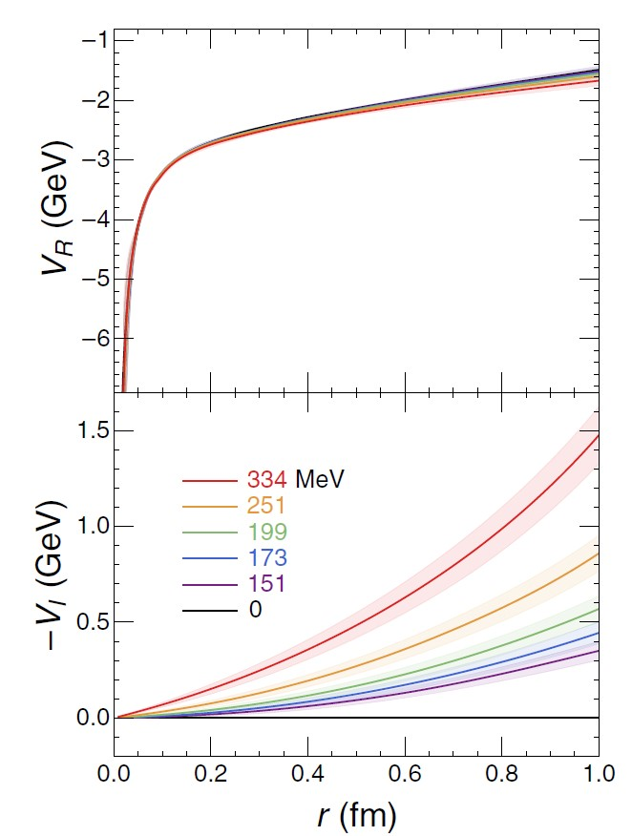
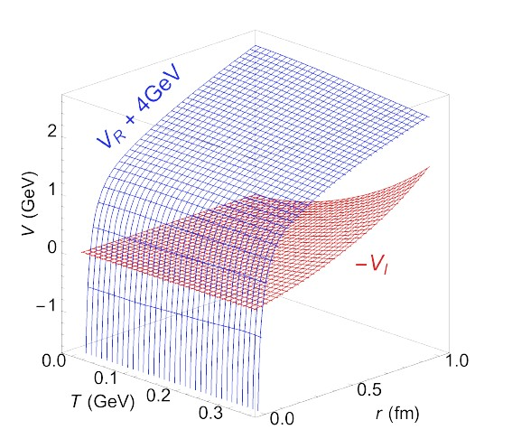
Best Fit of lQCD mass and width from HTL (open symbols) and DNNs (solid symbols)
The reconstructed T, r dependent potential
Chi2-per-data=16.5/30
10/15

Slide 16
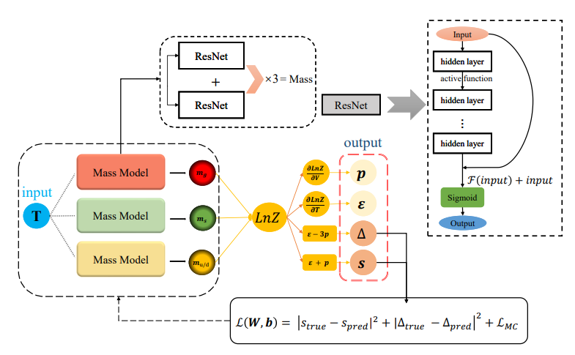
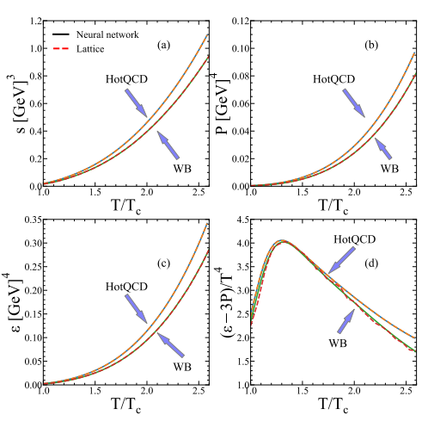
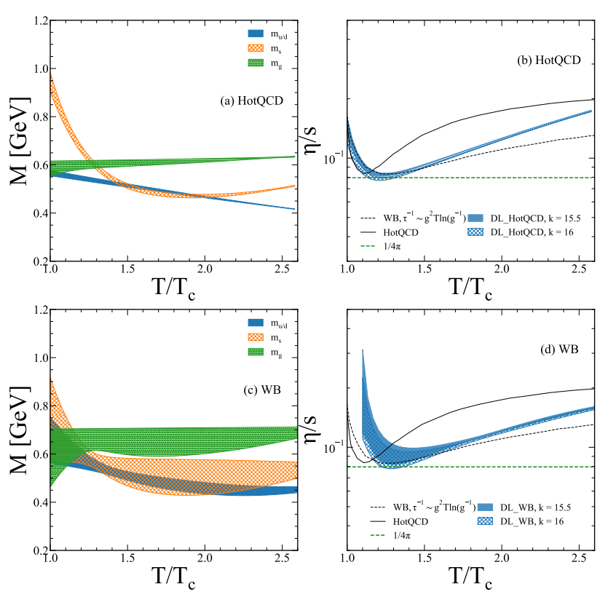
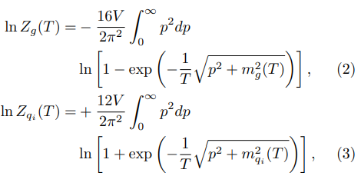
Quasi-particle analysis of lQCD thermodynamics
F.Li, H. Lue, L. Pang and G. Qin, arXiv:2211.07994
11/15

Slide 17
3, Dense matter EoS reconstruction for Neutron Star from M-R observation
JCAP08(2022)071 (arXiv:2201.01756)
arXiv:2209.0xxxx (soon)

Slide 18
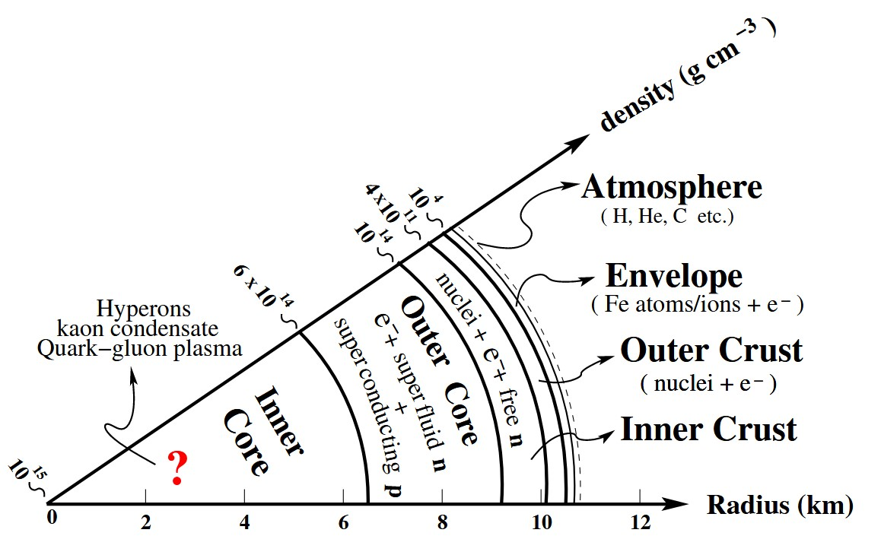
From EoS to Stellar Structure (MR)
Mass ~ 2 solar masses
Radii ~ 10 km
Densities ~ 8
Gravity ← → Pressure
Dense matter Equation of State
$$ρ_{0}$$
$$P\left(ρ\right)$$
12/15

Slide 19
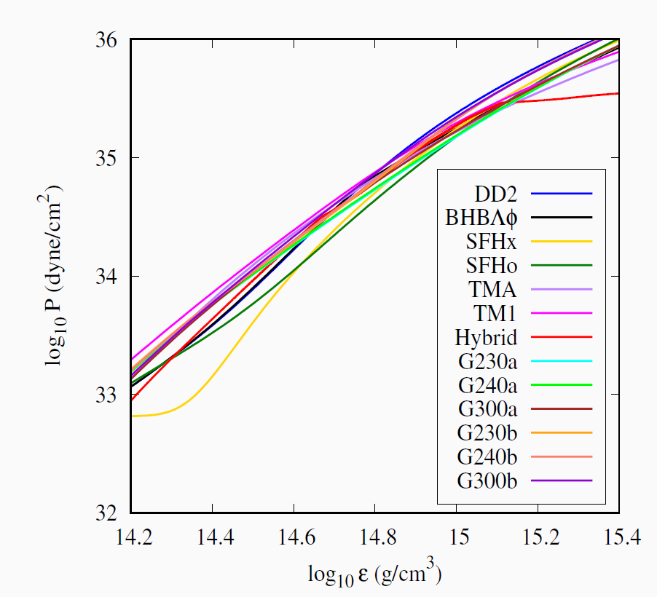
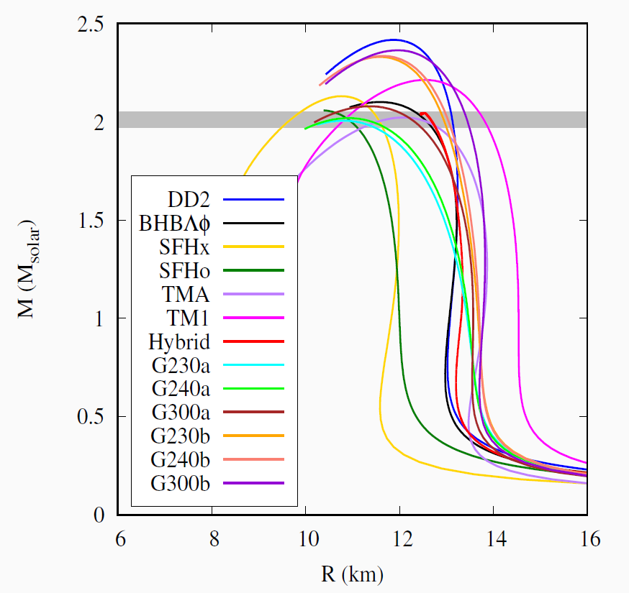
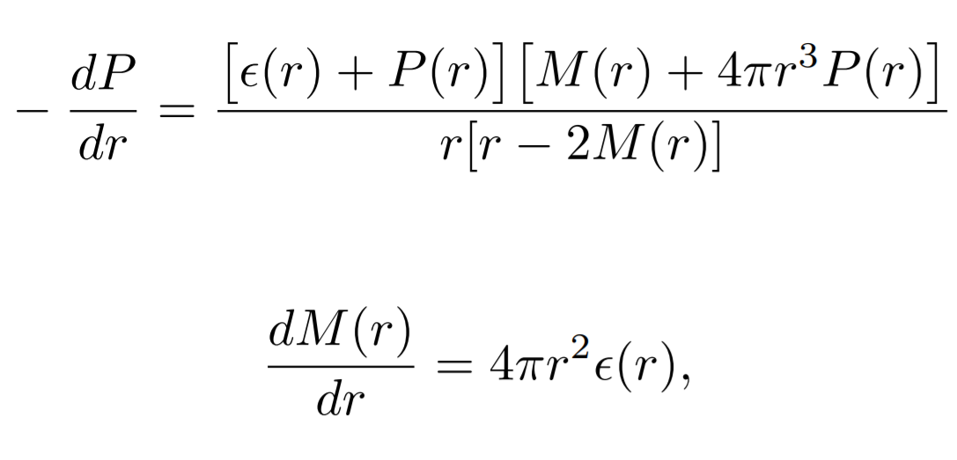
1-to-1 mapping from EoS to M(R)
Micro to Macro
TOV solver
13/15

Slide 20
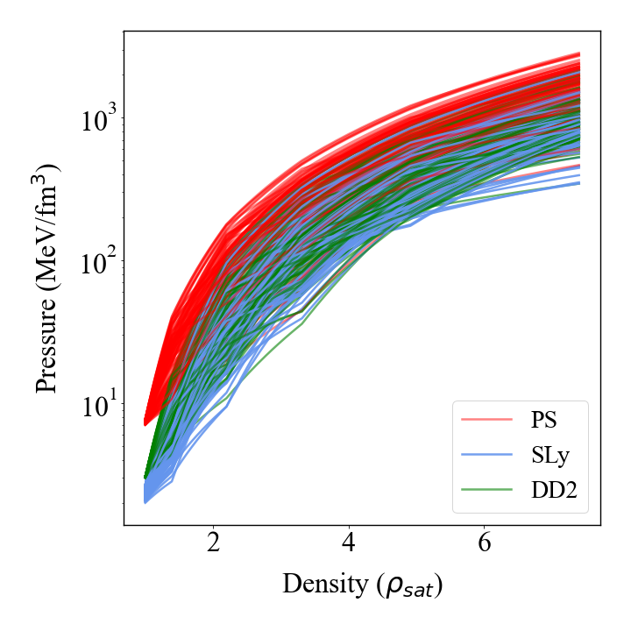
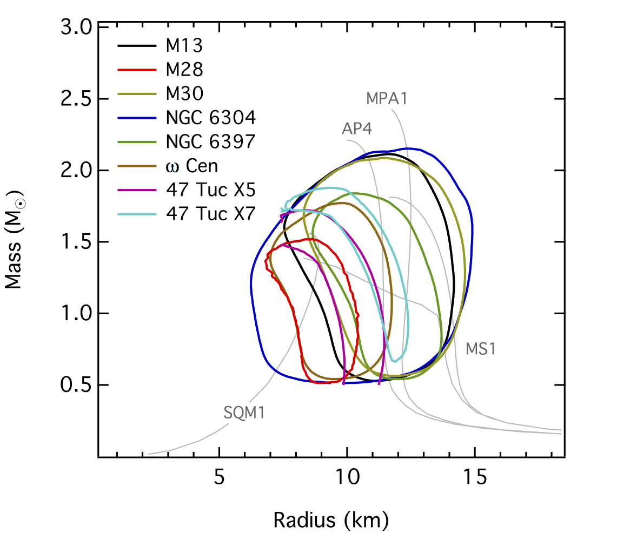
Inverse TOV solver
Noisy NS Observables to Equation of State ?
TOV solver
?
13/15

Slide 21
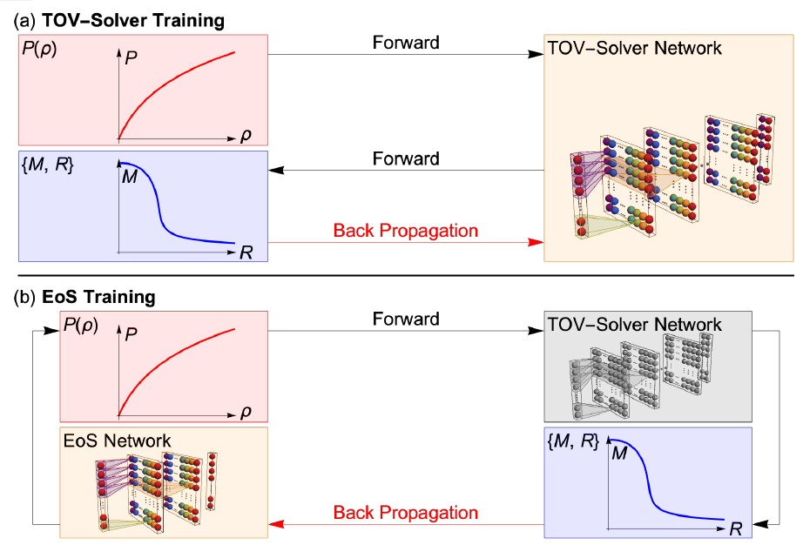
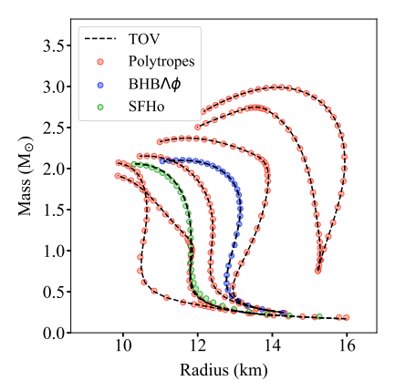
Infer matter’s EoS inside NS from M(R)
Generalized Bayesian Inference with DNN+AD:
Well validated through Mock Tests
With real observable we reconstruct the NS EoS also
S.Soma, K. Zhou*, et.al., JCAP98(2022)071,
Phys.Rev.D107(2023)083028
14/15

Slide 22
Infer matter’s EoS inside NS from M(R)
Generalized Bayesian Inference with DNN+AD:
Well validated through Mock Tests
With real observable we reconstruct the NS EoS also
S.Soma, K. Zhou*, et.al., JCAP98(2022)071,
Phys.Rev.D107(2023)083028
14/15

Slide 23
Summary : Inverse Problems
Explicit 1-to-1 mapping
Quantity of Interest
Accessible
Observation
Exist, but implicit
Physics Priors are needed, coult be put into :
1, training data (Implicit) : DL (network) learn the inverse mapping directly :
general mapping, avoid case-specific retraining
2, inference process (Explicit) : Chi2 fit+Bayesian inference+Gradient Descent :
Automatic differentiation and Network representation
If interested, for more discussion for QCD matter exploration with ML see Review: arXiv:2303.15136
Thanks！
15/15

Slide 24
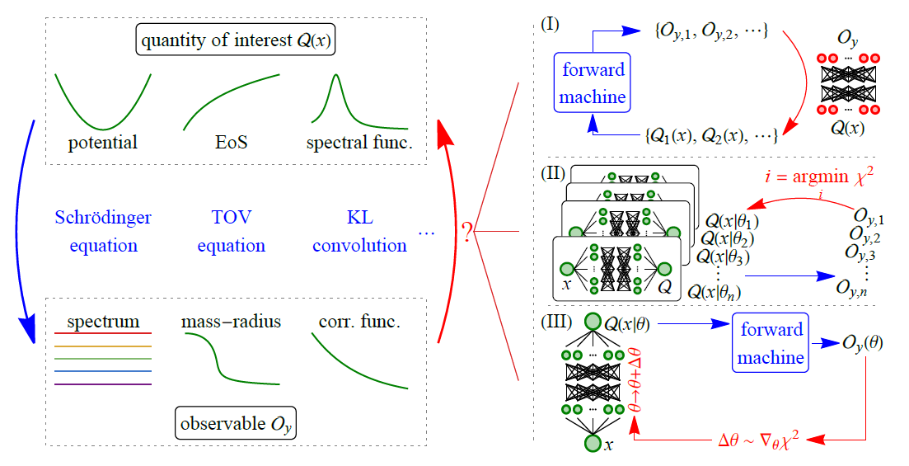
Overview : Inverse Problems Solving
15/15

Slide 25
Backup

Slide 26
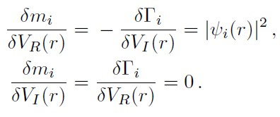
Perturbation on Schroedinger Eq.
Hellmann-Feynman theorem
Phys. Rev. (1939)
1

Slide 27
Uncertainty Estimation – Bayesian Inference
Sample potentials ~
Reference Sampler ~
( )
Re-weighting with :
to grantee the sampling following posterior
$$ω\left(θ\right)=p{\left(V_{θ}\left(T,r\right)\right)}/{\tilde{p}}\left(θ\right)$$
2

Slide 28
Eigenvalues of the Hamiltonian (with t-independent potential) : mass and width ?
3

Slide 29
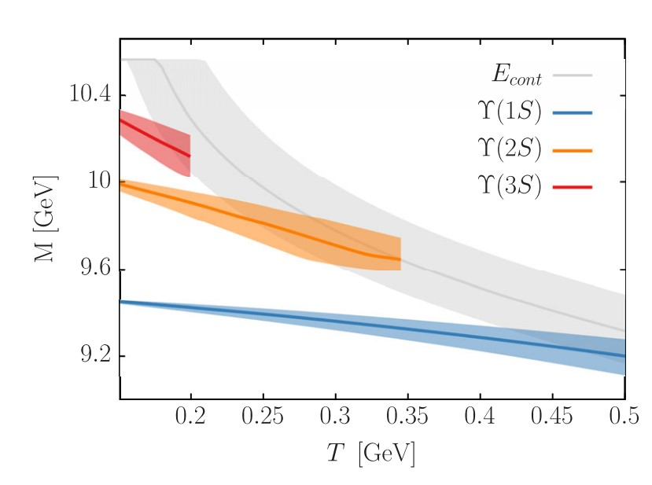
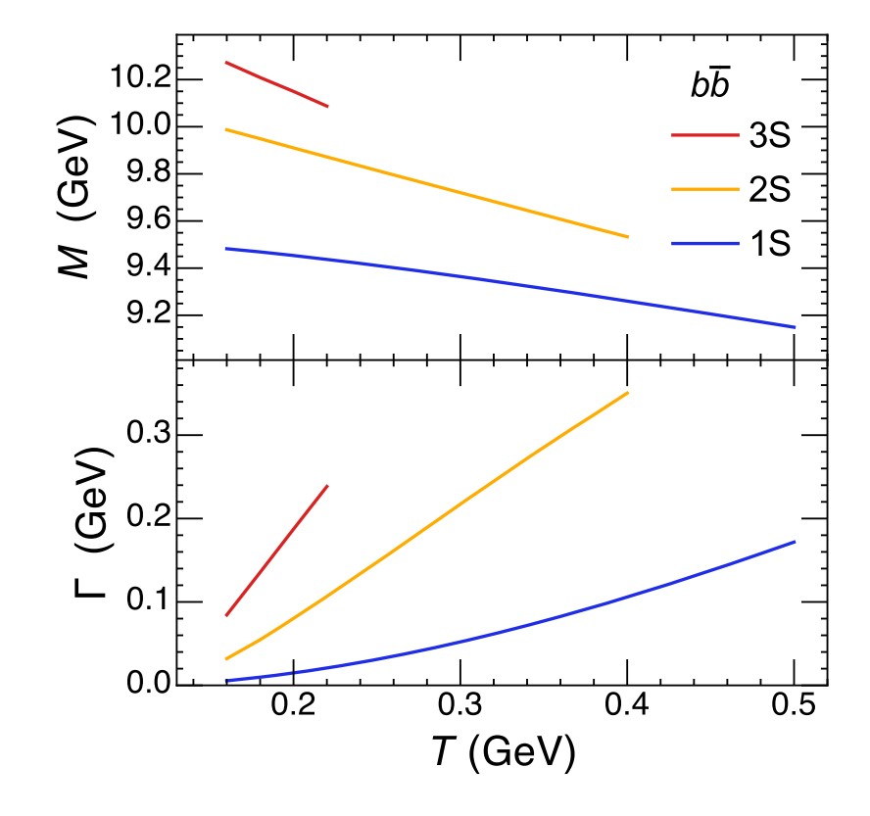
Potential model reproduce in-medium spectroscopy of others
D. Lafferty and A. Rothkopf, Phys. Rev. D 101, 056010 (2020)
4

Slide 30
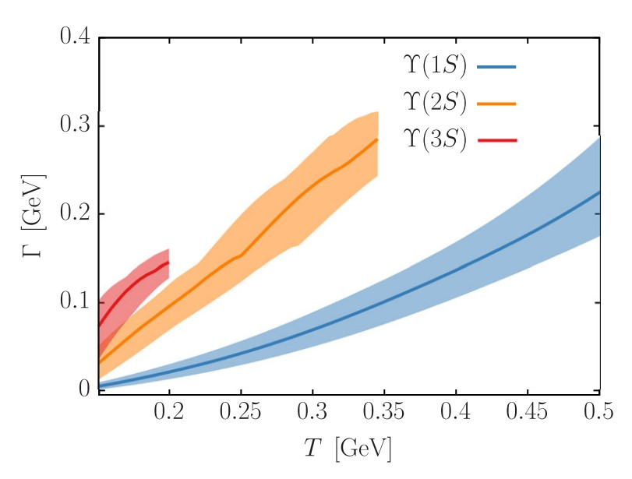
Potential model reproduce in-medium spectroscopy of others
D. Lafferty and A. Rothkopf, Phys. Rev. D 101, 056010 (2020)
4

Slide 31
Uncertainty estimation for NS EoS reconstruction-- reweighting
1, draw ensemble of M-R samples from measured likelihood (Gaussian approximated)
2, convert each set of M-R points into EoS via the reconstruction model
3, apply TOV-solver to convert the ensemble of EoSs to corresponding M-Rs
4, evaluate the weight for each EoS sample
5

