Slide 1
News from the Fermilab Muon g-2 experiment
Saskia Charity, University of Liverpool
Precision Tests of Fundamental Symmetries with Light Mesons @ ECT* Trento
14th June 2023

Slide 2
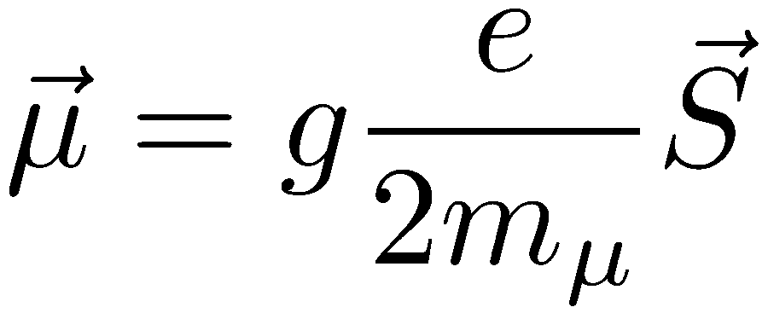
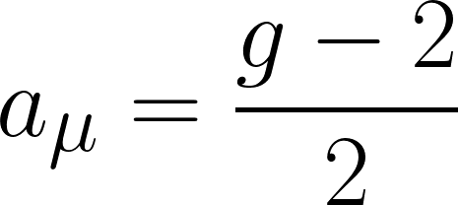
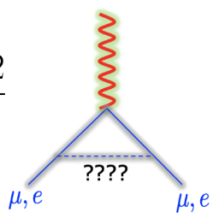
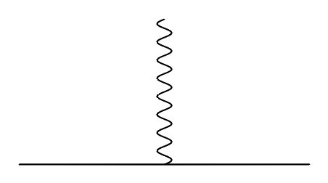
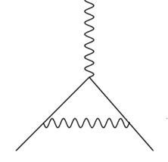
Experimental principle
Coupling between intrinsic magnetic moment and spin parameterised by g
g covers all possible interactions between lepton and magnetic field: QED, EW, HLbL, HVP
Tree-level (Dirac): g = 2 (a_{µ} = 0)
First QED term: a_{µ} = 0.0116 (α / 2π)
All physics: 0.00116592061(41) [0.35 ppm] (expt)
Discrepancy could indicate virtual BSM interactions
g=2 (Dirac)
QED (Schwinger)

Slide 3

Muon g-2 : what do we know?
FNAL-2021 result confirmed BNL result
  4.2σ discrepancy from Theory Initiative WP2020 SM prediction
  434 ppb (stat), 159 ppb (syst) uncertainty
  World avg uncertainty: 350 ppb
  5% of total dataset
The 2021 TI recommended SM value:
  Included work published in 2020
  HLbL data-driven and lattice
  HVP data-driven only
  Net uncertainty (driven by HVP): 368 ppb
The theory picture is very interesting!
  But today I’ll talk about the experiment
g-2 experiments
e+e- puzzles: KLOE, BABAR, CMD3…
Lattice
Measurement of a_{μ}^{HLO} (MUonE)

Slide 4
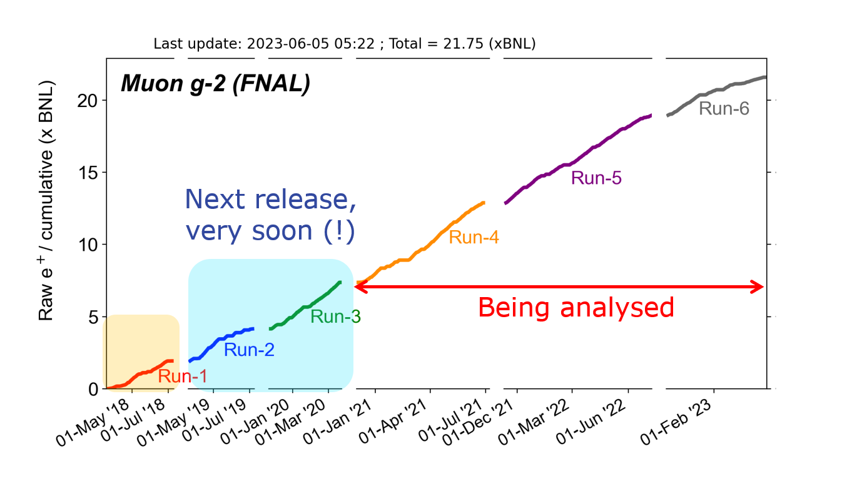
Current status of the measurement
Run 1 publication: 1 “BNL” statistics
Run 2/3 publication: 4 x Run-1 statistics, 2x reduction in total uncertainty vs Run-1 expected
  Analysis being finalised; release very soon!
Run 2/3 systematics sufficient for full dataset
TDR goal achieved: 21 BNL raw statistics accumulated in February 2023
Currently using beam for systematics measurements and beam dynamics studies
Run-6 will end in July : last muons of g-2
Magnet will stay powered for 1 year for field-related studies
On track for 140 ppb total uncertainty with full Run 1-6 statistics

Slide 5
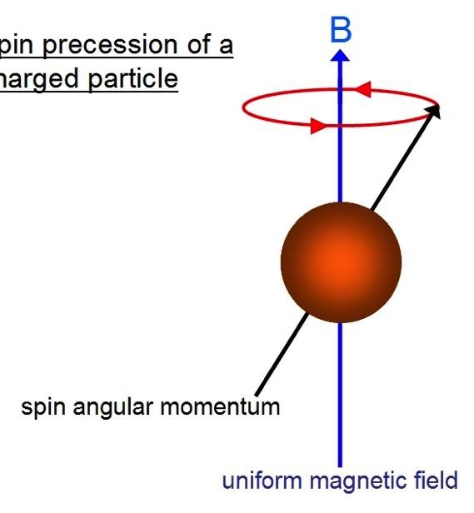
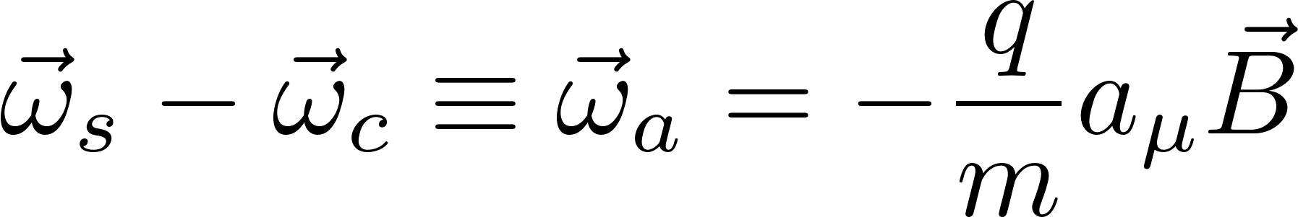
Spin precession
In presence of external B-field, muon spin precesses at frequency determined by g
Muons circulate in a magnetic storage ring with uniform vertical B-field
Difference between spin precession frequency and cyclotron frequency directly proportional to a_{µ}
Momentum
Spin
g=2
g>2

Slide 6
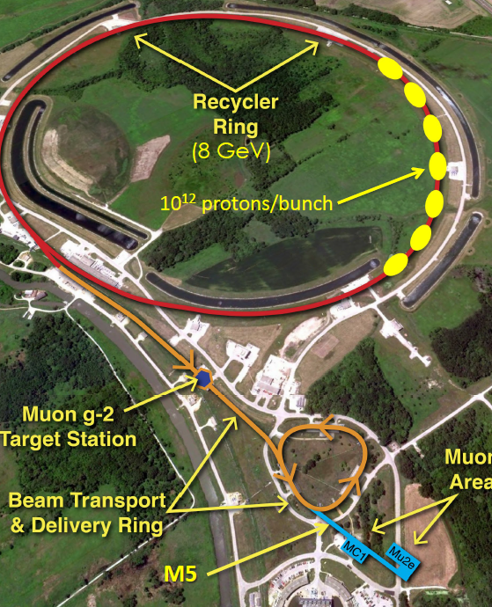
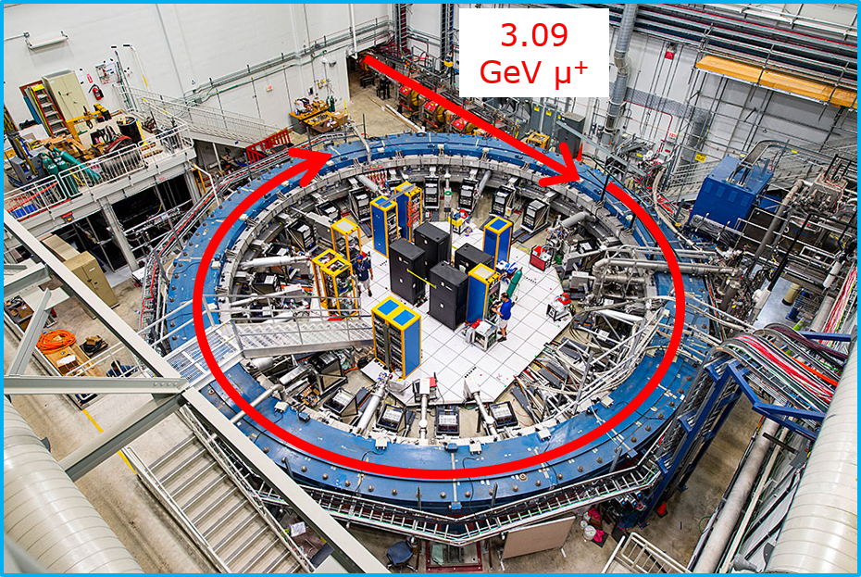
The FNAL Muon Campus
Recycler ring: 8 GeV protons
  10¹² protons / bunch ; 10k stored muons / bunch
8 GeV protons → pion production target
Pions → delivery ring → decay to μ⁺ and momentum-selected
3.09 GeV μ⁺ → g-2 storage ring magnet

Slide 7
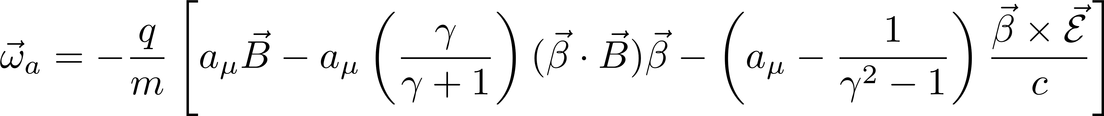
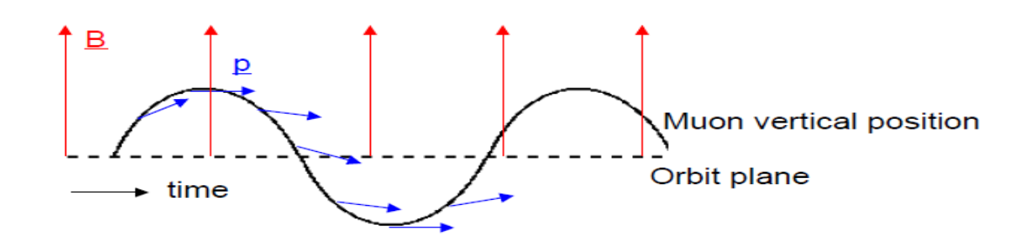
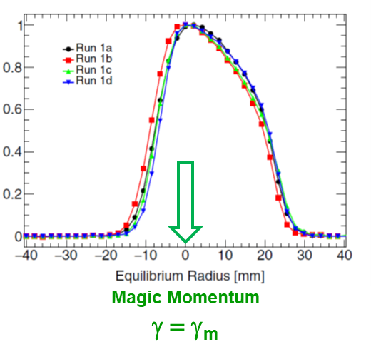
3.09 GeV/c – the magic momentum
0 if “in plane”
Term cancels at 3.094 GeV/c, the “Magic γ”
Pitch correction
E-field correction

Slide 8
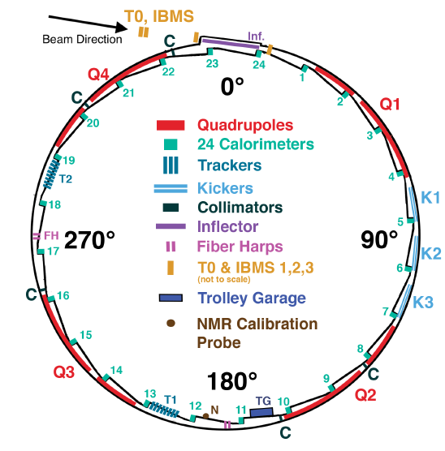
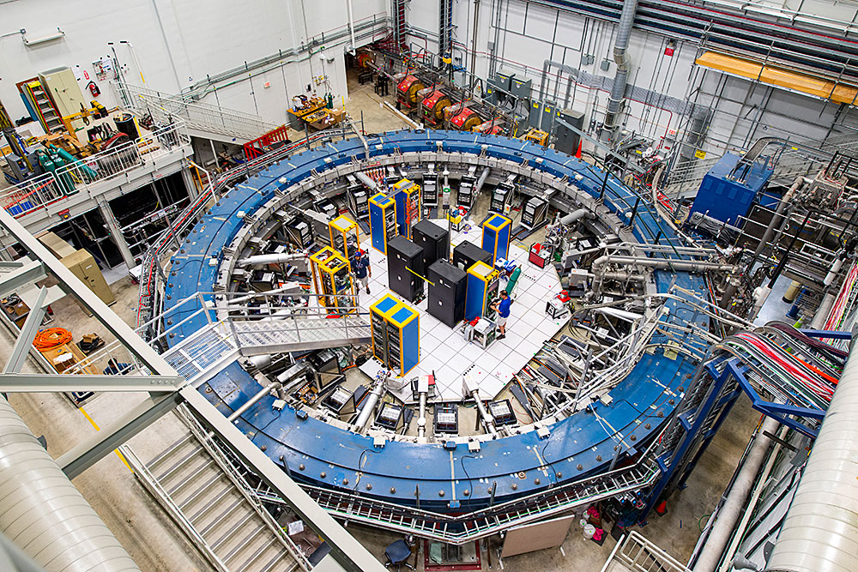
The g-2 experiment
3.09 GeV μ⁺
ECAL x24
decay e⁺
Polarized (95%) μ⁺ beam injected into 14m diameter magnetic storage ring
Muons stored for 700 μs (10 lifetimes)
Vertical field, 1.45 T
Decay e⁺ spiral into the centre of the ring
24 electromagnetic calorimeters detect decay e⁺
Number of decay e⁺ vs time is directly proportional to a_{μ}

Slide 9
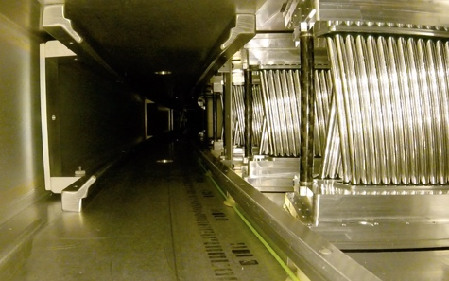
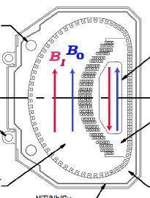
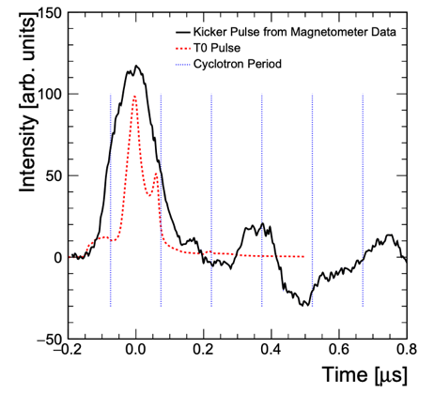
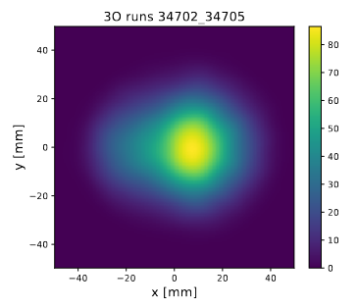
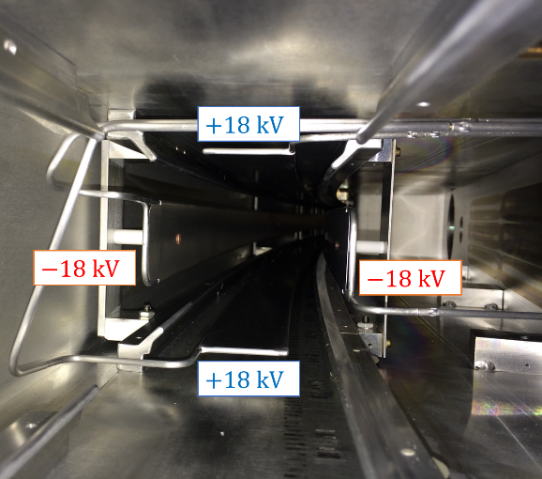
Storing and measuring the beam
Beam injected through inflector magnet → cancel main magnetic field
Straw trackers measure beam profile from e⁺ decay trajectories at 180° and 270°
Kicker magnet applies fast radial magnetic field on first turn
43.3% of azimuth covered by ESQs
ESQs pulse throughout muon fill → vertical focusing

Slide 10
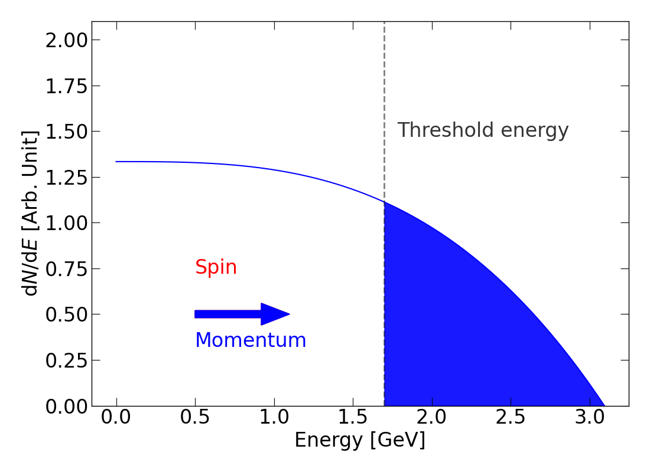
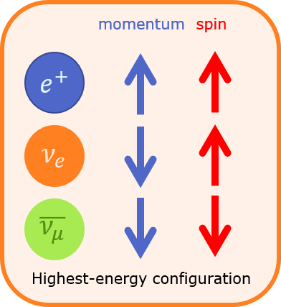
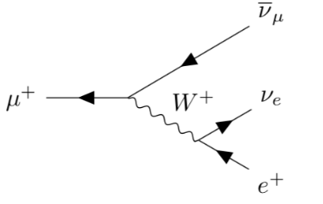
Fortunes of nature: parity violation
Highest energy e⁺ preferentially emitted in direction of muon spin
Oscillation in number of emitted decay e⁺ vs time directly proportional to decay asymmetry
Count N(t) = number of e⁺ above an energy threshold over time
Higher fraction detected above threshold when e⁺ emitted parallel to muon spin
N(t) depends on anomalous precession frequency
Frequency of oscillation = ω_{a}

Slide 11
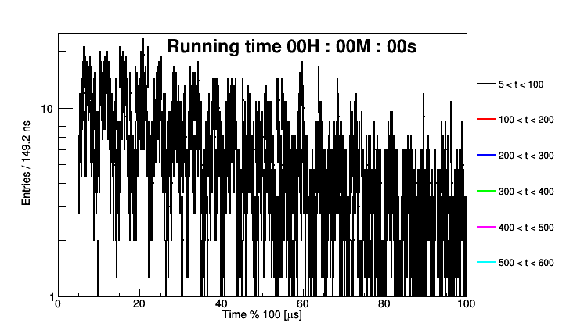
Extracting ω_{a}: 5-parameter fit function
Five-parameter fit function
$$N\left(t\right)=N_{0}e^{−t/τ}[1 −A\cos{(ω_{a}t+φ)} ]$$
Time-dilated muon lifetime
Precession frequency
Number of e⁺ vs time
Average spin phase at injection
Asymmetry

Slide 12
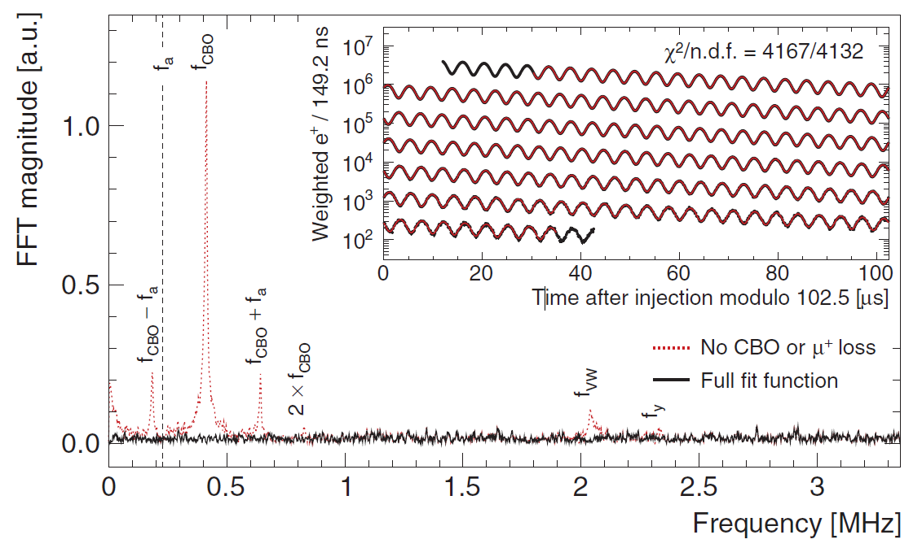
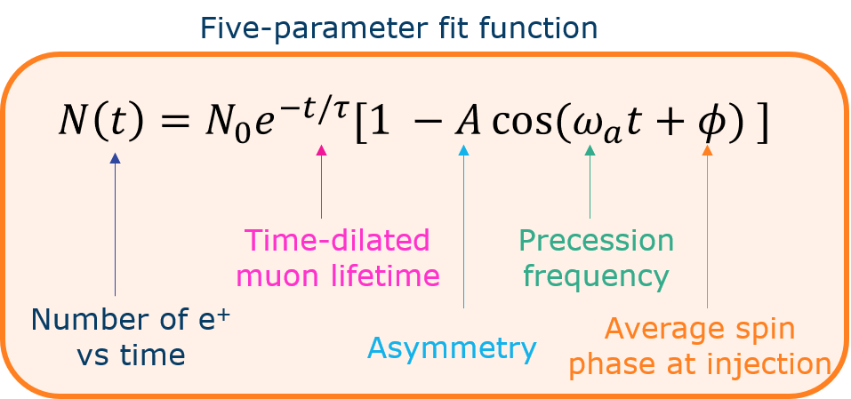
Extracting ω_{a}: 27-parameter fit function
27 parameter fit required to extract ω_{a}
In Run-23:
8 different analysis teams
19 analyses
3 run periods with different conditions

Slide 13
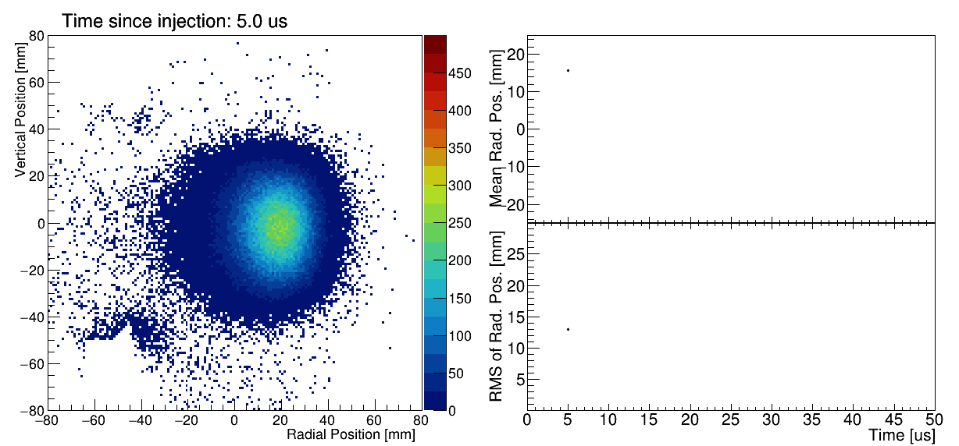
Muon beam dynamics: Coherent Betatron Oscillations

Slide 14
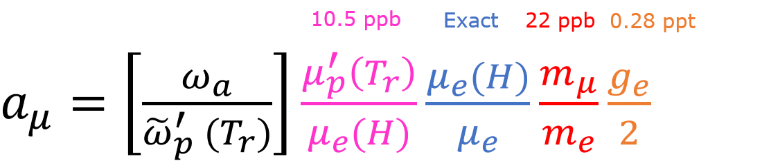
“Never measure anything but frequency…”
We know how to measure ω_{a} – how to measure other terms with required precision?
We measure the ratio of two frequencies: ω_{a} and ω_{p}
  ω_{a} : anomalous spin precession frequency
  ω_{p} : muon-weighted magnetic field expressed in terms of Larmor frequency of free proton
Phys. Rev. A 83, 052122 (2011)
Metrologia 13, 179 (1977)
Rev. Mod. Phys. 88 035009 (2016)
Phys. Rev. Lett. 82, 711 (1999)

Slide 15
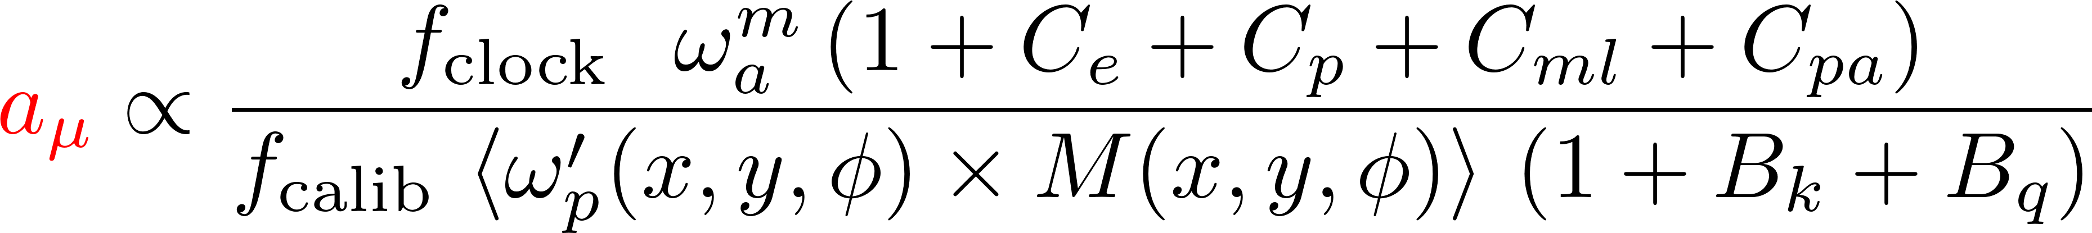
“… and corrections”
Anomalous precession frequency
Beam dynamics corrections
Clock blinding frequency
Absolute calibration frequency
Magnetic field map
Muon beam distribution
Transient magnetic field corrections

Slide 16
Run-1 Corrections & Uncertainties

Slide 17
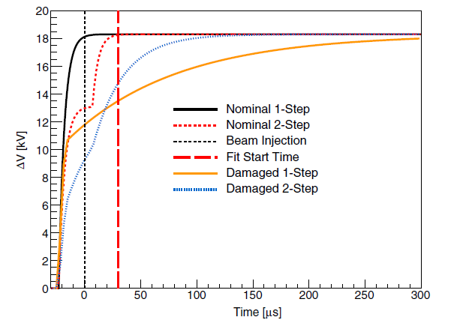
Run-1 Corrections & Uncertainties: C_{pa}
“Phase acceptance” correction: Run-1 only (caused by bad resistor in ESQs, fixed for Run-2)

Slide 18
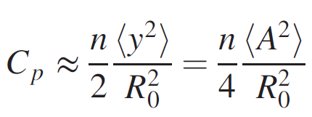
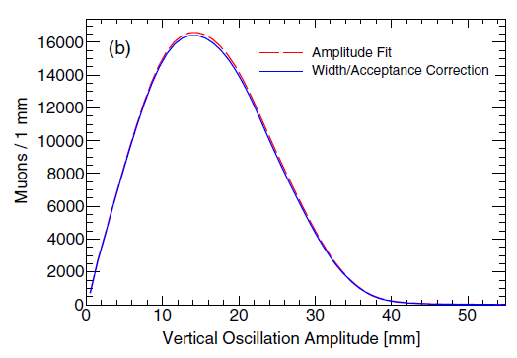
Run-1 Corrections & Uncertainties: C_{p}
Pitch correction

Slide 19
Run-1 Corrections & Uncertainties : C_{E}
E-field correction

Slide 20
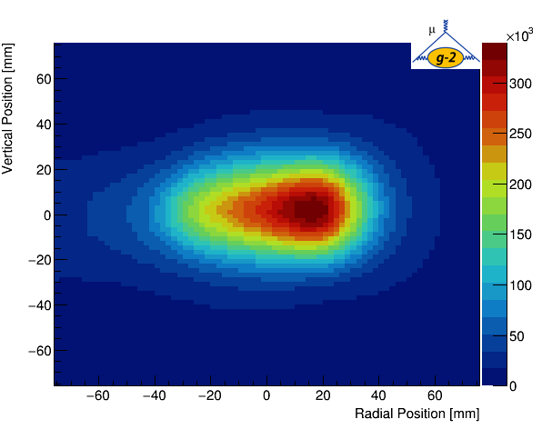
E-field Correction C_{e}
Term cancels at 3.094 GeV/c, the “Magic g”
Momentum spread of the beam – not all muons are at γ_{magic}
Term cancels out if beam is centred
Run-1: under-powered kicker meant equilibrium radius of beam slightly high → large E-field correction
Kick strength increased in Run-2 and Run-3: smaller correction
Several different analysis groups/ methods used

Slide 21
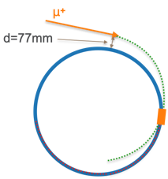
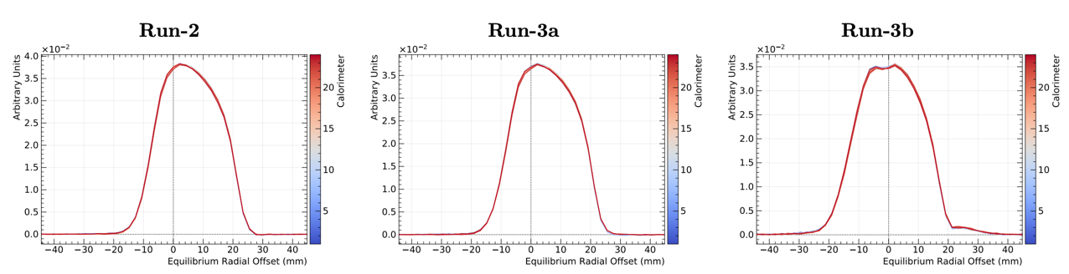
Run-1 vs Run-23 kicker strength
Run-23 divided into three data periods with different kicker conditions
Major upgrade to kicker hardware completed by end of Run-3

Slide 22
Run-1 vs Run-23 kicker strength
Run-23 divided into three data periods with different kicker conditions
Major upgrade to kicker hardware completed by end of Run-3

Slide 23
Run-1 vs Run-23 kicker strength
Run-23 divided into three data periods with different kicker conditions
Major upgrade to kicker hardware completed by end of Run-3

Slide 24
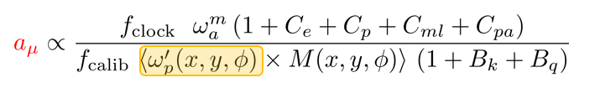
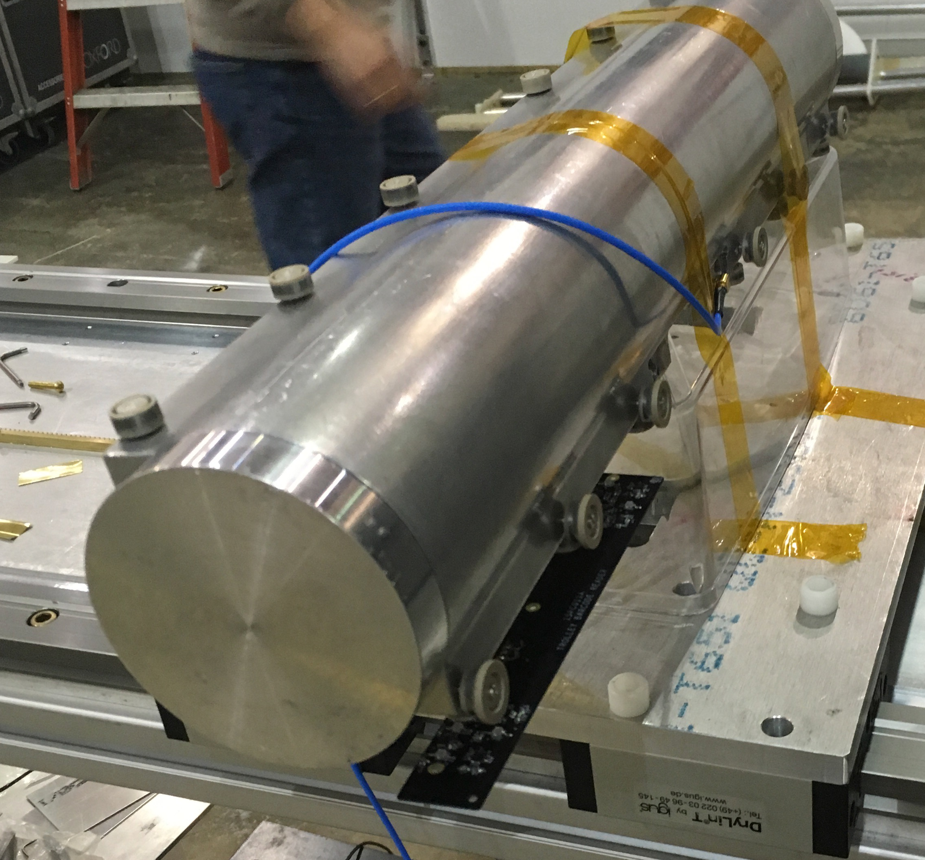
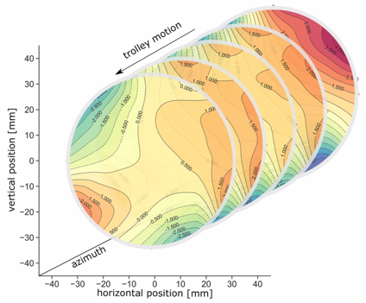
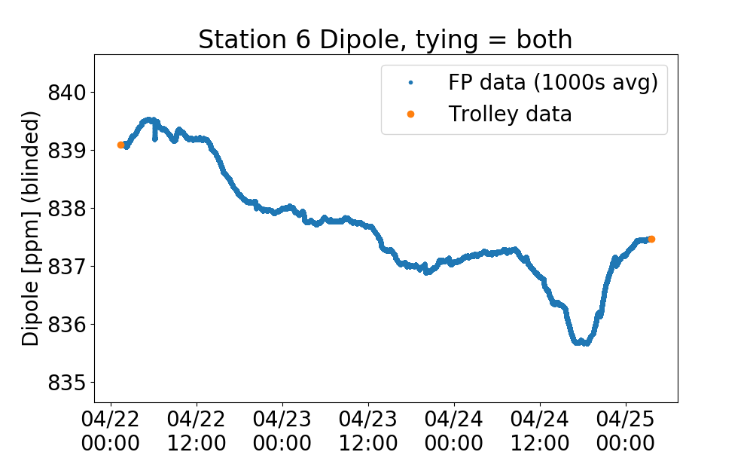
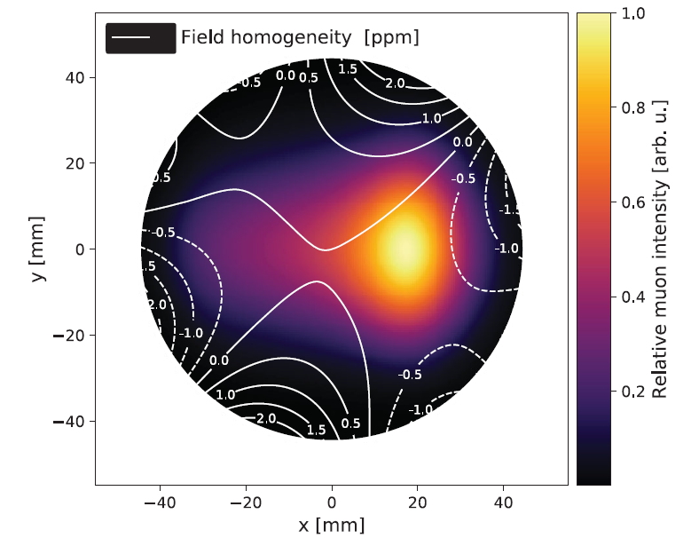
Magnetic field map
17-element Trolley maps full azimuth every few days (muons not present)
378 fixed probes monitor between trolley runs (during muon data collection)
Field map is interpolated between trolley runs using fixed probe information
Fold with muon beam distribution
Sequence 2D field slices as trolley moves
Fixed probes

Slide 25
Run-1 Corrections & Uncertainties
Transient field corrections

Slide 26
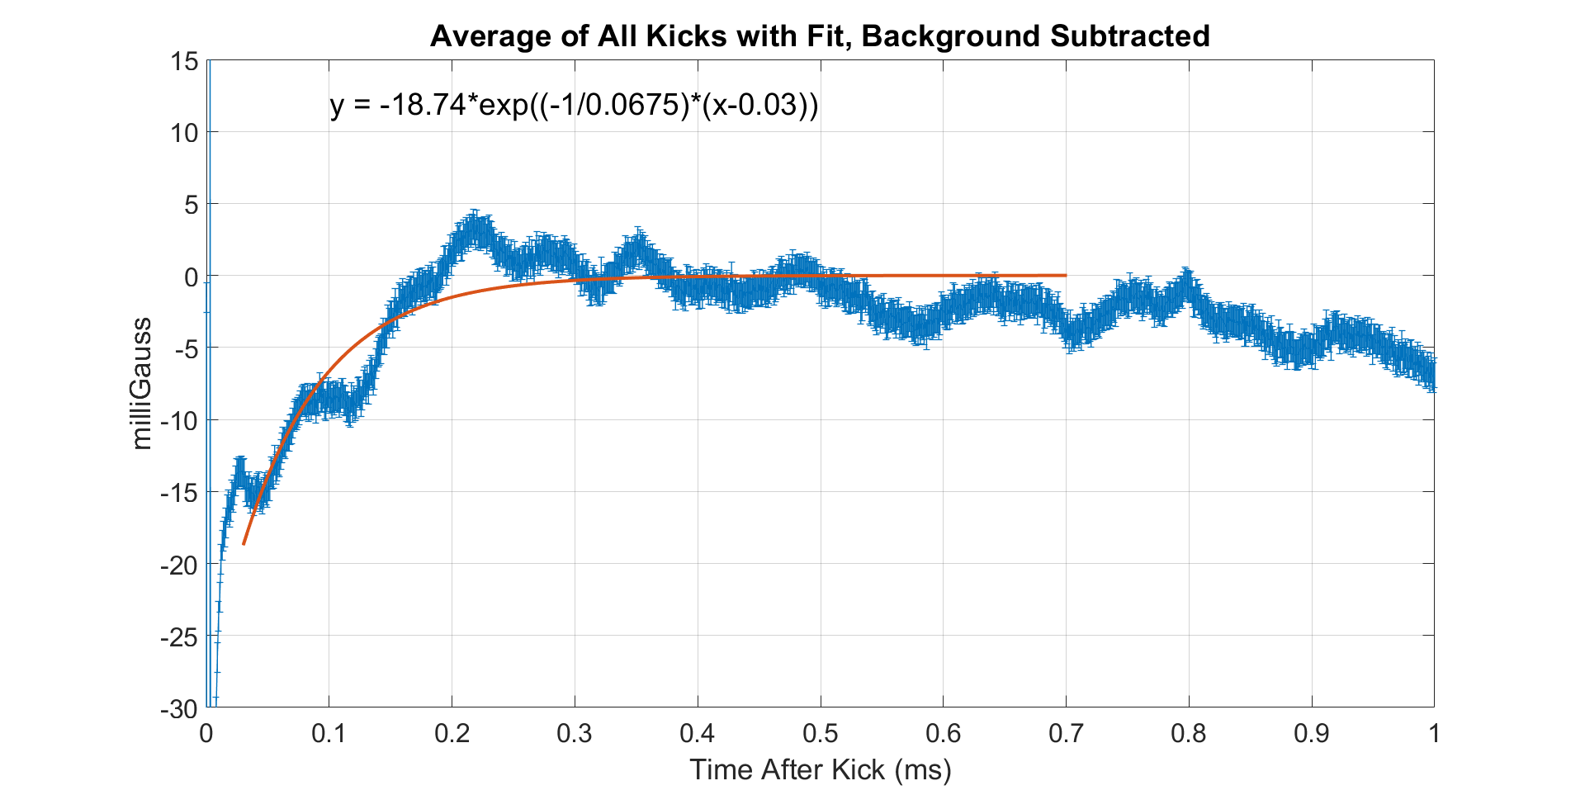
Transient magnetic field corrections: B_{k}
Muon kicker fires on every fill to “kick” muons onto correct orbit
Small eddy currents induced after “main” kick
Measure during beam-off periods using Faraday magnetometer
Run-1:
  B_{k} = -27 ppb ± 37 ppb
Run-23 (preliminary):
  B_{k} = -22 ppb ± 13 ppb

Slide 27
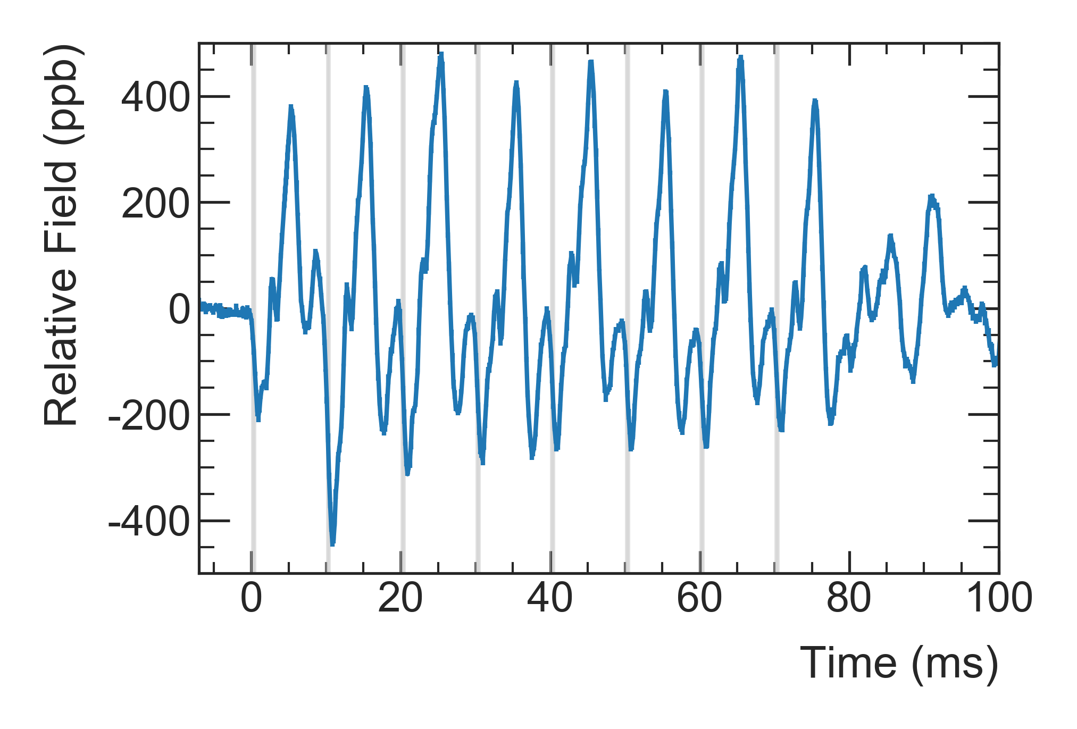
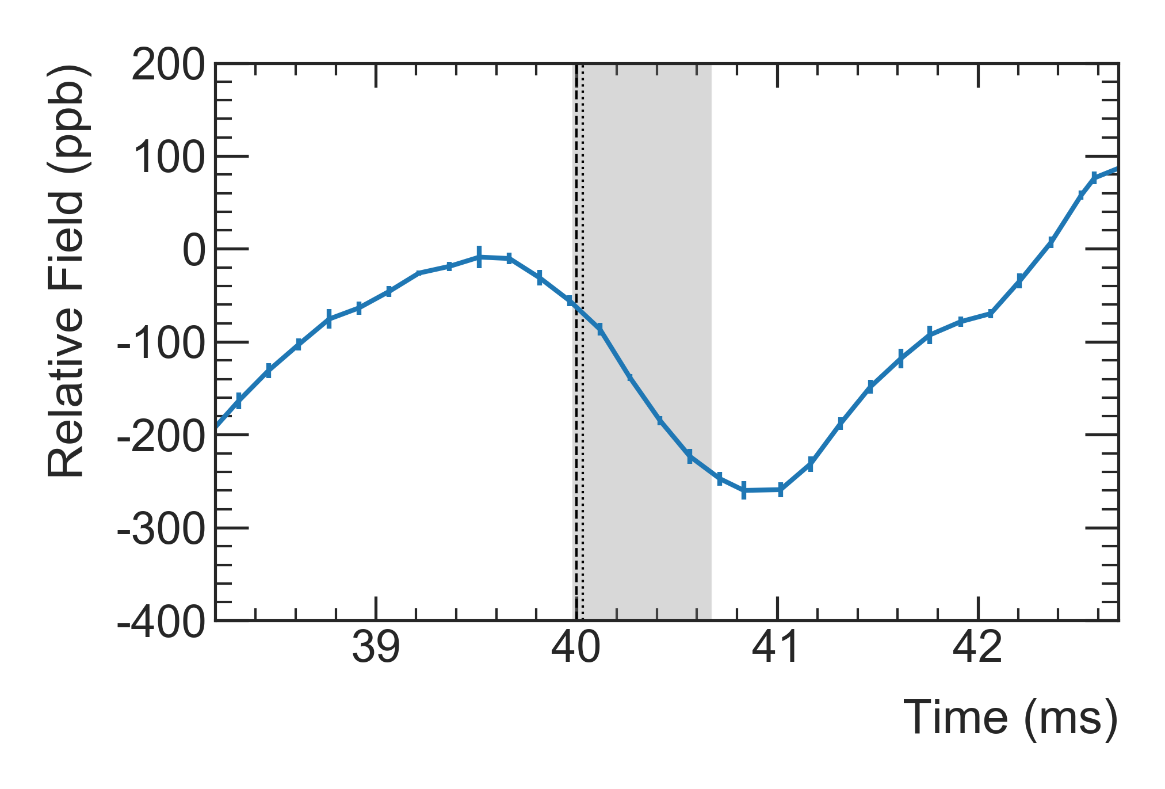
Transient magnetic field corrections: B_{q}
Quad pulsing induces oscillating transient B-field when muons are present in the ring
Quads don’t pulse when field trolley is present
Field oscillation too rapid to be detected by fixed probes
Dedicated measurements with mapping trolley
Run-1:
  B_{q} = -17 ppb ± 92 ppb
Run-23 (preliminary):
  B_{q} = -xx ppb +- 21 ppb
Dedicated measurement with more azimuthal locations
Measurements taken closer (in time) to muon data
Uncertainty acceptable for full statistics

Slide 28
Summary: muon g-2
Run 1 publication: 1 “BNL” statistics
Run 2/3 publication: 4 x Run-1 statistics
  Expected ~200 ppb stat error
  Expected ~100 ppb syst error
Release very soon – stay tuned!
Run 4/5/6 data analysis has begun
4x statistics w.r.t. Run 2/3
On track to achieve target of 140 ppb
Expected publication ~2025

Slide 29
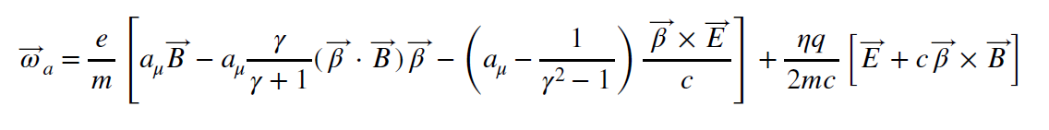
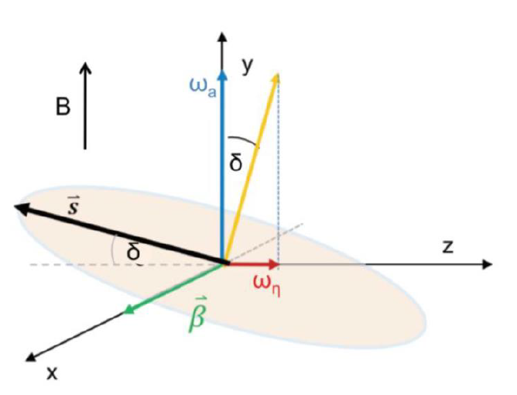
Also: Muon EDM Search
Muon EDM negligible in SM (CP violating)
Signature in g-2 experiment: tilt of muon precession plane causing vertical oscillation in e⁺ trajectories out of phase with g-2 signal
Current W.A. on μEDM set by BNL g-2 experiment: 1.8 x 10⁻¹⁹ e.cm
Run-1 data: analysis nearing completion
  Comparable limit to BNL; stats limited (100M tracks)
Run-23 : 4x more data, improved tracker efficiency (better than 4x scaling)
With full statistics: sensitive to 10⁻²⁰ e.cm

Slide 30
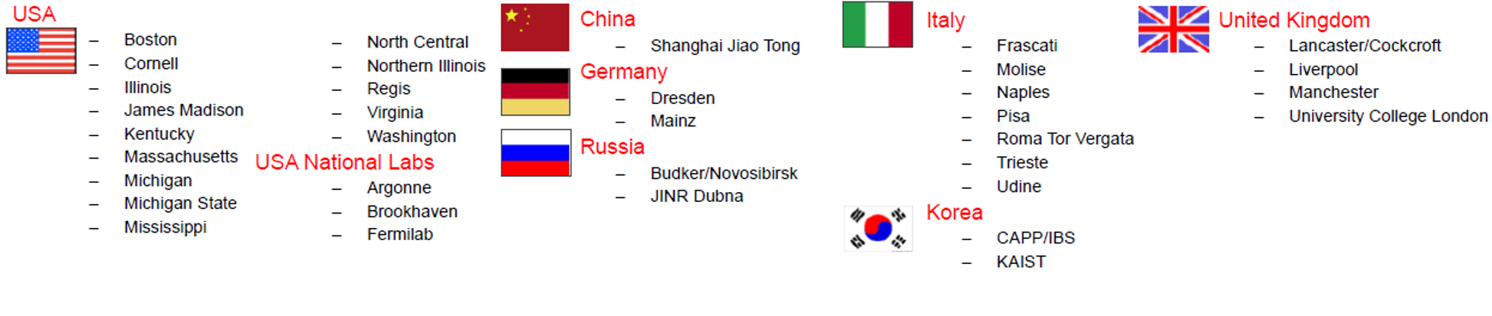
Thank you!

Slide 32
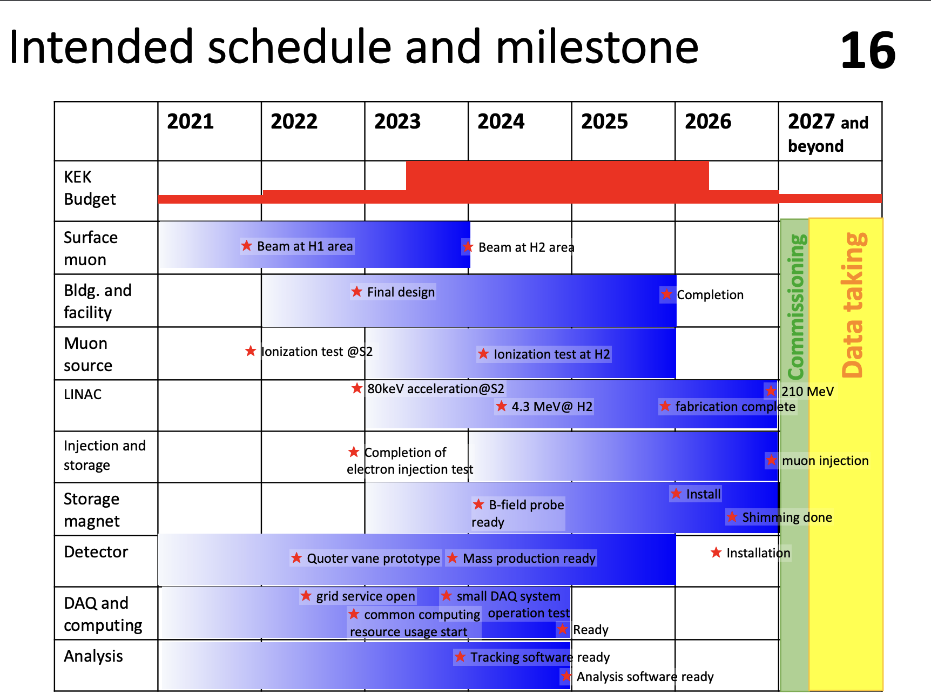
JPARC g-2

Slide 33
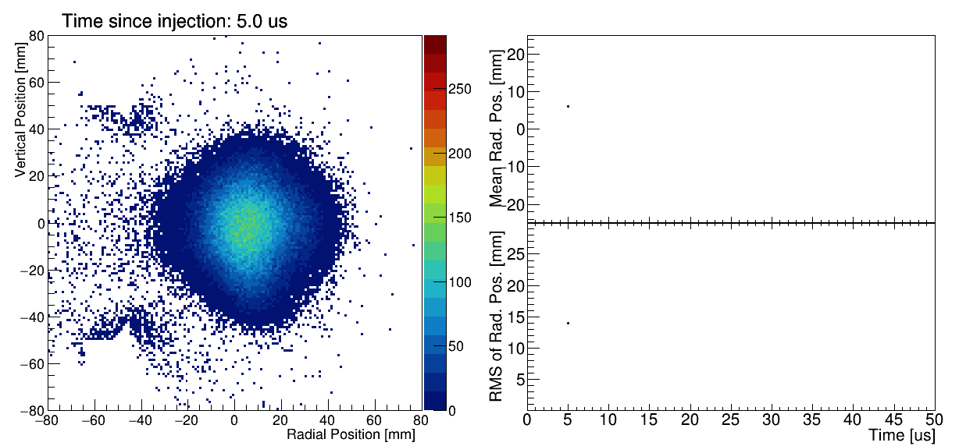
CBO in Run-3B

Slide 34
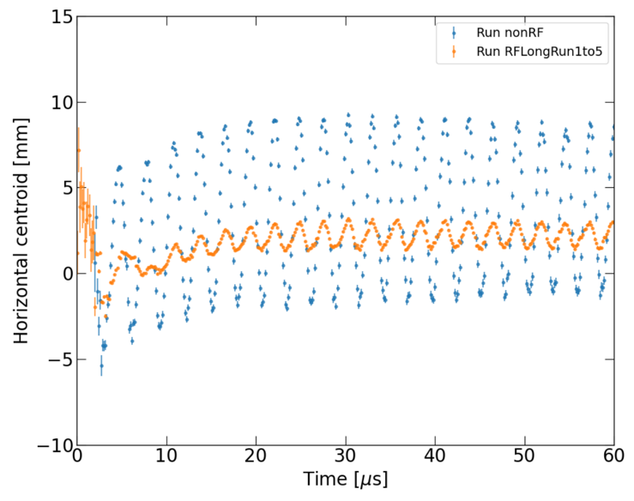
Run-4/5/6 : Quad-RF
Implemented active RF system in Run 5 (first time in any g-2 storage ring)
Turns on for first few microseconds to damp CBO
Will make fitting time-dependent precession distribution easier

Slide 35
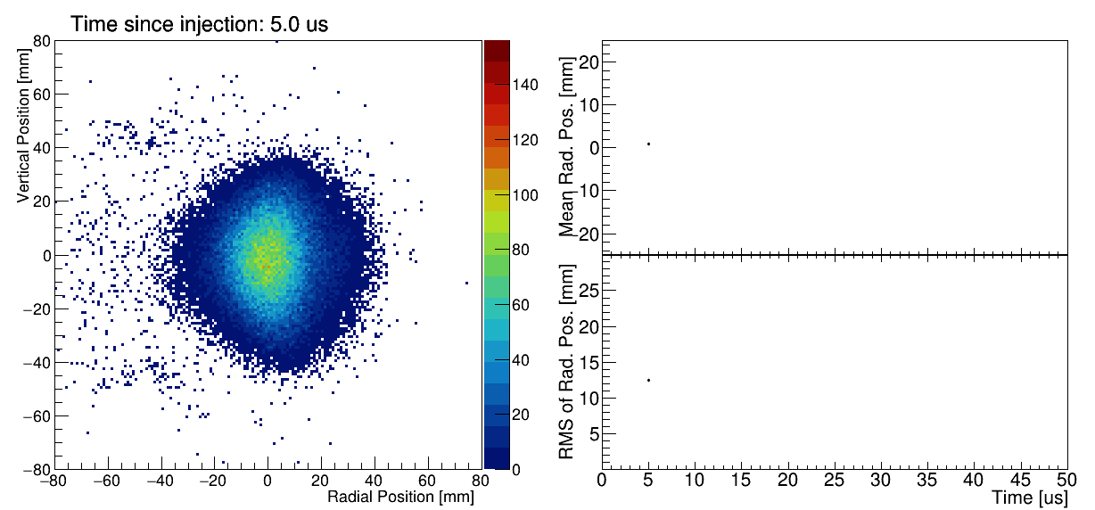
CBO with Quad RF (Run 5)

