Slide 1


Testing New Physics with Light Mesons
Andreas Crivellin
PSI & UZH
ECT* workshop, 15.06.2023
Work supported by

Slide 2
Outline
Introduction
Anomalies
  LFUV
  Cabibbo Angle Anomaly
  g-2
  Non-resonant di-leptons
  W mass and EW fit
Explanations
Implications for light mesons
Some crazy ideas for discussions
Conclusions
Andreas Crivellin

Slide 3
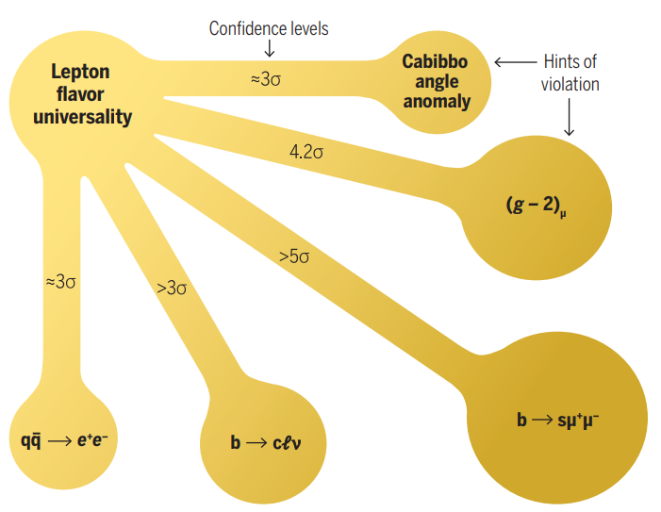
Hints for New Physics
EW observables
LFUV
AC, M. Hoferichter, Science 374 (2021)
m_{W}
≈3-4σ
Z→bb
Direct searches
γγ
ττ
bbγγ
WW
jj(jj)
Andreas Crivellin

Slide 4
New Particles
On the renormalizable level on can add:
  Scalars (spin 0, mass dimension 1)
  Fermions (spin ½, mass dimension 3/2)
  Vectors (spin 1, mass dimension 1)
Limited number of new interactions
8

Slide 5
Leptoquarks
Scalars or Vectors
5 gauge representations each which are invariant under the SM gauge group
Couple quarks to leptons
Maybe also quarks to quarks
  Proton decay
Are present in Grand Unified Theories

Slide 6
Z’ and W’
Z’: new neutral heavy gauge boson
W’: new charged heavy gauge boson
New heavy gauge bosons
8

Slide 7
Vector-like fermions
Left-handed and handed fields have the same quantum numbers
  Bare mass term (without symmetry breaking)
Can mix with SM fermions
Massive new fermions
8

Slide 8
Scalars (uncharged under QCD)
H: new neutral boson
H⁺: new charged heavy gauge boson
New Higgses
8

Slide 9
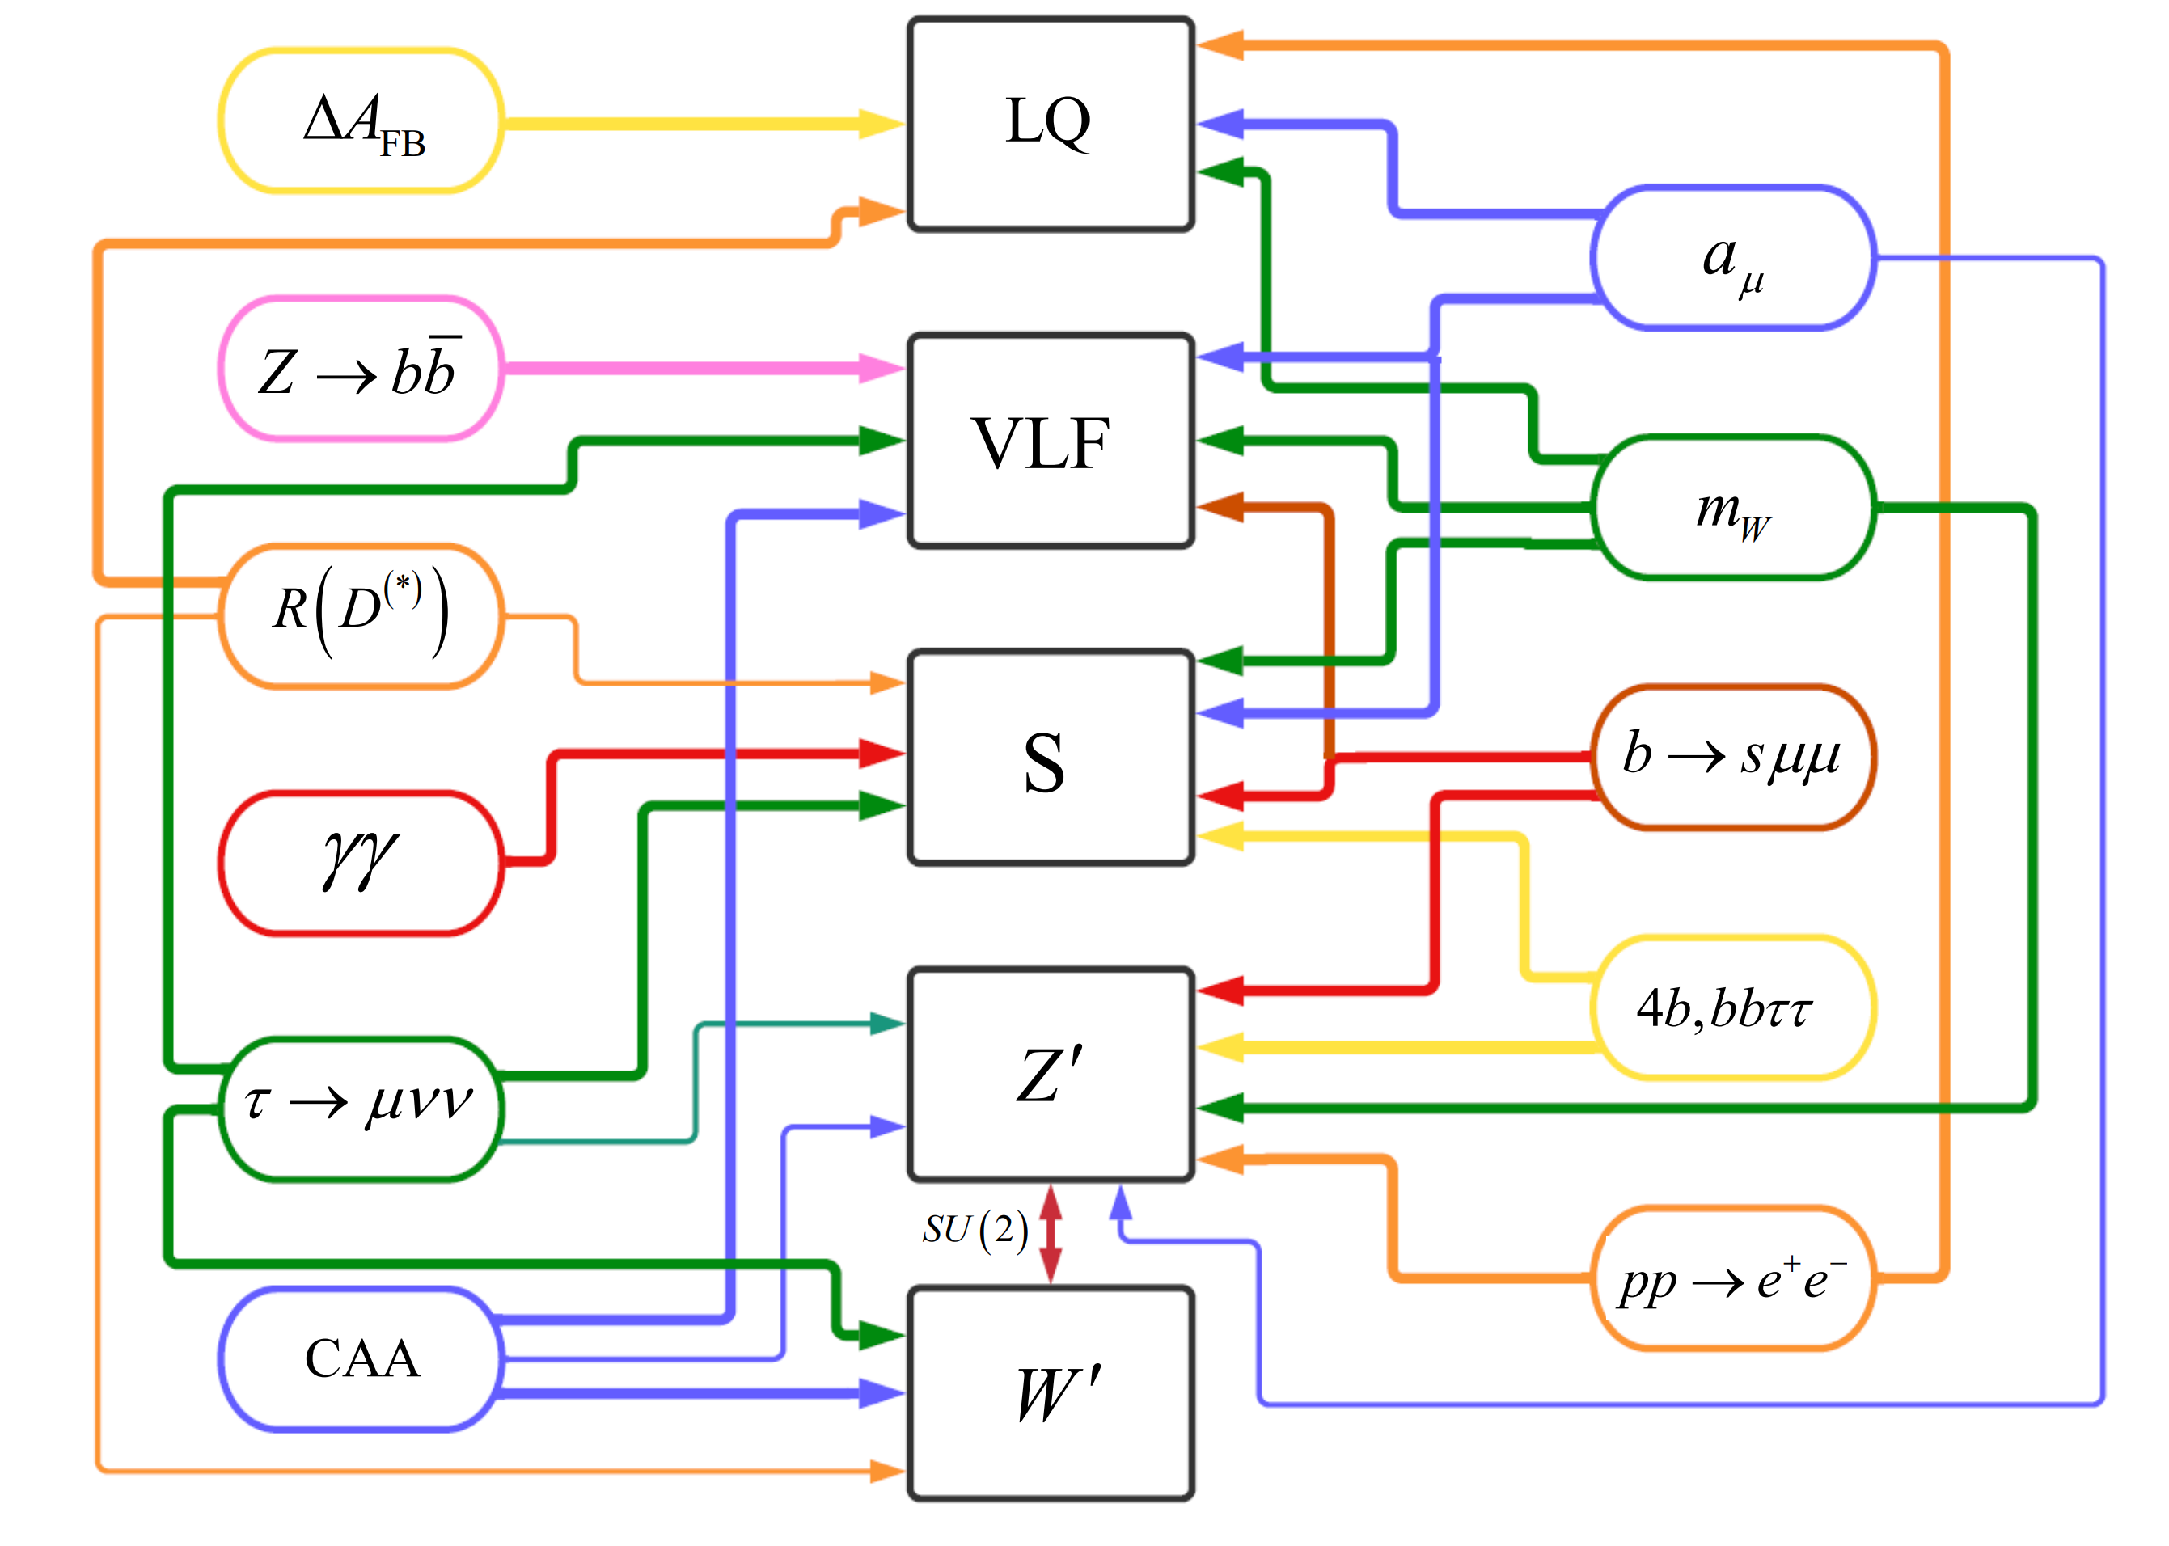
Expanations

Slide 10
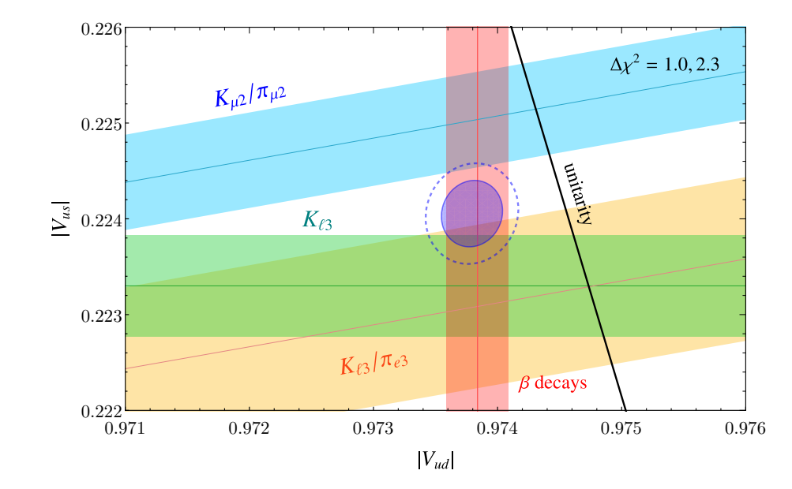
Cabibbo Angle Anomaly (CAA)
New Physics in light quarks?

Slide 11
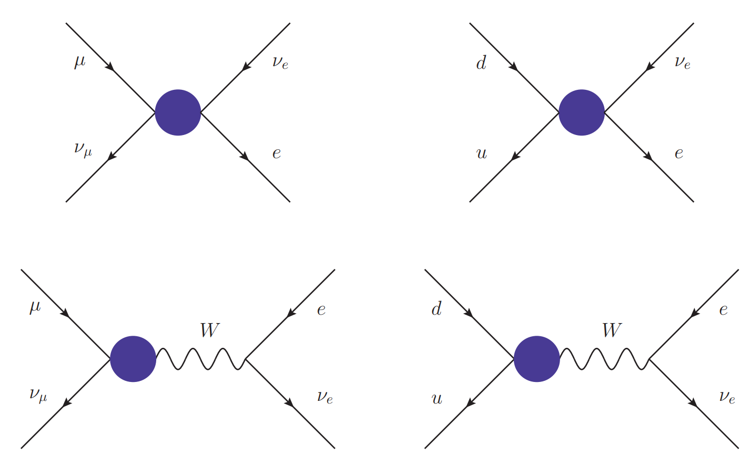
Explanations of the CAA
New physics in beta decays
New physics in muon decays
4-Fermi
W-u-d coupling
Vector
-like
quarks
W‘
Lepto
-quarks
W‘
W‘
Singly
charged
scalar
Z’
W-µ-ν coupling
4-Fermi
Vector
-like
leptons
W‘
Only interfering effects work

Slide 12
Cabibbo Angle Anomaly and EW Fit
4fermion effect in beta decays
  LQs
  W‘
Modifed W coupling in muon decay
  W-W‘ mixing
  Vector-like leptons
4 fermion effect in muon decay
  Z‘
  Singly charged scalar
Modified Wud coupling
  Vector-like quarks
>5σ improvement over SM hypothesis with VLLs

Slide 13
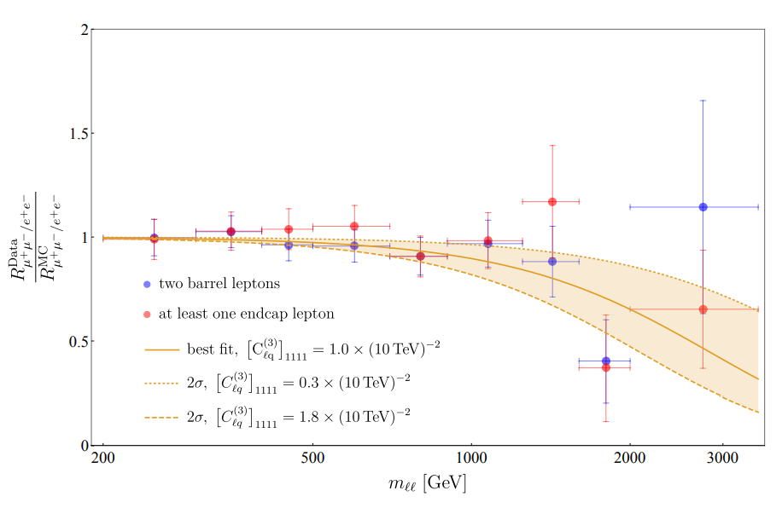
Non-Resonant Di-Leptons
CMS: arXiv:2103.02708
Excess in
di-electrons at
m_{ee}>1800GeV
Observed:
44 events
Expected
29.2 ± 3.6 events
Also ATLAS (2006.12946) and HERA (1902.03048) observe slightly more electrons than expected.
No excess in muon data
≈3σ hint for LFUV

Slide 14
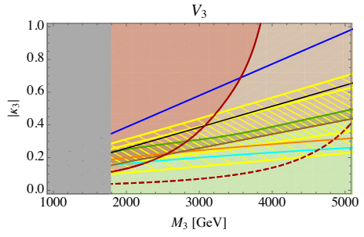
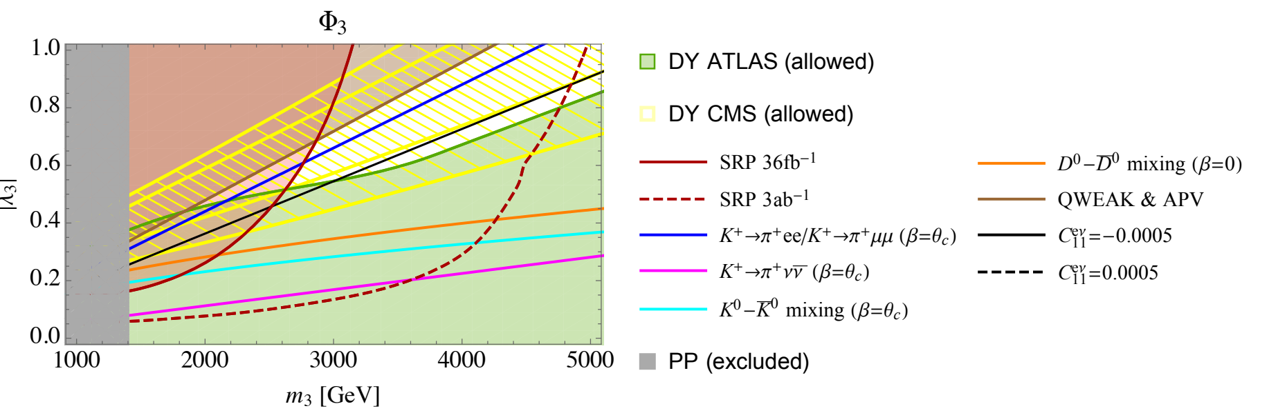
Leptoquarks
10 representations
Effect in R(π) and
beta decays
Possible effect in CP violation in η→µµ
8

Slide 15
PIONEER Goals
Improve
  R(π)=π→µν/π→eν
  Pion beta decay π⁺→ π⁰eν
  by an order of magnitude compare to current limits
Provide most precise test of
  µ/e universality
  CKM unitarity
What is the impact of these measurements?
Which New Physics can be found?
Andreas Crivellin

Slide 16
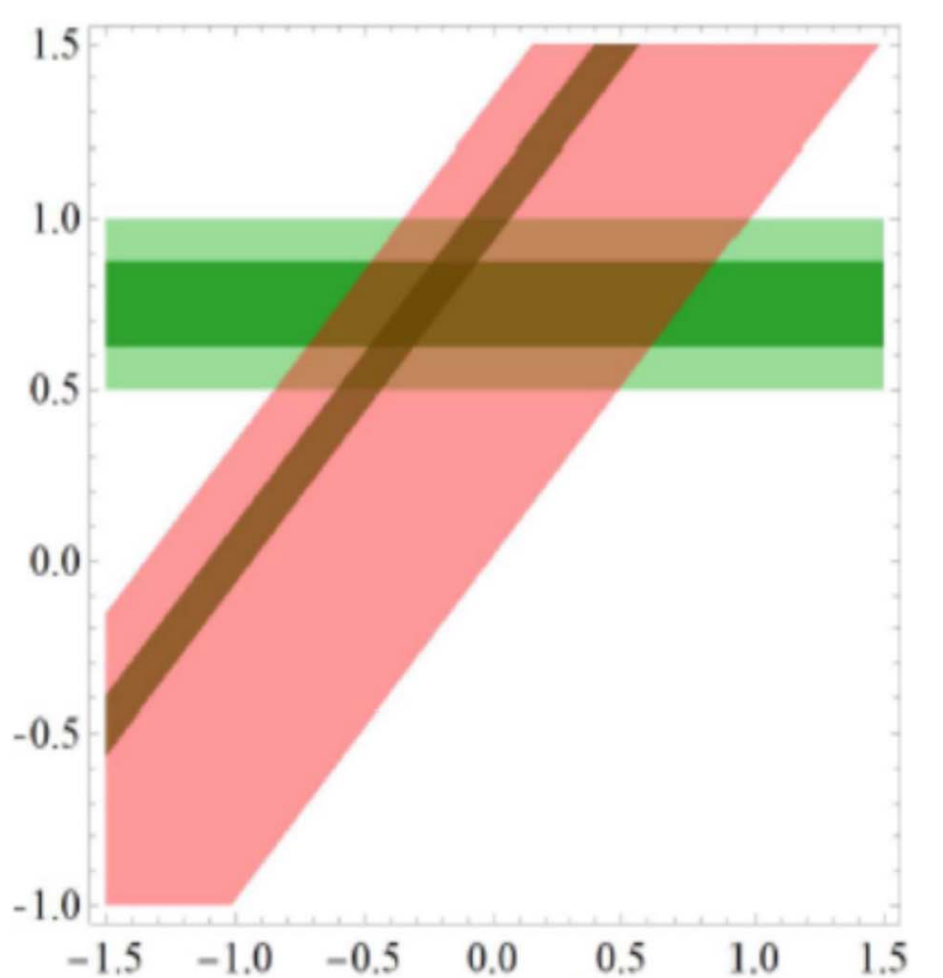
Impact of PIONEER
Test µ-e LFUV with unprecedented precision
Measure V_{ud} in theoretically clean pion beta decay
Test of New Physics
model
  Leptoquarks
  Vector-like leptons
  W` bosons
  Vector-like quarks
  Light new physics
talks of Asaf and Robert

Slide 17
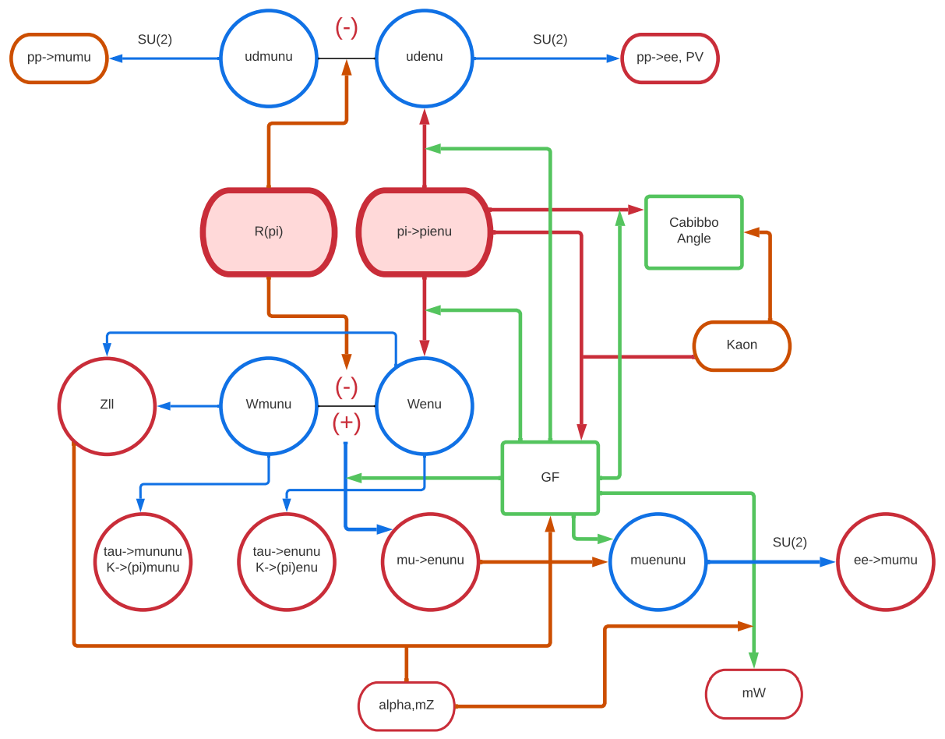
Impact of PIONEER II
Observables
Operators
SM Parameters

Slide 18
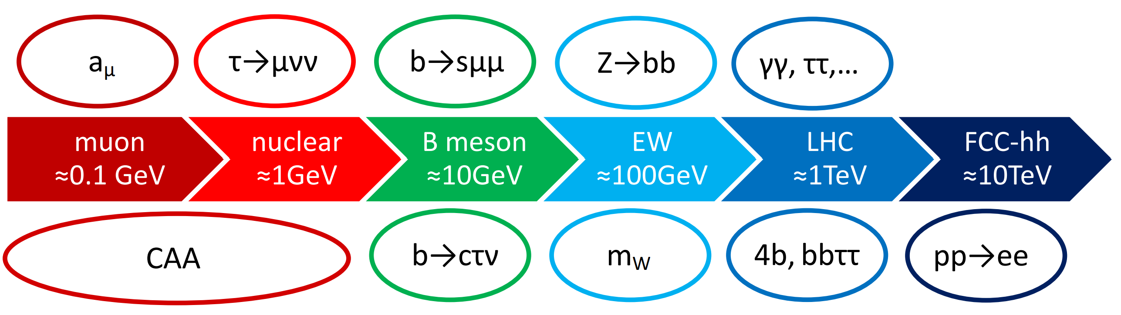
Conclusions
The Standard Model is crumbling;
PIONEER can contribute to its fall
Many intriguing anomalies emerged in the last years:
  LFUV
  EW observables
  Direct LHC searches

Slide 19
Idea for discussions
Constraints on NP from the η-η’ mixing and mass difference
  GeV scale particles coupling only to strange quarks are not excluded

Slide 20
Backup

Slide 21
Cabibbo Angle Anomaly
V_{ud} from
super-allowed
beta decays
V_{us} from
Kaon and
tau decays
Disagreement
leads to a
(apparent) violation of CKM unitarity
CMS, SGPR:
radiative corrections
Deficits in 1th row and column CKM unitarity

Slide 22
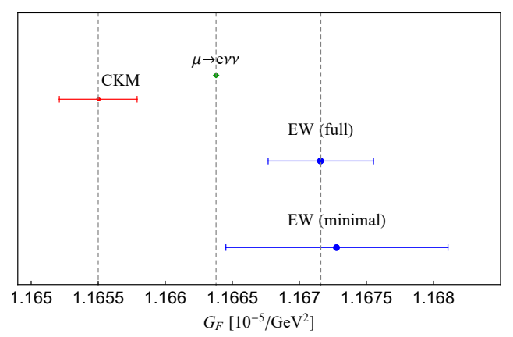
Correlations with EW fit
The Fermi constant can be determined from:
  The global
  EW fit
  (Z decays, α)
  Kaon and
  beta decays
  (assuming
  CMK unitarity)
  Muon decay
AC, Hoferichter, Manzari, PRL 127 (2021)
CAA results in tensions in the Fermi constant

Slide 23
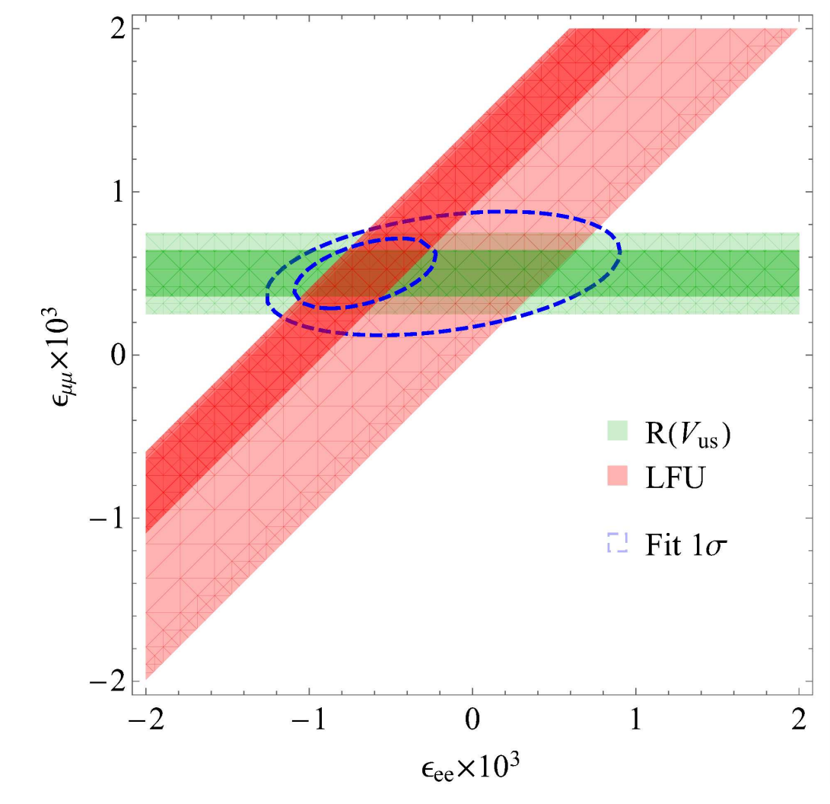
CAA and LFUV
Assume modified Wℓν couplings
V_{ud} from beta decays depends on Fermi constant
Fermi constant determined from
muon decay
Dependence on cancels
AC, M. Hoferichter PRL 2020
The CAA can be interpreted as a sign of LFUV

Slide 24
Explanations of the CAA
New physics in beta decays
New physics in muon decays
4-Fermi
Wud coupling
Vector
-like
quarks
W‘
Lepto
-quarks
W‘
W‘
Singly
charged
scalar
Z’
Wµν coupling
4-Fermi
Vector
-like
leptons
W‘
Only interfering effects work

Slide 25
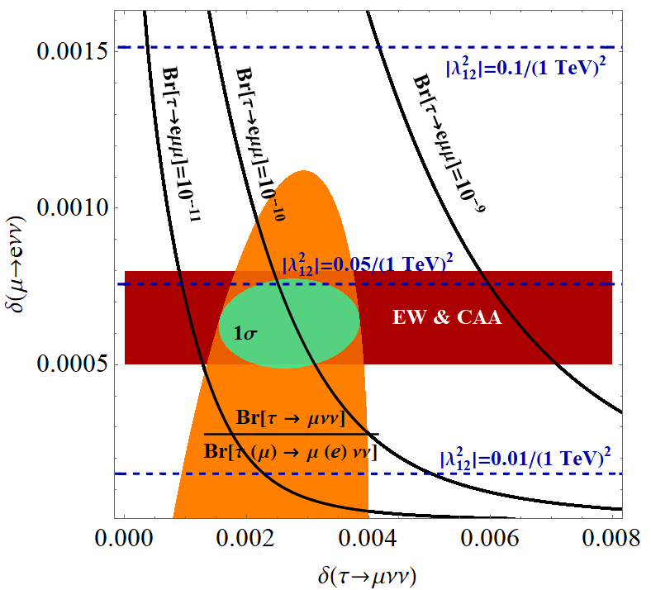
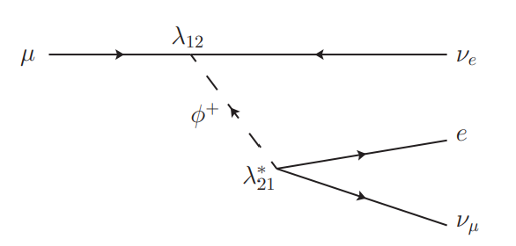
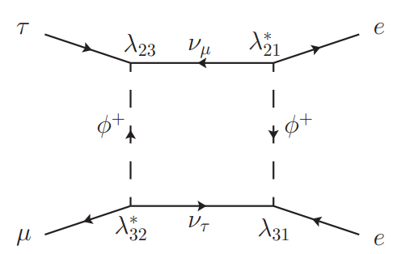
Singly Charged Scalar
Muon decay
τ→eµµ
A.C., F. Kirk, C. Manzari, L. Panizzi, arXiv:2012.09845
Can explain the CAA and τ→µνν

Slide 26
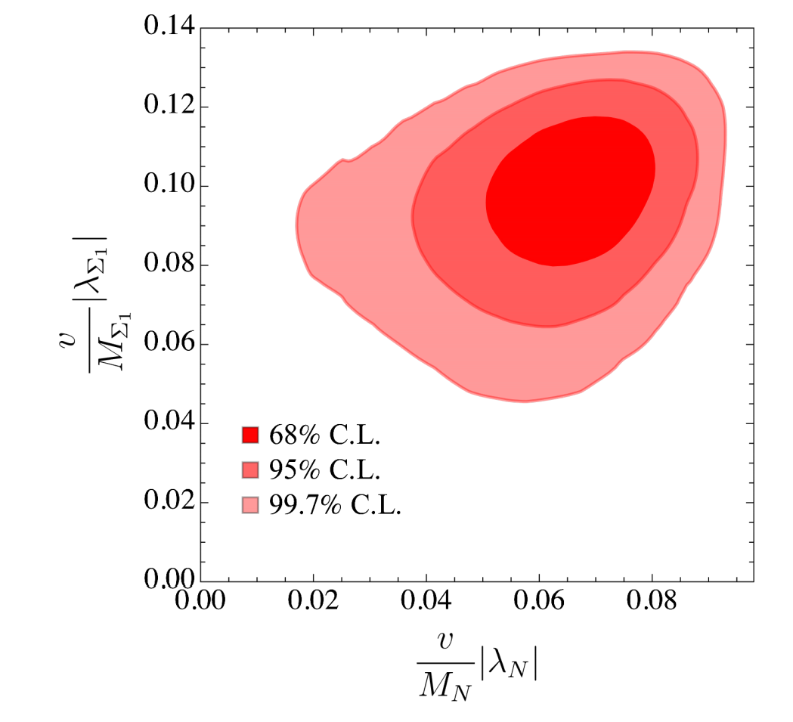
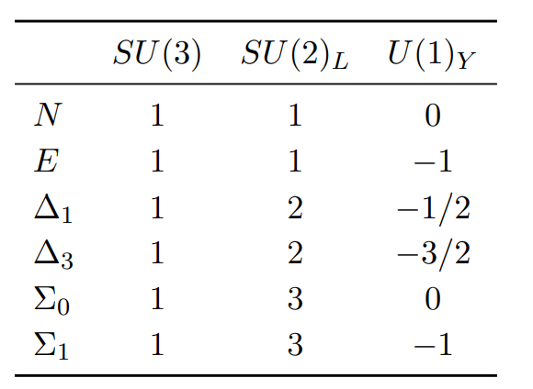
Vector-like leptons
6 representations
Mixing leads to modified
W and Z couplings to leptons
A single representations
does not give a good fit to data.
AC, F. Kirk, C. Manzari,
M. Montull JHEP, 2008.01113
>5σ improvement over SM hypothesis with VLLs

