Slide 1
Quantum Error Correction with Gauge Symmetries
Abhishek Rajput
Alessandro Roggero
Nathan Wiebe

Slide 2
Outline
Error Correction for LGTs
Repetition Codes
Integrating Repetition Codes with Gauss’s Law
Error Correction for 1+1 D and 2+1 D LGTs with Gauss’s Law
Outlook

Slide 3
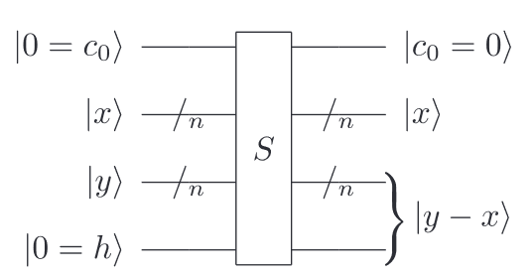
Quantum Error Correction using Gauge Symmetries
Quantum computers are promising alternative in regimes where simulating LGTs is costly
Real time dynamics
Issue: Time-evolution of LGTs can evolve an initial state into sectors violating gauge symmetries
Solutions:
Add energy penalty to Hamiltonian
Random gauge transformations
Use intrinsic gauge symmetry of theory to detect errors that violate gauge constraint (Stryker 2019)
Stryker 2019
Notes:
Lattice gauge theories: non-perturbative approaches for extracting physical quantities from continuum field theories
Define the fault tolerance of a procedure to be the property that if only one component in the procedure fails, then failure causes at most one error in each encoded block of qubits output from the procedure. For example, the failure of a single component in a fault-tolerant recovery procedure for quantum error-correction results in the recovery procedure being performed correctly, up to an error on a single qubit of the output.

Slide 4
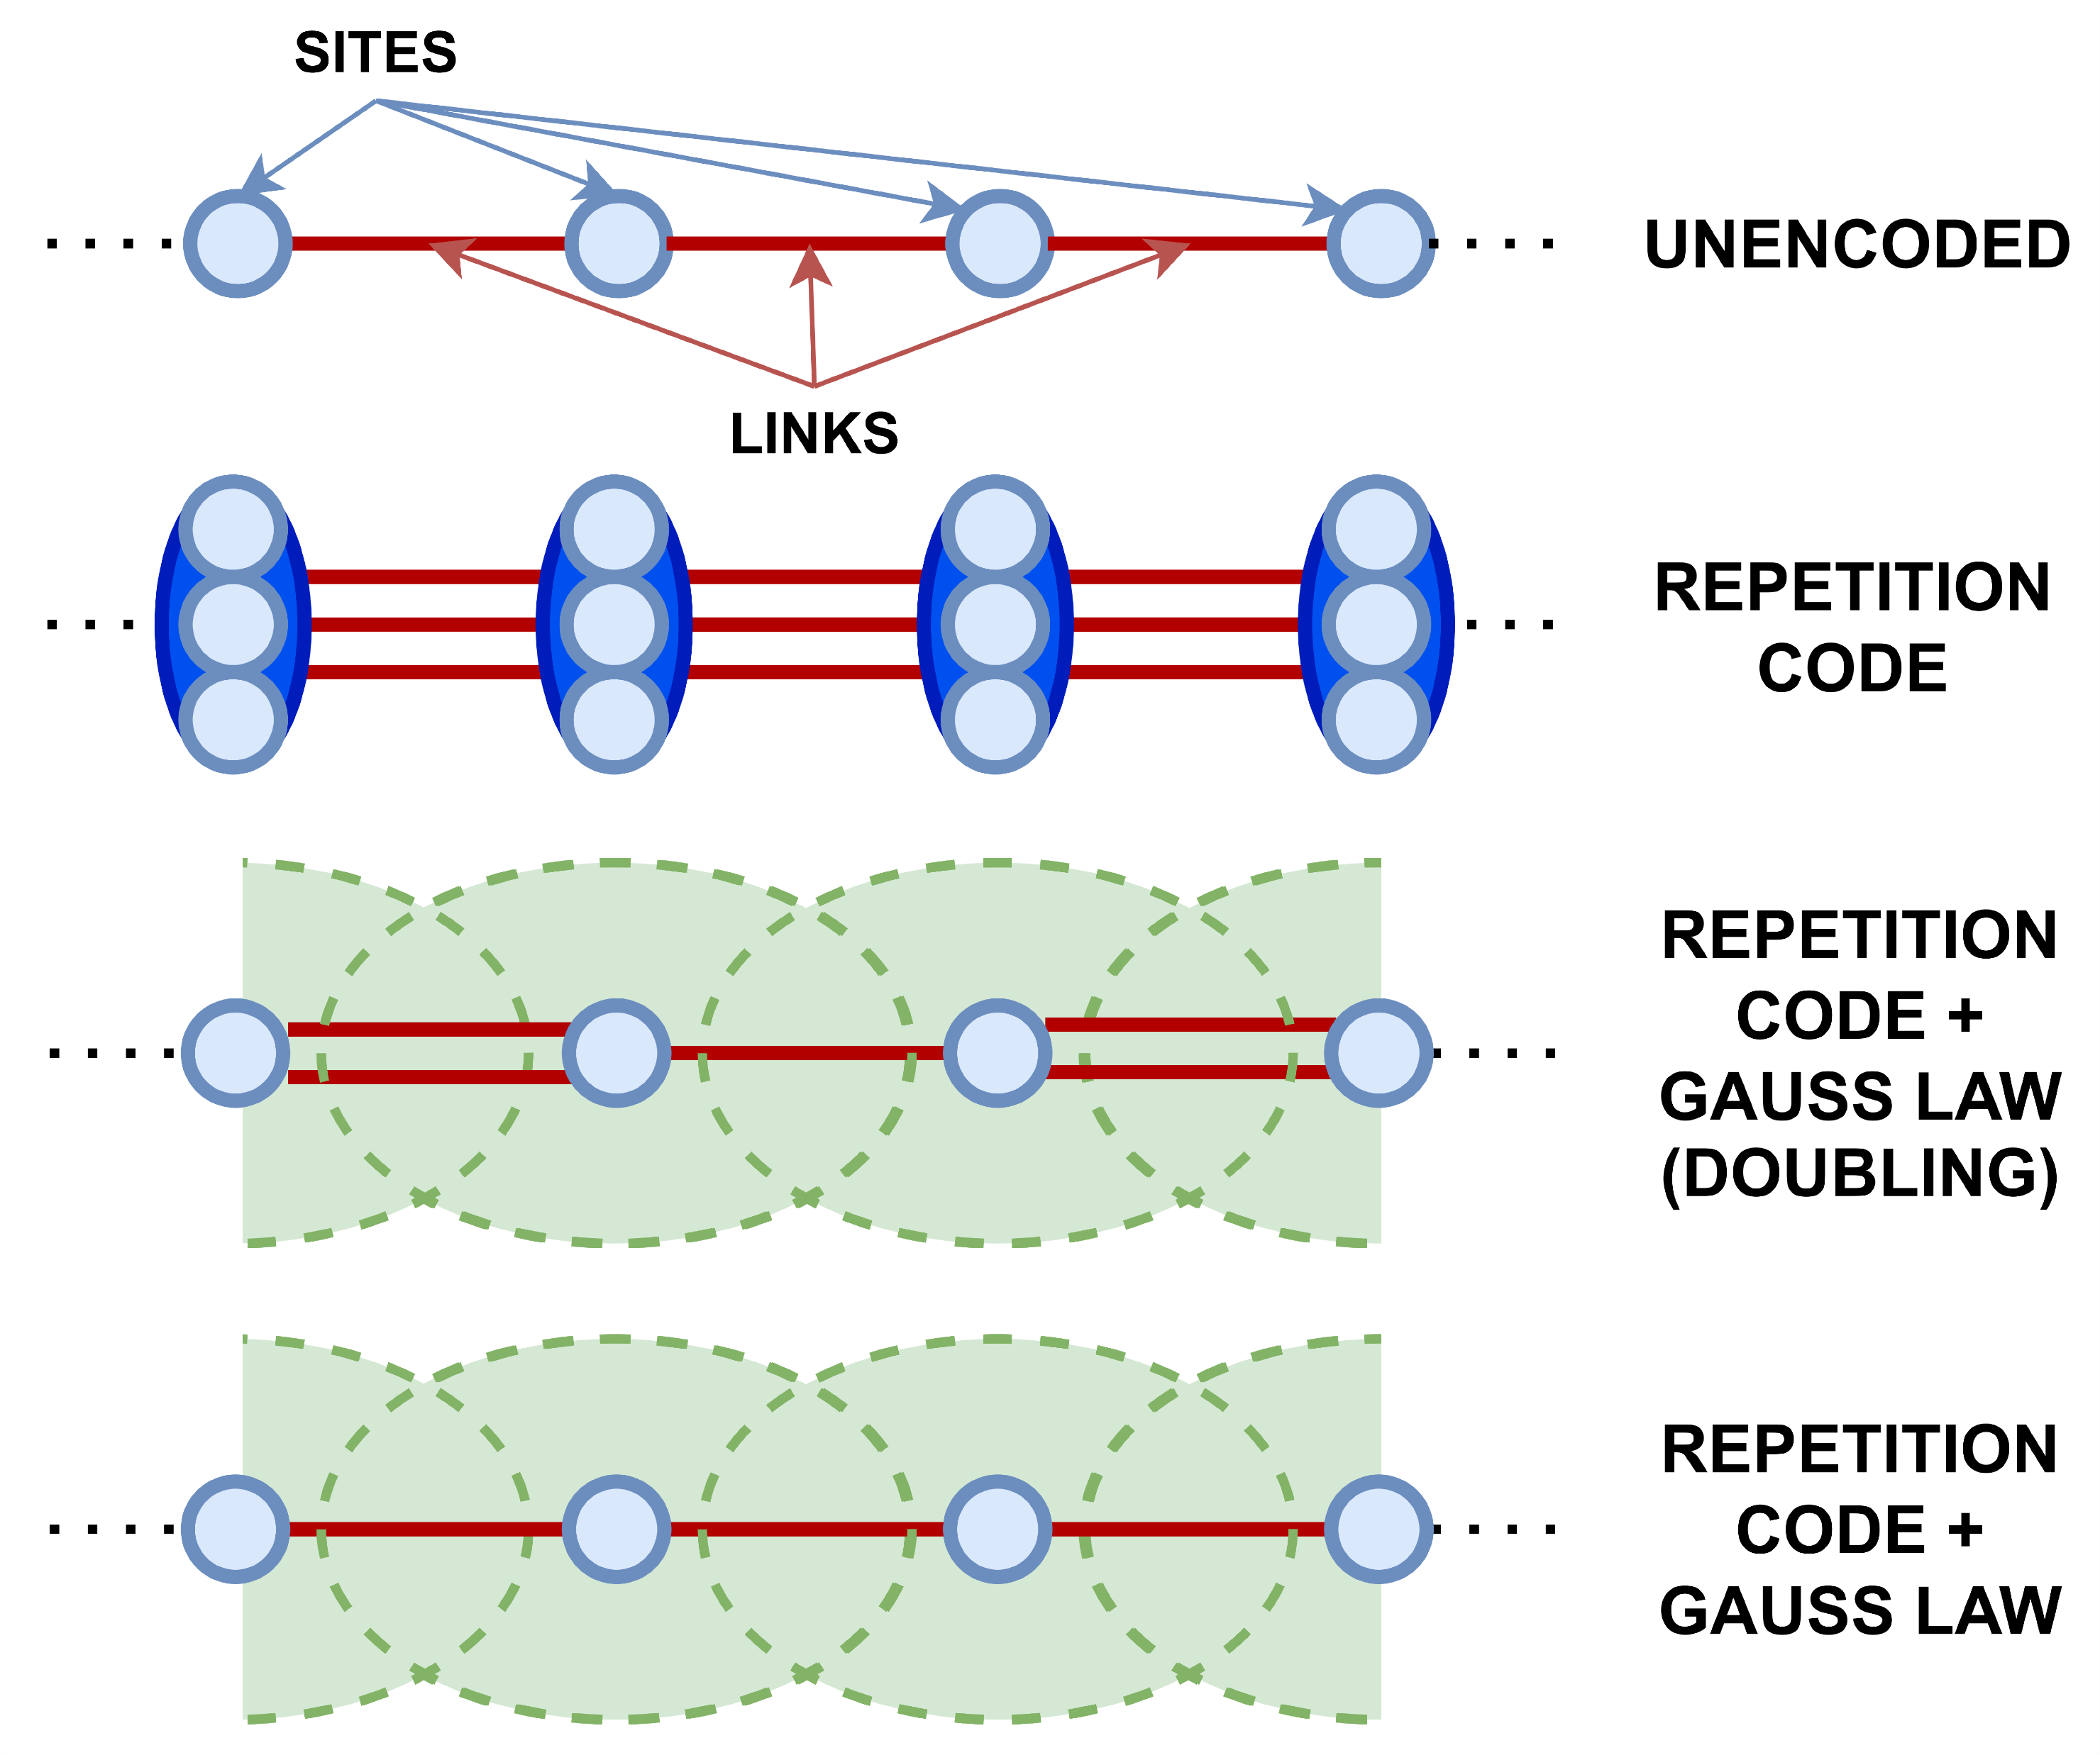
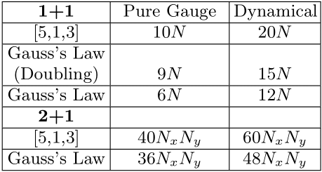
Quantum Error Correction using Gauge Symmetries
Use intrinsic gauge symmetry of theory to fault tolerantly detect and correct errors that violate gauge constraint
Design error correcting codes that exploit underlying gauge symmetry
Local gauge symmetry relates states of a group of sites and links
Use info to encode multiple qubits as single logical bit in EC code
Notes:
Lattice gauge theories: non-perturbative approaches for extracting physical quantities from continuum field theories
Define the fault tolerance of a procedure to be the property that if only one component in the procedure fails, then failure causes at most one error in each encoded block of qubits output from the procedure. For example, the failure of a single component in a fault-tolerant recovery procedure for quantum error-correction results in the recovery procedure being performed correctly, up to an error on a single qubit of the output.

Slide 5
Outline
Error Correction for LGTs
Repetition Codes
Integrating Repetition Codes with Gauss’s Law
Error Correction for 1+1 D and 2+1 D LGTs with Gauss’s Law
Outlook

Slide 6
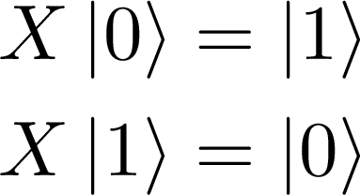
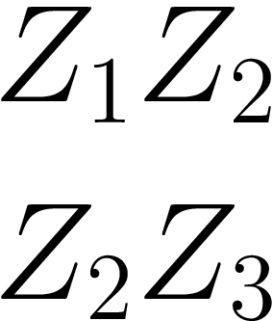
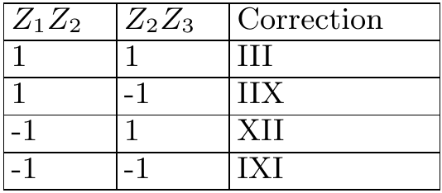
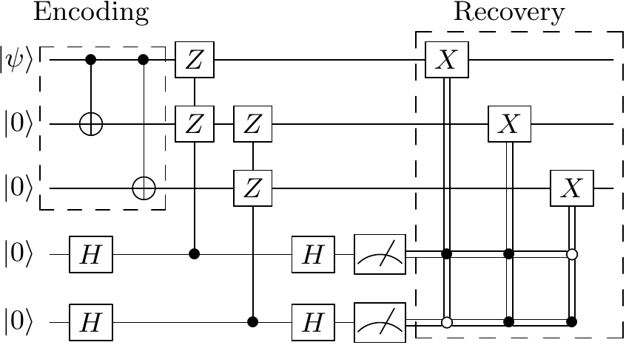
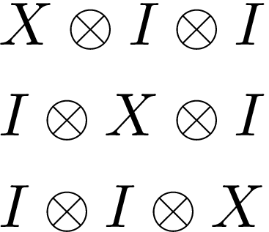
Repetition Codes: Bit-flip Errors
Noise, probability $p<1/2$
Noise, probability $p<1/2$
Encode: $0→000$ $1→111$
Channel
Channel
$$x∈\{0,1\}$$
$$y∈\left\{0,1\right\}$$
$$x?$$
$$000$$
$$100$$
$$x=0$$
Syndrome Outcomes
Bit-flip Errors
Measure Parities
Encoding
Full Error Correction Circuit
Possible Errors
Notes:
Z1Z2 generate the stabilizer group which stabilizer a non-trivial vector space V_S (-I is not in the stabilizer group and the generators commute with each other)
Dimension of V_S is 2^(n-l) where n is the dimension of the full vector space and l is the number of generators. In this case, 2^(3-2) = 2 and the code space is 2-dimensional and spanned by |000>, |111>

Slide 7
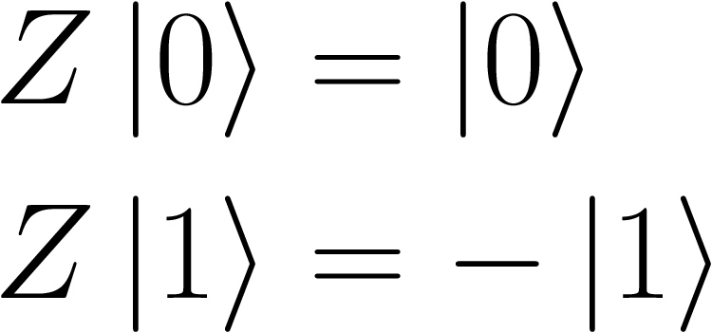
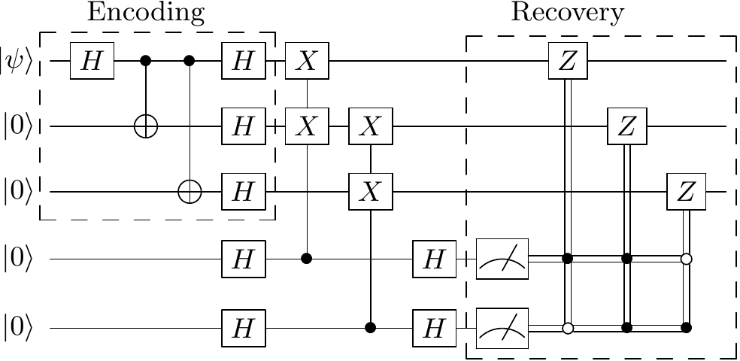
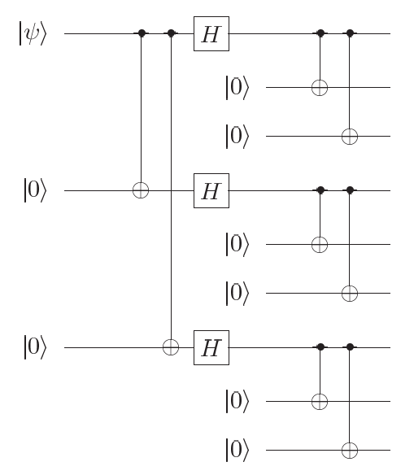
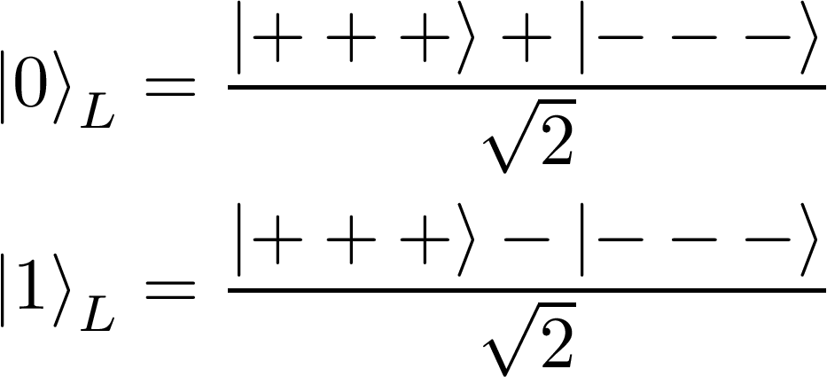
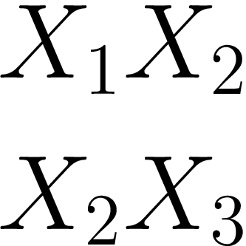
Repetition Codes: Phase-flip Errors
Full Error Correction Circuit
Phase-flip Errors
Phase-flip Errors
Encoding
Phase + Bit
(Shor code)
Measure Parities
Notes:
Combine BOTH to get Shor code to protect against all single qubit errors!
[5,1,3] code saturates quantum singleton bound, i.e. for any quantum code encoding k qubits in n and able to correct t errors, n >= 4t + k. Want to do better than even this!
Distance of a code is the smallest weight of an error such that O.N. basis psi_i and psi_j are no longer distinguishable (orthogonal) . Intuitively, code distance measures how far one basis state in the code space is away from another

Slide 8
Outline
Error Correction for LGTs
Repetition Codes
Integrating Repetition Codes with Gauss’s Law
Error Correction for 1+1 D and 2+1 D LGTs with Gauss’s Law
Outlook

Slide 9
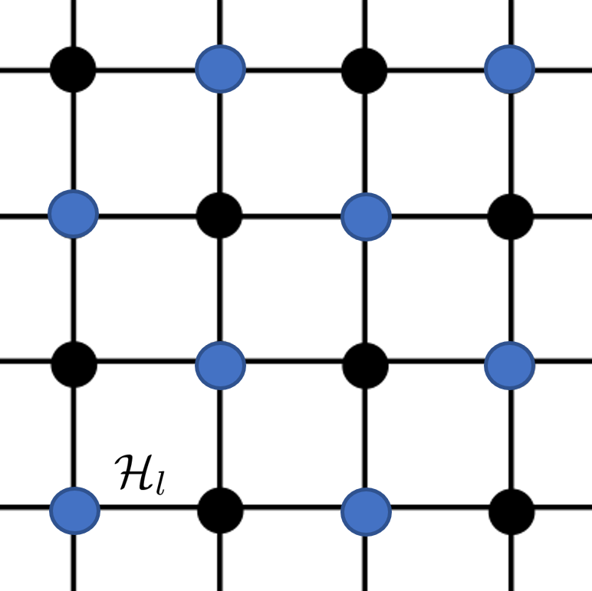
Abelian Lattice Gauge Theories
Focus on abelian LGTs with structure groups (e.g. Schwinger Model)
Discretize space with a lattice with even number of sites:
Each link l has separable Hilbert space $ℋ_{l}$ with orthonormal basis
Link operators and conjugate electric field
Fermionic fields on sites (staggered), occupation number 0 or 1
Gauss’s law local gauge symmetry:

Slide 10
Repetition Code with Gauss’s Law
Gauss’s law in 1D State of two adjacent links Physicality Condition
Bit-flip repetition code for pure gauge:
General physical state:
Controlled link raising or lowering operator:
Caveat: Phase flip errors commute with Gauss’s law!
Must encode each physical qubit in an underlying phase flip code first
Employ compressed bit-flip encoding at highest logical level
Notes:
- e_s = +1 for fermion, -1 for antifermions

Slide 11
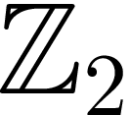
Repetition Code with Gauss’s Law
Controlled link raising or lowering operator:
Issue: $\hat{W_{s}}$ is generally not fault tolerant!
Two strategies in :
Logical to Physical CNOT:
Fault-tolerant version to protect against Z ancilla errors:
Possible generalizations to with different integer encodings
Unary encodings are simplest
Notes:
Remember we define the fault tolerance of a procedure to be the property that if only one component in the procedure fails, then failure causes at most one error in each encoded block of qubits output from the procedure. For example, the failure of a single component in a fault-tolerant recovery procedure for quantum error-correction results in the recovery procedure being performed correctly, up to an error on a single qubit of the output.
- In Z2, W_s is transversal, i.e. the CNOT can be implemented in a bit-wise fashion. Transversality implies fault tolerance
- Log to phys CNOT basically functions as a copy of the odd-numbered link with its flux value reset! More efficient to operations with this ancilla instead
- Second equivalent circuit can propagate Z errors from the ancilla bit

Slide 12
Outline
Error Correction for LGTs
Repetition Codes
Integrating Repetition Codes with Gauss’s Law
Error Correction for 1+1 D and 2+1 D LGTs with Gauss’s Law
Outlook

Slide 13
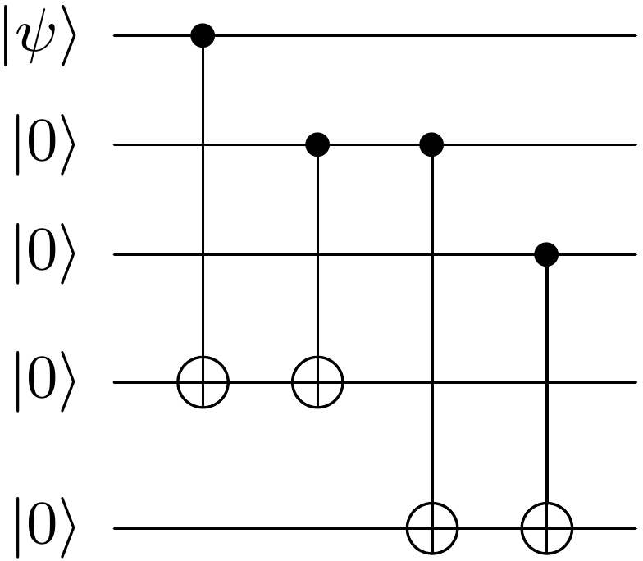
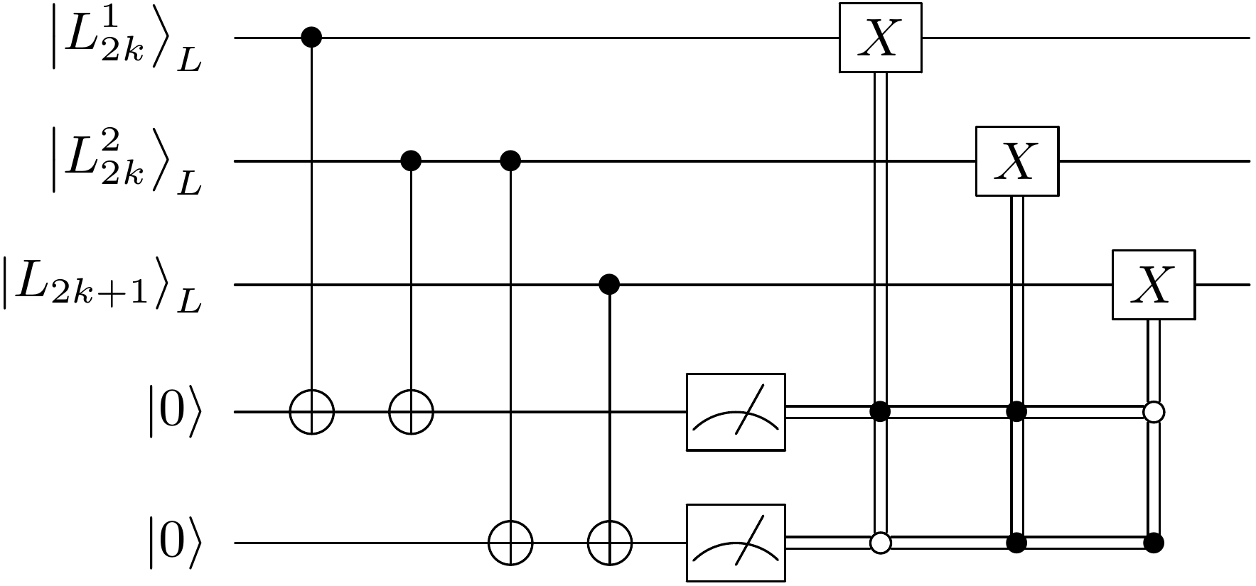
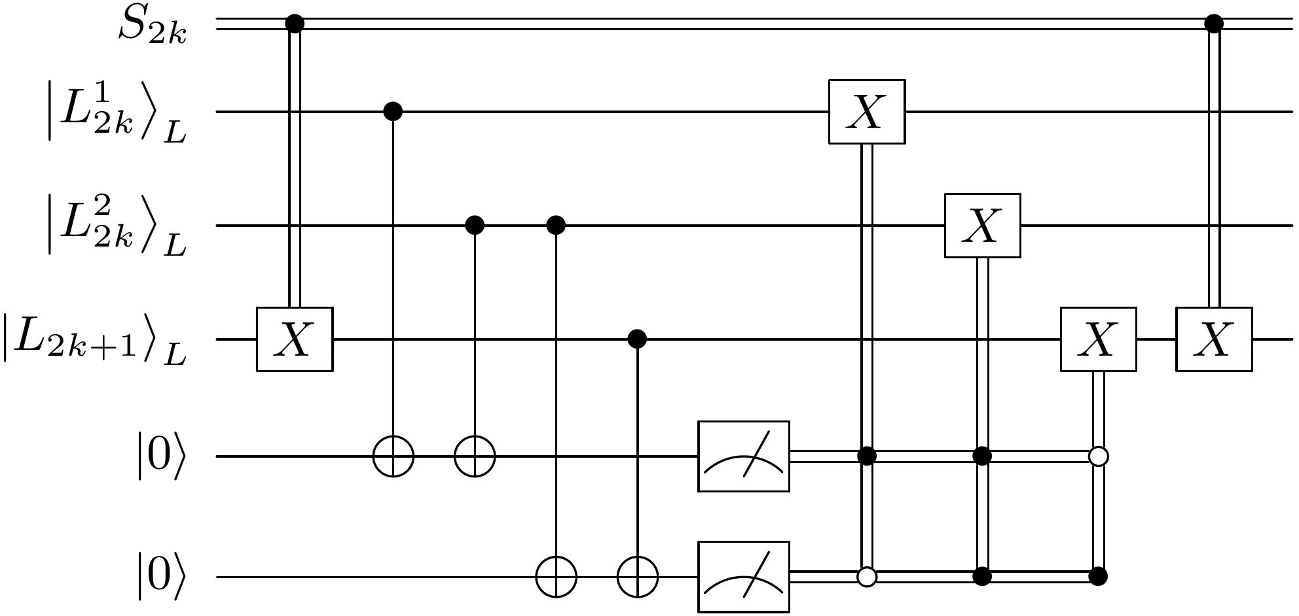
Error Correction for 1+1 D LGTs
Work with flux cutoff of 1 on links ( )
2N sites and 2N links with PBCs
Pure Gauge Theory
Non-Dynamical Fermions
Circuit equivalence for parity measurements
Log to Phys CNOT
Fault tolerant CNOT
Notes:
- Not strictly a stabilizer code since our logical operators move between physical and logical spaces!

Slide 14
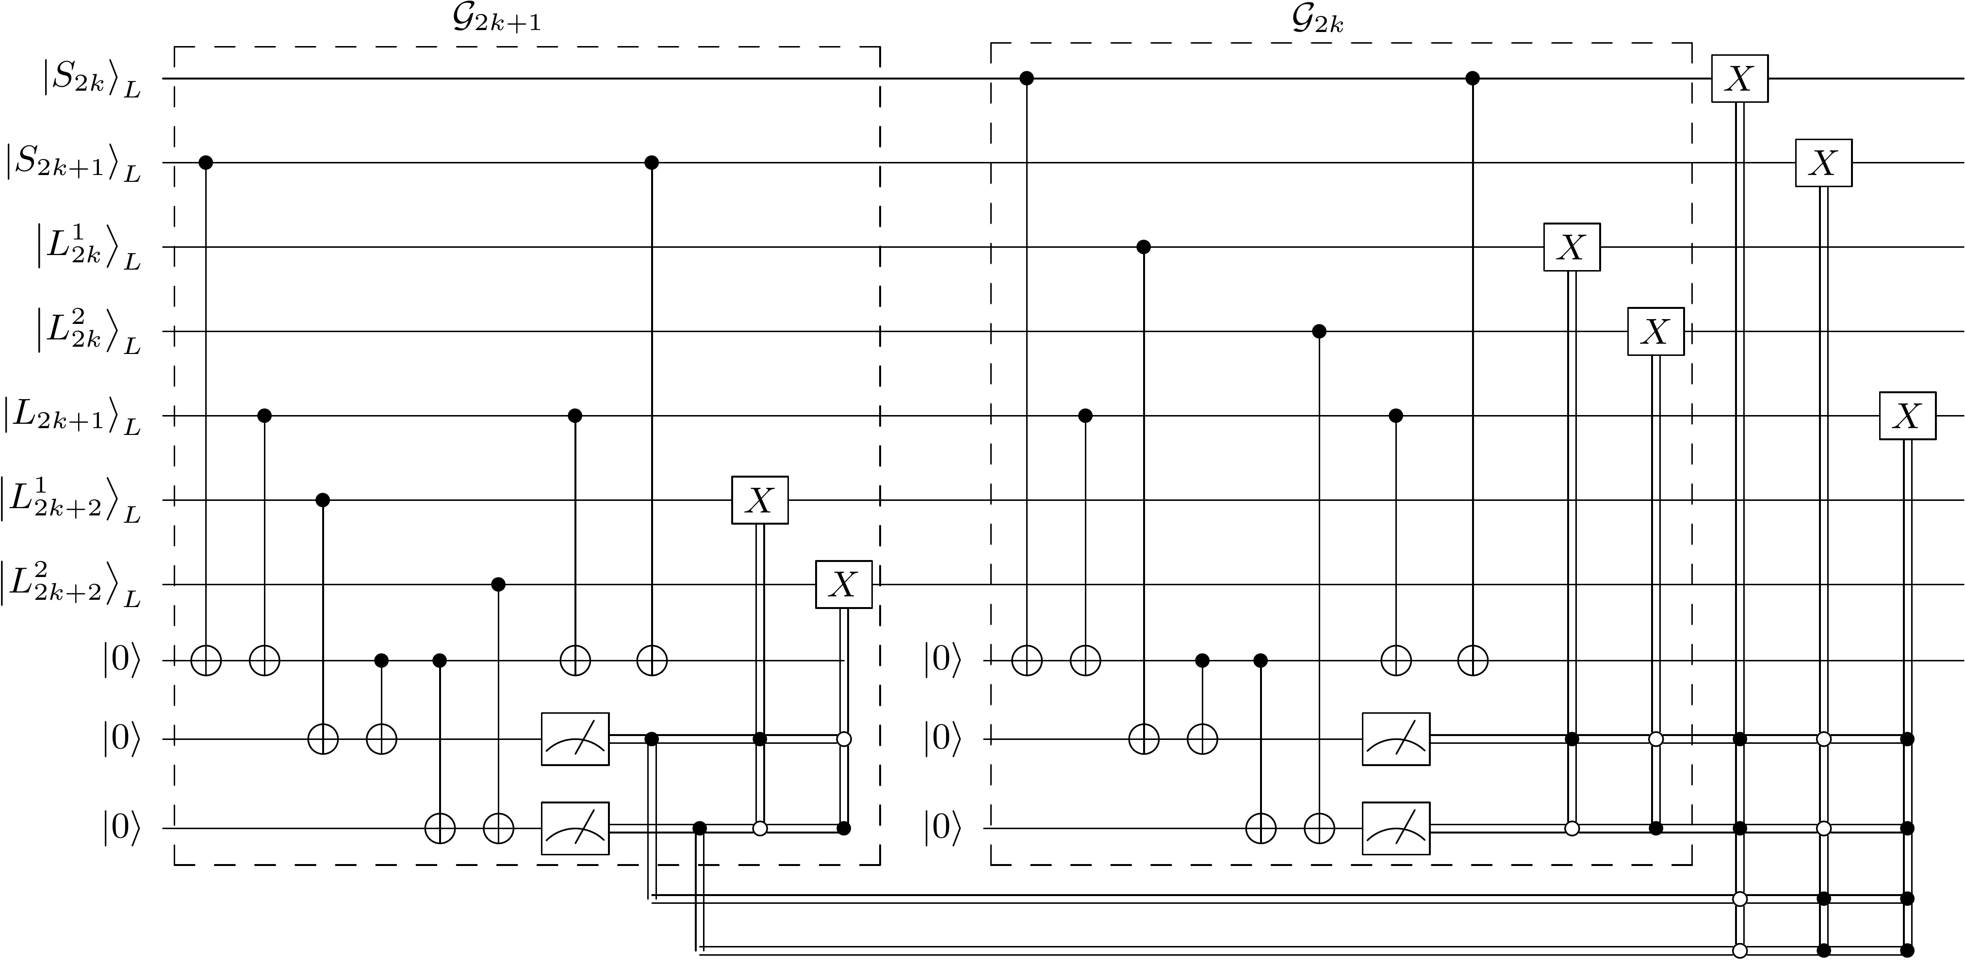
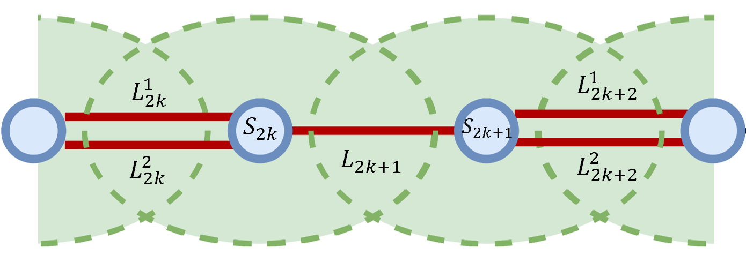
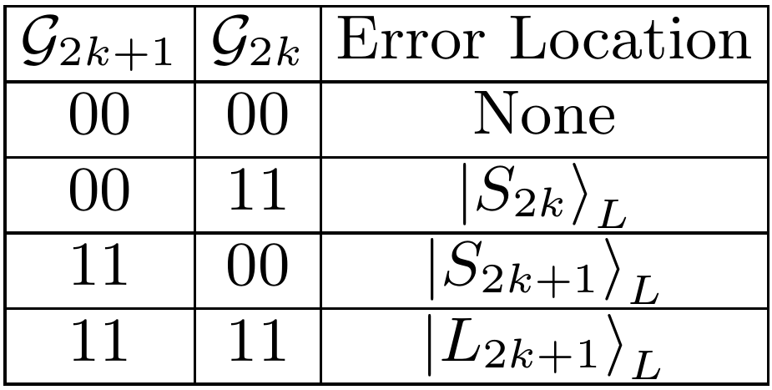
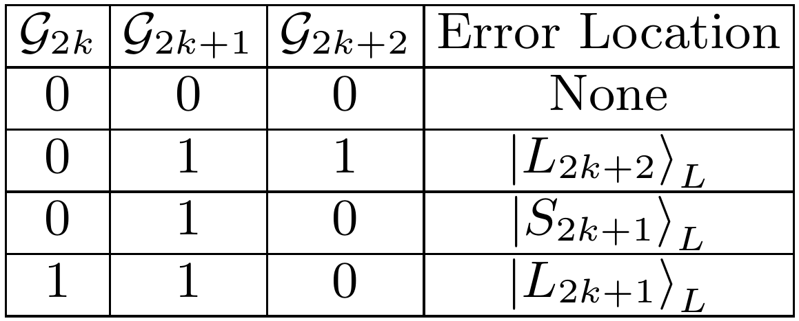
Error Correction for 1+1 D LGTs
Extended Gauss’s law checks
Notes:
-First pair of CNOTs stores the XOR of S_{2k+1} and L_{2k+1} into the first ancilla qubit and therefore serves as a copy of L_{2k+1} with its flux value reset
- Other two pairs of CNOTs compute parity between fake L_{2k+1} and the other 2 even numbered links

Slide 15
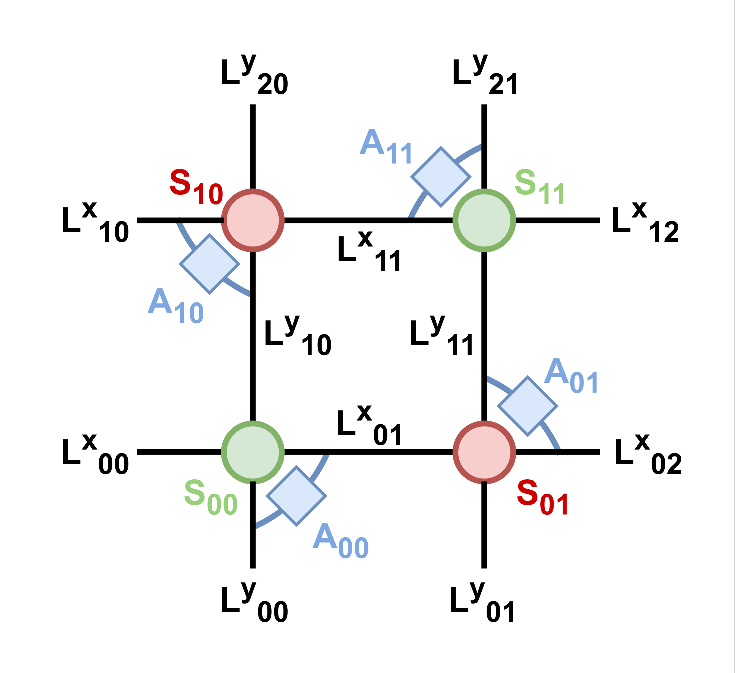
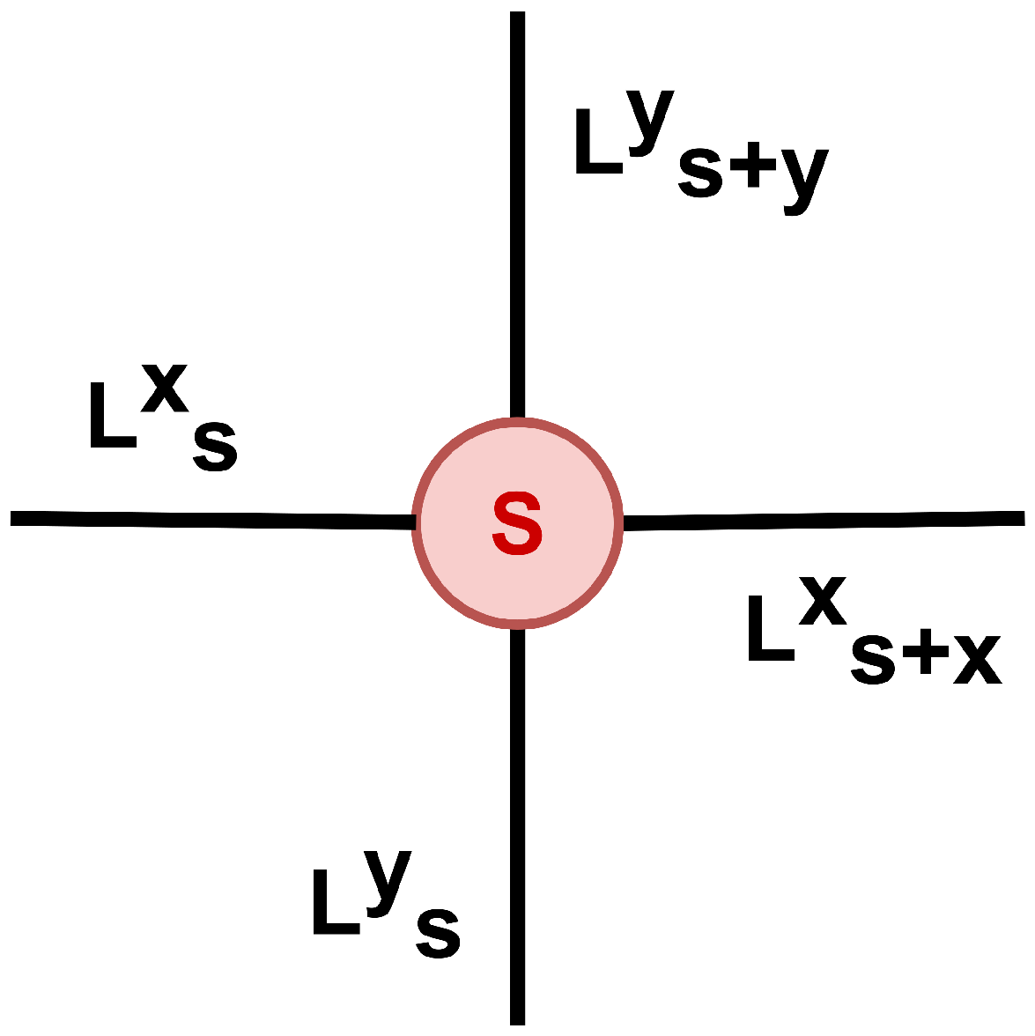
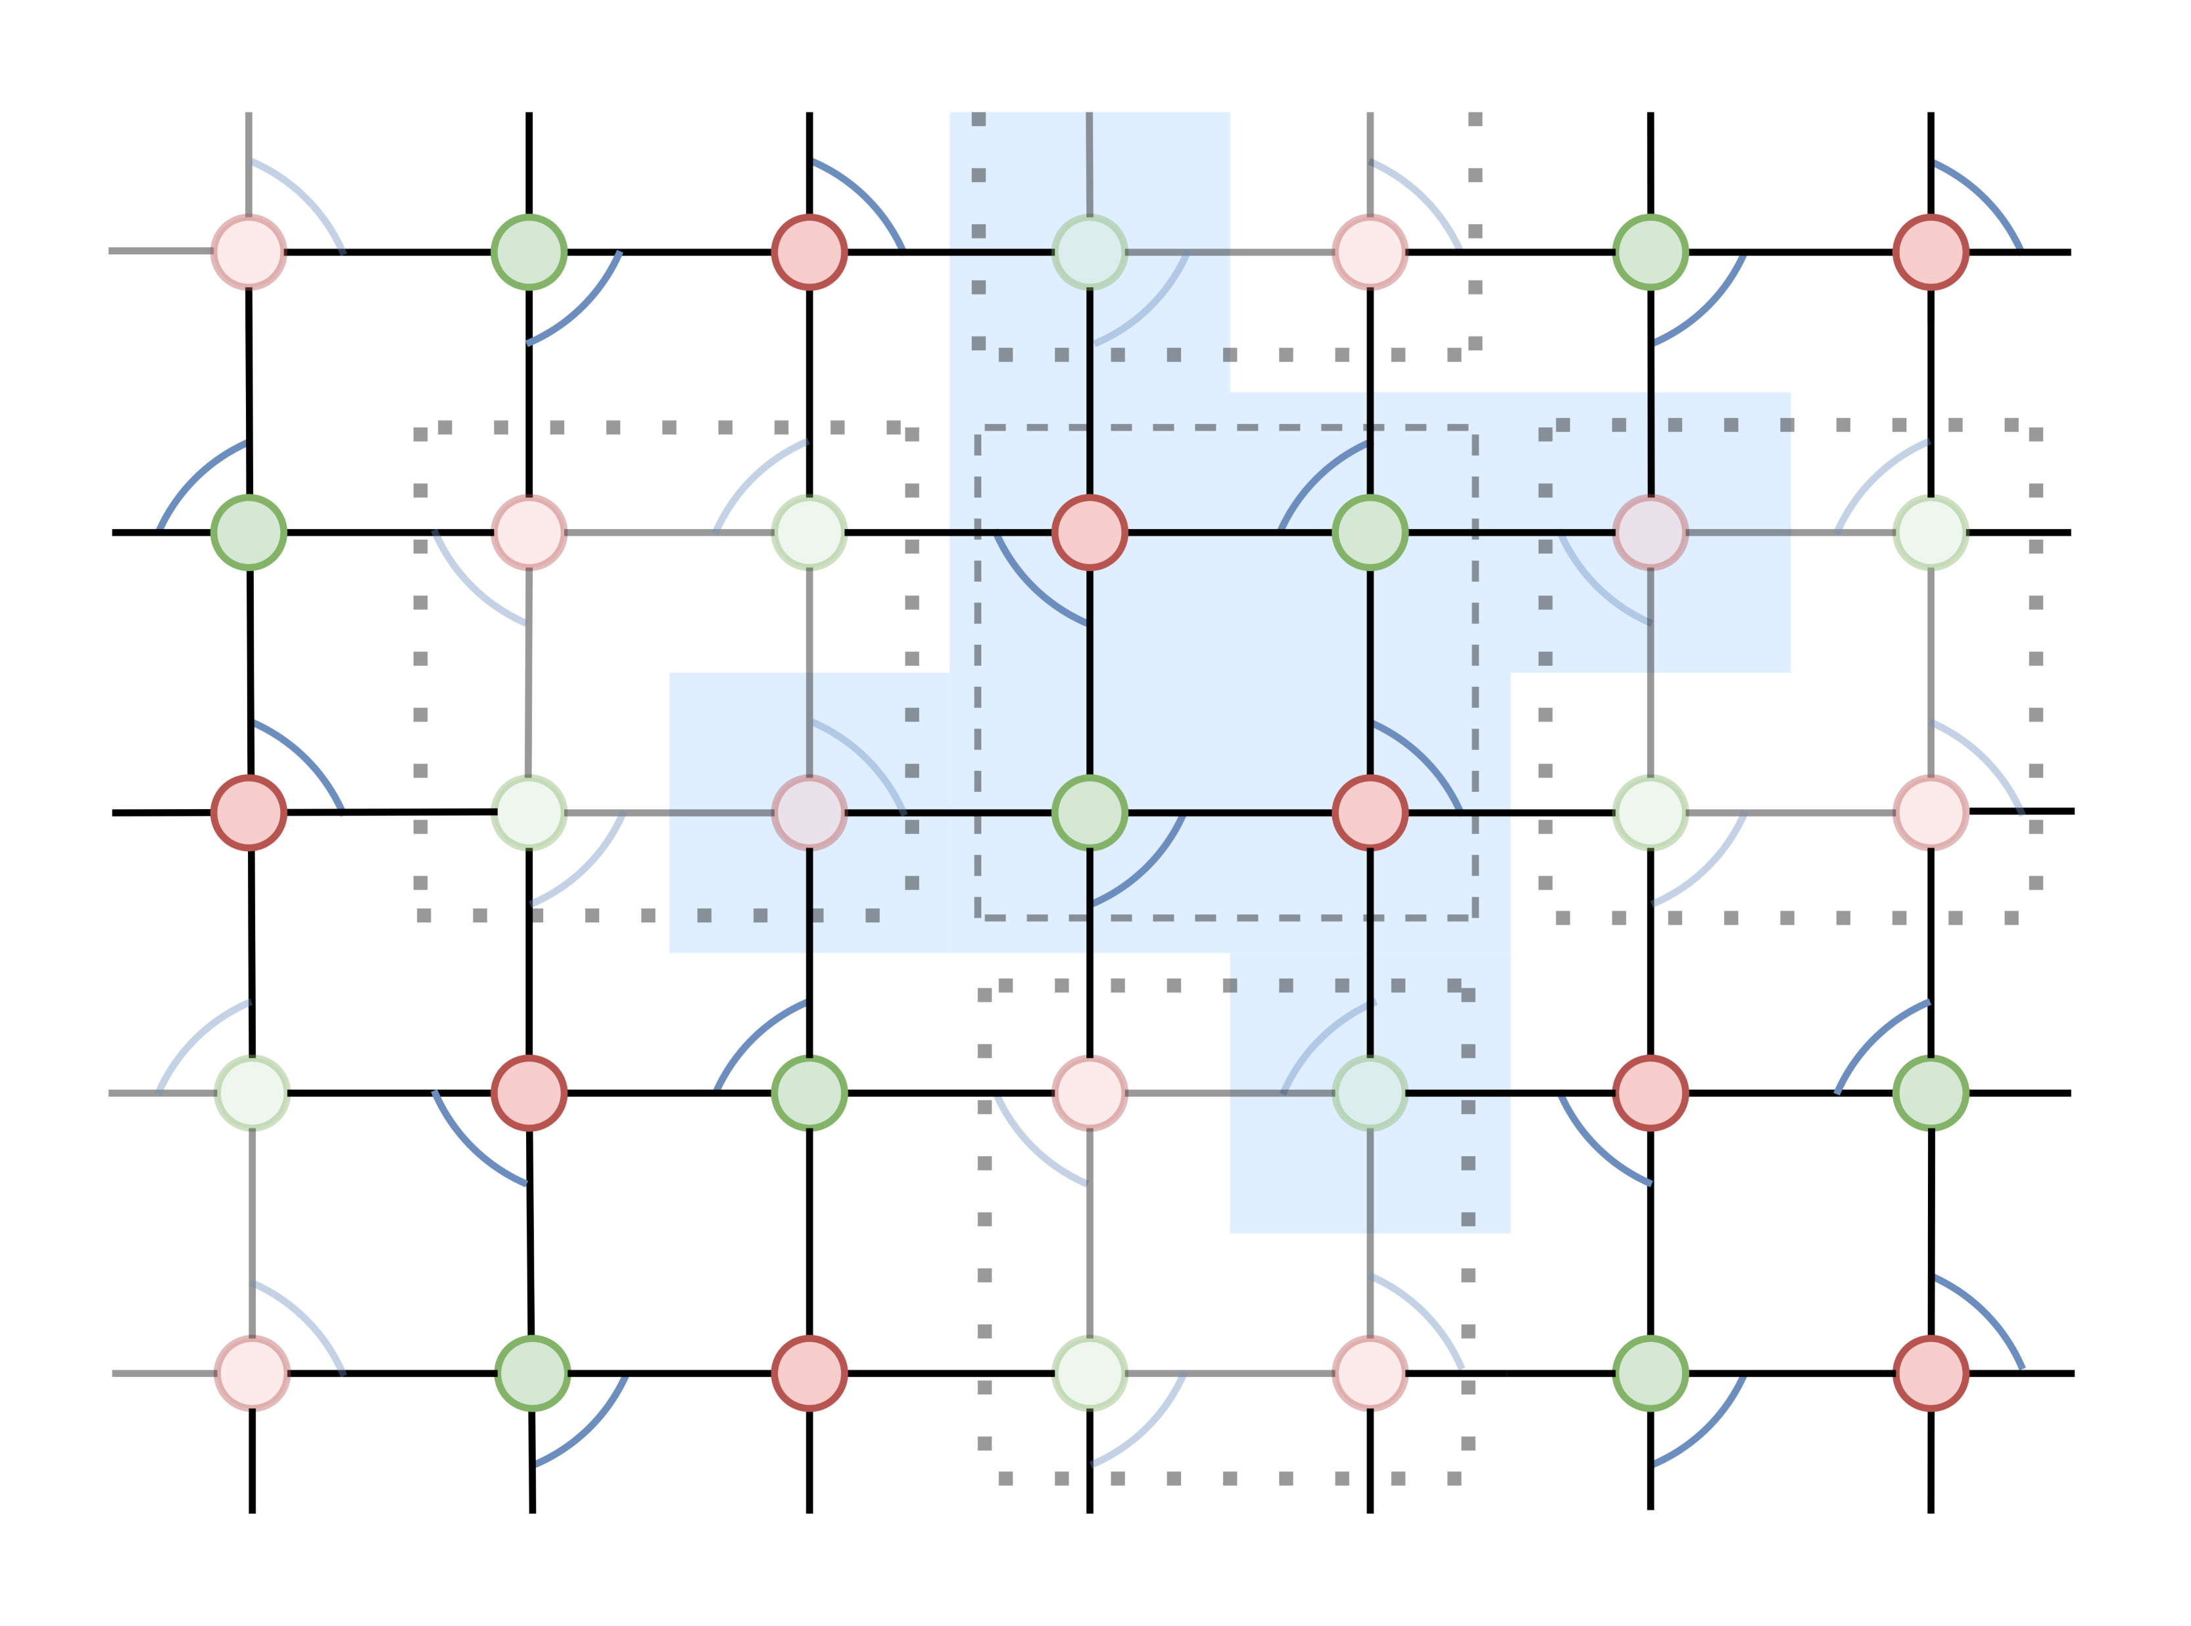
Error Correction for 2+1 D LGTs
Can express Gauss’s law as:
Ancillas to store parity
Two CNOT gates with control on links and target on ancillla
Update ancilla with CNOT whenever links are modified
Two rounds of measurements: bold then light plaquettes
Notes:
-Red sites are fermionic, blue sites are anti-fermionic
-Physical states are eigenvectors of the Z-string of operators with +1 eigenvalue on even sites and -1 on odd sites
-Assuming one error happens in the blue region during the two rounds of checks, we can correct it in these two rounds and resolve any ambiguity by measuring P^a stabilizers

Slide 16
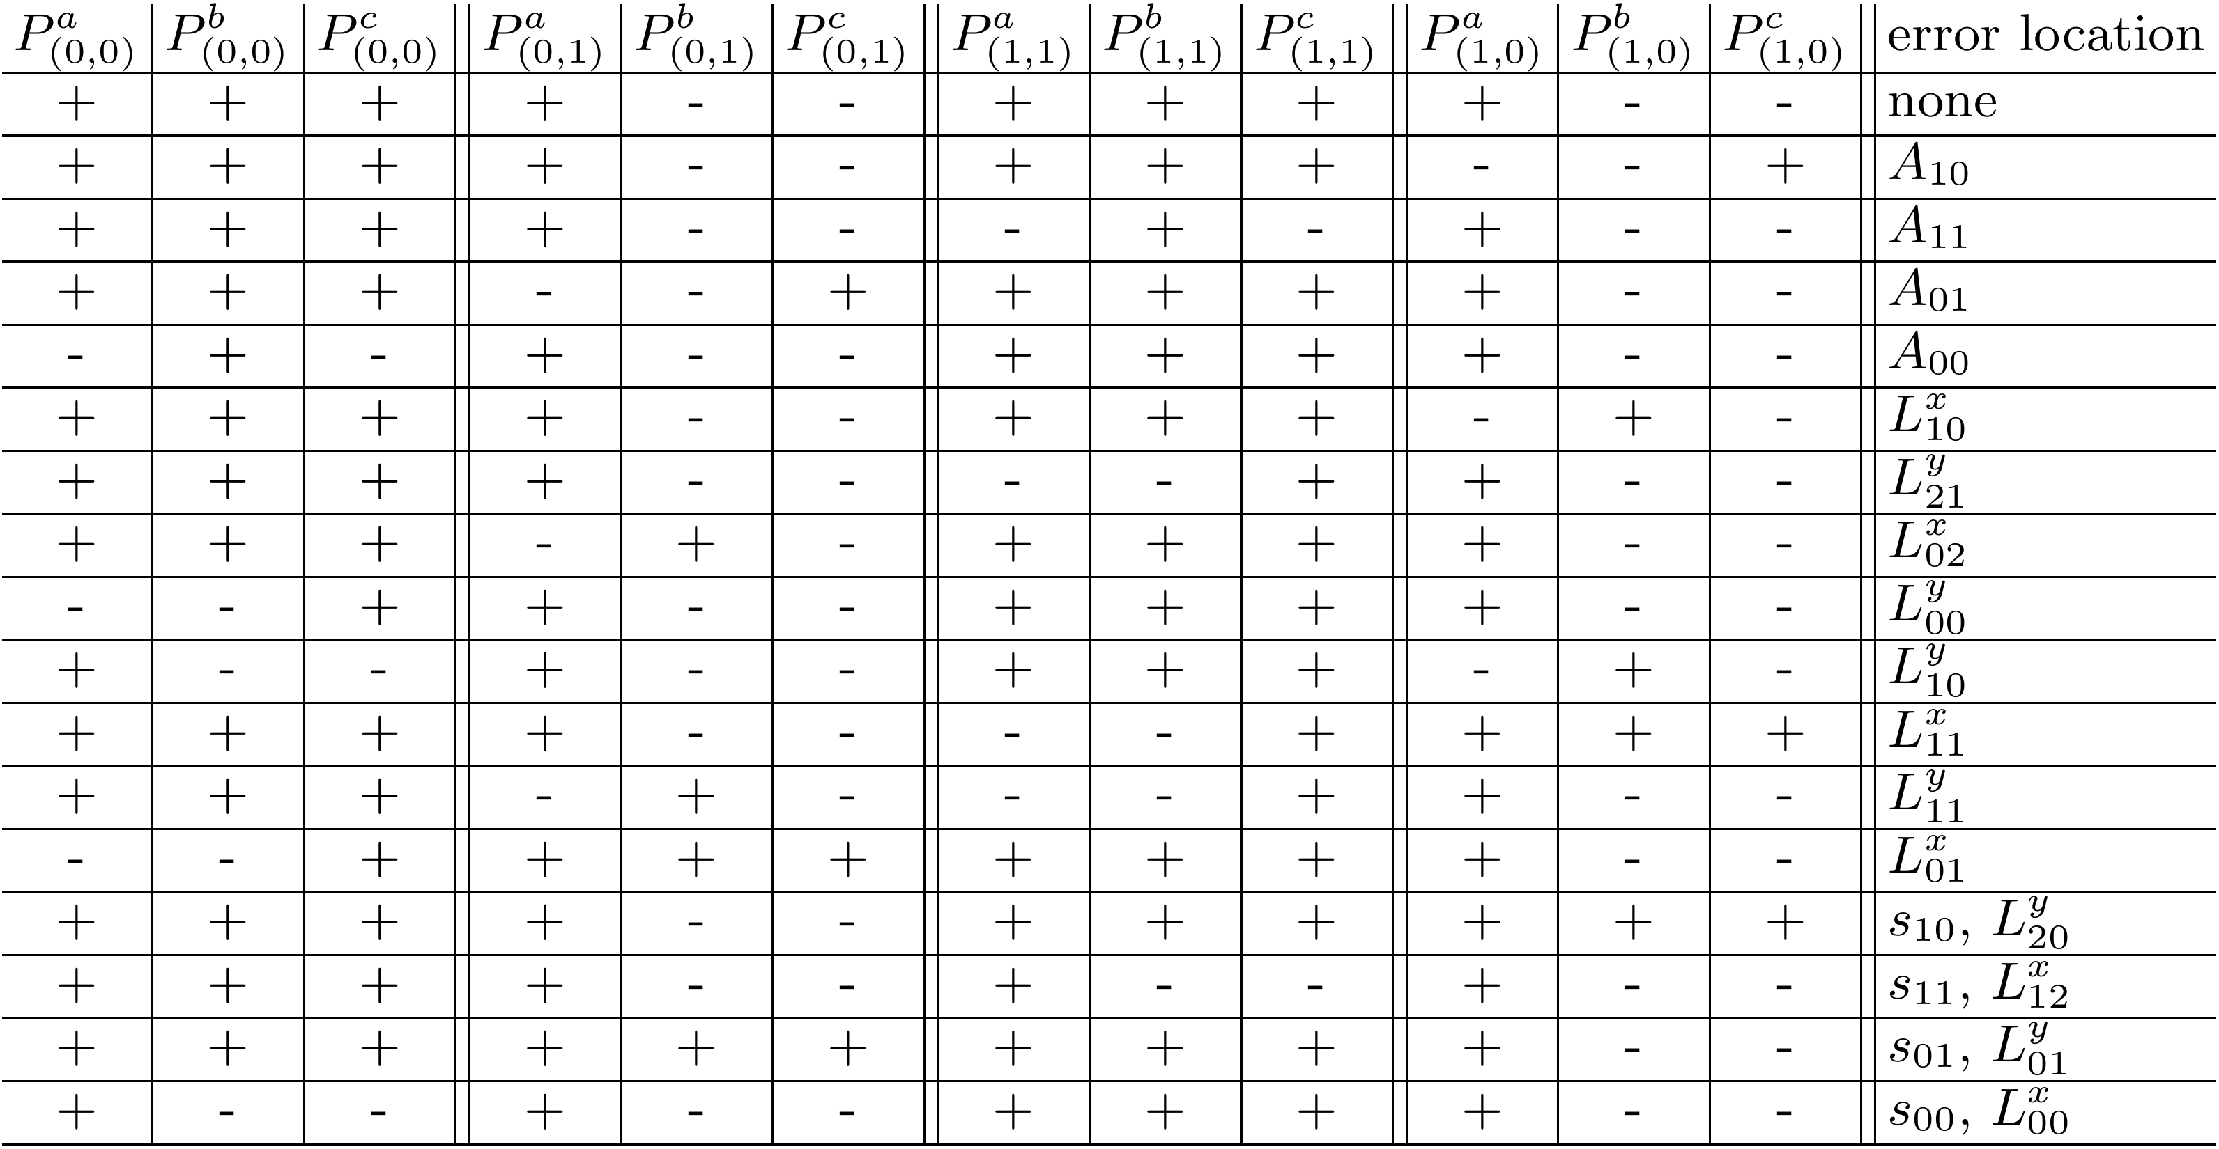
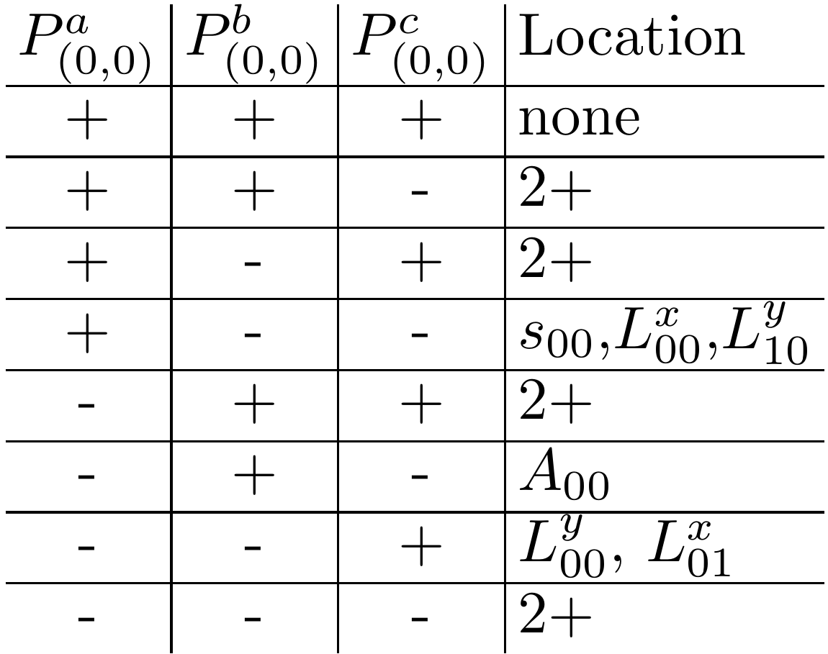
Error Correction for 2+1 D LGTs
Measure stabilizers:
Notes:
-Red sites are fermionic, blue sites are anti-fermionic
-Physical states are eigenvectors of the Z-string of operators with +1 eigenvalue on even sites and -1 on odd sites
-Assuming one error happens in the blue region during the two rounds of checks, we can correct it in these two rounds and resolve any ambiguity by measuring P^a stabilizers

Slide 17
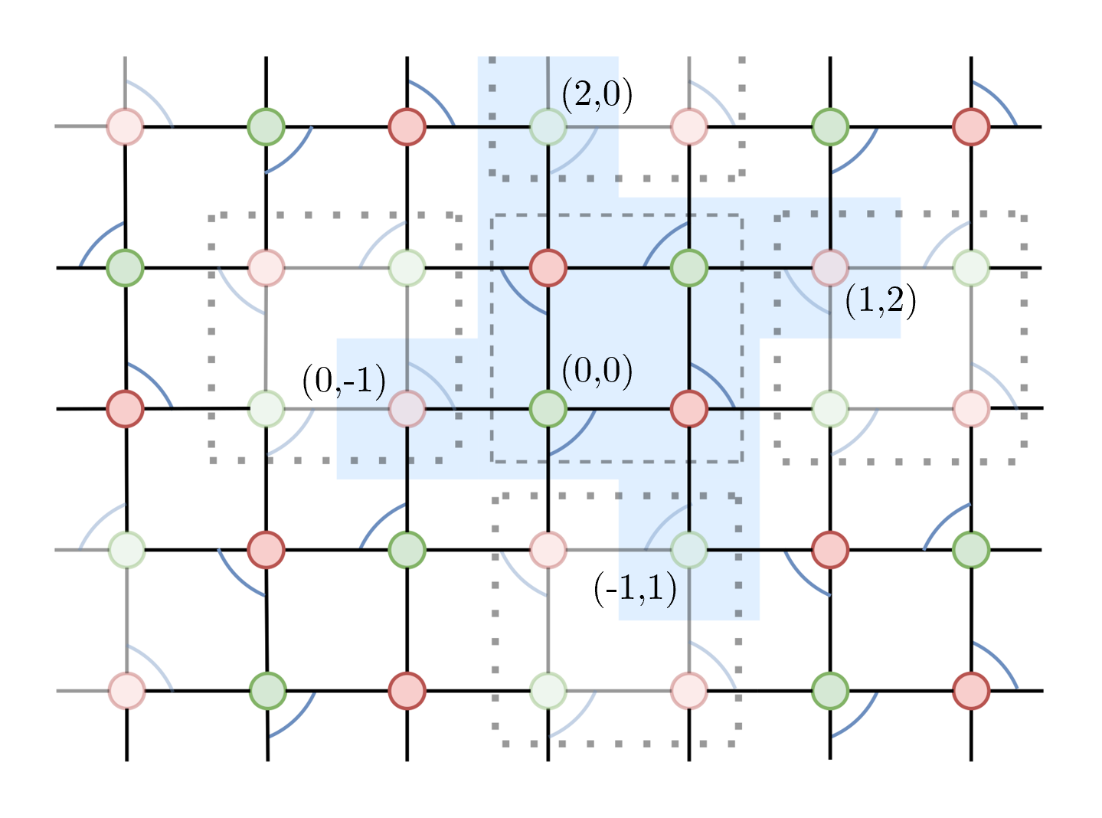
Error Correction for 2+1 D LGTs
Measure $P^{a}$ stabilizer around 4 indicated sites to resolve ambiguity
Notes:
Physical states are eigenvectors of the Z-string of operators with +1 eigenvalue on even sites and -1 on odd sites
Differences vs toric code: star operator in toric code is X string, plaquette operator is a Z string (our stabilizers are combinations of Z operators and we have three instead of two per site), logical operations don’t really correspond to homologically non-trivial cycles,

Slide 18
Outlook
Error correcting codes are “artificial gauge theories”
Logical Hilbert space determined by states satisfying local “Gauss’s law” symmetries
Larger cutoffs on links
Fault tolerant implementation of controlled-raising/lowering operator
Unary encoding; cutoff grows as polylog(1/ε) for simulation of dynamics
Other integer encodings? Integrate multiple error correcting codes?
2+1 D $Z_{4}$ gauge theory has been done
Extend constructions to higher distance
Compute threshold?
Integration of compressed encoding with time-evolution
Discrete subgroups of non-abelian gauge groups or multiple gauge symmetries?

