Slide 1

Studies of baryon timelike transition Form-Factors in QCD matter with dileptons
Motivations( emissivity of QCD matter -> Low mass dileptons, ρ in-medium spectral function → timelike baryon em. transitions)
Measurements of baryon electromagnetic transitions in NN and πN reactions in HADES
Summary & Outlook
P. Salabura
M. Smoluchowski Institute of Physics
Jagiellonian University, Kraków
Poland

Slide 2
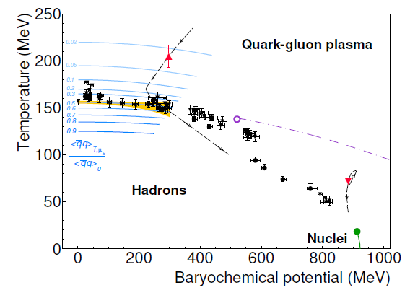
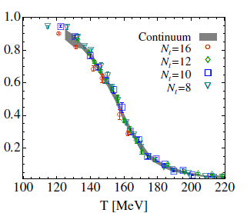

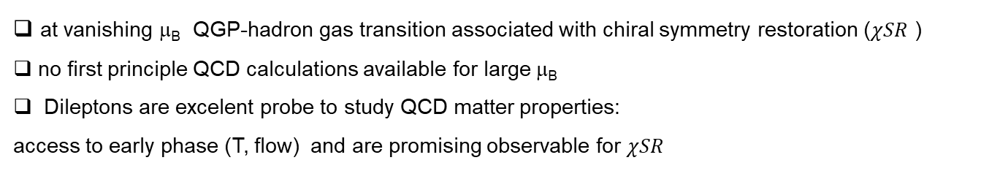
QCD phase diagram and chiral symmetry restoration
Lattice QCD
S. Borsnyi JHEP 73 ’2010
LHC
T≅155 MeV, μ_{B} = 0
Order par:. Chiral symmetry restoration
HADES Nature Physics (2019) 1040
RHIC, SPS
CBM/HADES
HADES
Heavy-ion collisions: properties of matter occurring in neutron star mergers
π, p beams:
  Reference measurements
  (vacuum, cold QCD matter)
  Explore electromagnetic structure of baryons/hyperons in time-like region
at vanishing μ_{B} QGP-hadron gas transition associated with chiral symmetry restoration ($χSR$ )
no first principle QCD calculations available for large μ_{B}
Dileptons are excelent probe to study QCD matter properties:
access to early phase (T, flow) and are promising observable for $χSR$
Explore the high-μ_{B} region of the QCD phase diagram
Focus on rare and penetrating probes
Address various aspects of baryon-meson coupling

Slide 3
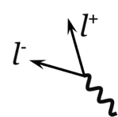
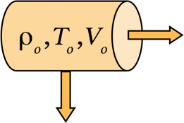
Emissivity of QCD matter with dilepton probe
Not disturbed by finite state interactions ! But needs integration over volume and time !
Π_{em} em. current-current correlator :q² < 1 GeV - in-medium VM ( ρ ) spectral functions- Vector Meson Dominance
LM dilepton yield in HIC is dominated by ρ in-medium propagator
q² > 1.5GeV qq radiation pQCD (flat)
Thermal distribution f ^{BE} (T) – thermometer

Slide 4
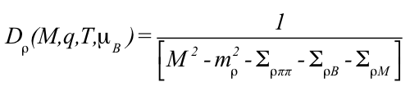
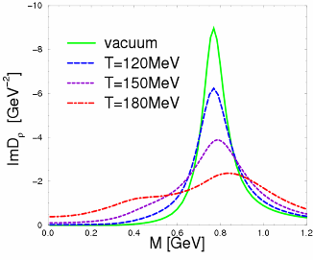

In medium ρ spectral function
Rapp, Wambach, Adv. Nucl. Phys. A25 (2000)1
ρ_{B}/ρ₀
0
0.1
0.7
2.6
@ SPS full energy
In Medium Im ${\text{}}_{ρ}$:
π
R(N*/Δ)
ρ
ρ
ρ
ρ
Δ(1232)
+
+ ...
N⁻¹
N⁻¹
dominant role of ρ - R couplings

Slide 5

ρ -meson : connection to χSR
QCD sum rules
[Weinberg ’67, Das et al ’67]
Weinberg Sum rules
P. M. Hohler and R. Rapp, NPA 892, 58 (2012)
ρ
SB
a₁
[Weinberg ’67, Das et al ’67; Kapusta+Shuryak ‘94]
in vacuum ρ-a₁ mass splitting
due to χS breaking (~ f_{π} , , …)
χSR – both spectra functions overlap at T_{c} - demonstrated by Hohler&Rapp PLBB731(2014)

Slide 6
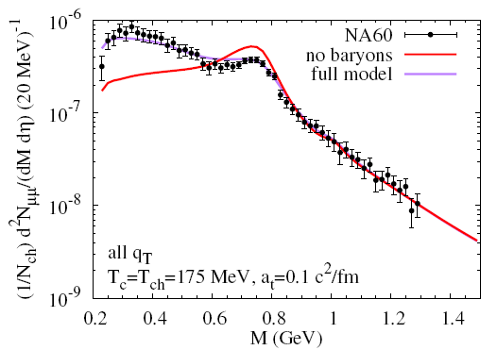
Dielepton thermal rates from HIC from SIS18 to RHIC
STAR √s=200 GeV
Na60 @ SPS In+In (μ+μ-)
HADES: Nature Phys. 15 (2019) 10, 1040-1045
PRC92 (2015)
√s=17.3 GeV
T~200 MeV
Data : Na60 EPJC 59 (2009) 607
calculations: Hess/Rapp: NPA806(2008)339.
Successful description of excess yield over large energy region by thermal radiation from in-medium ρ with significant broadening
..at LHC we still awaiting precision measurements : ALICE in Run4 and ALICE3 optimized for low mass dileptons !
NA60: T ~ 200 MeV - <T> of the early phase, HADES T~ 70 MeV „hot baryonic matter”
next step search for ρ/a₁ mixing ALICE3, NA60+, CBM ..

Slide 7
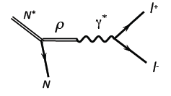
In medium ρ-B interactions–connection to Baryon Dalitz Decay
Δ, N(1520), …
>
Baryonic loops
sensitive to ρN N*/Δ couplings (BR N/Δ→Nρ)
related to baryon Dalitz Decay decays Δ/N*→Ne⁺e⁻
ρ
Σ_{ρB} =
>
h = N⁻¹
Important microscopic input to hadronic models
so far constraint in model calculations was provided by photo-absorption on nulceon, BR (R→Nρ), BR (R→Nγ)
Measure Dalitz decays NN and πN collisions ! → dedicated HADES hadron physics programme
Baryon Dalitz decays → em. Transition Form Factors

Slide 8
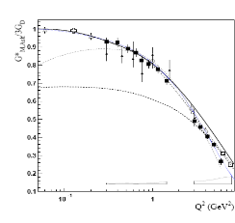
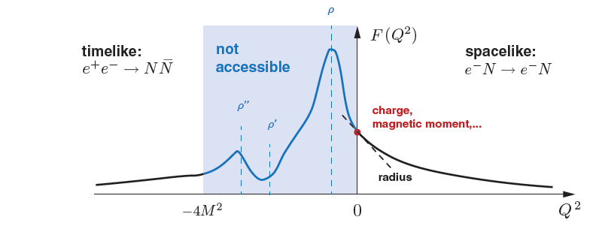
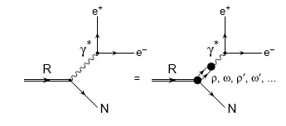
Baryon electromagnetic transitions
Dalitz decays
Δ → N γ
space-like
e⁺e⁻→RR
R → N e+e-
e⁻N→e⁻R(→Nπ)
„meson cloud”
G. Eichmann
„quark core”
N
Dalitz decays : em. Transition Form Factors (timelike)
(complementary to spacelike region)
I. G. Aznauryan and V. D. Burkert,
Prog. Part. Nucl. Phys. 67, 1 (2012)
models (timelike baryon transitions):
M. I. Krivoruchenko, et. al. An. Phys. 296, 299 (2002)
Q. Wan and F. Iachello, Int. J. Mod. Phys. A 20 (2005) 1846.
G. Ramalho and M.T. Peña, PRD 80 (2009) 013008
T. Pena and G. Ramalho, Phys.Rev. D85 (2012) 113014
M. Zetenyi, Gy. Wolf, Heavy Ion Phys. 17, 27 (2003).
„QED”
Effective Transition Form-Factor
Transition of point-like baryon

Slide 9





Δ (pπ⁺, pπ⁰) excitation in pp →ΔN √s= 2.42 GeV
13 PNPI + 2 HADES data sets
Bn-Ga PWA solutions: resonances: Δ(1232) and N(1440)
$$npπ^{+}$$
$$npπ^{+}$$
Δ(1232)
N(1440)
$$ppπ^{0}$$
$$ppπ^{0}$$
$$ppπ^{0}$$
HADES : Eur. Phys. J. A51 (2015) 137

Slide 10
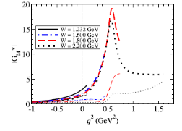



pp → p(Δ→pe⁺e– ) Δ Dalitz decay
HADES Phys. Rev. C95 (2017) no.6, 065205
M_{e+e-} > M_{π} <$M_{∆}$> ~1.4 GeV
π⁰→ γ e+e-
T. Pena and G. Ramalho, Phys.Rev. D85 (2012) 113014
pion cloud
Δ⁺ →pe+e-
core
BR (Δ→pe+e-)= 4.19 10⁻⁵ ± 0.62 (sys) ± 0.32(stat)
(First measurement ! : PDG entry)
Good agreement with 2 component model of TFF Ramahlo & Pehna (R&P) -> Slight rise v.s Mass due to VM(ρ) - pion cloud effect
Lepton angular distributions confirm dominance of G_{M} ( transverse polarized γ* ->B=1)
quark core
pion cloud
$$e^{+}e^{−}$$
π
Δ
N
Δ
N

Slide 11


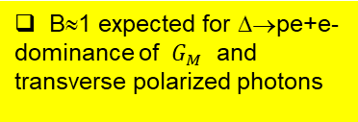
p-n data: $γ^{∗}$ polarization : e distributions in (helicity) frame
Dominated by Δ
Dominated by p-n bremsstrahlung ρ
OBE calculations
dσ/dcosθ ~ 1 + B cos²θ
E. L. Bratkovskaya, at. al PLB 348, 325 (1995).
$$M_{ee}>300 MeV/c^{2}$$
$$300>M_{ee}>140$$
B
B = 1.52±0.58
B= -0. 4 ± 0.2
B≈1 expected for Δ→pe+e- dominance of $G_{M}$ and transverse polarized photons
change of angular distribution
B ≈0 expected for p-n bremsstrahlung (see right for OBE) , B≈ -1 for ρ dominance

Slide 12
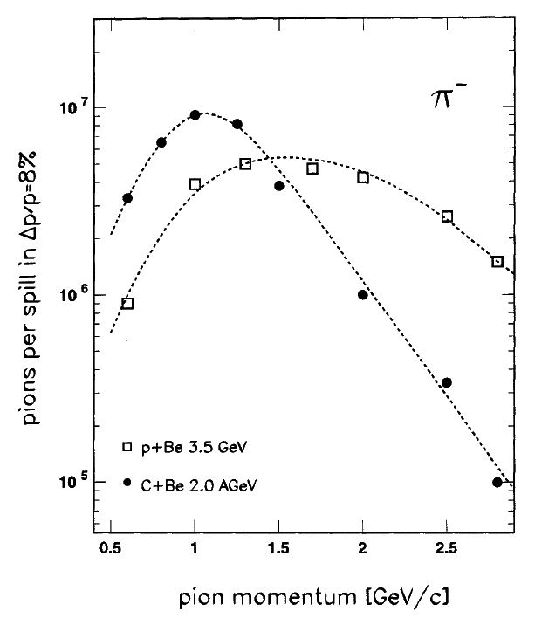
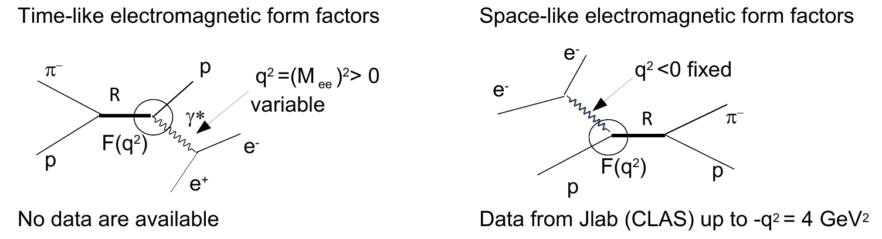
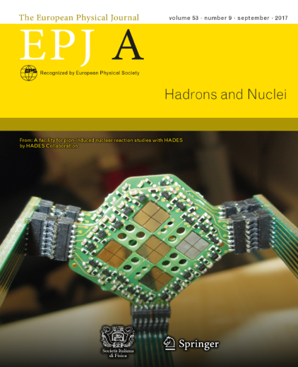
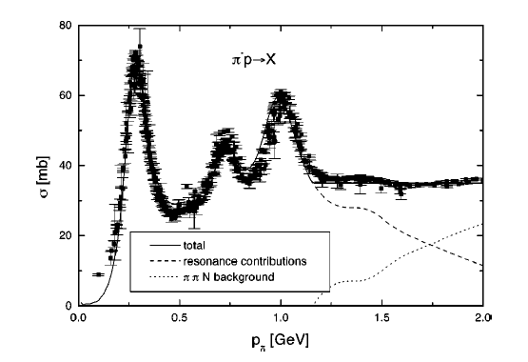
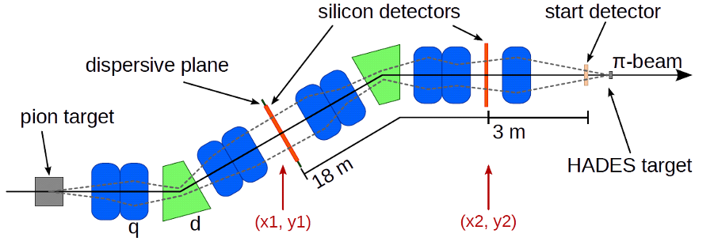
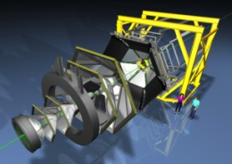
Pion Beam @ GSI
Eur. Phys. J. A (2017) 53: 188
Resonance production with m_{R} =√s !
reaction N+Be, secondary π⁻ with I ~ 2-3 10⁵/s
pion momentum Δp/p =2.2% (σ)
50% acceptance of pion beam line
First run:
√s =1.46-1.55 GeV (4 points)-second resonance region
PE (CH₂ )_{n} and C targets : 2-pion and e+e- production
pion beam tracker
diamond detector
η
ω
polyethylen
(CH₂)_{n} and C
Notes:
11

Slide 13
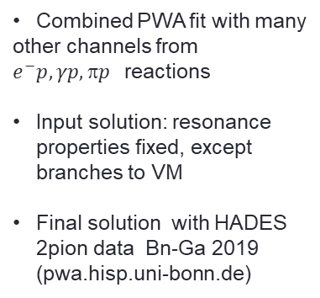
2 pion production: PWA (Bn-Ga) decomposition √s=1.49 GeV
„subthreshold” – no ρ peak in π⁺ π^{−,0} mass distributions
Combined PWA fit with many
other channels from $e^{−}p, γp, p$reactions
Input solution: resonance properties fixed, except branches to VM
Final solution with HADES 2pion data Bn-Ga 2019
(pwa.hisp.uni-bonn.de)
no N-σ
HADES:PRC C102 (2020) 024001
Notes:
12

Slide 14
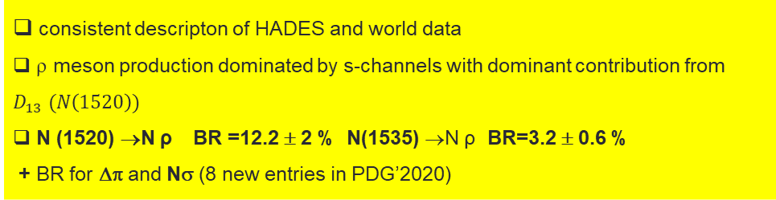
Total Cross Sections
nπ⁺π⁻
pπ⁻π⁰
[8-9]
D. M. Manley et al. Phys. Rev. D 30 (1984) 904 D. M. Manley and E.M. Saleski, Phys. Rev. D 45,
consistent descripton of HADES and world data
ρ meson production dominated by s-channels with dominant contribution from $D_{13} (N\left(1520\right))$
N (1520) →N ρ BR =12.2 ± 2 % N(1535) →N ρ BR=3.2 ± 0.6 %
+ BR for Δπ and Nσ (8 new entries in PDG’2020)
HADES coll. Phys.Rev.C 102 (2020) 2, 024001

Slide 15
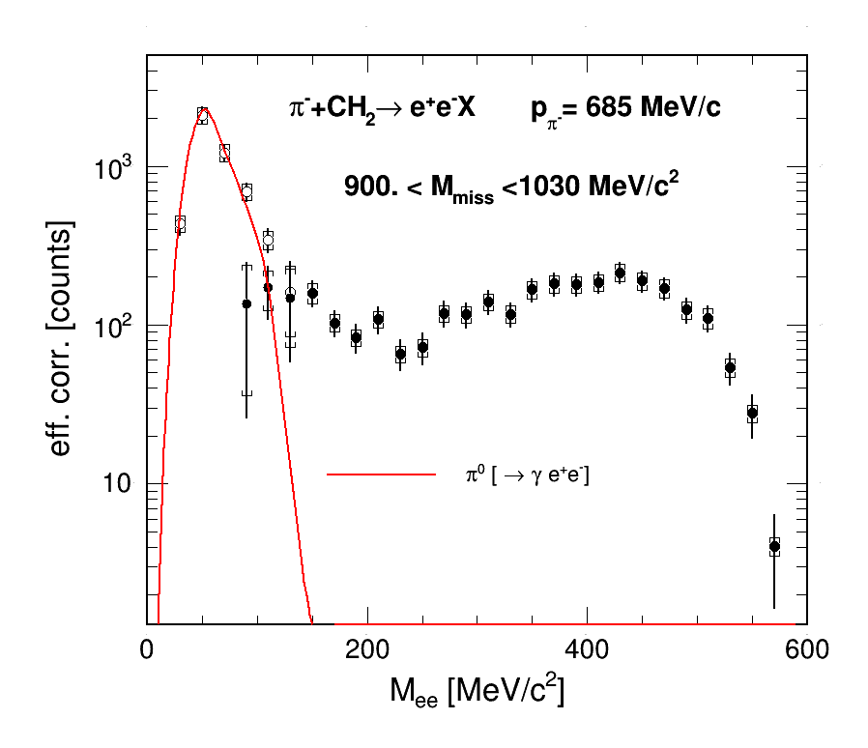
Selection of quasi-free π⁻p→ne⁺e⁻ /n π⁺π⁻
π⁻p→ne⁺e⁻
Selection of the exclusive π⁻p→ne⁺e⁻ channel using missing mass

Slide 16
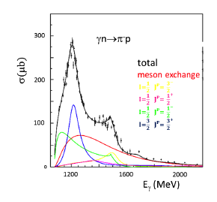
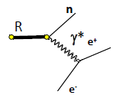
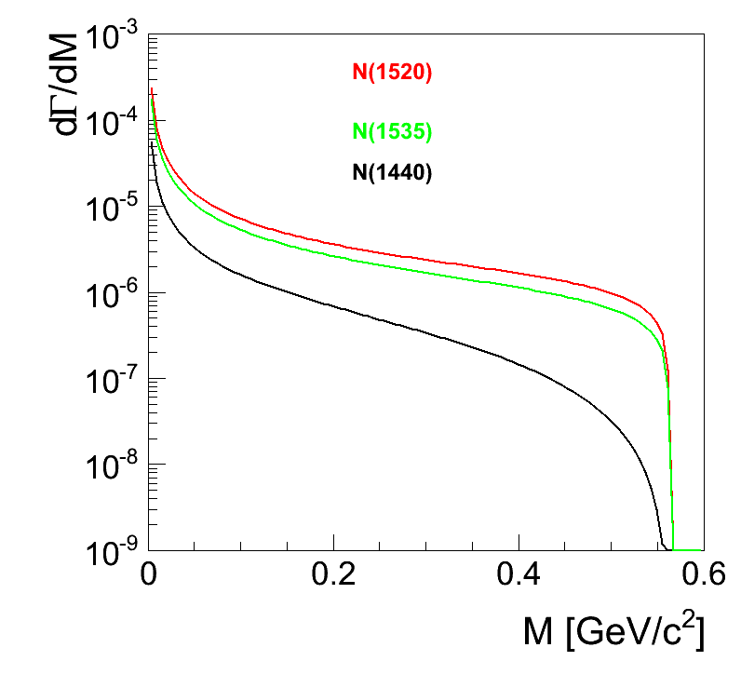

QED reference for eTFF
Bonn-Gatchina PWA
Limit at q²=0 given by π⁻p→nγ
Contribution of D13 to π⁻p→γn 27% (N1520 21%)
of S11 to π⁻p→γn 27% (N1535 15% )
Generalization to finite q² (QED)
M. Krivoruchenko et al., Ann. of Phys. 296, 299–346 (2002)
→ “point-like” description of R→Ne⁺e^{-:}
N*⁰→ne⁺e⁻
invariant mass distribution depends on J^{P}
(S11 and D13 same shape)
3/2⁻ D13
1/2⁻ S11
1/2⁺ P11
« γ « or « QED « reference
M_{ee}(GeV/c²)

Slide 17
eTFF (quark+meson cloud) model
Parameters of the model fitted
to spacelike data
Predictions for the
timelike region
Model for N-N(1520) transition
G. Ramalho and M. T. Pena, Phys. Rev. D95, 014003 (2017)
Quark core contribution :
Quark form factors inspired by VMD
Meson cloud contribution:
Based on pion electromagnetic form factor
Dominant contribution in the timelike region
Similar model for N-N(1535) transition
Phys.Rev. D101 (2020)114008

Slide 18

Two-component Lagrangian model
« Kroll-Lee-Zuminio »
« VDM1 » Lagrangian is used
Various non-resonant (Born term)
and resonant D13(1520), P11(1440), S11(1535),..)
Strong contribution of the Born term
$_{ρ}^{VDM1}$= ${\left(\frac{M}{M_{0}}\right)}^{}Γ_{ρ}^{0}$
→ Shape and yield sensitive to the interference between the γ and ρ contributions
M. Zetenyi and G. Wolf, Phys. ReV. C 86, 065209 (2012)
M. Zetenyi, et al. arXiv:2012.07546[nucl-th], 2020

Slide 19
„effective” N*/N em. TFF
QED reference constrainted by π⁻p→nγ data and available Bn-Ga solutions
Model independent results:
  Strong excess with respect to the point-like contribution-QED reference (up to a factor 5) -
Data driven model VDM1: QED (direct γ) + ρ→e+e- with constructive interferences gives a good description of the full spectrum
Two microscopic models describe also data very well :
Lagrangian (production + baryon Decay with VDM1)
eTFF model of N(1520)+N(1535) (quark + meson cloud)
M. Zetenyi et al. PRC 104(2021) 1,015201
G. Ramalho and M. T. Pena, Phys. Rev. D95, 014003 (2017)

Slide 20
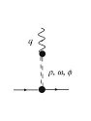


VMD in baryon decays
Test of VMD versions (equivalent for universal coupling g_{ρ}=g_{ρππ} )
Discussed in O’Connell Prog. Part. Nucl. Phys., Vol. 39,pp. 201-252, 1997
VMD2 : Sakurai, Phys. Rev 22 (1969) 981
most commonly used in Heavy Ion transport models
one single ρN coupling
mass dependent decay width to e+e-
$_{ρ}^{VDM2}$= ${\left(\frac{M_{0}}{M}\right)}^{3}$ $_{}^{0}$
VMD1 : Kroll, Lee & Zuminio Phys. Rev. 157 (1967) 1376
ρ contr. vanishes at m_{γ}*=0,
γN and ρN couplings fixed independently allows to fix BR(R→Nγ) and BR(R→Nρ) consistently
Important for in-medium rho-meson calculations as pointed out in
B. Friman, H.J Priner, Nucl. Phtys. A 617(1997)496
Phase between γ and ρ contributions to be fixed by data
γ or point-like contribution
$_{ρ}^{VDM1}$= ${\left(\frac{M}{M_{0}}\right)}^{}Γ_{ρ}^{0}$

Slide 21
VDM1/VDM2 comparison to data
QED reference
VDM2 (transition saturated by ρ) overestimate data below 400 MeV
VDM1 with constructive γ+ρ interference in good agreement

Slide 22
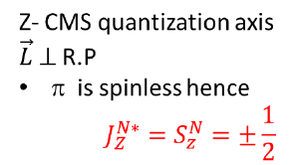
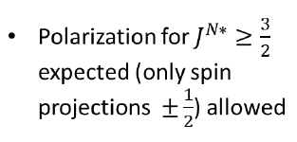














Polarisation of resonances in pion induced reactions
Reaction Plane
$\vec{π} × \vec{γ^{∗}}$
R.P ||$\vec{ L}$
n
$$Y^{′ }||\vec{L}$$
$$φ$$
CM (Z)
$$X^{′}$$
γ*
$$e^{−}$$
$$θ$$
$γ^{∗}$Rest frame (Helicity frame)
$$e^{+}$$
$$Z^{′}$$
n
p
ρ
$$J^{P}$$
$$^{H}$$
ρ^{dec} known, find ρ^{H} from data
π⁻
Models: GSI/Budpest
for e+e-
$^{dec}→ππ$/
e+e-)
E.Speranza et al..
PLB 764(2017)282

Slide 23
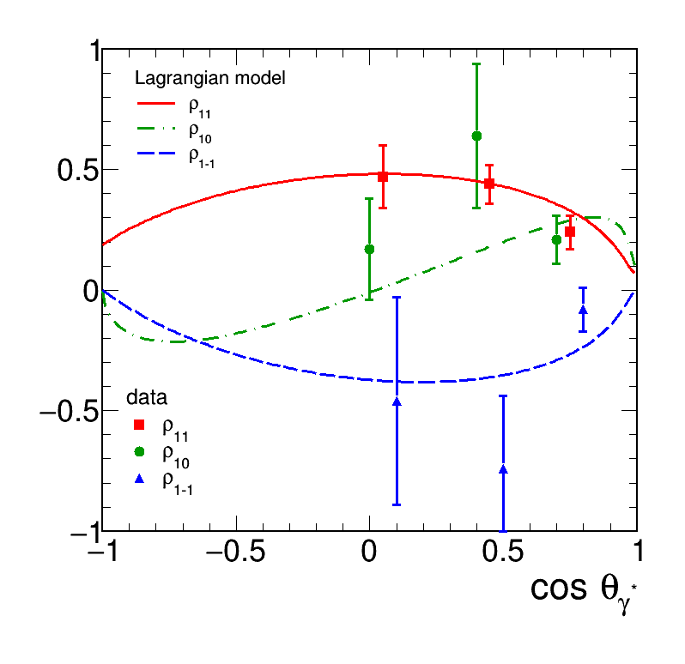
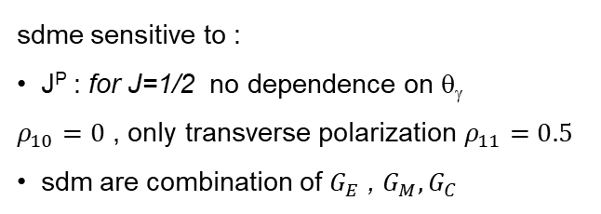
spin density matrix elements from e⁺/e⁻ data
ρ_{11 ,} ρ_{10,} ρ₁₋₁ extracted in 3 bins in cos θ_{γ}
sdme sensitive to :
J^{P} : for J=1/2 no dependence on θ_{γ}
$ρ_{10}=0$ , only transverse polarization $ρ_{11}=0.5$
sdm are combination of $G_{E}$ , $G_{M},G_{C}$
preliminary
J=1/2
J>1/2
data consistent with dominance of N1520 (J=3/2)
Good agreement with Lagrangian model (predictions!)
Powerfull observable.. but more precise data needed

Slide 24
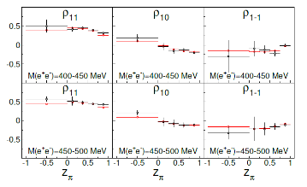
Outlook : experiments with pion beam
Exp. proposal at FAIR0/SIS18 : 2023-2025: explore the third resonance region (√s~1.7 GeV/c²)
1. Baryon meson couplings ππN, ωn, ηn , K⁰Λ, KΣ,….
→ Inputs for Partial Wave Analysis
→ Many baryon structure issues: confirmation of N’(1720),
Cascade decays (R→R’π→ Nπ π), „missing resonances”
η
ω
2. Time-like electromagnetic baryon transitions π⁻p→ne⁺e⁻
Broad range of q²=(M_{ee})² → sensitivity to form factors
Check of Vector Dominance (both for ρ and ω)
High prec. measureements of photon polarization - spin density matrix elements
expected sensitivity for spdme for N*(1520)

Slide 25
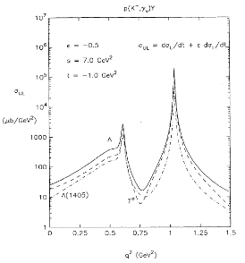
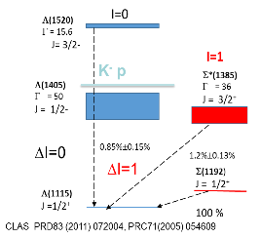
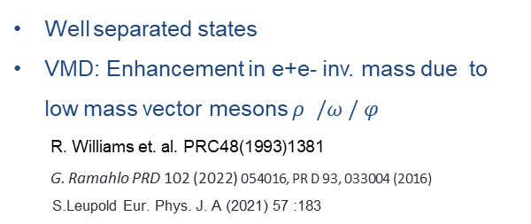
Hyperon Dalitz decays-em. transition Form Factors
Radiative decays
Well separated states
VMD: Enhancement in e+e- inv. mass due to low mass vector mesons $ρ /ω / φ$
R. Williams et. al. PRC48(1993)1381
G. Ramahlo PRD 102 (2022) 054016, PR D 93, 033004 (2016)
S.Leupold Eur. Phys. J. A (2021) 57 :183
SU(3) flavour partners
Σ(1385) - Δ(1232)
Λ(1520) – N(1520) ?
HADES measured Δ(1232) N(1520) transitions – significant enhancement (up to 5) w.r.t point-like (QED) – dominated, by pion cloud contribution.
Pion and Kaon cloud for hyperons ?

Slide 26
Summary
VM (ρ) do play an important role in baryon – γ* couplings
Baryon resonance studies with the GSI pion beam + HADES detector (2nd resonance region √s~1.5 GeV)
→ improved knowledge of baryon resonances- meson (ρ) couplings (new BR measurements!)
→ very new information on time-like electromagnetic baryon transitions
First test of Vector Dominance Model below 2π threshold and time-like electromagnetic transition form factor models → Important inputs for medium effects of ρ meson calculations
Electromagnetic decays of higher mass N*/Δ resonances in pion induced reactions and hyperons Y→Λγ, Y→Λe⁺e⁻ in pp reactions
2023-2025 : pion beam experiment in the third resonance region
Investigate heavier resonances N(1620), N(1720),…in e⁺e⁻ channels and many hadronic channels, e.g. π⁻p→ω/ρ n , π⁻p→ηn , K⁰Λ, KΣ,….
Study cold matter effects for VM with πA

Slide 27
Back-up

Slide 28
Y* radiative/Dalitz decays
Information on hadron structure (size of hyperon)
Dalitz decays of e.g. Λ(1405), Σ(1385), Λ(1520),..(narrow states)
radtiative BR about 10⁻⁵
Large rates needed (→ CBM) and SIS100 beam energy (First attempt by HADES in pp @4.5)
S.Leupold Eur. Phys. J. A (2021) 57 :183
HADES
Σ*
Λ*
~1 mb @ 30 GeV
~20 more than at SIS18
G. Ramahlo Phys.Rev.D 102

Slide 29
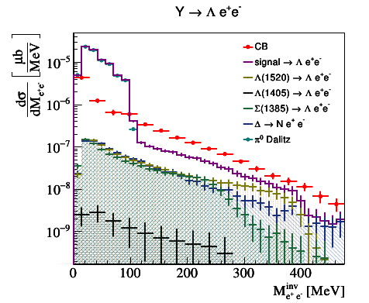

p+p @ 4.5 GeV
February 2022: pp @ 4.5GeV
HADES: Eur. Phys. J. A57, 138 (2021) feasibility study
Hyperon Dalitz decays: pp→pK⁺Λ(1520) [Λe⁺e⁻] [Λγ]
pp→pK⁺Σ(1385) [Λe⁺e⁻] [Λγ]
Ξ, Λ(1405), Λ(1520) production and decays
Λ−Λ correlations
dilepton production (higher mass baryon resonance decays, pair production above φ, mass,..)
Projections for Hyperon Dalitz decays
M > ${ M}_{π}$

Slide 30
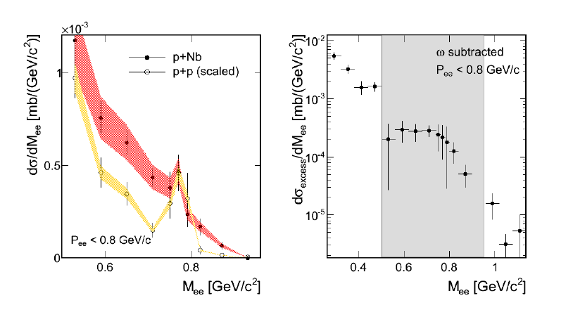
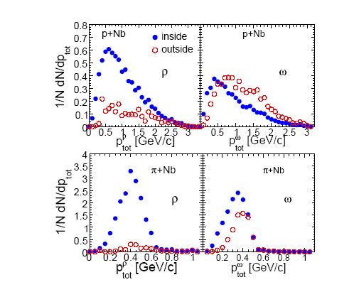


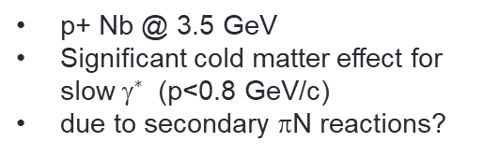
Vector meson in cold matter π⁻A→e⁺eX
p+ Nb @ 3.5 GeV
Significant cold matter effect for slow $^{∗}$ (p<0.8 GeV/c)
due to secondary πN reactions?
HADES PL715 (2012) 304
π-A better sensitivity to inside decays and low momentum
Projections for $π^{−}A$
$E_{π}=$1.17 GeV

Slide 31
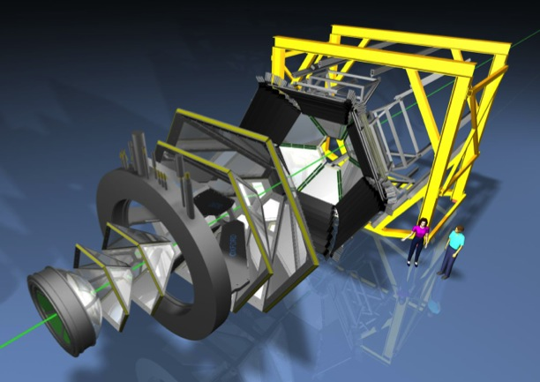
HADES
Spectrometer with ΔM/M - 2% at ρ/ω @ GSI/FAIR
electrons : RICH (hadron blind)
hadrons: TOF & dE/dx vs p
2004-2014: HI (A+A √s~2.4-2.6 GeV)
p+p, d+p, p+A √s =2.4-3.0 GeV π+p √s= 1.5 GeV
Upgrade 2018/2019
New RICH photon det
(HADES/CBM)
Forward tracking straws +RPC – Λ/Ξ reconstruction
in pp/pA (HADES/PANDA)
Elec. Calorimiter (lead glass)- neutral mesons
Planned: 200 kHz DAQ , 10 × count rate increase
Notes:
HADES is optimized for the detection of low-mass vector mesons!
Experiences from DLS called for large acceptance.

Slide 32
PWA results–8 new PDG entries!

Slide 33
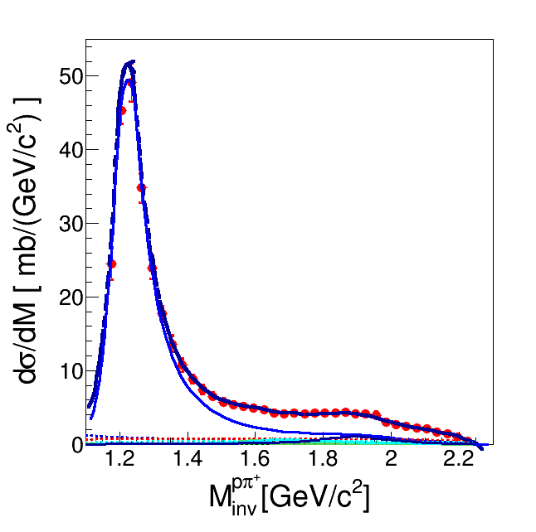
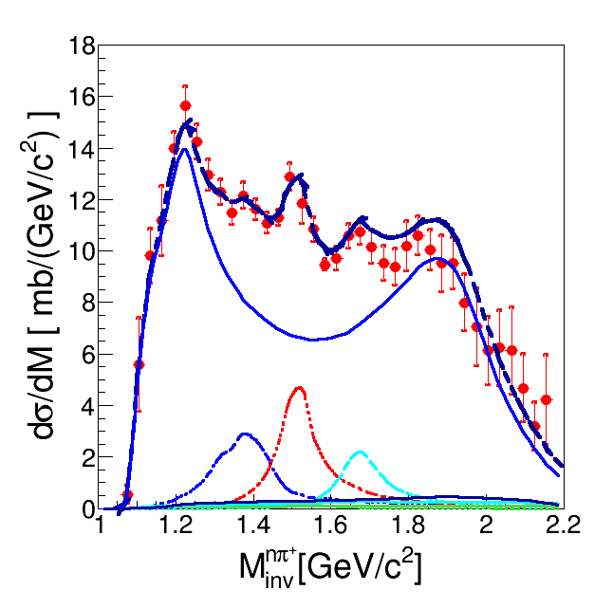

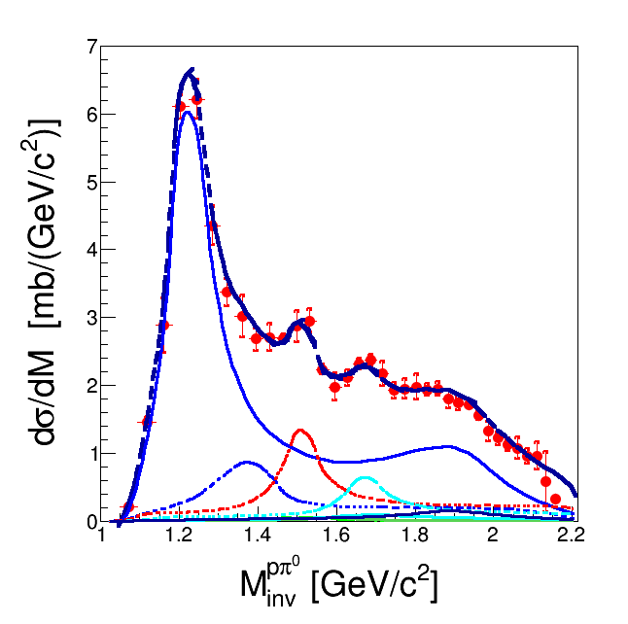
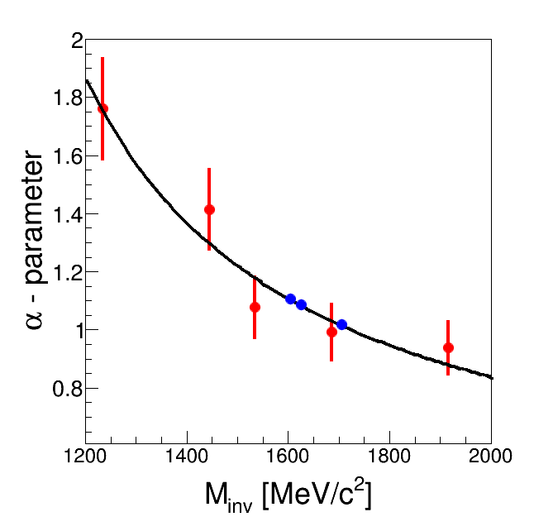


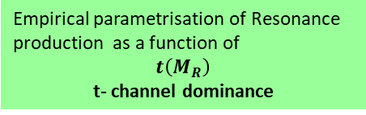
Resonance excition @ √s=3.1 GeV
n p π⁺
Resonance model:
Z. Teis et al., Z. Phys. A356 (1997) 421
J. Weil et al. (GiBUU) Eur. Phys. J. A48 (2012) 111
HADES : EPJA 50(2014) 42
Incoherent sum of (Δ, N*) resonances
R ( $\overline{q_{3}})$
p₁
p₂
$\overline{t}=(\overline{q_{3}}−\overline{q_{1,2}}$)
p p π⁰
Empirical parametrisation of Resonance production as a function of
$$t\left(M_{R}\right)$$
t- channel dominance

Slide 34
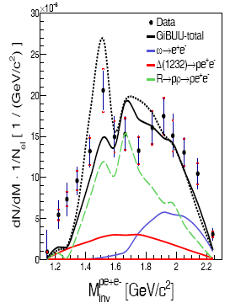
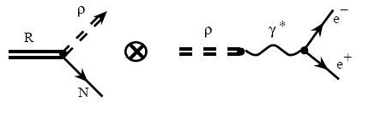
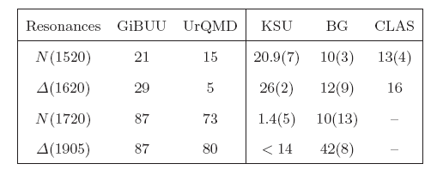
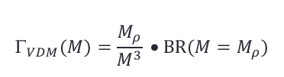
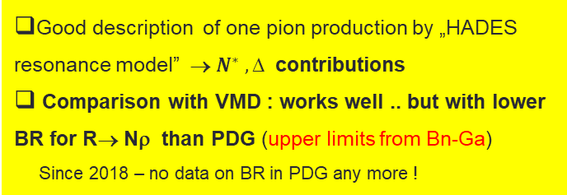
Higher mass resonances: pp→ppe+e- √s=3.1 GeV
Resonance model + „strict” VDM
$$_{VDM}(M)=\frac{M_{ρ}}{M^{3}} • BR(M=M_{ρ})$$
Good description of one pion production by „HADES resonance model” → $N^{∗} , $ contributions
Comparison with VMD : works well .. but with lower BR for R→ Nρ than PDG (upper limits from Bn-Ga)
Since 2018 – no data on BR in PDG any more !
Resonance -> Nρ Branching Ratios
Contr. to e+e-
38%
15%
22%
7%
pion beam !
PDG @ 2015

