Slide 1

Revised helicity evolution at small x: exact analytic solution of the large-N_{c} equations
Yuri Kovchegov
The Ohio state university
Based on work done with Dan Pitonyak and Matt Sievert (2015-2018, 2021), Florian Cougoulic (2019-2022), Josh Tawabutr (2020-2022), Andrey Tarasov (2021-2022), Daniel Adamiak, Nick Baldonado, Wally Melnitchouk, Nobuo Sato (2021, 2023), Jeremy Borden (2022)

Slide 2
Outline
Proton spin puzzle
Quark and gluon helicity evolution at small x:
  Quark and gluon helicity distributions at small x & polarized dipoles
  Small-x evolution equations for quark and gluon helicity
Solving the new evolution equations:
  Exact solution at large N_{c}: small-x asymptotics of quark and gluon helicity distributions
  Phenomenology: first fit of small-x polarized DIS data using evolution in x, predictions for EIC
Sivers and Boer-Mulders functions at small x.
Conclusions and Outlook

Slide 3
Proton Spin Puzzle: an Introduction

Slide 4
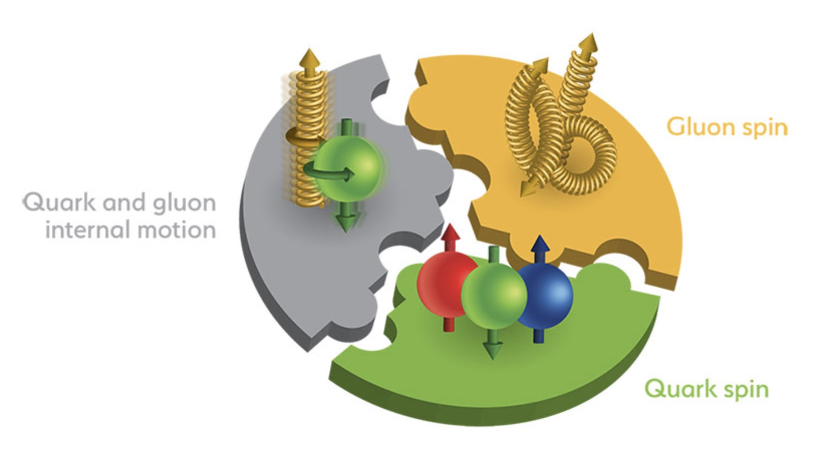
Proton Spin Puzzle
The spin puzzle began when the EMC collaboration
measured the proton g₁ structure function ca 1988.
Their data resulted in
It appeared (constituent) quarks do not carry all of the proton spin
(which would have naively corresponded to ).
Missing spin can be
  Carried by gluons
  In the orbital angular momenta of quarks and gluons
  At small x:
  Or all of the above!
Can’t integrate down to zero, use x_{min} instead!

Slide 5
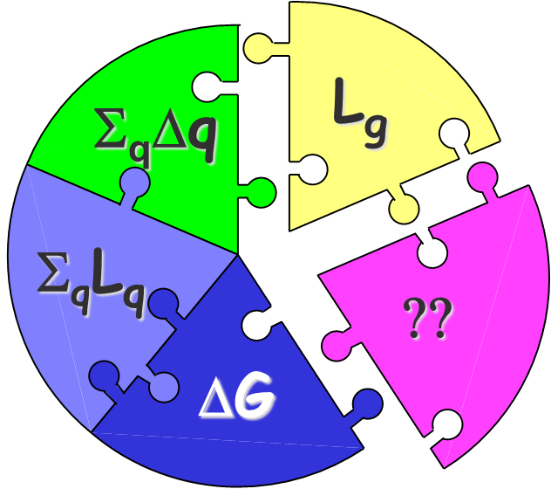
Current Knowledge of Proton Spin
The proton spin carried by the quarks is estimated to be (for )
The proton spin carried by the gluons is (for
, STAR+PHENIX+COMPASS +HERMES+… , analyzed by DSSV, JAM, NNPDF…)
Negative S_{G} is also possible (JAM ‘22).
Unfortunately, the uncertainties are large. Note also that the x-ranges are limited, with more spin (positive or negative) possible at small x.

Slide 6
Gluons and Quarks at Small-x
There is a large number of small-x gluons (and sea quarks) in a proton:
G(x, Q²) , q(x, Q²) = gluon and quark number densities / parton distribution functions (q=u,d, or S for sea).
x (# gluons or quarks)
Can the small-x gluons and
quarks carry a lot of
the proton spin?
=fraction of the proton momentum they carry

Slide 7
How much spin is there at small x?
E. Aschenauer et al, 2020 (DGLAP-based helicity PDF extraction from data)
Uncertainties are very large at small x. Note that this is xΔG, the uncertainties for ΔG are 1/x = 100-10000 times larger! EIC will reduce them, but only where there will be data.

Slide 8
EIC & Spin Puzzle
Still, even with the EIC data
we’ll need to extrapolate quark
and gluon spin down to smaller x.
Parton helicity distributions are sensitive to low-x physics.
EIC would have an unprecedented low-x reach for a polarized DIS experiment, allowing to pinpoint the values of quark and gluon contributions to proton’s spin (EIC WP ‘12):
ΔG and ΔΣ are integrated over x in the 0.001 < x < 1 interval.

Slide 9
Quark and Gluon Helicity at Small x
YK, D. Pitonyak, M. Sievert, arXiv:1511.06737 [hep-ph], arXiv:1610.06197 [hep-ph] (KPS);
YK, M. Sievert, arXiv:1505.01176 [hep-ph], arXiv:1808.09010 [hep-ph];
F. Cougoulic, YK, A. Tarasov, and Y. Tawabutr, arXiv:2204.11898 [hep-ph] (KPS-CTT).

Slide 10
Sub-Eikonal Operators

Slide 11
Dipole picture of DIS
x⁻
x⁺
Large q⁻ → large x⁻ separation
aka the “shock wave”

Slide 12
Polarized Dipole: non-eikonal small-x physics
All flavor-singlet small-x helicity observables depend on “polarized dipole amplitudes”:
Double brackets denote an object with energy suppression scaled out:
unpolarized quark
polarized quark: eikonal propagation,
non-eikonal spin-dependent interaction

Slide 13
Polarized fundamental “Wilson line”
To complete the definition of the polarized dipole amplitude, we need to construct the definition of the polarized “Wilson line” V^{pol}, which is the leading helicity-dependent contribution for the quark scattering amplitude on a longitudinally-polarized target proton.
At the leading order we can either exchange one non-eikonal t-channel gluon (with quark-gluon vertices denoted by blobs above) to transfer polarization between the projectile and the target, or two t-channel quarks, as shown above.
We employ a blend of Brodsky & Lepage’s LCPT and background field method-inspired operator treatment. We refer to the latter as the light-cone operator treatment (LCOT).

Slide 14
Notation
Fundamental light-cone Wilson line:
Adjoint light-cone Wilson line:

Slide 15
Sub-eikonal quark S-matrix in background gluon and quark fields
The full sub-eikonal S-matrix for massless quarks is (Balitsky&Tarasov ‘15; KPS ‘17; YK, Sievert, ‘18; Chirilli ’18; Altinoluk et al, ’20; YK, Santiago ‘21)
“helicity
independent”
“helicity
dependent”
“helicity
independent”
“helicity
dependent”

Slide 16
Helicity Observables at Small x

Slide 17
Dipole Gluon Helicity TMD
We start with the definition of the gluon dipole helicity TMD, corresponding to the Jaffe-Manohar PDF ΔG,
Here U^{[+]} and U^{[-]} are future and past-pointing
Wilson line staples (hence the name
‘dipole’ TMD, F. Dominguez et al ’11 – looks
like a dipole scattering on a proton):

Slide 18
Gluon Helicity
A calculation gives
Here we defined a new dipole amplitude G₂ (cf. Hatta et al, 2016; KPS 2017)
What is this D-D operator? Turns
out it is related to the DD operator
from before.

Slide 19
Quark Helicity PDF and TMD
The flavor-singlet quark helicity PDF and SIDIS TMD are
G₂ was defined before. This is the gluon admixture to quark helicity distributions.
The dipole amplitude Q is due to F¹² & axial current.
The contribution of G₂ comes from the DD operator in the quark S-matrix.
Hence, the DD operator is related to the Jaffe-Manohar distribution.

Slide 20
Amplitude Q
The amplitude Q is defined by
with , where
This is the ‘old’ KPS polarized dipole amplitude. U = adjoint light-cone Wilson line.

Slide 21
g₁ structure function
g₁ structure function is obtained similarly, using DIS in the dipole picture:
One gets
such that one reproduces the standard result

Slide 22
Helicity Evolution

Slide 23
Evolution for Polarized Quark Dipole
One can construct an evolution equation for the polarized dipole:
Spin-dependent (non-eikonal) vertex
polarized
particle
similar to the
unpolarized
BK evolution
box =
target shock
wave (proton)

Slide 24
Evolution for Polarized Quark Dipole
Equation does not close!

Slide 25
Large N_{c}
At large-N_{c} the equations close (Q → G).
Everything with 2 in the subscript (e.g., G₂ and Γ₂) is new compared to the KPS (‘15-’18) papers.

Slide 26
Initial Conditions
The initial conditions are given by the Born-level graphs
Similar Born-level calculation is done for G₂ and Γ₂.

Slide 27
“Neighbor” dipole
There is a new object in the evolution equation – the neighbor dipole amplitude.
This is specific for the DLA evolution. Gluon emission may happen in one dipole, but, due to lifetime ordering, may ‘know’ about another dipole:
We denote the evolution in the neighbor dipole 02 by
z’

Slide 28
Resummation Parameter
For helicity evolution the leading resummation parameter is different from BFKL, BK or JIMWLK, which resum powers of leading logarithms (LLA)
Helicity evolution resummation parameter is double-logarithmic (DLA):
The second logarithm of x arises due to transverse momentum (or transverse coordinate) integration being logarithmic both in the UV and IR.
This was known before: Kirschner and Lipatov ’83; Kirschner ’84; Bartels, Ermolaev, Ryskin ‘95, ‘96; Griffiths and Ross ’99; Itakura et al ’03; Bartels and Lublinsky ‘03.

Slide 29
Large-N_{c}&N_{f}
Equations also close in the large-N_{c}&N_{f} (Veneziano) limit.
This is more realistic as it includes quarks.
Everything with 2 in the subscript (e.g., G₂ and Γ₂) is new compared to the KPS (‘15-’18) papers.

Slide 30
Quark Helicity at Small x:
Asymptotics and Phenomenology
YK, D. Pitonyak, M. Sievert, arXiv:1610.06188 [hep-ph], arXiv:1703.05809 [hep-ph] (KPS);
F. Cougoulic, YK, A. Tarasov, and Y. Tawabutr, arXiv:2204.11898 [hep-ph] (KPS-CTT);
D. Adamiak, W. Melnitchouk, D. Pitonyak, N. Sato, M. Sievert, YK, 2102.06159 [hep-ph];
J. Borden and YK, 2304.06161 [hep-ph].

Slide 31
Small-x Asymptotics

Slide 32
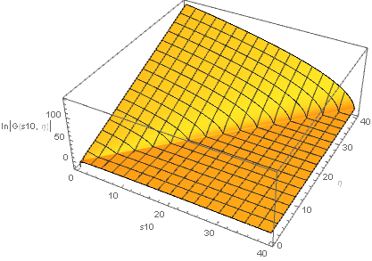

Solution of the Large-N_{c} Equations
F. Cougoulic, YK, A. Tarasov, Y. Tawabutr, 2022
The large-N_{c} equations for G and G₂ can be solved
numerically (and, possibly, analytically).

Slide 33
Small-x Asymptotics
Fitting the slope of the log plots of G and G₂ vs e we can read off the small-x intercept (the power of x):
F. Cougoulic, YK, A. Tarasov, Y. Tawabutr, 2022

Slide 34
Small-x Asymptotics for Helicity Distributions
The resulting small-x asymptotics for helicity PDFs and the g₁ structure function at large N_{c} is
This power (aka the intercept) is in complete agreement with the work by J. Bartels, B. Ermolaev, and M. Ryskin (BER, 1996) using infrared evolution equations (with the analytic intercept constructed by KPS in 2016):
“Peace in the valley.”
Right?

Slide 35
Analytic Solution of the Large-N_{c} Equations
We want to solve
these equations:

Slide 36
Analytic Solution of the Large-N_{c} Equations
The strategy is to use the double Laplace transform,
One gets the expressions for all the other dipole amplitudes this way, for instance
Neighbor amplitudes involve several different double Laplace transforms:

Slide 37
Analytic Solution of the Large-N_{c} Equations
In the end, all the amplitudes in the double-Laplace space can be expressed in terms of the initial conditions/inhomogeneous terms, e.g.,
with
More details in J. Borden, YK, 2304.06161 [hep-ph].

Slide 38
Small-x Asymptotics for Helicity Distributions
Let’s take a closer look at the anomalous dimension:
In the pure-glue case, Bartels, Ermolaev and Ryskin’s (BER) anomalous dimension can be found analytically. It reads (KPS ‘16)
Our evolution’s anomalous dimension can be found analytically at large-N_{c}
(J. Borden, YK, 2304.06161 [hep-ph]):

Slide 39
A Tale of Two Anomalous Dimensions
The two anomalous dimensions look similar enough but are not the same function.
Their expansions in α_{S} start out the same, then differ at four (!) loops (the first 3 terms agree with the existing finite-order calculations, the four-loop result is unknown):

Slide 40
A Tale of Two Intercepts
The intercept (largest power Re[ω]) is given by the right-most singularity (branch point) of the anomalous dimension.
For BER this gives
For us

Slide 41
A Tale of Two Intercepts
BER:
Us:
Our numerical solution also gave the intercept of 3.660 or 3.661, but we believed we had larger error bars.
We (still) disagree with BER. Albeit in the 3rd decimal point…

Slide 42
Phenomenology
D. Adamiak, N. Baldonado, YK, W. Melnitchouk, D. Pitonyak,
N. Sato, M. Sievert, A. Tarasov, Y. Tawabutr, = JAMsmallx in preparation

Slide 43
Polarized DIS and SIDIS data
We can use the large-N_{c}&N_{f} version of the evolution to fit all the existing world polarized DIS and SIDIS data.
Why not large-N_{c}? Have to distinguish a
true quark dipole from the subset of the
gluon one. Then can fit all helicity PDFs for
light quark flavors, in addition to the gluon
helicity PDF.
Hence, the quark amplitudes Q_{f} come with
the flavor index f.
Drawback: many dipole amplitudes,
hard to constrain all.
LO intercept is large: had to include running
coupling (not shown) into the evolution.

Slide 44
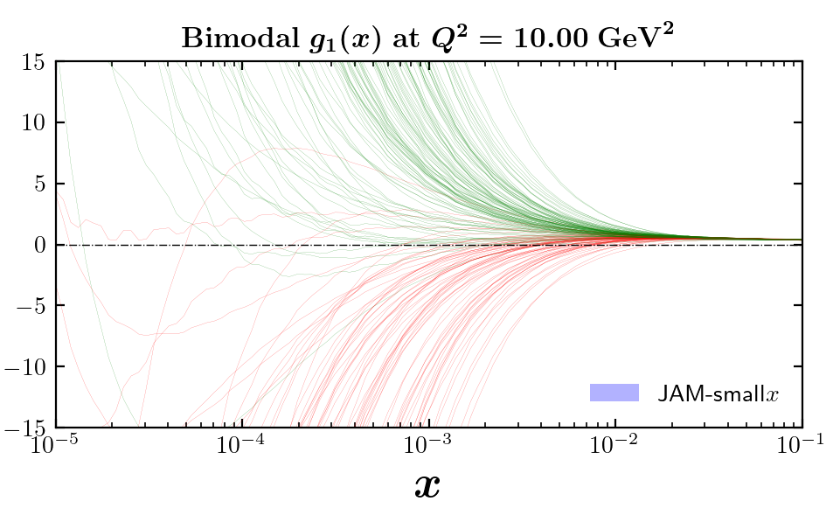
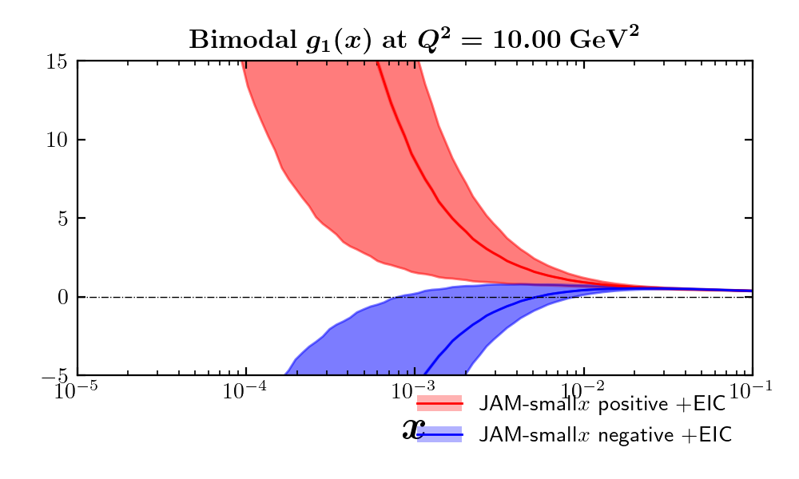
Proton g₁ structure function
JAM-smallx preliminary
Replicas
Error bands
JAM is based on a Bayesian Monte-Carlo: it uses replicas.
Due to the lack of constraints, everything is bi-modal!
This lines in the middle – PDF extractions using EIC pseudo-data, it would resolve the bi-modality.

Slide 45
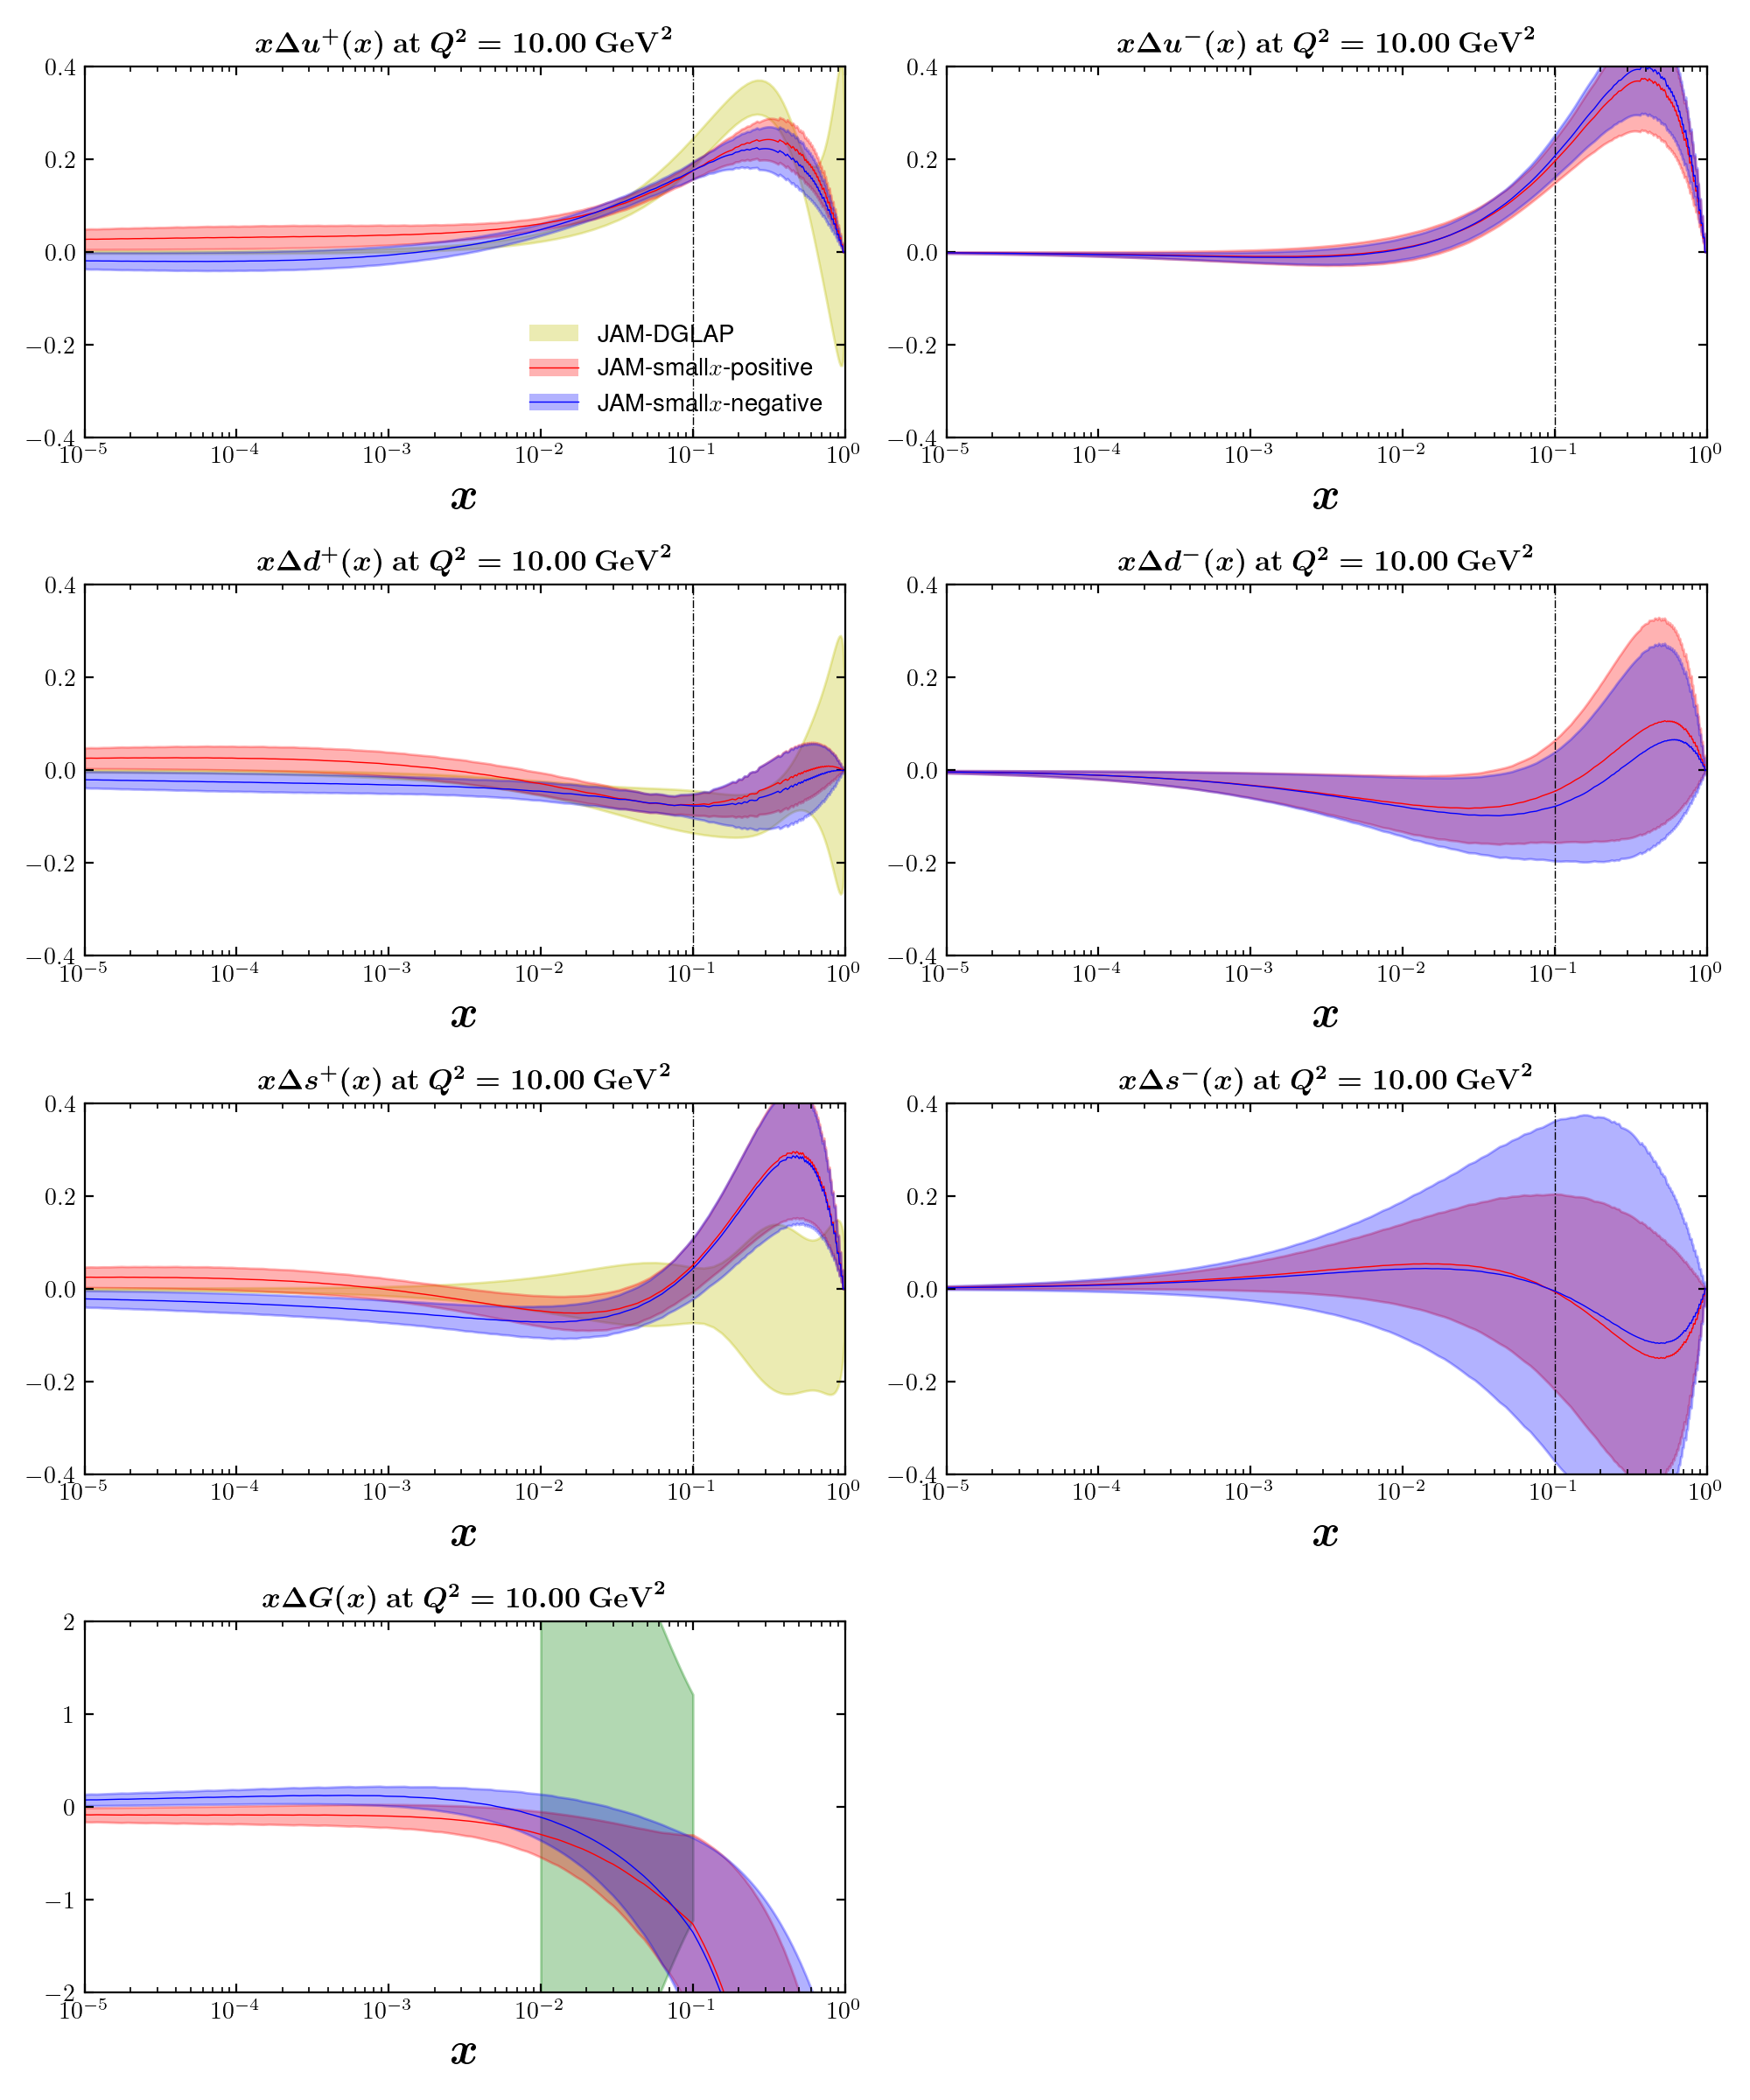
Helicity PDFs:
JAM-smallx preliminary
Here too, everything is bi-modal.
Again, lines in the middle
are the EIC pseudo-data.

Slide 46
Sivers and Boer-Mulders Functions at Small x
YK, M. G. Santiago, 2209.03538 [hep-ph]

Slide 47
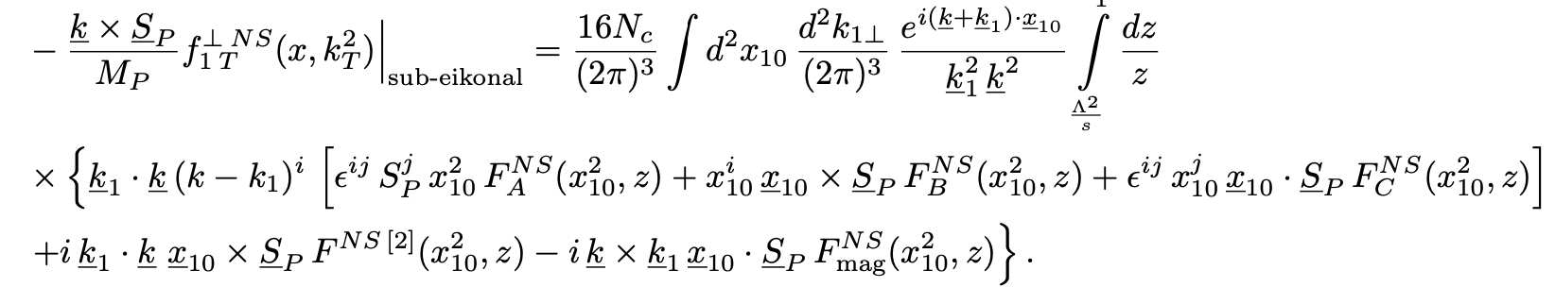
Sivers Function
Similar technique can be applied to the Sivers function: first, simplify it at small x. This gives (for the flavor non-singlet Sivers function, at the sub-eikonal order)
The dipole amplitudes F_{A}, F_{B}, F_{C} and F_{mag} are defined in terms of the same operators as the helicity dipole amplitudes. Except now the proton is transversely polarized.

Slide 48
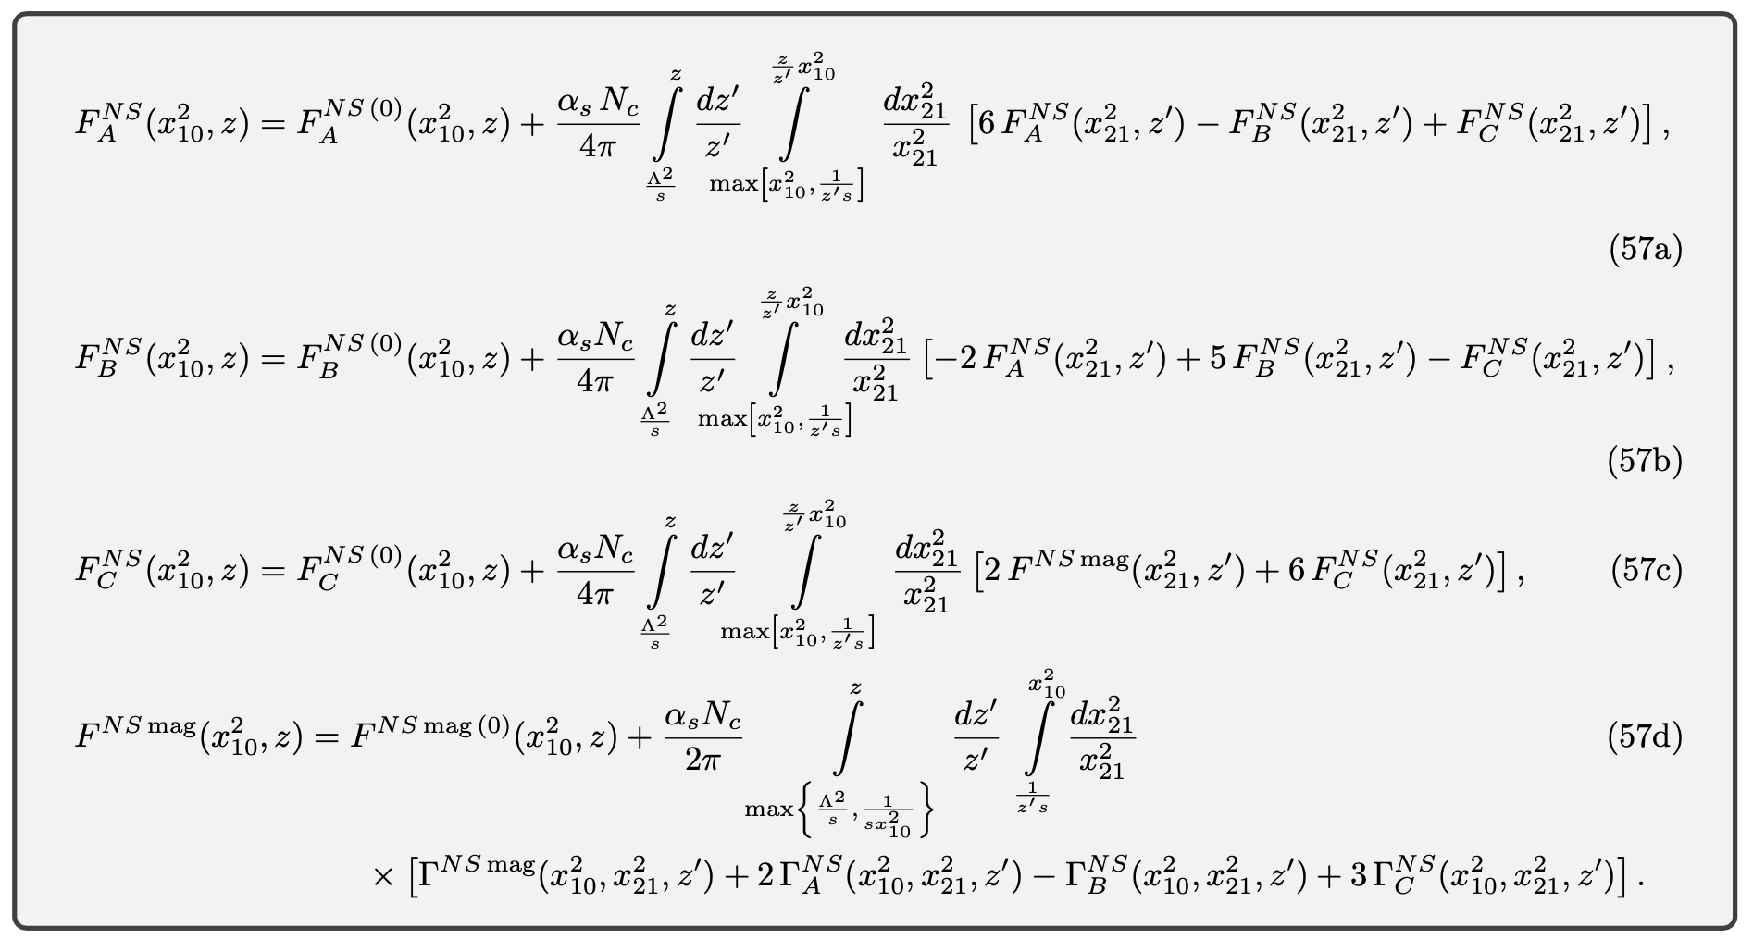
Sivers Function
YK, M. G. Santiago,
2209.03538 [hep-ph]
These amplitudes obey the following evolution equations at large N_{c} (plus 4 similar equations for the neighbor dipole amplitudes Γ):

Slide 49
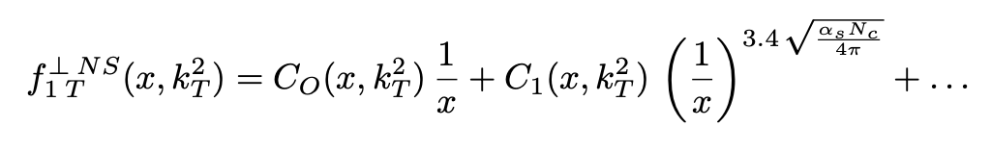
Sivers Function: Small-x Asymptotics
Solving those equations numerically, and adding the eikonal spin-dependent odderon contribution, we arrive at the following small-x asymptotics:
While the sub-eikonal contribution is nominally suppressed by a power of x (it is suppressed for zero α_{s}), the actual power in it for realistic α_{s} is close to 1.
Thus, the DLA correction is almost as large as the leading eikonal spin-dependent odderon contribution.
Spin-dependent
Odderon (Boer,
Echevarria, Mulders,
Zhou, 2015)
Our sub-eikonal
DLA contribution
YK, M. G. Santiago,
2209.03538 [hep-ph]

Slide 50
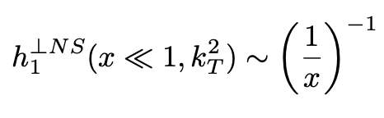
Boer-Mulders Function
Similar procedure yields, for the Boer-Mulders function,
Boer-Mulders function is sub-eikonal at small x. Moreover, the DLA correction to the sub-eikonal power of x is zero.
We observe that the intercepts of the leading small-x asymptotics terms for the T-odd leading-twist quark TMDs, the Sivers function and Boer-Mulders function, appear to receive no perturbative corrections (no α_{s} corrections). Could this be an exact statement in QCD?
YK, M. G. Santiago,
2209.03538 [hep-ph]

Slide 51
Conclusions
These equations have now been solved exactly analytically at large-N_{c} yielding the small-x asymptotics of ΔΣ(x, Q²) and ΔG(x, Q²). The study of the large-N_{c}&N_{f} equations and OAM distributions are under way.
First successful fit (JAMsmallx) of polarized world DIS data for x<0.1 done using solely the small-x helicity evolution. There is a clear possibility of a significant amount of proton spin to be found at small x, about 20% in the quark sector alone. This should help us solve the spin puzzle.
The same technique can be applied to other distribution functions. We have obtained the small-x asymptotics for the Sivers and Boer-Mulders functions, beyond the already known spin-dependent odderon contribution.
We have constructed new evolution equations in x for the quark and gluon helicity distributions. We can now predict the x-dependence of helicity PDFs at small x.

Slide 52
Backup Slides

Slide 53
Eikonality
One can classify various TMDs by their small-x asymptotics.
Eikonal behavior corresponds to (up to ~α_{S} corrections in the power)
Examples: unpolarized TMDs, Sivers function for gluons and quarks.
Sub-eikonal behavior corresponds to
Example: helicity TMDs.
Sub-sub-eikonal behavior is
Example: transversity.
We’ve been calling the leading power of x “eikonality”.

Slide 54
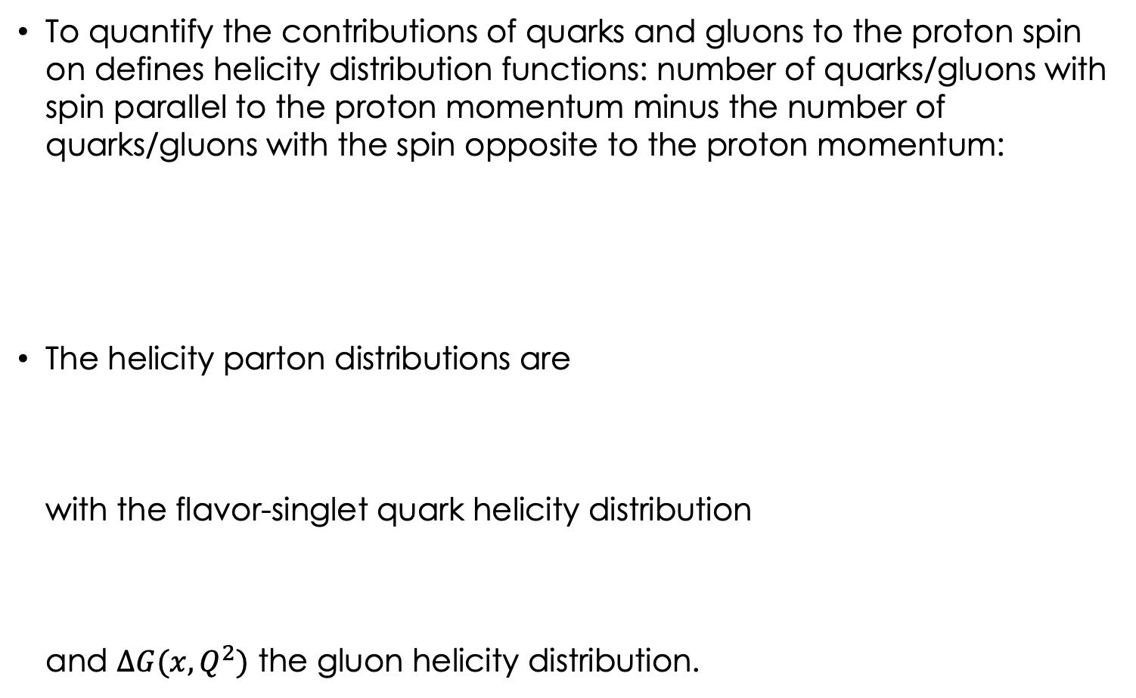
Helicity Distributions
To quantify the contributions of quarks and gluons to the proton spin on defines helicity distribution functions: number of quarks/gluons with spin parallel to the proton momentum minus the number of quarks/gluons with the spin opposite to the proton momentum:
The helicity parton distributions are
with the flavor-singlet quark helicity distribution
and $∆G(x,Q^{2})$ the gluon helicity distribution.

Slide 55
Small-x Spin Challenge
Can we constrain theoretically the amount of proton spin and OAM coming from small x?
Any existing and future experiment probes the helicity distributions and OAM down to some x_{min} .
At very small x (for the proton), saturation sets in: that region likely carries a negligible amount of proton spin. But what happens at larger (but still small) x?

Slide 56
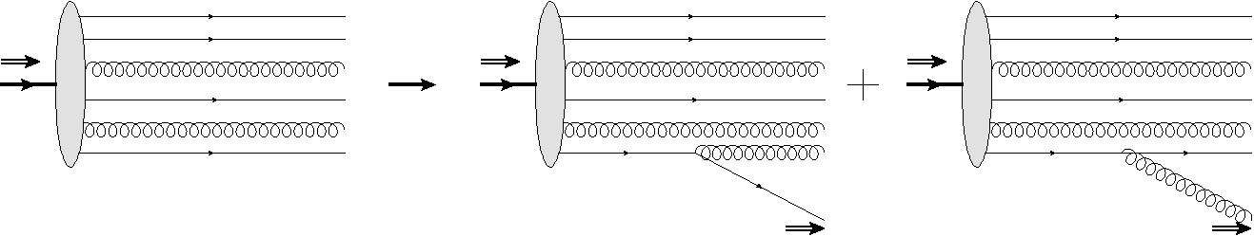
Helicity Evolution at Small x
To understand how much of the proton’s spin is at small x one can construct a helicity analogue of the BFKL equation:
These new helicity evolution equations are
subtle, since they must keep track of both
quark and gluon helicities. (Other small-x
evolution equations, BFKL/BK/JIMWLK, only
have gluons at leading order.)
polarized
proton
polarized
quark
polarized
gluon
D. Pitonyak, M. Sievert, Y.K. ‘15-’18 (KPS);
F. Cougoulic, YK, A. Tarasov, Y. Tawabutr ‘22

Slide 57
How much spin is there at small x?
2 x (quark
spin)
gluon
spin
E. Aschenauer et al, arXiv:1509.06489 [hep-ph], (DSSV = de Florian, Sassot, Stratmann, Vogelsang, DGLAP-based helicity PDF extraction from data)
Uncertainties are very large at small x! (EIC may reduce them.)

Slide 58
Philosophy of small-x approach to spin
DGLAP equation evolves in Q², it does not evolve in x.
Hence, DGLAP-based analyses (DSSV, NNPDF, standard JAM) cannot predict the x-dependence of PDFs.
If we want to predict helicity PDFs at small x, we need a different evolution equation that evolves in x.
Such equations were constructed by D. Pitonyak, M. Sievert, and YK, (KPS, 2015-2018) along with a recent important correction by F. Cougoulic, YK, A. Tarasov, Y. Tawabutr (KPS-CTT) in 2022; both works use an approach similar to the BK/JIMWLK evolution.
Other important work on spin at small x: J. Bartels, B. Ermolaev, M. Ryskin ‘95-’96; Y. Hatta et al ‘16; R. Boussarie, Y. Hatta, F. Yuan ‘19; G. Chirilli ‘21. Significant related works by R. Kirschner and L. Lipatov ‘83; T. Altinoluk, G. Beuf et al ‘20, ‘21.

Slide 59
Helicity Evolution Ingredients
Unlike the unpolarized evolution, in one step of helicity evolution we may emit a soft gluon or a soft quark (all in A⁻=0 LC gauge of the projectile):
When emitting gluons, one emission is eikonal, while another one is soft, but non-eikonal, as is needed to transfer polarization down the cascade/ladder.

Slide 60
Helicity Evolution: Ladders
To get an idea of how the helicity evolution works let us try iterating the splitting kernels by considering ladder diagrams (circles denote non-eikonal gluon vertices):
To get the leading-energy asymptotics we need to order the longitudinal momentum fractions of the quarks and gluons (just like in the unpolarized evolution case)
obtaining a nested integral

Slide 61
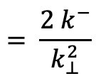
Helicity Evolution: Ladders
lifetime
$$= \frac{{2 k}^{−}}{k_{⊥}^{2}}$$
However, these are not all the logs of energy one can get here. Transverse momentum (or distance) integrals have UV and IR divergences, which lead to logs of energy as well.
If we order gluon/quark lifetimes as (Sudakov-β ordering)
then (z_{i} = k_{i}⁻/p⁻). and
we would get integrals like also generating logs of energy.

Slide 62
Helicity Evolution: Ladders
To summarize, the above ladder diagrams are parametrically of the order
Note two features:
  1/s suppression due to non-eikonal exchange
  two logs of energy per each power of the coupling!

Slide 63
Cross Checks

Slide 64
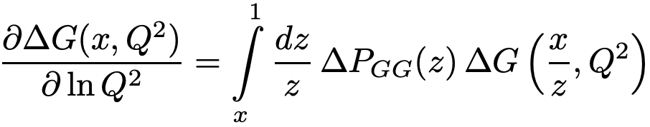
Cross Checks: spin-dependent DGLAP
Our evolution at large Q² can be cross-checked against the small-x limit of the spin-dependent DGLAP equation.
At DLA, ΔG is simply proportional to G₂:
We solved our large-N_{c} equations iteratively, comparing ln(Q²) terms with small-x spin-dependent DGLAP evolution.
We obtained a complete agreement with LO+NLO+NNLO DGLAP at small x
(R. Mertig, W.L. van Neerven ‘95; S. Moch, J.A.M. Vermaseren, A. Vogt, ‘14).
We can
predict
higher orders.

Slide 65
Cross Checks: two methods, ΔG in g₁
We rederived our evolution equations using the background field method.
This is in addition to a blend of Brodsky & Lepage’s LCPT and background field method-inspired operator treatment which I presented above (LCOT).
Finally, one can even verify that ΔG enters the expression for g₁ with the right coefficient using ΔG ~ G₂ and

Slide 66
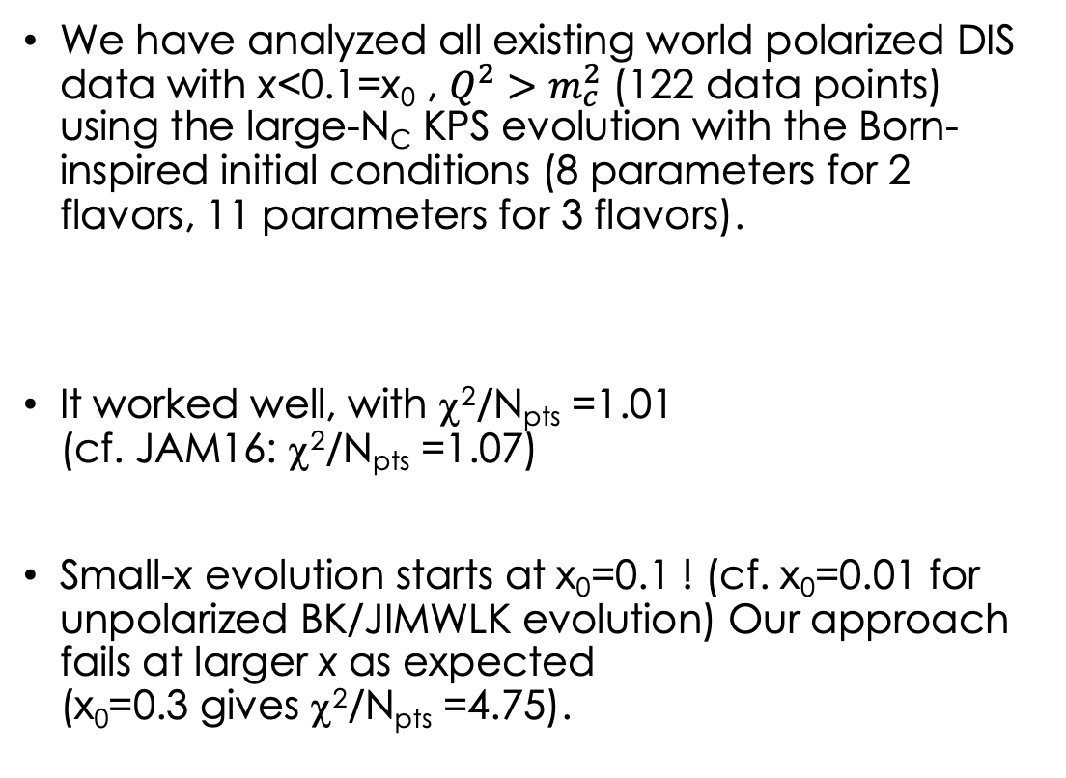
Small-x Polarized DIS Data
(Adamiak, Melnitchouk,
Pitonyak, Sato, Sievert,
YK, 2102.06159 [hep-ph]
= JAMsmallx)
We have analyzed all existing world polarized DIS data with x<0.1=x₀ , $Q^{2}>m_{c}^{2}$ (122 data points) using the large-N_{C} KPS evolution with the Born-inspired initial conditions (8 parameters for 2 flavors, 11 parameters for 3 flavors).
It worked well, with χ²/N_{pts} =1.01
(cf. JAM16: χ²/N_{pts} =1.07)
Small-x evolution starts at x₀=0.1 ! (cf. x₀=0.01 for unpolarized BK/JIMWLK evolution) Our approach fails at larger x as expected
(x₀=0.3 gives χ²/N_{pts} =4.75).

Slide 67
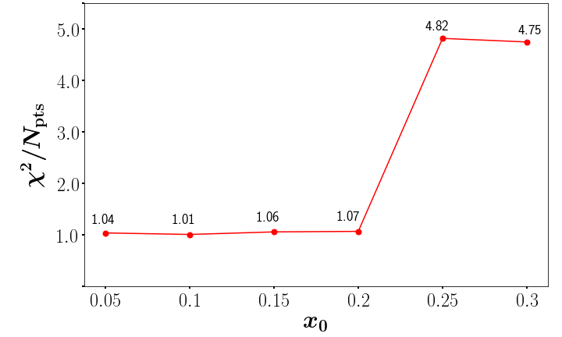
Where to start small-x evolution
The evolution starts at x=x₀, and continues toward smaller x.
The quality of our fit rapidly deteriorates for x₀>0.2, as expected from a small-x approach.
In unpolarized BK/JIMWLK evolution, typically x₀=0.01, so the fact that our fit works up to such a high x₀ is quite remarkable.

Slide 68
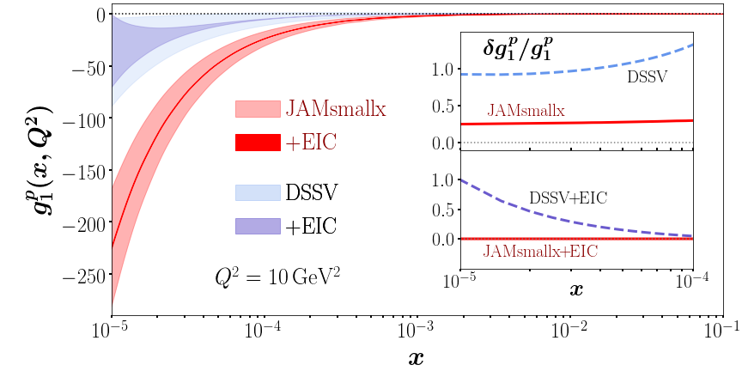
Prediction for g₁ structure function
g₁ structure function $≈$ spin-dependent part of $σ^{e+p}$
Thick band: 1σ CL; thin band: impact of EIC data. With the EIC pseudo-data we have 1096 data points.

Slide 69
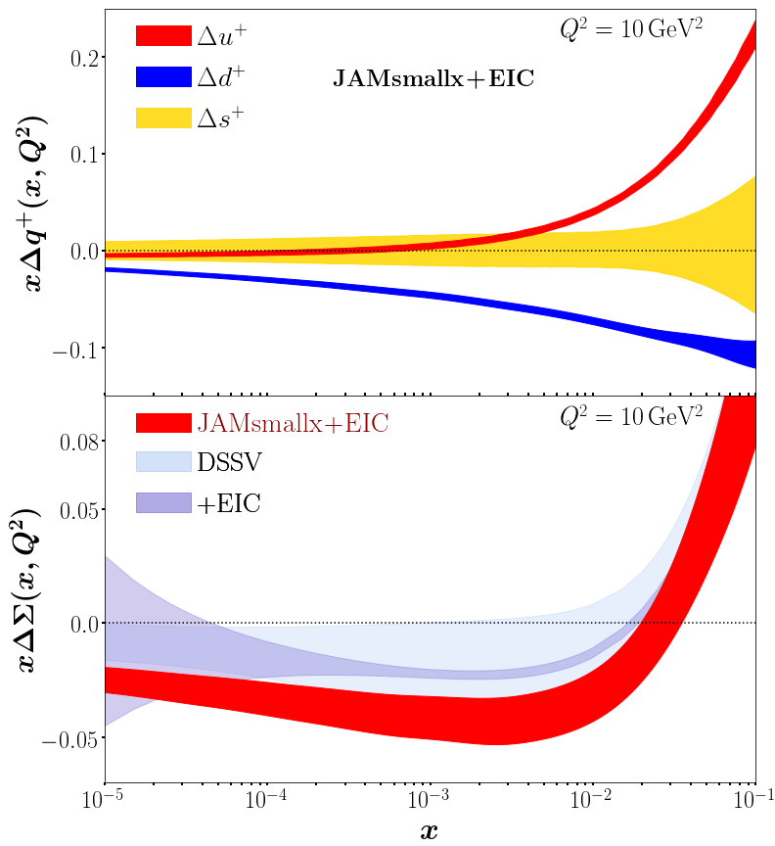
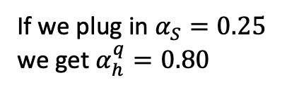
Predictions for helicity PDFs
D. Adamiak, W. Melnitchouk,
D. Pitonyak, N. Sato, M. Sievert & YK,
2102.06159 [hep-ph], in the
JAM Collaboration framework.
Our (red) error
band does not
explode in the
unmeasured
region. We can
predict spin at small x.
If we plug in $α_{S}=0.25$
we get $α_{h}^{q}=0.80$
old intercept!

Slide 70
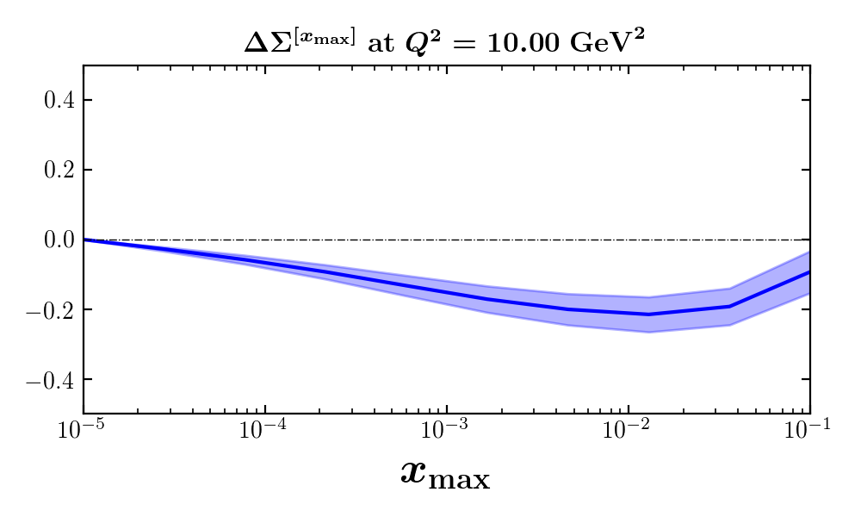
Small-x quarks impact on the proton spin
Potentially negative 10-20% of the proton spin may be carried by small-x quarks (JAMsmallx, preliminary):

Slide 71
Speculation on a path to resolving the spin puzzle
Above we discussed quark helicity at small x. Let’s add the orbital angular momentum (OAM) (Hatta & Yang, ’18; YK ‘19):
So, the net quark (1/2) helicity+OAM = (-1/2) helicity.
For x<0.001 we thus expect (preliminary!)
Add to this the larger-x numbers
We get
JAMsmallx, preliminary,
Adamiak, Melnitchouk,
Pitonyak, Sato, Sievert, YK

Slide 72
A warning
Note that the above phenomenology was done using the old version of the evolution equations. Consider it a proof of principle.
Phenomenology with the new corrected evolution equations is being developed as we speak.

