Slide 1
Non-invertible symmetries and Goldstone modes
Nabil Iqbal
Durham University
2211.09570
with Iñaki García-Etxebarria

Slide 2

Symmetries of QED
In this talk, I’ll discuss some new ways to think about a very familiar system: massless QED. (Applications to QCD as well).
Consists of massless fermions interacting via electric fields.
-
-
+
+
What are the symmetries, exactly?

Slide 3
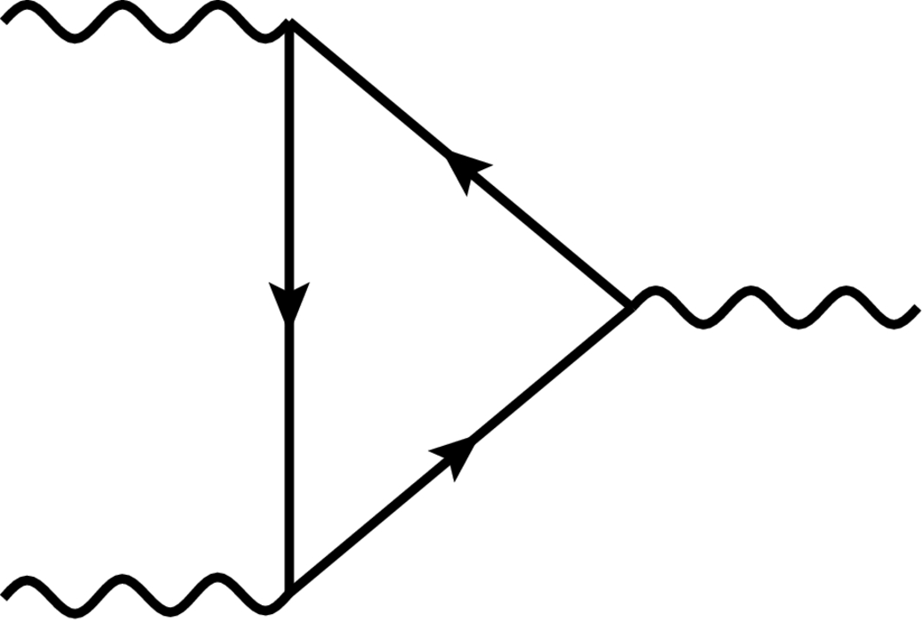
Symmetries of QED
First, let us consider freezing EM; view A as an external gauge field.
Global symmetries are very well-understood:
‘t Hooft anomaly: operator on RHS is a fixed external source. What about dynamical EM?

Slide 4


Generalizations of symmetry
To understand this, let’s review ordinary 1-index currents first.
An ordinary current counts particles; “catch them all” by integrating on a co-dimension 1 subspace. In Euclidean:
Defines a U(1)-valued topological codimension-1 surface operator.
(Fancy way to talk about “conserved charge”; call this a 0-form symmetry).

Slide 5

Higher form symmetries
Now a 2-index current (Gaiotto, Kapustin, Seiberg, Willet):
A 2-index current counts strings; as they don’t end in space or time, “catch them all” by integrating on a co-dimension 2 subspace:
Local current defines a U(1)-valued topological codimension-2 surface operator.
This is called a 1-form symmetry.

Slide 6


Symmetries of QED I
Now consider the situation where A is dynamical.
Vector current is gauged; no longer a global symmetry.
New 1-form global symmetry associated with conservation of magnetic flux.
No magnetic monopoles means that magnetic field lines don’t end. J^{μν} counts magnetic flux density. (e.g. 4d photon is a Goldstone mode!)

Slide 7
Symmetries of QED II
How about the axial current?
Now the right hand side of the anomaly equation is an operator, not a fixed source; it appears that the current is simply not conserved?
True situation is somewhat more subtle…

Slide 8
Symmetries of QED II
Summary of symmetries in massless QED:
1-form symmetry for magnetic flux conservation.
Non-conservation of axial charge given in terms of 2-form current.
Right way to think about this was explained recently in terms of non-invertible symmetry (Choi, Lam, Shao; Cordova, Ohmori).

Slide 9
Non-invertible symmetry in QED
No conserved gauge-invariant current. Conserved charge?
Try and make a topological surface operator like before:
This is gauge-invariant under small gauge transformations, but not large ones, unless ⍺ is 2𝜋 integer – but then the operator is always 1.
Feels like there is no useful conserved charge...

Slide 10
To fix this:
We can fix this by introducing a new degree of freedom. Original profound idea by Choi, Lam, Shao; Cordova, Ohmori. This reformulation by I. García-Etxebarria, NI; A. Karasik.
Introduce a compact scalar field θ on the defect:
Transforms like a Higgs phase; this now defines a topological operator (i.e. a new conserved charge).
There is now a gauge-invariant local current operator defined on the defect.
Operator is topological! (can be interpreted as a conserved charge)

Slide 11
Some remarks
Claim: this is the correct way to think about axial symmetry in QED.
Called non-invertible symmetry (much recent work!), as it has no inverse; Due to new degree of freedom, acting with the opposite charge doesn’t give a trivial operator.
Opens up many doors: what is the phase structure of these symmetries? Is there a Goldstone theorem? (Yes.) Can we do hydrodynamics? (Wait ~5 mins). Etc. etc.
=

Slide 12
Goldstone’s theorem I
Let’s first formulate Goldstone’s theorem for ordinary symmetries in Euclidean path-integral language (Hofman, NI).
Ward identity for U(1) current:
Integrate both sides over interior of S^{3.}
If vev of charged operator is nonzero, must be a power-law correlation in theory; this is Goldstone mode.

Slide 13
Goldstone’s theorem II: non-invertible
Let’s now formulate Goldstone’s theorem for these non-invertible symmetries.
Wrap the operator with the charge defect:
Take a derivative with respect to symmetry parameter:
Proof is essentially the same (except current operator is localized on defect). We have Goldstone mode.

Slide 14
Axion effective theory
What is the low-energy theory of the Goldstone mode? Axion theory:
“Why” is this theory massless?
Often some words about ”no U(1) instantons”; from our point of view, it is massless because it is the Goldstone mode of a spontaneously broken non-invertible symmetry.
(Same words apply in application to chiral limit QCD: explanation of why π₀ is massless despite anomaly. Also protects masslessness of many fields in string theory.)

Slide 15

Future directions:
Physical applications of higher-form and non-invertible symmetries are still in their infancy (See Saso’s talk yesterday). Basic questions are open:
Which systems have these symmetries? When is there a Goldstone theorem?
What is the phase structure? Phase transitions and critical phenomena?
For QED: can we reformulate chiral magnetohydrodynamics with these non-invertible symmetries as a guiding principle? Arpit’s talk next!
What is the new Landau paradigm built around these new symmetries?

Slide 16
Summary
Non-invertible symmetry is a new way to think about systems with an ABJ anomaly.
There is a Goldstone theorem for (some of) these non-invertible symmetries.
A new non-invertible Landau paradigm?
The End

