Slide 1
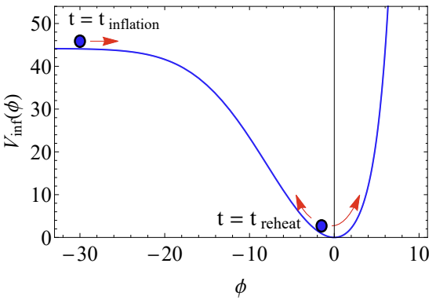
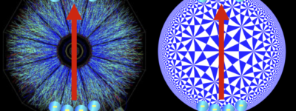
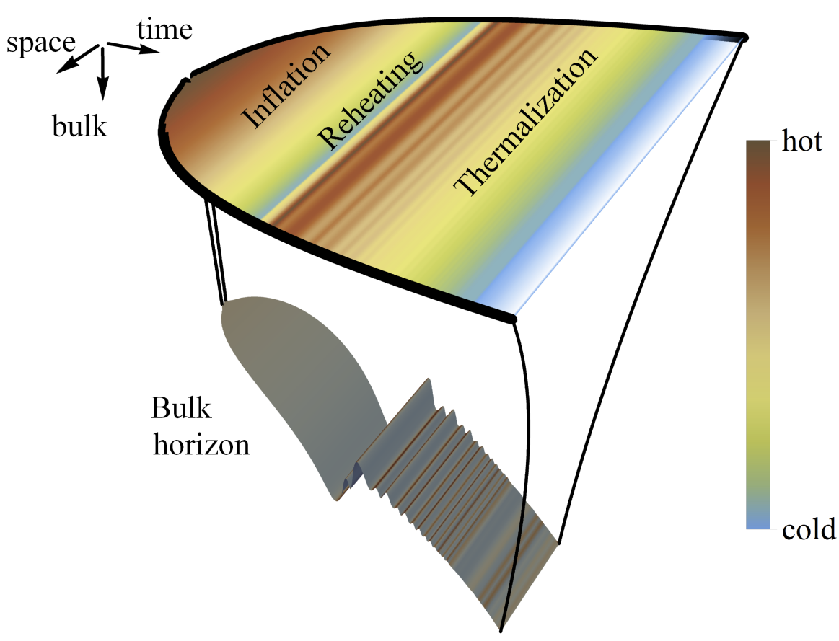
A dynamical inflaton coupled to strongly interacting matter
Holographic QFTs on curved backgrounds
With Jorge Casalderrey-Solana, Christian Ecker, Elias Kiritsis and David Mateos
Reference: 2011.08194 (JHEP), 2109.10355 (JHEP) and 2302.06618
Wilke van der Schee
Holographic perspectives on chiral transport
ECT*, Trento, 14 March 2023

Slide 2
motivation
Wilke van der Schee, CERN/Utrecht
Strongly coupled QFT on de Sitter space
Can be relevant for the early universe
Many first principle questions arise in de Sitter: thermodynamics, entropy etc
Can we understand inflation/reheating?
Evolution with dynamical boundary gravity and an inflaton
Semi-classical Einstein Equations on the boundary
A technical subtlety: how to extract the log terms?
Example with inflation, running down of inflaton and reheating
Strongly coupled sector like in hidden sector if relevant for our own universe
Major caveat: this is not quantum gravity on de Sitter
Notes:
Many states + linearized

Slide 3
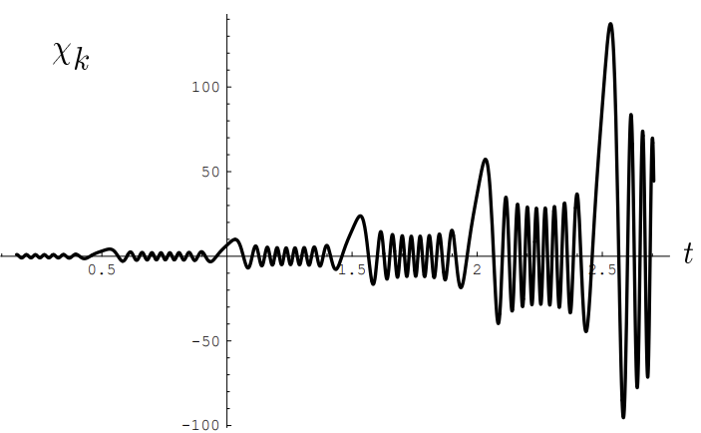
Inflation, preheating and reheating
Wilke van der Schee, CERN/Utrecht
Inflation
Inflaton vacuum energy leads to exponential expansion of the universe
Solves several problems in cosmology
Inflaton experiences friction and settles at bottom of potential
After inflation one is left with an empty universe
How to get a working universe
The inflaton energy needs to be transferred to Standard Model
Perturbative Reheating
Inflaton decays at an (approximately) constant rate (faster than H)
Decaying particles thermalize → big bang
Preheating
Bose enhancement leads to resonances: exponential transfer of energy
Bose enhanced states thermalize/reheat → big bang
Inflaton potential
Lev Kofman, Andrei Linde and Alexei A. Starobinsky, Towards the Theory of Reheating After Inflation (1997)
Notes:
Many states + linearized

Slide 4
Inflation, reheating and holography
Wilke van der Schee, CERN/Utrecht
Holographic set-up
Just like standard EH + inflaton + coupling to scalar:
Inflaton acts as a source for the scalar operator
Two technical complications:
Sources are now time-dependent numerical functions
holographic renormalization becomes more complicated
Trial and error:
Initial inflaton position, inflaton velocity, coupling strength, shape potential
Balance between numerical stability, runtime and making a ‘realistic’ universe
Inflaton potential
Notes:
Many states + linearized

Slide 5
A dynamical boundary
Wilke van der Schee, CERN/Utrecht
Study dynamics including semi-classical gravity:
Stress-tensor includes possible cosmological constant
NB: renormalisation counterterms are now physical
We treat the boundary Newton constant as a (small) parameter
Dynamics of scale factor S₀(t) is now consequence of Friedmann equations
How to initialise the dynamics
Start with thermal Minkowski profile and small boundary G_{N,4}
Jewel Ghosh, Elias Kiritsis, Francesco Nitti and Lukas Witkowski, Back-reaction in de Sitter QFTs: holography, gravitational DBI action and f(R) gravity (2020)
Paul Chesler and Abraham Loeb, Holographic duality and mode stability of de Sitter space in semiclassical gravity (2020)
Christian Ecker, WS, David Mateos and Jorge Casalderrey-Solana , Holographic evolution with dynamical boundary gravity (2021)
Notes:
Many states + linearized

Slide 6
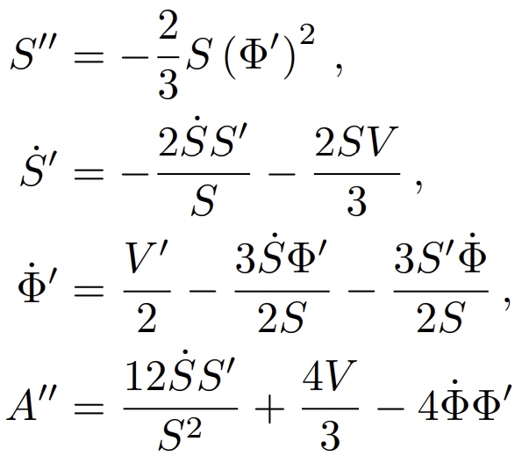
Some numerical details
Wilke van der Schee, CERN/Utrecht
Three bulk fields:
Characteristic formulation leads to nested set of linear ODEs (spectral elements):
S and Φ require boundary conditions: scale factor a(t) and inflaton φ(t)
Normally sources are specified by hand; here: 4D Einstein-Inflaton equations
Boundary conditions implemented through near-boundary expansion
Subtract first few logs analytically (for stability in spectral elements)
A requires initial boundary condition (energy density), then determined by SE-conservation
Boundary 4D Einstein-inflaton equations:
See also www.wilkevanderschee.nl for the full numerical code.
Notes:
Many states + linearized

Slide 7
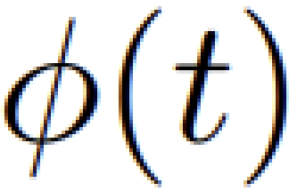
A dynamical boundary – consistent initial conditions
Wilke van der Schee, CERN/Utrecht
Near-boundary expansion scalar (and metric):
Crucial subtlety: logarithmic terms ψ_{n} solely determined by sources S₀(t)
Consistent IC not much of a problem with known source (ψ_{n} known analytically)
Dynamics of scale factor S₀(t) is now consequence of Friedmann equations
Sufficiently smooth solution requires knowledge of sufficient # of log’s
Log’s depend on time derivatives of S₀(t)
Solution: extract from near-boundary expansion of scalar (extract φ_{n})
Use time derivates to treat first few logs analytically
Final subtlety: VEV and energy density depend on S₀’’(t) and φ’’(t)
Solve resulting 6th order polynomial equation numerically
Sebastian de Haro, Kostas Skenderis and Sergey N. Solodukhin, Holographic Reconstruction of Spacetime and Renormalization in the AdS/CFT Correspondence (2001)
Notes:
Many states + linearized

Slide 8
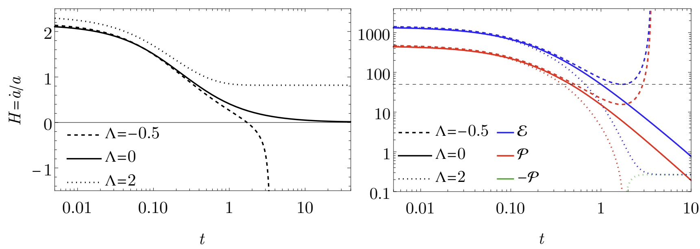
boundary gravity only
Wilke van der Schee, CERN/Utrecht
Stress-energy tensor for zero, positive and negative Λ
Positive Λ settles down to de Sitter state as studied before, includes (small) Casimir energy
Now also asymptotically flat + Big Crunch geometries
8/13
Christian Ecker, WS, David Mateos and Jorge Casalderrey-Solana, Holographic evolution with dynamical boundary gravity (2021)
Notes:
Many states + linearized

Slide 9
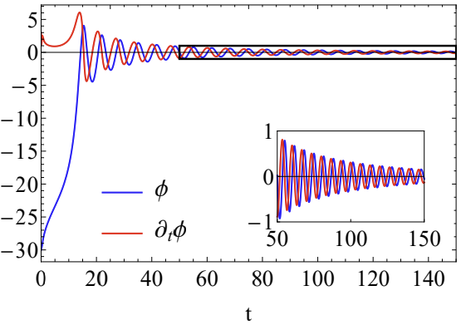
boundary gravity with an inflaton
Wilke van der Schee, CERN/Utrecht
Inflaton rolls down and undergoes damped oscillation
Rolls down relatively fast (helps numerical stability)
Inflaton potential
Inflaton dynamics
9/13
Notes:
Many states + linearized

Slide 10
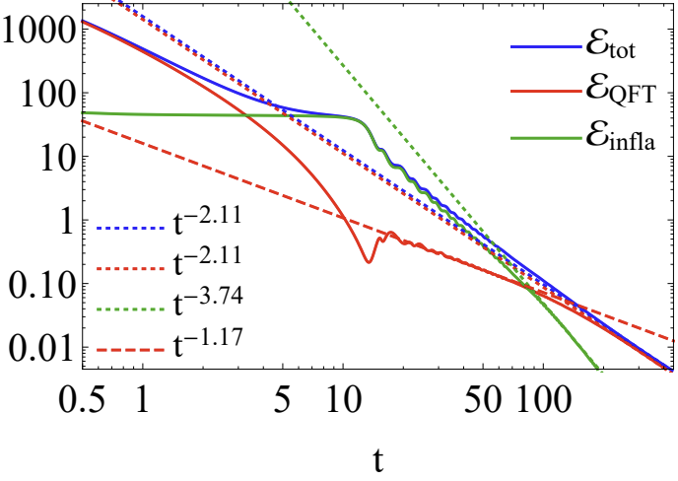
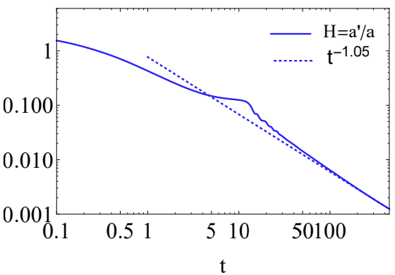
Inflation and reheating
Wilke van der Schee, CERN/Utrecht
Initially dominated by QFT energy
Quickly dilutes due to expansion
Then dominated by inflaton
Inflation, while slowly rolling down
Then inflaton reaches bottom: reheating
Inflaton loses energy to QFT
Finally universe dominated by QFT in thermal equilibrium
Energy densities (log-log)
Hubble rate
10/13
Inflating phase (t ~ 5 till 12)
Reheating (around t=13)
Notes:
Many states + linearized

Slide 11
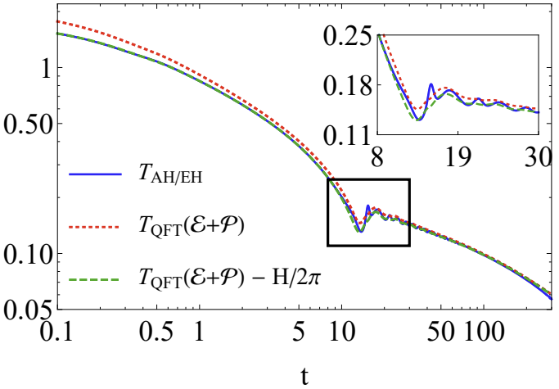
Temperature from bulk and qft
Wilke van der Schee, CERN/Utrecht
Temperature (log-log)
Three ways to determine temperature:
From energy density and EOS
From apparent horizon
From event horizon (agrees to apparent horizon)
Always `close to equilibrium’
Somewhat curious Casimir shift by de Sitter temperature
Also present in analytical solution of conformal case
11/13
Alex Buchel, Michal P. Heller and Jorge Noronha, Entropy Production, Hydrodynamics, and Resurgence in the Primordial Quark-Gluon Plasma from Holography (2016)
Notes:
Many states + linearized

Slide 12
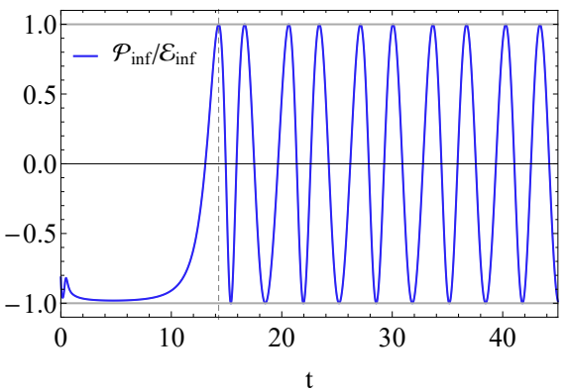
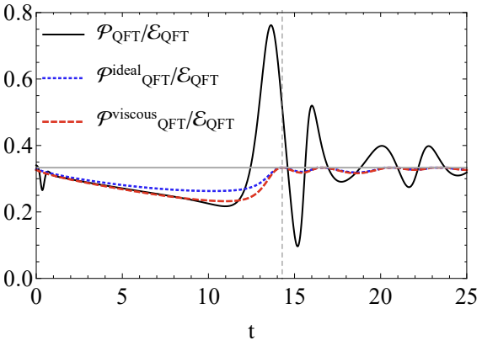
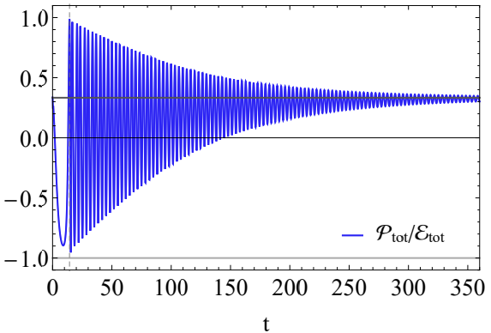
hydrodynamics
Wilke van der Schee, CERN/Utrecht
Hydrodynamic constitutive relation (ideal+viscous):
Quick initial hydrodynamisation (t~1)
Viscous hydrodynamics during inflation (t ~ 5 – 13)
Far-from-equilibrium during reheating (t~ 13 – 20)
12/13
Notes:
Many states + linearized

Slide 13
Discussion
Dynamical gravity and inflaton on the boundary
Technical progress: how to deal with the logs?
Several interesting evolution: flat space, Big Crunch
Inflation and reheating
First principles computation of strongly coupled reheating
Strongly coupled physics can thermalise after preheating
Currently not a `realistic universe’
Future
Realistic universe? Many e-foldings based on hydro?
Do we understand entropy of de Sitter?

Slide 14
Back-up

Slide 15
Non-conformal model on de sitter₄
Wilke van der Schee, CERN/Utrecht
De Sitter is conformally flat: almost trivial for CFT
Break scale invariance by V(Φ) with source M=1:
Leads to non-trivial EOS and bulk viscosity (no shear considered):
Entropy density
Trace anomaly
Bulk viscosity
Jorge Casalderrey-Solana, Christian Ecker, David Mateos and WS, Strong-coupling dynamics and entanglement in de Sitter space (2020)
Notes:
Note ihQCD: is possible to change from N=4 SYM

Slide 16
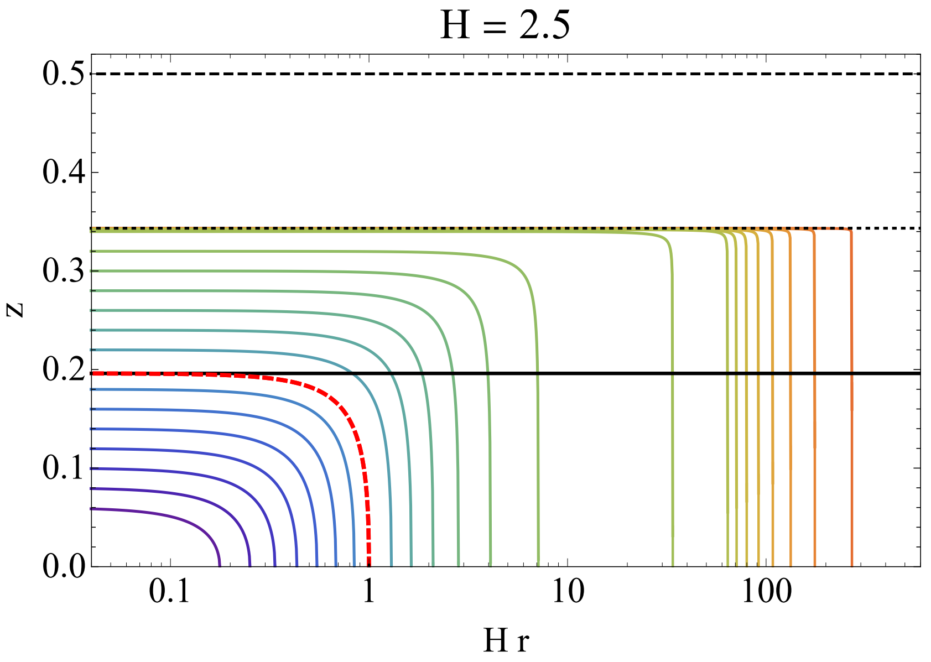
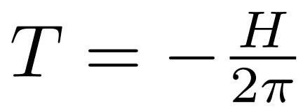
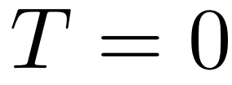
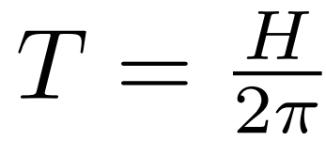
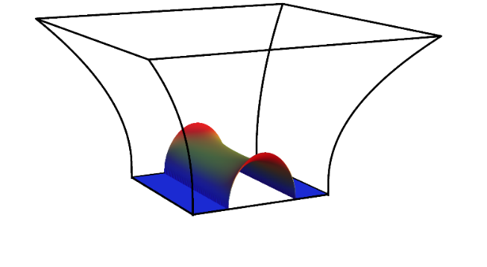
Bulk geometry with ds boundary
Wilke van der Schee, CERN/Utrecht
Event, apparent and ‘entanglement’ horizons for bulk dual to empty de Sitter
The apparent horizon is much beyond the event horizon
Also shown: extremal surfaces
`Temperature’ of AH is negative; curiosity?
Bulk confirms boundary intuition on Hawking temperature and boundary cosmological horizon
Apparent horizon:
Entanglement horizon:
Event horizon:
Boundary
Cosmological horizon
Jorge Casalderrey, Christian Ecker, David Mateos and WS, Strong-coupling dynamics and entanglement in de Sitter space (2020)

Slide 17
Time evolution of the protocol
Wilke van der Schee, CERN/Utrecht
Evolution of stress tensor for different Hubble constants
Energy density decreases towards vacuum energy (VE) (afterwards renormalised to zero)
Pressure decreases, changes sign and becomes –VE
Enthalpy is scheme independent, decays due to expansion
Energy density
Pressure
Enthalpy
Notes:
Note ihQCD: is possible to change from N=4 SYM

Slide 18
The approach towards hydrodynamics
Wilke van der Schee, CERN/Utrecht
Non-trivial hydrodynamic prediction
Δ captures our renormalisation scheme
Conjecture: scheme ambiguities cancelled by higher order transport coefficient ξ₅
Results
Viscous hydro works for small H (gradients). Negative `EOS’ for large H.
Paul Romatschke, Relativistic Viscous Fluid Dynamics and Non-Equilibrium Entropy (2009)
Notes:
Note ihQCD: is possible to change from N=4 SYM

Slide 19
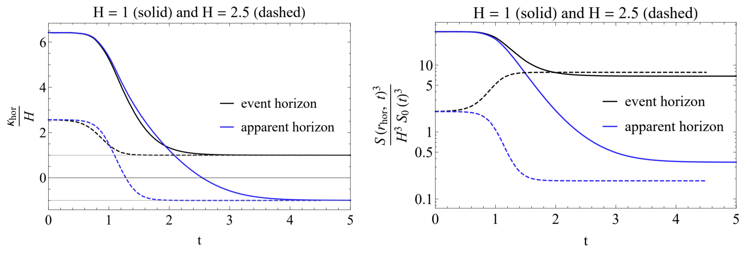
Black hole Thermodynamics
Wilke van der Schee, CERN/Utrecht
Keep track of bulk event and apparent horizons (EF coordinates)
Dynamical setting: horizons not coincide at late times:
Surface gravities can be shown analytically: EH confirms Hawking’s temperature in de Sitter
Area density apparent horizon vanishes for conformal theory
Surface gravity
Area densities
Willy Fischler, Sandipan Kundu and Juan Pedraza, Entanglement and out-of-equilibrium dynamics in holographic models of de Sitter QFTs (2013)
Alex Buchel, Entanglement entropy of N = 2∗ de Sitter vacuum (2019)
Notes:
Note ihQCD: is possible to change from N=4 SYM

Slide 20
Black hole Thermodynamics
Wilke van der Schee, CERN/Utrecht
Several interpretational issues
Expanding space: mapping boundary to bulk horizon not clear
Apparent horizon: time slicing dependent
In general: no volume law entropy density expected
Resolution → entanglement entropy is well defined
Surface gravity
Area densities
Willy Fischler, Sandipan Kundu and Juan Pedraza, Entanglement and out-of-equilibrium dynamics in holographic models of de Sitter QFTs (2013)
Alex Buchel, Entanglement entropy of N = 2∗ de Sitter vacuum (2019)
Notes:
Note ihQCD: is possible to change from N=4 SYM

Slide 21
entanglement in de Sitter
Wilke van der Schee, CERN/Utrecht
Extremal surfaces dual to spherical entangling regions:
Surfaces probe beyond event horizon if and only if entangling region bigger than visible universe
Only `superobservers’ can see behind event horizon
Apparent horizon:
Entanglement horizon:
Event horizon:
Boundary
Cosmological horizon
Jorge Casalderrey, Christian Ecker, David Mateos and WS, Strong-coupling dynamics and entanglement in de Sitter space (2020)

Slide 22
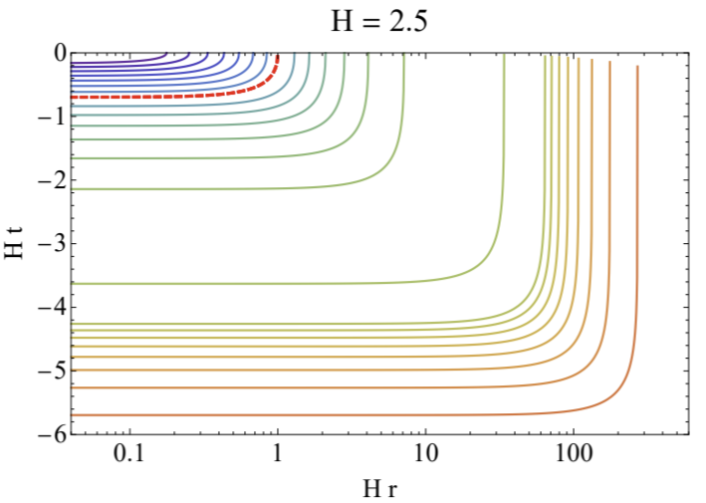
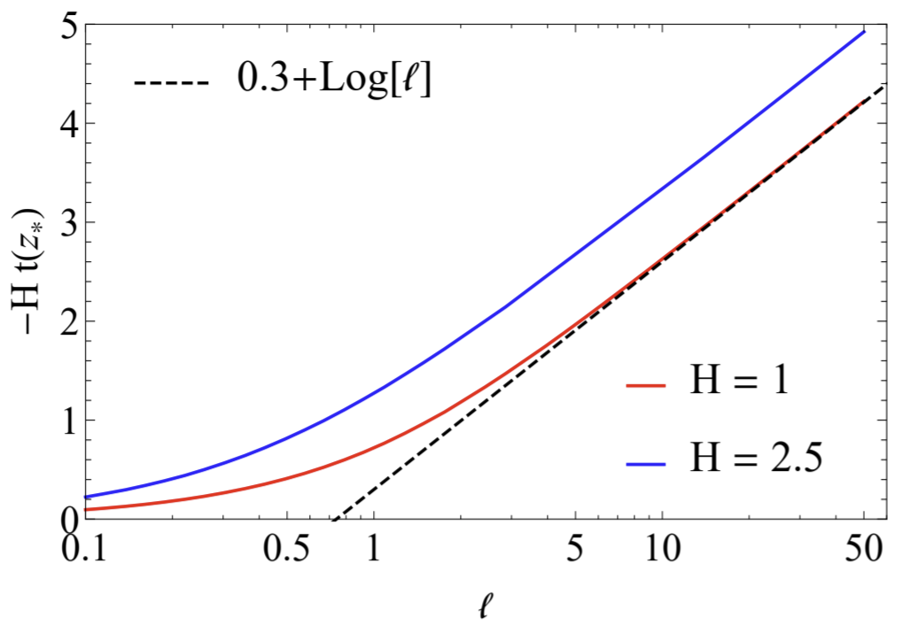
entanglement in de Sitter
Wilke van der Schee, CERN/Utrecht
Extremal surfaces go backward in time
Time at the deepest point grows exactly as log(l) for large l
Implies that `entanglement horizon’ contribution has a constant instead of volume law contribution
Standard `area law’ divergence still applies
Cosmological horizon

Slide 23
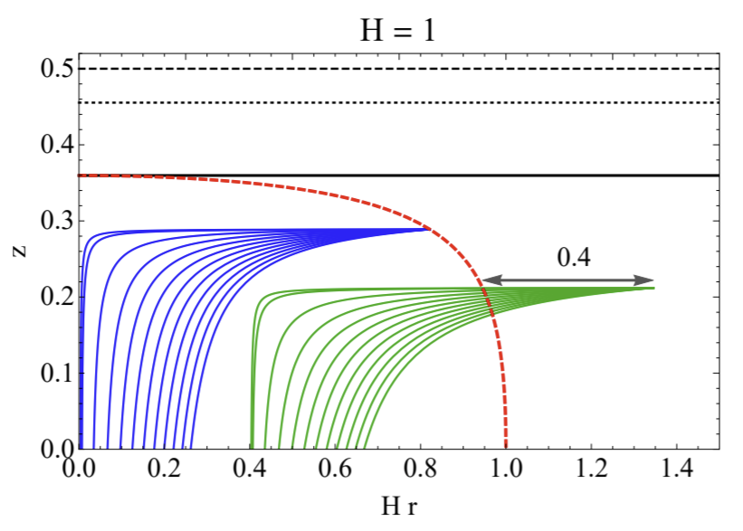
Cosmological horizon
Wilke van der Schee, CERN/Utrecht
Extremal surface dual to cosmological horizon:
Separates points in the bulk from which light can reach the (boundary) origin
Boundary cosmological horizon → full bulk cosmological horizon
Cosmological horizon
Jorge Casalderrey, Christian Ecker, David Mateos and WS, Strong-coupling dynamics and entanglement in de Sitter space (2020)

Slide 24
How we set up a state
Wilke van der Schee, CERN/Utrecht
Non-trivial boundary metric:
Start with thermal (high-temperature) state in flat space
Quench system by suitable fast tanh to constant Hubble parameter
Energy density decreases towards final `vacuum energy’ (VE)
Final (Bunch-Davis)-VE is ambiguous → chose scheme with zero VE
Hubble parameter
Energy density
Notes:
Note ihQCD: is possible to change from N=4 SYM

Slide 25
The numerical scheme
Wilke van der Schee, CERN/Utrecht
Eddington-Finkelstein metric ansatz:
Advantage: Einstein-scalar equations factorise in nested set of linear equations
Perform near-boundary expansion of A and S
Subtract first few divergent and log terms → treat them analytically
Expand remainder on finite element mesh (6 domains with 12 spectral points)
High precision time evolution (90 digit precision, 10000 time steps)
Evolution only 1+1D, but still takes ~1 day on a laptop
Notes:
Note ihQCD: is possible to change from N=4 SYM

Slide 26
The approach towards hydrodynamics
Wilke van der Schee, CERN/Utrecht
Comparing with the hydrodynamic constituent relations:
Symmetric set-up: only non-trivial part is bulk viscosity:
A subtlety: EOS and viscosity computed in flat space; what is the energy density in de Sitter space?
We decided to fix renormalisation freedom so that late time solution has zero energy density
(in any case: ambiguity is order H²) (also, note that scheme depends on H for our choice)
Notes:
Note ihQCD: is possible to change from N=4 SYM

Slide 27
Holographic renormalisation
Wilke van der Schee, CERN/Utrecht
Action needs (scheme-dependent) counter-terms:
Leads to an ambiguity in the stress-tensor:
α and β encode scheme dependencies (cosmological constant); fixed such that late time solution has vanishing energy
Ambiguities come in at order H ²
Notes:
Note ihQCD: is possible to change from N=4 SYM

Slide 28
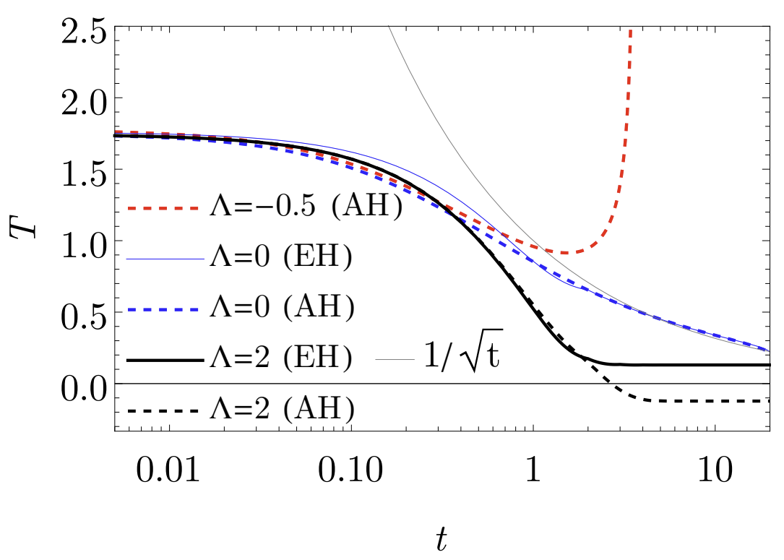
boundary gravity - Temperatures
Wilke van der Schee, CERN/Utrecht
Temperatures extracted from surface gravity event and apparent horizons
De Sitter case again settles down with negative AH ‘temperature’
For the big crunch geometry the EH location is not obvious (no future timelike infinity)
28/13
Notes:
Many states + linearized

Slide 29
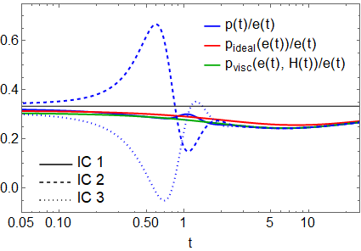
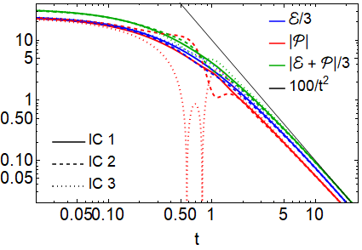
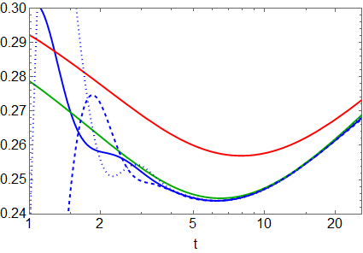
Hydrodynamisation and boundary gravity
Wilke van der Schee, CERN/Utrecht
Three different initial conditions for Λ = 0:
Stress-tensor, and hydrodynamisation: all hydrodynamise within a time of ~1/T
29/13
Notes:
Many states + linearized

Slide 30
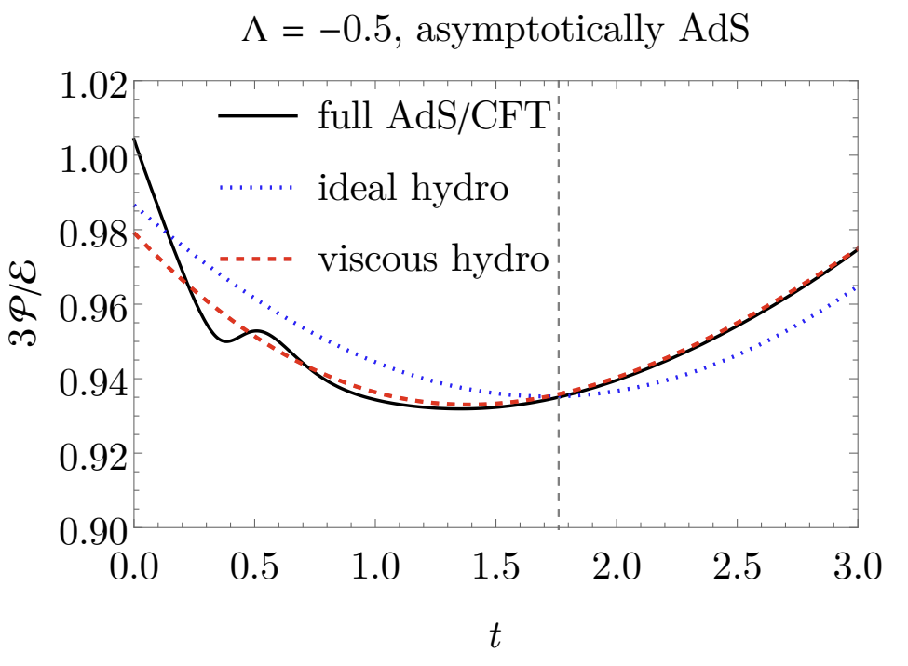
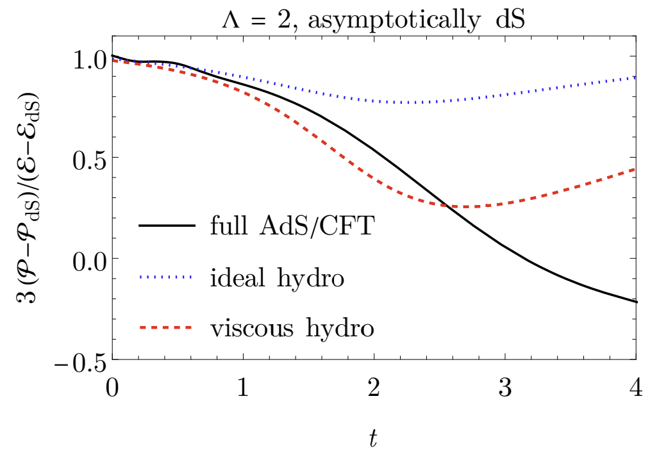
Hydrodynamisation and boundary gravity
Wilke van der Schee, CERN/Utrecht
AdS case: fast hydrodynamisation, hydro all the way till big crunch
dS case: hydrodynamisation, but falls out of equilibrium. Casimir energy important.
30/13
Notes:
Many states + linearized

