Slide 1
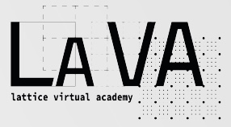
LaVA MEETING @ECT*
23/02/2023
Algorithms (2)
presented by
Francesco Di Renzo (University of Parma & INFN)

Slide 2
DISCLAIMER this will not look like a (piece of) syllabus, nor I will present a talk (lecture)
I will be alluding to both…
This is intended to provide material for a couple (maybe more) of videos within the structure sketched by Mike. There are quite a number of ties to other sections (not a problem).

Slide 3
Algorithms, Physics and Computational Strategies

Slide 4
Algorithms, Physics and Computational Strategies
Having discussed autocorrelation and integrated autocorrelation time,
a natural question arises: are there cases in which

Slide 5
Algorithms, Physics and Computational Strategies
Having discussed autocorrelation and integrated autocorrelation time,
a natural question arises: are there cases in which
Ising 2d (h=0) YES! … and for very good reasons!
II order phase transitions ... relevant picture is correlation over all length scales ... local VS global algorithms ...
This is an example of a VIRTUOUS LOOP gluing everything together

Slide 6
SIGN PROBLEMS: the tough problem par excellence
… i.e. living without a probability distribution …
… and we know that

Slide 7
SIGN PROBLEMS: the tough problem par excellence
… i.e. living without a probability distribution …
… and we know that
Any possible VIRTUOUS LOOP like before?

Slide 8
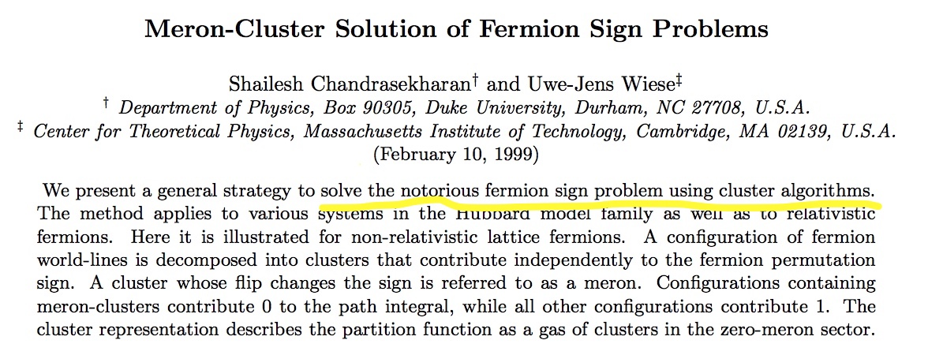
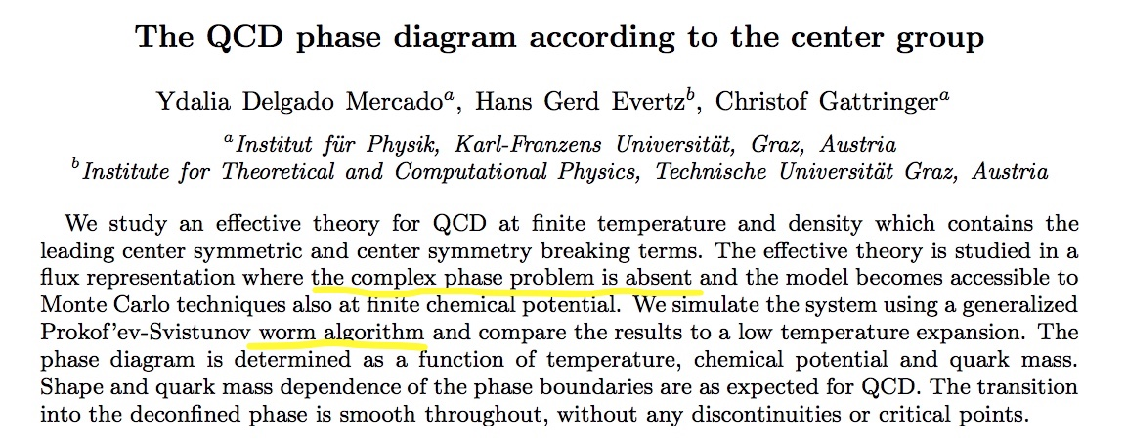
SIGN PROBLEMS: the tough problem par excellence
… i.e. living without a probability distribution …
… and we know that
Any possible VIRTUOUS LOOP like before?
YES!

Slide 9
SIGN PROBLEMS: the tough problem par excellence
… i.e. living without a probability distribution …
… and we know that
Any possible VIRTUOUS LOOP like before?
YES!
but NOT ALWAYS!!

Slide 10
SIGN PROBLEMS: the tough problem par excellence
… i.e. living without a probability distribution …
… and we know that
Any possible VIRTUOUS LOOP like before?
YES!
but NOT ALWAYS!!
Still, you will see quite a number approaches to taming/evading/mitigating the SIGN PROBLEM and they can (to a certain extent) enable (finite density QCD) computations!
Density of states
Lefschetz Thimbles / holomorphic flow / sign-optimised manifolds
complex Langevin
tensor networks
Imaginary chemical potential simulations
Taylor expansions at zero chemical potential
… with (analytic) continuation, (various) summation schemes needed (with Padè coming back to popularity…)

Slide 11
SIGN PROBLEMS: the tough problem par excellence
… i.e. living without a probability distribution …
… and we know that
Any possible VIRTUOUS LOOP like before?
YES!
but NOT ALWAYS!!
Still, you will see quite a number approaches to taming/evading/mitigating the SIGN PROBLEM and they can (to a certain extent) enable (finite density QCD) computations!
Density of states
Lefschetz Thimbles / holomorphic flow / sign-optimised manifolds
complex Langevin
tensor networks
Imaginary chemical potential simulations
Taylor expansions at zero chemical potential
… with (analytic) continuation, (various) summation schemes needed (with Padè coming back to popularity…)

Slide 12
SIGN PROBLEMS: the tough problem par excellence
… i.e. living without a probability distribution …
… and we know that
Any possible VIRTUOUS LOOP like before?
YES!
but NOT ALWAYS!!
Still, you will see quite a number approaches to taming/evading/mitigating the SIGN PROBLEM and they can (to a certain extent) enable (finite density QCD) computations!
Density of states
Lefschetz Thimbles / holomorphic flow / sign-optimised manifolds
complex Langevin
tensor networks
Imaginary chemical potential simulations
Taylor expansions at zero chemical potential
… with (analytic) continuation, (various) summation schemes needed (with Padè coming back to popularity…)

Slide 16
Perfect …There is a very good reason: thimbles always provide a BASIS to decompose any contour!

Slide 17
The SIGN PROBLEM is always nasty…
There are different decompositions as you move in parameter space!
Yust to mention one tricky point…

Slide 18
SIGN PROBLEMS: the tough problem par excellence
… i.e. living without a probability distribution …
… and we know that
Any possible VIRTUOUS LOOP like before?
YES!
but NOT ALWAYS!!
Still, you will see quite a number approaches to taming/evading/mitigating the SIGN PROBLEM and they can (to a certain extent) enable (finite density QCD) computations!
Density of states
Lefschetz Thimbles / holomorphic flow / sign-optimised manifolds
complex Langevin
tensor networks
Imaginary chemical potential simulations
Taylor expansions at zero chemical potential
… with (analytic) continuation, (various) summation schemes needed (with Padè coming back to popularity…)

Slide 19
SIGN PROBLEMS: the tough problem par excellence
… i.e. living without a probability distribution …
… and we know that
Any possible VIRTUOUS LOOP like before?
YES!
but NOT ALWAYS!!
Still, you will see quite a number approaches to taming/evading/mitigating the SIGN PROBLEM and they can (to a certain extent) enable (finite density QCD) computations!
Density of states
Lefschetz Thimbles / holomorphic flow / sign-optimised manifolds
complex Langevin
tensor networks
Imaginary chemical potential simulations
Taylor expansions at zero chemical potential
… with (analytic) continuation, (various) summation schemes needed (with Padè coming back to popularity…)

Slide 20
SIGN PROBLEMS: the tough problem par excellence
… i.e. living without a probability distribution …
… and we know that
Any possible VIRTUOUS LOOP like before?
YES!
but NOT ALWAYS!!
Still, you will see quite a number approaches to taming/evading/mitigating the SIGN PROBLEM and they can (to a certain extent) enable (finite density QCD) computations!
Density of states
Lefschetz Thimbles / holomorphic flow / sign-optimised manifolds
complex Langevin
tensor networks
Imaginary chemical potential simulations
Taylor expansions at zero chemical potential
… with (analytic) continuation, (various) summation schemes needed (with Padè coming back to popularity…)

Slide 21
SIGN PROBLEMS: the tough problem par excellence
… i.e. living without a probability distribution …
… and we know that
Any possible VIRTUOUS LOOP like before?
YES!
but NOT ALWAYS!!
Still, you will see quite a number approaches to taming/evading/mitigating the SIGN PROBLEM and they can (to a certain extent) enable (finite density QCD) computations!
Density of states
Lefschetz Thimbles / holomorphic flow / sign-optimised manifolds
complex Langevin
tensor networks
Imaginary chemical potential simulations
Taylor expansions at zero chemical potential
… with (analytic) continuation, (various) summation schemes needed (with Padè coming back to popularity…)

Slide 22
SIGN PROBLEMS: the tough problem par excellence
… i.e. living without a probability distribution …
… and we know that
Any possible VIRTUOUS LOOP like before?
YES!
but NOT ALWAYS!!
Still, you will see quite a number approaches to taming/evading/mitigating the SIGN PROBLEM and they can (to a certain extent) enable (finite density QCD) computations!
Density of states
Lefschetz Thimbles / holomorphic flow / sign-optimised manifolds
complex Langevin
tensor networks
Imaginary chemical potential simulations
Taylor expansions at zero chemical potential
… with (analytic) continuation, (various) summation schemes needed (with Padè coming back to popularity…)

Slide 23
Langevin algorithms, in a sense Simon’s simulations/computations issue

Slide 24
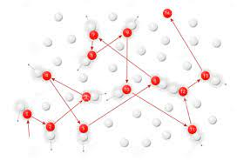
Langevin algorithms, in a sense Simon’s simulations/computations issue
Brownian motion (BM)
with (… solution of Fokker Planck eqn …)

Slide 25
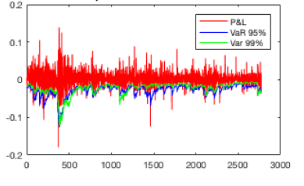
Langevin algorithms, in a sense Simon’s simulations/computations issue
Brownian motion (BM)
with (… solution of Fokker Planck eqn …)
Quite interestingly … (FINANCE) returns (log price change of a security) undergo BM…
The main goal is to reliably estimate the Value at Risk (VaR)

Slide 26
Langevin algorithms, in a sense Simon’s simulations/computations issue
Brownian motion (BM)
with (… solution of Fokker Planck eqn …)
Quite interestingly … (FINANCE) returns (log price change of a security) undergo BM…
Perhaps less known, but maybe more interestingly, another example of “non-Physics Langevin” is the
TREE CUTTING PROBLEM
i.e. When is the best time to cut a tree so that its net present value is maximised?
X(T) the size of your tree
p the price at which you sell it - c the cost of cutting
r>0 the rate of interest the bank pays to you

Slide 27
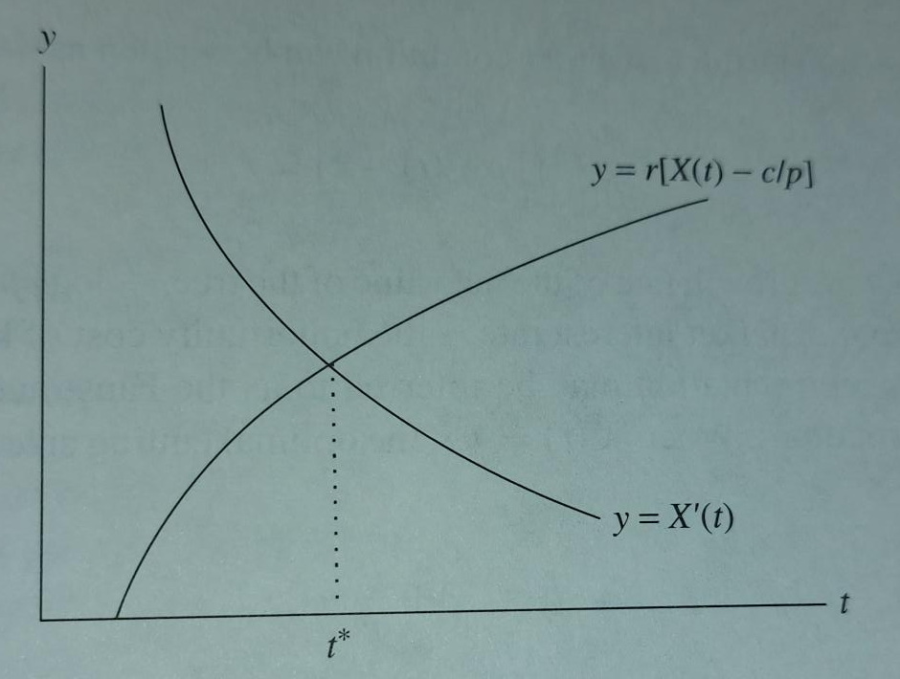
with first order condition

Slide 28
with first order condition
but growth is subject to “noise” … so …

Slide 29
Langevin and Stochastic Quantisation

Slide 30
Langevin and Stochastic Quantisation
You have a field theory and you add a degree of freedom
This is a fictitious time in which Langevin evolution takes place
Natural expectation values are now wrt the random (gaussian) noise

Slide 31
Langevin and Stochastic Quantisation
You have a field theory and you add a degree of freedom
This is a fictitious time in which Langevin evolution takes place
Natural expectation values are now wrt the random (gaussian) noise
Main assertion is
A proof can go through the definition of a time-dependent probability distribution of the fields
for which we can derive
the Fokker Planck equation

Slide 32
Langevin and Stochastic Quantisation
You have a field theory and you add a degree of freedom
This is a fictitious time in which Langevin evolution takes place
Natural expectation values are now wrt the random (gaussian) noise
Main assertion is
A proof can go through the definition of a time-dependent probability distribution of the fields

Slide 33
A first interesting feature: you can go for complex actions!

Slide 34
A first interesting feature: you can go for complex actions!
When the action is complex, Langevin equations amounts to complexifying the degrees of freedom
This amounts to averaging on a manifold which is different from the original one, but does not mean we are doubling the number of degrees of freedom

Slide 35
A first interesting feature: you can go for complex actions!
When the action is complex, Langevin equations amounts to complexifying the degrees of freedom
This amounts to averaging on a manifold which is different from the original one, but does not mean we are doubling the number of degrees of freedom
The probability distribution of the fields in time now reads
What we are mostly
interested in reads
The strategy of the proof is formally the same, i.e. going through Fokker Planck. In exponential notation this reads
A formal argument for correctness is still there, even if care is needed because we can not rule out convergence to a wrong result, but there are progress (at least) in the direction of spotting an incorrect convergence.

Slide 36
A second interesting feature: prototype of Numerical Stochastic Perturbation Theory

Slide 37
A second interesting feature: prototype of Numerical Stochastic Perturbation Theory
Since we now formally have a continuous stochastic process, we can think the Langevin equation solution as a function of the coupling constant of the theory and write a formal expansion
which we now have to plug into our Langevin equation

Slide 38
A second interesting feature: prototype of Numerical Stochastic Perturbation Theory
Since we now formally have a continuous stochastic process, we can think the Langevin equation solution as a function of the coupling constant of the theory and write a formal expansion
which we now have to plug into our Langevin equation
The result is a hierarchy of equations of increasing order, which we can exactly truncate at any given one
Perturbative orders for a given observable come almost from free: take the appropriate order when averaging over the evolution of the resulting process

Slide 39
A second interesting feature: prototype of Numerical Stochastic Perturbation Theory
Since we now formally have a continuous stochastic process, we can think the Langevin equation solution as a function of the coupling constant of the theory and write a formal expansion
which we now have to plug into our Langevin equation
The result is a hierarchy of equations of increasing order, which we can exactly truncate at any given one
Perturbative orders for a given observable come almost from free: take the appropriate order when averaging over the evolution of the resulting process
Langevin was the prototype, but one can also play the same game with other stochastic processes, i.e.
Hybrid Molecular Dynamics
Kramer equation
The main advantage is that you can reach much higher orders than you could afford in a standard, diagrammatic computation. (Remember: the computer is integrating the system for you)

