Slide 1
Opportunities with a 2nd focus in IP8 at the EIC
Pawel Nadel-Turonski
Stony Brook University
Tomography of light ions at an EIC,
ECT workshop, November 9-10, 2022

Slide 2
A 2nd focus in IR8 greatly improves forward acceptance
New physics opportunities
Complementarity with Detector 1 (EPIC) @ IR6
Potential synergies with Detector 2 and IR8 forward instrumentation
Key features include
Excellent low-p_{T} acceptance for protons and light nuclei from exclusive reactions
Detection of target fragments makes it possible to
  veto breakup to study coherent processes
  study the final state when breakup occurs
Also, note that the acceptance is much better than in fixed-target experiments like CLAS12 or SoLID, making Detector 2 particularly attractive for JLab users.

Slide 3
2nd focus – assessment in the DPAP report
The CORE proposal makes a convincing case for the significant gain in physics reach achievable with a secondary focus:
increased acceptance in the invariant momentum transfer t of the scattered proton in ep collisions, which directly translates into an increased resolution power for imaging partons in the transverse plane,
significantly improved abilities to detect nuclear breakup in exclusive and diffractive scattering on light and heavy nuclei. The distinction between coherent and incoherent scattering is essential for the physics interpretation of these processes,
prospects for a program of low-background γ gamma spectroscopy with rare isotopes in the beam fragments.

Slide 4
Forward detection at the EIC is unique
In most colliders, the only way to detect very forward particles is to let them drift far downstream, where a small angular difference will separate them from the beam.
  Low-p_{T} acceptance is then limited by the beam angular divergence at the IP (β*).
At the EIC, the longitudinal momentum loss of the scattered beam particles is not negligible, and is comparable to the intrinsic momentum spread within the beam
  In DIS, dp/p ~ x (the momentum of the struck parton).
  The intrinsic momentum spread (1σ) in the beam is typically a few times 10⁻⁴.
For x larger than the (10σ) beam momentum spread we can in principle detect all scattered beam particles – even ones with p_{T} = 0.
  At lower x (high x_{L}), one cannot reach p_{T} = 0, but the low-p_{T} acceptance can be greatly improved compared with only relying on the scattering angle and drift distance.
Heavy ions that change their rigidity (A/Z) behave like a that proton experiencing a longitudinal momentum loss.
  Losing one nucleon changes the rigidity by ~10⁻², which is also comparable to the beam momentum spread (10σ), making tagging of A-1 nuclei possible

Slide 5
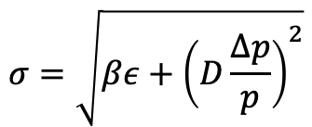
Dispersion and beam size at the detection point (2nd focus)
The forward detection has two ingredients:
  Dispersion (not just angle) separates scattered off-momentum particles from the beam
  A 2nd focus shrinks the beam size (σ) at the detection point so that detectors can be placed closer
$$σ=\sqrt{βε+{\left(D\frac{Δp}{p}\right)}^{2}}$$
Dispersion (D) translates a longitudinal momentum loss into a transverse displacement.
  dx = D dp/p, where dx is the transverse displacement at p_{T} = 0
  With D = 0.4 m, dp/p = 0.01, and p_{T} = 0, the transverse displacement for protons would be 4 mm
This should be compared with the (10σ) beam size at the detection point
  Without a 2nd focus: 4 cm (high luminosity / divergence), 2 cm (low luminosity / divergence)
  With a 2nd focus: 0.2 cm (high luminosity / divergence)

Slide 6





Far-forward acceptance with and without a 2nd focus
Ion fragments from ²³⁸U
Exclusive protons
$$p_{⊥}$$
(x_{L} = p’ / p_{beam} ~ 1 – x)
Excluded
Without 2nd focus: (EPIC @IR6)
Detected
Detected
Detected
Excluded
⬅ Z’ vs x_{RP}
$p_{⊥}$vs x_{L}➔
0.9
1
$$x_{L}$$
0
Limited by D and 2nd focus (β₂)
Limited by angular acceptance (β*)
With 2nd focus: (Detector 2 @ IR8)
$$p_{⊥}$$
Order-of-magnitude improvement in forward acceptance
Detected
Excluded
0
0.99
1
$$x_{L}$$

Slide 7
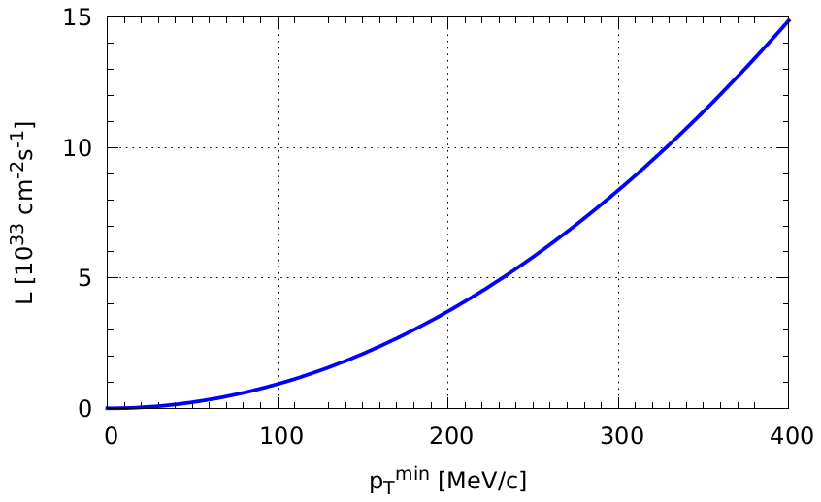
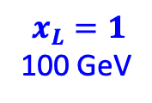

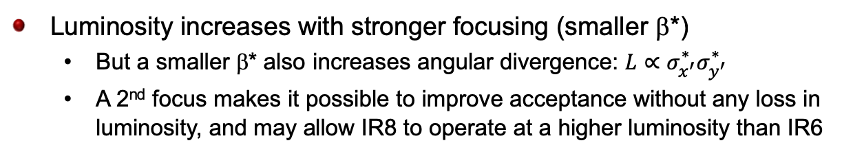

p_{T}-acceptance for protons and its connection to luminosity
$$p_{⊥}$$
Without focus (IR6)
Luminosity increases with stronger focusing (smaller β*)
  But a smaller β* also increases angular divergence: $L∝σ_{x^{′}}^{∗}σ_{y^{′}}^{∗}$
  A 2nd focus makes it possible to improve acceptance without any loss in luminosity, and may allow IR8 to operate at a higher luminosity than IR6
Detected
0
0.9
1
$$x_{L}$$
$$x_{L}=1$$
100 GeV
Limited by D and 2nd focus (β₂)
Limited by angular acceptance (β*)
Second focus
Highest $L$
$$p_{⊥}$$
With focus (IR8)
$$x_{L}<0.99$$
High-divergence (small β*)
High-acceptance (large β*)
Detected
0
0.99
1
$$x_{L}$$

Slide 8
2nd focus – examples of physics opportunities
Precision studies of exclusive reactions on the proton
  At max luminosity (10x275 GeV), the full t-range is covered in one setting (no gaps)
  High rates (σ x luminosity x acceptance) at low t and x (~10⁻²) make studies of timelike Compton processes feasible (TCS and perhaps DDVCS)
Coherent scattering on light ions
  Light ions detected down to very low t (no incoherent background)
  Transverse spatial imaging, diffraction, shadowing
DVCS on nuclei
  Tagging of scattered light ion or veto of breakup of heavy ion
  In combination with high-resolution photon detection
→ talk by C. Hyde

Slide 9
2nd focus – examples of physics opportunities (continued)
Tagging of specific incoherent channels by detecting final nucleus, e.g.,
  A-1: reactions on a bound proton with a spectator nucleus
  A-2: short-range correlations
  etc
Coherent diffraction on heavy nuclei
  Veto of breakup with A-1 tagging, nuclear photons
  Sensitive to gluon saturation
Rare isotopes
  Detection and identification of heavy fragments
  Excited states of exotic, short-lived nuclei

Slide 10
Exclusive coherent scattering on nuclei
⁴He
²⁰⁸Pb
With a 2nd focus, recoiling light nuclei at moderate x can be detected for all t.
  For heavier nuclei and lower x, one can use a hybrid method, vetoing breakup for low t and detecting nuclei in the high-t tail, where incoherent backgrounds are higher
Heavy nuclei never emerge from the beam
  Veto of breakup
  Large incoherent background
    high veto efficiency required.
  A-1 tagging important for “high” t tail
  Nuclear photons (veto efficiency and excitation)
1 fm⁻¹ = 0.2 GeV
1 fm⁻² = 0.04 GeV²
10 fm⁻² = 0.4 GeV²
20 fm⁻² = 0.8 GeV²

Slide 11
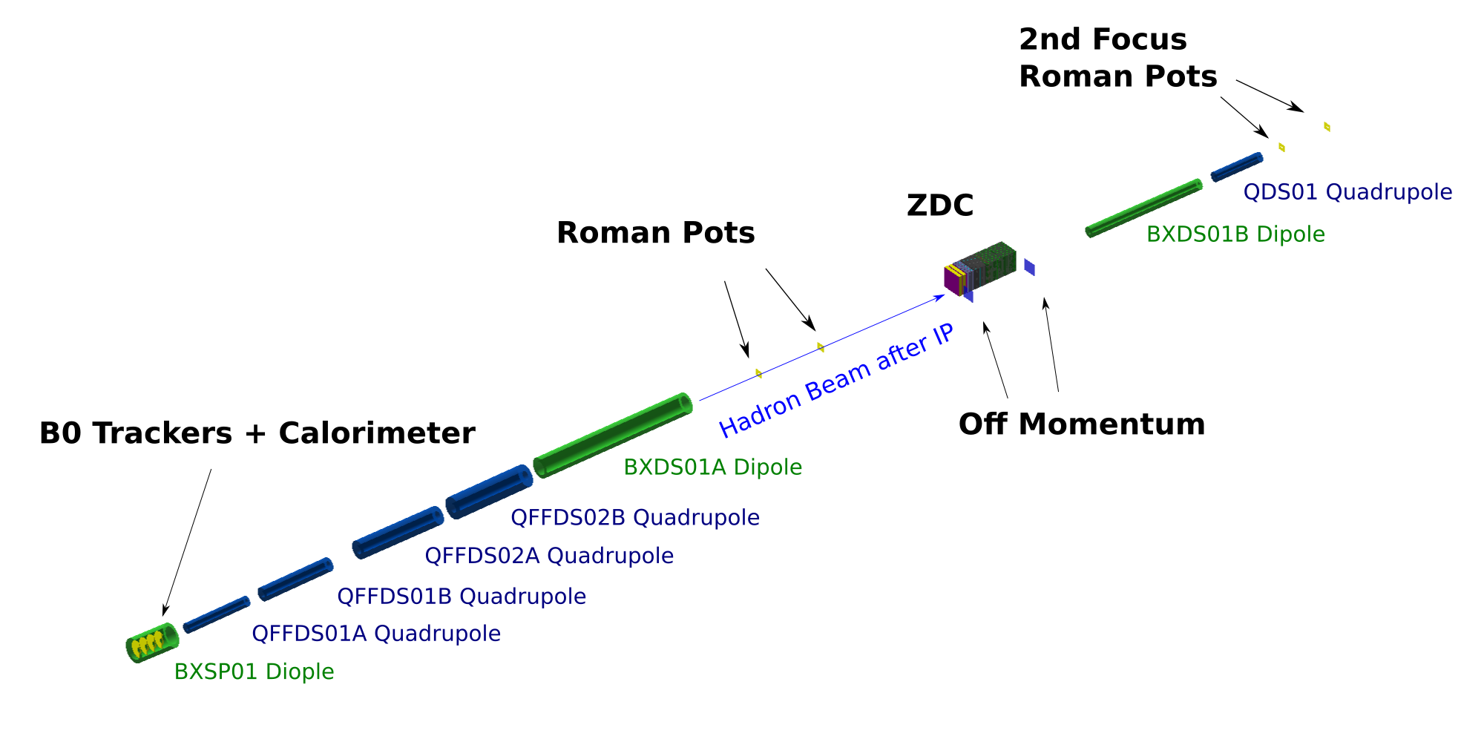
IR8 layout
Green dipole magnets generate dispersion
Blue quadrupole magnets focus the beam, changing the beta function (x and y)

Slide 12
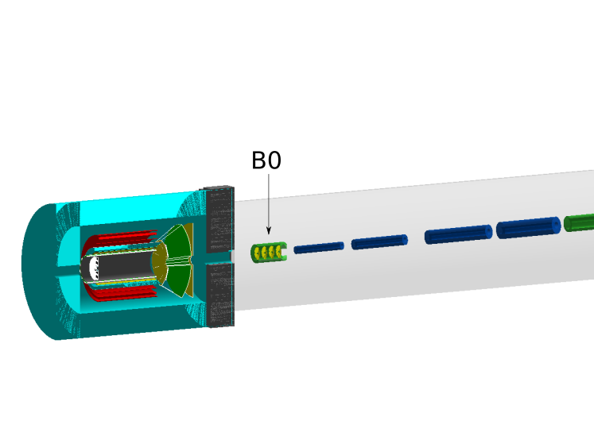
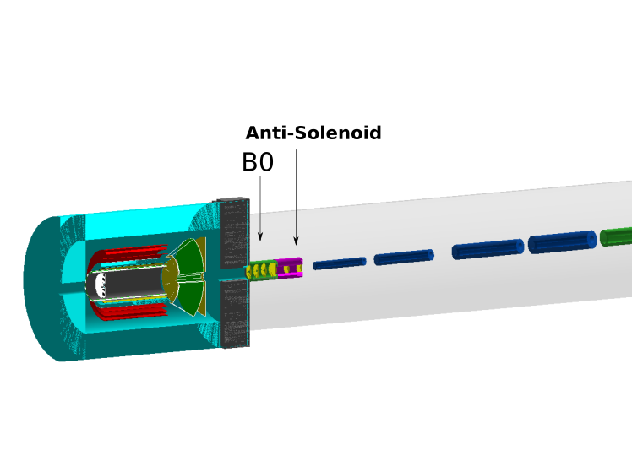
Improved detection in the intermediate region?
ZDC
B0 + anti-solenoid
Nuclear de-excitation photons
18 GeV e on 110 GeV/A ²³⁸U
Accelerator operations require compensation of the field of the main detector solenoid.
Using an (anti-)solenoid with opposite polarity is most advantageous for the accelerator
It could also improve acceptance for very forward photon detection.
An anti-solenoid can fit in the space in front of the ion FFQs (blue), located 7.5 m from the IP, by shifting the B0 towards the IP in IR8. This has no impact on the accelerator lattice or IR6.

Slide 13
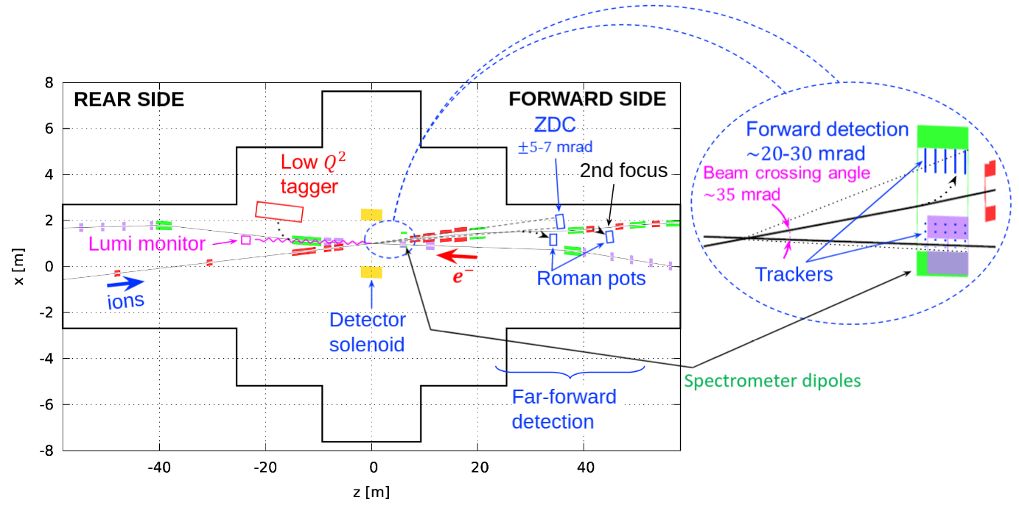
Large-p_{T} acceptance
neutrals
spectators
2nd focus
In contrast to low-p_{T}, where acceptance is limited by the beam, there is no upper limit in p_{T}.
  Particles that are not detected at the 2nd focus will be detected in the drift section before it, or in the B0 magnet in front of the quads (red), or in the hadron endcap of the central detector
Losses will, however, occur in the transition between each region.

Slide 14
Detector II/IP8 and WG charge
“With a clear mandate from DPAP and the EICUG to support and organize a Detector II/IP8 effort, the
SC held discussions with Project, Detector I and CORE leadership. We agreed to form a dedicated
working group that would address the following charge:”
Engage the broader community, including theorists, accelerator physicists and Detector I experimentalists, to fully develop projections for the portfolio of measurements that are complementary to the Detector I physics program, including those that capitalize on the implementation of the secondary focus.
Work with the EICUG Steering Committee and Project to recruit new institutions and establish a diverse and vibrant 2nd Detector working group.
Utilize the extended design period for Detector 2 to identify groups that will focus on R&D for emerging technologies that could provide another aspect of complementarity to Detector 1.
Facilitate the development of a unified concept for a general-purpose detector at IR8. In particular, the 2nd detector should be complementary to the project detector at IR6 and may capitalize on the possibility of a secondary focus at IR8.

Slide 15
Thank you!

Slide 16
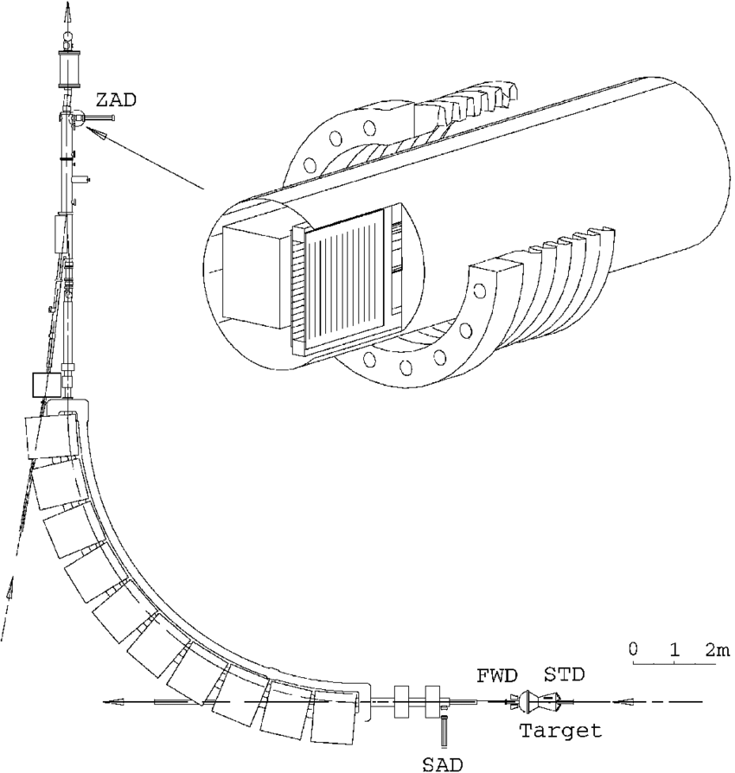
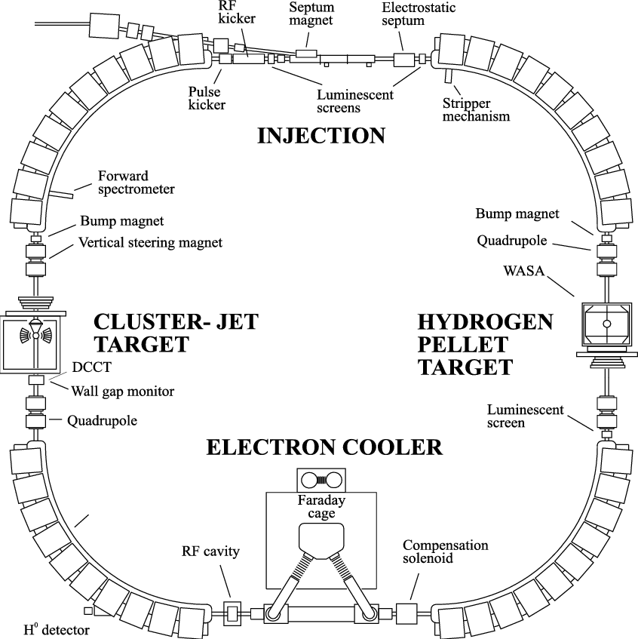
Far-forward detection at the CELSIUS storage ring in Uppsala, Sweden
Focus with Roman pots
trackers
2nd Roman pot
Z-tagger
bellows
dipoles
quads
ZDC

Slide 17
Beam momentum spread for protons
From ”Accelerator and beam conditions critical for physics detector simulations for the EIC”
At low energy, beam quality deteriorates making exclusive measurements a little more challenging than one might think
Beam momentum spread
In general, momentum spread can be reduced at the expense of luminosity, but baseline beam parameters from the CDR were not optimized for momentum spread.
A recent study made by the BNL accelerator group suggests that for protons there is significant headroom and that for 275 GeV protons and 10 GeV electrons a luminosity of 1.2 x 10³⁴ can be reached with a momentum spread of 4.1 x 10⁻⁴.
  See details on next slide

Slide 18
DPAP report – assessment of physics capabilities - complementarity
The CORE studies for DVCS and exclusive meson production find that the reaction kinematics can be reconstructed from the central detector alone. This allows the extension of the parton imaging program from the proton to nuclei, and it may increase the precision of measuring t in ep collisions. The panel regards this as a good example of specialization/optimization to enhance the complementarity between two detectors, discussed below.
Please note that the nuclear DVCS studies relied on both a 2nd focus and an extension of the high-resolution PbWO₄ EMcal to cover the full outgoing electron hemisphere (η < 0). Electron beam energies of 5-10 GeV were assumed, as these are best suited for 3D structure measurements.

