Slide 1

DVCS on Nuclei with a 2nd EIC Detector
EICUG: Second Detector Working Group
30 September 2022
Charles Hyde
Old Dominion University

Slide 2
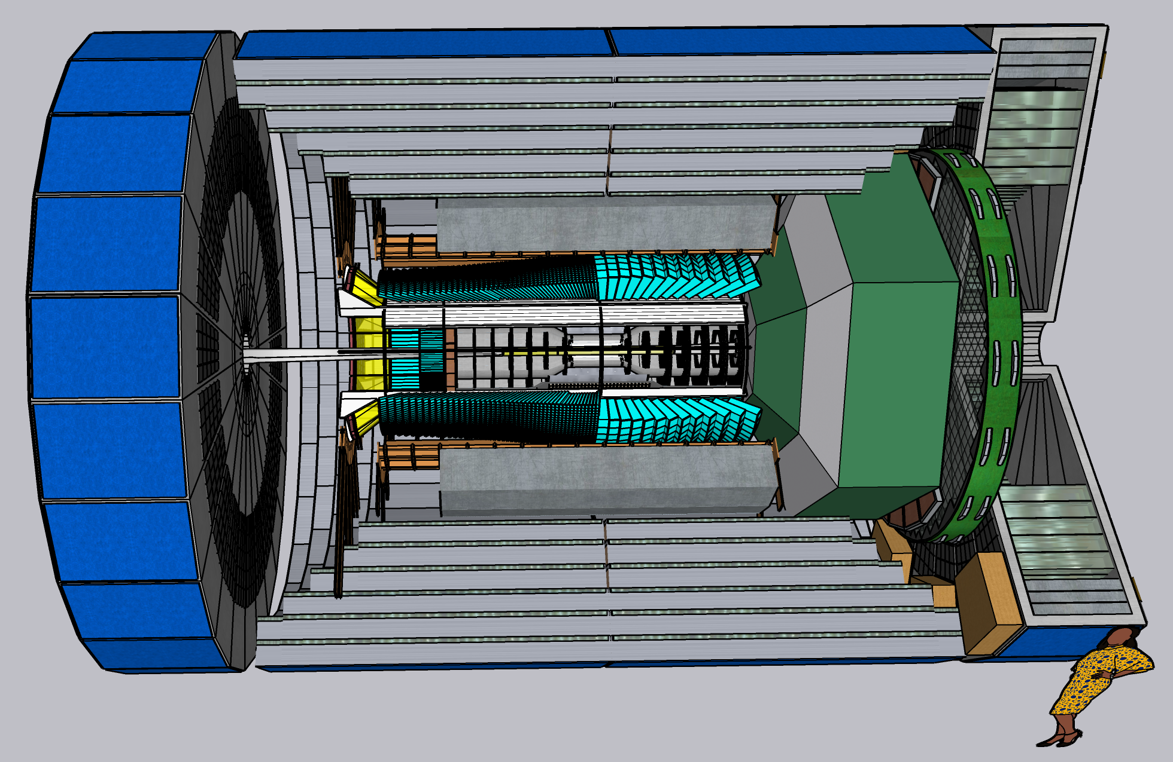
CORE as a Candidate 2nd Detector https://arxiv.org/abs/2209.00496

Slide 3
CORE as a Candidate 2nd Detector https://arxiv.org/abs/2209.00496
Muon ID, HCal, EMCal for |η|≤ 3.5
High resolution PbWO₄ EMCal –3.5 < η ≤ 0
  Catches all DVCS electrons and photons
Single technology Si (MAPS) tracker
Full PID
Flexible integration with accelerator lattice
  ±4m length

Slide 4
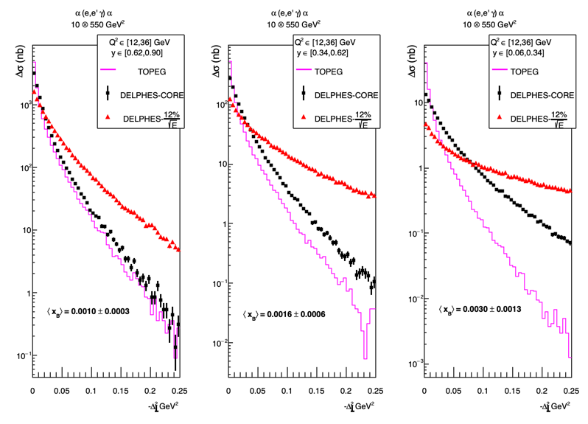
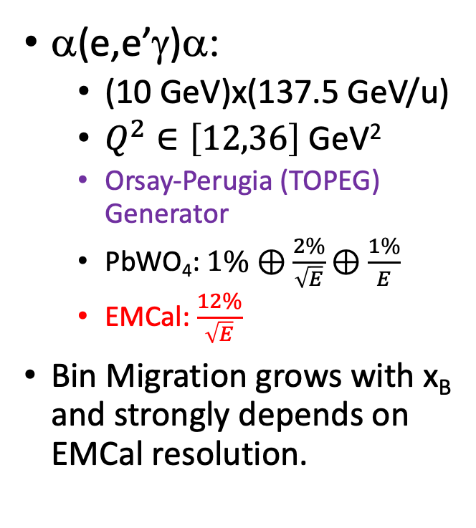



DVCS Bin Migration Comparison
α(e,e’γ)α:
  (10 GeV)x(137.5 GeV/u)
  $Q^{2}∈\left[12,36\right]$ GeV²
  Orsay-Perugia (TOPEG) Generator
  PbWO₄: $1\%⊕\frac{2\%}{\sqrt{E}}⊕\frac{1\%}{E}$
  EMCal: $\frac{12\%}{\sqrt{E}}$
Bin Migration grows with x_{B} and strongly depends on EMCal resolution.
$\left\langle x_{B}\right\rangle$=0.004
$\left\langle x_{B}\right\rangle$=0.0064
$\left\langle x_{B}\right\rangle$=0.012

Slide 5
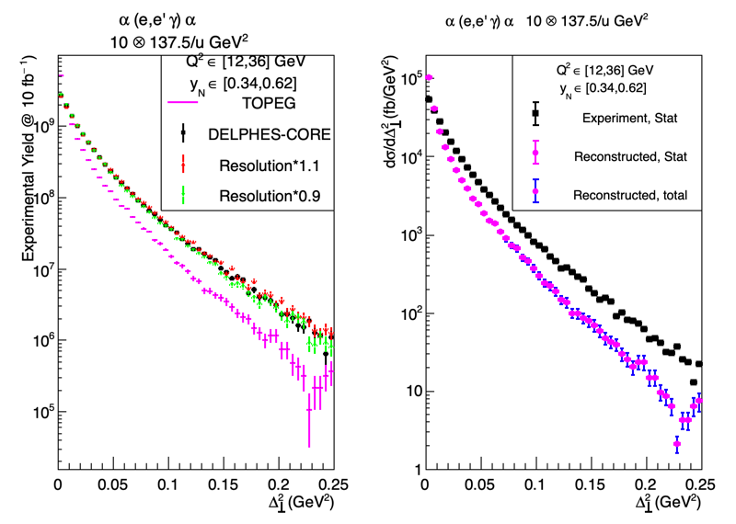



Coherent DVCS on light nuclei. Unfolding the Bin Migration
P-2, p.2
TOPEG event generator
DELPHES FastMC
Systematic uncertainty in reconstructed cross section estimated by varying PbWO₄ resolution event-by-event ±10%
Error bars from uncertainty of bin-migration remain small.
$$“truth”$$
$$reconstruction$$
$\left\langle x_{B}\right\rangle$=0.0016

Slide 6
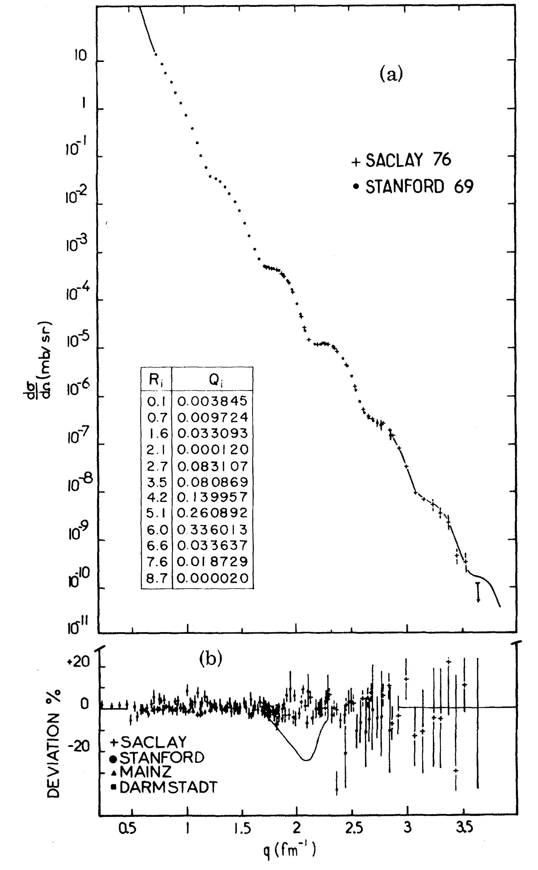
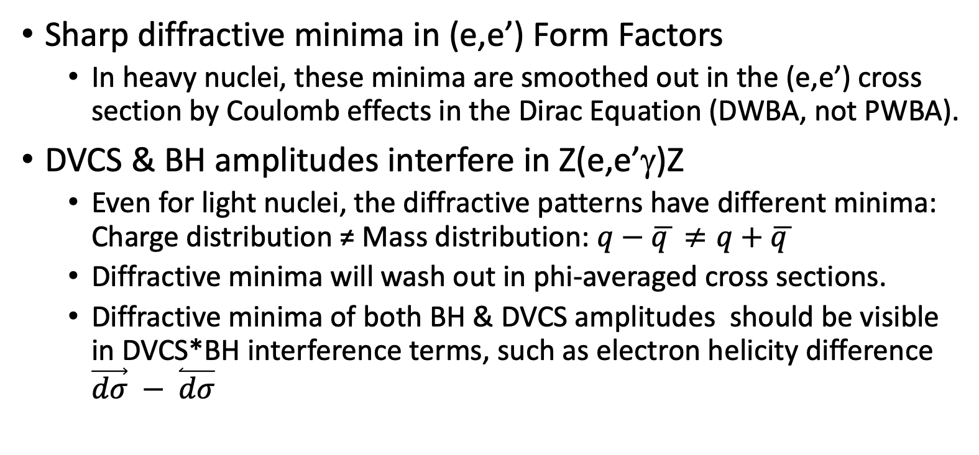
Comment on Diffractive Minima in Nuclear DVCS
Sharp diffractive minima in (e,e’) Form Factors
  In heavy nuclei, these minima are smoothed out in the (e,e’) cross section by Coulomb effects in the Dirac Equation (DWBA, not PWBA).
DVCS & BH amplitudes interfere in Z(e,e’γ)Z
  Even for light nuclei, the diffractive patterns have different minima:
  Charge distribution ≠ Mass distribution: $q−\overline{q }≠q+$ $\overline{q }$
  Diffractive minima will wash out in phi-averaged cross sections.
  Diffractive minima of both BH & DVCS amplitudes should be visible in DVCS*BH interference terms, such as electron helicity difference $\vec{dσ} − \overset{⃐}{dσ}$

Slide 7
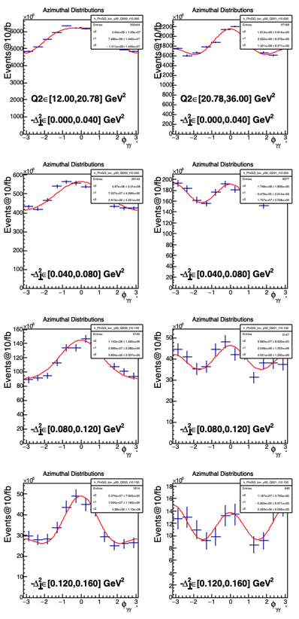
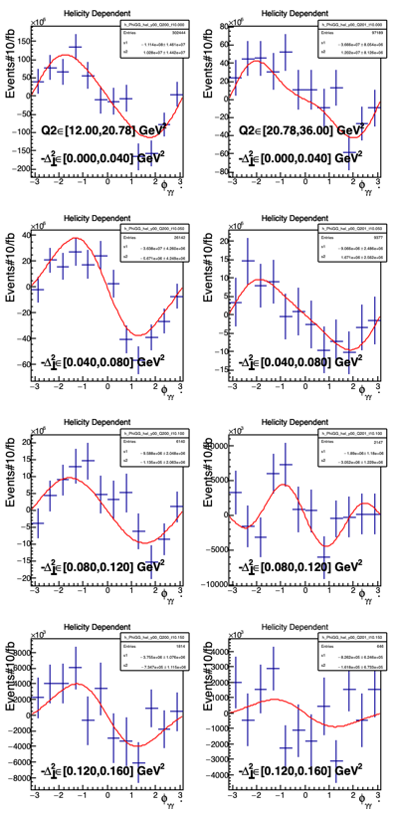
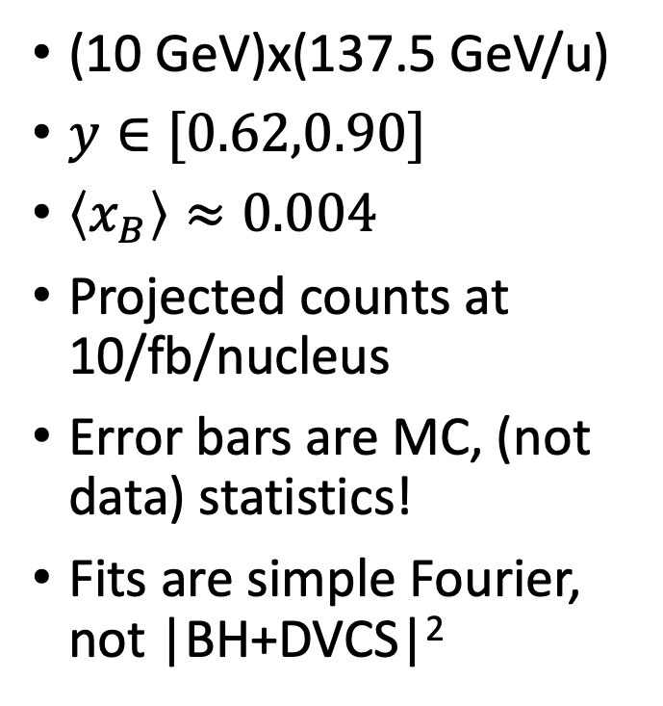

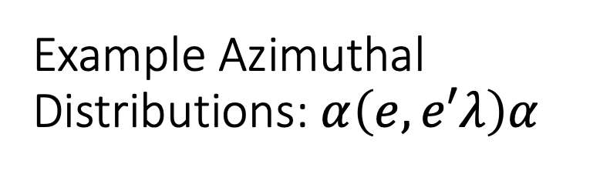

Example Azimuthal Distributions: $α\left(e,e′λ\right)α$
$$σ\left(+\right)+ σ(−)$$
$$σ\left(+\right)− σ(−)$$
(10 GeV)x(137.5 GeV/u)
$y∈[0.62,0.90]$
$\left\langle x_{B}\right\rangle ≈0.004$
Projected counts at 10/fb/nucleus
Error bars are MC, (not data) statistics!
Fits are simple Fourier, not |BH+DVCS|²

Slide 8
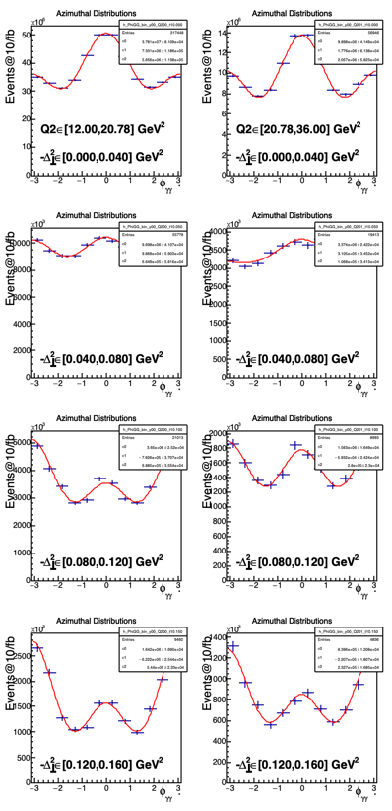
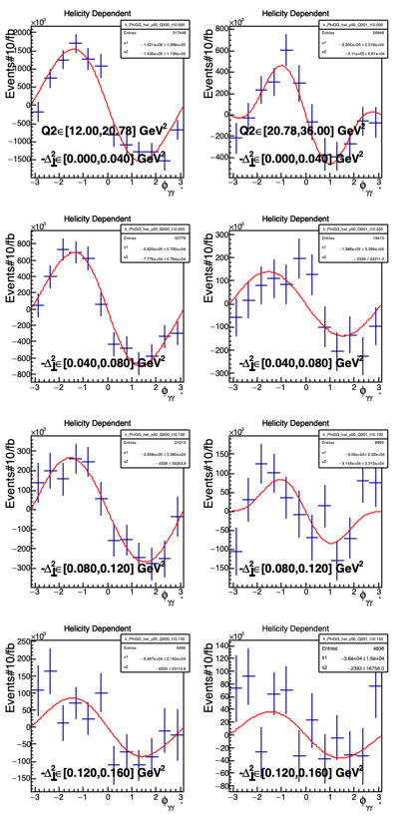
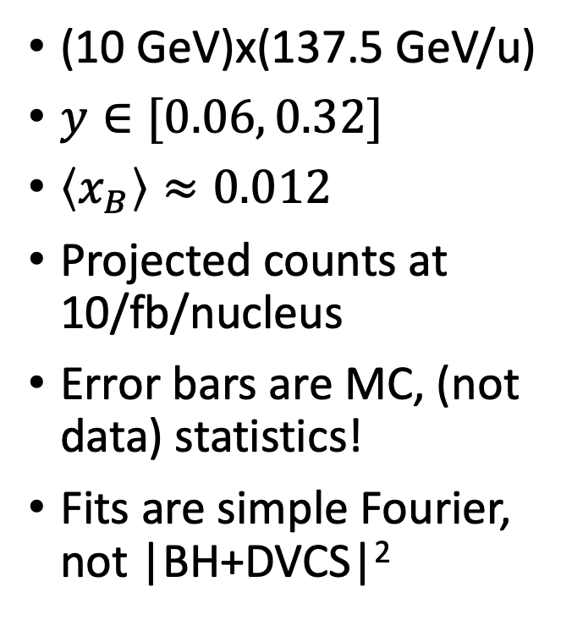
Example Azimuthal Distributions: $α\left(e,e′λ\right)α$
$$σ\left(+\right)+ σ(−)$$
$$σ\left(+\right)− σ(−)$$
(10 GeV)x(137.5 GeV/u)
$y∈[0.06, 0.32]$
$\left\langle x_{B}\right\rangle ≈0.012$
Projected counts at 10/fb/nucleus
Error bars are MC, (not data) statistics!
Fits are simple Fourier, not |BH+DVCS|²

Slide 9
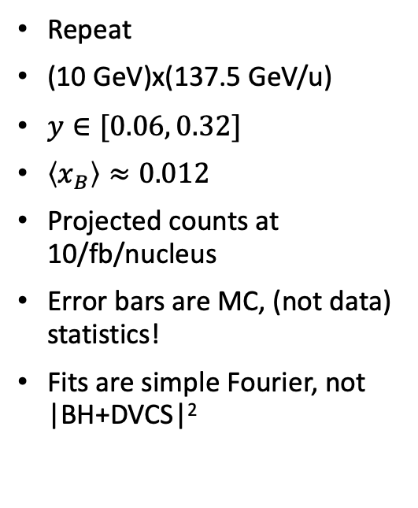
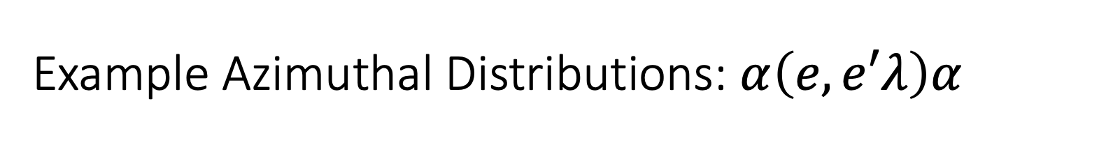


Example Azimuthal Distributions: $α\left(e,e′λ\right)α$
$$σ\left(+\right)+ σ(−)$$
$$σ\left(+\right)− σ(−)$$
Repeat
(10 GeV)x(137.5 GeV/u)
$y∈[0.06, 0.32]$
$\left\langle x_{B}\right\rangle ≈0.012$
Projected counts at 10/fb/nucleus
Error bars are MC, (not data) statistics!
Fits are simple Fourier, not |BH+DVCS|²

Slide 10
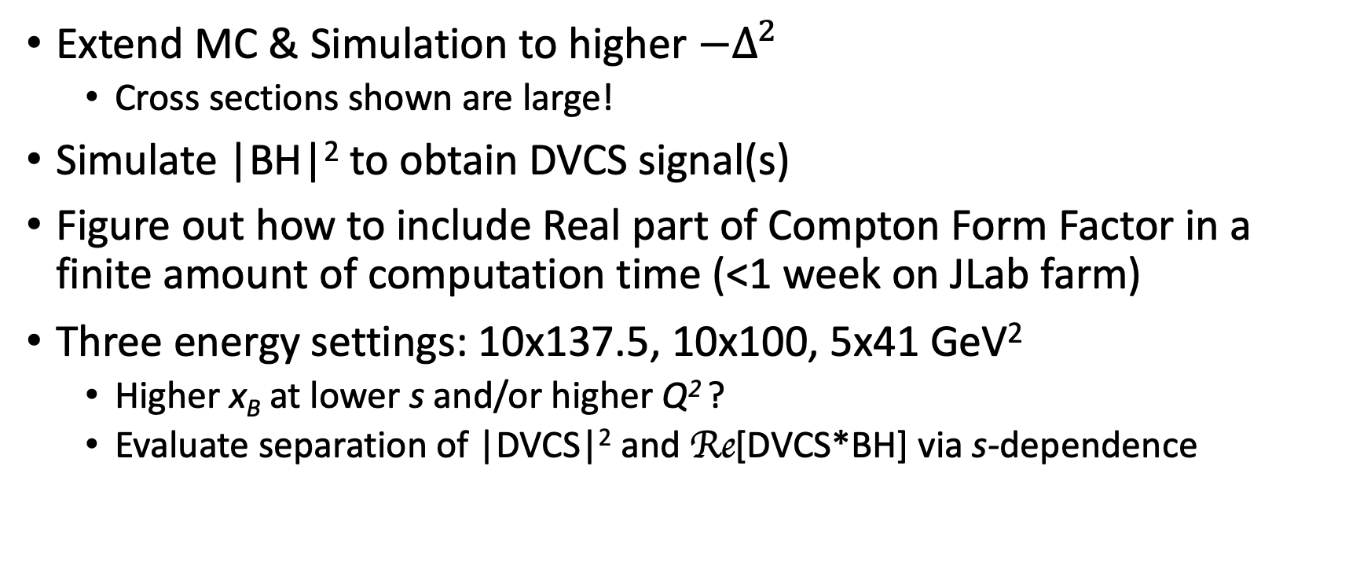
Next Steps
Extend MC & Simulation to higher $−Δ^{2}$
  Cross sections shown are large!
Simulate |BH|² to obtain DVCS signal(s)
Figure out how to include Real part of Compton Form Factor in a finite amount of computation time (<1 week on JLab farm)
Three energy settings: 10x137.5, 10x100, 5x41 GeV²
  Higher x_{B} at lower s and/or higher Q² ?
  Evaluate separation of |DVCS|² and Re[DVCS*BH] via s-dependence

Slide 11

Conclusions
High Resolution EMCal in full range $η<0$ is an enabling technology for nuclear DVCS
  Combining DVCS and Deep Virtual $φ$ or J/$ψ$ allows separation of gluon and quark distributions in light nuclei
Need event generators for heavier nuclei (e.g. ¹⁶O), even approximate

