Slide 1
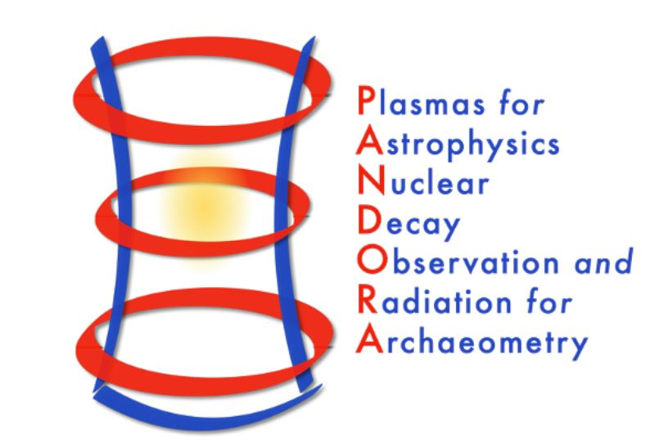
Numerical estimation of in-laboratory plasma opacity resembling KN plasma ejecta in the framework of the PANDORA project
Ph.D. Student MATTEO BEZMALINOVICH
Key Reaction in Nuclear Physics - ECT* Workshop Trento Dec 12-16, 2022

Slide 2
Numerical estimation of in-laboratory plasma
opacity resembling KN plasma ejecta
in the framework of the PANDORA project
Ph.D. goals

Slide 3
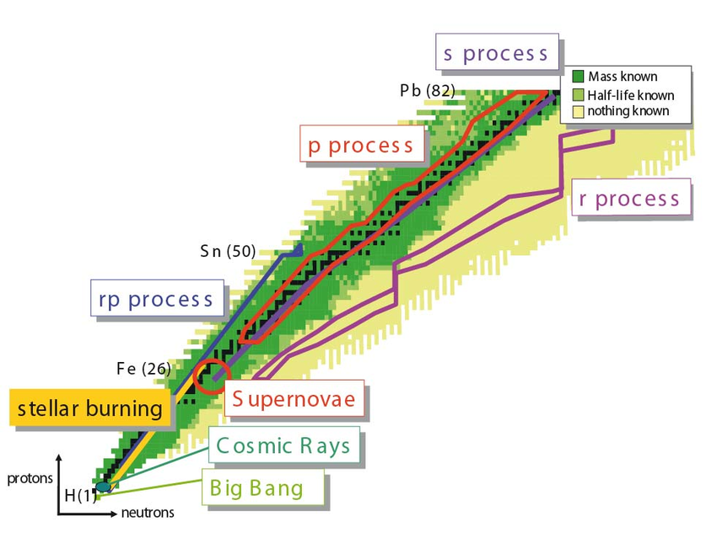
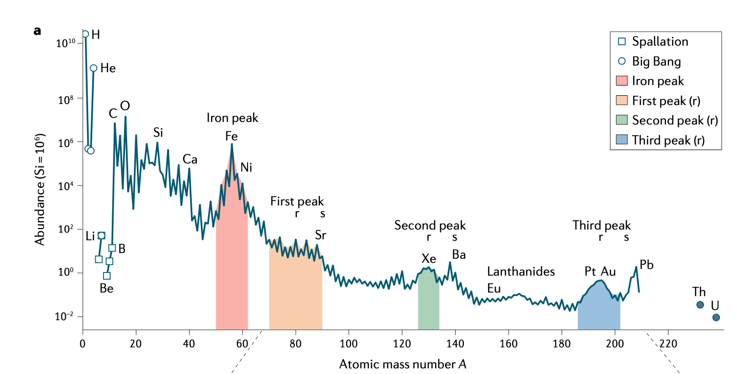
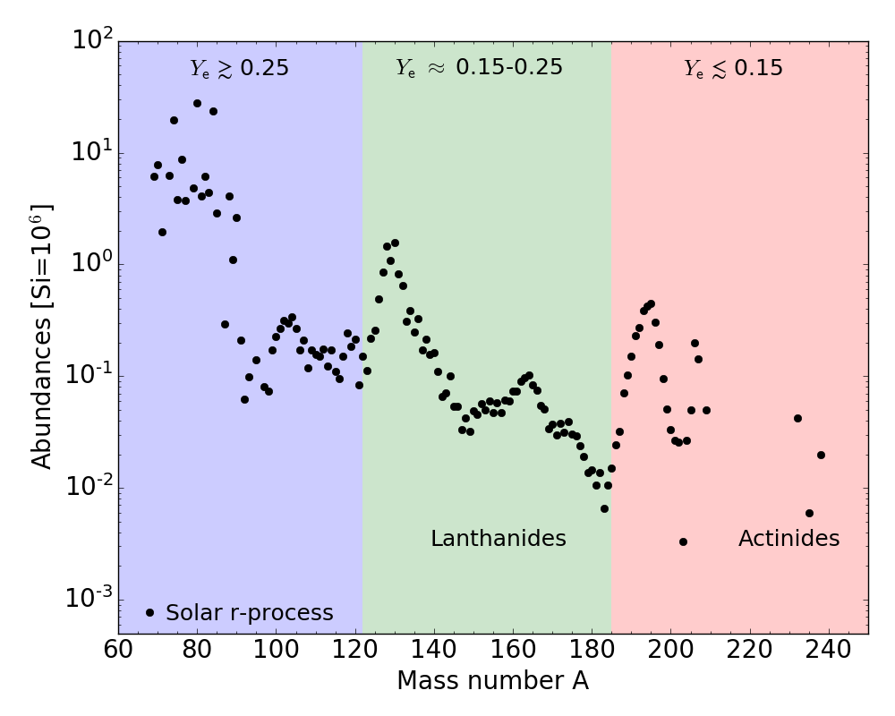
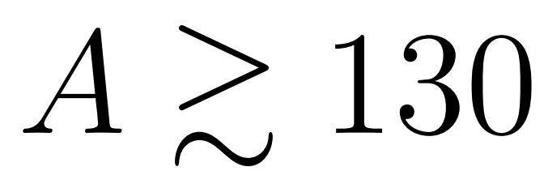
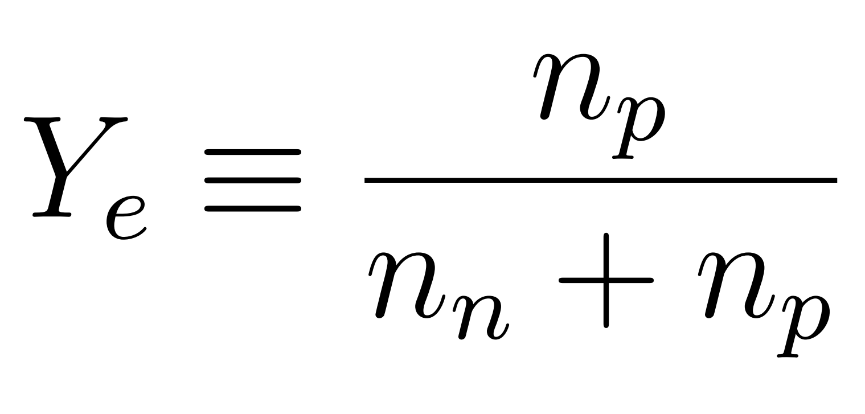
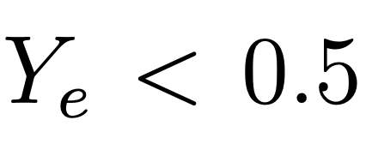
Rapid neutron capture process
KN plasma ejecta
How to build heavier neutron-rich isotopes beyond ⁵⁶Fe?
Chart of nuclides
Siegel D. M., Nat. Rev. Phys. 4, 306-318 (2022).
Blaum K., Novikov Yu. N., Werth G., Contemporary Physics 51, 2 (2010).
r- process
Neutron-rich nuclei far from the stability valley

Slide 4
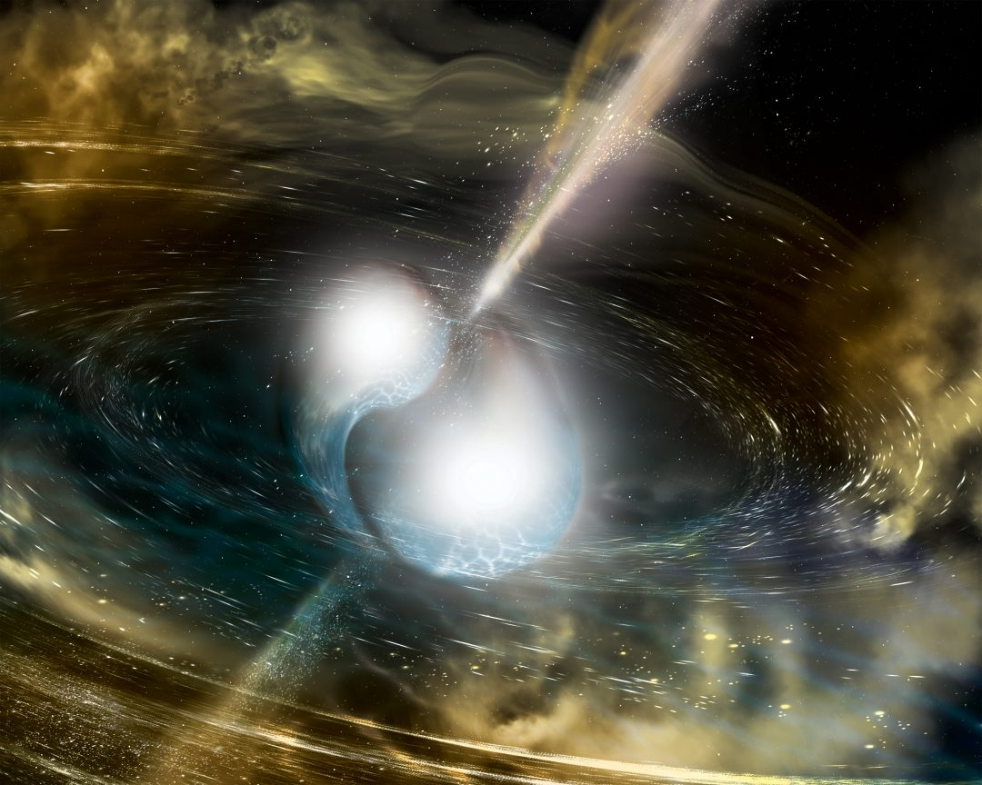
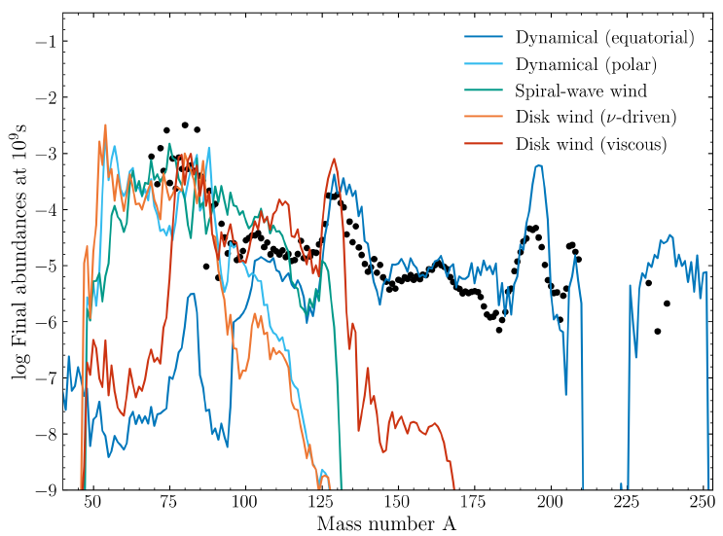
Binary Neutron Star (BNS) Merger
KN plasma ejecta
GW170817
AT2017gfo

Slide 5
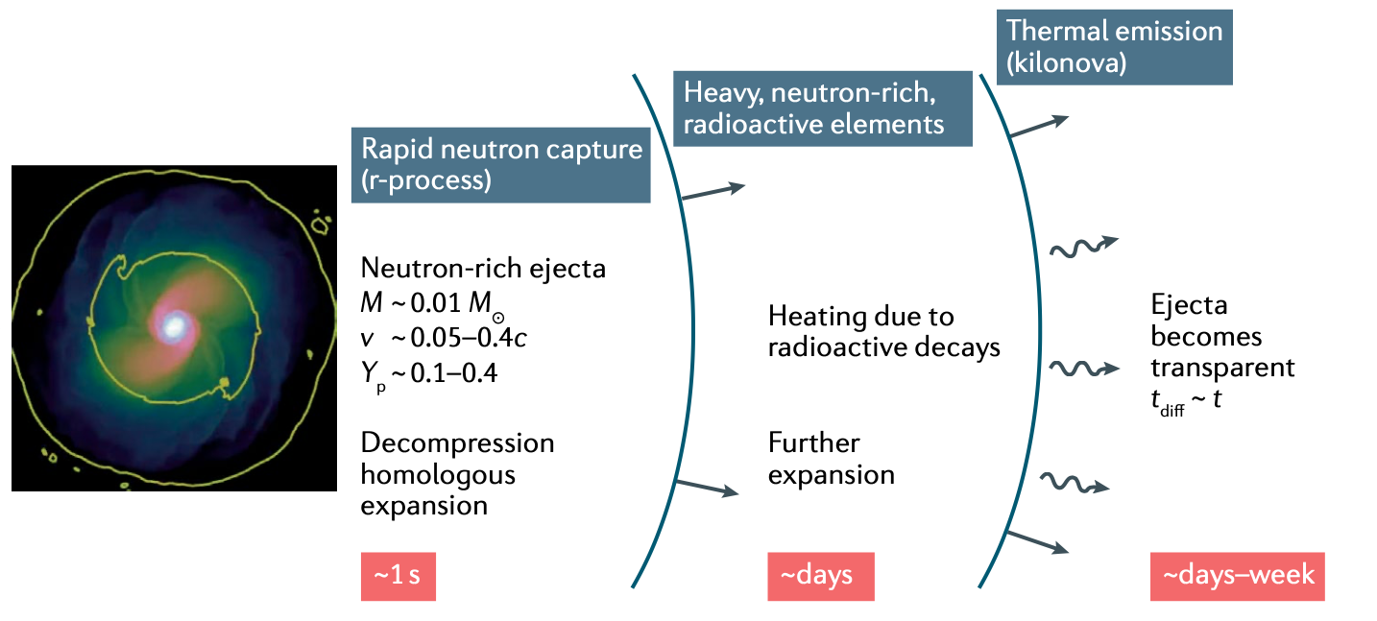
The kilonova
KN plasma ejecta
Luminosity peak
Heating rate Q (and thus from nucleosynthesis)
Opacity κ
Siegel D. M., Nat. Rev. Phys. 4, 306-318 (2022).
Low-opacity for lanthanide-poor ejecta (Y_{e} ≿ 0.25)
‘Blue kilonova emission’
High-opacity for lanthanide-rich ejecta (Y_{e} ≲ 0.25)
‘Red kilonova emission’
Kasen D. et al., Nature 551, 80–84 (2017).

Slide 6
What are we looking for?
In-laboratory plasma
Theoretical Scenario
Experiment
Layers of ejecta
Different densities and temperatures
Photon-matter collisions
Radiation attenuation by opacity
In-laboratory compact magnetic plasma trap
Suitable plasma species for experimental measurements
Non-homogeneous and anisotropic medium
Opacity measurements
Numerical model
Different densities and temperatures of the medium
Opacity numerical estimation
Atomic abundances prediction
Energy transport through the plasma
KN light-curve numerical code

Slide 7
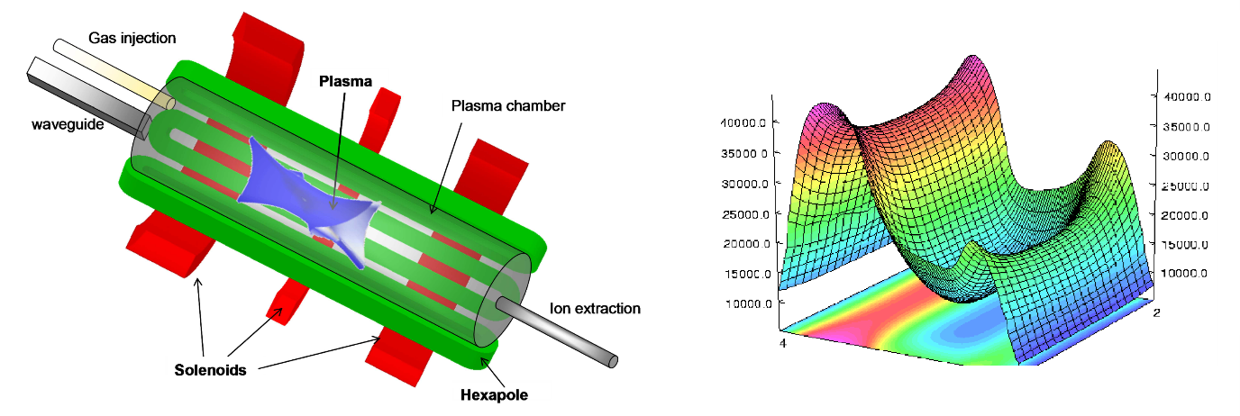
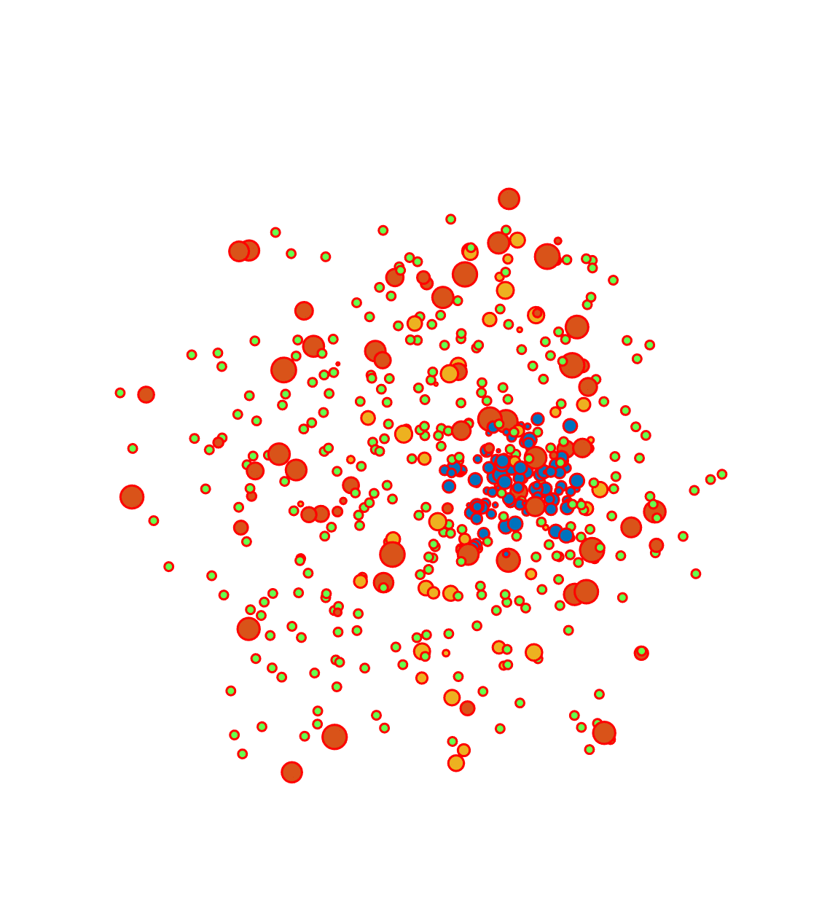
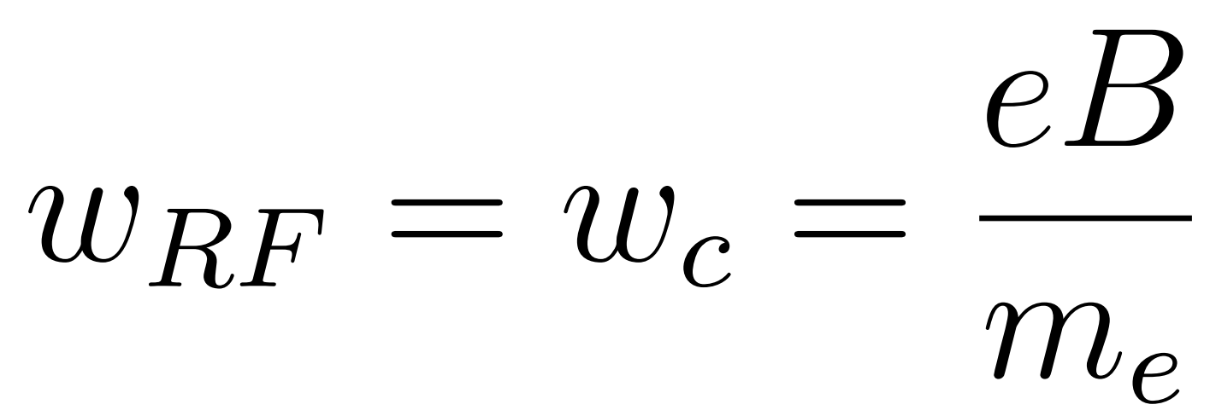
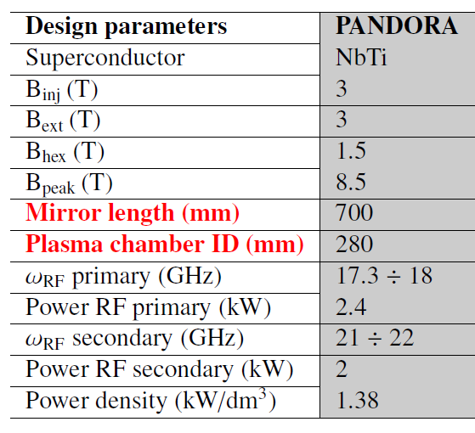
In-laboratory plasma
Electron Cyclotron Resonance (ECR) plasma
Electron Cyclotron Resonance (ECR) magneto-plasmas have historically served the accelerator community as source for multi-charged ion beams to be accelerated
Microwaves igniting and sustaining plasma, 5 kW and 18-21 GHz
ECR mechanism:
B-min magnetic field structure (max 3 T)
ECR surface
$$B_{ECR}=\frac{ω_{RF}m}{q}$$

Slide 8
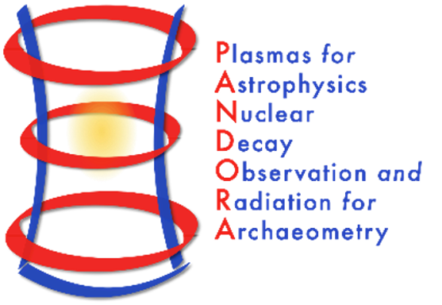
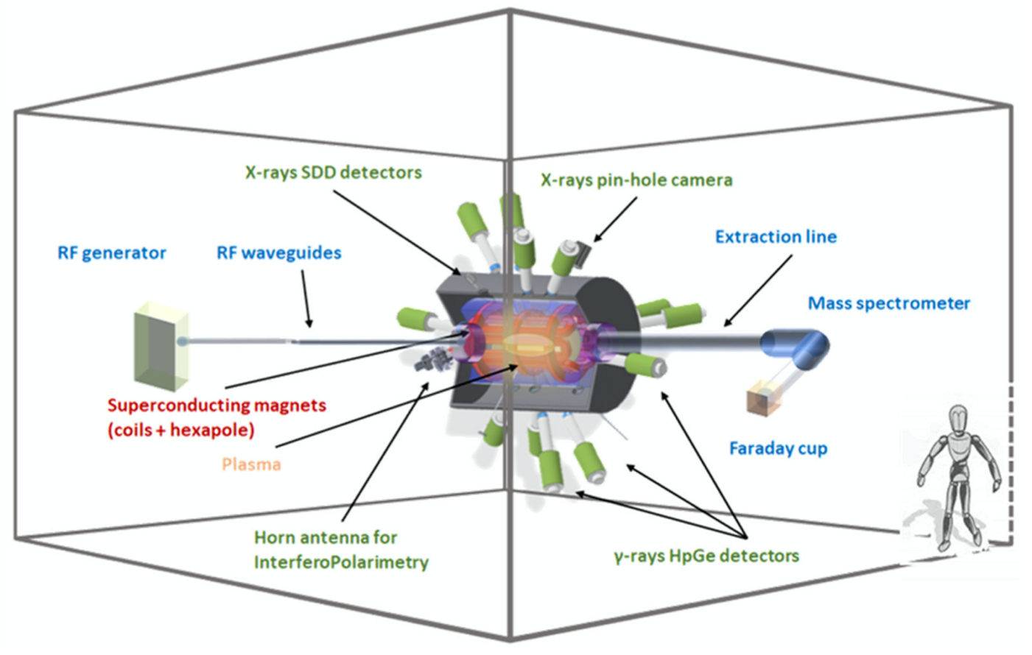
PANDORA
PANDORA
Superconducting magnetic plasma trap where plasma are generated via the electron cyclotron resonance (ECR) mechanism, sustained via microwave, and confined by the magnetic trap
Interdisciplinary research with a multi-diagnostics setup:
Measure in-plasma 𝛽-decays of selected radioactive isotopes (¹⁷⁶Lu, ¹³⁴Cs, and ⁹⁴Nb)
Reproduce the plasma environments of KN in laboratory and study plasma opacity
Reminder: talk by A. Pidatella!!!
n_{e}: 10¹⁰ - 10¹³ cm⁻³
T_{e}: few eV
D. Mascali et al., Universe 8, 80 (2022).

Slide 9
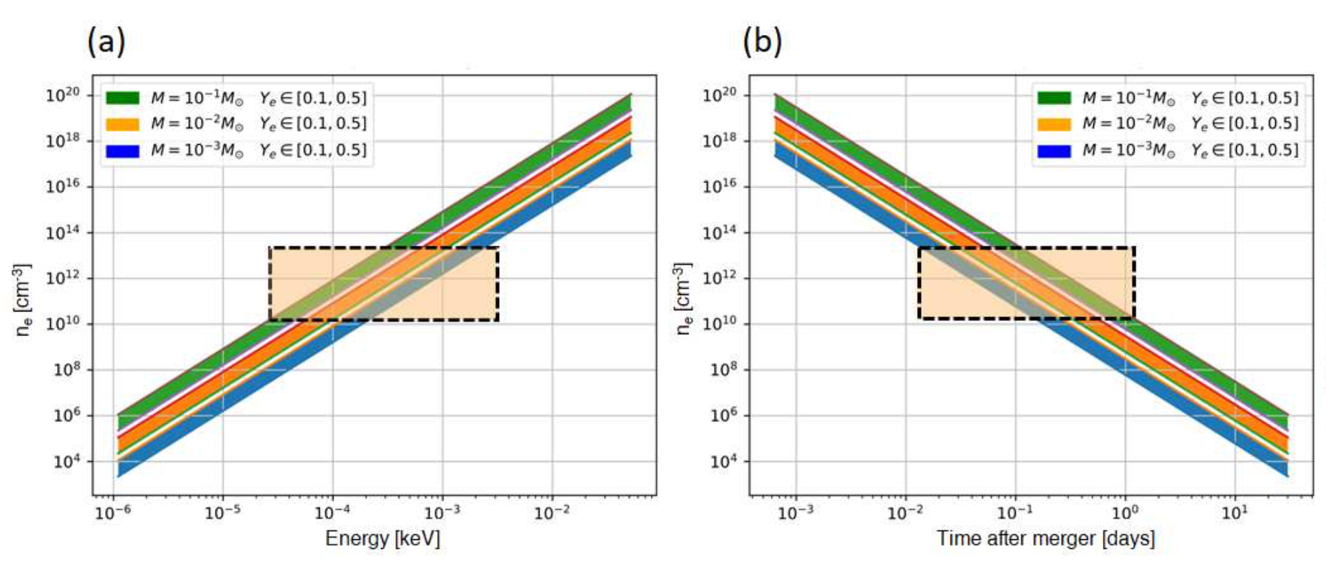
Ejecta stage vs. in-laboratory plasma conditions
PANDORA
max n_{e}
min n_{e}
min E
max E
Pidatella A. et al., IL NUOVO CIMENTO C 44, 65 (2021).
𝚫T
For the modeled ejecta:
Densities n_{e}∼ 10¹⁰ − 10¹⁴ cm⁻³ in an energy range of few eV
Time after merger 𝚫T ∼ 10⁻² – 10⁰ [days]

Slide 10
Numerical estimation
of opacity
Work overview procedure
ECR plasma

Slide 11
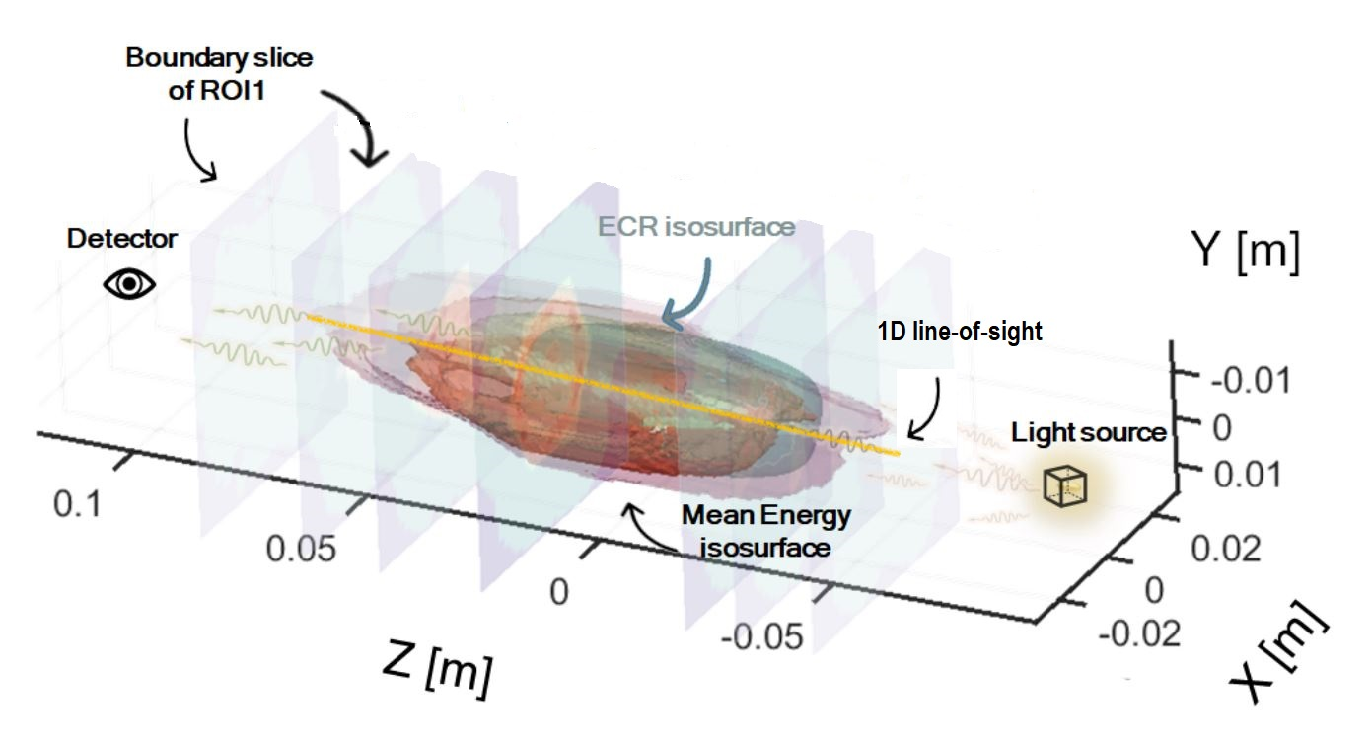
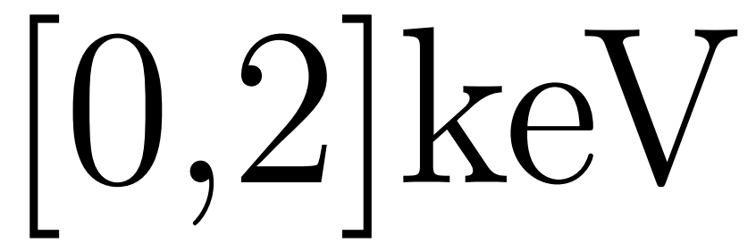
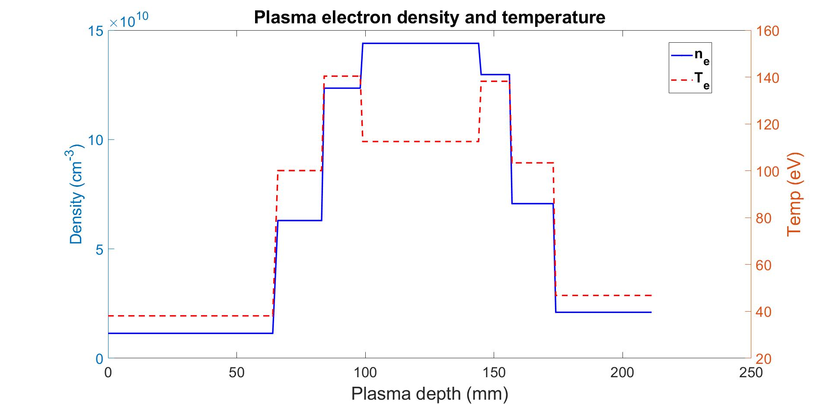
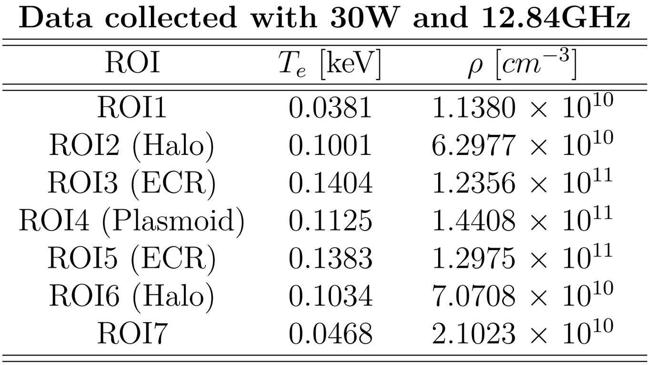
Thermodynamic parameters
Numerical estimation
of opacity
Energy interval of the data set:
WARNING: The data used for the numerical simulations were previously collected by the ATOMKI/Debrecen research group for X-ray emission spectroscopy analysis

Slide 12
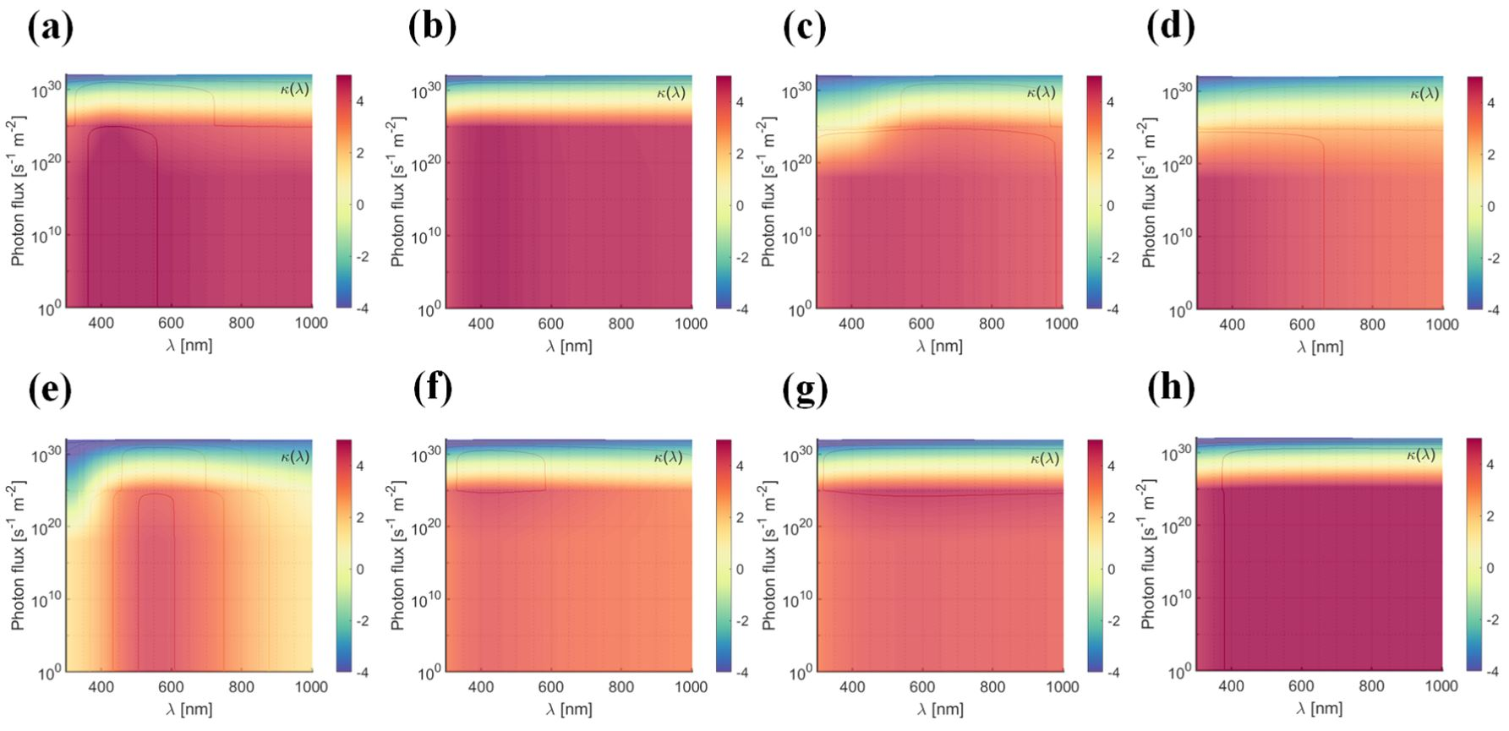
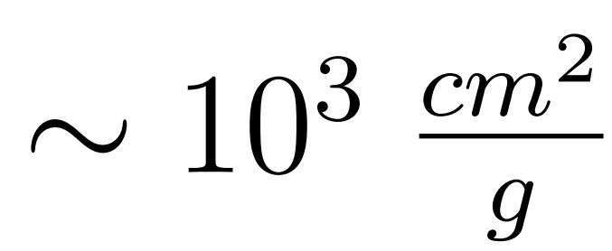
Numerical opacity
Numerical estimation
of opacity
Thermodynamic parameters achieved in Flexible Plasma Trap (FPT)
Configuration (a-d) - Density
Temperature
Configuration (e-h) - Density
Temperature
Elements of interest:
Selenium (34) (a,e)
Strontium (38) (b,f)
Zirconium (40) (c,g)
Niobium (41) (d,h)
A. Pidatella et all. Frontiers in Astronomy and Space Science 9, 931744, 2022
The absence of radiation (no external photon flux) involves an extremely opaque plasma opacity of the order
This effect is attenuated with the slightly increase of radiation field, unless it goes for sources with a high photon flux which would decrease such values

Slide 13
Further goals?
Ph.D. Goals
β-decay
(s-process)
Modelling on atomic inputs
PANDORA
Level Population
Opacity
(r-process)
1D line-of-sight NLTE
Full 3D resolution NLTE
Opacity
Radiative Transfer Equation (RTE)
Level Population
Emissivity

Slide 14
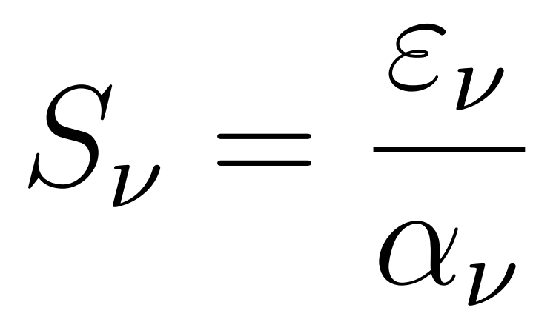
RTE equation
Ph.D. Goals
Radiative Transfer Equation (RTE)
Spectral
radiance
Radiation beam losses of energy through scattering and absorption
Radiation beam energy gain by emission and energy redistribution by scattering
Emissivity, absorption coefficient and intensity
S_{ν} source function defined as the ratio between the emissivity and the absorption coefficient (hence the opacity)
N_{u} upper level population
N_{l} lower level population
τ_{ν} medium optical depth

Slide 15
KN light-curve model
Ph.D. Goals
What has been achieved
Numerical tool capable to extrapolate densities and temperatures ✓
Numerical investigation of opacity ✓
Coherence with the theoretical kilonovae scenario
Further goals
Extend the numerical tool from 1-D to 3-D
Optimize the in-laboratory opacity investigation with ECR plasma as benchmark for the theoretical kilonovae scenario
Atomic KN abundance (SKYNET)
RTE equation
Opacity numerical estimation
KN light-curve model

Slide 16
Thank you for your attention

Slide 17
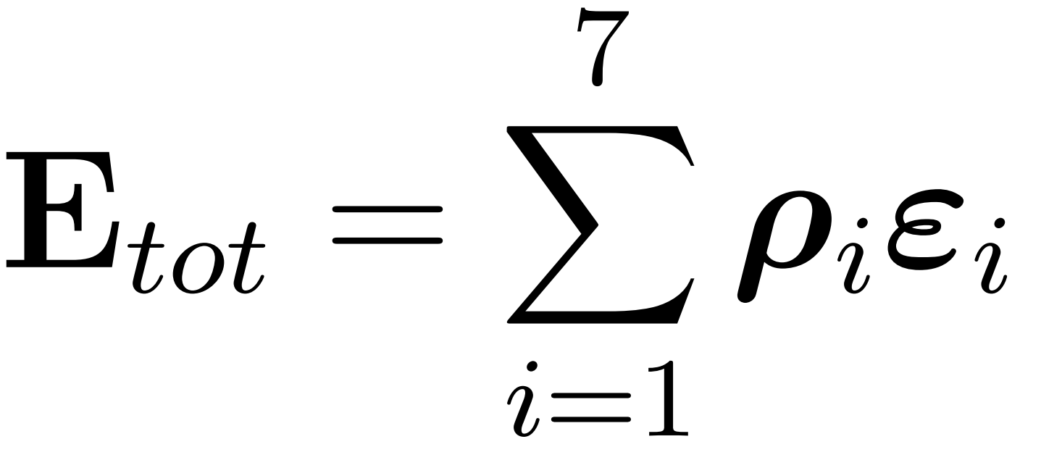
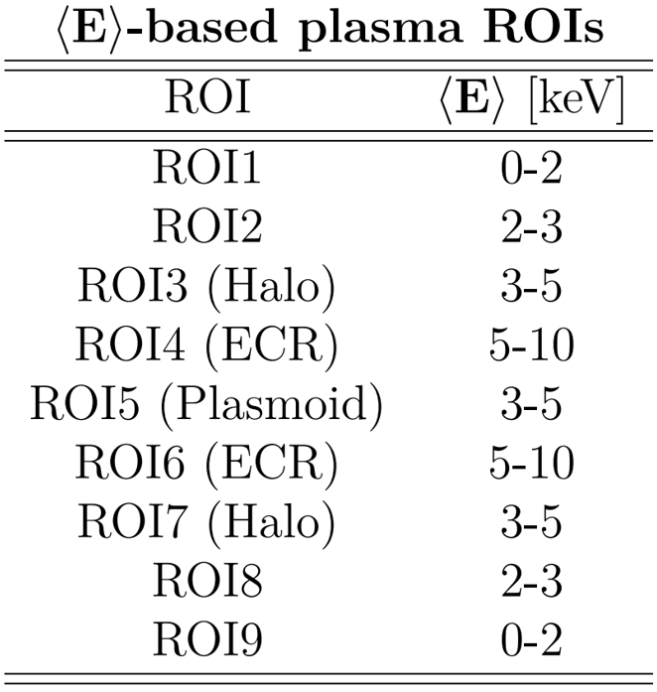
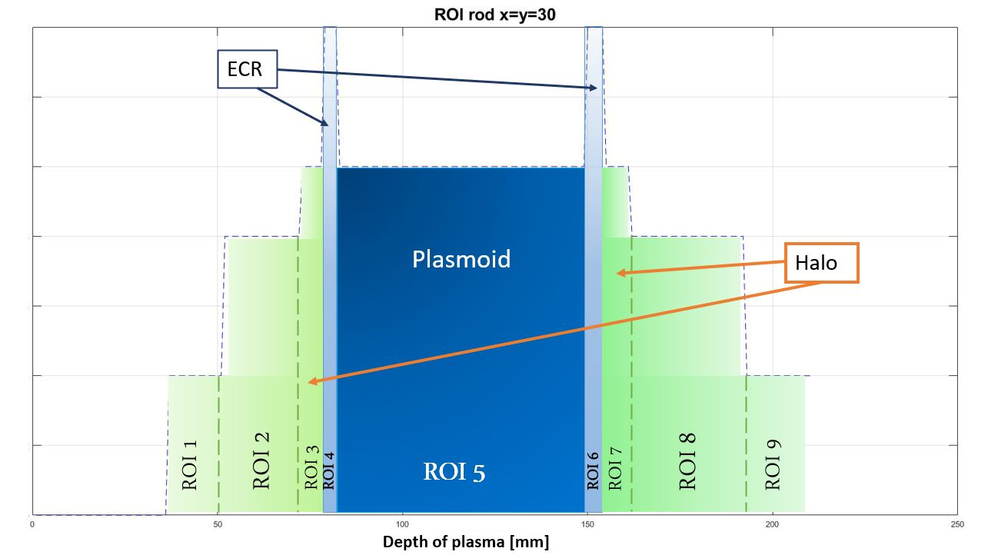
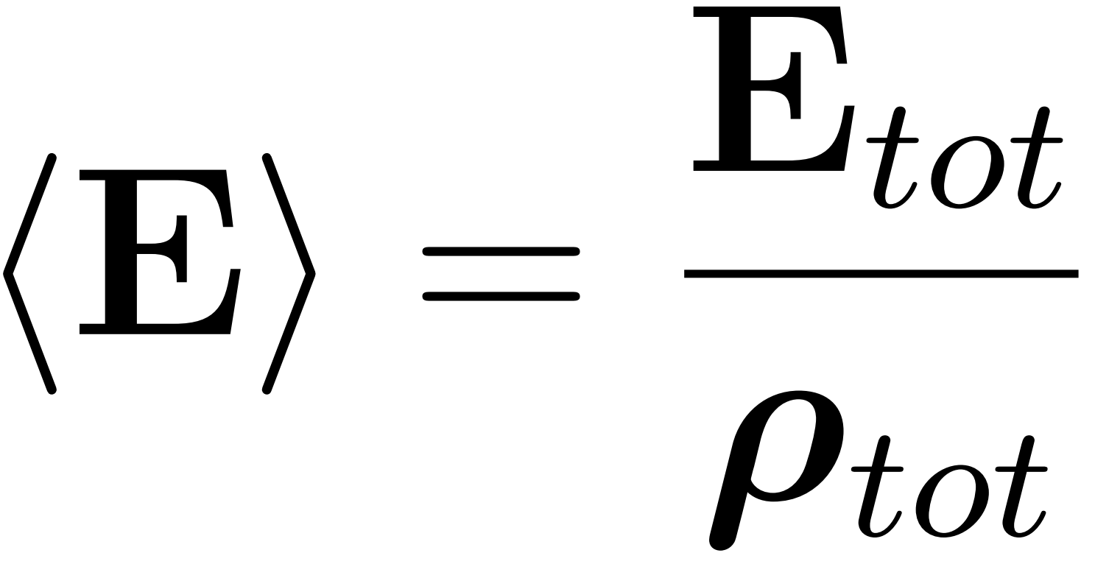
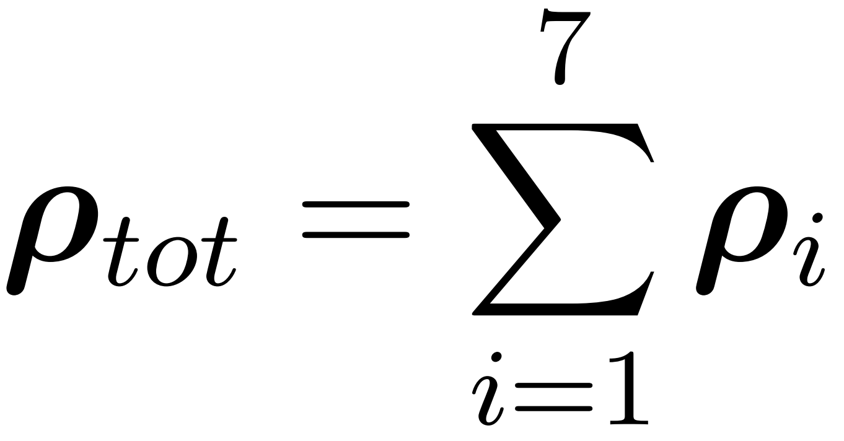
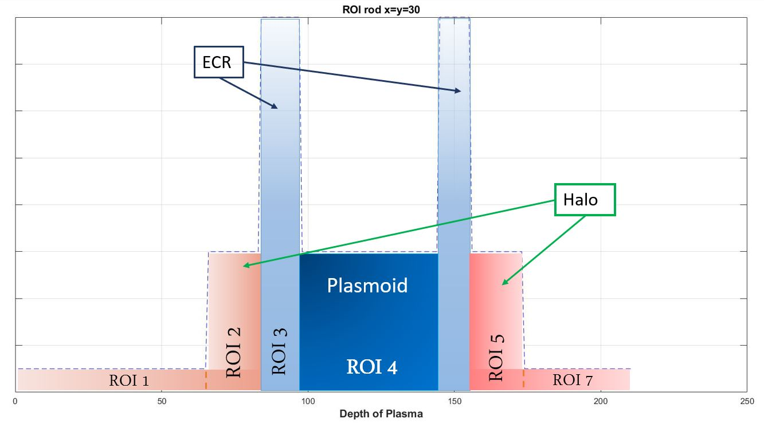
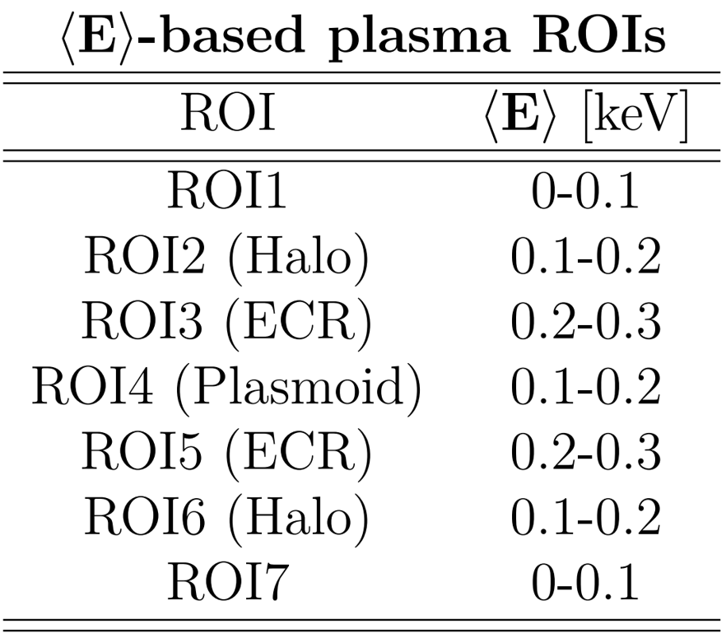
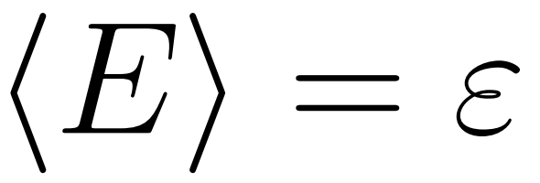
ROI criterion
Numerical estimation
of opacity
Energy intervals of the data set:
Energy interval of the data set:

Slide 18
Opacity vs. Radiation
Numerical estimation
of opacity

