Slide 1

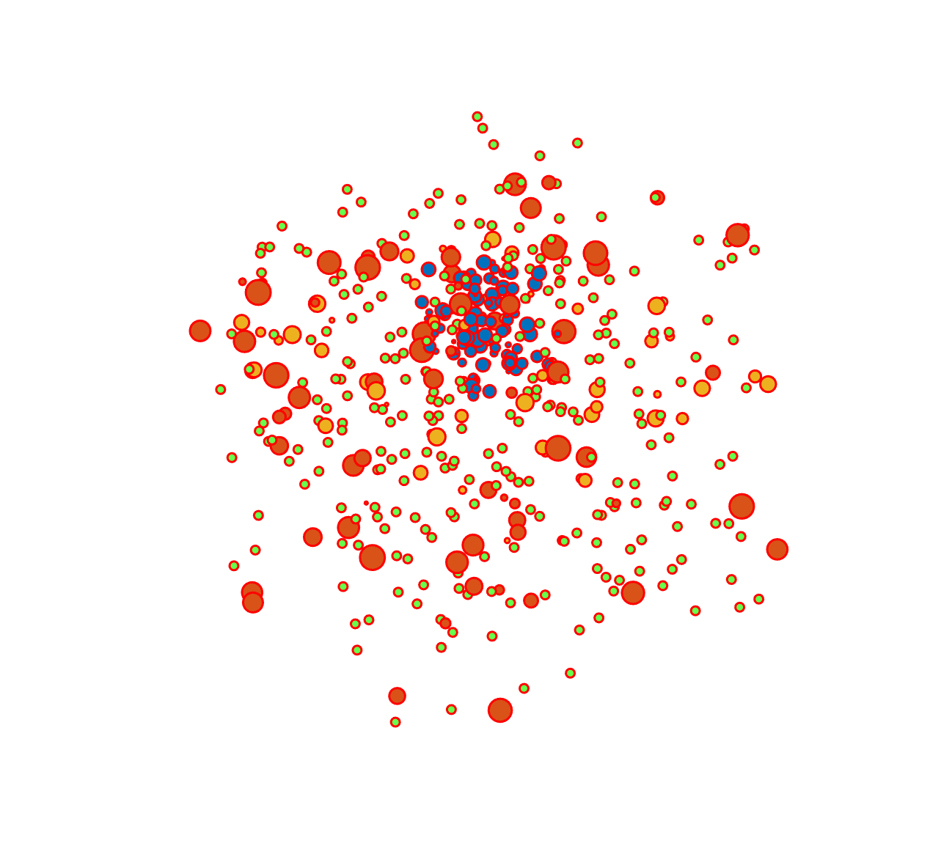

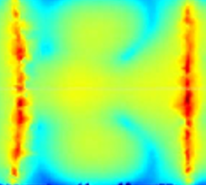
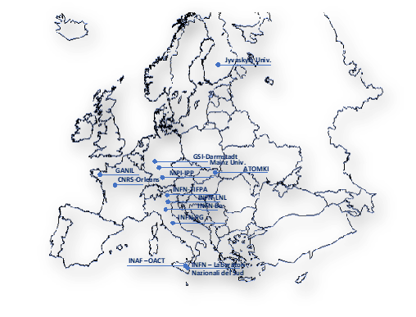
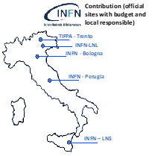


Status and progress of the PANDORA plasma trap: a facility to investigate on atomic and nuclear inputs for key nucleosynthesis branchings
Angelo Pidatella on behalf of the PANDORA collaboration
INFN, Laboratori Nazionali del Sud
Key Reactions in Nuclear Astrophysics, 12 -16 December 2022 – ECT*

Slide 2
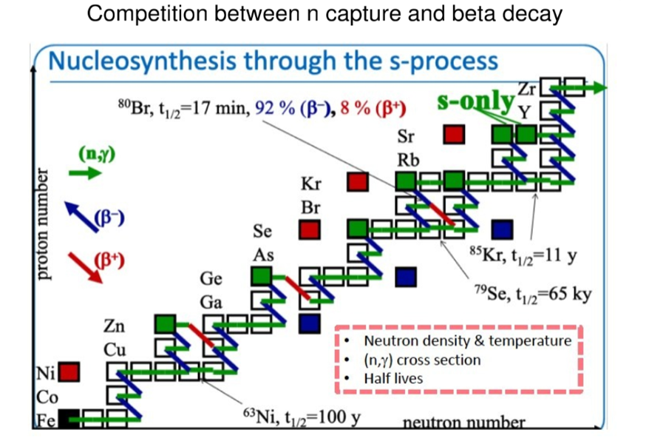

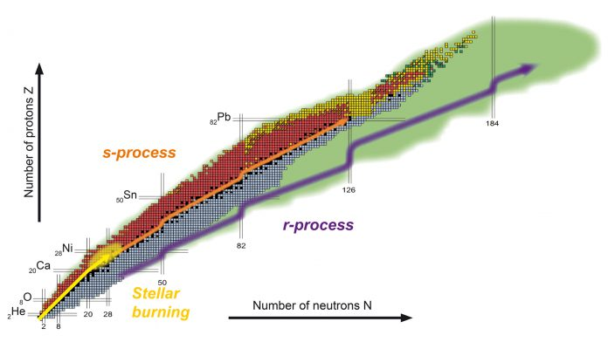
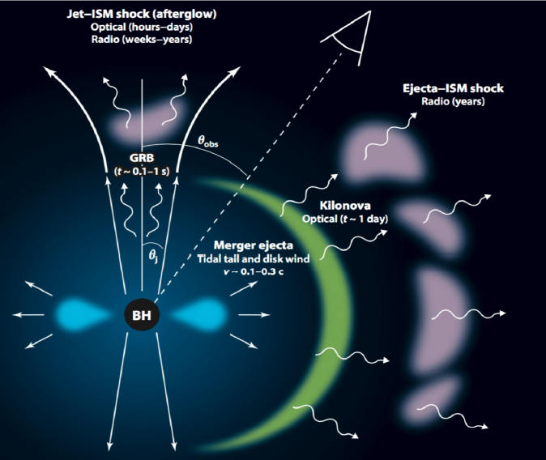

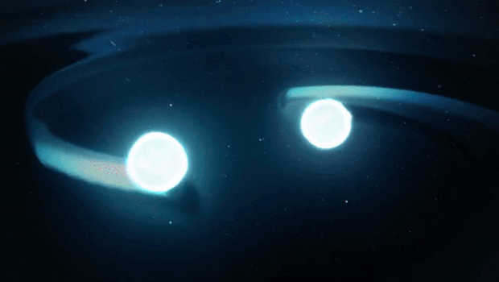
Highlights of physics perspectives for s- and r-process nucleosynthesis
Busso, M. et al., Ann Rev Astron. Astrophys. 37 (1999) 239
Cristallo, S. et al., APJ Suppl. 197, 17 (2011)
Slow Neutron Capture Process (s-process)
Low neutron density (~10⁵ – 10⁶ cm⁻³) and capture lifetime ~ 10⁴ years
Absorption process competes with β and α-decay reactions – populates the valley of stability
UNIVERSE FACTORY: AGB STARS
OPEN ISSUES: DEMANDING FOR WEAK-INT. INPUT FOR ASTROPHYSICAL MODELS
Rapid Neutron Capture Process (r-process)
High neutron density (~10²³ – 10²⁴ cm⁻³) and capture lifetime ~ 10⁻⁶ s
Absorption process competes with inverse (γ,n) reaction – populates the neutron drip line
UNIVERSE FACTORY: SN, NS MERGERS
OPEN ISSUES: WEAK R-PROCESS YIELDS CONSTRAIN, OPACITY INFO MISSING IN THE KILONOVA PREDICTION
Metzger B.D., Kilonovae. Living Rev Relativ 23, 1 (2020)
A. Pidatella - KRINA, 12 -16 Dec 2022 – ECT*

Slide 3







Highlights of physics perspectives for s- and r-process nucleosynthesis
Study of bound-β decay in a high-energy content plasma
The large effects of stellar conditions in β-decays have been measured in a few cases at storage rings
Theory of perturbed decay rates in stellar environments (Takahashi, Yokoi ‘80s – TY)
The β-decay model: detailed inputs on the level population and charge state distribution of the plasma ions, as well as on the electron energy distribution function (EEDF).
TERRESTRIAL
  Bare ¹⁸⁷Re⁷⁵⁺ ions decay, due to the bound-state beta decay, becomes 9 orders
  of magnitude faster than neutral ¹⁸⁷Re atoms with a half-life of 42 Gyr
VS.
F Bosch, et al., PRL 77 (1996) 5190
Beta-decay rates of highly ionized heavy atoms in stellar interiors, K Takahashi and K Yokoi, Atomic Data and Nuclear Data Tables 36, 375 (1987)
STELLAR
c. d.
c. d.
→ $λ_{i}$ can differ by orders of magnitude
$$λ^{∗}=p_{0}λ_{0}+ p_{1}λ_{1}+ …$$
$$t_{1/2}= \frac{\ln{2}}{λ}$$
→ additional transitions (different forbiddeness) can appear in $λ_{0}$
c. c.
c. c.
b. c. / b. d.
CSD and level population of ions
A. Pidatella - KRINA, 12 -16 Dec 2022 – ECT*
EEDF of electrons

Slide 4
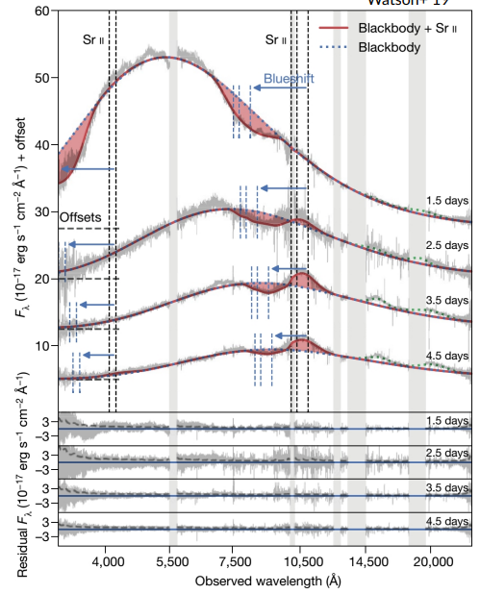



Highlights of physics perspectives for s- and r-process nucleosynthesis
Magneto-plasma opacity relevant for kilonova light-curve
Ejecta from BNS systems: first evidence of r-process nucleosynthesis in kilonova (KN) AT2017gfo, from Gravitational-Wave event GW170817
KN light-curve, 2 fundamental inputs: (1) r-process nucleosynthesis yields (fixing the heating rate) (2) opacity (fixing the exchange of energy between plasma and radiation)
Opacity impacts on KN emission, influencing post-merging plasma ejecta composition (r-process multi-components)
Opacity from theoretical models: large uncertainty factor, blending of many millions atomic transition lines, experimental data are largely desired!
BLACKBODY SPECTRUM VS. OBSERVED KN SPECTRUM
(2)
c. d.
(1)
ABSORPTION SPECTRAL FEATURES – OPACITY DEPENDENT
c. c.
A. Pidatella - KRINA, 12 -16 Dec 2022 – ECT*
Watson, D., et al. Nature 574497-500, (2019)

Slide 5
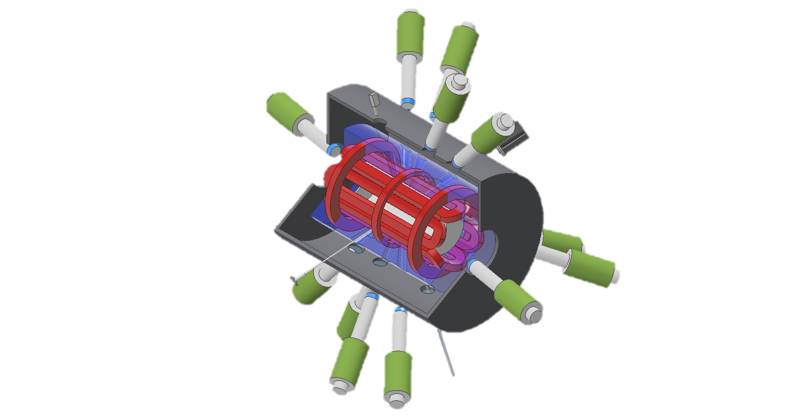
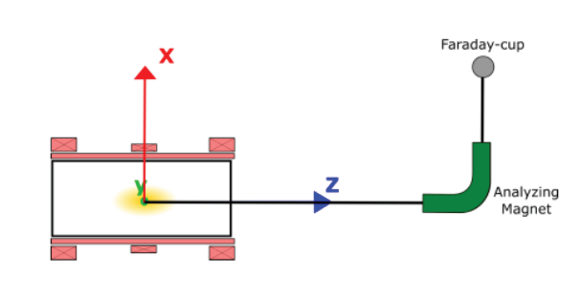
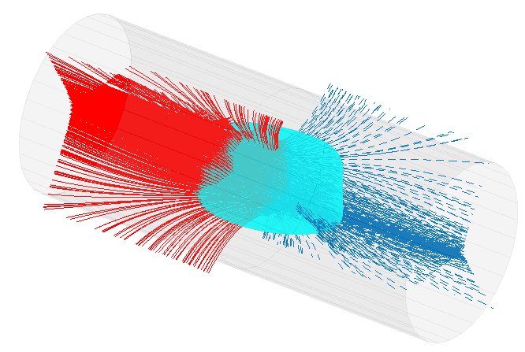
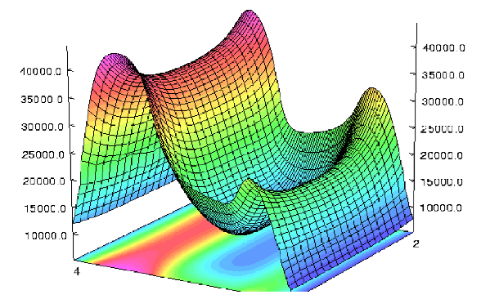
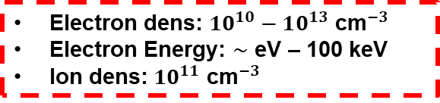
The PANDORA project: a new multidisciplinary project and facility
Radial X-ray pinhole camera
14 HpGe γ-ray detector array
Typical Electron Cyclotron Resonance (ECR) Ion Source for accelerators
SDD detector
Superconductive magnetic system
Gas injection
ECR heating surface
ECR plasma
Microwaves igniting and sustaining plasma, 5 kW and 18-21 GHz
Extraction line - diagnostic
Fiber for optical spectrometry
Min-B field providing MHD-stability and plasma confinment
Electron dens: $10^{10}−10^{13}$ ${\text{cm}}^{−3}$
Electron Energy: $∼$ eV – 100 keV
Ion dens: $10^{11}$ ${\text{cm}}^{−3}$
Mascali,D. et al, Eur. Phys. J. A (2017) 53: 145
A. Pidatella - KRINA, 12 -16 Dec 2022 – ECT*
Mascali D. et al, Universe 8 (2), 80 (2022)

Slide 6
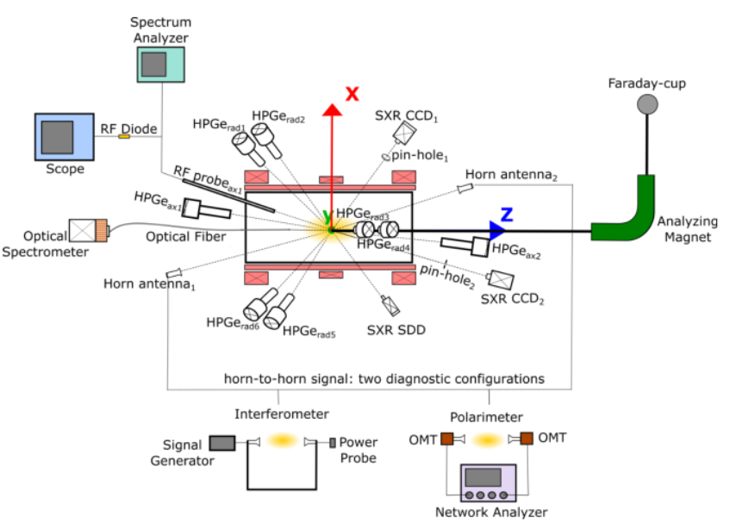
The PANDORA project: a new multidisciplinary project and facility
Radial X-ray pinhole camera
14 HpGe γ-ray detector array
70 cm
PANDORA
SDD detector
Superconductive magnetic system
28 cm
Gas injection
ECR heating surface
ECR plasma
Microwaves igniting and sustaining plasma, 5 kW and 18-21 GHz
Extraction line - diagnostic
Fiber for optical spectrometry
Min-B field providing MHD-stability and plasma confinment
Electron dens: $10^{10}−10^{13}$ ${\text{cm}}^{−3}$
Electron Energy: $∼$ eV – 100 keV
Ion dens: $10^{11}$ ${\text{cm}}^{−3}$
Mascali,D. et al, Eur. Phys. J. A (2017) 53: 145
A. Pidatella - KRINA, 12 -16 Dec 2022 – ECT*
Mascali D. et al, Universe 8 (2), 80 (2022)

Slide 7
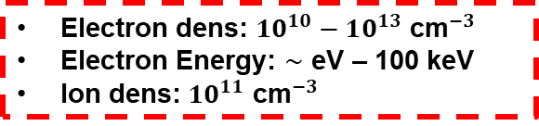
The PANDORA project: a new multidisciplinary project and facility
Radial X-ray pinhole camera
14 HpGe γ-ray detector array
SDD detector
PANDORA concept: compact plasma trap to magnetically confine ions of radioisotopes in a microwave-sustained ECR plasma
Goal: nuclear β-decay and spectroscopic measurements in a plasma resembling astrophysical conditions (temperature, ion charge state distribution)
Plasma diagnostics system: RF probes, optical and X-ray spectrometers → correlation of experimental measurements to plasma parameters
Assembling multi-diagnostic setup: simultaneously monitor plasma parameters and carry measurements under stable conditions
Superconductive magnetic system
ECR plasma
s-process nucleosynthesis + β-decay branching
r-process cosmic sites
Nuclear reaction rates in stars
Compact binary object spectroscopy (kilonova transient): to characterize composition and to identify GW events
PHYSICS OF INTEREST FOR MMA AND NUCLEAR ASTROPHYSICS
Fiber for optical spectrometry
Electron dens: $10^{10}−10^{13}$ ${\text{cm}}^{−3}$
Electron Energy: $∼$ eV – 100 keV
Ion dens: $10^{11}$ ${\text{cm}}^{−3}$
Mascali,D. et al, Eur. Phys. J. A (2017) 53: 145
A. Pidatella - KRINA, 12 -16 Dec 2022 – ECT*
Mascali D. et al, Universe 8 (2), 80 (2022)

Slide 8
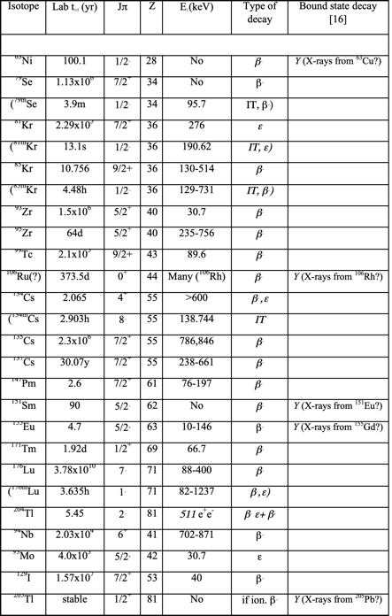
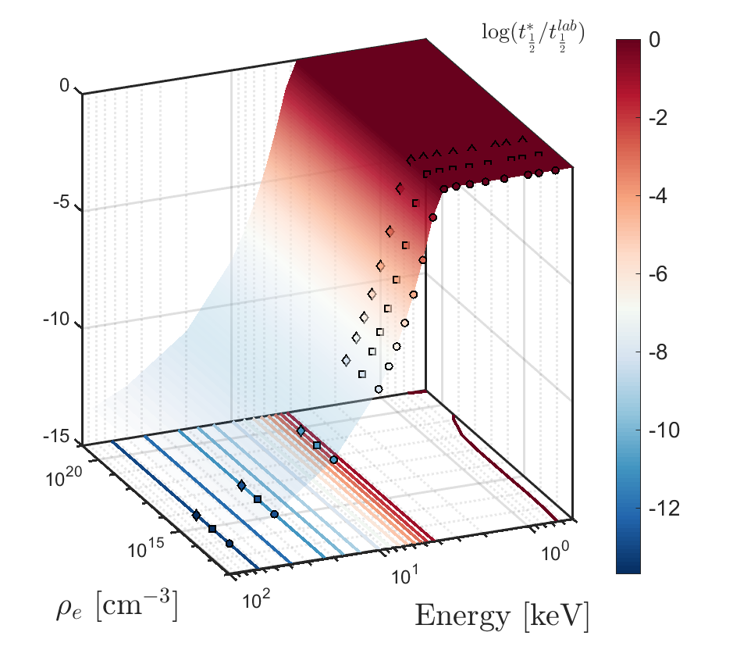



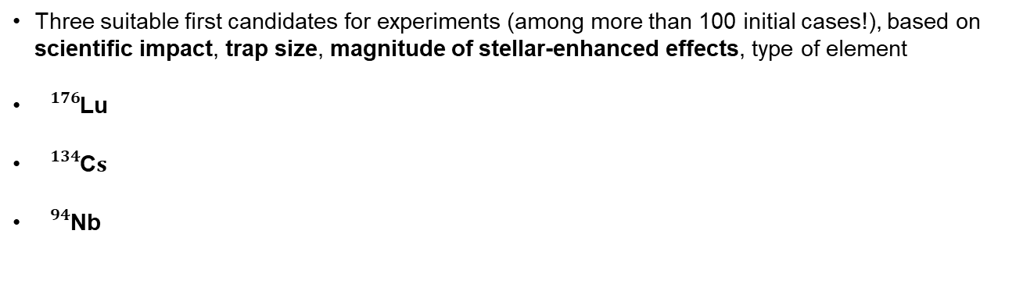

The PANDORA project – physics cases Day 1
Study of bound-β decay in a high-energy content plasma
Three suitable first candidates for experiments (among more than 100 initial cases!), based on scientific impact, trap size, magnitude of stellar-enhanced effects, type of element
${}_{}^{176}{\text{Lu}}$
${}_{}^{134}{\text{C}s}$
${}_{}^{94}{\text{Nb}}$
Cosmo-chronometer/thermometer – Expected theor. reduced lifetime $∼6$ orders of magnitude
s-process branching in AGB stars – Expected theor. reduced lifetime $∼3$ orders of magnitude
s-process branching in AGB stars – Expected theor. reduced lifetime $∼4$ orders of magnitude
OF INTEREST FOR AGB MODELS
$${}_{}^{176}{\text{Lu}}$$
More than 120 isotopes of astrophysical and nuclear physics interest!!
PANDORA can become, in perspective, a big facility!
A. Pidatella - KRINA, 12 -16 Dec 2022 – ECT*
D. Mascali et al., EPJ web of conference 227, 2020, 01013

Slide 9
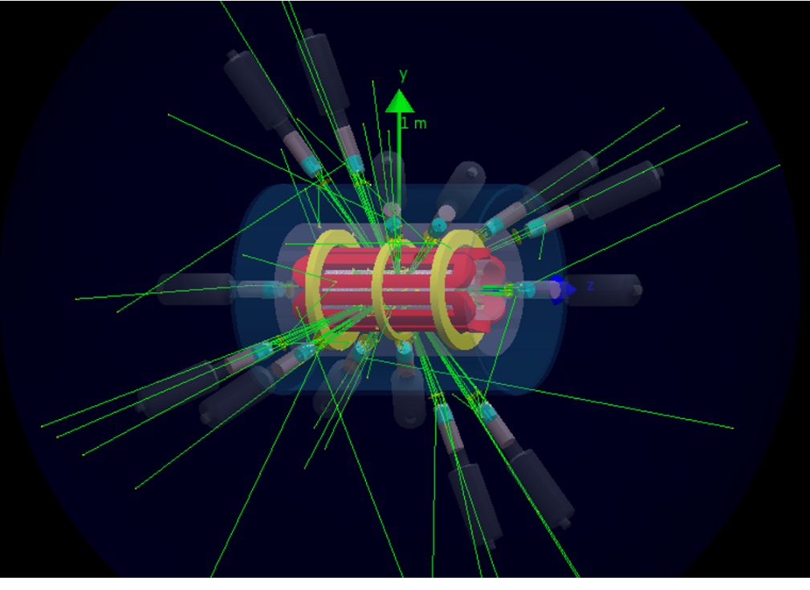

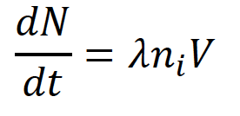
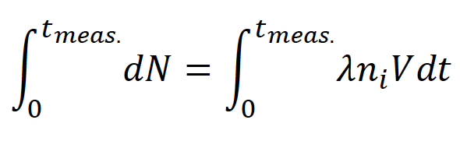
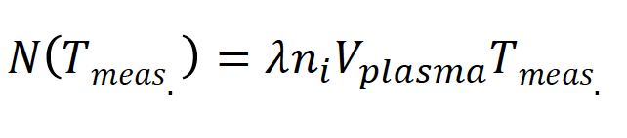
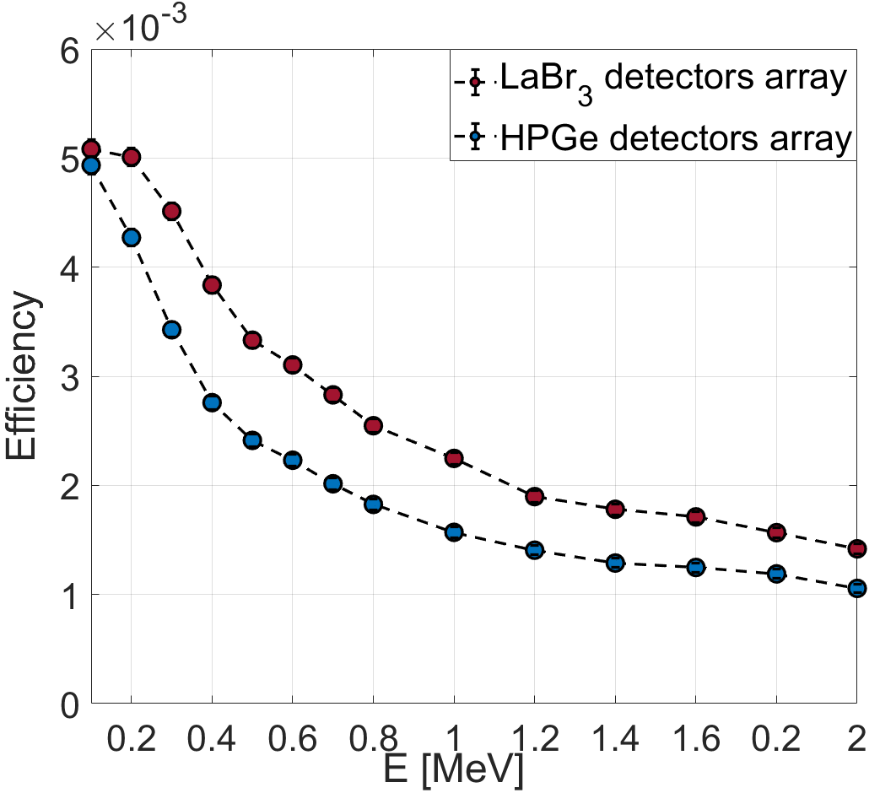
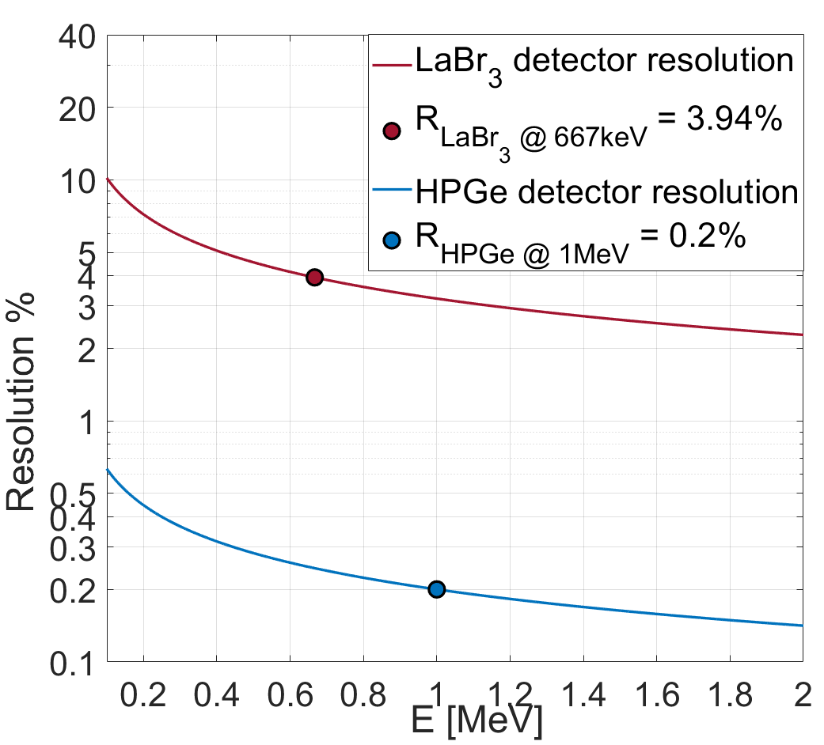
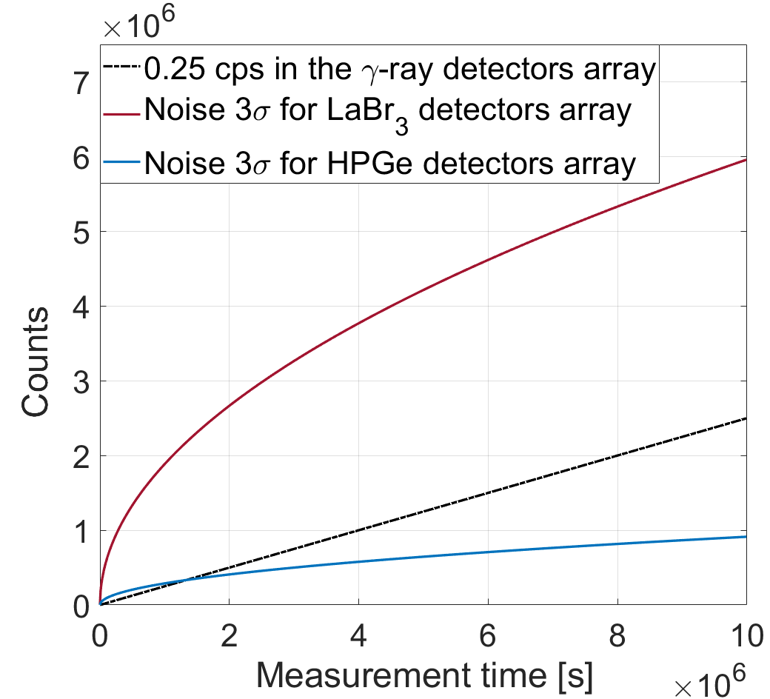
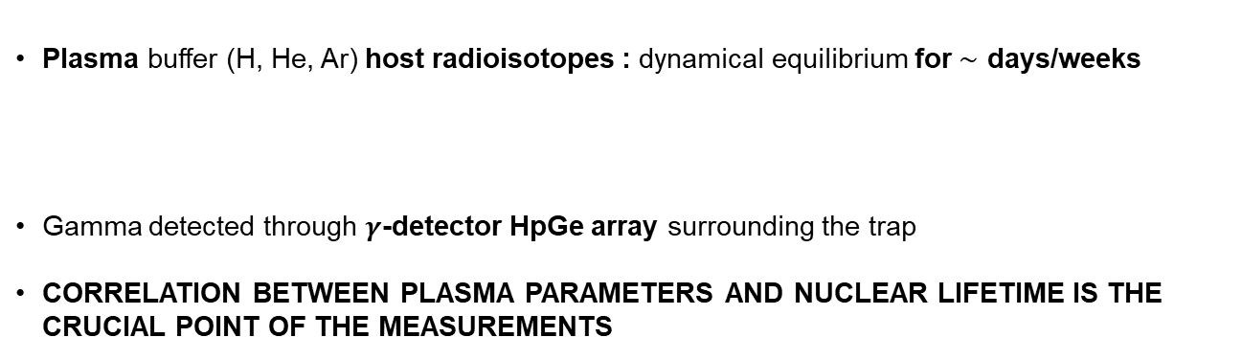
The PANDORA project – concept of nuclear decay detection
The decay-products can be tagged by γ -rays coming out from the ‘‘radio-product’’ with typical energies between 200 keV and 1800 keV
Plasma buffer (H, He, Ar) host radioisotopes : dynamical equilibrium for $∼$ days/weeks
Gamma detected through $γ$-detector HpGe array surrounding the trap
CORRELATION BETWEEN PLASMA PARAMETERS AND NUCLEAR LIFETIME IS THE CRUCIAL POINT OF THE MEASUREMENTS
Plasma volume (const.)
Isotope activity
Density of the isotope in the plasma (const.)
E. Naselli et al., EPJ web of conferences 227, 2020, 02006
Isotope | t_{1/2} [ yr ] | E_{γ} [ keV ]
¹⁷⁶Lu | 3.78 · 10¹⁰ | 202.88 & 306.78
¹³⁴Cs | 2.06 | 795.86
⁹⁴Nb | 2.03 · 10⁴ | 871.09
σ_{Res} = 7.57 keV
σ_{Res} = 0.24 keV
HPGe vs LaBr3
A. Pidatella - KRINA, 12 -16 Dec 2022 – ECT*

Slide 10
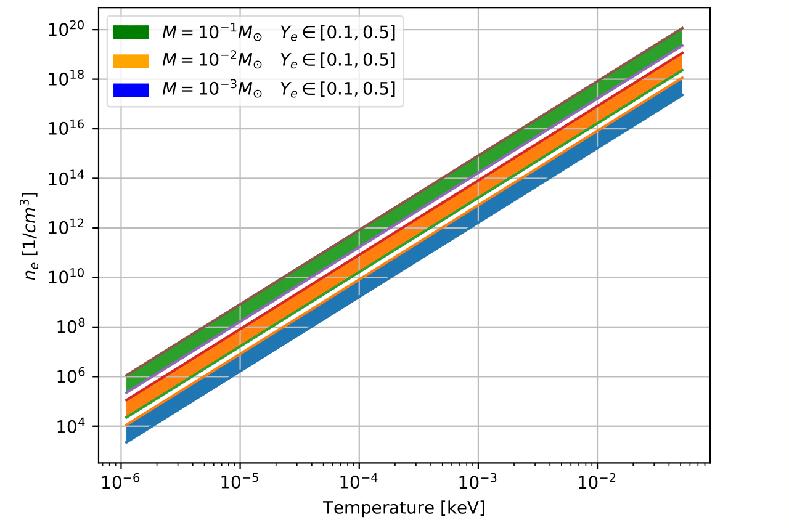
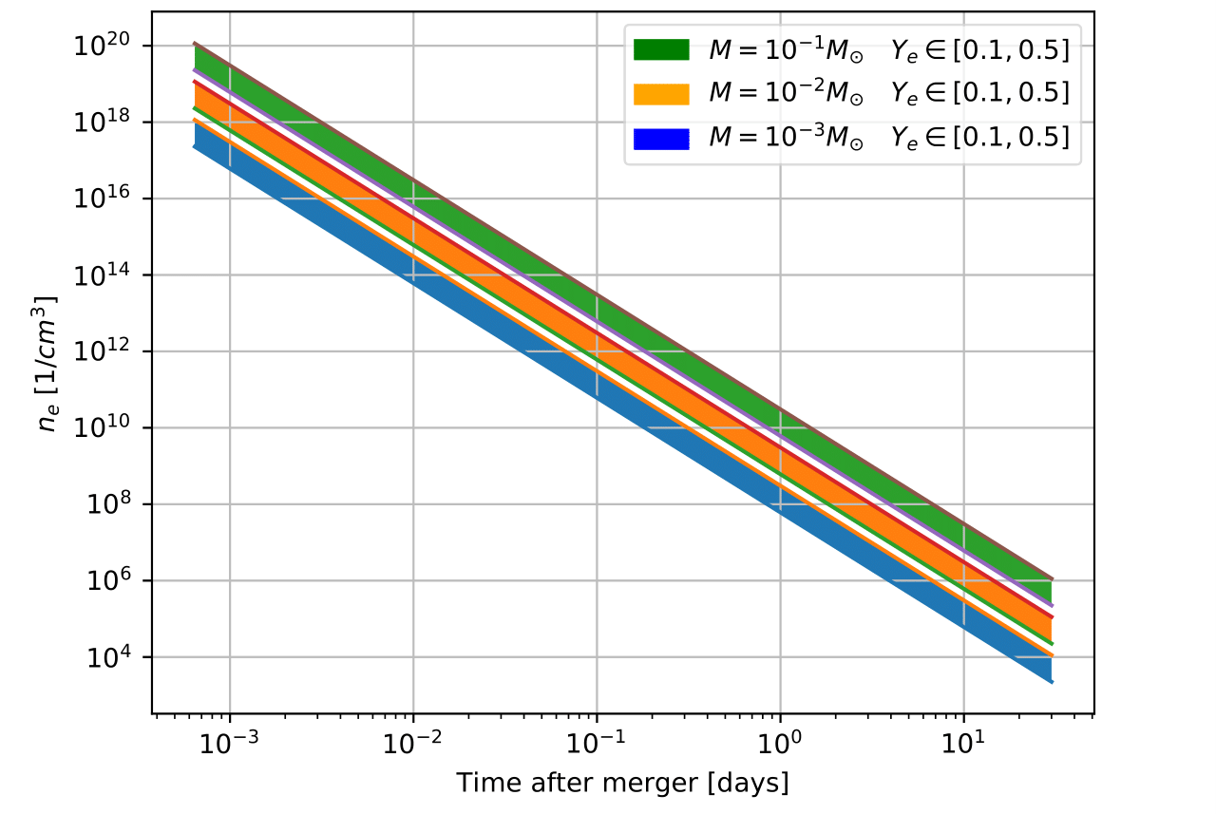
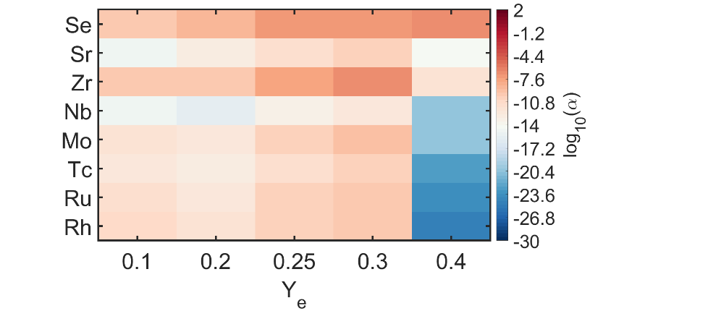
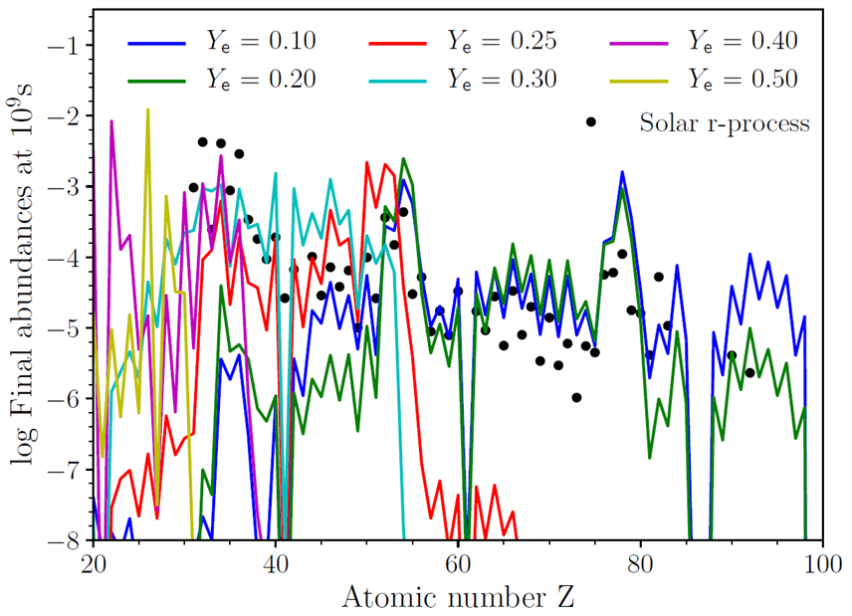
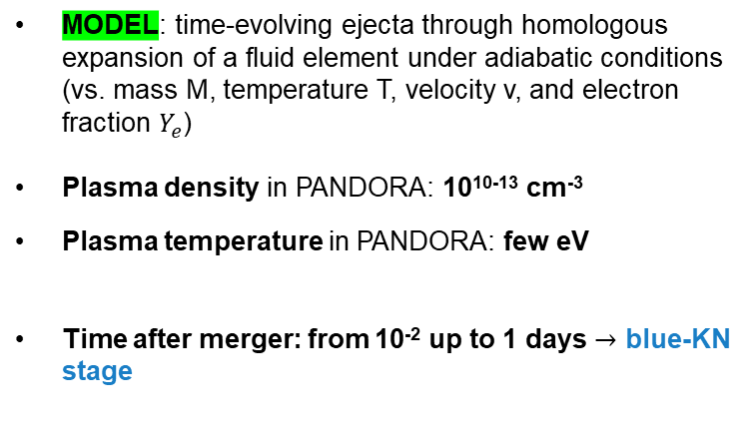
The PANDORA project – physics cases Day 1
Magneto-plasma opacity relevant for kilonova light-curve
MODEL: time-evolving ejecta through homologous expansion of a fluid element under adiabatic conditions (vs. mass M, temperature T, velocity v, and electron fraction $Y_{e}$)
Plasma density in PANDORA: 10¹⁰⁻¹³ cm⁻³
Plasma temperature in PANDORA: few eV
Time after merger: from 10⁻² up to 1 days $→$ blue-KN stage
IDENTIFICATION OF PHYSICS CASES
Time-dependent r-process elements abundances from SKYNET, with distribution of ejecta properties from astrophysical simulations → LIGHT R-PROCESS ELEMENTS, LOW NEUTRON RICHNESS
MEAN OPACITY vs. T, weighted with abundances from SKYNET: synthetic spectra of opacity from FLYCHK
Pidatella, A., et al. Nuovo Cimento 44 C (2021) 65
Recent supporting work on Se relevance : K., Hotokezaka, M. Tanaka, et al., MNRAS 515, L89–L93 (2022)
Opacity weighted on abundances from SKYNET
A. Pidatella - KRINA, 12 -16 Dec 2022 – ECT*

Slide 11

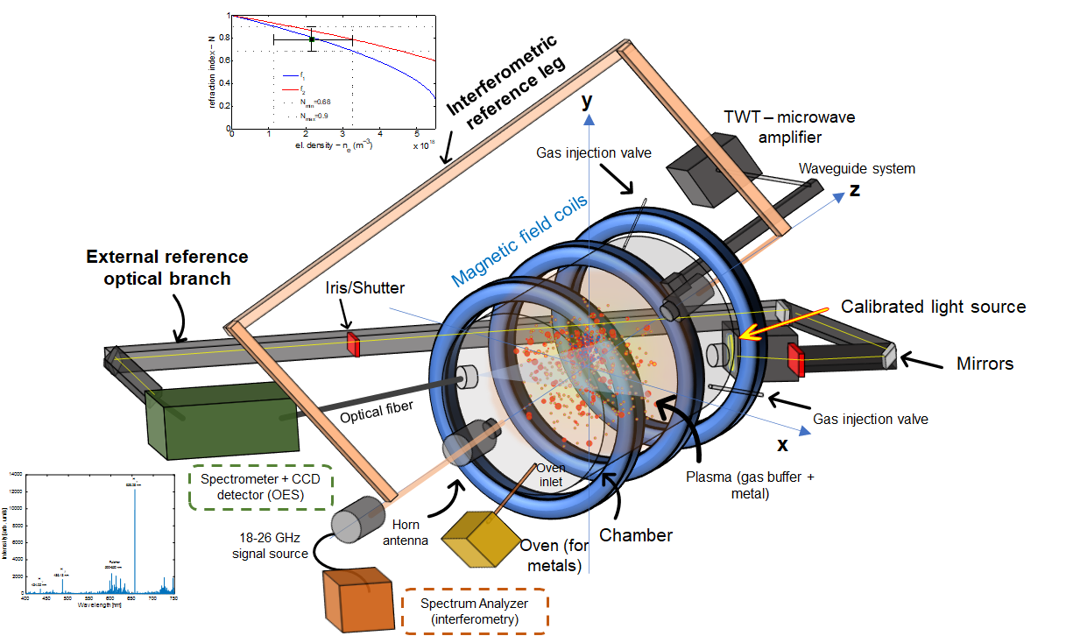






The PANDORA project – concept of spectroscopic plasma analysis
Hydrogen spectrum
Opacity direct measurement: TRANSMITTANCE
  $$H_{α}$$
RF power: from 40 W to 450 W
RF frequency: 3.76, 6.78 GHz
Gas pressure: 1 · 10⁻³ and 1 · 10⁻² mbar
Pidatella, A.,et al. Frontiers in Astronomy and Space Sciences, 10.3389/fspas.2022.931744 (2022)
  $$H_{γ}$$
  $$H_{β}$$
OES diagnostics
Profilometry/Secondary diagnostics
To be measured: independent measurements
Opacity of metal/buffer mixture: strongly dependent on density and temperature profile
A. Pidatella - KRINA, 12 -16 Dec 2022 – ECT*

Slide 12
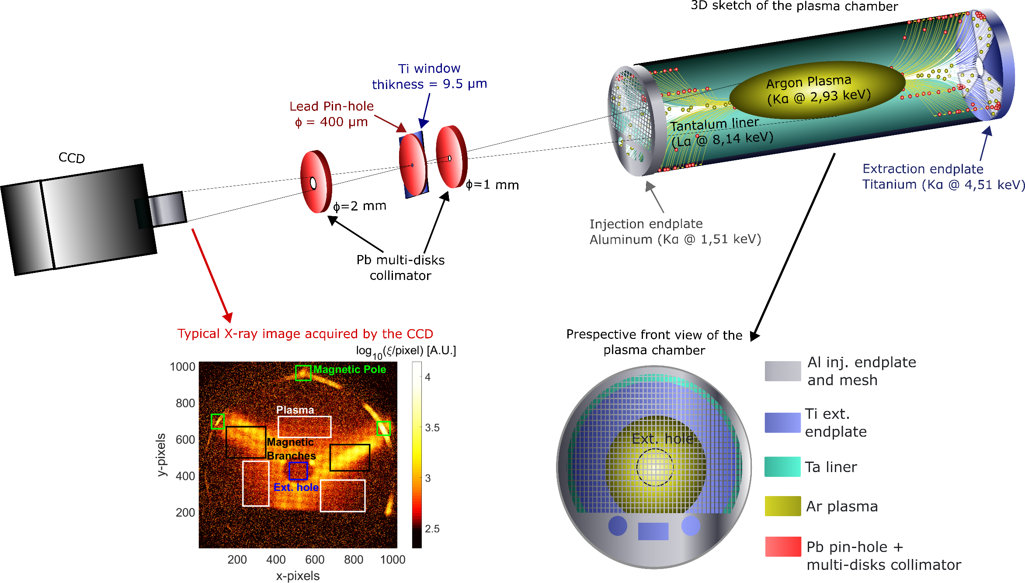
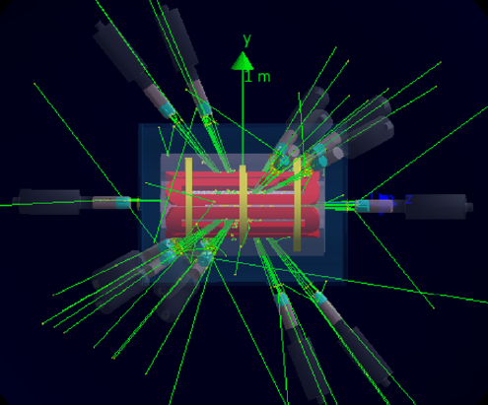
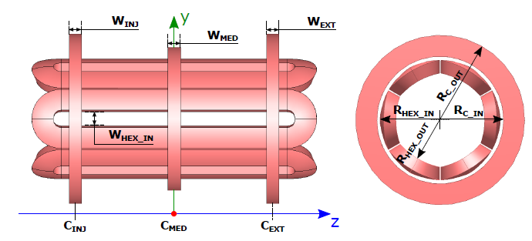
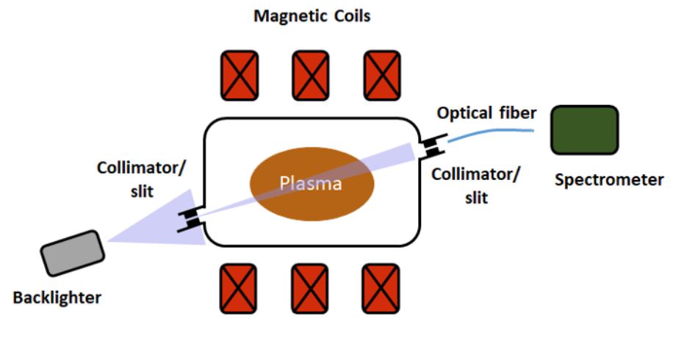
The PANDORA project: timeline
D Mascali et al., Plasma Physics and Controlled Fusion 64(3):035020
Jan. 2022
E Naselli et al, Frontiers in Physics, 692 (2022)
GAMMA-PANDORA agreement:
HpGe det. @ LNS
PANDORA plasma characterization
X-ray and interferopolarimetry upgrades
May 2022 → selection of the best technical solution
2020
2021
2022
2023
2024
2025
Trap’s design, procurement, installation and commissioning
OES → plasma opacity preliminary studies
Pidatella, A.,et al. Frontiers in Astronomy and Space Sciences
10.3389/fspas.2022.931744 (2022)
PANDORA Phase-1 experimental run
GS Mauro et al, Frontiers in Physics, 621(2022)
A. Pidatella - KRINA, 12 -16 Dec 2022 – ECT*

Slide 13
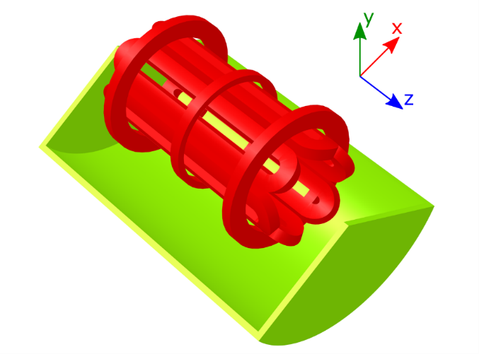
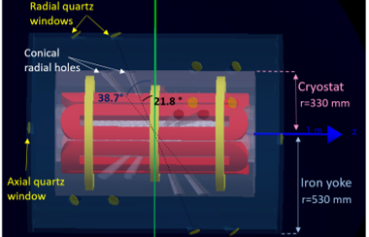
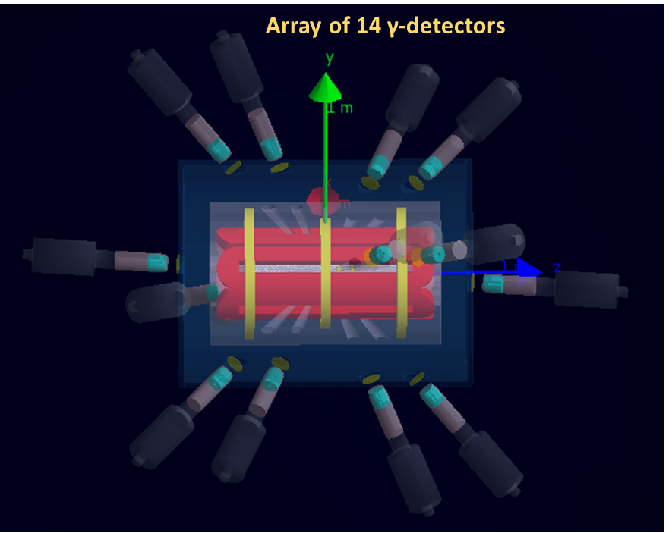
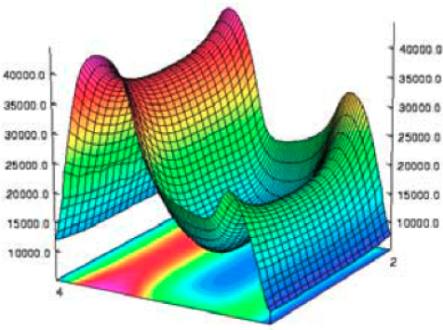
PANDORA : status trap and diagnostic array
Formalized a Collaboration Agreement with GAMMA to use 16 HPGe detectors of GALILEO
Array of 14 HPGe detectors placed around the trap for γ-tagging of β-decaying nuclei
Photopeak detection efficiency (interplay between detector number and mechanical constraint)
Signal to noise ratio (high background self-generated inside the trap)
Magnetic field effects on HPGe charge collection
c. d.
Magnetic trap: 3 SC coils (axial confinement) + 1 SC HEX (radial confinement)
High charge state ions: ions must remain in the plasma long enough (tens of ms), high-frequency needed!
Designed to operate at 18-21 GHz in MHD-stable configuration
c. c.
GS Mauro et al, Frontiers in Physics, 621(2022)
A. Pidatella - KRINA, 12 -16 Dec 2022 – ECT*
E Naselli et al, Frontiers in Physics, 692 (2022)

Slide 14
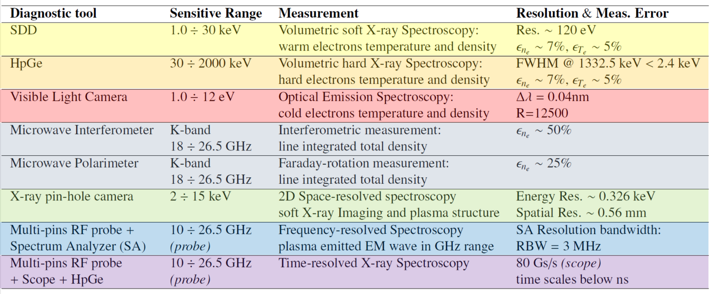
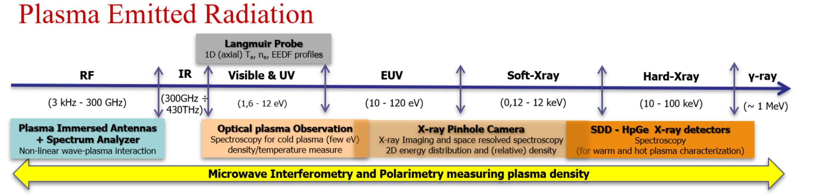
PANDORA : status trap and diagnostic array
Volumetric soft and hard X-ray temperature and density
Average density and temperature, line ratios
Line-integrated density
Tomographic info on density and temperature
On-line monitoring of all plasma parameters (density, T, CSD)
Investigation of the plasma properties in all energetic domains
Performing high-resolution spatial and time resolved analysis
A. Pidatella - KRINA, 12 -16 Dec 2022 – ECT*

Slide 15


Multi-messenger events: GW + EM signals
Spectroscopic observations
Astrophysical models studying s- and r-process branchings
Nuclear Theory: weak-interaction rate change in stellar-enhanced environments
Weak interactions models: coupling nuclear and electronic degrees of freedom → single-particle mean-field scheme, predictions of β-decay rates
Radiative transfer in non-LTE plasmas
PANDORA
Theory
Experiments
Models & Simulations
Observations
Plasma models: self-consistent approach coupling Maxwell eqs. to particle dynamics → detailed plasma and atomic physics
Virtual experiments: detection efficiency, particle transport, diagnostic lines design
Multi-diagnostics training on testbench
Direct measurements in plasma environments suiting several astrophysical scenarios
Nuclear and atomic inputs: weak-interaction rates + plasma opacity
A. Pidatella - KRINA, 12 -16 Dec 2022 – ECT*

Slide 16
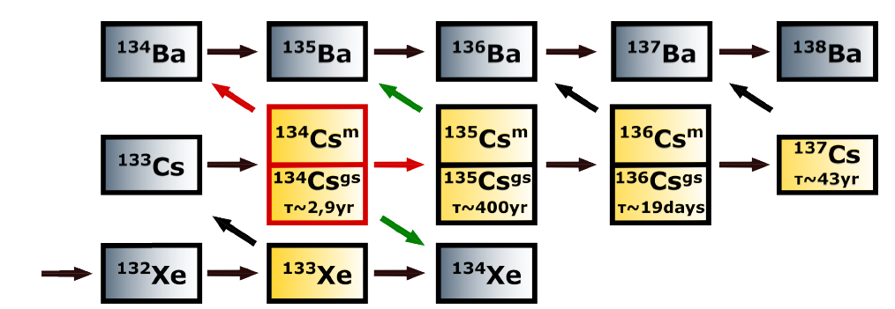
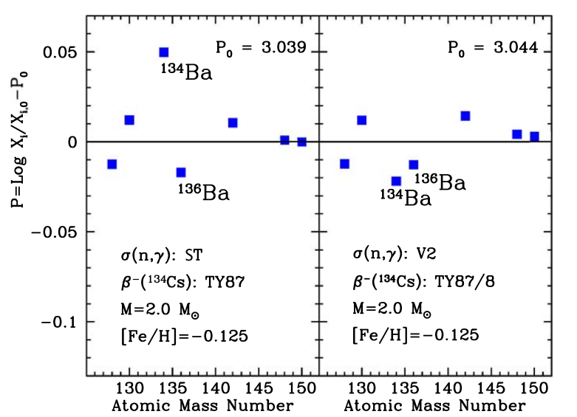
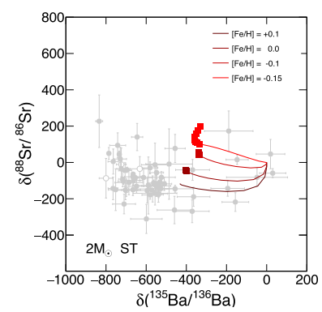
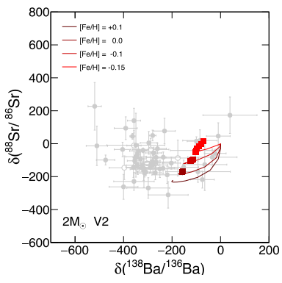
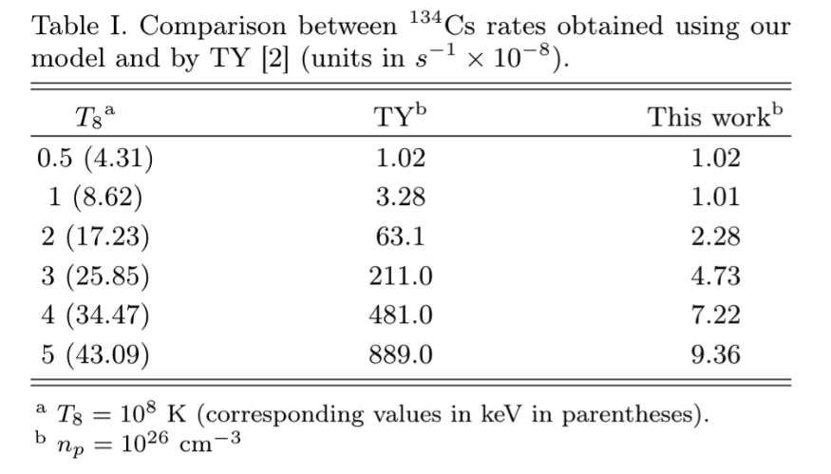


Theory: status and progress
Example: AGB model (Palmerini et al. 2021), ¹³⁴Cs decay, affecting the isotopic admixture of Ba and the effectiveness of the branching point at ¹³⁵Cs → ¹³⁴Ba and ¹³⁶Ba, status as purely s-process nuclei is not reproduced very well by galactic neutron capture nucleosynthesis, when the decay rate is taken from TY
Improvements of the model when different decay rates enters in the model: input from full QM model – relativistic Dirac-Hartree-Fock solution including both internuclear and interelectronic interactions
Decay rate of Cs is affected concurrently by two major factors: the presence of 3 nuclear excited states of Cs, and the electronic excitation, also up to a complete ionization
PANDORA domain
TY
THIS WORK
Palmerini, S. et al (2021) ApJ 921 7
S. Taioli et al. ApJ 933(2):158, July 2022
A. Pidatella - KRINA, 12 -16 Dec 2022 – ECT*

Slide 17
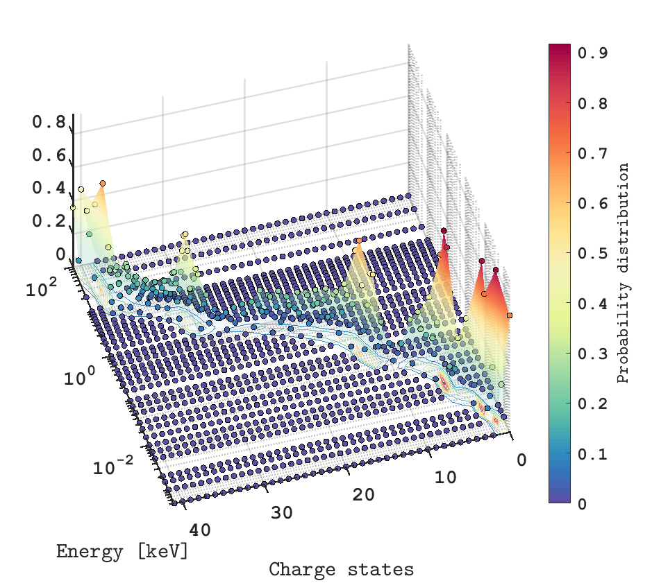
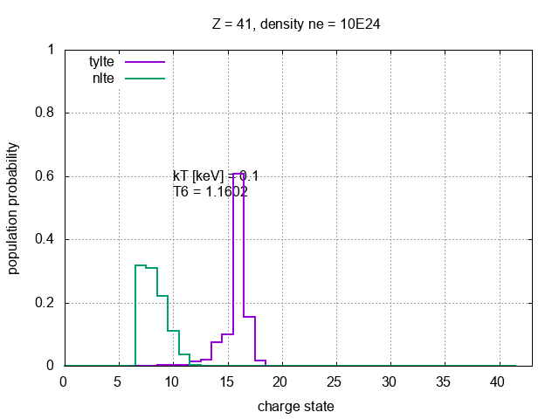




Theory: status and progress
$${}_{}^{94}{Nb→^{94}Mo}$$
LTE vs NLTE plasma: relevant discrepancies for low-density plasma in the CSD
LTE (Statistical) vs. NLTE (balance equation): detailed atomic physics in plasma
NLTE might impact also nuclear reaction Q-value
$$10^{12}cm^{−3}$$
Nuclear level energy
Ion level energy
IPD contribution
⁹⁴Nb (β⁻) case
Low density
High density
Courtesy of A. Mengoni
A. Pidatella - KRINA, 12 -16 Dec 2022 – ECT*

Slide 18

Simulations: status and progress
Some recent investigations
Plasma modelling: ion dynamics transport → studying CSD in plasma for space-resolved β-decay + detailed atomic physics
  B Mishra, et al., Frontiers in Physics 10, 17, (2022)
  A Galatà, et al., Frontiers in Physics 777, (2022)
Virtual experiments:
  Measurability of decay rate
  E Naselli, et al., Frontiers in Physics, 692 (2022)
  Optical properties of layered plasma emission
  A Pidatella, et al., Frontiers in Astronomy and Space Sciences 9, 225, (2022)
Detection efficiency: impact of short-lived radioisotopes’ neutral depositions on the plasma chamber walls, being an additional source of background for the HPGe detectors array
More details in M. Bezmalinovich talk!
A. Pidatella - KRINA, 12 -16 Dec 2022 – ECT*

Slide 19


Simulations: status and progress
Plasma modelling: ion dynamics transport → studying CSD in plasma for space-resolved β-decay + detailed atomic physics
  B Mishra, et al., Frontiers in Physics 10, 17, (2022)
  A Galatà, et al., Frontiers in Physics 777, (2022)
Argon buffer gas Charge State Distribution in plasma
Space-resolved Charge State Distribution – expected impact on space-dependent gamma-decay from beta decaying nuclei
IN PROGRESS: flux of radioisotope in plasma buffer to study CSD and beta-decay rate
A. Pidatella - KRINA, 12 -16 Dec 2022 – ECT*

Slide 20


Simulations: status and progress
Virtual experiments:
  Measurability of decay rate
  E Naselli, et al., Frontiers in Physics, 692 (2022)
Isotope | t_{1/2} [ yr ] | E_{γ} [ keV ]
¹⁷⁶Lu | 3.78 · 10¹⁰ | 202.88 & 306.78
¹³⁴Cs | 2.06 | 795.86
⁹⁴Nb | 2.03 · 10⁴ | 871.09
Expected ¹⁷⁶Lu lifetime in the PANDORA plasma
“Measurability” of ¹⁷⁶Lu (and other nuclei) lifetime computed using GEANT4 simulations assuming an array of 14 HPGe-detectors
Expected experimental measurement time considering cps, det. Efficiency
¹³⁴Cs ~ 6 h
¹⁷⁶Lu > 30 days
Neutral ¹⁷⁶Lu
A. Pidatella - KRINA, 12 -16 Dec 2022 – ECT*
1% Lu of 10¹³ cm⁻³ (Vp=1500 cm³)

Slide 21








Simulations: status and progress
Detection efficiency: impact of short-lived radioisotopes’ neutral depositions on the plasma chamber walls, being an additional source of background for the HPGe detectors array
Let’s focus on the ¹³⁴Cs decay process, relevant for s-process nucleosynthesis branching points in AGB stars modelling
Modelling the Cs neutral dynamics in chamber and gamma rate
Deposition tracking
Deposition map
γ-events in 12 h
log10(γ)
Magnetic field lines
log10(deposited)
v [m/s]
log10(γ)
Max. deposition ~ oven location
NO PLASMA
Inlet spot
WITH PLASMA

Slide 22
Experiments: status and progress
Some recent investigations
Experimental plasma characterization for opacity studies → Flexible Plasma Trap (FPT) @ LNS
  A Pidatella, et al., Frontiers in Astronomy and Space Sciences 9, 225, (2022)
X-Ray imaging with shuttered CCD – space-resolved and spectral-resolved imaging of plasma → FPT @ LNS
Interfero-Polarimetric plasma density measurements from Lissajous figures and inverse profilometry
G Torrisi, et al., Frontiers in Astronomy and Space Sciences 9, (2022)
A. Pidatella - KRINA, 12 -16 Dec 2022 – ECT*

Slide 23











Experiments: status and progress
Experimental plasma characterization for opacity studies
  A Pidatella, et al., Frontiers in Astronomy and Space Sciences 9, 225, (2022)
First data: using line-ratio method, H-plasma + Ar-H mixtures, estimate plasma parameters
First campaign of OES measurements, closely reproducing KN conditions – few eV, and 10¹¹ cm⁻³
Characterizing plasma density and temperature from line ratios
Flexible Plasma Trap @ LNS (setup Feb 2022)
Monitoring plasma stability from emission line ratios
  $$H_{α/β}$$
7 exp. configurations, different pressures: many spectra per cfg.
Hydrogen spectrum
Average density and temperature proportional to the effective emission coefficients $χ_{λ}$.
  $$H_{α}$$
RF power: from 40 W to 450 W
RF frequency: 3.76, 6.78 GHz
Gas pressure: 1 · 10⁻³ and 1 · 10⁻² mbar
  $$H_{α/β}$$
  $$H_{β}$$
  $$H_{γ}$$
  $$H_{β/γ}$$
A. Pidatella - KRINA, 12 -16 Dec 2022 – ECT*

Slide 24
Summary and conclusions
Many open questions and issues in nuclear physics and nuclear astrophysics on both nuclear and extranuclear aspects of key reactions for s- and r-process nucleosynthesis
Can we provide experimental nuclear and atomic inputs to advance knowledge of stellar process?
PANDORA: a new multi-disciplinary project and research facility
  First-of-its-kind β-decay measurements in plasmas
  Magneto-plasma opacity measurements in conditions similar to kilonovae ejecta in BNS
  Timeline: trap and chamber on-construction – Expected starting run in 2024-25
  Several progress: crossing theory, numerical simulations, and experiments on scalable plasma trap @ LNS
    Testing diagnostics
    Designing experimental setup, numerical predictions of physics in plasma
Huge impact on nuclear physics and stellar nucleosynthesis
Heavy r-process elements production in n-star merging + multi-messenger astronomy, GW events
A. Pidatella - KRINA, 12 -16 Dec 2022 – ECT*

Slide 25

















2022 - A special topic on Frontiers dedicated to PANDORA physics and technology (11 papers)
TDR available at the following link:
https://pandora.infn.it/public/pandora-tdr
and also from INFN-LNS website:
https://www.lns.infn.it/it/apparati/pandora.html
Also collaborating in the nuclear fusion research programme for the Divertor Tokamak Test (DTT) project
A. Pidatella - KRINA, 12 -16 Dec 2022 – ECT*

Slide 26
Thank you very much for your attention!!
Also collaborating in the nuclear fusion research programme for the Divertor Tokamak Test (DTT) project
A. Pidatella - KRINA, 12 -16 Dec 2022 – ECT*

Slide 27



Slide 28
Atomic theory supporting weak interaction rates
Method: single-particle mean-field (MF) approximation to the internuclear and interelectronic interactions.
Improvements allowed via higher accuracy many-body methods for including dynamical correlation (Hjorth-Jensen et al. 2017).
Ab-initio calculation of the transition operator written in terms of the total QED Hamiltonian, proved accurate in reproducing a few terrestrial observables (Morresi et al. 2018). We generalized to include the temperature and density dependency for dealing with astrophysical conditions.
Weak Hamiltonian is factorized into the product of leptonic and hadronic currents (Morresi et al. 2018).
We also require that the hadronic current is separable into neutron and proton field operators, which means essentially that the decaying neutron acts as a single-particle correlated to the core of the remaining nucleons only geometrically, so as to recover the experimental total angular momentum of the parent reactant.
Furthermore, one can safely assume that the leptonic current can be written as a product of the neutrino and electron quantum field operators. The hadronic and leptonic currents are both reckoned by the self-consistent numerical solution of the Dirac-Hartree-Fock equation (DHF).
Protons and neutrons are interacting via a semiempirical relativistic Wood-Saxon potential, while the electron-electron Coulomb repulsion is modelled via a LDA to the electron gas (Slater 1951; Salvat et al. 1987). Electrons populate the energy levels according to a Fermi-Dirac distribution, and the chemical potential is assessed by assuming that they behave as an ideal Fermi gas in a box with a relativistic energy-momentum dispersion. The non-orthogonality between the bound initial and final orbitals, the possible presence of shake-up (excitation) and shake-off (ejection) are also taken into account in the calculation of the continuum electron wavefunction.
At high temperature, we considered positron formation, enforcing the overall neutrality of the plasma.

Slide 29



About Microwave Interferometry
Mach-Zender-type interferometer based on 2 horn-antennas and operating at 18-26 GHz
Interferometry: density determination is based on the phase‐shift induced by the plasma refractive index
Multipath suppression
INTERFEROMETER: “Frequency swept” method with post-filtering procedure of the beating signal S(ω)
The presence of plasma (accounted by the plasma) only shifts the beating frequency, while multipath introduce spurious components in the spectrum

Slide 30





About Microwave Imaging Profilometry
(by solving EM inverse scattering problem)
Measured data:
,
Unknowns:
Reconstructing 1D plasma density profile solving inverse EM problem in linear approx.
Dispersive model for cold isotropic plasma with collisions
E_{inc}
E_{scatt}
Courtesy of G. Torrisi, E. Naselli
G. Torrisi et al. 2019 JINST 14 C09031

Slide 31


Typical plasma characterization: X-ray diagnostic
Integrated X-ray imaging: volumetric detail, plasma volume
Single-Photon Counting X-ray imaging: space- and spectral-resolved detail
3
2
1
Spatially-Resolved Spectroscopy and Spectrally-Resolved Imaging
Ti
Ar
Ta
D Mascali et al., Plasma Physics and Controlled Fusion 64(3):035020
Jan. 2022, DOI: 10.1088/1361-6587/ac4349
E. Naselli et al 2022 JINST 17 C01009

Slide 32




About the relevance of structured plasma density and temperature on opacity
Pidatella, A.,et al. Frontiers in Astronomy and Space Sciences
10.3389/fspas.2022.931744 (2022)

Slide 33

Something on continuous self-consistent feedback among experiments and plasma modelling
2006-2009
ELECTROMAGNETIC SIMULATIONS
ELECTRON DYNAMICS
2011
MICROWAVE ABSORPTION IN AN ANISTOTROPIC AND DISPERSIVE MEDIUM
SELF-CONSISTENT APPROACH
ENERGY GAIN DUE TO ECR
ENERGY REDISTRIBUTION DUE TO COLLISIONS
COLLISIONAL DIFFUSION
2012-2013
OVERALL CHARGE NEUTRALITY
2014-2016
Plasma Modelling: confinement and heating
IONS DYNAMICS INCLUDING CSD BUILD-UP AND CONFINING ELECTROSTATIC FIELD
2017-2020
IONIZATION
CHARGE EXCHANGE
COLLISIONAL DIFFUSION
BUILD UP OF CSD
2020 - …
BUILD UP OF AN ELECTROSTATIC POTENTIAL RESPONSIBLE FOR CONFINEMENT

Slide 34



Something on continuous self-consistent feedback among experiments and plasma modelling
2006-2009
ELECTROMAGNETIC SIMULATIONS
ELECTRON DYNAMICS
2011
MICROWAVE ABSORPTION IN AN ANISTOTROPIC AND DISPERSIVE MEDIUM
SELF-CONSISTENT APPROACH
ENERGY GAIN DUE TO ECR
ENERGY REDISTRIBUTION DUE TO COLLISIONS
COLLISIONAL DIFFUSION
2012-2013
FORWARD DIFFERENCE METHOD
v(t+1)=v(t) + a*T_{step} → x(t+1)=x(t)+ v(t+1)*T_{step}
RELATIVISTIC BORIS METHOD (LEAPFROG)
EVENTUAL EXTERNAL EM FIELD
e-e COLLISIONS: LANGEVIN EQUATION
Δv_{Lang}= v(t+1)-v(t)= - ν_{s}v(t)*T_{step}+v^{rand}
2014-2016
Plasma Modelling: confinement and heating
DIFFUSION COEFFICIENTS
v(t+1)=v(t) - ν_{s}*v(t)*T_{step}+v^{rand} + q*[v(t)xB]
2017-2020
SLOWING DOWN
DIFFUSION
A Galatà et al 2016 Plasma Sources Sci. Technol. 25 045007
Realistic plasma description
Plasma concentrates inside the ECR resonance
The plasmoid-halo structure is spontaneously formed
2020 - …

Slide 35

Something on continuous self-consistent feedback among experiments and plasma modelling
2006-2009
ELECTROMAGNETIC SIMULATIONS
ELECTRON DYNAMICS
2011
MICROWAVE ABSORPTION IN AN ANISTOTROPIC AND DISPERSIVE MEDIUM
SELF-CONSISTENT APPROACH
ENERGY GAIN DUE TO ECR
ENERGY REDISTRIBUTION DUE TO COLLISIONS
COLLISIONAL DIFFUSION
2012-2013
14.521 GHz
14.324 GHz
2014-2016
Plasma Modelling: confinement and heating
2017-2020
Realistic plasma description
Evidence of the frequency-tuning influence on plasma structure
Possible slicing of 3D energy density maps in different energy intervals: info on spatial distribution of electrons and ions
A Galatà et al 2016 Plasma Sources Sci. Technol. 25 045007
2020 - …
14.521 GHz
14.324 GHz

