Slide 1

New frontiers in nuclear astrophysics using indirect techniques: the Trojan Horse Method
KEY REACTIONS IN NUCLEAR ASTROPHYSICS
M. La Cognata
Laboratori Nazionali del Sud - INFN, Catania, Italy

Slide 2

Nuclear astrophysics: from the laboratory to the cosmos
Nuclear parameters (cross sections, …)
Elemental yield → comparison with abundances observed in stars and meteorites to validate models
The purpose of nuclear astrophysics is to provide reliable nuclear physics input for astrophysical models
Astrophysical models: how a star works
PROBLEM: cross sections are needed at energy of 10-100 keV
Model input parameters: magnetic field, metallicity, …
Change the model until observables are matched by predictions
Astrophysical models are very complex: assumptions on stellar structure and on stellar parameters (age, mass…) → need of multiple independent constraints

Slide 3
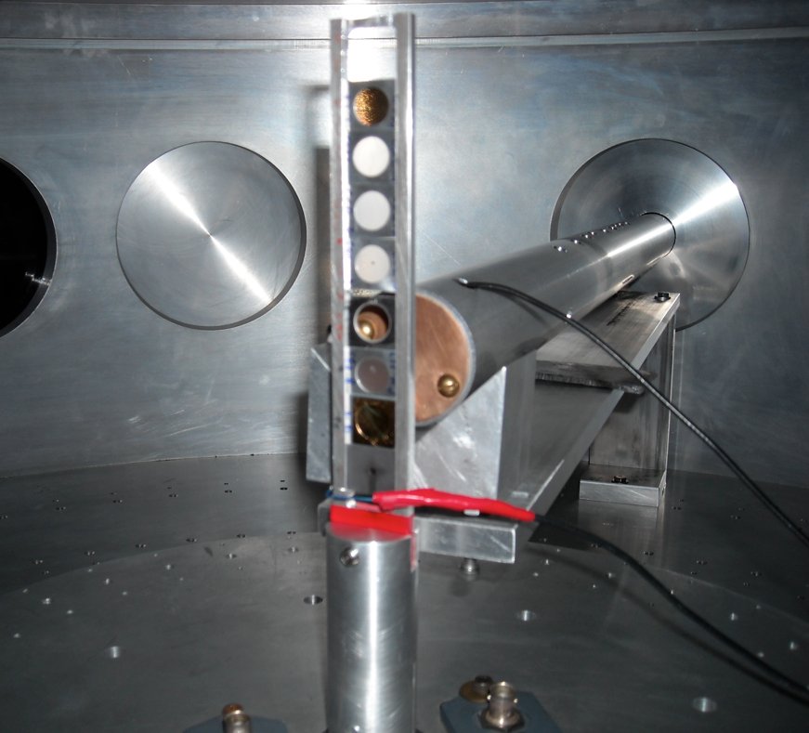
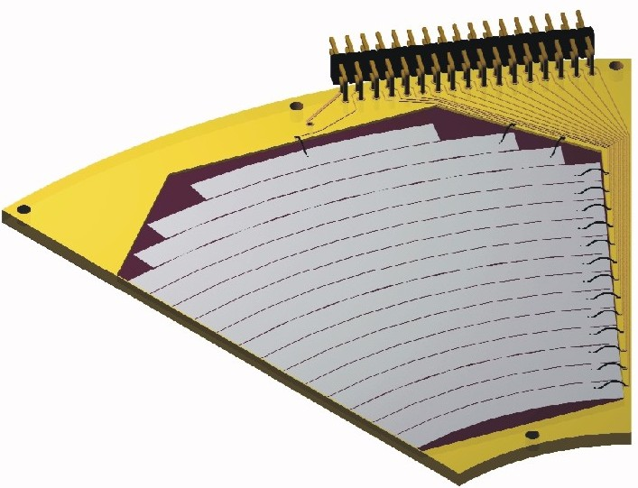
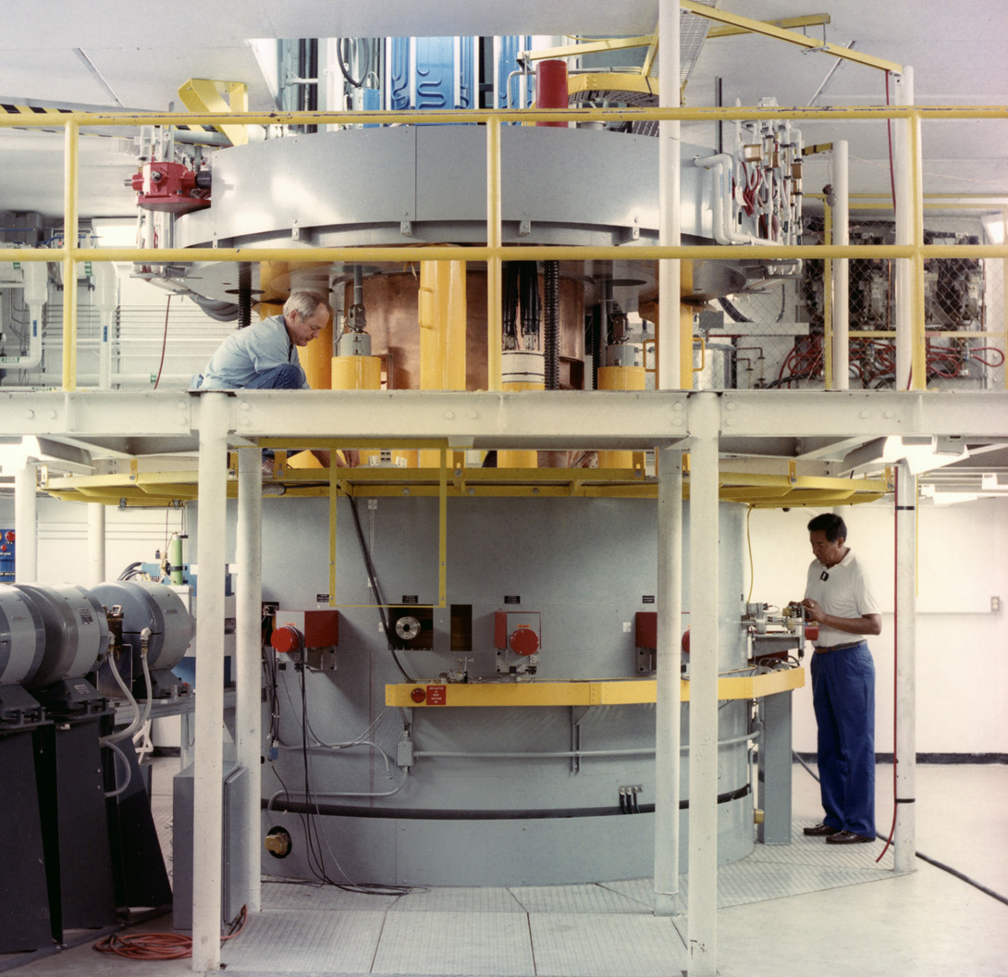
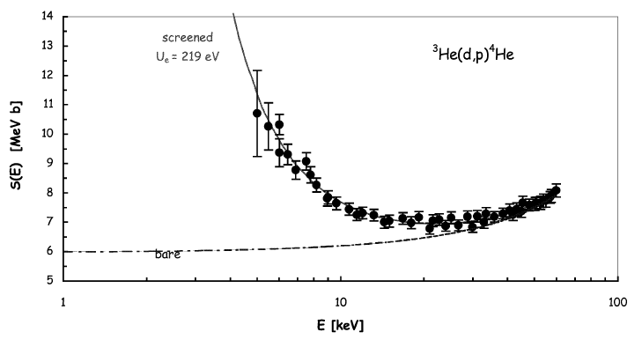

The need of indirect methods: direct vs. indirect methods
How to measure the A+x→c+C reaction in a direct way?
However, several reasons make the low-energy region of astrophysical interest difficult to access
Coulomb barrier suppression of the cross section
Cosmic background and systematic errors due to, e.g., straggling in the target
Electron screening hiding the nuclear cross section
Detector →
kinematic observables
- Energy
- Emission angle
& Particle identification
Target (A)
Beam (x)
Reaction
product (c)
It looks quite simple!

Slide 4
The need of indirect methods: direct vs. indirect methods
Nuclear reaction theory required
→ cross checks of the methods needed
→ possible spurious contribution
→ additional systematic errors (is the result model independent?)
Several reaction mechanisms link the two channels
Entrance channel:
A+a
Reaction products
C+c+…
Advantages include no need of low energies → no straggling, no Coulomb suppression, no electron screening
Possibility to access astrophysical energies with high accuracy
To recall the previous sketch:
Indirect methods are especially useful in the case of reactions involving radioactive nuclei
Higher cross sections
Possibility to study reactions induced by neutrons on radioactive nuclei
Reactions among unstable nuclei
Easier experimental procedures
Nuclear reaction theory
R. Tribble et al., Rep. Prog. Phys. 77 (2014) 106901

Slide 5
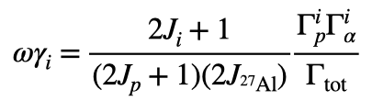
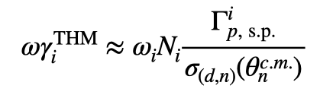
The Trojan Horse Method (THM)
²H
n
When narrow resonances dominate the S-factor the reaction rate can be calculated by means of the resonance strengths and resonance energies only. Both can be deduced from the THM cross section.
Let’s focus on resonance strengths
p
⁴He
²⁷Al
The strengths are calculated from resonance partial widths
In the THM approach we determine the strength in arb.units. Normalization to a known resonance is necessary
²⁴Mg
What is its physical meaning?
Area of the Breit-Wigner describing the resonance
Advantage:
no need to know the resonance shape (moderate resolution necessary)
THM => Transfer to the continuum
ANC => Transfer to a bound state
In both cases peripherality has to be enforced
THM: in the case of resonant reactions a metastable state is formed (²⁸Si), escaping the nuclear interaction region and later decaying to α+²⁴Mg

Slide 6
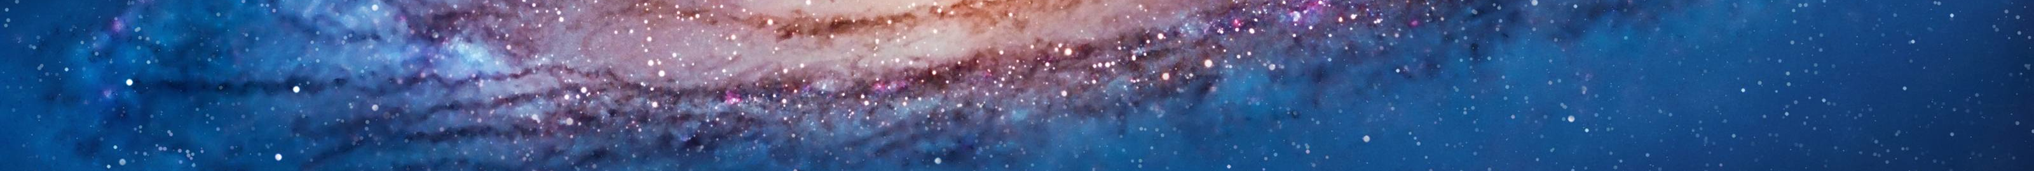


THM: Basic features
Plane Wave Impulse Approximation:
● beam energy >> a = x ⊕ b breakup Q-value
● projectile wavelength k⁻¹ << x – b intercluster distance
+ plane waves in the entrance and exit channel
➔ the 3-body cross section factorizes:
From the experiment
Evaluated through a MC code
HOES 2-body cross section
● KF kinematic factor
● φ(p_{b})² spectator momentum distribution
● dσ^{off}/dΩ off-shell cross section
or “nuclear” (N) cross section
dσ^{off}/dΩ → dσ/dΩ (on shell)
The penetration factor P_{l} has to be introduced:

Slide 7
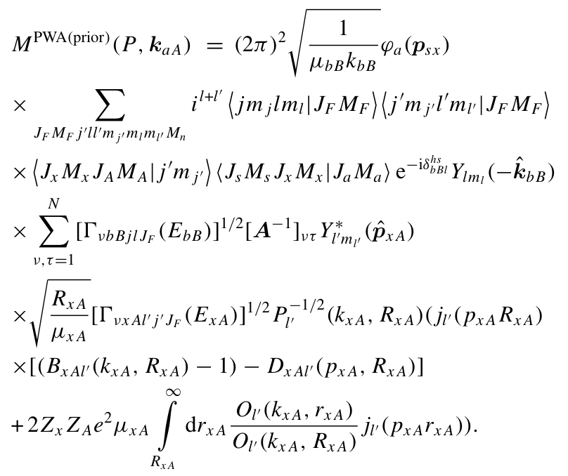
The full THM: the resonant case (A. Mukhamedzhanov)
a
s
R. Tribble et al., Rep. Prog. Phys. 77 (2014) 106901
x
In the latest years, large efforts were made to give a quantitative justification of THM, to estimate the uncertainties and improve the description of the 2→3 cross section
b
A
F*
B
Fourier transform of the s-x relative motion wave function
Amplitude of the TH reaction
Same R-matrix term as in OES cross section but for the appearence of the inverse penetration factor making it possible to observe suppressed resonances at low energies
Angular dependence of the cross section (spin-parity taken into account)
solid sphere scattering phase shift
Inverse penetration factor
HOES effects → negligigle at usual experimental precisions
R-matrix-like boundary condition

Slide 8
Effects of final state Coulomb interaction on the two-body cross section
From recent update of the theory within the formalism of the three-body Coulomb
asymptotic states (CAS) (A.M. Mukhamedzhanov and A.S. Kadyrov FBS 2019)
=E_{0(bB)} – E_{bB(f)}
Crucial role of ζ=η_{cs} +η_{Cs} - η_{R(F*s)}
a
s
x
Coulomb renormalization factor:
Coulomb effects on the resonance line shape plus energy dependence of the cross section.
c
A
F*
C
The conclusions are:
The simultaneous inclusion of the Coulomb effects in the intermediate and final state decreases the effect of the final-state Coulomb interactions on the triple differential cross section.
In particular if one of the Coulomb parameters in the final state, for example η_{bs}, is zero or very small then the cumulative effect of the Coulomb interactions in the intermediate and final state is negligible.

Slide 9



THM vs. OES astrophysical factor
Direct data:
THM data:
Remember that:
is the formal partial resonance width for the decay of this level into channel c=x+A or c=b+B.
Where:
It can be calculated (DWBA, CDCC, PWBA…) or taken from measurements
The matrix D⁻¹ and VνcC(EcC) are the same in the TH and OES astrophysical factors.
The THM S-factor does not contain the penetration factor, which has to be inserted for comparison with direct data

Slide 10




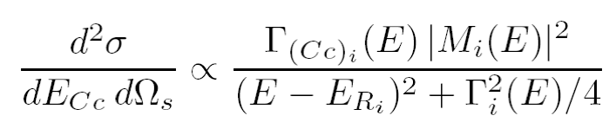
Moreover: exploring negative energies with the THM
Using the kinematics of three body reactions:
s-x Fermi motion
s-x binding energy
It is possible to achieve negative energies in the A-x channel
How to deal with negative energies? what is their meaning?
Standard R-Matrix approach cannot be applied to extract the resonance parameters of the A(x,c)C reaction because x is virtual —> Modified R-Matrix is introduced instead (A. Mukhamedzhanov 2010)
At negative energies M² is given by the product of the Whittaker function and the ANC of the F state populated in the transfer reaction
Merging together ANC and THM —> deep connection of these two indirect methods

Slide 11
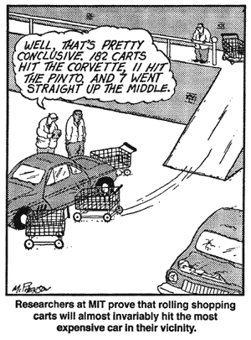
Experimental applications
²⁷Al(p,α)²⁴Mg (²H)
¹²C+¹²C fusion (¹⁴N)
¹⁶O+¹⁶O fusion (²⁰Ne)

Slide 12
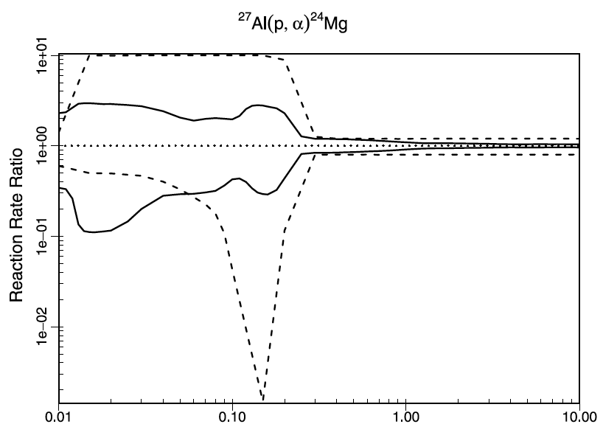
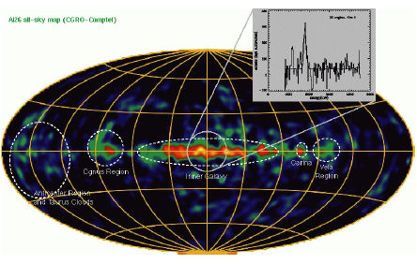
The ²⁷Al(p,α)²⁴Mg reaction
MgAl cycle in massive stars
Up to one order of magnitude uncertainty
²⁶Al/²⁷Al abundance ratio
²⁶Al abundance is used to estimate the number of Galactic neutron stars and, therefore, of neutron star mergers (sources of GW). The ²⁶Al/²⁷Al is generally estimated, so it is influenced by ²⁷Al abundance predictions
It is ignited at temperatures > 0.03 GK and it is important to determine the abundances of medium mass nuclei

Slide 13
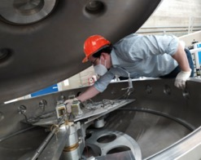
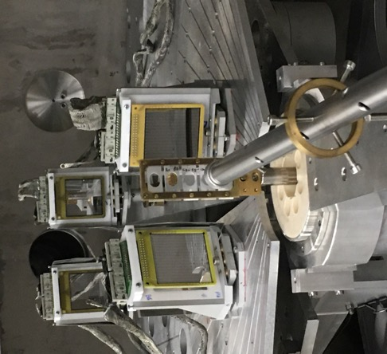

The ²H(²⁷Alp,α²⁴Mg)n reaction study
²⁴Mg
CD₂ target
⁴He
The experiment was carried out by local people only, though the proposal included 25 people from 7 countries → international effort
²⁷Al @ 80 MeV
From LNS Tandem
The experiment at INFN-LNS Catania (right after the end of national lockdown in spring 2020)
PI: F. Hammache (Orsay) – S. Palmerini (PG)

Slide 14
Reaction channel selection
Then the Qvalue spectrum is reconstructed
Two peaks for ²⁴Mg gs and 1st excited
Arrows: theoretical Qvalues
A=1 from the fit
First the mass of the undetected particle is deduced from the energy conservation law:
Y=E_{beam}-E_{A}-E_{C}
X=p_{A}²/2u
No additional peaks are found, meaning that no spurious processes are seen
However, some background is present, but to the percent level for ²⁴Mg ground state contribution

Slide 15
Evidence of the quasi-free reaction mechanism
d
𝛼
²H
When the breakup is quasi-free, n retains the same momentum as inside d (adiabatic process). So n-momentum distribution should be the same as in d
n
²⁹Si
²⁷Al
²⁵Mg
p
Possible non QF processes
⁴He
d
⁵He
²⁷Al
²⁴Mg
²⁹Si
²⁷Al
²⁴Mg
The red curve is the theoretical one: normalization is the only fitting parameter

Slide 16
Extraction of the resonance strengths
Gamow window for 50 MK
Energy in cm (keV) [from STARLIB] | Jpi | Strength (eV) [from STARLIB] | error (eV) | Strength (eV) [from THM] | error (eV)
71.5 | 2+ | 2.47E-14 | up lim | 8.23E-15 | up lim
84.3 | 1- | 2.60E-13 | up lim | 1.67E-14 | 3.2E-15
193.5 | 2+ | 3.74E-07 | up lim | 2.50E-07 | up lim
214.7 | 3- | 1.13E-07 | up lim | 4.36E-08 | up lim
486.74 | 2+ | 0.11 | 0.05 | 0.107 | 0.021
609.49 | 3- | 0.275 | 0.069 | 0.245 | 0.054
705.08 | 1- | 0.52 | 0.13 | 0.261 | 0.065
855.85 | 3- | 0.83 | 0.21 | 0.61 | 0.35
903.54* | 3- | 4.3 | 0.4 | 4.20 | 0.38
1140.88 | 2+ | 79 | 27 | 73 | 14
1316.7 | 2+ | 137 | 47 | 124 | 28
1388.8* | 1- | 54 | 15 | 61 | 12
Following discussion in APJ 708 (2010) 796 the red line is a fit with a sum of Gaussian functions, with fixed energies and fixed widths (from MC). Heights are proportional to strengths
The most intense resonances in STARLIB were all included in the fit down to about 200 keV
* Normalization strengths

Slide 17
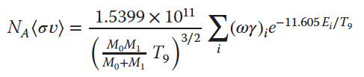


Calculation of the reaction rate
The reaction rate is the main input of astrophysical models. It is the folding of the cross section and of the Maxwell-Boltzmann distribution.
If the cross section is dominated by narrow resonances as in this case, it can be written as
In units of cm³mol⁻¹s⁻¹.
Therefore, the rate is determined by resonance energies and strengths.
The reaction rate was calculated using RatesMC, a MC code to calculate the reaction rate taking lognormal distributions for the measured strengths, and Porter-Thomas distributions in the case only upper limits are available
The green line is the THM recommended rate
The comparison with the results in the literature shows a reduced reaction rate due to the 84 keV resonance
S. Palmerini et al. Eur. Phys. J. Plus (2021) 136: 898
M. La Cognata et al. Phys. Lett. B (2022) 826: 136917

Slide 18


¹²C+¹²C fusion
C-burning crucial phase in the nucleosynthesis of massive stars (> 8 M_{ʘ}), determines M_{up},
ignition trigger for superbursts and Type Ia supernovae
astrophysical energy: 1 – 3 MeV
From direct measurement, minimum E: 2.1 MeV
extrapolations differ by 3 orders of magnitude without inclusion of resonances
Indirect measurement with THM down to 1 MeV: ¹²C(¹⁴N,α²⁰Ne)²H and ¹²C(¹⁴N,p²³Na)²H. Resonances dominate the astrophysical energy
¹²C+ ¹²C → α + ²⁰Ne
¹²C+ ¹²C → p + ²³Na
Mazarakis (1973)
Spillane (2007)
Barron-Palos (2006)
High-Cujec (1977)
Kettner (1980)
Tan (2020)
Fruet (2020)
Tumino (2018)
Hindrance?
10⁻²² b 10⁻⁷ b
Notes:
upper bound for the mass of the progenitors of CO white dwarfs (M_up)

Slide 19
Our Experiment with the THM
¹²C(¹²C,α)²⁰Ne and ¹²C(¹²C,p)²³Na reactions via the Trojan Horse Method applied to the ¹²C(¹⁴N,α²⁰Ne)²H and ¹²C(¹⁴N,p²³Na)²H three-body processes → ²H from the ¹⁴N as spectator s
Observation of ¹²C cluster transfer in the ¹²C(¹⁴N,d)²⁴Mg* reaction (R.H. Zurmȗhle et al. PRC 49 (1994) 5)
E_{14N} =30 MeV> E_{coul} d,p/α coincidence detection
Direct breakup
¹⁴N
d
¹²C
E_{QF} = E14N -10.27 MeV
a,p
¹²C
²⁴Mg*
²⁰Ne,²³Na
A. Tumino et al., Nature (2018)

Slide 20
Our Experiment with the THM
¹²C(¹²C,α)²⁰Ne and ¹²C(¹²C,p)²³Na reactions via the Trojan Horse Method applied to the ¹²C(¹⁴N,α²⁰Ne)²H and ¹²C(¹⁴N,p²³Na)²H three-body processes → ²H from the ¹⁴N as spectator s
Observation of ¹²C cluster transfer in the ¹²C(¹⁴N,d)²⁴Mg* reaction (R.H. Zurmȗhle et al. PRC 49 (1994) 5)
Total reaction rate
E_{14N} =30 MeV> E_{coul} d,p/α coincidence detection
Direct breakup
¹⁴N
d
¹²C
E_{QF} = E14N -10.27 MeV
a,p
¹²C
²⁴Mg*
²⁰Ne,²³Na
Color shadings mark typical regions for C-burning
Compared to CF88, the present rate increases from a factor of 1.18 at 1.2 GK to a factor of more than 25 at 0.5 GK
A. Tumino et al., Nature (2018)

Slide 21
Recent theoretical developements to investigate the ¹²C+¹²C fusion:
THM results triggered further works.
1. Debated Coulomb corrections
Theory calculations based on DWBA (Mukhamedzhanov et al., PRC 2019): large corrections (red squares) to the initially reported S-factors. However, several points are obscure, such as:
-the numerical stability of the calculations involving a transfer to the continuum is not guaranteed and needs a more critical examination.
-¹²C+¹²C unusual potential parameters: extremely large diffuseness and radius;
-bin functions to reproduce resonances with an unphysically large number of nodes, thus highly oscillatory pattern responsible for the huge decrease of the transfer process.
Theory calculations using the Feynman path-integral method (Bonasera and Natowitz PRC(R) 2020) and including some l=0 resonances, lead to S-factor values (green color) in agreement with results from the THM experiment (orange circles), highlighting the role of resonances
New DWBA calculations to be published soon
Possible experiment with ¹³C+¹²C, but ¹³C not an easy TH nucleus (l=1 intercluster motion)

Slide 22
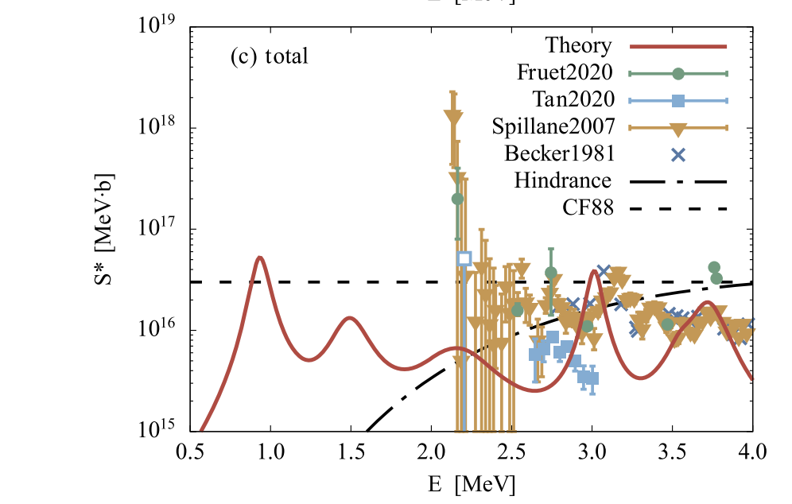

Recently, the AMD provided a a quantitative description of the low-energy resonances by handling the channel coupling and nuclear rotation without adjustable parameters.
It successfully described the gross structure of the main observed resonances above and below the Gamow window.
The calculation suggested no low-energy suppression of the S*-factor (hindrance?)
Y. Taniguchi & M. Kimura, PLB 823 136790 (2021)
«We evaluate the ¹²C+¹²C fusion reaction rate using a microscopic model, the antisymmetrized molecular dynamics. Using the model, we calculated the fusion cross sections treating coupling of the entrance (¹²C+¹²C) and exit channels (alpha+²⁰Ne and p+²³Na). We obtained resonances that enhance the fusion cross sections in low-energy regions, which rejects the hindrance model.»

Slide 23
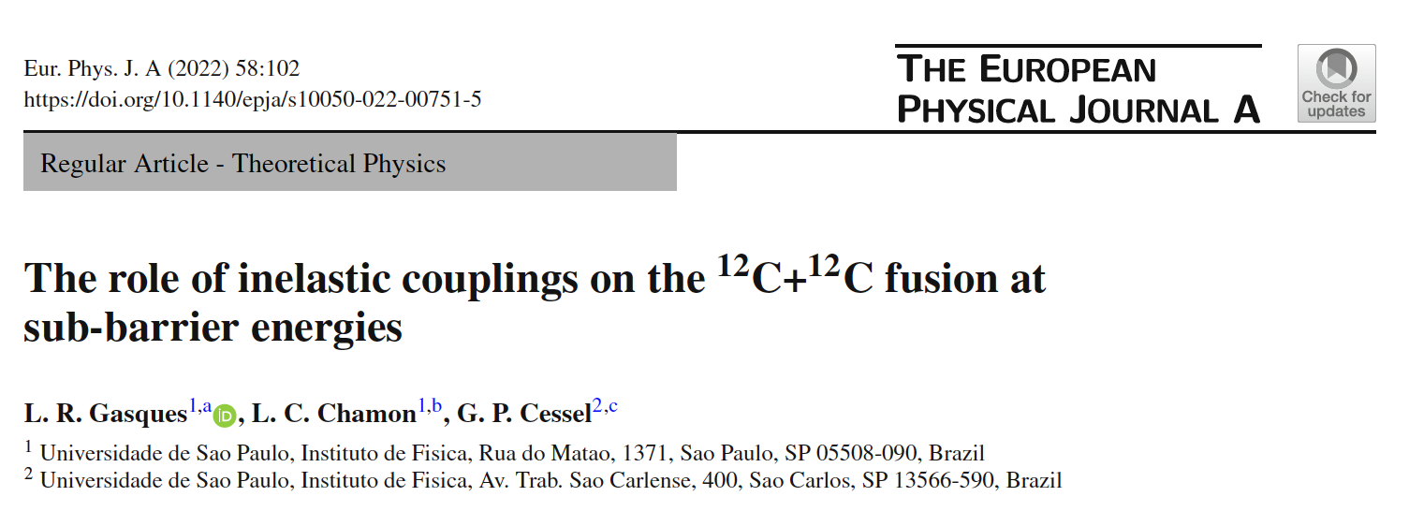
¹²C+¹²C fusion cross sections investigated at sub-barrier energies using the Brasilian Nuclear Potential interaction.
The (weak) imaginary potential simulates the (weak) absorption of flux from the elastic and inelastic channels to the fusion process and leads to the possibility of describing resonances associated to virtual molecular states involving the two carbons
Notice: the couplings to inelastic states play a crucial role in the description of the fusion cross sections.
The solid black was calculated within the CC framework, while the dotted green curve was obtained without considering the coupling (SC) to inelastic states of 12C

Slide 24
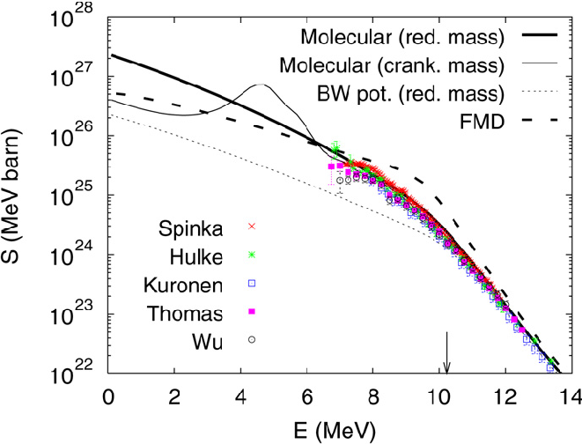
¹⁶O+¹⁶O with the THM
¹⁶O(²⁰Ne,αα)²⁸Si
¹⁶O(²⁰Ne,pα)³¹P
¹⁶O(¹⁶O,α)²⁸Si
¹⁶O(¹⁶O,p)³¹P
to study
2 Performed measurements:
E_{20Ne} = 45 MeV @Heavy Ion Lab., Warsaw
→ For normalization of the two-body cross section to the direct data
(b) E_{20Ne} = 35 MeV @Inst. Nucl. Phys., Astana
→ Approaching lower energies
A. Diaz-Torres et al. / PLB 652 (2007) 255–258
E_{Ne} = 45 MeV ⇔ E_{Ne-O} = 20 MeV (B_{C} ~17 MeV)
Incident energy used to breakup ²⁰Ne into ¹⁶O+α (E_{binding} = 4.73 MeV)
→ Two-body reaction takes place at low ¹⁶O−¹⁶O relative energies
²⁰Ne
projectile
α
“spectator”
Quasifree
breakup
Detected in
the experiment
Three particles in the exit channel:
All the kinematic variables can be calculated from the energies and the emission angles of any two of them → we choose the most convenient!
¹⁶O
α, p, ...
¹⁶O
target
²⁸Si, ³¹P, ...
Two-body
reactions
of interest

Slide 25
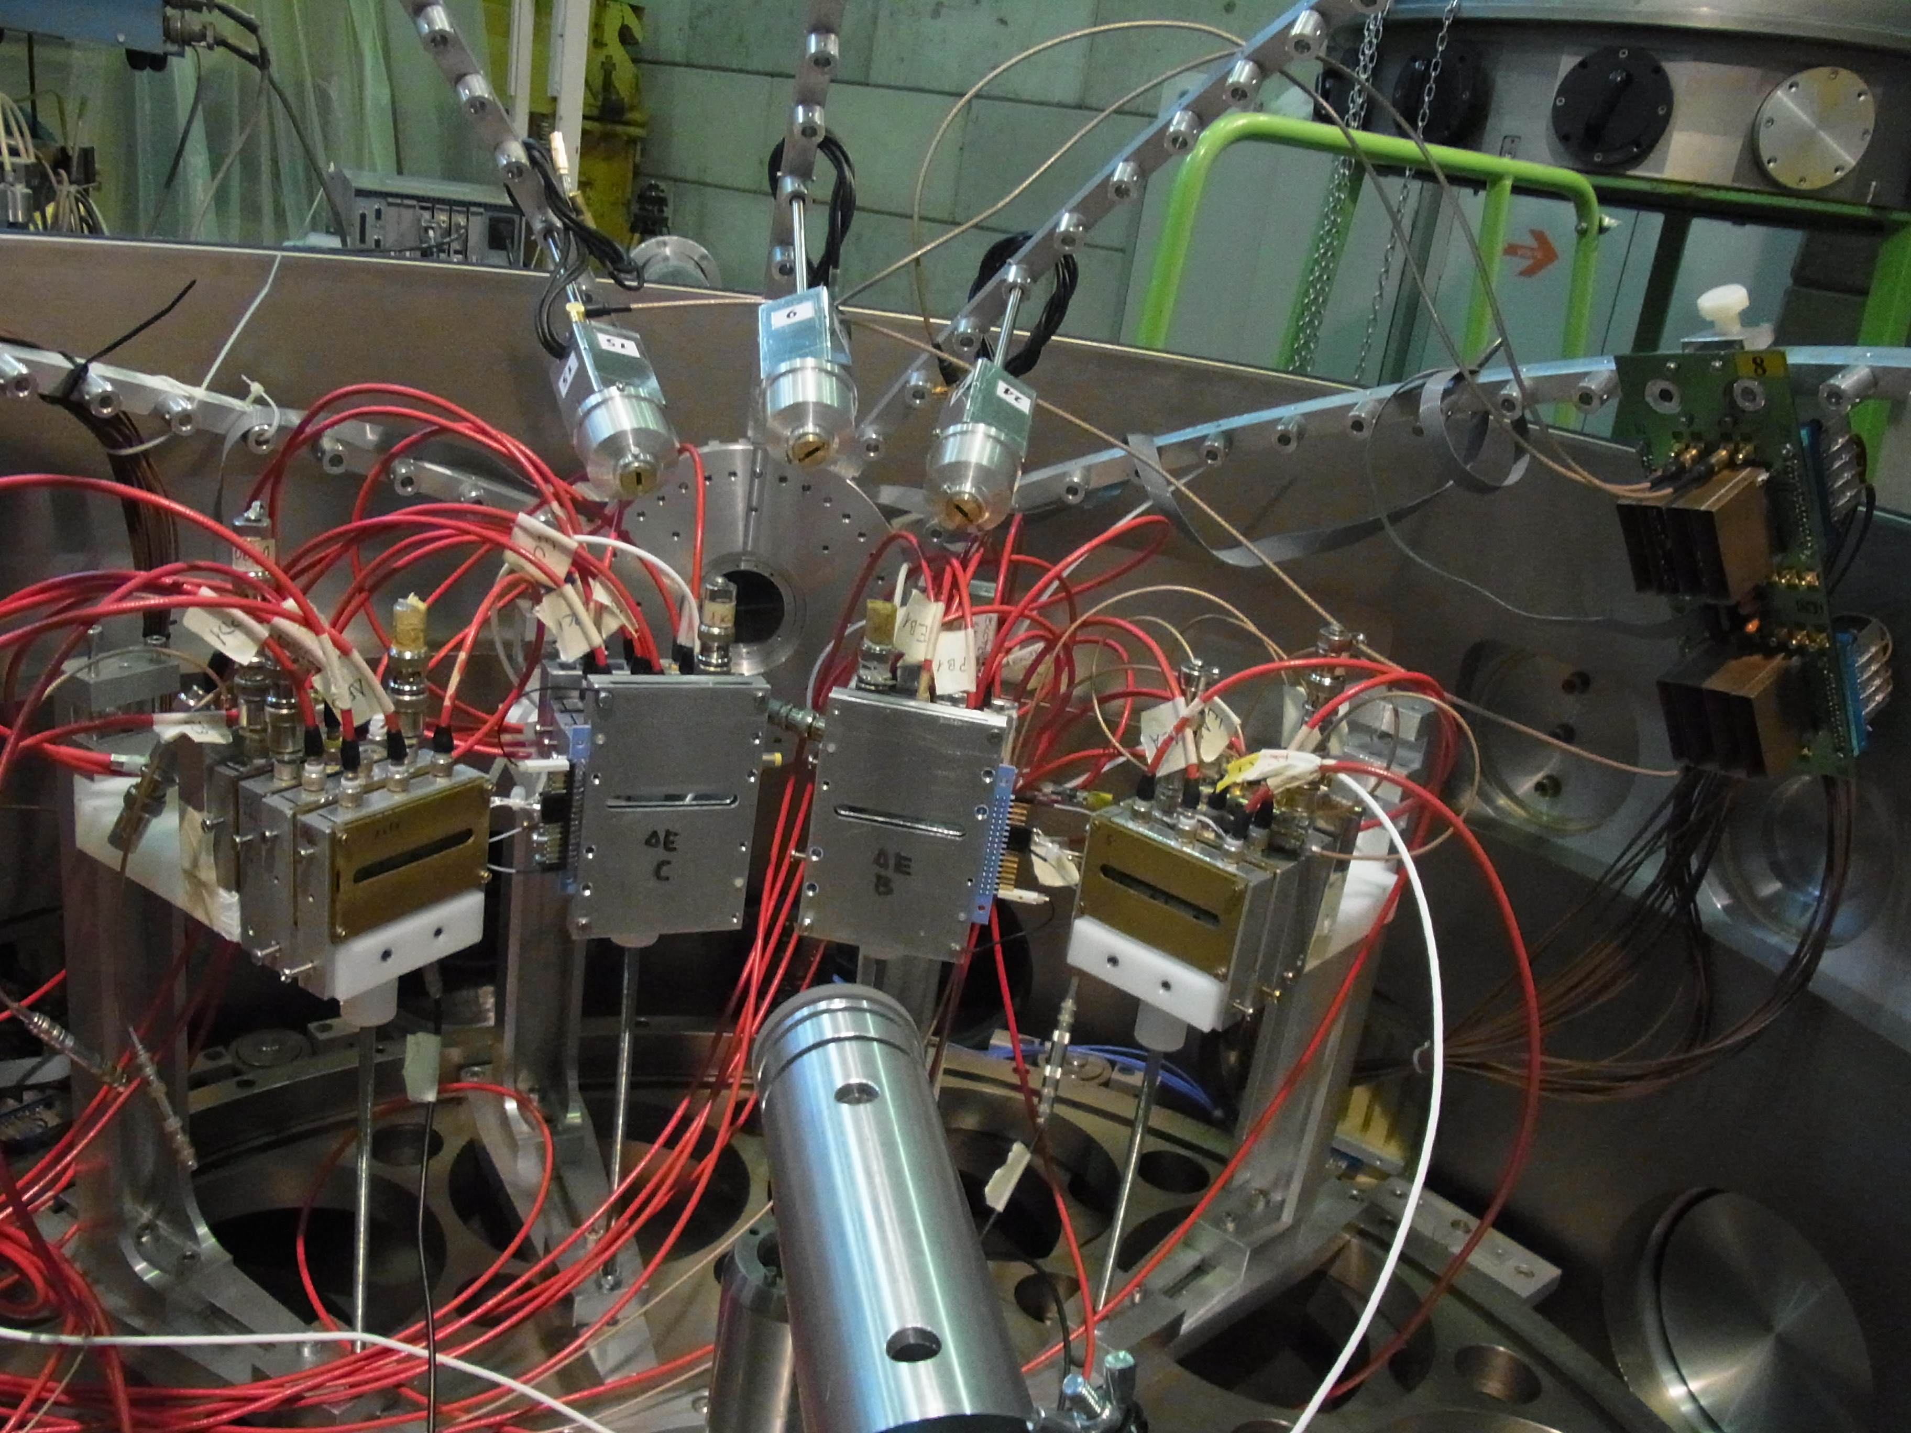
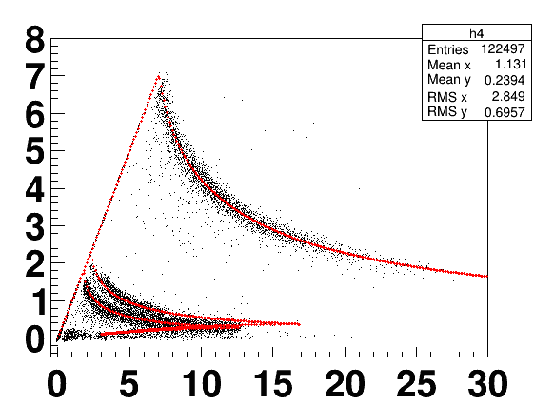
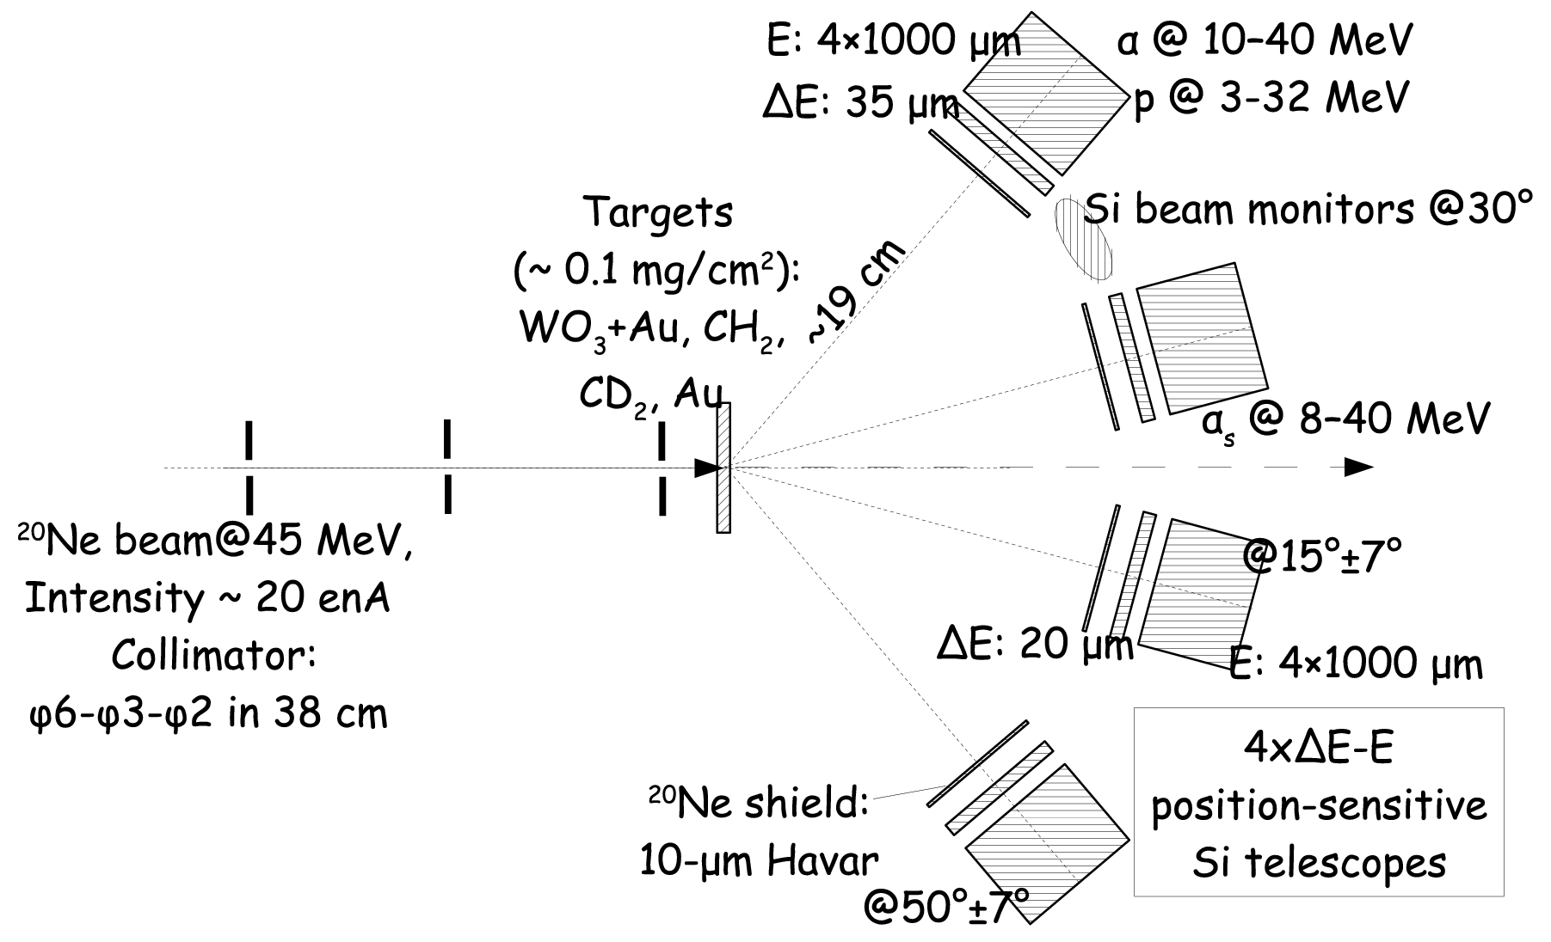
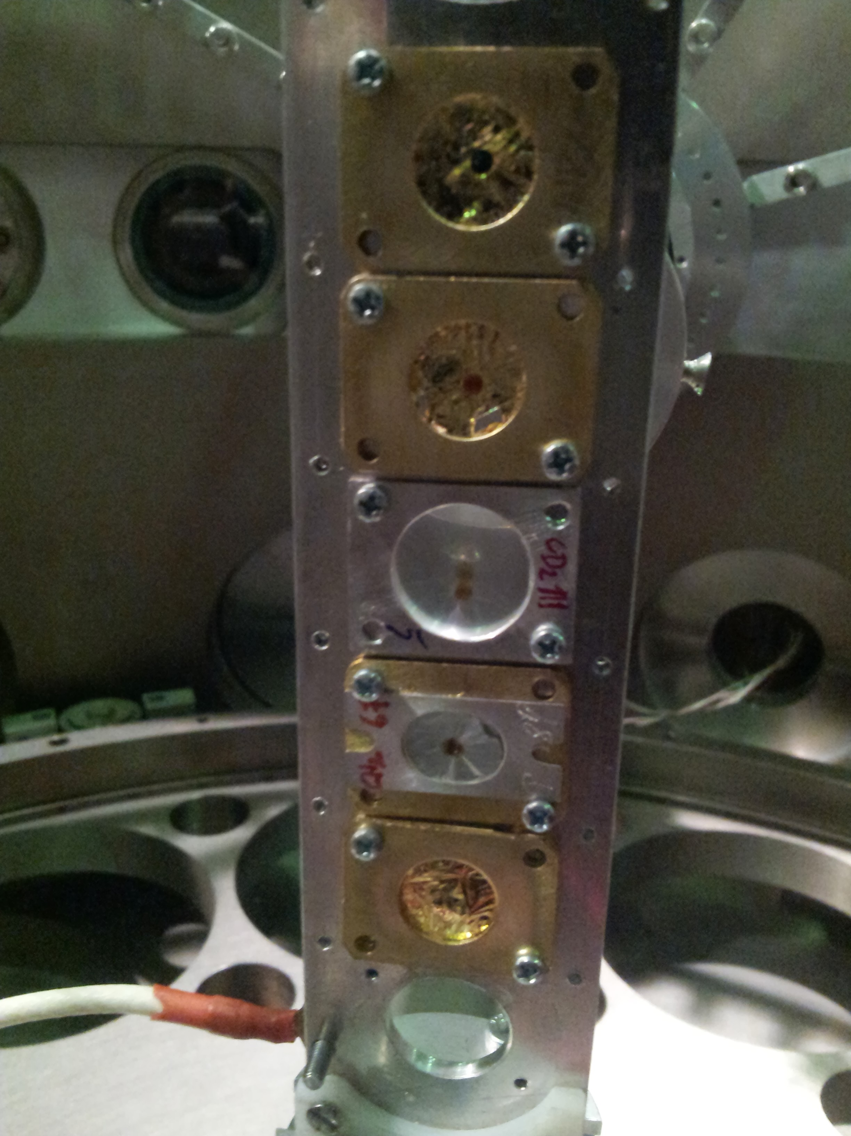
¹⁶O+¹⁶O with the THM: the experiments
Setup @ Heavy Ion Laboratory, Warsaw
α
d
p
p-α or α-α
coincidence events

Slide 26
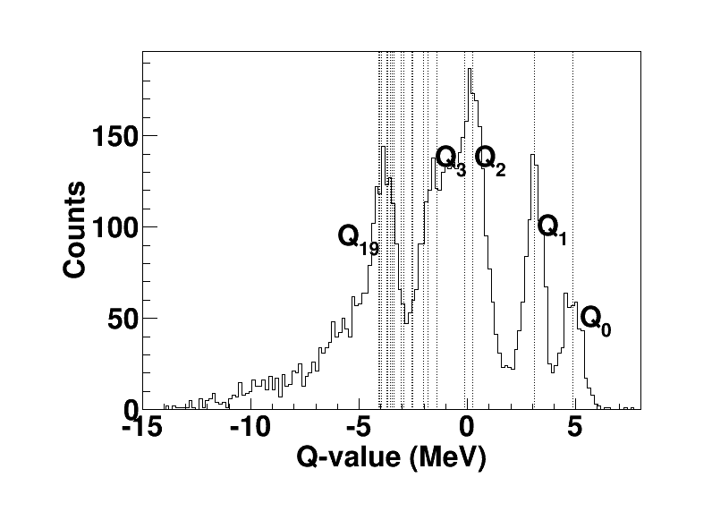
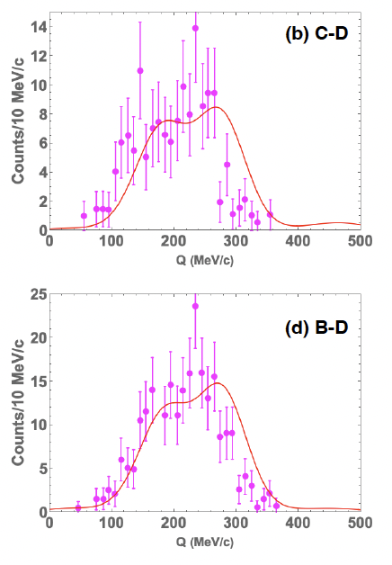
¹⁶O+¹⁶O with the THM: validity test
(thanks to Dr. S. Hayakawa)
Experimental momentum distribution of α inside ²⁰Ne from Q₀ and Q₁ data
No single peak at 0 MeV/c
→ Evidence of a more complicated breakup mechanism
Good agreement with calculations that account for the deformation of ²⁰Ne (totally new development by S. Typel)
Q-value = E_{28Si} – E_{20Ne} + E_{α1} + E_{α2} (MeV)
- Corresponds well to the ²⁸Si excited levels
- Good reconstruction of three-body kinematics
Evidence of the ¹⁶O(²⁰Ne,αα)²⁸Si three-body channel
Paper ready for submission

Slide 27
Summary
Introduction: what is nuclear astrophysics? How to measure nuclear reactions at astrophysical energies?
Indirect methods: the THM. Study of the ²⁷Al(p,α)²⁴Mg reaction through the ²H(²⁷Alp,α²⁴Mg)n process
The ¹²C+¹²C fusion reaction and the effect of low-energy resonances
New TH nuclei: towards the ¹⁶O+¹⁶O fusion reaction
Concluding: indirect methods are alternative and sometimes unique tools to explore astrophysical energies

Slide 28
Thank you for your attention

