Slide 1
Reaction-Rate Dependencies in Linear, Acyclic Networks
Brad Meyer
Clemson University

Slide 2
Four Requirements for Meaningful Nuclear Property Measurements (modified from The et al. 1998)
An appropriate astrophysical model of a process significant for nucleosynthesis.
An observable from that process, usually an abundance result that is either known or measurable.
The dependency of the value of the observable on the value of a nuclear property.
An experimental strategy for measuring that nuclear property, or at least of using measurable data to better calculate it.

Slide 3
Goal: present a picture of the evolution of a class of reaction networks that may be helpful in identifying key reactions for nucleosynthesis processes or at least understand their governing role.

Slide 4
Linear, Acyclic Networks
Linear: rates are independent of abundances and do not change with time.
Acyclic: reactions proceed in only one direction so that there are no cycles.

Slide 5
Caption

Slide 6
Processes that may be modeled with linear, acyclic networks
Radioactive decay chains (e.g., in kilonovae)
S process (AGB/Massive Stars)
N process (neutron burst in core-collapse See shells)
I process (low-metallicity stars)
Gamma process (explosive burning in O-rich shells)

Slide 7
Misch et al. (2021)

Slide 8
Processes that may be modeled with linear, acyclic networks
Radioactive decay chains (e.g., in kilonovae)
S process (AGB/Massive Stars)
N process (neutron burst in core-collapse See shells)
I process (low-metallicity stars)
Gamma process (explosive burning in O-rich shells)

Slide 9
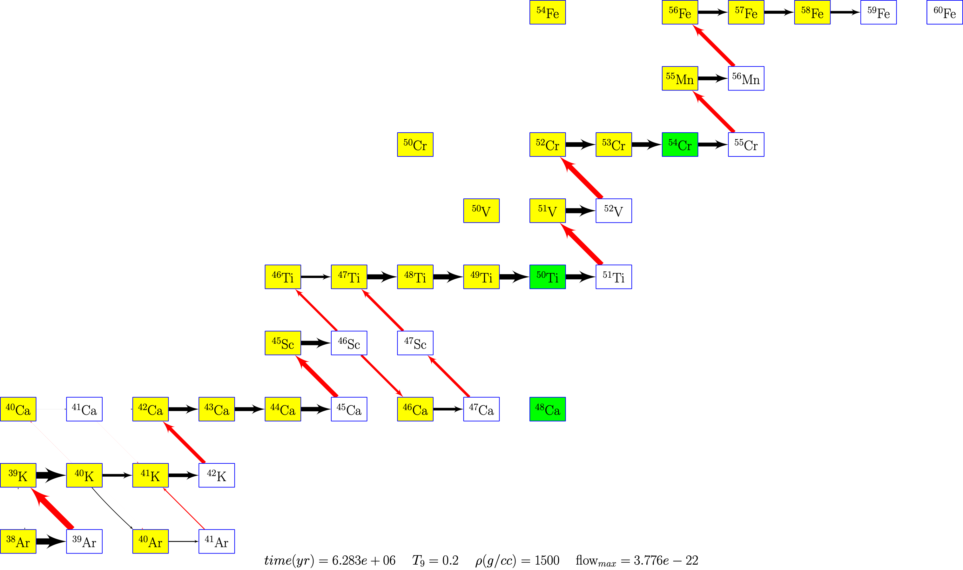

Slide 10
Processes that may be modeled with linear, acyclic networks
Radioactive decay chains (e.g., in kilonovae)
S process (AGB/Massive Stars)
N process (neutron burst in core-collapse See shells)
I process (low-metallicity stars)
Gamma process (explosive burning in O-rich shells)

Slide 11
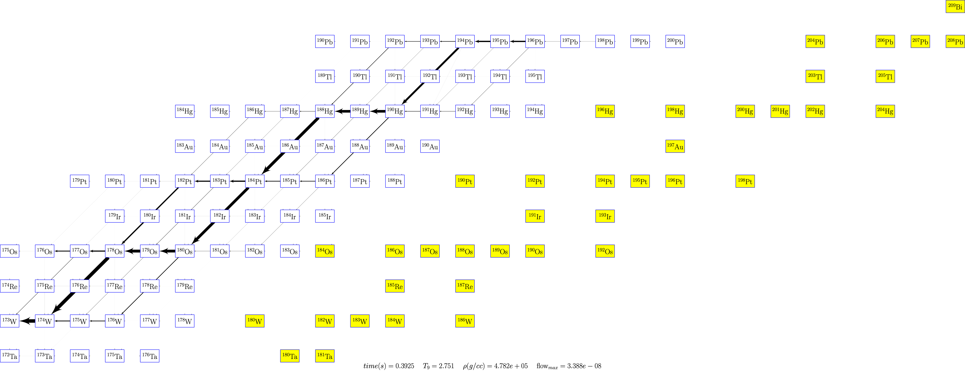

Slide 12
Murchison Meteorites
Fireball at 10:58am local time, September 28, 1969
Separated into three fragments before crashing leading to a observed tremor
Fragments collected over 13 square km with largest 7 kg
Over 100 kg collected

Slide 14
Murchison presolar grains

Slide 15
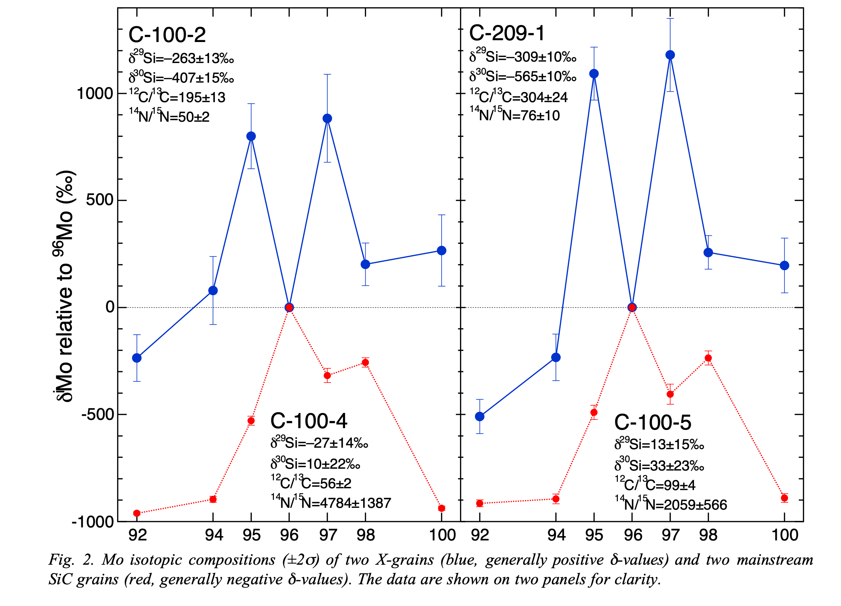
Pellin et al. (1999)

Slide 16
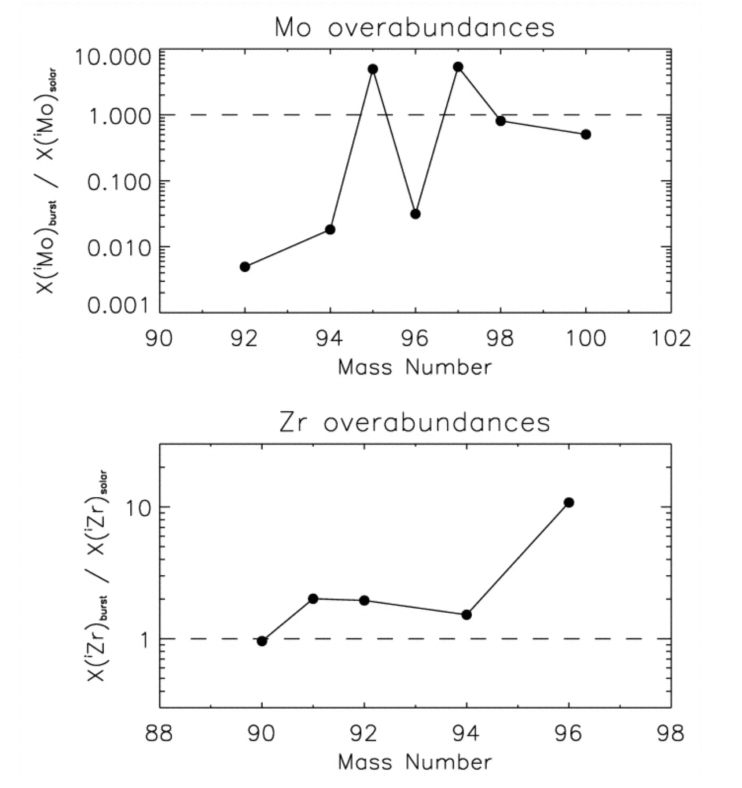
Meyer et al. (2000)

Slide 17
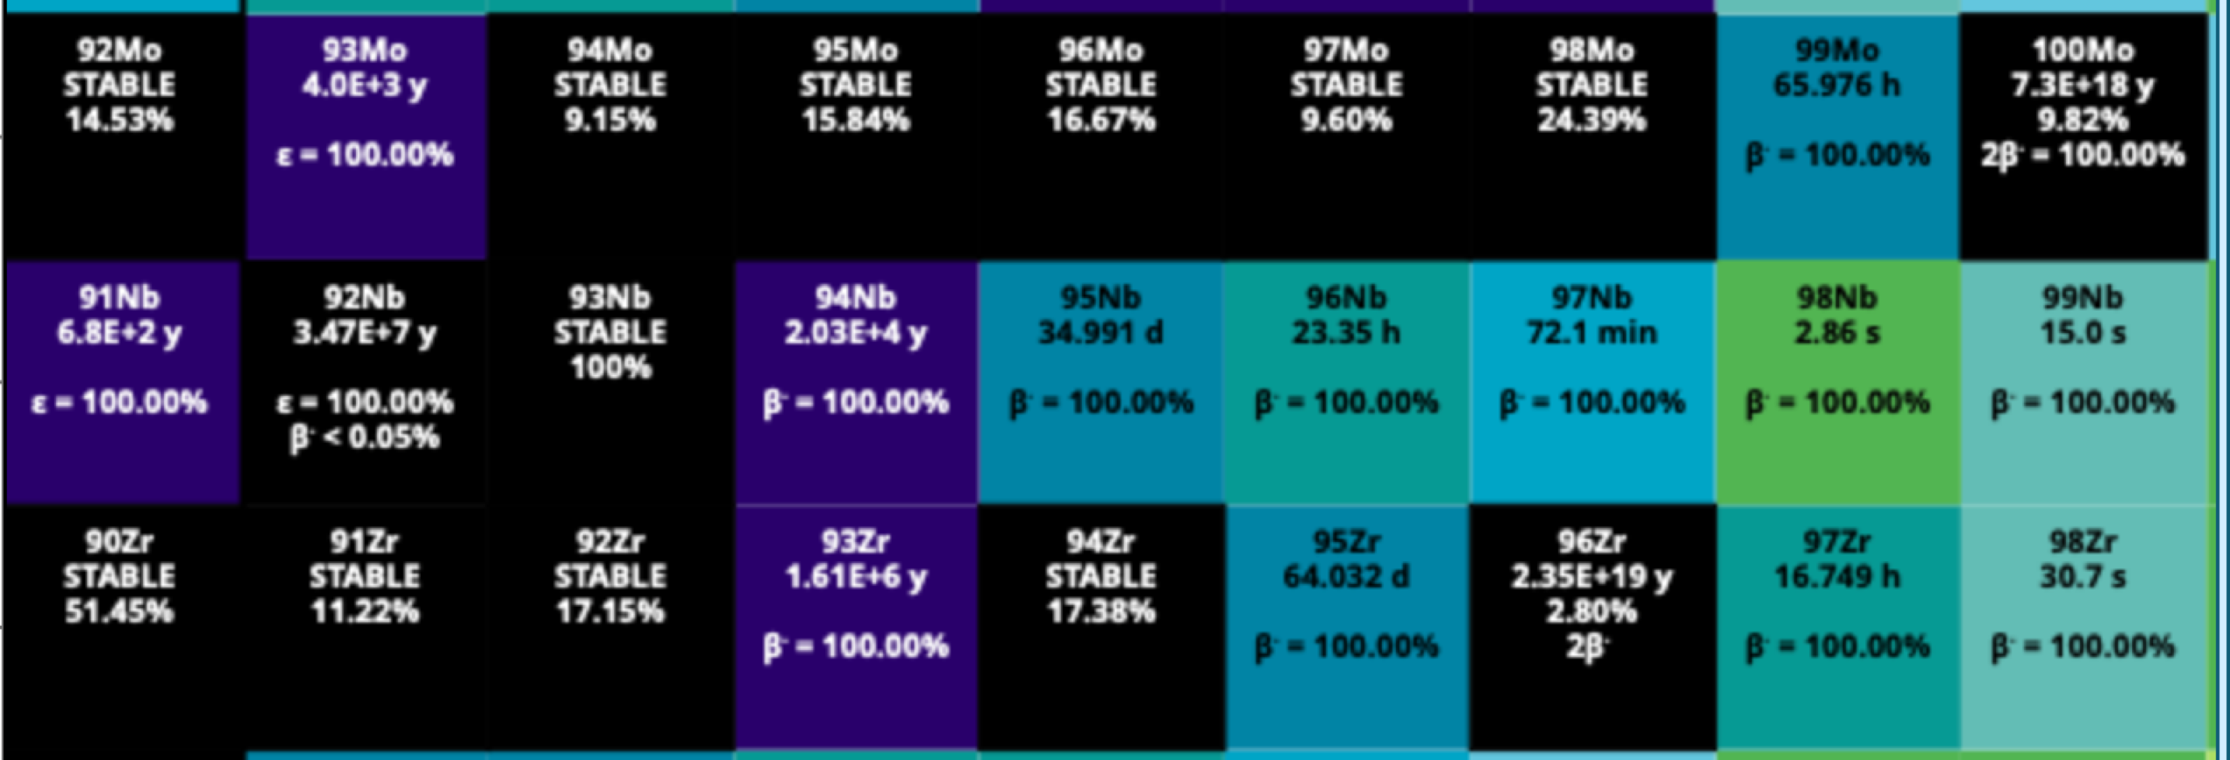
Analytic solution?

Slide 18
$$\frac{dY_{i}(τ)}{dτ}=-\underset{k≠i}{∑}α_{ik}Y_{i}(τ)+\underset{k≠i}{∑}α_{ki}Y_{k}(τ)$$
$$\frac{dY}{dτ}=AY$$

Slide 19
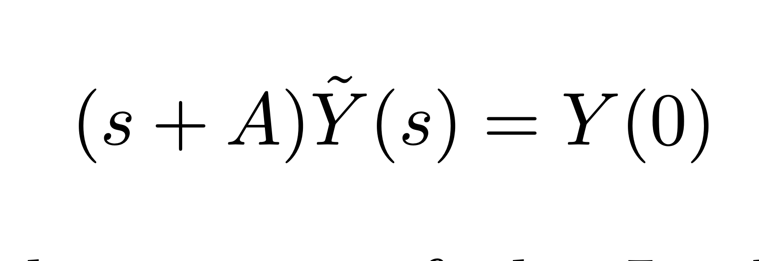

Slide 20
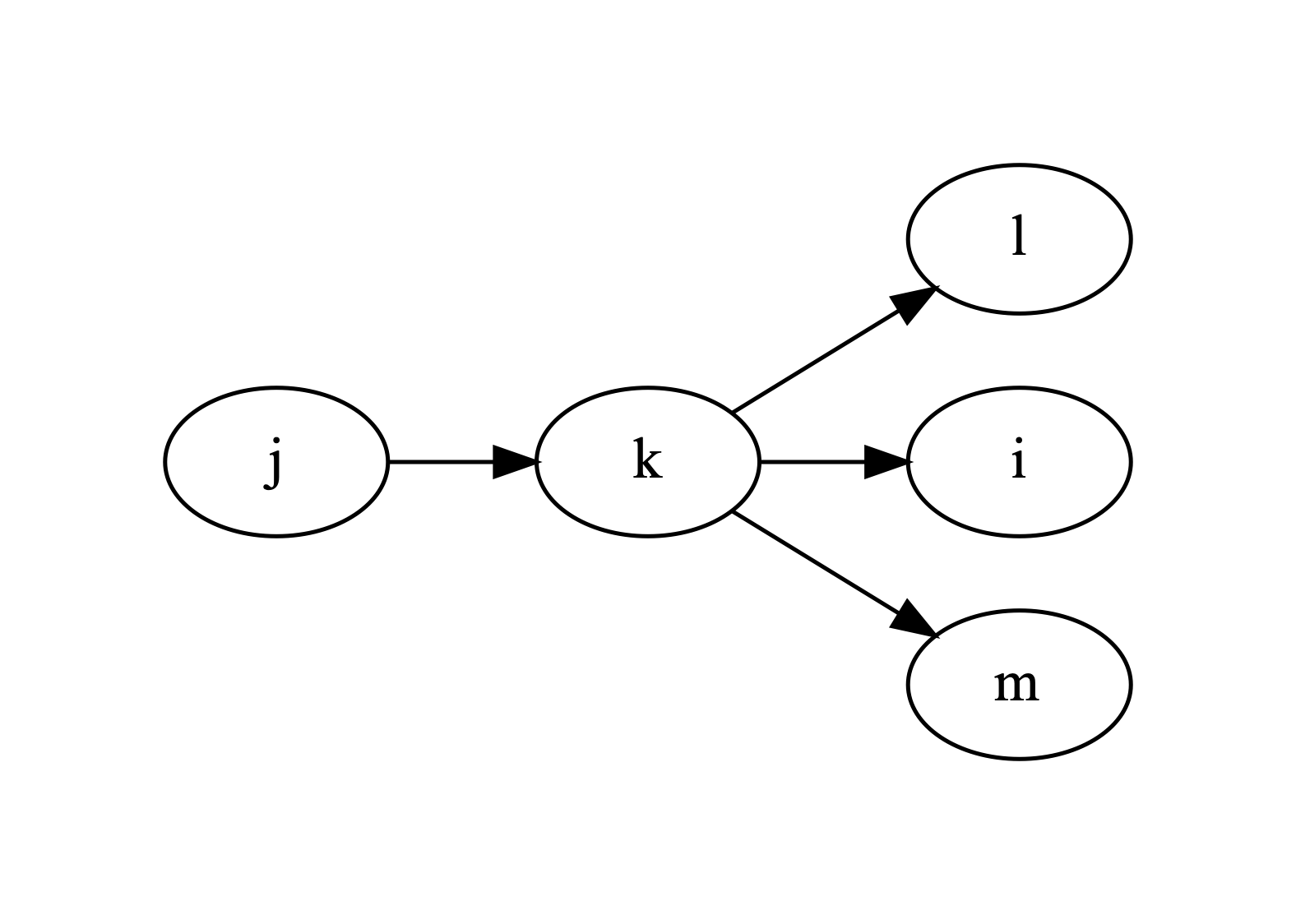
$$α_{k}=α_{k}^{(P)}+\underset{j∉P}{∑}α_{kj}$$

Slide 21
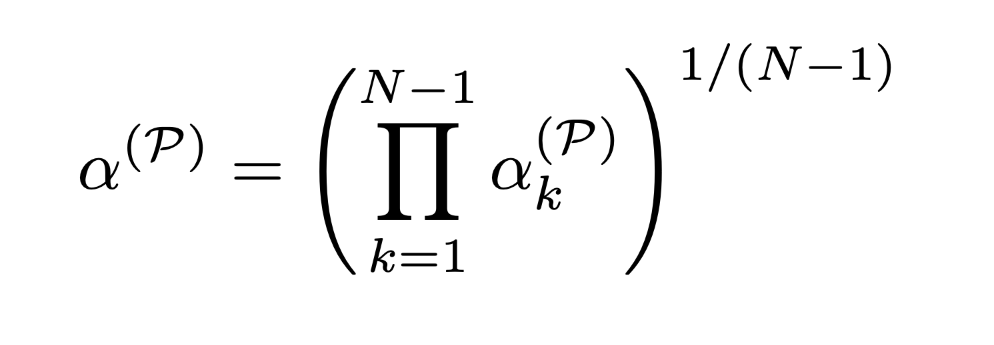
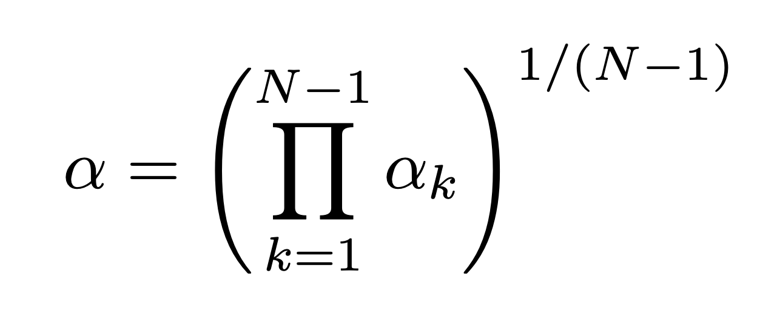
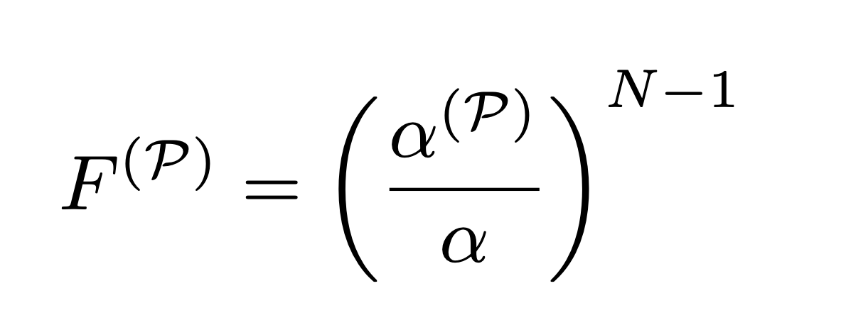

Slide 22
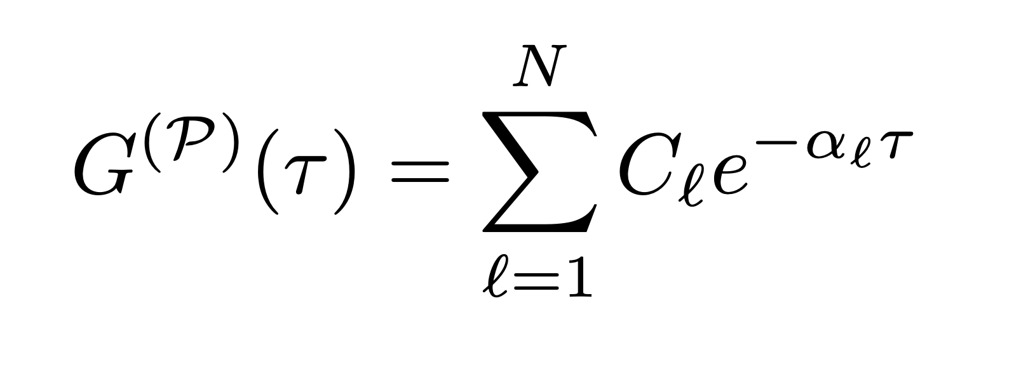

Slide 23
Exact Solution
$$G^{(P)}(τ)=\overset{j}{\underset{i=1}{∑}}C_{i}e^{-α_{i}τ}$$
This solution has been well studied in the past but has some shortcomings
Numerical issues due to addition/substraction of the many terms $C_{i}e^{-α_{i}τ}$
Does not provide much physical insight

Slide 24
Previous analytic work
Clayton, Fowler, Hull and Zimmerman 1961 (CFHZ) found an approximate solution for the s-process
$$ψ_{k}(τ)=λ_{k}\frac{(λ_{k}τ)^{m_{k}-1}}{Γ(m_{k})}e^{-λ_{k}τ}$$
Replaces actual cross sections with a (typically) smaller number of equal cross sections

Slide 25
CFHZ Approximate Form
Led to significant insight into the s-process
Useful but too limited for our purposes, especially when we want to compare contributions from multiple paths accurately
Clayton et. al (1961)

Slide 26
$${\overline{h}}_{n}(α_{1},....α_{N})=B_{n}(x_{1},...,x_{N})$$

Slide 28
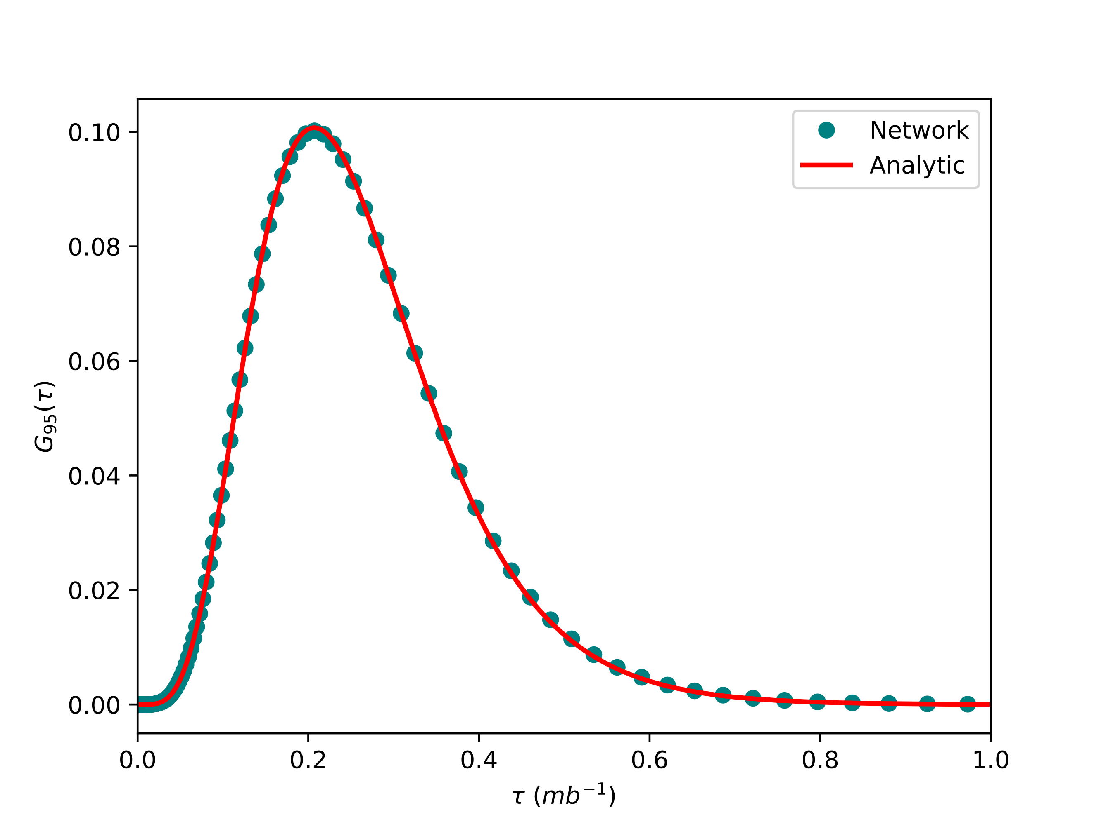
$${}^{90}Zr→^{95}Zr$$
$$T_{9}=1$$

Slide 29
Simple Neutron burst for Zr isotopes
Analytic calculation
$$G^{(P)}=\frac{{\left(α^{(P)}τ\right)}^{N-1}}{(N-1)!}exp\left(-α_{max}τ+\overset{4}{\underset{j=1}{∑}}x_{j}\frac{(-τ)^{j}}{j!}\right)$$
$$\begin{aligned}N=4 \\ α^{(P)}=23.044898 \\ α_{max}=41.52 \\ x_{1}=0.343 \\ x_{2}=0.0091 \\ x_{3}=-0.00000686 \\ x_{4}=-0.0000270\end{aligned}$$

Slide 30
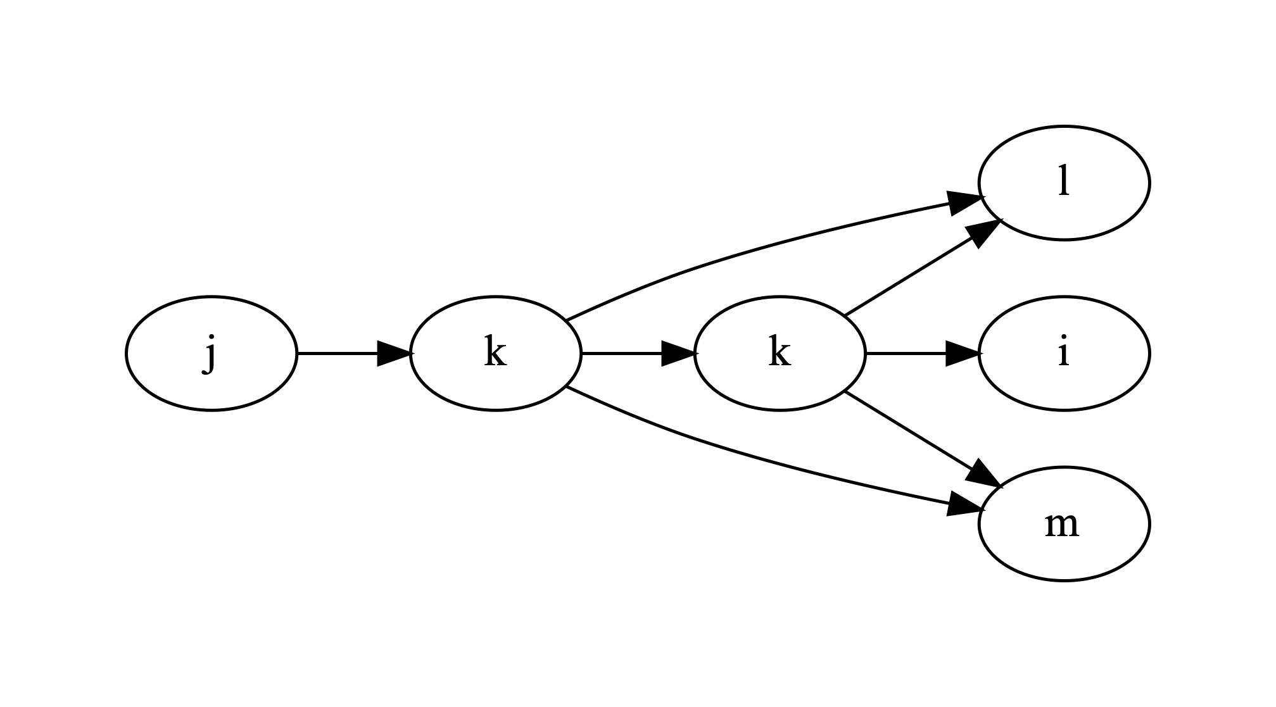
$$\frac{∂G_{N}^{(P)}(τ)}{∂α_{k,j∉P}}=-\frac{1}{α_{k}^{(P)}}G_{N+1}^{(P+k)}(τ)$$

Slide 31
$$\frac{∂G_{N}^{(P)}(τ)}{∂α_{k}^{(P)}}=\frac{1}{α_{k}^{(P)}}\left(G_{N}^{(P)}(τ)-G_{N+1}^{(P+k)}(τ)\right)$$
—

Slide 32
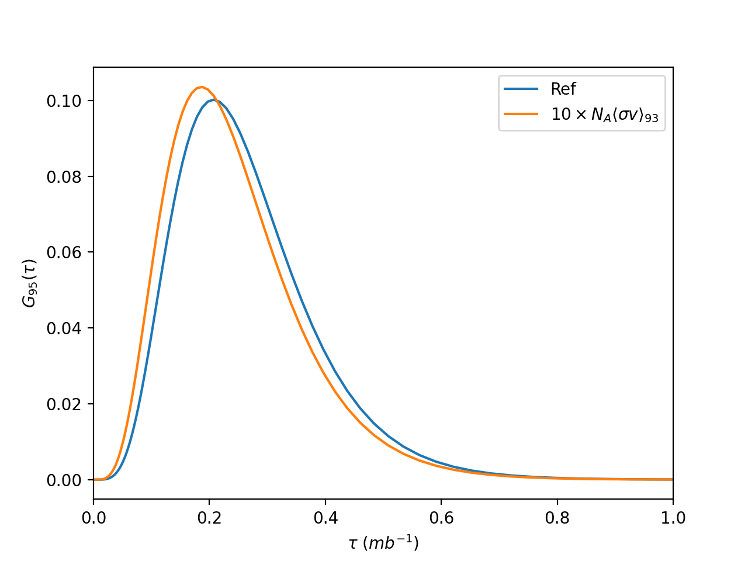
$$\frac{∂G_{N}^{(P)}(τ)}{∂α_{k}^{(P)}}=\frac{1}{α_{k}^{(P)}}\left(G_{N}^{(P)}(τ)-G_{N+1}^{(P+k)}(τ)\right)$$

Slide 33
S/I-process
Abundances for calculations run at constant neutron number density
top: $n={10}^{7}cm^{-3}$ (s-process conditions)
bottom: $n={10}^{15}cm^{-3}$ (i-process conditions)
Hampel et. al (2016)

Slide 34
I-process
Abundance pattern fits for CEMP-i
LP625-44
I-process provides a much better fit than r or s process
Hampel et. al (2016)

Slide 35
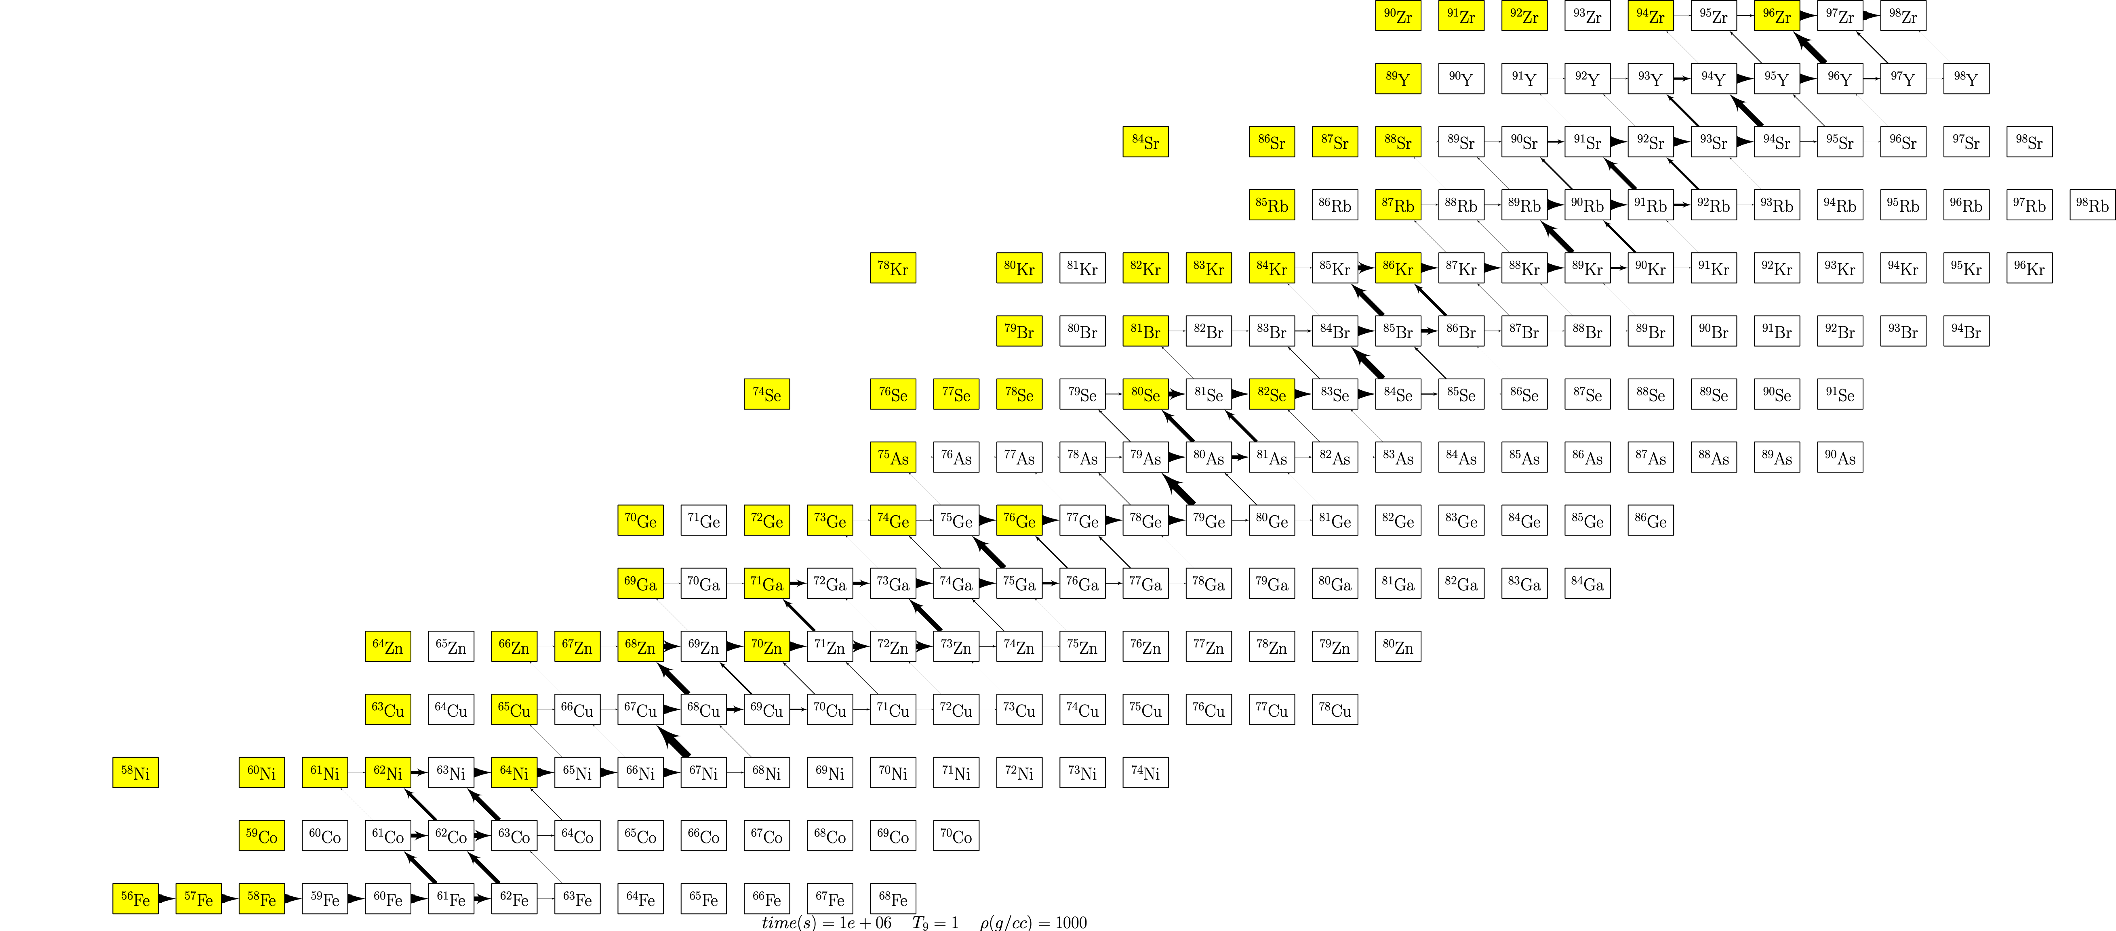

Slide 36
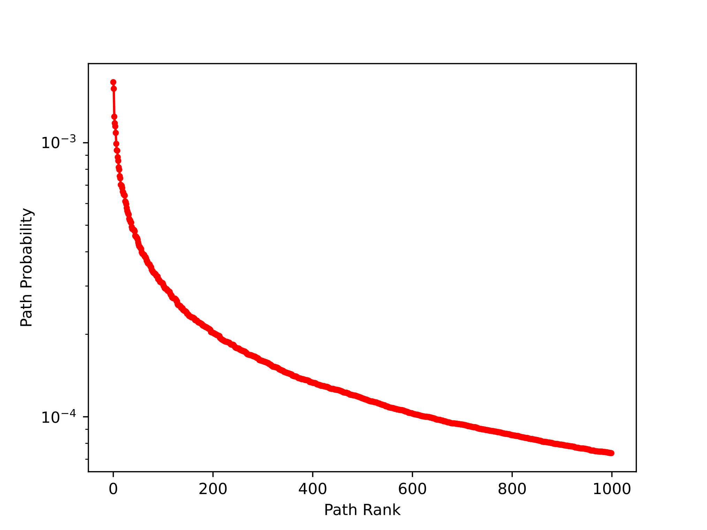
7.3 x 10¹¹ paths!
56Fe —> 98Zr in i-process with T9 = 1 and nn = 1015 per cc

Slide 37
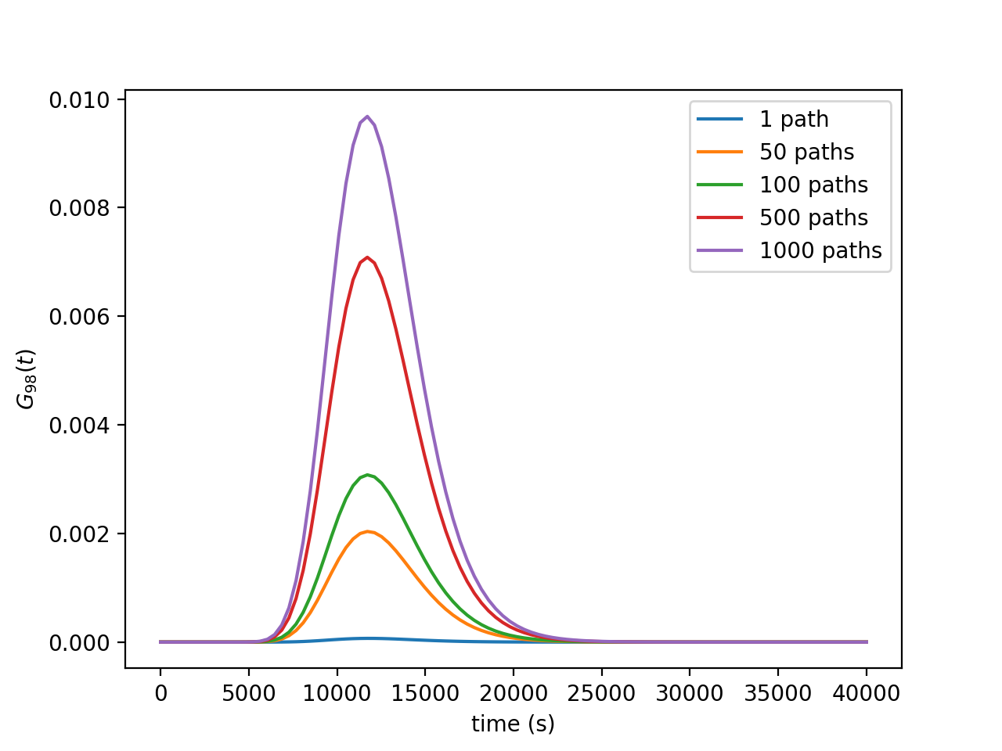

Slide 38
n + fe57 -> fe58 + gamma 99.9 2.99e-04
n + ni63 -> ni64 + gamma 98.3 2.99e-04
n + zr97 -> zr98 + gamma 99.9 2.99e-04
n + fe60 -> fe61 + gamma 99.9 2.99e-04
n + ni66 -> ni67 + gamma 99.9 2.99e-04
n + ge77 -> ge78 + gamma 99.9 2.99e-04
n + fe58 -> fe59 + gamma 99.9 2.99e-04
n + ni64 -> ni65 + gamma 99.9 2.99e-04
n + sr92 -> sr93 + gamma 99.9 2.99e-04
n + ni65 -> ni66 + gamma 99.9 2.99e-04
n + fe56 -> fe57 + gamma 99.9 2.99e-04
n + fe59 -> fe60 + gamma 99.9 2.99e-04
n + se82 -> se83 + gamma 99.7 2.98e-04
n + kr86 -> kr87 + gamma 99.1 2.98e-04
n + cu67 -> cu68 + gamma 99.7 2.98e-04

Slide 39
Table 1
zn73 -> ga73 + electron + anti-neutrino_e 65.9 2.19e-04
br85 -> kr85 + electron + anti-neutrino_e 69.2 2.15e-04
n + kr85 -> kr86 + gamma 69.2 2.15e-04
rb91 -> sr91 + electron + anti-neutrino_e 64.6 2.00e-04
n + se80 -> se81 + gamma 61.2 1.88e-04
co63 -> ni63 + electron + anti-neutrino_e 62.7 1.82e-04
n + co62 -> co63 + gamma 63.7 1.81e-04
as80 -> se80 + electron + anti-neutrino_e 56.4 1.76e-04
n + fe61 -> fe62 + gamma 52.2 1.54e-04
fe62 -> co62 + electron + anti-neutrino_e 51.6 1.53e-04
n + co61 -> co62 + gamma 47.7 1.45e-04
fe61 -> co61 + electron + anti-neutrino_e 47.7 1.45e-04
co62 -> ni62 + electron + anti-neutrino_e 35.6 1.16e-04
n + ni62 -> ni63 + gamma 35.6 1.16e-04
n + as80 -> as81 + gamma 38.7 1.10e-04
as81 -> se81 + electron + anti-neutrino_e 37.8 1.09e-04
n + br85 -> br86 + gamma 30.7 8.38e-05
br86 -> kr86 + electron + anti-neutrino_e 29.9 8.35e-05
zn71 -> ga71 + electron + anti-neutrino_e 31.5 7.39e-05
n + ga71 -> ga72 + gamma 31.5 7.39e-05
n + ga72 -> ga73 + gamma 31.5 7.39e-05

Slide 40
webnucleo.org

Slide 41
Goal: present a picture of the evolution of a class of reaction networks (linear DA networks) that may be helpful in identifying key reactions for nucleosynthesis processes or at least understand their governing role.

Slide 42
Four Requirements for Meaningful Nuclear Property Measurements (modified from The et al. 1998)
An appropriate astrophysical model of a process significant for nucleosynthesis.
An observable from that process, usually an abundance result that is either known or measurable.
The dependency of the value of the observable on the value of a nuclear property.
An experimental strategy for measuring that nuclear property, or at least of using measurable data to better calculate it.

Slide 44
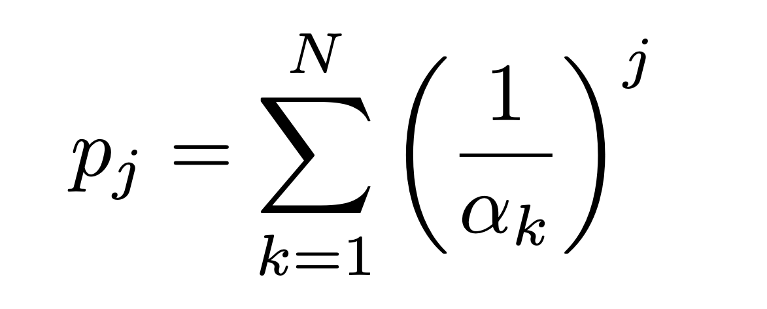
Raw moments:
$$μ_{k}^{(P)}=\frac{F^{(P)}}{α_{N}}B_{k}\left(0,κ_{2}^{(P)},...,κ_{k}^{(P)}\right)$$
Central moments:

Slide 45
$$μ_{k}^{(P)}=\frac{F^{(P)}}{α_{N}}B_{k}\left(0,κ_{2}^{(P)},...,κ_{k}^{(P)}\right)$$

