Slide 1
Study of E1 resonances with ab initio interactions
October 27th, 2022
Mikael Frosini
DES/IRESNE/DER/SPRC/LEPh

Slide 2
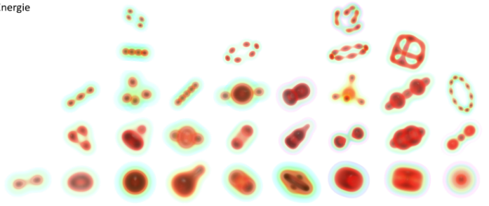
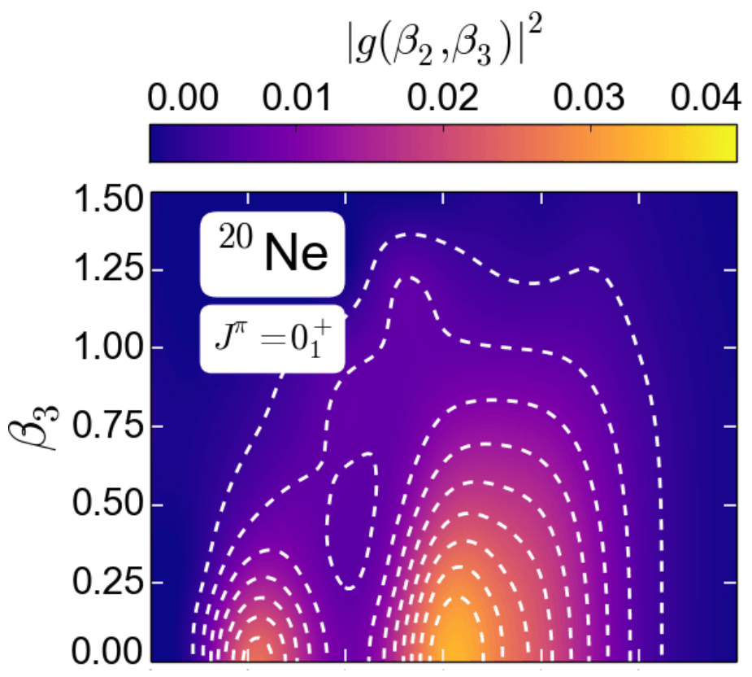
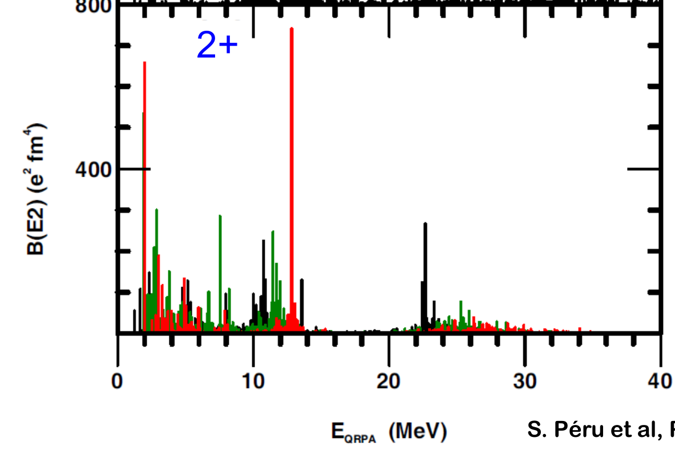
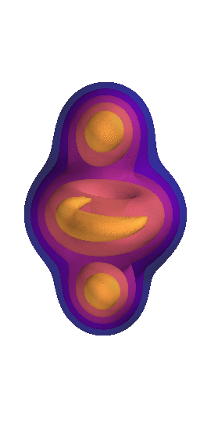
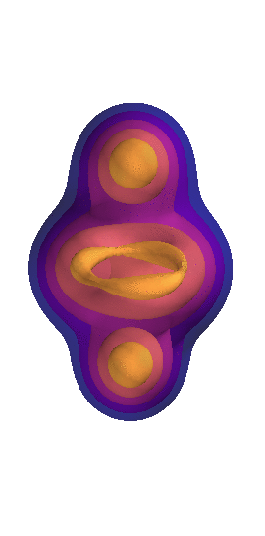
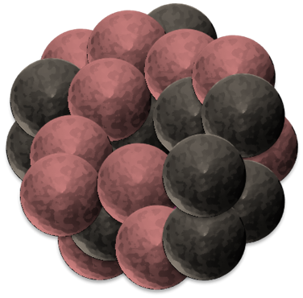
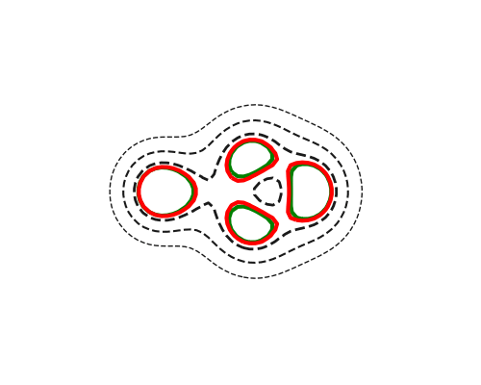
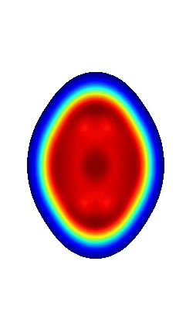
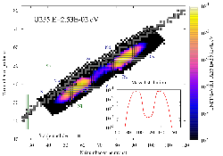
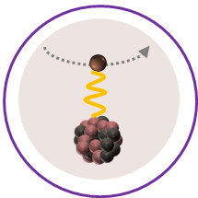
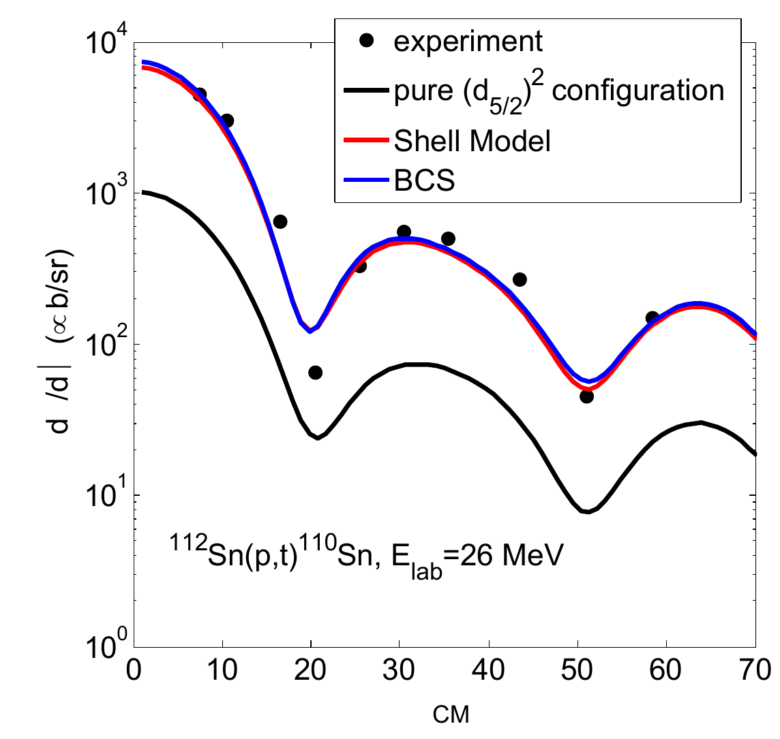
Challenges in nuclear structure
Today’s focus on E1 resonances
New to the game
Very flexible theoretical tools recently implemented
(Incomplete) Preliminary studies in several directions
Hoping input to converge towards exp. interests
Already partially done after this week
Ground-state
masses, radii, density profile, …
cEDF-HFB intrinsic density
(courtesy of J-P. Ebran)
Excitation spectra
energies, transition probabilities, response function to electroweak probes, …
Decay modes
lifetime, yields, …
Ab initio QFAM time-dependent intrinsic density
cEDF-HFB (courtesy of J-P. Ebran)
Reactions
cross sections, …
Effect of pairing interaction on two-neutron transfer reactions, Potel et. al.

Slide 3
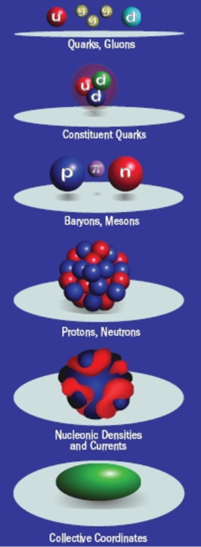

Modelling the nuclear problem with microscopic methods
Degrees of freedom
Energy scales
High numerical cost
Currently limited mass range
Systematically improvable
Error estimation
Ab initio interaction
Derived consistently with QCD
Adjusted on small systems
Hadronic Physics
Neutron mass
Microscopic models
Pion mass
Reasonable numerical cost
Large domain of applicability
Not systematically improvable
Limited error estimation
Proton separation energy in lead
Energy density functional
Phenomenological interaction
Adjusted in nuclei
Vibrational state in Tin
Macroscopic models
Nuclear Physics
Liquid drop model
Rigid rotor
Collective Hamiltonians
Low numerical cost
Focused on selected observables
Good descriptivity
Low predictive power
No error estimation
Rotational state in
Uranium

Slide 4
Progress of ab initio / in medias res methods
Ab initio methods
A structure-less nucleons as degrees of freedom
Interaction mediated by pions and contact terms (e.g. Weinberg PC)
Solve A-body Schrödinger equation to relevant accuracy
Steady progress in the last decades
Light nuclei
Exponential
scaling
Quasi-exact methods
1990’s
Closed shells
2000’s
Polynomial
scaling
Expansion methods
Single-reference
Singly open-shells
Polynomial
scaling
2010’s
Symmetry-breaking
Multi-reference
Doubly open-shells
Mixed / Polynomial
Scaling
2020-?
Courtesy of B. Bally
Valence space
Symmetry-breaking
Multi-reference

Slide 5
Outline
A few words on QRPA-FAM formalism
  Nuclear many-body problem
  QRPA formalism
  Illustration of the Finite Amplitude Method
Sources of errors and uncertainty quantifications
  Interaction uncertainties
  Many-body truncations
Preliminary results
  Validating QRPA with ab initio interactions
  Finite temperature and desexcitation
  Effect of triaxiality for E1 resonances
  First steps towards odd nuclei
Going beyond QRPA with PGCM

Slide 6
Outline
A few words on QRPA-FAM formalism
  Nuclear many-body problem
  QRPA formalism
  Illustration of the Finite Amplitude Method
Sources of errors and uncertainty quantifications
  Interaction uncertainties
  Many-body truncations
Preliminary results
  Validating QRPA with ab initio interactions
  Finite temperature and desexcitation
  Effect of triaxiality for E1 resonances
  First steps towards odd nuclei
Going beyond QRPA with PGCM

Slide 7



Nuclear structure problem
Schrödinger equation in nuclear structure
Ab initio nucleon-nucleon potential
1, 2, 3 , … A body
Derived from QCD (Chiral EFT)
Fitted on light (A<5) systems
Correlated eigenstates
A! parameters
(Not an observable)
$$H |Ψ^{A,J,π,i}〉=E^{A,J,π,i}|Ψ^{A,J,π,i}〉$$
Extremely complex
Approximation of the interaction
Effective field theories (ab initio)
Phenomenological interaction (EDF)
Approximation of the A-body problem
Exact method truncations (ab initio)
Phenomenological ingredients (EDF)
Numerically affordable

Slide 8
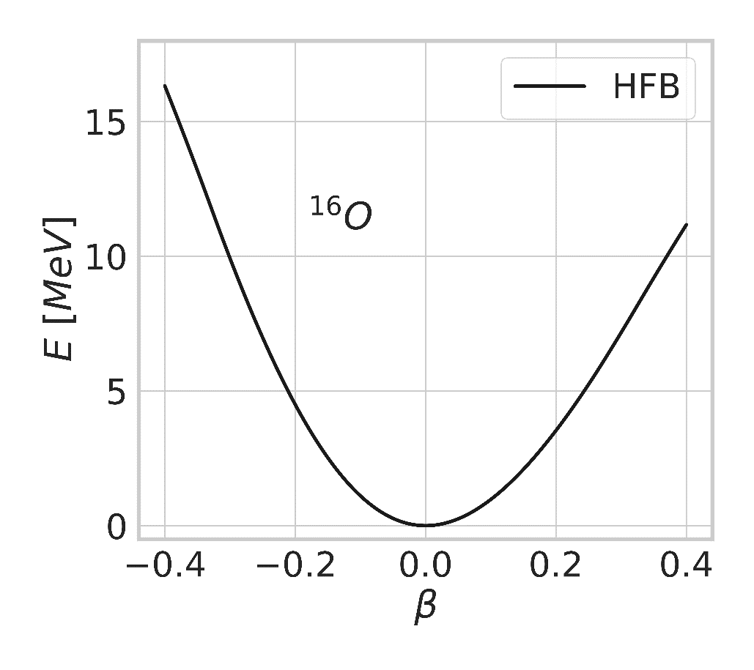



From HFB to QRPA matrix
Ground state: Mean-field approximation (HFB)
Minimize energy over set of (simple) product states
Definition of energy functional
Choice of symmetries / set of product states / dofs
  Compromise physics / runtime
Choice of starting point
Minimization of functional
$$E[Φ]$$
$$|Φ〉↔ℛ$$
$$|Φ+δΦ〉≡exp\left(Z\right)|Φ〉$$
$$E\left[Φ+δΦ\right]≡E\left[Φ\right]+H^{20}⋅Z+⋯$$
⬅ Follow steepest descent

Slide 9
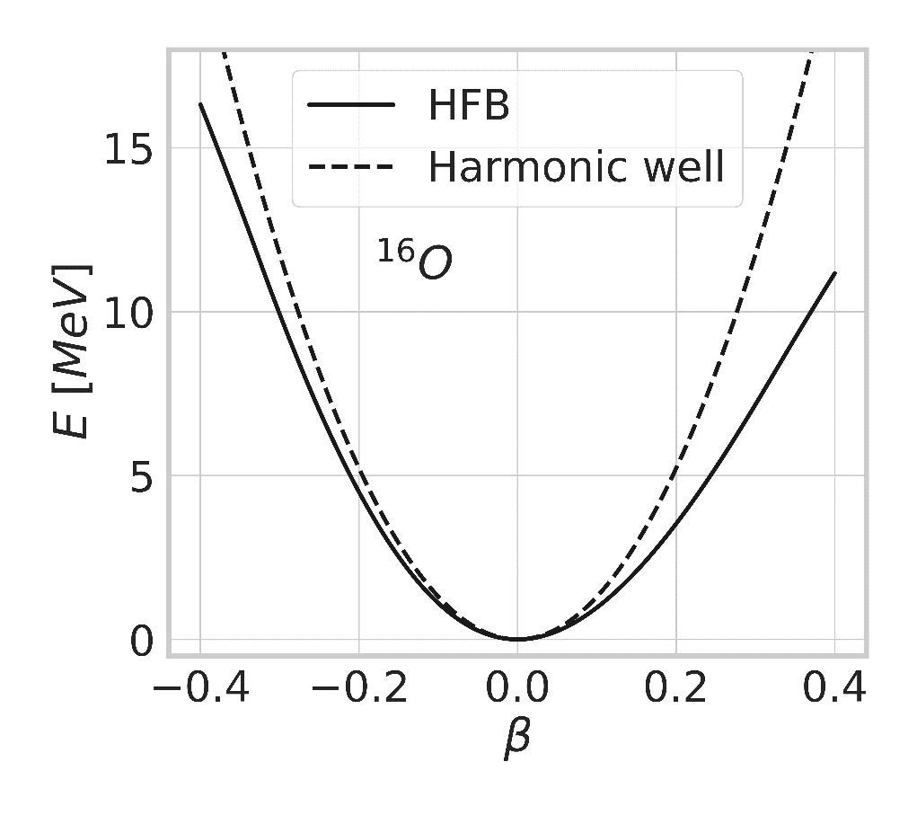

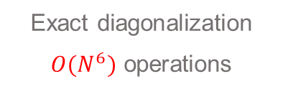
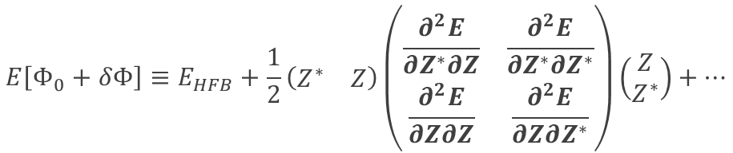
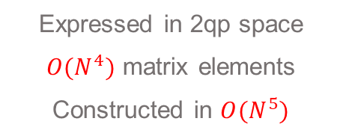
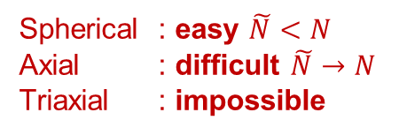

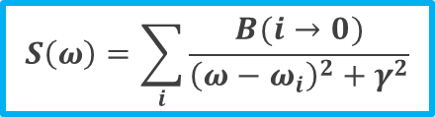
From HFB to QRPA matrix
Excitations and QRPA matrix
How does the system vibrate in its well ?
$$E\left[Φ_{0}+δΦ\right]≡E_{HFB}+\frac{1}{2}\left(\begin{matrix}Z^{∗} & Z\end{matrix}\right)\left(\begin{matrix}\frac{∂^{2}E}{∂Z^{∗}∂Z} & \frac{∂^{2}E}{∂Z^{∗}∂Z^{∗}} \\ \frac{∂^{2}E}{∂Z∂Z} & \frac{∂^{2}E}{∂Z∂Z^{∗}}\end{matrix}\right)\left(\begin{matrix}Z \\ Z^{∗}\end{matrix}\right)+⋯$$
Vibrational spectrum hidden in Hessian : QRPA matrix
Spherical : easy $\tilde{N}<N$
Axial : difficult $\tilde{N}→N$
Triaxial : impossible
Expressed in 2qp space
$O(N^{4})$ matrix elements
Constructed in $O(N^{5})$
MATRICIAL QRPA
Exact diagonalization
$O(N^{6})$ operations
Phenomenological smearing
$$M=\left(\begin{matrix}A & B \\ B^{∗} & A^{∗}\end{matrix}\right)$$
$$S\left(ω\right)=\sum_{i}{\frac{B(i→0)}{{\left(ω−ω_{i}\right)}^{2}+γ^{2}}}$$
$$ω_{i}, B\left(LM,i→0\right), X_{i}$$

Slide 10
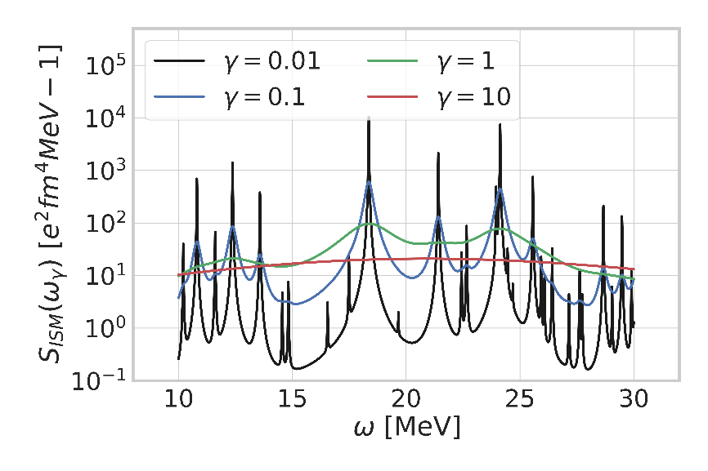

From HFB to QRPA matrix
Excitations and QRPA matrix
Next order tells us how the system vibrates in its well
$$E\left[Φ_{0}+δΦ\right]≡E_{HFB}+\frac{1}{2}\left(\begin{matrix}Z^{∗} & Z\end{matrix}\right)\left(\begin{matrix}\frac{∂^{2}E}{∂Z^{∗}∂Z} & \frac{∂^{2}E}{∂Z^{∗}∂Z^{∗}} \\ \frac{∂^{2}E}{∂Z∂Z} & \frac{∂^{2}E}{∂Z∂Z^{∗}}\end{matrix}\right)\left(\begin{matrix}Z \\ Z^{∗}\end{matrix}\right)+⋯$$
Vibrational spectrum hidden in Hessian : QRPA matrix
Diagonalization replaced by linearized TD-HFB
QRPA-FAM
$$i\dot{ℛ}=\left[ℋ+ℱ\left(t\right),ℛ\right]$$
Complex contour integration
Individual modes
Binned strength function
Transition densities
Moments
Harmonic response in Fourier space
$$δ𝓡\left(ω\right)=\left[𝓗_{0},δ𝓡\left(ω\right)\right]+\left[𝓕\left(ω\right)+δ𝓗\left\{δ𝓡\left(ω\right)\right\}, 𝓡_{0}\right]$$
HFB-like self-consistent equation $O\left(N^{4}\right)$

Slide 11
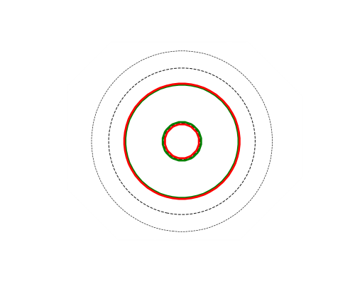
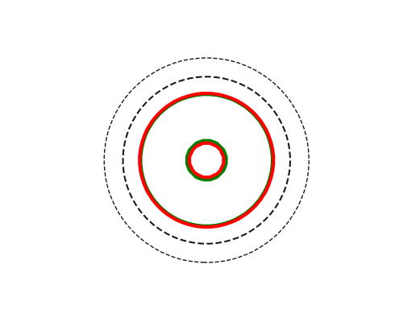
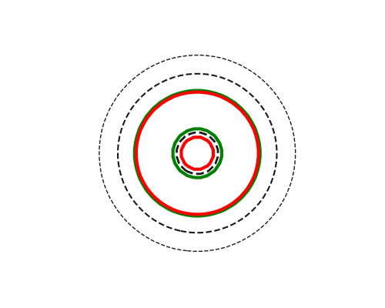
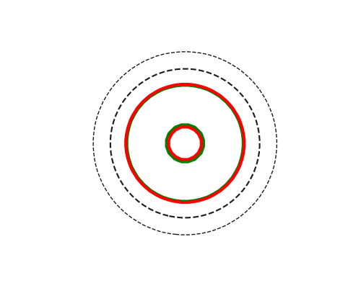
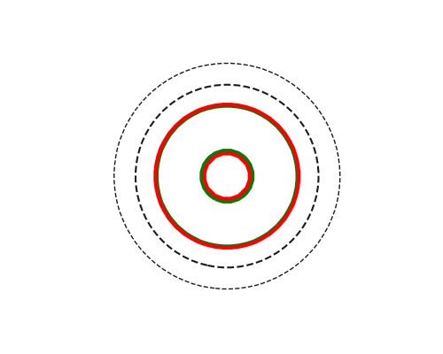
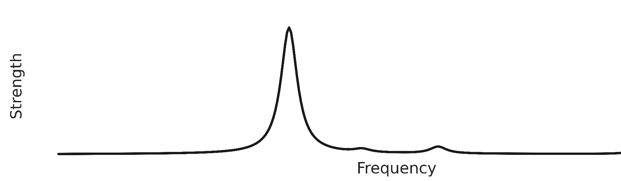
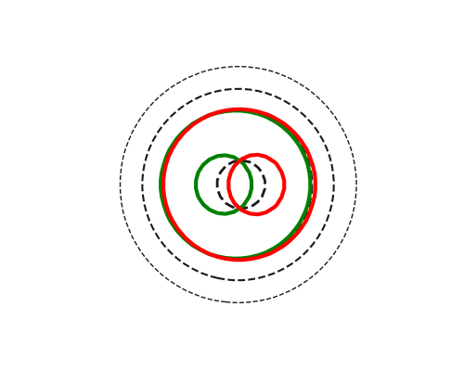
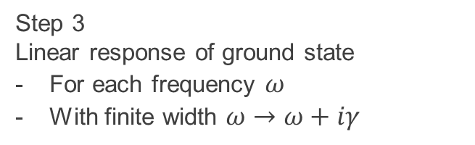
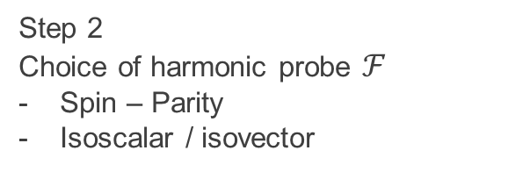
Illustration of QRPA –FAM in a spherical nucleus
Step 1
Modelisation of ground state
HFB mean-field
Step 2
Choice of harmonic probe $ℱ$
Spin – Parity
Isoscalar / isovector
Step 3
Linear response of ground state
For each frequency $ω$
With finite width $ω→ω+iγ$
O16
Isoscalar monopole
« Breathing mode »
Other possible probes
Isovector monopole
Low frequency
Discrete states
Individual excitations
High frequency
Leaving validity domain
Isovector dipole
Giant resonance
Collective excitation

Slide 12
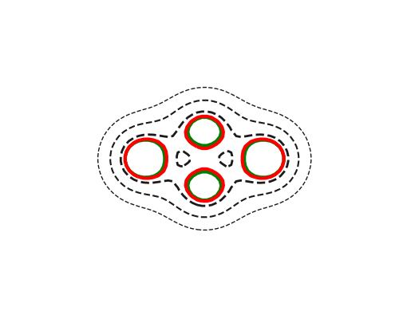
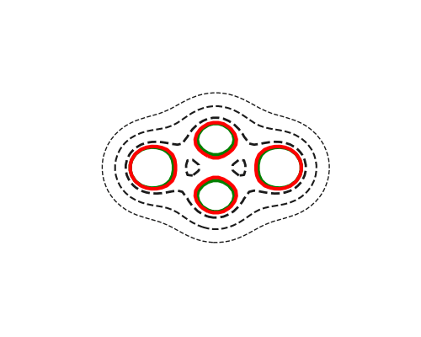
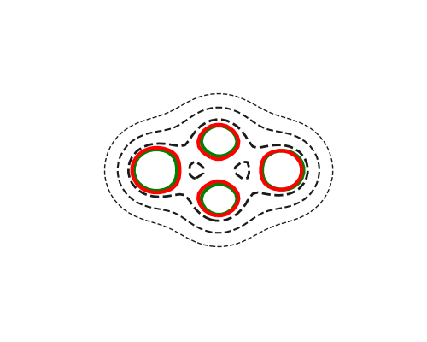

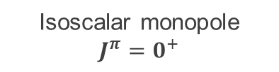



QRPA-FAM in deformed nuclei : illustration in neon 20
Clusterisation : α+C12+α
Open shell nuclei better described by symmetry broken mean-field
Breaking symmetries allows to include static correlations
  Deformation : multi-particle multi-hole
  Particle number : superfluidity
O16+ α observed
PGCM
Experiment
Isoscalar monopole
$$J^{π}=0^{+}$$
Isovector dipole
$$J^{π}=1^{−}$$
Isoscalar quadrupole
$$J^{π}=2^{+}$$
Isoscalar octupole
$$J^{π}=3^{−}$$
Frosini et al.
EPJA 58,4,64 (2022)
Symmetry breaking
Coupling between modes

Slide 13
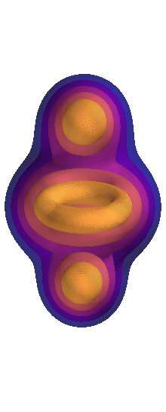
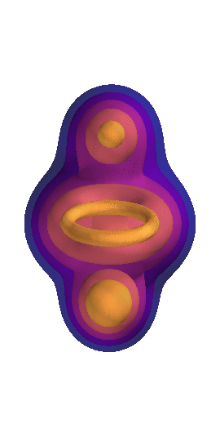
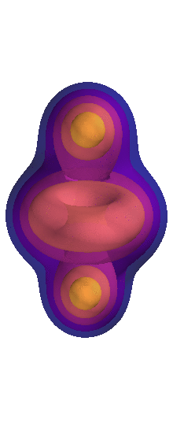
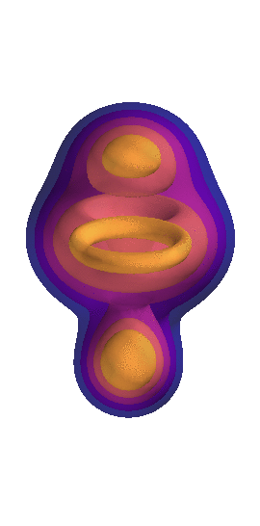
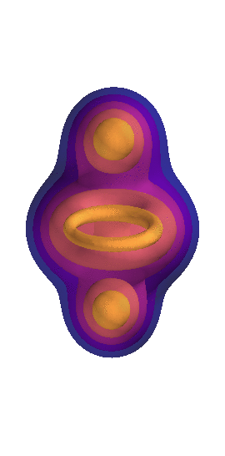
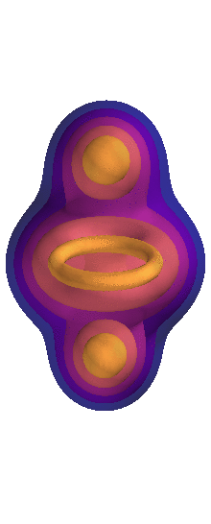
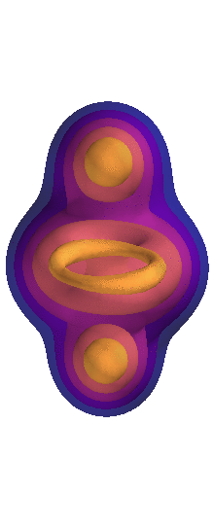
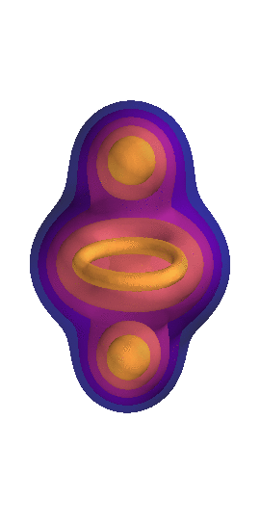










QRPA-FAM in deformed nuclei : illustration in neon 20
Clusterisation : α+C12+α
Open shell nuclei better described by symmetry broken mean-field
Breaking symmetries allows to include static correlations
  Deformation : multi-particle multi-hole
  Particle number : superfluidity
O16+ α observed
PGCM
Experiment
Isoscalar monopole
$$J^{π}=0^{+}$$
Isovector dipole
$$J^{π}=1^{−}$$
Isoscalar quadrupole
$$J^{π}=2^{+}$$
Isoscalar octupole
$$J^{π}=3^{−}$$
$$K^{π}=0^{+}$$
$$K^{π}=0^{−}$$
$$K^{π}=0^{+}$$
$$K^{π}=0^{−}$$
Frosini et al.
EPJA 58,4,64 (2022)
$$K^{π}=1^{−}$$
$$K^{π}=1^{+}$$
$$K^{π}=1^{−}$$
Symmetry breaking
Coupling between modes
Degeneneracy removal
Spurious mode admixture
$$K^{π}=2^{+}$$
$$K^{π}=2^{−}$$
Obvious limitation
Vibrational modes with good symmetries?
Projected QRPA [Federschmidt, Ring, NPA (1985)]
Towards PQFAM? [A. Porro, PhD thesis, CEA Saclay]
$$K^{π}=3^{−}$$
C12 (3 α) + 2 α ?
To be investigated

Slide 14
Outline
A few words on QRPA-FAM formalism
  Nuclear many-body problem
  QRPA formalism
  Illustration of the Finite Amplitude Method
Sources of errors and uncertainty quantifications
  Interaction uncertainties
  Many-body truncations
Preliminary results
  Validating QRPA with ab initio interactions
  Finite temperature and desexcitation
  Effect of triaxiality for E1 resonances
  First steps towards odd nuclei
Going beyond QRPA with PGCM

Slide 15
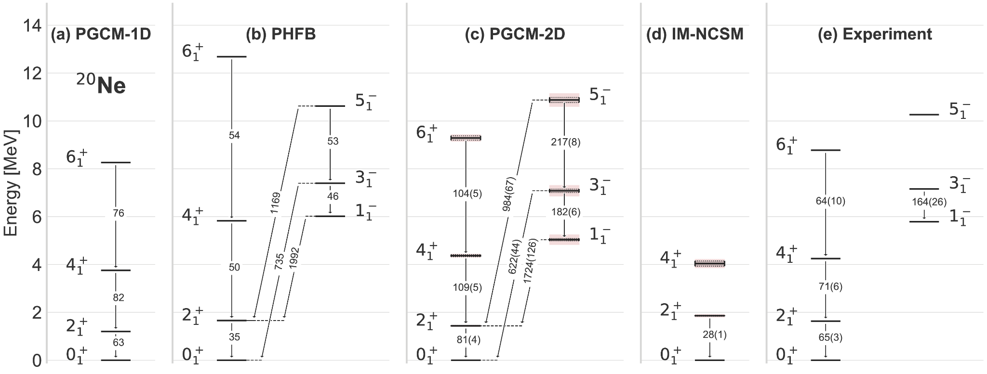
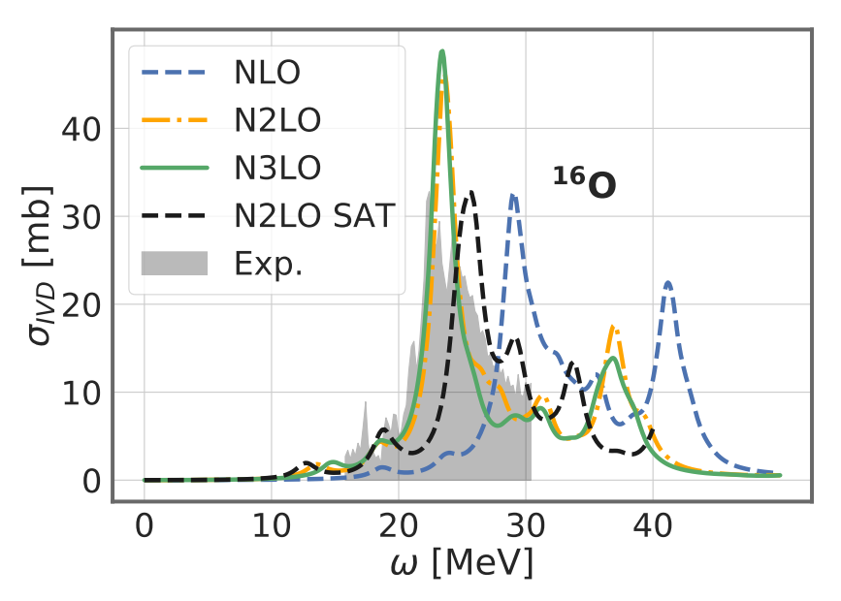
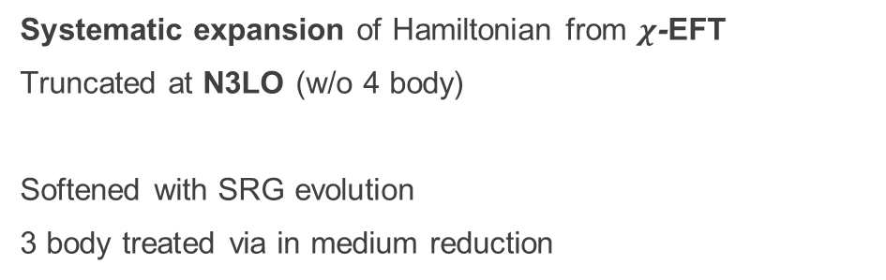
Expected quality of HFB-QRPA in ab initio I – Interaction
Chiral expansion and error estimation
Errors under control?
Systematic expansion of Hamiltonian from $χ$-EFT
Truncated at N3LO (w/o 4 body)
Softened with SRG evolution
3 body treated via in medium reduction
Systematic : Convergence between N2LO and N3LO
Statistic: LECs determination (not evaluated yet in this work)
[Hühter et al Phys.Lett.B 808 (2020) 135651]
Subleading
What about many-body?
[Frosini et al EPJA 54, 4, 151 (2021)]
Shown to be lower then 2-3 %

Slide 16
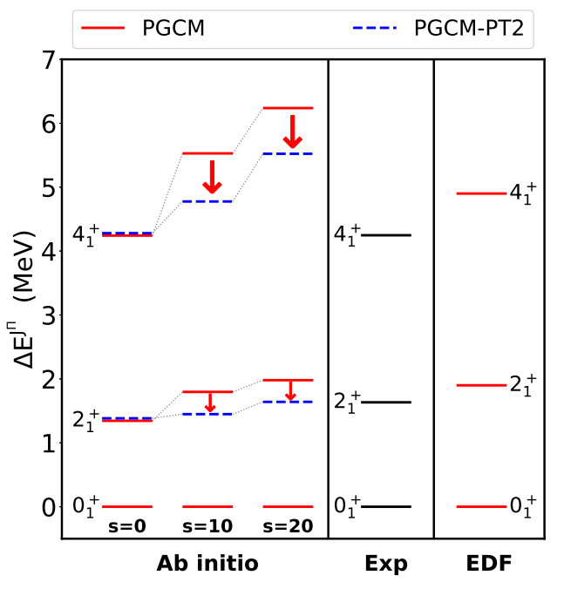
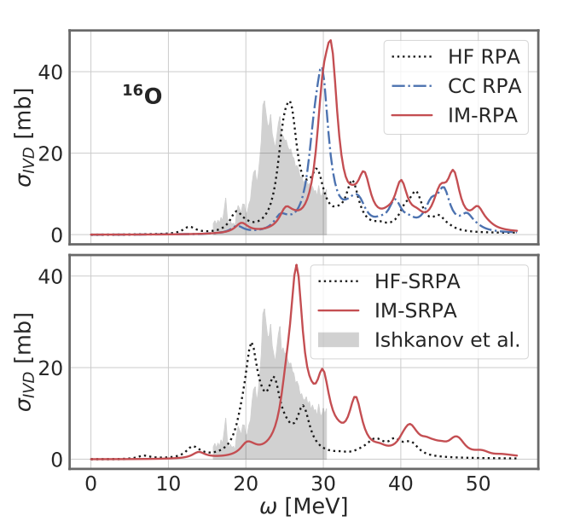
Expected quality of HFB-QRPA in ab initio II – Many-body
1. Model space truncation (under control)
2. Many-body expansion
HFB + 1p1h very crude
Why should it work at all?
Including correlations to the ground state
CC, IMSRG ➔ non perturbative dynamical correlations
Systematically shifting spectroscopy to the right
Including correlations to excited states
SRPA ➔ enlarging space to 2p-2h
Systematically shifting strength to the left
Cancellations between complementary missing effects
Beaujeault-Taudière et al. (2022), arXiv 2203.13513
In Energy Density Functional
EDF incorporates ground state correlations by default
  QRPA strength "already" shifted right
  SRPA should shift if left
Phenomenological corrections included a posteriori
Confirmed by other approaches
Duguet et al. (2022), arXiv 2209.03424

Slide 17
Outline
A few words on QRPA-FAM formalism
  Nuclear many-body problem
  QRPA formalism
  Illustration of the Finite Amplitude Method
Sources of errors and uncertainty quantifications
  Interaction uncertainties
  Many-body truncations
Preliminary results
  Validating QRPA with ab initio interactions
  Finite temperature and desexcitation
  Effect of triaxiality for E1 resonances
  First steps towards odd nuclei
Going beyond QRPA with PGCM

Slide 18
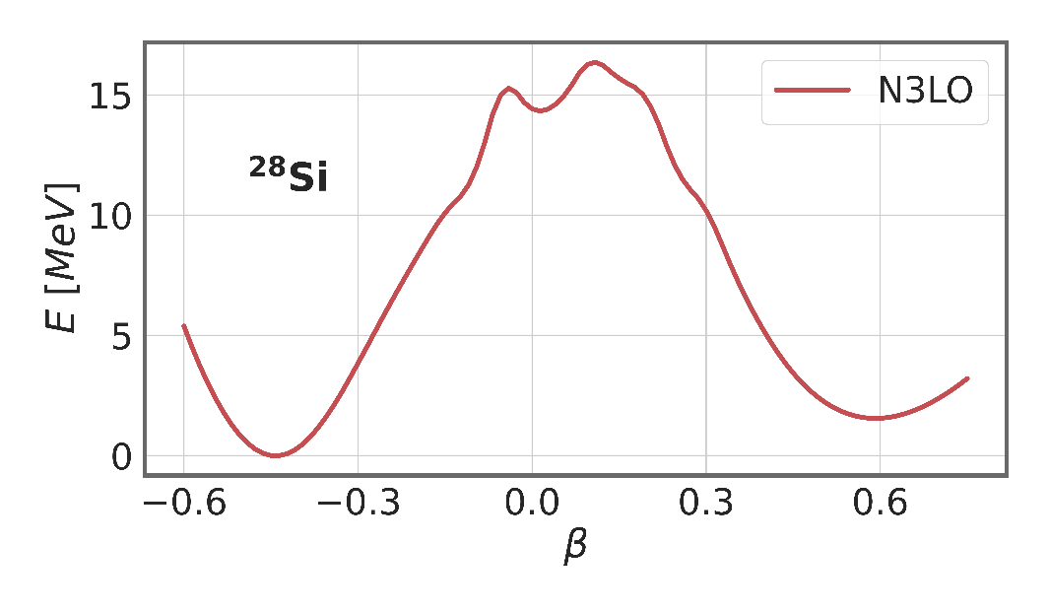
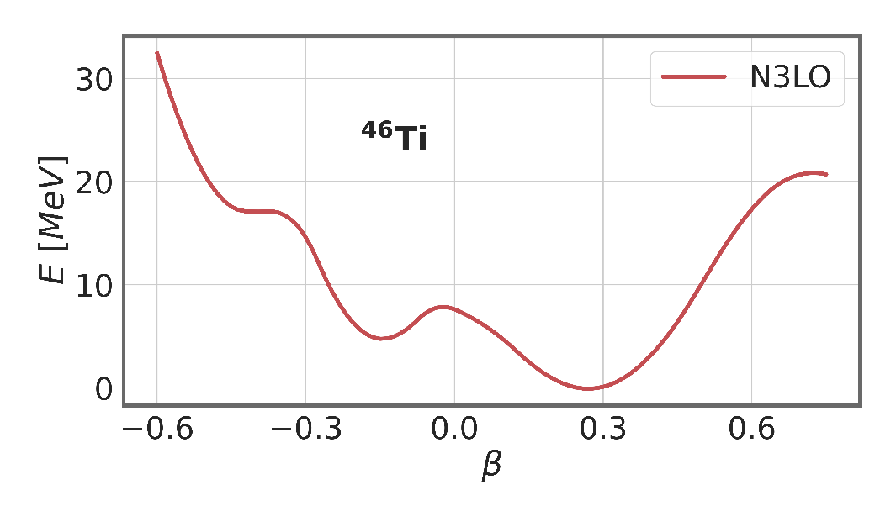
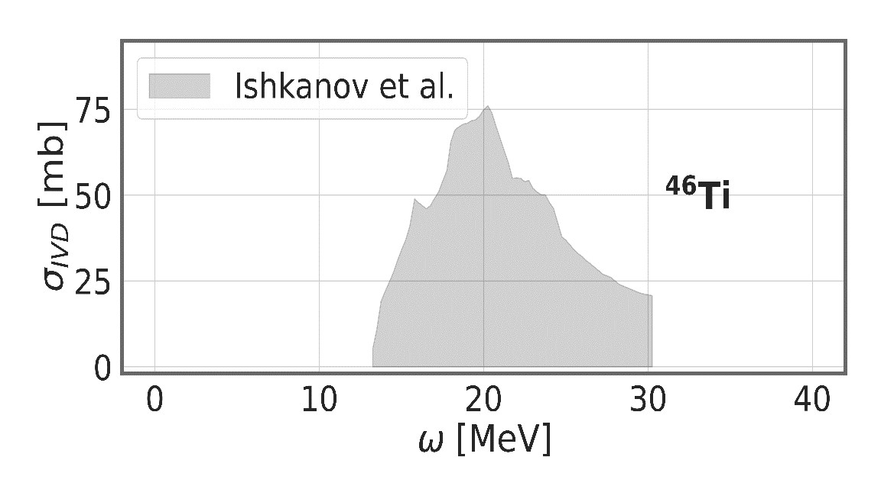
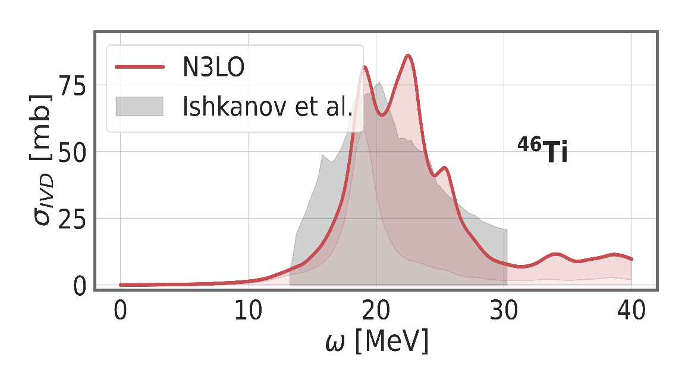


Validating ab initio axial QRPA-FAM to E1 response in medium-mass systems
First application to superfluid + deformed nuclei with ab initio interactions
Interaction consistently derived from first principles at N3LO [R. Roth]
Mean-field solved in harmonic oscillator basis
Mean-field breaks rotational symmetry
Prolate Ti46 with small anharmonicities
Deformations compatible with Energy Density Functional predictions
« Harder » ab initio surface : less correlations
Good reproduction of GDR
QRPA profile strongly depends on deformation
Oblate Si28 with double well
QRPA-FAM explores only oblate well
  Coupling between wells introduced in other theories
Good position of the main peak

Slide 19


Systematic calculations of isotopic chains
Chiral N3LO
[Hühter et al Phys.Lett.B 808 (2020) 135651]
EM 1.8/2.0
[K. Hebeler et al. Phys. Rev. C 83, 031301(R) (2011)]
Missing intruder state
Need for benchmark with other interactions / methods
Cf. Kamila Sieja study of Neon chain
Cf. Sonia Bacca study of O22
But « fair » comparison needed
  Same interaction / different models
  Same models / different interactions
Motivation for our ongoing developments
Low energy modes
in neutron rich
N=Z clusterization
A unique access to spectroscopic properties of all nuclei
Ab initio interactions
Fitted in light systems
Tested in (singly) closed shells
Energy Density Functional
Could spectroscopy be used for the fit?
Generation of resonance database
Evolution accross isotopic chains
Low energy strength at play in reactions
Towards publicly available spectrosopy predictions
As a function of the interaction, chiral order
Sensitivity analysis to the parametrisation [A. Roux]
Only valence space spectroscopy

Slide 20


Comparing uncomparable results
Shell model calculation (Kamila Sieja)
QRPA + N3LO calculation
Similarities, differences: no way to interpret !
Wrong structure of reference state?
Missing high order many-body? Anarmonicities?
Interaction artifacts? Which interaction?
Is this difference nucleus dependent?
Only way to answer:
Run QRPA with same interaction
Run beyond QRPA with both interaction

Slide 21


Low energy strength and inverse sum rule
Dipole polarizability (I. Brandherm presentation)
Predictions in open-shell nuclei
Tend to follow the trend
Careful with log-log scale
Comparisons of error bars?
To be investigated in more details…
And beyond QRPA
Ti46
Fe56
Si28

Slide 22

Finite temperature… and unanswered questions
Finite temperature
QRPA-FAM naturally builds on top of statistical reference state
Finite temperature with Boltzmann weights → excited state
Equal filling approximation for odd nuclei
Objective : desexcitation
Desexcitation spectrum → detailed balance
Wibowo et al. (2019), PRC 100, 024307
$$S^{∗}\left(E\right)=\frac{1}{1−e^{−\frac{E}{T}}}S(E)$$
Low energy up-bend not reproduced
Missing low energy poles?
Higher multipolarities?
Higher order correlations?
Interaction?
Excitation energy significantly affects GDR
From deformed to spherical mean-field
Shifting towards low energy
Welcoming feedback

Slide 23





Generalizing to triaxial systems : preliminary results
Light systems and triaxiality
Axial shape approximation is accurate in most of large systems
But not so much in lighter systems
Cluster configurations in ground and excited states
Island of deformation around magnesium
Model space can be reduced and complexity increased!
Influence on the QRPA-FAM strength functions
Good qualitative description of axial D1M
Axial calculation with chiral interaction
Good localization of the two main peaks
Missing hierarchy between two peaks
Triaxiality corrects for this effect (subleading correction)
Very encouraging results to be confirmed in other systems!

Slide 24









QRPA-FAM in odd systems : very preliminary results and questions
Odd nuclei make ¾ of systems… and play as much role as even-even (in neutron capture at least)
In principle, same story
Blocked HFB state
EFA
Axial blocking
Triaxial blocking
Statistical QRPA-FAM (like FT)
Exchange a column in U and V
Linearised TD-HFB+blocking
Does not tell you which K to block…
All approximations of prolate Al27 are consistent…
… but show wrong strength profile
Triaxiality does not help (only midly triaxial at HFB level)
Oblate vacuum much closer to experiment
Luck ? Misled by interaction? False interpretation?
Need for better understanding + beyond QRPA to decide
Constrainting experimental data ?

Slide 25
Outline
A few words on QRPA-FAM formalism
  Nuclear many-body problem
  QRPA formalism
  Illustration of the Finite Amplitude Method
Sources of errors and uncertainty quantifications
  Interaction uncertainties
  Many-body truncations
Preliminary results
  Validating QRPA with ab initio interactions
  Finite temperature and desexcitation
  Effect of triaxiality for E1 resonances
  First steps towards odd nuclei
Going beyond QRPA with PGCM

Slide 26






Beyond the harmonic approximation with PGCM
Generator Coordinate Method
QRPA
$$\left|Ψ_{ν}> =∫dq f_{ν}\left(q\right)\right|Φ\left(q\right)>$$
$$\left|Ψ_{ν}> =Q_{ν}^{+ } \right|Φ\left(q\right)>$$
Shape (and orientation) mixing
2qp elementary excitations
Courtesy of A. Porro
Anarmonicities & shape coexistence
Selected coordinates
Computationally expensive
Harmonic limit of exact PGCM
All coordinates explored
Low computational cost
Next step : apply PGCM to E1 resonances
Need to break parity
Need for triaxiality to get all the strength (especially for oblate nuclei)
  Expensive AMP restoration
  Can AMP be avoided as in QRPA?
  What are the right coordinates?
    To be continued…
Not without projection !
Ongoing study of monopole resonances
PGCM performed on $q≡\left(Q^{20},r^{2},β,φ_{N},φ_{Z}\right)$
Compared to axial QRPA and experiment
PGCM found superior to QRPA
Better position of the main peak
Small structures not appearing in QRPA
Envisioned improvement: double projection
Porro et al. (2022), in preparation

Slide 27
Conclusion and perspectives
First extension of QRPA-FAM to open-shells with ab initio interactions
Access to new observables and in particular E1 resonances
Very cheap method with results in good agreement with experimental data
First impression : shift not needed, broadening needed
Towards systematic study in the range of validity of the theory
Beyond QRPA approaches under investigation
  PGCM (ongoing), TD-HFB (thesis starting next year), PGCM-PT (starting next year)
Testing ground for interactions
  Ab Initio (already present), Gogny D1 (almost ready), Gogny 3-body (hopefully soon)
Need for experimental feedback to know what to look at…
  Systematics on open-shells could help discriminate between theoretical approaches / interactions
  Comparing apples to apples (and no pears / oranges / bananas)
Investigation of new physics and new systems
Triaxiality for medium mass clustered nuclei
Odd nuclei (QRPA in EFA, axial blocking, triaxial blocking)
Restoration of symmetries and anharmonicities (PGCM)
Work in progress on desexcitation and finite temperature

Slide 28


Thanks for your attention
Thomas Duguet
Vittorio Somà
Benjamin Bally
Andrea Porro
Alberto Scalesi
Gianluca Stelini
Jean-Paul Ebran
Yann Beaujeault-Taudière
Noël Dubray
Antoine Roux
Rémi Bernard
Gilles Noguerre
Alessandro Pastore
Pierre Tamagno
Robert Roth

Slide 29

PGCM in O16

