Slide 1


TMDs. From Jlab to the EIC
Trento
20+5
Anselm Vossen
Research supported by the

Slide 2
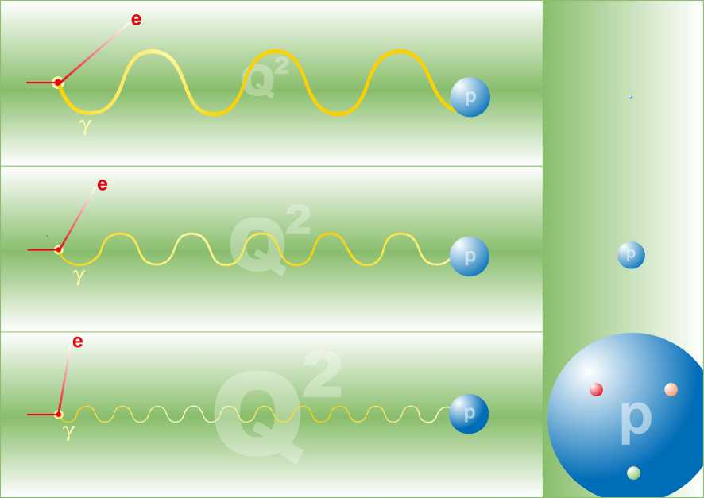
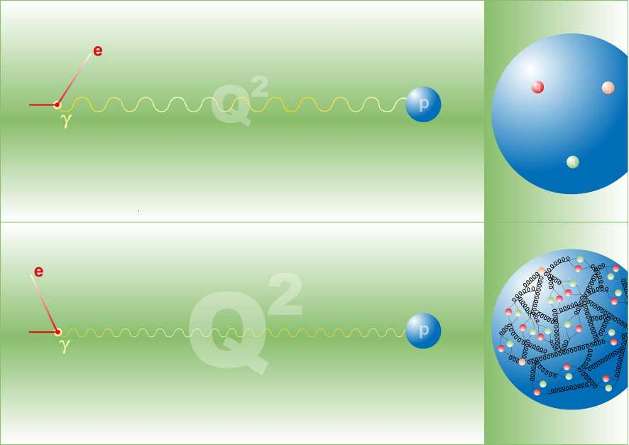
From Jlab to the EIC
Valence Quarks
To extract 3D structure
Need luminosity
Exposure
Glue and sea-quarks
wavelength

Slide 3
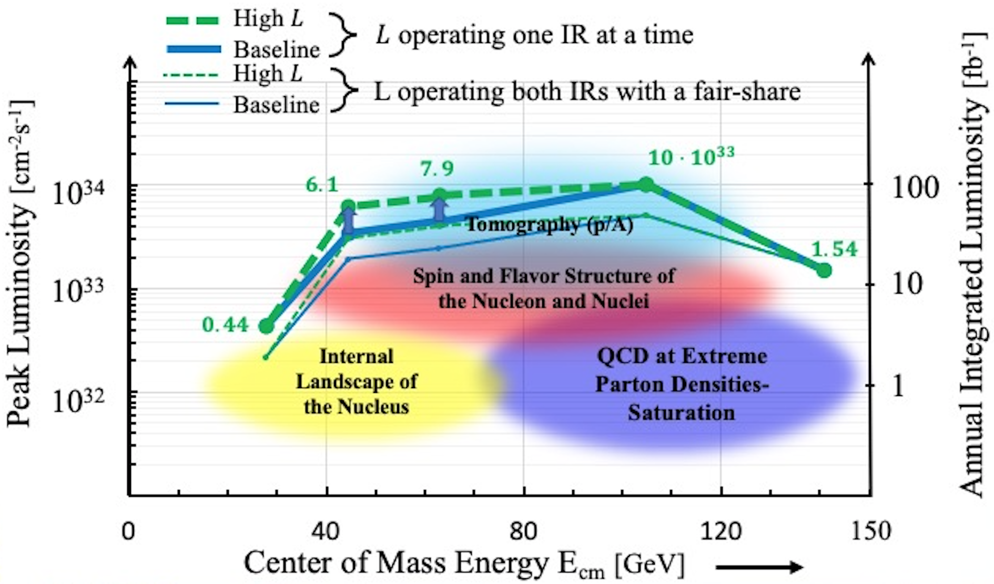
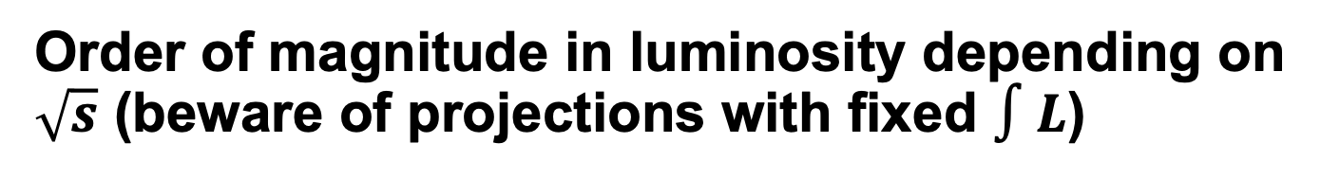
Order of magnitude in luminosity depending on $\sqrt{s}$ (beware of projections with fixed $∫L$)

Slide 4
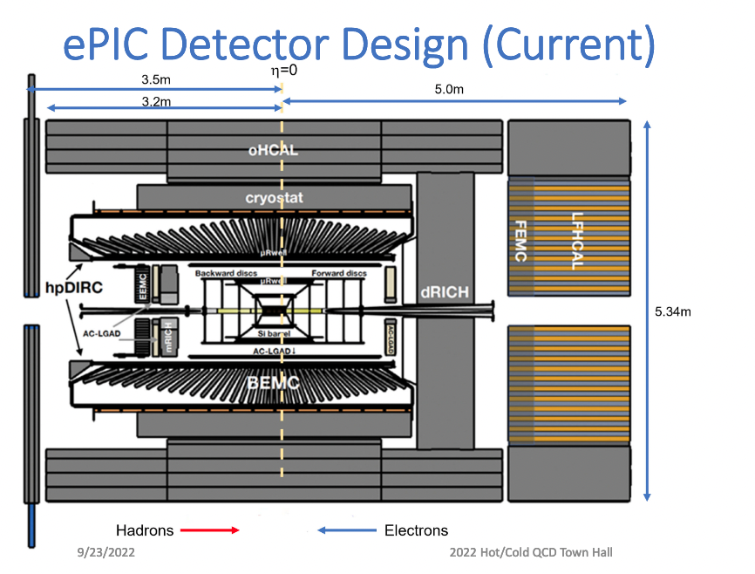
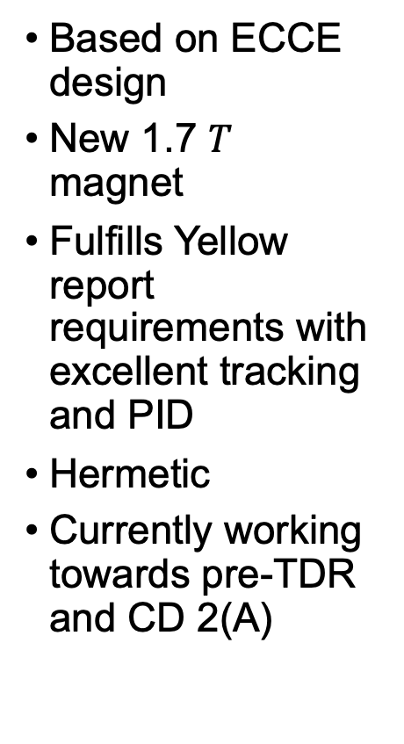
EIC Project Detector
Based on ECCE design
New 1.7 $T$ magnet
Fulfills Yellow report requirements with excellent tracking and PID
Hermetic
Currently working towards pre-TDR and CD 2(A)
J. Lajoie

Slide 5
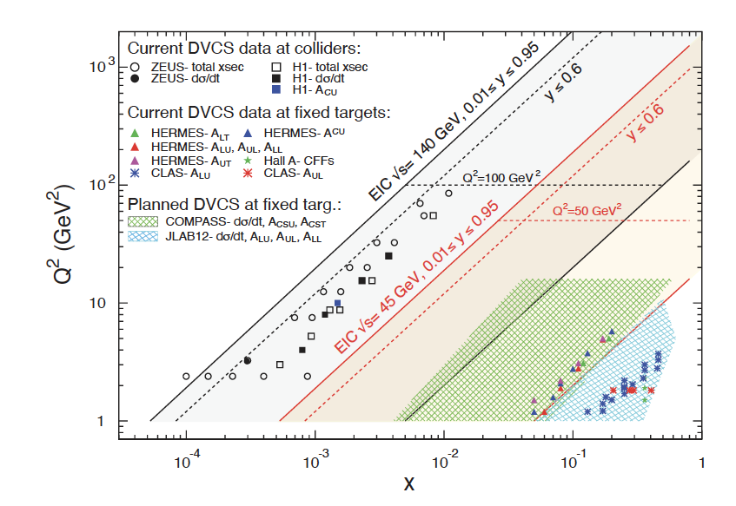
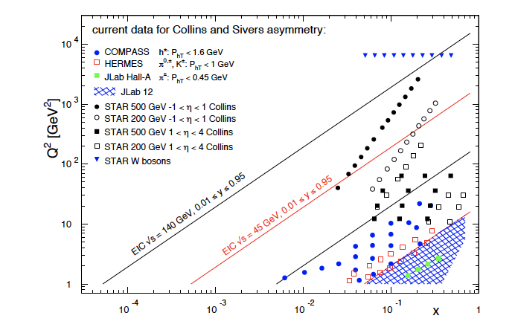
TMD physics at an EIC: Coverage
Common theme on EIC impact
  Extended kinematic coverage and precision, along with polarization
  and possible beam charge degrees of freedom allow multi-pronged approach →needed to extract multidimensional objects
  TMD factorization is valid
Large $Q^{2}$ lever arm: probe evolution, disentangle contributions to $σ$
Coverage to low $x:$ access sea and gluon distributions

Slide 6
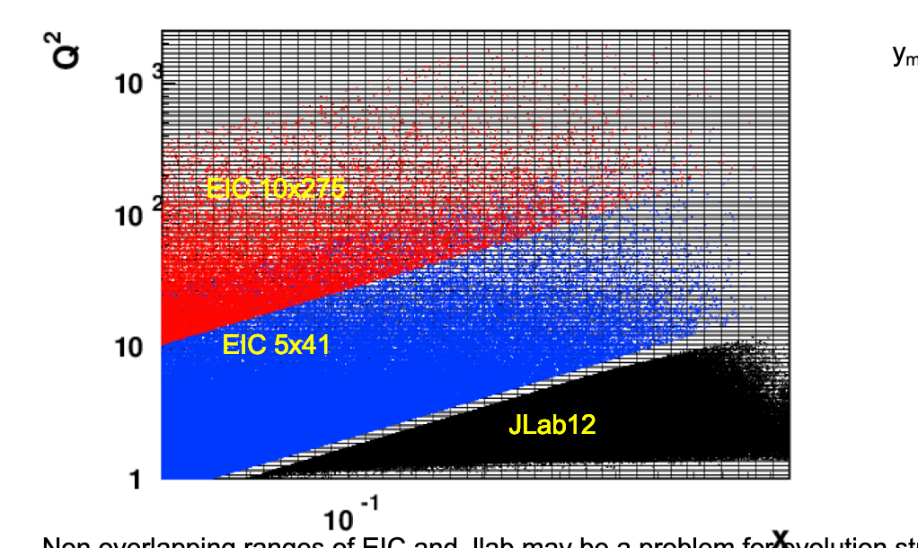
Big picture: Kinematics low/high sqrtS
y>0.025
From H. Avakian

Slide 7
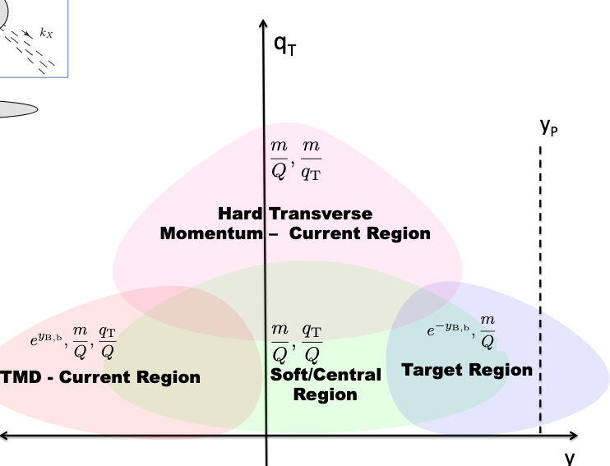
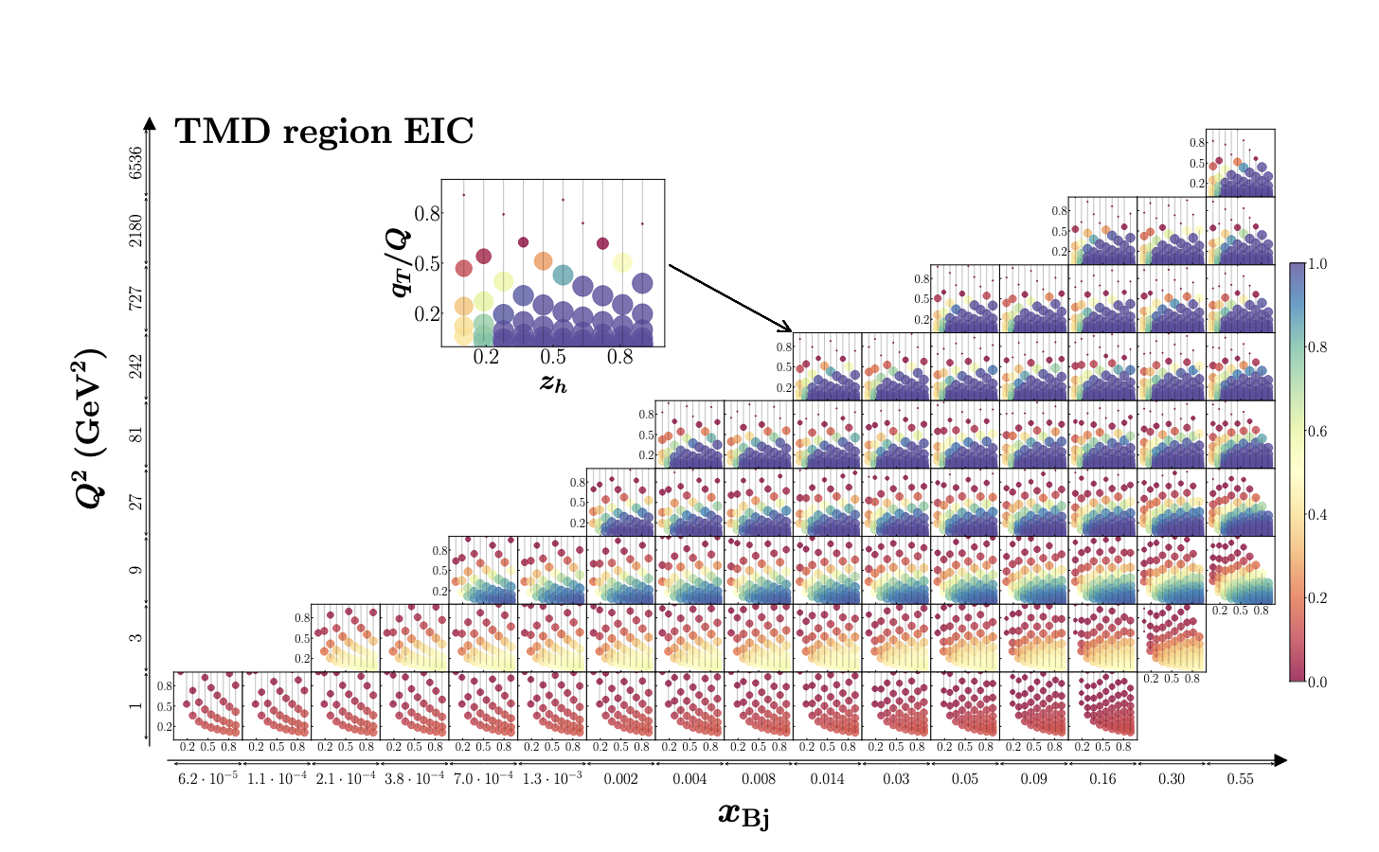
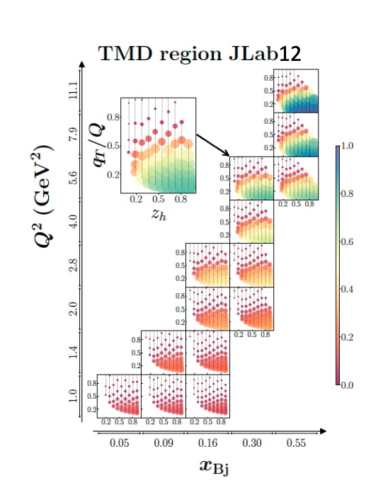
Applicability of TMD Framework
JHEP 04 (2022) 084
EIC also larger, overlapping phase space for colinear and matching region
Less correction from TMD expectations framework
  →Challenges and opportunities at JLab

Slide 8
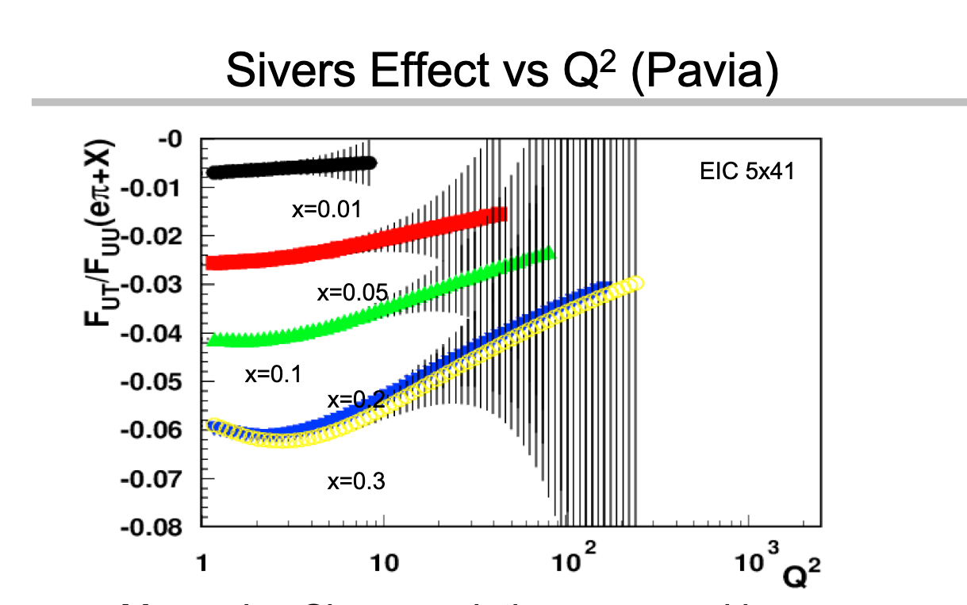


Expected TMD signal →$Q^{2}$dependence
Evolution doesn’t quite cancel.
Also confirmed by STAR W results
➔TMDs might give largest signal at low y
➔Evolution effects best measured at large x, low y, wide range of $Q^{2}$
From A Signori by way of Harut

Slide 9
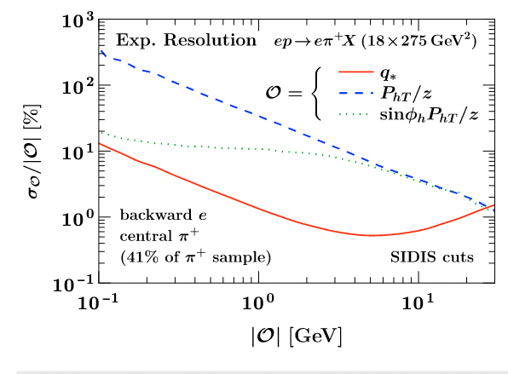

Progress in kinematic reconstruction
ML Method using
full hadronic final state
Connor Pecar, Duke
arXiv:2209.14489
Reconstruction of relevant TMD quantities
in the lab frame
Gao, Michel, Stewart, Sun [2209.1121]
$$q^{∗}=−\sin{φ_{h}P_{hT}/z}$$

Slide 10
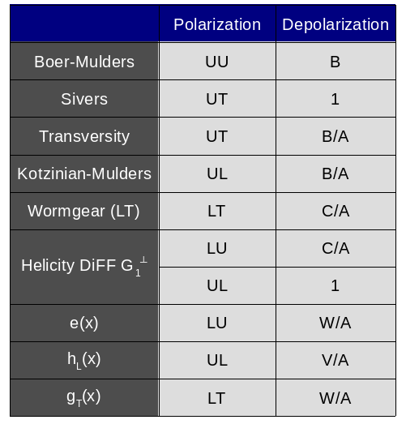
Depolarization Factors
Twist 2
Twist 3
Slide from C. Dilks

Slide 11
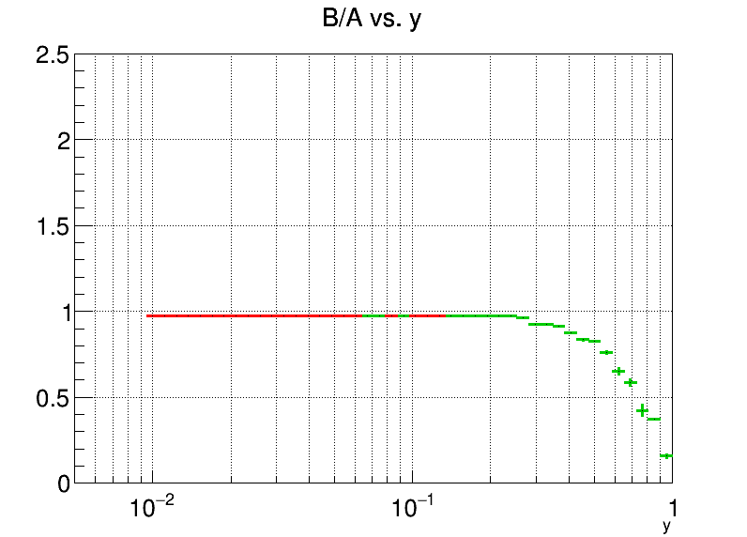
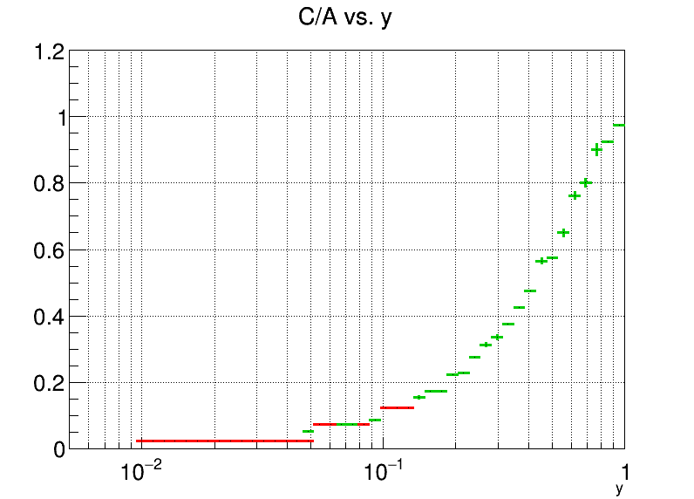
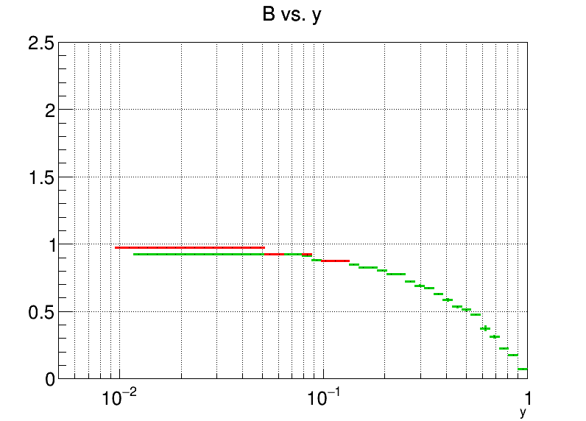
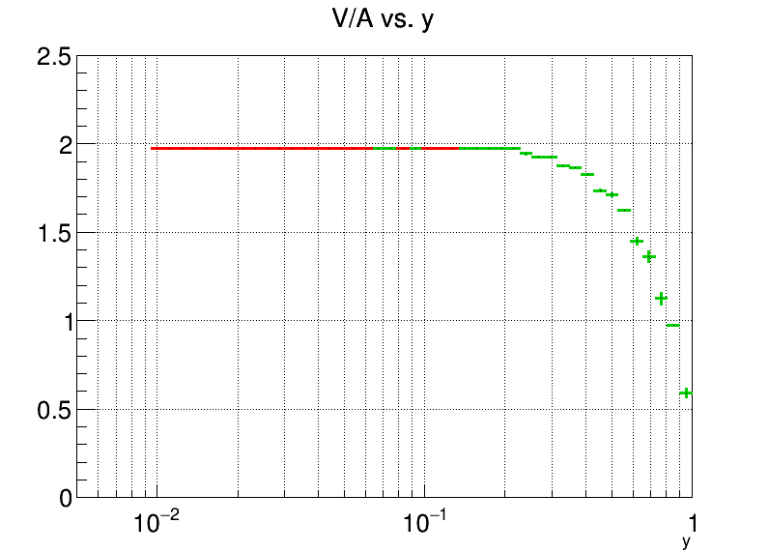
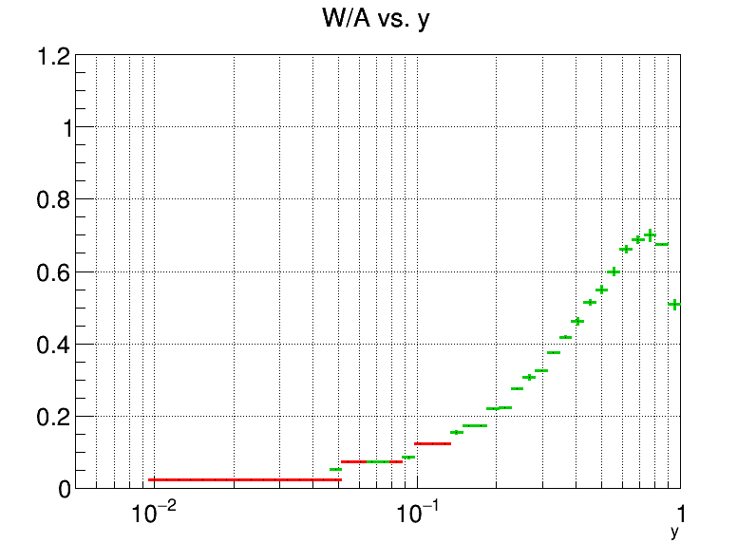





Depolarization factors for some TMDs are suppressed at EIC kinematics
Wormgear,
Kotzinian-Mulders
transversity
Wormgear, $G_{1}^{⊥}$
5x41
18x275
Longitudinal polarized $e^{−}$
Boer Mulders
$$e\left(x\right), g_{T}(x)$$
$$h_{L}$$
Longitudinal polarized $e^{−}$
EIC (Athena) Fast Simulation, C.Dilks, Duke

Slide 12
Depolarization Factors
Twist 2
More accessible at JLab
Twist 3
Slide from C. Dilks

Slide 13


Exemplary $A_{UT}$ measurement: transversity
Phys.Lett.B 816 (2021) 136255
10 $fb^{−1}$ at each energy
→impact
from IFF
Similar (backup)
Both, EIC and SoLID systematics limited→differences might be more articulated for more
exclusive final states

Slide 14
Example: transversity extraction from Jlab and the EIC
But careful with parametrization bias…
Phys.Lett.B 816 (2021) 136255

Slide 15
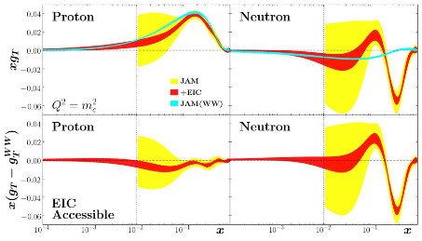

Access to twist3 $g_{T}$
JAM, Yellow Report

Slide 16
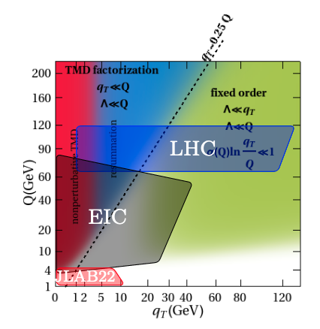
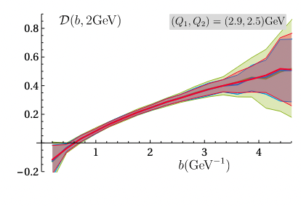
CS Kernel extraction
EIC
JLab20
A. Vladimirov APCTP Focus Program 7/20/22

Slide 17
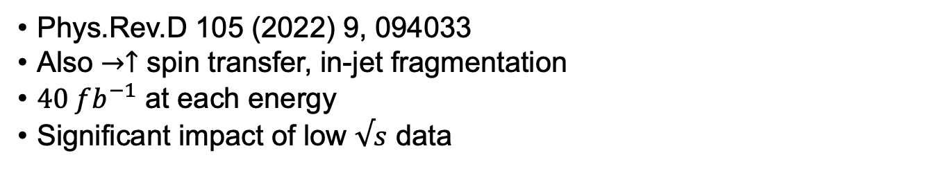

Precision $Λ$ physics at the EIC
Phys.Rev.D 105 (2022) 9, 094033
Also $→↑$ spin transfer, in-jet fragmentation
$40 fb^{−1}$ at each energy
Significant impact of low $√s$ data

Slide 18
Lambda feed-down composition vs JLab20
EIC
JLAB12, 20
Study by M. McEneaney(Duke)
JLab12 similar
Possible to unfold at the EIC (not so much at Jlab)
ML methods might help

Slide 19
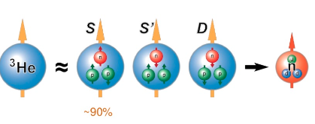
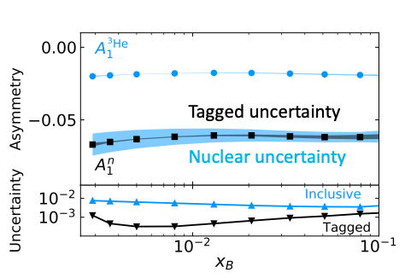
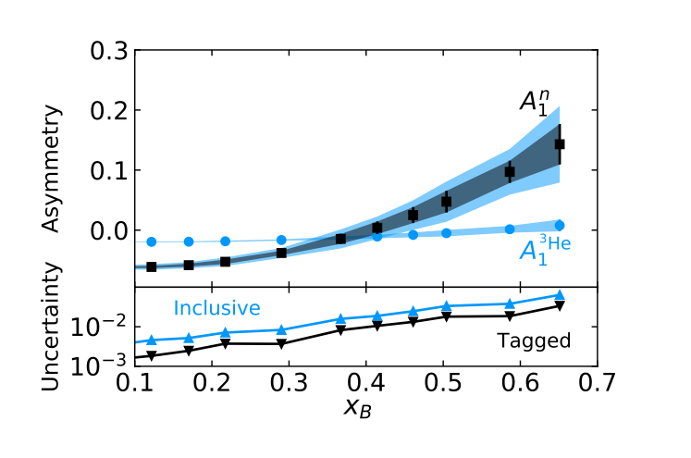

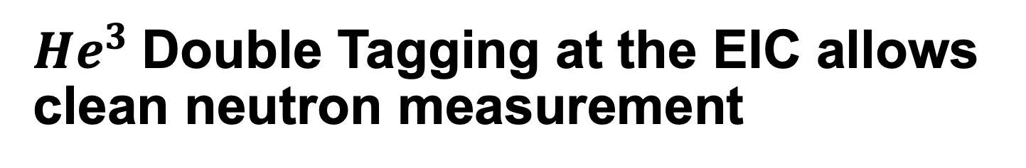
$He^{3}$Double Tagging at the EIC allows clean neutron measurement
Neutron is to $87\%$ polarized
Double tagged events thus
provide access to polarized
neutron beam
Reconstruction of initial neutron
momentum from tagged protons allows reduction of uncertainties
from nuclear corrections
Friščić, I, Nguyen, D, Pybus, JR, Jentsch et al

Slide 20
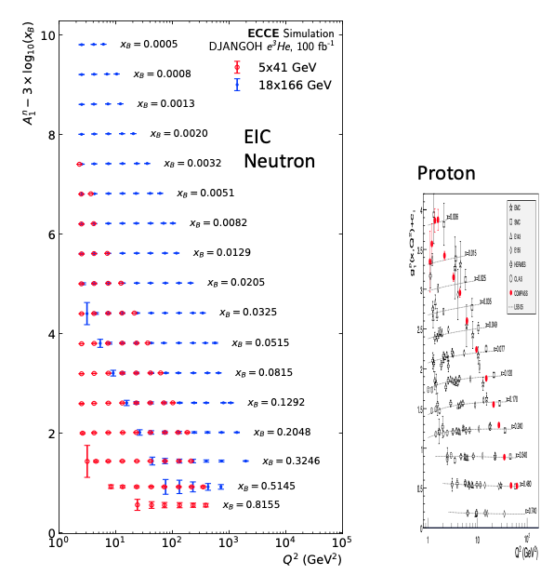
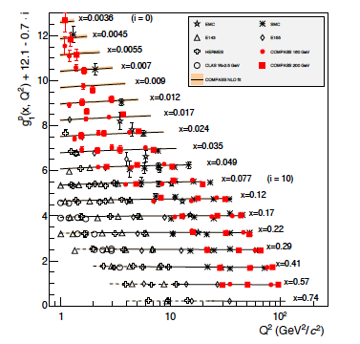

Projections for $A_{1}$
D. Nguyen@AGS User’s meeting 2022

Slide 21
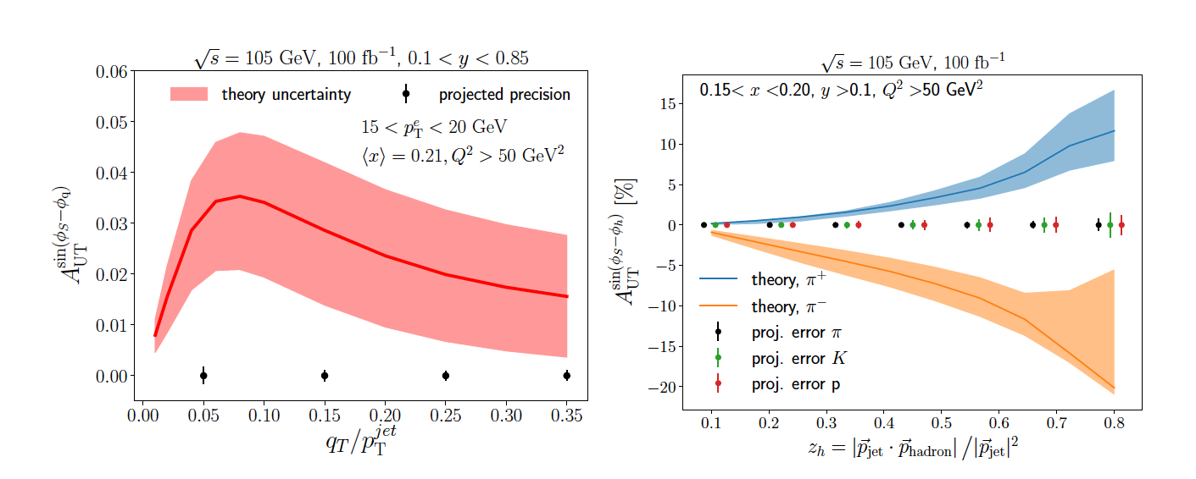
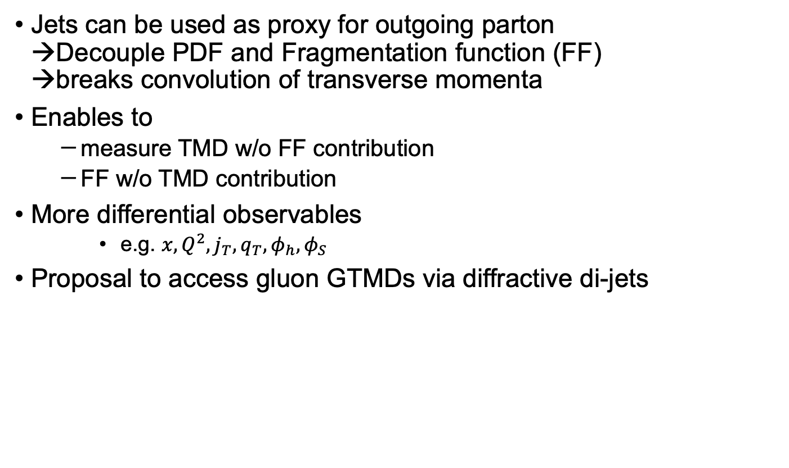
Accessing TMD PDFs and FFs with Jets
Jets can be used as proxy for outgoing parton
→Decouple PDF and Fragmentation function (FF)
→breaks convolution of transverse momenta
Enables to
  measure TMD w/o FF contribution
  FF w/o TMD contribution
More differential observables
    e.g. ${x,Q^{2},j}_{T}, q_{T},φ_{h},φ_{S}$
Proposal to access gluon GTMDs via diffractive di-jets
Phys.Rev.D 102 (2020) 7, 074015
Sivers asymmetry
Collins asymmetry

Slide 22

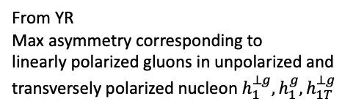
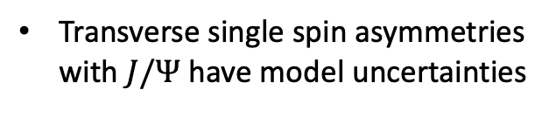
Gluon TMDs from $J/Ψ$ and di-jets
From YR
Max asymmetry corresponding to
linearly polarized gluons in unpolarized and
transversely polarized nucleon $h_{1}^{⊥g},h_{1}^{g},h_{1T}^{⊥g}$
From Yellow Report,
Study by L. Zhang, B. Xiao
Transverse single spin asymmetries
with $J/Ψ$ have model uncertainties

Slide 23
Energy-Energy Correlations
Precision calculations
Close connection to TMD framework
Yellow Report

Slide 24
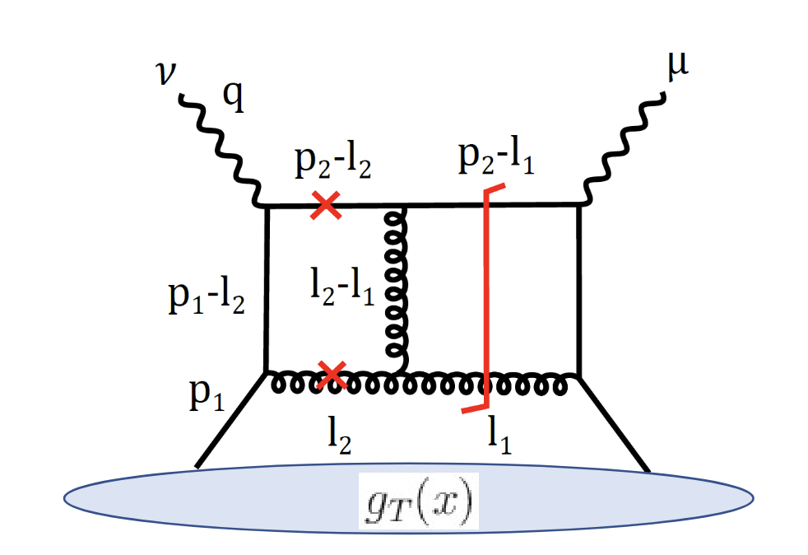
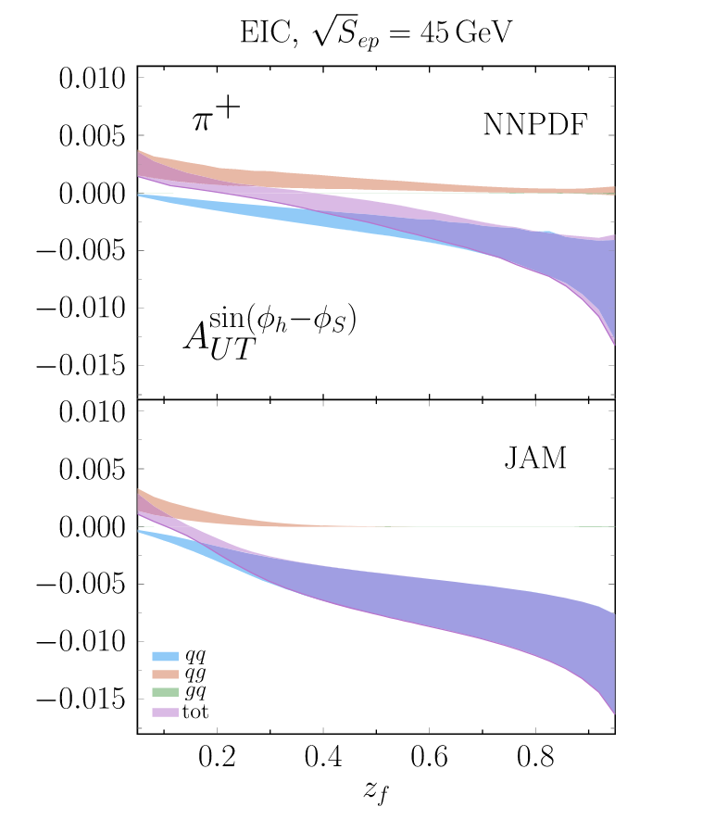
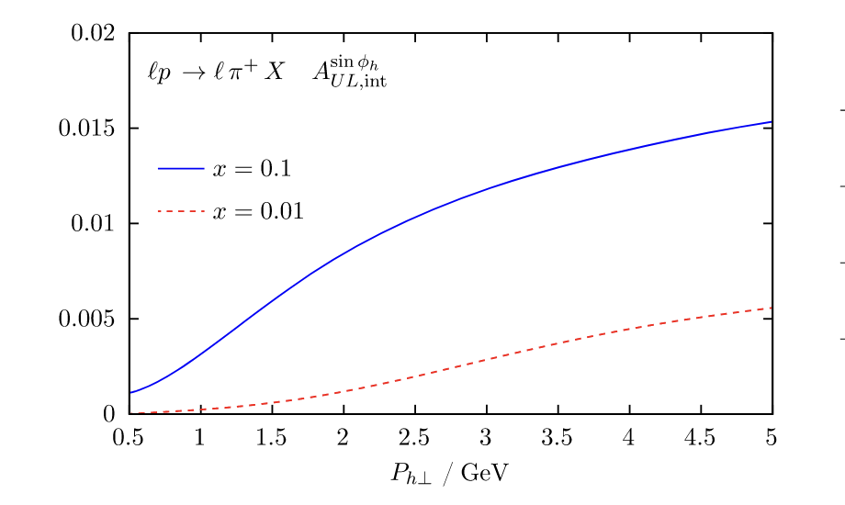

Appearance of perturbative asymmetries
Additionally: perturbative generation of asymmetries from $g_{T}$
What about di-hadron correlations?
Abele, Aicher, Piacenza, Schafer, Vogelsang (2022)
Benic et al. Phys. Rev. D 104, 094027

Slide 25
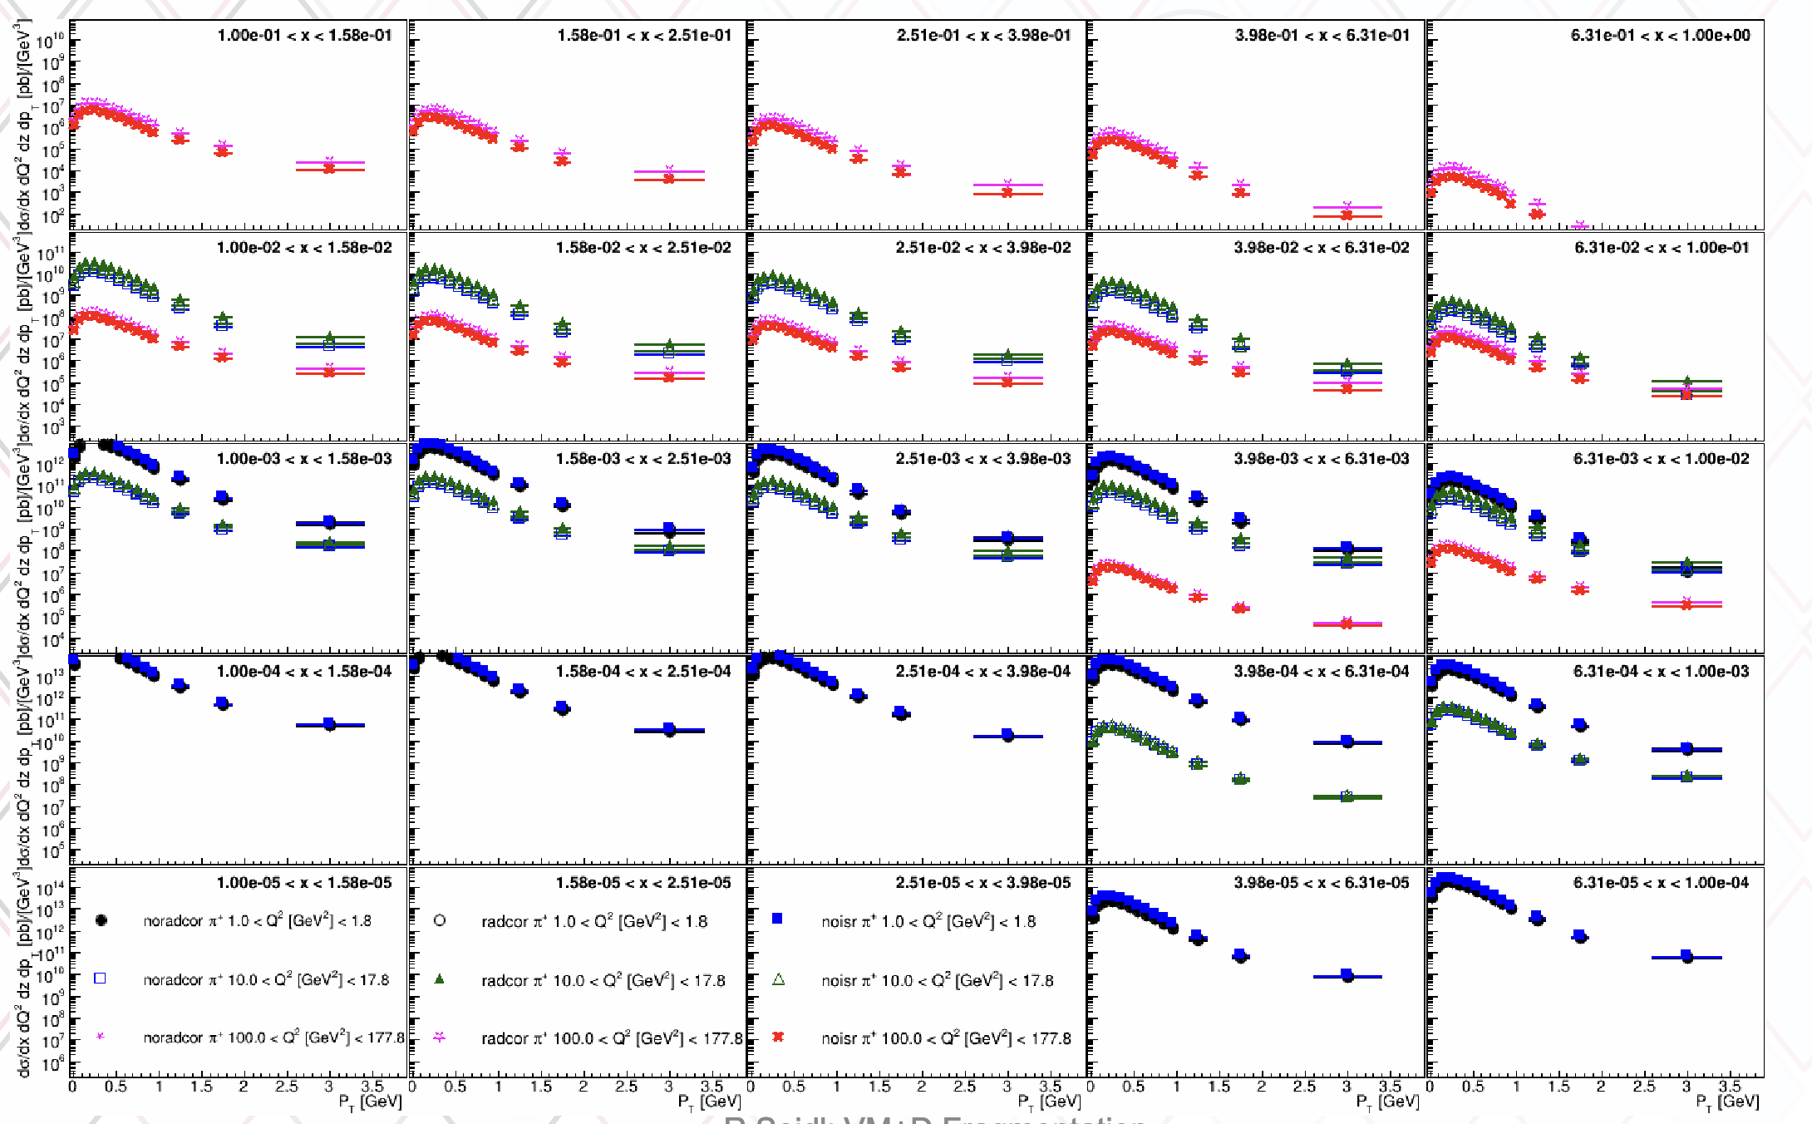
First glance at radiative effects
Simulations by R. Seidl
Radgen effect on cross-section
More detailed studies underway

Slide 26
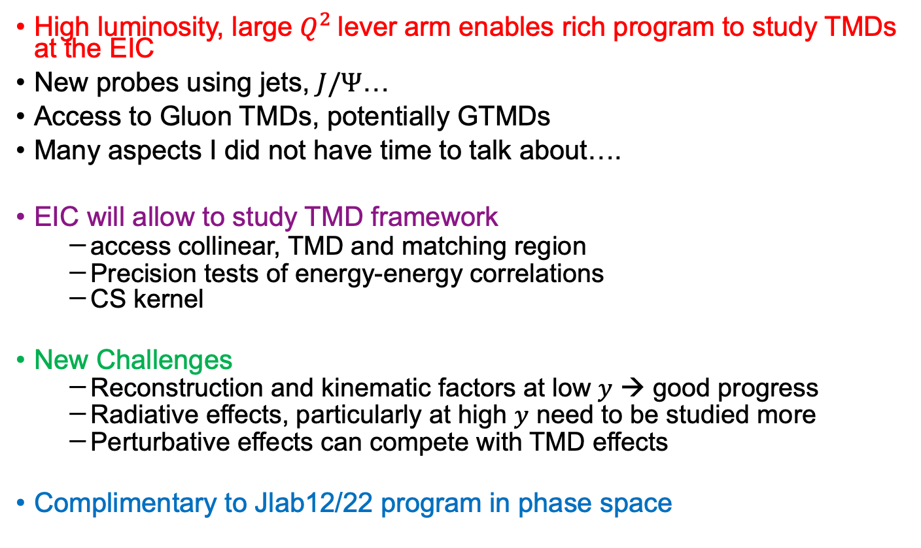
Summary and Conclusions
High luminosity, large $Q^{2}$lever arm enables rich program to study TMDs at the EIC
New probes using jets, $J/Ψ$…
Access to Gluon TMDs, potentially GTMDs
Many aspects I did not have time to talk about….
EIC will allow to study TMD framework
  access collinear, TMD and matching region
  Precision tests of energy-energy correlations
  CS kernel
New Challenges
  Reconstruction and kinematic factors at low $y$ → good progress
  Radiative effects, particularly at high $y$ need to be studied more
  Perturbative effects can compete with TMD effects
Complimentary to Jlab12/22 program in phase space

Slide 27

$10 fb^{−1}$ for each energy

Slide 29
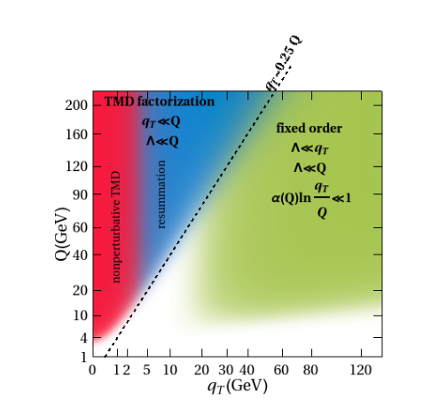

Slide 30
Impact from di-hadron measurements

Slide 31
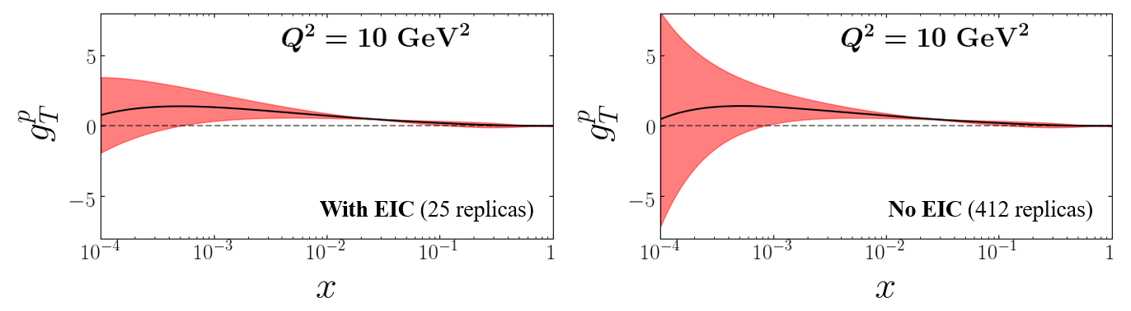

Slide 32
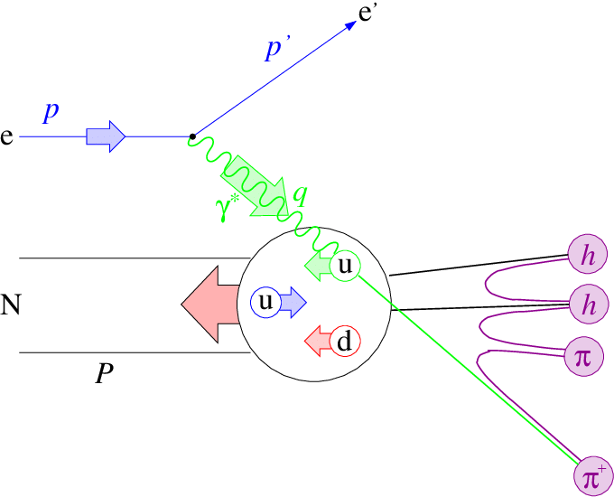
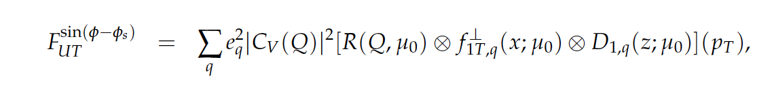
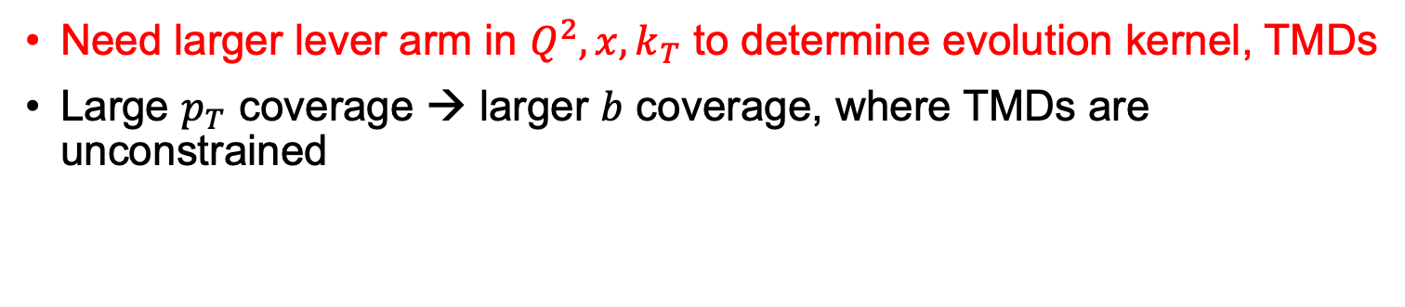
Evolution of TMDs
Evolution Kernel
TMD PDF
TMD FF
Need larger lever arm in $Q^{2}, x, k_{T}$ to determine evolution kernel, TMDs
Large $p_{T}$ coverage → larger $b$ coverage, where TMDs are unconstrained

Slide 33
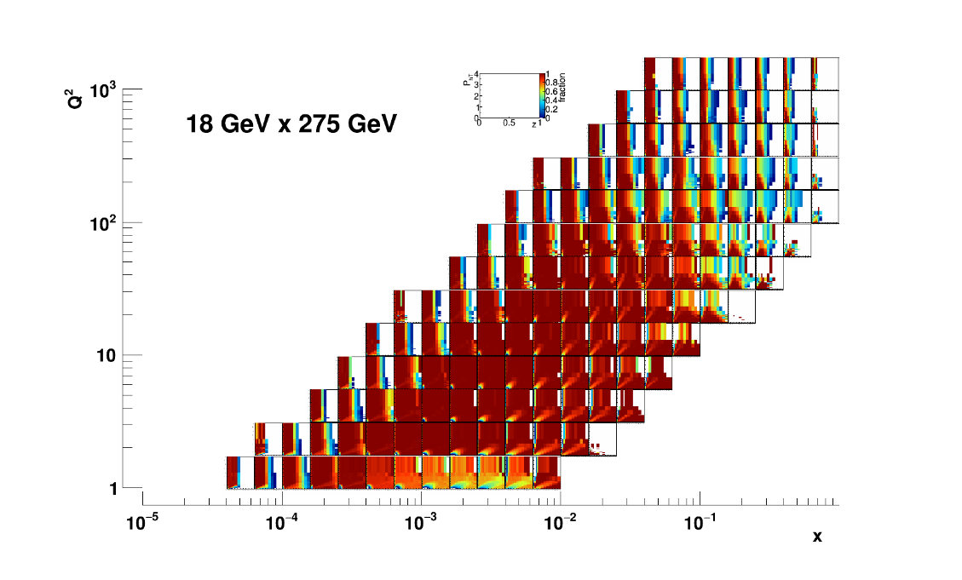




Acceptance I ($y>0.01)$
From Athena

Slide 34
TMDs

Slide 35




Depolarization Factors
Depolarization Factors
Depolarization factors (and ε) depend on (x,y,Q²)
Asymmetry denominator:
  ∫ dσ_{UU} ~ A
 | Twist 2 | Twist 3
Unpolarized Beam | A, B | V
Longitudinal Beam | C | W
Asymmetry, for modulation
M(θ, ϕ_{h}, ϕ_{R}, ϕ_{S})
Structure Functions

Slide 36
Depolarization Factors
Twist 2
Twist 3

Slide 37





Depolarization Factors
JLab Monte Carlo
10.6 GeV
22 GeV

Slide 38
Depolarization Factors
Twist 2
More accessible at JLab
Twist 3

Slide 39


Also shown in $Λ^{↑}$ projections
Plots provided by Jinlong Zhang

Slide 40





Sensitivity coefficients for PV17
5x41
10x100
Impact at high $x, low k_{t}/Q$ (see backup)
From A. Bacchetta at YR meeting

Slide 41

From Alexey Vladimirov
→see parallel session

Slide 42


Sensitivity of transversity extraction via di-hadrons
From Marco Radici

Slide 43



2nd IR data will be in transition
region collinear/TMD, target/current
Prokudin et al. (YR SIDIS meeting)
See also JHEP 10 (2019) 122, JHEP10(2019)122

Slide 44
Acceptance I ($y>0.01)$
At full energy Acceptance at high $x, Q^{2}$ might also be impacted by PID capabilities

Slide 45


Jets
TMD through jets
  →similar motivation as single/di-hadron SIDIS: TMD effects largest at high $x,$explore full phase space
  →Statistics Hungry:
  higher $W$
  More differential observables
    e.g. ${x,Q^{2},j}_{T}, q_{T},φ_{h},φ_{S}$
  →Statistics famished channels
    Exclusive di-jets to access GTMDs
    …
Exploring transition region for jets
  Study role of hadronization corrections
  …
M. Arratia

Slide 47
Outline/Overview
General picture lumi, x
Kinematic coverages (e.g the transversity paper has a nice plot)
Statistics to be collected at the EIC at different energies

Slide 48
1 slide on EIC, ePIC

Slide 49
Kinematics at the EIC (low y)

Slide 50
Rad Corr
--ralf Plot
Qiu?, Also Nobuo at CPHI

Slide 51
CS kernel
Vladimirov at CPHI

Slide 52
Affinity
Take Hermes as standin for JLab20 from prokudin, boglione paper, eic affinities

Slide 53
Depolarization Factors

Slide 54
General Considerations

Slide 55
New Opportunities at EIC
Jet Physics
Saturation
Gluon TMDs
He3→Dien at 2nd Det workshop

Slide 57
Specific Studies
Upol
Impact (see YR), low sqrtS paper
E(x)
Transversity (paper)
Di-hadrons
General questions how low in x one should go

Slide 59
Status EIC vs Jlab (solid, upgrade..?)

Slide 61
Conclusions

