Slide 1



Double Deeply Virtual Compton with SoLID
Alexandre Camsonne
Jefferson Laboratory Hall A
September 28th 2022
ECT
Opportunities with Jefferson Laboratory luminosity and energy upgrades

Slide 2
DVCS / Double DVCS
γ∗ + p
γ‘(∗) + p’
l⁺ + l⁻
Guidal and Vanderhaegen : Double deeply virtual Compton scattering off the nucleon (arXiv:hep-ph/0208275v1 30 Aug 2002)
Belitsky Radyushkin : Unraveling hadron structure with generalized parton distributions (arXiv:hep-ph/0504030v3 27 Jun 2005)

Slide 3
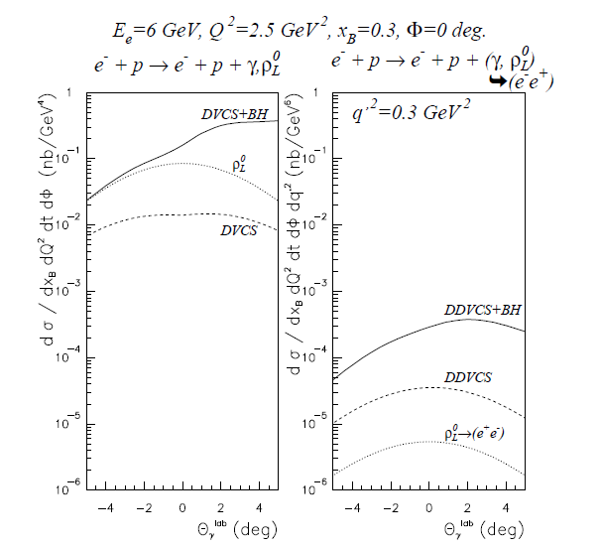
DDVCS cross section
VGG model
Order of
~0.1 pb = 10⁻³⁶cm²
About 100 to 1000 smaller than DVCS
Virtual Beth and Heitler
Interference term enhanced by BH
Contributions from mesons small when far from meson mass

Slide 4
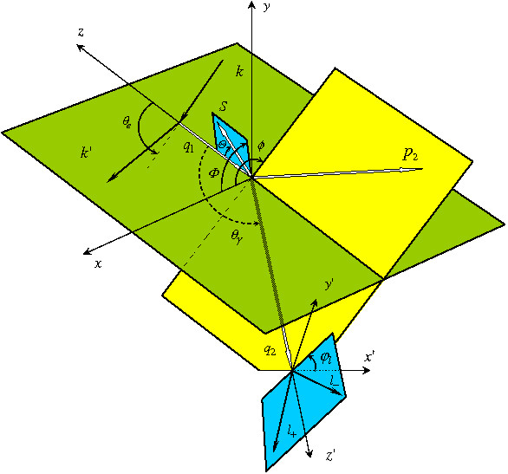
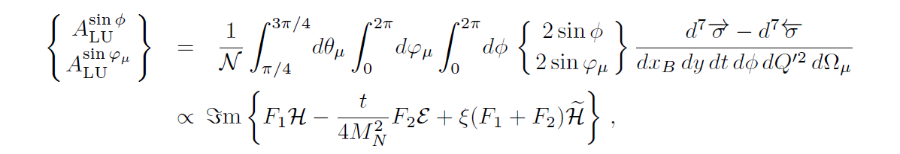
Double Deeply Virtual Compton Scattering
p = p1+p2
q = ½ (q1+q2)
Δ = p1-p2 = q2-q1
Q²= − q²
ξ =
Q²
η =
Δ.q
2p.q
p.q
scattered proton
scattered electron
Q²= -(k-k’)²
x_{bj}=
Q²
2p₁q₁
outgoing virtual photon
Belitsky Radyushkin : Unraveling hadron structure with generalized parton distributions (arXiv:hep-ph/0504030v3 27 Jun 2005)
lepton pair from virtual photon

Slide 5


Kinematical coverage
JLab 11 GeV
25 GeV
40 GeV
DVCS
η = ξ
2
H^{u}(η , ξ)
2
$$Q^{2}<M_{l^{+}l^{−}}^{}$$
$$Q^{2}>M_{l^{+}l^{−}}^{}$$
DVCS only probes η = ξ
line
Example with model of GPD H for up quark
Jlab : Q²>0
Kinematical range increases with beam energy ( larger dilepton mass )
η
ξ

Slide 6
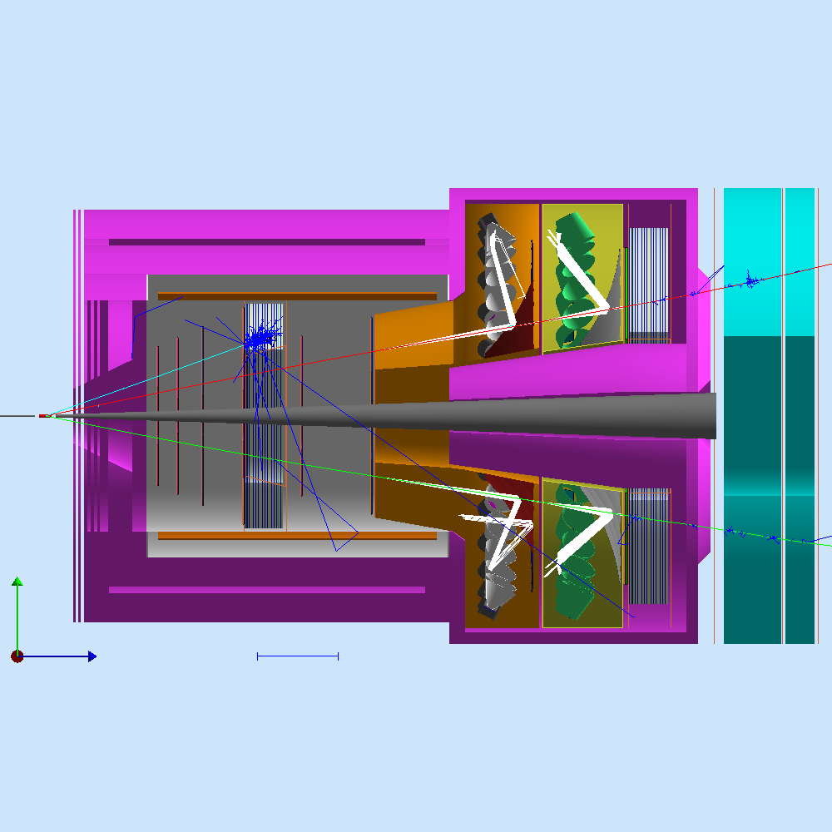
SoLID JPsi Setup
Muon chambers
Cernkov detectors
Large Angle Calorimeter
Iron plate
Iron plate
Forward Calorimeter
GEM trackers

Slide 7
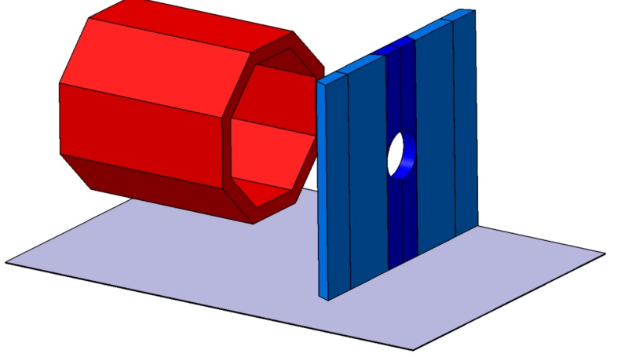


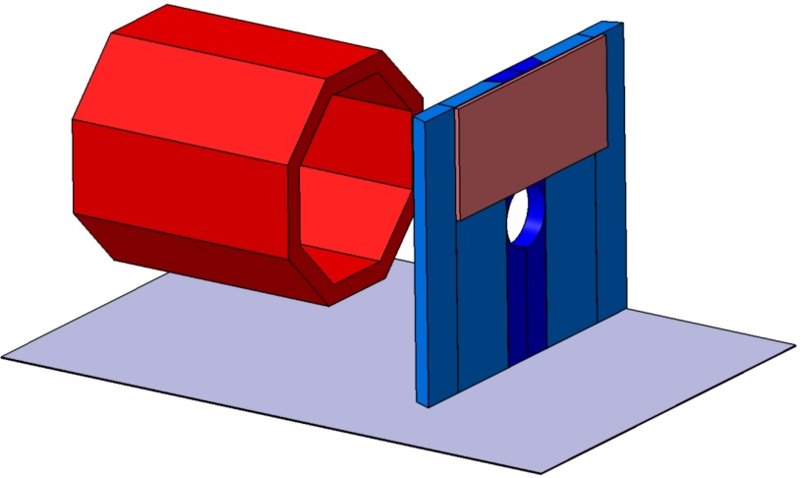
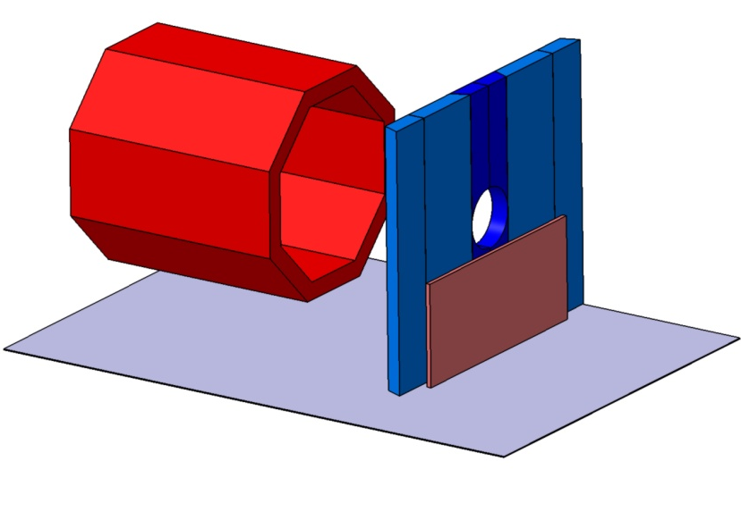
Coordinates Layer 1
Iron wall 1
Ch 1 +
Ch 1 -
Reference = Magnet
Ch 2 +
Y
X
Z
Ch 2 -

Slide 8
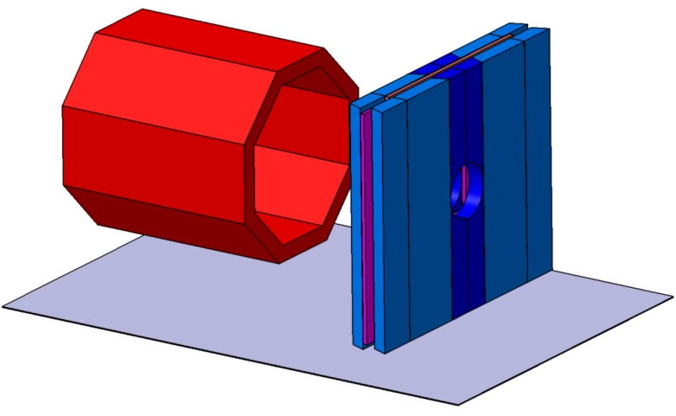


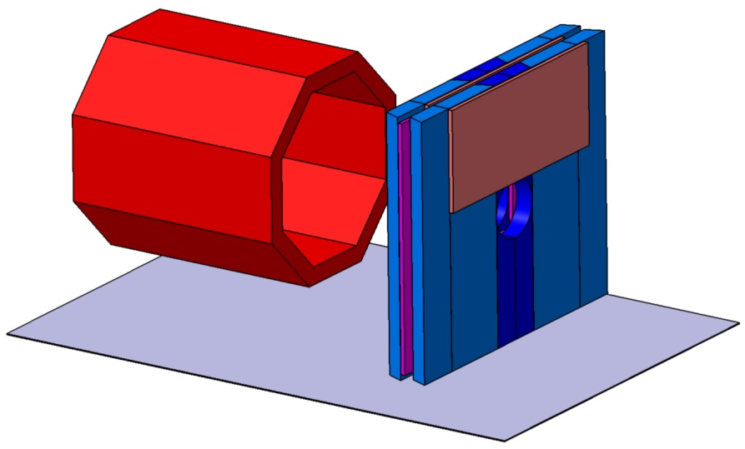

Coordinates Layer 2
Iron wall 2
Ch 3 -
Ch 3 +
Ch 4 +
Reference = Magnet
Y
X
Z
Ch 4 -

Slide 9
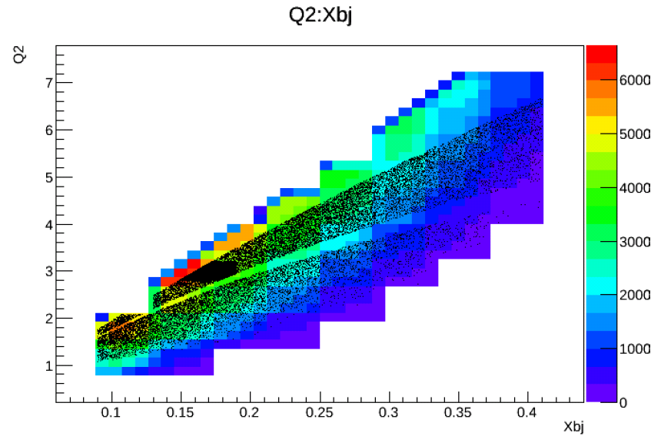
Counts J/psi setup 60 days at 10^37 cm⁻²s⁻¹

Slide 10


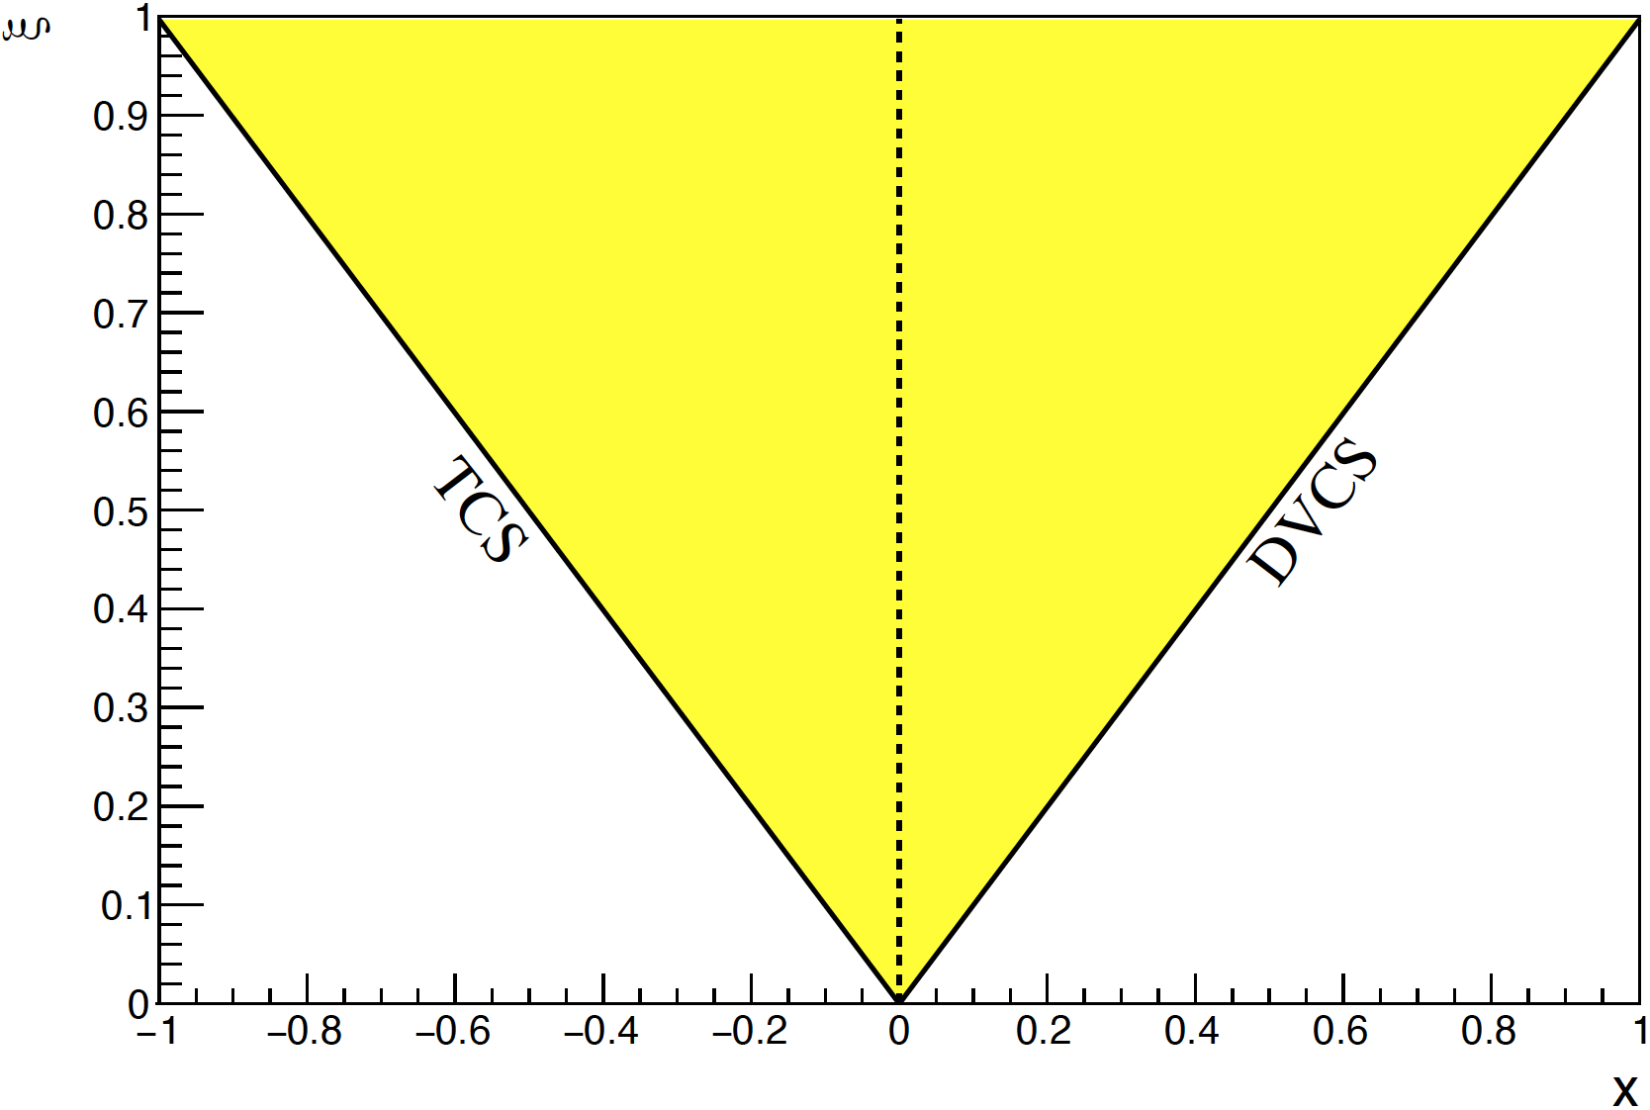
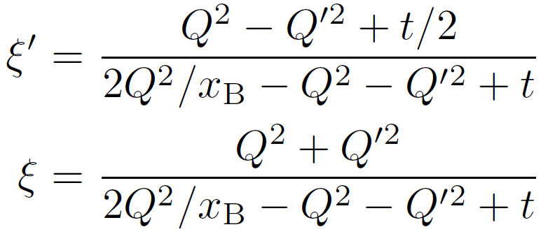
Double Deeply Virtual Compton Scattering with SoLID at JLab 12GeV
DDVCS explores wide off-axis kinematic region of GPDs, beyond DVCS and TCS. The exclusive reaction has about 100 times smaller crosssection than DVCS and thus needs high luminosity and large acceptance.
The SoLID apparatus completed with muon detectors at large and forward angles, enables DDVCS measurements with both polarized electron and positron beams at 11GeV.
DDVCS
Lumi = 1e37/cm²/s
8-28 deg polar angle
full azimuthal
50 days of electron BSA
plus 50 days of positron BCA
S. Zhao et al. EPJ A 57 (2021) 240
JLab LOI12-15-005 (M. Boer,A. Camsonne,K. Gnanvo, E. Voutier, Z.W. Zhao et al.)

Slide 11
Higher luminosity J/Psi setup tracking study
Weizhi Xiong
Simple Kalman filter tracking

Slide 12
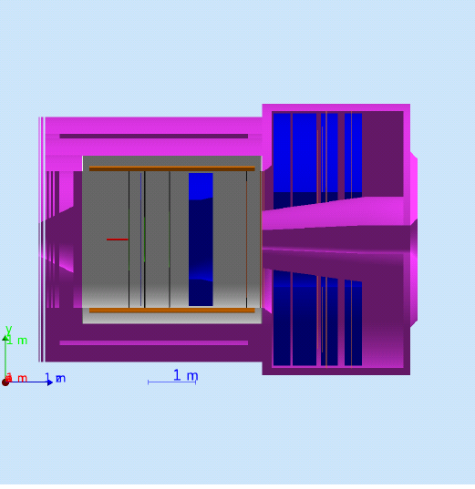
Dedicated setup
Target moved 2m from Jpsi position inside and switch to 45 cm target
Iron plate from 3rd layer yoke in front and behind calorimeter
Remove Gas Cerenkov
Try to reach 10³⁸ cm⁻²s⁻¹
30 uA on 15 cm target ( typical run in Hall A no beam dump upgrade required )
Additionnal trackers planes
Pixellized (MAPS or GEMs or superconducting nanowire ) planes to reduce combinatorial
Possible superconducting vertex tracker for vertex cut
Iron plates

Slide 13
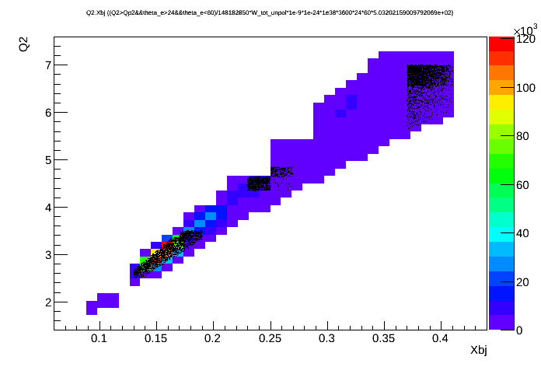
Expected accuracy dedicated setup
90 days at 10³⁸ cm⁻²s⁻¹

Slide 14
Higher luminosity ?
Current could go up to 80 uA
Target length up to 1 meter ( ~1.8 10^39 cm⁻²s⁻¹ )
Tracker occupancy and photon background
  Reduce amount of Copper in GEM
  Micromegas option
  Build smaller chambers and add more channels
  Study complement with 2D pad readout
  Superconducting tracker option
  Radiation hardened silicon and MAPS
Calorimetry
  Study liquid scintillator and cryogenics calorimeter option
  Superconducting detector to replace PMT ( 1 ns width pulse to increase rate capability )
Cerenkov
  Superconducting detector to replace PMT ( 1 ns width pulse to increase rate capability )
  HBD type Cerenkov for Large Angle calorimeter
6. 10^38 cm⁻²s⁻¹
Technically doable mostly matter of cost

Slide 15
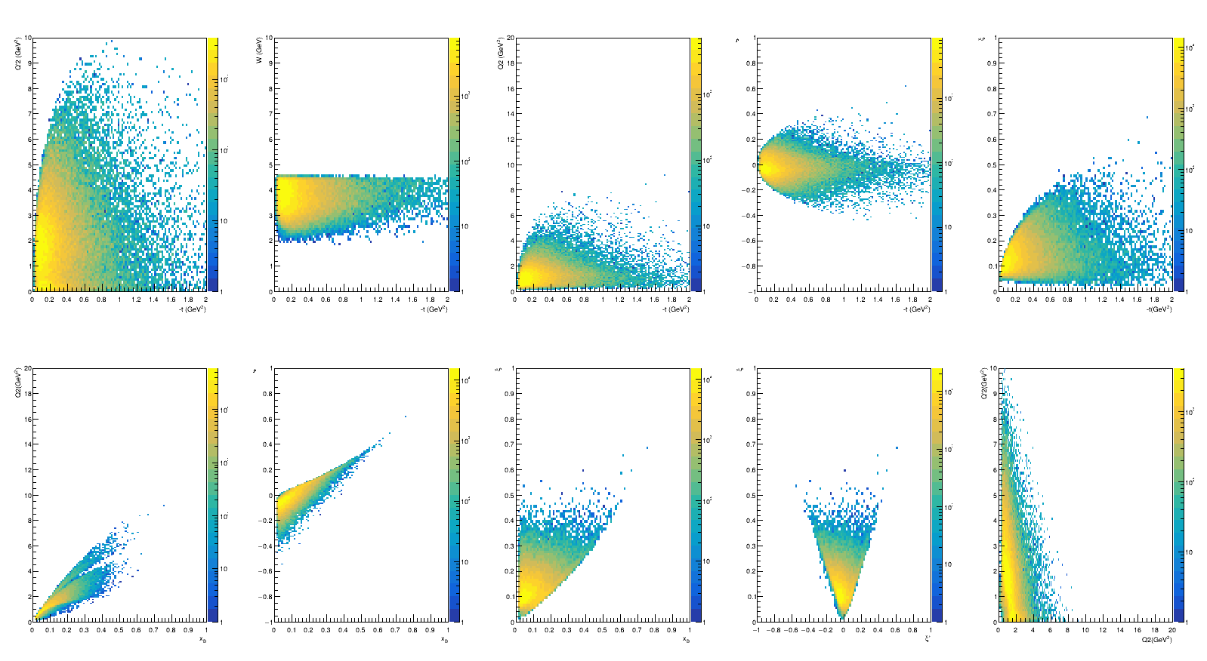
Kinematical coverage 11 GeV
Zhiwen Zhao (GRAPE)

Slide 16
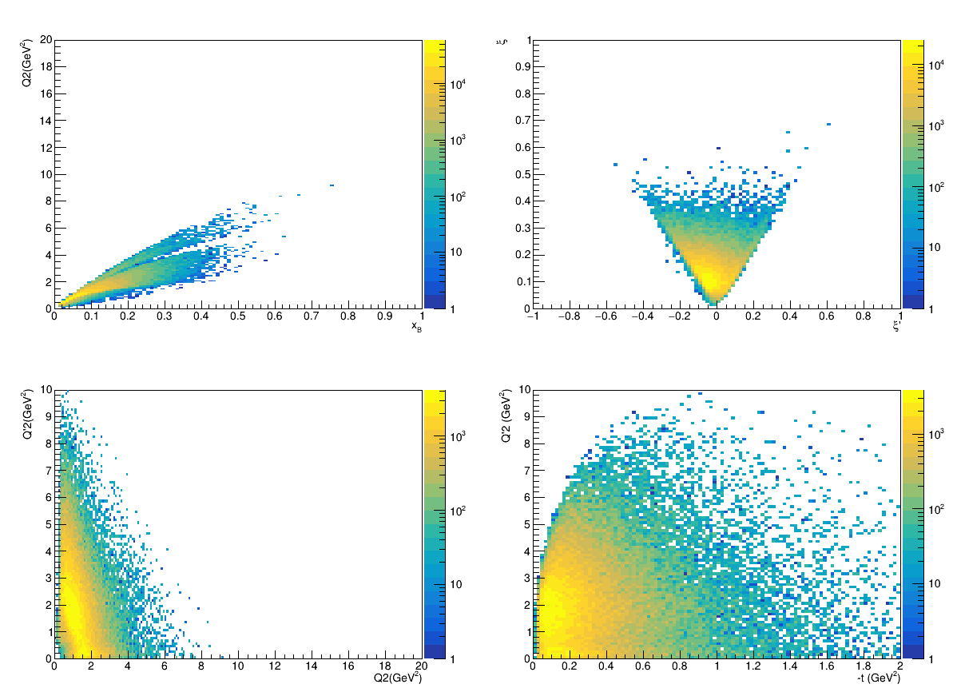
Kinematical coverage 11 GeV
Zhiwen Zhao (GRAPE)

Slide 17
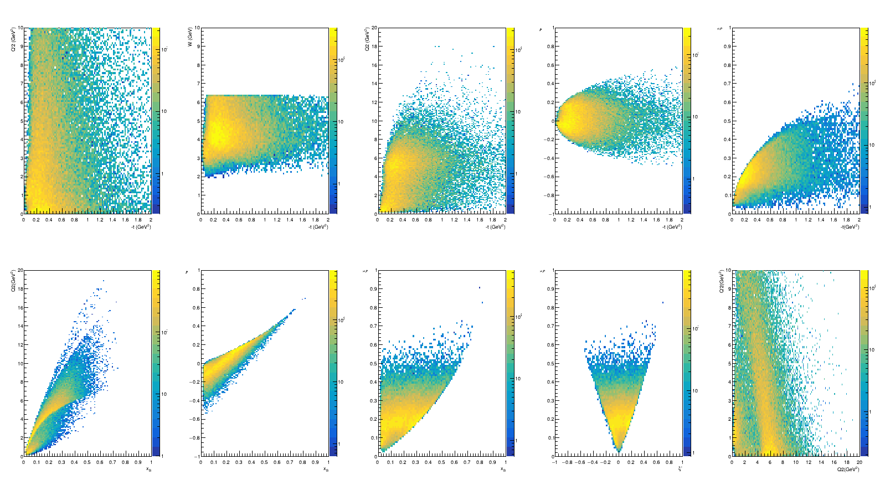
Kinematical coverage 22 GeV
Zhiwen Zhao (GRAPE)

Slide 18
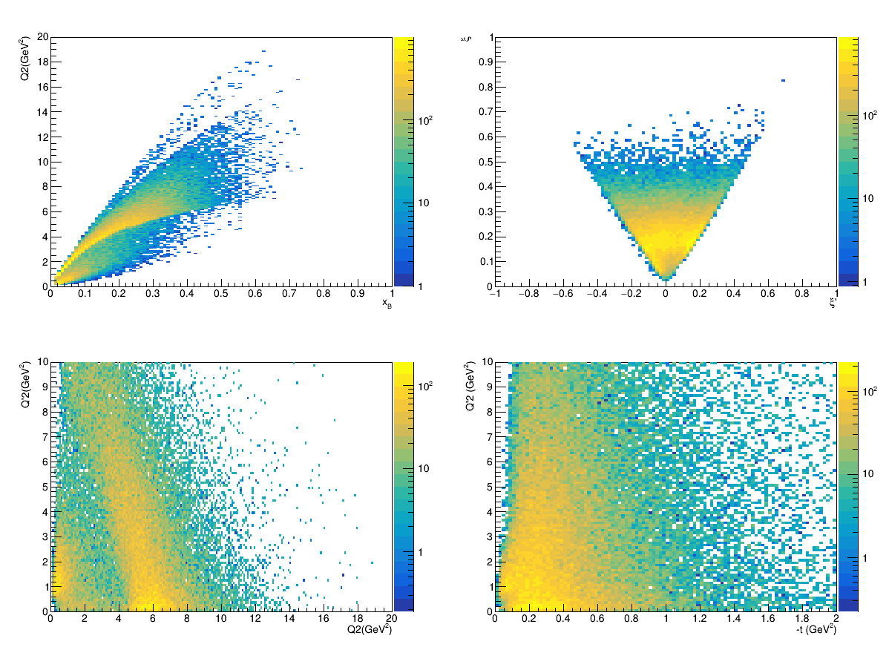
Kinematical coverage 22 GeV
Zhiwen Zhao (GRAPE)

Slide 19
11 GeV vs 22 GeV
Zhiwen Zhao (GRAPE)

Slide 20
Zhiwen Zhao (GRAPE)

Slide 21
11 GeV vs 22 GeV
Zhiwen Zhao (GRAPE)

Slide 22
11 GeV vs 22 GeV
Much better Q2 Q’2 coverage
Want Q2 and Q’2 large enough for factorization
Zhiwen Zhao (GRAPE)

Slide 23
Quick numbers for J/Psi settings
50 days at 10^37
Beam energy | e-mu-mu+ | pmu-mu+
11 | 180156 | 1.37175e+06
22 | 51600 | 2.75867e+06
Cross section about 3 times lower : could run at 10 uA or with 45 cm target
Acceptance better when detecting proton but dominated by low Q2/Q’2

Slide 24
Yulia Furletova and Sonny Mantry

Slide 25
Crossection proportional to center of mass energy ~ factor 2 at 22 GeV
Yulia Furletova and Sonny Mantry

Slide 26
Timeline / To do list
Full analysis with tracking
Dust off generator and complete physics simulation
Muon detector simulation and design
12 GeV Proposal DDVCS J/Psi setup with muon detector
Study impact of DDVCS on GPDs and D-term extraction
Study of maximum luminosity achievable with dedicated setup
Proposal for dedicated setup at 12 GeV ?
Proposal for 22 GeV running with J/Psi setup

Slide 27
Conclusion
DDVCS measurement can be do concurrently with J/psi experiment at 10^37 cm⁻².s⁻¹ with additional muon detectors outside of SoLID ( doubles J/Psi statistics )
Studying improved setup for 10^38 cm⁻².s⁻¹
22 GeV greatly enhance the kinematical reach, rates down by about factor of 3
CLFV experiment can also run concurrently with DDVCS setup
First step propose muons detector for J/Psi setup and study higher luminosity dedicated setup

