Slide 1
GPDs through Universal Moment Parameterization (GUMP)
Yuxun Guo
University of Maryland, College Park
YG, X. Ji and K. Shiells [2207.05768]

Slide 2
Outline
Introduction – GPDs
GUMP for GPD analysis
+ Experiment obs. (in progress)
JLab 20+ GeV upgrade.

Slide 3
GPDs, nucleon spin and 3D imaging
Simple parton picture is not enough for the nucleon spin!
Without transverse dimension
With transverse dimension
AM are related to partons with trans. displacement – GPDs.

Slide 4
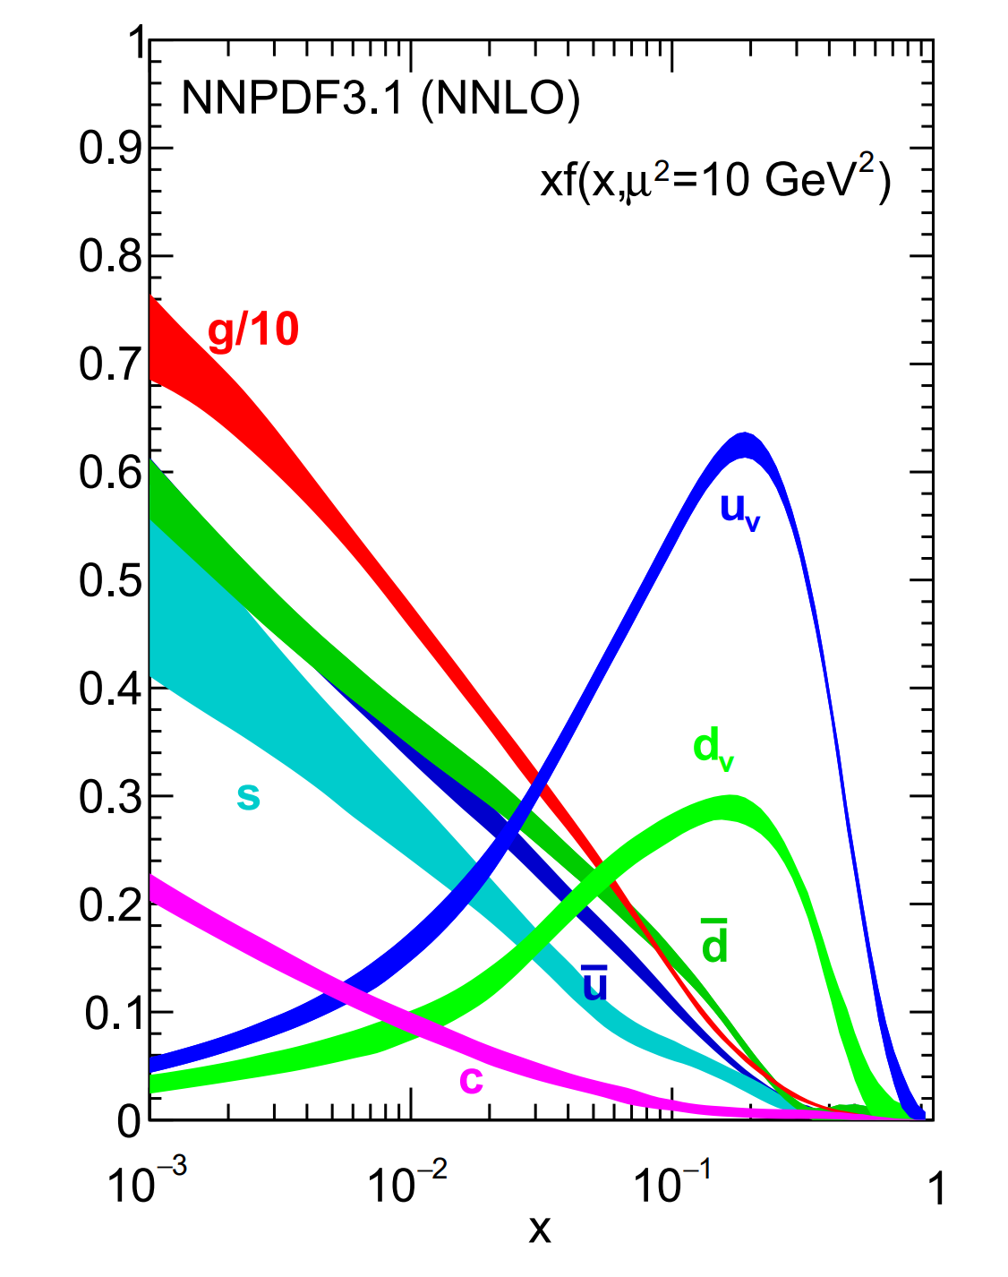
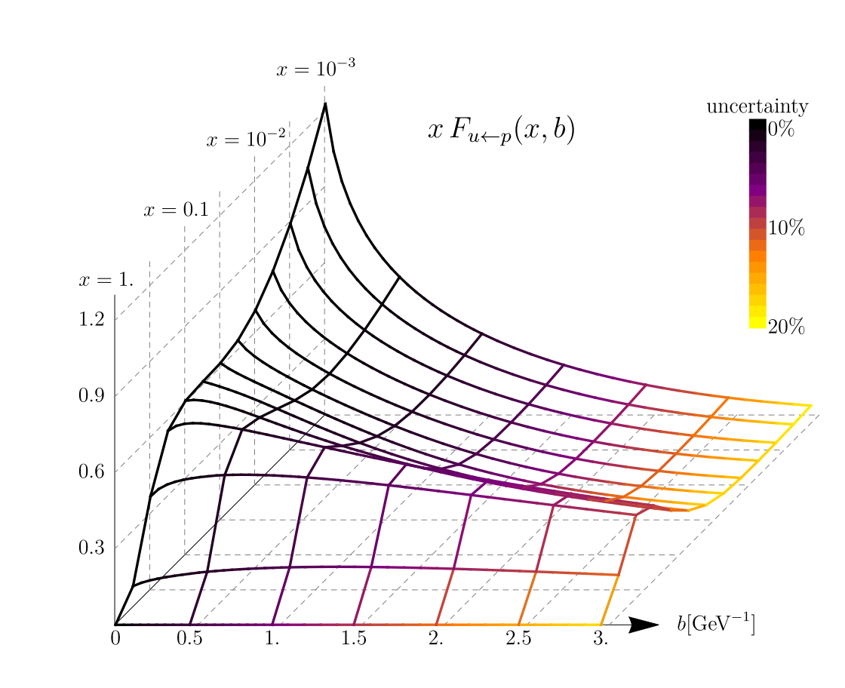
Motivation
At this point, not much information is known about GPDs.
PDFs
TMDPDFs
GPDs
Inclusive DIS (PDFs)
DVCS (CFFs)
DVMP (TFFs)
Lattice moments (GFFs)
Lattice x-dependence
…
TCS, DDVCS
NNPDF:2017mvq
Scimemi:2019cmh

Slide 5
Conf. moment param. of GPD
The conformal moment parameterization of GPD is very helpful
Mueller:2005ed
Advantages:
Polynomiality condition:
- In moment space, you get this almost for free.
Conformal moments are (LO) multiplicatively renormalizable
- Solve evolution equation in x space is much slower.
Balitsky:1987bk

Slide 6
Fitting strategy
PDFs
GPDs
Parameterize the PDF basis:
Same basis and equivalent parameterization
The simplest ansatz:
Caveats:
GPDs have more species (H, E, Ht, Et) and higher dimension ( , t).
Certain choice of ansatz for all these GPDs needed.
Evolve and global fitting
Evolve and global fitting

Slide 7
Small x_{B} region and two-step fitting
4 species * 5 flavor (with just u and quark) = basis with 20 GPDs
Extremely large system with hundreds of parameters
Consider the small x_{B} ( ) region:
KM model
Kumericki:2009uq
Semi-forward fitting
Off-forward fitting
DVCS (CFFs)
DVMP (TFFs)
TCS, DDVCS
Lattice constraints
Inclusive DIS (PDFs)
Lattice moments (GFFs)
Lattice x-dependence

Slide 8
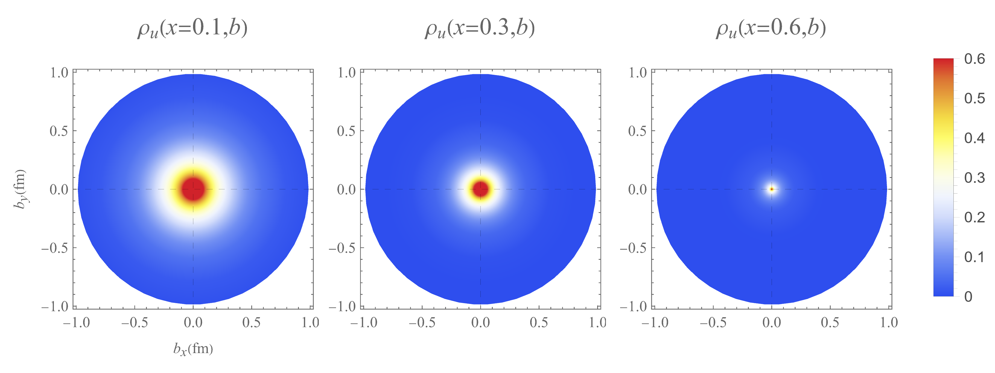
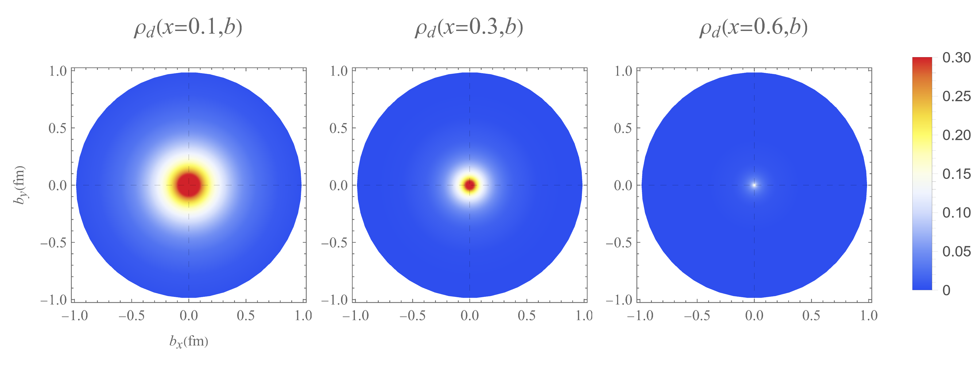
Example – quark densities (unp.)
Burkardt:2002hr
up
down

Slide 9
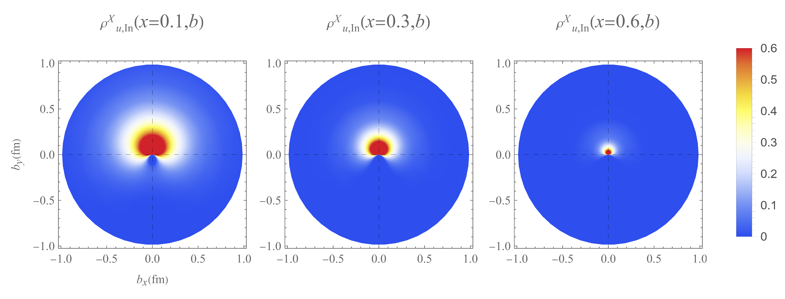
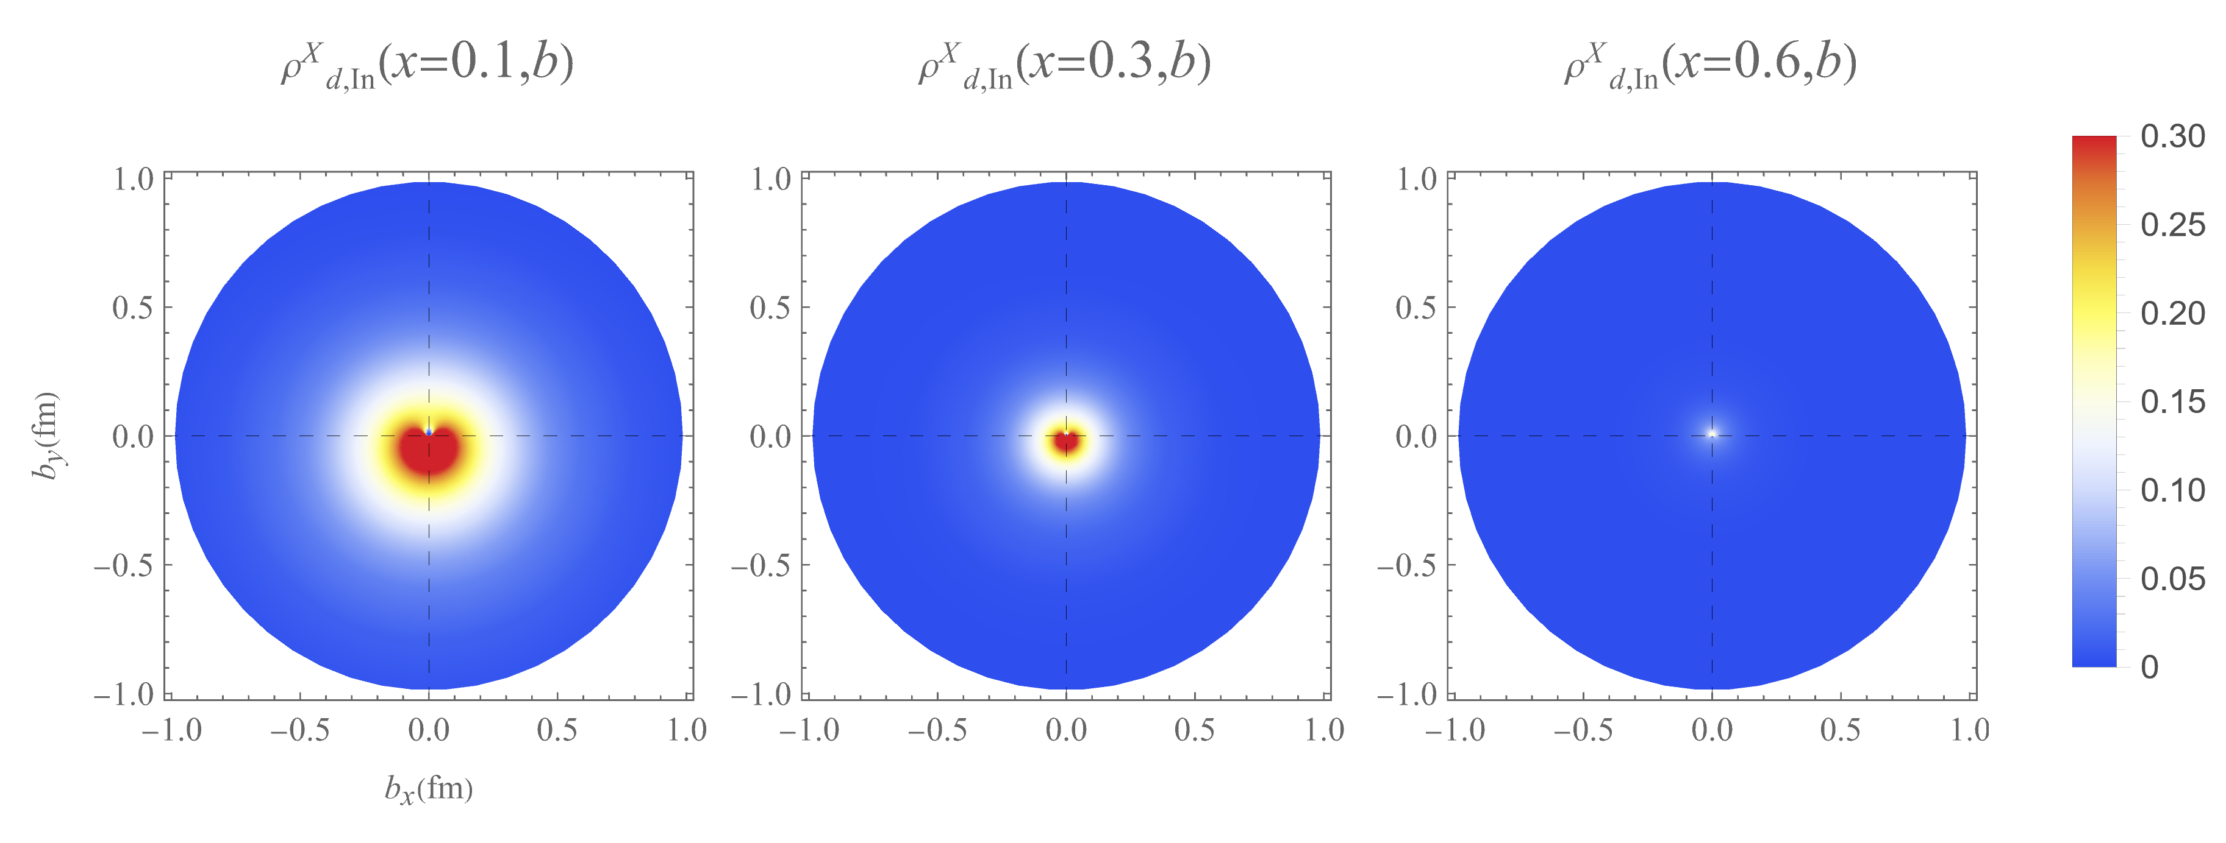
Example – quark densities (trans. pol.)
Guo:2021aik
up
down

Slide 10
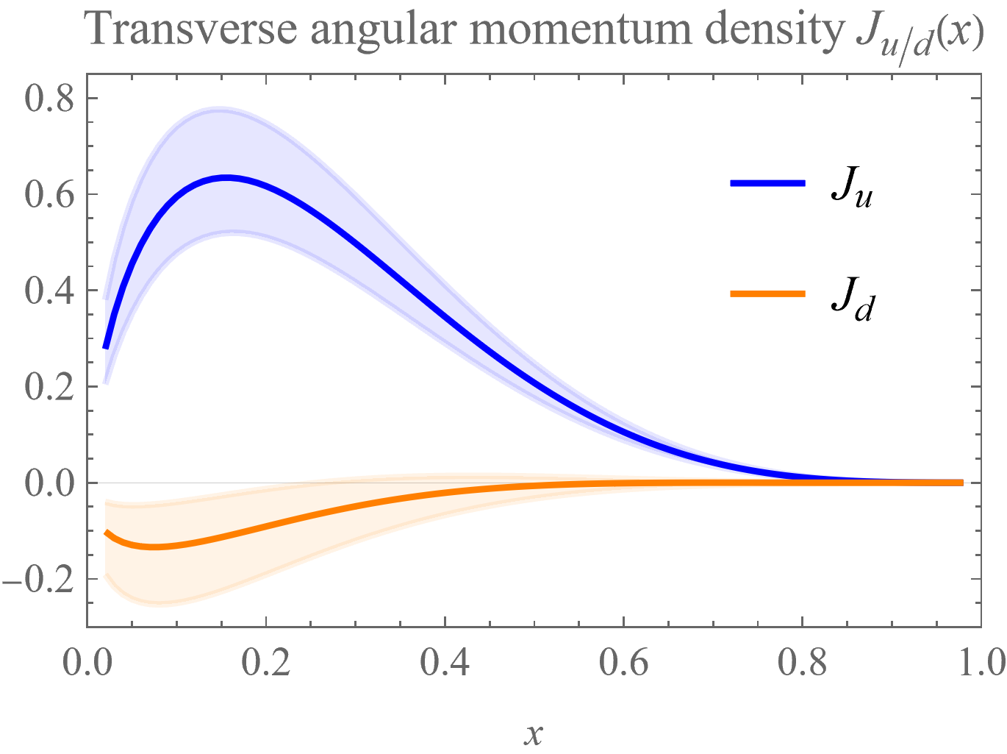
Example – quark trans. AM densities
Ji sum rule
Ji:1996ek

Slide 11
Next Step: Exp. Observables
Lots of DVCS measurement/analysis are done recently!
…

Slide 12
How does energy upgrade benefit DVCS?

Slide 13
Higher twist effects and scaling
Current JLab DVCS data cover limited region of large Q
Collinear factorization for leading-twist GPD extraction
Higher twist correction needed to be studied
Test of scaling and universality (factorization)
Leverage in large Q is in needed to resolve them with larger beam energy
Guo:2022cgq

Slide 14
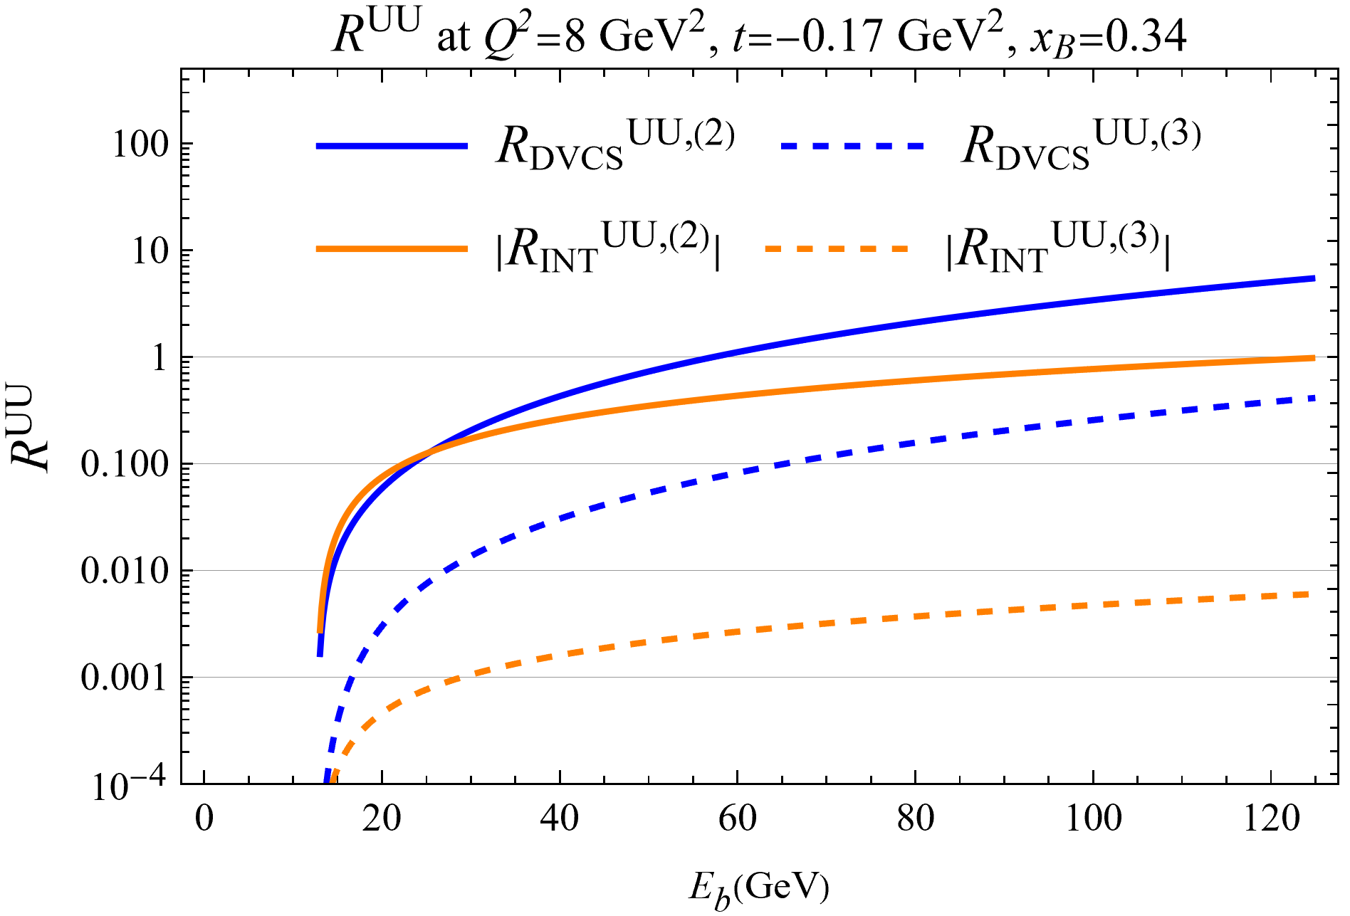
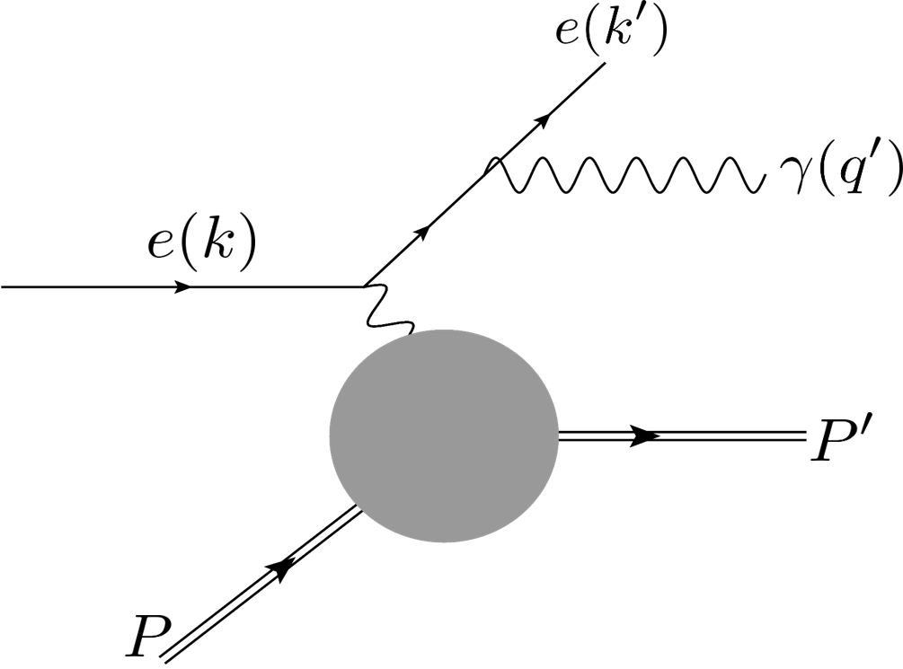
Reduced BH background
High energy with small y suppresses the Bethe-Heitler background.
Guo:2022cgq

Slide 15
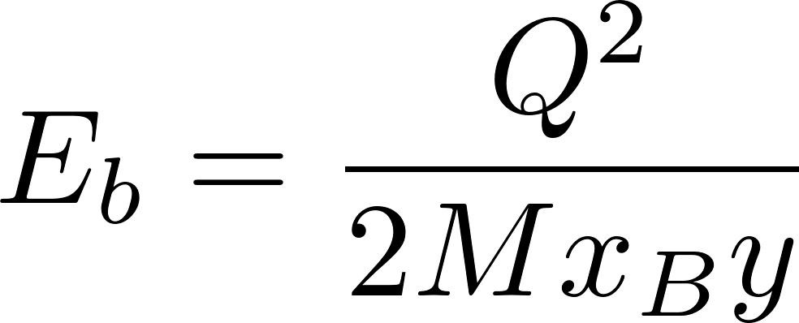
Kinematic access for DVCS
In short, we practically want
large Q and coverage of small and large x_{B}
small y
Suppressed higher-twist
 | 0.2 | 0.3 | 0.4 | 0.5
0.2 | 53.3 | 35.5 | 26.7 | 21.3
0.3 | 35.5 | 23.7 | 17.8 | 14.2
0.4 | 26.7 | 17.8 | 13.3 | 10.7
0.5 | 21.3 | 14.2 | 10.7 | 8.53
JLab 20+ GeV
JLab 12 GeV
Suppressed BH
With Q²= 4 GeV² and E_{b} in GeV

Slide 16
Summary
GUMP: Global GPD analysis combing Lat. and Exp.
JLab data with high precision and different polarizations are extremely important for off-forward constraints.
More kinematic coverage is crucial for both theory & practice
Also true for the meson production (Gluonic constraint not directly accessible from DVCS)

Slide 17
Thank you!

Slide 18
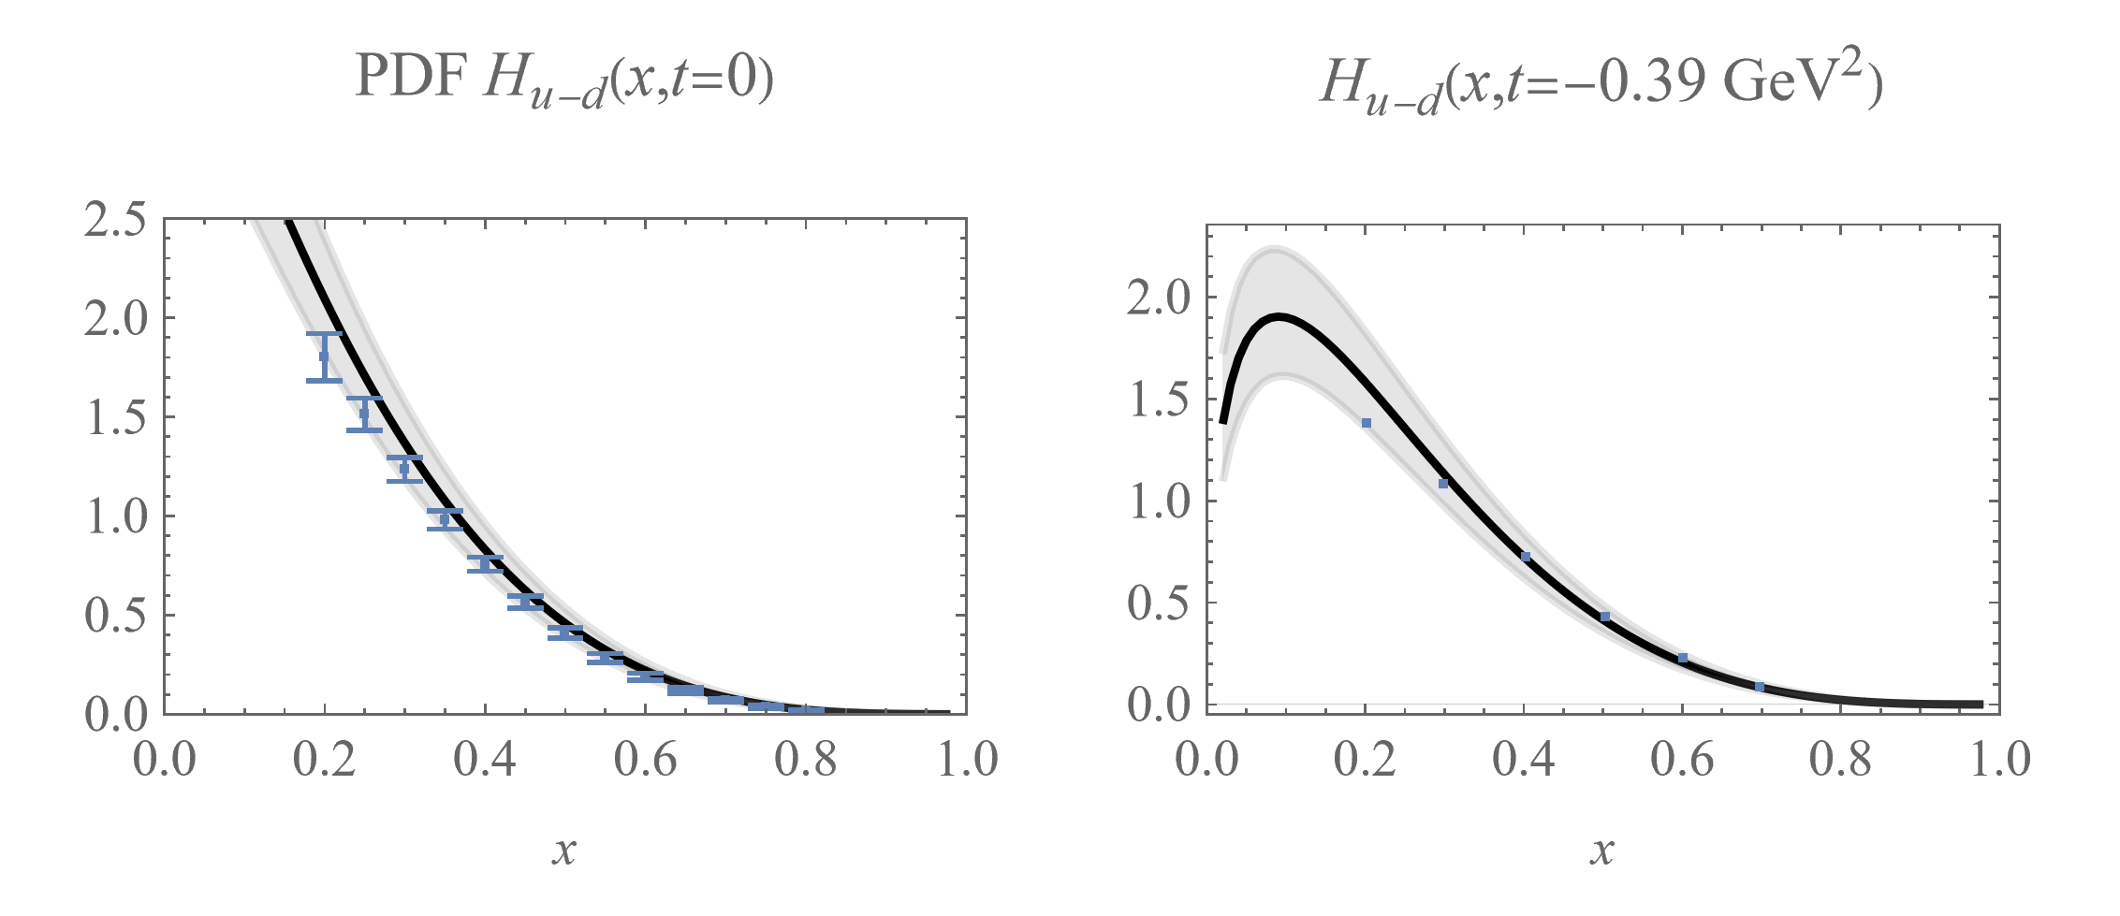
Fitting t-dependent PDF Hq/Eq(x,t)
Xie:2021equ
Lin:2020rxa
LHPC:2007blg
GPDs are fitted to forward PDFs, lattice t-dependent PDFs and lattice form factors.

