Slide 1
Probe Fundamental Symmetries and BSM Physics via the Primakoff Effect
Liping Gan
University of North Carolina Wilmington
Outline
Introduction
Current JLab Primakoff program at 6 & 12 GeV
New opportunities with future 20-24 GeV upgrade
Summary

Slide 2
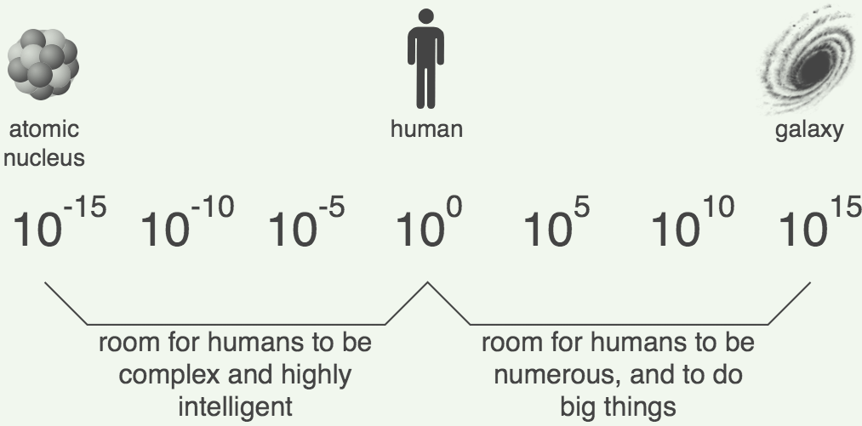
Challenges in Physics
Confinement QCD
Nature of QCD confinement
Its relationship to the dynamical chiral symmetry breaking
New physics beyond the Standard Model (SM)
New sources of CP violation
Dark matter
Dark energy
The Primakoff effect provides a great experimental tool to explore both
fundamental issues.

Slide 3
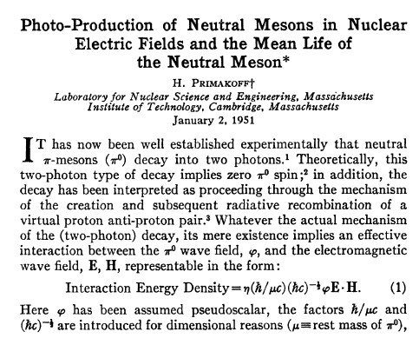
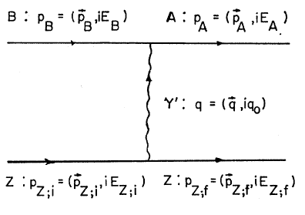
What is the Primakoff Effect?
H. Primakoff, Phys. Rev. 81, 899 (1951)

Slide 4
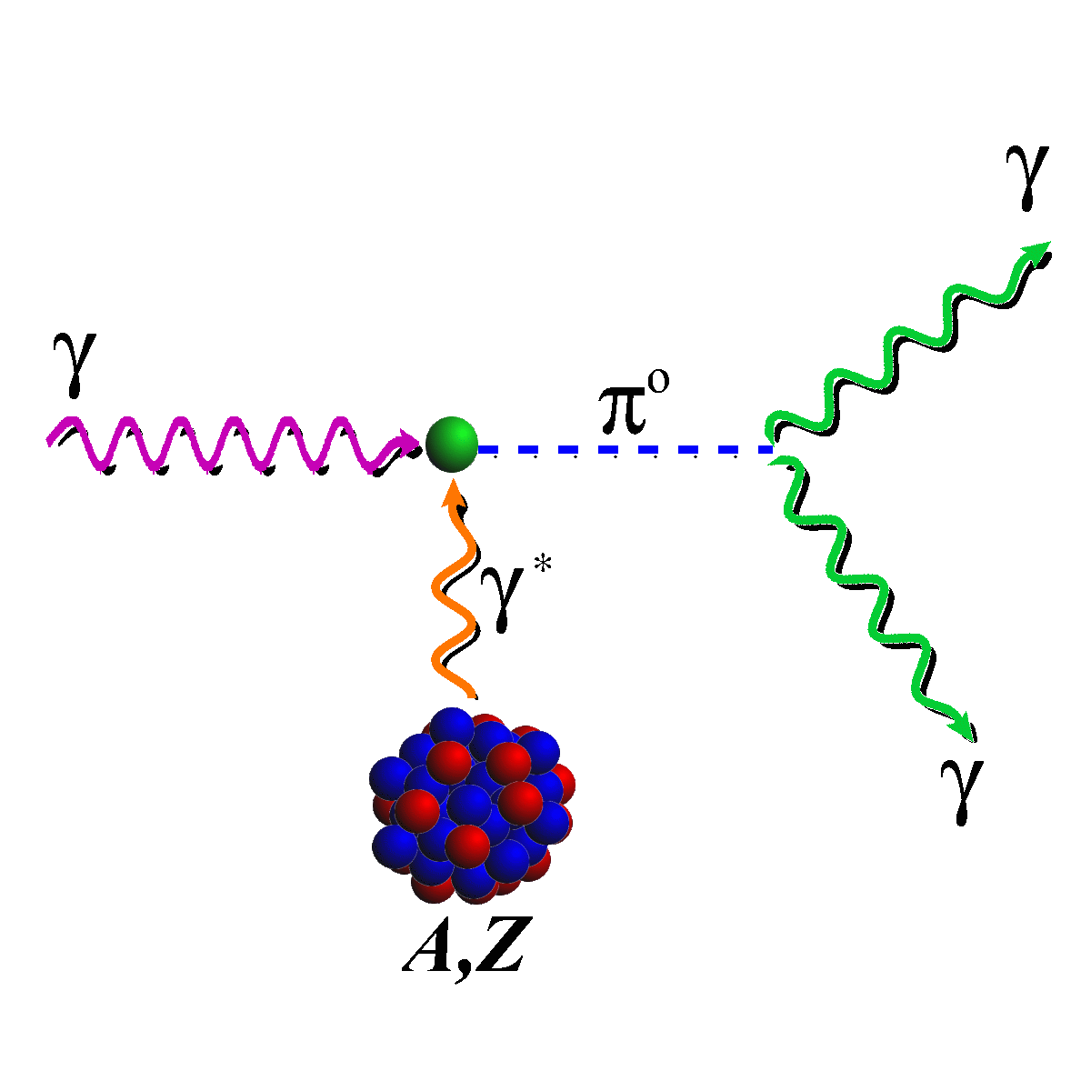
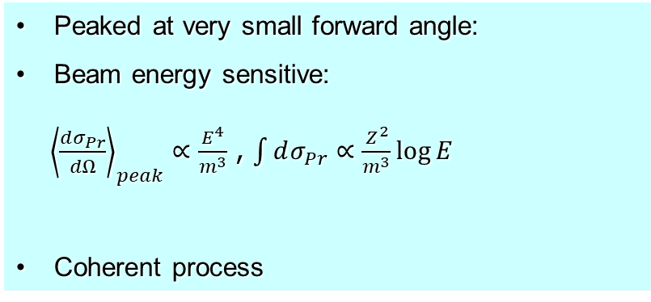
Distinguishable Features of Primakoff Effect
¹²C target
ρ,ω
Primakoff
Nucl. Coherent
Nucl. Incoh.
Interference
Peaked at very small forward angle:
Beam energy sensitive:
${\left\langle \frac{dσ_{Pr}}{dΩ}\right\rangle }_{peak}∝\frac{E^{4}}{m^{3}}$ , $\int{dσ_{Pr}}∝\frac{Z^{2}}{m^{3}}\log{E}$
Coherent process
The higher beam energy is, the higher Primakoff cross and the better separation of Primakoff from the nuclear backgrounds.
A higher beam energy is more important for more massive particle

Slide 5
Primakoff Program at JLab 6 & 12 GeV with Nuclear Targets
Precision measurements of electromagnetic properties of π⁰, η, η′ via Primakoff effect
Two-Photon Decay Widths:
  Γ(π⁰→γγ) @ 6 GeV
  Γ(η→γγ)
  Γ(η′→γγ)
Transition Form Factors
at Q² of 0.001-0.3 GeV²/c²:
F(γγ*→ π⁰), F(γγ* →η), F(γγ* →η′)
Input to Physics:
precision tests of chiral
symmetry and anomalies
determination of light quark
mass ratio
η-η′ mixing angle
input to calculate HLbL in (g-2)_{μ}
Input to Physics:
π⁰,η and η′ electromagnetic
interaction radii
is the η′ an approximate
Goldstone boson?
input to calculate HLbL in (g-2)_{μ}

Slide 6
Low-Energy QCD Symmetries and Light Mesons
QCD Lagrangian in Chiral limit (m_{q}→0) is invariant under:
Chiral symmetry SU_{L}(3)xSU_{R}(3) spontaneously breaks to SU(3)
  8 Goldstone Bosons (GB)
U_{A}(1) is explicitly broken:
(Chiral anomalies)
  Γ(π⁰→γγ), Γ(η→γγ), Γ(η′→γγ)
  Non-zero mass of η₀
SU_{L}(3)xSU_{R}(3) and SU(3) are explicitly broken:
  GB are massive
  Mixing of π⁰, η, η′
  The π⁰, η, η′ system provides a rich laboratory to study the symmetry structure of QCD at low energies.

Slide 7
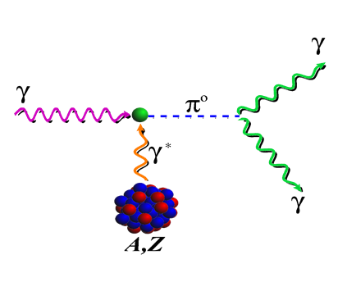
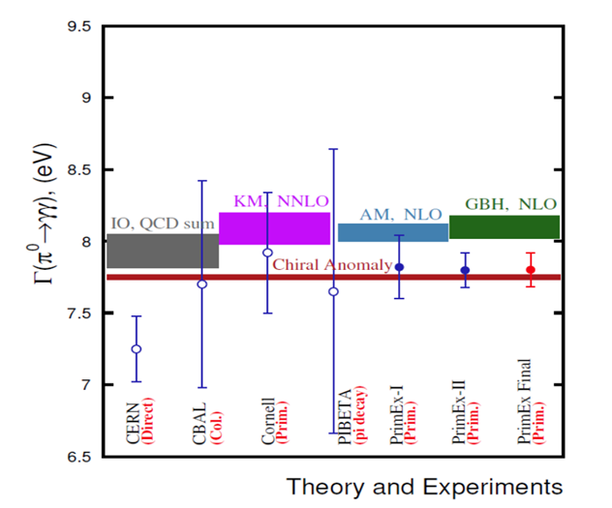
Status of Primakoff Program at JLab 6 & 12 GeV
Precision measurements of electromagnetic properties of π⁰, η, η′ via Primakoff effect
The chiral anomaly prediction is exact for massless quarks:
Γ(π⁰→γγ) is one of the few quantities in confinement region that QCD can calculate precisely at ~1% level to higher orders!
Two-Photon Decay Widths:
  Γ(π⁰→γγ) @ 6 GeV
  Γ(η→γγ)
  Γ(η′→γγ)
Transition Form Factors
at Q² of 0.001-0.5 GeV²/c²:
F(γγ*→ π⁰), F(γγ* →η), F(γγ* →η′)
Science 368, 506-509 (2020)
Input to Physics:
precision tests of chiral
symmetry and anomalies
determination of light quark
mass ratio
η-η′ mixing angle
input to calculate HLbL in (g-2)_{μ}
Input to Physics:
π⁰,η and η′ electromagnetic
interaction radii
is the η′ an approximate
Goldstone boson?
input to calculate HLbL in (g-2)_{μ}
1.50% accuracy

Slide 8


Status of Primakoff Program at JLab 6 & 12 GeV (cont.)
Precision measurements of electromagnetic properties of π⁰, η, η′ via Primakoff effect
$$ηr^{2}$$
Two-Photon Decay Widths:
  Γ(π⁰→γγ) @ 6 GeV
  Γ(η→γγ)
  Γ(η′→γγ)
$$A\frac{dσ_{Pr}}{dΩ}=Γ_{γγ}\frac{8αZ^{2}}{m_{η}^{3}}\frac{β^{3}E^{4}}{Q^{4}}{\left|F_{e.m.}(Q^{2})\right|}^{2}\sin^{2}{θ_{η}}$$
Transition Form Factors
at Q² of 0.001-0.5 GeV²/c²:
F(γγ*→ π⁰), F(γγ* →η), F(γγ* →η′)
On-Going PrimEx-eta experiment
Two data sets were collected in 2019 and in 2021.
The third run started on Aug 18 until Dec 19, in 2022.
Input to Physics:
precision tests of chiral
symmetry and anomalies
determination of light quark
mass ratio
η-η′ mixing angle
input to calculate HLbL in (g-2)_{μ}
Input to Physics:
π⁰,η and η′ electromagnetic
interaction radii
is the η′ an approximate
Goldstone boson?
input to calculate HLbL in (g-2)_{μ}

Slide 9
Physics for Γ(η→γγ) Measurement
Resolve long standing discrepancy between previous collider and Primakoff measurements:
2. Extract η-η′mixing angle:
PDG
3. Improve calculation of the η-pole
contribution to Hadronic
Light-by-Light (HLbL) scattering
in (g-2)_{μ}
4. Improve all partial decay widths
in the η-sector

Slide 10
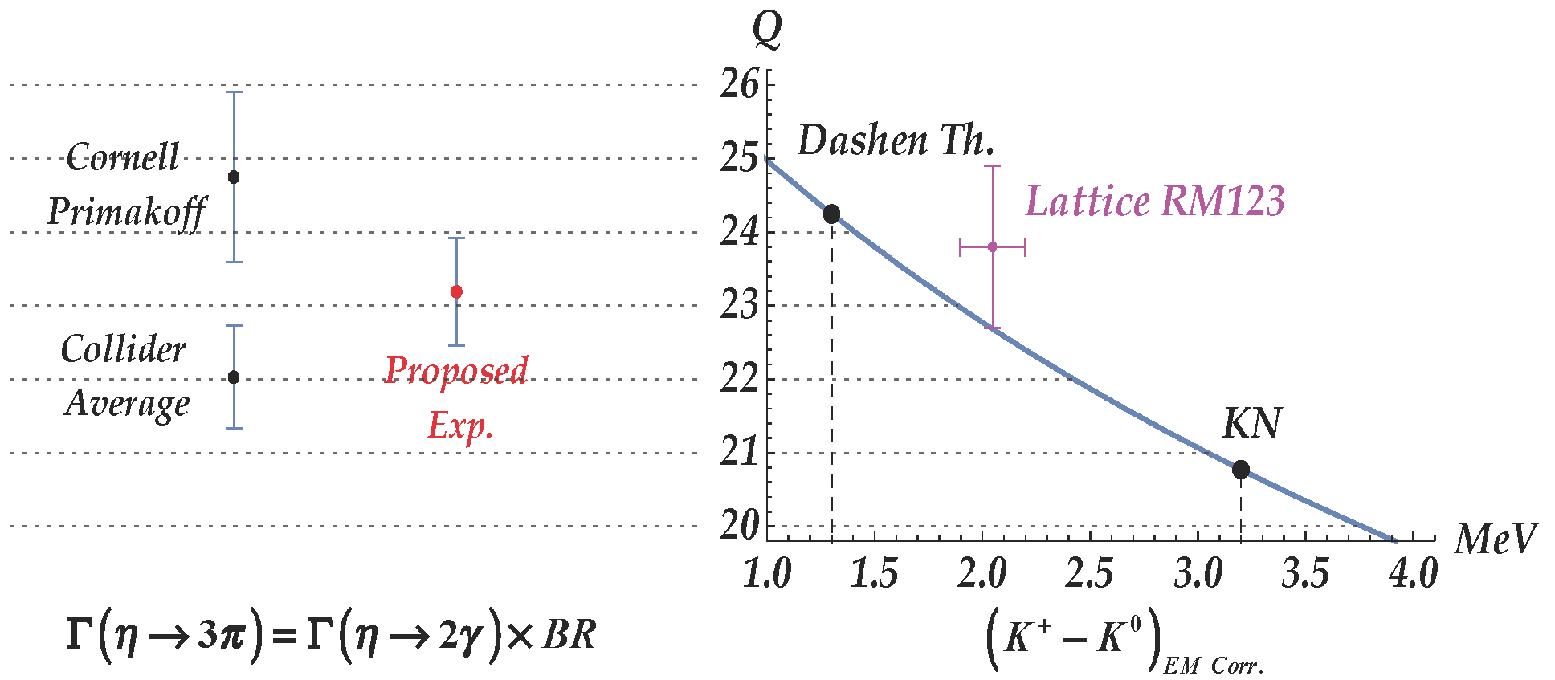
Precision Determination Light Quark Mass Ratio
  A clean probe for quark mass ratio:
    𝜂→3π decays through isospin violation:
    is small
    Amplitude:
Phys. Rept. 945 (2022) 1-105

Slide 11
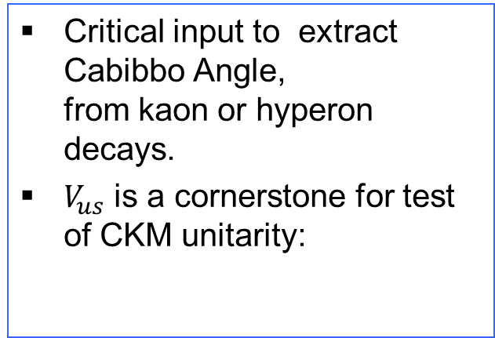
Precision Determination Light Quark Mass Ratio
  A clean probe for quark mass ratio:
    𝜂→3π decays through isospin violation:
    is small
    Amplitude:
Phys. Rept. 945 (2022) 1-105

Slide 12
PrimEx-eta Experiment on Γ(η→γγ) in Hall D
Tagged photon beam (~8.0-11.7 GeV).
Pair spectrometer and a TAC detector for the photon flux control.
Liquid Hydrogen (3.5% R.L.) and ⁴He targets (~4% R.L.)
The η decay photons are detected by Forward Calorimeter (FCAL); the charged decay
particles of η are detected by the GlueX spectrometer.
CompCal and FCAL to measure Compton scattering off atomic electron for control of overall
systematics.
12

Slide 13
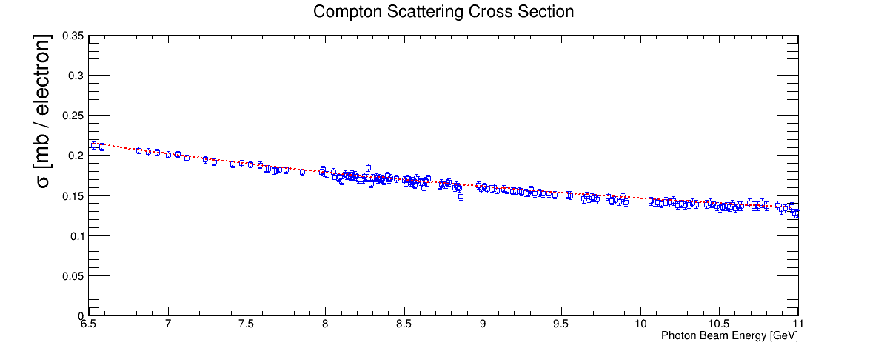
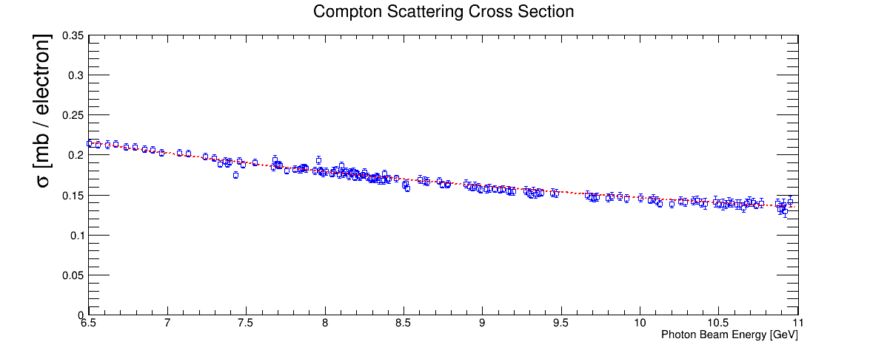


Control Systematics with Compton Scattering
Be target
$$γ+e→γ^{′}+e^{′}πr^{2}$$
preliminary
NLO QED prediction
⁴He target
$$γ+e→γ^{′}+e^{′}πr^{2}$$
preliminary
NLO QED prediction

Slide 14




Preliminary Results on the η Yield
η Yield from phase I data:
Simulations:
$$η→γγ$$
preliminary
$$η→π^{0}π^{0}π^{0}$$
$$γ+{}_{}^{4}{He}→η+{{}_{}^{4}{He}r}^{2}$$
$$E_{γ}: 8−11 GeV πr^{2}$$

Slide 15
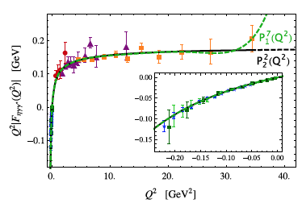
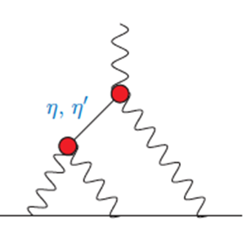
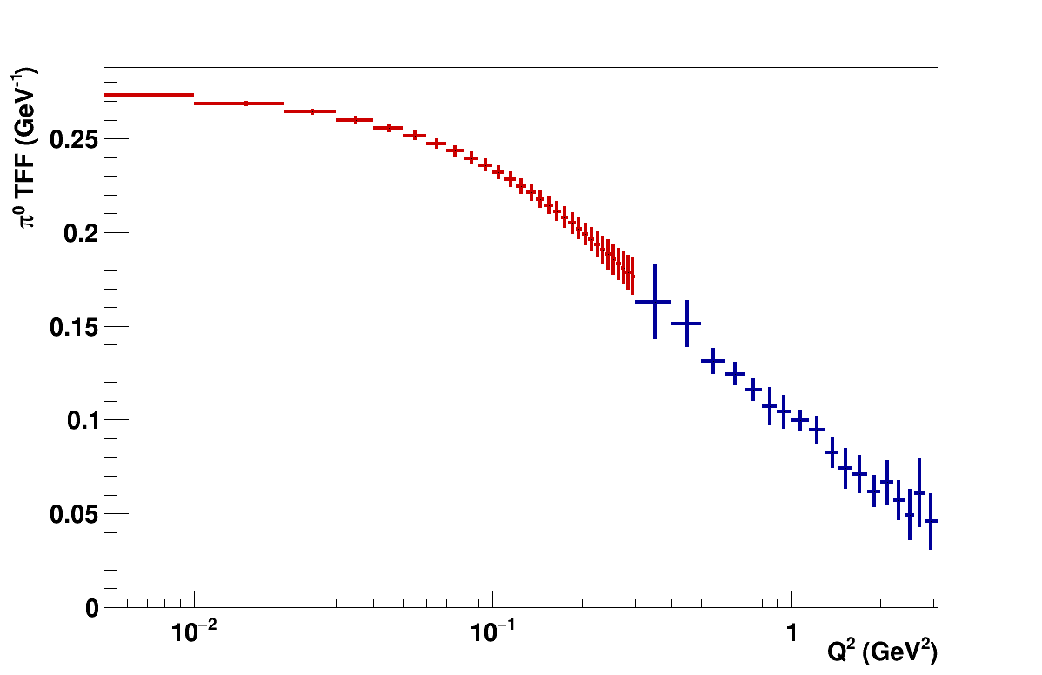
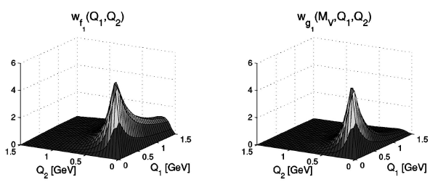
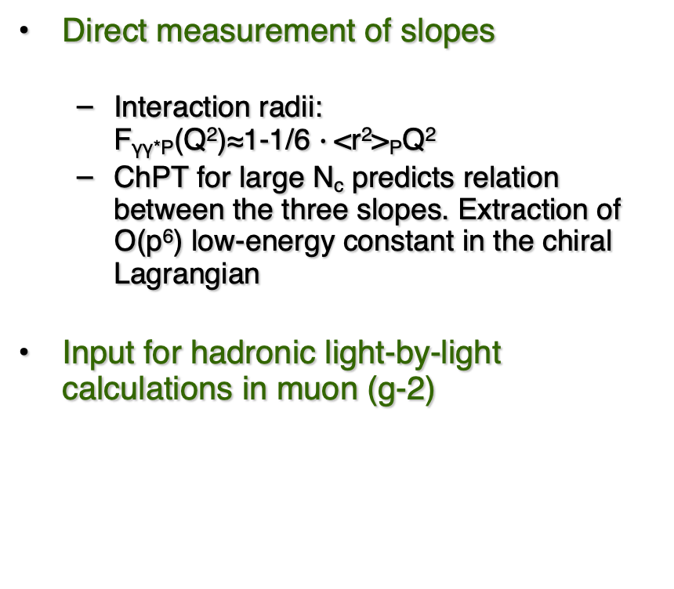
Space-Like Transition Form Factors
(Q² : 0.001-0.3 GeV²/c²)
Direct measurement of slopes
  Interaction radii:
  F_{γγ*P}(Q²)≈1-1/6 $∙$<r²>_{P}Q²
  ChPT for large N_{c} predicts relation between the three slopes. Extraction of Ο(p⁶) low-energy constant in the chiral Lagrangian
Input for hadronic light-by-light calculations in muon (g-2)
No data
$$π^{0}, η,η′$$
Projected E12-22-003
on F(γγ*→ π⁰)
Phys.Rev.D65,073034

Slide 16


Enhancement with a 24 GeV Beam
Higher Primakoff cross section:
Better separation of Primakoff from nuclear processes:
$${γ+{}_{}^{4}{He→}η}^{′}+{}_{}^{4}{He}$$
$${γ+{}_{}^{4}{He→}η}^{′}+{}_{}^{4}{He}$$
A 24 GeV beam will significantly enhance the measurements of decay width Γ(ηꞌ→γγ), the transition form factors F(η→γ*γ) and F(ηꞌ→γ*γ).

Slide 17

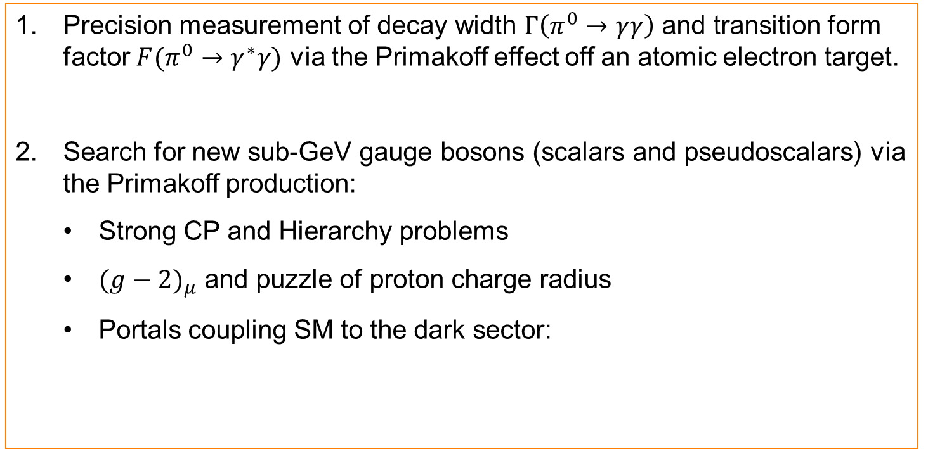
New opportunities with JLab 24 GeV Upgrade
Precision measurement of decay width $Γ\left(π^{0}→γγ\right)$ and transition form factor $F(π^{0}→γ^{∗}γ)$ via the Primakoff effect off an atomic electron target.
Search for new sub-GeV gauge bosons (scalars and pseudoscalars) via the Primakoff production:
  Strong CP and Hierarchy problems
  ${(g−2)}_{μ}$ and puzzle of proton charge radius
  Portals coupling SM to the dark sector:

Slide 18
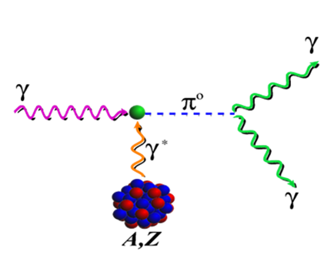
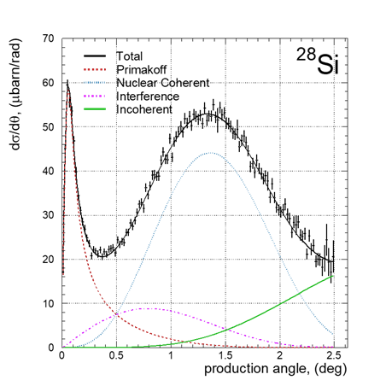



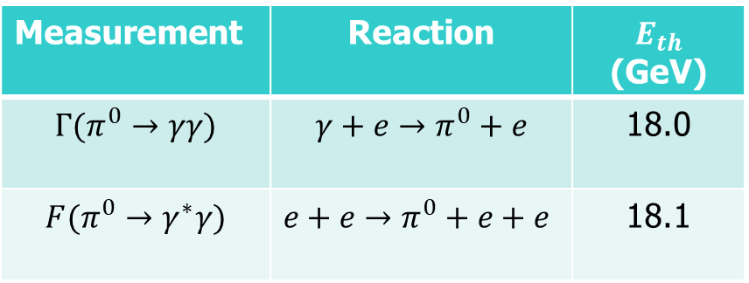


Advantages of the $π^{0}$ Primakoff Production off an Electron
Advantages of an electron target:
Eliminate all nuclear backgrounds
A point-like electron to eliminate nuclear effects
Recoiled electron detection
PrimEx-II: ${γ+{}_{}^{28}{Si→}π}^{0}+{}_{}^{28}{Si}$
$AE_{γ}:$ 4.45-5.30 GeV
$AE_{γ}:$ 20-23 GeV
$$\frac{dσ_{Pr}}{dΩ}=Γ_{γγ}\frac{8α}{m_{π}^{3}}\frac{β^{3}E^{4}}{Q^{4}}\sin^{2}{θ_{π}}$$
$$γ+e→π^{0}+e$$
Science 368, 506-509
Measurement | Reaction | $E_{th}$ (GeV)
$$Γ(π^{0}→γγ)$$ | $${γ+e→π}^{0}+e$$ | 18.0
$$F(π^{0}→γ^{∗}γ)$$ | $${e+e→π}^{0}+e+e$$ | 18.1
Main challenges for nuclear targets:
Nuclear backgrounds
Nuclear effects
No recoil detection

Slide 19
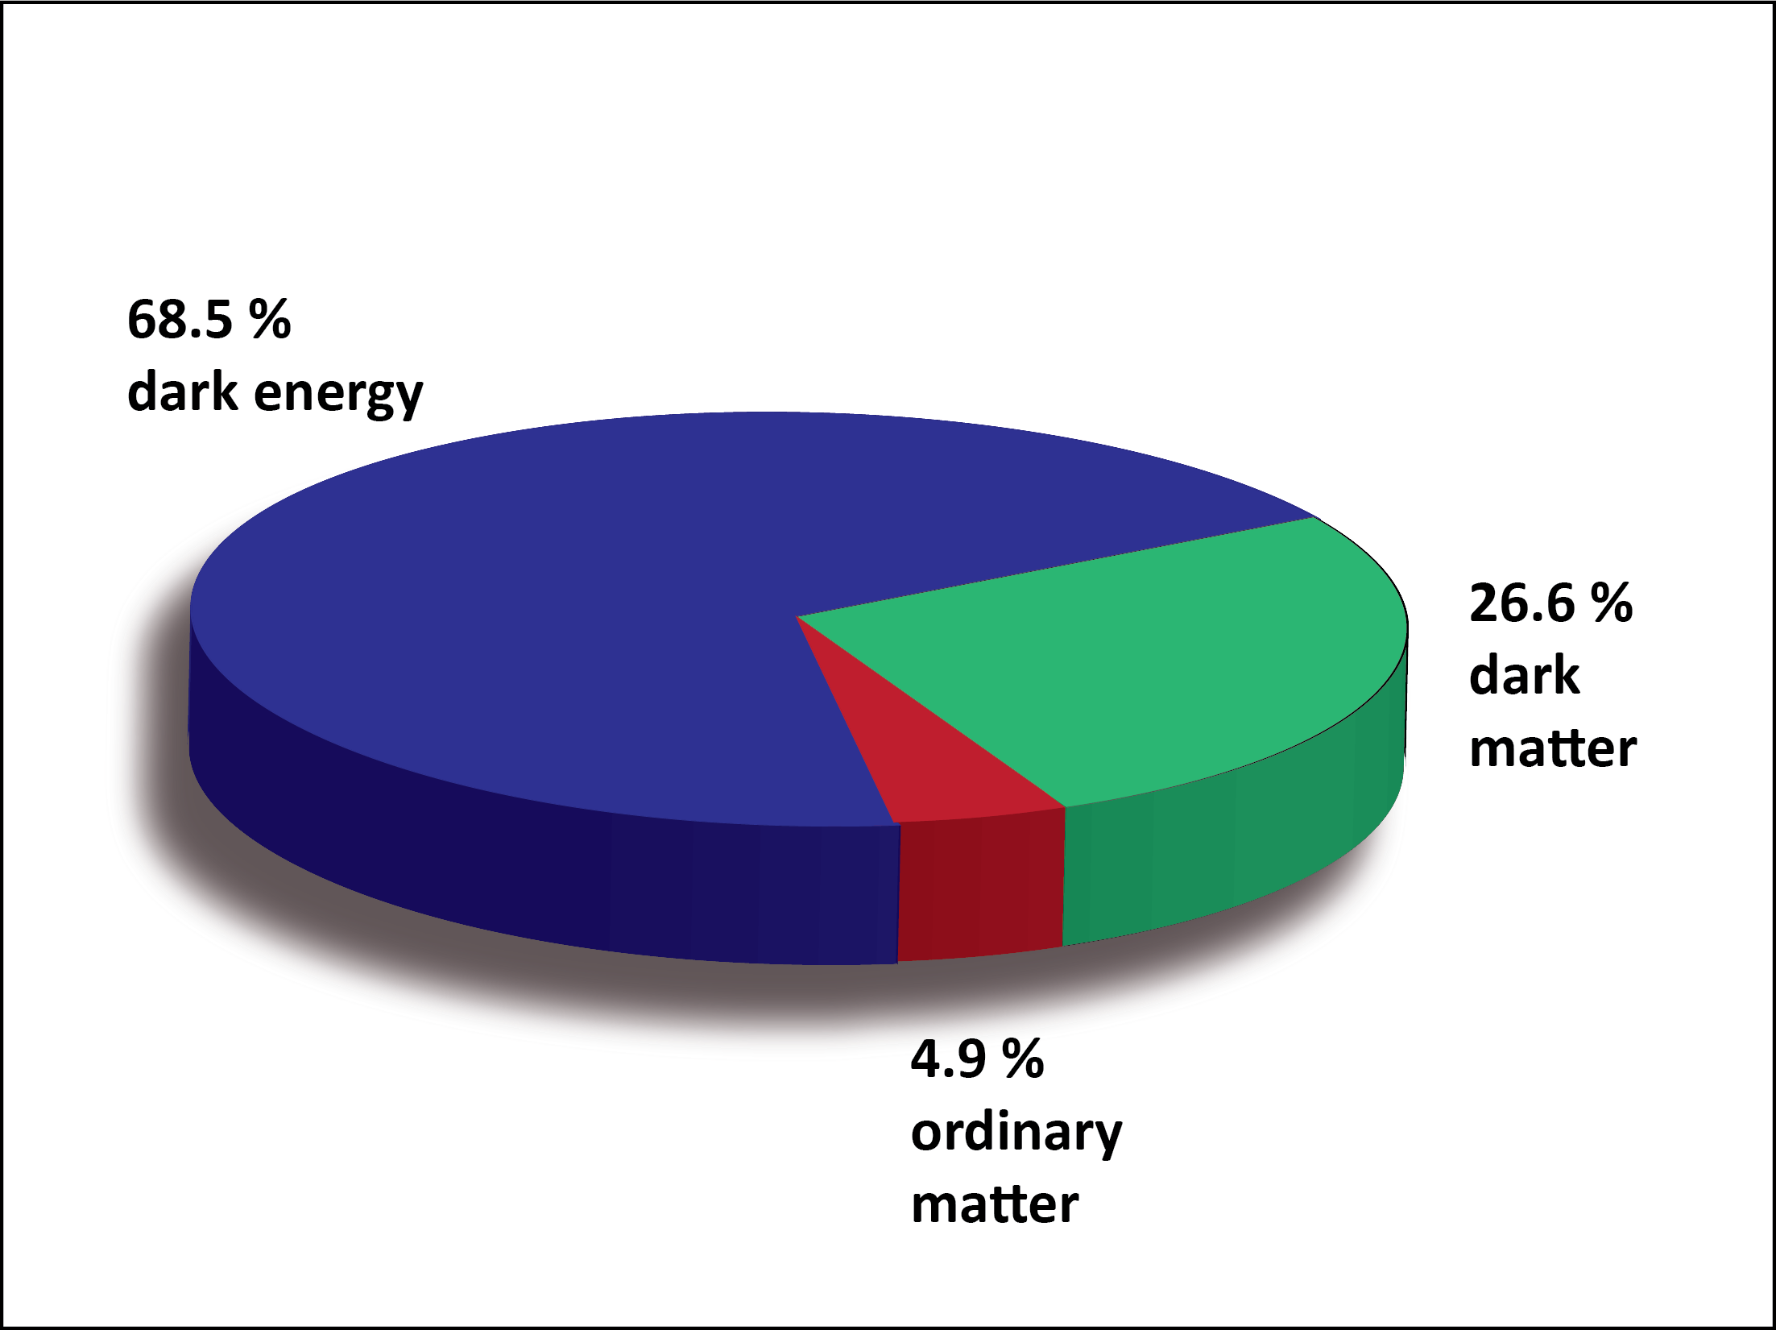
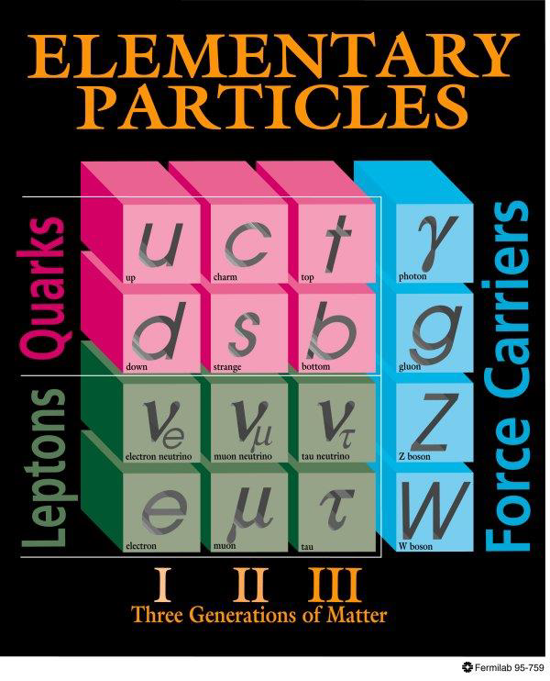
BSM Physics in Dark Sector
Dark Sector
New gauge forces, bosons and fermions beyond SM.
The stability of dark matter can be explained by the dark charge conservation.

Slide 20
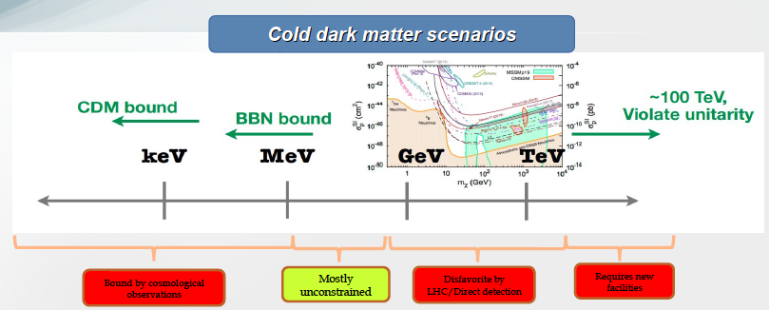
Where to Search for Dark Matter?
Sub-GeV region represents a good discovery opportunity

Slide 21
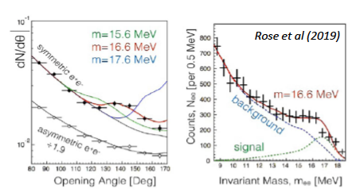
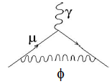

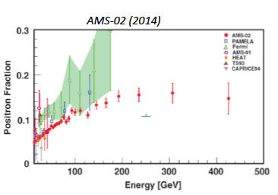
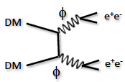

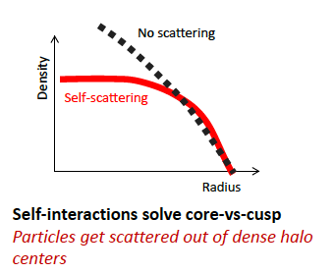
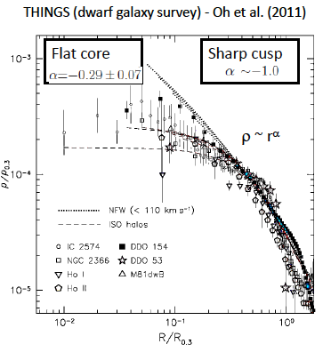
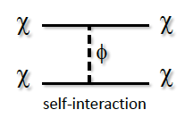
Motivation for sub-GeV New Physics
If these anomalies are interpreted in terms of new physics, all point to new forces with mediator particles in the MeV–GeV mass range!

Slide 22
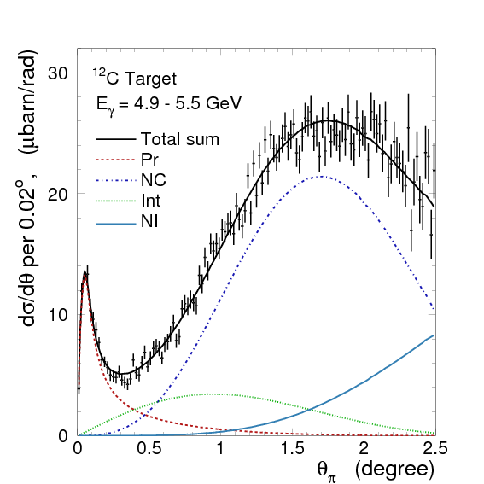
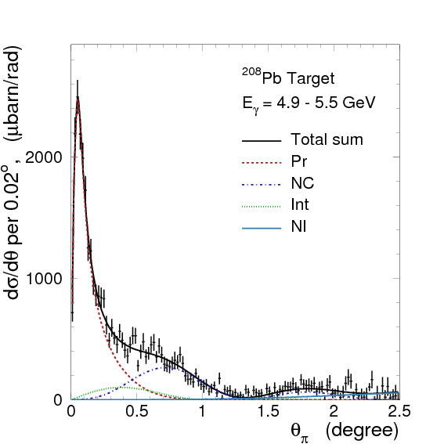

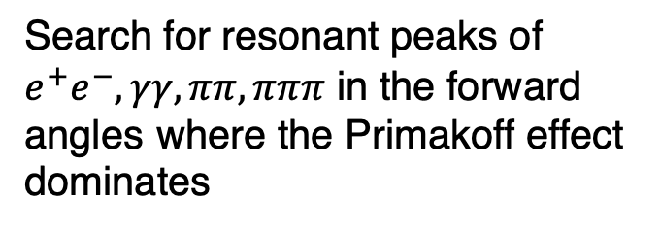
Search for New Scalar and Pseudoscalar via Primakoff Effect
Favorable experimental condition:
A high energy beam
A high Z nuclear target
Improve by more than two-orders of magnitudes with a 20+ GeV beam
$$\frac{dσ_{Pr}}{dΩ}\sim \frac{c_{γ}^{2}αZ^{2}}{8πΛ^{2}}∙\frac{β^{3}E^{4}}{Q^{4}}∙{\left|F_{e.m.}(Q)\right|}^{2}\sin^{2}θ_{a}$$
¹²C
²⁰⁸Pb
Search for resonant peaks of $e^{+}e^{−}, γγ, ππ, πππ$ in the forward angles where the Primakoff effect dominates
PrimEx I

Slide 23
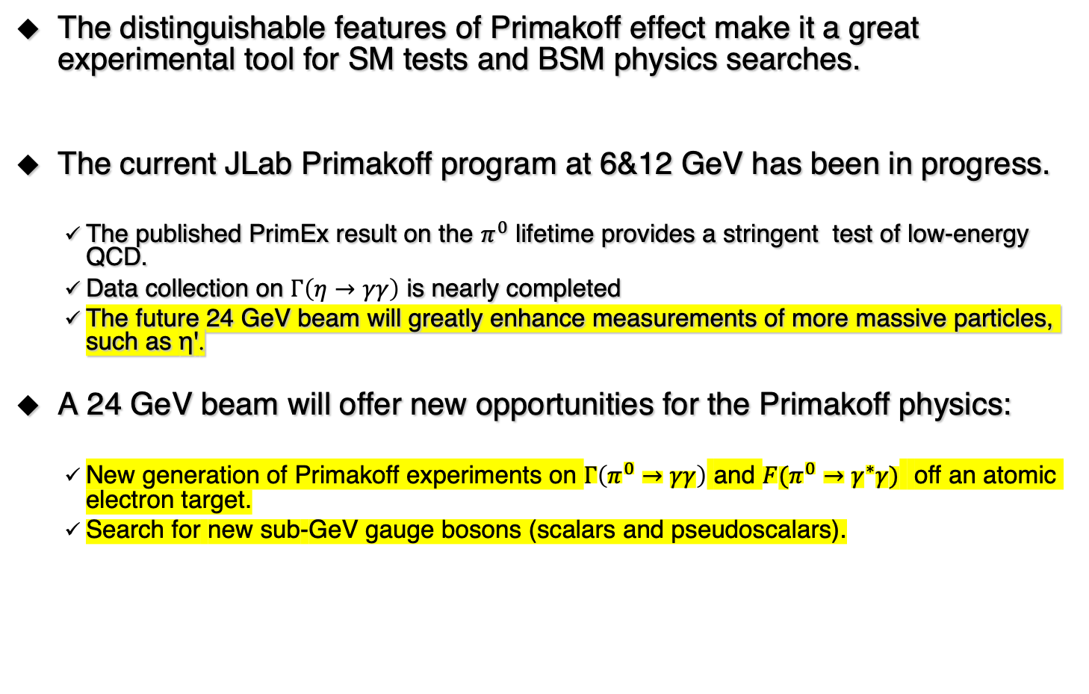
Summary
The distinguishable features of Primakoff effect make it a great experimental tool for SM tests and BSM physics searches.
The current JLab Primakoff program at 6&12 GeV has been in progress.
  The published PrimEx result on the $π^{0}$ lifetime provides a stringent test of low-energy QCD.
  Data collection on $Γ\left(η→γγ\right)$ is nearly completed
  The future 24 GeV beam will greatly enhance measurements of more massive particles, such as ηꞌ.
A 24 GeV beam will offer new opportunities for the Primakoff physics:
  New generation of Primakoff experiments on $Γ\left(π^{0}→γγ\right)$ and $F(π^{0}→γ^{∗}γ)$ off an atomic electron target.
  Search for new sub-GeV gauge bosons (scalars and pseudoscalars).
Thanks for support by NSF PHY-1812396 and PHY-2111181.

Slide 24
Differential Cross Sections
PrimEx I:
²⁰⁸Pb
¹²C
PrimEx II:
¹²C
²⁸Si
Fitting data with new theoretical calculations to extract Γ($π^{0}→γγ$)
  Phys.Rev. C80, 055201 (2009); Phys.Part.Nucl.Lett.,9,3 (2012)

